Slide 1


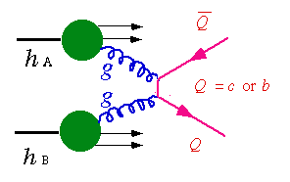
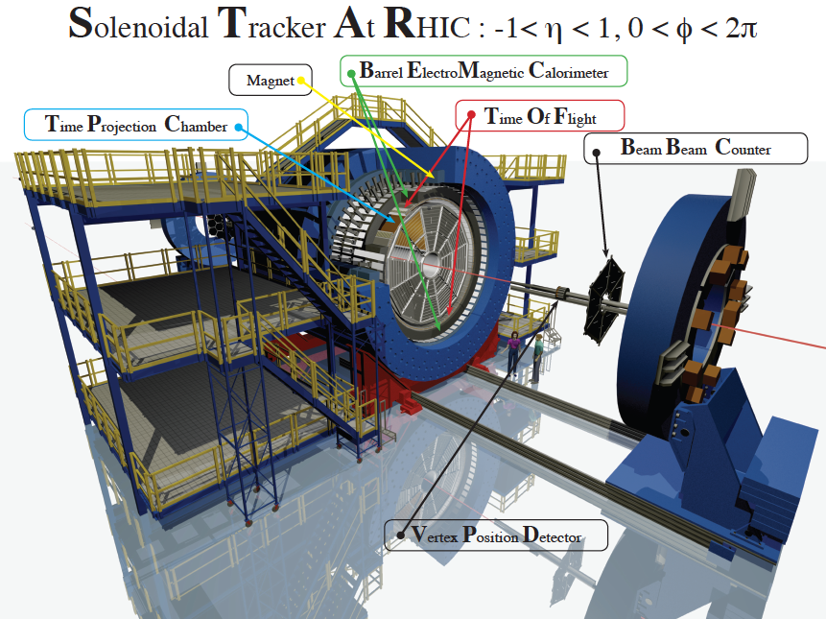
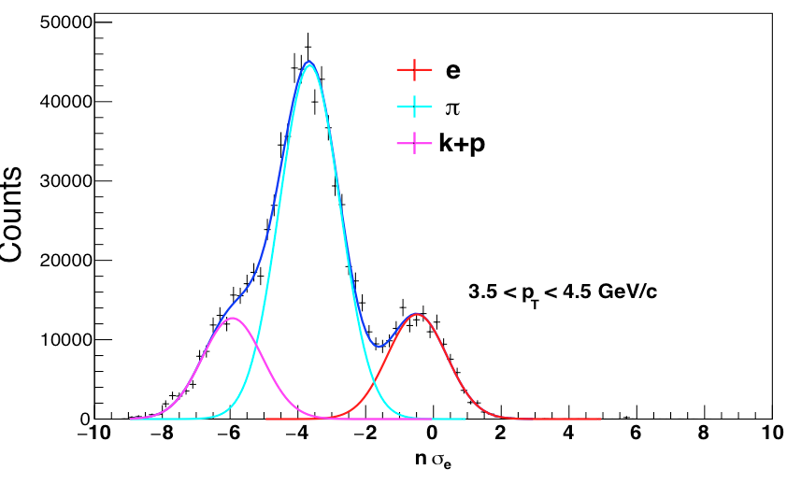
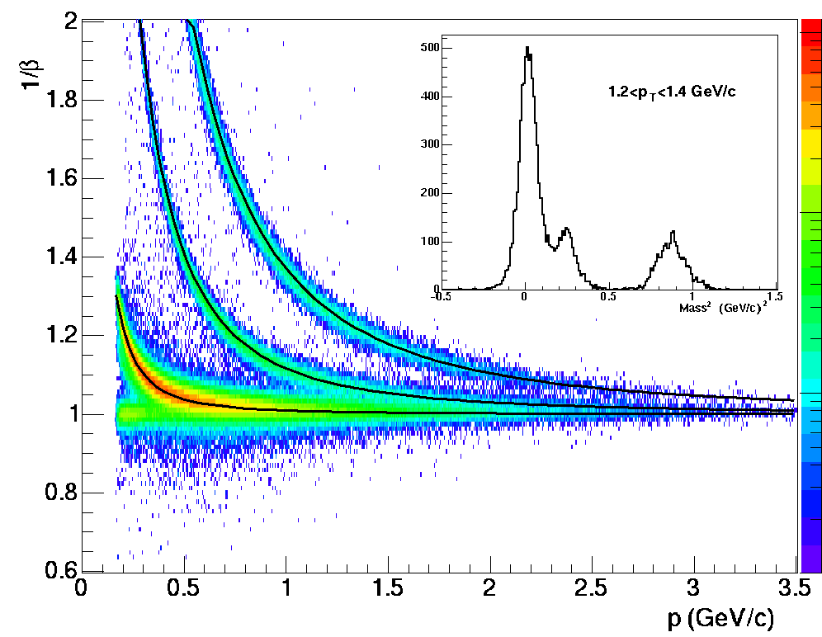
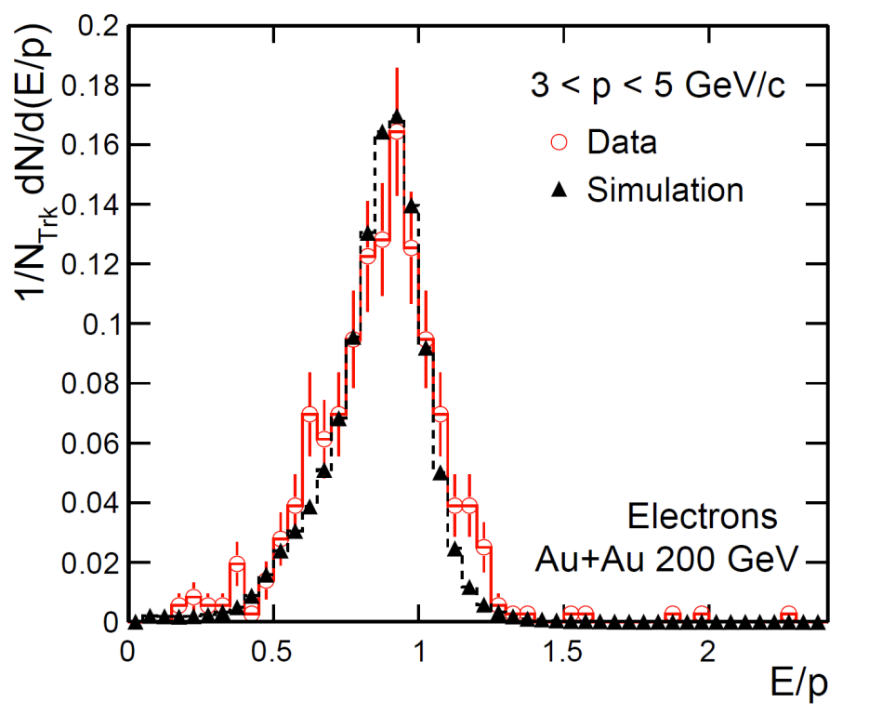
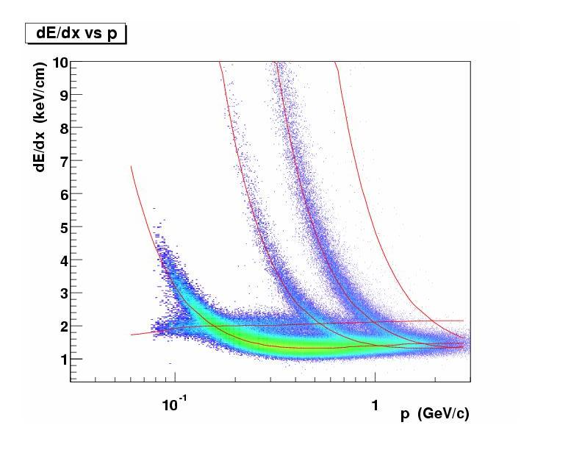



Measurements of electrons from semileptonic decays of open heavy flavor hadrons in p+p and Au+Au collisions at √s_{NN}=200 GeV
Xiaozhi Bai^{(1,2)}for the STAR Collaboration
1.Central China Normal University, 2. University of Illinois at Chicago
Abstract
Heavy flavor quarks have been suggested as excellent probes to study the properties of the hot and dense nuclear matter created in high-energy heavy- ion collisions. In this regard, high precision measurements of heavy flavor production in p+p collisions are also important as they provide a reference to study the medium effects in heavy-ion collisions. In this poster, we will present the latest results on electrons produced from semileptonic decays of open heavy flavor hadrons in p+p and Au+Au collisions at √s_{NN}=200 GeV. The p+p results are extracted from data taken by the STAR experiment at the Relativistic Heavy Ion Collider in the year 2012, which have a highly improved precision than previous results over a wider range of transverse momentum, 0.3<p_{T}<12 GeV/c. With this new p+p baseline, improved nuclear modification factors R_{AA} in Au+Au collisions are also obtained and compared with theoretical model calculations.
The invariant cross section for nonphotonic electron is calculated according to:
Motivation
  Heavy-flavor production in p+p collisions is calculable by perturbative QCD with inputs from universal parton distribution functions and fragmentation functions, albeit with large uncertainties from the choice of quark mass, factorization and renormalization scale parameters. Precise measurements of heavy-flavor production cross section in p+p collisions are essential to validate such a framework and to constrain the available parameter space [1]. These measurements also provide a baseline to interpret heavy-flavor measurements in heavy-ion collisions for the study of quark-gluon plasma and its interaction with heavy-flavor quarks. Heavy flavor quarks produced from semi-leptonic decay of open heavy flavor hadrons,so it is a good proxy to measure heavy flavor quark production.
K⁺
e⁻
D⁰
v_{e}
D⁰
K⁻
N_{npe}: electrons from open heavy flavor decay
N_{photonic}: electrons from photon conversion, π⁰/η Dalitz decay
N_{inclusive} : all the electron pass the electron ID cut.
purity: purity of inclusive electron
Ε_{photonic} :photonic electron reconstruction efficiency
ε_{trk/trg}: tracking or trigger effiiciency
ε_{dEdx/EMC}: electron ID (dE/dx or EMC) efficiency
π⁺
STAR Detector(in 2012)
Time Projection Chamber
|η|<1, 0<Φ<2π
tracking, momentum measurement.
electron ID
Barrel Electromagnetic Calorimeter
|η|<1, 0<Φ<2π
electron ID through E/p and triggering
on high p_{T} electron (1.5 GeV/c < p_{T})
Time Of Flight
|η|<0.9, 0<Φ<2π
electron ID through flight time.
at low p_{T} (p_{T} < 1.5 GeV/c)
Vertex Position Dectector
Minbias trigger
Data Analysis
Purity and photonic efficiency
dEdx purity fit
k
p
d
π
e,μ
Result and Conclusion
            Production cross section in 200 GeV p+p collisions
              measured as a function of p_{T} over a broad p_{T} range 0.3-12 GeV/c with significantly improved precision than previous measurements.
              confirm and constrain pQCD FONLL calculations.
            R_{AA} in 200 GeV Au+Au collisions
              strong suppression for p_{T}>4 GeV/c in central collisions, less towards more peripheral collisions.
              Likely enhancement at low p_{T} in both central andperipheral collisions.
Data analysis
References: [1] STAR collaboration, Phys. Rev. D 83 (2011) 52006 [2] R.E. Nelson et al. PRC 87 (2013) 01498
Notes:
1

