Slide 1
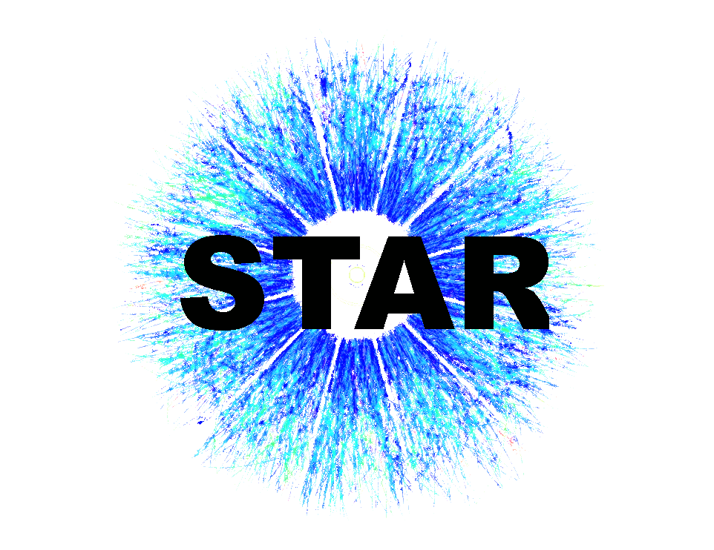



Flow measurements and selection of body-body and tip-tip enhanced samples in U+U collisions at STAR
Hui Wang (for STAR Collaboration)
Brookhaven National Lab

Slide 2
Outline
Motivation
STAR detector and data set
v₁ measurements
Azimuthal anisotropy in U+U collisions
Selection of body-body and tip-tip enhanced samples
Summary

Slide 3
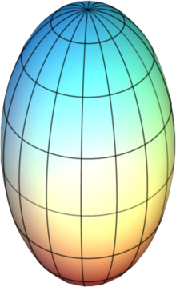
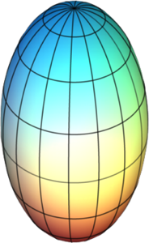
Motivation for U+U Collisions
Allows us to manipulate the initial geometry and study:
How multiplicity depends on N_{part} and N_{coll}
Path-length dependence of jet quenching
Particle production in heavy-ion collisions
Other effects
U+U Collisions
Au+Au Collisions
+
+
Oblate
+
Prolate
Can we see a difference between Au+Au and U+U and preferentially select body-body or tip-tip U+U collisions?

Slide 4
Selecting Body-body or Tip-tip
In two-component model, multiplicity depends on the N_{part} and N_{coll} and since v₂ is propotional to initial eccentricity
large v₂ and small N_{ch}
N_{part} = 10
N_{coll} = 5
fully overlapping
*idealizations
N_{part} = 10
N_{coll} = 25
small v₂ and large N_{ch}
If dN/dη depends on N_{coll}, large dN/dη should correlate with small v₂.
    Central U+U collisions are ideal for testing particle production
Strategy: select events with few spectators (fully over-lapping), then measure v₂ vs. multiplicity: how strong is the correlation?

Slide 5
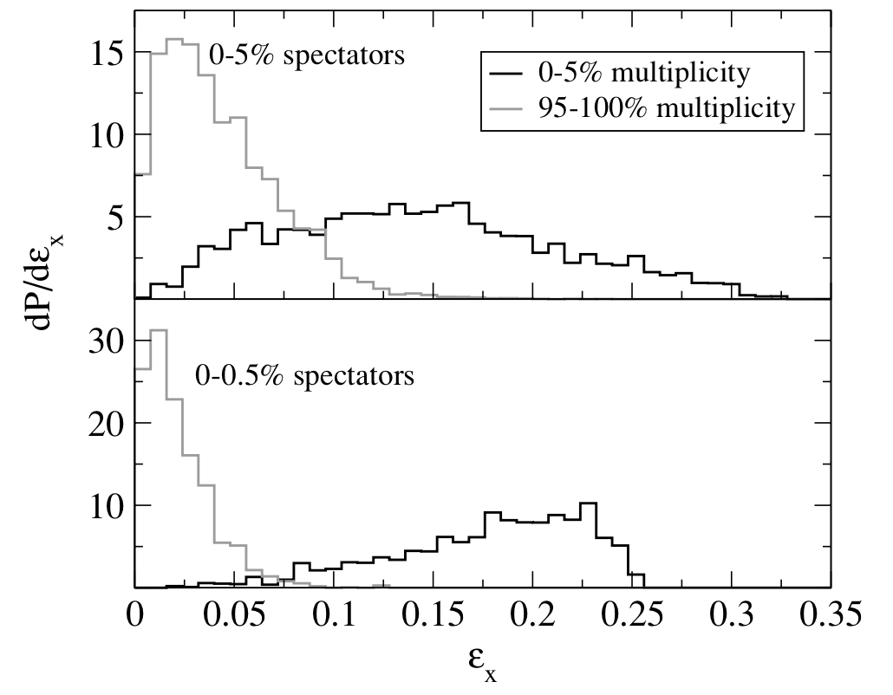
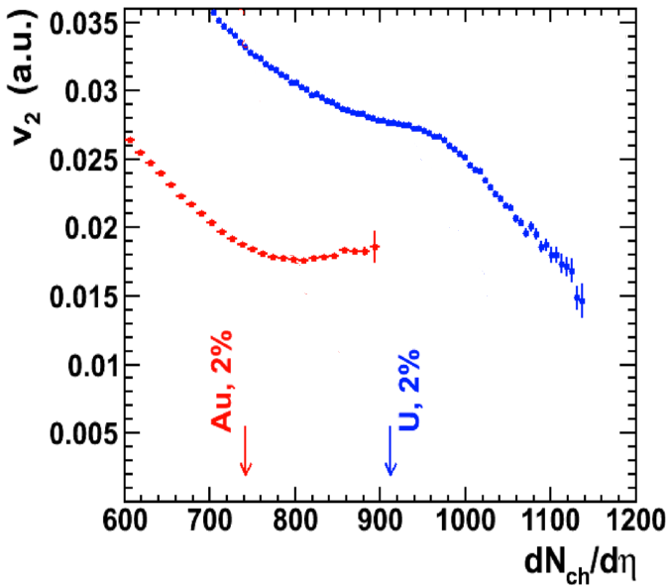
Expectations from Models
0-5% fewest spectators
0-0.5% fewest spectators
highest multiplicity
lowest multiplicity
Anthony Kuhlman and Ulrich Heinz
Phys. Rev. C 72, 037901 (2005)
Sergei A. Voloshin
Phys. Rev Lett. 105, 172301 (2010)
Simulations show that after selecting most fully overlapping collisions,
  high multiplicity events correlate with small eccentricity (tip-tip)
  lower multiplicity with large eccentricity (body-body)
The correlation of tip-tip collisions with high multiplicity and small eccentricity leads to a kink in v₂ at high dN/dη

Slide 6
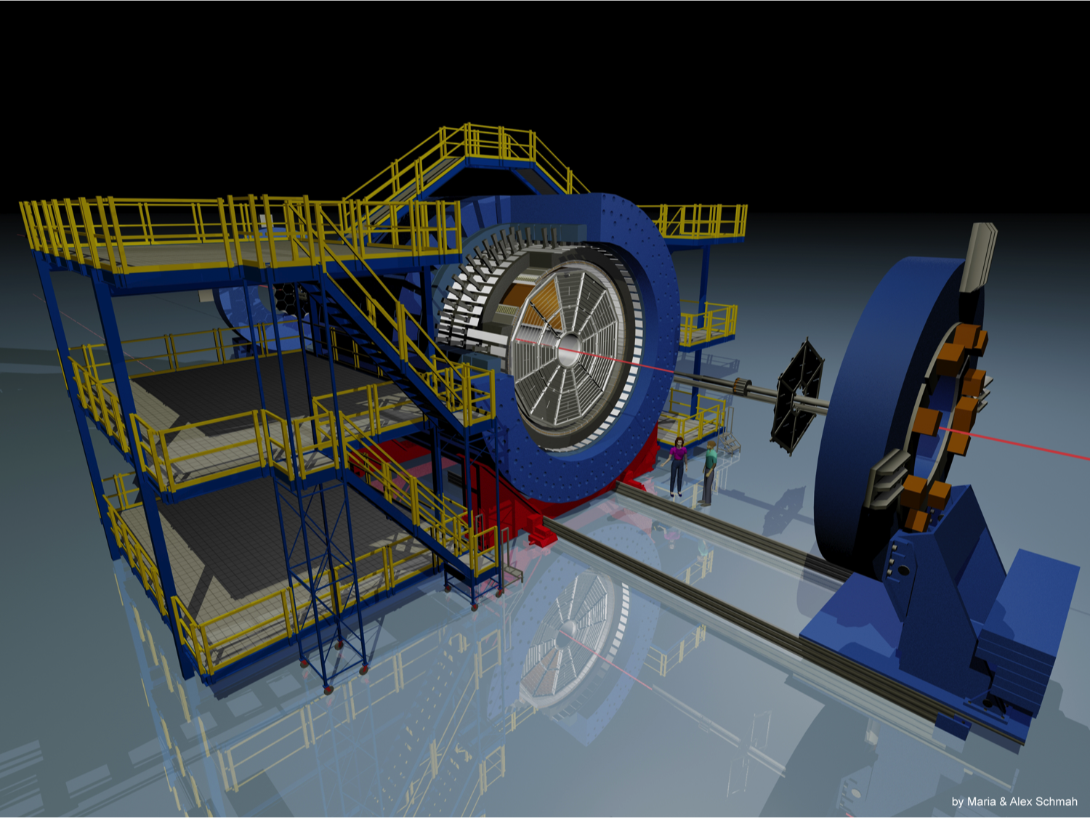
STAR Detector and Data Set
  Full azimuthal coverage
Efficient tracking
  |η| < 1.0
  p_{T} > 0.2 GeV/c
U+U data collected in a 3 week exploratory run
ZDCs counting spectator neutrons used to select central collisions
A | √s_{NN} GeV | Year | Events (x10⁶)
Au | 200 | 2011 | 700 (mini-bias)
U | 193 | 2012 | 360 (mini-bias) 13 (central 1% ZDC)
We’ve measured the v₁ using event plane method
For event plane method, we use ZDC-SMDs
We’ve measured the v₂ using both event plane and Q-cumulants method
For Q-cumulants method, we use efficiency-corrected 2nd and 4th order cumulants

Slide 7

v₁{ZDC-SMD}
v₁ was measured with respect to the 1st order EP, obtained from STAR ZDC-SMDs.
v₁(η) was fit with a straight line passing (0, 0) to retrieve the slope parameter.
The slope parameters are consistent with each other for minbias collisions of Au+Au at 200 GeV and U+U at 193 GeV.
Statistical errors only

Slide 8
v₂{ZDC-SMD}
v₂ was measured with respect to the 1st order EP, obtained from STAR ZDC-SMDs.
v₂(p_{T}) looks similar between Au+Au and U+U for 10-40% collisions.
The p_{T}-integrated v₂ are close to each other for minbias collisions of Au+Au at 200 GeV and U+U at 193 GeV.
Statistical errors only
In order to see differences, we need to move to central collisions

Slide 9
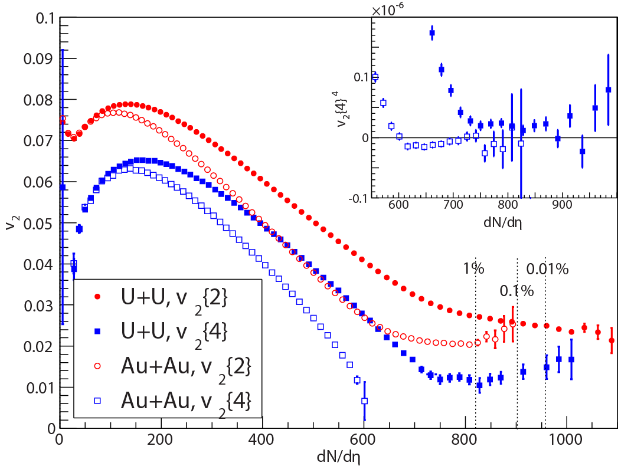
Minimum-bias U+U and Au+Au
No evidence of knee structure for central U+U
  Glauber plus 2-component model suggests knee structure at ~2% centrality
  Knee washed out by additional multiplicity fluctuations?¹
  Other interpretations?
The U+U v₂{4} results are non-zero in central
  Result of intrinsic prolate shape of the Uranium nucleus
  Au v₂{4}⁴ becomes consistent with zero
¹Maciej Rybczyński, et. al.
Phys.Rev. C87 (2013) 044908
Dashed lines represent top centrality percentages for U+U collisions based on multiplicity, curves are used to guide the eye
v₂{4} data: we see the prolate shape of the Uranium nucleus ✓
The lack of a knee indicates a weakness in our multiplicity models

Slide 10
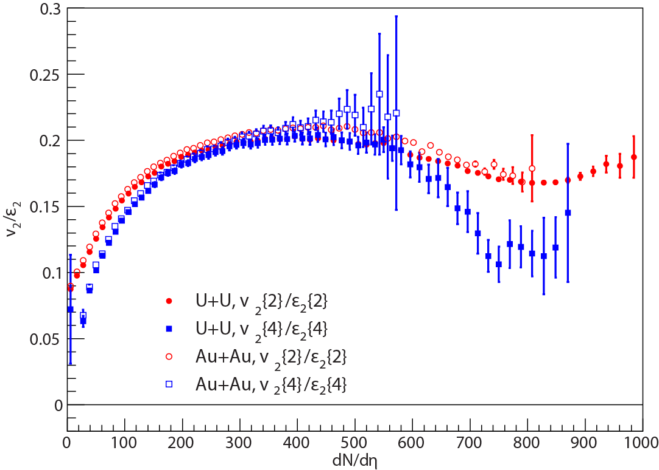
v₂/ε₂
v₂/ε₂ follows the same trend for U+U and Au+Au
  As long as the oblate shape of Au is accounted for
Instead of saturating or slowly rising, v₂/ε₂ drops in the most central collisions
The drop is sharper for U+U v₂{4}/ε₂{4}
geometry dominated by initial state physics
geometry dominated by impact parameter
Results suggest an overestimation of ε₂ in central collisions or deviation from v₂∝ε₂ (non-flow, hydro fluctuations?)
Very central collisions provide a stringent test of models

Slide 11
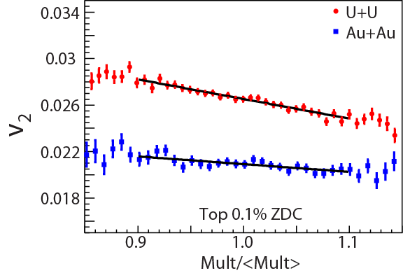
Studying Full Overlap Events
v₂
minimum bias
Minimum bias: impact parameter dominates geometry
fully overlapping
dN/dη
Central ZDC selection b->0
Au+Au dN/dη is dominated by fluctuations
    No correlation between v₂ and multiplicity
U+U dN/dη depends on geometry & fluctuations
      Larger v₂ associated with small multiplicity
Use slope of v₂ vs dN/dη in U+U to look for correlation between dN/dη and geometry
  Expect a strong negative slope
Use Au+Au as the control sample to show we select full overlap
  Expect a zero or slightly positive slope

Slide 12
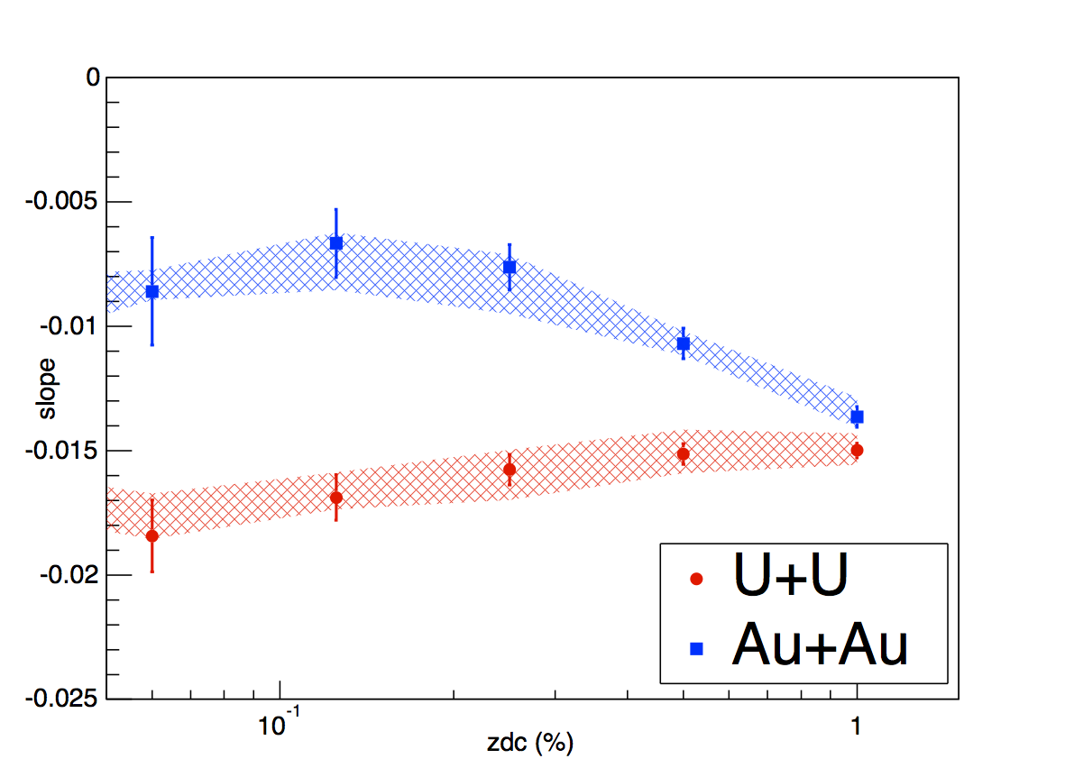
Slope vs. ZDC
ZDC Centrality | U+U | Au+Au
0.125% | 6 | 4
0.25% | 7 | 5
0.5% | 9 | 6
1.0% | 12 | 8
2.0% | 17 | 12
more overlapping
fewer spectators
Number of spectator neutrons in each direction from Glauber model
Systematical errors are estimated by varying fitting range and efficiency correction
For tighter cuts, the U+U slope becomes steeper than the Au+Au control sample
Demonstrates that dN/dη is larger for tip-tip U+U collisions: dN/dη can be used to select tip-tip vs body-body enhanced samples

Slide 13
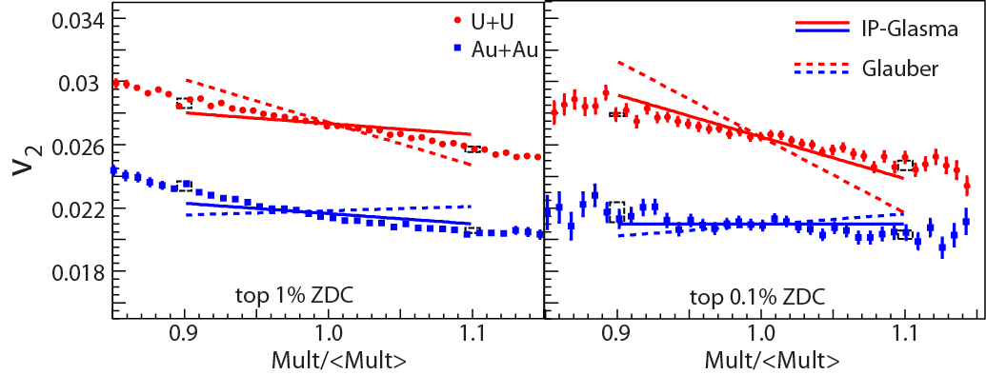
IP-Glasma vs. Glauber
U+U
Mult: |η|<1
Au+Au
Lines are model eccentricities scaled by the ratio of <v₂> and <ε₂>
Dashed boxes are systematical errors
Glauber plus 2-component model overpredicts U+U data and predicts negative slopes for Au+Au data
IP-Glasma model¹ (solid color lines) matches data better, especially for top 0.1% ZDC
¹Bjoern Schenke, Prithwish Tribedy and Raju Venugopalan
arXiv:1403.2232

Slide 14
Summary
U+U collisions open up a stringent testing ground of initial states and multiplicity production models
No evidence of kink structure in central v₂ results from current analysis, more fluctuations than NBD? ¹
v₂/ε₂ turns over in central collisions for both Au+Au and U+U!?
    Overestimation of ε₂ in Glauber model?
The combination of ZDC and multiplicity can be used to select body-body or tip-tip enhanced samples of central U+U collisions
    High multiplicity events are biased toward tip-tip enhanced collisions, low multiplicity toward body-body enhanced collisions
    Data show weaker correlations than model predictions: larger multiplicity fluctuations?
IP-Glasma model does a better job of describing data
See also the poster of John Campbell: Azimuthally-sensitive HBT in UU collisions. # I-08
¹Maciej Rybczyński, et. al.
Phys.Rev. C87 (2013) 044908

Slide 15
Back Up

Slide 16
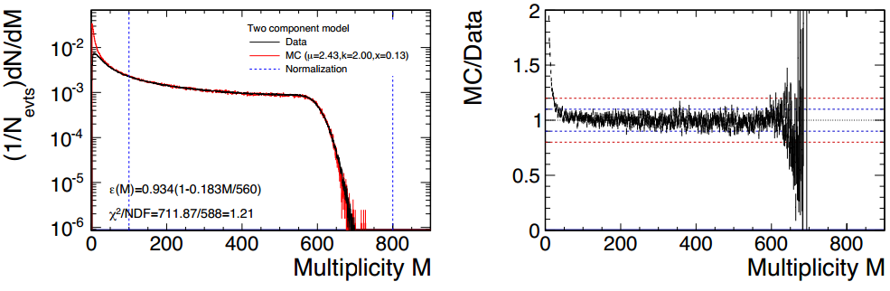
Glauber Model
Assume deformed Woods-Saxon distribution
Average number of particles from each nucleon follows 2-component model
Generate N_{ch} by sampling a negative binomial distribution with parameters n_{AA} and k=2
Hiroshi Masui, et. al.
Physics Letters B 679 (2009) 440–444

Slide 17
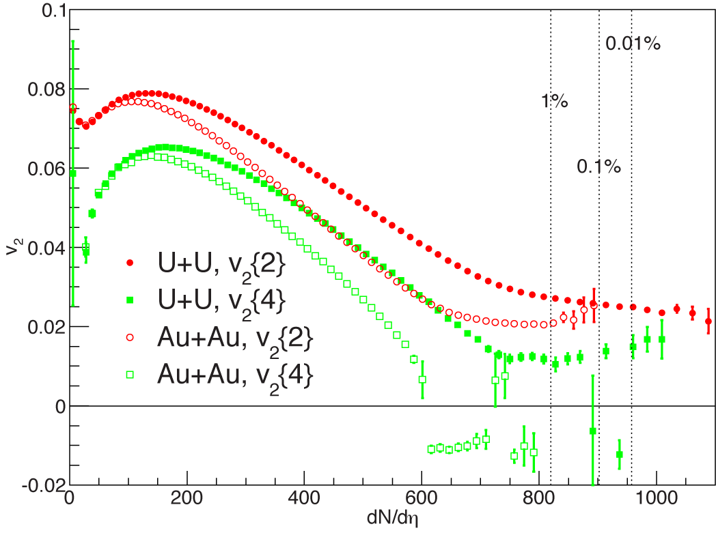
Minimum-bias U+U and Au+Au
The v₂{4} results are calculated from v₂{4}⁴ and by taking the fourth root

Slide 18
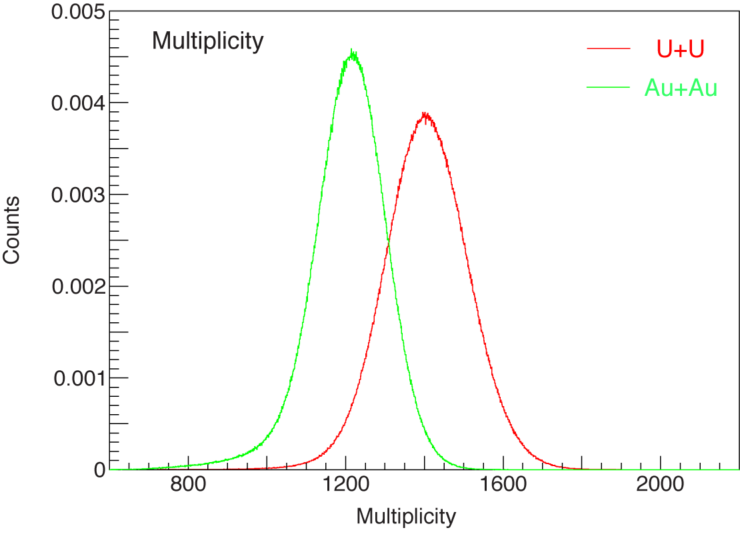
Multiplicity
The corrected multiplicity distribution for 1% central ZDC events

Slide 19
Δη dependence
Remove peak at small Δη to reduce non-flow effects

Slide 20
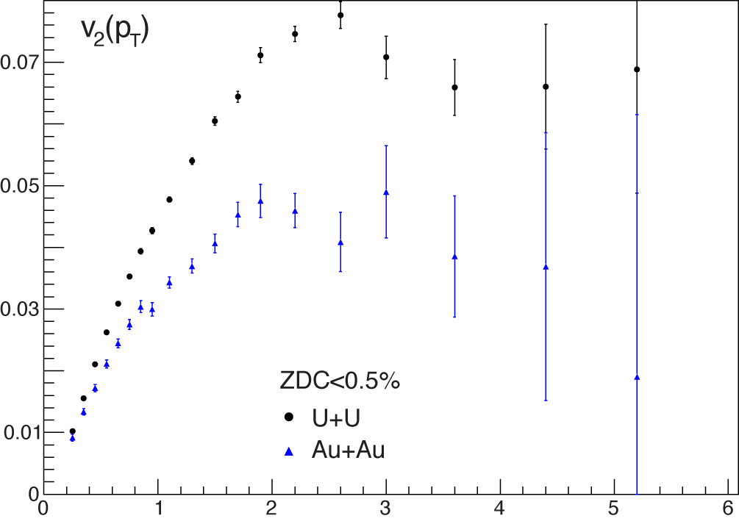
Toward Path Length Dependence of Quenching
v₂{2}
p_{T}
Larger difference in-plane vs out-of-plane path length in U+U?
  Need to split U+U results into multiplicity bins (body-body vs. tip-tip)
  A larger-sized data sample of central U+U events will be needed

Slide 21
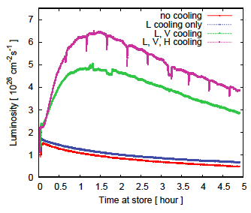
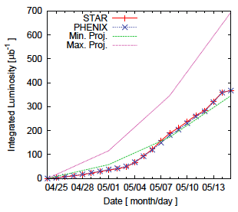
Collection of U+U data sample
Implementation of cooling led to huge improvement in accessible luminosity
Made acheivement of possible goals

Slide 22
Studying Full Overlap Events
+
+
Impact Parameter
+
+
U+U:
Or
Or
U+U:
+
Geometry
+
Geometry
Multiplicity
Multiplicity
Au+Au:
Impact Parameter
Au+Au:
Fluctuation
Without selection on over-lapping region, the impact parameter will dominant geometry
We will see correlations between v₂ and multiplicity for both Au+Au and UU
  Larger v₂ associated with small multiplicity
With the selection on fully over-lapping region, the impact parameter effects are reduced
The multiplicity difference in Au+Au is dominant by fluctuations
  No correlation between v₂ and multiplicity
The multiplicity difference in U+U is dominant by geometry
    Larger v₂ associated with small multiplicity

Slide 23
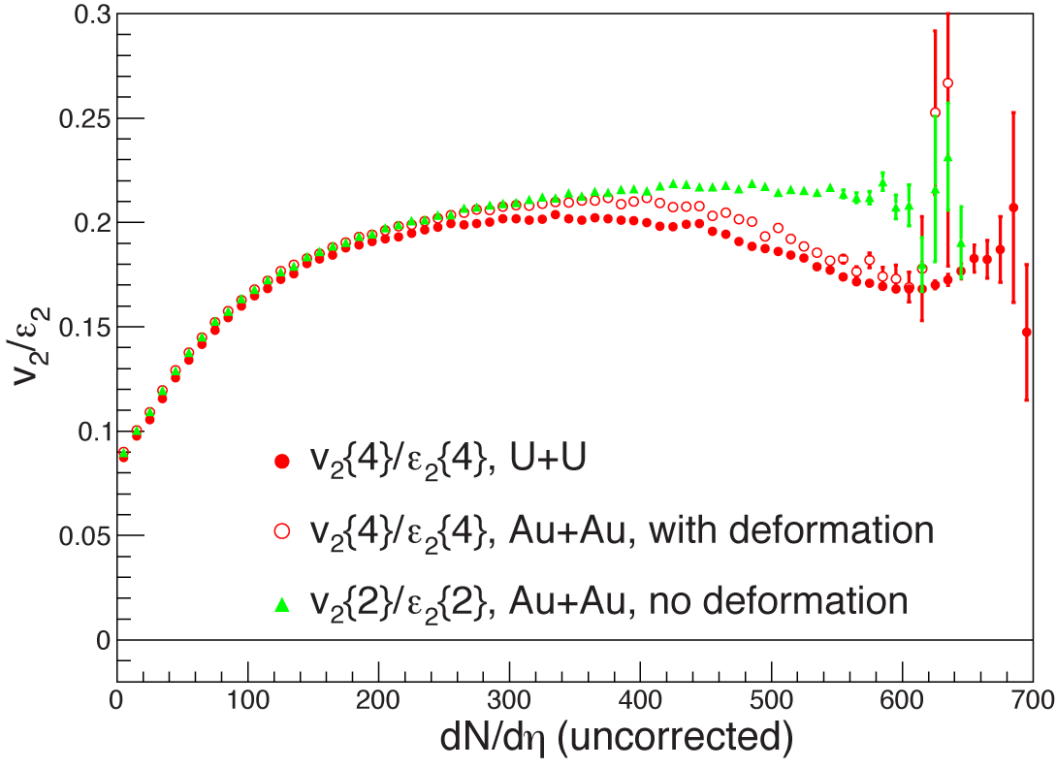
Effects of deformation in Au
QM2012
Previous study assume no deformation for Au nuclei
With deformation in Au+Au, the split between U+U and Au+Au is reduced

