Slide 1
The Rapidity Density Distributions and Longitudinal Expansion Dynamics of Identified Pions from the STAR Beam Energy Scan
Christopher Flores
(University of California, Davis)
For the STAR Collaboration
Quark Matter 2015 Kobe, Japan
September 29, 2015

Slide 2
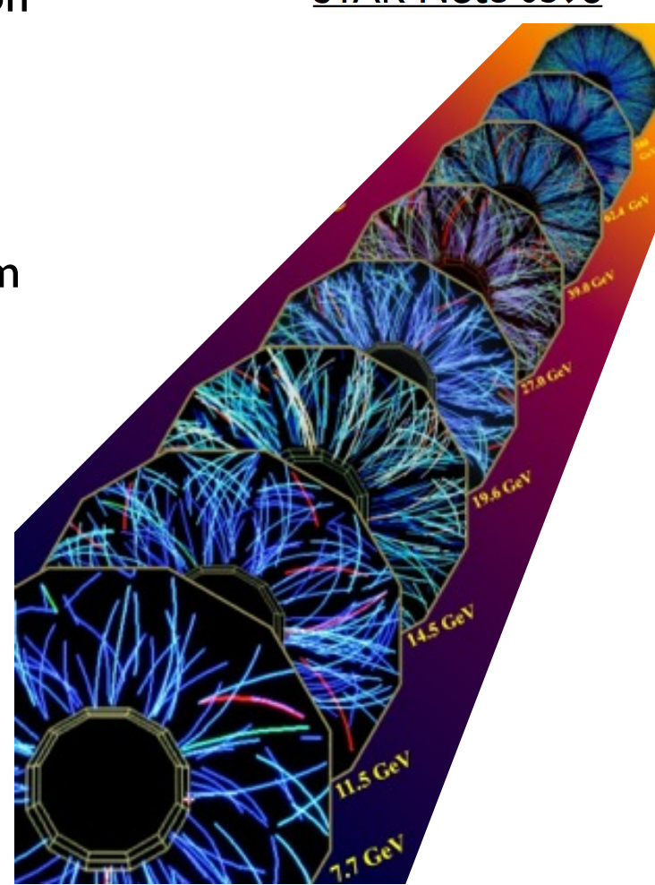
Outline
Motivation
Beam Energy Scan Program
Rapidity Density Distributions and Longitudinal Dynamics
STAR - Particle Identification
Identified Pion Spectra
Rapidity Density Distributions
Identified π⁺/π⁻ and NA49 Comparison
Full Phase Space Yields
Longitudinal Expansion
“Dale” Observable
Summary

Slide 3
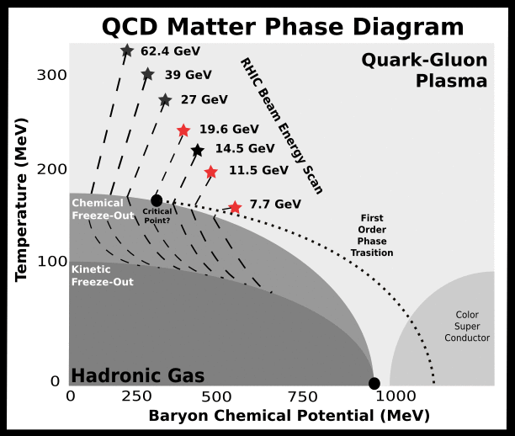
The Beam Energy Scan Program at RHIC
Study of the QCD Phase Diagram
Search for Critical Point
Search for Phase Transition Phenomena - softening of EOS
In this Talk
Top 10% Central Au+Au :
√s_{NN} = 7.7, 11.5, and 19.6 GeV
Rapidity dependence of pions
Longitudinal expansion dynamics

Slide 4
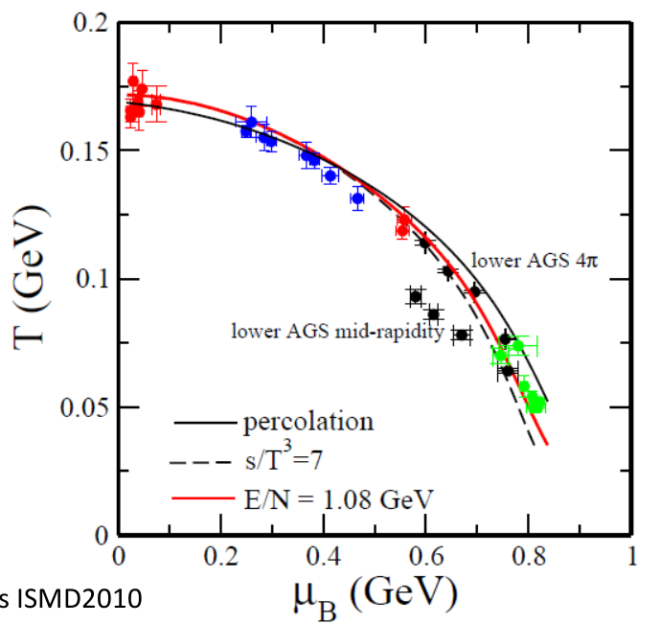
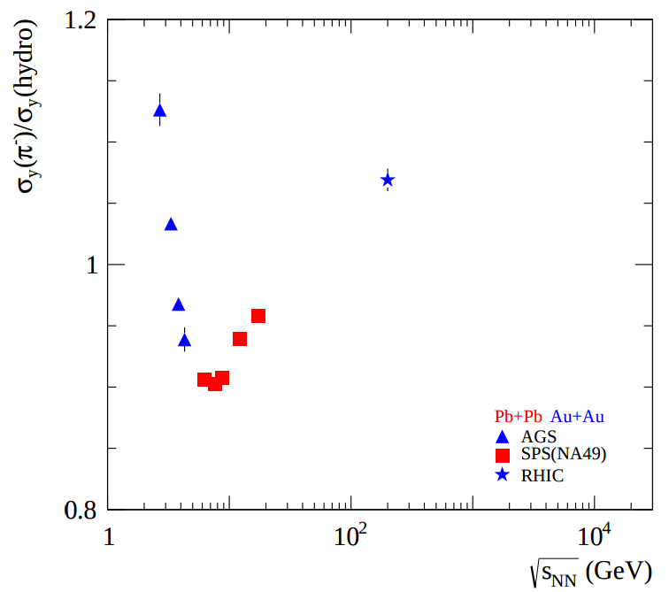
Rapidity Density Distributions and
Longitudinal Expansion
J. Cleymans ISMD2010
Rapidity Density distributions allow:
More complete characterization of the whole system chemistry
Full Phase Space Yields
Studies of the system’s longitudinal expansion dynamics → dN/dy width
Results from AGS and SPS show
minimum at ~ √s_{NN} = 7 GeV
Interpreted as a minimum in speed of sound
Would be a consequence of a softening
of the EOS
Used as evidence of the onset of deconfinement
M. Bleicher hep-ph/0509314, H. Petersen nucl-th/0611001, A. Rustamov arXiv:1201:4520

Slide 5
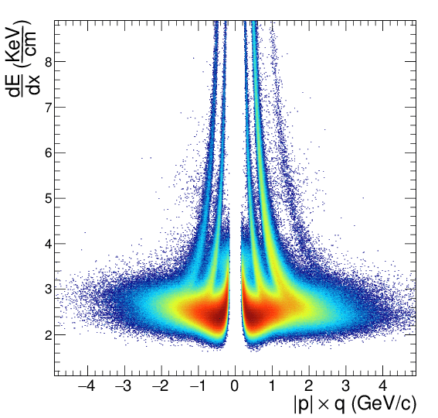
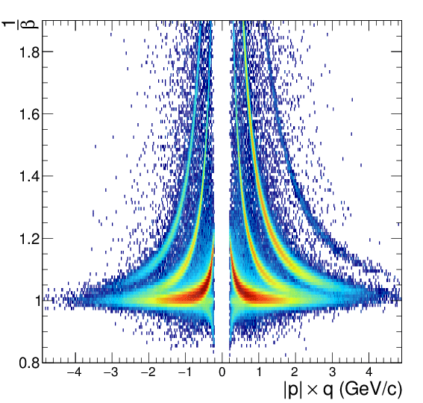
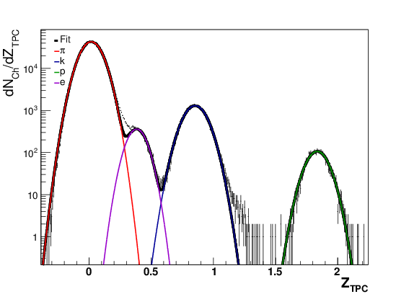
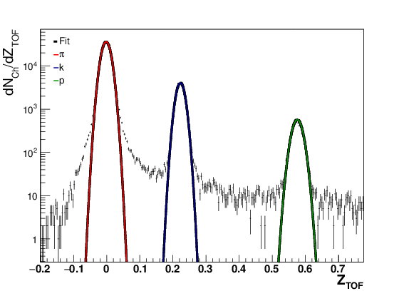
The STAR Detector
Particle Identification
-1.0 < η < -0.8
Yield Extraction from TPC
Yield Extraction from TOF
Event Selection:
Top 10% Central
|Vz| < 30 cm
Particle Identification:
Energy Loss in TPC
Time of Flight in TOF
Excellent PID throughout full rapidity range
y = (-.05,.05]
m_{T}-m₀ = (0.225,0.250]
y = (-.05,.05]
m_{T}-m₀ = (0.500,0.525]

Slide 6
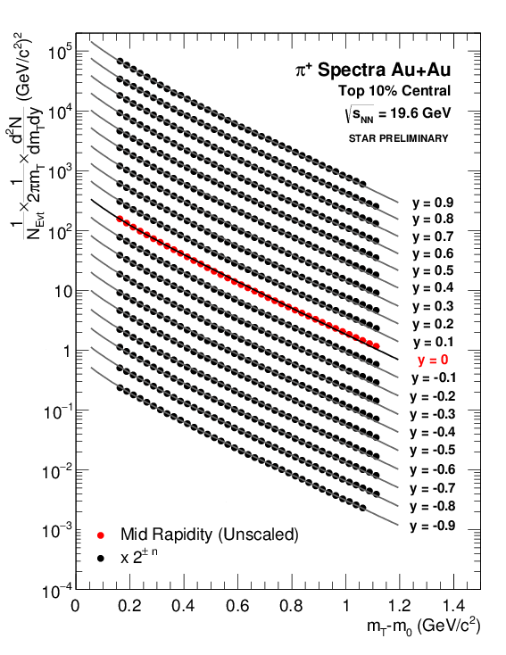
Identified Pion Spectra at 19.6 GeV
Spectra corrected for detector efficiency and acceptance in each rapidity bin
Spectra Fit with two parameter Bose-Einstein
Fit is extrapolated into unmeasured region and integrated to obtain dN/dy
Points with m_{T}-m₀ < .5 (Gev/c²) are obtained from TPC (dE/dx)
Points with m_{T}-m₀ ≥ .5 (Gev/c²) are obtained from TOF (1/β)

Slide 7
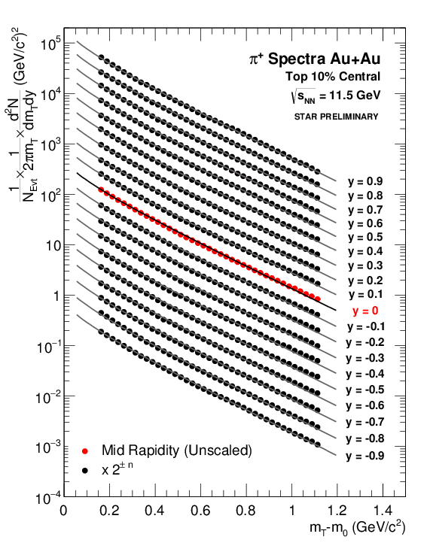
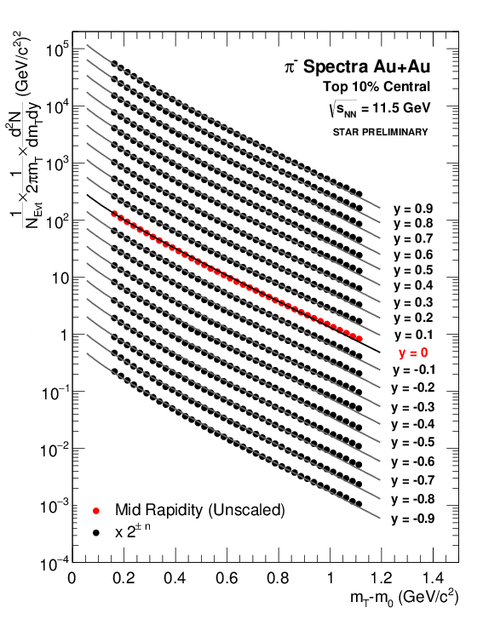
Identified Pion Spectra at 11.5 GeV
Spectra corrected for detector efficiency and acceptance in each rapidity bin
Spectra Fit with two parameter Bose-Einstein
Fit is extrapolated into unmeasured region and integrated to obtain dN/dy
Points with m_{T}-m₀ < .5 (Gev/c²) are obtained from TPC (dE/dx)
Points with m_{T}-m₀ ≥ .5 (Gev/c²) are obtained from TOF (1/β)

Slide 8
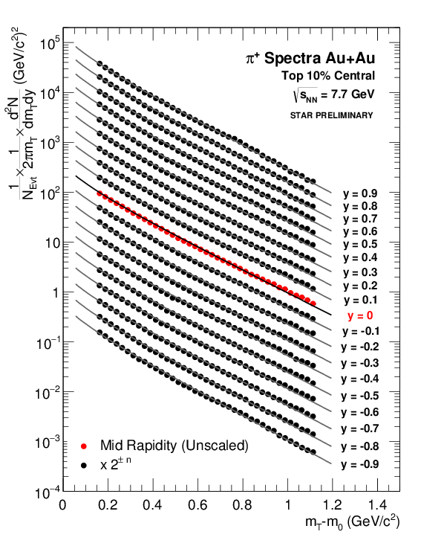
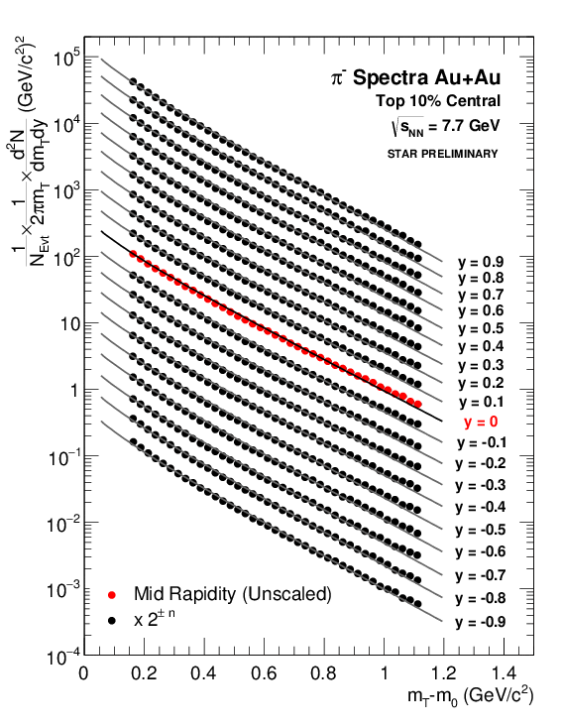
Identified Pion Spectra at 7.7 GeV
Spectra corrected for detector efficiency and acceptance in each rapidity bin
Spectra Fit with two parameter Bose-Einstein
Fit is extrapolated into unmeasured region and integrated to obtain dN/dy
Points with m_{T}-m₀ < .5 (Gev/c²) are obtained from TPC (dE/dx)
Points with m_{T}-m₀ ≥ .5 (Gev/c²) are obtained from TOF (1/β)

Slide 9
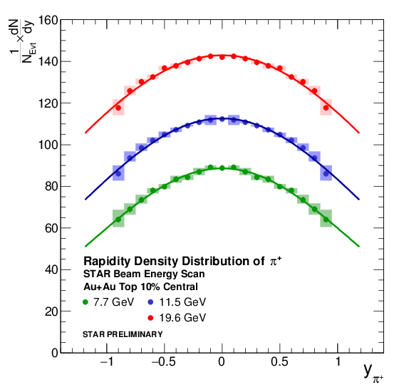
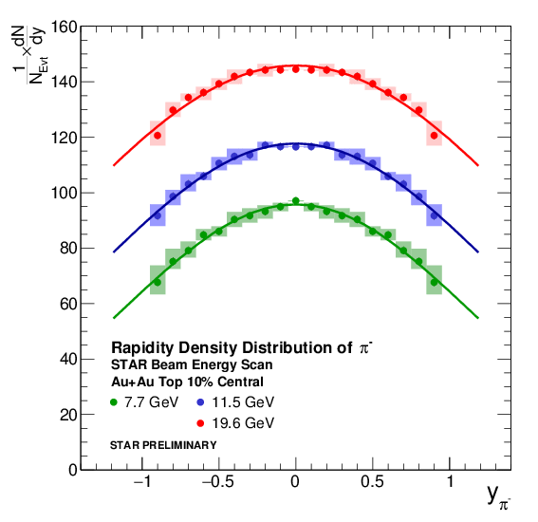
Rapidity Density Distributions of π
Results are not feed-down or background corrected.
Results are not feed-down or background corrected.
Forward/Backward asymmetries remaining after efficiency and acceptance corrections are included as systematic errors.
Distributions are fit with Gaussian functions with means fixed to y = 0.

Slide 10
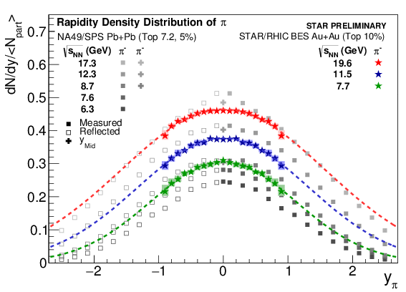
Comparison with NA49
System size dependence is removed by <N_{Part}> scaling
STAR's acceptance permits measurements forward and backward of mid-rapidity
NA49: S. V. Afanasiev et al. PRC 66, 054902 (2002)

Slide 11
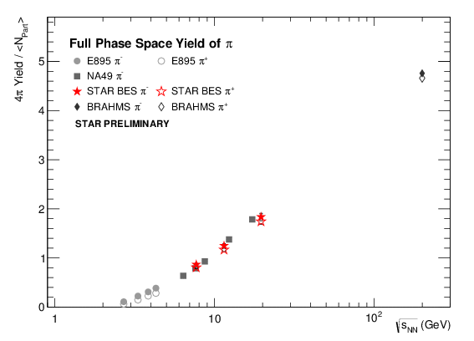
Full Phase Space Yields
STAR results continue the trend of full phase space yields
STAR results include both π⁺ and π⁻ (only π⁻ in this energy range previously)
STAR data points include both statistical and systematic errors
All rapidity density spectra have been fit with single Gaussian Functions.
E895: J. L. Klay et al, PRC 68, 05495 (2003)
NA49: S. V. Afanasiev et al. PRC 66, 054902 (2002)
BRAHMS: I.G. Bearden et al., PRL 94, 162301

Slide 12
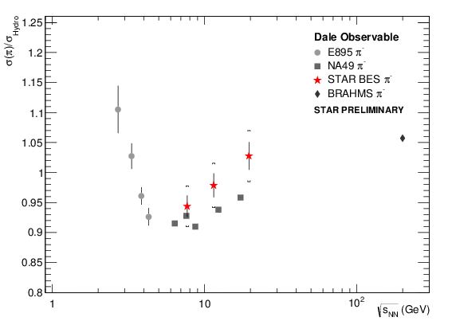
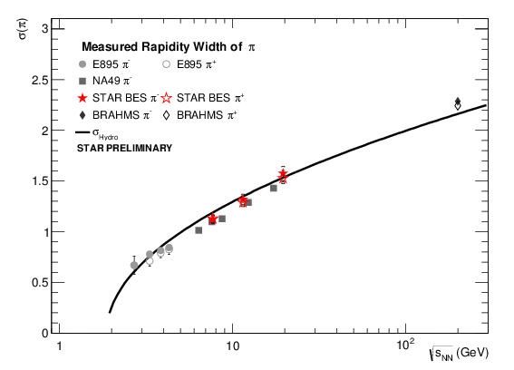
Dale Observable
STAR sees an increase in the ratio of the measured pion width to the predicted hydro width confirming trend of previous NA49 measurements.
All rapidity density spectra have been fit with single Gaussian Functions.
E895: J. L. Klay et al, PRC 68, 05495 (2003)
NA49: S. V. Afanasiev et al. PRC 66, 054902 (2002)
BRAHMS: I.G. Bearden et al., PRL 94, 162301
All rapidity density spectra have been fit with single Gaussian Functions.
STAR Data points include both statistical and systematic errors.
σ_{y}(hydro): P. Carruthers and M. Duong-van, Phys.Lett. B41, 597 (1972)

Slide 13
Summary
STAR has measured the transverse mass spectra of identified pions over a broad rapidity range for the first time from the lower energies of the beam energy scan.
The Spectra have been used to:
Obtain the rapidity density distributions
Shown Comparison with NA49’s Results
Extract full phase space yields
STAR contributes both π⁺ and π⁻
Study the expansion dynamics
STAR observes increase in σ(π)/σ(hydro) as a function of √s_{NN} in measured range

Slide 14
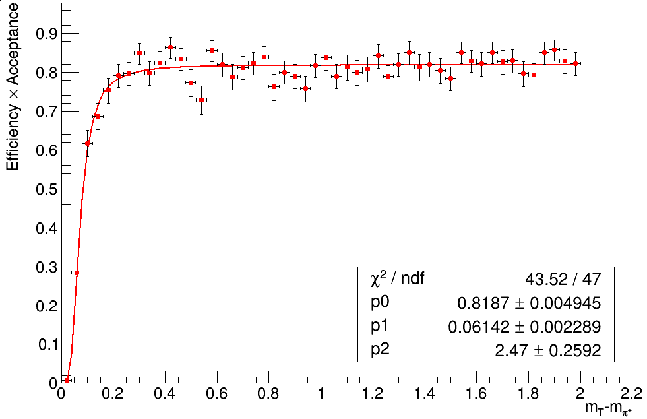
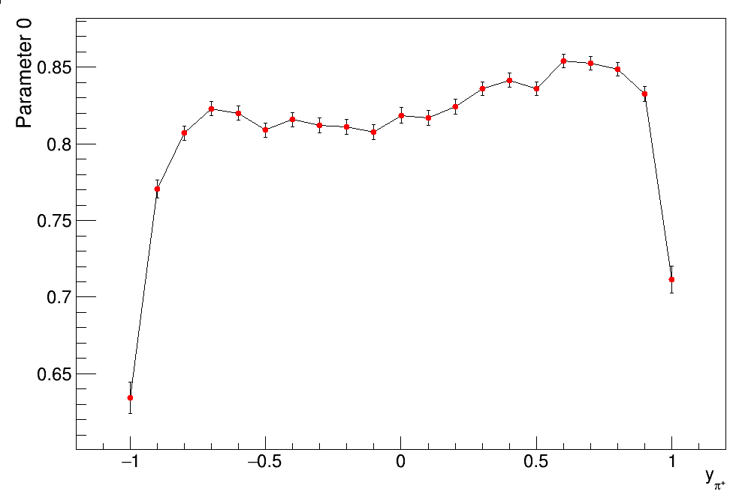
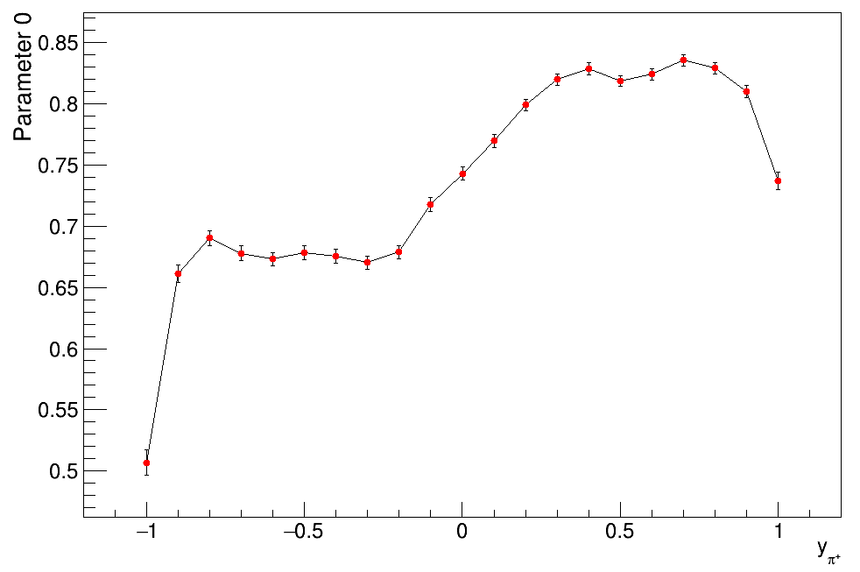
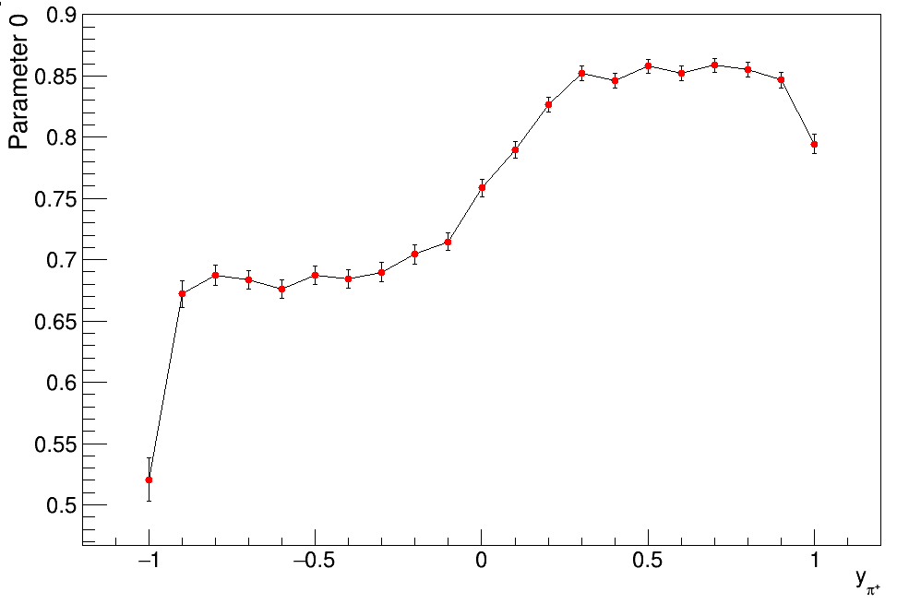
Back-Up: Efficiency and Acceptance
Efficiency X Acceptance obtained for each energy and rapidity bin via embedding Monte-Carlo Tracks into real data.
√s_{NN} = 19.6 GeV
y=0
√s_{NN} = 19.6 GeV
√s_{NN} = 11.5 GeV
√s_{NN} = 7.7 GeV

