Slide 1
STAR Heavy-Ion Program in 2015+
Zhangbu Xu (for the STAR Collaboration)
Key Questions in Heavy-Ion Program
Properties of sQGP and its thermalization
QCD critical point and 1st phase transition line
Detailed Mechanism of jet quenching
Novel symmetries in QCD
New (exotic) particles
Initial state of gluonic matter in nuclear collisions
Identify Key Measurements
Upgrades relevant to 2015+

Slide 2
Charges from ALD and Priority
Collaboration Priority:
2012---2016 (HFT+MTD+…) AA, AB, pp (Dunlop’s talk) 2017—~2018 (Forward Upgrades): pA and polarized pp (He3)
~2019 preparation for eRHIC
~2020+: eSTAR (workshop tomorrow)
Are we done with HI by ~2016+:
If eRHIC starts 2023+ or evidence of critical point
or new discoveries in next 5 years demand further experiments My talk➔
I am herein charging the PHENIX and STAR Collaborations with generating new decadal plans that lay out your proposed
science goals and detector upgrade paths for the period 2011-2020.
--- Steve Vigdor

Slide 3
How to answer these questions
Hot QCD matter: high luminosity RHIC II (fb⁻¹ equivalent)
Heavy Flavor Tracker: precision charm and beauty
Muon Tagging Detector (MTD): e+μ and μ+μ at mid-rapidity
Trigger and DAQ upgrades to make full use of luminosity
Phase structure of QCD matter: possible Phase II BES
Near-term upgrades for p+p collisions
Forward GEM Tracker: flavor-separated anti-quark polarizations
Forward Hadron Calorimeter: strange quark polarization
Roman Pots phase II: search for glueballs
Cold QCD matter and nuclear spin: high precision p+p and p+A, followed by e+p and e+A
Major upgrade of capabilities in forward direction
Devote the time to explore p+A, not d+A
Existing mid-rapidity detectors well suited for portions of the initial e+p and e+A program, but must extend detection capability to larger rapidities
In Blue: Beyond mid-term upgrade for RHIC II

Slide 4
Summary of the plan
 | Near term (Runs 11-13) | Mid-decade (Runs 14-16) | Long term (Runs 17– )
Colliding systems | p+p, A+A | p+p, A+A | p+p, p+A, A+A, e+p, e+A
Upgrades | FGT, FHC, RP, DAQ10K, Trigger | HFT, MTD, Trigger | Forward Instrum, eSTAR, Trigger
(1) Properties of sQGP | Υ, J/ψ → ee, m_{ee}, v₂ | Υ, J/ψ → μμ, Charm v₂, R_{CP}, corr, Λ_{c}/D ratio, μ-atoms | p+A comparison
(2) Mechanism of energy loss | Jets, γ-jet, NPE | Charm, Bottom | Jets in CNM, SIDIS, c/b in CNM
(3) QCD critical point | Fluctuations, correlations, particle ratios | Focused study of critical point region
(4) Novel symmetries | Azimuthal corr, spectral function | e-μ corr, μ-μ corr
(5) Exotic particles | Heavy anti-matter, glueballs
(6) Proton spin structure | W A_{L}, jet and di-jet A_{LL}, intra-jet corr, (Λ+Λ) D_{LL}/D_{TT} |  | Λ D_{LL}/D_{TT}, polarized DIS & SIDIS
(7) QCD beyond collinear fact | Forward A_{N} |  | Drell-Yan, F-F corr, polarized SIDIS
(8) Properties of initial state |  |  | Charm corr, Drell-Yan, J/ψ, F-F corr, Λ, DIS, SIDIS
Detector Upgrade driven schedule: Measurements listed when they first become possible
Many will continue in future periods
Carl Gagliardi, STAR Decadal Plan – June, 2011 PAC Meeting

Slide 5
Properties of sQGP and Critical Point
Chemical properties and Baryon density
Identified particle yields
Multibaryon states
Acoustic Effect and η/s
Initial state fluctuation and viscous damping
v_{n} from different beam species
Thermalization:
Charm hydrodynamic flow
Thermal leptons

Slide 6
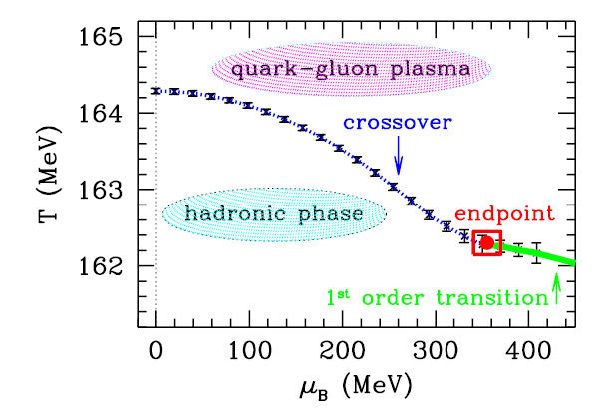
Thermodynamic properties of hot QCD state
A thermodynamic state is specified by a set of values of all
the thermodynamic parameters necessary for the description of the system. --- statistical mechanics by K. Huang
Temperature (T), chemical potential (μ), pressure(P), viscosity (η) …
Chemical/thermal Equilibrium at certain stage of the evolution
At the predicted QCD phase boundary
persistent from SPS to RHIC
Temperature decreases atAGS and SIS
A. Andronic et al., NPA 837 (2010) 65

Slide 7
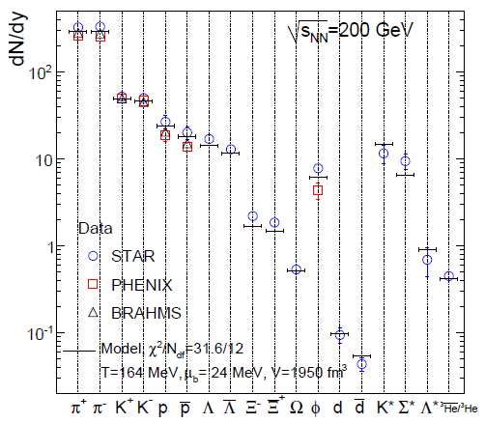
Predictable Production Rate
Why is it so predictable?
T=164MeV?
A. Andronic, P. Braun-Munzinger, J. Stachel, and H. Stocker, Phys.Lett.B697:203-207,2011
+ -

Slide 8
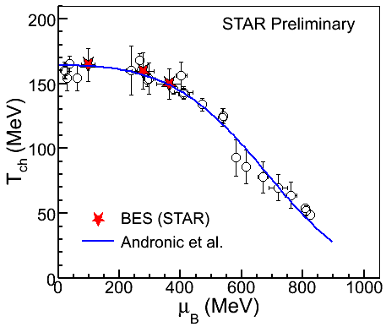
Predictability is a shock
If I told you that:
create a state of matter at 4x10¹² degrees out of a few thousands of particles
Matter and antimatter do not annihilate at energy density 100 times the normal nuclear density
Anti-nuclei and nuclei with weak binding energy carry information from the QGP phase transition (Temperature = 160MeV)
All particles maintain statistical equilibrium (no sign of annihilation but coalescence)
Models that assume thermal equilibrium correctly account for yields spanning 11 orders of magnitude. (1000 π, 10⁻⁸ ⁴He) ±0.00000000001
How many of you would say that “I expect that!”?
That is what we did when we found all these
Heavy antimatter nuclei!
One of the major successes of RHIC program: convincing data on thermal system,
hydrodynamics and phase diagram
Mohanty QM11

Slide 9
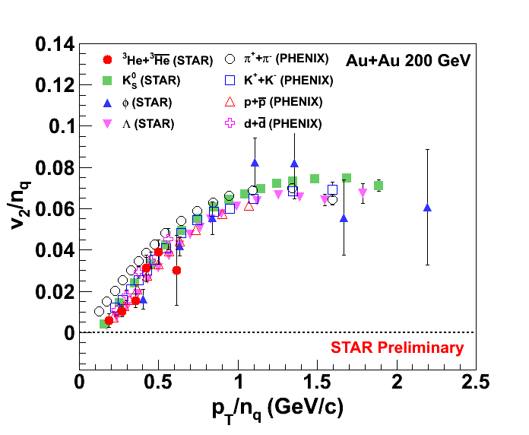
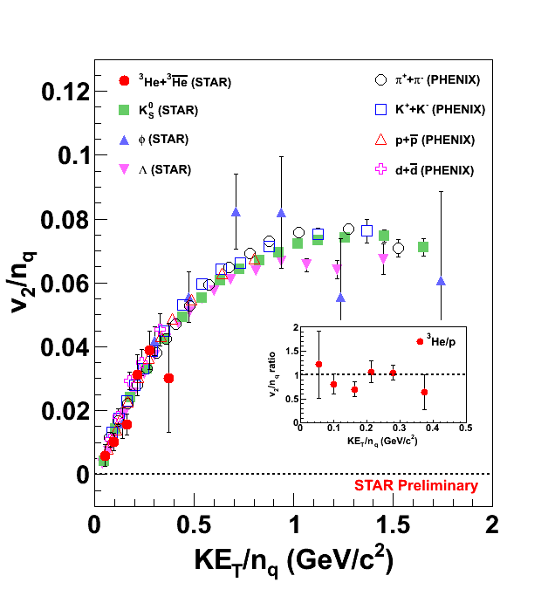
NCQ Scaling
STAR, arXiv:0909.0566 [nucl-ex]
PHENIX, PRL 99, 052301 (2007)
d(p+n) : n_{q} = 2 x 3 ³He(2p+n) : n_{q} = 3 x 3
Number of constituent quark scaling holds well for v₂ of ³He.

Slide 10
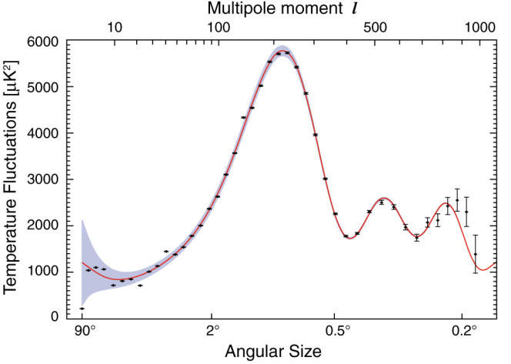
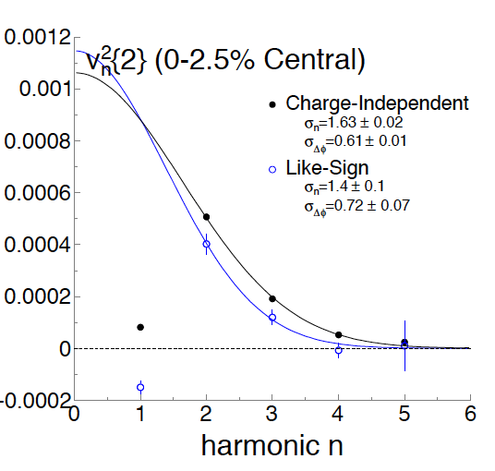
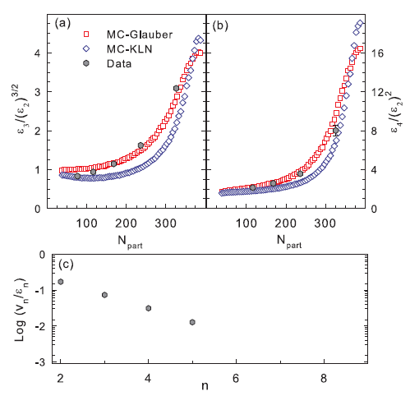
Fourier expansion (v_{n}): Power Spectrum?
This is the Power Spectrum of Heavy-Ion Collisions
STAR Preliminary
look at v_{n}²{2} vs n to extract power spectrum in nearly symmetric collisions
Width and falling slope vs n may be related to viscous and acoustic effects
QM11, P. Sorensen, A. Mocsy, B. Bolliet, Y. Pandit, arXiv:1102.1403; R. Lacey et al. , arXiv:1105.3782

Slide 11
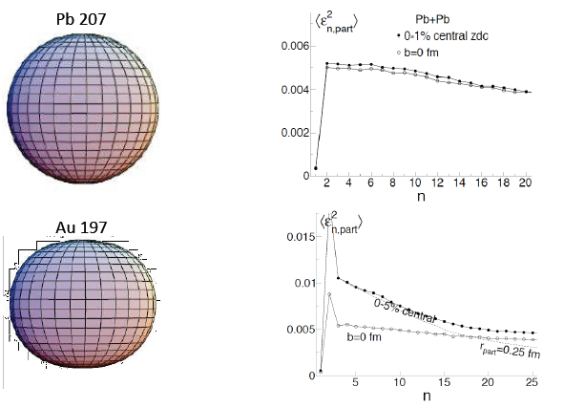
Decouple viscosity from fluctuation: Beam flexibility
In Progress
Program beyond 2015+
Change initial conditions: Au+Au, Pb+Pb, Cu+Pb, U+U
Quantify initial state fluctuation and viscosity (+-10%?)
Beyond phase I BES
Mapping viscosity/s in (μ, T) phase diagram
If critical point or 1st order phase transition line or softening EOS: bulk and shear viscosity
PID v_{n}?
Deviation from statistics
pA program on initial state configuration
Paul Sorensen

Slide 12
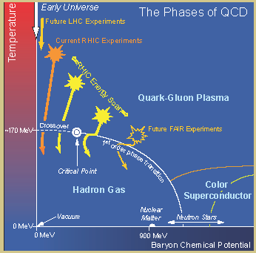
Where is the QCD critical point?
Phase II Expedition
39, 62, and 200 GeV collisions are qualitatively similar
Even extends to LHC energies
But many changes appear at lower energies (11.5, 7.7)
Narrowing down the region of interest (19.6, 27) in run 11
Future (2015+): need detailed study of the key region
Finer energy steps with higher statistics, beam species
Quantify the properties
A landmark on the QCD phase diagram

Slide 13
sQGP properties and phase diagram
Beyond 2017
Charmed correlation with HFT (fast readout)
Phase II BES for precision viscosity (η/s) in phase diagram(μ,T) plane?
pA program to understand the initial-state gluon configuration
Charm hydrodynamic flow
v_{n} with different beam species at top energy
More particles to test thermal model (~x100)

Slide 14
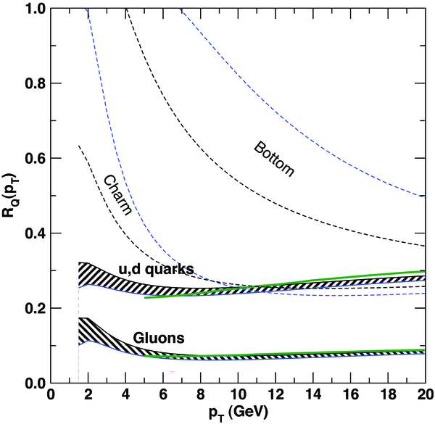
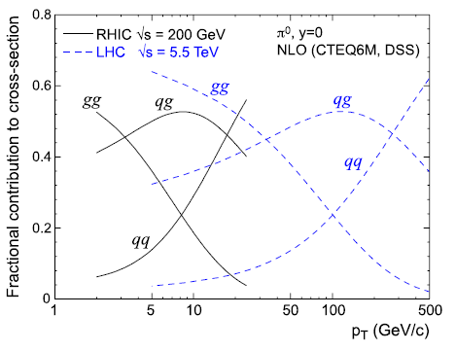
Mechanism of jet energy loss
Quark vs gluon: color factor
heavy vs light quarks: deadcone effect
Heavy-quarks in medium resonant states?
RHIC advantage: Leading hadron PID at high-z, [10,20]GeV/c
WHDG

Slide 15
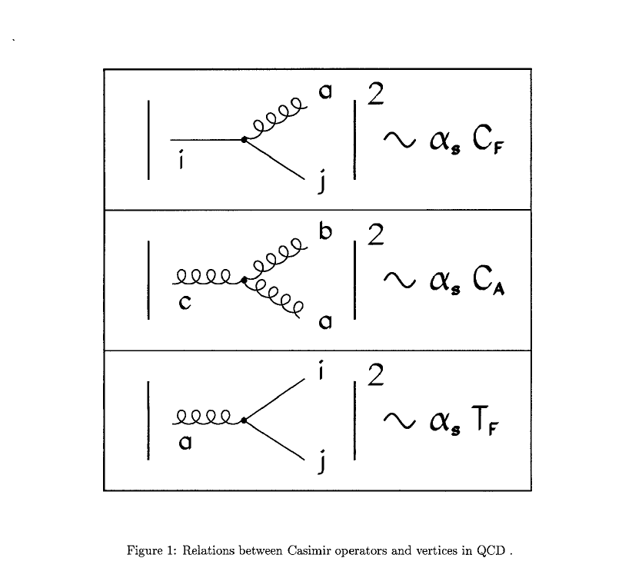
Energy Loss and fundamental QCD
path length L
One mechanism of energy loss : Medium induced gluon radiation
ΔE_{g}
~ 9/4
⇒ C
<q>: energy density, RHIC/LHC
L: anisotropy, Cu+Pb
C: quark vs gluon
ΔE_{q}
Δ
E
<q>
2
∼
α
C
^
L
s
Experimentally observable (of E_{loss}) related to basic ingredient
of QCD - Gauge Group through Color Factors
Or extracting an effective Color Factor
R. Baier et al., NPB 483 (1997) 291
M. Gyulassy et al., PRL 85 (2000) 5535
S. Wicks et al, nucl-th/0512076

Slide 16
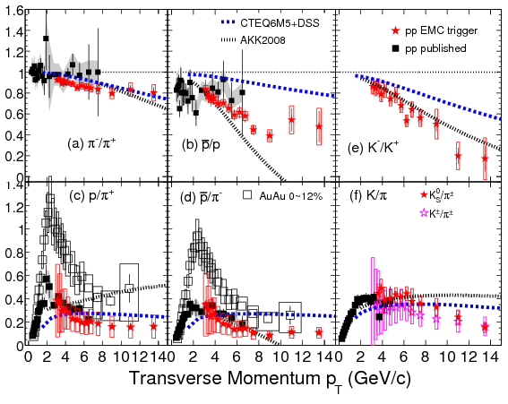
Quark vs gluon from hadron suppression
STAR, B. Mohanty
STAR, P. Fachini STAR, Yichun Xu
PRL 97, 152301 (2006)
STAR Preliminary
Curves: X-N. Wang et al PRC70(2004) 031901
No sign of stronger gluon energy loss in p/π or p/p ratios
X.N. Wang and X.F. Guo, NPA 696(2001)788
T. Renk and K. Eskola, PRC 76 (2007)027901
W. Liu, C.M. Ko, B.W. Zhang, nucl-th/0607047
Need good understanding of how quarks and gluons turn into hadrons

Slide 17
Global Fit on Fragmentation Function
In principle, allow to separate quark-to-proton and
anti-quark-to-proton fragmentation functions
The best constraint on the gluon fragmentation function D_{g}^{p} at large values of z currently available.
Daniel de Florian, Rodolfo Sassot and Marco Stratmann
arXiv: 0707.1506 [hep-ph]; Phys.Rev.D76:074033,2007.
DSS Fragmentation Functions –provided by W. Vogelsang

Slide 18
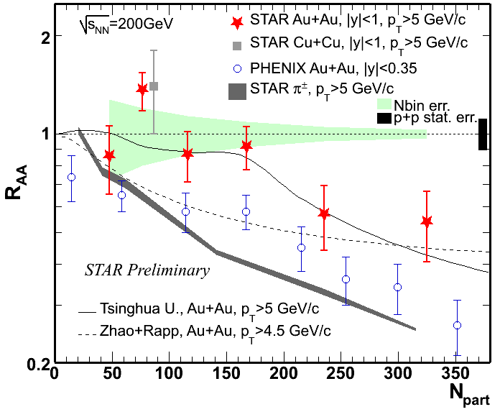
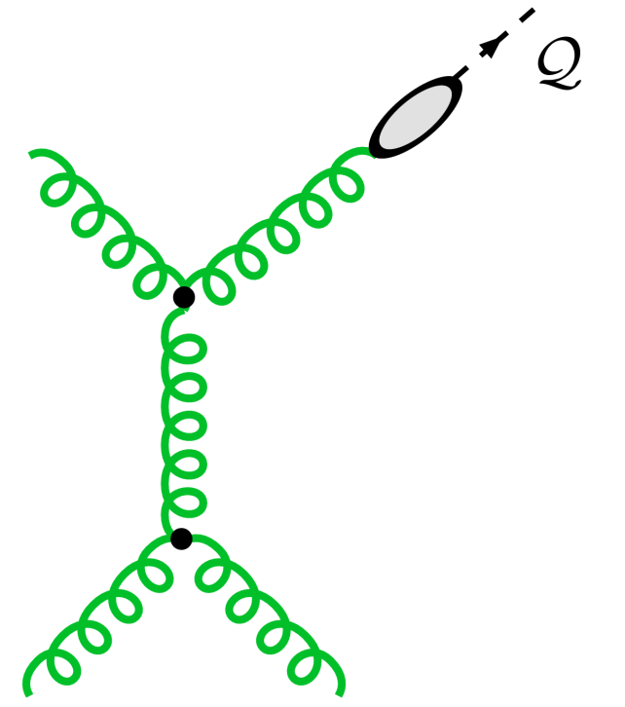
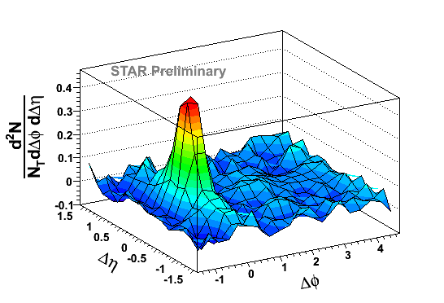
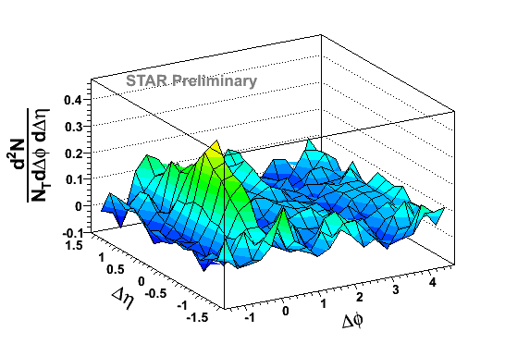
Tag Gluon/quark jet at RHIC
Lansberg
Can we use high-pt J/Ψ to tag gluon?
Jet
QM11: leading pion jet ⬅➔ leading (p+K) jet
Prompt γ

Slide 19
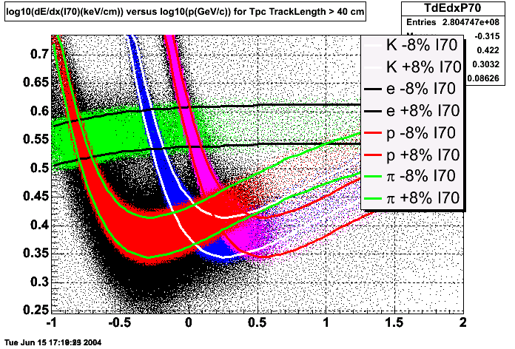
Turn PID Jet into a program
In Progress
Program in 2015+
Large data volume with DAQ1000 (DAQ10K/Trigger)
Install GEM Monitoring of TPC Tracking (GMT) surrounding TPC for space-charge and drift velocity monitoring
Cosmic Ray triggers mixed in normal data taking: dE/dx, alignment
Pile-up Protect events with ±45μs TPC drift time dE/dx, momentum resolution
PID Fragmentation Function at high z (<10%?)
MTD and EMC triggers on J/Psi, rate and IAA feasibility
Possible detector upgrades: Complementary PID at 10<pt<20 GeV/c -2<η<-1

Slide 20
Exotic particles and rare decays
RHIC: a very flexible machine
RHIC: a high-rate machine
C.M. Energy (GeV) | collision species
500 | Polarized p+p
200 | Polarized p+p, Au+Au, d+Au, Cu+Cu
130 | Au+Au
62.4 | Polarized p+p, Au+Au, Cu+Cu
39 | Au+Au
19--22 | Au+Au, Cu+Cu
11 | Au+Au
7.7 | Au+Au
9.2 | Au+Au test
200 | U+U (2010--2011)
Annual Au+Au collisions to tape: STAR: ~1 billion; PHENIX: ~10 billion
Luminosity p+p Equivalent: fb⁻¹
Annual particles to tape: >10¹²
RHIC: new and rare particle factory
Antimatter: antinuclei, antihypernuclei
Glueball:
Dibaryons: [Ξ⁰ Ξ⁻] ◊ Ξ⁻ + Λ
Strangelet: PRC 76 (2007) 011901
Muonic atoms: π−μ, K-μ, p-μ, antimatter
Rare Decays: η→e⁺e⁻,Σ⁺→pl⁺l⁻

Slide 21
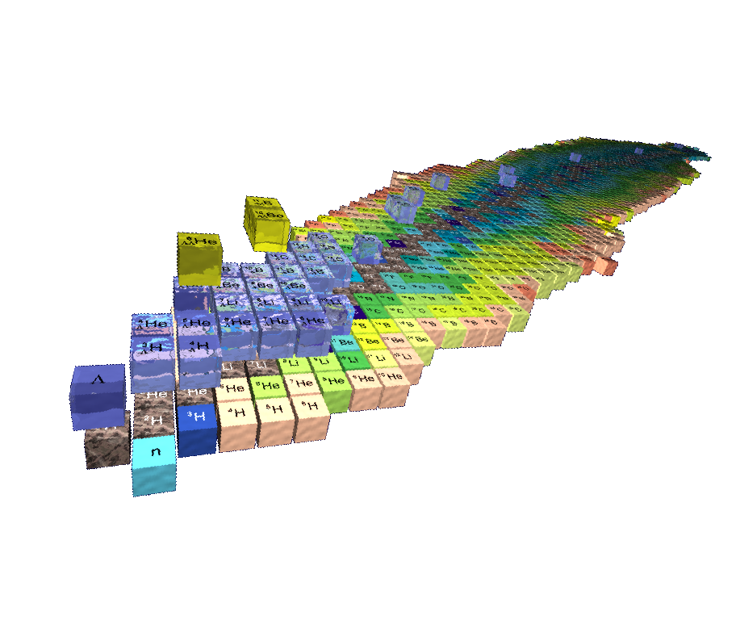
3-D Chart of Nuclides
S=-2
S=-1
S=-0
-2
-1

Slide 22
Hypernucleus and Dibaryon
Huang, UCLA
Precision measurement;
Rate can be very well predicted,
If we don’t find, it doesn’t exist!

Slide 23
Rare Decay η→e⁺e⁻: an example
[PRL94(2005)021801]
Physics beyond standard model enhances rare decay rate (10⁻⁹ to 10^{-8,-7})
RHIC: ideal for such search;
>10¹¹ η annual yield;
Clean Low-pt electron identification
η→e⁺e⁻ PDG BR <2.7x10⁻⁵
STAR Simulation
STAR Preliminary
~10⁷ η

Slide 24
Even Heavier Antimatter
Formation of antimatter clusters in the hadronisation phase transition: U. Heinz et al. JPG: 12 (1986) 1237
Pull ‾α from vacuum (Dirac Sea): W. Greiner, IJMPE 5 (1995) 1

Slide 25
Antinuclei in nature (new physics)
To appreciate just how rare nature produces antimatter (strange antimatter)
RHIC: an antimatter machine
Seeing a mere antiproton or antielectron does not mean much– after all, these particles are byproducts of high-energy particle collisions.
However, complex nuclei like anti-helium or anti-carbon are almost never created in collisions.
AMS antiHelium/Helium sensitivity: 10⁻⁹
Dark Matter, Black Hole➔ antinucleus production via coalescence

Slide 26
User Facility on exotic and rare processes
Antimatter: low-energy atom; Astrophysics: CERN, AMS
Hypernuclei, dibaryon: nuclear structures Strangeness Pomeron/Odderon
Rare decays: e⁺e⁻ collider; precise physics
A program appealing to other communities?
How do we get other communities involved?
Relevant upgrades: DAQ10K, High-level Trigger, TOF, HFT, MTD, RP II

Slide 27
Novel Symmetries
Local Parity Violation
Chiral Symmetry
STAR, PRL 103, 251601
Crucial to verify if parity violation is the correct explanation
U+U collisions: collisions with more v₂ and less B field than Au+Au

Slide 28
In-medium Vector-Meson and χ symmetry
NA60, PRL96(2006)162301
Model with in-medium vector-meson mass broadening describes dimuon spectral function in NA60 at SPS
R Rapp et al. Phys.Rept.462(2008)176
Enhancement at around M=0.5GeV observed by RHIC not described by the model extrapolating from SPS
PHENIX PRC 81(2010)034911

Slide 29
Measure Irreducible background
In addition to the dimuon measurements
eμ correlation simulation with Muon Telescope Detector at STAR from ccbar:
S/B=2 (M_{eu}>3 GeV/c2 and p_{T}(eμ)<2 GeV/c)
S/B=8 with electron pairing and tof association
L. Ruan et al., Journal of Physics G: Nucl. Part. Phys. 36 (2009) 095001

Slide 30
Catching thermal leptons: QED for QCD
Exciting possible new discoveries: K-μ atoms; antimatter mounic hydogen: ‾p-μ⁺
Direct measure of single lepton spectrum from thermal radiation

Slide 31
Understanding Symmetry and DOF
LPV:
beam energy: deconfinement, chiral symmetry
Beam species: magnetic field
Medium effect on vector mesons (chiral symmetry, resonant states):
beam energy;
Spectra and v₂ vs M_{l+l-}
HFT+MTD upgrade 2017-
First glimpse of dilepton spectra around ρ₀ and 1<M<3GeV
Atoms as a tool?
Beyond 2017
Phase II BES?
Detailed studies of DOF
STAR at RHIC is the best detector to study LPV and Chiral symmetry restoration:
flexible machine to change conditions beam species (magnetic field), BES (turn on/off QGP)
Large Acceptance (good for both LPV and chiral symmetry)
Excellent lepton PID (both electrons and muons at midrapidity, who else has that!)
Since the beginning of physics, symmetry considerations have provided us with an extremely powerful and useful tool in our effort to understand nature. Gradually they have become the backbone of our theoretical formulation of physical laws. — Tsung-Dao Lee Particle Physics and an Introduction to Field Theory (1981), 177

Slide 32
Cold QCD matter – the initial state at RHIC
STAR
preliminary
pp
peripheral dAu
central dAu
RHIC may provide unique access to the onset of saturation
Future questions for p+A
What is the gluon density in the (x,Q²) range relevant at RHIC?
What role does saturation of gluon densities play at RHIC?
What is Q_{s} at RHIC, and how does it scale with A and x?
What is the impact parameter dependence of the gluon density?

Slide 33
Some planned p+A measurements
Nuclear modifications of the gluon PDF
Correlated charm production
Gluon saturation
Forward-forward correlations (extension of existing π⁰-π⁰)
h-h
π⁰-π⁰
γ-h
γ-π⁰
Drell-Yan
Able to reconstruct x₁, x₂, Q² event-by-event
Can be compared directly to nuclear DIS
True 2 → 1 provides model-independent access to x₂ < 0.001
Λ polarization
Baryon production at large x_{F}
What more might we learn by scattering polarized protons off nuclei?
Forward-forward correlations, Drell-Yan, and Λs are also very powerful tools to unravel the dynamics of forward transverse spin asymmetries – Collins vs Sivers effects, TMDs or Twist-3, …
Easier to measure
Easier to interpret
Carl Gagliardi, STAR Decadal Plan – June, 2011 PAC Meeting

Slide 34
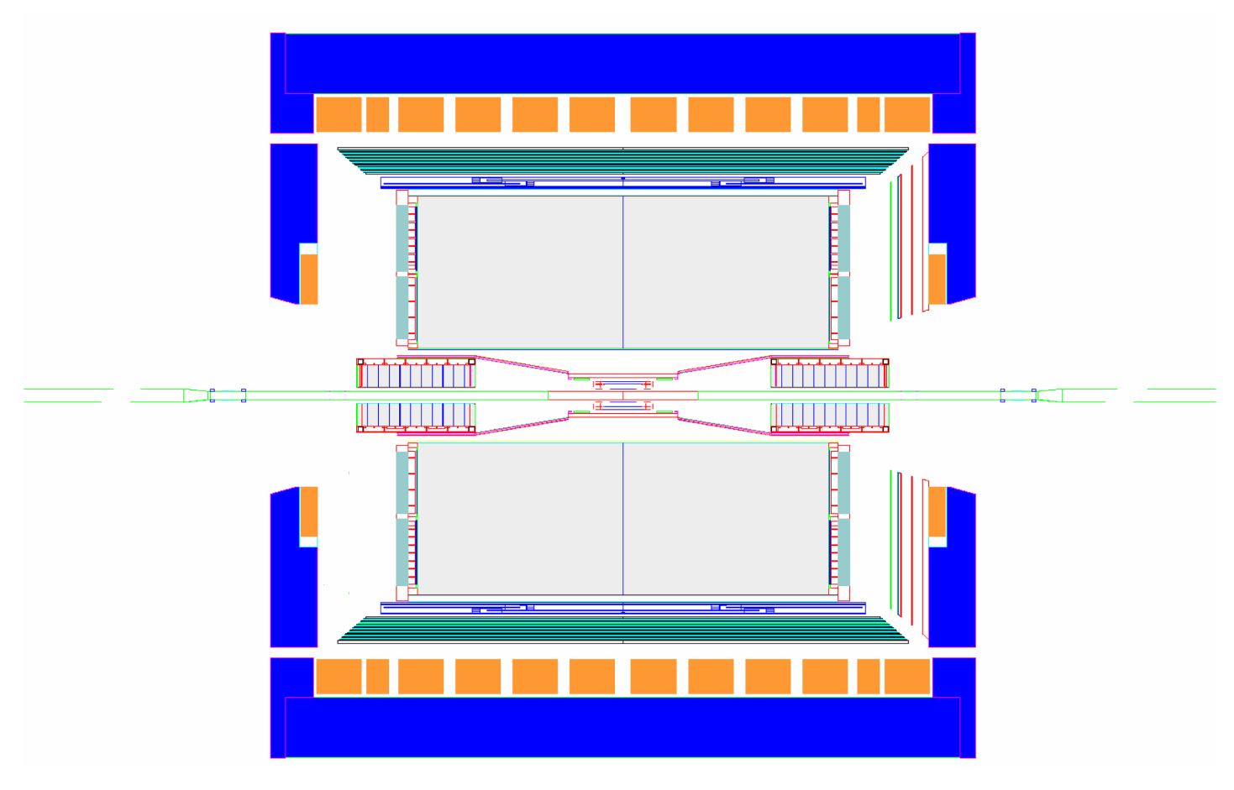
Forward Instrumentation Upgrades
proton
nucleus
~ 2016
~ 6 GEM disks
Tracking: 2.5 < η < 4
FMS
FHC
W powder HCal
Preshower
1/2” Pb radiator
Shower “max”
RICH
Baryon/meson separation
Forward instrumentation optimized for p+A and transverse spin physics
Charged-particle tracking
e/h and γ/π⁰ discrimination
Baryon/meson separation
Carl Gagliardi, STAR Decadal Plan – June, 2011 PAC Meeting

Slide 35
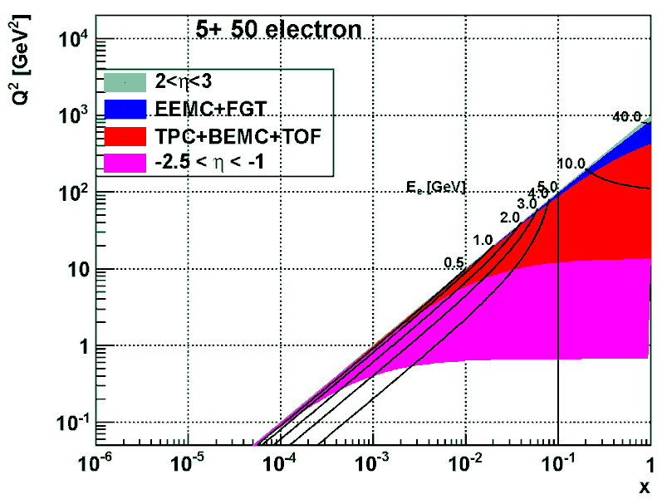
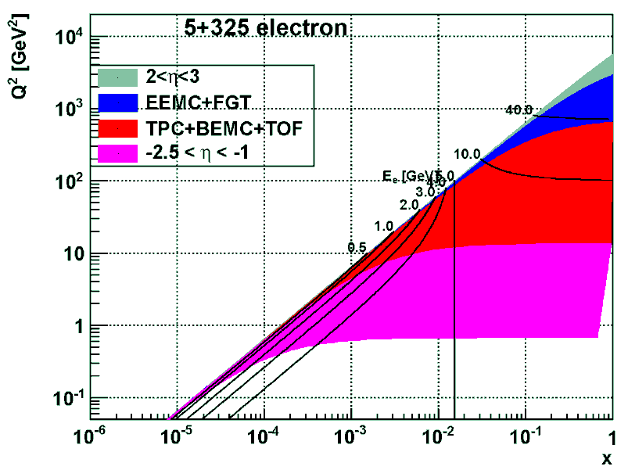
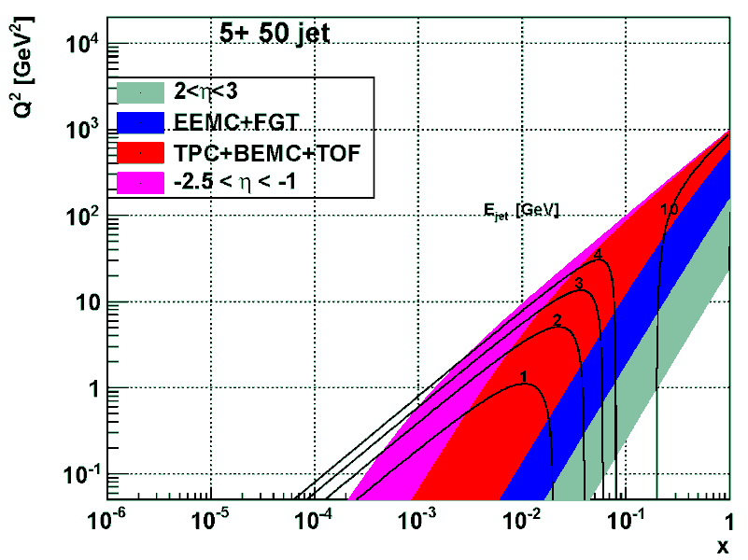
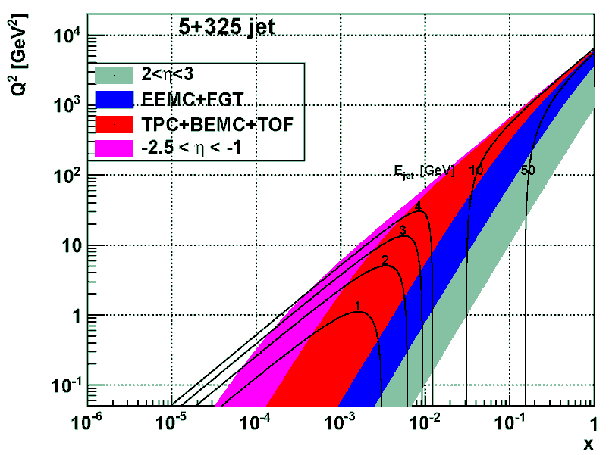
eRHIC phase 1: kinematic range
5 GeV e + 50 GeV/nucleon
5 GeV e + 325 GeV/nucleon
DIS region
TPC+
BEMC+TOF
Missing today
EEMC+FGT
SIDIS region
Missing today
Missing today
“Forward” (-2.5 <~ η < -1) electron acceptance essential to span deep-inelastic (DIS) regime
Both backward and forward hadron coverage valuable for semi-inclusive deep-inelastic (SIDIS) scattering

Slide 36
STAR → eSTAR Optimizing STAR for e+p and e+A collisions from 5+50 to 5+325 GeV
Inclusive scattering over the entire deep-inelastic region
Key measurements
F_{L} in e+p and e+A: direct measure of gluon densities in nucleons and nuclei
g₁ in e+p and e+³He: nucleon spin structure
F₂^{A}/F₂^{d}: parton distributions in nuclei (including gluons via Q² evolution)
Need electron detection, ID, and triggering over -2.5 <~ η < -1
Combined mini-TPC/threshold gas Cherekov detector
Semi-inclusive deep-inelastic scattering over a broad (x,Q²) domain
Key measurements
Flavor-separated helicity distributions, including strangeness
Collins, Sivers, Boer-Mulders, and other transverse spin distributions
Flavor-separated parton distributions in nuclei, including strangeness
Parton energy loss in cold nuclear matter
Need hadron detection and identification beyond the TPC/EEMC
Extend TOF to cover -2 < η < -1
GEM disks (from forward instrumentation upgrade) plus hadronic calorimetry in the region 2 < η < 3
Deeply-virtual Compton scattering
Key measurement
GPDs
Need forward proton and expanded photon detection
Roman pots (also valuable for spectator proton tagging in e+³He)
EM calorimetry for -4 < η < -1
Carl Gagliardi, STAR Decadal Plan – June, 2011 PAC Meeting

Slide 37
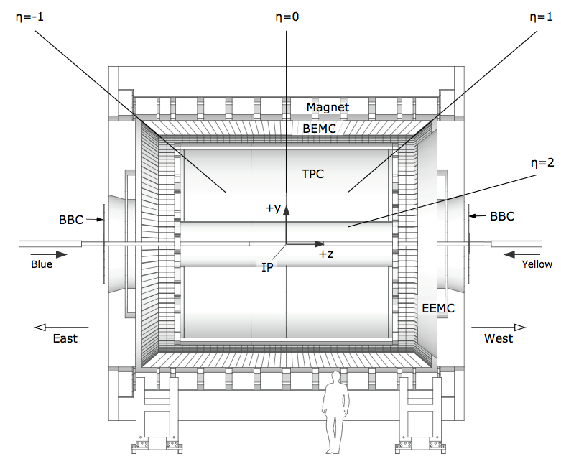
Evolving from STAR into eSTAR
proton/nucleus
electron
ToF: π , K identification,
t0, electron
ECal: electrons and photons
GCT: a compact
tracker with enhanced
electron capability
Combine high-threshold (gas)
Cherenkov with TPC(-like)
tracking
HCal: W powder, spaghetti cal
Simulations ahead:
eSTAR task force formed
ToF
ECal
TPC i.s.
GCT
TPC i.s.
GEM disks
HCal
EIC Generic Detector R&D Panel:
GCT: LOI toward multi-institution R&D effort
HCal: R&D proposal

Slide 38
STAR Forward Instrumentation R&D Projects
An Endcap TOF + PID
-2<η<-1, electron E<~5GeV
TOF+TPC+EMC (shower), hadron PID Rice+UT+BNL+UCLA (USA) USTC+Tsinghua (China)
Ongoing discussion, proposal for second EIC R&D call?
Roman Pot Phase II
Important for ep, pHe3, pA
BNL+CU+ODU+SINS+WUT
FSC+FMS+RICH+GEM
2<η<4, DY+hadron jets
PS+BNL+TUAM+UCLA+IU+KU?

Slide 39
Conclusions
Properties of sQGP and thermalization
Mechanism of jet quenching
Novel symmetry
Search for exotic particles
Properties of cold gluonic matter
Mapping and quantifying matter properties in QCD phase diagram
Validate and quantify the fundamental difference of gluon and quark jet energy loss
Understanding the possible symmetries and DOF
User facility for hypernuclei, multibaryon states, rare decays
Nuclear structure function, Initial condition, CGC, jet energy loss in nuclei
STAR(--2016)➔pSTAR(2017-18)➔eSTAR(2020)

Slide 40
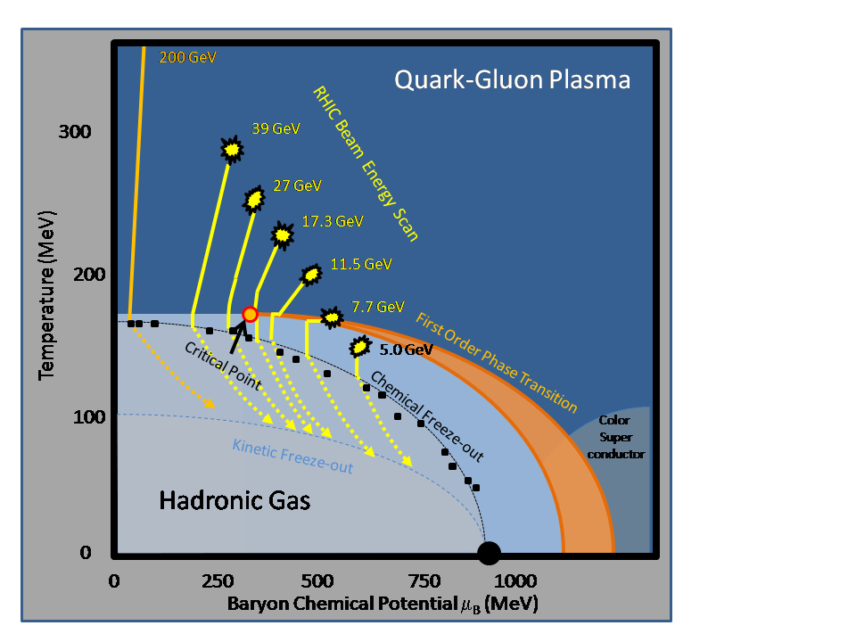
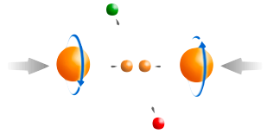
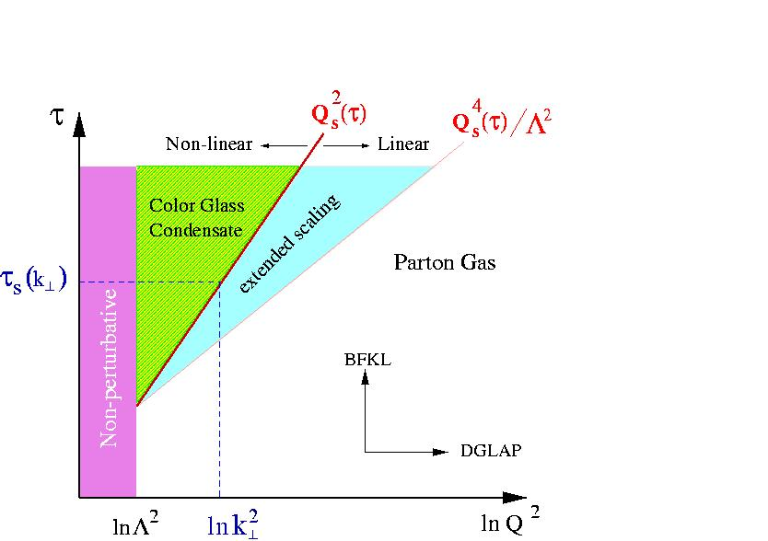
RHIC: eight key unanswered questions
Hot QCD Matter
Partonic structure
6: Spin structure of the nucleon
7: How to go beyond leading twist
and collinear factorization?
1: Properties of the sQGP
2: Mechanism of energy loss:
weak or strong coupling?
3: Is there a critical point, and if so, where?
4: Novel symmetry properties
5: Exotic particles
8: What are the properties of
cold nuclear matter?
Carl Gagliardi, STAR Decadal Plan – June, 2011 PAC Meeting

Slide 41
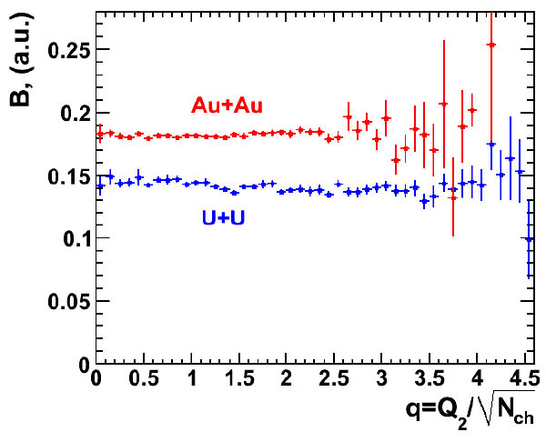
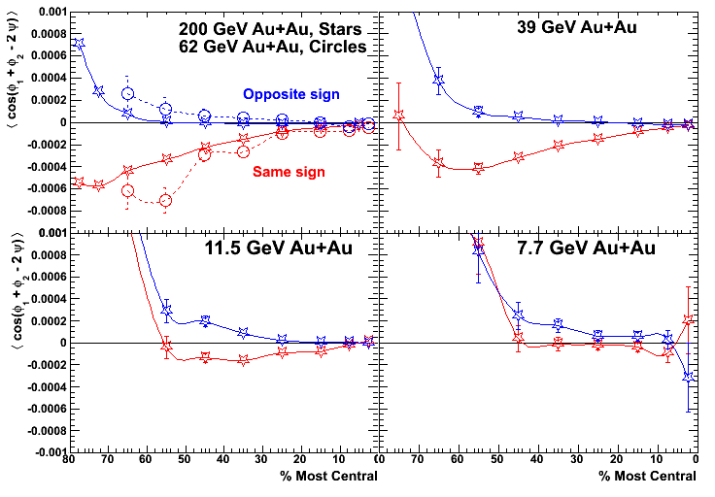
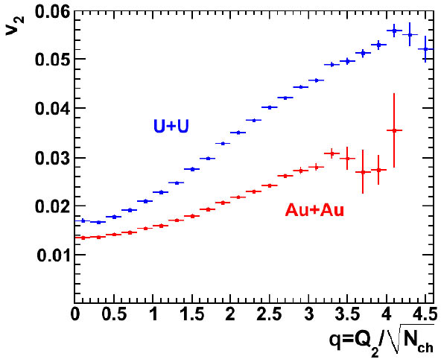
Novel symmetries: local strong parity violation
Transitions between domains with different topological charge may induce parity violation in the dense matter
Similar transitions (at much higher energies) might have produced the matter-antimatter asymmetry in the early universe
Magnetic field in A+A plays a key role: chiral magnetic effect
Crucial to verify if parity violation is the correct explanation
U+U collisions: collisions with more v₂ and less B field than Au+Au

Slide 42
Discover antimatter Unstable Nuclei
NEXT:
Discover antimatter Unstable Nuclei: ⁴Li➔³He+p
⁴He*➔d+d, t+p
⁵Li➔⁴He+p
⁴_{Λ}H➔⁴He+π (x100)
Clear energy excess: EMC energy vs TPC Energy He3bar (top panel) He3 (bottom panel) Run10, He3bar efficiency with Et>2.5GeV is 62%
Proposed Trigger:
L0 EMC HT>1.8 or 2.5GeV
L0 decision on TPC sector readout
Read events at high rate with 1--2 TPC sectors (DAQ10K)
Full RHIC II luminosity
Two order of magnitude enhancement

Slide 43
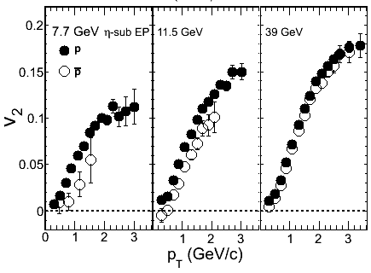
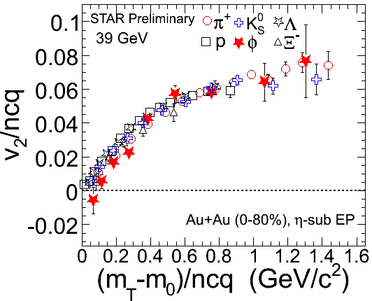
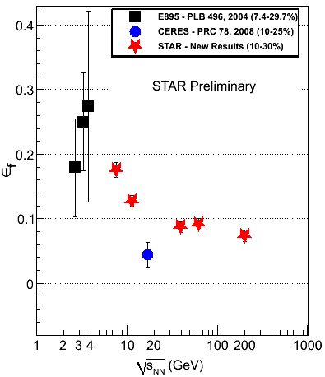
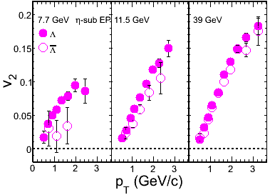
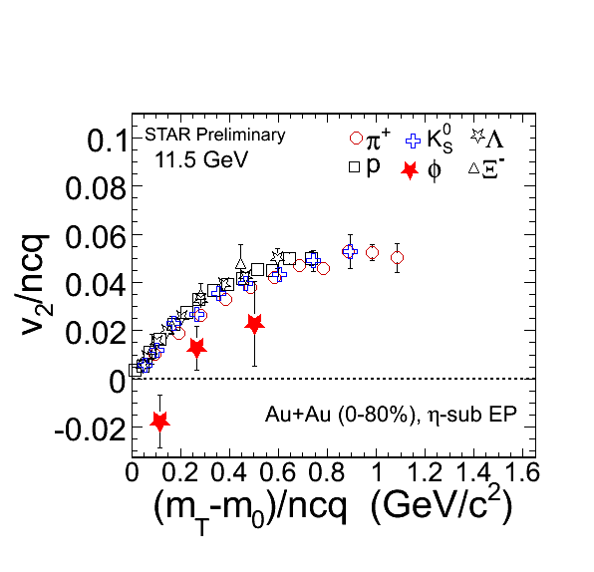
Phase II Expedition
STAR Preliminary
STAR Preliminary
39, 62, and 200 GeV collisions are qualitatively similar
Even extends to LHC energies
But many changes appear at lower energies (11.5, 7.7)
Narrowing down the region of interest (19.6, 27) in run 11
Future (2015+): need detailed study of the key region
Finer energy steps with higher statistics, beam species

Slide 44
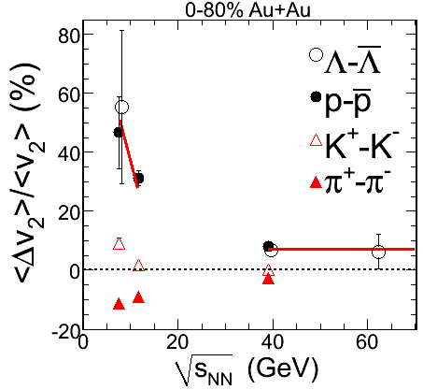
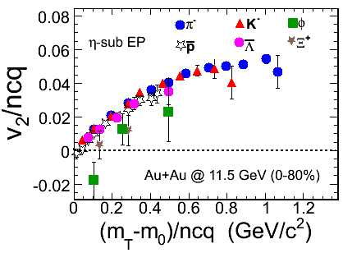
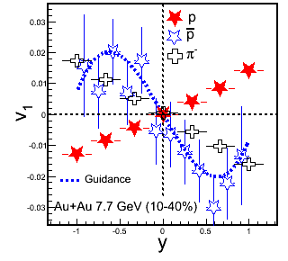
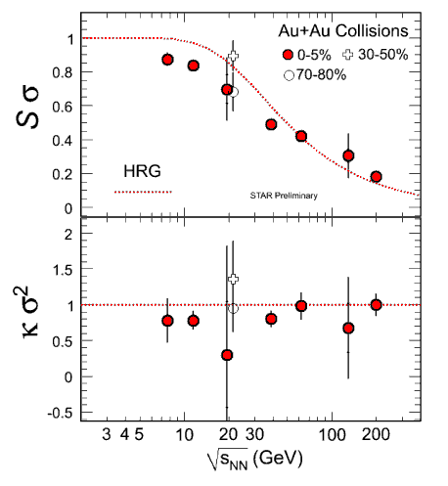
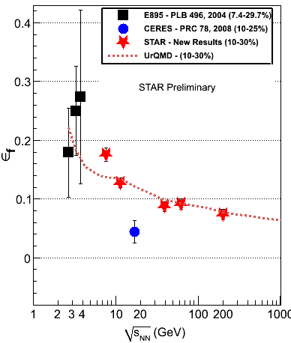
Summary
Successful RHIC BES Program from Collider/Accelerator and experimental side
New observations:
Identified hadron production & freeze-out
parameters reveals high net-baryon
density at these energies.
Effect on several observables seen.
Hadronic interactions at low energy.
Small φ meson v₂ at 11.5 GeV.
Disappearance of dynamical charge correlations.
Interesting trends for observables related to
softening of EOS. Non-monotonic variation
of freeze-out eccentricity. Change in sign of
proton v₁ with energy and centrality.
Large acceptance & excellent PID allows for
fluctuations measurements. Deviations from
HRG and Poisson statistics. Is being used to
study structure of the QCD phase diagram.
STAR Preliminary
STAR Preliminary
STAR Preliminary
STAR Preliminary
Need to complete the first phase of BES program

Slide 45
Rate Estimates
Muon PID using TOF/TPC/MTD
the antimatter muonic hydrogen: >1000 candidates in 500M central events
MTD trigger for π-μ high-pt atoms with single TPC sector readout
Atom | μ pt (GeV/c) | Hadron pt | Atom pt | dN/dy
π−μ | [0.17,0.3] | [0.22,0.4] | [0.39,0.7] | 3e-4
K-μ | [0.17,0.3] | [0.8,1.4] | [0.97,1.7] | 3e-5
p-μ | [0.17,0.3] | [1.5,2.7] | [1.7,3.0] | 1e-5
π−μ | >1.5 | >2 | >3.5 | 1e-8

Slide 46
Lifetime of a hypertriton
Lifetime related to binding energy
Theory input: the Λ is lightly bound in the hypertriton
[1] R. H. Dalitz, Nuclear Interactions of the Hyperons (Oxford Uni. Press, London, 1965).
[2] R.H. Dalitz and G. Rajasekharan, Phys. Letts. 1, 58 (1962).
[3] H. Kamada, W. Glockle at al., Phys. Rev. C 57, 1595(1998).

Slide 47
STAR Experiment
MRPC ToF Barrel
MTD
EMC Barrel
EMC End Cap
FMS
BBC
FPD
TPC
Roman Pots
Phase 2
computing
DAQ1000
COMPLETE
Trigger and DAQ
Upgrades
FGT
HFT
Ongoing
R&D

Slide 48
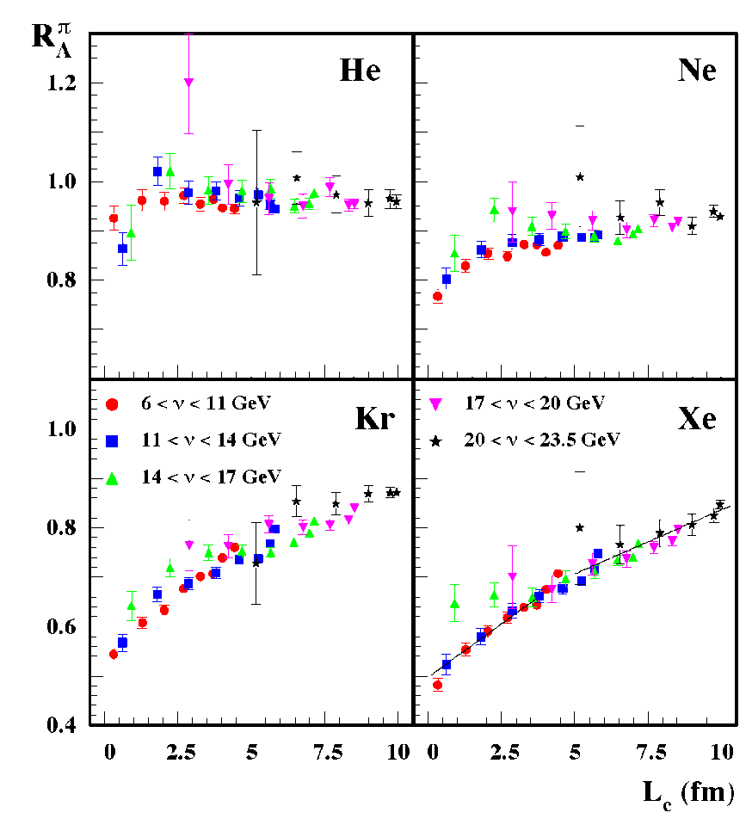
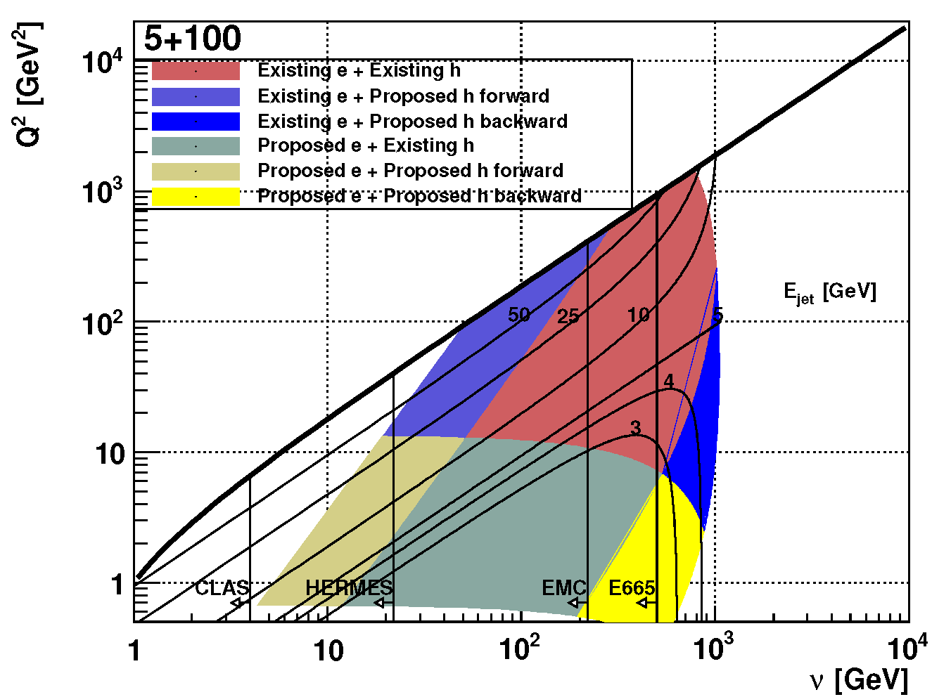
Parton energy loss in cold QCD matter
HERMES, NP B780, 1
L_{c} up to few 100 fm
Complementary tool to investigate partonic energy loss
HERMES: hadrons can form partially inside the medium
Mixture of hadronic absorption and partonic energy loss
eRHIC: light quark hadrons form well outside the medium
Heavy quarks: unexplored to date. Low β → short formation time
Carl Gagliardi, STAR Decadal Plan – June, 2011 PAC Meeting

