Slide 1



Measurement of J/ψ production in p+p collisions at √s = 500 GeV at STAR experiment
Rongrong Ma (BNL)
Hard Probes 2015
McGill University, Montreal, Canada
June 29 – July 3, 2015

Slide 2
Outline
Motivation
STAR experiment
J/ψ measurements
  Cross section
  Yield ratio of ψ(2s) to J/ψ
  J/ψ yield vs. event activity
Summary

Slide 3
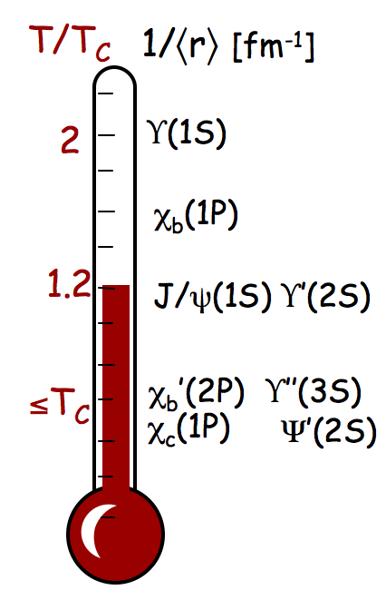
J/ψ measurements in heavy-ion collisions
Quarkonia are predicted to be sequentially melted in Quark Gluon Plasma due to color-screening of the parton constituents →a thermometer of the medium.
Suppression of J/ψ was proposed as a direct probe of deconfinement.
The pp results serve as a reference for the same measurements in heavy-ion collisions.
Need to fully understand the production mechanism in pp collisions.

Slide 4
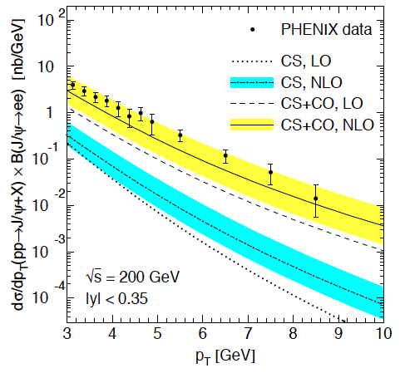
Do we understand J/ψ in pp?
NRQCD long-distance matrix at Next-to-Leading Order from world-data fitting.
Phys. Rev. D84 (2011) 051501

Slide 5
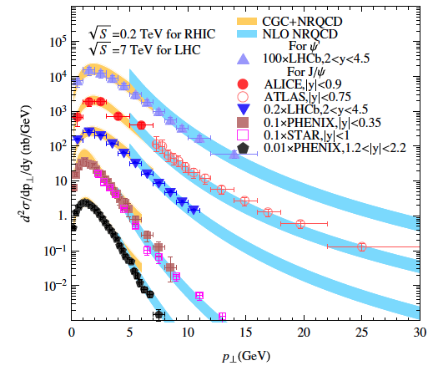
Do we understand J/ψ in pp?
NRQCD long-distance matrix at Next-to-Leading Order from world-data fitting.
Color Glass Condensate effective theory to calculate cross section at low p_{T}
Phys. Rev. D84 (2011) 051501
Phys.Rev.Lett. 113 (2014) 192301
Low p_{T}
Good data-theory agreement over 0 < p_{T} < 30 GeV/c

Slide 6

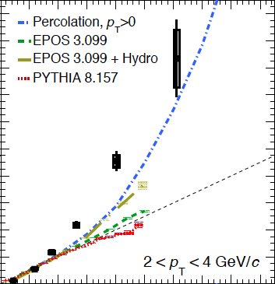

A closer look: event multiplicity dependence
ALICE pp @ 7 TeV
arXiv:1505.00664
Stronger-than-linear rise of open charm production vs event activity.
Similar behavior seen for inclusive J/ψ at both mid- and forward-rapidity.
Several ideas on the market:
  PYTHIA 8: c and b quarks produced in Multi-Parton-Interaction -> underestimate yield at large multiplicity
  Percolation model: string screening -> quadratic rise at high multiplicity
  Hard process is associated with larger gluon radiation
D meson
Collective effects in high-multiplicity pp collisions?
Do we see similar or different behavior at RHIC?

Slide 7

The Solenoid Tracker At RHIC (STAR)
Mid-rapidity detector: |η| < 1, 0 < φ < 2π
Time-Of-Flight
Muon Telescope Detector
TPC: precise momentum and energy loss
TOF: fast detector
BEMC: trigger on and identify electrons
MTD: trigger on and identify muons
  Cover 45% geometrical acceptance within |η|<0.5
Time Projection Chamber
Barrel ElectroMagnetic Calorimeter

Slide 8
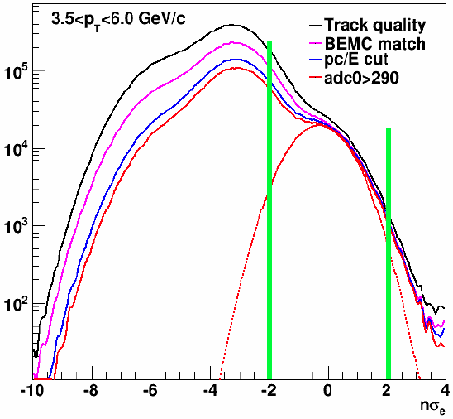
J/ψ measurements at high p_{T}
Decay channel: J/ψ → e⁺ + e⁻
Data set: p+p collisions at 500 GeV taken in 2011
High Tower (HT) trigger with a threshold of 3.5 GeV/c using BEMC
  Sampled integrated luminosity ~ 22 pb⁻¹
Electron identification
  One decay electron fire trigger
  0.3 < p_{track}/E_{cluster} < 1.5
  |nσ_{e}|<2

Slide 9
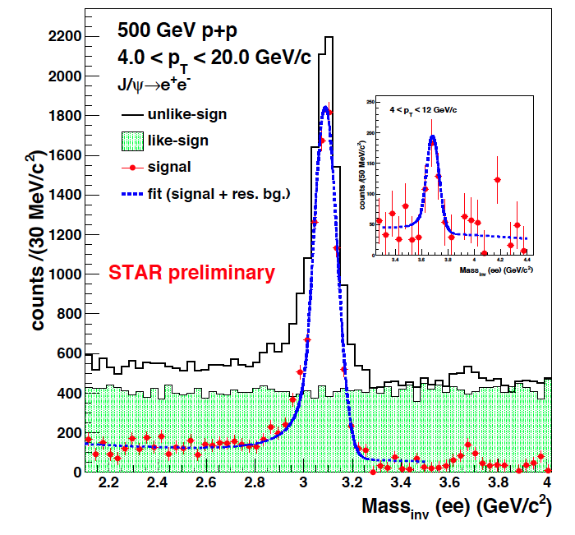
Extract J/ψ yield
Clear signals for ψ(2s) and J/ψ
Combinatorial background: estimated by like-sign pairs and subtracted.
Correlated background: estimated by fitting Crystal ball function (signal) + exponential function
Signal extraction: bin counting within [2.7,3.2] GeV/c²

Slide 10
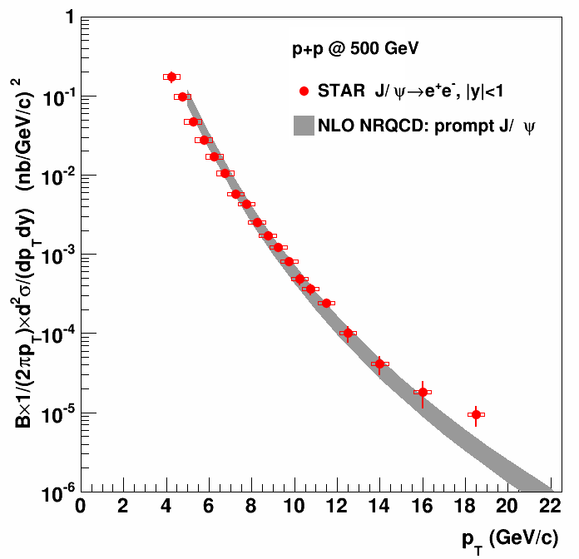
J/ψ cross section above 4 GeV/c
STAR preliminary
NRQCD
PRL 106 (2011) 042002
PRD 84 (2011) 114001
JHEP05 (2015) 103
Cross section measured within 4 < p_{T} < 20 GeV/c
NRQCD prediction agrees well with data

Slide 11
J/ψ cross section above 4 GeV/c
STAR preliminary
NRQCD
PRL 106 (2011) 042002
PRD 84 (2011) 114001
JHEP05 (2015) 103
Cross section measured within 4 < p_{T} < 20 GeV/c
NRQCD prediction agrees well with data
Follows x_{T} scaling with n ~ 5.6, which reflects number of active partons in J/ψ production

Slide 12
Yield ratio of ψ(2s) to J/ψ
~18% of systematic
uncertainty
Follows world data trend with p_{T}, and no obvious collision energy dependence
Help to pin down the feed-down contribution from ψ(2s) to J/ψ

Slide 13
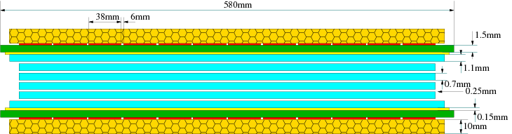
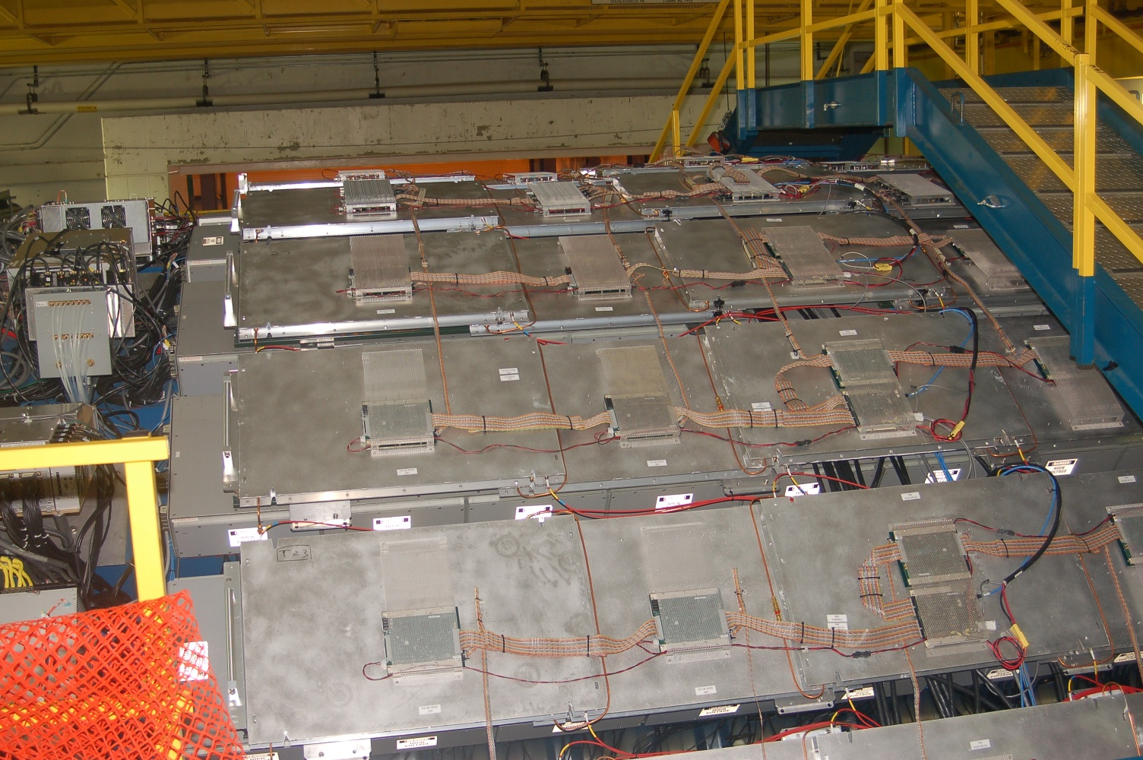
J/ψ measurements at low p_{T}
Enabled by the new Muon Telescope Detector
Multi-gap Resistive Plate Chamber (MRPC)
  gas detector, avalanche mode
Installed behind the return iron bars of the magnet
  5 interaction length
Muon identification utilizing precise timing measurement.
Double-end readout -> measure hit position along the beam direction.
In 2013, 63% of MTD was installed. MTD trigger commissioned in May.
Installation completed in early 2014
  122 trays, 1439 readout strips and 2878 readout channels

Slide 14
Extract J/ψ yield
Decay channel: J/ψ → μ⁺ + μ⁻
Data set: p+p collisions at 500 GeV taken in 2013
MTD dimuon trigger: two hits in MTD
    Sampled integrated luminosity ~ 7.7 pb⁻¹
Muon identification
  Match TPC tracks to MTD
  Require z residual below 20 cm
Background: fitting Gaussian (signal) & expo+pol0
Signal extraction: bin counting within [2.8,3.3] GeV/c²

Slide 15
Characterize event activity
Multiplicity of
TOF matched tracks
|η| < 0.9
Insensitive to pile-up effects

Slide 16
J/ψ yield vs. event activity
+15% one-sided global errors along both x- and y- directions
  Work in progress to reduce it
Clear correlation between soft and hard processes
  Different trends for J/ψ yield vs. event activity at low and high p_{T}
Stronger-than-linear growth in high multiplicity events

Slide 17
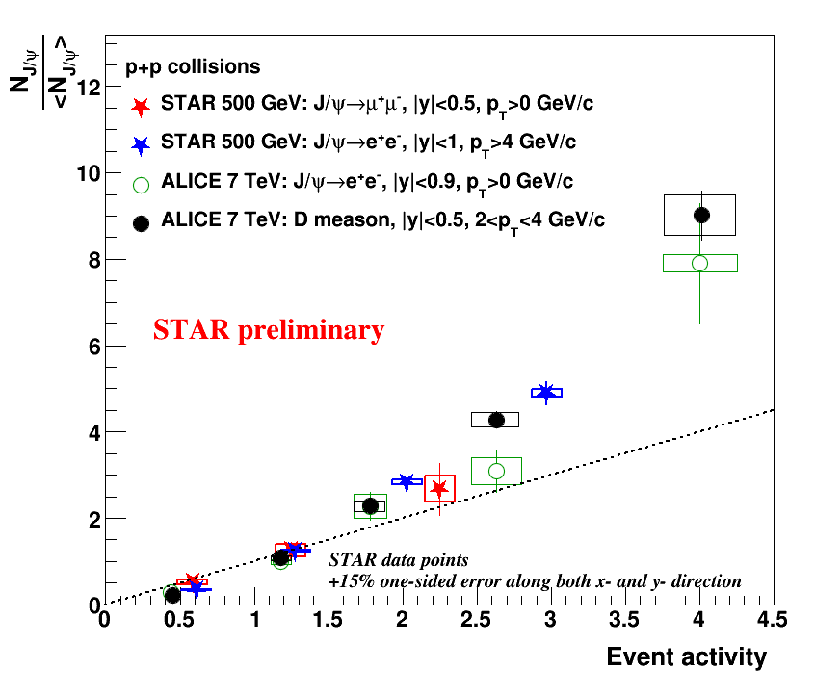
Compare to LHC
The rising trend is similar at RHIC compared to LHC
  Universal dependence of relative J/ψ yield on event activity at different energy?
ALICE J/ψ: Phys.Lett. B712 (2012) 165-175
ALICE D-meson: arXiv:1505.00664

Slide 18
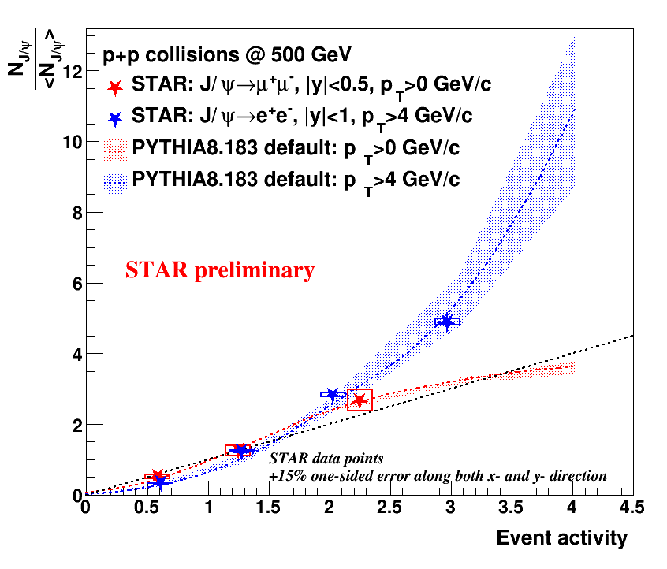
Data vs PYTHIA
Default tune of PYTHIA 8.183
Both the rising trend and p_{T} dependence observed in data can be reasonably reproduced by PYTHIA8
  It seems to do a better job at RHIC than LHC

Slide 19
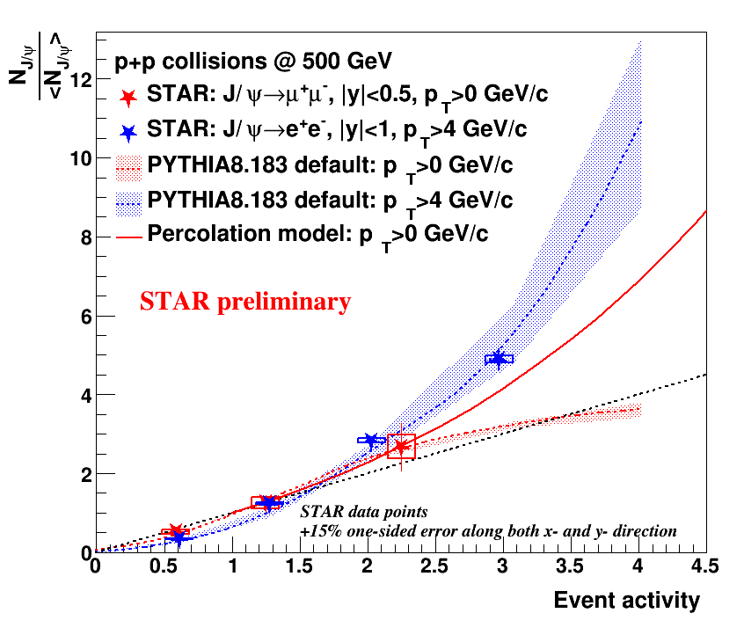
Data vs Percolation model
Percolation model: PRC 86 (2012) 034903
private communication
Both the rising trend and p_{T} dependence observed in data can be reasonably reproduced by PYTHIA8
  It seems to do a better job at RHIC than LHC
The trend is also qualitatively reproduced by percolation model.
  Stronger rise at large multiplicity than PYTHIA8
Test with larger multiplicity bins is important

Slide 20
Summary
Inclusive J/ψ cross section are measured above 4 GeV/c via the di-electron channel.
  Agrees with NRQCD calculation.
For the first time, J/ψ is reconstructed via the di-muon channel at STAR using the new MTD.
The relative J/ψ yield grows rapidly as the event multiplicity increases, and the high p_{T} J/ψ grows even faster than the low p_{T} J/ψ.
  Work in progress to reduce the systematic uncertainties.
PYTHIA8 and percolation model can reproduce the rising trend of the J/ψ. PYTHIA8 can also describe the high p_{T} range.
  Test with even higher multiplicity bins is important.
Theoretical inputs are very welcome.

Slide 21
Backup

Slide 22
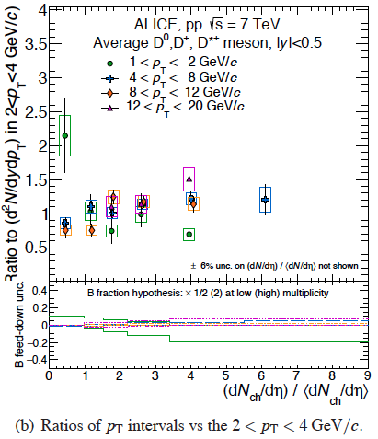
p_{T} dependence at the LHC
Clear p_{T} dependence of the trend.
Almost a factor 2 of difference between low p_{T} and high p_{T} J/ψ at lowest and highest multiplicity bins

Slide 23
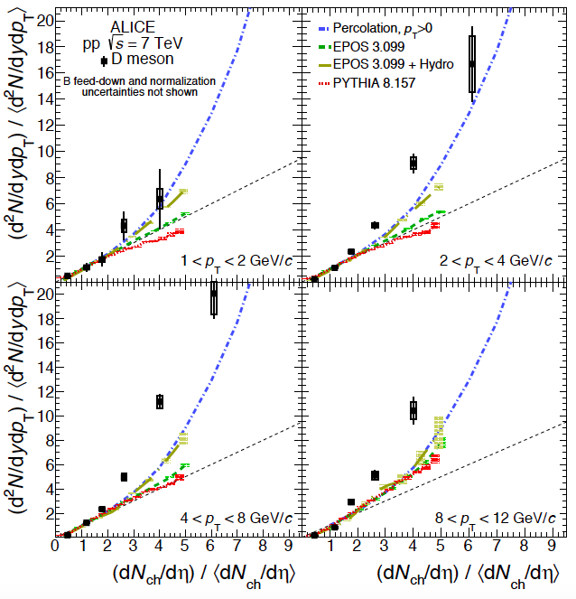
Comparison with models at LHC
Both PYTHIA and EPOS underestimate the yield
The percolation model agrees better with data.

