Slide 1



New STAR Results
- A Peek into the RHIC Heavy Flavor Era
Rongrong Ma (BNL)
for the STAR Collaboration
2016 RHIC&AGS Annual Users’ Meeting Brookhaven National Lab
June 7-10, 2015

Slide 2

Outline
Motivation
STAR experiment
  Heavy Flavor Tracker (HFT)
  Muon Telescope Detector (MTD)
Recent heavy flavor results
  R_{AA} and v₂ measurements for D⁰
  R_{AA} and v₂ measurements for J/ψ
Summary & Outlook

Slide 3
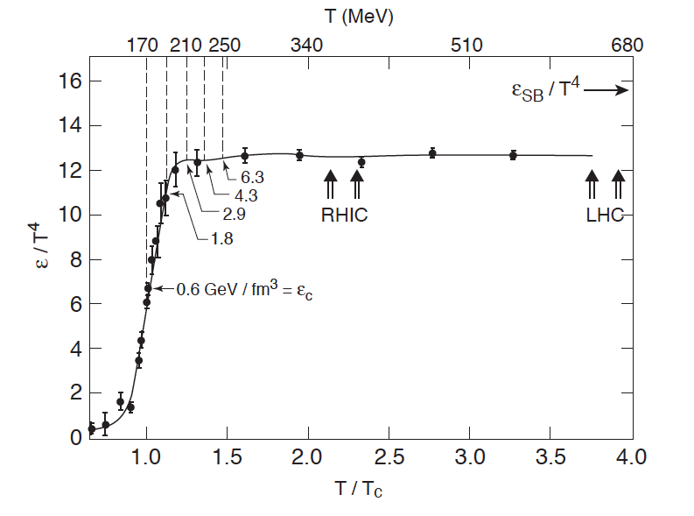
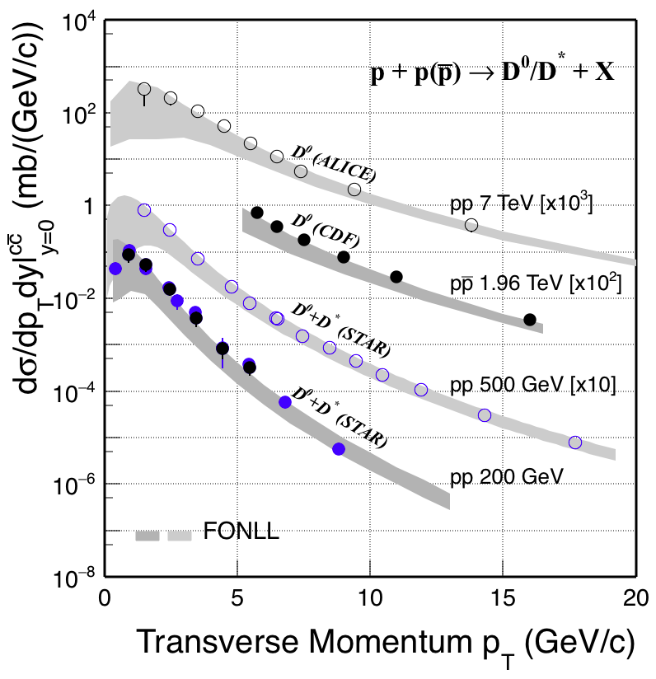
Probe QGP with charm quark
pQCD predicts a phase transition from confined hadrons to Quark Gluon Plasma (QGP) in heavy-ion collisions where partons are the relevant degrees of freedom.
Contemp.Phys. 42 (2001) 209, courtesy F. Karsch
Charm quark: m_{c} >> T_{QGP}, Λ_{QCD}
  Produced in the hard scatterings at the early stage of nuclear collisions → experience the entire evolution of medium
  Charm cross section scales with N_{coll} in Au+Au collisions → important input for models to calculate regeneration contribution to charmonium
    Currently, 16% uncertainty in 0-10% Au+Au events*
  Clean probe at RHIC as contributions from gluon splitting and bottom quark are small.
  Its production rate is well described by pQCD in elementary collisions
STAR: PRD 86 (2012) 072013, NPA 931 (2014) 520
CDF: PRL 91 (2003) 241804; ALICE: JHEP01 (2012) 128
FONLL: PRL 95 (2005) 122001
*PRL 113 (2014) 142301

Slide 4
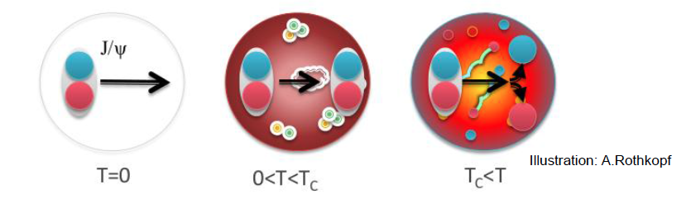
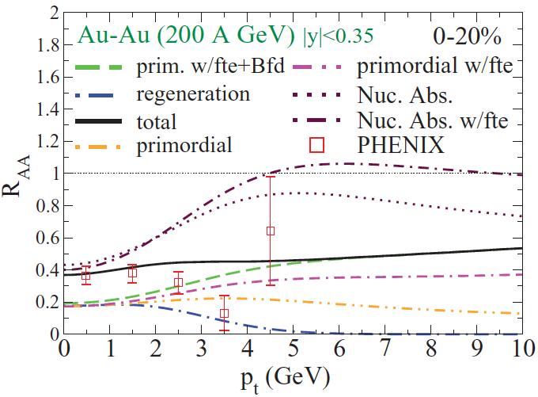
Probe QGP with quarkonium
Color-screening: quarkonium dissociates in the medium
J/ψ suppression was proposed as a direct proof of QGP formation
T. Matsui and H. Satz PLB 178 (1986) 416
However, interpreting J/ψ suppression is no easy job!
  Hot nuclear matter effects
    Dissociation
    Regeneration from uncorrelated quarks
    Medium-induced energy loss
    Formation time effects
  Cold nuclear matter effects
  Feed-down of excited charmonium states
  and B-hadrons
Phys. Rev. C 82, 064905

Slide 5

The Solenoid Tracker At RHIC
Mid-rapidity detector: |η| < 1, 0 < φ < 2π
TPC: precise momentum and energy loss
HFT: topological reconstruction of D meson
  σ_{DCA} < 50 μm for kaon at 750 MeV/c
  1st layer of PXL <0.4%X₀
  Take data: 2014-2016
MTD: trigger on and identify muons
  Precise timing measurement (σ~100 ps)
  Fully installed in 2014
Muon Telescope Detector
Time Projection Chamber
Heavy Flavor Tracker
70% (HFT) and 30% (MTD) of Run14 data were used for results shown here.
Notes:
Di-muon trigger rejection factor is 26
Muon purity above 1.5 GeV/c is >~85%
# of good MTD hits in MB is 1.6, and is 4 in 0-5% most central events

Slide 6
D⁰ R_{AA} in central Au+Au collisions
R_{AA} > 1 for p_{T} ~ 1.5 GeV/c
Charm coalescence with the flowing medium
STAR Preliminary
STAR: PRL 113 (2014) 142301

Slide 7
D⁰ R_{AA} in central Au+Au collisions
R_{AA} > 1 for p_{T} ~ 1.5 GeV/c
Charm coalescence with the flowing medium
STAR Preliminary
R_{AA} << 1 for p_{T} > 2.5 GeV/c
Strong charm-medium interaction leading to sizable energy loss
STAR: PRL 113 (2014) 142301

Slide 8
D⁰ R_{AA} in central Au+Au collisions
R_{AA} > 1 for p_{T} ~ 1.5 GeV/c
Charm coalescence with the flowing medium
STAR Preliminary
R_{AA} << 1 for p_{T} > 2.5 GeV/c
Strong charm-medium interaction leading to sizable energy loss
Similar suppression as pions at high p_{T}
Collisional energy loss is important
Shapes of parton spectrum & fragmentation function need to be taken into account.
STAR: PRL 113 (2014) 142301

Slide 9
First D⁰ v₂ measurement at RHIC
STAR Preliminary
Finite D⁰ v₂ observed above 2 GeV/c

Slide 10
D⁰ v₂: data vs model
  Theory: arXiv:1506.03981
  private comm.
STAR Preliminary
Data favor a model with charm diffusion
→ Charm quark flows in the medium

Slide 11
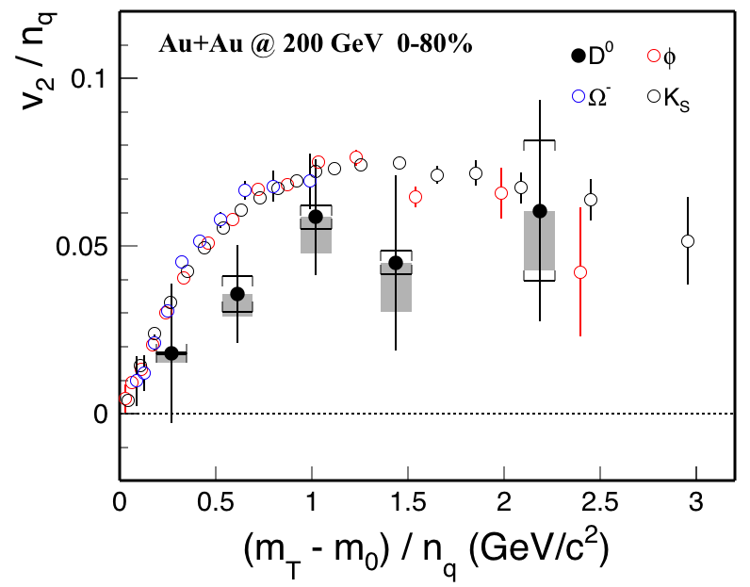
v₂: D⁰ vs light hadrons
STAR Preliminary
STAR: PRL 116 (2016) 062301
v₂ for D⁰ is systematically lower than those of light hadrons
→ Hints that charm quarks might not be fully thermalized with medium

Slide 12
Can theory describe R_{AA} & v₂?
  Theory: arXiv:1506.03981
  arXiv:1505.01413
  private comm.
STAR: PRL 113 (2014) 142301
STAR Preliminary
STAR Preliminary
Favors model with charm diffusion coefficient between 2-11.
Measurements with better precision are needed to discriminate between different models.

Slide 13
J/ψ suppression in Au+Au collisions
Scale uncertainty for σ_{inel} and N_{coll}
Di-electron:
STAR PLB 722 (2013) 55
STAR PRC 90, 024906 (2014)
Distinct rising R_{AA} with p_{T} for J/ψ in all centrality bins as seen in the di-electron channel

Slide 14
Closer look at the central collisions
Di-electron:
STAR PLB 722 (2013) 55
STAR PRC 90, 024906 (2014)
Strong suppression at low p_{T}
  Dissociation
  Cold nuclear matter effect
  Regeneration
Less suppression at high p_{T}
  Dissociation
  Formation time effect
  Feed-down from B-hadrons

Slide 15
Compare with model calculations
STAR PLB 722 (2013) 55
STAR PRC 90, 024906 (2014)
Y.-p. Liu, et al. PLB 678 (2009) 72
X. Zhao et al. PRC 82 (2010) 064905
Both models include dissociation of the prompt J/ψ and contribution of regenerated J/ψ → qualitatively reproduce the rising trend seen in the data.

Slide 16
J/ψ dissociation at high p_{T}
STAR, PRL 111 (2013) 052301
L. Yan, P. Zhuang, and N. Xu, PRL 97 (2006) 232301
V. Greco, C.M. Ko, and R. Rapp, PLB 595 (2004) 202
X. Zhao and R. Rapp, arXiv: 0806.1239
Y. Liu, N. Xu and P. Zhuang, NPA 834 (2010) 317
U.W. Heinz and C. Shen, (private communication)
STAR PLB 722 (2013) 55
Y.-p. Liu, et al. PLB 678 (2009) 72
X. Zhao et al. PRC 82 (2010) 064905
J/ψ v₂ is consistent with zero at high p_{T} → regeneration contribution is small given finite v₂ of charm quarks.
Meanwhile, J/ψ is strongly suppressed at high p_{T} in central events → dissociation

Slide 17
Summary & Outlook
Heavy-flavor results using part of Run14 data taken with newly upgraded MTD and HFT detectors are shown.
D meson by HFT
  Charm quarks interact strongly with the medium
  Charm quarks also flow with the medium, even though they do not seem to be fully thermalized.
J/ψ by MTD
  Distinct rising R_{AA} with p_{T}
  At high p_{T}, R_{AA} < 1 & v₂ ~ 0 → dissociation in effect
Outlook
  Run14&16 Au+Au data: improve precision of total charm cross-section; more differential measurements for D and J/ψ mesons; measurements of even rare probes, e.g. Λ_{c}, ϒ, etc
  Run15 pp/pA data: important reference measurements & cold nuclear matter effects

Slide 18
Backup

Slide 19
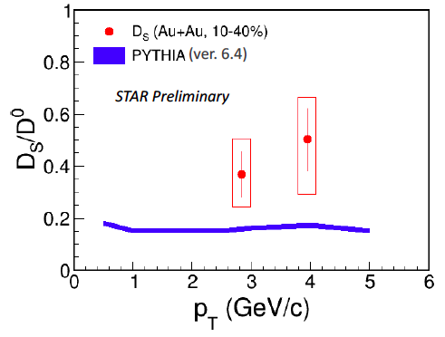
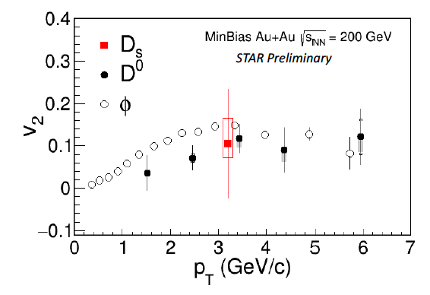
D_{s}: strange quark makes difference
R_{AA} of D_{s} > D⁰: strangeness enhancement in QGP
v₂ of D_{s} < D⁰: earlier freeze-out of D_{s}
PRL 110 (2013) 112301
STAR: PRL 116 (2016) 062301
Calls for more statistics to make conclusive comparison between expectations and measurements (Run14+16).

Slide 20
Does J/ψ flow?
Measure the second-order Fourier coefficient (v₂)
  Primordial: little or zero v₂
  Regenerated: inherit v₂ from the constituent charm quarks
Consistent results from di-muon channel within large error bars

Slide 21
ϒ measurement
Excess
N_{ϒ} ~ 50 ± 22
Fit signal distribution after background subtraction:
  Mean of ϒ is fixed to PDG value, while width is determined from simulation.
  Ratio of ϒ(2S)/ϒ(3S) is fixed to pp value, and shape of bb and Drell-Yan background is estimated using PYTHIA

Slide 22
ϒ(2S+3S)/ϒ(1S) ratio
PLB 735 (2014) 127
PRL 1029(2012) 222301
Consistent with di-electron channel within large error bars
The statistical error can be further reduced:
  A factor of 7 more statistics with full Run14+16 data
  Usage of mix-event can reduce statistical error by √2

