Slide 1

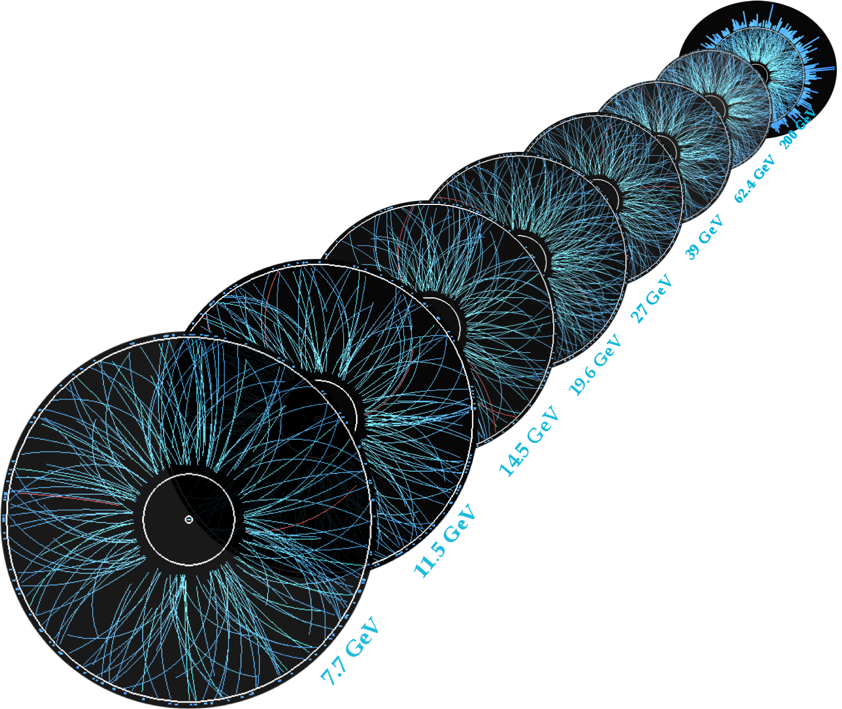

STAR Detector Upgrades
Rosi Reed
Lehigh University
For the STAR Collaboration

Slide 2

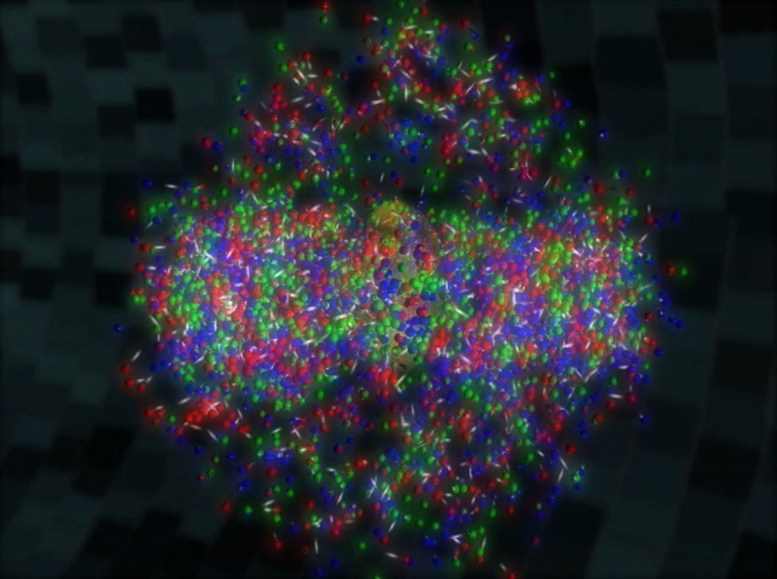
Outline
Beam Energy Scan I highlights
STAR’s Beam Energy Scan II Program
Upgrade detectors
  inner Time Projection Chamber
  endcap Time Of Flight
  Event Plane Detector
Polarized p+p/p+A/A+A program
Upgrade detectors
  Forward Calorimeter System
  Forward Tracking System

Slide 3
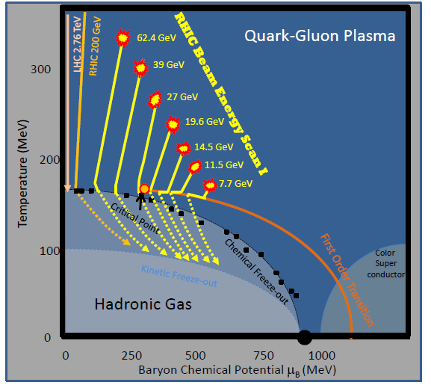
Exploring the QCD phase diagram
BES-I
At low μ_{B}, the phase transition between QGP and hadrons is smooth cross-over
  Is there a 1st order transition and a critical point at higher μ_{B}?
At what energies is a QGP created in the lower energy collisions?
  Search for the turn-off of QGP signatures
RHIC Beam Energy Scan Phase 1
Vary temperature T and baryon chemical potential μ_{B}
Carried out 2010-2014

Slide 4
STAR BES-I
Signs of 1st order phase transition
Directed flow (v₁)
  Net protons: double sign change
  Simple hydro models can predict the structure
  Transport models such as UrQMD fail
Softening of EOS?
Expected in mixed phase
Phys. Rev. Lett. 112, 162301 (2014)

Slide 5
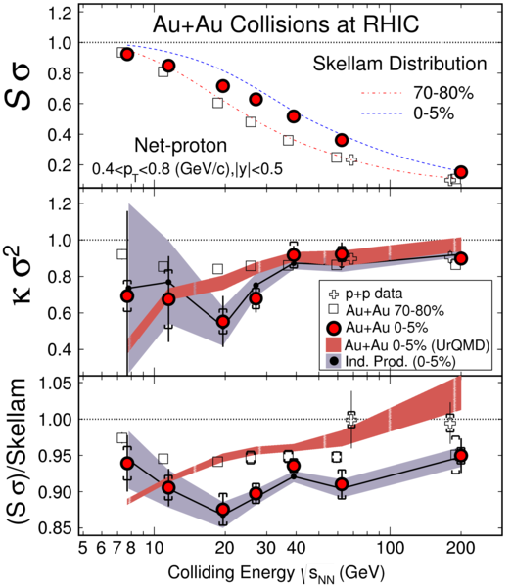
STAR BES-I
The QCD critical point
See Bill Llope’s talk on Tuesday!
Phys. Rev. Lett. 112 (2014) 32302
CP → Divergence of susceptibilities (χ) and correlation lengths (ξ)
  Ratios of cumulants of the net-particle multiplicity distributions should diverge
~2-3σ from Poisson
~100 MeV gap in μ_{B} between √s_{nn} = 10 and 20 GeV
Miss features that are narrow in μ_{B}

Slide 6
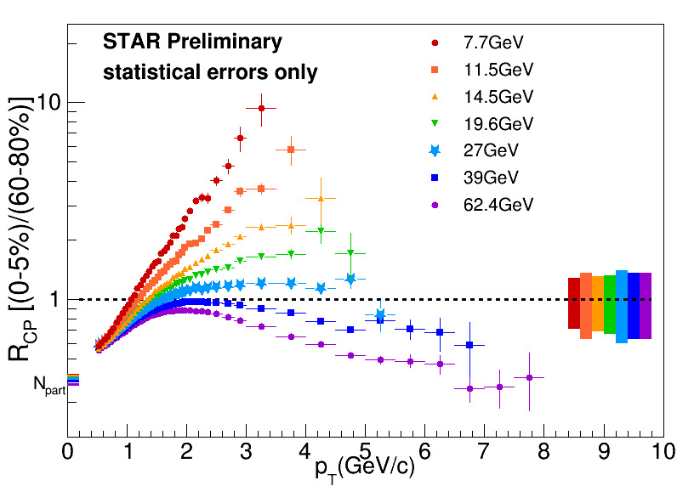
STAR BES-I
Turn-off of sQGP signatures
arxiv:1601.01644
Do we see the turn off of jet quenching?
  Enhancement competes with suppression complicating the measure of the turn off of QGP effects at low √s_{NN}
    2016 d+Au Collisions will help quantify CNM effects

Slide 7
BES-I → BES-II
2015 NSAC RECOMMENDATION:
  The upgraded RHIC facility provides unique capabilities that must be utilized to explore the properties and phases of quark and gluon matter in the high temperatures of the early universe and to explore the spin structure of the proton.
Trends and features from BES-I motivate for experimental measurements with higher statistical and systematic precision
  Requires strong and concerted theoretical response
Detector upgrades planned for BES-II focus on maximizing the fraction of measured particles from each collision
The goal of BES-II is to turn trends and features into definitive conclusions and new understanding of the key features of QCD.
http://science.energy.gov/~/media/np/nsac/pdf/2015LRP/2015_LRPNS_091815.pdf

Slide 8
BES-I → BES-II
More Statistics
BES-I exploratory scan was carried out to shed light on these questions
  Tantalizing hints of a CP with 8 < √S_{NN} < 20 GeV
  How can we capitalize on these results?
More data
  Electron cooling
    RHIC Luminosity upgrade
    Needed for lower energies
  Many results statistics limited
2015LRP

Slide 9
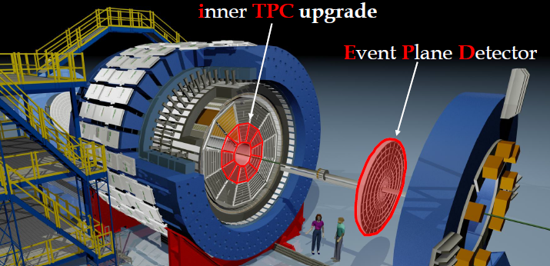
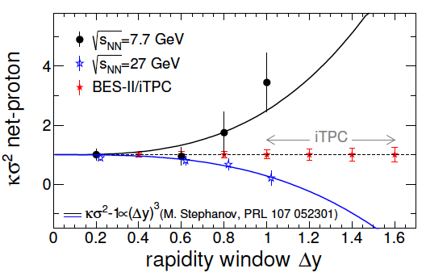
BES-I → BES-II
Larger Acceptance
Better coverage
  Detector upgrades increase the acceptance at high η
  iTPC
  eTOF
  EPD
Expanding in η
  Allows better quantification of the fluctuations → ensures measurement is sensitive to the QGP physics
  Varying μ_{B} either by |y| or √s_{NN}
2015LRP

Slide 10
iTPC
TPC iTPC
Sparse pads cover full area;
better dE/dx;
−1 < η < 1 −1.5 < η < 1.5;
p_{T} >125 MeV/c p_{T} > 60 MeV/c.

Slide 11
iTPC
Improves
  Momentum resolution
  dE/dx resolution 7.5% to 6.2%
  Acceptance
    From |η| < ~1.0 to |η| < 1.5, from P_{T}>125 MeV/c to P_{T}>60 MeV/c
    iTPC upgrade extends the rapidity coverage by 50%
Current inner TPC pad row geometry is not fully instrumented
  Only 20% of the inner sector path length is sampled
  iTPC increases the path length coverage in the inner sectors to 100%
Benefits many analyses, especially:
  Fluctuations (Kurtosis)
  Baryon v₁ measurements
Improves 2nd-order event-plane res, away from mid-rapidity by x2
  Enhancing elliptic flow measurements
  For dielectron measurements it reduces hadron contamination from a dominant source of uncertainty (20%) down by an order of magnitude
    Much less than the expected statistical uncertainty (10%).
iTPC project has been approved!
https://drupal.star.bnl.gov/STAR/starnotes/public/sn0644

Slide 12
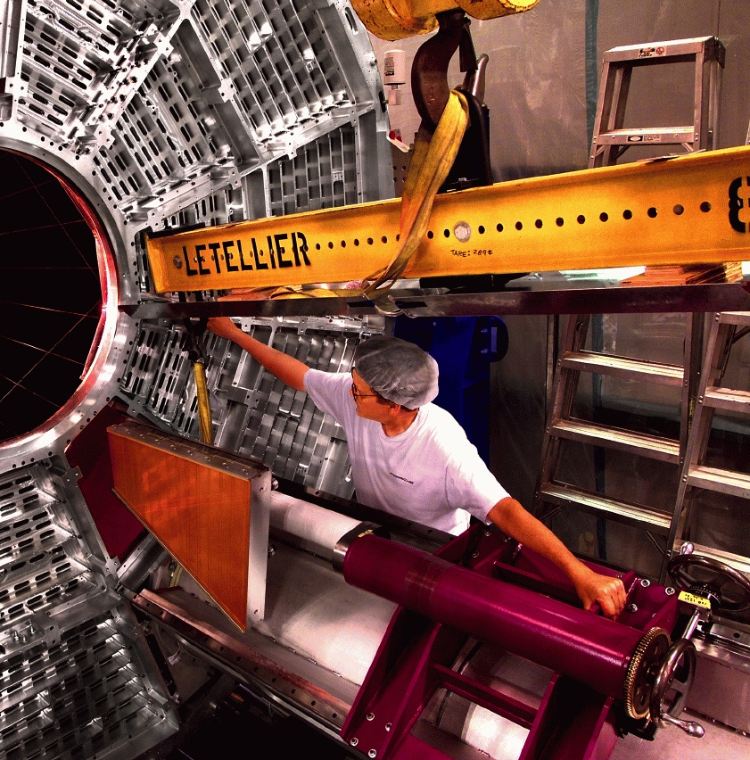
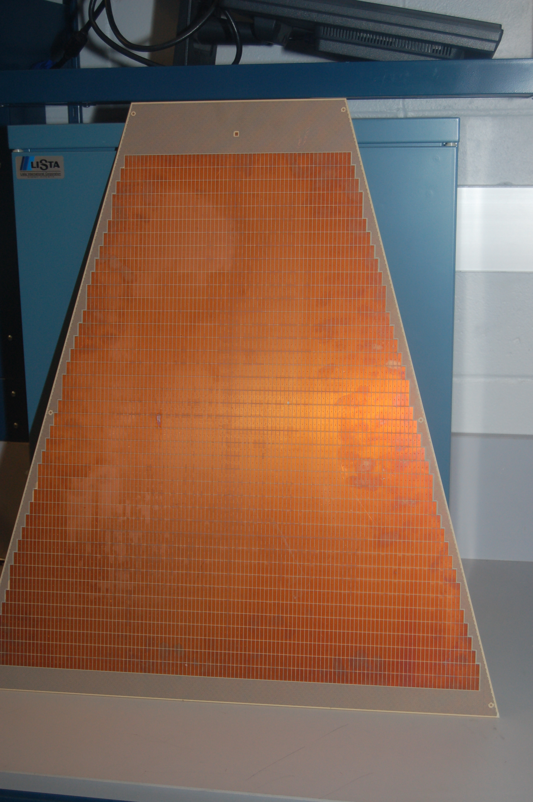
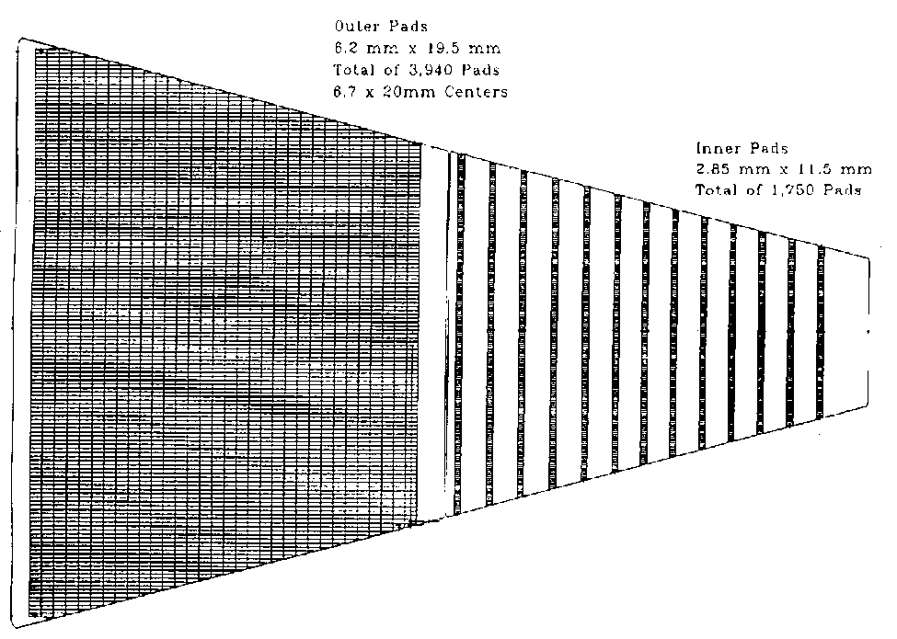
The iTPC in a nutshell
Inner sector 1/12
The upgrade increases N_{channels} in the 24 inner sectors by ~x2
Provide complete coverage for a inner sector
New electronics for inner sectors
Pad plane layout for one sector
Current
Future
Outer Inner

Slide 13
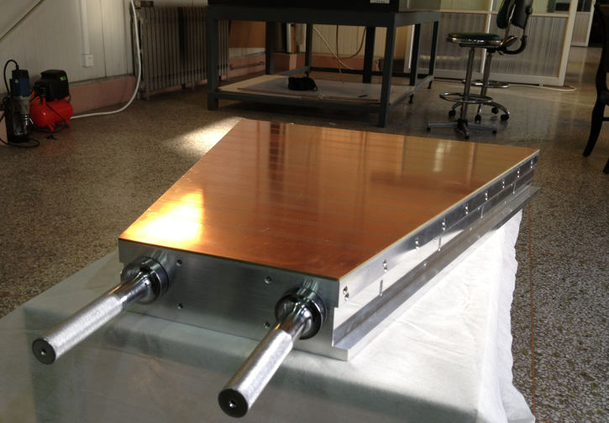
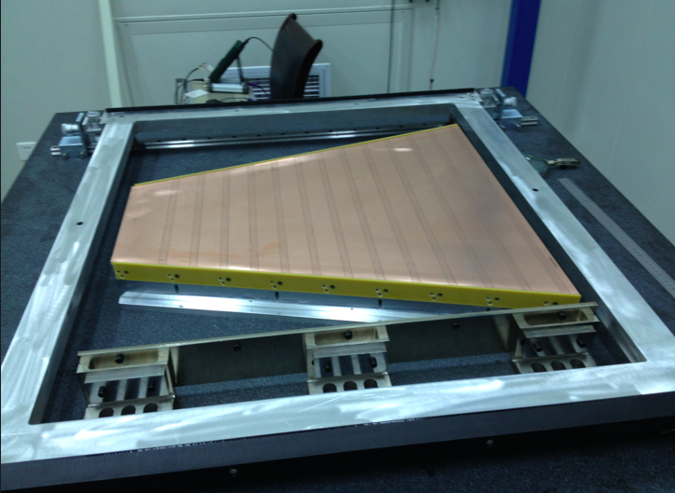
iTPC sectors
Prototype – original layout
Padplane glued onto strongback
Only modification is slot position
Pure construction project, little or no engineering design left
Improves electrostatics between inner and outer sector
Ready for construction
Wire mounting prototype at Shandong University, China

Slide 14
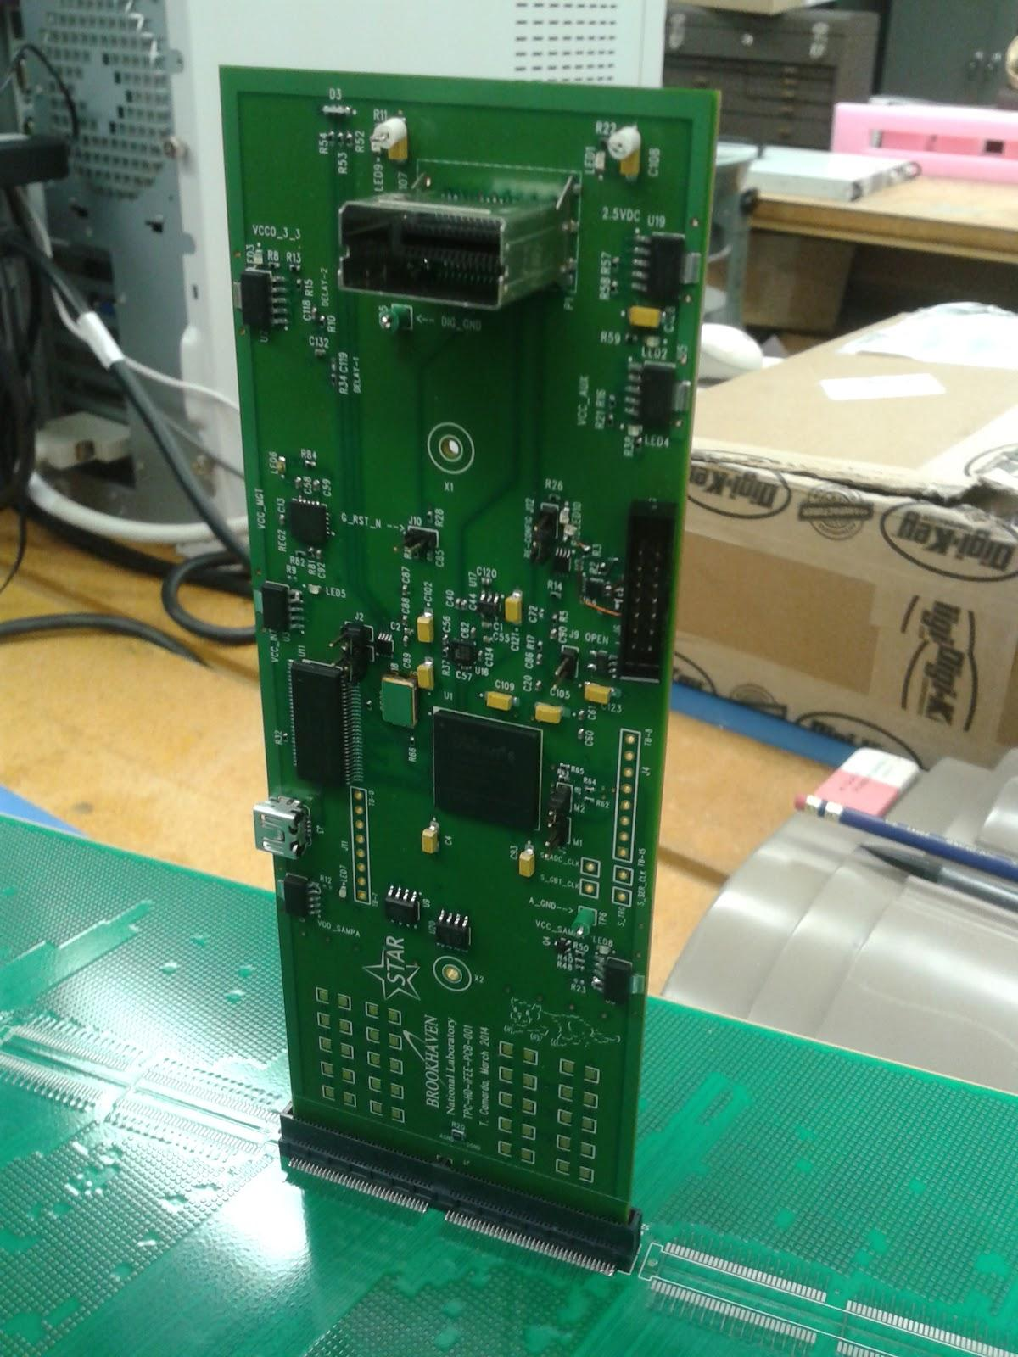
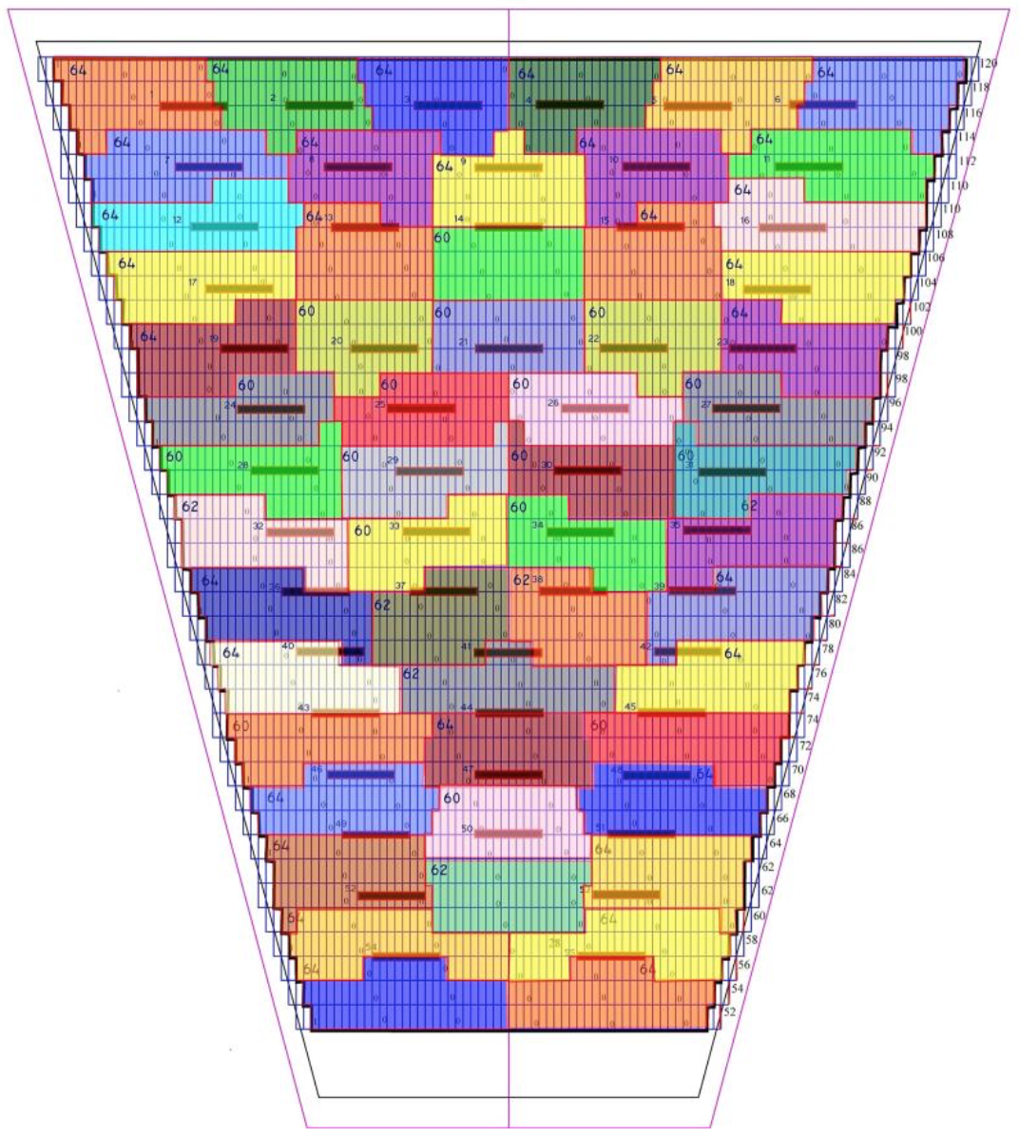
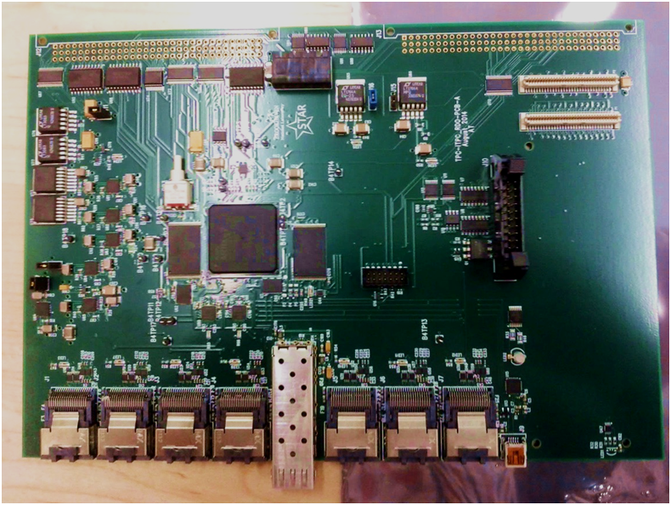
iTPC Electronics
iFEE based on current FEE layout, but using ALICE SAMPA chip
2x N_{channels} per FEE
RDO similar to existing
Developed by BNL electronics group
Fully instrumented TPC connections to FEE
Pre-prototye iFEE electronic card shown plugged into the padplane
RDO prototype

Slide 15
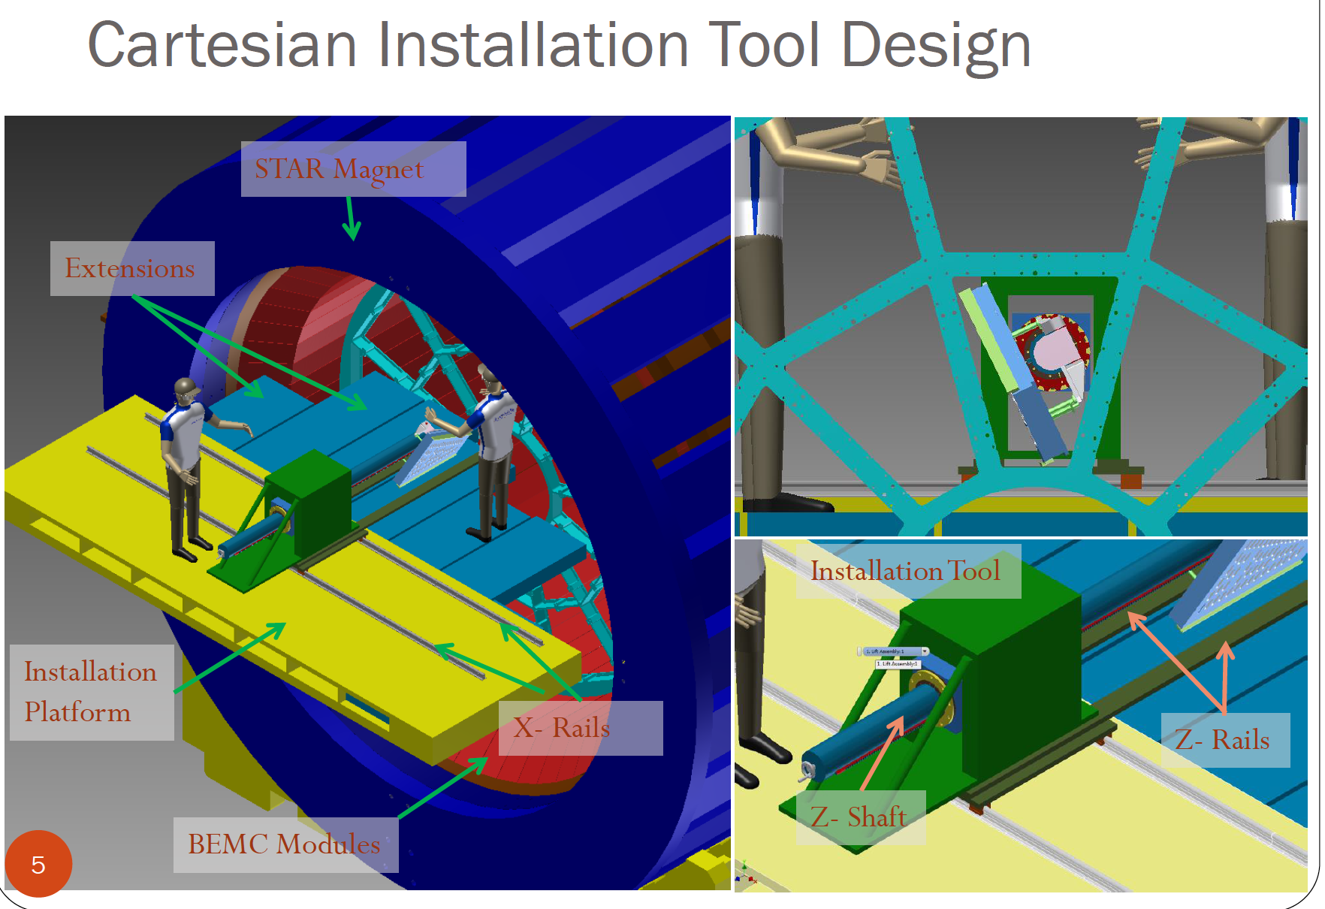
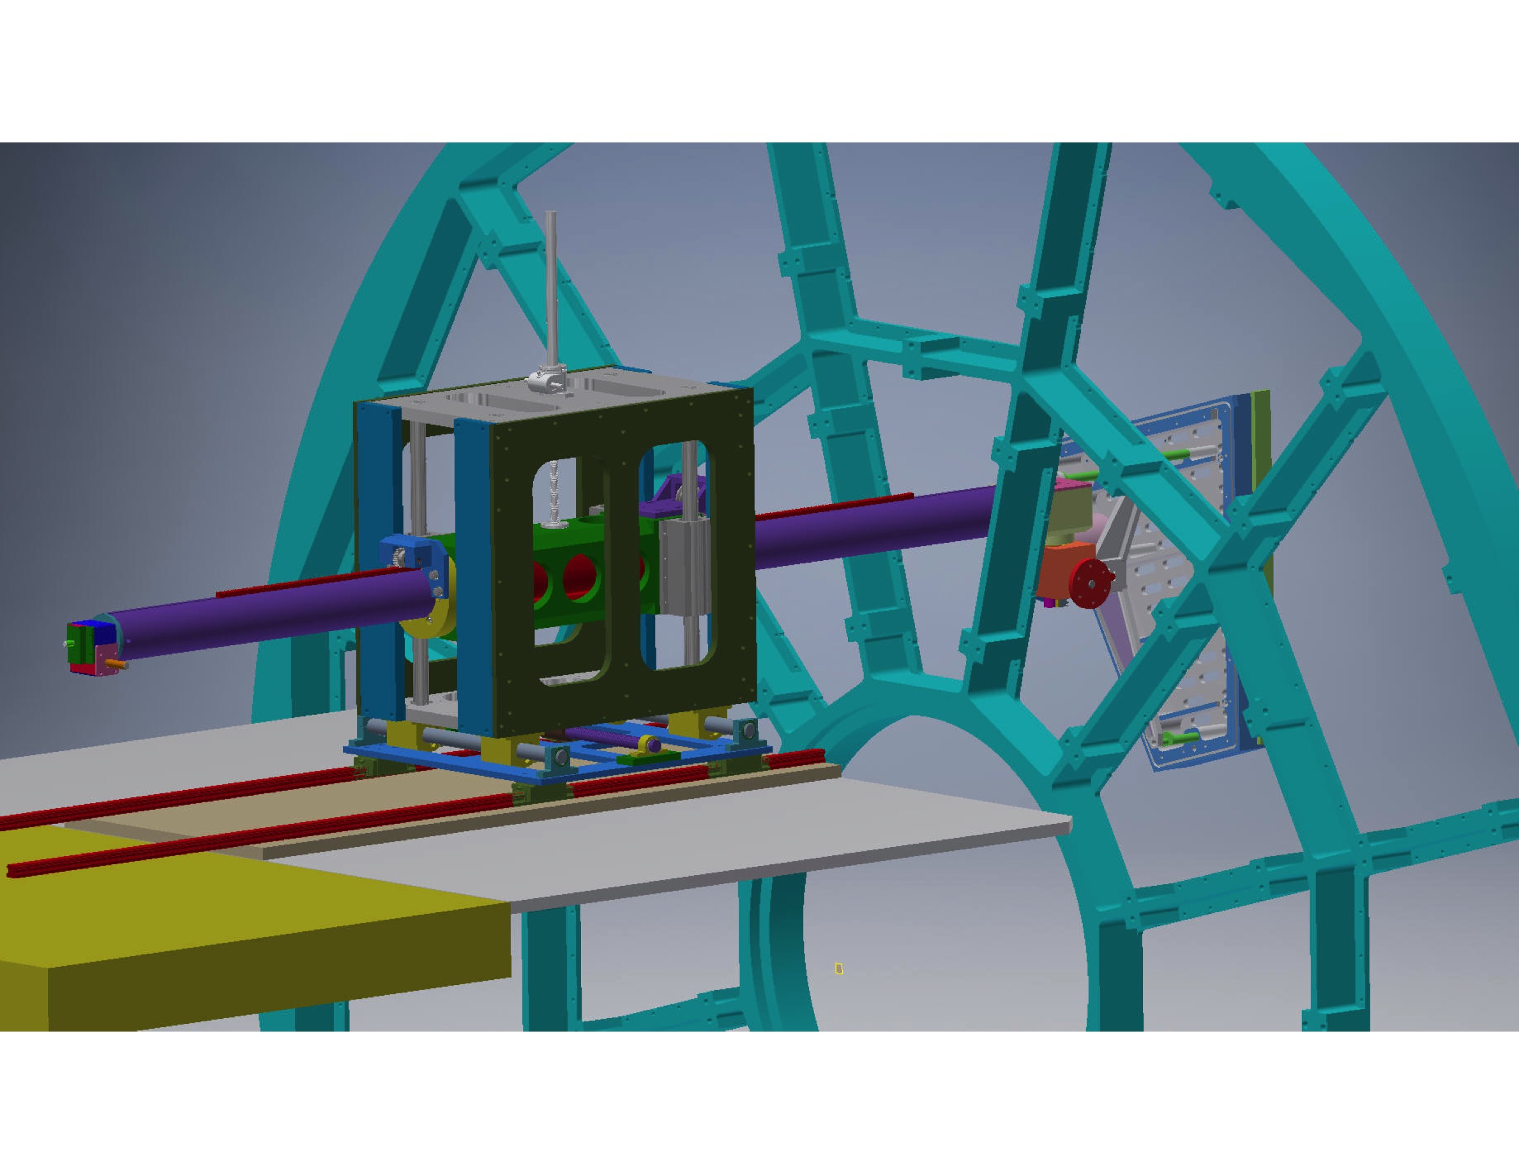
iTPC Insertion Tooling
Insertion tooling needed for installation and for replacement of two outer bad sectors
Designed by Rahul Sharma, Ralph Brown and much input from LBL, CERN

Slide 16
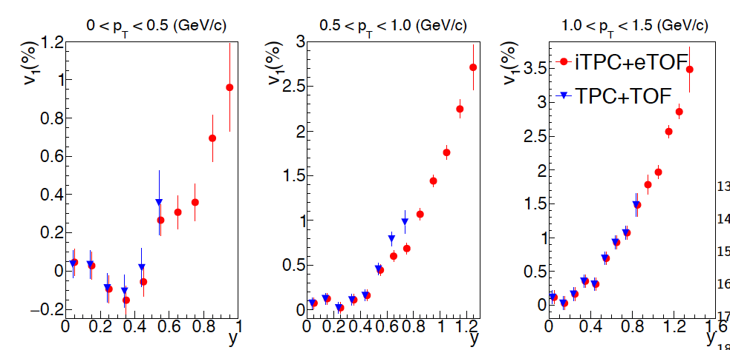
Direct Flow Improvements
Proton directed flow as a function of rapidity for minimum-bias Au + Au collisions at √s_{NN} = 19.6 GeV
  Based on UrQMD
Simulated v₁(y) compared between the acceptance of the STAR TPC with the existing TOF barrel and the upgraded acceptance after addition of the iTPC and the eTOF

Slide 17
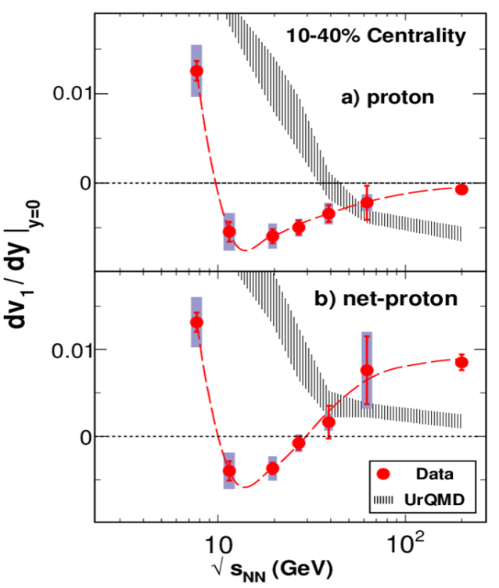
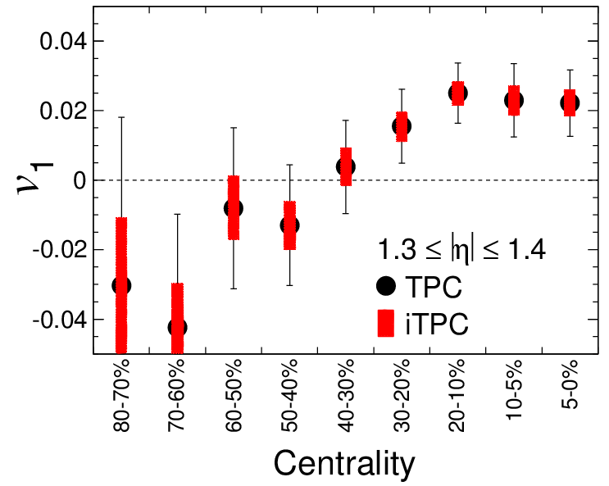
iTPC → BES II directed flow
  UrQMD at 19.6 GeV
The Forward v₁ measurement as a function of centrality
  Shows improvements due to iTPC coverage
Directed flow for protons and net-protons BES-I
PRL 112,162301 (2014)

Slide 18
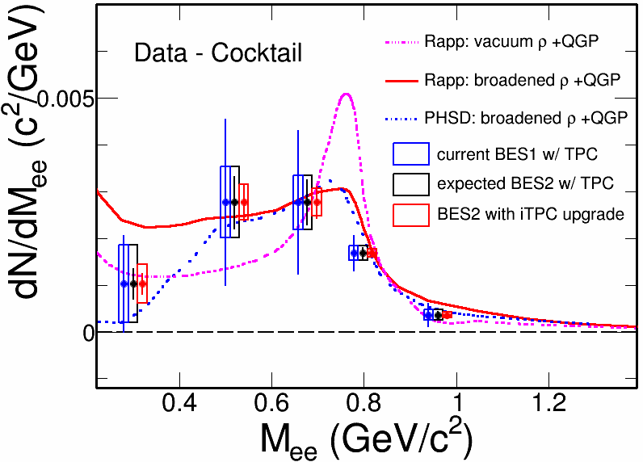
Di-electron measurements in BES-II
Improved dE/dx will reduce the dominant systematic error
Distinguish between models with different ρ-meson broadening
Study effect of total baryon density on Low-Mass Region (LMR) excess

Slide 19
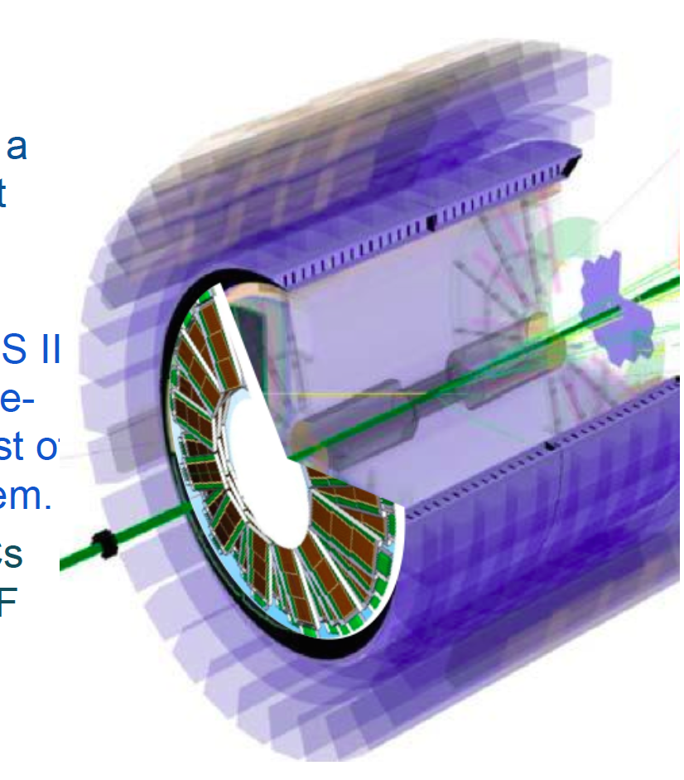
eTOF
endcap Time Of Flight
Compressed Baryonic Matter Experiment (CBM) institutions proposed installing CBM TOF modules inside east pole-tip
Acceptance
  −1.6 < η < −1.1
Provides STAR with an endcap TOF for BES-II
Provides CBM a large-scale integration test of the CBM TOF system

Slide 20
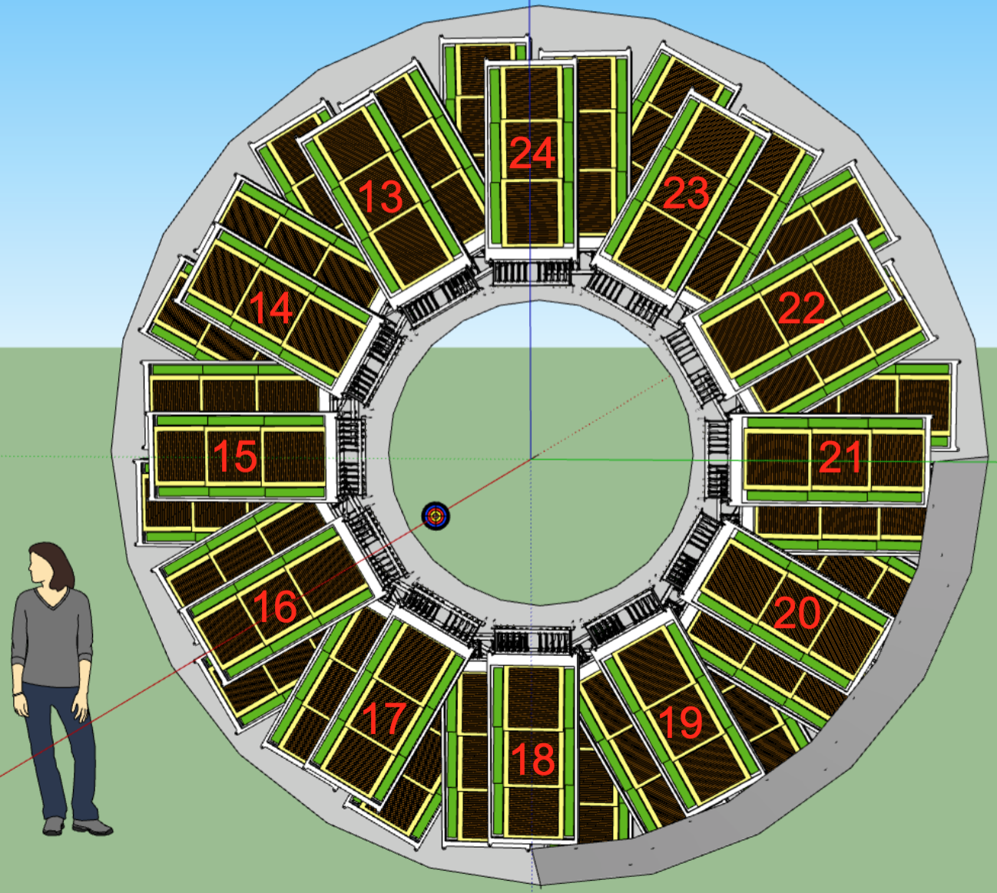
eTOF
Allows for PID in the η range provided by the iTPC upgrade
eTOF needed for PID at forward rapidities
Efficiency dE/dx drops rapidly due to p_{Z} boost
Key for the fixed target program

Slide 21
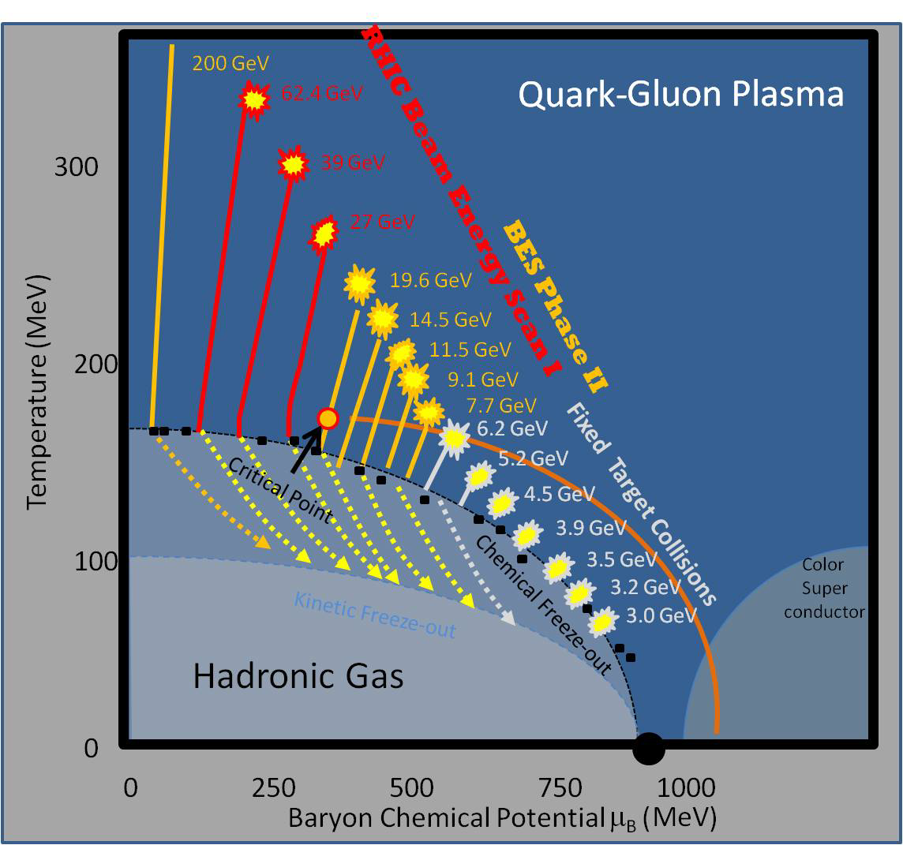
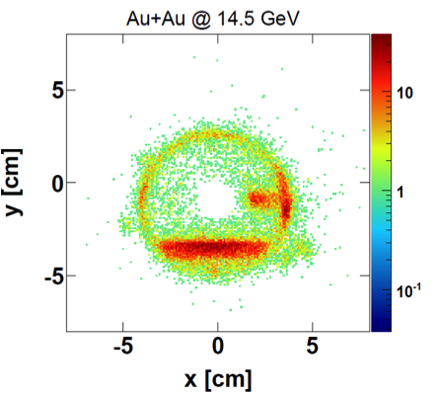
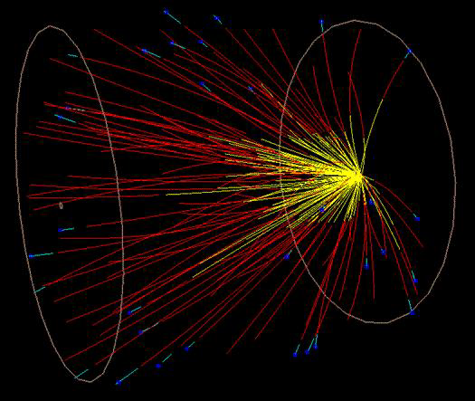
BES-I → BES-II
New energies
See Kathryn Meehan’s talk on Tuesday!
Target inserted into beam pipe
  Z = 210 cm
Test run done parasitically
  No interference w/collider mode data
More efficient →small dedicated runs
2014 − √S_{NN} = 3.9 GeV

Slide 22
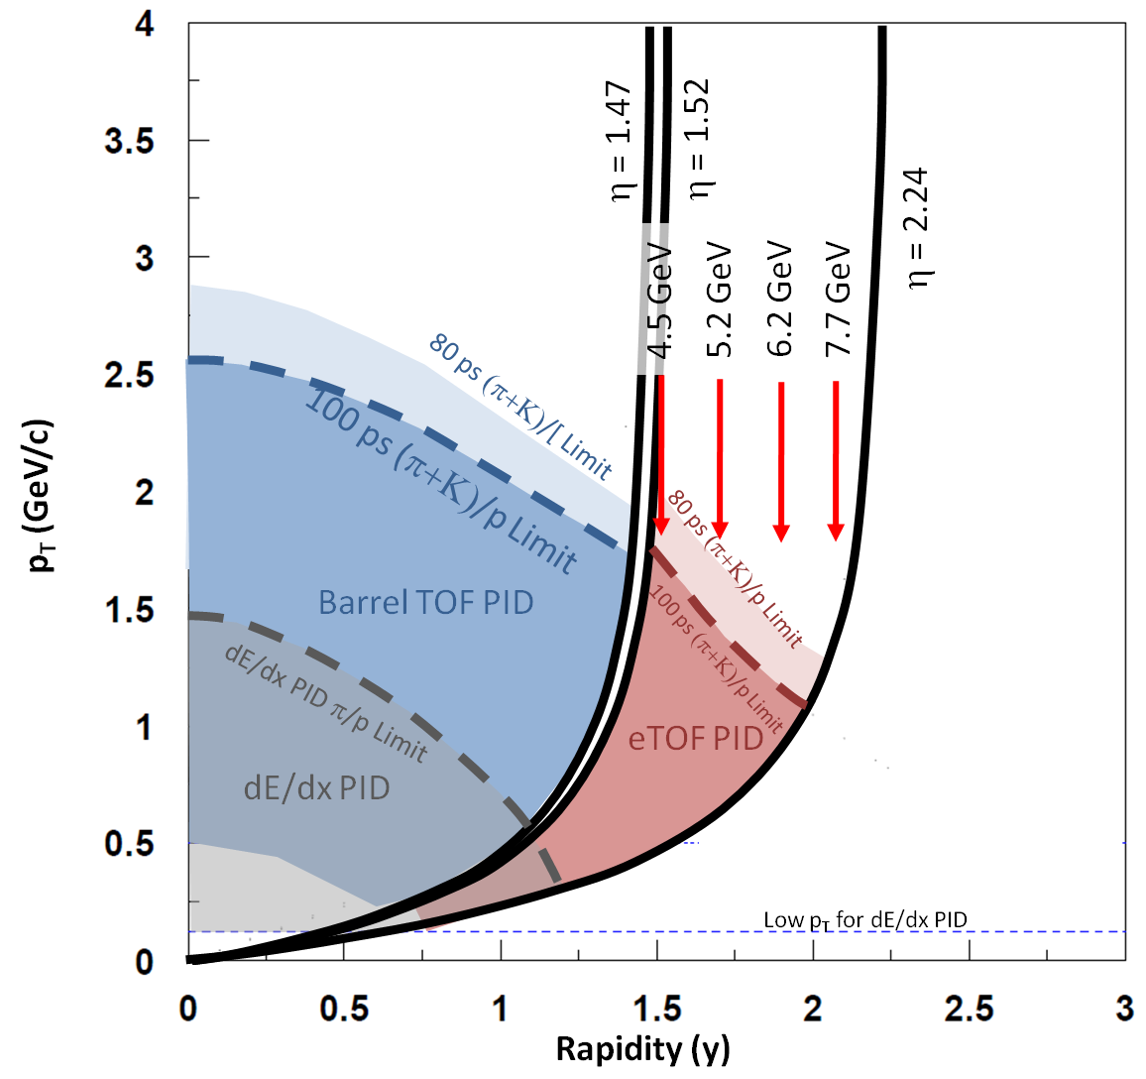
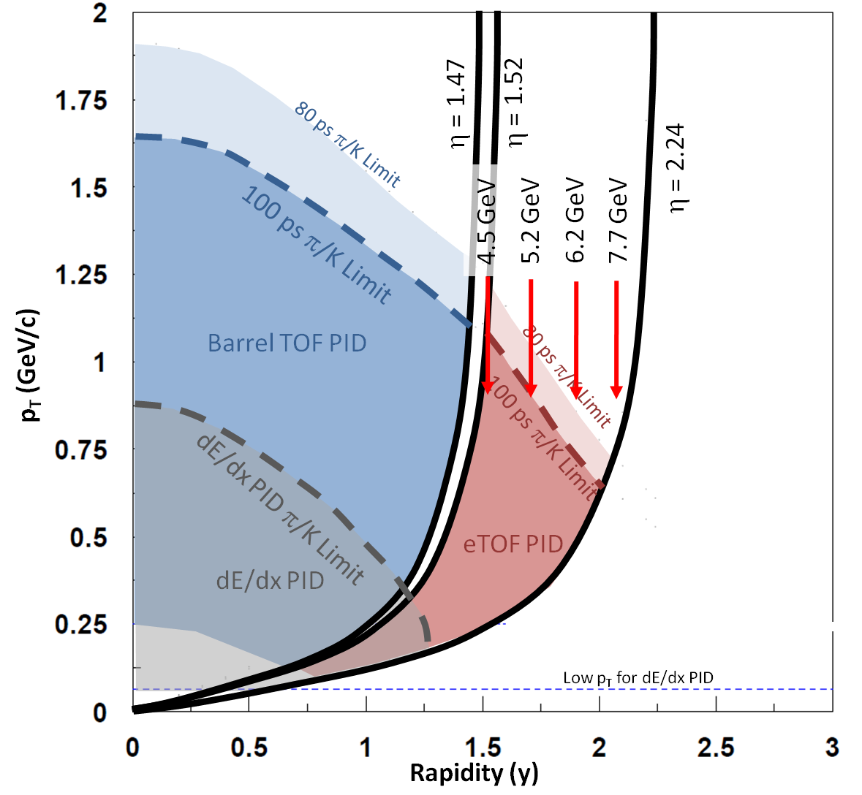
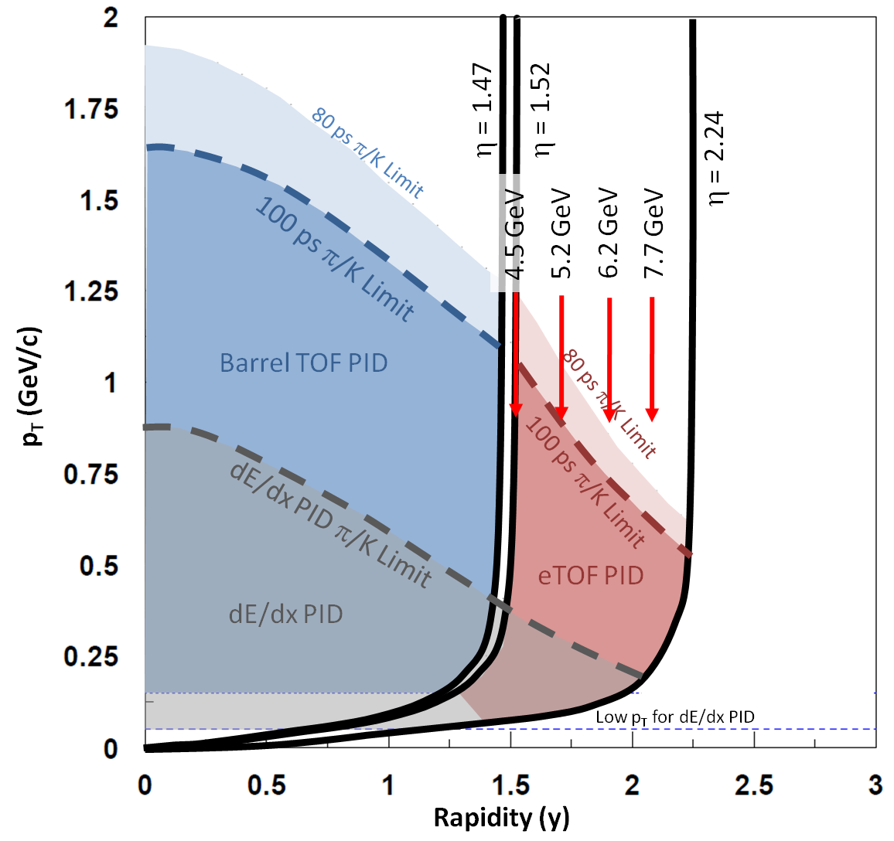
y – p_{T} Map Fixed Target
p
NA49 → onset of deconfinement = √S_{NN} = 7.7GeV
  < 7.7 GeV not possible in collider mode
Using just the iTPC upgrade → energy range from 3 to 4.5 GeV
eTOF upgrade allows √S_{NN} = 3-7.7 GeV
Phys. Rev. C77, 024903 (2008),
K
π

Slide 23
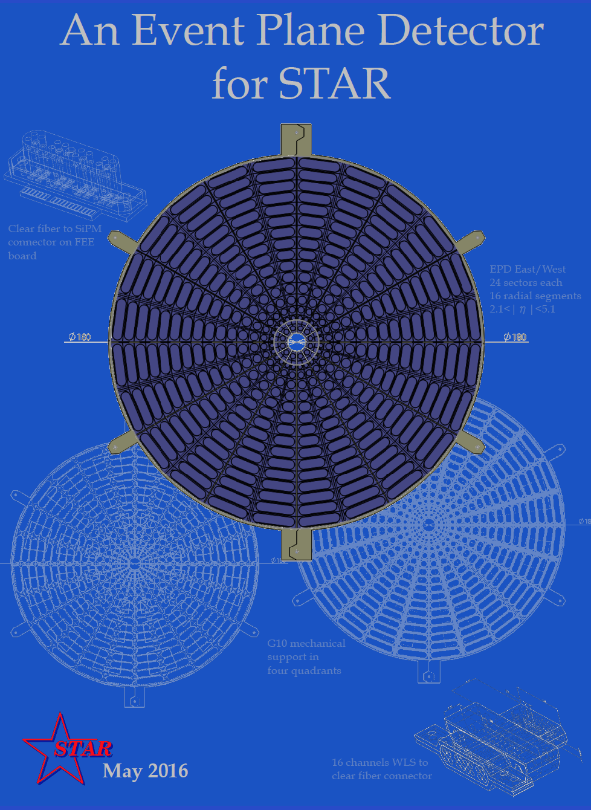
EPD
2.1 < |η| < 5.1
Greatly improved Event Plane info (especially 1st-order EP)
Determine Centrality outside mid-rapidity
Better trigger & background reduction

Slide 24
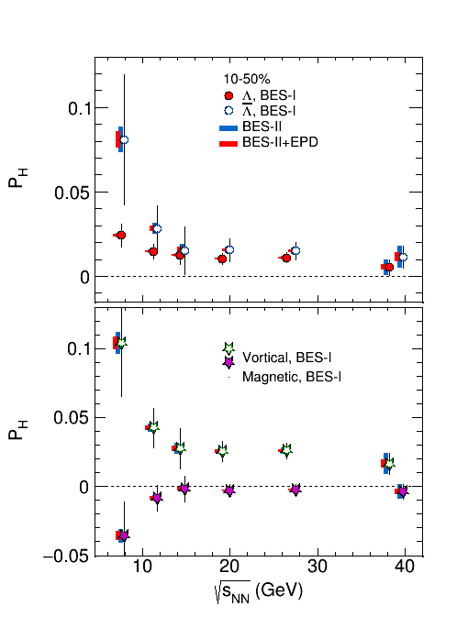
EPD Improvements
BES-II
BES-II + EPD
The average polarization of and Λ from 20-50% central collisions
  No feed-down effects → Stat uncertainty only
The vortical and magnetic contributions to Λ and emitted directly from the hot zone created in a heavy ion collision
  Statistical errors only
  Scale of P_{V} has an uncertainty of +60% and -5% due to uncertainty in the amount of feed-down
P_{H}
STAR Preliminary
STAR Preliminary
P_{V,M}

Slide 25
EPD Improvements
Magnetic, BES-I
STAR Preliminary
P_{V,M}
Zooming we can see that the current results are not significant for √s_{NN} ≥ 27 GeV
Increase in statistics and EPD allow for a ~3σ effect
Gives an independent measure of B, key for CME/CVE verification

Slide 26
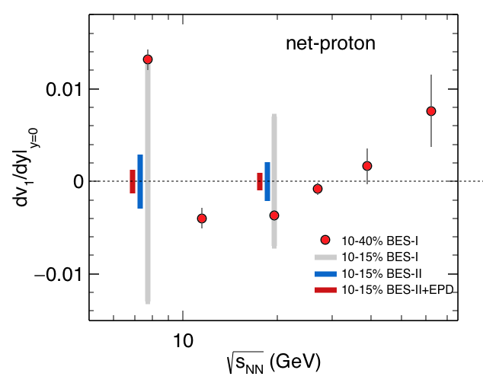
EPD Improvements
Net proton v₁ versus √s_{NN} at mid-rapidity
  BES I data from 10-40%
The grey bars indicate what the error bars would have been with a narrow centrality
BES-I Data
BES-II
BES-II + EPD

Slide 27
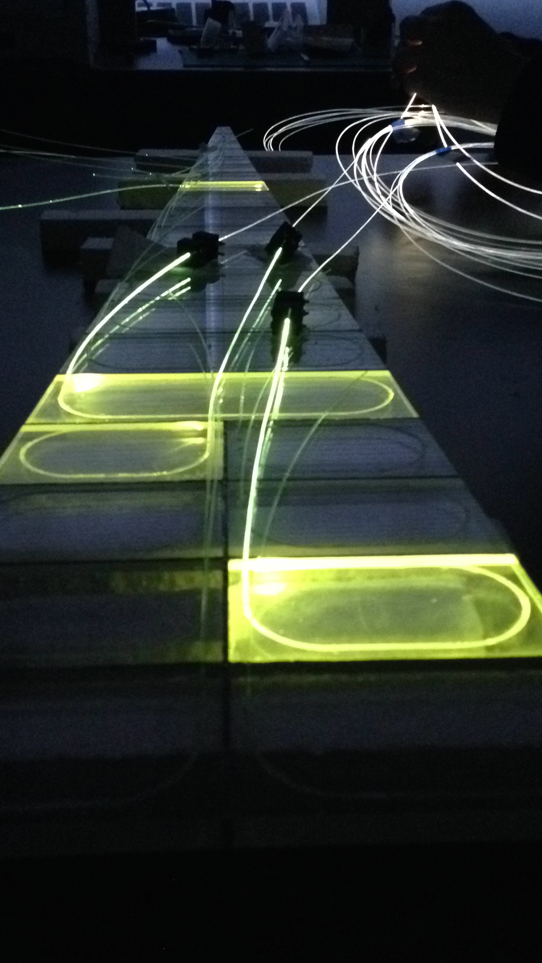
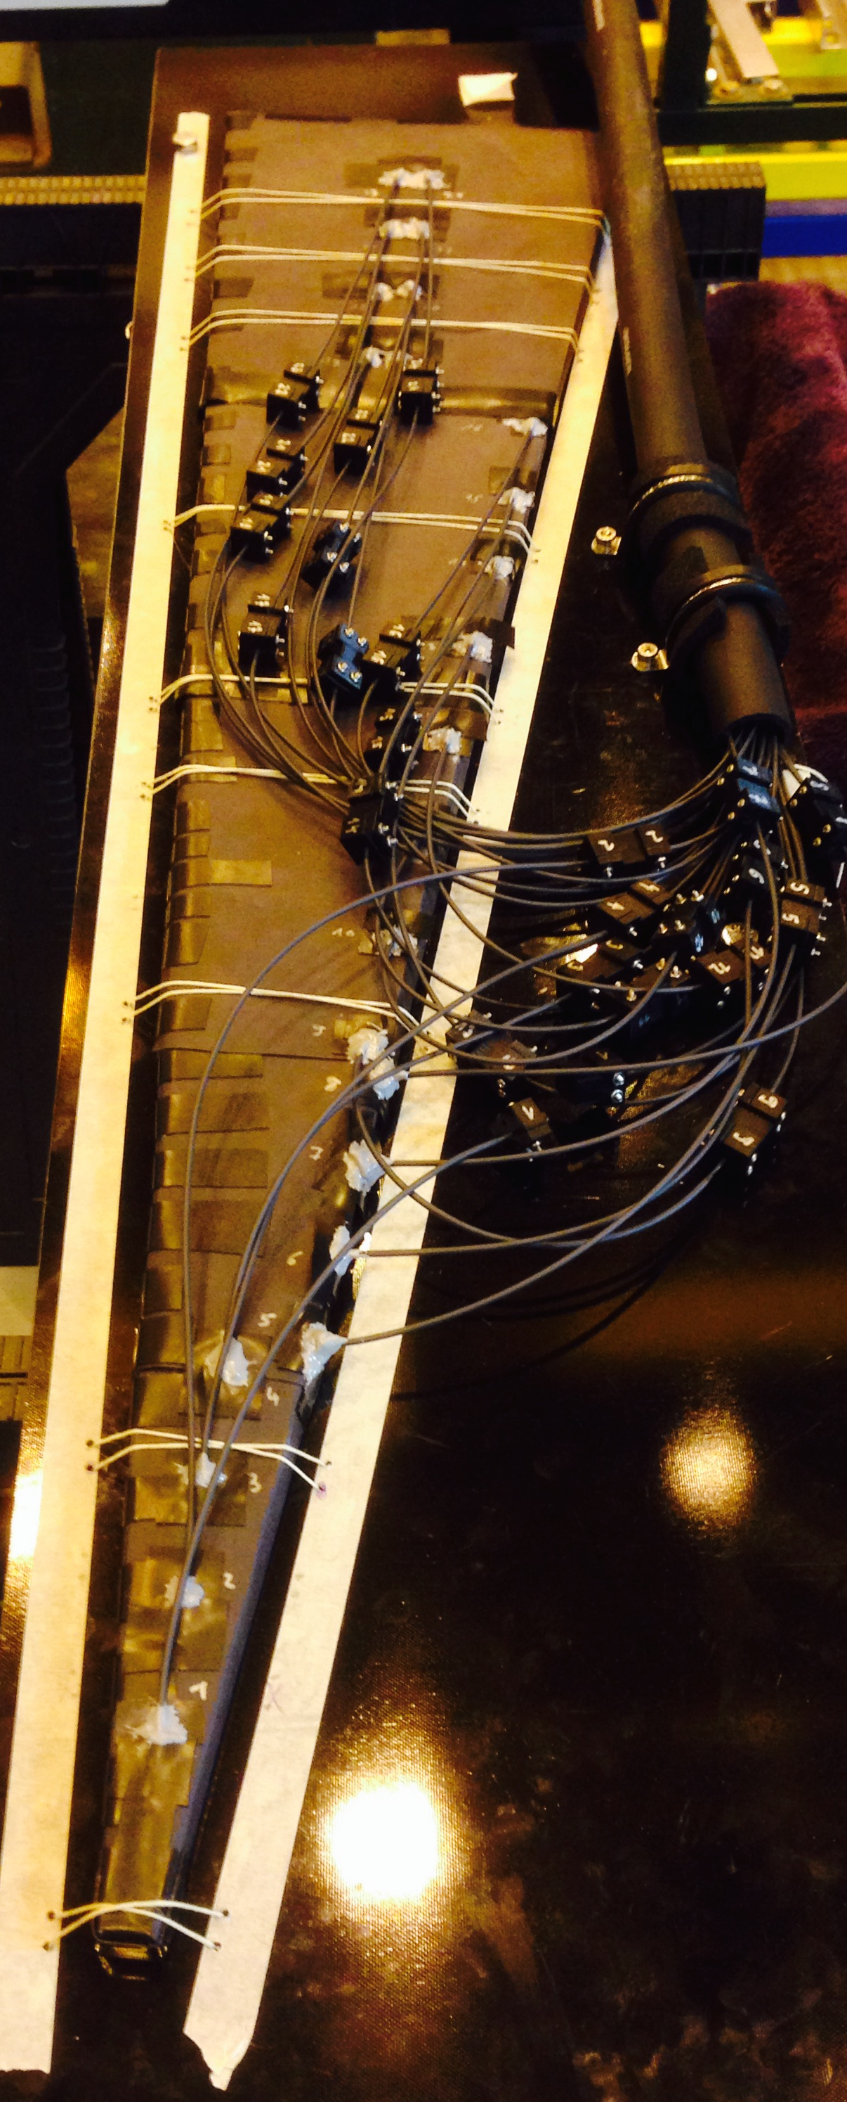
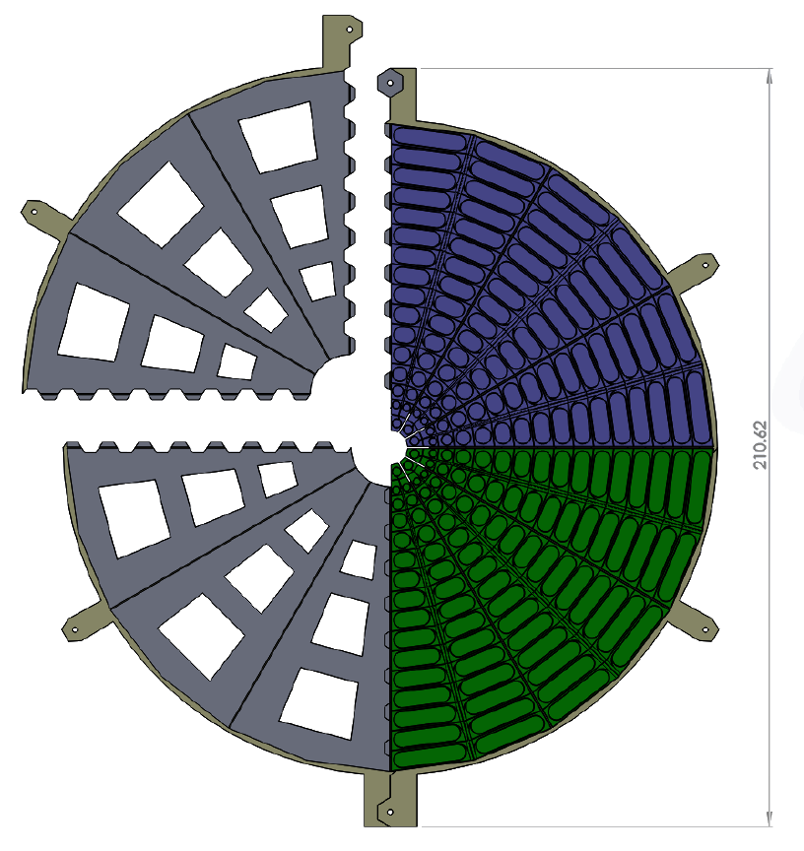
EPD Prototype and Design
1 sector prototype successfully deployed in run 16
EPD internal STAR review complete
1/8th EPD installation run 17 for Detector Commissioning

Slide 28
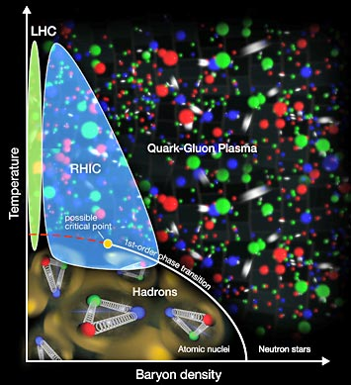
From 7.7 GeV →510 GeV
RHIC is an amazingly versatile machine
7.7 GeV (and below!) to study QCD phase diagram →
510 GeV polarized protons to study the spin structure of the proton
d

Slide 29
R_{pA} in Drell Yan + Direct Photon
See Elke-Caroline Aschenauer’s talk later today!
Fundamental questions
  What is the A dependence of nuclear PDFs
    R_{pA} in Drell-Yan channels
  What are the signals for gluon saturation?
  What is the A dependence?
    Diffraction
    Di-hadron
    Hadron+jet or γ+jet
  What is the origin of the large single spin asymmetries at high x and η?
    Only possible with polarized pp collisions
See the RHIC Cold QCD Plan at: Arxiv:1602.03922

Slide 30
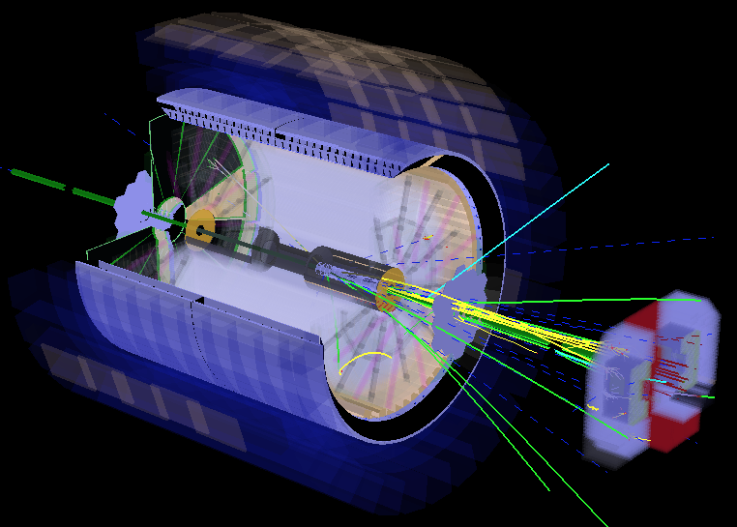
FCS and FTS
Proposed FCS+FTS provide access to very small x
  Facilitates investigations into the dynamics and nonlinear evolution effects in the regime of high gluon-density.
Forward Calorimeter System
Forward Tracking System

Slide 31
Forward Calorimeter System (FCS)
Uses the refurbished PHENIX sampling ECal
  EM resolution ~8%/√E
Hadronic calorimeter is a sandwich Pb scintillator plate sampling type
  Hadronic resolution ~70%/√E
  HCAL reuses QT based FMS readout system
    ~30% of the FMS electronics
    The rest of FMS used for the EMCal section
  Uses the existing Forward Preshower Detector installed in 2015
  2.5 < η < 4

Slide 32
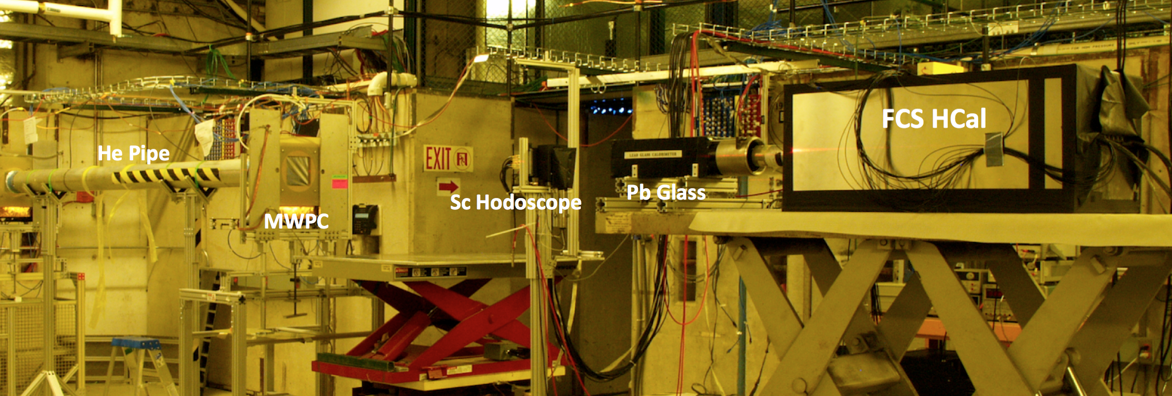
FCS – 2014 Beam test at FNAL
Tested the response to hadrons, electrons and muons
  3 < E < 32 GeV
  Successful test results from 2012
Ideally reconstructed E = E_{EMCal} + E_{HCal}
With E dependent weighting of E_{EMCal} energy measured e/h ratio ~0.95
  Constant above 10 GeV.

Slide 33
Forward Tracking System (FTS)
  Forward transverse spin asymmetry measurements for p+p and p+A requires distinguishing h⁺/h⁻ for p < 80 GeV/c
  Forward Drell-Yan measurements require excellent eID/γID to suppress hadron background
    Improves eID by comparing charged p to E from FCS
  Saturation signals with γ+jet
    Improves γID by vetoing hits from charged particles
Use single-sided double-metal Silicon Ministrip sensors
  Builds on the successful experience from the STAR IST detector (part of HFT)
Low material budget in detector acceptance

Slide 34
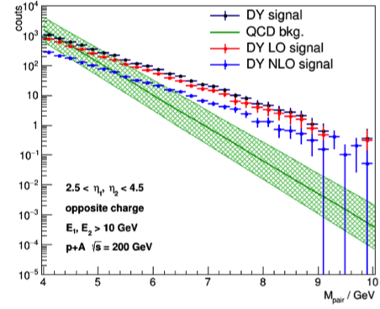
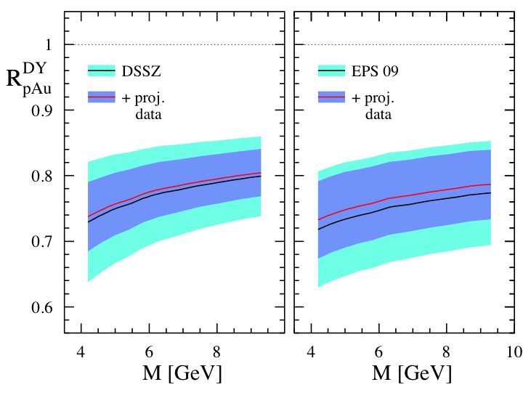
A dependence of nuclear PDFs
Arxiv:1602.03922
Arxiv:1602.03922
DY measurement: challenge is to suppress hadronic background while maintaining high electron efficiency
The impact of the DY R_{pA} data for the anticipated statistics for a future p+Au run compared current DSSZ/EPS-09 uncertainties

Slide 35
A dependence of nuclear PDFs
R_{ub} = 1 indicates nuclear PDF is not modified
ub → ubar
Other PDFs at: Arxiv.1602.03922
1
Arxiv:1602.03922

Slide 36
Kinematic Coverage in x–Q²
Past, Present, and Future Experiments Capabilities
LHC experiments cover the same x-range as DY
at forward h at RHIC → higher Q²
Nuclear modifications already significantly reduced
At intermediate Q², DY at RHIC will extend the low-x reach by nearly one decade compared to EIC
Arxiv:1602.03922

Slide 37
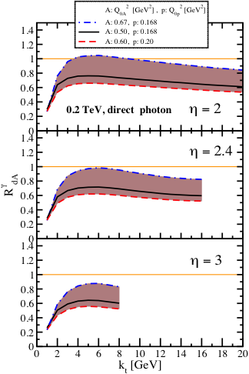
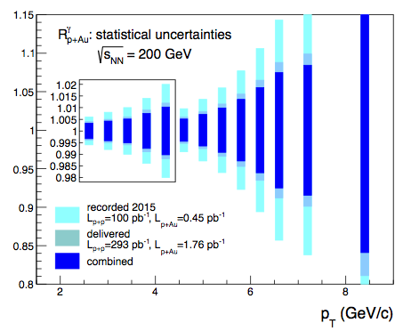
Gluon Saturation
A:Q_{0A}² [GeV²], p: Q_{0p}² [GeV²]
A: 0.67, p: 0.168
A: 0.50, p: 0.168
A: 0.60, p: 0.20
Measurements so far in p(d)+A collisions have strongly interacting initial+ final states
  Complicates theoretical treatment
Remove final state strong interaction by using γ and DY electrons
Arxiv:1602.03922

Slide 38
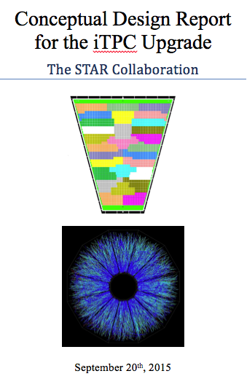
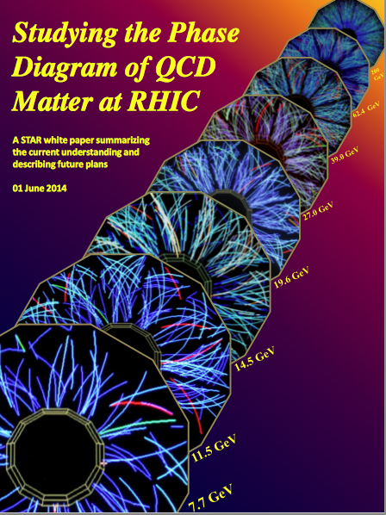
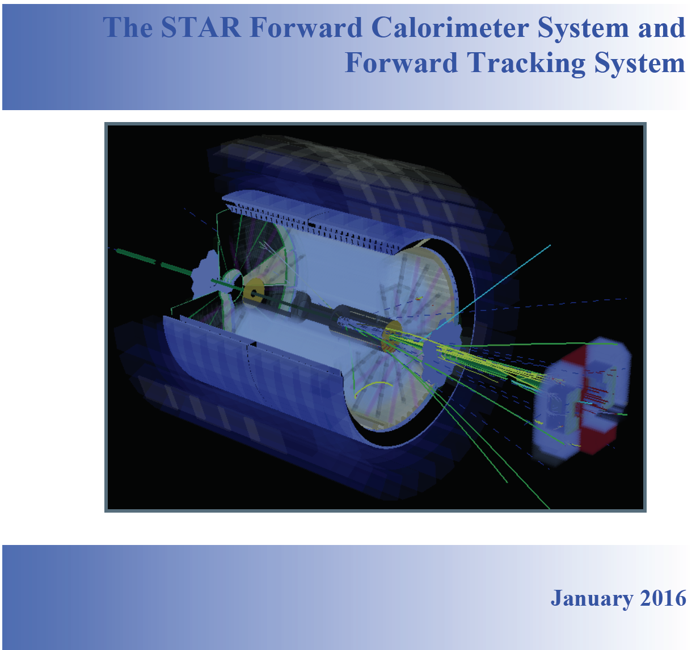
Summary
FCS and FTS will allow reach to low x to probe the fundamental structure of nucleons in new kinematic regimes
iTPC, EPD, eTOF enable superior BES-II program
  Increase acceptance
  Increase statistics
  Decrease systemic uncertainties

Slide 39
Back up

Slide 40
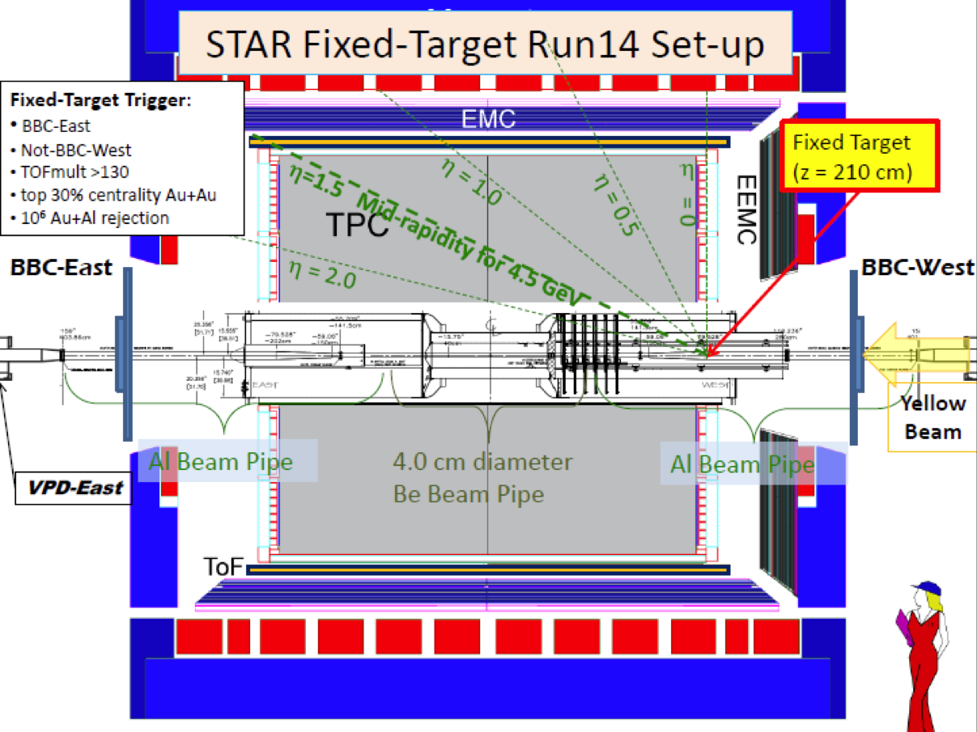
BES-I → BES-II
New energies
See Kathryn Meehan’s talk on Tuesday!
Target inserted into beam pipe
Test run done parasitically
  No interference w/collider mode data
  More efficient →small dedicated runs
2014 − √S_{NN} = 3.9 GeV

Slide 41
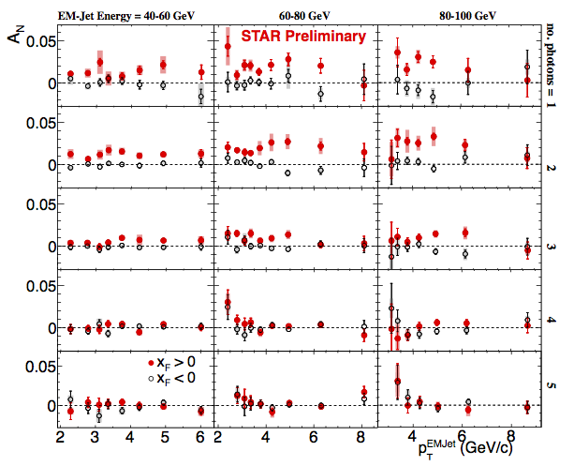
Single Spin Asymmetries
What are the subprocesses driving the large A_{N} at high x_{F} and η?
FTS allows π⁺/π⁻
Calorimeters only allow π⁰
Want to explore η
(can already measure mid-η)
Results show the process is not 2-2
Diffraction?
Arxiv:1602.03922

Slide 42
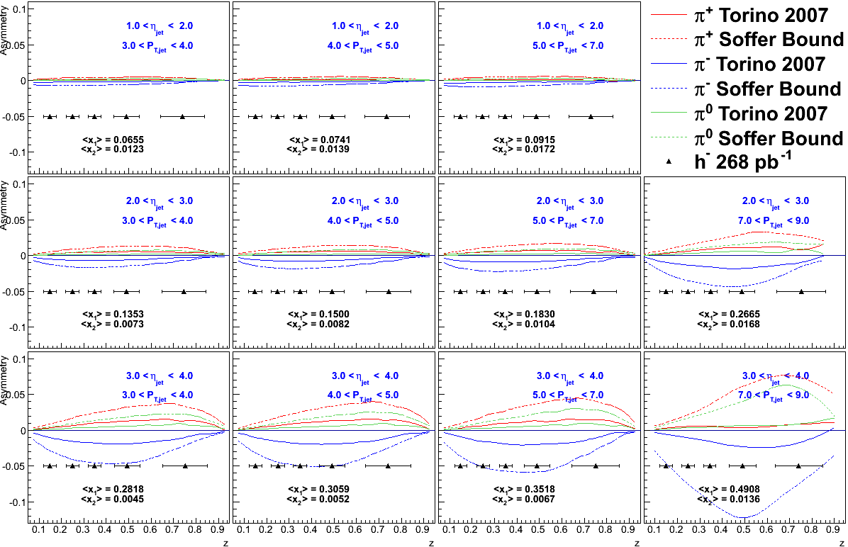
Collins

Slide 43
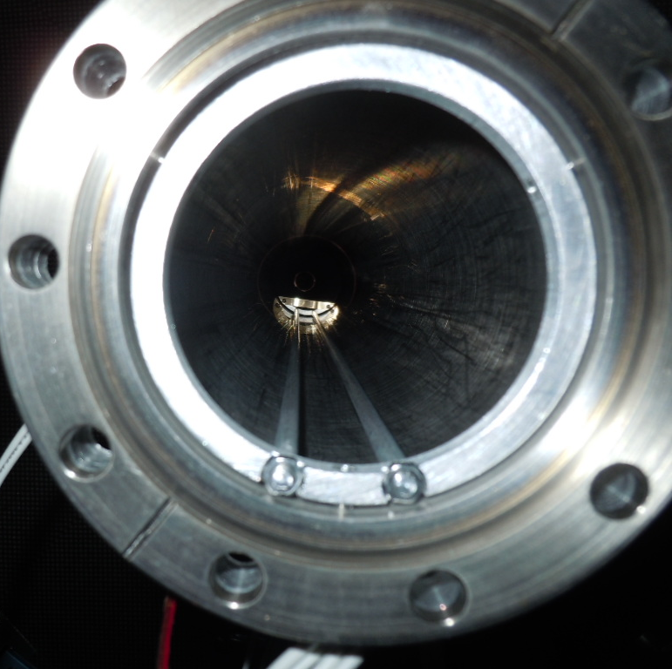
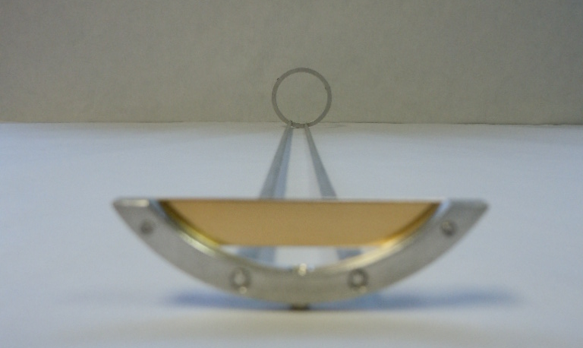
Target Design 2014 and 2015
remove
Target design:
Gold foil
1 mm Thick
~1 cm High
~4 cm Wide
210 cm from IR

Slide 44

Net-proton cumulants in BES-II
BES-I has revealed a non-trivial energy dependence Rapidity length of the correlation is important
Measure as function of Δy_{p} in wide range is needed to establish true nature of correlation → iTPC

Slide 45
Planned BES II Measures
Collision Energies (GeV): | 7.7 | 9.1 | 11.5 | 14.5 | 19.6
Chemical Potential (MeV): | 420 | 370 | 315 | 260 | 205
Observables | Millions of Events Needed
R_{CP} up to p_{T} 4.5 GeV | NA | NA | 160 | 92 | 22
Elliptic Flow of φ meson (v₂) | 100 | 150 | 200 | 300 | 400
Local Parity Violation (CME) | 50 | 50 | 50 | 50 | 50
Directed Flow studies (v₁) | 50 | 75 | 100 | 100 | 200
asHBT (proton-proton) | 35 | 40 | 50 | 65 | 80
net-proton kurtosis (κσ²) | 80 | 100 | 120 | 200 | 400
Dileptons | 100 | 160 | 230 | 300 | 400
Proposed Number of Events: | 100 | 160 | 230 | 300 | 400
QGP
1st P.T.
C.P.
EM Probes

Slide 46
BES Phase I – What have We Learned
The BES at RHIC spans a range of μ_{B} that could contain features of the QCD phase diagram.
Signatures consistent with a parton dominated regime either disappear, lose significance, or lose sufficient reach at the low energy region of the scan.
Dilepton mass spectra show a broadening consistent with models including hadron gas and quark-gluon plasma components
There are indicators pointing towards a softening of the equation of state which can be interpreted as evidence for a first order phase transition.
The higher moment fluctuation is sensitive to critical phenomena, but these analyses place stringent demands on the statistics.

Slide 47


Response of the FCS prototype module to hadrons
Energy deposition in HCal section (Y-axis) vs energy deposition in EMCal section (X-axis) for 12 GeV hadrons (left panel). A weighted sum of the energy deposited in EMCal and HCal section for 12 GeV hadrons (right panel).

Slide 48





y – p_{T} Map Colider
p
e
fxte
K
π

Slide 49



Low Energy Electron Cooling at RHIC
Start with 14.5 and 19,6 3X improvement
Following year, 7.7, 9.1, and 11.5. 4X improvement with eCooling
Run 24 weeks
Improve luminosity for low energy beams with electron cooling
100 MHz SRF Gun
58 m from IP2

Slide 50

STAR BES-I
Turn-off of sQGP signatures
Phys.Rev.Lett. 110 (2013) 142301
Substantial particle-antiparticle split at lower √s_{NN}
Linear dependence on the baryon chemical potential

Slide 51


Search for Phase Transition : directed flow
A linear fit over |y| ≤ 0.5 used to find dv1/dy for all species & energies
The dip in dv1/dy indicates an interplay between hydro and baryon dynamics (EOS)
Λ follows p within errors

Slide 52

Cumulant Ratio of Net-Proton multiplicity distributions
Collision Energy Dependence
Looking for fluctuation in S and κ
σ2/M increases with increasing energy, consistent with Poisson expectation
Non-monotonic behavior of net-proton κσ2 seen in top 5% central collisions
Peripheral collisions show smooth trend
UrQMD (no Critical Point), shows suppression at lower energies - due to baryon number conservation
Uncertainties requires better measurements – motivation for BES II

Slide 53



iTPC Improved performance
Increase rapidity coverage |η| < 1 to |η| < 1.5
Increased efficiency for |η| >1 both in p_{T} and particle specieS
Improved dE/dx
7.5->6.2%

Slide 54

iTPC

Slide 55


iTPC

Slide 56

BES-I White paper

