Slide 1

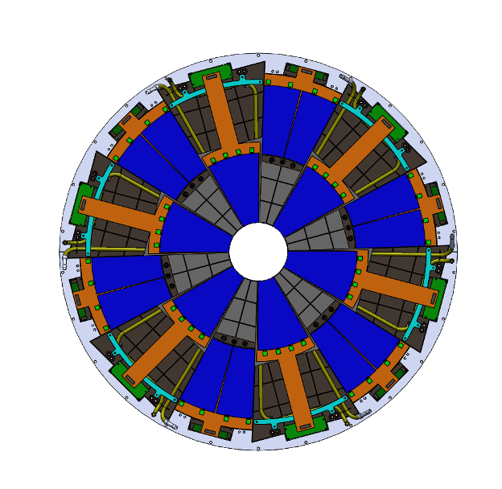
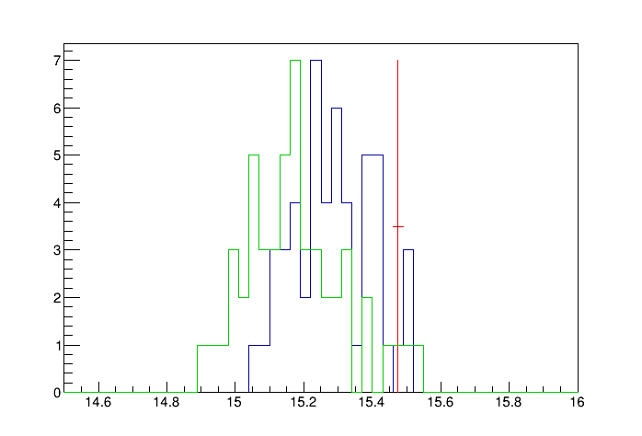
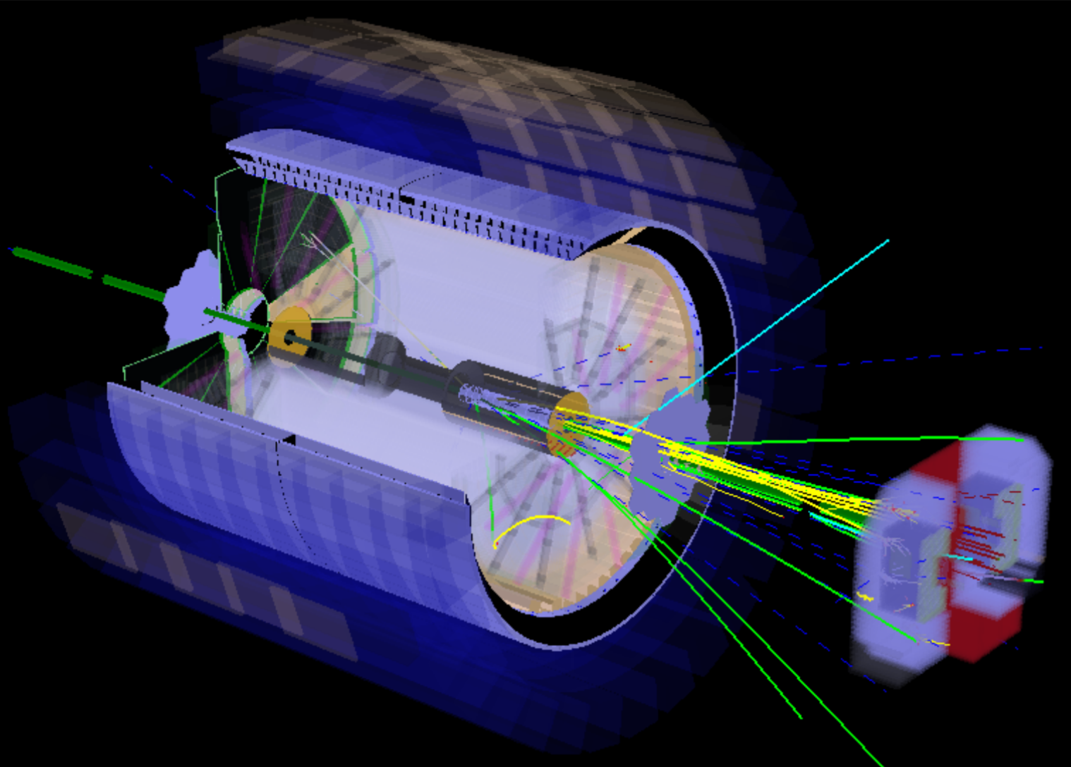
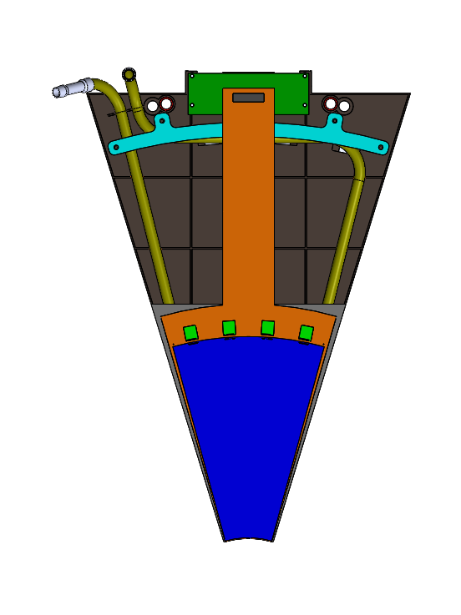
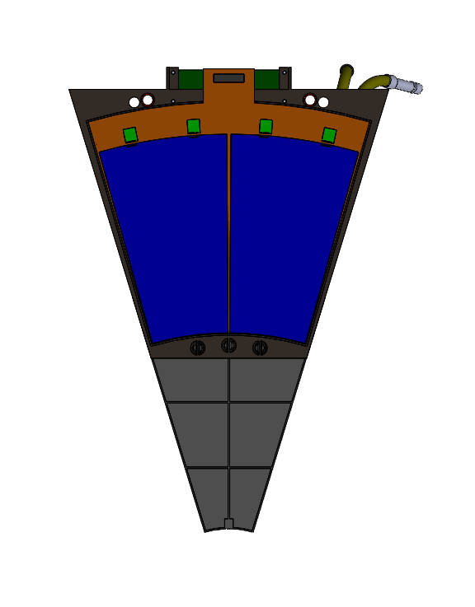
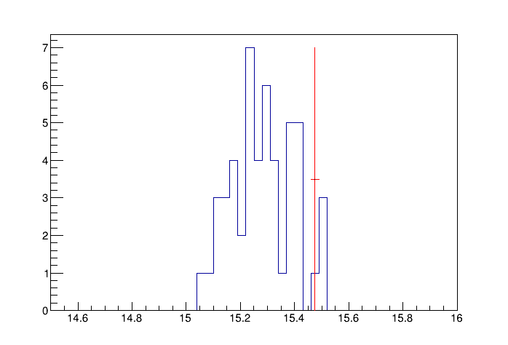
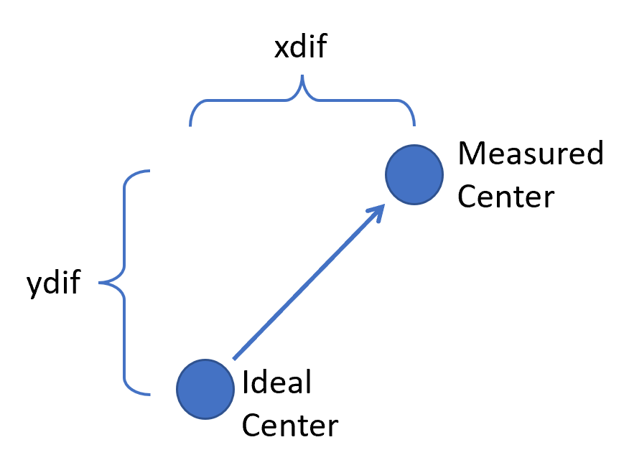
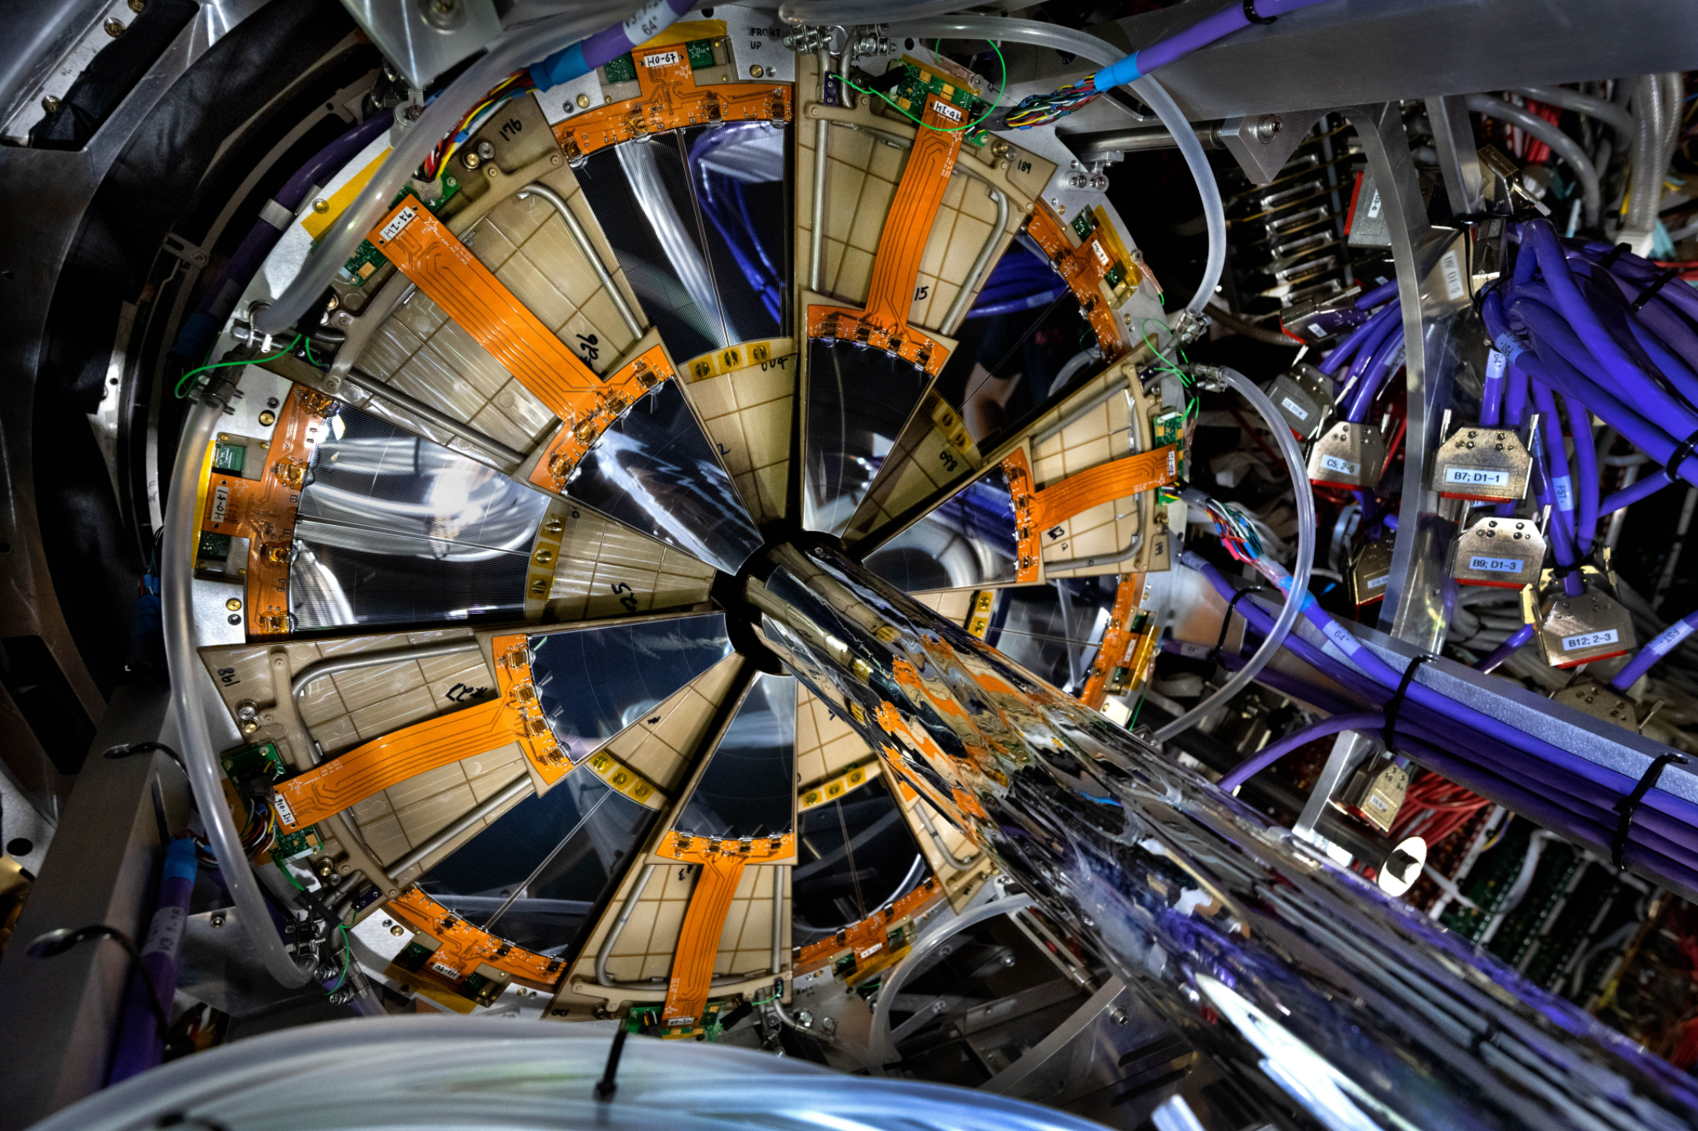
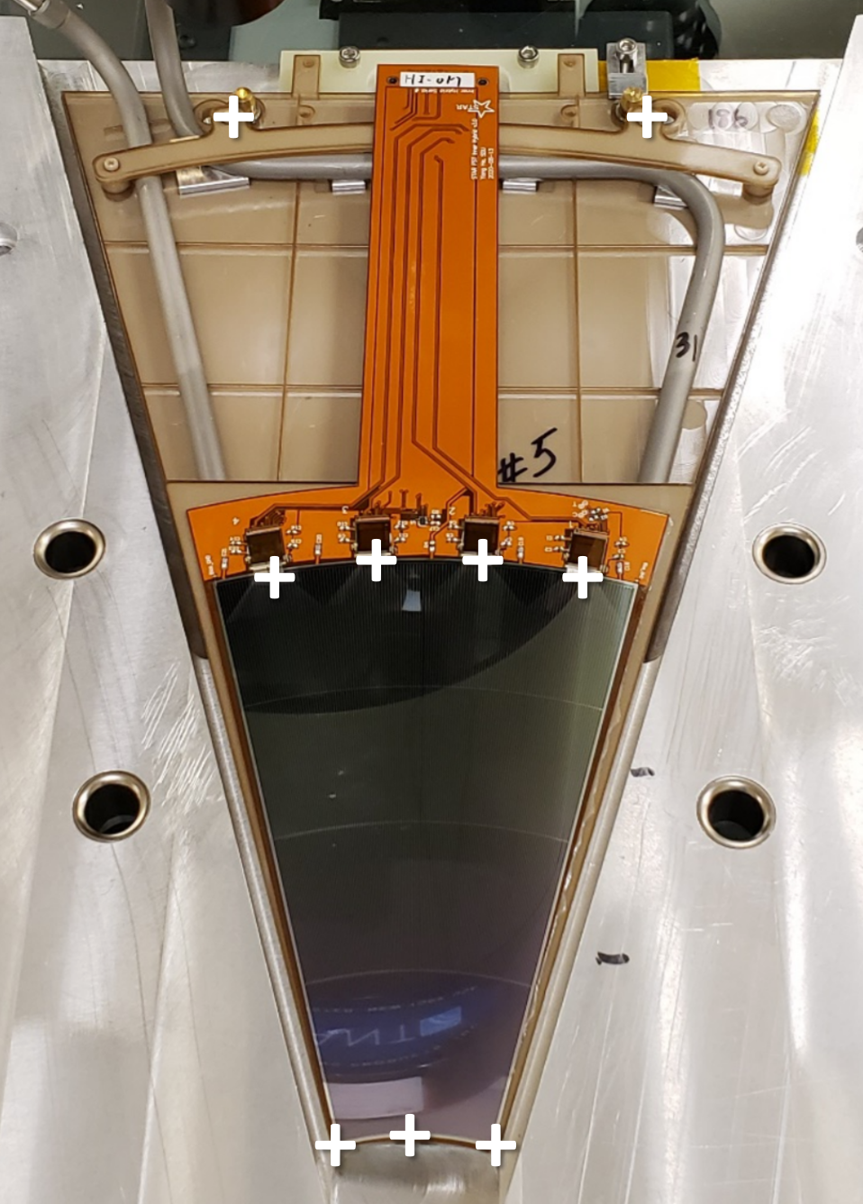
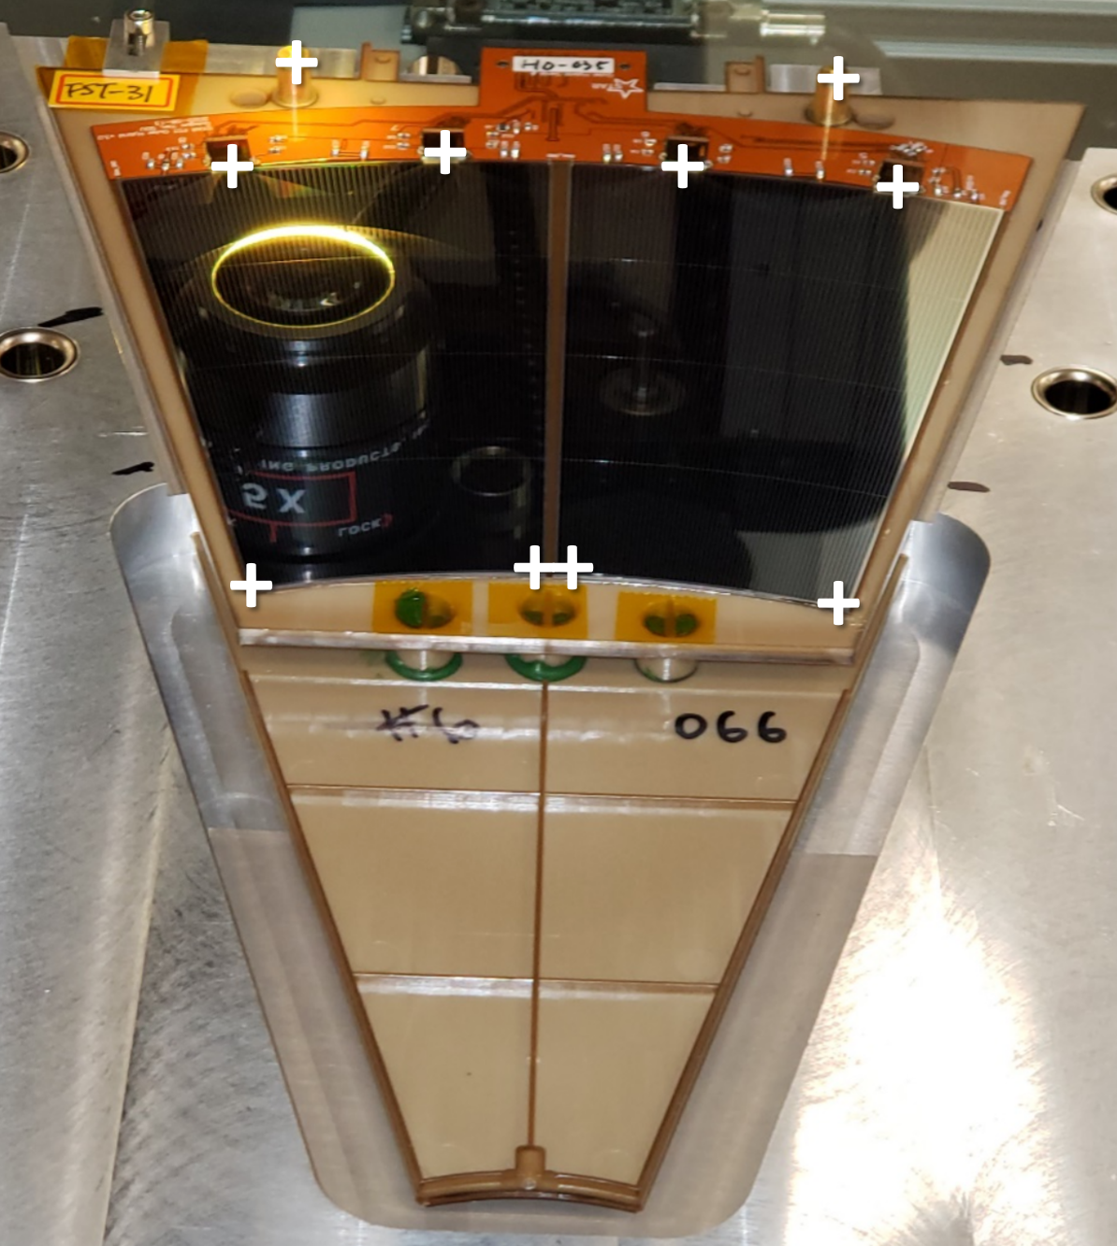
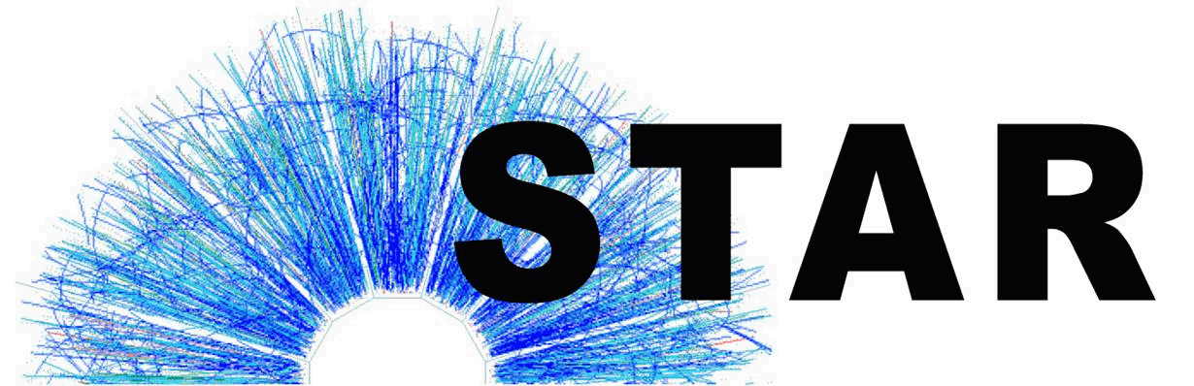




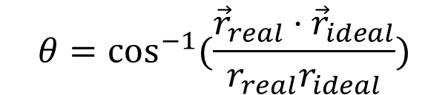
STAR FST Module Survey Data Analysis
Emily Branson of Abilene Christian University for the STAR Collaboration
www.acu.edu
The STAR Experiment
Forward Silicon Tracker
Survey Data Analysis
Results
The primary focus of the STAR experiment is to investigate the properties of Quark-Gluon Plasma (QGP). This is a state of matter which can be created in the collisions of the RHIC heavy ion beams at BNL. The STAR experiment also allows for study of spin structure.
The STAR experiment’s measurement capabilities in the forward region will be enhanced by the Forward Upgrade, which will allow for further investigation of QGP and spin structure.
The FST is composed of 3 layers of disks, each with 12 silicon tracking modules. Each module has an “inner” sensor and two “outer” sensors
to form the inner and outer rings of the disks.
FST disk
First, the positions of each reference point on each module were plotted to provide an overview of the survey data.
Left Pad Array Intersection Plot
Below is an example of one such histogram, with the blue lines showing the measured positions for one key point (Left Pad Array Intersection Point) for all modules, and the red line showing the ideal position for that reference point. It is clear from this plot that there is some offset between the measured and ideal positions.
Mean = 15.2837
Mean = 15.481
Mean = 15.1768
mm
Inner sensor
Outer sensors
Left Pad Array Intersection Plot
Above is a plot of the same point (Left Pad Array Intersection Point) but with the alignment matrices for each module applied to the ideal value. The resulting values are shown as green lines. It can be seen from the mean values that the aligned points are closer to the real values than the ideal value is. This plot is one example of the application of the alignment matrices to the ideal values.
mm
STAR Forward Upgrade
FST Module Survey
Alignment Matrices
Conclusion
  The Forward Upgrade is an ongoing project to update the STAR experiment. This upgrade allows measurements of charged particles closer to the beamline (2.5 < η < 4) than the previous systems allowed. The Forward Upgrade involves the addition of new detectors, including a Forward Silicon Tracker (FST).
In order to quantify how close to the design positions the assembled sensors are, a survey of the modules was performed. This involved measuring the positions of certain features (key points) on the sensors with respect to reference points on the module. This way, offsets in the assembled tracker can be accounted for by using alignment matrices to transfer from ideal to real coordinates.
The matrices will be applied to the ideal coordinates to transform them into the measured coordinates. There are two matrices per sensor: one, which transfers the positions, and one, which rotates the axes.
Based on comparing the means of real, ideal, and aligned reference points, the matrices created in this process appear to be generally effective at moving the ideal coordinates closer to the real coordinates. Other methods of calculating these matrices may be explored to compare their effectiveness.
The transfer matrices were found by calculating the difference between the measured center and ideal center of each sensor.
real .
For the rotation matrices, the angle difference between the measured “sensor center → key point” vector and the ideal “sensor center → key point” vector was found for key points on the sensor. These angles were then averaged for an overall rotation angle.
Acknowledgements
$${\vec{r}}_{real}$$
θ
ideal .
US DOE Grant DE-FG02-03ER41243
$${\vec{r}}_{ideal}$$
CENTER.
$$θ=\cos^{−1}{(\frac{{\vec{r}}_{real}⋅{\vec{r}}_{ideal}}{r_{real}r_{ideal}})}$$
Forward Silicon Tracker
DEPARTMENT OF ENGINEERING AND PHYSICS

