Slide 1
Status Update on STAR Upgrades
Huan Zhong Huang
Department of Physics and Astronomy
University of California at Los Angeles
For the STAR Collaboration
QM2012, Aug 13-18, 2012

Slide 2
RHIC – a Dedicated QCD Facility
QCD – Fundamental Corner Stone of the Standard Model !!
-Dynamics of QCD in bulk matter, vacuum structure and hadrons?
Condensed Matter Physics with Underlying QCD Interactions !
We are beyond the QGP discovery phase already !
LHC -- Energy/Temperature Frontier
RHIC – New Horizons in QCD Phase Structure, Vacuum
Excitation, Initial State Color Charge Dynamics,
Hadron Structure and Exotics
STAR continues to explore new QCD horizons with planned
detector upgrades and vigorous scientific programs
in the coming decade !

Slide 3
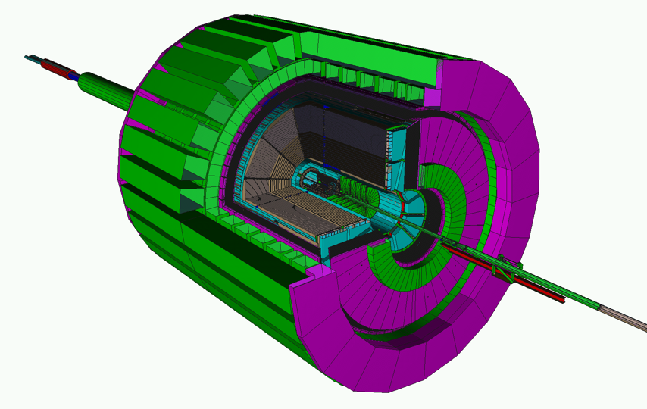
STAR Detectors Fast and Full azimuthal particle identification
EMC+EEMC+FMS
(-1 ≤ η ≤ 4)
MTD FY12-14
TPC
TOF
DAQ1000
HFT FY13-14
FGT FY12-13

Slide 4
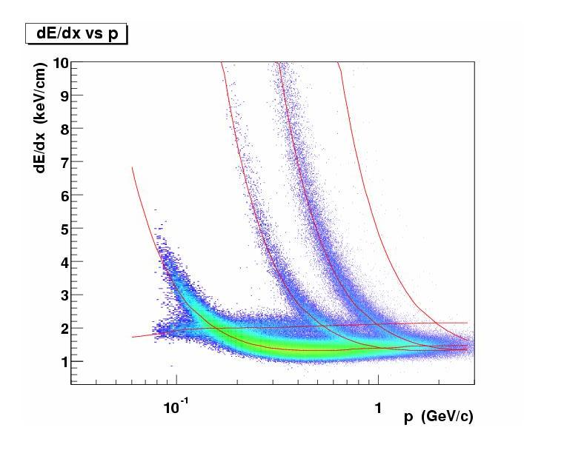
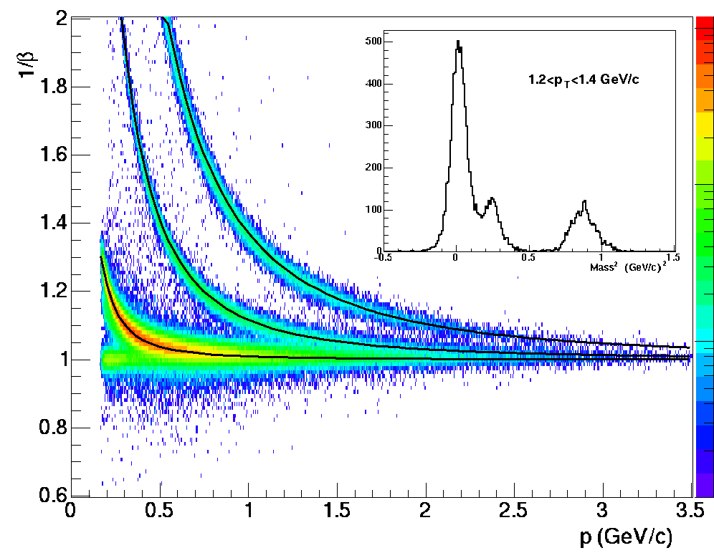
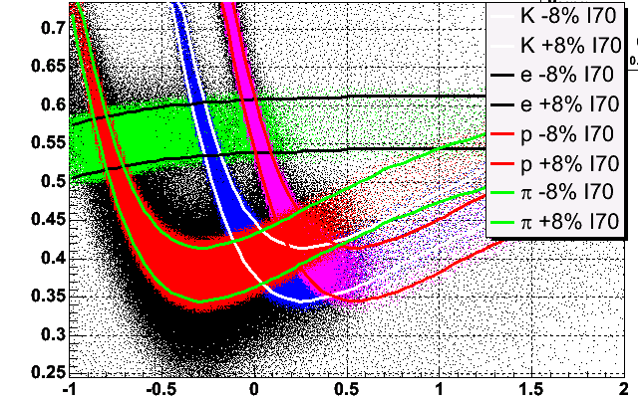
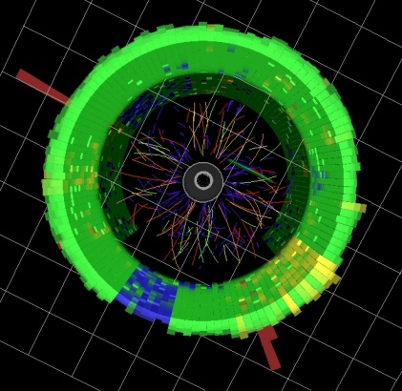
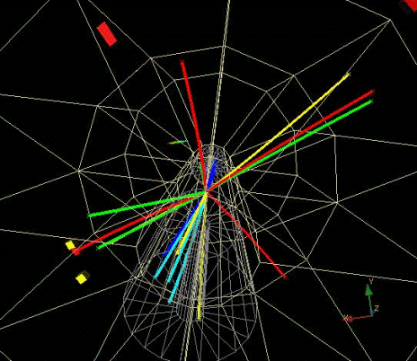
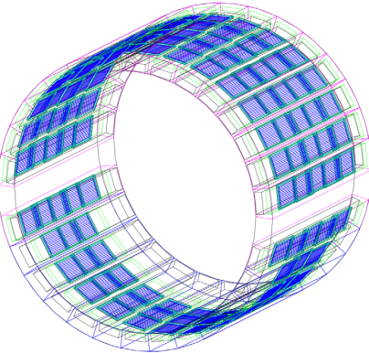
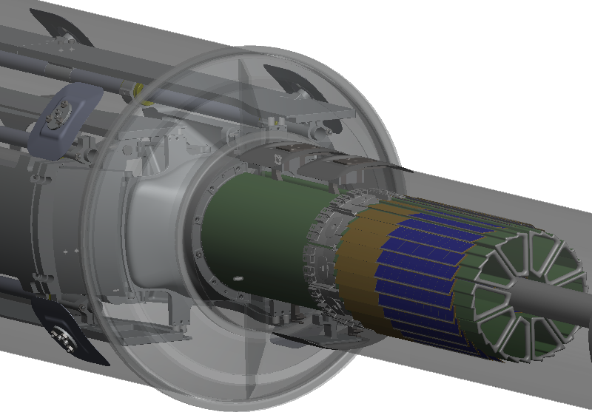
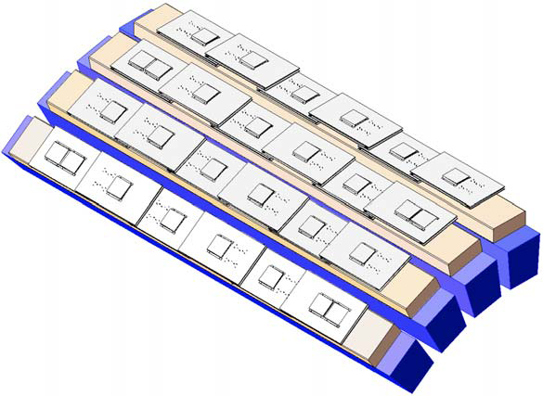
Particle Identification at STAR
TPC TOF TPC
TPC
K p d
π
e, μ
TOF
Log₁₀(p)
Charged hadrons
Hyperons & Hyper-nuclei
MTD
HFT
EMC
Jets
Neutral particles
Jets & Correlations
High p_{T} muons
Heavy-flavor hadrons
Multiple-fold correlations among the identified particles!
Nearly perfect coverage at mid-rapidity

Slide 5
STAR Upgrade Path
Ongoing and Near Term
FGT 14/24 quadrants in 2012 and complete for 2013 run
HFT engineering run 2013 and complete in FY14
MTD 13/118 in 2012, 50-75/118 run 13 and complete 14
Roman Pots Phase II – pp2pp
Physics Focuses:
FGT – W program from polarized p+p collisions
HFT – Heavy quark collectivity and
separating Charm and Bottom energy loss
MTD – Upsilon states and e-μ correlations

Slide 6
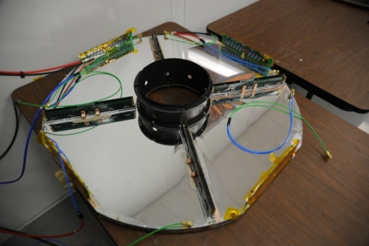
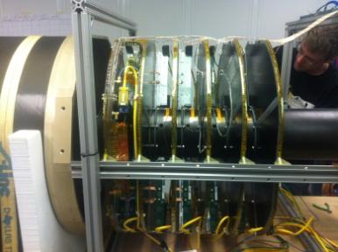
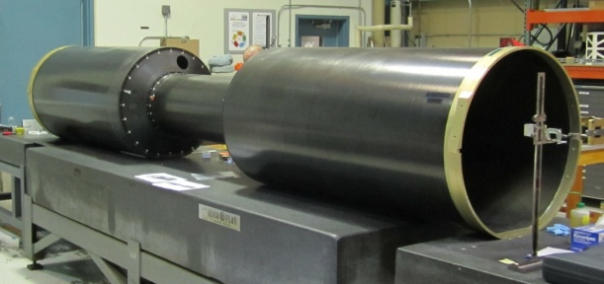
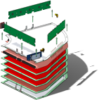
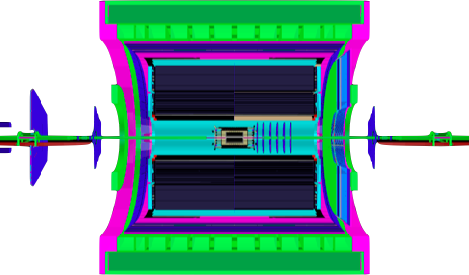
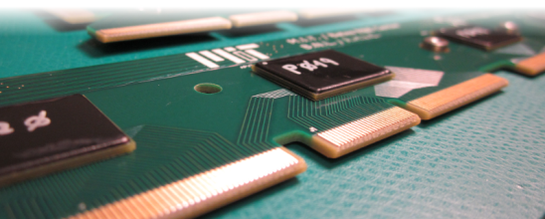
Forward GEM Tracker -- 2013
Layout
Quarter section
Disk
Quarter section
BEMC
APV module
Packaged APV chip
FGT
EEMC
TPC
14/24 Quads installed for run 2012 !
Detector performance is being
evaluated.
STAR Detector

Slide 7
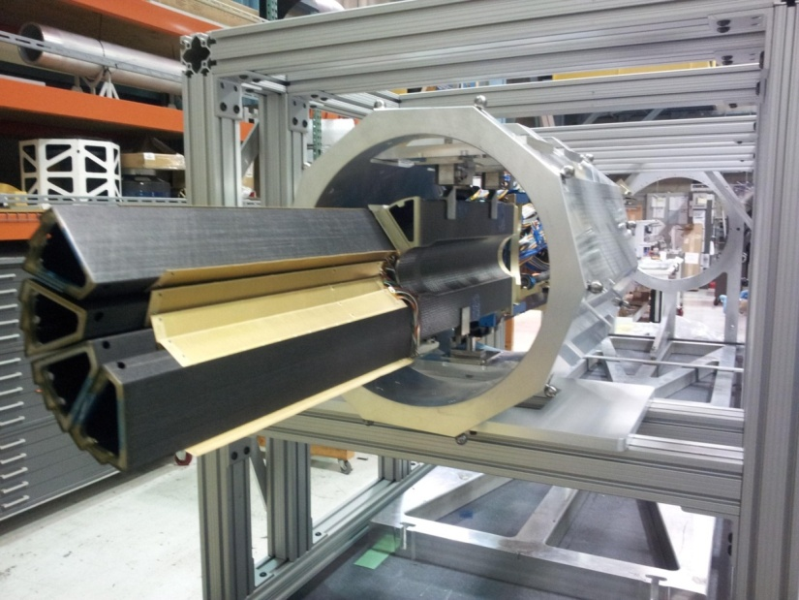
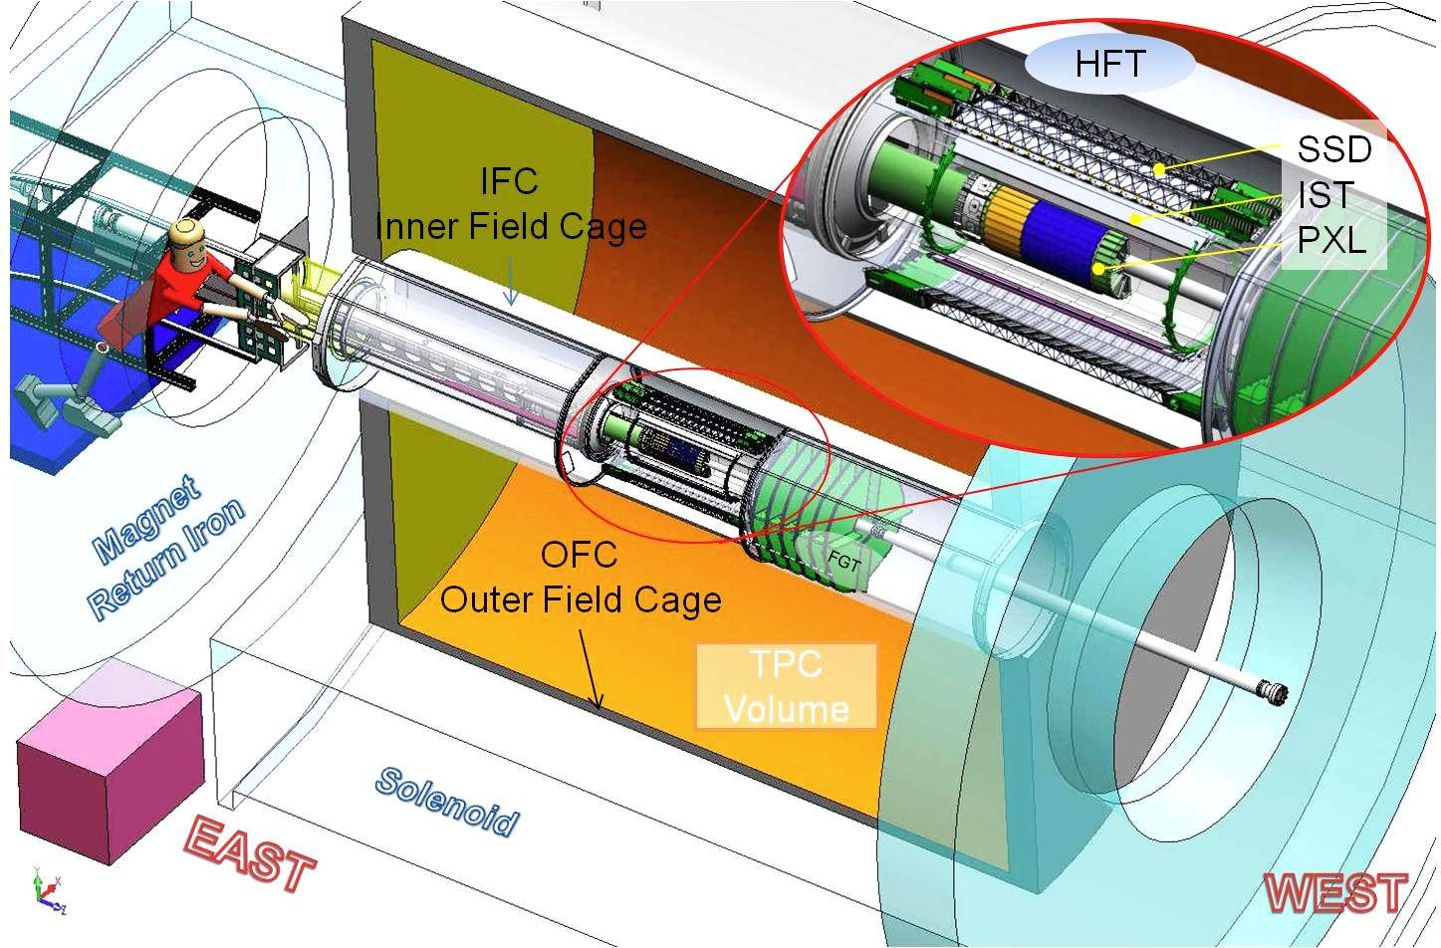
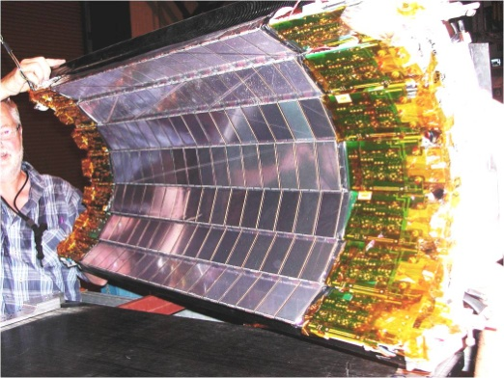
Heavy Flavor Tracker -- 2014
3 detector systems;
PXL 2 layers of CMOS
IST 1 layer at 14 cm
SSD 1 layer
Engineering run 2013
Full system installed in 2014

Slide 8
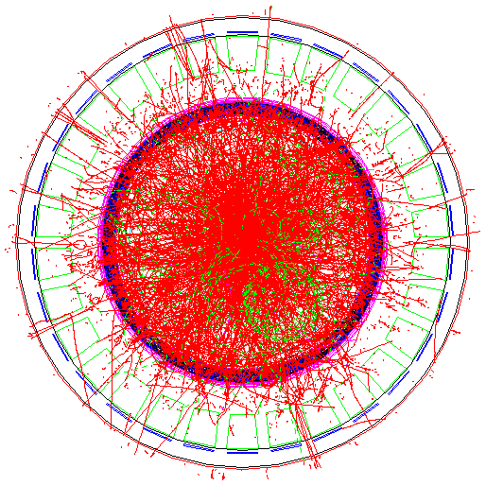
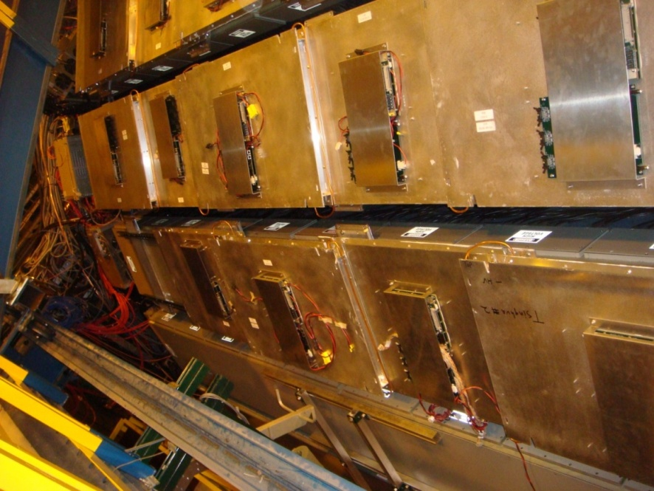
Muon Telescope Detector -- 2014
Multi-gap Resistive Plate Chamber (MRPC):
gas detector, avalanche mode
A detector with long-MRPCs covers the
whole iron bars and leave the gaps in-
between uncovered. Acceptance: 45% at
|η|<0.5
118 modules, 1416 readout strips, 2832 readout
channels
Long-MRPC detector technology, electronics
same as used in STAR-TOF
Run 2012 -- 10%; 2013 – 43%+; 2014 – 100%
Successful commissioning run in 2012

Slide 9
STAR Upgrade Path
Intermediate Future (Decadal Plan) 2016+
TPC Inner Sector Readout Upgrade
VFGT – using FGT technology in the very forward region
PID Detector – Meson/Baryon separation
Forward Calorimeter System
Physics Focuses:
Beam Energy Scan – Phase II program
Forward photon/electron/jet(leading hadron)
p+p -- transverse spin dynamics
(transversity function and Collins frag.
QCD twist-3 processes)
pp/pA -- Drell-Yan, h-h, gamma-h correlations
(initial conditions and CGC)
AA -- Forward HQ NPE R_{AA} and eta dependence

Slide 10
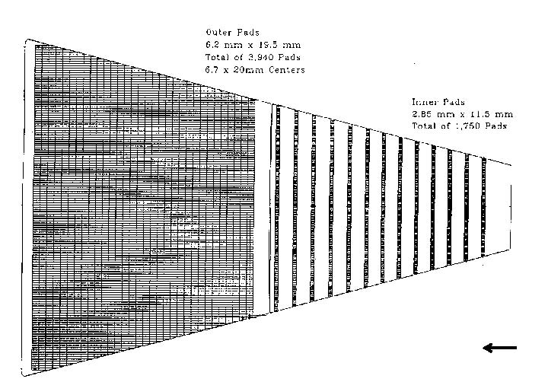
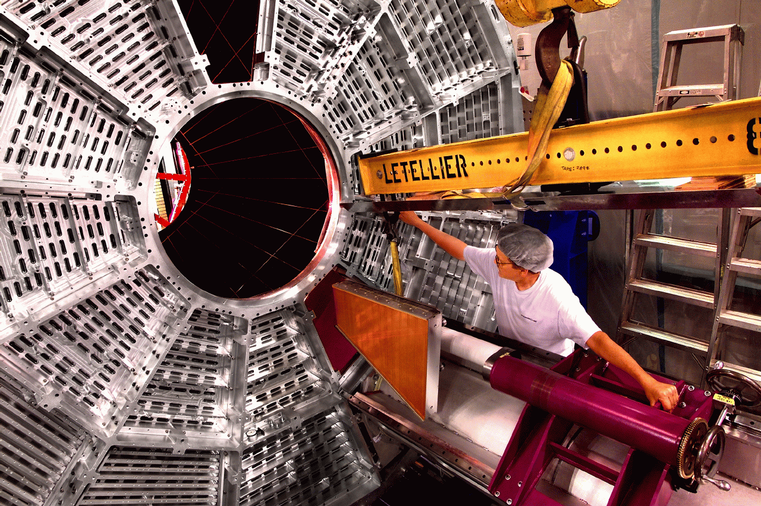
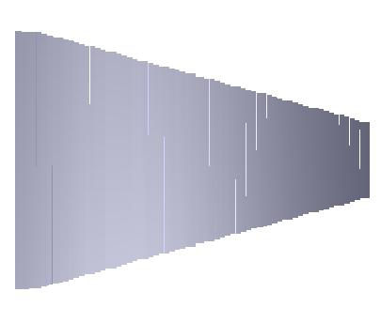
Inner TPC Pad Readout Upgrade – iTPad Project
Much better tracking and dE/dx PID capability
η 1.0-1.7 region -- broad physics impact on
transverse spin physics program
hyperon and exotic particle searches
high pT identified particles
BES Phase II+

Slide 11
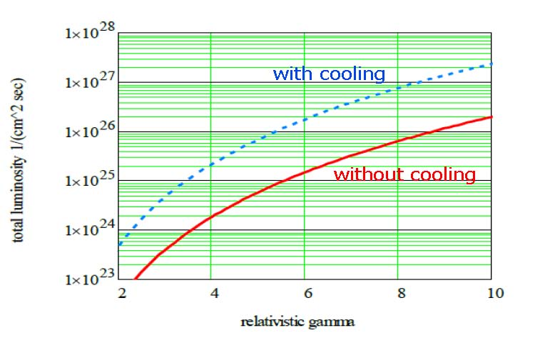
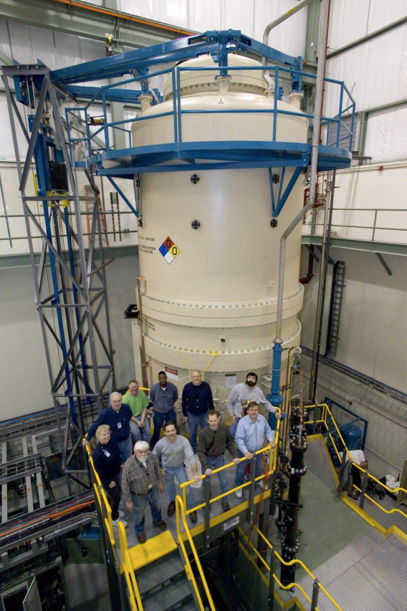
STAR Vision for BES II Program
Likely beam energies below 25 GeV with improved statistics
particularly for the lower end of the beam energies !
-- need electron cooling from CAD to be more efficient
-- match iTPC upgrade schedule for better detector coverage
A. Fedotov – RHIC-AGS User Meeting 2012
Electron cooling necessary !!
Use RF Gun Cooler OR
Use Fermi Lab Pelletron ?
RHIC CAD installation of the e-cooling device
~ 4 years !
BES-II takes data in 2016 +

Slide 12
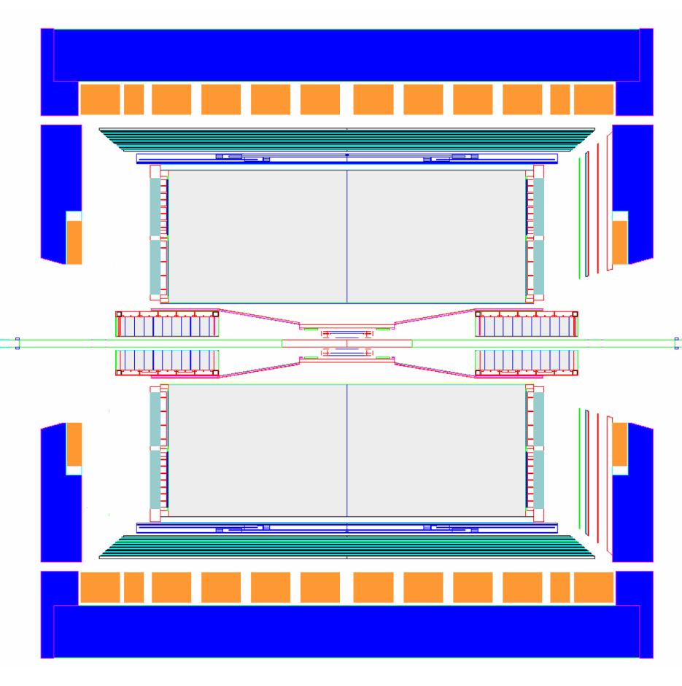
STAR forward instrumentation upgrade
proton
nucleus
~ 6 GEM disks
Tracking: 2.5 < η < 4
~ 2016
Forward Calorimeter System (FCS)
FHC (E864)
Pb-Sc HCal
FHC (E864)
W-Powder EMCal
RICH/Threshold
Baryon/meson separation
Forward instrumentation optimized for p+A and transverse spin physics
Charged-particle tracking
e/h and γ/π⁰ discrimination
Possibly Baryon/meson separation

Slide 13
STAR Plan for the Forward Upgrades
1) The Forward Calorimeter System (FCS) benefited from
an EIC detector R&D project for constructing W-
powder EMC modules. Current R&D effort focuses on
compact read-out scheme and mechanical properties.
We plan to build a full-scale prototype FCS module.
2) The Very Forward GEM Tracker (VFGT) detector is
likely to be GEM based. Details of the design
depends on our experiences with the FGT project.
3) RICH detector in STAR forward direction has not been
demonstrated. Threshold Cerenkov detector is also
under consideration. This detector will not be
included in the initial phase of the upgrade project.
4) Schedule: Develop CD documents and Proposals
aiming at VFGT/FCS construction starting 2015+

Slide 14
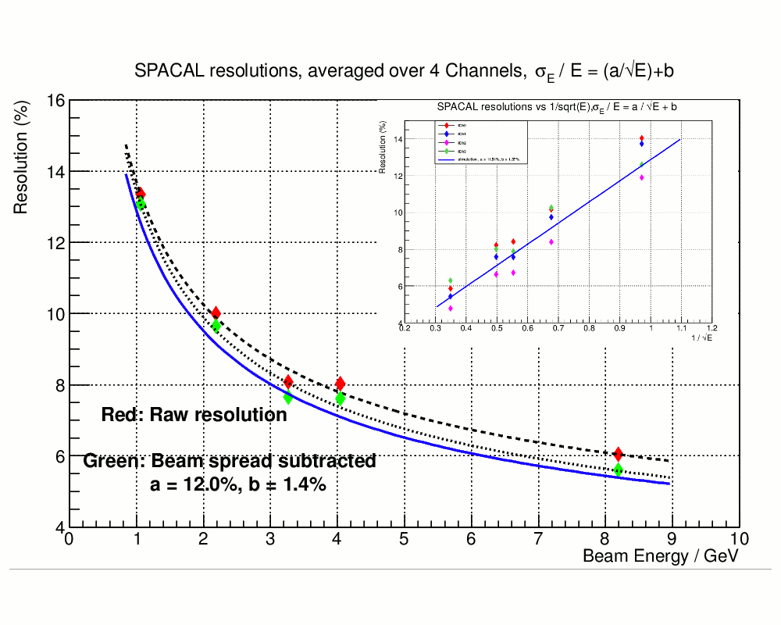
EIC Detector R&D Project: SPACAL works!
Also measured:
1.Uniformity of response across
the towers.
2. Energy resolution with and
without mirror.
3. Perform scans along the towers
with electrons and muons.
4.
Estimated effects of attenuation
and towers non-uniformities
on resolution.
Viable EMC detector technology developed through EIC R&D
A prototype hadron calorimeter module will be built in 2013

Slide 15
STAR Upgrade Path Towards eSTAR
Future eSTAR Option -- Detector R&D:
EMC – Compact W-powder SPACAL
Crystals – PWO and BSO testing
ETTIE – electron PID and tracking in the forward
Simulations
STAR will be ready with a detector coverage
to explore eA physics during the initial phase
of the eRHIC development !

Slide 16
Outstanding QCD Questions at RHIC
-- STAR Decadal Plan

Slide 17
Backup

Slide 18
STAR FCS R&D Status
MC, stand alone GEANT4, done.
Pi0 reconstruction – 80% eff. At 100 GeV
Energy resolution EM – 12/sqrt(E), constant term ~2%
Energy resolution for hadrons 50%-60%/sqrt(E), range 10-80 GeV
e/h rejection few*1000 @ 80 GeV
We plan to build a full scale prototype module !
What are the Physics Capability for this Detector?
Possible optimization of detector configuration with re-use of the E864 SPACAL?

Slide 19
“Phase diagram” for gluon density
saturation
region
relatively dense
region
non-perturbative region
dilute region
Dilute region (x large): pQCD works, the multiple scattering (power corrections) are not
important
Relatively dense region (x relatively small): multiple scattering starts to become important, any additional scattering is power suppressed by
Saturation region (x extremely small): all the additional scattering becomes equally important, all power terms have to be resummed

Slide 20
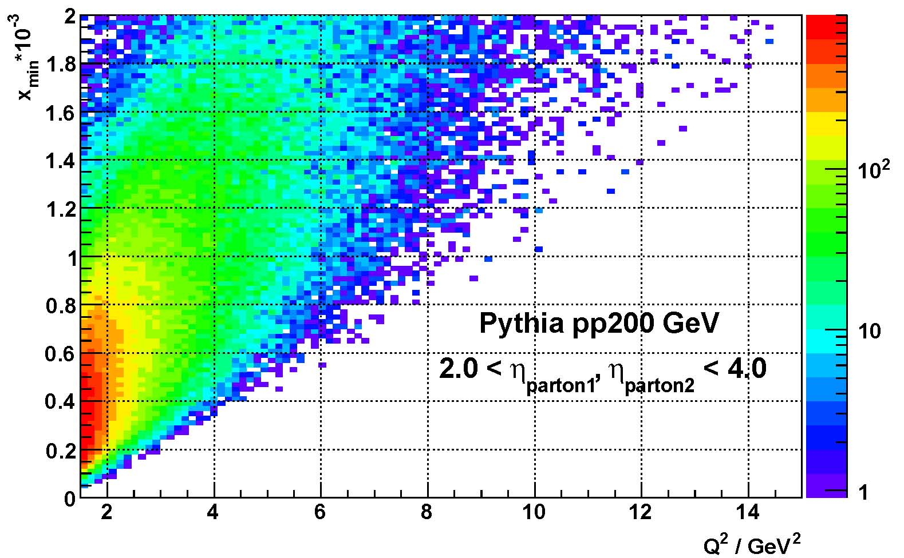
Accessible x-Q² phase space from h-h
correlations in the forward direction

