Slide 1

The STAR COLD QCD PHYSICS
Program after 2020
The Tale of the initial state:
nucleon to nuclei
E.C. Aschenauer
https://drupal.star.bnl.gov/STAR/starnotes/public/sn0648
https://drupal.star.bnl.gov/STAR/starnotes/public/sn0669

Slide 2
Physics in 2021+
Objective:
unique program addressing several fundamental questions in QCD
→ essential to
the mission of the RHIC physics program in cold and hot QCD
fully realize the scientific promise of the EIC
  lay the groundwork for the EIC, both scientifically and by refining the experimental requirements
  Test EIC detector technologies under real conditions, i.e SiPMs
based on two pillars in pp, pA and AA collisions
midrapidity program based on existing STAR detector utilizing iTPC, eToF and EPD upgrades
forward rapidity program based on unique upgrade of STAR
Upgrade consisting of Hcal + ECal + tracking (Si +sTGCs) at 2.5 < η < 4
Goal:
Have the forward upgrade operational for a polarized pp@500 GeV run in 2021
and the sPHENIX data taking periods

Slide 3

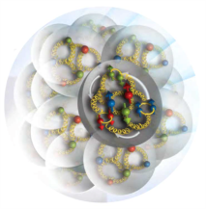
The objectives of the STAR Forward upgrade
unique measurements to answer the hot questions in cold QCD
How are the sea quarks and gluons, and their spins, distributed in space and momentum inside the nucleon?
How do the nucleon properties emerge from them and their interactions?
How do color-charged quarks and gluons, and colorless jets, interact with a nuclear medium?
How do the confined hadronic states emerge from these quarks and gluons?
How do the quark-gluon interactions create nuclear binding?
How does a dense nuclear environment affect the quarks and gluons, their correlations, and their interactions?
What happens to the gluon density in nuclei? Does it saturate at high energy, giving rise to a gluonic matter with universal properties in all nuclei, even the proton?
gluon
emission
gluon recombination
?
=

Slide 4
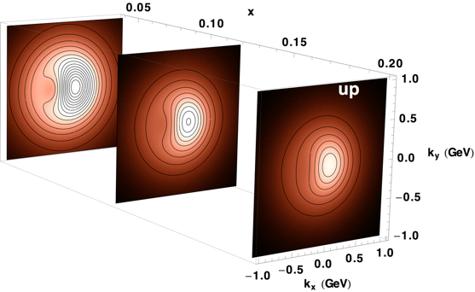
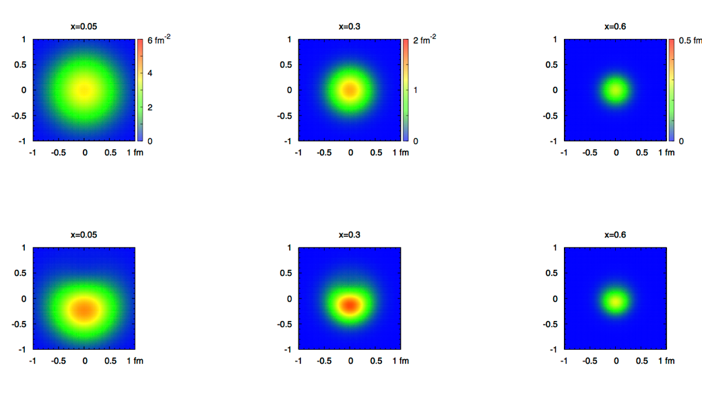
2+1 dimensional Imaging of Quarks & Gluons
Wigner function
W(x,b_{T},k_{T})
QCD genetic map
∫d²b_{T}
∫ d²k_{T}
Momentum
space
Coordinate
space
f(x,k_{T})
TMDs
f(x,b_{T})
GPDs
(Spin-dependent) 2+1D transverse momentum images
(Spin-dependent) 2+1D spatial images from exclusive scattering
down quark
x
Recent theoretical work indicates direct access to Gluon Wigner function
through diffractive di-jets in UPC (arXiv:1706.01765)

Slide 5
TMDs at STAR
Before STAR TMDs came only from fixed target data → high x @ low Q²
needed to establish concept at high Q² and wide range in x
polarised pp at RHIC
STAR unique kinematics: from high to low x at high Q²

Slide 6
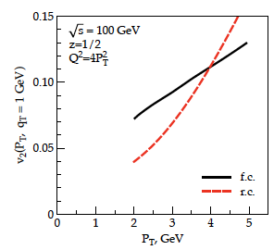
TMDs and “QGP” in small systems
Collective flow signatures
seen even in the smallest
systems and at the lowest
RHIC energies
Phys. Rev. C 95 (2017) 034910
TMD formalism in DIS predicts a distribution for linearly polarized gluons in an unpolarized target. This is reflected in cos(2φ) asymmetries in dijet production
Study azimuthal anisotropy as a function of the rapidity dis-balance of the jets
Process sensitive to unpolarized and linearly polarized gluon distribution
Phys.Rev. D94 (2016) no.1, 014030
Phys.Rev.Lett. 115 (2015) no.25,252301
Phys.Rev. D91 (2015) no.7, 074006
Phys.Lett. B743 (2015) 134-137

Slide 7
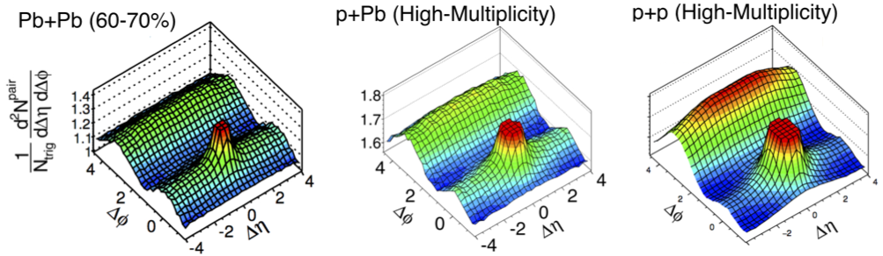
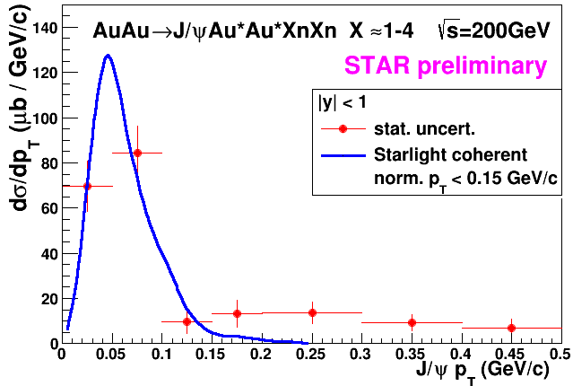
Proton structure important for QGP in small systems
Collective phenomena seen in pA collisions, i.e. ATLAS 1409.792
H. Mäntysaari & B. Schenke
arXiv:1607.01711
In a hydro-picture (used in AA)
fluctuations in the proton are
crucial to understand the seen
pA@LHC behaviors
Mapping spatial gluon structure of the proton in x and Q²
through excl. J/Ψ production
Examples of proton density
profiles at x ~ 10⁻³
ep: will provide the ultimate answer
BUT
pp/pA/AA: J/Ψ in UPC
Study
coherent
and
incoherent
J/Ψ prod.
Notes:
make simpler

Slide 8
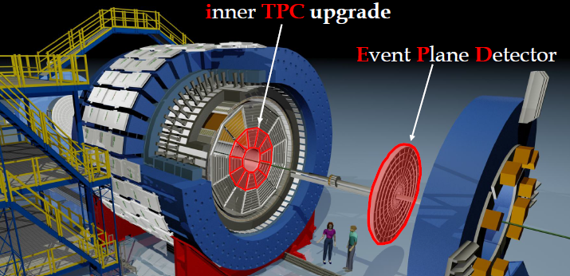
STAR in 2021
Endcap TOF
iTPC:
Rebuilds the inner sectors
of the TPC
Continuous Coverage
Improves dE/dx
Extends η coverage from
1.0 to 1.5
Lowers p_{T} cut-in from
125 MeV/c to 60 MeV/c
EPD:
Improves trigger
Reduces background
Allows a better and independent reaction plane
EndCap TOF:
PID at η = 0.9 to 1.5
π,K,p,e Acceptance and PID capabilities with the combination of iTPC and eTOF.

Slide 9
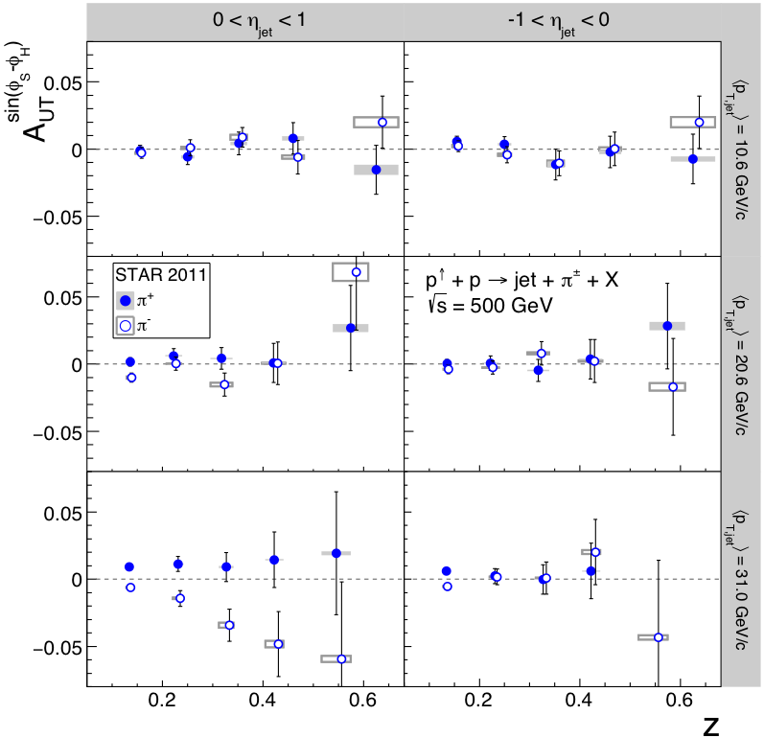
Jets to access Transversity x Collins
STAR arXiv:1708.07080 (PRD 97, 032004 (2018))
200 vs. 500 GeV Comparison:
first observation of a TMD at low x
and high Q²
Evolution: 200 GeV ←→ 500 GeV
factor 3 in Q
Test of factorization & Universality
→ compare with transversity from IFF
→ compare with SIDIS and e+e-
Triggered a lot of theory work
proof of factorization:
Kang et al. arXiv:1705.08443
asymmetry calculation:
Kang et al. arXiv:1707.00913
First Sign TMDs survive at low x and high Q²

Slide 10
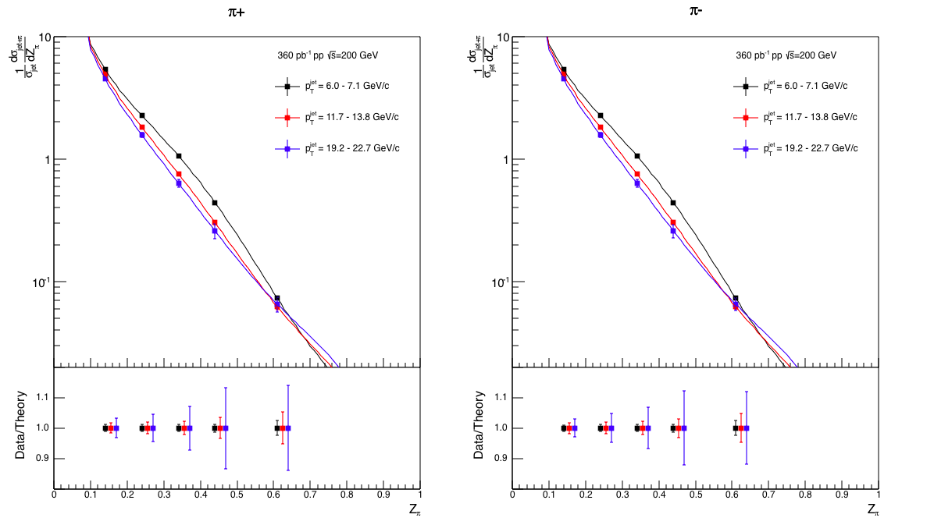
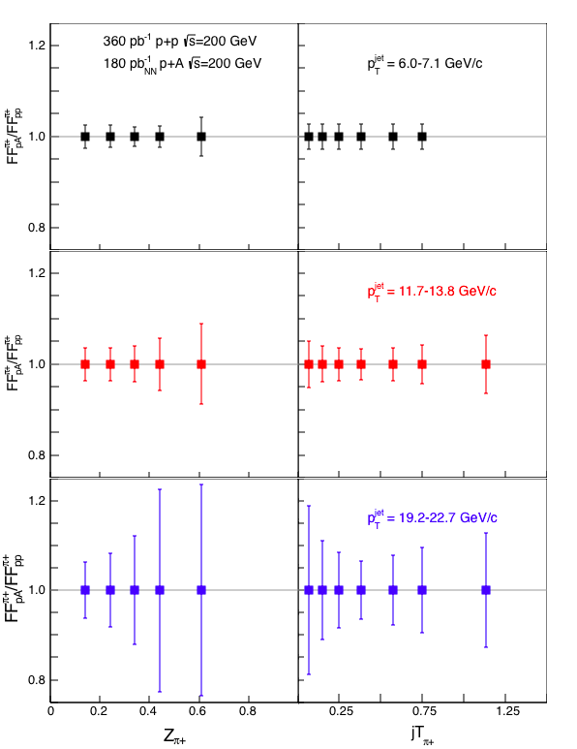
fragmentation functions in pp and pA
Observable: hadron in jet
fragmentation functions
in p+A/p+p at |η| < 0.4
p+p:
π+
π-
only at RHIC:
measure nuclear
effects for
polarized FF
→ nCollins

Slide 11
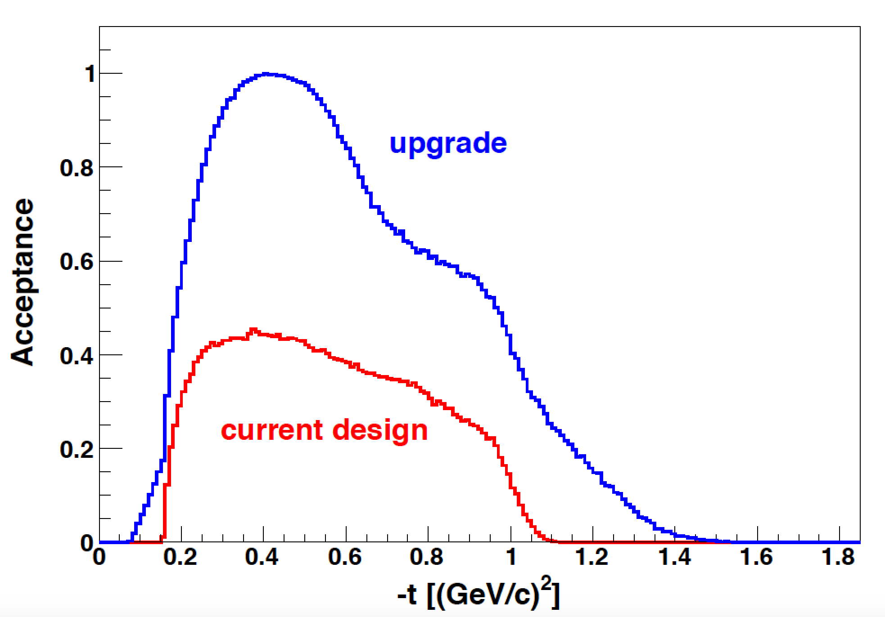
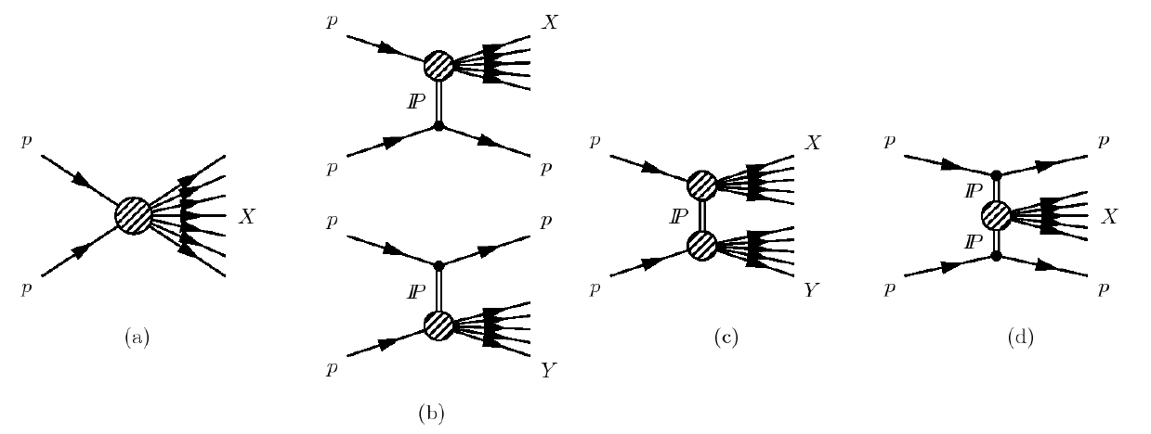
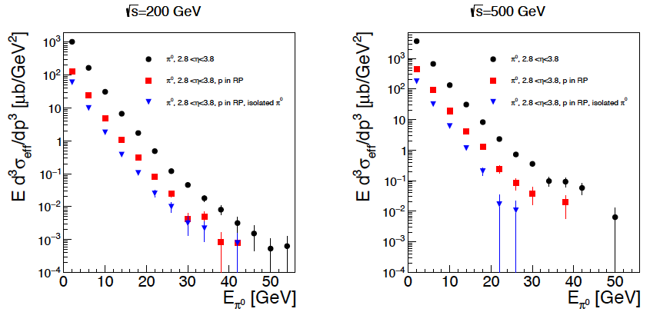
Diffraction: A neglected child at RHIC
Processes:
STAR RP the optimal
tool to tag
diffractive processes
2021+
2015+2017
inclusive cross section
Pythia-8
~20% at least
diffractive
Many more interesting physics opportunities with diffraction
SSA for UPC J/Ψ production → GPDs
Di-jets in UPC → gluon Wigner function (arXiv:1706.01765)
R_{pA} for diffractive events → saturation

Slide 12


Slide 13
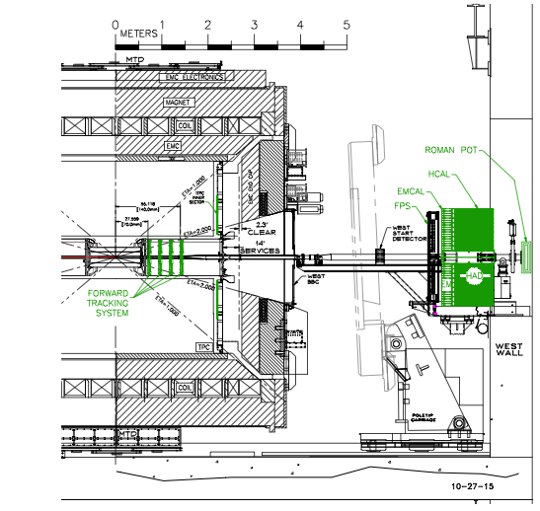
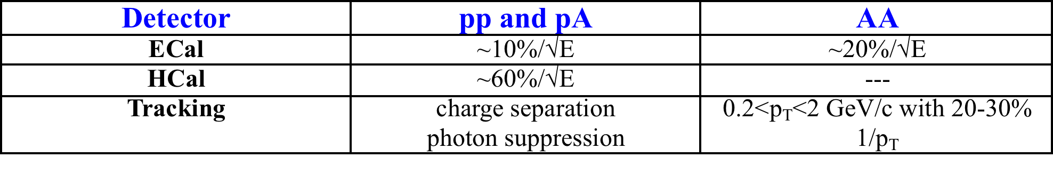
The STAR Forward Upgrade
Requirements from Physics:
Calorimeter System:
Intensive R&D work on both ECal and Hcal
as part of STAR and EIC Detector R&D
several beam test and STAR in situ tests
system optimized for cost and performance
ECal:
reuse PHENIX PbSC calorimeter
with new readout on front instead of W/ScFi SPACAL
significant cost reduction ☺
uncompensated calorimeter system ☹
HCal:
sandwich iron-scintillator plate sampling Calo
Same readout for both calorimeters → cost
Cost:
ECal: 0.57 M$
Hcal: 1.53 M$
Preshower: 0.06 M$
based on extensive experience from prototypes
contingency and manpower included
Total: 2.2 M$

Slide 14
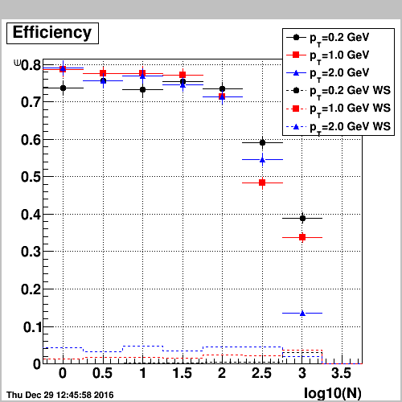
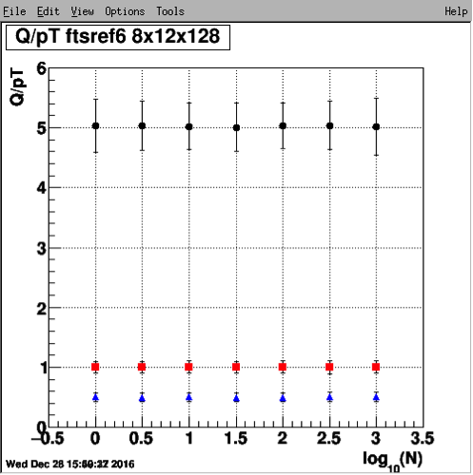
The STAR Forward Upgrade
Si + Small-strip Thin Gap Chambers
3 Si disks + 4 sTGC
Si- disks:
90, 140, 187 cm from IP
sTGC:
270, 300, 330, 360 cm
from IP (outside Magnet)
Momentum resolution: 20-30%
for 0.2 < p_{T} < 2 GeV/c
track finding efficiency: 80%@100 tr/ev
0.2 GeV/c
pions
1 GeV/c
2 GeV/c
Cost: 3.3 M$

Slide 15
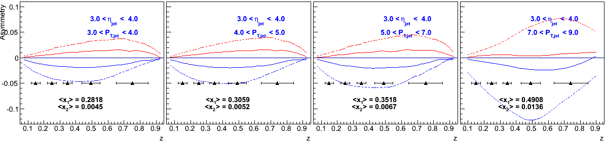
TMDs at STAR: Transversity
h^{+/-}
jet
Transverity is the 3rd PDF critical to fully describe the Proton wave function
→ measure at high x
→ Observable: hadron in jet
→ constrain tensor charge
  tensor charge useful for low-energy explorations of BSM
  new physics ⇒ of today precision is an issue.
Tensor charge
Different extractions
Different extractions

Slide 16

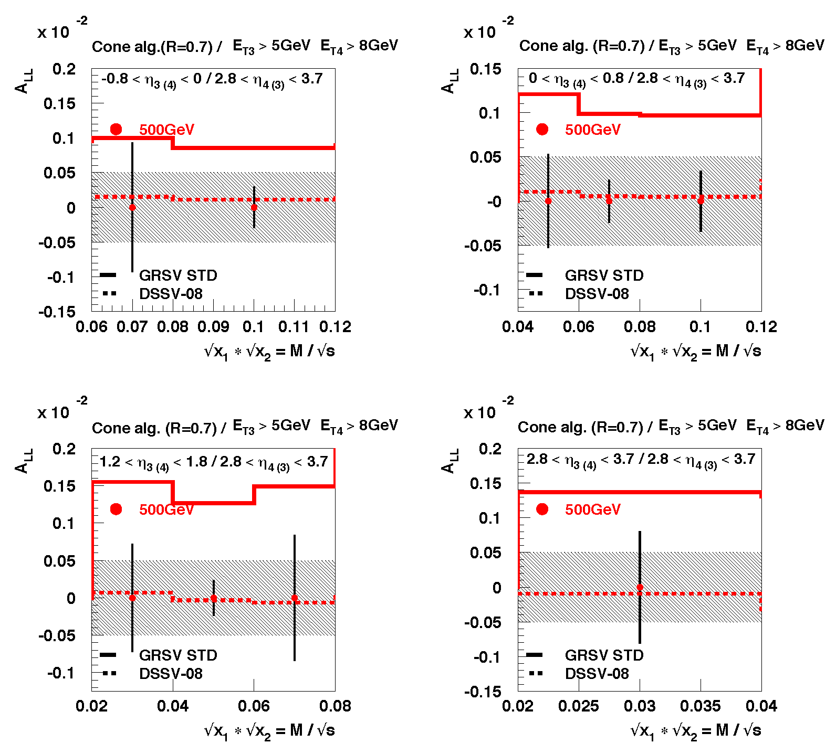
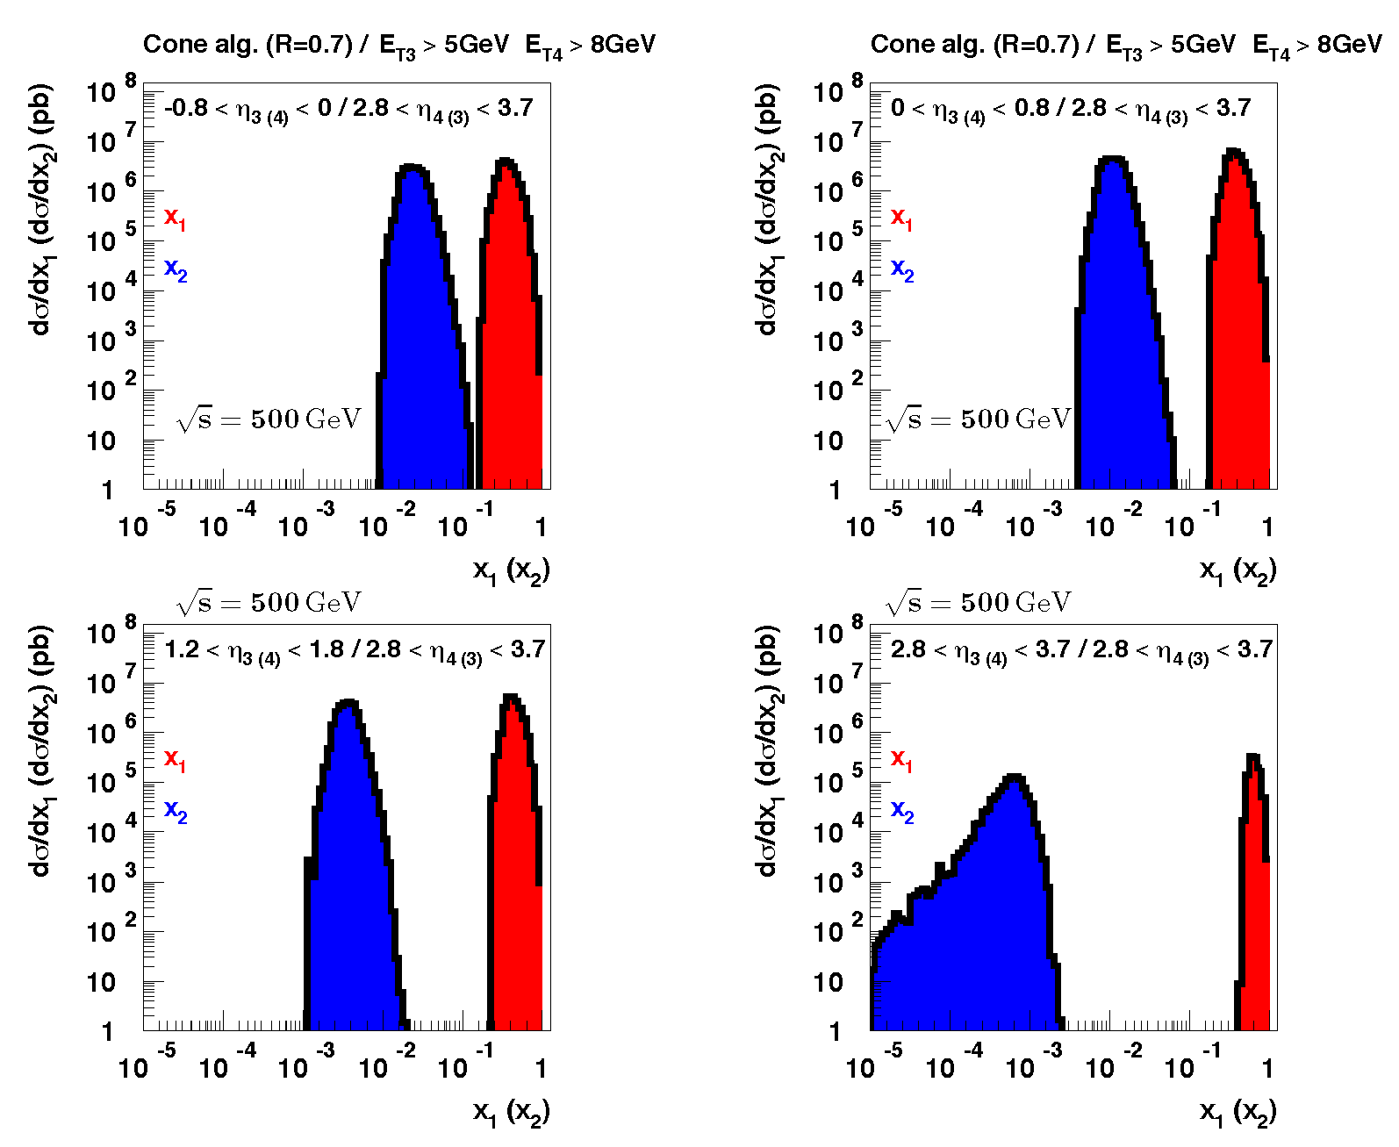
How polarized are the Gluons?
Data till 2009
DIS +
RHIC ≤2009
only way
to constrain low x
further
go forward
Di-Jets@2.5 < η < 4.0
DIS +
RHIC ≤2015
STAR and PHENIX
data till 2015
reduce uncertainties
at x ~ 10⁻³ by factor 2

Slide 17
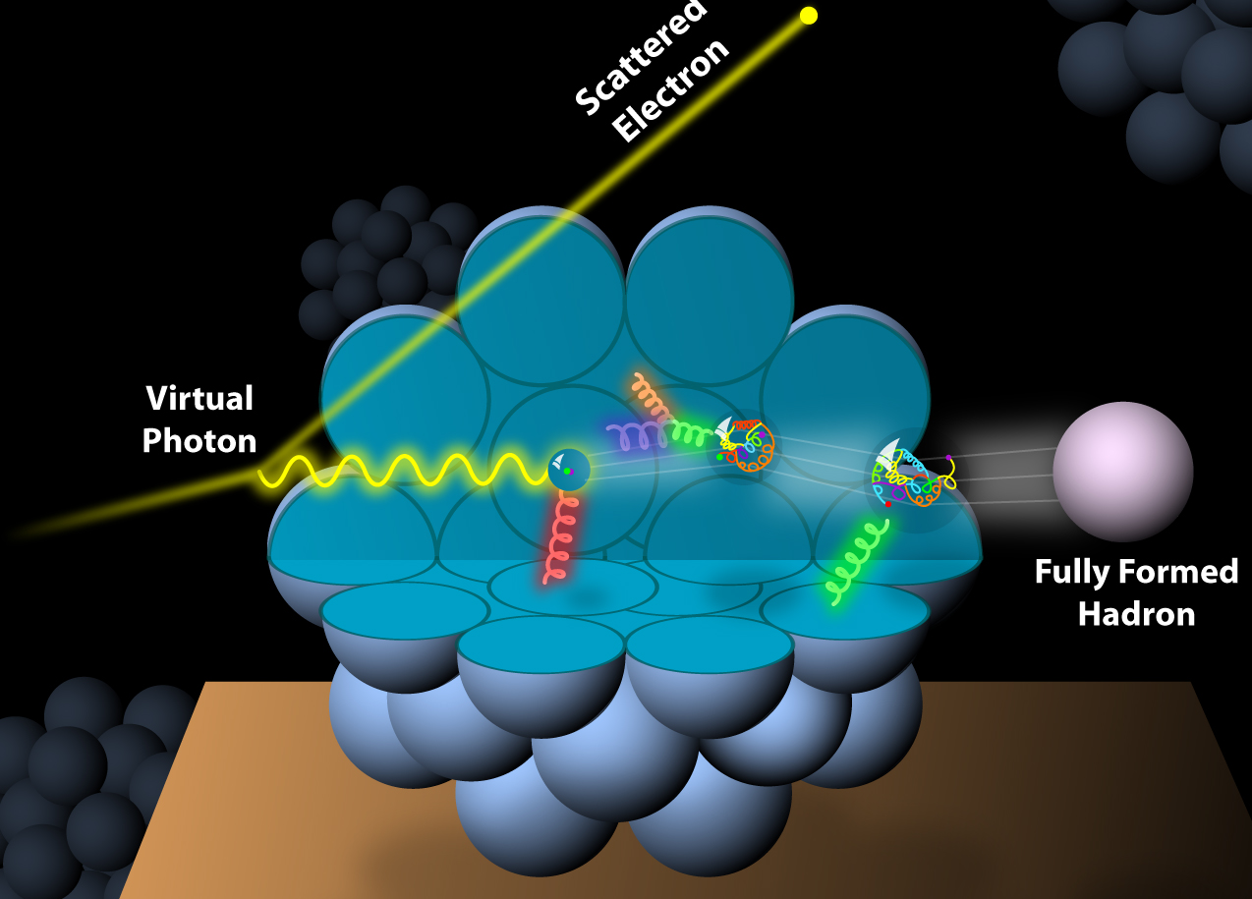
What about Nuclei?
Incoming
Electron Beam

Slide 18
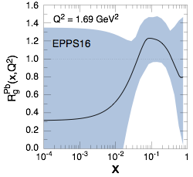
How Does The initial state IN AA Look?
3 conundrums of the initial state:
What are the nPDFs at low-x?
How saturated is the initial state of the nucleus?
What is the spatial transverse distributions
of nucleons and gluons?
  How much does the spatial distribution
fluctuate? Lumpiness, hot-spots etc.
Current knowledge including
first LHC pA data
pA@RHIC: unique kinematics
can measure nPDF in a x-Q² region
where nuclear effects are large
  Q² > Q_{s}² over a wide range in x
Observables free of final state effects
  Gluons: R_{pA} for direct photons
  Sea-quarks: R_{pA} for DY
Scan A-dependence prediction by
saturation models
can access saturation regime at
forward rapidities
RHIC pA y≤4
direct photon
2.8 < η < 3.8
Saturation

Slide 19
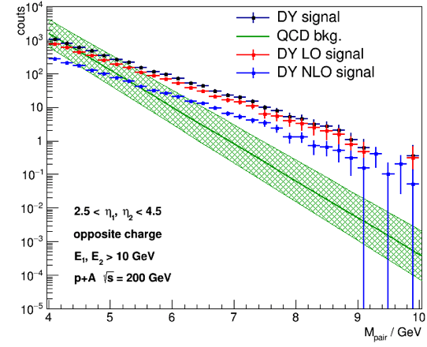
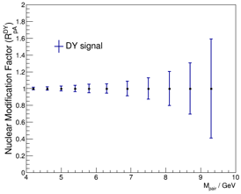
How Does The initial state IN AA Look?
pA: DY@2.5 < h < 4.5
pA: Direct Photon@2.5 < h < 4.5
Uncertainties:
2015 + 2023 pp&pA
direct photon:
Q²: ~p_{t}²
Q²>5 GeV²
Impact on nPDFs: → sea quarks
Impact on nPDFs: → gluons
Both DY and direct photon R_{pA} give significant constraints on nPDF
alternative observables and kinematics to EIC
DY:
Q²: ~M²
Q²>16 GeV²
Uncertainties:
2023 pp & pA

Slide 20


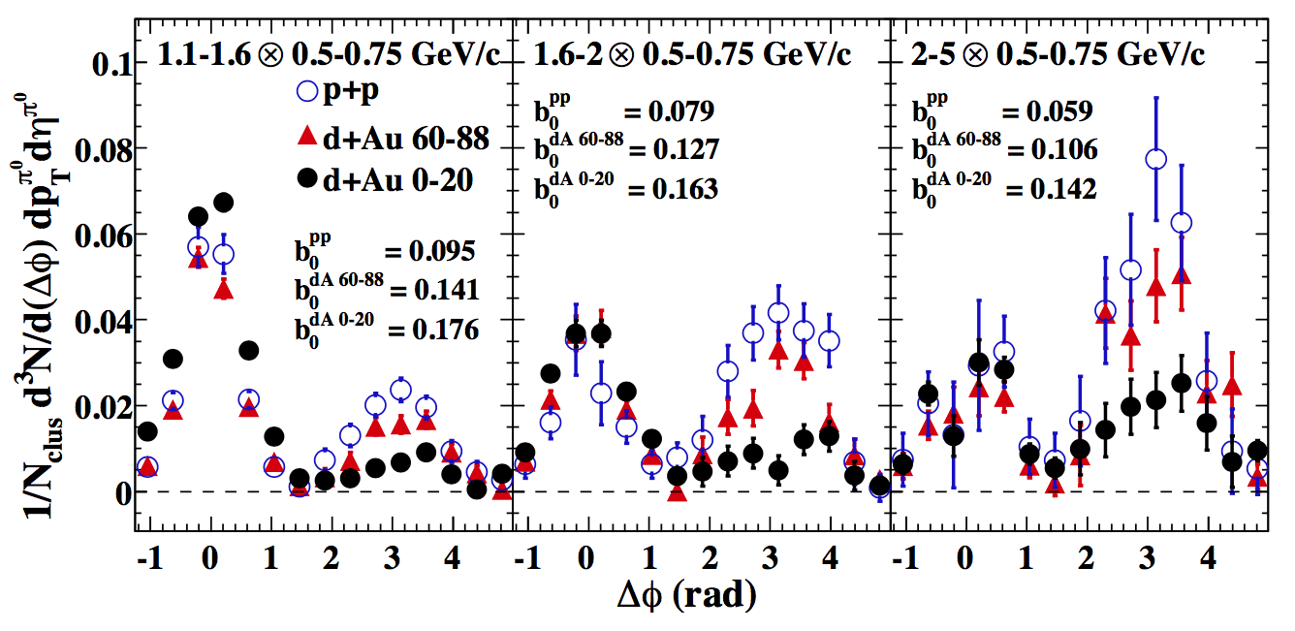
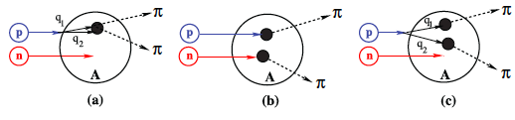
Key Observable for Saturation in pA
small x
Bremsstrahlung
~ s_{s}ln(1/x)
pQCD 2→2 process = back-to-back di-jet
Forward jet
p
p
Away side jet
Phys. Rev. Lett. 107, 172301 (2011)
With high gluon density
2→1 (or 2→many) process = Mono-jet
Recombination
~ s_{s}r
p/d
dilute
parton
system
Au
dense gluon field
CGC predicts suppression of back-to-back correlation
dA: alternative explanation through double interactions

Slide 21
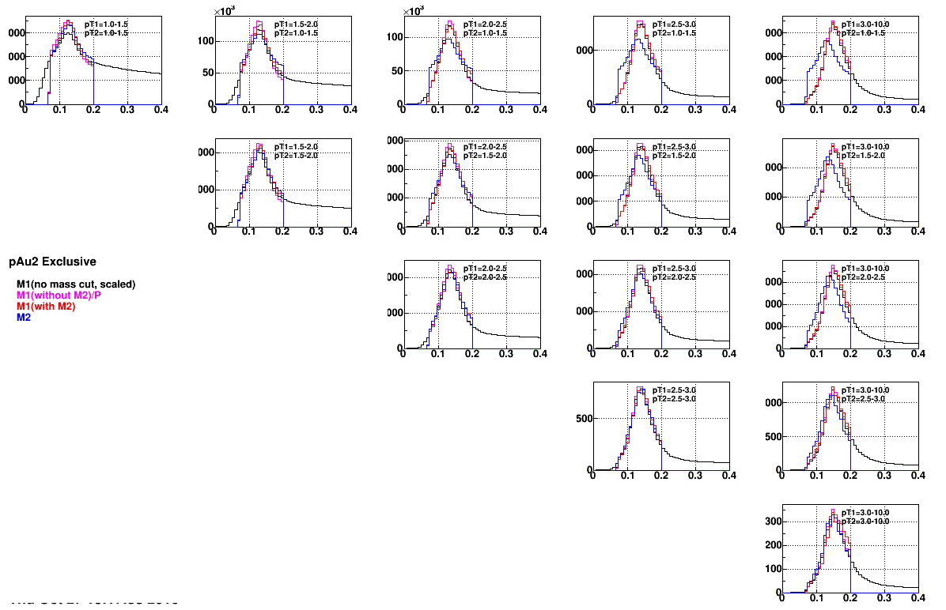
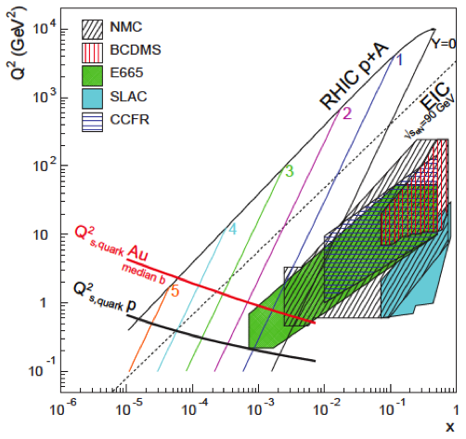
Key Observable for Saturation in pA
2015 Di-hadron correlations: scanning in x → study the evolution of Q_{s}² in x
Scan A-dependence: pAu and pAl → study the evolution of Q_{s}²(x) with A
Resolve ambiguity what causes the suppression in dAu
p_{T}^{trig}
1 GeV
>3 GeV
1 GeV
p_{T}^{assoc}
m^{trig}_{NoCut, scaled}
m^{trig}_{scaled}
m^{trig}_{withAssoc}
m^{assoc}
>3 GeV

Slide 22
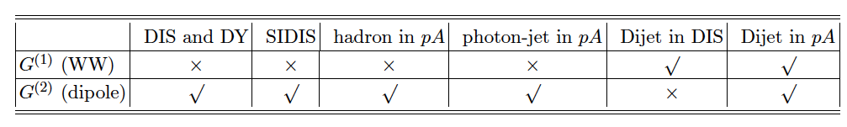
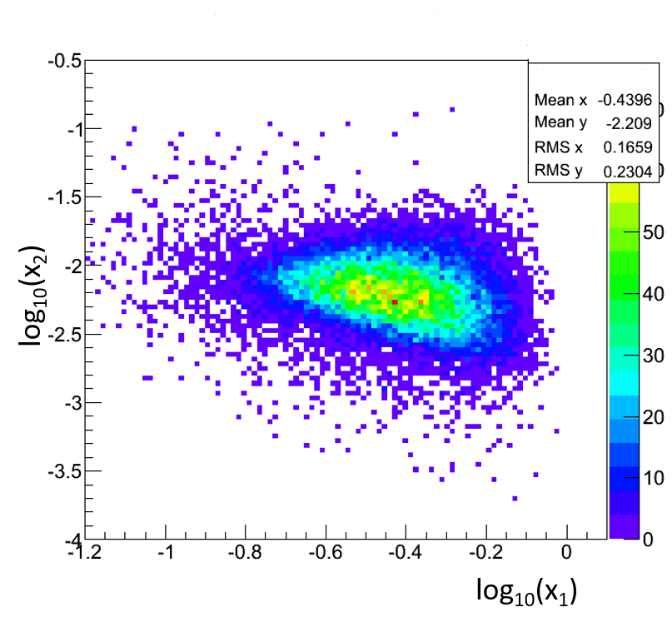
Saturation with the forward upgrade
Expand the number of observables:
rigorous test of theory predictions
get a handle on the different gluon distributions
provide variety of high precision data to test universality of CGC ←→ EIC
study of evolution/universality of Q_{s}² with A and x for different probes
arXiv:1101.0715
CGC prediction for
R_{pA} direct photon:
jet-hadron / jet photon correlations
→ 1M events with forward upgrade
in 2023 pAu and pAl

Slide 23
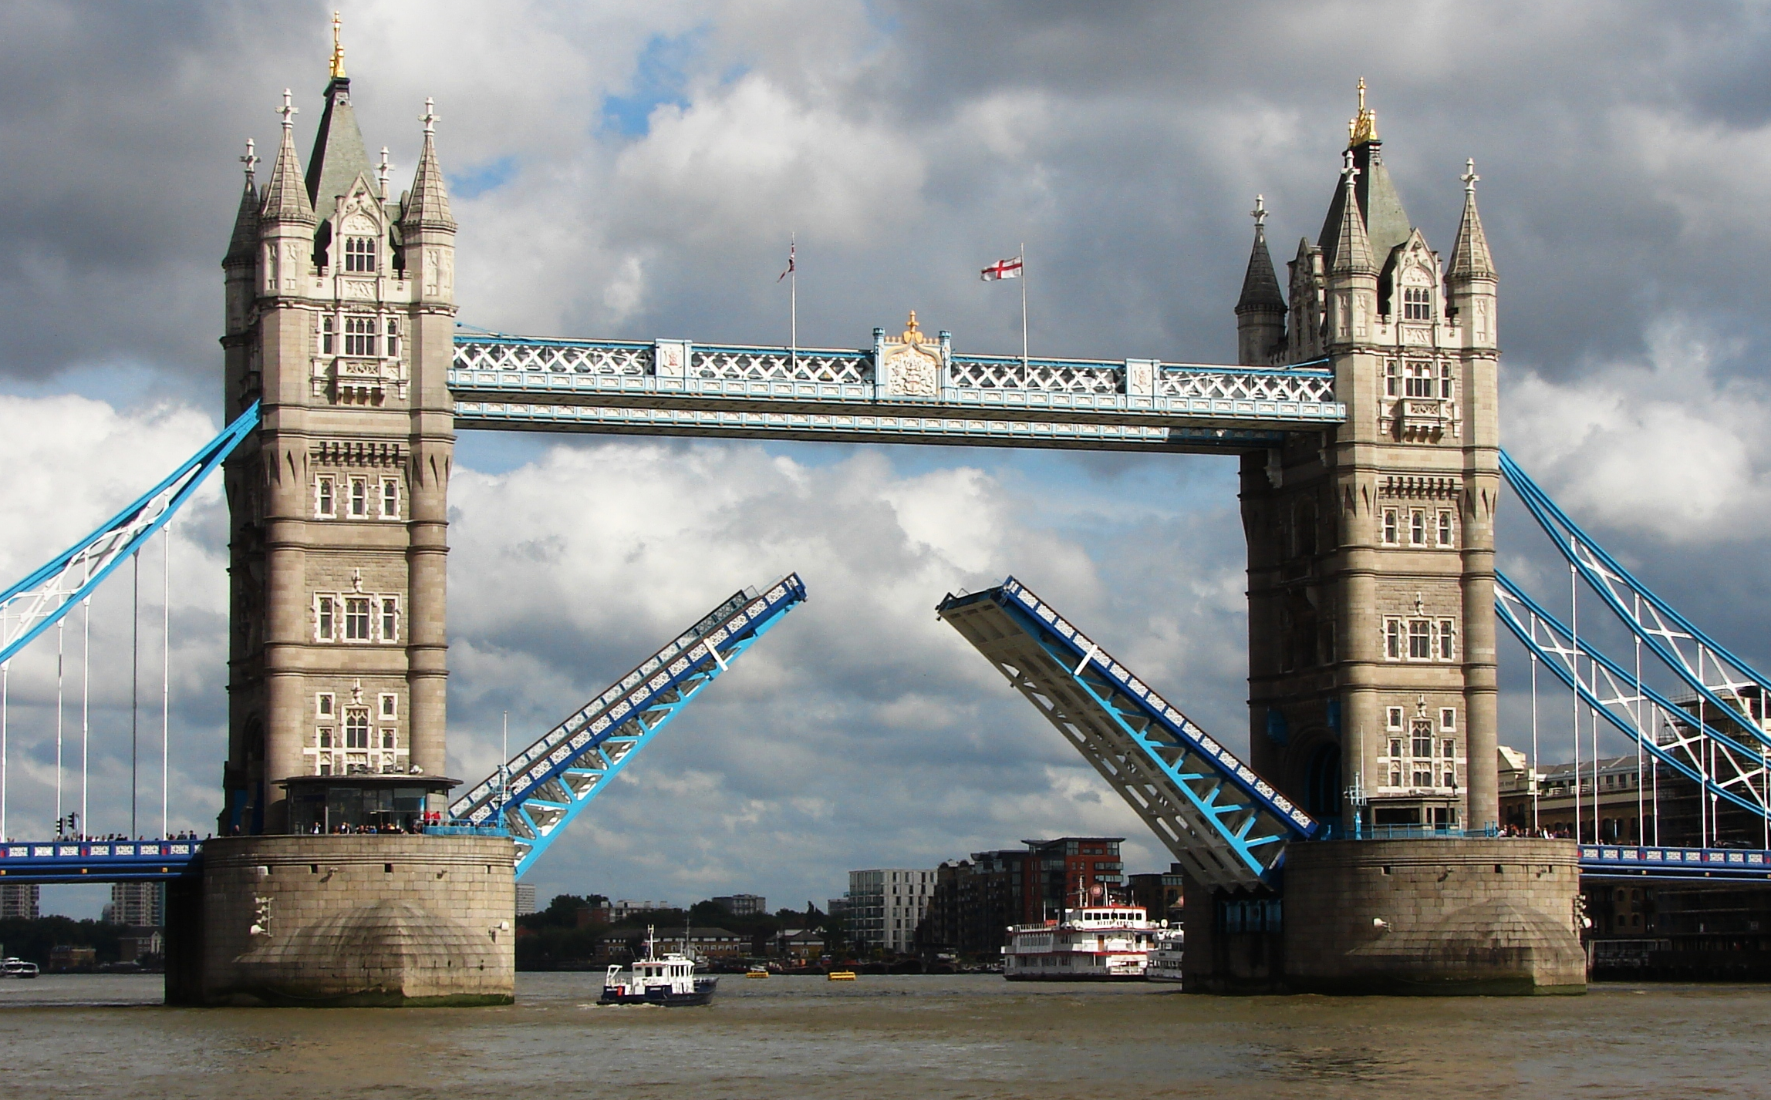
Summary
Unique STAR forward and midrapidity pp/pA/AA program addressing
several fundamental questions in QCD
The STAR cold QCD program gives the opportunity to do EIC physics
10 years earlier
STAR pp/pA
EIC
universality
factorization
evolution
inform EIC physics program
experimental requirements

Slide 24


Slide 25
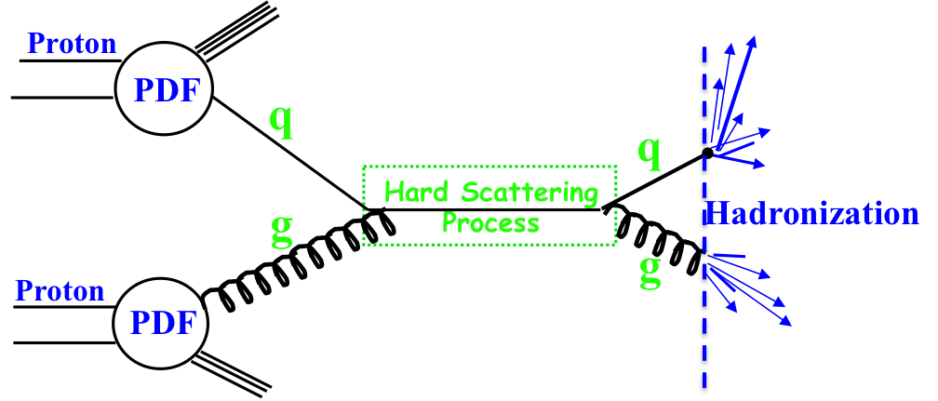
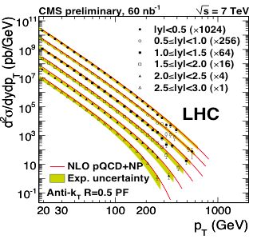

EIC’s Physics Impact, Complementarity and Uniqueness
Complementarity
QCD has two concepts which lay its foundation
factorization and universality
To tests these concepts and separate interaction dependent phenomena from
intrinsic nuclear properties
different complementary probes are critical
Probes: high precision data from ep, pp, e+e-
Factorization
Universality
Example: Measure PDFs at HERA at √s=0.3 TeV:
Predict pp and measurements at √s=0.2, 1.96 & 7 TeV
$$p\overline{p}$$
(un)polarized cross section ~
PDF ⊗ hard-scattering ⊗ Hadronization
hard-scattering : calculable in QCD
PDFs and Hadronization: need to be determined experimentaly
Notes:
start from intrinsic part can separate inteaction by universality
real time phenomena

Slide 26
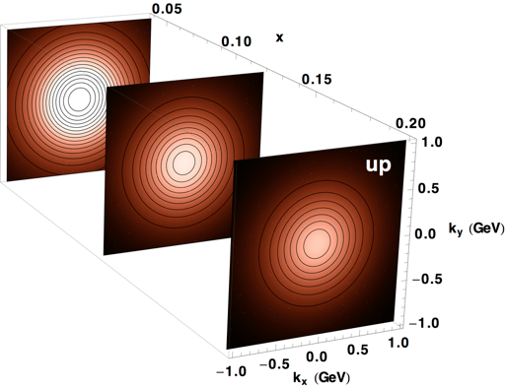
Golden Observables
Initial State
Final State
SIVERS/Twist-3
Collins Mechanism
asymmetry in jet fragmentation
  p^{+/-}p⁰ azimuthal distribution in jets
  Interference fragmentation function
A_{N} for pions
→ Novel Twist-3 FF Mechanisms
A_{N} for heavy flavour → gluon
A_{N} for W^{+/-}, Z⁰, DY
A_{N} for jets, direct photons
related through
related through
Probes correlations of proton spin to parton transverse motion
Probes transversity x spin-dependent FF
Collins function: unpolarized hadron from a transversely polarized quark

Slide 27
TMDs at STAR
Unique Opportunities:
constrains TMD evolution
are TMDs relevant in the gluon and sea-quark dominated regime?
high precision data sets to test QCD concepts of factorization and universality
→ answers critical to have a optimal TMD program at EIC
Goals:
Increase statistics for A_{N} DY from 2017
→ TMD evolution world best constrain ← → A_{N}(W^{+/-} Z⁰)
→ Sivers sign change
Unravel the mystery what is the underlying process of A_{N}
→ measure A_{N} for p^{+/-}
→ clear prediction of importance of special Collins like FF
flavor tagging of the Twist-3 equivalent of the Sivers fct.
→ Observable h^{+/-} with z > 0.5 in jet

Slide 28
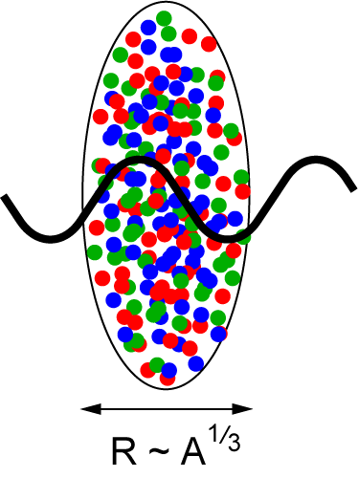
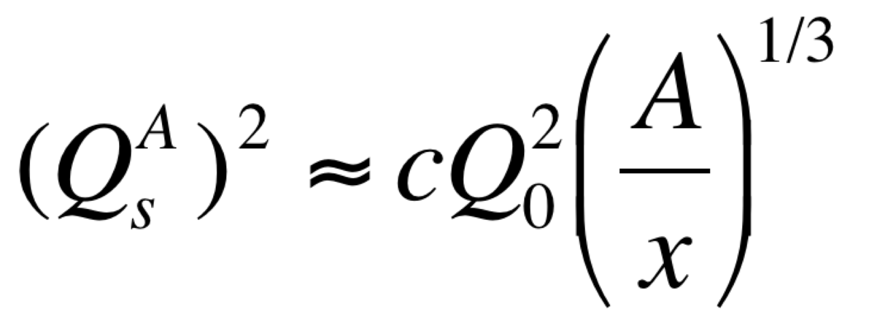
Studying non-linear effects
Scattering of electrons off nuclei:
Probes interact over distances L ~ (2m_{N} x)⁻¹
For L > 2 R_{A} ~ A^{1/3} probe cannot distinguish between nucleons in front or back of nucleon
Probe interacts coherently with all nucleons
Nuclear “Oomph” Factor
Pocket Formula:
Enhancement of Q_{S} with A ⇒ non-linear QCD regime reached at significantly lower energy in A than in proton

Slide 29
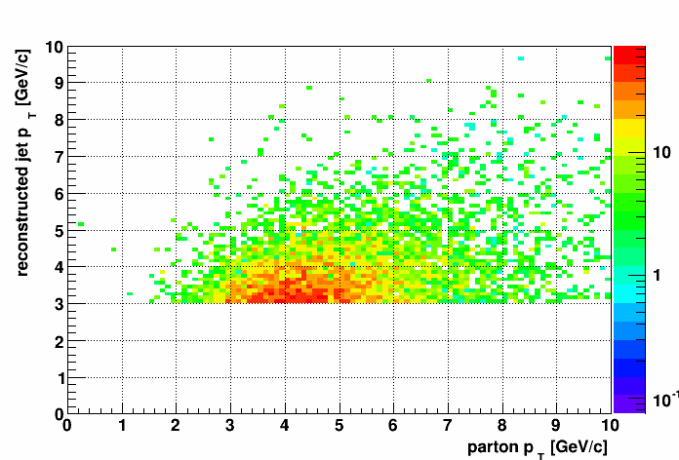
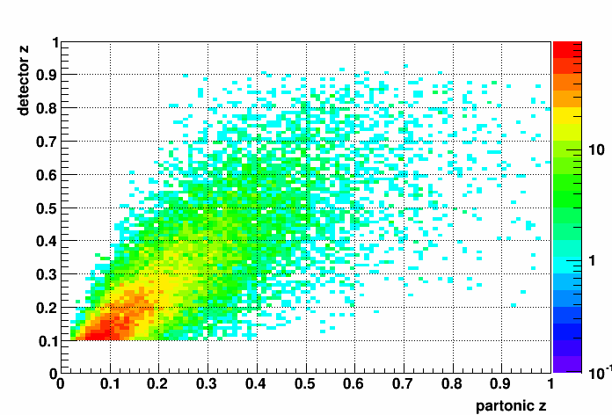
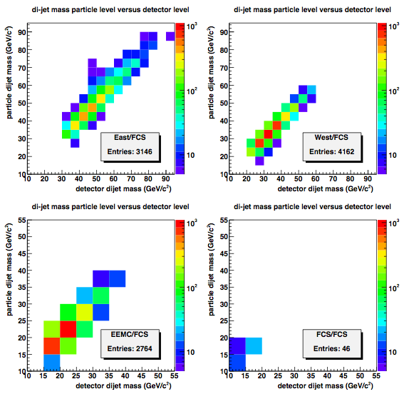
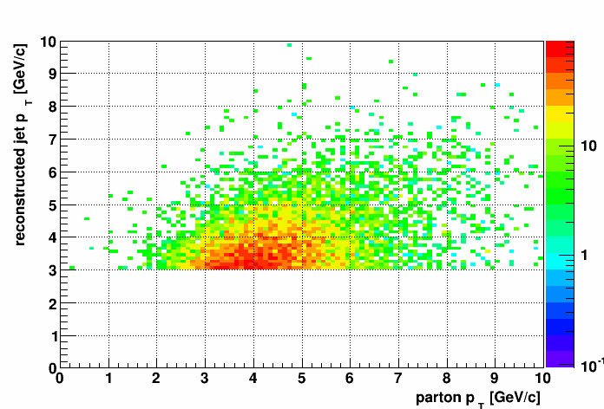
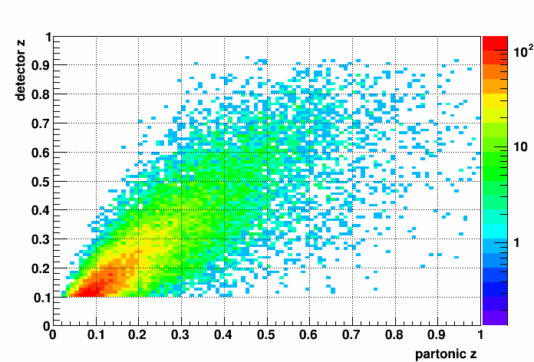
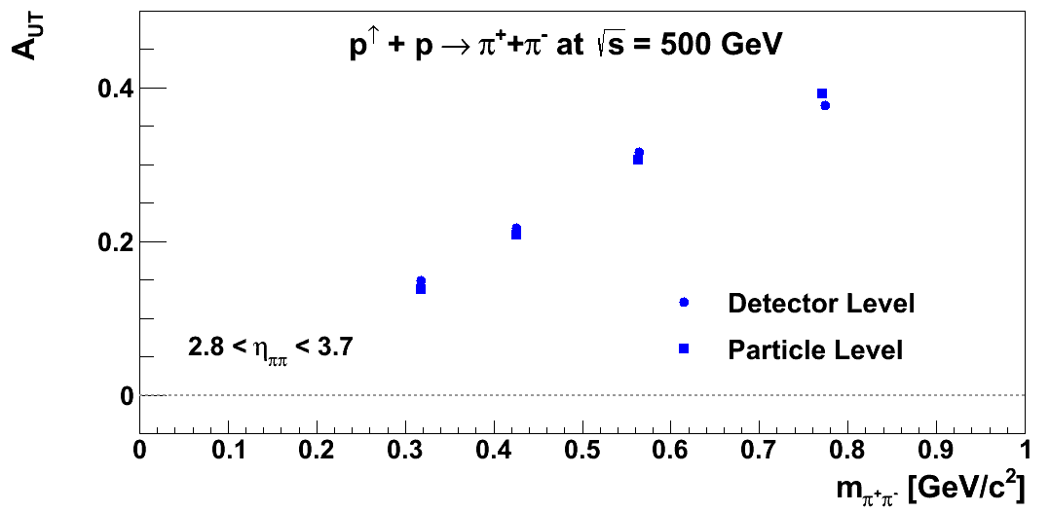
STAR Forward upgrade performance
Transverse momentum smearing for reconstructed
jets compared to that of the associated parton.
The upper figure shows the smearing for jets
with 2<h<3 and the lower for those with 3<h<4.
Smearing of z, the fractional momentum of
the outgoing parton/jet carried by the outgoing
hadron. The upper figure shows the smearing
for jets with 2<h<3 and the lower figure for
jets with 3<h<4.

Slide 30
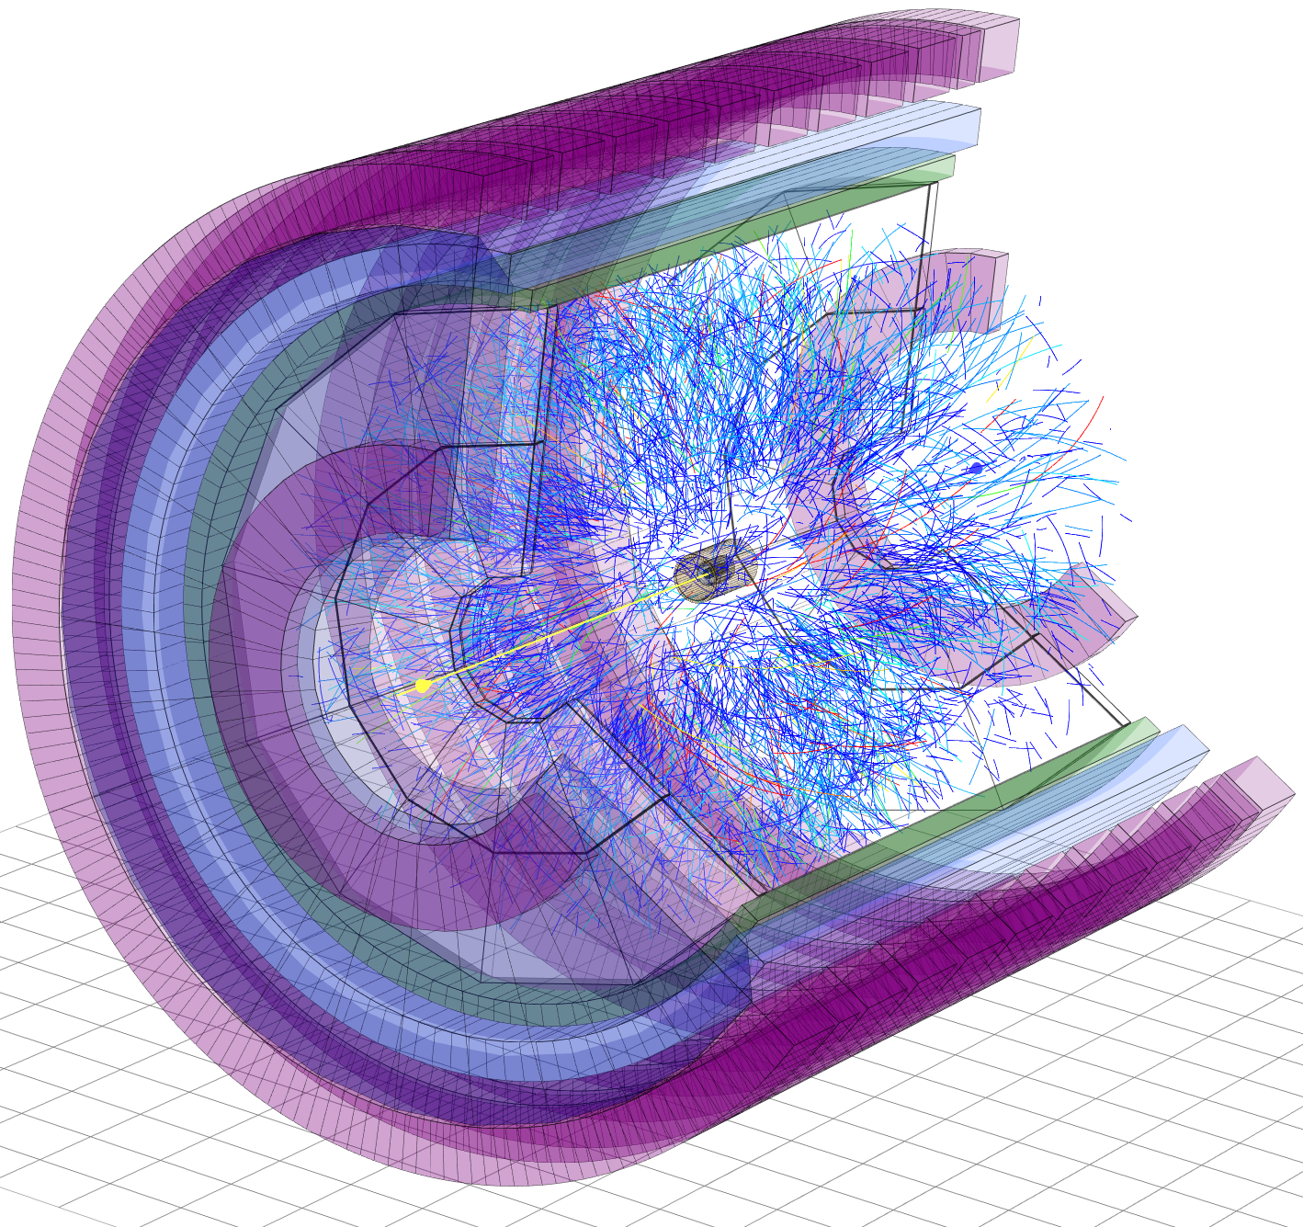
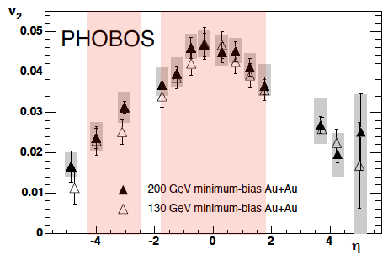
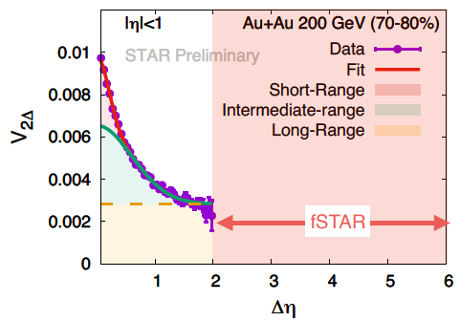
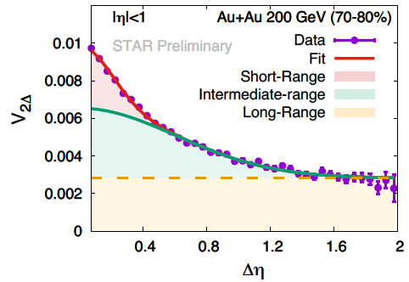
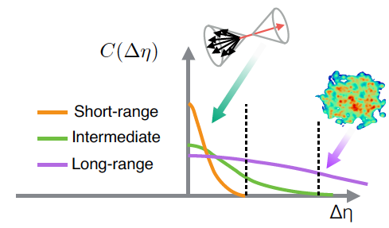
Forward physics in A+A collisions
Goal : Measurements of global observables in heavy ion collisions over wide range
of rapidity at RHIC
Constraining longitudinal structure of the initial stages of HICs
Constraining the temperature dependence profile of transport parameters
η
Till today:
Sparse RHIC data for higher order flow harmonics (v₃, v₄, v₅) &
rapidity density correlations/fluctuations
Phys Rev C 72, 051901(R) (2005)
Why do we need wider
window in rapidity?
Flow like correlations are
early time long-range → large Dh
Background comes from Jets & non-flow
→ small Dh
Precise extraction of flow (azimuthal correlations)
requires measurements over wide window of rapidity
iTPC
fSTAR

Slide 31
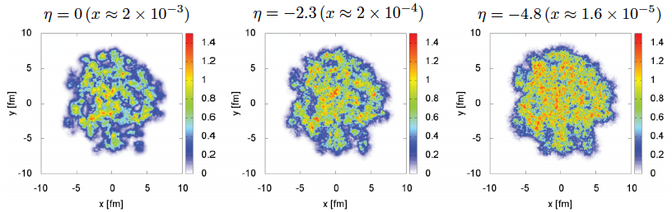
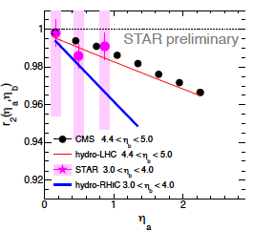
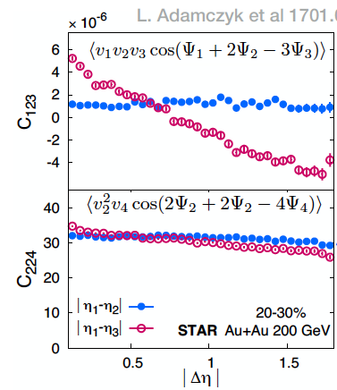



Forward physics in A+A collisions
Long-range two particle correlations are of great interest → ridge in small systems
Rapidity ←→ x
Rapidity evolutions → predictions of non-linear regime of High energy QCD effective theory (CGC)
LHC data provide constrains for BK,
JIMWLK, RHIC data will provide test
Schenke, Schlichting 1605.07158
Stronger
De-correlation
predicted at
RHIC than LHC
Observables:
L. Adamczyk et al 1701.06497
Measurement from STAR
with existing detectors :
Hint of longitudinal
de-correlations
Wider Δη can probe this
in more details

Slide 32

Summary of forward AA measurements
New Possibility: Global Lambda Polarization → hopefully many more will come
Can reconstruct Lambda in pp
Need to see we can reconstruct
Lambdas in AuAu
Might impact requirements on
tracking detectors

