Slide 1
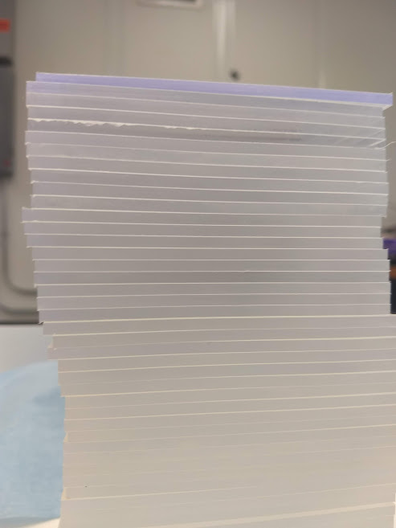
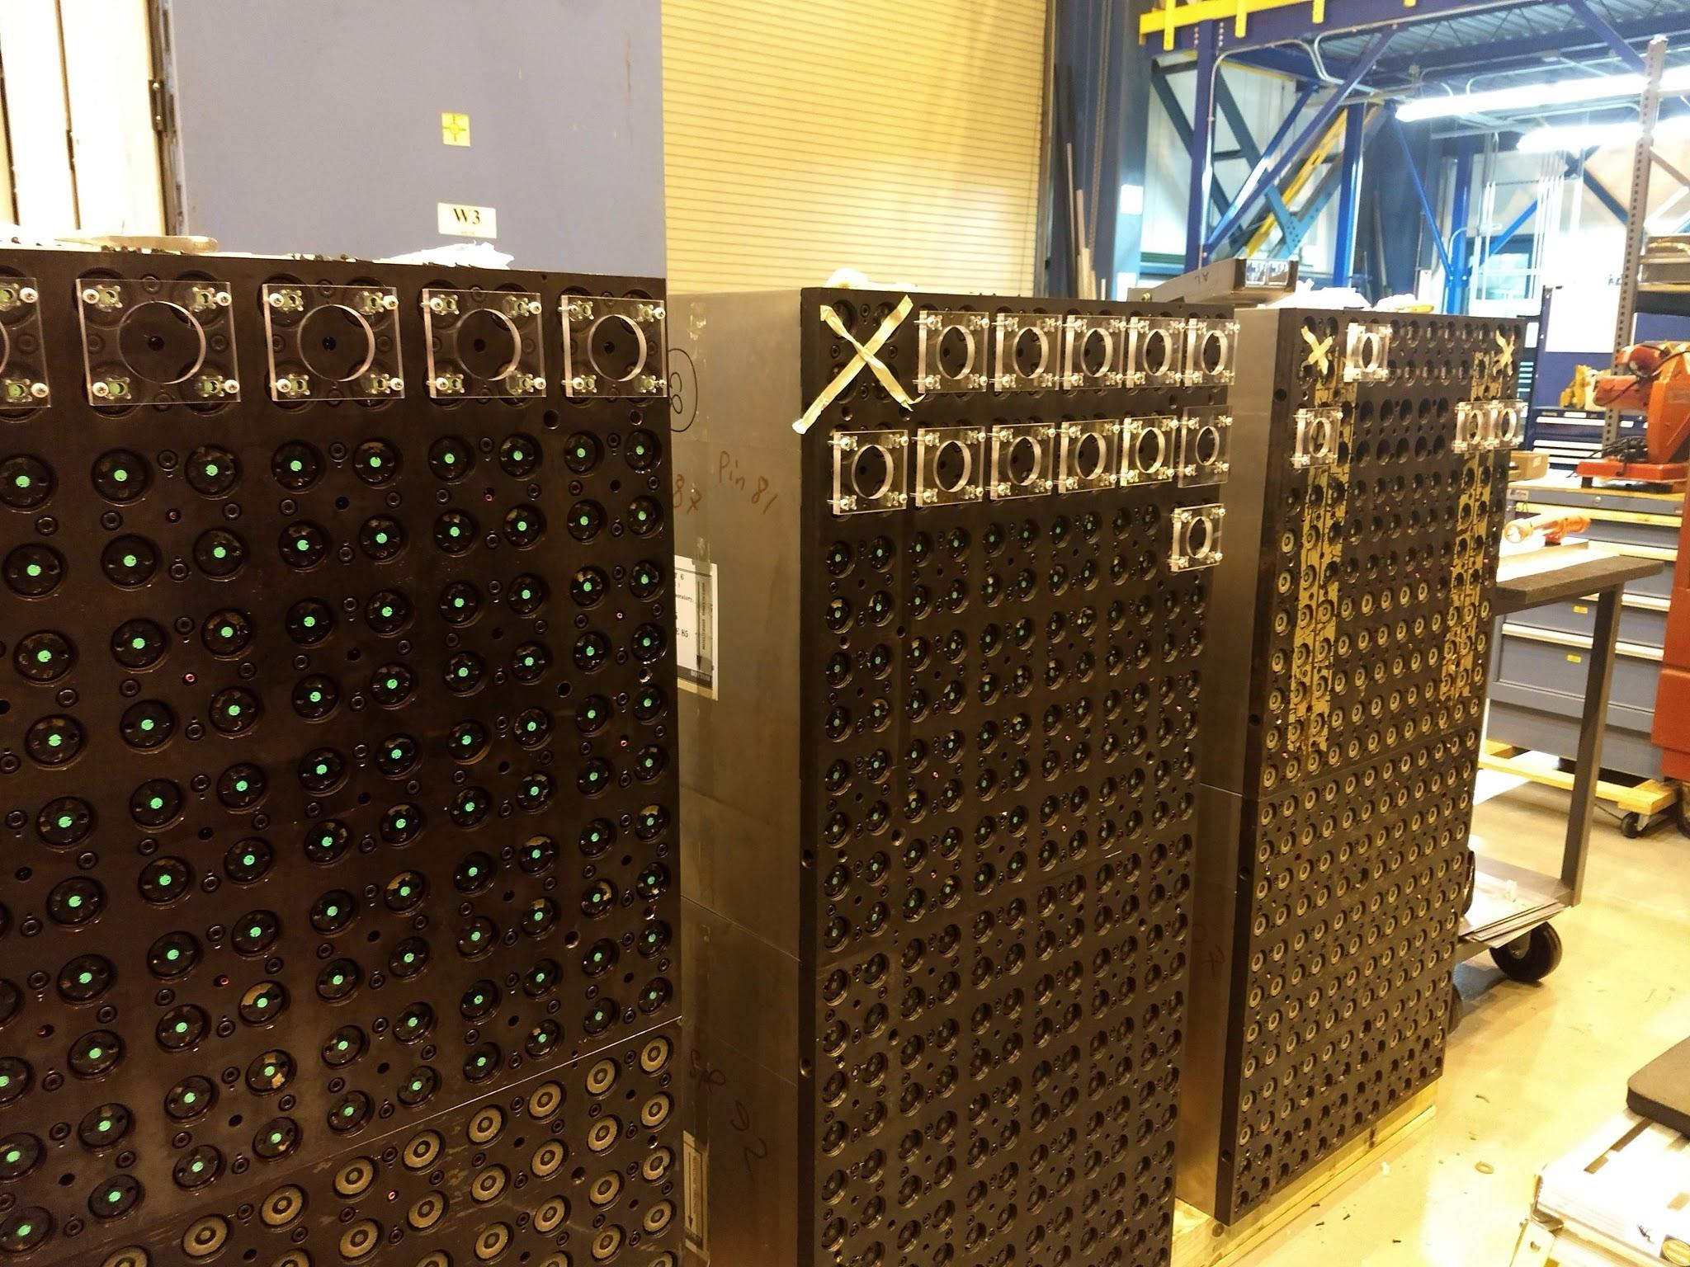
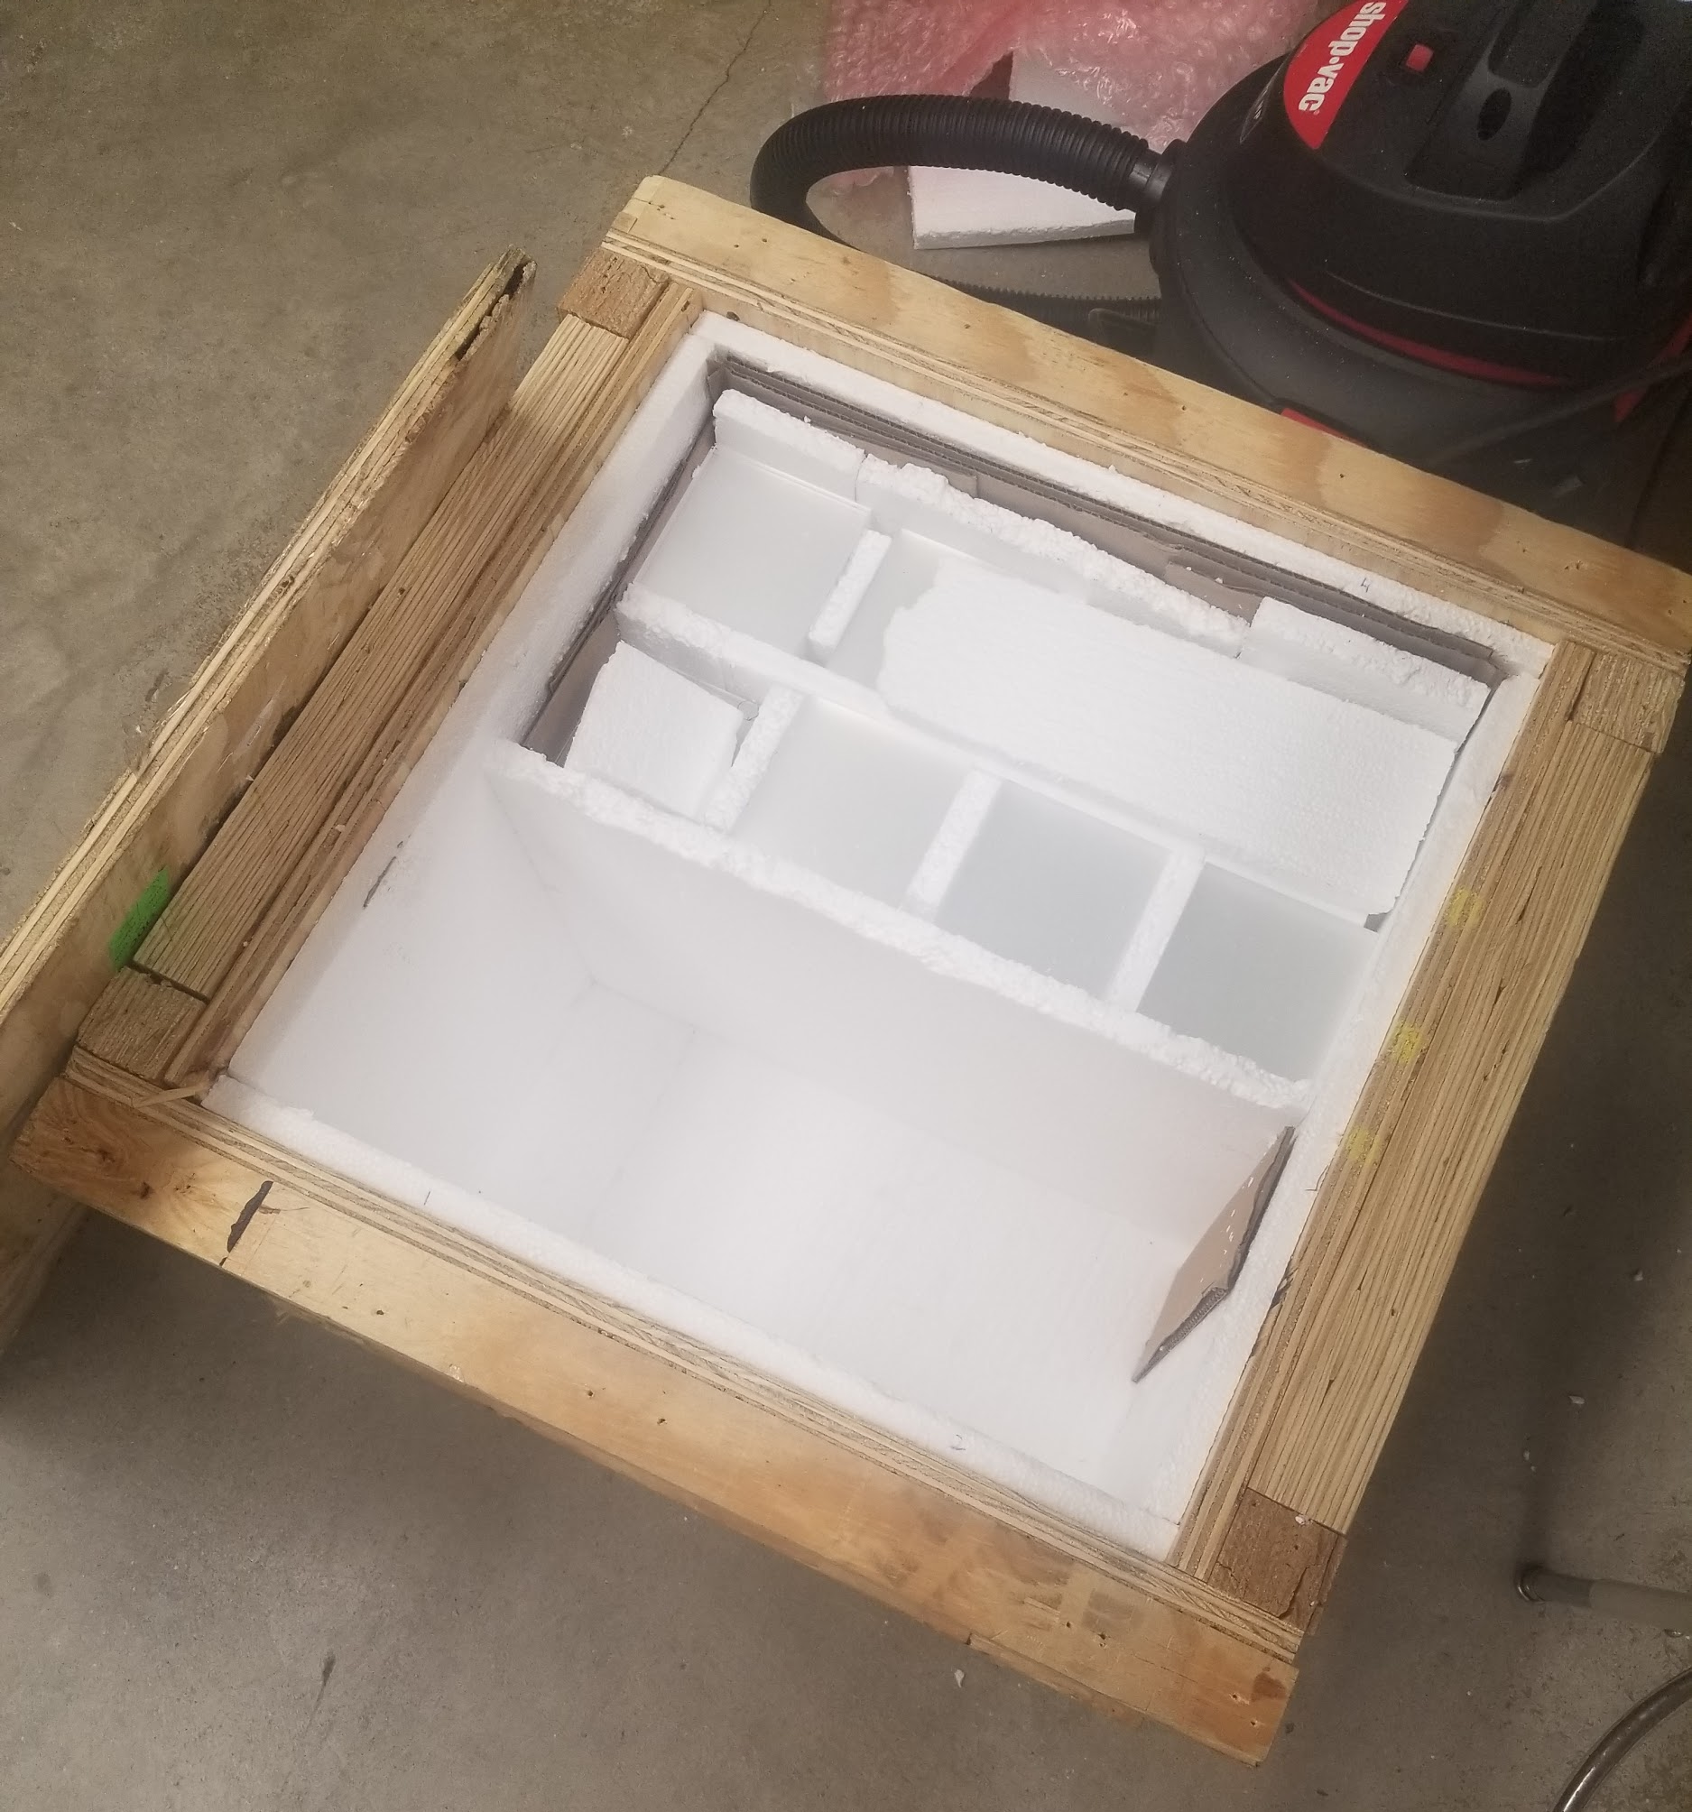
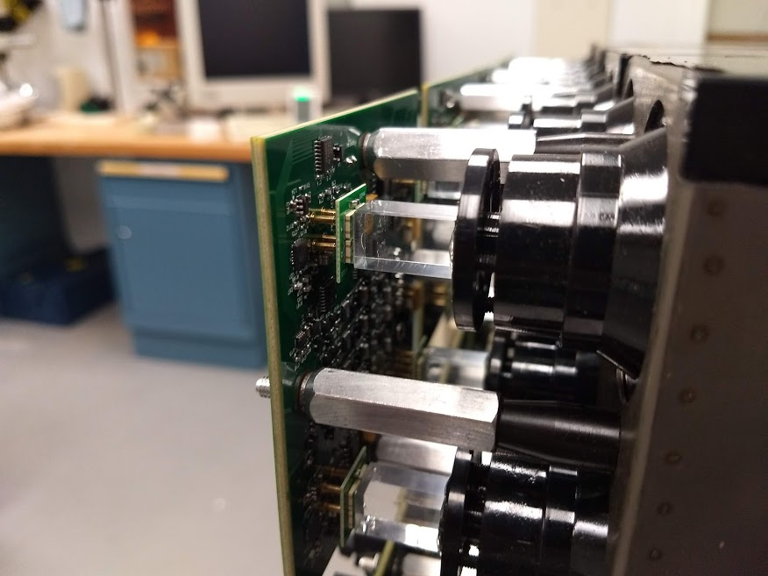
Preparing the HCal for the Forward Calorimeter System Upgrade
Anand Agrawal, William Bakke, Michael Bukowski, Claire Kovarik, JD Snaidauf
Mentors: Prof. Stanislaus, Prof. Gibson, Prof. Grosnick, Prof. Koetke
Department of Physics and Astronomy, Valparaiso University
for the STAR Collaboration
Supported in part by:
Why a STAR Forward Upgrade
How does the HCAL work
The Solenoidal Tracker at RHIC (STAR) Forward Upgrade is designed to explore QCD at low regions of x, where x is the parton momentum fraction. The upgrade includes tracking detectors and calorimetry; this poster focuses on the calorimetry.
The Forward Calorimeter System (FCS) is replacing the Forward Meson Spectrometer (FMS). The FMS was an electromagnetic calorimeter, mainly detecting photons, including those from π⁰ decays.
The new FCS will provide both electromagnetic (ECal) and hadronic (HCal) calorimetry that are critical for various physics programs.
For example, di-jet reconstruction with the FCS will provide insight into the gluon contribution to the spin of the proton,ΔG.
The proposed FCS system will have very good (~10%√ (E)) electromagnetic and (~50%/√ (E)+10%) hadronic energy resolutions.
The HCal is made of alternating pieces of iron and scintillator forming a “tower”.
The gap between two iron absorber plates is 3.1 mm. Scintillation tiles of thickness 1.4 mm are placed inside these gaps.
There are 63 absorber plates and 64 scintillation plates in a single HCal tower.
Scintillation light from a single tower is collected with a 3 mm thick wavelength shifting (WLS) plate, which is placed in the gap between two adjacent HCal towers.
Figure: HCal scintillation tiles (97 x 95 x 1.4mm) convert energy from charged particles into light. Iron absorbers are placed between the scintillators to develop the hadronic shower.
Figure:
Fe-scintillator sandwich structure of the HCal.
The Forward Calorimeter System
The FCS will replace the FMS in the forward region of the detector (2.5<𝜂<4.0), allowing for reconstruction of a broader range of particles, π⁰, e^{+/-}, γ, charged hadrons and jets. The ECal ($0.41M) will be located in front of the HCal ($1.56M). The half of the 18720 scintillating tiles needed for the HCAL were completed at VU and delivered to STAR.
Work Done at Valparaiso University
The work at VU this summer (and extending into the fall) involved five students polishing, painting, and packing 9600 rectangular scintillation tiles for the HCal.
Polishing Procedure: Place 7-10 tiles, longer-edge down, onto the rotating polishing machine for 30 seconds while applying some pressure. Then, rotate the tiles 180º and polish the opposite edge, repeat the procedure several times.
Cleaning and Painting Procedure: Tiles are wiped dry with a cloth towel, removing any leftover polishing compound on the surface. Once 150 to 200 tiles are polished, we group them in sets of 20, painting the shorter edges twice, one initial coat and then a second coat usually two hours after the first.
Removing Plastic Film and Packing Procedure: Once the paint is dry, one can begin removing the protective plastic film with a sharp object and placing the tiles in an uline-poly bag. They can then be placed in the shipping crate.
Figure: Forward region of the STAR detector. The ECal is placed in front of the HCal. Cost was paid via an NSF MRI grant.
ECal Overview
PHENIX ECal became available for use in 2016 so STAR chose to use
ECal is alternating layers of lead and scintillator configuration with new Electronics.
Figure:
ECal modules from PHENIX
FEE
Card
Figure: ECal electronics: Silicon photomultipliers (SiPM’s) are solid state photomultipliers that convert light to electronic signals (also used for the HCal). The Front End Electronics (FEE) cards read out the SiPM signals. The light guides optimize the connection to the SiPM readout while the fiber bundle directs light from the tower into the light guide.
SiPM
Light guide
The polishing machine that is used to polish the edges of the scintillation tiles.
The protective film on the tiles needs to be removed and excess paint has to be chipped off before the tiles can be shipped (left). The tiles are placed in special uline-poly bags (right).
Crate of tiles received from OSU. Once the tiles are prepared, they are packed in the same crate for shipping to BNL.
Fiber Bundle

