Slide 1



STAR Forward Upgrade
Ming Shao (for STAR Collaboration)
USTC/BNL

Slide 2
Outline
Introduction
Selected STAR measurements in a long-term RHIC operation
Forward upgrade at STAR
Summary

Slide 3
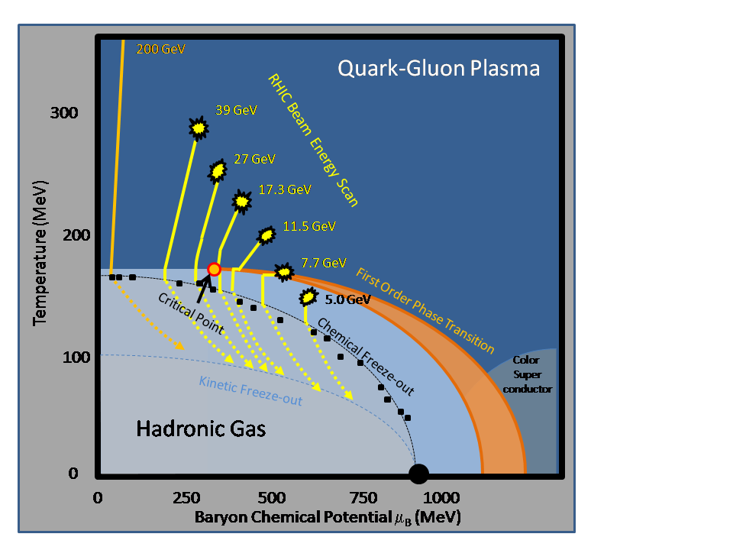
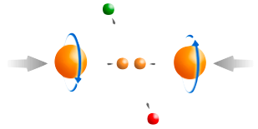
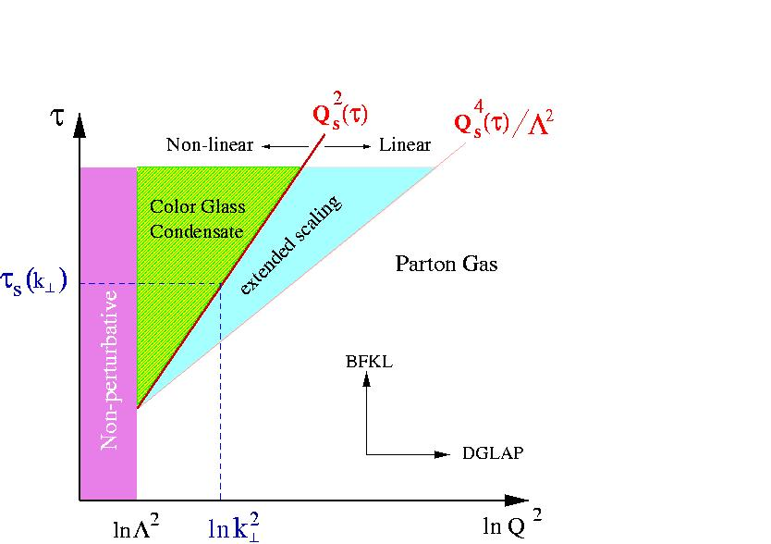
RHIC: eight key unanswered questions
Hot QCD Matter
Partonic structure
6: Spin structure of the nucleon
7: How to go beyond leading twist
and collinear factorization?
1: Properties of the sQGP
2: Mechanism of energy loss:
weak or strong coupling?
3: Is there a critical point, and if so, where?
4: Novel symmetry properties
5: Exotic particles
8: What are the properties of
cold nuclear matter?

Slide 4
Summary of the STAR decadal plan
 | Near term (Runs 11-13) | Mid-decade (Runs 14-16) | Long term (Runs 17– )
Colliding systems | p+p, A+A | p+p, A+A | p+p, p+A, A+A, e+p, e+A
Upgrades | FGT, FHC, RP, DAQ10K, Trigger | HFT, MTD, Trigger | Forward Instrum, eSTAR, Trigger
(1) Properties of sQGP | Υ, J/ψ → ee, m_{ee}, v₂ | Υ, J/ψ → μμ, Charm v₂, R_{CP}, corr, Λ_{c}/D ratio, μ-atoms | p+A comparison
(2) Mechanism of energy loss | Jets, γ-jet, NPE | Charm, Bottom | Jets in CNM, SIDIS, c/b in CNM
(3) QCD critical point | Fluctuations, correlations, particle ratios | Focused study of critical point region
(4) Novel symmetries | Azimuthal corr, spectral function | e-μ corr, μ-μ corr
(5) Exotic particles | Heavy anti-matter, glueballs
(6) Proton spin structure | W A_{L}, jet and di-jet A_{LL}, intra-jet corr, (Λ+Λ) D_{LL}/D_{TT} |  | Λ_bar D_{LL}/D_{TT}, polarized DIS & SIDIS
(7) QCD beyond collinear fact. | Forward A_{N} |  | Drell-Yan, F-F corr, polarized SIDIS
(8) Properties of initial state |  |  | Charm corr, Drell-Yan, J/ψ, F-F corr, Λ, DIS, SIDIS
Detector Upgrade driven schedule
Measurements listed when they first become possible
Many will continue in future periods
Notes:
The state-of-the-art nuclear PDFs suffer from large uncertainties in
the gluon density functions in the range relevant at RHIC energies. Further constraints from
p+A measurements are mandatory to improve the gluon PDFs, so that hard probes can be
used as benchmark cross sections against which the signals and properties of the QGP can
be extracted. Therefore, it is of extreme importance that the applicability of factorization be
tested in p+A interactions.

Slide 5
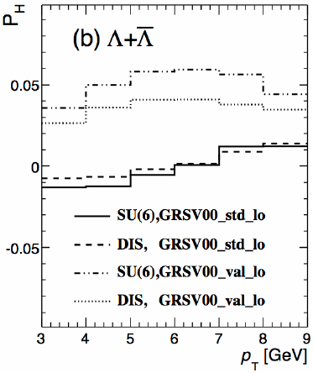
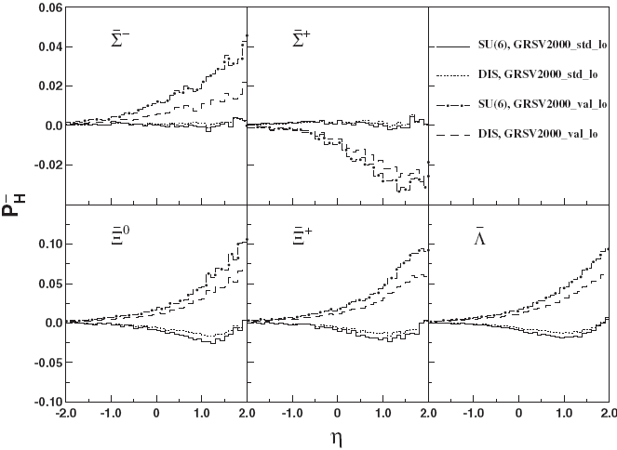
Future D_{LL} measurement
Lambda Spin Transfer
2.5 < η < 3.5
ΔD model
ΔS(x) model
Phys. Rev. D78 (2008), 054007
Phys. Rev. D81 (2010), 057501
Sensitive to the parton helicity distributions and to polarized fragmentation
Better sensitivity at forward
Anti-Lambda more sensitive to parton helicity distributions
Transversity distribution can also be accessed by D_{TT}

Slide 6
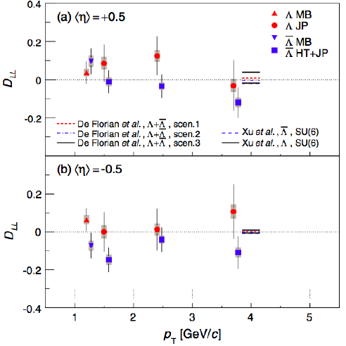
D_{LL} at mid-rapidity
• STAR has performed initial Λ D_{LL} measurements at mid-rapidity
– Provides access to strange quark helicity distribution
– Most interesting with quite high p_{T} Λ (trigger and stat limited)
• Similar measurements at forward rapidity are very promising
– Requires Forward Hadron Calorimeter upgrade
Phys. Rev. D 80, 111102 (R) (2009)
Forward hadron calorimeter to measure (anti-)neutron
Experimental challenging, baryon/meson identification needed
Notes:
2 pb−1 data
For RHIC, it has been suggested to study the transfer of longitudinal beam spin in the production
of hyperons [203]. Such measurements are sensitive to the parton helicity distributions and to
polarized fragmentation. Hyperons are rather abundantly produced at RHIC and their polarization
can in many cases be measured from the azimuthal distribution of the decay hadrons. It is
expected that the polarization of (¯) hyperons is carried predominatly by strange(anti-strange)
quarks [204]. Recent model calculations [205, 206] for and ¯ hyperon DLL indeed show the
expected sensitivity to differences in allowed fits of the strange quark and anti-quark distributions
to DIS data. In the case of the ¯, this sensitivity is found larger than the sensitivity to polarized
fragmentation.

Slide 7
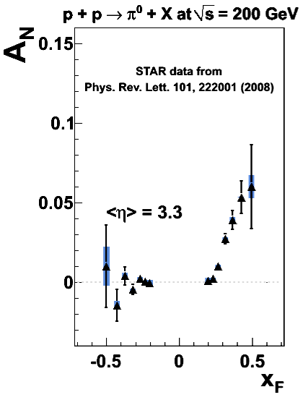
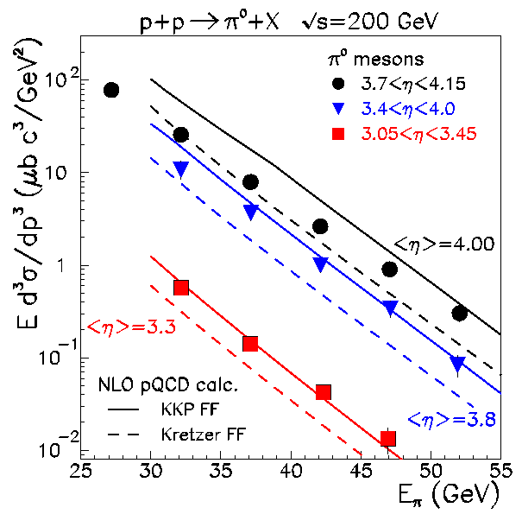
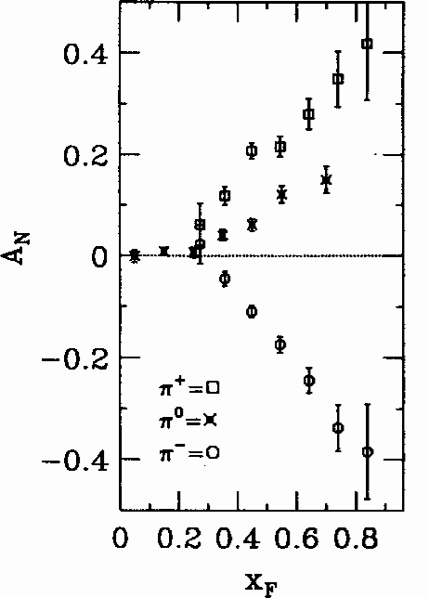
Transverse Single Spin Asymmetries
√s=19.4 GeV
E704
PLB 261, 201 (1991)
PRL 97, 152302
Large transverse spin asymmetries consistent over an order of magnitude in √s up to 200 GeV
Cross sections measured at forward rapidity at RHIC are reasonably described by pQCD
Proposed pQCD mechanisms for large A_{N}:
  Sivers Effect: parton orbital motion
  Collins Effect: transversity + fragmentation
Left
Right

Slide 8
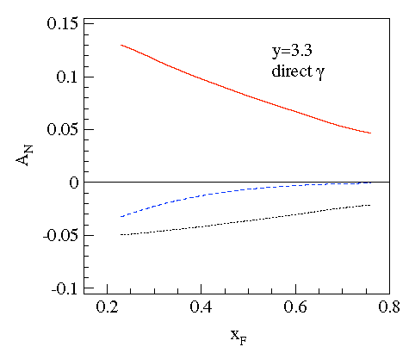
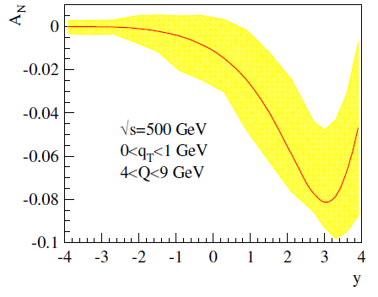
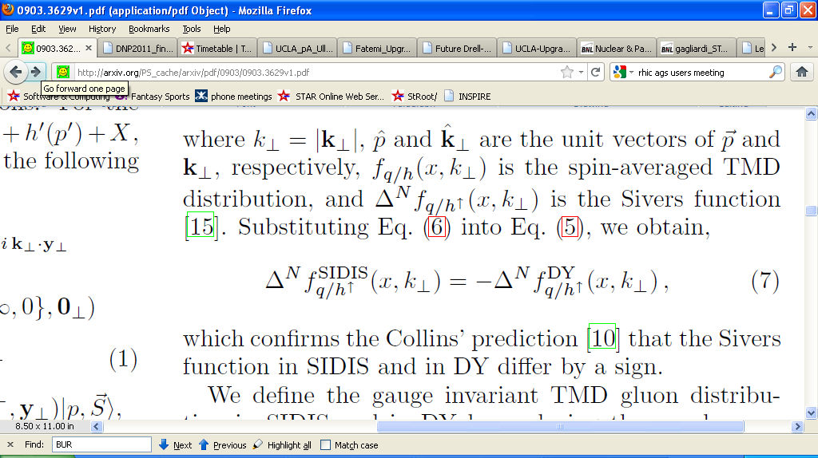
Future Transverse Measurements
Forward rapidity direct γ A_{N}
Drell-Yan A_{N}
Forward jets and correlations
Z-B. Kang et al, PRD 83, 094001
Extracted from
p+p↑ → π+X A_{N}
Extracted from SIDIS Sivers functions (“new” and “old”)
e/h, γ/π⁰ discrimination crucial, forward upgrade needed!
Sivers function measured in SIDIS vs DY expected to differ by a sign
Need DY results to verify the sign change: critical test of TMD approach
Full jet reconstruction
Notes:
STAR will be testing predictions that the single photon AN will be of the opposite
sign as that measured in DIS, due to the absence of contributions from Collins fragmentation
and the orderly factorization breaking expected from the analysis of the Wilson line term. This
measurement is considered of high priority.

Slide 9
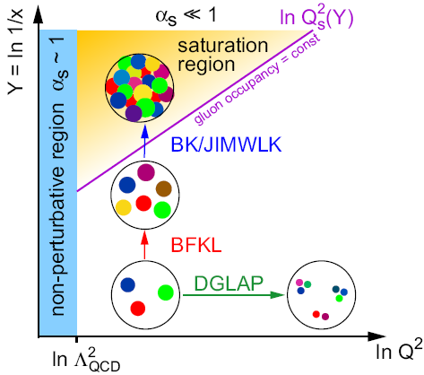
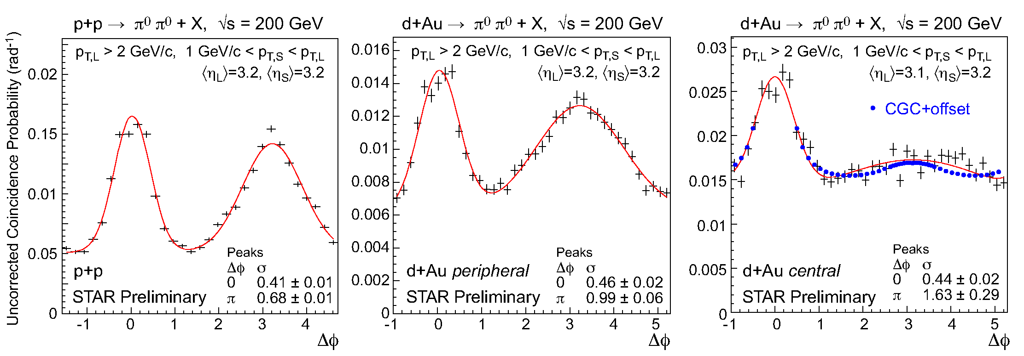
Cold QCD matter – the initial state at RHIC
RHIC may provide unique access to the onset of saturation
Future questions for p+A
  What is the gluon density in the (x,Q²) range relevant at RHIC?
  What role does saturation of gluon densities play at RHIC?
  What is Q_{s} at RHIC, and how does it scale with A and x?
  What is the impact parameter dependence of the gluon density?
pp
peripheral dAu
central dAu

Slide 10
Summary p+A measurements
Nuclear modifications of the gluon PDF
  Correlated charm production
Gluon saturation
  Forward-forward correlations (extension of existing π⁰-π⁰)
    h-h
    π⁰-π⁰
    γ-h
    γ-π⁰
  Drell-Yan
    Able to reconstruct x₁, x₂, Q² event-by-event
    Can be compared directly to nuclear DIS
    True 2 → 1 provides model-independent access to x₂ < 0.001
  Λ polarization
  Baryon production at large x_{F}
What more might we learn by scattering polarized protons off nuclei?
Easier to measure
Easier to interpret
Notes:
On the other hand, many observables in p+A collisions require gluons to contribute at the
leading order in partonic scattering. Thus p+A collisions provide more direct information on the
response of a nuclear medium to a gluon probe. However, soft color interactions between p and
A before the hard collision takes place have the potential to alter the nuclear wave function and
destroy the universality of parton properties [268]. The breakdown of factorization has already been
observed in comparisons of diffractive final states in e+p collisions at HERA and p+p collisions at
the Tevatron [269].
Ultimately it will be the combination of a strong p+A and e+A program, each providing
complementary measurements, that will answer the questions raised above in full.

Slide 11
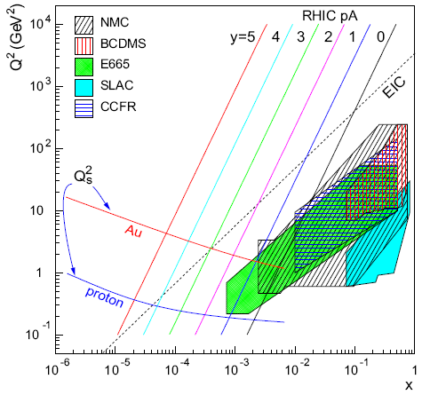
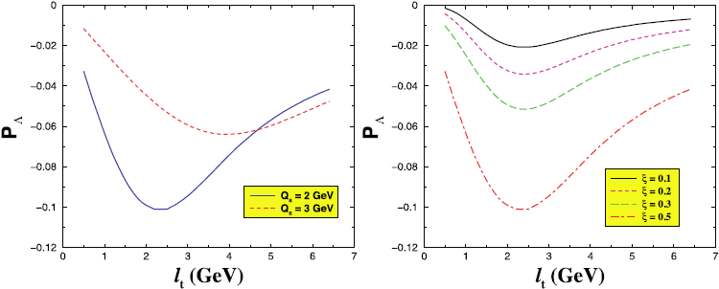
Future Gluon Saturation Measurements
Drell-Yan in the forward direction
  access to sea quark distributions in the nucleus at x < 0.001.
  an order of magnitude lower x than DIS data, and DY from EPS09.
  significant constrain on nuclear gluon distribution
Forward J/Psi
Forward-forward correlation
  h-h / π⁰-π⁰ / γ-h / γ-π⁰
  Scan on A mass
  Λ transverse polarization
  unique in extracting x-dependence of saturation scale
Boer and Dumitru, Phys. Lett. B 556, 33 (2003)
Notes:
Saturation Physics: Drell-Yan When measured in the forward direction, Drell-Yan di-lepton production in p+A collisions at
RHIC can provide access to sea quark distributions in the nucleus at x < 0.001. This is nearly
an order of magnitude lower x than the nuclear DIS data, and over an order of magnitude lower
x than the Drell-Yan data, that form the primary inputs for EPS09. Furthermore, measurements
of the Drell-Yan nuclear dependence at RHIC can also provide significant constraints on the nuclear
gluon distribution at very low x via evolution [263].
Forward J/ production will be measured concurrently with Drell-Yan scattering. J/ production
in these kinematics is dominated by gg fusion, so this will provide complementary information
about the gluon density at very low x.
lamda Polarization
A unique way to extract x-dependence of saturation scale in p+A collisions is the study of
polarization in the forward region where saturation of the gluon density is expected. The process
p(d) ! " X is sensitive to saturation and could help to determine properties of this phenomenon.

Slide 12
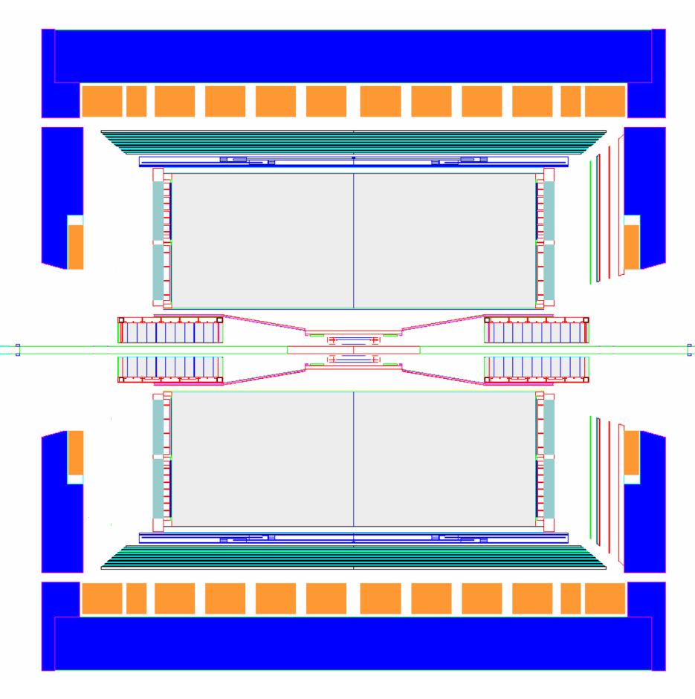
STAR Detector Forward Upgrade
proton
nucleus
~ 6 GEM disks
Tracking: 2.5 < η < 4
~ 2016
FMS
FHC
W powder E/Cal
Preshower
1/2” Pb radiator
Shower “max”
RICH
Baryon/meson separation
Forward instrumentation optimized for p+A and transverse spin physics
  Charged-particle tracking
  e/h and γ/π⁰ discrimination
  Baryon/meson separation
New capabilities for forward rapidity Drell-Yan, forward-forward correlations, forward rapidity jet reconstruction
Significant interest in p+A measurements: nature of the initial state in nuclear collisions (understanding the gluon distribution at low-x)
Fits with plan towards an eSTAR detector for a future e-p/A collider (eRHIC)
Several design exist, being evaluated

Slide 13
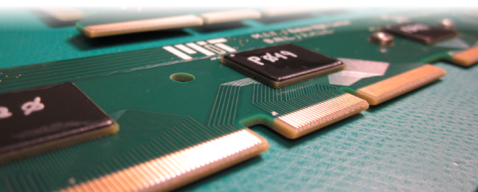
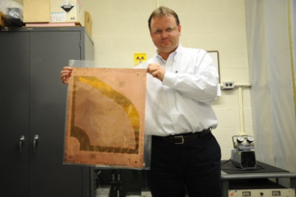
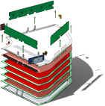
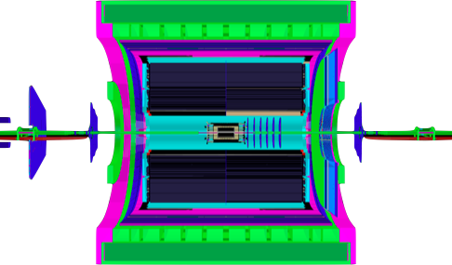
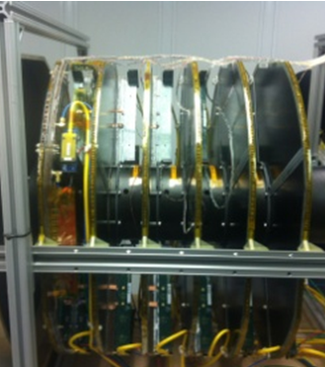

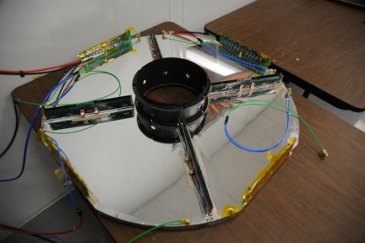
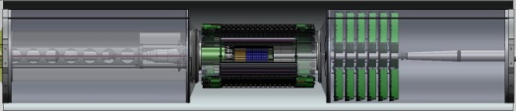
Very Forward GEM Tracker (VFGT)
Add forward tracking to STAR
  Drell-Yan
  Transverse spin physics in valence quark region etc.
Design based on FGT
  Risks understood
  Lower R&D costs
  Fit in existing support structure
Decadal Plan calls for such an upgrade
spatial resolution ~70 μm

Slide 14
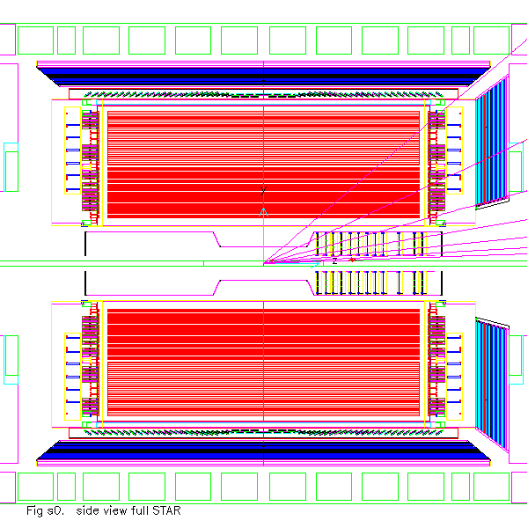
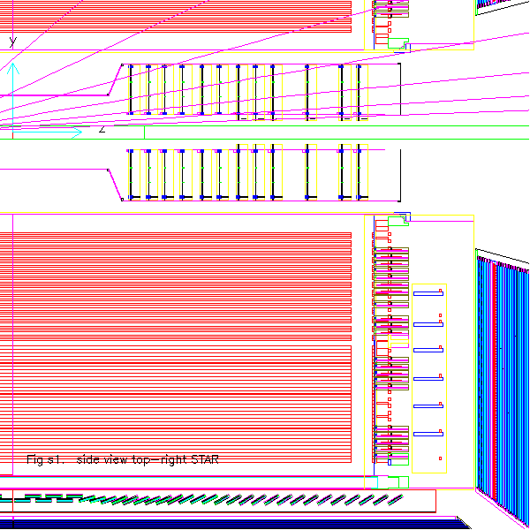
VFGT in the STAR simulation
η=1.0
inner radius of 7cm for last 6 discs
FGT
η=2.0
η=3.0
η=2.0
η=4.0
VFGT
IP at z=0 up to η~3.5
IP at z=-50 up to η~4.0
Δφ ~ 0.15ΔZ/p_{z}
For η~4.0, p_{Z}=100GeV/c, ΔZ=2m, deflect distance ~100μm, FGT-like spatial resolution may work!
Notes:
At pz=100GeV/c, reflect distance ~45 micron

Slide 15
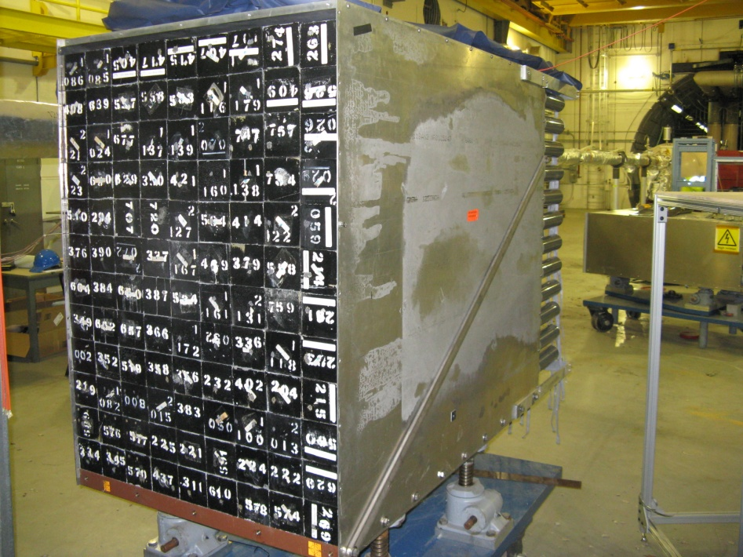
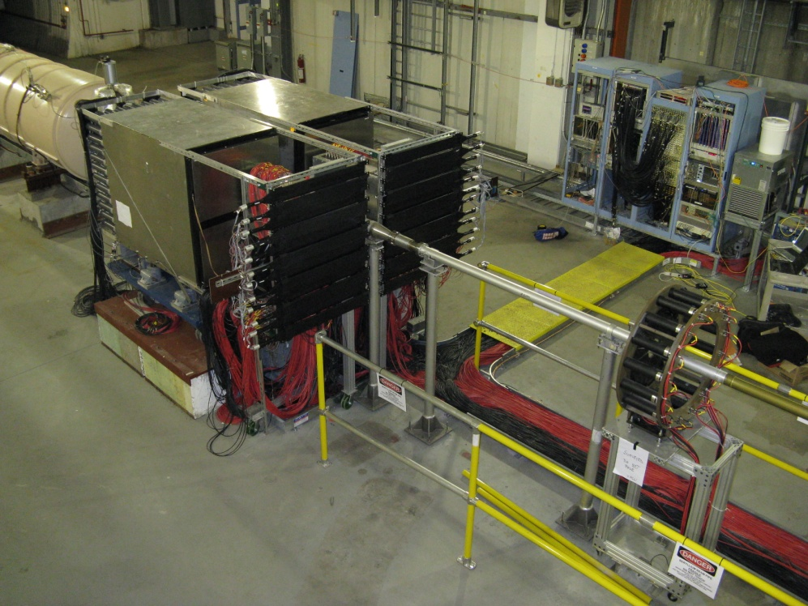
Forward Hadron Calorimeter
δE/√(E) = 0.344/√(E) from E864 NIM
Re-use of E864 hadron calorimeter
Excellent energy resolution demonstrated
Pulse shape analysis to separate electron from hadrons
Pixelation to match ~1.6 cm Moliere radius
Being tested at RHIC IP2 to evaluate its performance
Test setup at RHIC IP2

Slide 16
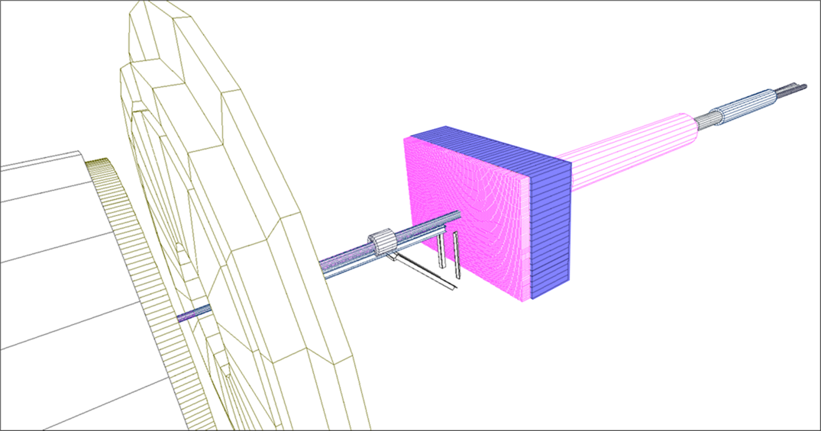
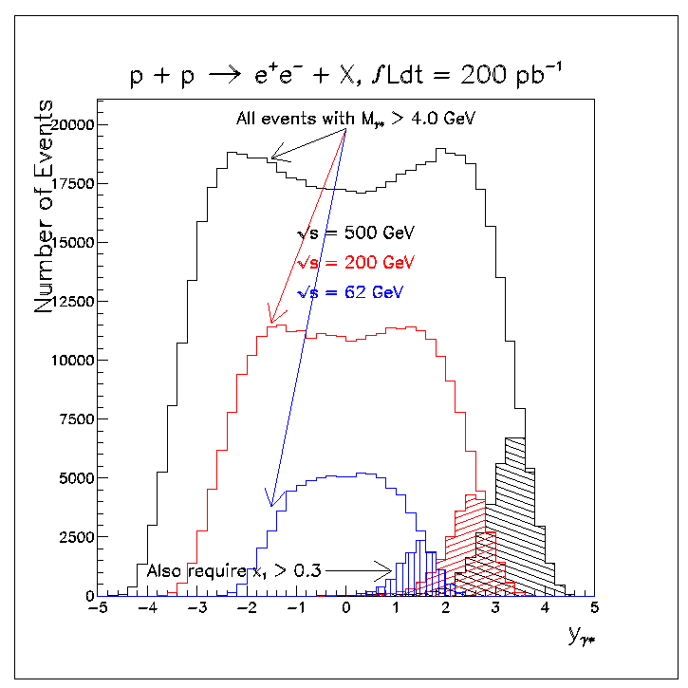
New Calorimeter R&D
Requirement:
  Efficient π⁰ reconstruction at 100 GeV.
  Good γ/π⁰ discrimination.
  Good e/h separation ( 1000) with high electron efficiency.
  Reasonable energy resolution for jets and single hadrons.
  Trigger capability
  Fit into available space.
  Readout insensitive to the magnetic field.
  Sufficiently radiation hard.
Tile HCAL
SPACAL EMC
Solution:
  W powder, fiber readout, compensating (SPACAL) EMC
  compensating tile HCAL tail catcher
Forward Calorimeter System- FCS
Notes:
DY x-section ~ nb
Pi0 x-section ~ ub
Single gamma x-section ~1 order magnitude lower than pi0
Compared to the STAR FMS and FHC detectors, FSC will provide finer segmentation, suitably matching our physics goals, full azimuthal angle and extensive pseudo-rapidity h coverage such that jet physics and correlation measurements can be definitively addressed.

Slide 17
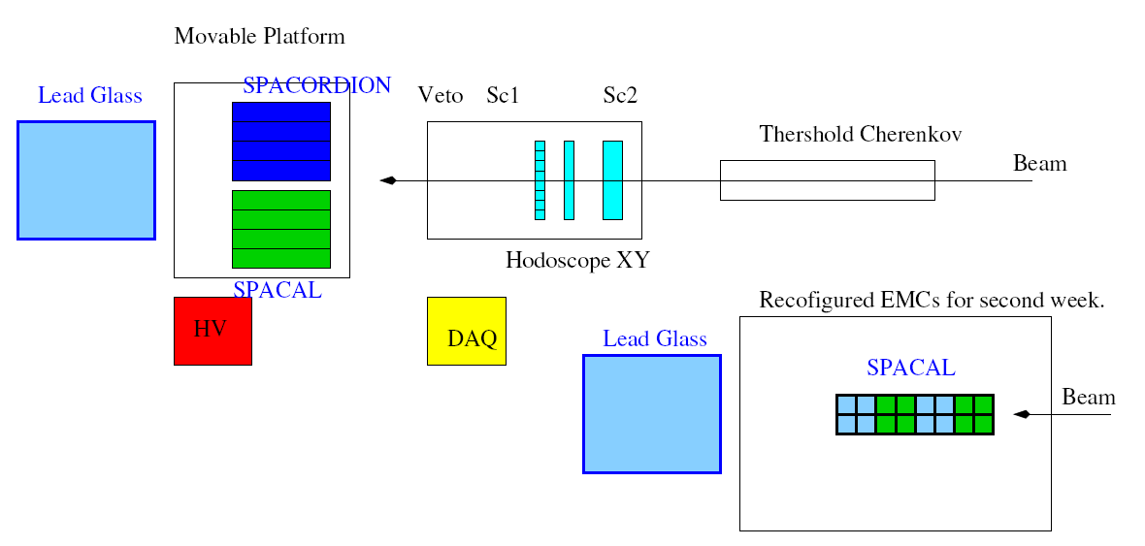
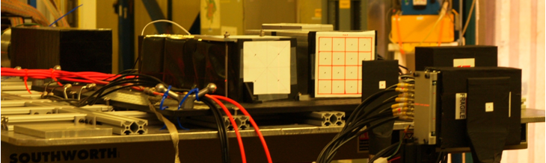
Calorimeter R&D UCLA/TAMU/PSU
T1018 Setup at FNAL MT6 Beam line.
January 2012.
SPACORDION
SiPMT readout
Lead Glass
SPACORDION
SPACAL
Lead Glass
SPACAL
SiPMT/
Hodoscope

Slide 18
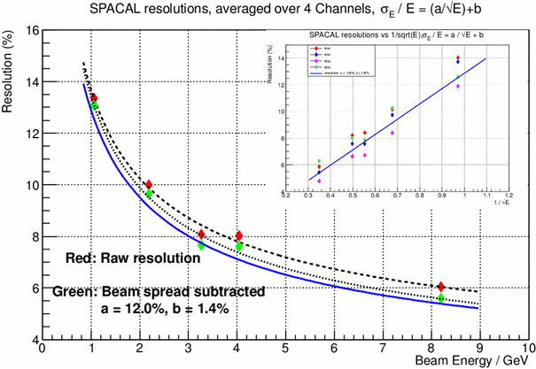
Test Results - SPACAL works
Also measured:
  Uniformity of response across the towers.
  Energy resolution with and without mirror.
  Perform scans along the towers with electrons and muons.
  Estimated effects of attenuation and towers non-uniformities on resolution.
Resolution is close to expected (12%@1GeV).
Light yield is very good ~2000 p.e./GeV

Slide 19
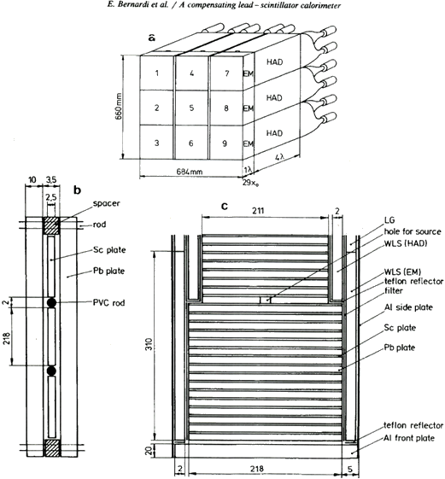
Hadronic Calorimeter Upgrade
Understand HCAL with simulation
  Took ZEUS 1987 experimental data for Pb/Sc tile compensated calorimeter to verify simulation
.
The length of the detector is 5 interaction length. Fit into STAR.
It is segmented to EM and Hadronic parts.
It is compensated with good energy resolution for hadrons.
Experimentally measured longitudinal and transverse shower developments.
Geometry is simple.

Slide 20
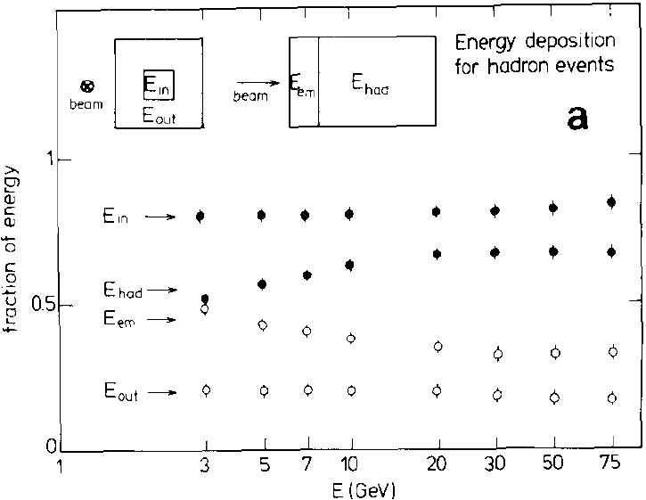
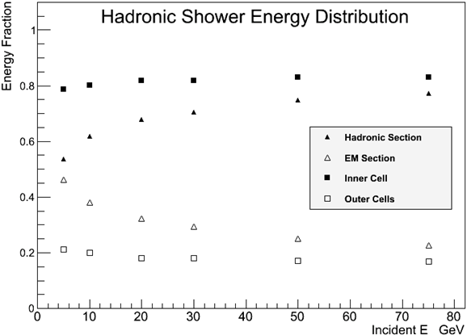
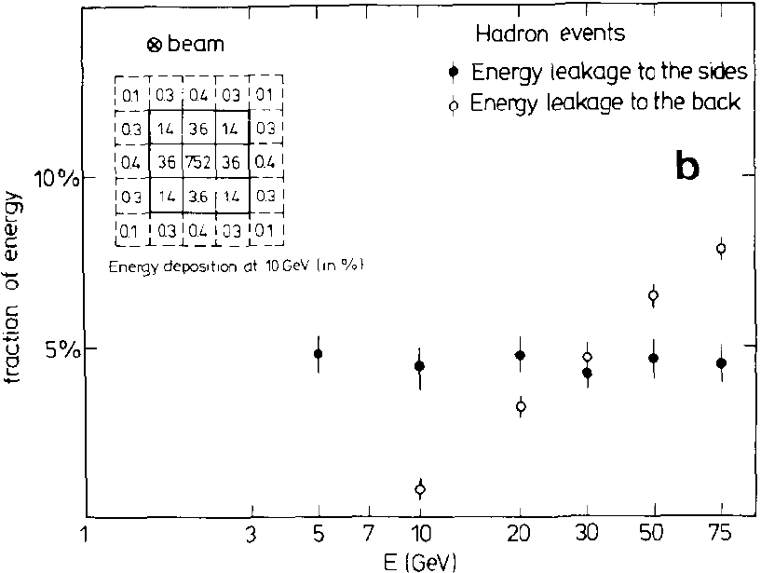
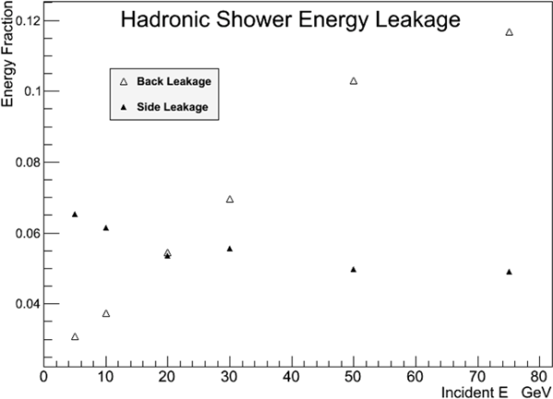
Hadronic Response
Tested 2 possible geant4 physics lists for hadronic physics: QGSP_BERT, LHEP
(QGSP_BERT recommended by CALICE collaboration)
Compared with beam test results for ZEUS calorimeter prototype
QGSP_BERT failed to reproduce the e/h from the ZEUS test
LHEP gives reasonable agreement for hadronic energy resolution, e/h and shower profile
Our Simulation
ZEUS Data
Bernardi et al., NIM A 262, (1987) 229-242
ZEUS Data
Our Simulation

Slide 21
STAR R&D for FCS
MC, stand alone GEANT4, done. Compare with Geant3 used in STAR simulation framework?
Pi0 reconstruction – 80% eff. At 100 GeV
Energy resolution EM – 12/sqrt(E), constant term ~2%
Energy resolution for hadrons 50%-60%/sqrt(E), range 10-80 GeV
e/h rejection few*1000 @ 80 GeV
Need to build a full scale prototype module !
What are the Physics Capability for this Detector?
Combined FMS+FHC and FCS, cost vs physics?

Slide 22
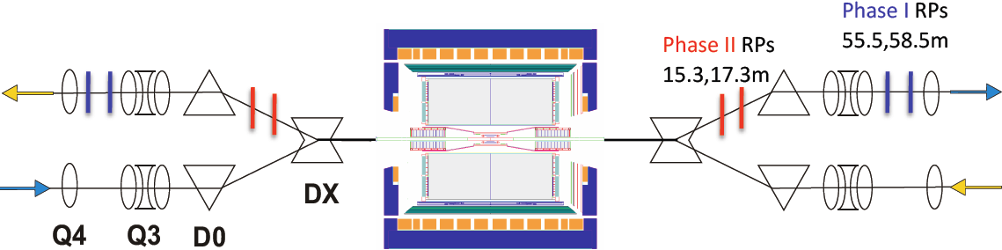
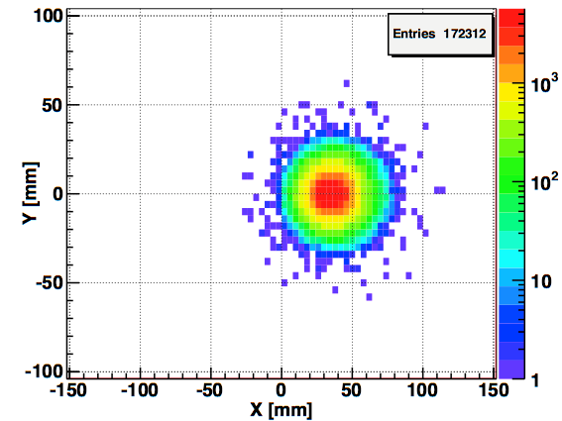
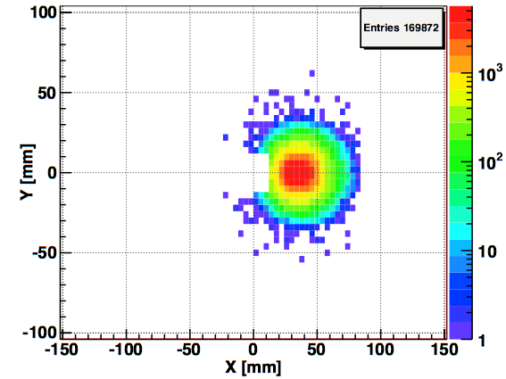
Roman Pot Phase II
Simulated spectator protons from p+3He
Glueball search in the Double Pomeron Exchange (DPE) process
Search for the Odderon
Spin dependence of the elastic and diffractive scattering in polarized pp collisions
Polarized proton on polarized Helium scattering
Possibility of new physics of sphaleron production in DPE
Roman Pots phase II upgrade will tag ~98% of spectators
Notes:
√s = 500 GeV
|t|~0.2 -1.5 (GeV/c)² (0.003 – 0.035 in Phase I)
wide rapidity gaps, > 4 units for M_{X} < 3 GeV/c² at √s = 500 GeV
higher reach in M_{X}: max ~25/10 GeV/c² (500/200 GeV)
no special beam optics required, high lumnosity
planned to be installed in 2013

Slide 23
Other planned upgrade
RICH
  LHCb-like low mass Cherenkov vs. Threshold Cherenkov?
  Baryon/meson separation for eg. anti_Lambda decay (charged daughter)
  Charged pion ID
Pre-shower
  Lead convertor (2-3 radiation-length) + coarse readout (~1mm) GEM
  Provide pi0 identification and pi0/γ separation.
  Charge sign determination
Notes:
BBC inner: It would be used for local polarimetry for the spin physics program, and to learn
about the physics in Diffractive Dissociation, and to help in finding the reaction plane in Heavy Ion
measurements.

Slide 24
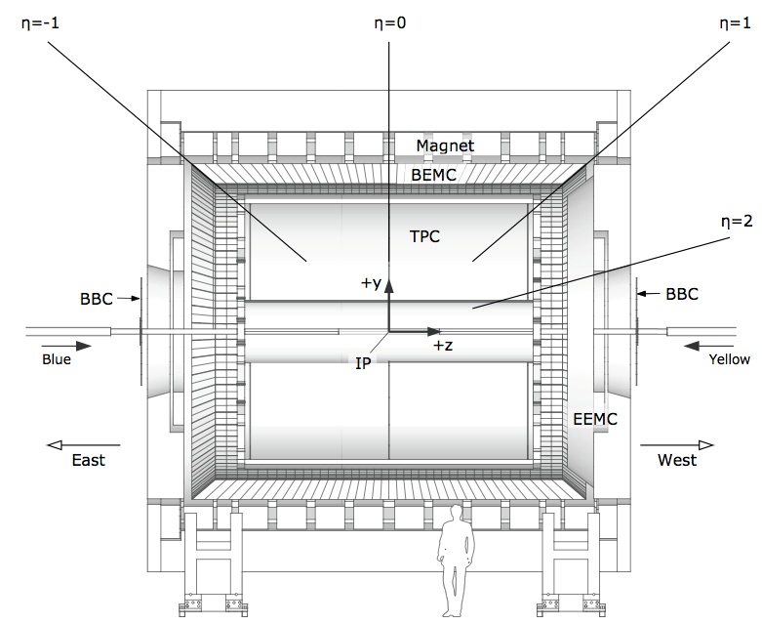
Evolving from STAR into eSTAR
proton/nucleus
electron
ToF: π , K identification,
t0, electron
ECal: electrons and photons
GCT: a compact
tracker with enhanced
electron capability
-Combine high-threshold (gas) Cherenkov with TPC(-like) tracking
HCal: W powder, spaghetti calorimeter
Simulations ahead
eSTAR task force formed
ToF
ECal
TPC i.s.
GCT
TPC i.s.
GEM disks
HCal
EIC Generic Detector R&D Panel:
GCT: LOI toward multi-institution R&D effort
HCal: R&D proposal
TRD+TOF: R&D proposal

Slide 25
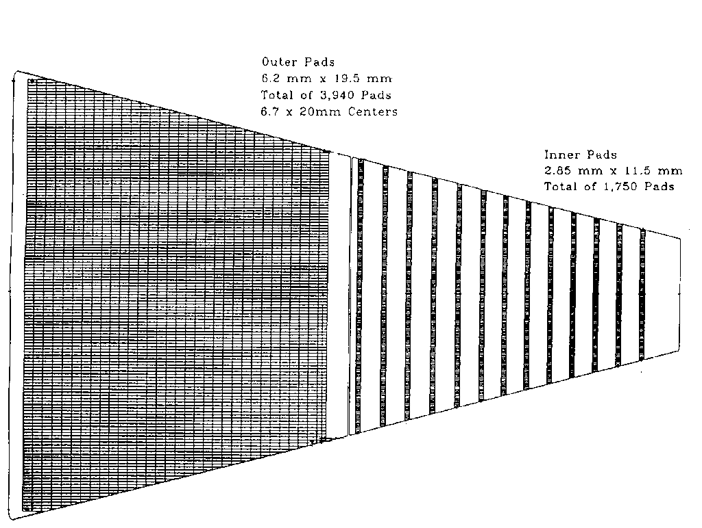
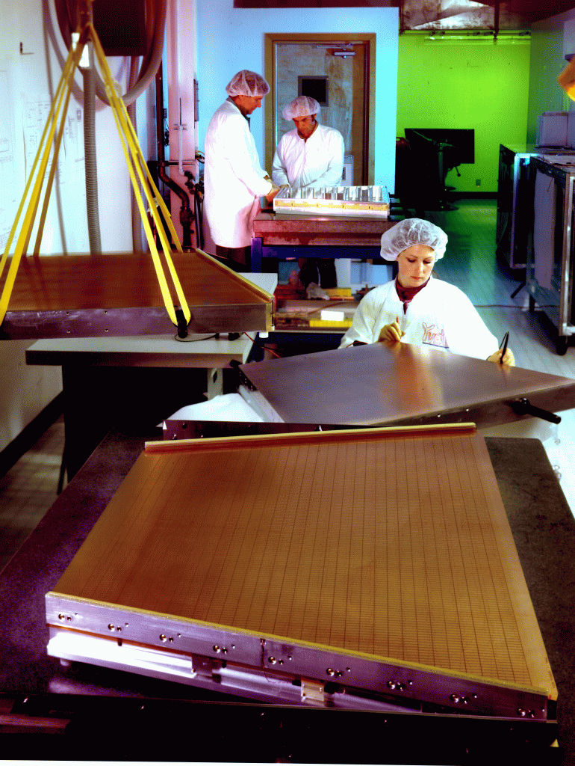
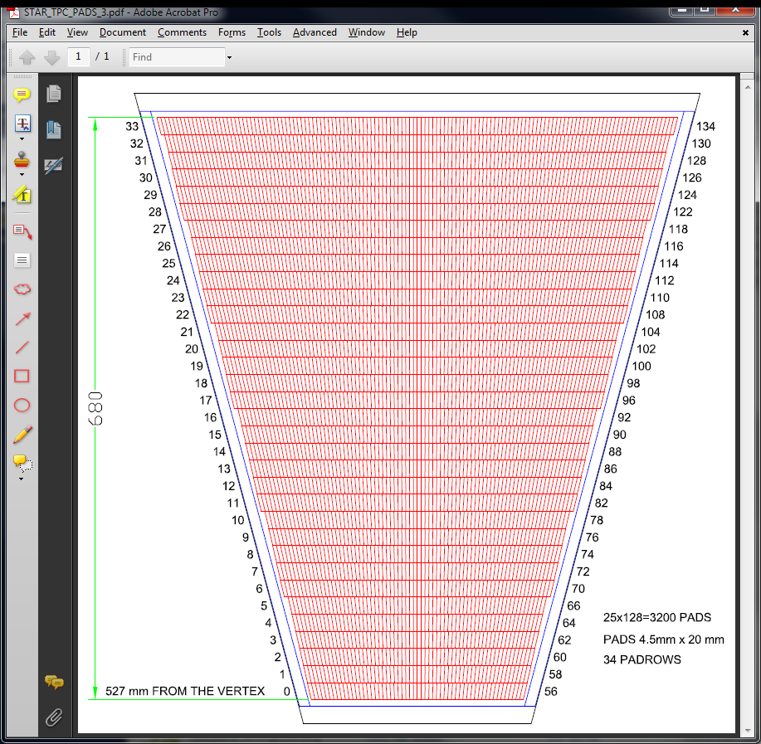
TPC inner sector (iTPC) upgrade
ALICE-TPC
What will benefit from iTPC?
  AA BES-II (fixed-target)
  Electron/hadron ID
  Extended tracking (1<|η|<1.5-2) and dE/dx capability
  Hyperon/exotic particle reco.

Slide 26
Summary
Forward Detector upgrade at STAR crucial for the (polarized) pp/pA/AA (2017-2020) and future ep/eA program
Major components (eg. FCS) of forward upgrade progress well. Some upgrade – RICH/pre-shower is currently under consideration/discussion.
Evolve from conceptual design to more details: physics simulation -> detector requirements, prototype test.
STAR will go FORWARD.

Slide 27
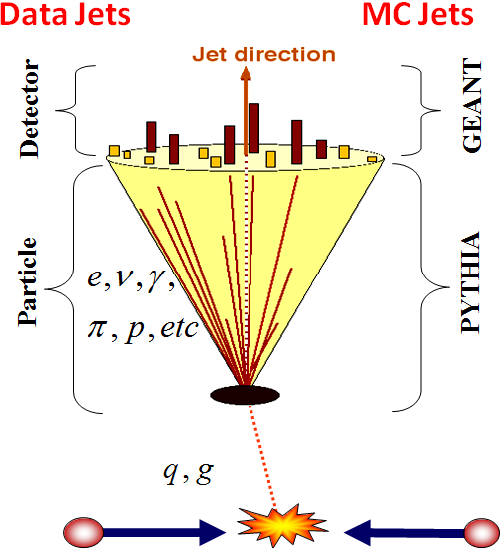

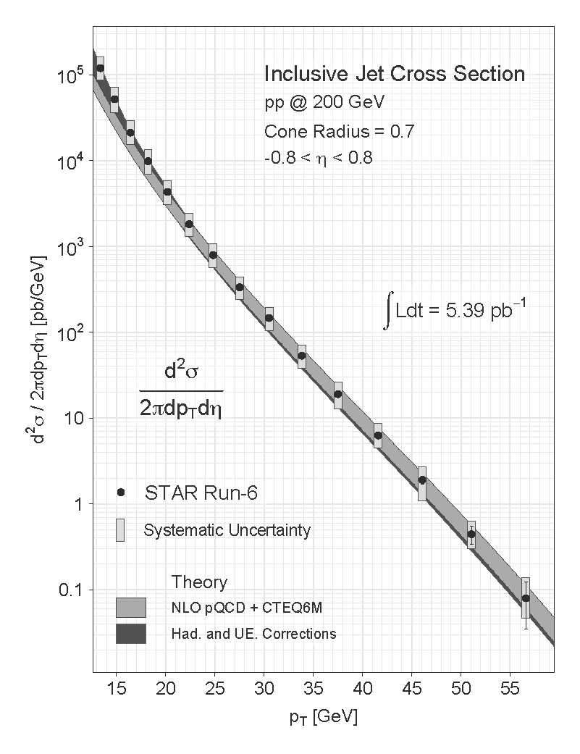
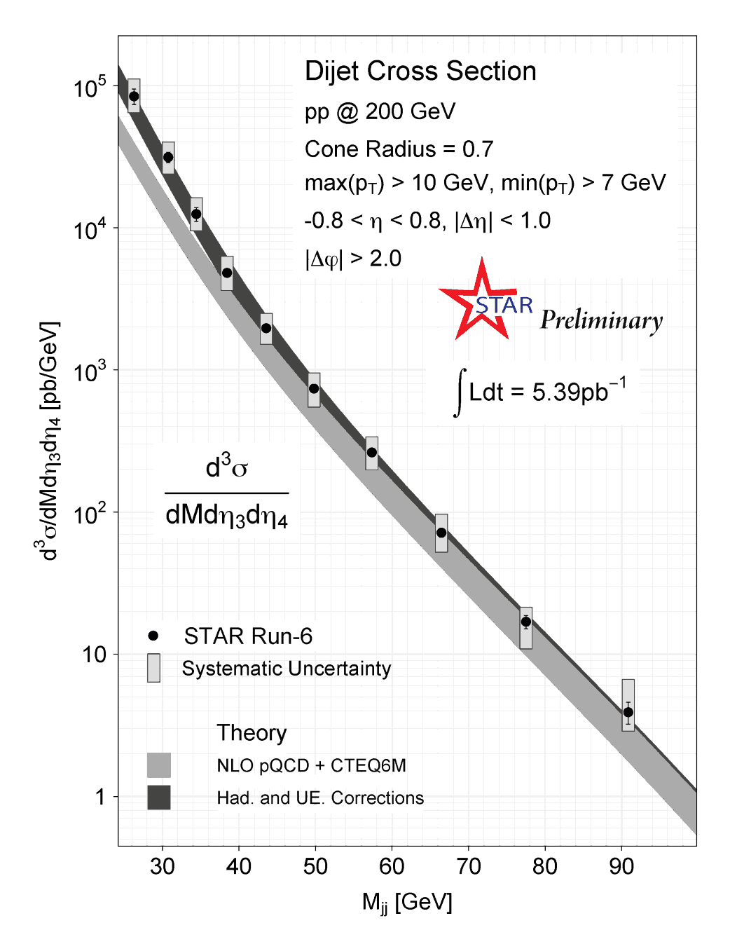

Reconstructing Inclusive and di-Jet at STAR
The large acceptance of the STAR detector makes it well suited for jet measurements:
TPC provides excellent charged-particle tracking and p_{T} information over broad range in η
Extensive EM calorimetry over full 2π in azimuth and for -1 < η < 2
Sophisticated multi-level trigger on EMC information at tower and patch scale
Use midpoint cone algorithm
Data well described by NLO pQCD when including hadronization and underlying event corrections from PYTHIA
Hadronization and UE corrections more significant at low jet p_{T}
Reconstructing correlated probes (eg. di-jet, γ-jet) provides information on initial state partonic kinematics at LO
This allows for constraints on the shape of Δg(x)
27

Slide 28
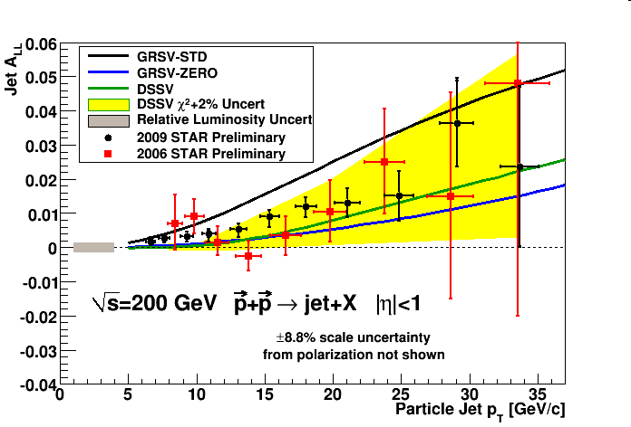
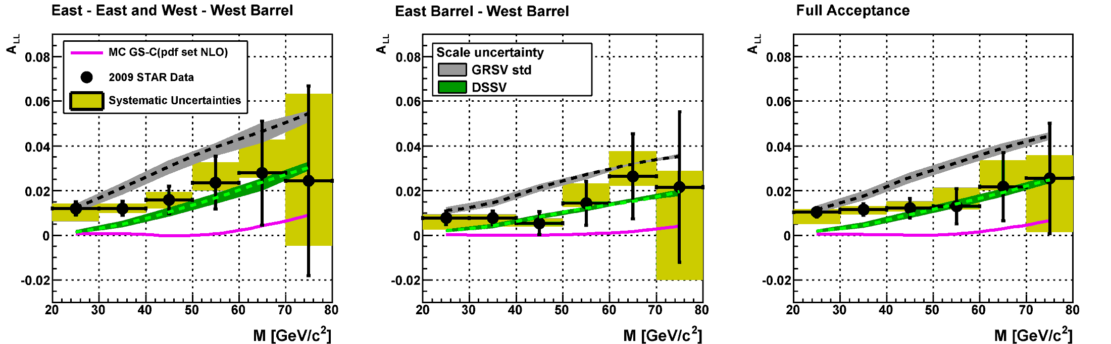
Recent Inclusive and di-Jet A_{LL}
2009 results are a factor of 3 or greater more precise than 2006
Data falls between predictions from DSSV and GRSV-STD
28

Slide 29


Future Inclusive and di-Jet Sensitivity
Future running at 200 GeV expected to significantly reduce uncertainties
Inclusive and di-jet A_{LL} in 500 GeV
  Higher energies give access to lower x_{g}
  Expect A_{LL} to be smaller than 200 GeV
  Projections shown are purely statistical
  Forward jets in EEMC region sensitive to even lower x_{g}
Projected Stat. Uncertainty: 50% Pol 390 pb⁻¹, 600 pb⁻¹ delivered
29
Notes:
500 GeV 190 pb-1 (Run 12 and 13)
200 GeV 40? pb-1 (Run 13)

Slide 30






STAR W A_{L} - Probing the Sea
Detect Ws through e⁺/e⁻ decay channels
V-A coupling leads to perfect spin separation
  LH quarks and RH anti-quarks
Neutrino helicity gives preferred direction in decay
STAR Run 9 Result
PRL 106, 062002 (2011)
At forward/backward rapidity there is increased sensitivity to single quark flavor
30

Slide 31



Future STAR W Measurements
Forward GEM Tracker upgrade
  6 light-weight triple-GEM disks using industrially produced GEM foils
  Partial Installation for 2012
Multi-year program
  L ≈ 300 pb⁻¹
  P ≈ 70%
  Significant constraints on the polarized anti-quark sea distributions
S/B = 5
31

Slide 32
Mechanism for Large Transverse Spin Effects
Sivers mechanism: asymmetry in production of forward jet or γ
Collins mechanism: asymmetry in the forward jet fragmentation
S_{P}
S_{P}
k_{T,q}
p
p
p
p
S_{q}
k_{T,π}
Sensitive to proton spin – parton transverse motion correlations
Sensitive to transversity
Need to go beyond inclusive hadron measurements
Possibilities include jets, direct photons, di-hadron correlations, etc.
Notes:
Sivers=Initial State and Collins=Final State

Slide 33



Forward Rapidity Collins Asymmetry
Jet axis and leading pion define plane. Angle between normal to plane and spin is Collins Angle, γ
Collins asymmetry in forward direction slightly positive (consistent with observed pion A_{N}), but
shows no sign of cos(γ) dependence.
-3 -2 -1 0 +1 +2 +3
Collins Angle, γ
=γ
A_{N}f(γ)
Notes:
Slight positive asymmetry consistent with observed pion asymmetry.

Slide 34
Sivers effect sign change
In SIDIS, knock a colored quark out of a color-neutral nucleon
  Quark was bound to the rest of the nucleon before the interaction
  Final-state interaction that produces the interference is attractive
In Drell-Yan, a quark in one hadron annihilates with an anti-quark of the same flavor and opposite color from the other hadron
  The rest of the “other hadron” has the same color charge as the incident quark
  Initial-state interaction that produces the interference is repulsive
Leads to opposite signs for the Sivers effect in the two cases
  A very important test of the TMD approach
A_{N}DY and COMPASS both expect to observe the sign change
  Assumption: This will be a done deal before STAR (or PHENIX) can perform meaningful Drell-Yan measurements

Slide 35


Slide 36



Pushing transversity even further forward
Collins asymmetry in jets
D’Alesio et al,
PRD 83, 034021
PRL101, 042001 (2008)
Pushing out to the FMS rapidity will probe quark transversity at high x
Need to trigger on and measure jets with leading charged pions
  Collins effect for π⁰ is expected to be very small
  Very large, and opposite sign, A_{N} are observed for inclusive π±

Slide 37

Future A_{LL} measurement γ-jet correlation
A_{LL} of γ -jet pair access direct leading-order extraction of ΔG(x)/G(x).
Dominate by qg->qγ, process selectivity
Forward γ and full jet capability will extend STAR acceptance
Notes:
Say something about inclusive jet, pi and di-jet A_LL first.

Slide 38



Leading Twist Nuclear Effects in pA
Measurements Constraining nPDFs: Correlated charm measurements (no long-term upgrade needed)

Slide 39

Baryon Production at large x_{F}
Phys. Rev. Lett. 90, 092301 (2003); 91, 259901 (2003)
Test baryon stopping scenario at RHIC
Calculable in weak-coupling QCD – intrinsic semi-hard scale Qs
Transverse momentum flatten with increasing energy and A mass
Longitudinal steepen with increasing energy and A mass
Effect more significant for Λ and hyperons
PID challenging at forward !

Slide 40


STAR Magnetic Field
Chris QM09 talk : http://drupal.star.bnl.gov/STAR/files/QM2009_Perkins_v5_0.ppt
Radial and Azimuthal fields impart impulses in the Φ direction and partially cancel

Slide 41


Run8 FMS-FTPC (Jim Drachenberg)
http://www.star.bnl.gov/protected/spin/drach/Run8FMS/FMS-FTPC_correlation/
ΔΦ = 0.1 Δz/p_{z} (Δz=2.5m)
= 0.25 radian / GeV
For 10GeV at y=0 @ FMS
Δy @ x=20cm = 0.5cm
Δy @ x=40cm = 1.0cm
Δy @ x=80cm = 2.0cm
For 50GeV at y=0 @ FMS
Δy @ x=20cm = 0.1cm
Δy @ x=40cm = 0.2cm
Δy @ x=80cm = 0.4cm
FTPC+FMS have done charge
separation with STAR magnet at
2.8<η<3.8
E ~ 10GeV

Slide 42
Required kinematic coverage for Drell-Yan
pp500
  y_{pair} = 4, M_{pair} = 4.5 GeV corresponds to x ~ 0.5
  Would like to reach pseudo-rapidities up to ~ 4.3
    4.3 would “fill the corners” of the FMS square hole
    Requires electron detection/identification to >~ 85 GeV
    Material between IR and FMS grows rapidly beyond η ~ 4.3
pA/pp200
  How close can our acceptance go to the edge of the pole-tip hole at η = 2?
  Very little yield beyond η ~ 3
  Would like to detect/identify electrons down to ~ 10 GeV

Slide 43


SPACAL
Compensation calorimeter & Fast speed of response
D.Acosta et al., NIM A302 (1991) 36-46
SPACAL had fast (25ns) ‘electron’ trigger.
e/h rejection ~1000 at 80GeV, electron efficiency ~90%
R.Wigmans, NIM A494 (2002) 277-287
Outstanding hadron energy resolution
Notes:
Connection to slide (4) SPACAL is easily outperform CMS and ATLAS systems for jets <100 GeV,
eRHIC domain.
Particle identification additional benefit (eRHIC I think wants it DIRC etc).

Slide 44


Slide 45


Si detector package (RP-I)
4 planes of 400 µm Silicon microstrip detectors:
  4.5×7.5 cm² sensitive area
  100 um pitch => good resolution, low occupancy
  Redundancy: 2X- and 2Y-detectors in each package
  Closest proximity to the beam ~10 mm
  8 mm trigger scintillator with two PMT readout
SVX chips
Detector board
Si
LV regulation

Slide 46


RICH Design for STAR
LHC-b: 2 RICHs with 3 radiators
Notes:
Thought to be better than compass and hera-b

Slide 47




RICH components
Aerogel from NOVOSIBIRSK
LHC-b HPD
High optical parameters (Lsc≥43mm at 400 nm)
Combines vacuum photo-cathode technology with solid state technology.
Single Photon Sensitivity (200 - 600nm), 30% QE at 200 nm.
Fast signal (rise-fall times of a few ns) and negligeable jitter
(<1 ns)
Aerogel from JAPAN
n = 1.045
n = 1.050
160mm
transmission length(400nm): 46mm

Slide 48

Notes:
Single photon and pi0, rho production x-section

Slide 49




eRHIC phase 1: kinematic range
5 GeV e + 50 GeV/nucleon
5 GeV e + 325 GeV/nucleon
DIS region
TPC+
BEMC+TOF
Missing today
EEMC+FGT
SIDIS region
Missing today
Missing today
“Forward” (-2.5 <~ η < -1) electron acceptance essential to span deep-inelastic (DIS) regime
Both backward and forward hadron coverage valuable for semi-inclusive deep-inelastic (SIDIS) scattering

Slide 50
STAR → eSTAR
Optimizing STAR for e+p and e+A collisions from 5+50 to 5+325 GeV
Inclusive scattering over the entire deep-inelastic region
  Key measurements
    F_{L} in e+p and e+A: direct measure of gluon densities in nucleons and nuclei
    g₁ in e+p and e+³He: nucleon spin structure
    F₂^{A}/F₂^{d}: parton distributions in nuclei (including gluons via Q² evolution)
  Need electron detection, ID, and triggering over -2.5 <~ η < -1
    Combined mini-TPC/threshold gas Cherenkov detector
Semi-inclusive deep-inelastic scattering over a broad (x,Q²) domain
  Key measurements
    Flavor-separated helicity distributions, including strangeness
    Collins, Sivers, Boer-Mulders, and other transverse spin distributions
    Flavor-separated parton distributions in nuclei, including strangeness
    Parton energy loss in cold nuclear matter
  Need hadron detection and identification beyond the TPC/EEMC
    Extend TOF to cover -2 < η < -1
    GEM disks (from forward instrumentation upgrade) plus hadronic calorimetry in the region 2 < η < 3
Deeply-virtual Compton scattering
  Key measurement
    GPDs
  Need forward proton and expanded photon detection
    Roman pots (also valuable for spectator proton tagging in e+³He)
    EM calorimetry for -4 < η < -1

Slide 51


Parton energy loss in cold QCD matter
HERMES, NP B780, 1
L_{c} up to few 100 fm
Complementary tool to investigate partonic energy loss
HERMES: hadrons can form partially inside the medium
  Mixture of hadronic absorption and partonic energy loss
eRHIC: light quark hadrons form well outside the medium
Heavy quarks: unexplored to date. Low β → short formation time

