Slide 1
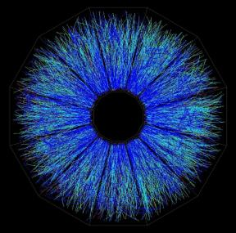

STAR BES-I results and BES-II Program
Zhangbu Xu
(for the STAR Collaboration)
Has RHIC prepared to search for
a sharp phase transition?
BES-I:
decadal plans and results
BES-II:
what are we looking for?
STAR preparation for the only
known collider experiment in the whole
Universe taking data in 2019-2020
CPOD 2016, Wroclaw

Slide 2
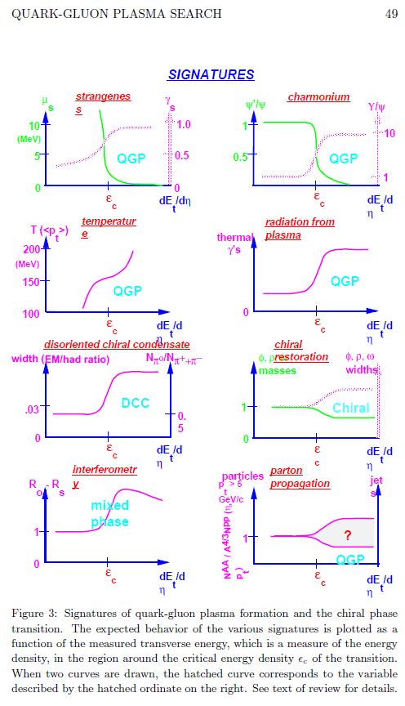
Why/How-to search for critical point and first-order phase transition?
J. Harris and B. Mueller, 1996
Chemical Equilibrium
Kinetic equilibrium
Thermal radiation
Chiral symmetry restoration
Color deconfinement
Long duration of mixed phase
Jet Quenching
We have been preparing and looking
before RHIC even started.

Slide 3
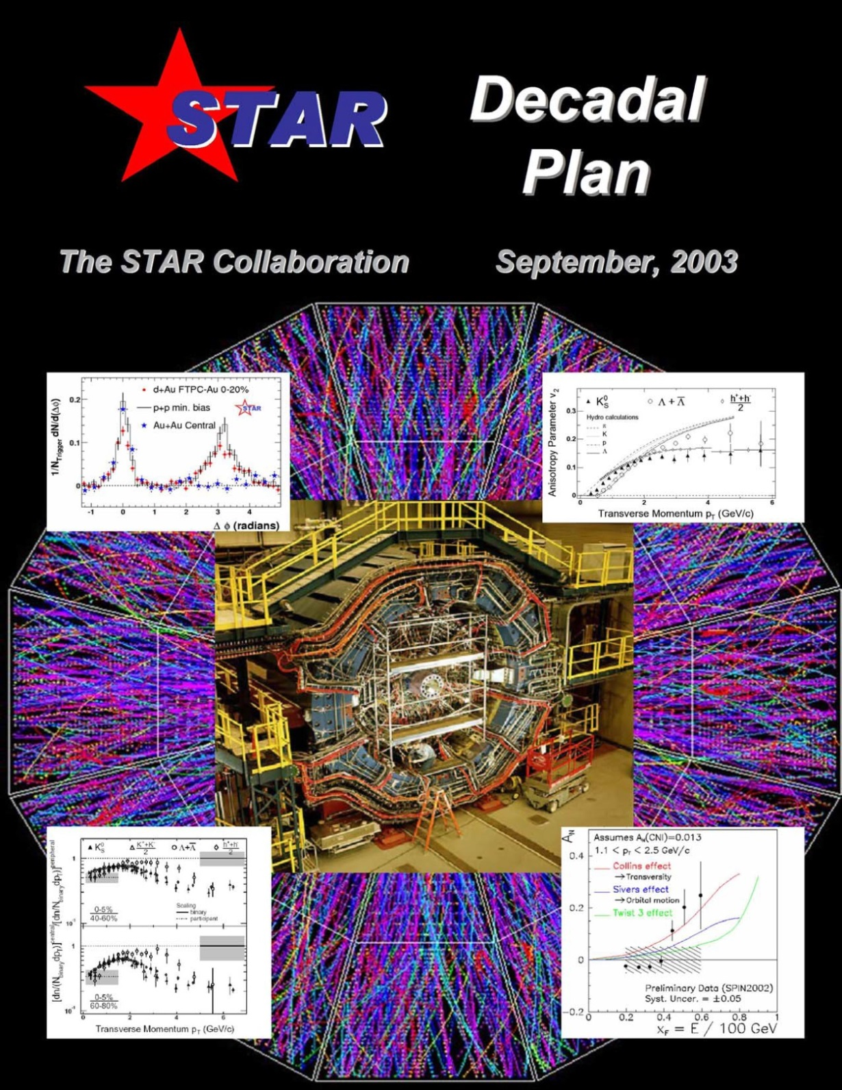
The first Decadal Plan
Chaired by Dick Majka (Yale)
Major observations:
Jet quenching
Large anisotropic flow
Constituent quark scaling
2005 STAR Whitepaper
Chaired by Steve Vigdor (IU)
Discovery of QGP doesn’t require:
non-interacting quark and gluons
first-order phase transition
chiral symmetry restoration

Slide 4
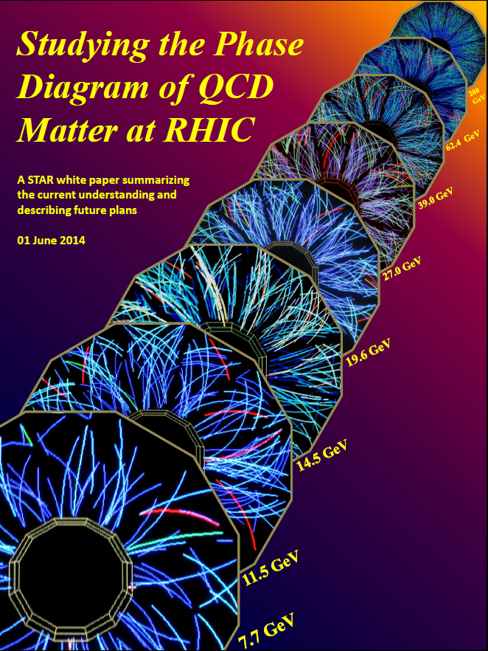
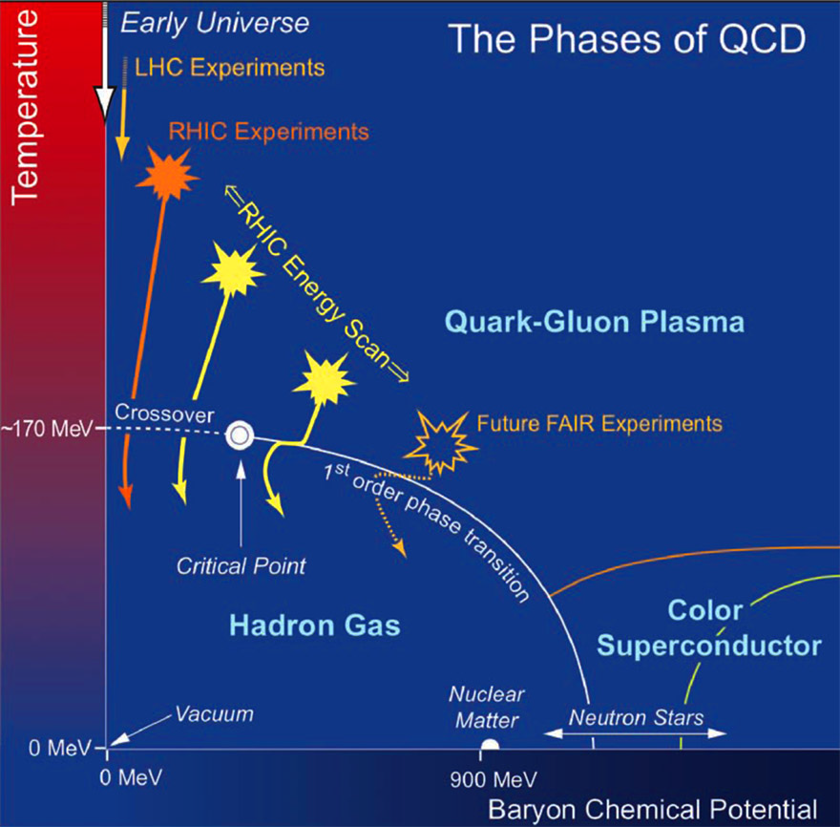
Beam Energy Scan Phase I (2010-2014)
STAR 2005 Whitepaper: Nucl. Phys. A 757 (2005) 102
Extend RHIC Au+Au measurements down toward SPS energy, search for possible indicators of a rapid transition in measured properties.
Chaired by S. Vigdor (IU)
2008 RHIC 3000events at 9.2GeV, Phys. Rev. C 81 (2010) 24911
2010: http://arxiv.org/pdf/1007.2613.pdf
2014:
https://drupal.star.bnl.gov/STAR/starnotes/public/sn0598
NSAC LRP 2007
http://science.energy.gov/np/nsac/

Slide 5
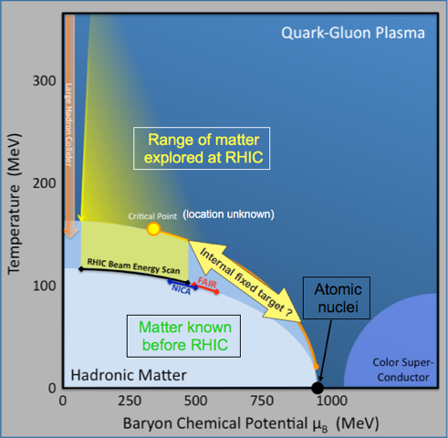
Mapping the QCD Phase Diagram
RHIC uniquely suited to map the QCD phase diagram at finite baryon density
Thermodynamics applicable
  Chemical and thermal fit
  Comparisons with LQCD
Change of Symmetry (degree of freedom)
  Chiral symmetry restoration
  Quark and gluon degree of freedom
  Response to external field
Equation of State (soft)
Critical behavior
  Critical exponent
  Critical fluctuation
Hints of new behavior in first Beam Energy Scan
Beam Energy Scan Phase 2 (BES II):
from hints to quantitative understanding

Slide 6
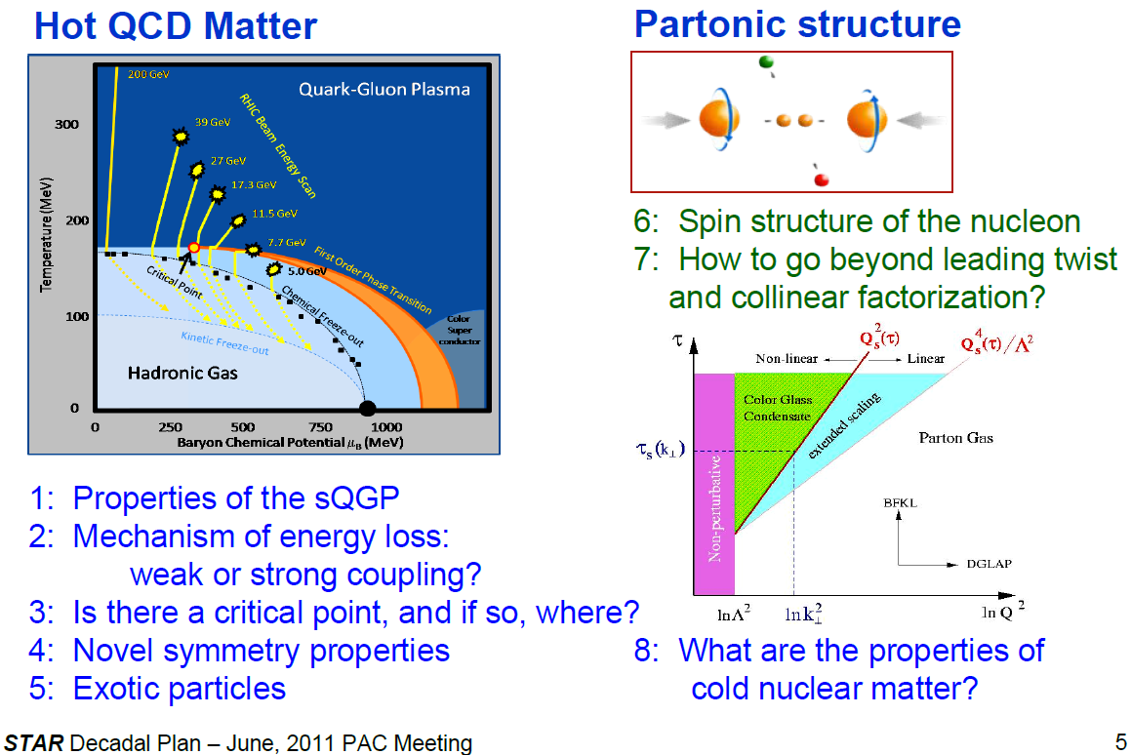
STAR has a comprehensive program

Slide 7
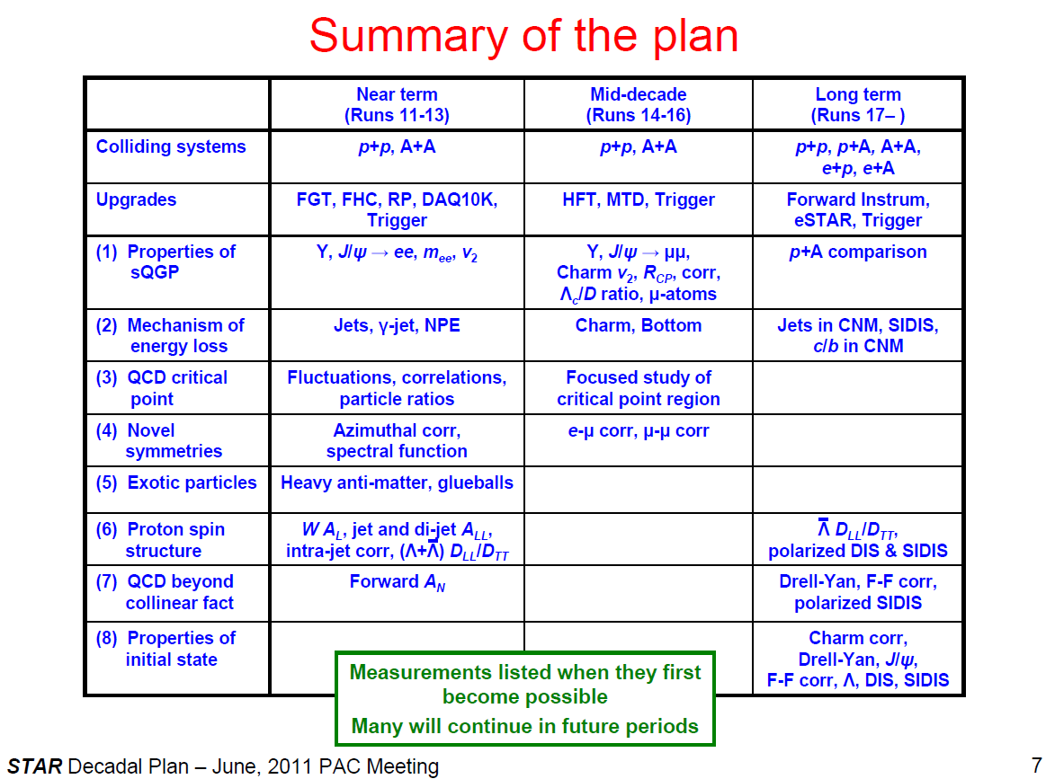
Plan in 2011
BES-I BES-II
C. Gagliardi for the STAR Collaboration

Slide 8
RHIC has been adaptable to science needs
2010-2013 | 2014 | 2015 | 2016 | 2017 | 1018 | 2019 | 2020 |  | 2022+
Au+Au p+p | Au+Au | p+p p+A | Au+Au d+Au | p+p Au+Au | Isobar Au+Au | Au+Au | Au+Au |  | Au+Au pp,pA
ΔG, QGP properties | Charm flow | Ref. A_{N} | D_{c}, Λ_{c} ϒ, Jets | Fc sign | CME, Λ↑ | Critical Point, Phase Transition |  |  | Jets, ϒ forwardA_{N}
BES-I | 200, 14.5 | 200 | 200-19.6 | 500, 62.4 | 200, 27 | BES-II 11-20 | BES-II 7-11 |  | 200
BES-I
2010-13 2014-16
BES-I BES-II
BES-II
Expand to include several programs:
p+A in run 15,
pp500 in run17,
Isobar (Zr, Ru-96) in run 18
BES-II more compelling, detector and machine upgrades in 2018
Future high-luminosity jets and Upsilon in 2020+

Slide 9
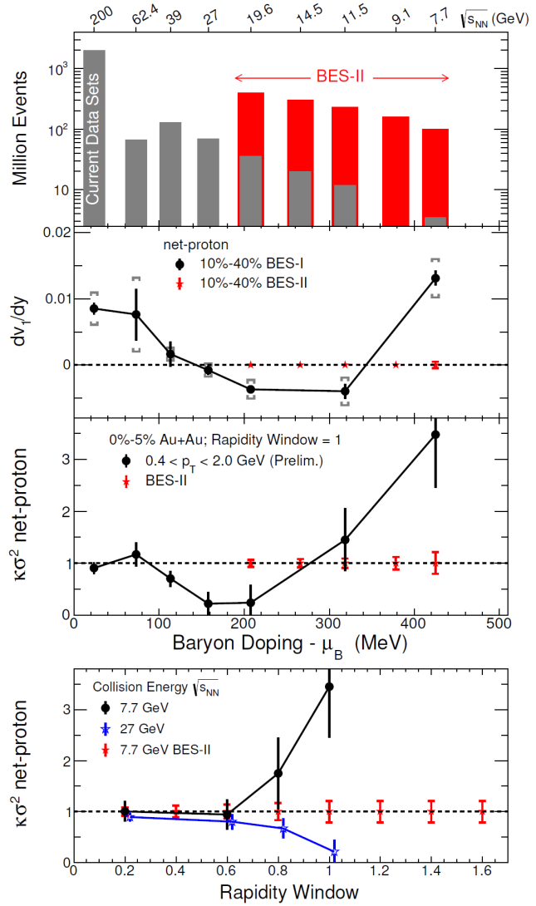
Highlights of BES-II and Upgrades in LRP 2015
Strong Endorsement by the NSAC 2015
http://science.energy.gov/~/media/np/nsac/pdf/2015LRP/2015_LRPNS_091815.pdf
Data from BES-I provide qualitative evidence for a reduction in the QGP pressure, with consequences for flow patterns and droplet lifetimes that have long been anticipated in collisions that form QGP not far above the crossover region. (See second panel of Figure 2.10.)
The detector upgrades planned for BES-II focus on maximizing the fraction of the particles in each collision that are measured, which is particularly important for fluctuation observables.
The trends and features in BES-I data provide compelling motivation for a strong and concerted theoretical response, as well as for the experimental measurements with higher statistical precision from
BES-II. The goal of BES-II is to turn trends and features into definitive conclusions and new understanding.

Slide 10


STAR Detector System
15 fully functioning detector systems
EEMC
ESMD
Magnet
MTD
BEMC
BSMD
TPC
TOF
BBC
FMS
FPS
DAQ
Trigger
RP
ZDC
NSAC 2015 RECOMMENDATION #I:
The upgraded RHIC facility provides unique capabilities that must be utilized to explore the properties and phases of quark and gluon matter in the high temperatures of the early universe and to explore the spin structure of the proton.
HFT
Excellent PID at mid-rapidity, X10³ increases in DAQ rate since 2000, most precise Silicon Detector (HFT)

Slide 11
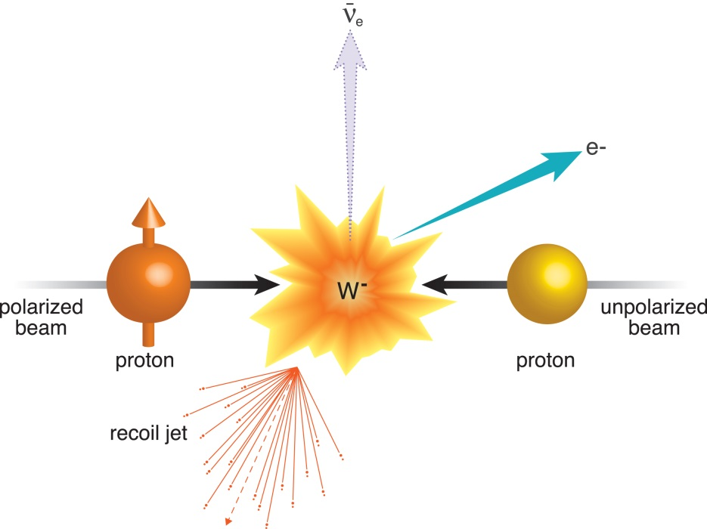
Pre-BES-II, we have strong programs in Heavy-Flavor, Spin sign-change and TMD, Symmetry
How to know certain color interactions are repulsive and others attractive:
A View of the Colorful Microcosm Within a Proton (foundation for run 2017)
https://www.bnl.gov/rhic/news2/news.asp?a=1824&t=pr
STAR paper Phys. Rev. Lett. 116, 132301 (2016)

Slide 12
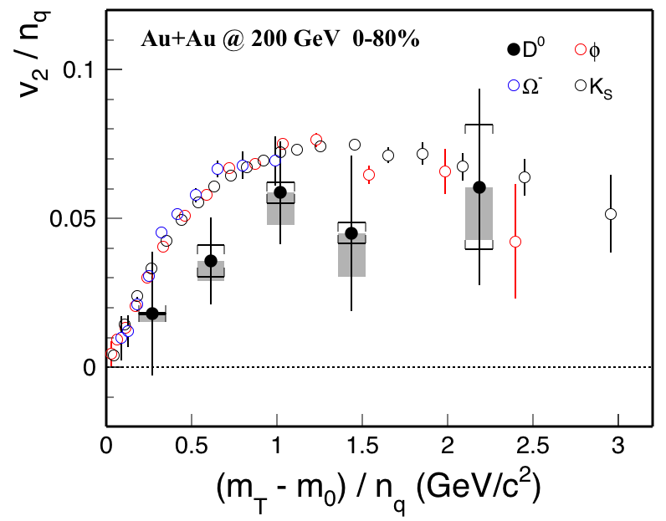
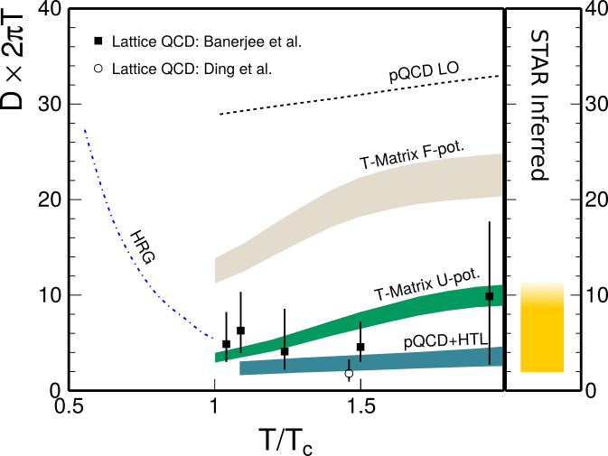
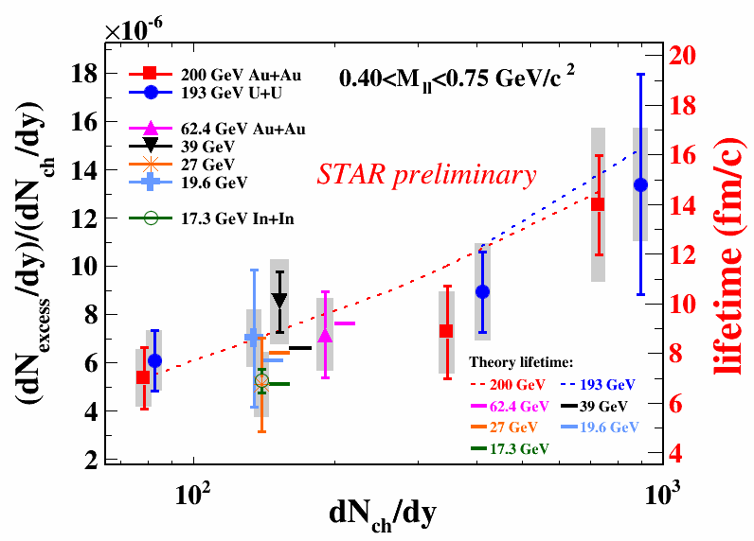
(STAR QM15) Penetrating Probes
STAR Preliminary
Brownian motion (diffusion) of heavy quarks
Heavy Flavor Tracker (HFT) delivers
its first results
First result of quarkonia suppression
from the Muon Telescope Detector (MTD)
Charm flows at RHIC top energy
Extracted diffusion coefficient compared
to theory
Low-mass di-electron production
Measured in many systems (Au+Au, U+U, p+p)
and different energies (19.6, 27, 39, 62, 200 GeV)
Quantifying how vector mesons evolve in the medium
The yields probe timescale of collisions
PLB750(2015)

Slide 13
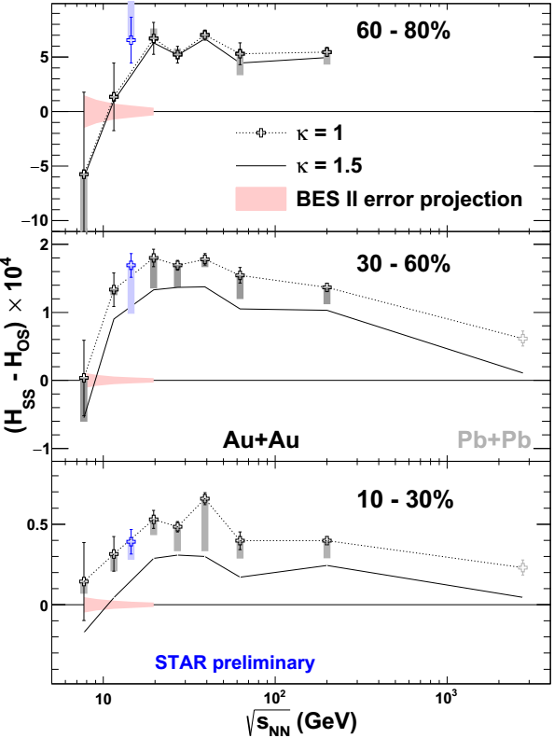
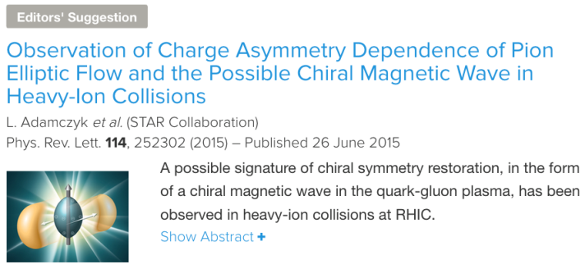
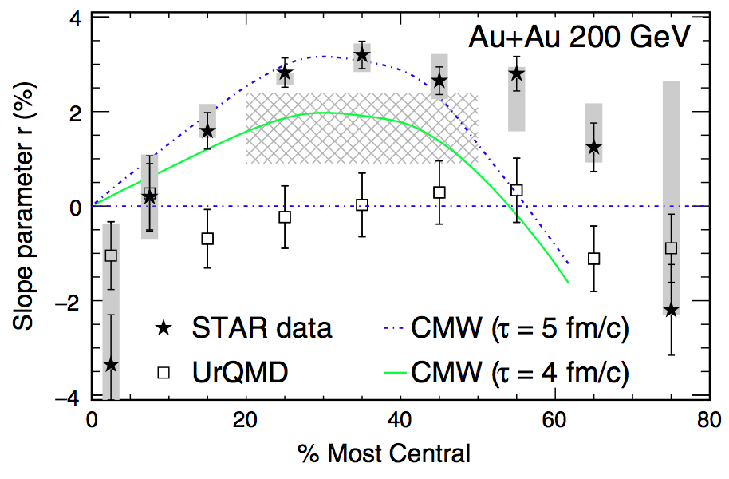
QCD phase transition is a chiral phase transition (I)
PRL113(2014)
Charge separation (14.5GeV)
Bulk charge dependence of π± v₂
Low-mass dilepton excess
Global polarization of hyperons

Slide 14
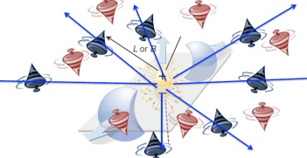
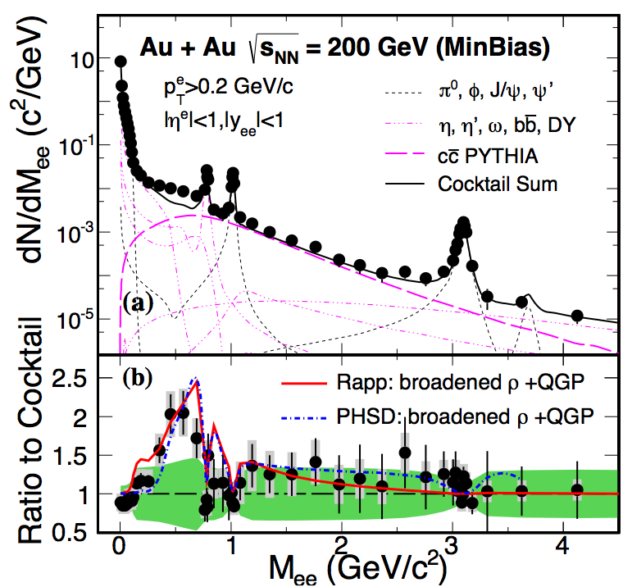
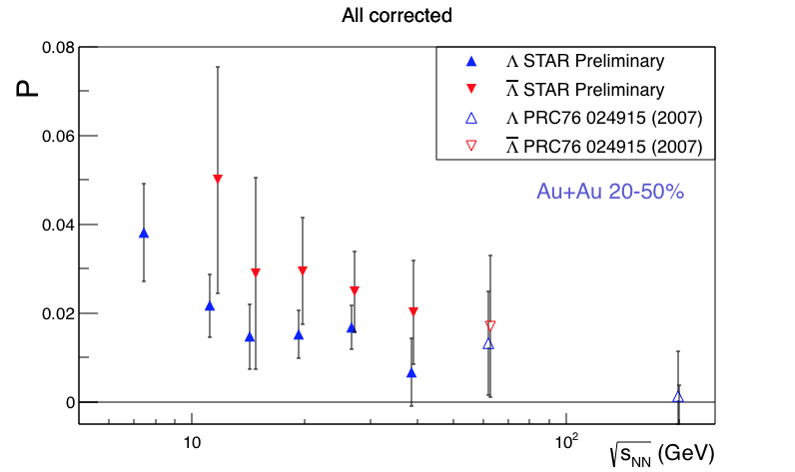
QCD phase transition is a chiral phase transition
Charge separation (14.5GeV)
Bulk charge dependence of π± v₂
Low-mass dilepton excess
Global polarization of hyperons
PRL113(2014)

Slide 15
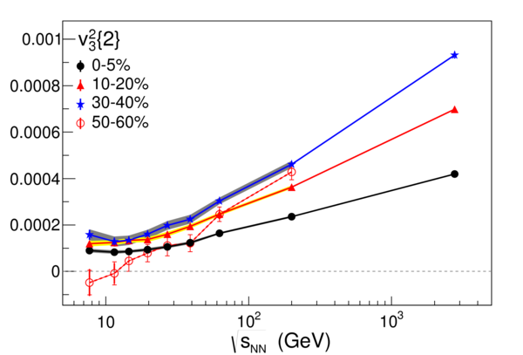
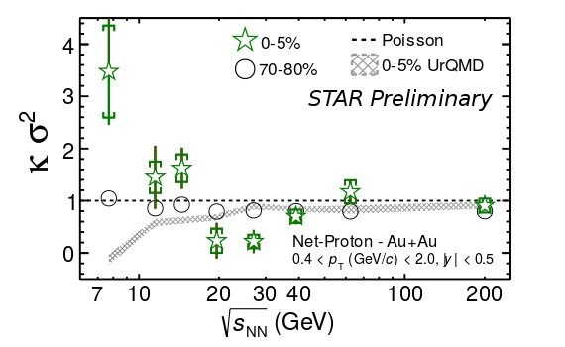
(STAR) Map QCD phase diagram (I)
PRL 116(2016)
PRL112(2014)
Beam Energy Scan Program:
Turn off QGP Signatures
triangle flow (v₃) in peripheral at low energy
consistent with zero
Search for critical point
net-proton Kurtosis possibly not Poissonian and
grow with accepted rapidity window
AND…

Slide 16
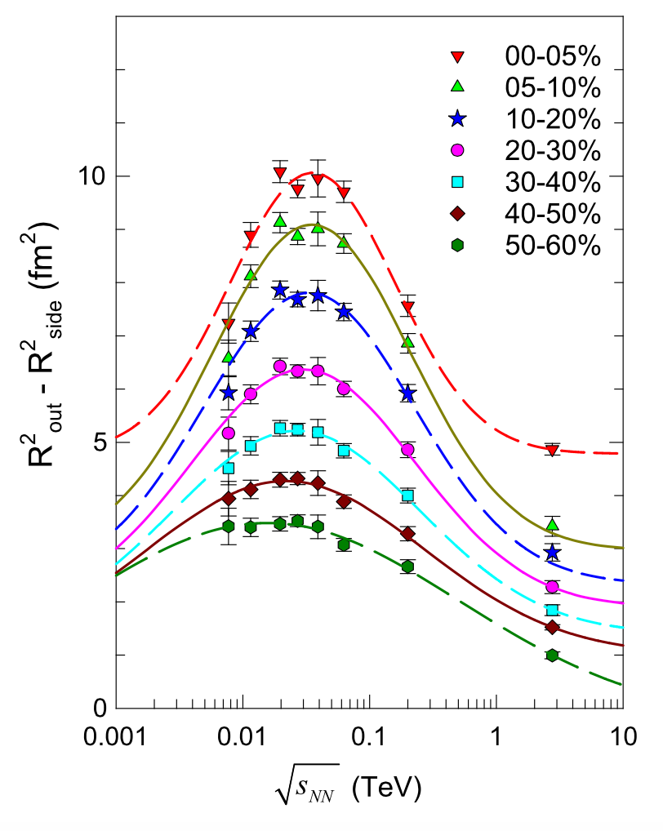
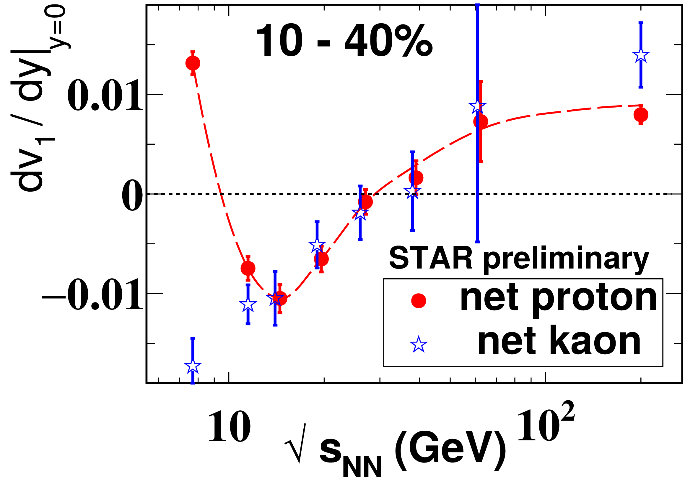
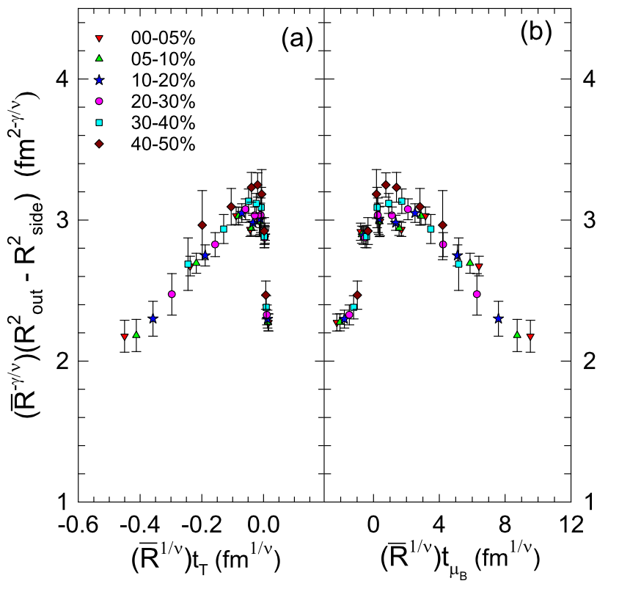
(STAR) Map QCD phase diagram (II)
PRL112(2014)
Beam Energy Scan Program:
…
Search for first-order phase transition
  minimum net-proton v1 slope from
  interplay between baryon stopping and soft EOS
  Finite Size (HBT) Scaling shows Criticality
  compressibility, speed of sound?
R. Lacey, PRL 114, 142301 (April 2015)
STAR, PRC92(2015)

Slide 17
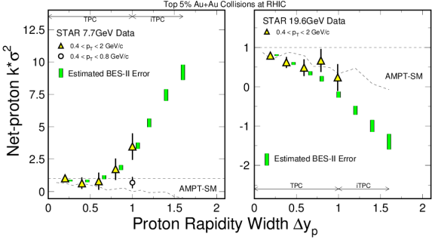
Detector Upgrades necessary for net-proton Kurtosis
Reach the necessary rapidity width of the correlation/fluctuation (~1-2 unit)
B. Ling and M. Stephenaov, Phys.Rev. C93 (2016) 034915

Slide 18
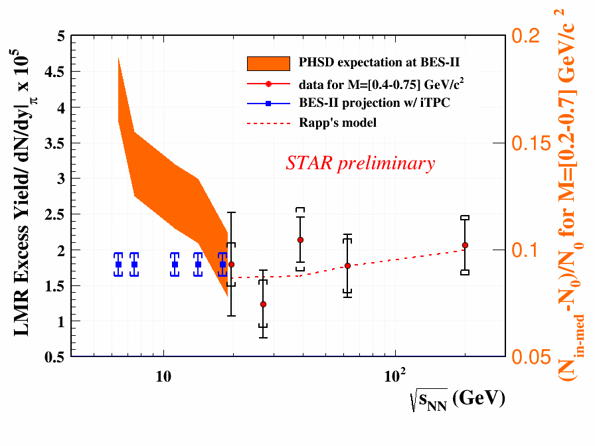
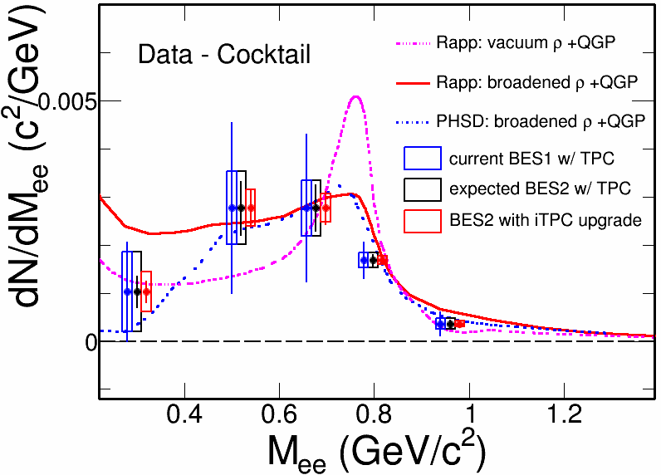
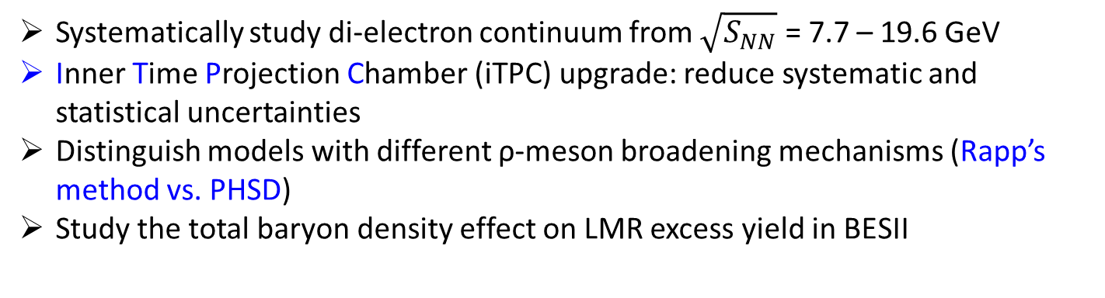
Enable Di-electron measurements
Systematically study di-electron continuum from $\sqrt{S_{NN}}$ = 7.7 – 19.6 GeV
Inner Time Projection Chamber (iTPC) upgrade: reduce systematic and statistical uncertainties
Distinguish models with different ρ-meson broadening mechanisms (Rapp’s method vs. PHSD)
Study the total baryon density effect on LMR excess yield in BESII

Slide 19
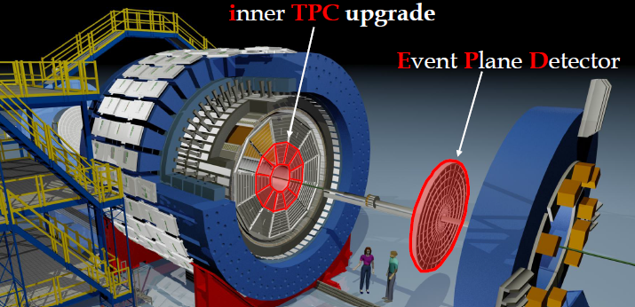
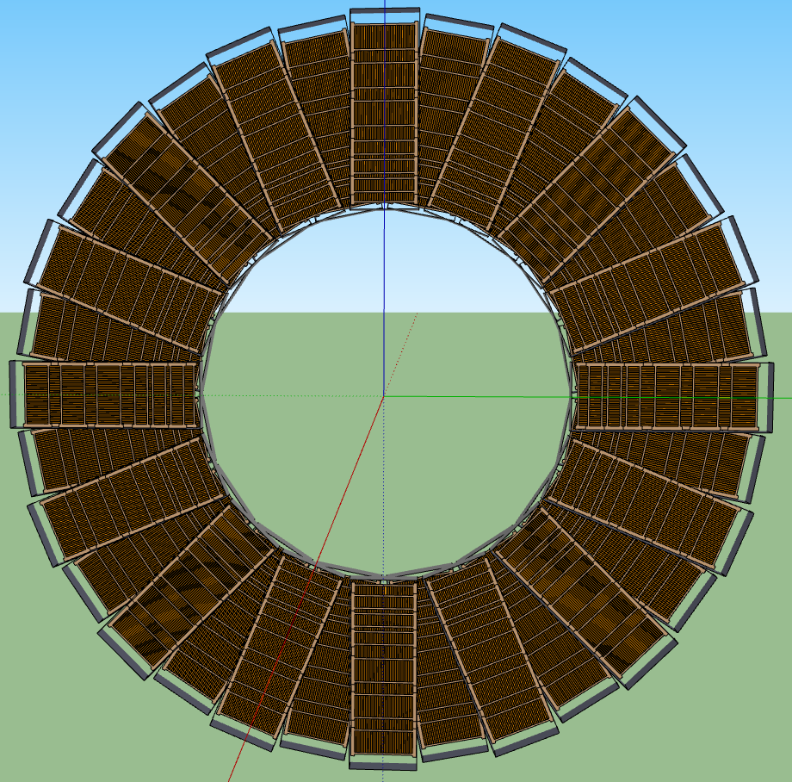
The STAR Upgrades and BES Phase II
Major improvements for BES-II
Endcap TOF
EPD Upgrade:
Improves trigger
Reduces background
Allows a better and independent reaction plane measurement critical to BES physics
iTPC Upgrade:
Rebuilds the inner sectors of the TPC
Continuous Coverage
Improves dE/dx
Extends η coverage from 1.0 to 1.5
Lowers p_{T} cut-in from 125 MeV/c to 60 MeV/c
EndCap TOF Upgrade:
Rapidity coverage is critical
PID at η = 0.9 to 1.5
Improves the fixed target program
Provided by CBM-FAIR

Slide 20
STAR is a multi-purpose detector; with modern capabilities
Period | Physics | Upgrades
2008 | Generic | Trigger QT
2009 | Generic | TPC/DAQ1000
2010-2011 | BES I, PID | TOF
2013--2015 | Heavy-Flavor | HFT, MTD
2015--2016 | Heavy-Flavor Diffractive, nPDF | FMS, FPS, Roman Pots
2017 | Spin Sign Change Diffractive | FMS Post-shower
2018 | Isobar (Zr, Ru), CME, dileptons | (EPD?)
2019--2020 | BES II | iTPC, EPD, CBM endcap TOF
2022-2023 | High-statistics Unbiased Jets, Open Beauty, PID FF Drell-Yan, Longitudinal correl | Forward West, HFT+?
>50M$ worth of upgrades going into 2019+

Slide 21
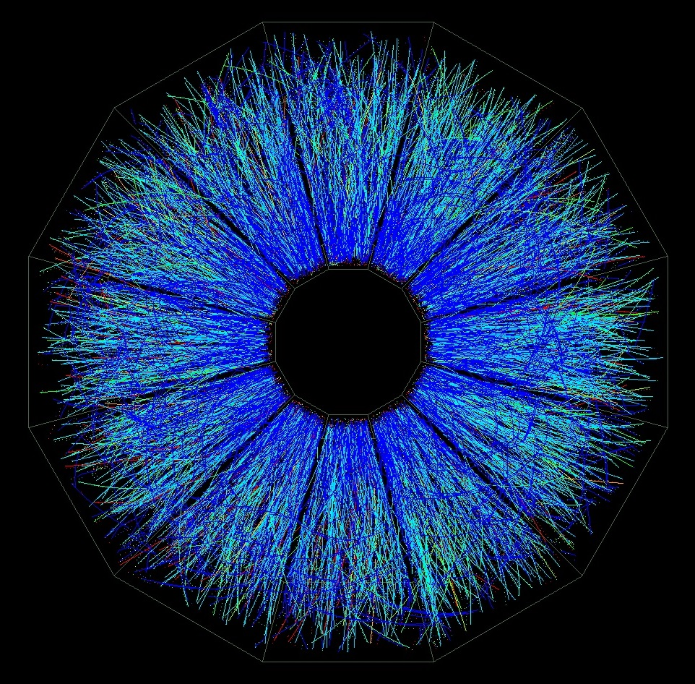
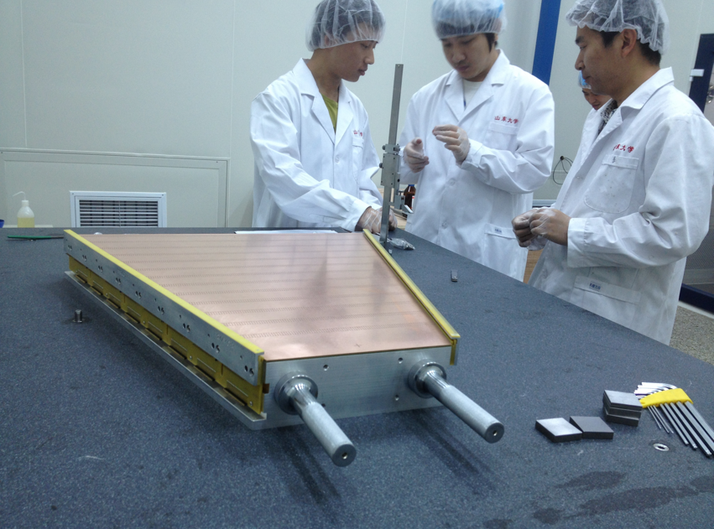
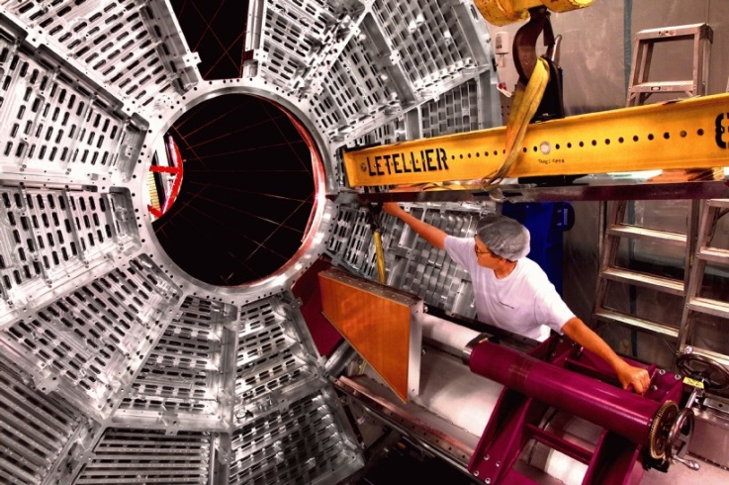
iTPC project
Rebuilds the inner sectors of the TPC
Continuous Coverage
Improves dE/dx
Extends η coverage from 1.0 to 1.5
Lowers p_{T} cut-in from 125 MeV/c to 60 MeV/c
https://drupal.star.bnl.gov/STAR/starnotes/public/sn0644

Slide 22
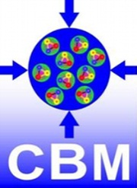
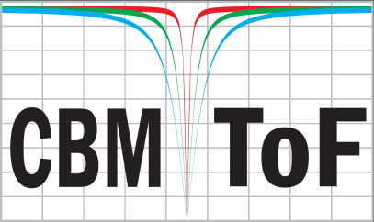
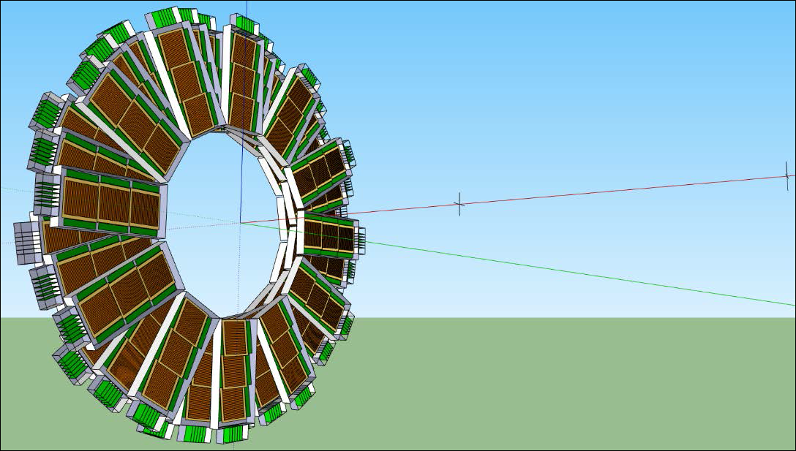
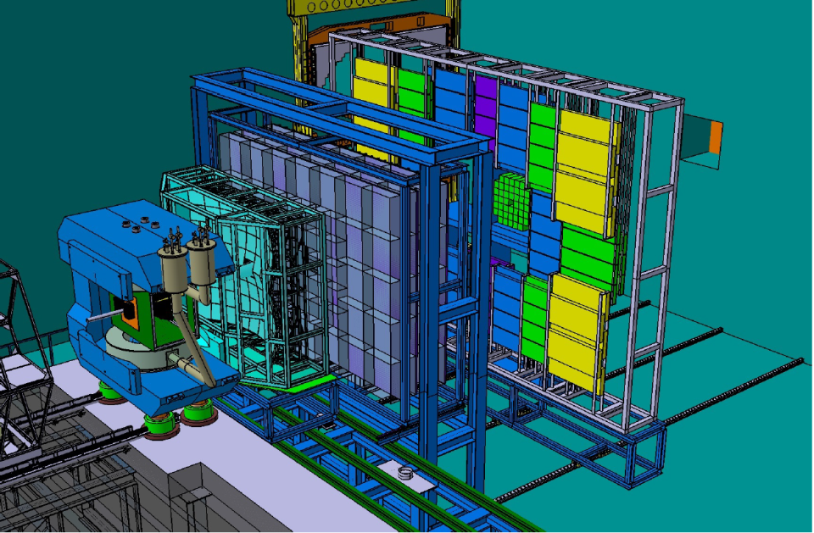


ToF Wall proposal for STAR
Active area: 8.7 m²
MRPC: 32 x 6 cm²
MRPC: 32 x 12 cm²
Chinese glass
# RPCs: 2 x 192
# channels: 24576
Granularity and overlap may be higher than needed
3940
CBM
920
RICH TRD TOF
Ingo Deppner (Heidelberg)

Slide 23
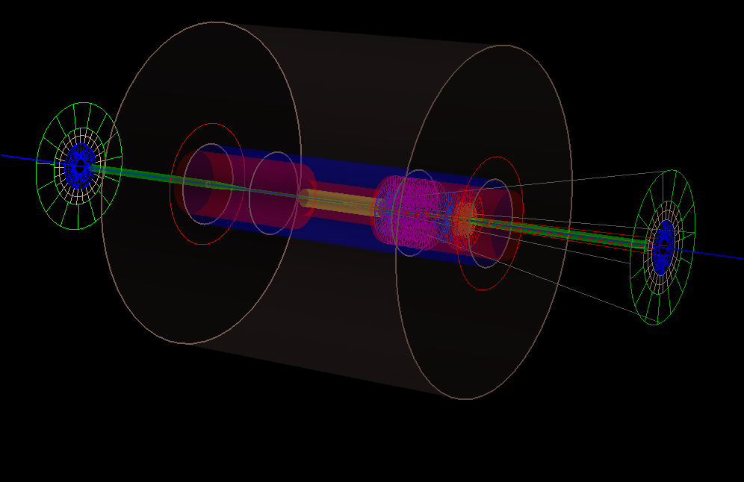
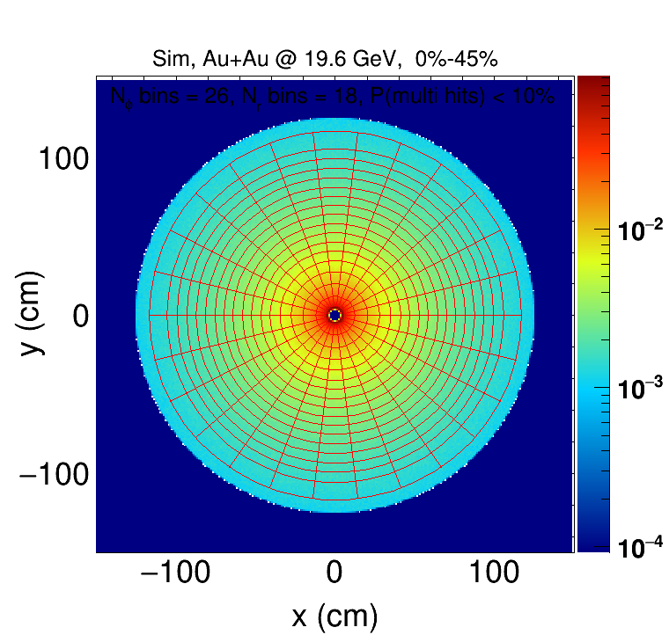
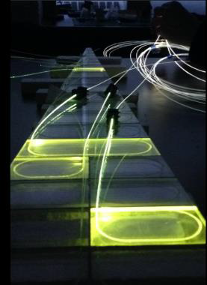
Event Plane Detector
24 sector design
16 channels per sector
Optimal pad sizes determined through simulation
2.3<η<5.0

Slide 24
Rapidity Coverage (<=2017)
TPC+FMS (2016-2017)
TPC-FMS
FMS-FMS
TPC-FMS

Slide 25
Rapidity Coverage (BES-II)
TPC+iTPC+eTOF+EPD+FMS (2019--)
TPC-FMS
FMS-FMS
TPC-FMS

Slide 26
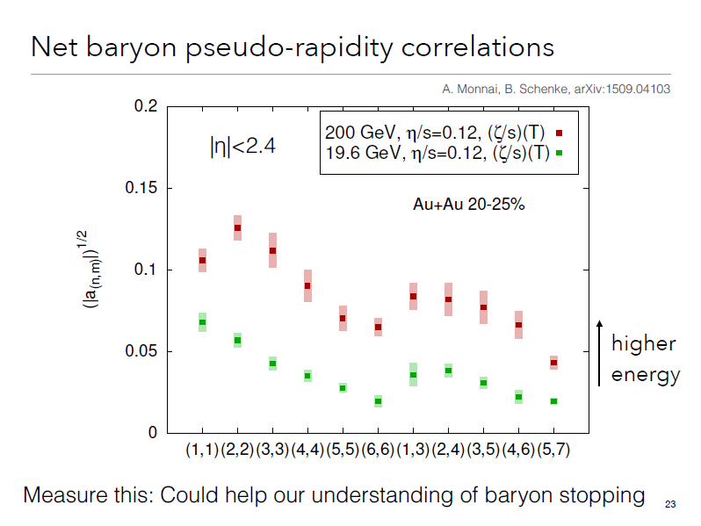
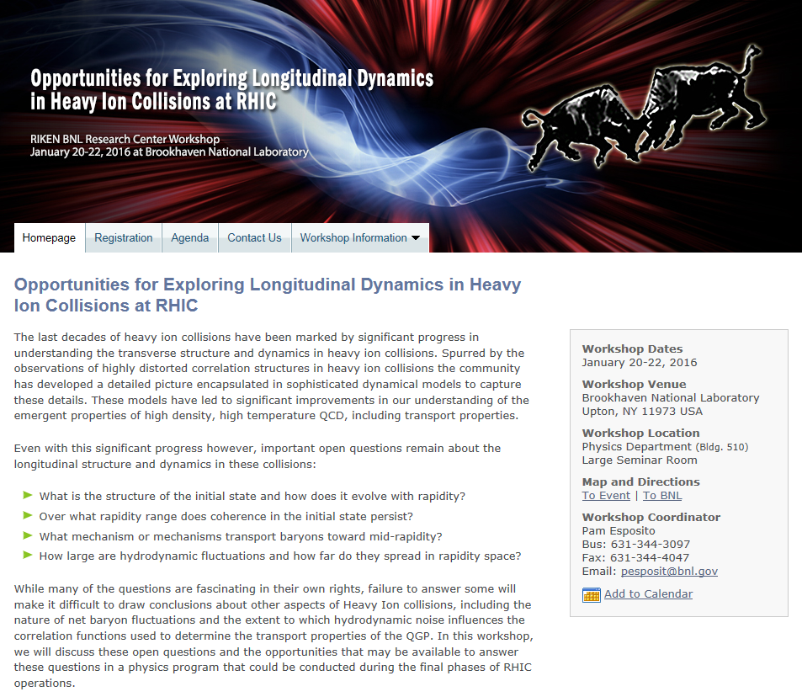
η/s and 3+1D hydrodynamics
Uncertainties in the correct physics of the initial state are still problematic:
gluon saturation or Glauber?
To what extent do thermal fluctuations during the expansion phase contribute to the correlations observed in the data?
Both of these pressing uncertainties can be addressed by extending the longitudinal acceptance of the STAR detector.
In addition, unexplored topics on particle ID (baryon, strangeness) correlations.

Slide 27
Statistics Needed in BES-II
Collision Energies (GeV): | 7.7 | 9.1 | 11.5 | 14.5 | 19.6
Chemical Potential (MeV): | 420 | 370 | 315 | 260 | 205
Observables | Millions of Events Needed
R_{CP} up to p_{T} 4.5 GeV | NA | NA | 160 | 92 | 22
Elliptic Flow of φ meson (v₂) | 100 | 150 | 200 | 300 | 400
Local Parity Violation (CME) | 50 | 50 | 50 | 50 | 50
Directed Flow studies (v₁) | 50 | 75 | 100 | 100 | 200
asHBT (proton-proton) | 35 | 40 | 50 | 65 | 80
net-proton kurtosis (κσ²) | 80 | 100 | 120 | 200 | 400
Dileptons | 100 | 160 | 230 | 300 | 400
Proposed Number of Events: | 100 | 160 | 230 | 300 | 400
QGP
1st P.T.
C.P.
EM Probes

Slide 28
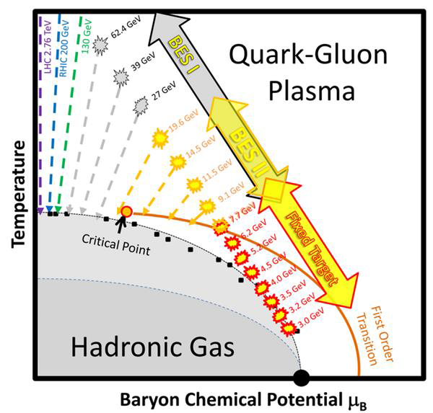
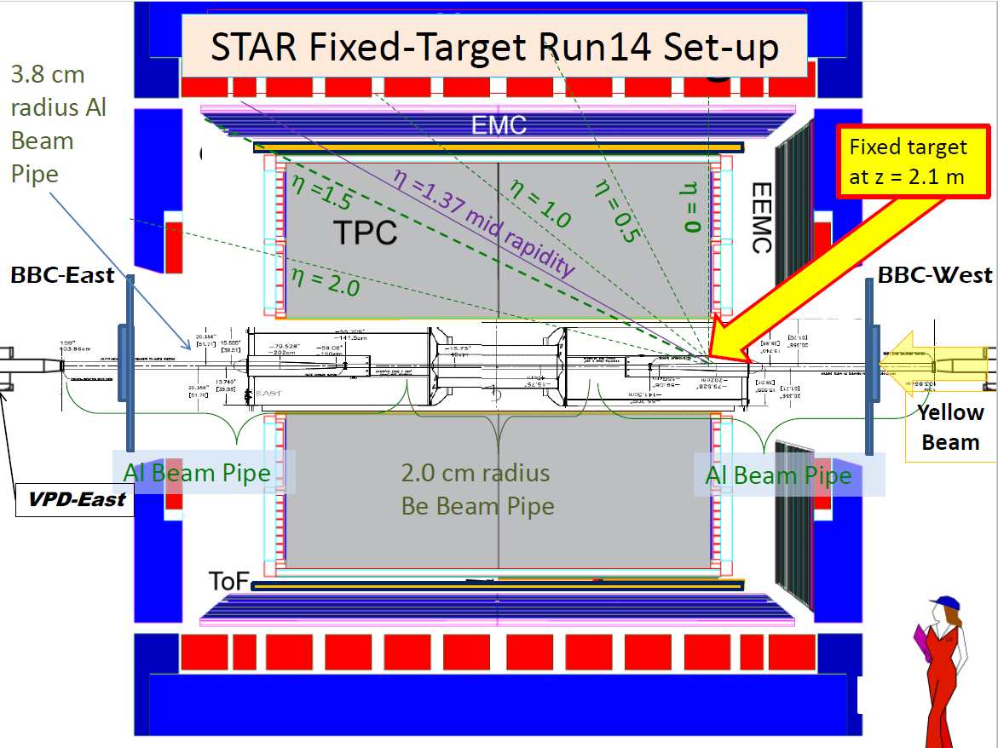
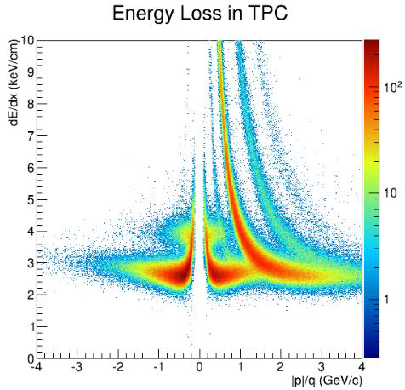
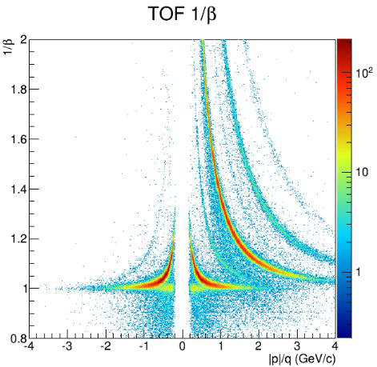
Fixed Target Program with STAR
Extend energy reach to
overlap/complementary AGS/FAIR/JPARC
Real collisions taken in run 14 and results
(K. Meehan @ QM15 & WWND16)
Upgrades (iTPC+eTOF+EPD) crucial
Unprecedented coverage and PID
for Critical Point search in BES-II
Spectra, flow, fluctuations and correlations
Au+Au FXT at 3.9GeV

Slide 29
Summary
We have signs of rapid transition from BES-I in the regime of BES-II energy range.
Many measurements in BES-II will allow us to pin down the location of a rapid transition in signals:
HBT, v_{n}, Kurtosis, chirality (dilepton, charge separation)
Collider luminosity and detector upgrades necessary to achieve NSAC recommendation on BES-II program
Need significant theory input (BES Theory Topical Collaboration):
what constitutes a BES-II discovery (first-order phase transition or critical point)?
How a follow-up should be carried out?
This is an exciting time for potentially the biggest discovery in the field.
As the only collider experiment in that time period, responsibility is enormous. We know we can do this.

