Slide 1
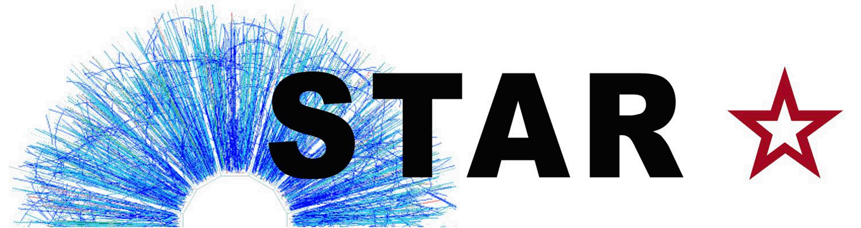
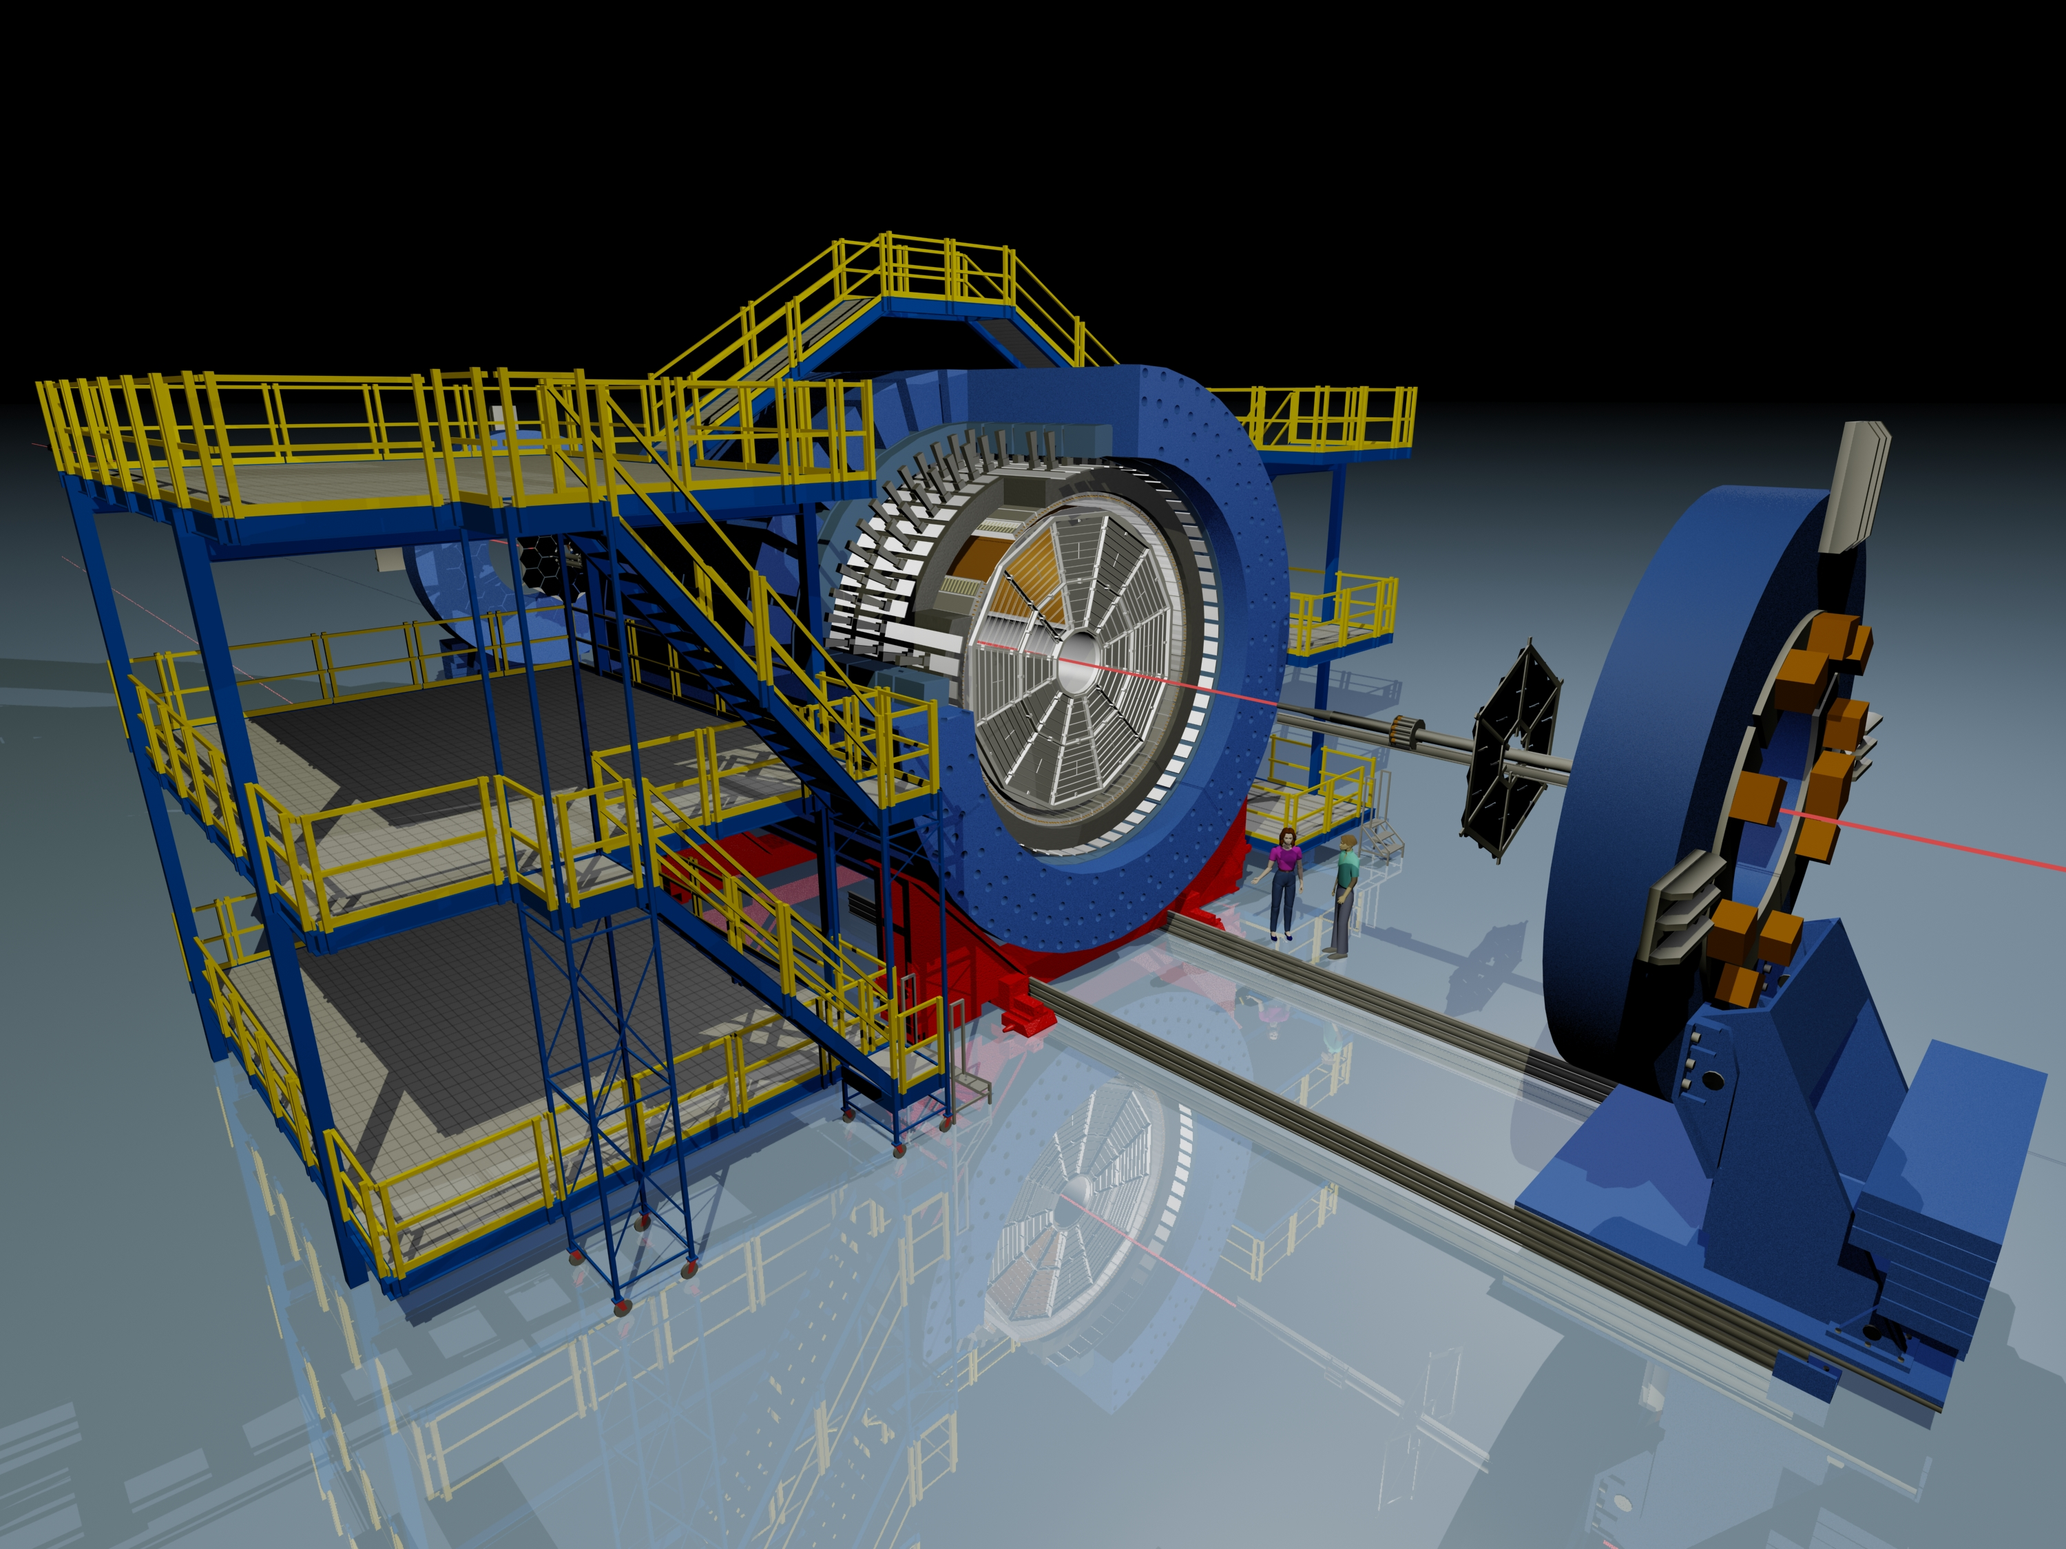
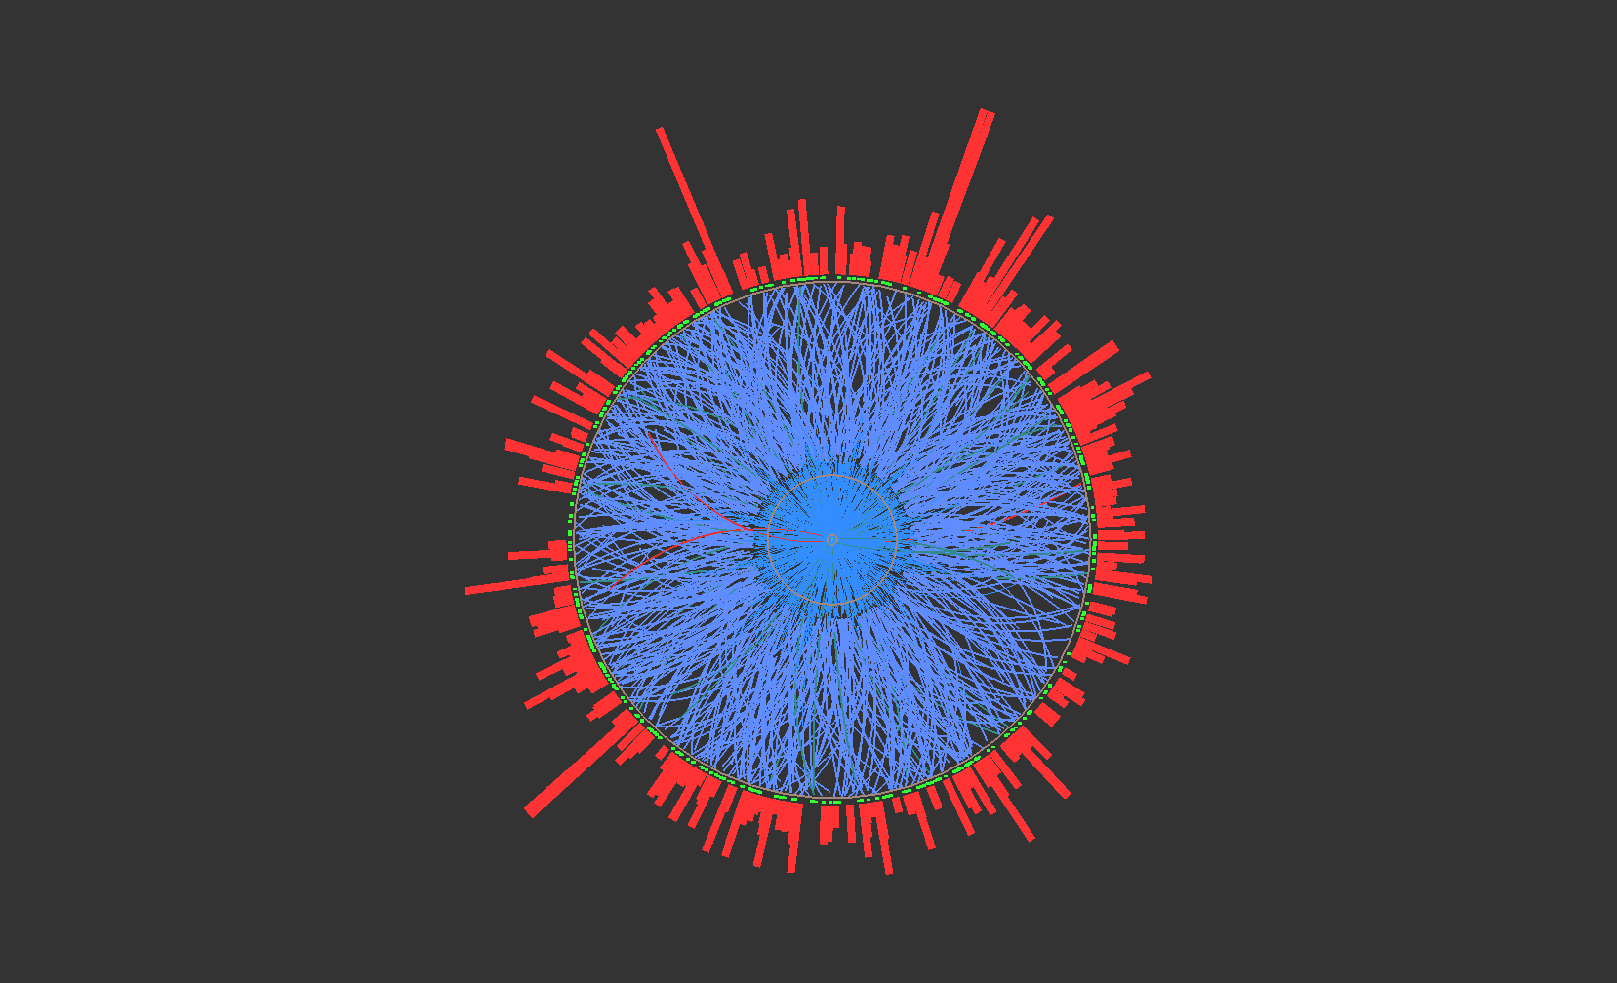
Semi-inclusive charged jet measurements in Au+Au collisions at √s_{NN}= 200 GeV
Peter Jacobs
Lawrence Berkeley National Laboratory
for the STAR Collaboration

Slide 2

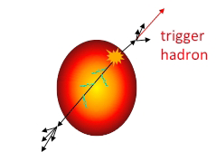
Observable: semi-inclusive h+jet correlation
Trigger-normalized yield of jets recoiling from a high p_{T} hadron trigger
Measured
Calculable in pQCD
Recoil jet
acceptance
Semi-inclusive: event selection only requires trigger hadron
experimentally clean; trigger bias theoretically calculable
Count all recoil jet candidates:
uncorrelated background corrected at level of ensemble-averaged distributions
jet selection does not impose fragmentation bias
Trigger
hadron
Expected geometric bias: surface, not tangential
Large path length for recoil
Model studies: T. Renk, PRC74, 024903; H. Zhang et al., PRL98 212301;…

Slide 3
Analysis details
Dataset
Year 2011 data: Au+Au, √s_{NN}=200 GeV
Minbias trigger; 500M events after cuts
  Offline centrality selection 0-10%, 60-80% (mid-rapidity raw multiplicity)
Charged jet reconstruction
Charged tracks: 0.2<p_{T}^{track}<30 GeV/c
Algorithm: anti-k_{T}, R=0.2, 0.3, 0.4, 0.5
  Jet centroid: |η^{jet}|<1.0 – R
  Recoil jet centroid acceptance: [π−π/4, π+π/4]
Recoil jet
acceptance
Hadron trigger
Charged particle, 9<p_{T}<30 GeV/c
  Inclusive selection: choose one trigger particle without regard to rest of event ➔ trigger may not be highest p_{T} track
Trigger
hadron
Uncorrelated background measured via mixed events (new method)
Correction for background fluctuations and instrumental effects
  Event-wise pedestal shift ρ*A (Fastjet prescription)
  Unfolding of ensemble averaged distribution
Corrected p_{T}^{jet} > 0
Procedures are coupled

Slide 4
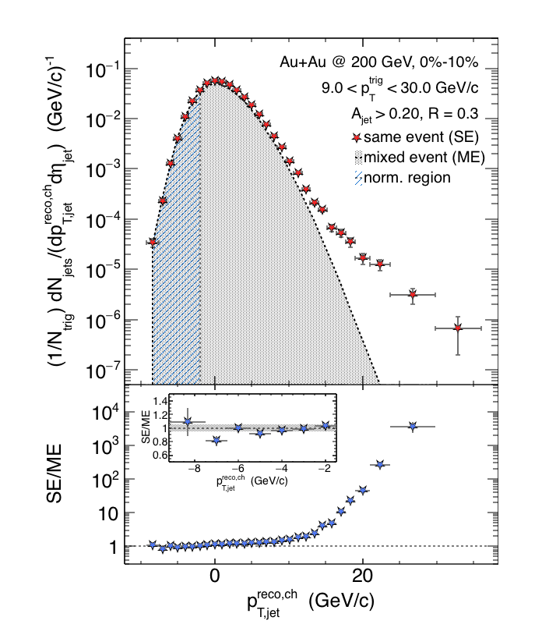
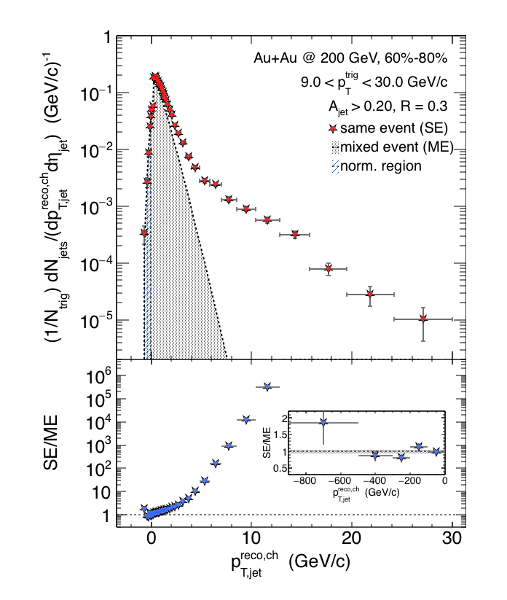

Recoil jet spectrum
Recoil jets
ρ = estimated background energy density
Trigger
hadron
Central Au+Au
Peripheral Au+Au
Preliminary
Preliminary
Mixed event distribution is good description of combinatorial jet background

Slide 5
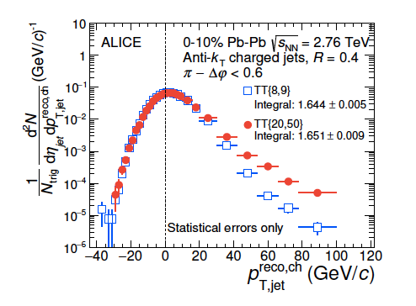
Recoil jet spectrum: RHIC vs LHC
Recoil jets
Central Au+Au, √s_{NN}=200 GeV
Trigger
hadron
Closely related ALICE measurement
arXiv:1506.03984
Central Pb+Pb, √s_{NN}=2.76 TeV
Preliminary

Slide 6
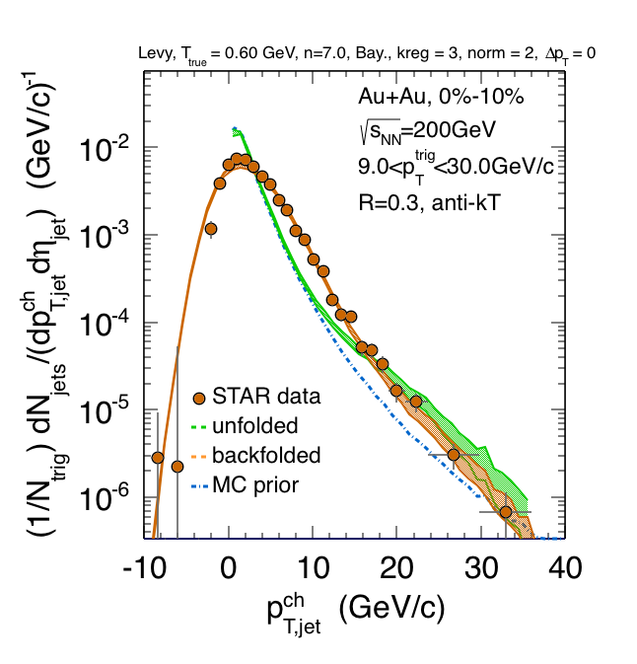
Correction of p_{T}-scale via unfolding
SE-ME
Preliminary
SE-ME
Preliminary
Unfolding generates large off-diagonal covariance➔ corrected distribution is unbinned
  Unfolding algorithms: SVD, Bayesian
  Systematic variations: prior, regularization, tracking efficiency, ME normalization, bkgd fluctuation distribution
  Consistency check: χ² of backfolding

Slide 7
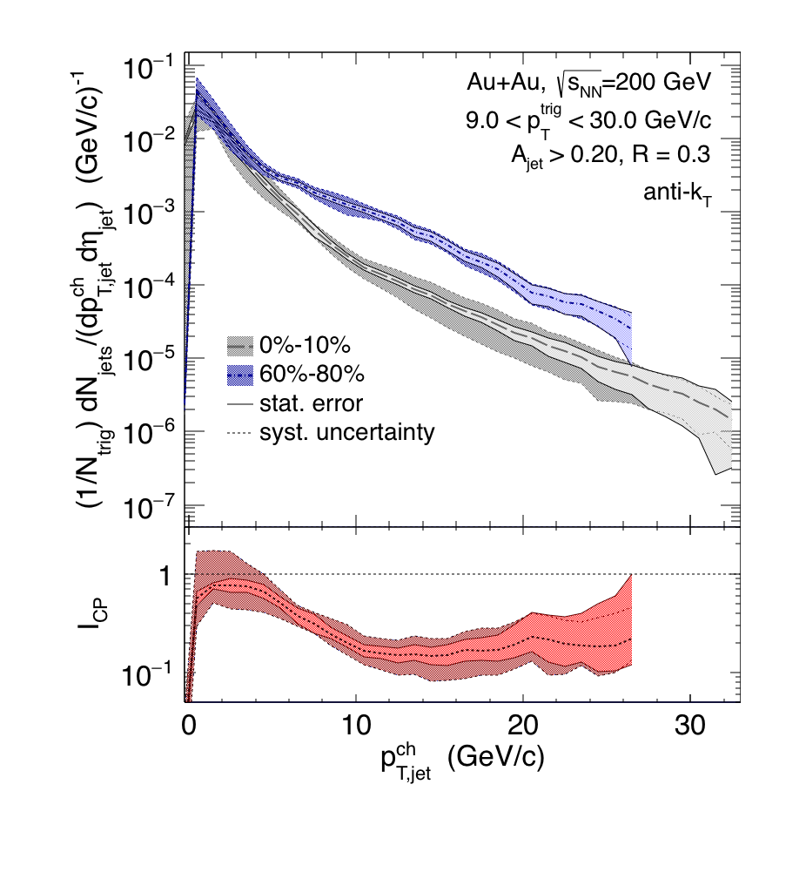
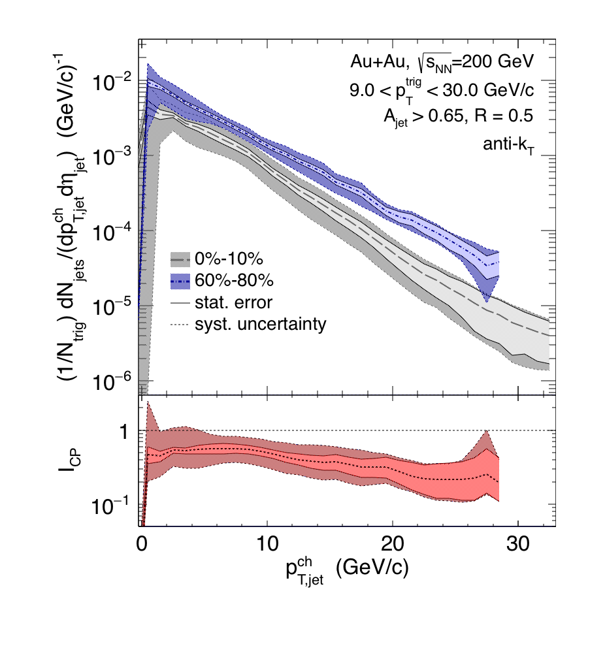
Recoil yield suppression
R=0.3
R=0.5
Preliminary
Preliminary
Calculate spectrum shift
requires distributions ~ exponential, ratio ~ flat
RHIC: smaller shift for larger R
R=0.5: smaller shift at RHIC than LHC
Out-of-cone energy transport ?
comparison requires similar trigger bias ➔ theory calculation
Spectrum Shift Periph/pp ➔Central
 | p^{ch}_{T,jet} range [GeV] | Shift R=0.3 [GeV] | Shift R=0.5 [GeV]
Au+Au @ 200 GeV | [10,20] | -6.3 ± 0.6 ± 0.8 | -3.8 ± 0.5 ± 1.8
Pb+Pb @ 2.76 TeV ALICE arXiv:1506.03984 | [60,100] |  | -8 ± 2

Slide 8
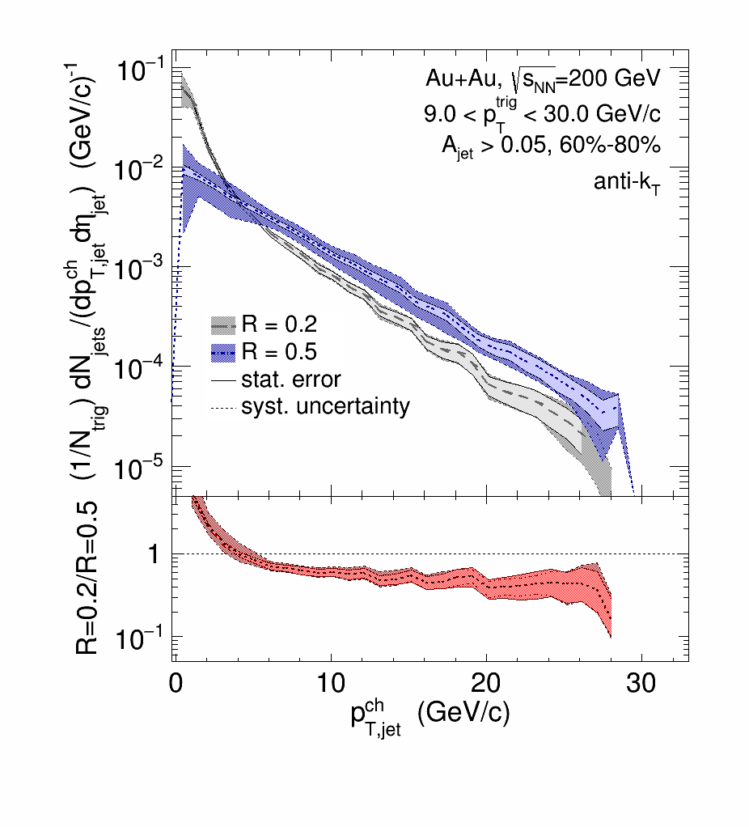
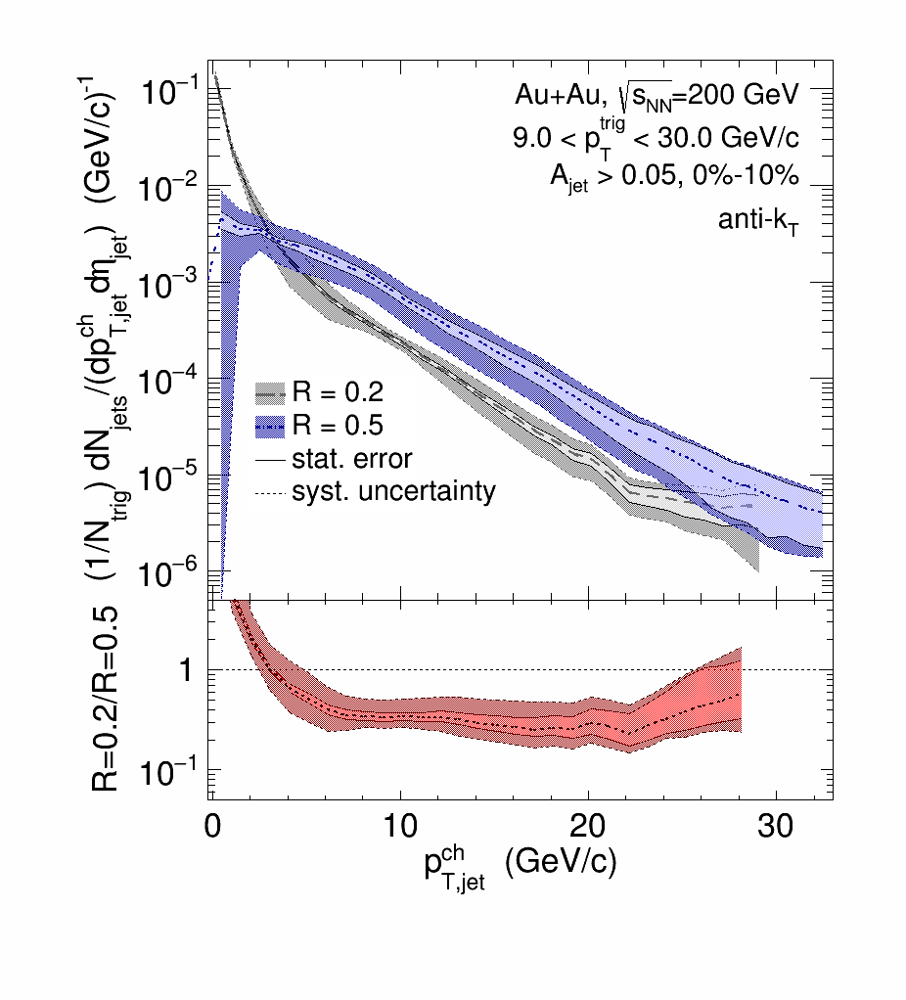
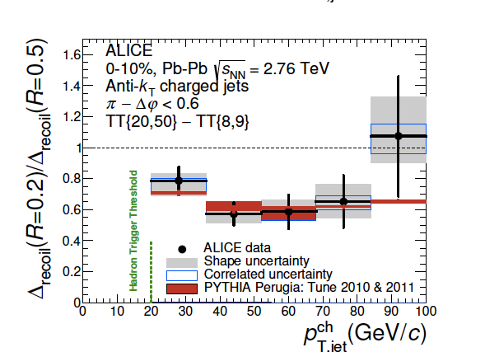
Intra-jet broadening: recoil yield vs. R
Redistribution of jet energy transverse to jet axis
Au+Au peripheral
Au+Au central
0.5
Preliminary
Preliminary
Au+Au central
0.3
arXiv:1506.03984
Ratios for peripheral and central are consistent within uncertainties
compatible with some broadening within R<0.5
future measurement (higher stats): reduce uncert.
LHC: similar picture in overlapping p_{T} range

Slide 9
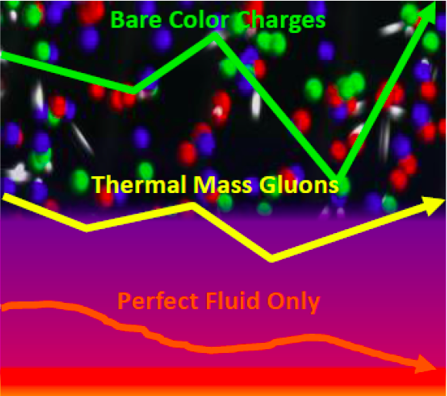
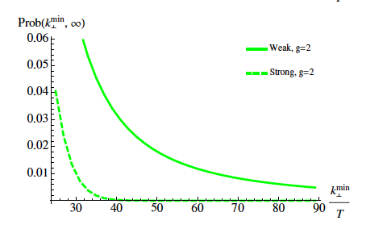
Inter-jet broadening: secondary scattering off the QGP
Discrete scattering centers or effectively continuous medium?
d’Eramo et al, arXiv:1211.1922
Distribution of momentum transfer k_{T}
Strong coupling:
Gaussian distribution
Conjecture for weak coupling: Δφ distribution dominated by single hard Molière scattering at “sufficiently large” Δφ
vacuum QCD effects fall off more rapidly
“sufficiently large” not yet known
?
Δφ

Slide 10
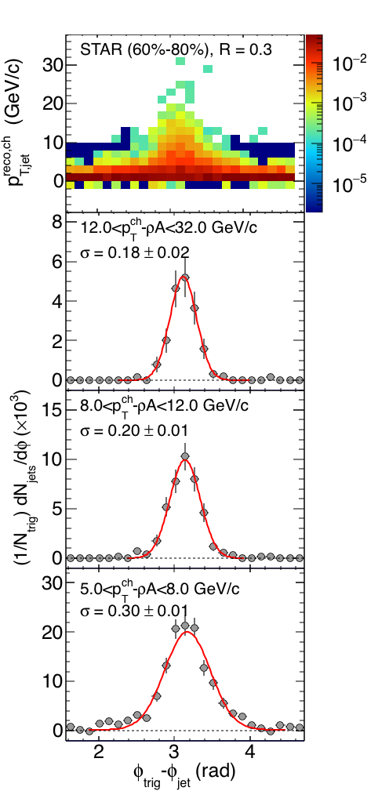
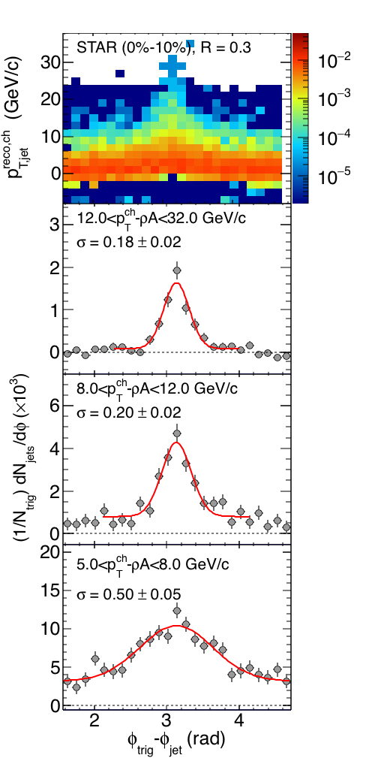
Inter-jet broadening: data
Δφ
Quantitative search requires absolute normalization
  ➔ semi-inclusive distribution
Au+Au √s_{NN}=200 GeV
p_{T}^{trig}>9 GeV/c
peripheral
central
Consistent with zero at current precision
Low energies: hint of finite yield at large Δφ yield at but not fully corrected for uncorrelated background
QCD calculation in progress (d’Eramo): will indicate integrated luminosity needed for significant measurement
Preliminary
Preliminary
Δφ
Δφ

Slide 11
Summary and Outlook
Semi-inclusive h+jet correlations:
jet measurements with large R over full p_{T} range at RHIC
comparable to similar ALICE measurement
Recoil yield is suppressed
Suggests less out-of-cone energy transport for
large R
central A+A collisions
central AA @ RHIC vs. LHC
Intra-jet broadening:
compatible with some broadening within R<0.5
Large-angle scattering: probe quasi-particle degrees of freedom in QGP
proof of principle; low energy jets are crucial
QCD calculation in progress ➔ future measurements at RHIC and LHC
Next step: extend to fully measured jets with BEMC (higher int lumi in Year 14 data)
reduced systematic uncertainties for all observables
Theory calculations needed to assess biases, compare RHIC/LHC

Slide 12
Backup slides

Slide 13
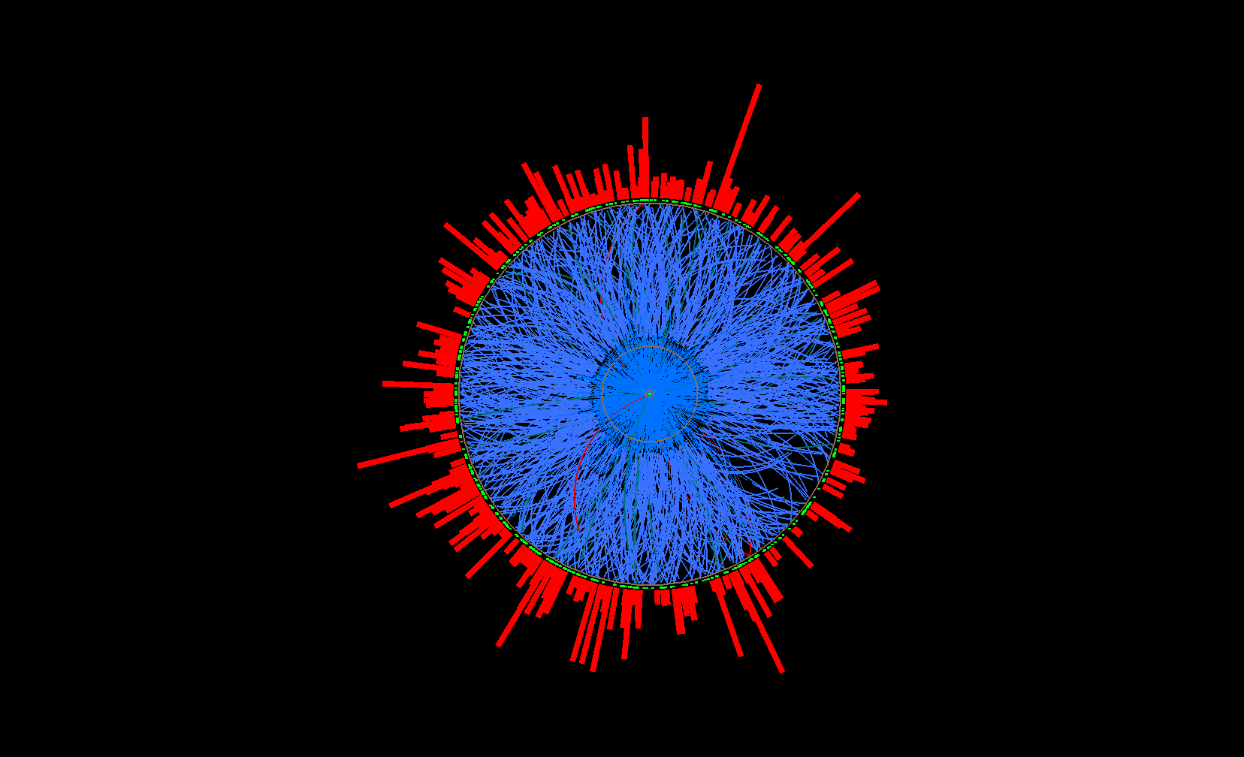
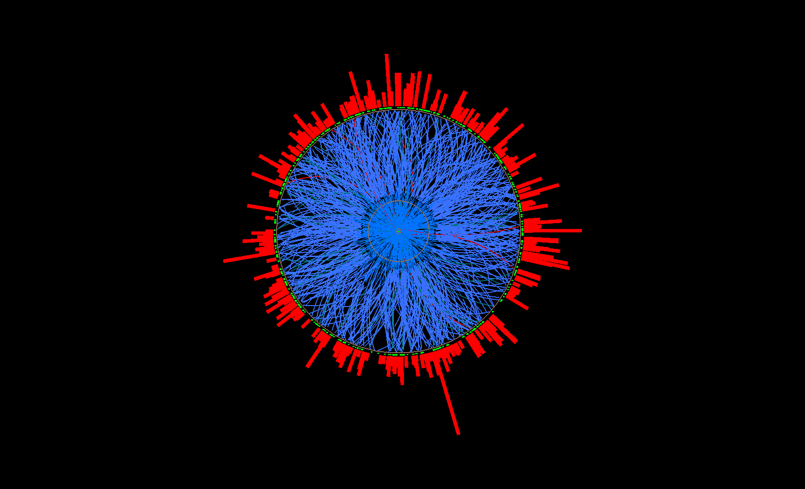
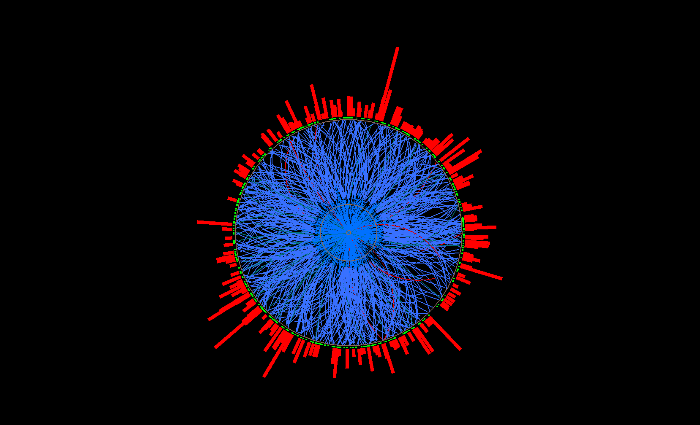
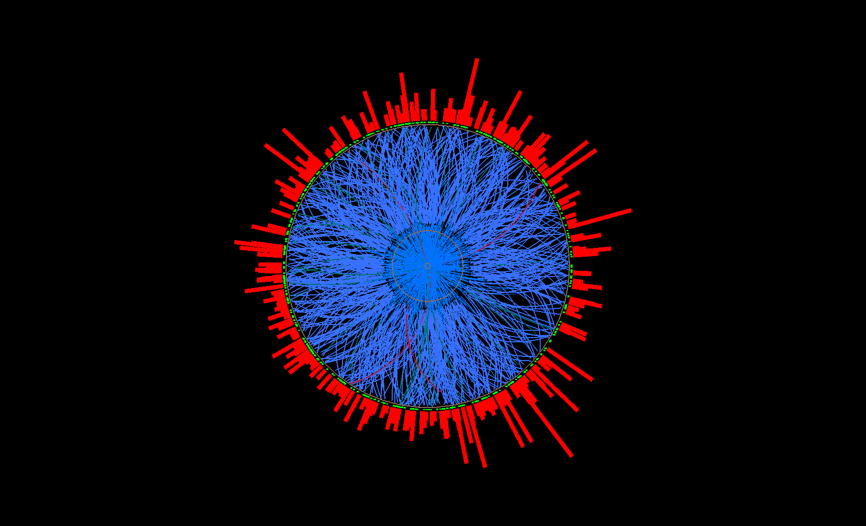
Uncorrelated Background: Mixed Events
Mixed event
Mix only similar centrality, Ψ_{EP} ,
z-vertex position
Pick one random
track per real event
→ add to mixed
event
…
Ev. 1
Ev. 2
Real events
Ev. 3
Ev. 765

Slide 14
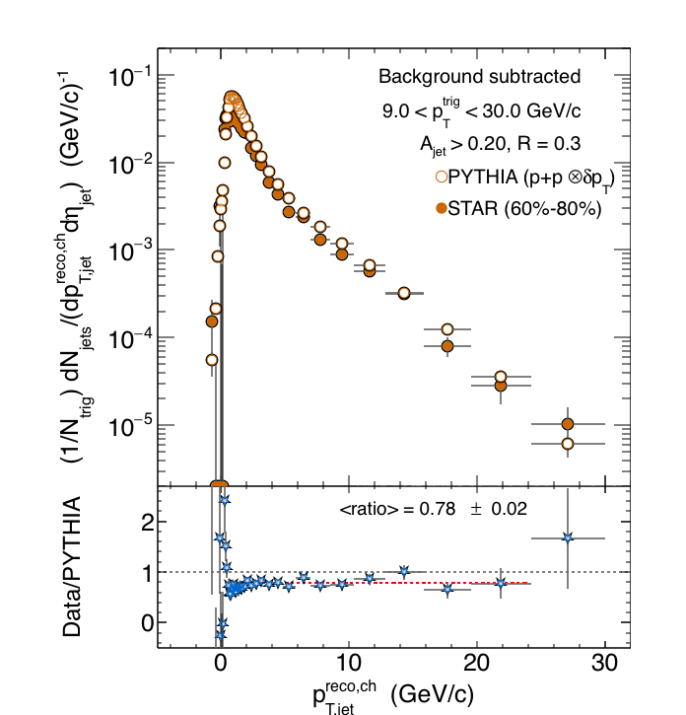
Comparison of recoil jet spectra:
STAR Au+Au 60-80 and PYTHIA pp
Peripheral 60-80%
Smeared PYTHIA: convolute recoil jet spectrum from p+p@200 GeV with distribution of background fluctuations
Compare Au+Au 60-80% with smeared PYTHIA
Both shape and yield in good agreement

Slide 15
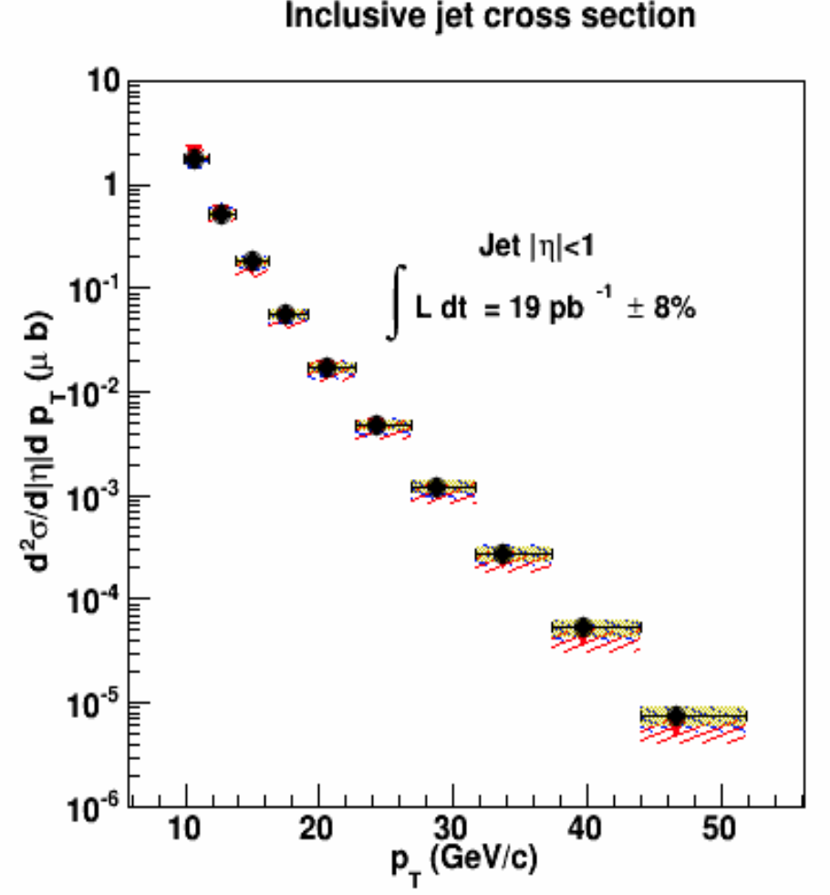
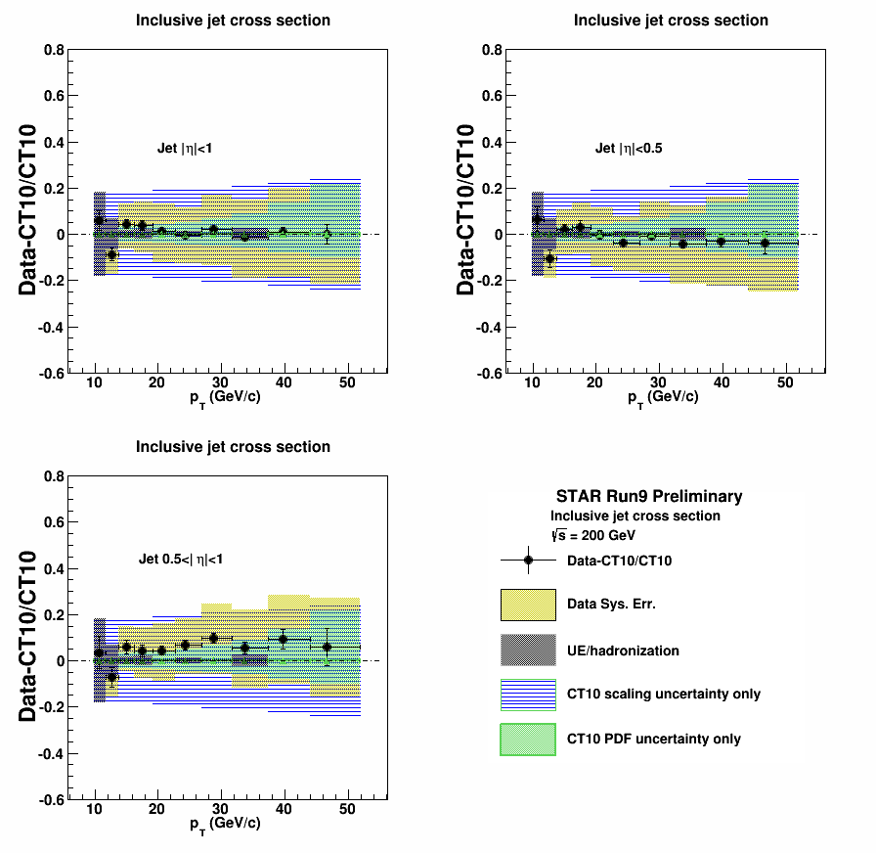
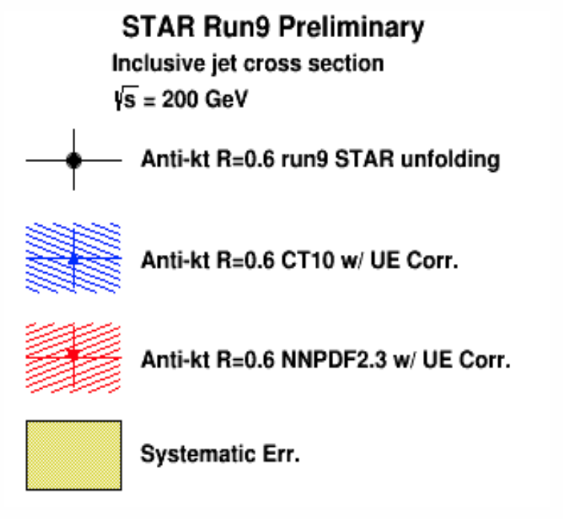
Jets in STAR: inclusive jet cross section in p+p collisions at √s=200 GeV
Good and improvable systematic uncertainties over broad kinematic range
Good agreement with NLO pQCD
Jets in heavy ion collisions: instrument is in place, need the right algorithms

Slide 16
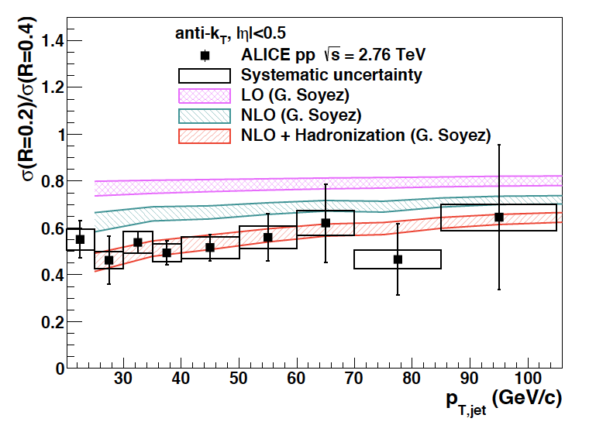
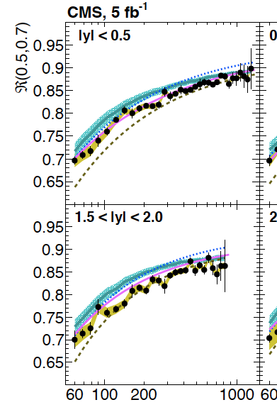
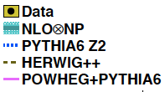
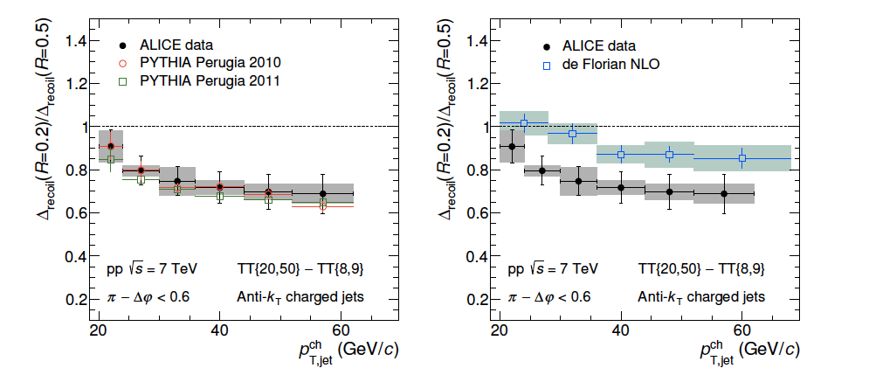
Intra-jet structure:
(semi-)inclusive ratios at different R
Inclusive jets, pp √s= 2.76, 7 TeV
Jets with different R sensitive to different components of shower
CMS 5 fb⁻¹
Phys.Rev. D90 (2014) 072006
R
σ(R=0.2)/σ(R=0.4)
σ(R=0.5)/σ(R=0.7)
pp √s=7 TeV
Phys.Lett. B722 (2013) 262
Calculable perturbatively:
require (N)NLO + non-pert. corrections
MC models ~OK
p_{T}^{jet} (GeV)
Semi-inclusive h+jet, pp √s=7 TeV
Ratios in vacuum
sensitive to transverse jet structure
rigorous data/theory comparison
➔ Now use to measure intra-jet broadening due to quenching
arXiv:1506.03984

Slide 17
Secondary scattering off the QGP: low p_{T}^{jet}
ΔΦ, at low p_{T}
Peripheral
Preliminary
Significant difference at 5 < p_{T}-ρA < 8 GeV/c
→ Flow?
→ Φ dependent normalization needed?
→ Background from multiple interactions?
→ More studies needed!
Central
Preliminary

