Slide 1



Improving Energy Resolution for the STAR Forward Calorimeter System
David Kapukchyan
for the STAR Collaboration
Fall Meeting of APS Division of Nuclear Physics
October 2022, New Orleans, LA
Supported in part by:

Slide 2
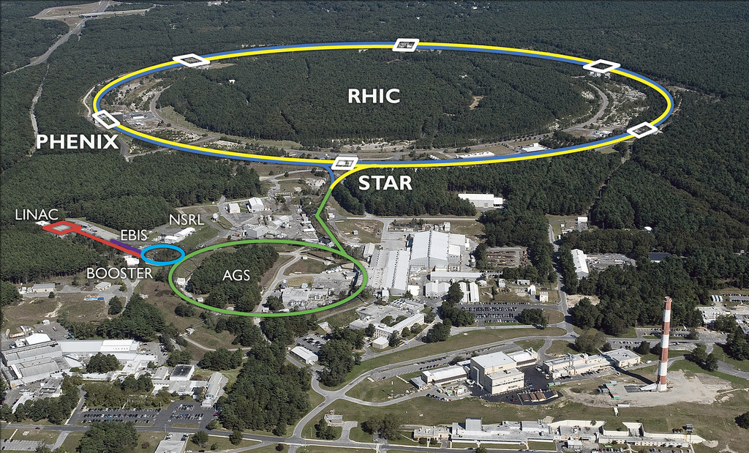
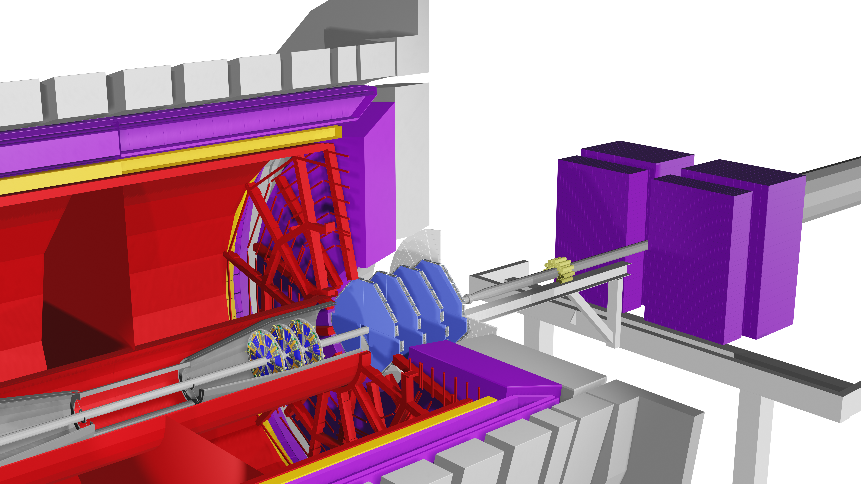
STAR Forward Upgrade
STAR detector is located at the Relativistic Heavy Ion Collider (RHIC) at Brookhaven National Lab on Long Island NY
RHIC is the only polarized pp collider in the world
Upgraded Forward Calorimeters
Preshower (EPD)
Electromagnetic (ECal)
Hadronic (HCal)
Upgrades STAR capabilities in 2.5<𝜂<4
Almost full 2𝜋 coverage in azimuth
Tracking and Calorimetry will provide excellent PID
Tracking
small strip Thin Gap Chambers
Silicon Disks

Slide 3
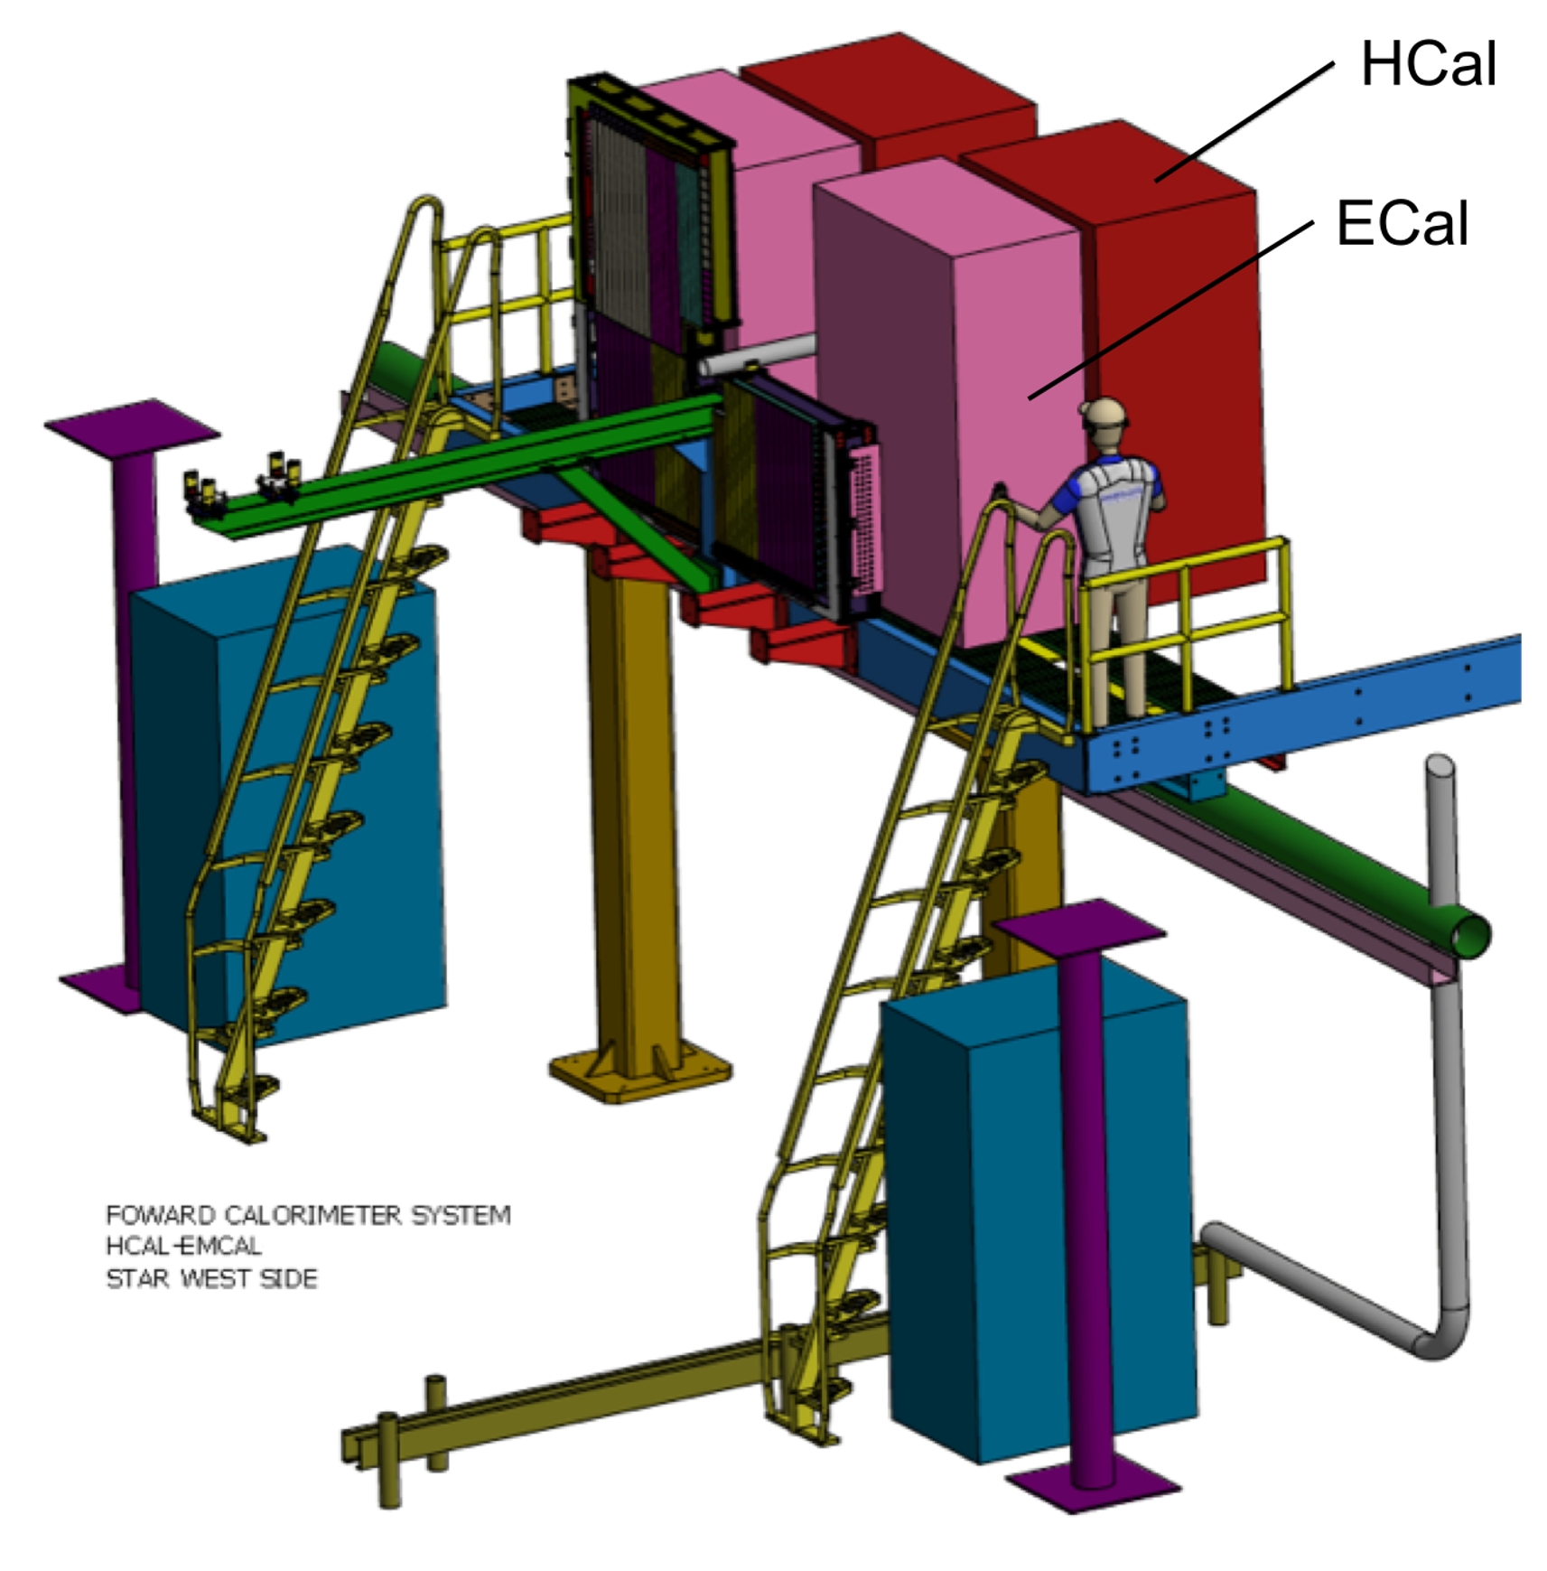

Forward Calorimeter System (FCS)
Located ~ 7m from STAR IP on STAR west platform
Both Ecal and Hcal split into two halves (North/South)
Use SiPMs for readout
ECal is Pb/Sc sandwich (from PHENIX)
  ~10%/$\sqrt{E}$
  5x5 cm² lateral size, ~18 $X_{0}$
HCal is Steel/Sc sandwich built from scratch
  ~60%/$\sqrt{E}$
  10x10 cm² lateral size, ~4.5 𝜆
Preshower is existing EPD detector (not shown)

Slide 4
Getting the energy
Signals from a detector are digitized by time integrating the voltage (ADC) of the signal over the whole time of a trigger window
STAR trigger windows are defined by the time between RHIC bunches (bunch crossing)
The energy deposited in the detector (E)=ADC*Gain
  Gain needs to be calibrated
  See Xilin Liang’s talk next
Electronics time integrate Voltage over time to get total charge and convert charge to digital value (ADC)

Slide 5
Digitization of Signal
Sample Signal from DEP showing multiple RHIC bunch crossings
DEP boards digitize signal every ~13.5 ns
This comprises 1 timebin (Tb)
There are 8 Tb in 1 RHIC bunch crossing
There is up to 100 Tb of data for every channel in every event
Energy = (Fitted signal integral)*Gain
  Each signal/peak is fitted to a Gaussian
  Fitted signal to all peaks shown in black
  Amplitude of Gaussian is proportional to integral
Peaks found using discrete second derivative test
Triggered RHIC crossing peak at Tb=50
Peak Start Time
Peak End Time
Peak Start Time
Peak End Time
Peak Start Time
Peak End Time
Peaks outside triggered RHIC bunch crossings

Slide 6
Challenges
Example of Overlapping signals
Fitting is time consuming and want to avoid fitting in cases where it is not needed
  If only 1 peak in the triggered crossing adding up the ADCs is sufficient
Overlapping signals from untriggered RHIC crossing
  Want to eliminate energy contribution coming from surrounding peaks
  Fitting will help but need accurate count of peaks
Second derivative method can identify noise as peaks
  Don’t want to fit a signal to noise
  More peaks → more fitting parameters → computation time
Need to eliminate energy contribution from this peak.
Example of noise identified as peaks
These are extra peaks coming from noise

Slide 7
Eliminating Peaks Coming From Noise
No Tunneling
Compute a probability a peak is a real peak or noise
  Call this method peak tunnelling as it was inspired by quantum tunneling
Assumes noise follows a Normal distribution
  Parameters need to be tuned to data set
Merge peaks that have low probabilities together
  Higher probability peak is identified as peak position when merging
Peaks combined
Peak Tunneling

Slide 8
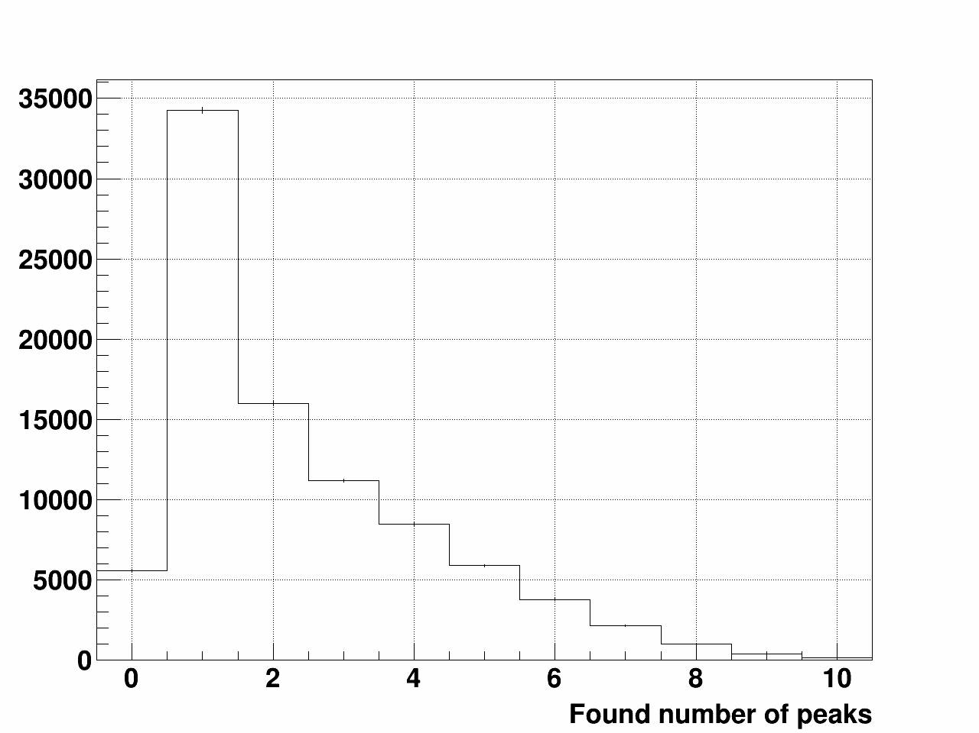
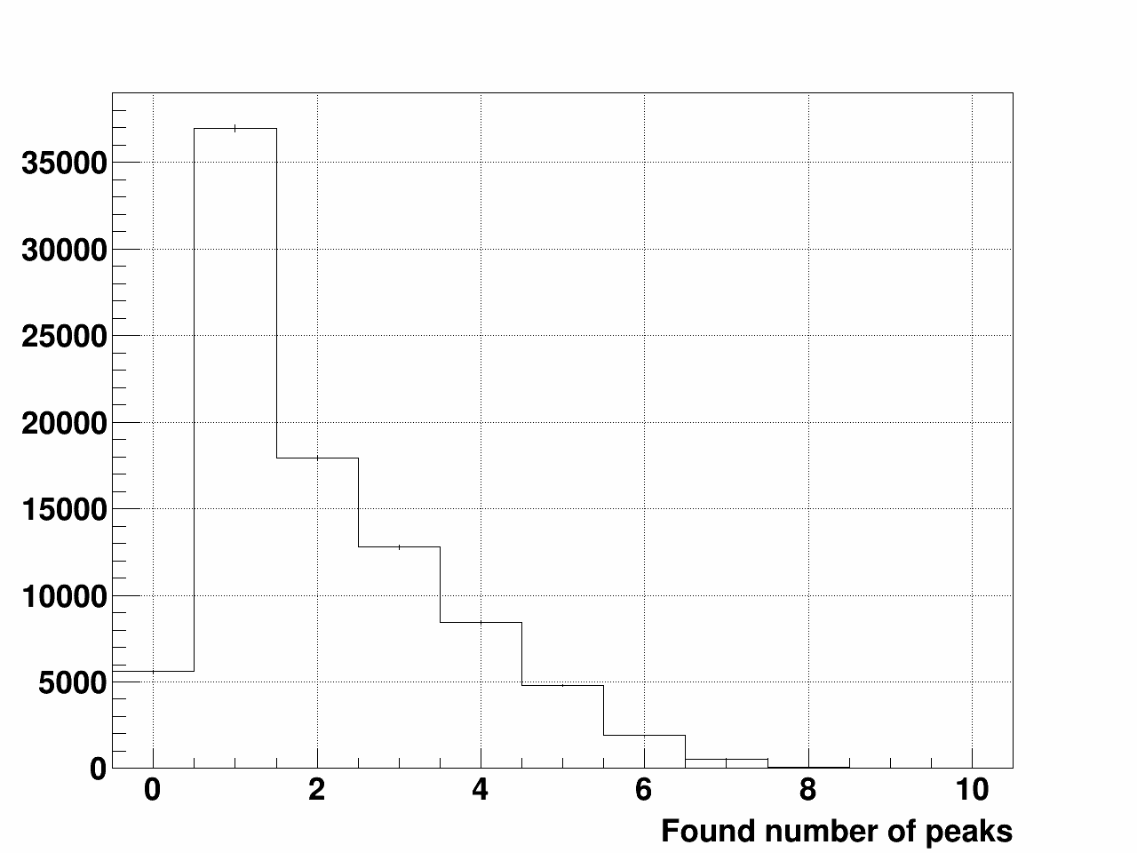
Performance: number of peaks
No Tunneling
Ran 100 events on RHIC run 22 pp data
Plots show number of peaks with and without peak tunneling method
Peak tunneling shows much lower number of peaks on average
Peak Tunneling

Slide 9
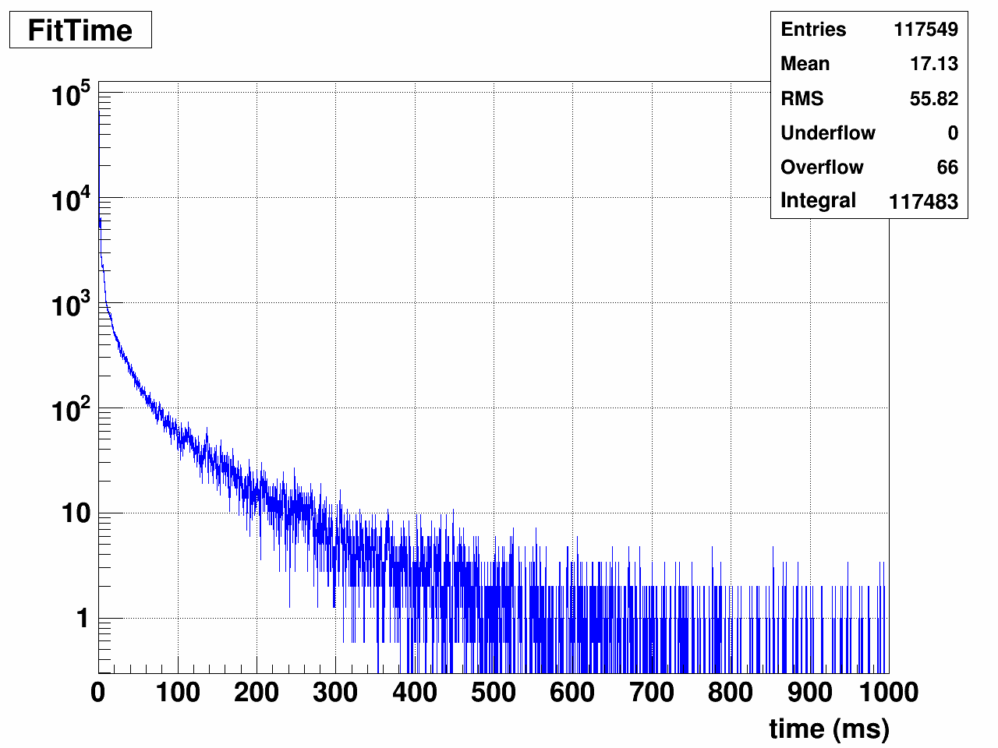
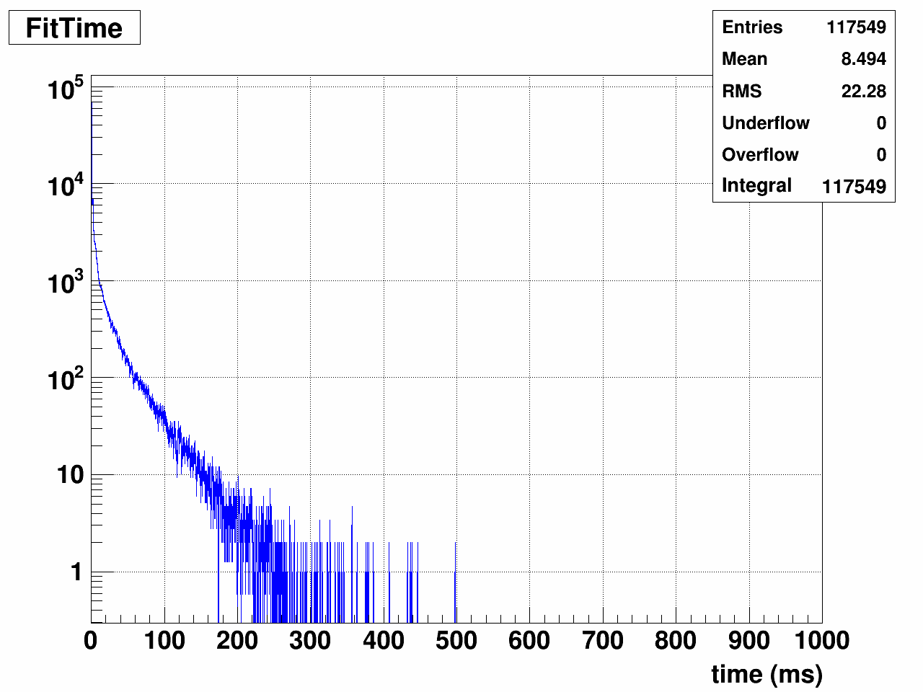
Performance: timing
No Tunneling
Fitting all signals to known signal shape with a fixed number of peaks
Timing with peak tunneling is twice as fast
This is due to less peaks so fewer fitting parameters
Peak Tunneling

Slide 10
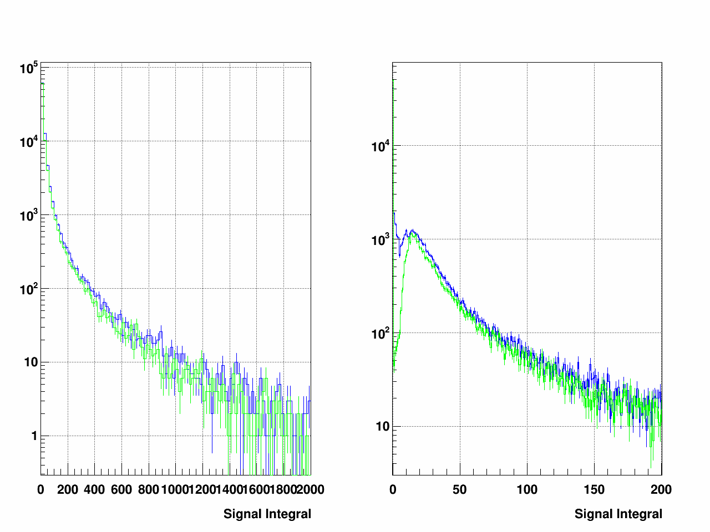
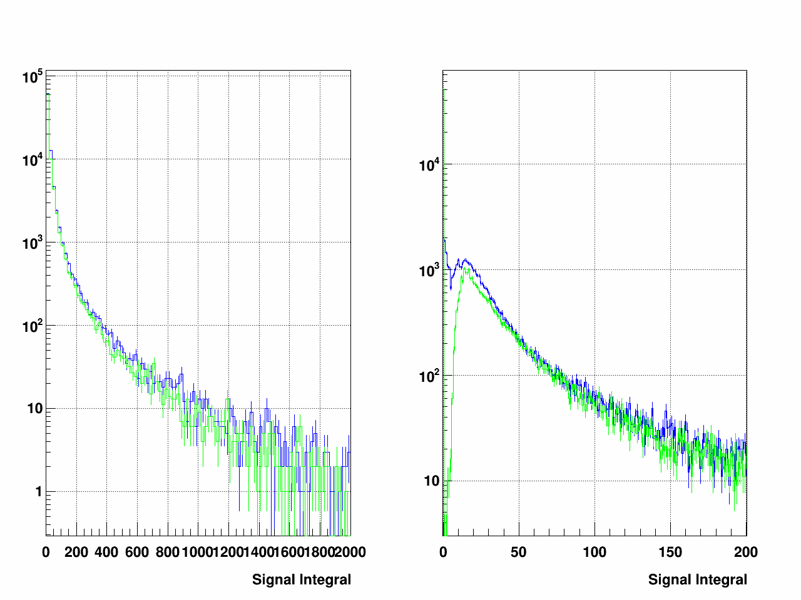
Performance:
ADC Sum
No Tunneling
Blue is Sum8 Method
Green is fitting all peaks
Plots are comparing fitted signal integral with just summing ADCs with and without tunneling
Sum8 method adds ADCs in 8 Tb of triggered RHIC crossing
  Fastest method
  Shown in Blue
Sum8 method to fitting overestimates low side of energy compared to fitting
  Shown in Green
Very little difference in integral sum between with and without tunneling
Peak Tunneling

Slide 11
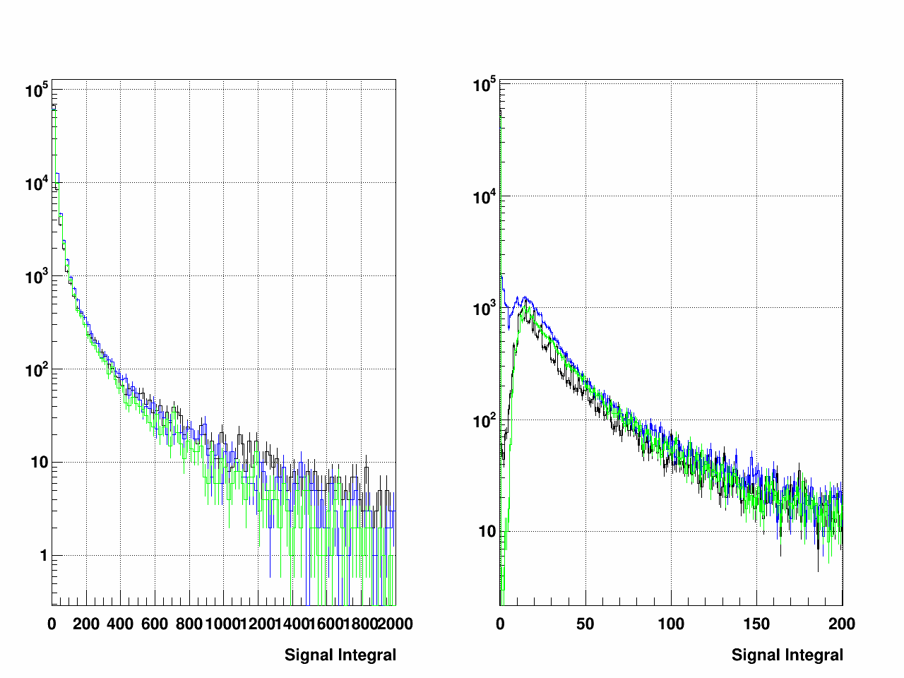
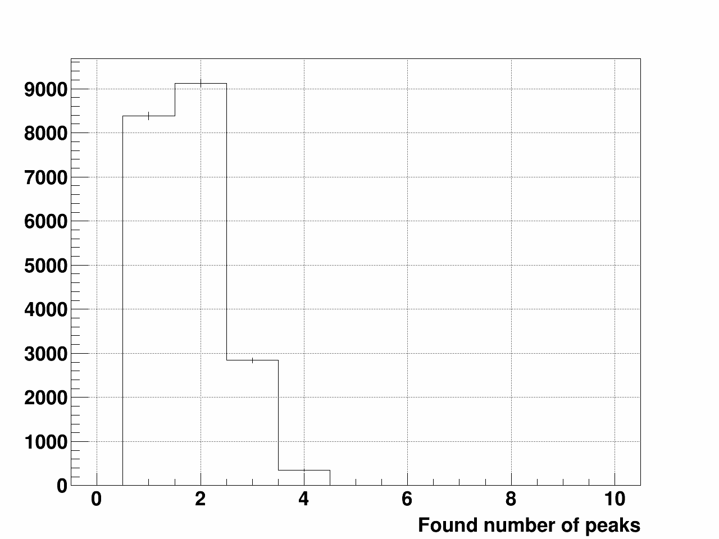
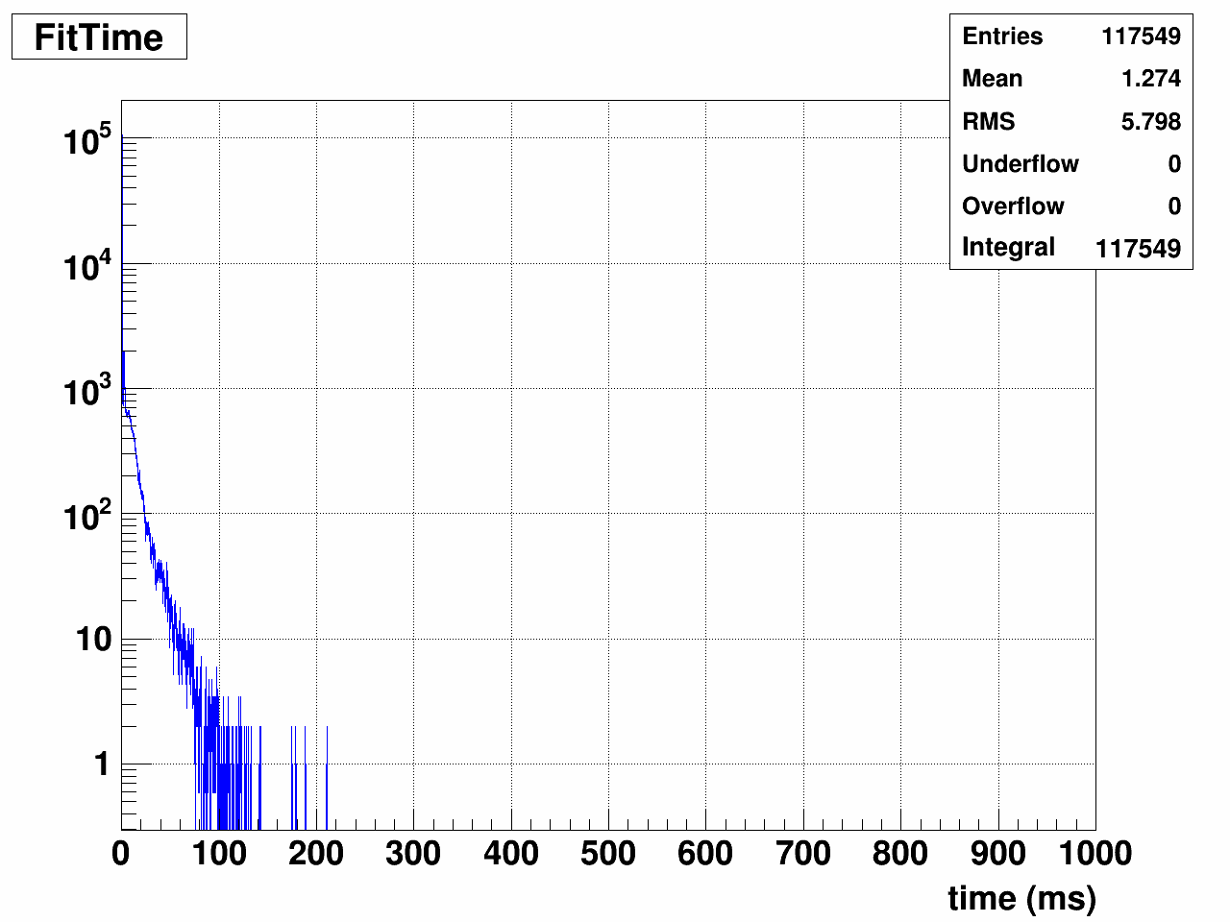
Putting it all together
Final ADC sum
Blue is Sum8 Method
Green is fitting all peaks
Black is result after cuts
Final algorithm uses peak tunneling to determine number of peaks and their locations
Cut out all peaks not within 3 RHIC bunch crossings
  This ensures only overlapping peaks are fit
Only fit peaks in those cases all other use Sum8 method
Final number of peaks
Final Timing for 100 events
Accurate determination of peaks leads to faster computation time
Aids in fitting overlapping peaks to correctly determine the energy

Slide 12
Conclusions
STAR Forward upgrade greatly enhances capabilities of STAR in forward region
  Upgrade will allow much better particle ID at STAR forward region
The FCS uses latest technology to help improve energy determination
  DEP boards have much finer digitization to record more details about the raw signal
  More information means more analysis, which means more computation time to determine energy
Developed robust algorithm to find peaks and determine energy quickly
  Employed peak tunneling to reduce noise on found peaks
  Cut out fitting peaks that don’t overlap

Slide 13
Backup

Slide 14
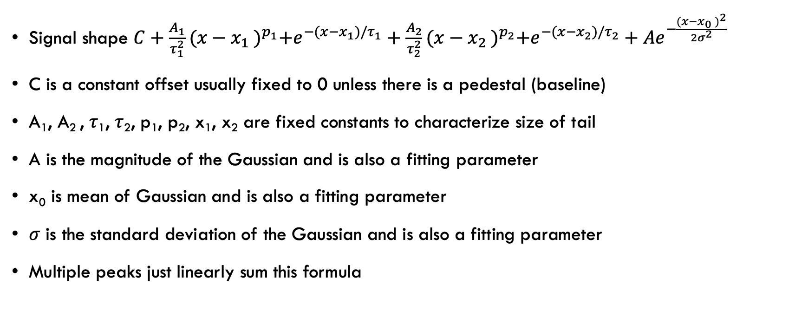
Fitted Signal shape
Signal shape $C+\frac{A_{1}}{τ_{1}^{2}}{(x−x_{1} )}^{p_{1}}+e^{−(x−x_{1})/τ_{1}}+\frac{A_{2}}{τ_{2}^{2}}{(x−x_{2} )}^{p_{2}}+e^{−(x−x_{2})/τ_{2}}+Ae^{−\frac{{(x−x_{0} )}^{2}}{2σ^{2}}}$
C is a constant offset usually fixed to 0 unless there is a pedestal (baseline)
A₁, A₂ , 𝜏₁, 𝜏₂, p₁, p₂, x₁, x₂ are fixed constants to characterize size of tail
A is the magnitude of the Gaussian and is also a fitting parameter
x₀ is mean of Gaussian and is also a fitting parameter
𝜎 is the standard deviation of the Gaussian and is also a fitting parameter
Multiple peaks just linearly sum this formula

Slide 15
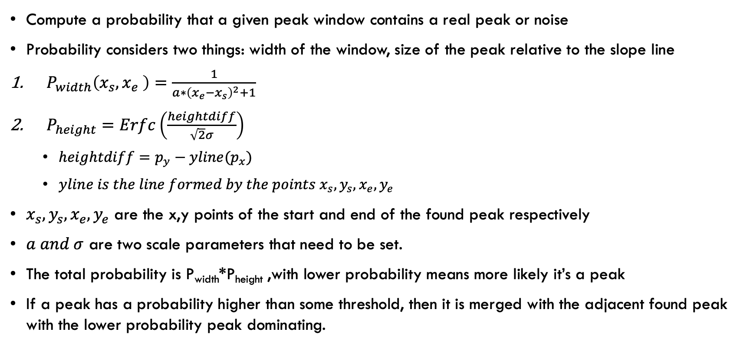
Peak Tunnel Method
Compute a probability that a given peak window contains a real peak or noise
Probability considers two things: width of the window, size of the peak relative to the slope line
$P_{width}\left(x_{s}, x_{e} \right)=\frac{1}{a∗{\left(x_{e}−x_{s}\right)}^{2}+1}$
$P_{height}=Erfc\left(\frac{heightdiff}{\sqrt{2}σ}\right)$
  $heightdiff=p_{y}−yline(p_{x})$
  $yline is the line formed by the points x_{s},y_{s},x_{e},y_{e}$
$x_{s},y_{s},x_{e},y_{e}$ are the x,y points of the start and end of the found peak respectively
$a and σ$ are two scale parameters that need to be set.
The total probability is P_{width}*P_{height} ,with lower probability means more likely it’s a peak
If a peak has a probability higher than some threshold, then it is merged with the adjacent found peak with the lower probability peak dominating.

Slide 16
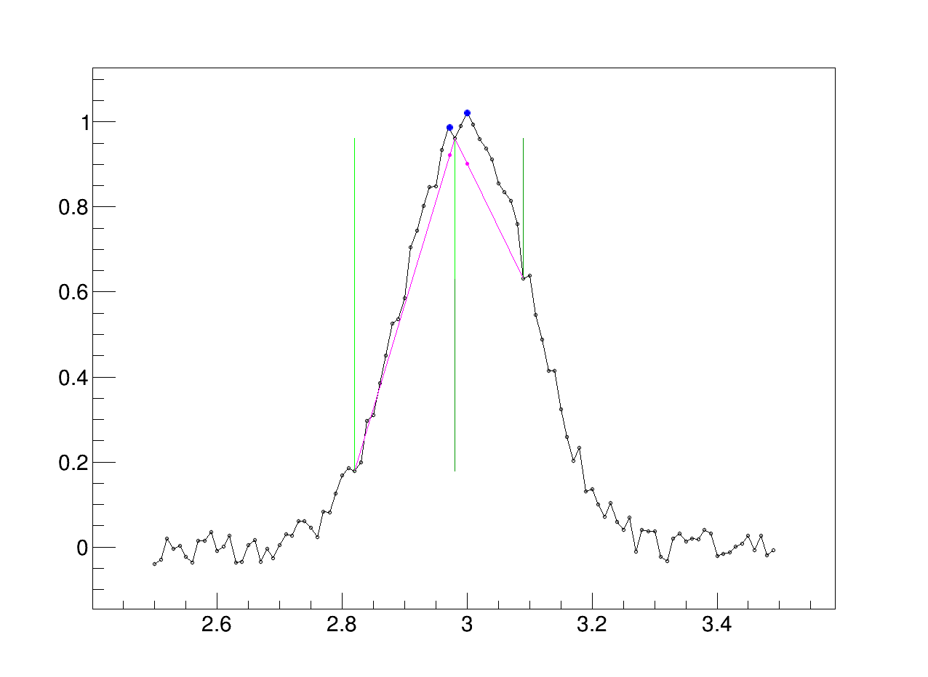
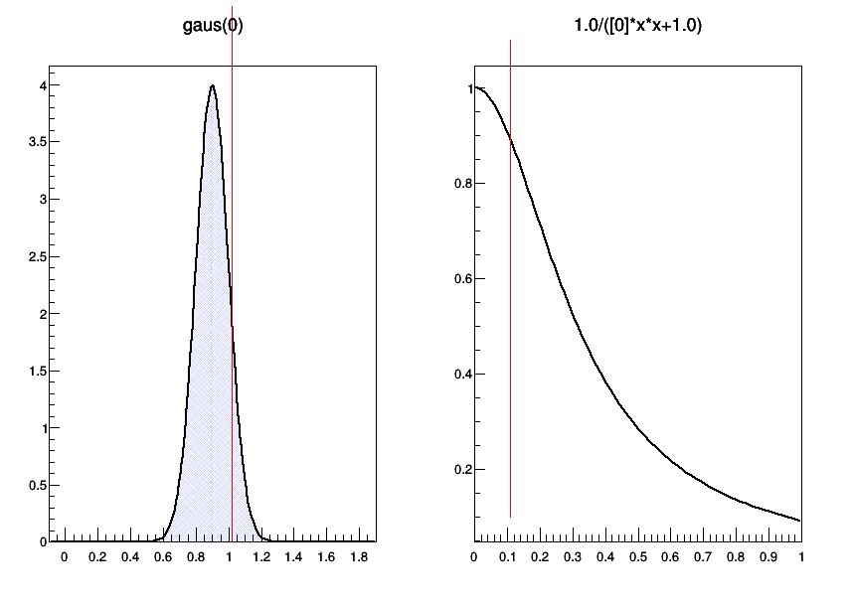
Tunnel Method Illustrated

Slide 17
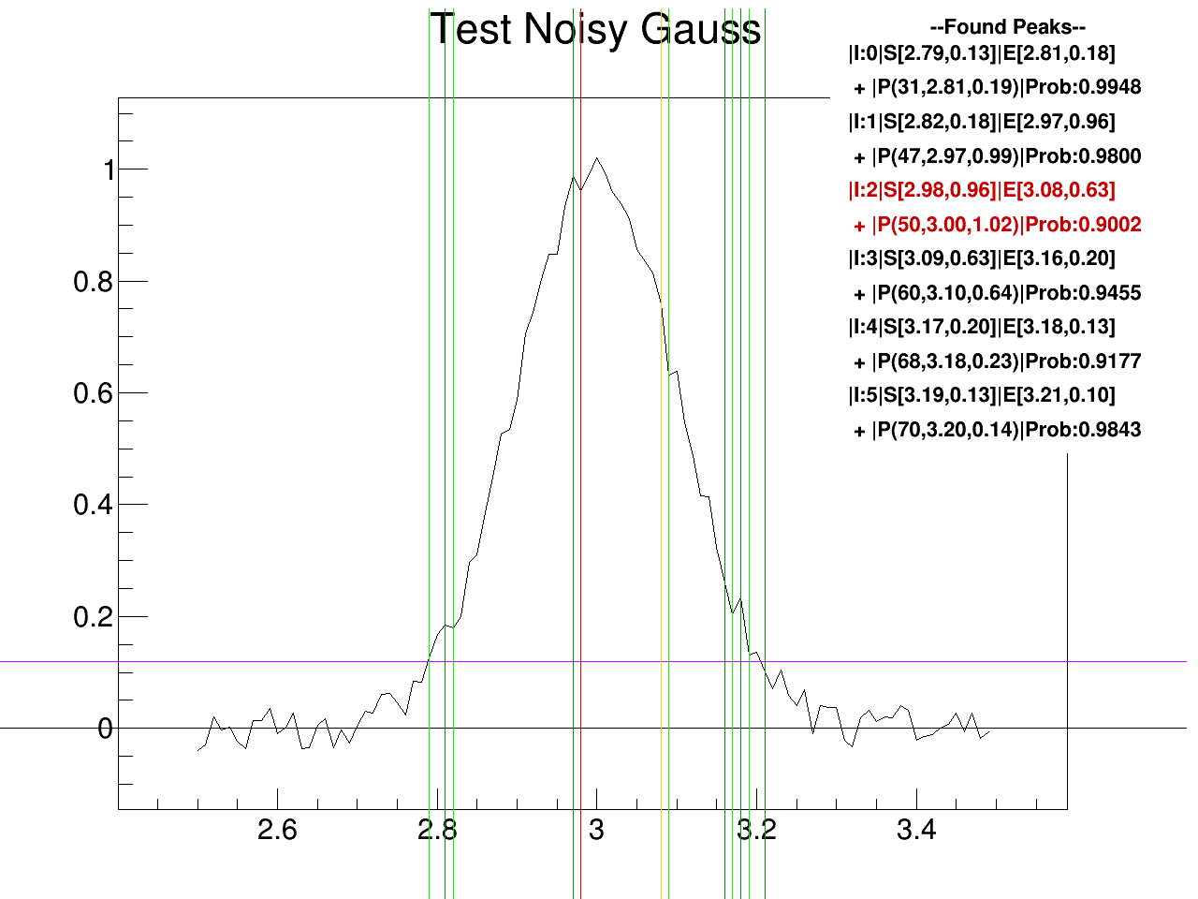
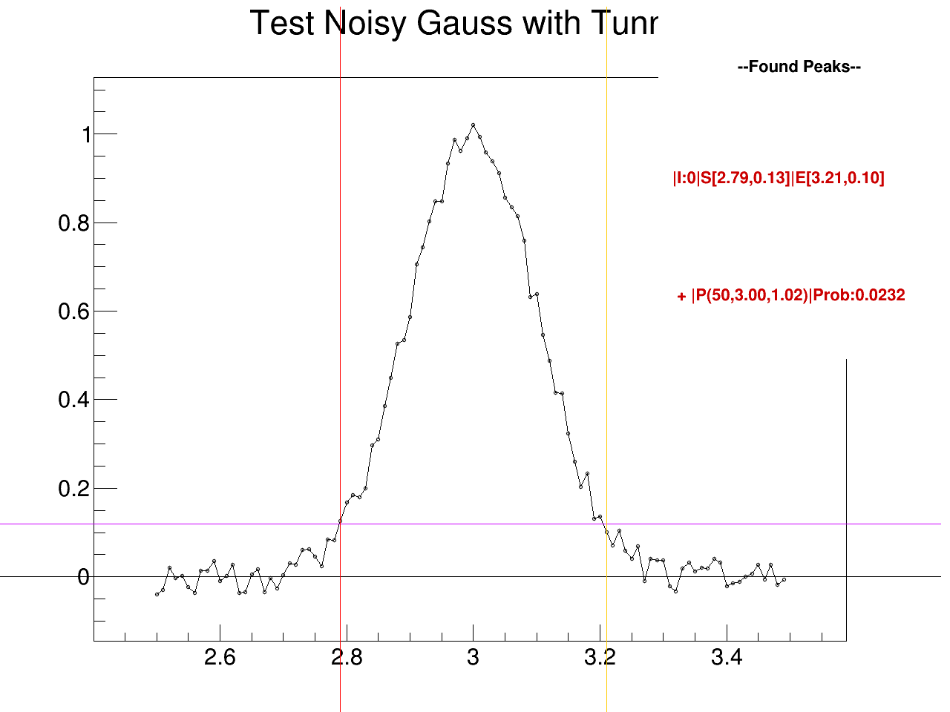
Tunnel Method At Work

