Slide 1




STAR Heavy Flavor Tracker
Qiu Hao (LBNL)
for the STAR Collaboration

Slide 2
Outline
Physics motivation
Design
  Heavy Flavor Tracker
  PiXeL detector
  Monolithic Active Pixel Sensors
Status and performance
  Status
  Signal, pedestal and noise scan
  Efficiency
  Survey and alignment
  Hit residual and track DCA
Summary
Qiu Hao
2

Slide 3
Physics Motivation
Heavy flavor
  m_{b,c} >> T_{C}, Λ_{QCD}, m_{u,d,s}
  Produced early in initial hard scatterings Good probe to QGP
  Total number conserved in system evolution at RHIC
However, it’s also difficult to study heavy flavor quarks in experiments
  Limited yield comparing with light flavor particles
  Large combinatorial background for direct reconstruction of open heavy flavor hadrons without displaced decay vertex reconstruction
  Large kinematics smearing for studies with electrons from semi-leptonic decay
A precision vertex detector will be an important tool to asses HF physics.
Qiu Hao
3

Slide 4
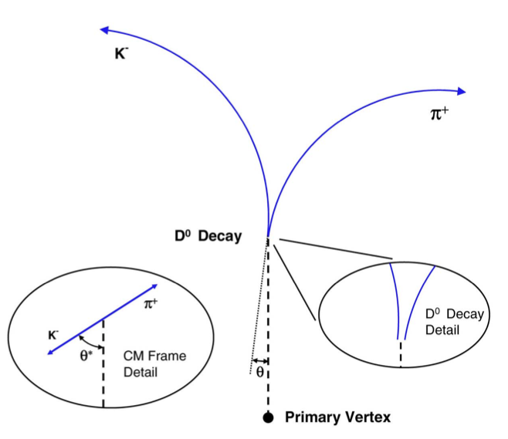
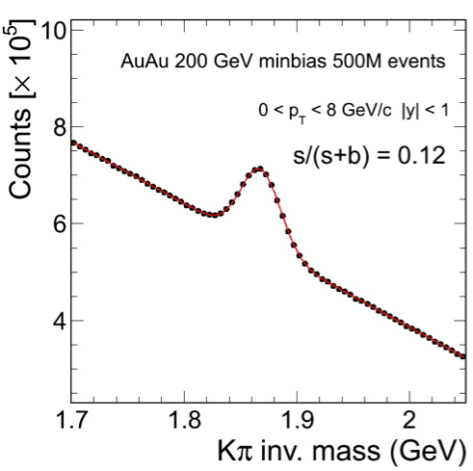
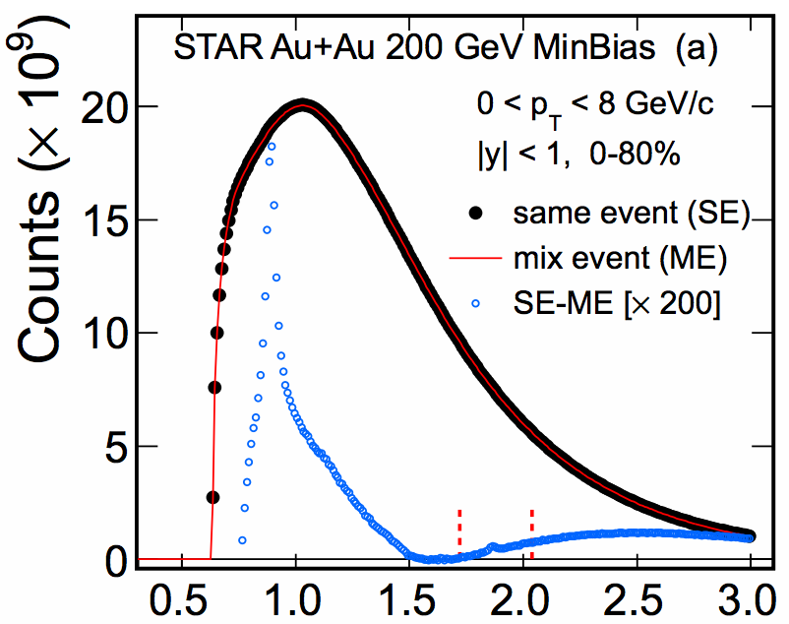
How Heavy Flavor Tracker Helps
HFT can be used to study heavy flavor production by reconstruction of displaced decay vertices
  D⁰ → K⁻ π⁺
    BR = 3.83 % cτ ~ 120 μm
  → p K⁻ π⁺
    BR = 5.0 % cτ ~ 60 μm
  B mesons → J/ψ + X or e + X
    cτ ~ 500 μm
s/(s+b) = 0.0001
without HFT
simulation with HFT
arXiv:1404.6185
Qiu Hao
4

Slide 5
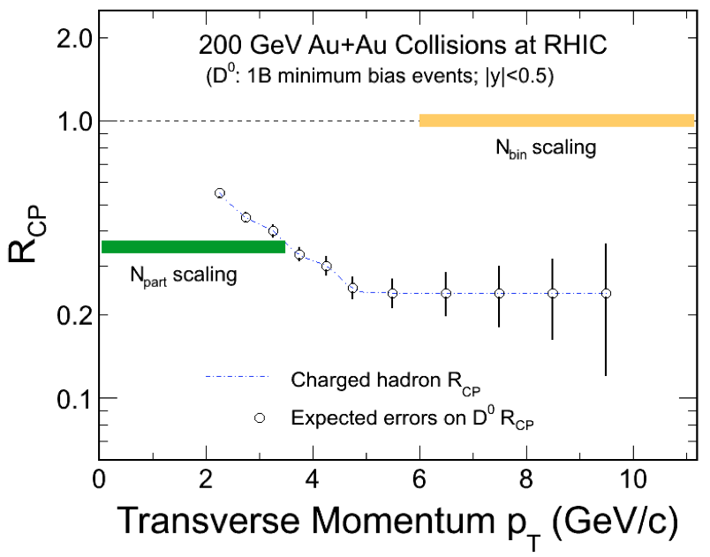
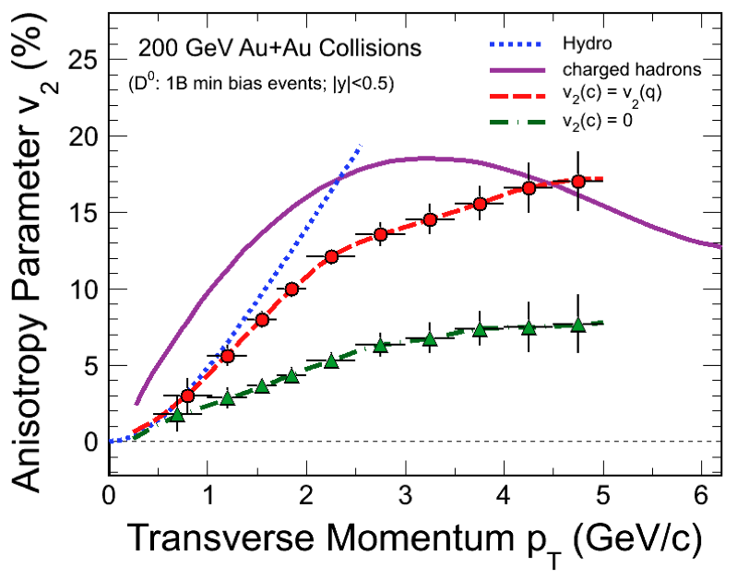
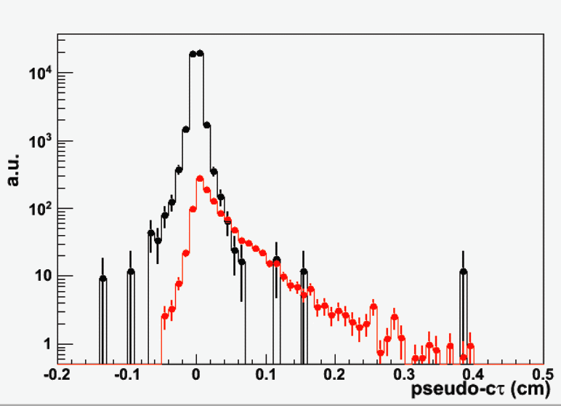
Examples of Physics with HFT
simulation of separating prompt and B decayed J/ψ with HFT
projection of D⁰ R_{CP} with HFT
projection of D⁰ v₂ with HFT
Total charm yield baseline for charmonium suppression & coalescence
R_{CP}, R_{AA} energy loss mechanism, QCD in dense medium
Charm collectivity degree of light flavor thermalization
Low radiation length enables reconstruction of D⁰ down to very low p_{T}, enabling more direct and precise measurement of total charm cross section and charm flow.
Separating charm and beauty probing the medium with heavy quarks with different mass
Qiu Hao
5

Slide 6
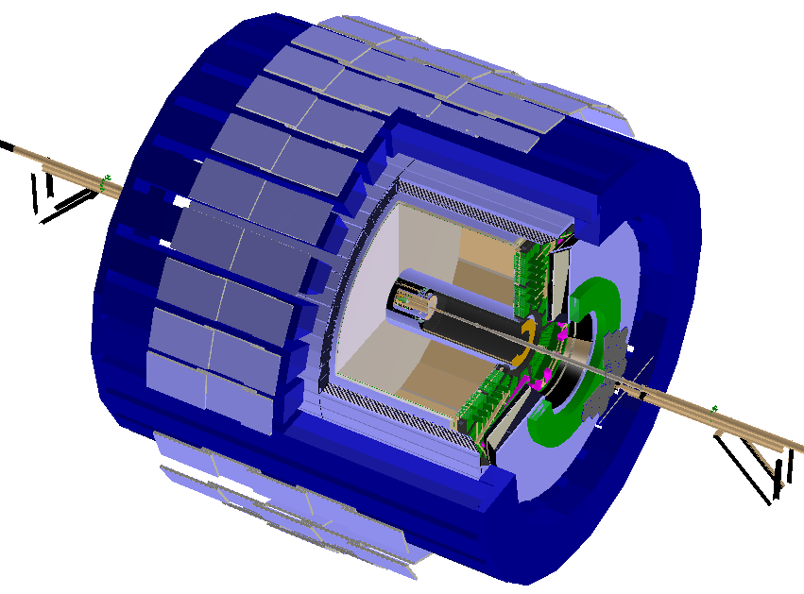

HFT in STAR
Tracking & dE/dx:
Time Projection Chamber
Particle ID:
Time Of Flight detector
Electromagnetic Calorimetry:
Barrel EMC
+Endcap EMC
Muon Telescope Detector (runs 13/14)
Heavy Flavor Tracker (run 14)
Full azimuthal particle identification at middle rapidity
Qiu Hao
6

Slide 7
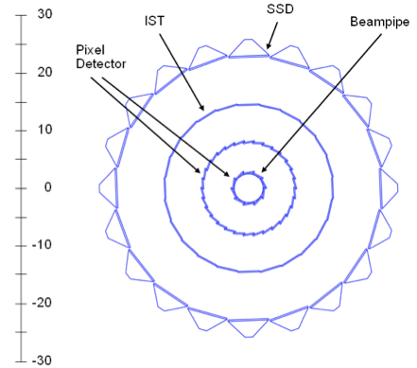
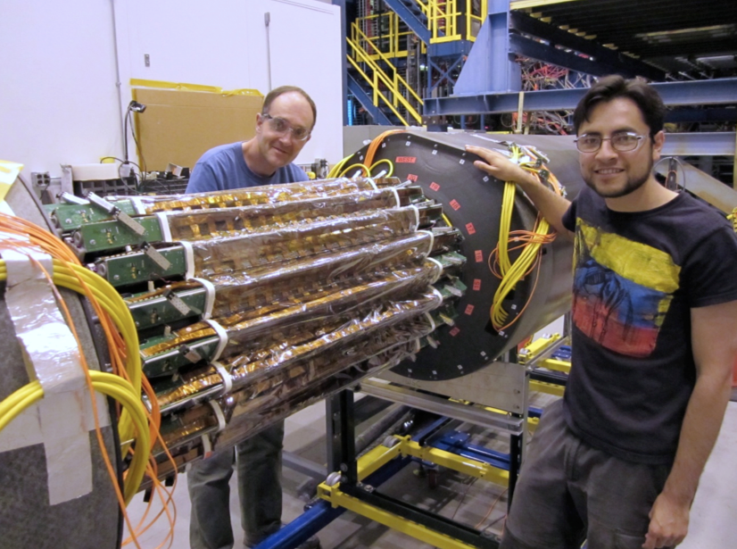
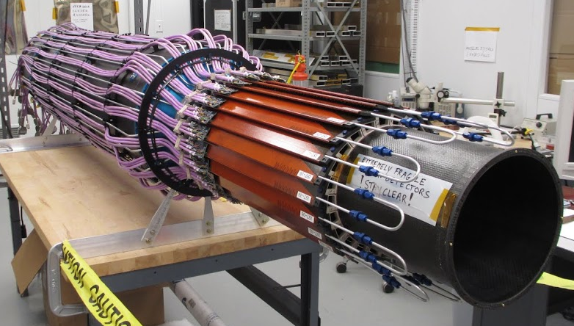
HFT Design
Silicon Strip Detector:
existing detector with new faster electronics
double sided silicon strip modules with 95 μm pitch
σ_{r-φ}: 20 μm
σ_{z}: 740 μm
radius: 22 cm
X/X₀: 1 %
Intermediate Silicon Tracker:
single-sided double-metal silicon pad
sensors with 600 μm × 6 mm pitch
σ_{r-φ}: 170 μm σ_{z}: 1800 μm
radius: 14 cm X/X₀ < 1.5 %
See details at poster M-30 by Yaping Wang
The task of SSD and IST is to guide the track from TPC to the innermost PXL detector with high hit density.
Qiu Hao
7

Slide 8
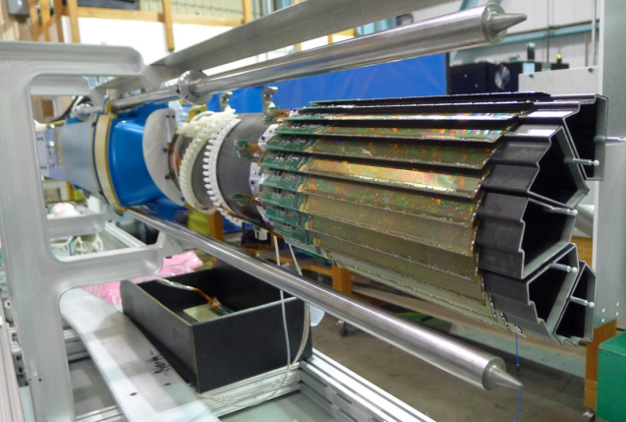
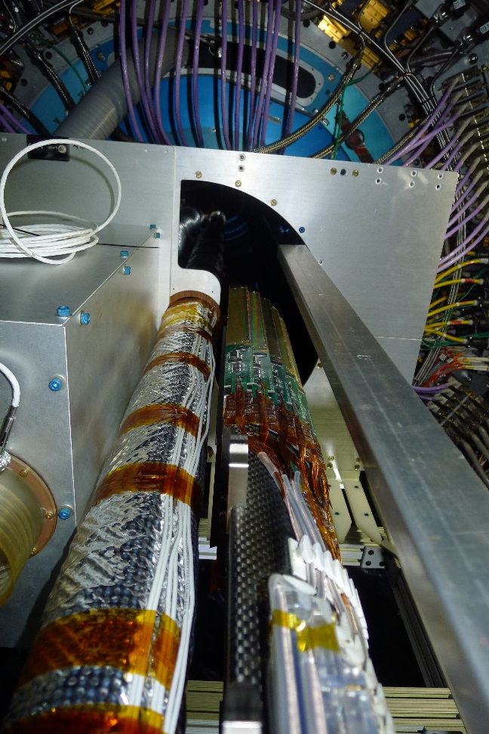
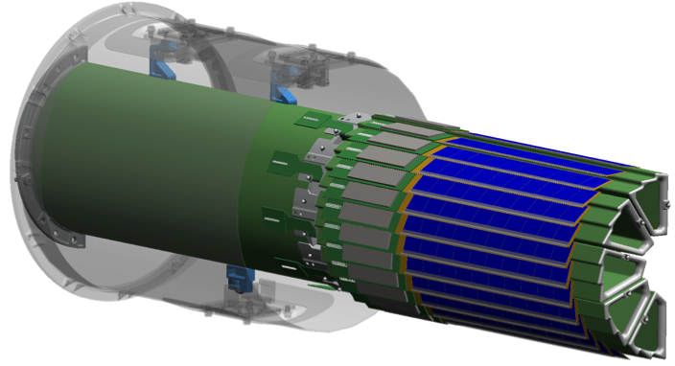
Pixel Detector Design
PIXEL detector
10 sectors * 4 ladders (1 inner + 3 outer) * 10 Monolithic Active Pixel Sensors
  20.7 μm pixel pitch
  thinned down to 50 μm
  used in a collider experiment for the first time
light carbon fiber support
radius:
  2.9 cm (inner)
  8.2 cm (outer)
σ:
= 7.8 μm vibration
X/X₀: 0.4 % / layer
360 M pixels in total
air cooled
xyz constraint
xy constraint
x constraint
3 kinematic mounts locate the PXL half on the PXL supporting tube.
PXL insertion can be done in ~12 hours, by pushing PXL halves along rails and latching on kinematic mounts.
2 sets of PXL detectors and 40 spare ladders are made, to replace damaged detector units when needed.
Qiu Hao
8

Slide 9
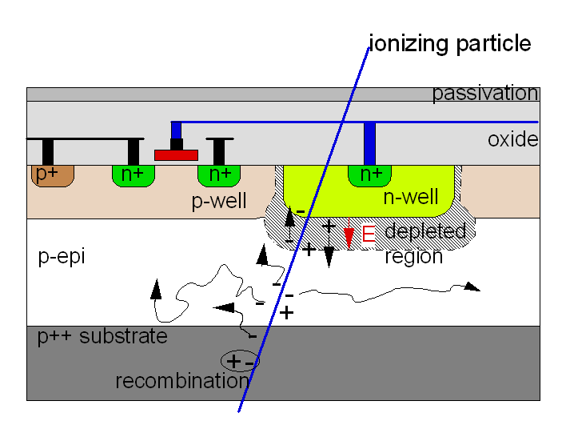
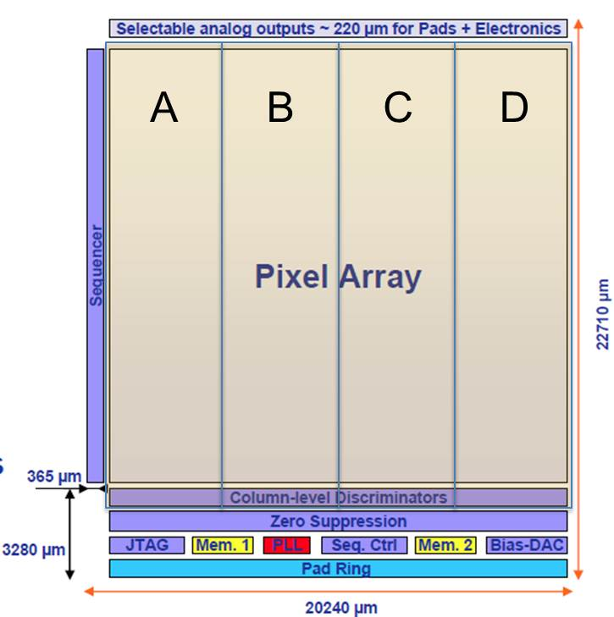
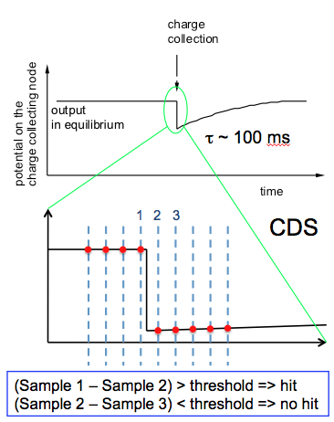
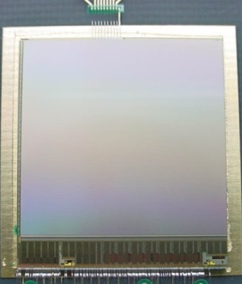


Monolithic Active Pixel Sensors
signal mainly from thermal diffusion in the low-doped epitaxial layer (10~15 μm)
100 % fill-factor
MIP signal < 1000 electrons
collected in large E-field depleted region
MAPS pixel cross-section (not to scale)
  Reticle size (~ 4 cm²)
  928 x 960 ~= 890 k pixels
  Pixel pitch 20.7 μm
Developed by PICSEL group of IPHC-Strasbourg.
(Marc Winter et al.) Thank you!
standard commercial CMOS technology
sensor and signal processing are integrated in the same silicon wafer
discriminator & zero suppression in sensor, readout raw hits directly
  integration time 185.6 μs
Correlated Double Sampling
Qiu Hao
9

Slide 10
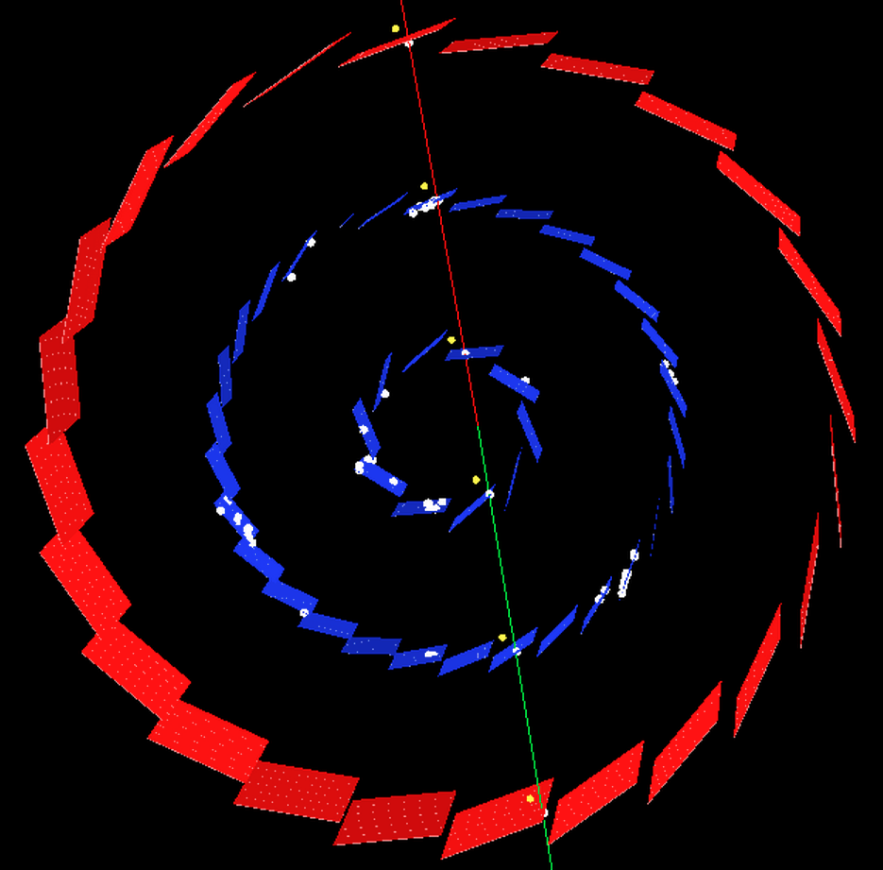
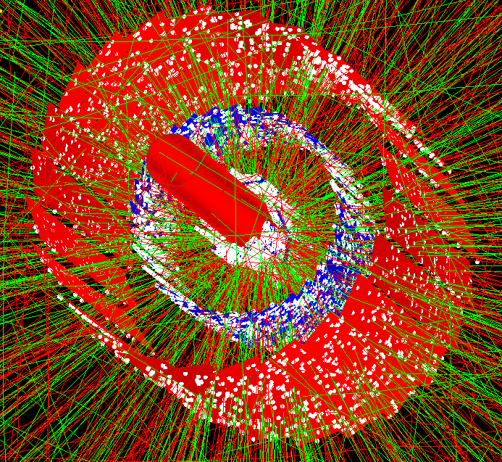
HFT Status
a cosmic event a Au+Au 200 GeV event
The full system has been installed for RHIC 2014 running.
Cosmic data were taken for commission, alignment and efficiency studies (before Feb. 9 and whenever there is long time with no beam)
Some detector performance optimization during 14.5 GeV Au+Au run (Feb. 14 ~ Mar. 11)
200 GeV Au+Au data taking with PXL and IST since Mar. 15
SSD is still in commission – SSD and IST are redundant in guiding TPC track to PXL.
Qiu Hao
10

Slide 11
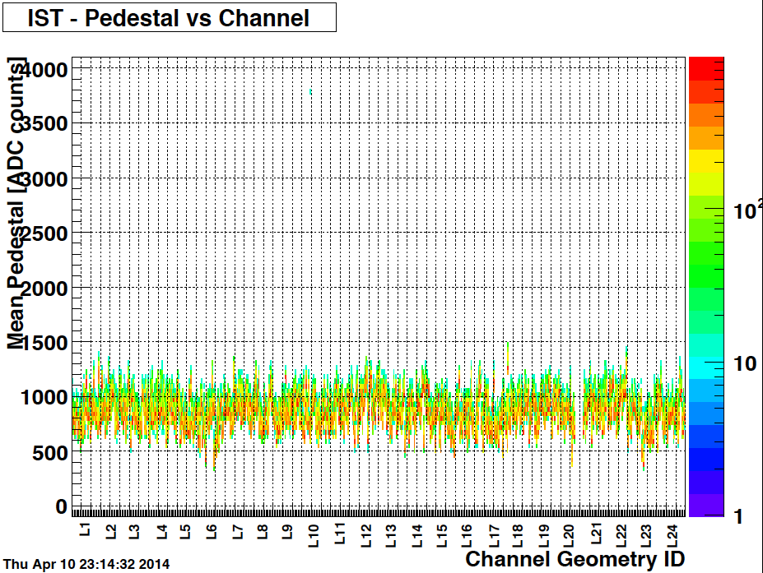
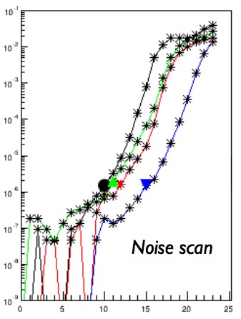
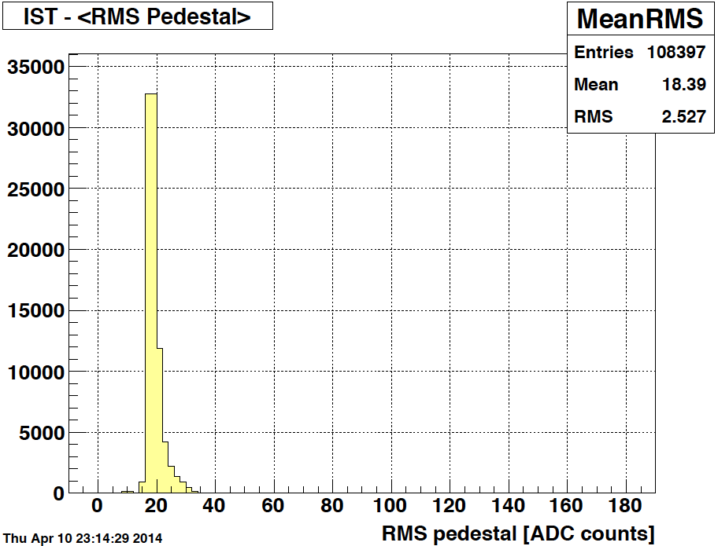
Signal, Pedestal and Noise Scan
noise rate
RMS noise
IST Pedestal
IST signal with MIP
MVP ~ 440 ADCs
IST has stable pedestal and RMS level over all channels
signal to noise ratio ~ 23
Noise data for PXL and pedestal data for IST and SSD are taken at least once per day without beam, to monitor PXL noise rate, hot pixels, and calibrate IST pedestal.
See details at poster M-30 by Yaping Wang
5 2.5 0 -2.5 -5 -7.5
threshold with respect to current value (mV)
Optimize sub-array thresholds in a PXL sensor for noise rate = 2.e-6
Qiu Hao
11

Slide 12
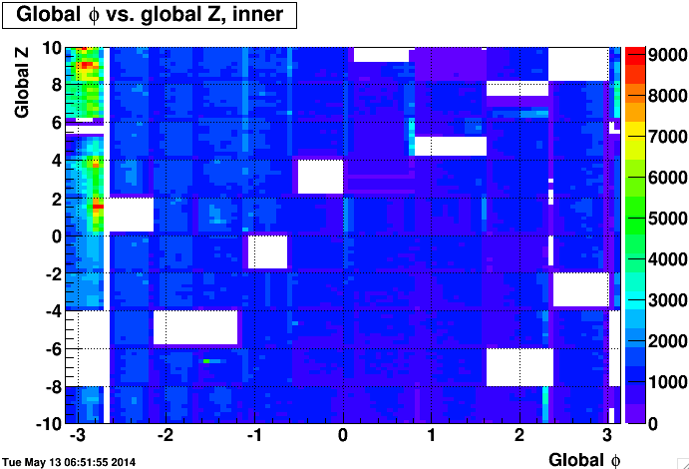
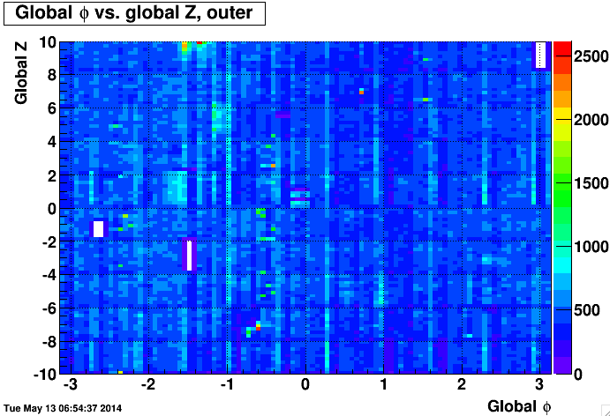
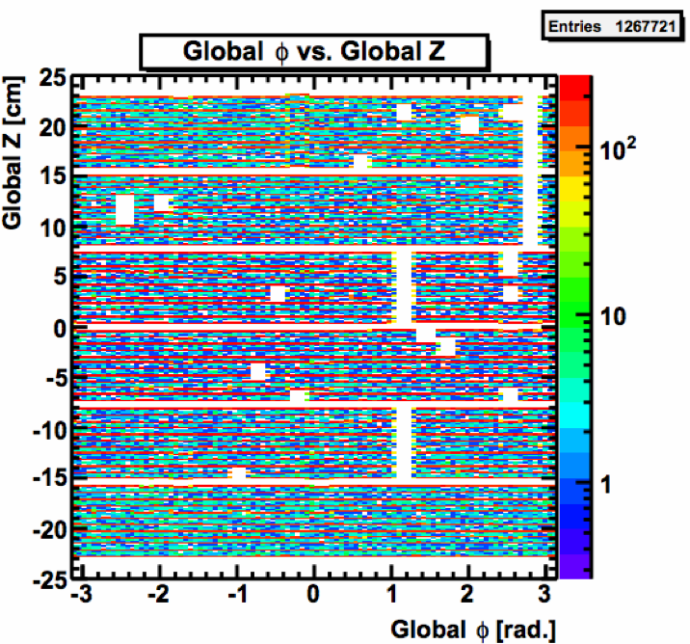
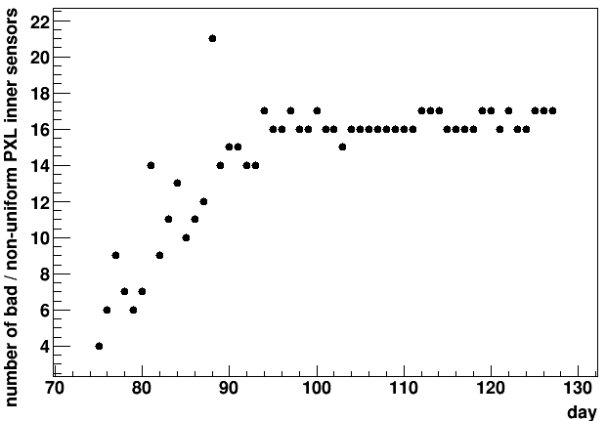
Damage and Remediation
Z vs. φ of hits in PXL inner layer Z vs. φ of hits in PXL outer layer
layer | inactive units
PXL inner | 14 %
PXL outer | 1 %
IST | 4 %
Z vs. φ of IST hits
Most PXL sensor damages appears to be radiation related damage possibly due to latch up in thinned sensors.
  Minimal or no damage for > 1 month: our operational methods were successful at stopping or greatly reducing the rate of damage.
  PXL and IST are only turned on when collision rate < 55 kHz.
  the full PXL detector resets every 15 minutes
  Latch up thresholds changed from 400 mA to 120 mA above the measured operating current for each ladder
100 inner sensors in total
Qiu Hao
12

Slide 13
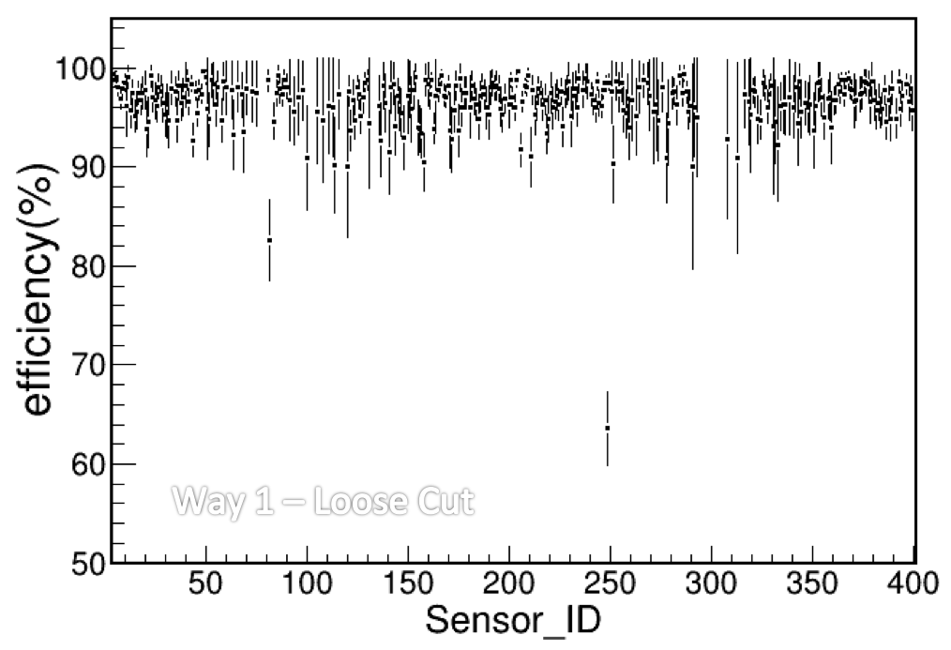
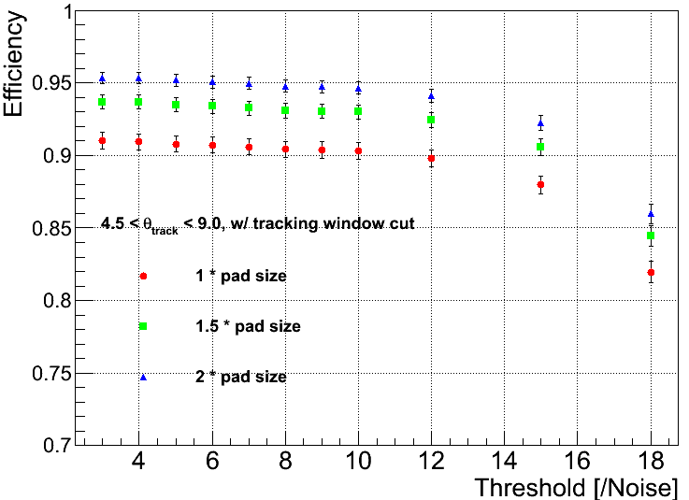
Efficiency
Low statistics of near horizontal cosmic operational threshold / noise = 5
PXL sensor efficiency measured with cosmic ray: hits / projection
Before the detector response optimization and running with the beam
Average = 97.2 %
IST efficiency measured with cosmic ray: hits / projection
~ 95 % at operational threshold / noise
Tuning for including HFT in tracking is going on…
Qiu Hao
13

Slide 14
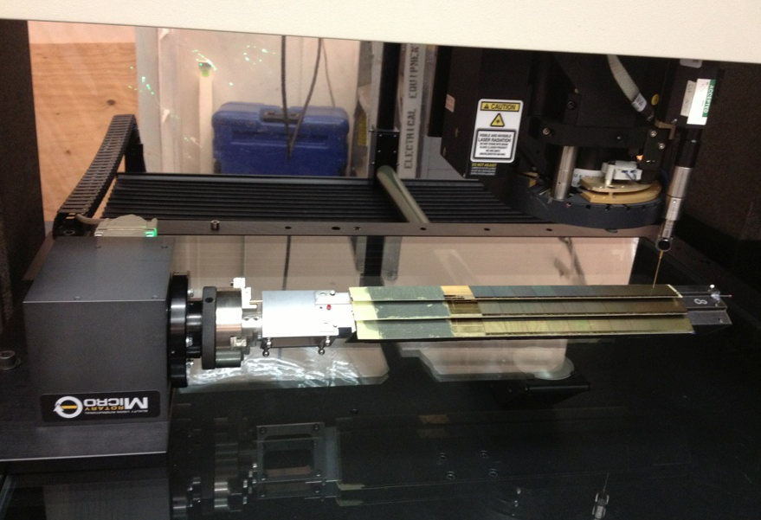
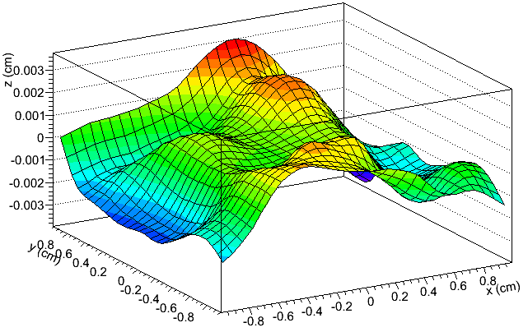
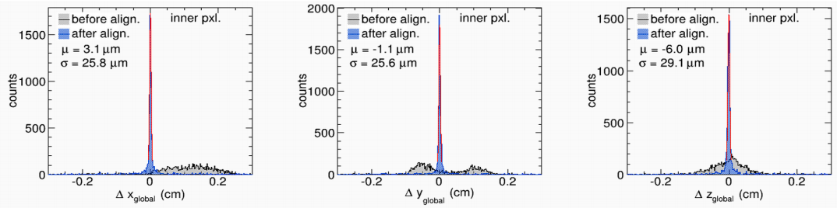
Survey and Alignment
PXL sensor surface profile from survey
+- 30 μm > PXL hit error
Coordinate Measurement Machine is used to survey HFT detector parts.
Cosmic ray is used to align different HFT detector parts.
see details at poster M-13 by Michael Lomnitz
PXL hit residual distribution before and after PXL half to half alignment
Qiu Hao
14

Slide 15
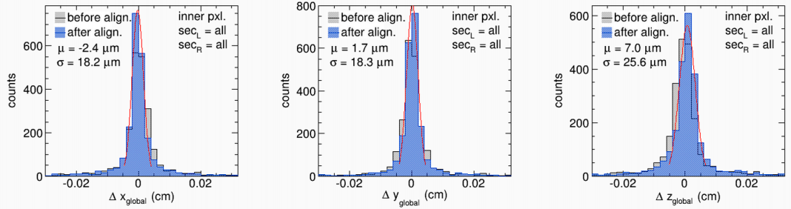
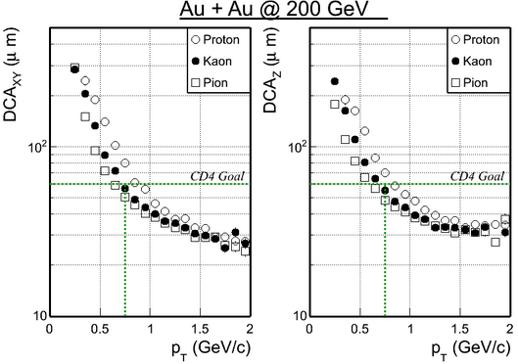
Hit Residual and Track DCA
PXL hit residual to cosmic track projection after PXL sector alignment: σ < 25 μm, match the design goal
IST hit residuals to cosmic track projection: σ_{x} = 200 μm, σ_{z} = 1800 μm
match IST pad size
DCA resolution for tracks with TPC + 1 IST hit + 2 PXL hits
~ 30 μm at high p_{T}
Below project goal: 60 μm for kaon with p_{T} = 750 MeV/c
Qiu Hao
15

Slide 16
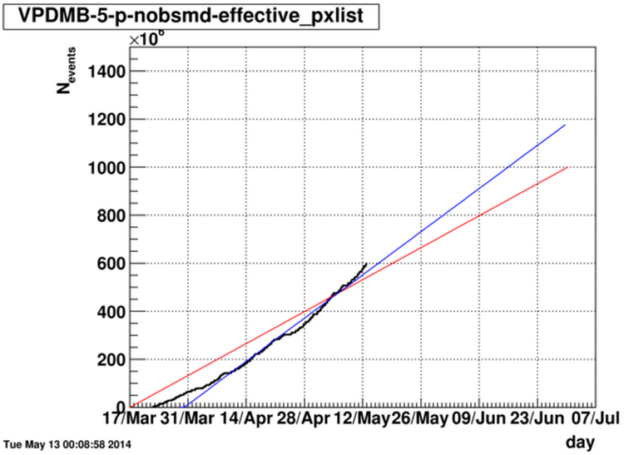
Summary
STAR Heavy Flavor Tracker will enable or enhance many open heavy flavor measurements, by reconstructing open heavy flavor hadrons with displaced decay vertices.
State-of-art MAPS technology is used for the first time in a collider experiment in the PXL detector.
equivalent goal considering inactive units now
original goal
All 3 sub-detectors (PXL, IST, SSD) are finished with construction and inserted into STAR before RHIC year 2014 running.
With survey and preliminary alignment, we already achieved ~30 microns pointing resolution for high p_{T} tracks reconstructed with HFT hits.
Data taking with PXL and IST is on a good trend to reach our goal: 1.3 B Au+Au 200 GeV minimum bias events. p+p 200 GeV and more Au+Au data will come in run 15 & 16.
New physics results with HFT will greatly enhance our understanding of QGP created at RHIC.
Qiu Hao

Slide 17
Thank you
☺
Qiu Hao

