Slide 1

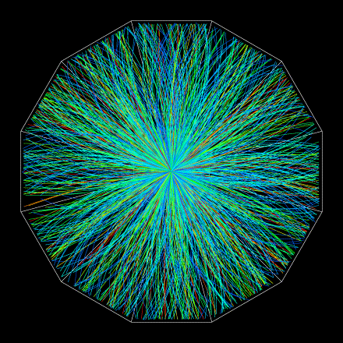

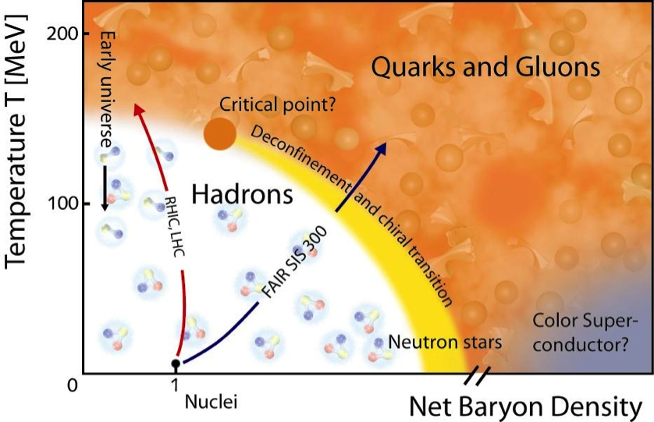
Results from STAR
Beam Energy Scan Program
Michal Šumbera
Nuclear Physics Institute AS CR, Řež/Prague
(for the STAR Collaboration)

Slide 2
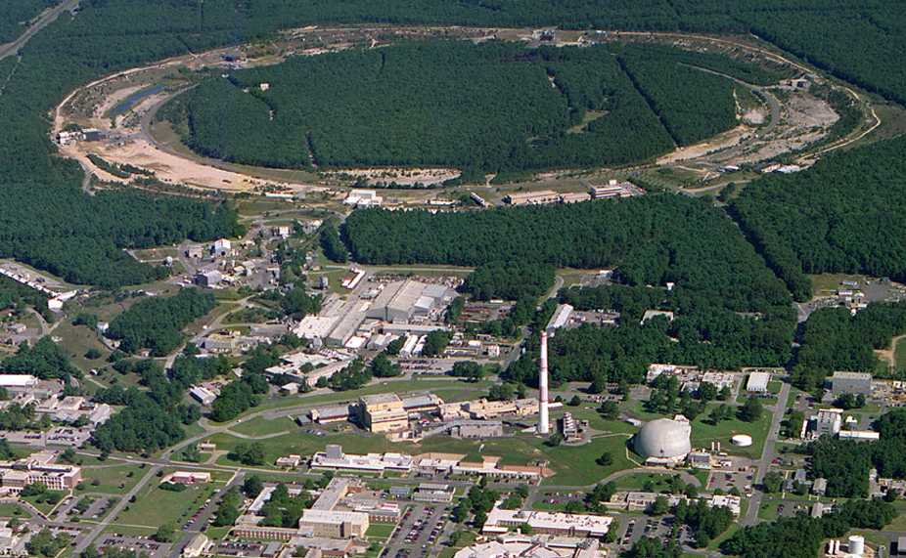
Relativistic Heavy Ion Collider
Brookhaven National Laboratory (BNL), Upton, NY
Year | System | √s_{NN} [GeV]
2000 | Au+Au | 130
2001 | Au+Au | 200
2002 | p+p | 200
2003 | d+Au | 200
2004 | Au+Au p+p | 200, 62.4 200
2005 | Cu+Cu | 200, 62.4, 22
2006 | p+p | 62.4, 200, 500
2007 | Au+Au | 200
2008 | d+Au p+p Au+Au | 200 200 9.2
2009 | p+p | 200, 500
2010 | Au+Au | 200, 62.4, 39, 11.5, 7.7
2011 | Au+Au p+p | 200,19.6,27 500
2012 | U+U Cu+Au p+p | 193 200 200,510
PHOBOS
BRAHMS
RHIC
PHENIX
STAR
AGS
TANDEMS
Animation M. Lisa
World’s (second) largest operational heavy-ion collider
World’s largest polarized proton collider

Slide 3
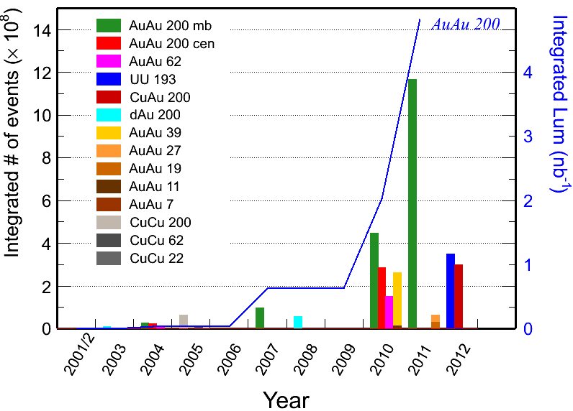
Recorded Datasets
Fast DAQ + Electron Based Ion Source + 3D Stochastic cooling

Slide 4
The RHIC Beam Energy Scan Project
Since the original design of RHIC (1985), running at lower energies has been envisioned
RHIC has studied the possibilities of running lower energies with a series of test runs: 19.6 GeV Au+Au in 2001, 22.4 GeV Cu+Cu in 2005, and 9.2 GeV Au+Au in 2008
In 2009 the RHIC PAC approved a proposal to run a series of six energies to search for the critical point and the onset of deconfinement.
These energies were run during the 2010 and 2011 running periods.
A landmark of the QCD phase diagram

Slide 5
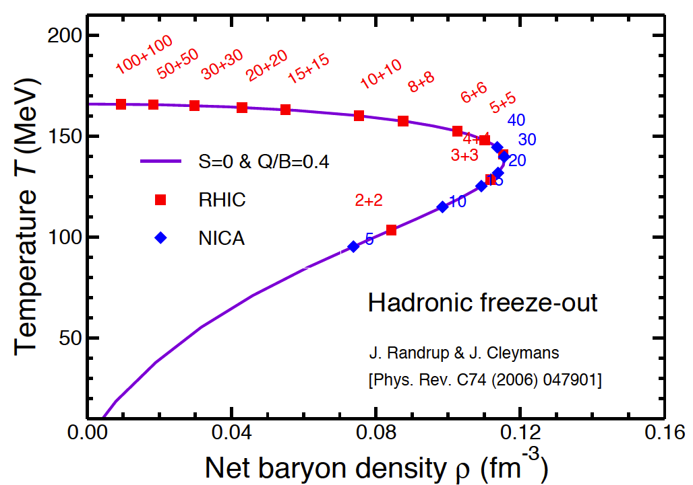
Maximum Net Baryon Density
ρ_{max}≈ ¾ρ₀
The maximum net baryon density at freeze-out expected for √s_{NN}≈6-8 GeV

Slide 6
The RHIC Beam Energy Scan Motivation
0) Turn-off of sQGP signatures
1) Search for the signals of phase boundary
2) Search for the QCD critical point
See talks after the break:
Nihar Sahoo: Higher moments of net-charge multiplicity distributions…
Zhiming Li: Dynamical higher cummulant ratios of net and total protons…

Slide 7
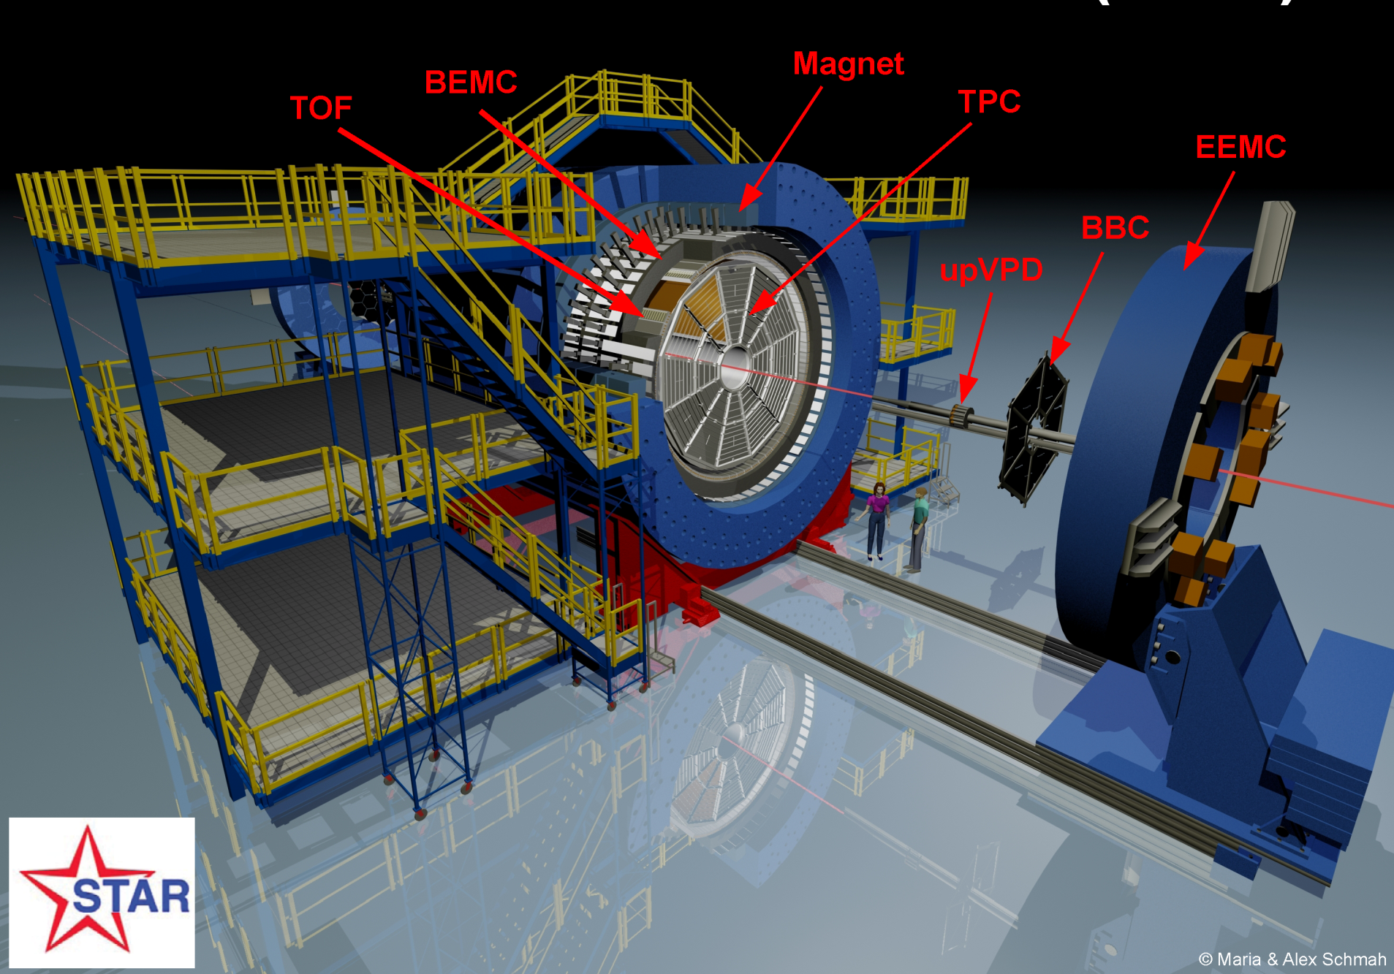
TPC:
Detects Particles in the |η|<1 range
π, K, p through dE/dx and TOF
K⁰_{s}, Λ, Ξ, Ω, φ through invariant mass
Coverage: 0 < φ < 2π |η| < 1.0
Uniform acceptance: All energies and particles

Slide 8
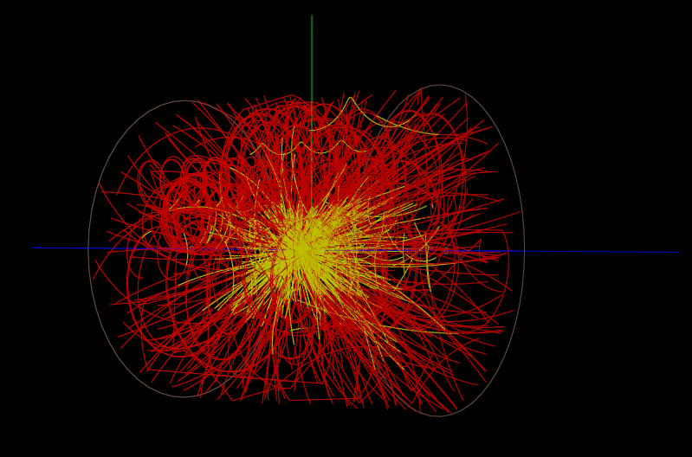
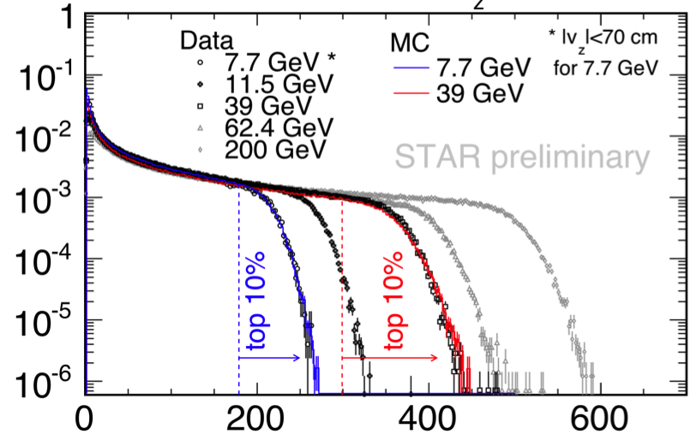
BES Data Taking
BES-I Data:
Year | √s_{NN} [GeV] | events(10⁶)
2010 | 39 | 130
2011 | 27 | 70
2011 | 19.6 | 36
2010 | 11.5 | 12
2010 | 7.7 | 5
2012* | 5 | Test Run
dN_{evt} / (N_{evt} dN_{ch})
Uncorrected N_{ch}
Detector performance generally improves at lower energies.
Geometric acceptance remains the same, track density gets lower.
Triggering required effort,
but was a solvable problem.
Central Au+Au at 7.7 GeV in STAR TPC

Slide 9
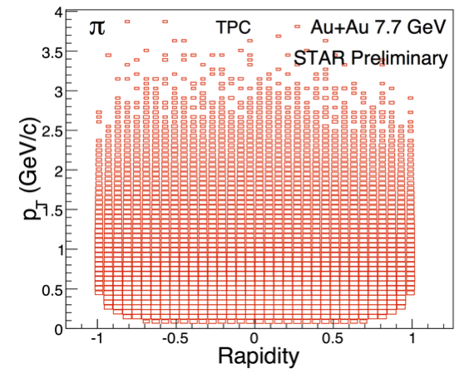
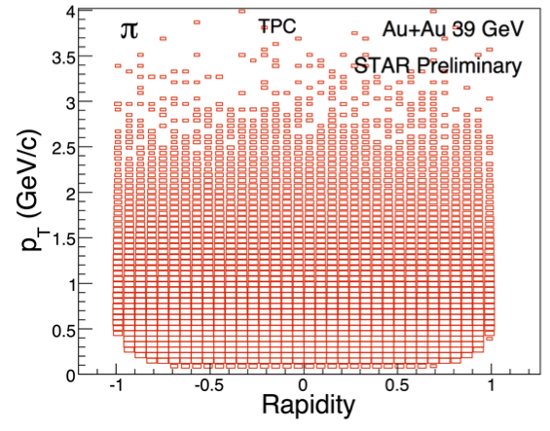
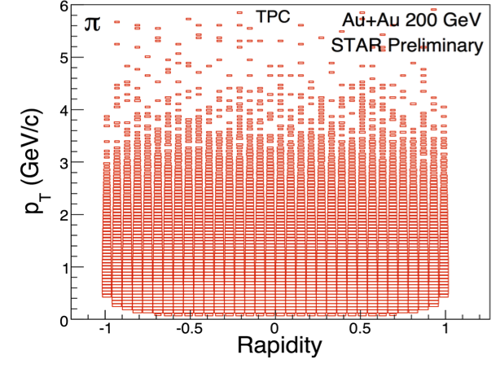
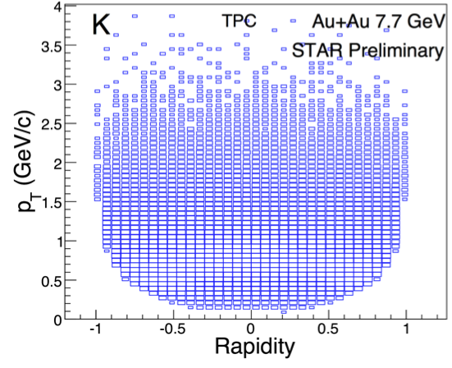
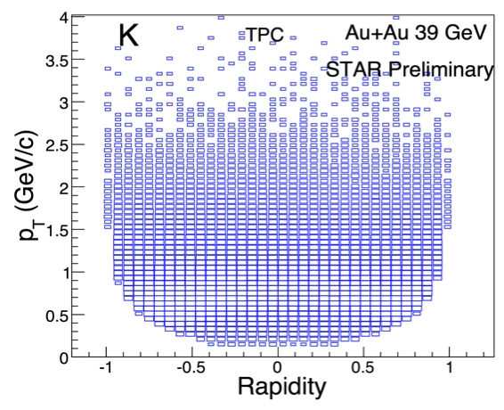
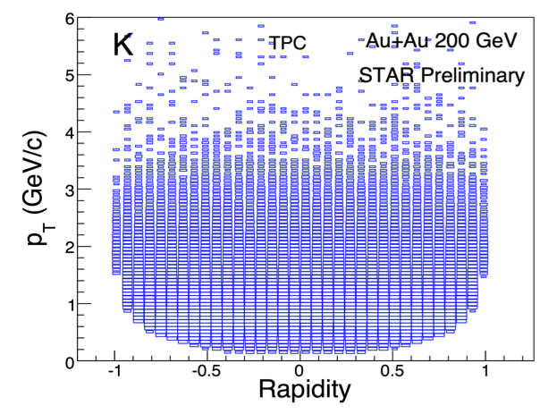
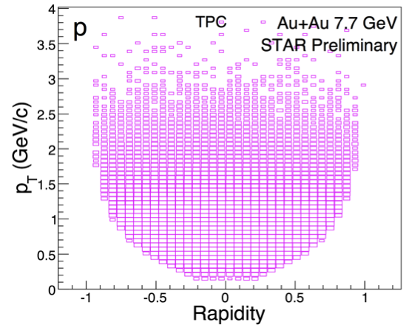
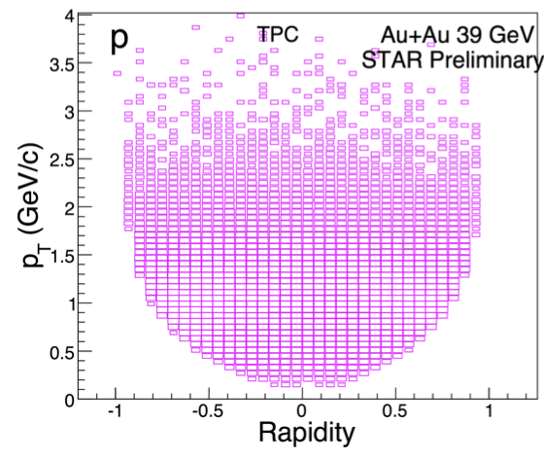
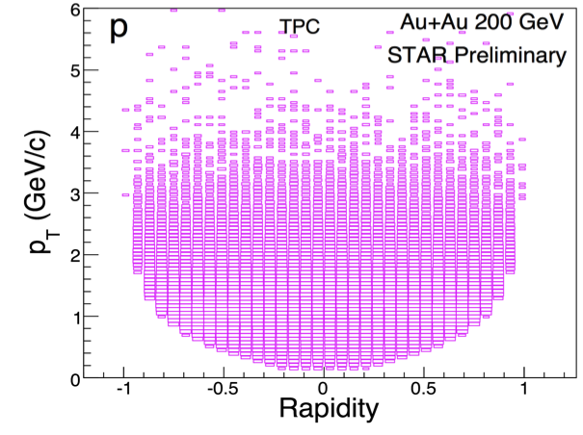
STAR TPC - Uniform Acceptance over all RHIC Energies
Au+Au at 7.7 GeV Au+Au at 39 GeV Au+Au at 200 GeV
Crucial for all analyses

Slide 10
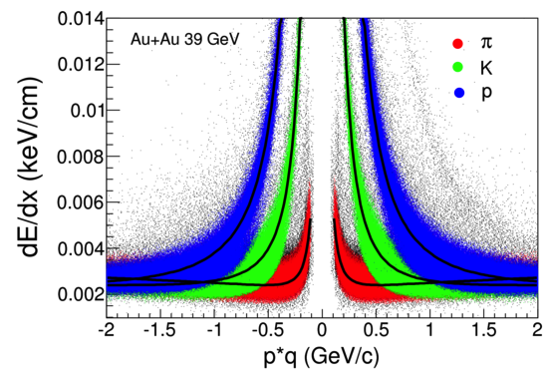
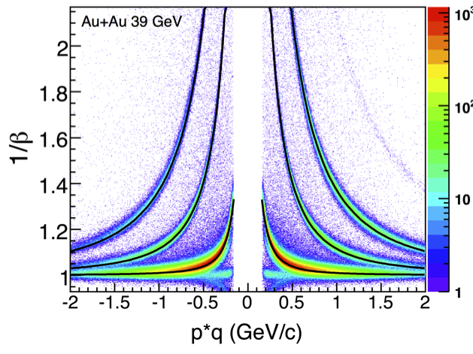
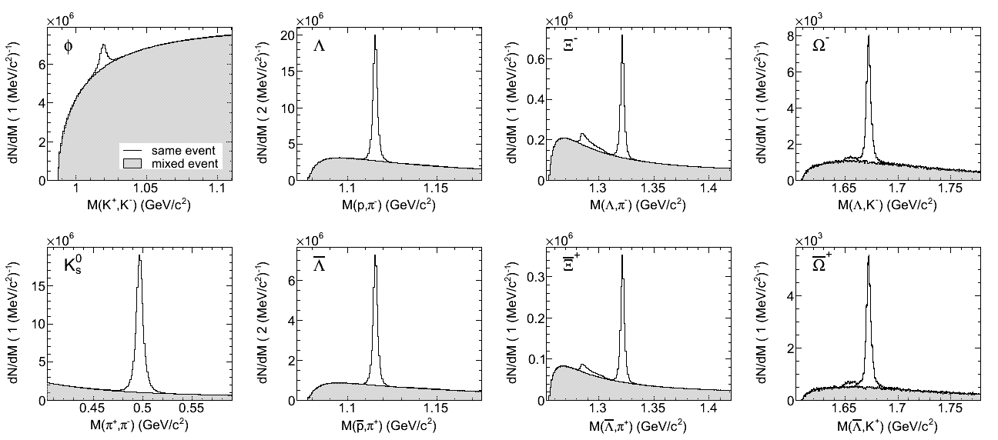
Particle Identification
PID (TPC+TOF):
π/K: p_{T}~1.6 GeV/c
p: p_{T}~3.0 GeV/c
Strange hadrons:
decay topology & invariant mass
TPC
TPC+TOF
dE/dx (MeV/cm)
Au+Au 39 GeV

Slide 11
Selected Results

Slide 12
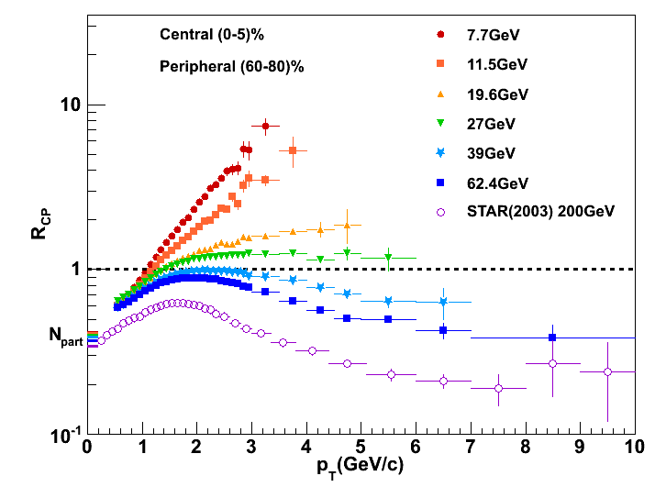
Suppression of Charged Hadrons …
(0-5%/60-80%)
PRL 91, 172302 (2003)
STAR Preliminary

Slide 13
… and its Disappearance
(0-5%/60-80%)
PRL 91, 172302 (2003)
STAR Preliminary
R_{CP} ≥ 1 at √s_{NN} ≤ 27 GeV - Cronin effect?

Slide 14
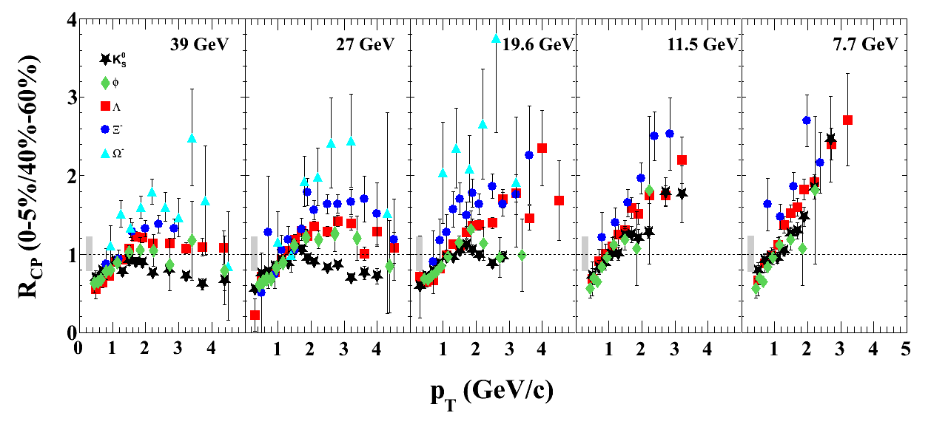
R_{CP} : Identified Particles
STAR Preliminary
Baryon-meson splitting reduces and disappears with decreasing energy
For p_{T} > 2 GeV/c:
R_{CP} (K⁰_{s}) < 1 @ √s_{NN} > 19.6 GeV
R_{CP} > 1 @ √s_{NN} ≤ 11.5 GeV

Slide 15
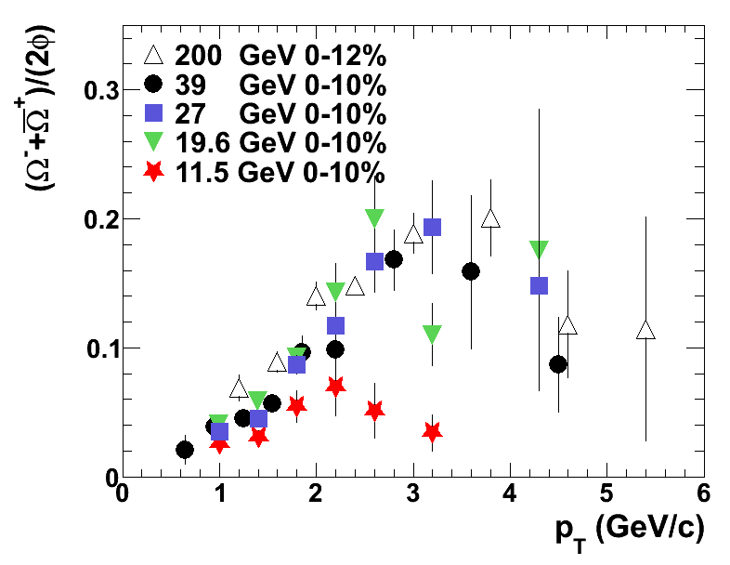
Baryon/Meson Ratio
STAR Preliminary
Ω/φ ratio falls off at 11.5 GeV

Slide 16
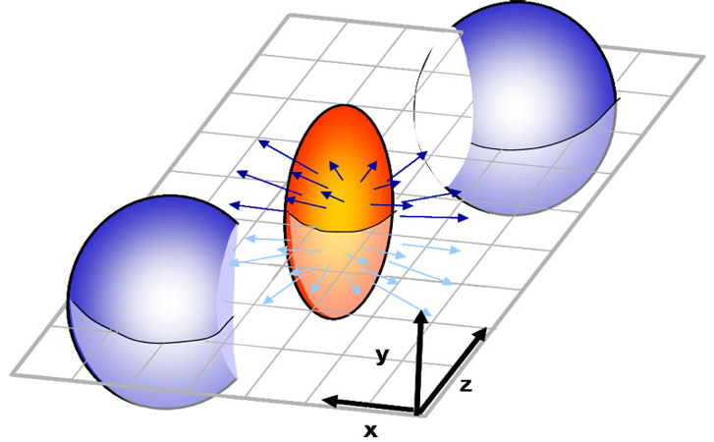
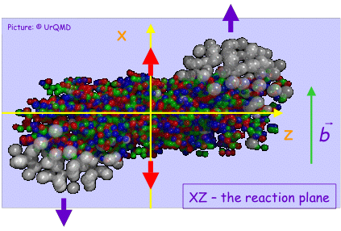
Azimuthal Anisothropy
Directed flow is quantified by the first harmonic:
Directed flow is due to the sideward motion of the particles within the reaction plane.
<p_{x}> or directed flow
Generated already during the nuclear passage time (2R/γ≈.1 fm/c@200GeV)
It probes the onset of bulk collective dynamics during thermalization
rapidity
v₁(y) is sensitive to baryon transport, space - momentum correlations and QGP formation
(preequilibrium)

Slide 17
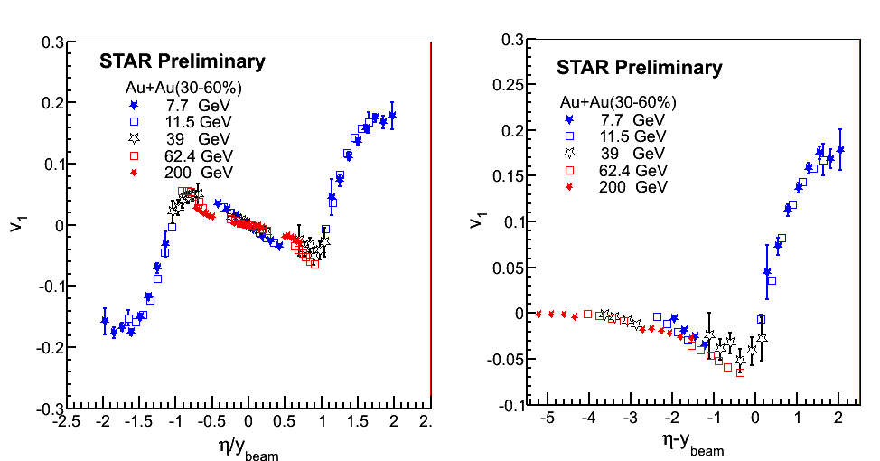
Charged Hadrons v₁: Beam Energy Dependence
Data at 62.4&200GeV from STAR, PRL 101 252301 (2008)
Scaling behavior in v₁ vs. η/y_{beam} and v₁ vs. η’=η-y_{beam}

Slide 18
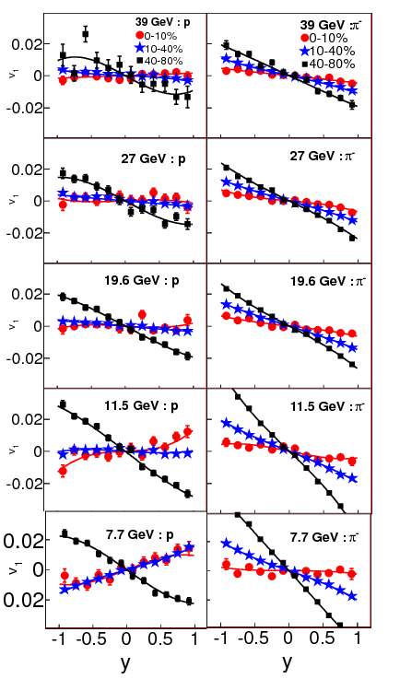
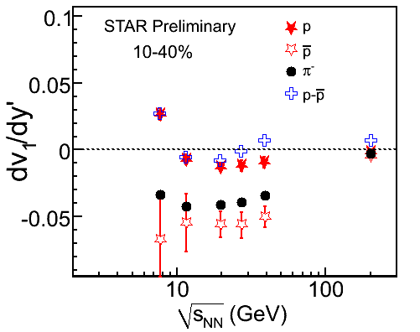
Directed Flow of p and π
p π
STAR Preliminary
v₁
Mid-central collisions:
Pion v₁ slope: Always negative (7.7-39 GeV)
(Net)-proton v₁ slope: changes sign between 7.7 and 11.5 GeV - may be due to the contribution from the transported protons coming to midrapidity at the lower beam energies

Slide 19
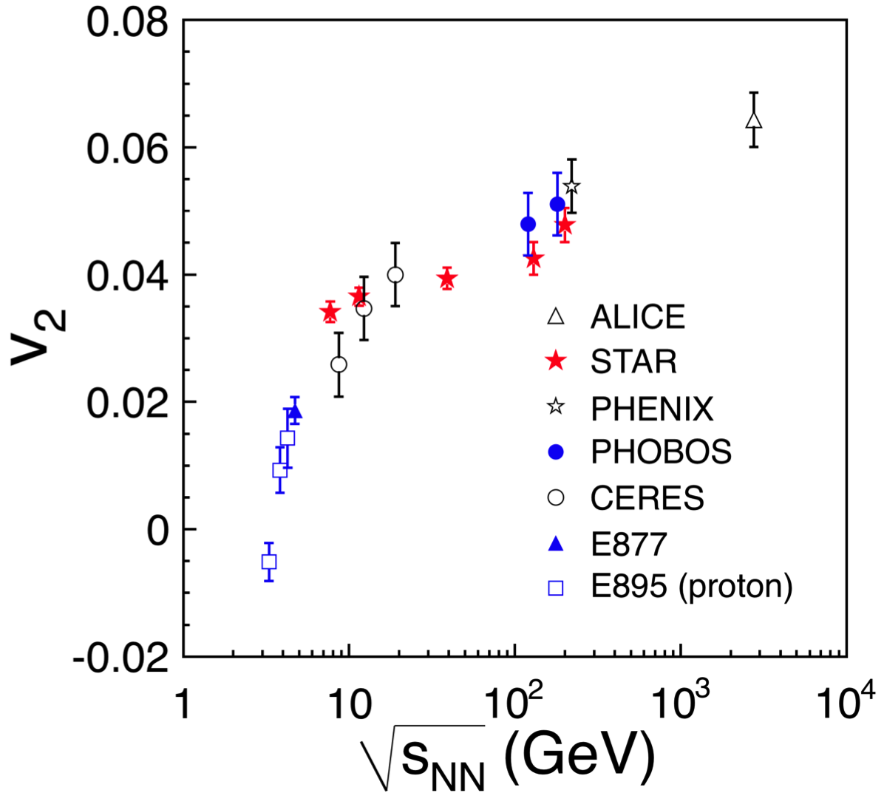
Energy Dependence of v₂
STAR, ALICE: v₂{4} results
Centrality: 20-30%
ALICE: PRL 105, 252302 (2010)
PHENIX: PRL 98, 162301 (2007)
PHOBOS: PRL 98, 242302 (2007)
CERES: Nucl. Phys. A 698, 253c (2002).
E877: Nucl. Phys. A 638, 3c(1998).
E895: PRL 83, 1295 (1999).
STAR 130 Gev: Phys.Rev. C66,034904 (2002).
STAR 200 GeV:
Phys.Rev. C72,014904 (2005).
STAR Preliminary
The rate of increase with collision energy is slower from 7.7 to 39 GeV compared to that between 3 to 7.7 GeV

Slide 20
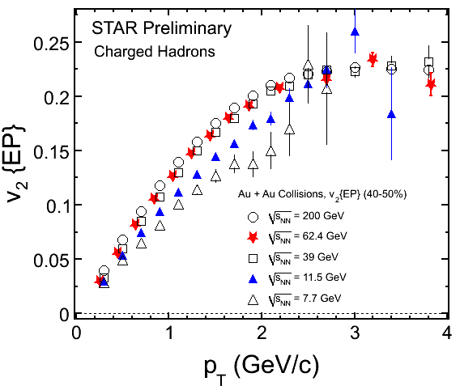
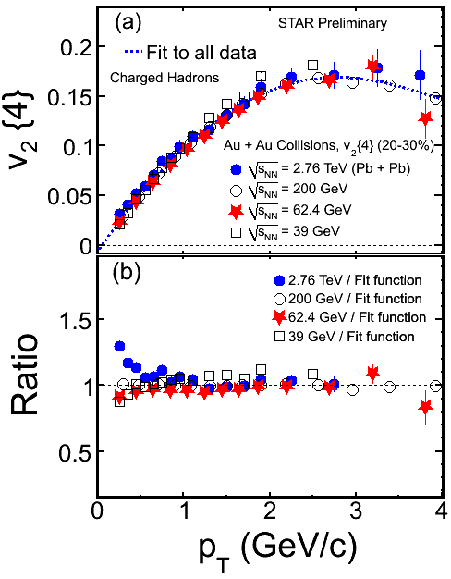
v₂(p_{T}): First Result
STAR: Nucl.Phys. A862-863(2011)125
v₂ (7.7 GeV) < v₂ (11.5 GeV) < v₂ (39 GeV)
v₂ (39 GeV) ≈ v₂ (62.4 GeV) ≈ v₂ (200 GeV) ≈ v₂ (2.76 TeV)
sQGP from 39 GeV to 2.76 TeV

Slide 21
v₂(p_{T}): Final Result
STAR Coll.: e-Print arXiv:1206.5528
ALICE data: PRL 105, 252302 (2010)
For p_{T} < 2 GeV/c: v₂ values rise with increasing √s_{NN}
For p_{T} ≥ 2 GeV/c: v₂ values are (within stat. errors) comparable
The increase of v₂ with √s_{NN,}could be due to change of chemical
composition and/or larger collectivity at higher collision energy.

Slide 22
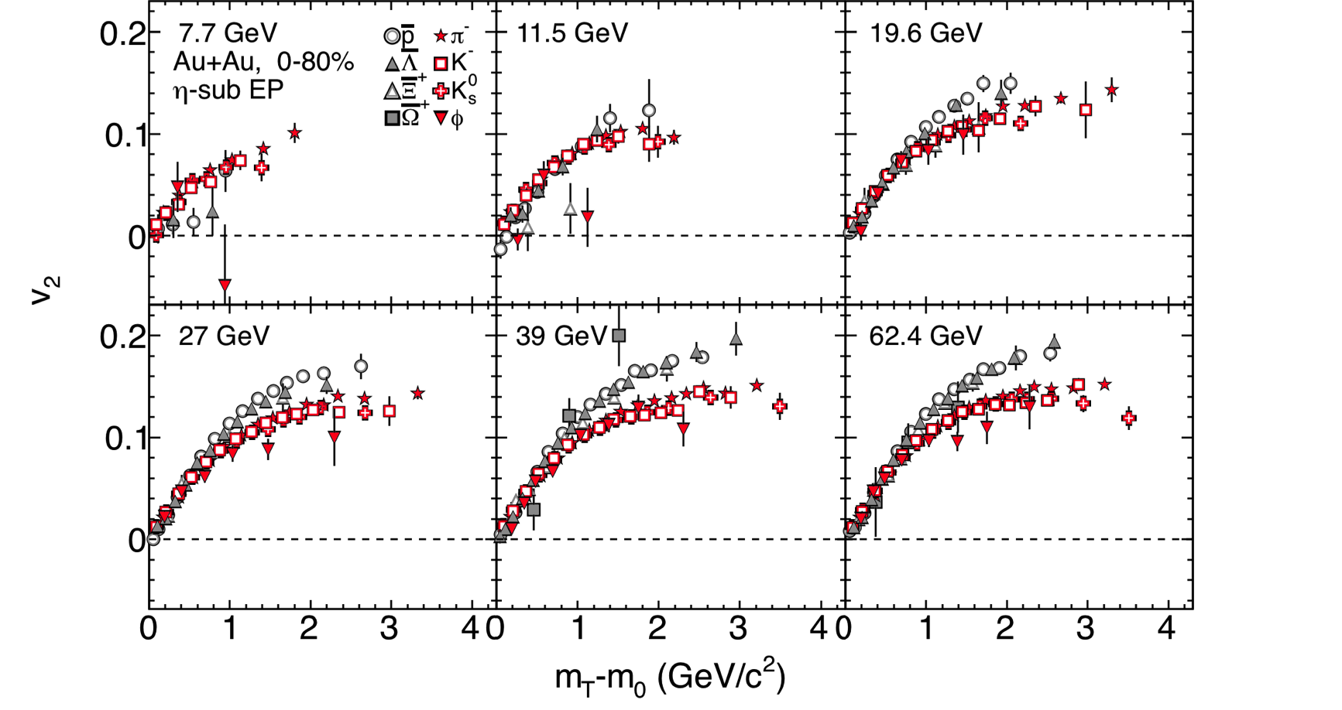
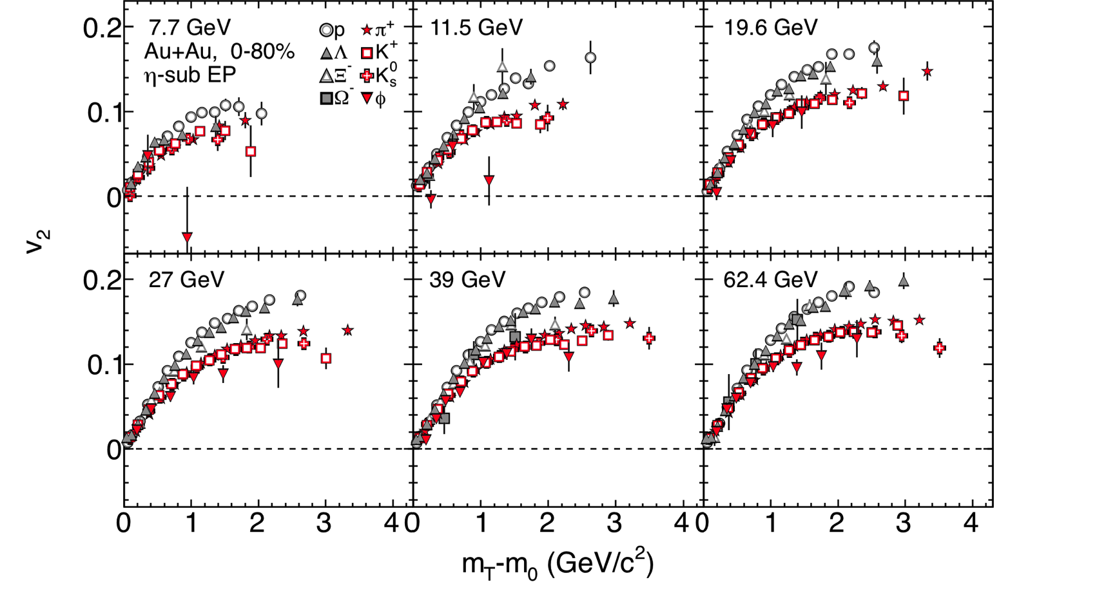
v₂ vs. m_{T}-m₀
STAR Preliminary
Corresponding anti-particles
Particles
Baryon–meson splitting is observed when collisions energy ≥ 19.6 GeV
for both particles and the corresponding anti-particles
For anti-particles the splitting is almost gone within errors at 11.5 GeV
Notes:
22

Slide 23
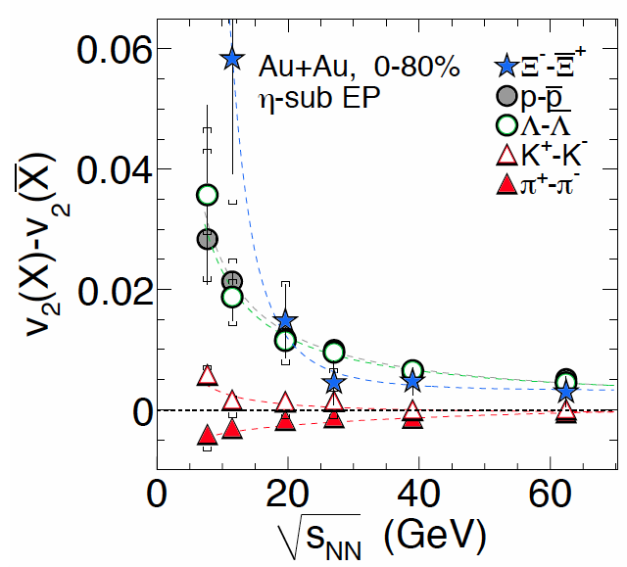
Particles vs. Anti-particles
Beam energy ≥ 39 GeV
Δv₂ for baryon and anti-baryon
within 10%
Almost no difference for mesons
Beam energy < 39 GeV
The difference of baryon and anti-baryon v₂
→ Increasing with decrease of beam energy
At √s_{NN} = 7.7 - 19.6 GeV
v₂(K⁺)>v₂(K⁻)
v₂(π⁻) >v₂(π⁺)
Possible explanation(s)
Baryon transport to midrapidity?
ref: J. Dunlop et al., PRC 84, 044914 (2011)
Hadronic potential?
ref: J. Xu et al., PRC 85, 041901 (2012)
STAR Preliminary
The difference between particles and anti-particles is observed
Notes:
23

Slide 24
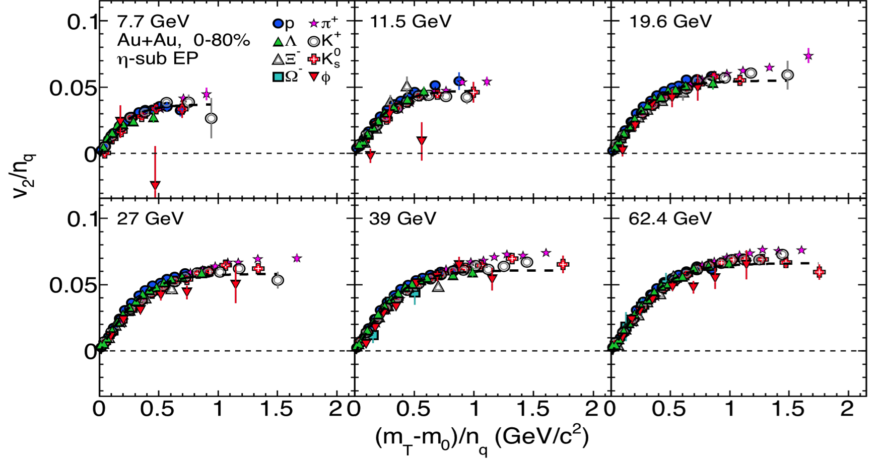
NCQ Scaling Test
Particles
STAR Preliminary
Universal trend for most of particles – n_{cq} scaling not broken at low energies
ϕ meson v₂ deviates from other particles in Au+Au@(11.5 & 7.7) GeV:
~ 2σ at the highest p_{T} data point
Reduction of v₂ for ϕ meson and absence of n_{cq} scaling ➔ during the evolution the system remains in the hadronic phase [B. Mohanty and N. Xu: J. Phys. G 36, 064022(2009)]

Slide 25
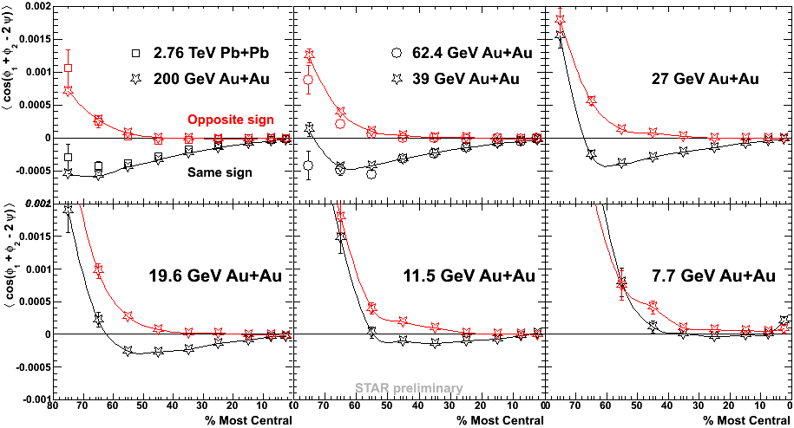
Disappearance of Charge Separation w.r.t. EP
ALICE, arXiv:1207.0900
<cos(φ₁ + φ₂ − 2Ψ)> = <cos(φ₁ – Ψ)cos(φ₂ – Ψ)> − <sin(φ₁ – Ψ)sin(φ₂ – Ψ)>
Motivated by search for local parity violation. Require sQGP formation.
The splitting between OS and LS correlations (charge separation) seen in top RHIC energy Au+Au collisions.
Charge separation signal disappears at lower energies (≤ 11.5 GeV)!

Slide 26
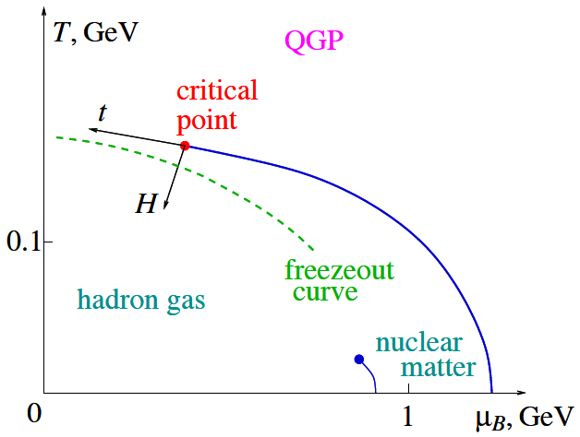
Accessing Phase Diagram
T-μ_{B}:
From spectra
and ratios

Slide 27
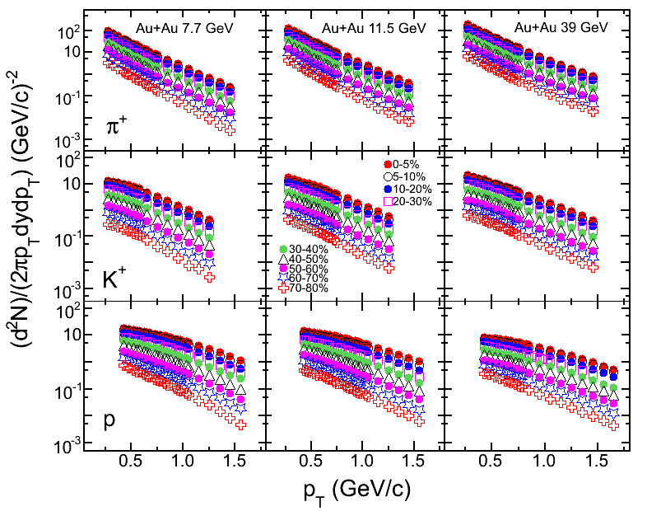
π, K, p Spectra
STAR Preliminary
Slopes: π > K > p. Proton spectra: without feed-down correction
π,K,p yields within measured p_{T} ranges: 70-80% of total yields

Slide 28
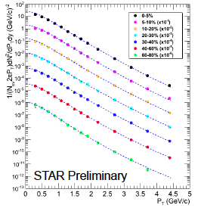
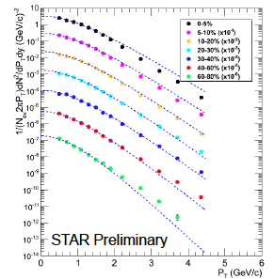
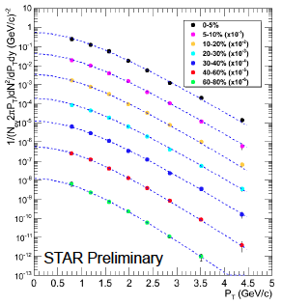
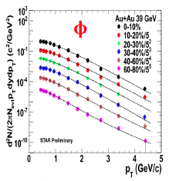
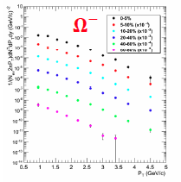
Strange Hadron Spectra
K⁰_{s}
Λ
Ξ⁻
Au+Au 39 GeV
Au+Au 39 GeV
Au+Au 39 GeV
φ, K⁰_{s}: Levy function fit
Λ, Ξ : Boltzmann fit
Λ: feed-down corrected
STAR Preliminary
STAR Preliminary

Slide 29

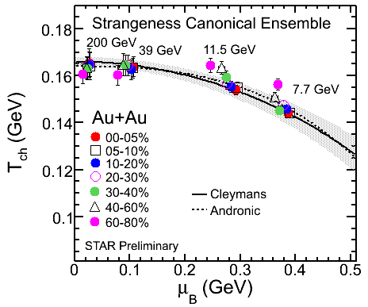
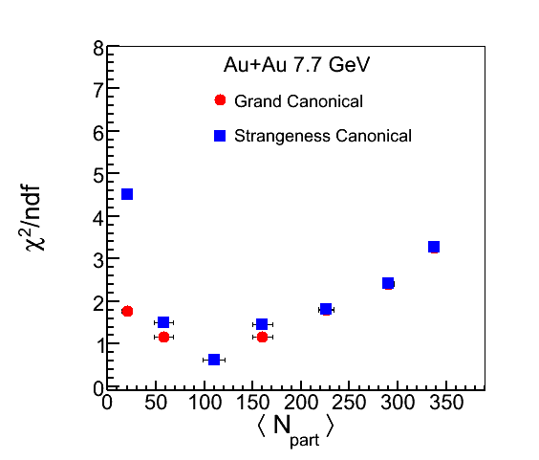
Chemical Freeze-out Parameters
THERMUS* Model:
T_{ch} and μ_{B}
Particles used:
π, K, p, Λ, K⁰_{s}, Ξ
STAR Preliminary
Centrality dependence of freeze-out
temperature with baryon chemical potential
observed for first time at lower energies
S. Wheaton & J.Cleymans, Comput. Phys. Commun. 180: 84, 2009.
Notes:
Extracted thermodynamic quantities: Τ_{ch,} μ_{B,} μ_{s} and γ_{S} For Grand Canonical: Quantum numbers (B, S, Q) conserved on average For Strangeness Canonical: Strangeness quantum number (S) conserved exactly

Slide 30
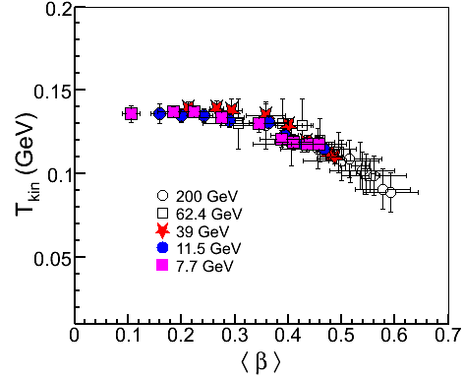
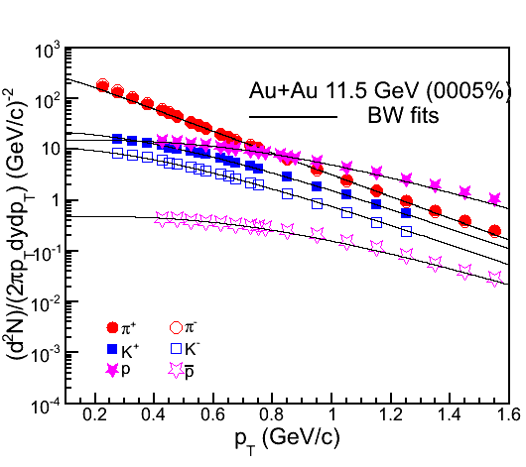
Kinetic Freeze-out Parameters
Blast Wave: T_{kin} and <β>
Particles used: π,K,p
STAR Preliminary
Au+Au
STAR Preliminary
Higher kinetic temperature corresponds to lower value of average
flow velocity and vice-versa

Slide 31
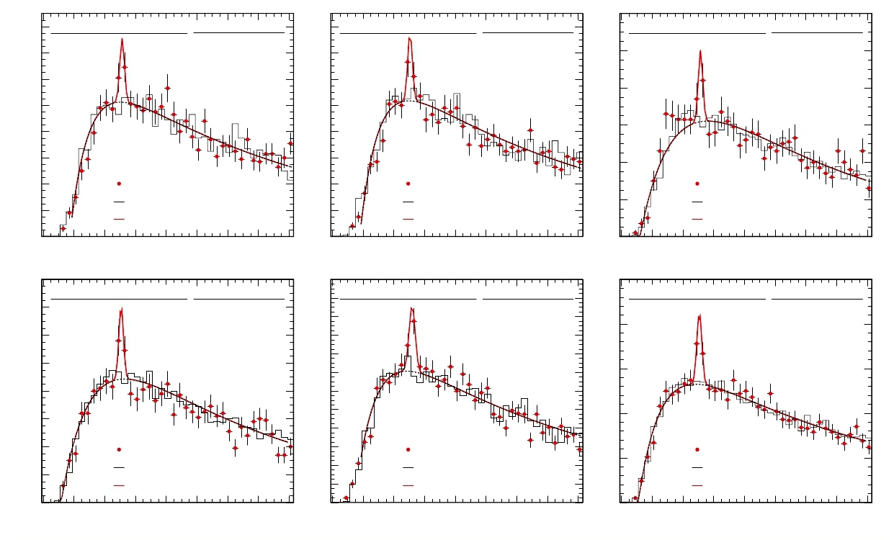
Hypertriton Production
Counts
Counts
120
160
140
Run10 7.7 GeV minbias
Signal
χ2 / ndf 25.8 / 32
Yield 45.57 ± 17.35
Mean 2.991± 0.001
160
140
Run10 11.5 GeV minbias
Signal
χ2 / ndf 28.5 / 32
Yield 41.18 ± 17.29
Mean 2.991± 0.001
Counts
Run11 19 GeV minbias
Signal
χ2 / ndf 60.7 / 34
Yield 42.11± 14.00
Mean 2.991± 0.001
100
120
100
80
120
100
80
80
60
60
40
20
STAR Preliminary
Signal
rotated background
signal+background fit
60
40
20
STAR Preliminary
Signal
rotated background
signal+background fit
40
20
STAR Preliminary
signal
rotated background
signal+background fit
0
0
0
2.94 2.96 2.98
2.94 2.96 2.98
3
3.02 3.04 3.06 3.08 3.1
Minv(He3+π-)(GeV)
2.94 2.96 2.98
3
3.02 3.04 3.06 3.08 3.1
Minv(He3+π-)(GeV)
3
3.02 3.04 3.06 3.08 3.1
Minv(He3+π-)(GeV)
160
240
250
Counts
Run11 27 GeV minbias
Signal
χ2 / ndf 64.2 / 34
Yield 46.43 ± 16.34
Mean 2.991± 0.001
Counts
Run10 39 GeV minbias
Signal
χ2 / ndf 41.1 / 32
Yield 88.12 ± 20.98
Mean 2.992 ± 0.002
Counts
Run10 200 GeV minbias
Signal
χ2 / ndf 75.3 / 34
Yield 82.91± 20.32
Mean 2.991± 0.000
140
120
220
200
180
200
100
80
160
140
120
150
60
40
20
100
80
60
40
20
100
50
STAR Preliminary
signal
rotated background
signal+background fit
STAR Preliminary
Signal
rotated background
signal+background fit
STAR Preliminary
signal
rotated background
signal+background fit
0
2.94 2.96 2.98
0
0
2.94 2.96 2.98
3
3.02 3.04 3.06 3.08 3.1
-
2.94 2.96 2.98
3
3.02 3.04 3.06 3.08 3.1
-
3
3.02 3.04 3.06 3.08 3.1
-
Minv(He3+π )(GeV)
Minv(He3+π )(GeV)
Minv(He3+π )(GeV)
_
3
Λ
H + H produced at √s_{NN} = 7.7, 11.5, 19.6, 27, 39, 200 GeV (minbias)
3
Λ

Slide 32

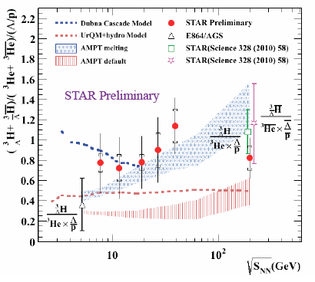
Phase Boundary Search With Nuclei
Strangeness Population Factor:
Beam energy dependence of S₃ behaves differently in QGP
and pure hadron gas
- S. Zhang et al., PLB 684 (2010) 224
- J. Steinheimer et al.,PLB 714 (2012) 85
S₃ indicates (with 1.7σ )
an increasing trend
Needs higher statistics to
make conclusive statement

Slide 33
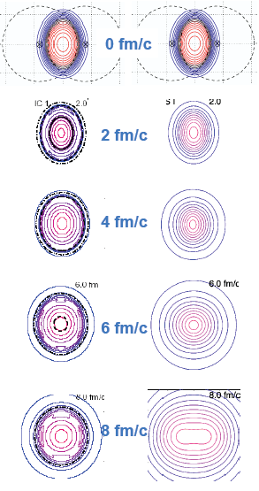
Time evolution of the collision geometry
Spatial eccentricity
Initial out-of-plane eccentricity
Stronger in-plane pressure gradients drive preferential in-plane expansion
Longer lifetimes or stronger pressure gradients cause more expansion and more spherical freeze-out shape
We want to measure the eccentricity at freeze out, ε_{F}, as a function of energy using azimuthal femtoscopic radii R_{x} and R_{y}:
Evolution of the initial shape depends on the pressure anisotropy
- Freeze-out eccentricity sensitive to the 1st order phase transition.
Non-monotonic behavior could indicate a soft point in the equation of state.
With 1st
order P.T.
Without 1st
Order P.T.
Kolb and Heinz, 2003, nucl-th/0305084

Slide 34

Azimuthal HBT: First result
J. Phys. G: Nucl. Part. Phys. 38 (2011) 124148
√s_{NN} (GeV)
x
Is there a non-monotonic behavior?

Slide 35

Azimuthal HBT: More Data
-1.0<y<-0.5
-0.5<y<0.5
0.5<y<1.0
Is the discrepancy due to centrality or rapidity range? - NO

Slide 36
Beam Energy Scan Phase- II

Slide 37

BES Phase-II proposal
Electron cooling will provide
increased luminosity ~ 10 times
Proposal BES-II (Years 2015-2017):
Fedotov, W. Fischer,
private discussions, 2012.
√s_{NN} [GeV] | μ_{B} [MeV] | Requested Events(10⁶)
Au+Au 19.6 | 206 | 150
Au+Au 15 | 256 | 150
Au+Au 11.5 | 316 | 50
Au+Au 7.7 | 420 | 70
U+U: ~20 | ~200 | 100
1% Au target
Fixed Target Proposal:
Annular 1% gold target inside the STAR beam pipe
2m away from the center of STAR
Data taking concurrently with collider mode at beginning of each fill
No disturbance to normal RHIC running
Notes:
In that figure, the lower curves are without electron cooling and upper are with electron cooling. The dotted curve represents with longer bunches.

Slide 38

Fixed Target Set-up

Slide 39

STAR BES Program Summary
√s_{NN} (GeV)
39
19.6
7.7
5
2.5
Explore QCD
Diagram
BES phase-I
BES phase-II
Fixed Target
QGP properties
Test Run
0
112
206
420
585
775
μ_{B} (MeV)
Large range of μ_{B} in the phase diagram !!!

Slide 40
Summary
STAR results from BES program covering large μ_{B} range provide important constraint on QCD phase diagram.
Different features show up:
  Proton v₁ slope changes sign between 7.7 GeV and 11.5 GeV
  Particles-antiparticles v₂ difference increases with decreasing √s_{NN}
  φ-meson v₂ deviates from others for √s_{NN} ≤ 11.5 GeV
Search for the critical point continues:
  Proposed BES-II program
  Fixed target proposal to extend μ_{B} coverage up to 800 MeV

Slide 41
STAR Collaboration
Argonne National Laboratory, Argonne, Illinois 60439
Brookhaven National Laboratory, Upton, New York 11973
University of California, Berkeley, California 94720
University of California, Davis, California 95616
University of California, Los Angeles, California 90095
Universidade Estadual de Campinas, Sao Paulo, Brazil
University of Illinois at Chicago, Chicago, Illinois 60607
Creighton University, Omaha, Nebraska 68178
Czech Technical University in Prague, FNSPE, Prague, 115 19, Czech Republic
Nuclear Physics Institute AS CR, 250 68 Řež/Prague, Czech Republic
University of Frankfurt, Frankfurt, Germany
Institute of Physics, Bhubaneswar 751005, India
Indian Institute of Technology, Mumbai, India
Indiana University, Bloomington, Indiana 47408
Alikhanov Institute for Theoretical and Experimental Physics, Moscow, Russia
University of Jammu, Jammu 180001, India
Joint Institute for Nuclear Research, Dubna, 141 980, Russia
Kent State University, Kent, Ohio 44242
University of Kentucky, Lexington, Kentucky, 40506-0055
Institute of Modern Physics, Lanzhou, China
Lawrence Berkeley National Laboratory, Berkeley, California 94720
Massachusetts Institute of Technology, Cambridge, MA
Max-Planck-Institut f\"ur Physik, Munich, Germany
Michigan State University, East Lansing, Michigan 48824
Moscow Engineering Physics Institute, Moscow Russia
NIKHEF and Utrecht University, Amsterdam, The Netherlands
Ohio State University, Columbus, Ohio 43210
Old Dominion University, Norfolk, VA, 23529
Panjab University, Chandigarh 160014, India
Pennsylvania State University, University Park, Pennsylvania 16802
Institute of High Energy Physics, Protvino, Russia
Purdue University, West Lafayette, Indiana 47907
Pusan National University, Pusan, Republic of Korea
University of Rajasthan, Jaipur 302004, India
Rice University, Houston, Texas 77251
Universidade de Sao Paulo, Sao Paulo, Brazil
University of Science \& Technology of China, Hefei 230026, China
Shandong University, Jinan, Shandong 250100, China
Shanghai Institute of Applied Physics, Shanghai 201800, China
SUBATECH, Nantes, France
Texas A\&M University, College Station, Texas 77843
University of Texas, Austin, Texas 78712
University of Houston, Houston, TX, 77204
Tsinghua University, Beijing 100084, China
United States Naval Academy, Annapolis, MD 21402
Valparaiso University, Valparaiso, Indiana 46383
Variable Energy Cyclotron Centre, Kolkata 700064, India
Warsaw University of Technology, Warsaw, Poland
University of Washington, Seattle, Washington 98195
Wayne State University, Detroit, Michigan 48201
Institute of Particle Physics, CCNU (HZNU), Wuhan 430079, China
Yale University, New Haven, Connecticut 06520
University of Zagreb, Zagreb, HR-10002, Croatia
Thank You

Slide 42
Back up

Slide 43

Chemical Freeze-out : Inelastic collision ceases
Particle ratios get fixed
★THERMUS : Statistical thermal model
Ensemble used – Grand Canonical and Strangeness Canonical
For Grand Canonical: Quantum numbers (B, S, Q) conserved on average
To consider incomplete strangeness equilibration:
For Strangeness Canonical: Strangeness quantum number (S) conserved exactly
Extracted thermodynamic quantities: Τ_{ch,} μ_{B,} μ_{s} and γ_{S}
Thermus, S. Wheaton & Cleymans, Comput. Phys. Commun. 180: 84-106, 2009.

Slide 44
Kinetic Freeze-out : Elastic collision ceases
Transverse momentum spectra get fixed
Blast Wave : Hydrodynamic inspired model
E. Schnedermann et al., Phys. Rev. C 48, 2462 (1993)
Particle spectra are fitted simultaneously
Extracted thermodynamic quantities: Τ_{kin} and <β>

Slide 45

Elliptic Flow and Collectivity
Initial spatial anisotropy
y
Pressure gradient
φ
x
INPUT
Spatial Anisotropy
2v₂
Interaction among
produced particles
dN/dφ
dN/dφ
OUTPUT
0
φ
2π
Momentum Anisotropy
0
φ
2π
λ=(σρ)⁻¹
Free
Streaming
v₂ = 0
Adapted from B. Mohanty

Slide 46

The RHIC Beam Energy Scan Motivation
Lattice Gauge Theory (LGT) prediction on the transition temperature T_{C} is robust.
LGT calculation, universality, and models hinted the existence of the critical point on the QCD phase diagram* at finite baryon chemical potential.
Experimental evidence for either the critical point or 1st order transition is important for our knowledge of the QCD phase diagram*.
* Thermalization has been assumed
M. Stephanov, K. Rajagopal, and E. Shuryak, PRL 81, 4816(98);
K. Rajagopal, PR D61, 105017 (00)
http://www.er.doe.gov/np/nsac/docs/Nuclear-Science.Low-Res.pdf
Quarks nad Gluons
Net baryon density

Slide 47

Particle Ratio Fluctuations
K/p
STAR Preliminary
STAR Preliminary
p/π
STAR Preliminary
Monotonic behavior of particle ratio fluctuations vs. √s_{NN}

Slide 48

Higher Moments: Net-protons
S σ ~ χ_{Β}⁽³⁾/χ_{Β}⁽²⁾
κσ² ∼ χ_{Β}⁽⁴⁾/χ_{Β}⁽²⁾
0-5% central collisions:
Deviations below Poisson
observed for √s_{NN} > 7.7 GeV
Peripheral collisions:
Deviations above Poisson
observed for √s_{NN} < 19.6 GeV
Higher statistics needed
at 7.7 GeV and 11.5 GeV
and possibly a new data
point around ~15 GeV

Slide 49

Higher Moments: Net-charge
S σ ~ χ_{Β}⁽³⁾/χ_{Β}⁽²⁾
κσ² ∼ χ_{Β}⁽⁴⁾/χ_{Β}⁽²⁾
Data lies in between
Poisson and HRG model
expectations
Higher statistics needed
at 7.7 GeV and 11.5 GeV
and possibly a new data
point around ~15 GeV

Slide 50

(C) Searching QCD Critical Point
observable
Enhanced Fluctuations
near Critical Point
CO₂ near
liquid-gas
transition
√s_{NN}
T. Andrews. Phil. Trans. Royal Soc., 159:575, 1869
Particle ratio fluctuations (2nd moments)
- K/π, p/π, K/p
Conserved number fluctuations
- Higher moments of net-protons, net-charge,..
Nihar Sahoo: Higher moments of net-charge multiplicity distributions at RHIC energies in STAR
Zhiming Li: Dynamical higher cummulant ratios of net and total protons at STAR

Slide 51


CSE + CME → Chiral Magnetic Wave:
collective excitation
signature of Chiral Symmetry Restoration
Peak magnetic field ~ 10¹⁵ Tesla !
(Kharzeev et al. NPA 803 (2008) 227)

Slide 52
Chiral Magnetic effect + Local Parity Violation
A direct measurement of the P-odd quantity “a” should yield zero.
S. Voloshin, PRC 70 (2004) 057901
Non-flow/non-parity effects:
largely cancel out
P-even quantity:
still sensitive to charge separation
Directed flow: expected to be the same for SS and OS

