Slide 1


Three-dimensional Kaon Source Extraction from STAR Experiment at RHIC
Michal Šumbera
NPI ASCR Prague
(for the STAR Collaboration)
1

Slide 2
Outline
Why and how to extract the source shape?
1D source extraction: previous and recent results
Kaon data analysis details
3D source shape analysis: Cartesian surface – spherical harmonic decomposition technique
3D source function extraction: correlation moments fitting
Comparison to thermal blast wave model
Conclusions
2

Slide 3
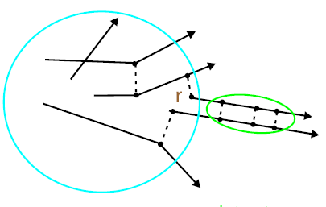
Source imaging
Technique devised by
D. Brown and P. Danielewicz
PLB398:252, 1997
PRC57:2474, 1998
Inversion of linear integral equation to obtain source function
1D Koonin-Pratt equation
Encodes FSI
Emitting source
Source function
(Distribution of pair separations in pair rest frame)
Correlation
function
Kernel is independent
of freeze-out conditions
Model-independent analysis of emission shape
(goes beyond Gaussian shape assumption)
3

Slide 4

Inversion procedure
Freeze-out occurs after last scattering. ⇒ Only Coulomb & quantum statistics effects included the kernel.
Expansion into B-spline basis
4

Slide 5
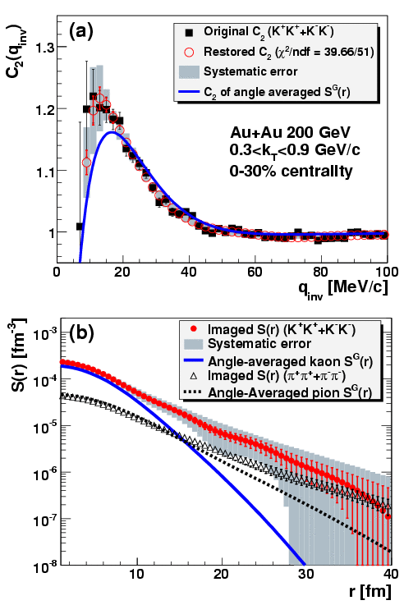
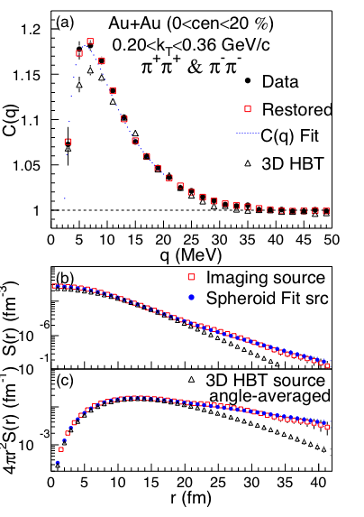
Previous 1D source imaging results
PHENIX, PRL 98:132301,2007
PHENIX, PRL 103:142301,2009
Observed long non-gaussian tails attributed to
non-zero particle emision duration and contribution of long-lived resonances

Slide 6
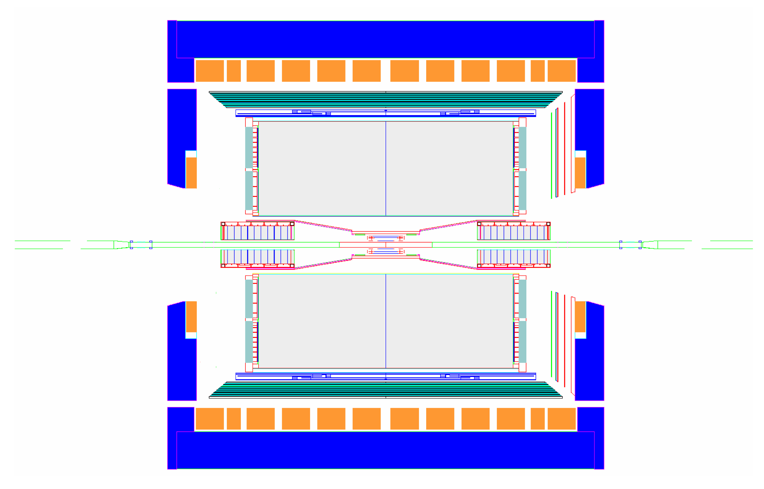
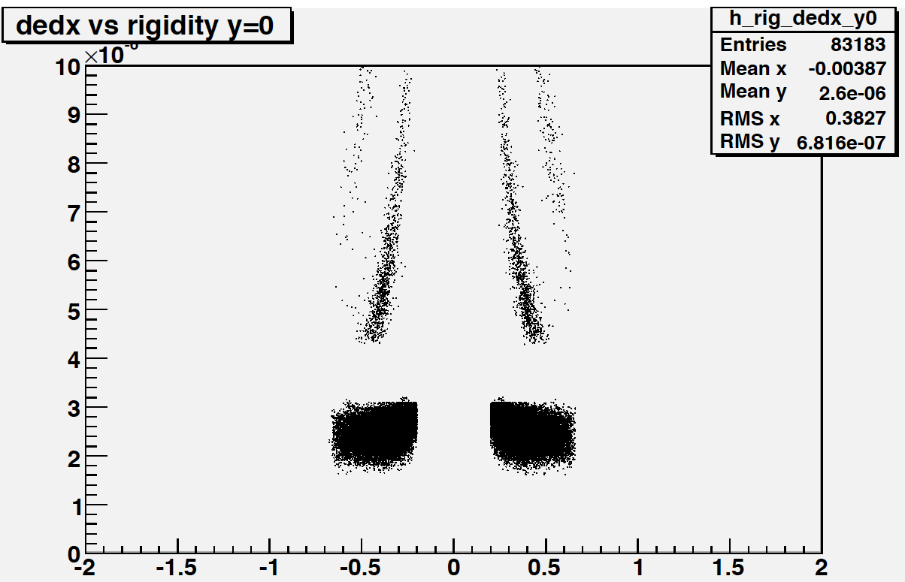
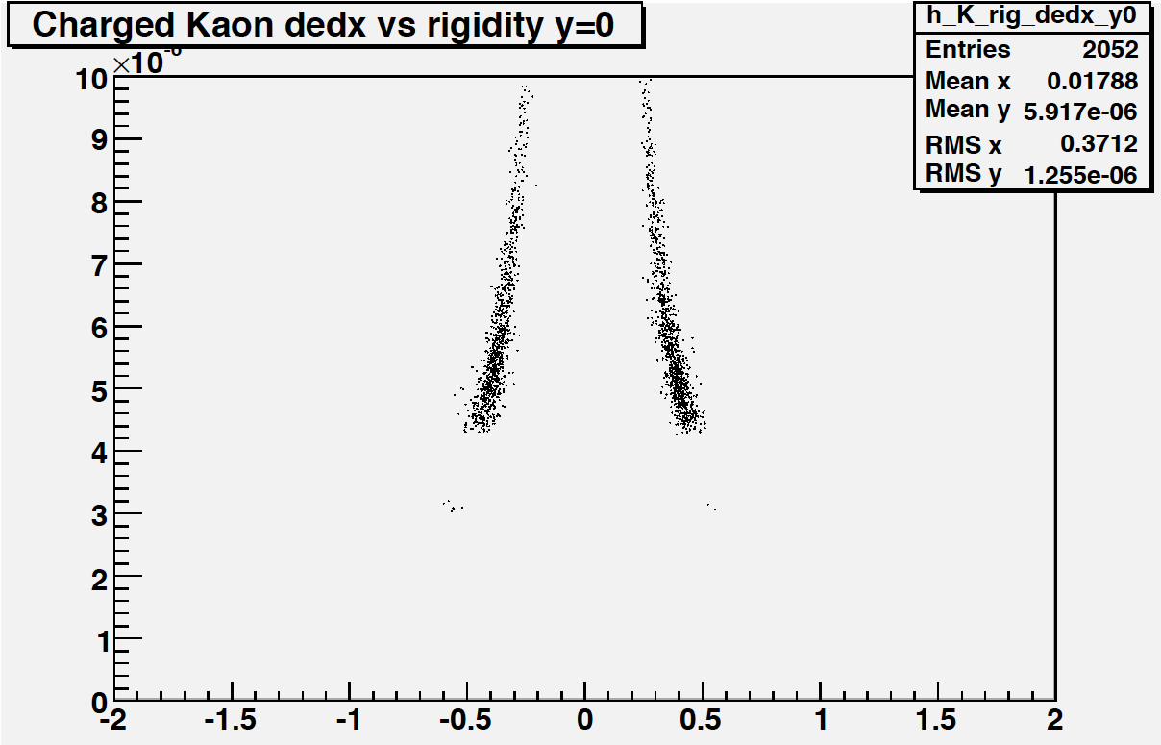
Kaon data analysis
20% most central Au+Au @ √s_{NN}=200 GeV
Run 4: 4.6 Mevts, Run 7: 16 Mevts
Particle ID selection via TPC dE/dx:
NSigmaKaon<2.0 && NSigmaPion>3.0
&& NSigmaElectron>2.0
TPC
dE/dx vs rigidity:
before after
PID
cuts
|y| < 0.5 & 0.2 < p_{T} < 0.4 GeV/c

Slide 7
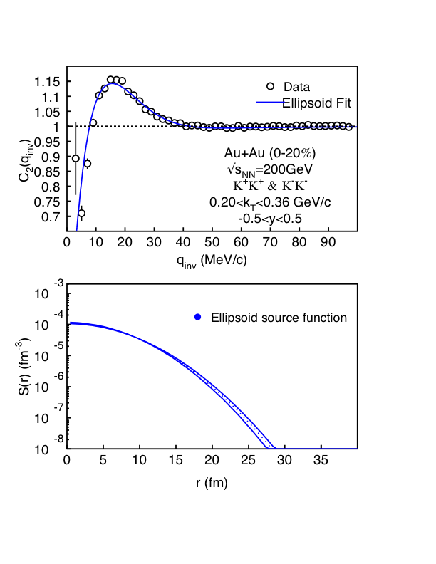
STAR kaon 1D source shape result
PHENIX, PRL 103:142301,2009
34M+83M=117M
K⁺K⁺ & K⁻K⁻ pairs
STAR data are
well described
by Gaussian,
contrary to
PHENIX no
non-gaussian
tails are observed.
May be due
to a different
k_{T}-range:
STAR bin is
4x narrower.
STAR preliminary
STAR preliminary

Slide 8
3D source shape analysis
Danielewicz and Pratt,
Phys.Lett. B618:60, 2005
Expansion of R(q) and S(r) in Cartesian Harmonic basis
α_{i} = x, y or z
x = out-direction
y = side-direction
z = long-direction
3D Koonin-Pratt:
(3)
Plug (1) and (2) into (3)
⇒
Invert (1)
⇒
Invert (2)
⇒

Slide 9
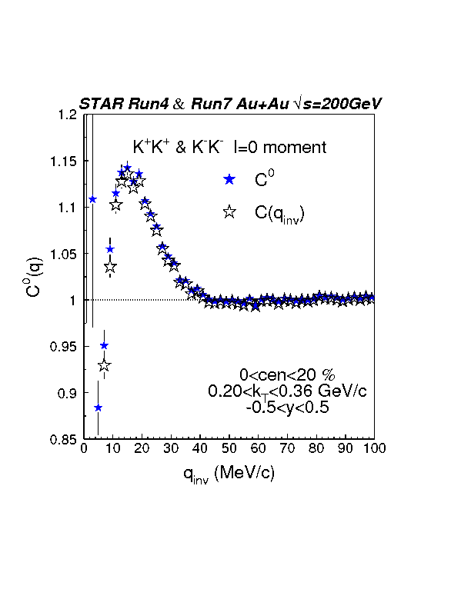
C⁰(q_{inv}) vs C(q_{inv}): comparison
K⁺K⁺ & K⁻K⁻ l=0 moment
C⁰(q_{inv})
C(q_{inv})
STAR preliminary

Slide 10
Extracting 3D source function
Fit to the 3D correlation function with a trial functional form for S(r).
Trial function: 4-parameter ellipsoid (3D Gaussian)
Since the 3D correlation function has been decomposed into its independent moments, this is equivalent to a simultaneous fit of 6 independent moments with the trial functional form.

Slide 11
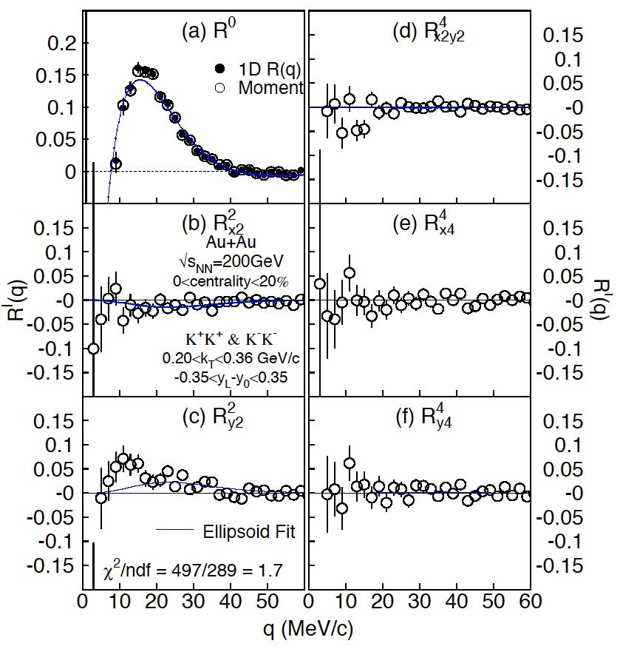
Independent correlation moments
R^{l}_{α1…αl} , 0≤l≤4
Extracted
3D Gaussian
fit parameters:
λ = 0.48 ± 0.01
r_{x} = (4.8 ± 0.1) fm
r_{y} = (4.3 ± 0.1) fm
r_{z} = (4.7 ± 0.1) fm
STAR preliminary

Slide 12
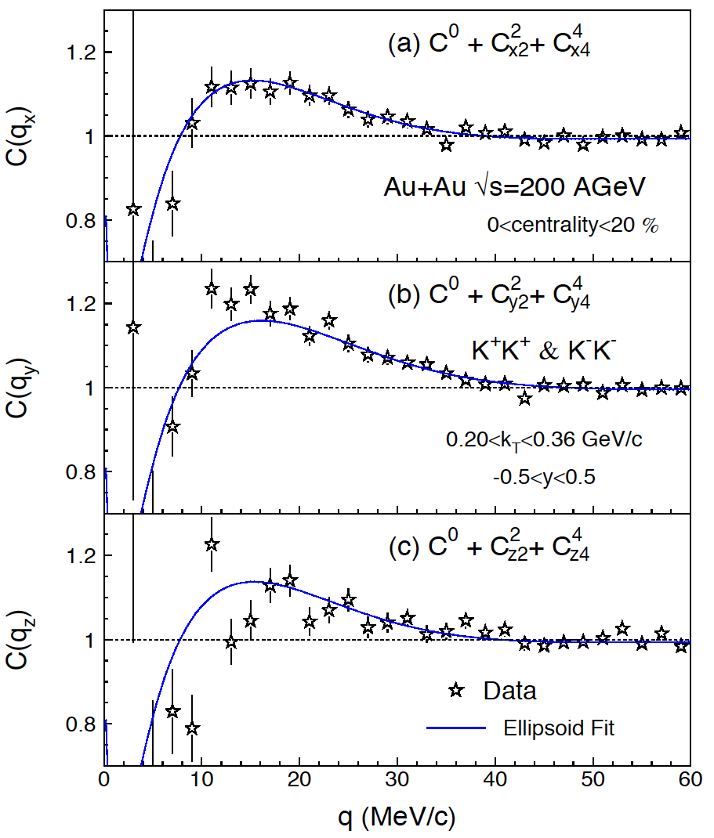
Kaon correlation function profiles
C(q_{x}) ≡ C(q_{x},0,0)
C(q_{y}) ≡ C(0,q_{y},0)
C(q_{z}) ≡ C(0,0,q_{z})
STAR preliminary

Slide 13
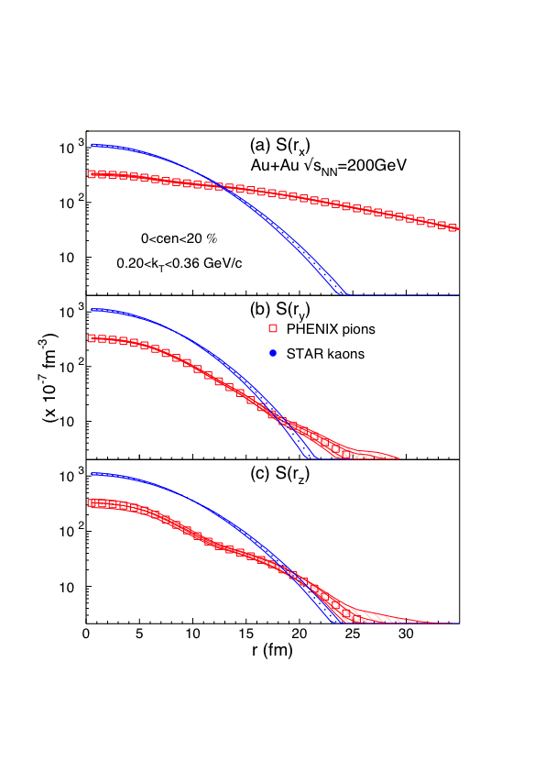
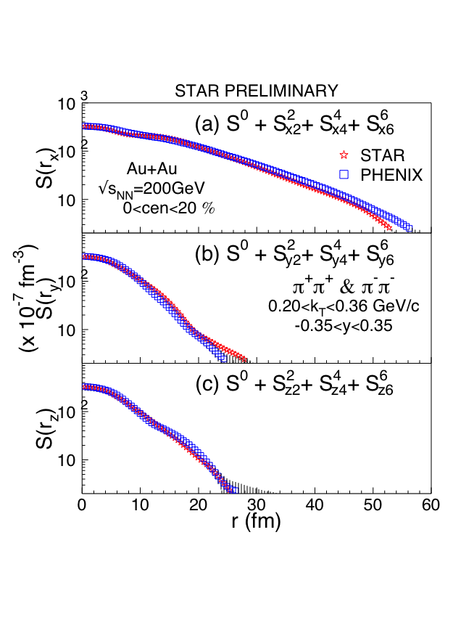
Kaon vs. pion 3D source shape
P. Chung, STAR, arXiv:1012.5674 [nucl-ex]
PRL 98:13230
PRL 98:13230
STAR preliminary
STAR preliminary
Pion and kaon 3D source shapes
are very different: Is this due to
the different dynamics?
Very good agreement on 3D pion source
shape between PHENIX and STAR

Slide 14
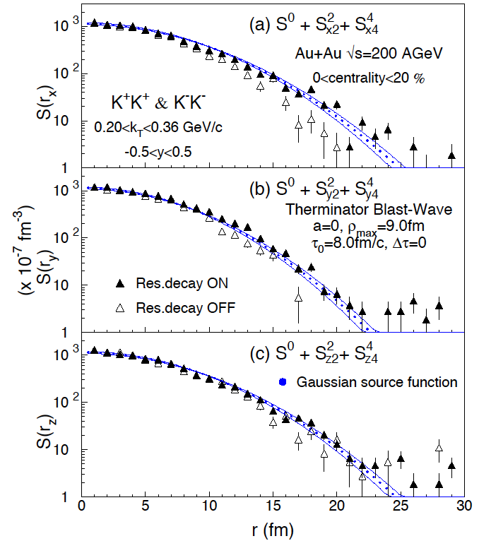
Comparison to thermal BW model
Therminator (A. Kisiel et al., Phys. Rev. C 73:064902 2006) basic ingredients:
Longitudinal boost invariance.
Blast-wave expansion with transverse velocity profile semi-linear in transverse radius ρ: v_{r}(ρ)=(ρ/ρ_{max})/(ρ/ρ_{max}+v_{t}). Value of v_{t} =0.445 comes from the BW fits to particle spectra from Au+Au @ 200GeV: STAR, PRC 79:034909, 2009.
Thermal emission takes place at proper time τ, from a cylinder of infinite longitudinal size and finite transverse dimension ρ_{max}.
Freeze-out occurs at τ = τ₀ +aρ. Particles which are emitted at (z, ρ) have LAB emission time t² = (τ₀ +aρ)²+z² .
Emission duration is included via Δτ.
STAR preliminary

Slide 15
Conclusions
First model-independent extraction of kaon 3D source shape.
Source function of mid-rapidity, low-momentum kaons from 20% most central Au+Au collisions at √s_{NN}=200 GeV is Gaussian – no significant non-Gaussian tail is observed.
Comparison with Therminator model indicates kaon emission from a fireball with transverse dimension and lifetime which are consistent with values from two-pion interferometry.
In contrast to pions, kaons are emitted instantaneously in the source element rest frame from a freeze-out hypersurface with no ρ−τ correlation.
Kaons and pions may be subject to different dynamics owing to their emission over different timescales.

Slide 16
Backup slides

Slide 17
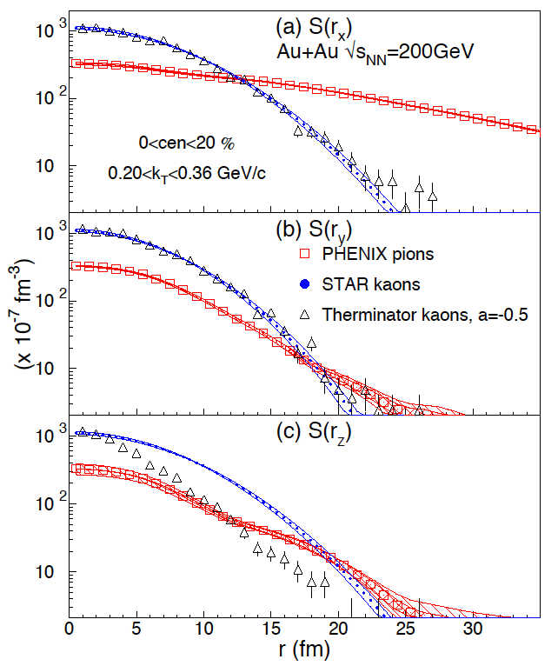
Kaon vs. pion 3D source shape
P. Chung, STAR, arXiv:1012.5674 [nucl-ex]
PRL 98:13230
PRL 98:13230
STAR preliminary
STAR preliminary
Pion and kaon 3D source shapes
are very different: Is this due to
the different dynamics?
Very good agreement on 3D pion source
shape between PHENIX and STAR

Slide 18
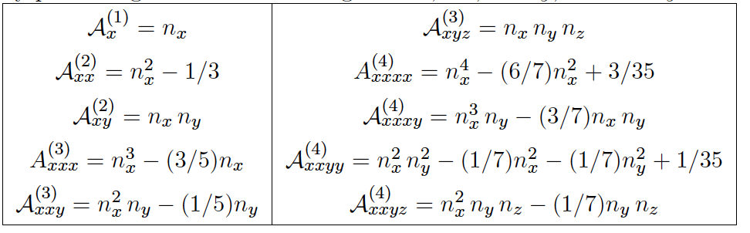
Cartesian harmonics basis
Based on the products of unit vector components, n_{α1} n_{α2} ,…, n_{αℓ} . Unlike the spherical harmonics they are real.
Due to the normalization identity n²_{x} + n²_{y} + n²_{z} = 1, at a given ℓ ≥ 2, the different component products are not linearly independent as functions of spherical angle.
At a given ℓ, the products are spanned by spherical harmonics of rank ℓ′ ≤ ℓ, with ℓ′ of the same evenness as ℓ.

Slide 19
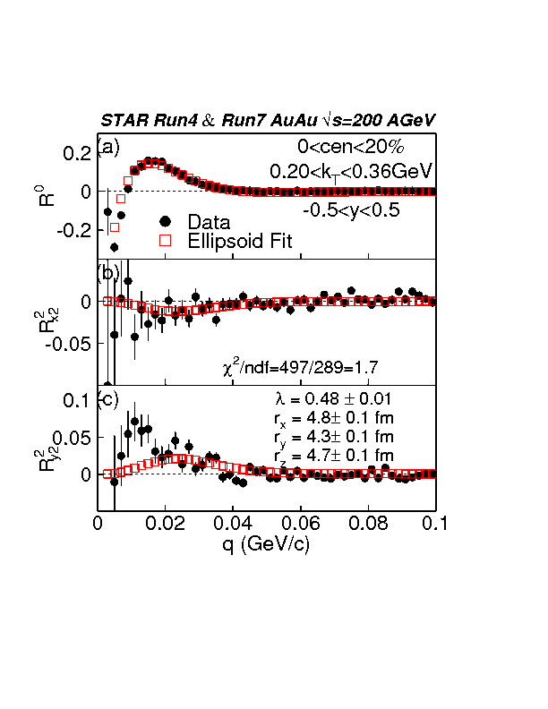
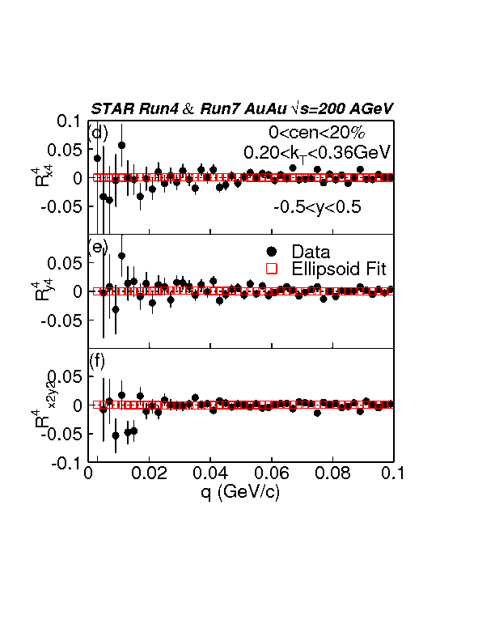
Ellipsoid fit
STAR preliminary
STAR preliminary

Slide 20
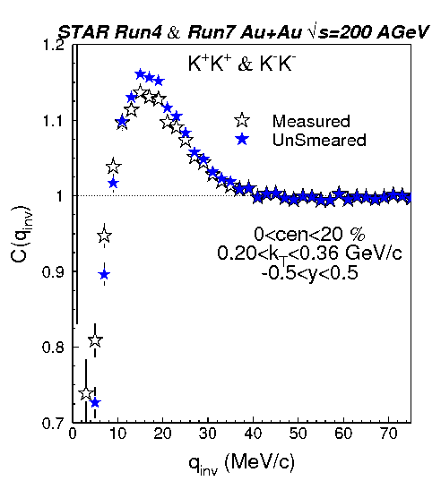
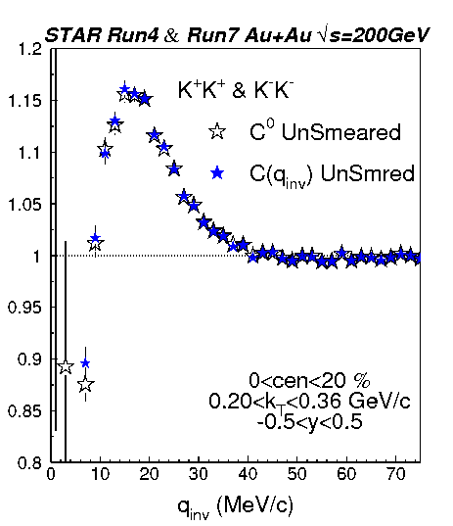
Momentum resolution correction
1D C(q) Corrected vs C(q) UnSmeared
1D C(q) UnSmeared vs C⁰ (q) UnSmeared)
STAR preliminary
STAR preliminary

