Slide 1




Kaon Freeze-out Dynamics
in √s_{NN}=200 GeV Au+Au Collisions at RHIC*
Michal Šumbera
sumbera@ujf.cas.cz .
for the
collaboration
Nuclear Physics Institute
Czech Academy of Sciences
*) Phys. Rev. C 88, 034906 (2013)
XLIII International Symposium on Multiparticle Dynamics
September 15-20, 2013 Illinois Institute of Technology, Chicago, IL

Slide 2
Correlation femtoscopy in a nutshell (1/3)
p₂
2.0
x₂
1.5
~1/R B-E
R
x₁
1.0
0.5
~1/R F-D
p₁
0.0
0.0
0.5
1.0
1.5
2.0
Correlation function of two identical bosons/fermions at small momentum difference q shows effect of quantum statistics.
Height/depth of the B-E/F-D bump λ is related to the fraction (λ^{½}) of particles participating in the enhancement.
Its width scales with the emission radius as R⁻¹.

Slide 3
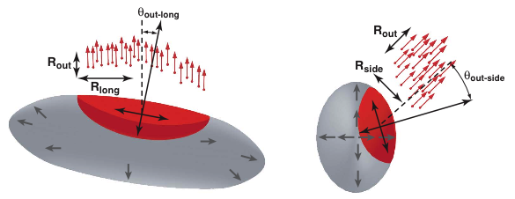
Correlation femtoscopy in a nutshell (2/3)
The correlation is determined by the size of region from which particles with roughly the same velocity are emitted
⇒ Femtoscopy measures size, shape, and orientation of homogeneity regions
Notes:
The function S(r) is a Gaussian parameterization of the source, which is convoluted with the kernel (wavefunction-squared)

Slide 4
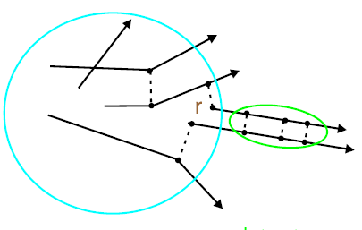
Correlation femtoscopy in a nutshell (3/3)
1D Koonin-Pratt equation
Encodes FSI
Emitting source
Source function
(Distribution of pair separations in the pair rest frame)
Correlation
function
Kernel K(q,r) is independent of freeze-out conditions
S(r) is often assumed to be Gaussian ⇒ HBT radii
Other option: Inversion of linear integral equation to obtain source function
Model-independent analysis of emission shape
(goes beyond Gaussian shape assumption)
Notes:
The function S(r) is a Gaussian parameterization of the source, which is convoluted with the kernel (wavefunction-squared)

Slide 5

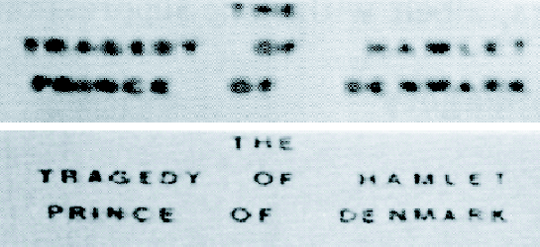
Source Imaging
Technique devised by
D. Brown and P. Danielewicz
PLB398:252, 1997
PRC57:2474, 1998
Geometric information from imaging.
General task:
From data w/errors, R(q), determine the source S(r).
Requires inversion of the kernel K.
Optical recognition: K - blurring function, max entropy method
R:
Any determination of source characteristics from data, unaided by reaction theory, is an imaging.
S:
Notes:
The function S(r) is a Gaussian parameterization of the source, which is convoluted with the kernel (wavefunction-squared)

Slide 6
Inversion procedure
Freeze-out occurs after the last scattering. ⇒ Only Coulomb & quantum statistics effects included in the kernel.
Expand into B-spline basis Vary S_{j} to minimize χ²
D. A. Brown, P. Danielewicz: UCRL-MA-147919
Notes:
The function S(r) is a Gaussian parameterization of the source, which is convoluted with the kernel (wavefunction-squared)

Slide 7
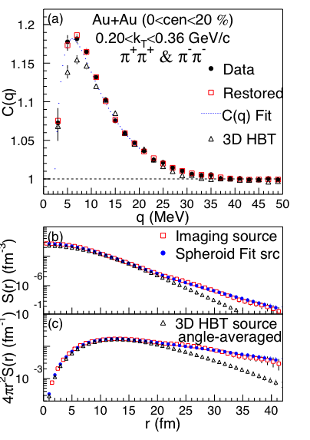
Why Kaons?
PHENIX, PRL 98:132301,2007
Pion source shows a heavy,
non-Gaussian tail
Interpretation is problematic
  Tail attributed to decays of long-lived resonances, non-zero emission duration etc.
Kaons: cleaner probe
  less contribution from resonances
PHENIX 1D kaon result shows also a long non-Gaussian tail

Slide 8
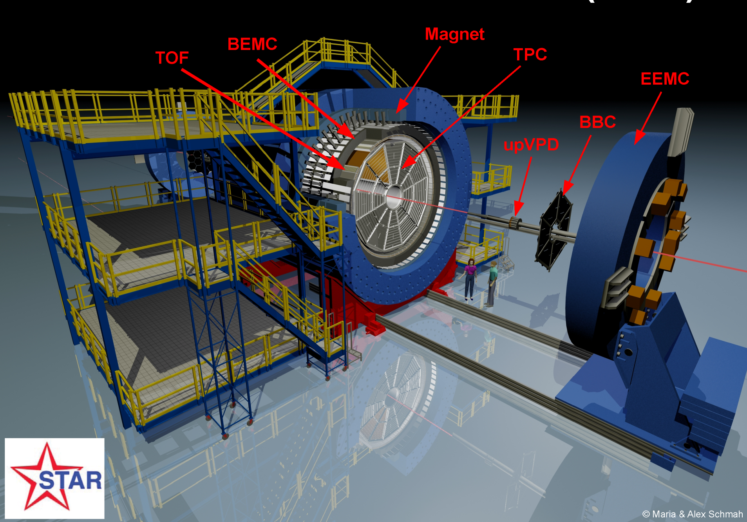
The STAR Experiment
Time Projection Chamber
  ID via energy loss (dE/dx)
  Momentum (p)
Full azimuth coverage
Uniform acceptance
  for different energies
  and particles
The Solenoidal Tracker At RHIC
Notes:
8

Slide 9
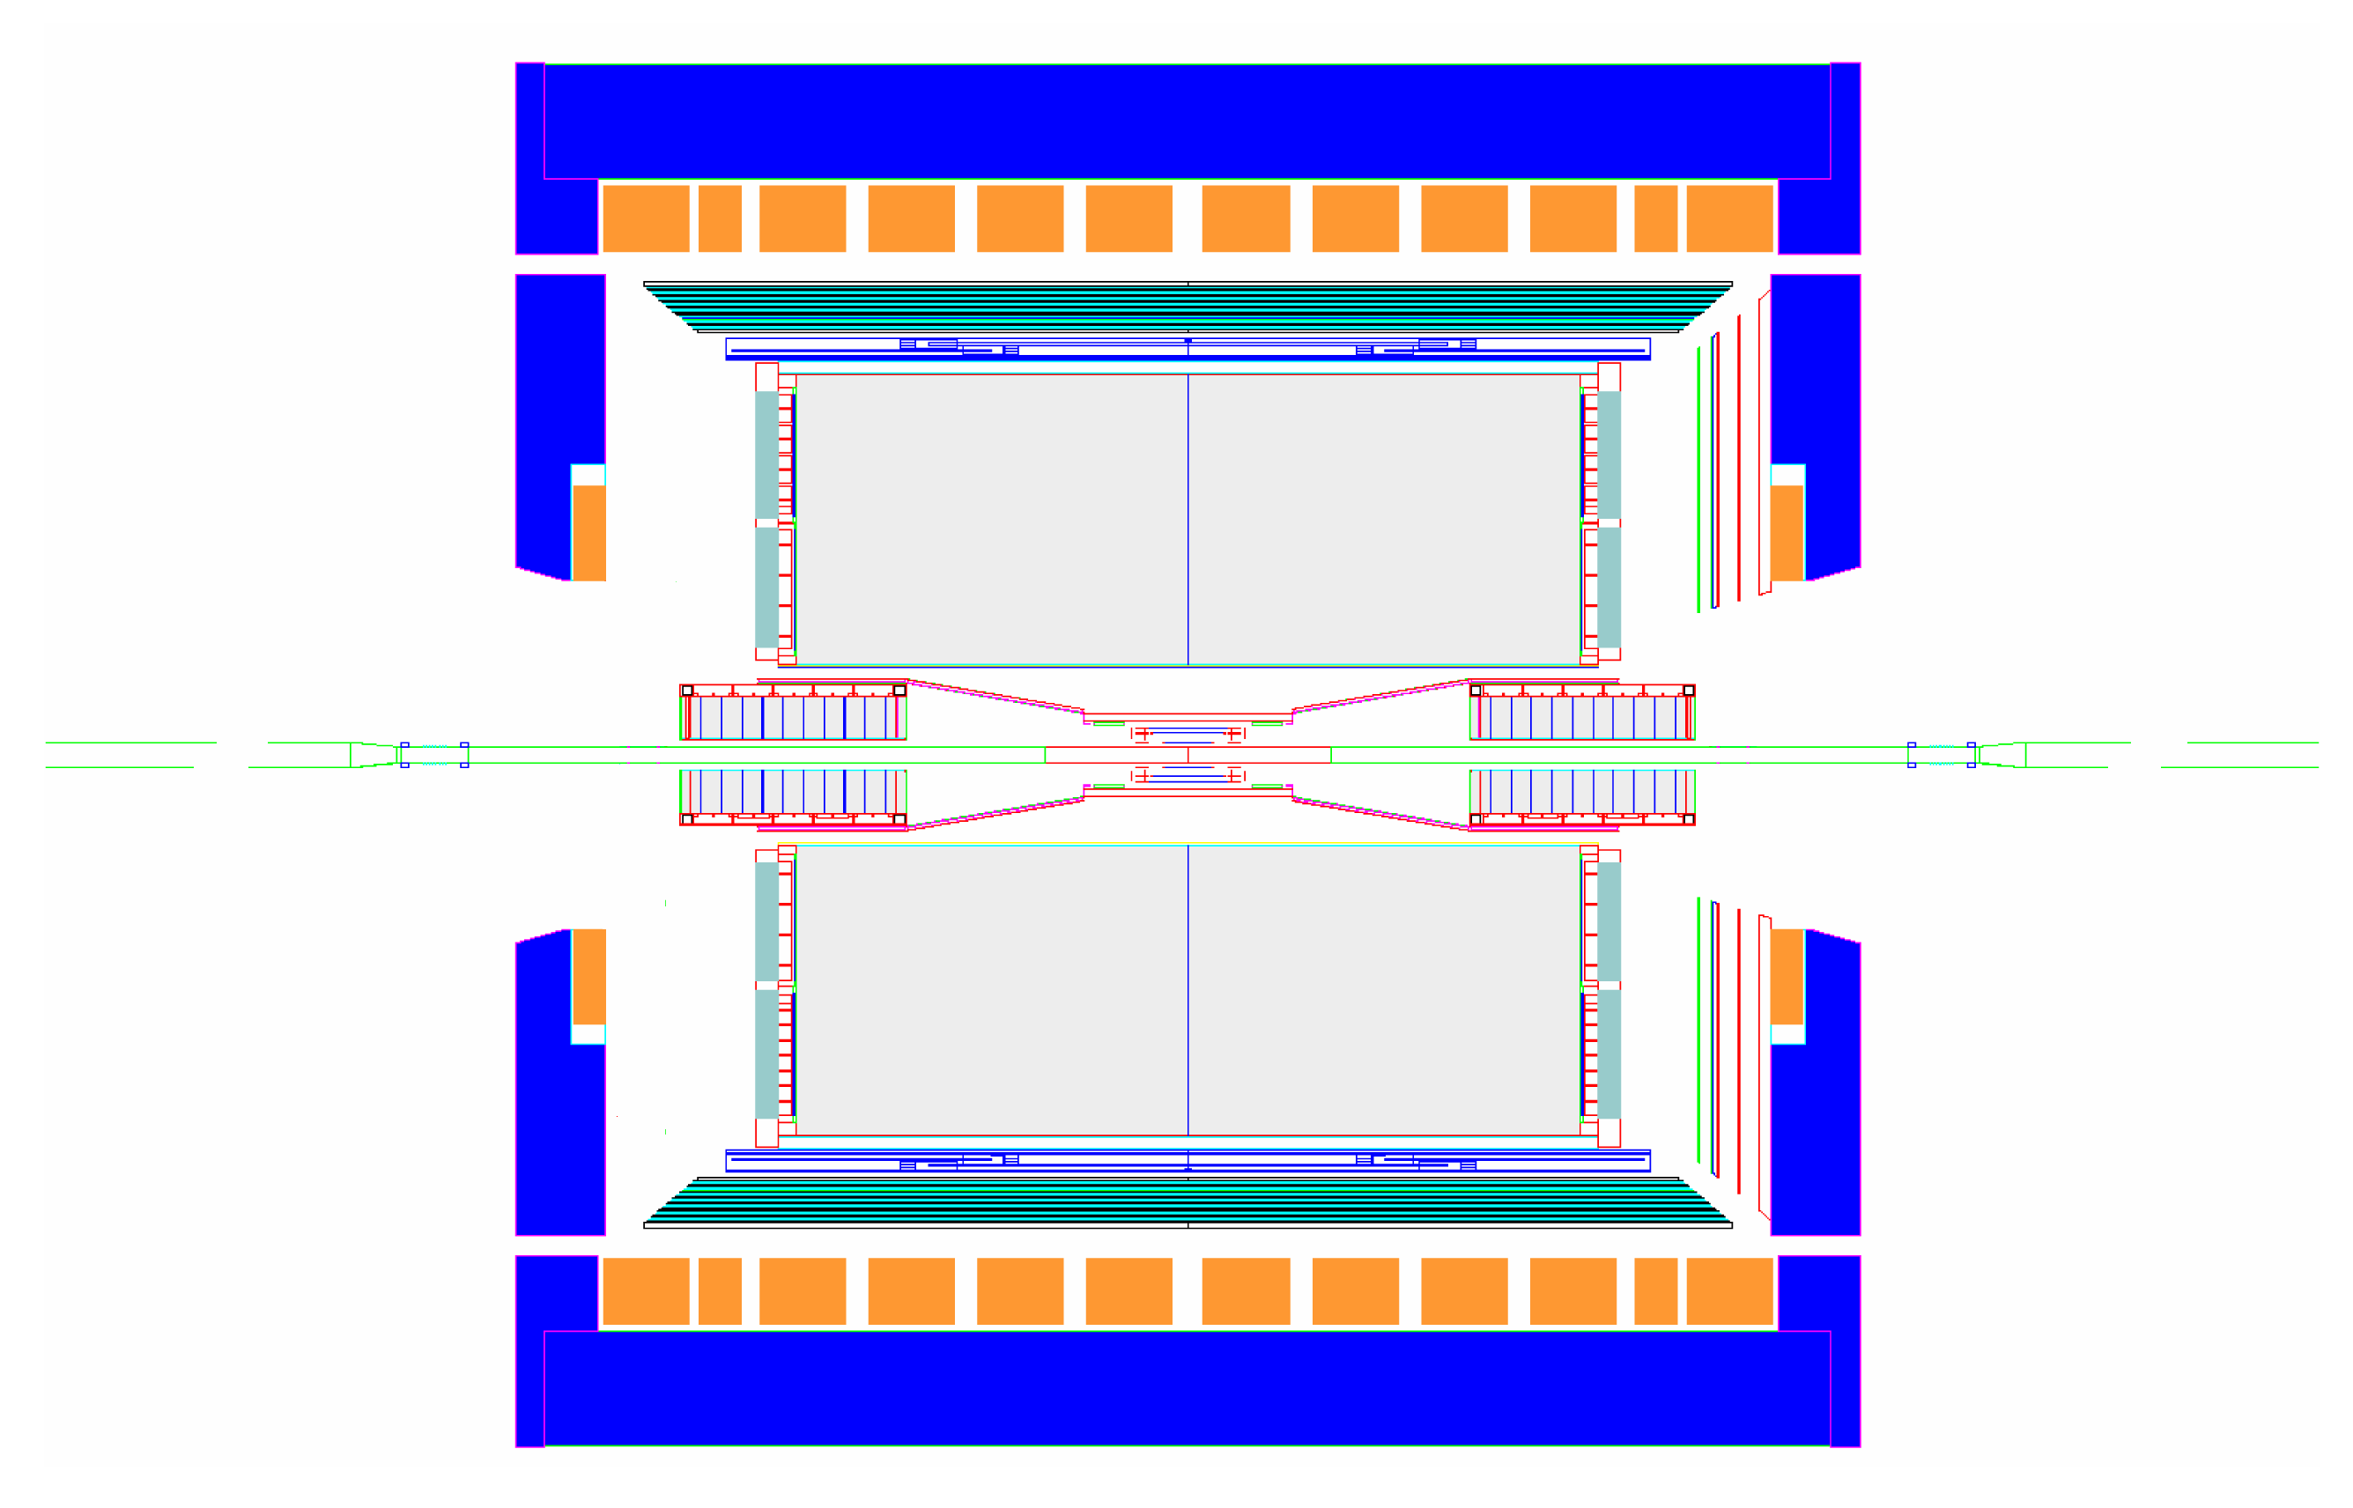
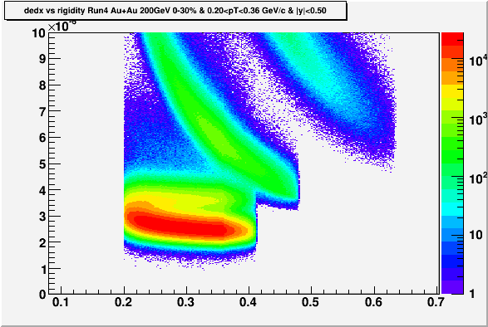
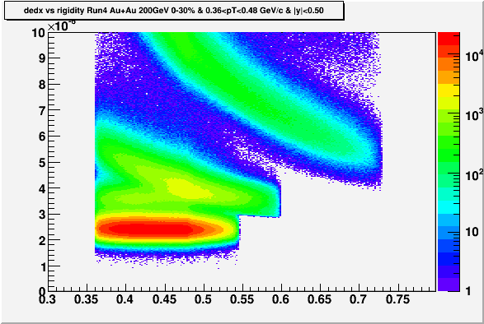

Kaon femtoscopy analyses
Au+Au @ √s_{NN}=200 GeV
Mid-rapidity |y|<0.5
Source shape: 20% most central
  Run 4: 4.6 Mevts, Run 7: 16 Mevts
m_{T}-dependence: 30% most central
  Run 4: 6.6 Mevts
TPC
0.2<k_{T}<0.36 GeV/c
0.36<k_{T}<0.48 GeV/c
dE/dx (keV/cm)
p
dE/dx (keV/cm)
p
dE/dx
dE/dx
K
K
π
π
Rigidity (GeV/c)
Rigidity (GeV/c)
Notes:
Motivate next slide!

Slide 10
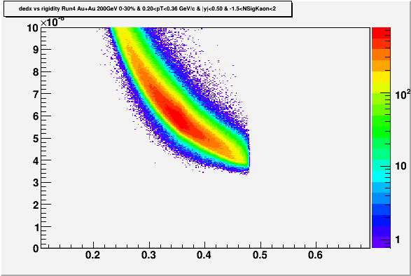
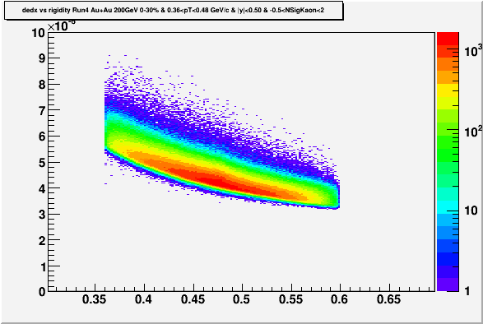
PID cut applied
Source shape analysis
  dE/dx: nσ(Kaon)<2.0 and nσ(Pion)>3.0 and nσ(electron)>2.0
  nσ(X) :deviation of the candidate dE/dx from the
  normalized distribution of particle type X at a given momentum
  0.2 < p_{T} < 0.4 GeV/c
m_{T}-dependent analysis
-1.5< nσ(Kaon)<2.0
-0.5< nσ(Kaon)<2.0
0.2<k_{T}<0.36 GeV/c
0.36<k_{T}<0.48 GeV/c
dE/dx (keV/cm)
dE/dx (keV/cm)
dE/dx
dE/dx
K
K
Rigidity (GeV/c)
Rigidity (GeV/c)

Slide 11
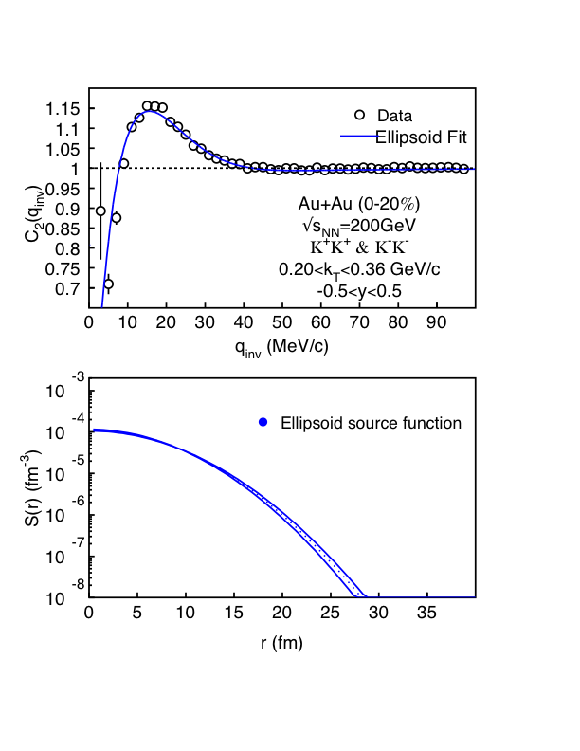
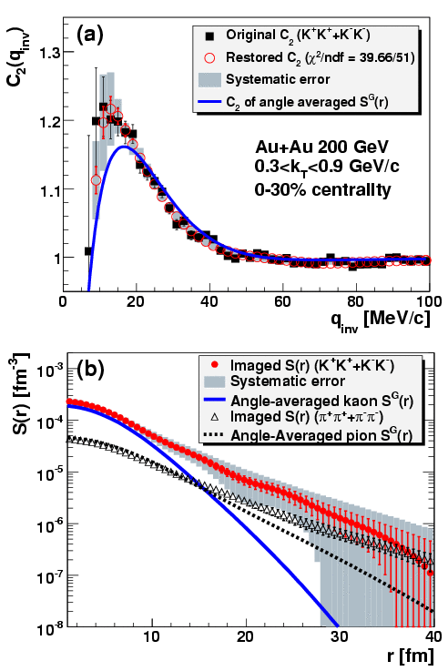
1D analysis result
34M+83M=117M (K⁺K⁺ & K⁻K⁻) pairs
PHENIX, PRL 103:,142301, 2009
STAR PRELIMINARY
STAR PRELIMINARY
STAR data well described by a single Gaussian. Contrary to PHENIX no non-gaussian tails observed. May be due to a different k_{T}-range: STAR bin is 4x narrower.

Slide 12
3D source shapes
Expansion of R(q) and S(r) in Cartesian Harmonic basis
Danielewicz and Pratt, Phys.Lett. B618:60, 2005
α_{i} = x, y or z
x = out-direction
y = side-direction
z = long-direction
3D Koonin-Pratt:
Plug (1) and (2) into (3)
⇒
Invert (1)
⇒
Invert (2)
⇒
Notes:
12

Slide 13
Shape analysis
l=0 moment agrees 1D C(q)
  Higher moments relatively small
Trial function form for S(r):
4-parameter ellipsoid (3D Gauss)
Fit to C(q): technically a simultaneous fit on 6
independent moments
R^{l}_{α1…αl} , 0 ≤ l ≤ 4
Result: statistically good fit
arXiv:1302.3168
λ = 0.48 ± 0.01
r_{x} = (4.8 ± 0.1) fm
r_{y} = (4.3 ± 0.1) fm
r_{z} = (4.7 ± 0.1) fm
Run4+Run7
200 GeV Au+Au
Centrality<20%
0.2 < k_{T} < 0.36 GeV/c

Slide 14
Correlation profiles and source
arXiv:1302.3168
arXiv:1302.3168
C(q_{x}) ≡ C(q_{x},0,0)
C(q_{y}) ≡ C(0,q_{y},0)
C(q_{z}) ≡ C(0,0,q_{z})
Gaussian source fit with error band
  N.B.: Low statistics shows up as systematic uncertainty on shape assumption
Notes:
14

Slide 15
Source: Data comparison
kaon vs. pion: different shape
  Long pion tail caused by resonances and/or emission duration?
  Sign of different freeze-out dynamics?
PRL100, 232301 (2008)
arXiv:1302.3168
Notes:
15

Slide 16
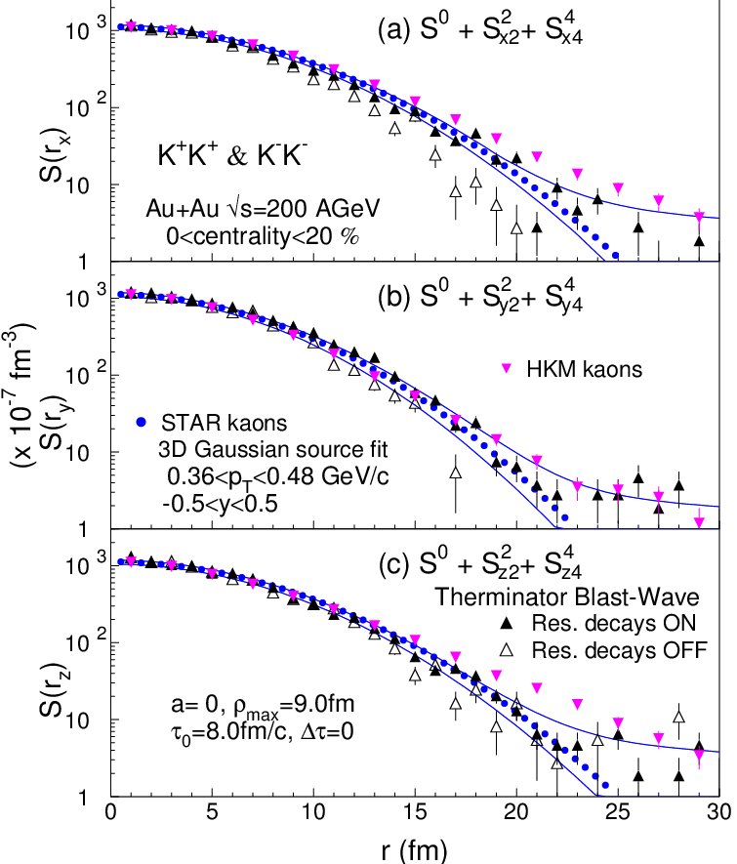
Source: Model comparison
Therminator
  Blast-wave model (STAR tune):
    Expansion: v_{t}(ρ)=(ρ/ρ_{max})/(ρ/ρ_{max}+v_{t})
    Freeze-out occurs at τ = τ₀ +aρ.
    Finite emission duration Δτ
  Kaons: Instant freeze-out
  (Δτ = 0, compare to Δτ~2 fm/c of pions) at τ₀ = 0.8 fm/c
  Resonances are needed for proper description
Hydrokinetic model
  Hybrid model
    Glauber initial+Hydro+UrQMD
  Consistent in “side”
  Slightly more tail (r>15fm) in “out” and “long”
arXiv:1302.3168
Therminator: Kisiel, Taluc, Broniowski, Florkowski, Comput. Phys. Commun. 174 (2006) 669.
HKM: PRC81, 054903 (2010)
data from Shapoval, Sinyukov, private communication
Notes:
16

Slide 17
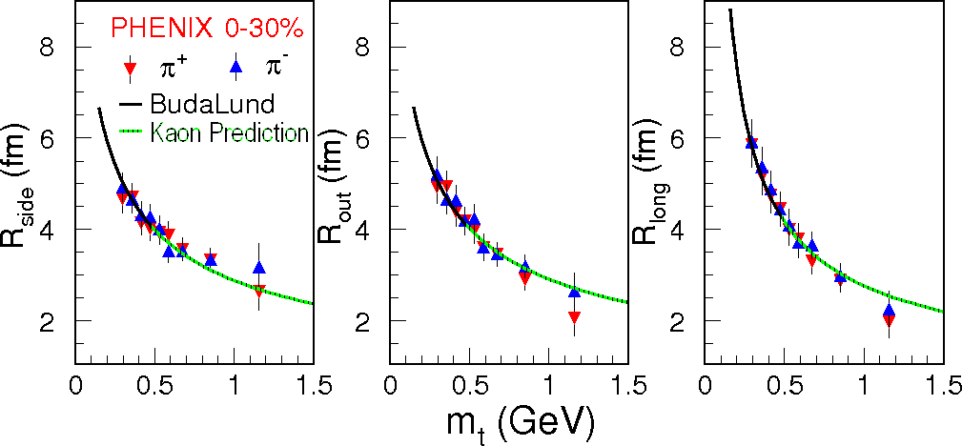
RHIC pion radii and perfect fluid hydrodynamics
M. Csanád and T. Csörgő: arXiv:0800.0801[nucl-th]
Au+Au √s_{NN}=200GeV
Excellent description of PHENIX pion data (PRL 93:152302, 2004)
using exact solutions of perfect fluid hydrodynamics (Buda-Lund).
Ideal hydro has inherent m_{T}-scaling ⇒ predicts kaon radii m_{T}-dependence

Slide 18
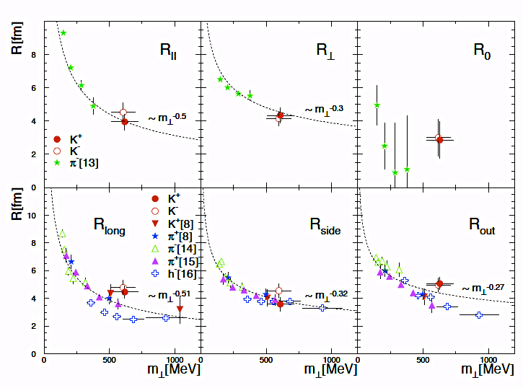
SPS results on pions and kaons
S.V. Afanasiev et al. (NA49 Coll).: Phys. Lett B557(2003)157
“The kaon radii are fully consistent with pions and the hydrodynamic expansion model. “
Yano-Koonin-Podgoretsky radii
Bertsch-Pratt radii
“Pions and kaons seem to decouple simultaneously.”
Notes:
The function S(r) is a Gaussian parameterization of the source, which is convoluted with the kernel (wavefunction-squared)

Slide 19
Kaon RHIC result
Radii: rising trend at low m_{T}
  Strongest in “long”
Buda-Lund model
  Perfect hydrodynamics,
  inherent m_{T}-scaling
  Works perfectly for pions
  Deviates from kaons in the “long” direction in the lowest m_{T} bin
HKM (Hydro-kinetic model)
  Describes all trends
  Some deviation in the “out” direction
  Note the different centrality definition
arXiv:1302.3168
Buda-Lund: M. Csanád, arXiv:0801.4434v2
HKM: PRC81, 054903 (2010)

Slide 20
Summary
First model-independent extraction of kaon 3D source shape presented
No significant non-Gaussian tail is observed
in RHIC √s_{NN}=200 GeV central Au+Au data
Model comparison indicates that kaons and pions may be subject to different dynamics
The m_{T}-dependence of the Gaussian radii indicates that m_{T}-scaling is broken in the “long” direction

Slide 21

Thank You!
Argonne National Laboratory, Argonne, Illinois 60439
Brookhaven National Laboratory, Upton, New York 11973
University of California, Berkeley, California 94720
University of California, Davis, California 95616
University of California, Los Angeles, California 90095
Universidade Estadual de Campinas, Sao Paulo, Brazil
University of Illinois at Chicago, Chicago, Illinois 60607
Creighton University, Omaha, Nebraska 68178
Czech Technical University in Prague, FNSPE, Prague, 115 19, Czech Republic
Nuclear Physics Institute AS CR, 250 68 Řež/Prague, Czech Republic
University of Frankfurt, Frankfurt, Germany
Institute of Physics, Bhubaneswar 751005, India
Indian Institute of Technology, Mumbai, India
Indiana University, Bloomington, Indiana 47408
Alikhanov Institute for Theoretical and Experimental Physics, Moscow, Russia
University of Jammu, Jammu 180001, India
Joint Institute for Nuclear Research, Dubna, 141 980, Russia
Kent State University, Kent, Ohio 44242
University of Kentucky, Lexington, Kentucky, 40506-0055
Institute of Modern Physics, Lanzhou, China
Lawrence Berkeley National Laboratory, Berkeley, California 94720
Massachusetts Institute of Technology, Cambridge, MA
Max-Planck-Institut f\"ur Physik, Munich, Germany
Michigan State University, East Lansing, Michigan 48824
Moscow Engineering Physics Institute, Moscow Russia
NIKHEF and Utrecht University, Amsterdam, The Netherlands
Ohio State University, Columbus, Ohio 43210
Old Dominion University, Norfolk, VA, 23529
Panjab University, Chandigarh 160014, India
Pennsylvania State University, University Park, Pennsylvania 16802
Institute of High Energy Physics, Protvino, Russia
Purdue University, West Lafayette, Indiana 47907
Pusan National University, Pusan, Republic of Korea
University of Rajasthan, Jaipur 302004, India
Rice University, Houston, Texas 77251
Universidade de Sao Paulo, Sao Paulo, Brazil
University of Science \& Technology of China, Hefei 230026, China
Shandong University, Jinan, Shandong 250100, China
Shanghai Institute of Applied Physics, Shanghai 201800, China
SUBATECH, Nantes, France
Texas A\&M University, College Station, Texas 77843
University of Texas, Austin, Texas 78712
University of Houston, Houston, TX, 77204
Tsinghua University, Beijing 100084, China
United States Naval Academy, Annapolis, MD 21402
Valparaiso University, Valparaiso, Indiana 46383
Variable Energy Cyclotron Centre, Kolkata 700064, India
Warsaw University of Technology, Warsaw, Poland
University of Washington, Seattle, Washington 98195
Wayne State University, Detroit, Michigan 48201
Institute of Particle Physics, CCNU (HZNU), Wuhan 430079, China
Yale University, New Haven, Connecticut 06520
University of Zagreb, Zagreb, HR-10002, Croatia
STAR Collaboration

Slide 22
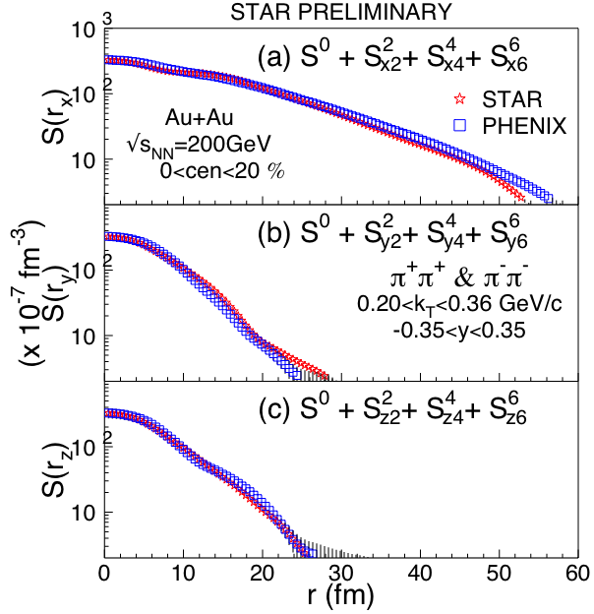
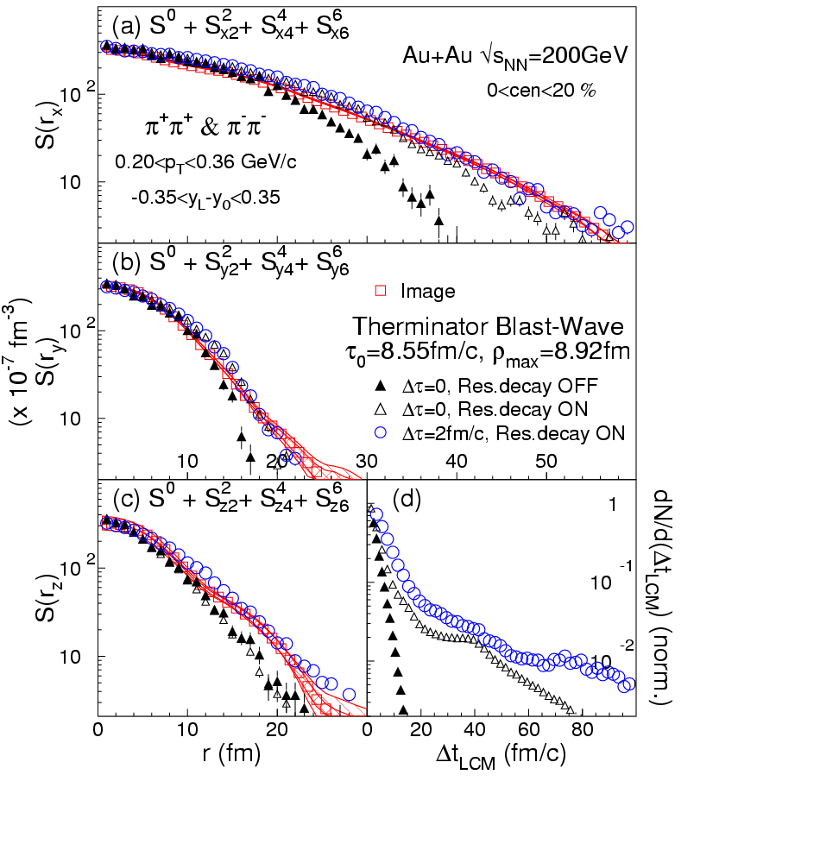
3D pions, PHENIX and STAR
PHENIX, PRL100, 232301 (2008)
P. Chung (STAR), arXiv:1012.5674 [nucl-ex]
STAR PRELIMINARY
Elongated source in “out” direction
  Therminator Blast Wave model suggests non-zero emission duration
Very good agreement of PHENIX and STAR 3D pion source images

Slide 23
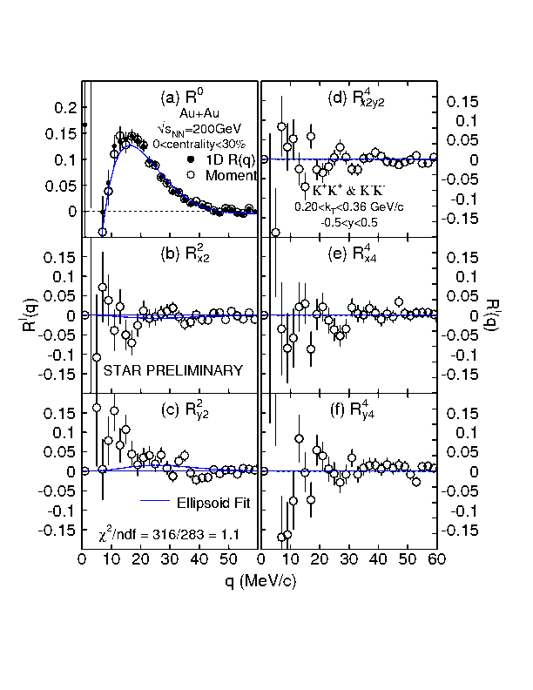
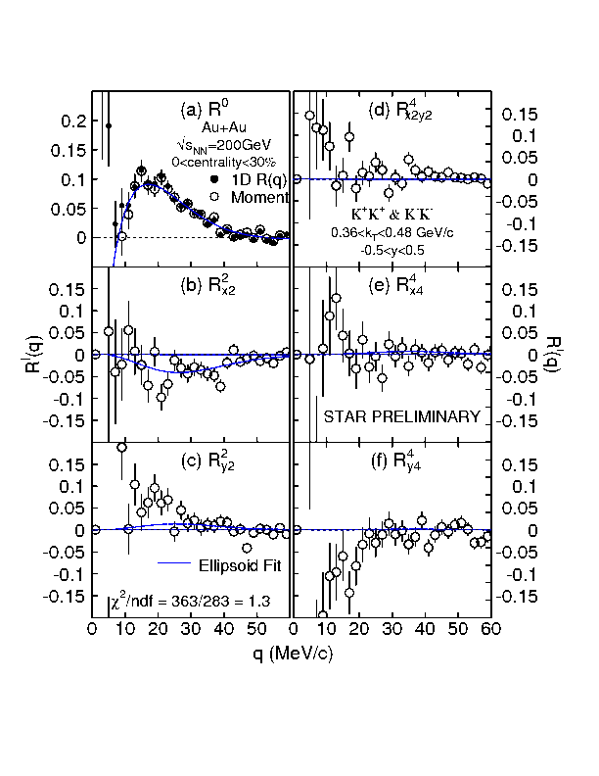
Fit to correlation moments
0.2<kT<0.36 GeV/c
0.36<kT<0.48 GeV/c
STAR PRELIMINARY
STAR PRELIMINARY
Dataset #2
Run4 Cent<30%

Slide 24
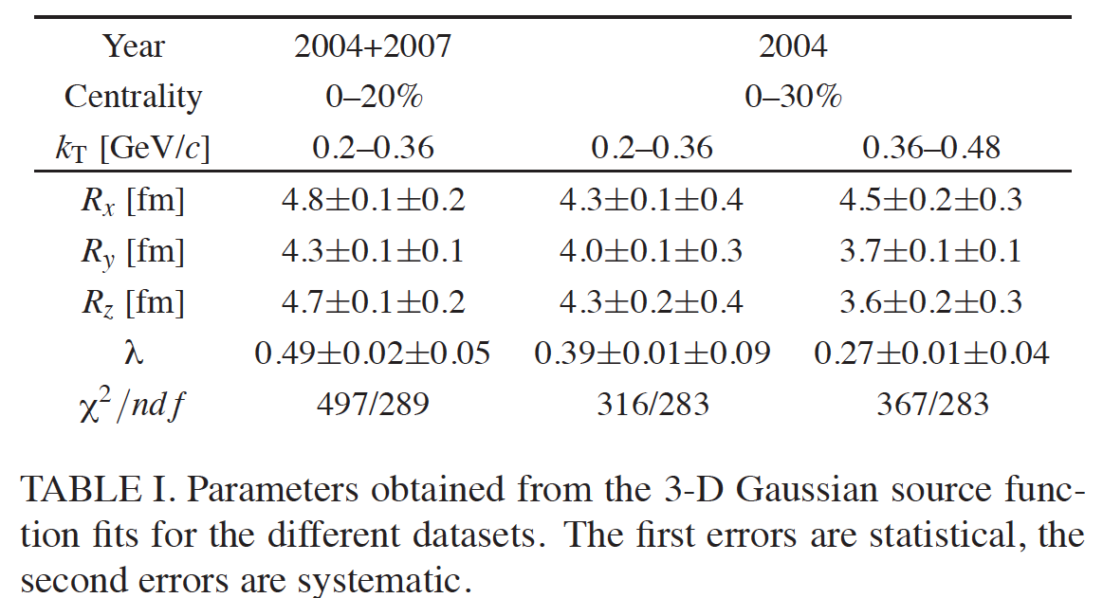
Source parameters

Slide 25
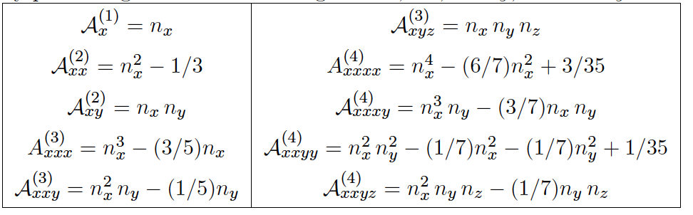
Cartesian harmonics basis
Based on the products of unit vector components, n_{α1} n_{α2} ,…, n_{αℓ} . Unlike the spherical harmonics they are real.
Due to the normalization identity n²_{x} + n²_{y} + n²_{z} = 1, at a given ℓ ≥ 2, the different component products are not linearly independent as functions of spherical angle.
At a given ℓ, the products are spanned by spherical harmonics of rank ℓ′ ≤ ℓ, with ℓ′ of the same evenness as ℓ.

Slide 26
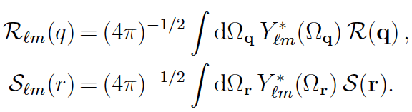
Spherical Harmonics basis
Disadvantage: connection between the geometric features of the real source function S(r) and the complex valued projections S_{ℓm}(r) is not transparent.
Y_{ℓm} harmonics are convenient for analyzing quantum angular momentum, but are clumsy for expressing anisotropies of real-valued functions.

Slide 27
Source: Model comparison
Therminator
  Blast-wave model (STAR tune):
    Expansion: v_{t}(ρ)=(ρ/ρ_{max})/(ρ/ρ_{max}+v_{t})
    Freeze-out occurs at τ = τ₀ +aρ.
    Finite emission duration Δτ
  Kaons: Instant freeze-out
  (Δτ = 0, compare to Δτ~2 fm/c of pions) at τ₀ = 0.8 fm/c
  Resonances are needed for proper description
Hydrokinetic model
  Hybrid model
    Glauber initial+Hydro+UrQMD
  Consistent in “side”
  Slightly more tail (r>15fm) in “out” and “long”
PRL100, 232301 (2008)
arXiv:1302.3168
Therminator: Kisiel, Taluc, Broniowski, Florkowski, Comput. Phys. Commun. 174 (2006) 669.
HKM: PRC81, 054903 (2010)
data from Shapoval, Sinyukov, private communication
Notes:
27

