Slide 1




J/ψ R_{AA} and v₂ via the di-muon channel in Au+Au collisions at √s_{NN} = 200 GeV from STAR Experiment
Takahito Todoroki (BNL)
for the STAR Collaboration
Quarkonium Working Group 2016
PNNL, Richland, WA
June 6th – 10th, 2016

Slide 2
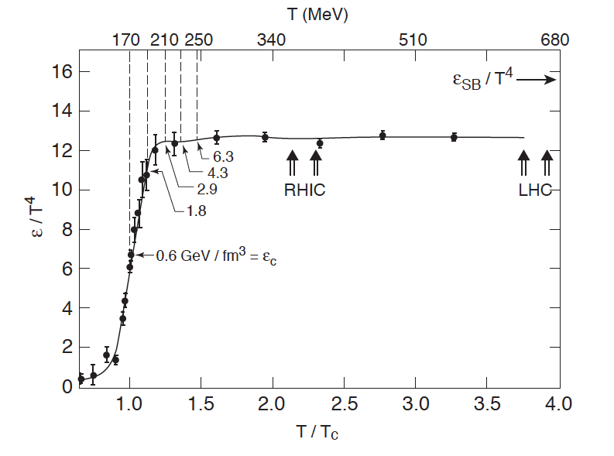
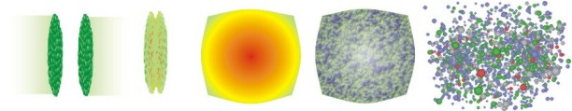
Quark-Gluon Plasma
QCD predicts a phase transition from confined hadrons to Quark- Gluon Plasma (QGP) where partons are the relevant degrees of freedom
Contemp.Phys. 42 (2001) 209, courtesy F. Karsch
Form QGP with relativistic heavy ion collisions
Initial Collision
QGP &
Hydrodynamic Expansion
Freeze-out
Pre-Equilibrium
Hadronization &
Hadron Gas Phase
http://www.phy.duke.edu/
research/NPTheory/

Slide 3
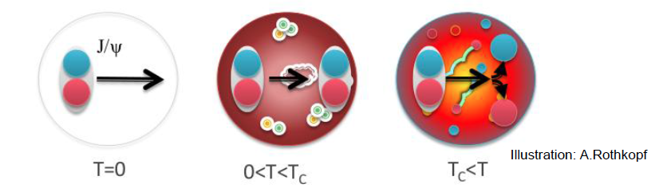
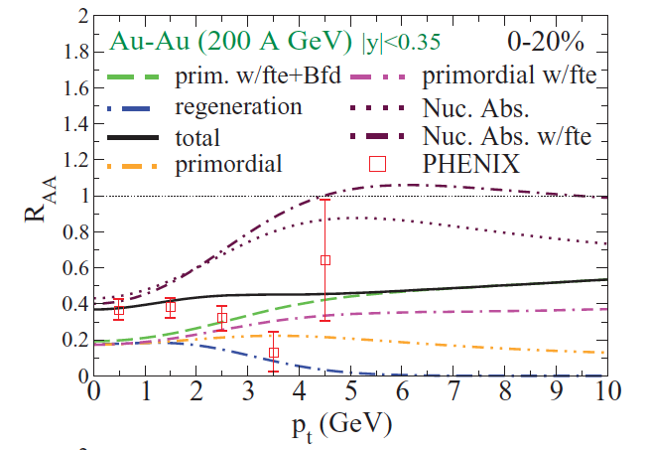
Probe QGP with J/ψ
Color-screening: J/ψ dissociate in the medium
J/ψ suppression was proposed as a direct proof of deconfinement
T. Matsui and H. Satz PLB 178 (1986) 416
HOWEVER
Various production mechanisms
  Prompt: direct production; decay of ψ(2S) and χ_{c} (40%)
  Non-prompt: B-meson decay (Up to 20% at high p_{T})
Phys. Rev. C 82, 064905
Different effects in play
  Hot nuclear matter effects
    Dissociation
    Regeneration from uncorrelated quarks
    Medium-induced energy loss
  Cold nuclear matter effects

Slide 4

The Solenoid Tracker At RHIC (STAR)
Mid-rapidity detector: |η| < 1, 0 < φ < 2π
Time-Of-Flight
Muon Telescope Detector
TPC: precise momentum and energy loss
TOF: measure time-of-flight
BEMC: trigger on and identify electrons
MTD: trigger on and identify muons
  Fully installed in 2014 behind magnet
  Precise timing measurement (σ~100 ps)
  Relatively high efficiency for J/ψ at low p_{T} → cover wide kinematic range
Time Projection Chamber
Barrel ElectroMagnetic Calorimeter
Notes:
Di-muon trigger rejection factor is 26
Muon purity above 1.5 GeV/c is >~85%
# of good MTD hits in MB is 1.6, and is 4 in 0-5% most central events

Slide 5
Analysis details
Decay channel: J/ψ → μ⁺ + μ⁻
Dimuon trigger: two hits in MTD
Data set: Au+Au collisions at 200 GeV recorded in 2014
  Integrated luminosity ~ 14.2 nb⁻¹
  Only 30% is used for the results presented here
  Equivalent amount of data have been taken in 2016 experiment!!
Muon identification cuts
  Energy loss measurement by TPC
  Match TPC tracks to MTD
    Distance between MTD hits and projected TPC tracks along both z and φ directions
    Time difference between MTD measured time and expected travel time of muons

Slide 6
Extract J/ψ yield
Signal extraction
Mixed-event → combinatorial background.
Fit background-subtracted unlike-sign with Gaussian+pol3
Signal = (counting in [2.9,3.3] GeV/c²) – (residual background)
No bremsstrahlung tail
S/B = 1:23
N ~ 4000
Sig ~ 11.5σ
Notes:
S/B = 1:5 in 0-60% AuAu collisions for STAR
Width of Jpsi is 40 MeV

Slide 7
J/ψ yield in p_{T} bins
Good significance in each p_{T} bin
Larger J/ψ p_{T} → larger S/B, wider J/ψ peak and fewer signal counts

Slide 8
Invariant yield of J/ψ
Collision Centrality
0%: head-head collisions
100%: peripheral collisions
B_{ll}: branching ratio to di-lepton
First mid-rapidity measurement of J/ψ yield in Au+Au collisions via the di-muon channel for 1 < p_{T} < 10 GeV/c

Slide 9
Invariant yield of J/ψ
Collision Centrality
0%: head-head collisions
80%: peripheral collisions
Di-electron:
STAR PLB 722 (2013) 55
STAR PRC 90, 024906 (2014)
Consistent with the published di-electron results using Run10 data over the entire kinematic range.

Slide 10
J/ψ suppression:
Scale uncertainty for σ_{inel} and N_{coll}
Di-electron:
STAR PLB 722 (2013) 55
STAR PRC 90, 024906 (2014)
Confirm the rising R_{AA} with p_{T} seen in the di-electron channel

Slide 11
Closer look at the 0-20% central collisions
Di-electron:
STAR PLB 722 (2013) 55
STAR PRC 90, 024906 (2014)
Strong suppression at low p_{T}
  Dissociation
  Cold nuclear matter effect
Less suppression at high p_{T}
  Dissociation
  Formation time effect
  Feed-down from B-hadrons

Slide 12
Compare with model calculations
STAR PLB 722 (2013) 55
STAR PRC 90, 024906 (2014)
Y.-p. Liu, et al. PLB 678 (2009) 72
X. Zhao et al. PRC 82 (2010) 064905
Both models include dissociation of the prompt J/ψ and contribution of regenerated J/ψ → qualitatively reproduce the rising trend seen in the data.

Slide 13
J/ψ R_{AA} vs N_{part}
Total uncertainty of pp reference
STAR PLB 722 (2013) 55
Y.-p. Liu, et al. PLB 678 (2009) 72
X. Zhao et al. PRC 82 (2010) 064905
Significant suppression for J/ψ above 4 GeV/c in 0-20% and 20-40% centralities → dissociation
Both models qualitatively reproduce the centrality dependence

Slide 14
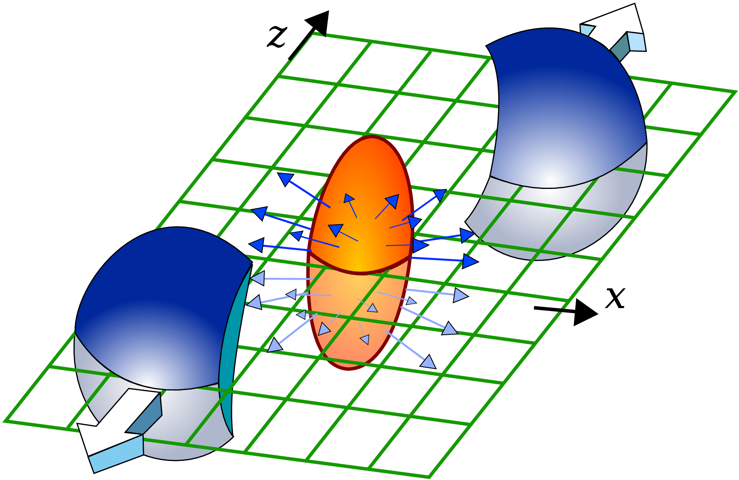
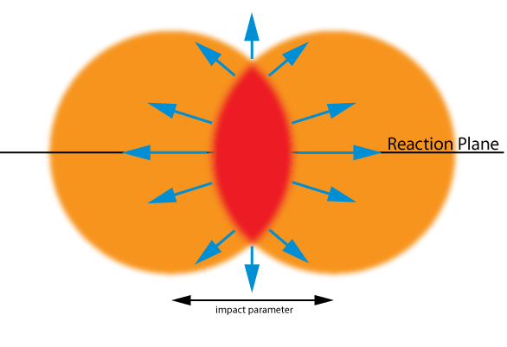
Collective Flow
Anisotropies in momentum space originate from initial-geometry via hydrodynamic expansion
Charged hadron
Reaction Plane
Ψ
STAR, PRL.92.062301
Voloshin and Zhang, Z.Phys.C70, 665
Elliptic flow (v₂) :
  Low p_{T} : sensitive to medium viscosity
  High p_{T} : sensitive to energy loss

Slide 15
Does J/ψ flow?
Measure elliptic flow v₂
  Primordial J/ψ : little or zero v₂
  Regenerated J/ψ : inherit v₂ from the constituent charm quarks
For p_{T} above 2 GeV/c, v₂ is consistent with zero → contribution of regenerated J/ψ is small
  Non-flow effects estimated using J/ψ-h correlation in pp collision can account for possible deviation of v₂ from zero at high p_{T}
J/ψ → e⁺ + e⁻
STAR, PRL 111 (2013) 052301
L. Yan, P. Zhuang, and N. Xu, PRL 97 (2006) 232301
V. Greco, C.M. Ko, and R. Rapp, PLB 595 (2004) 202
X. Zhao and R. Rapp, arXiv: 0806.1239
Y. Liu, N. Xu and P. Zhuang, NPA 834 (2010) 317
U.W. Heinz and C. Shen, (private communication)

Slide 16
Does J/ψ flow?
Measure elliptic flow v₂
  Primordial J/ψ : little or zero v₂
  Regenerated J/ψ : inherit v₂ from the constituent charm quarks
Consistent results from di-muon channel within large error bars
7 times more statistics are yet to come!!

Slide 17
Summary
First J/ψ measurements via di-muon channel at mid-rapidity by the STAR experiment in Au+Au collisions
Invariant yield of J/ψ is obtained, and R_{AA} rises with p_{T}
  Significant suppression in central collisions above 4 GeV/c → dissociation
  Measure J/ψ in pA (Run15) to quantify CNM, especially at low p_{T}
Updated J/ψ v₂ in di-electron channel combining Run10 and Run11 data → favors small contribution from regeneration above 2 GeV/c
  Results in di-muon channel with 7 times more statistics are yet to come and can shrink uncertainties!!

Slide 18
Backup

Slide 19
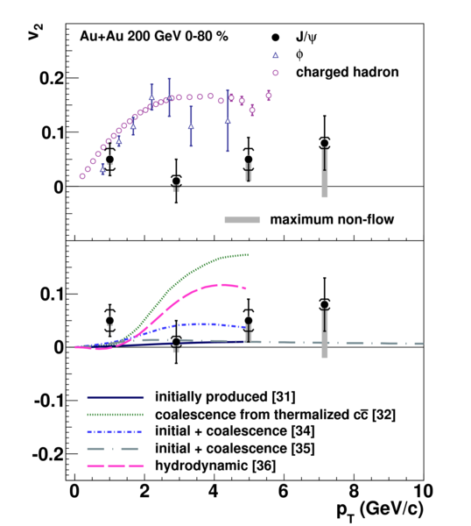
Compare J/ψ v₂
  By combining published results with Run11 analysis, the statistical error bar is reduced by a factor of √2.
  Additional systematic uncertainty is assigned due to J/ψ yield extraction.
STAR, PRL 111 (2013) 052301

Slide 20
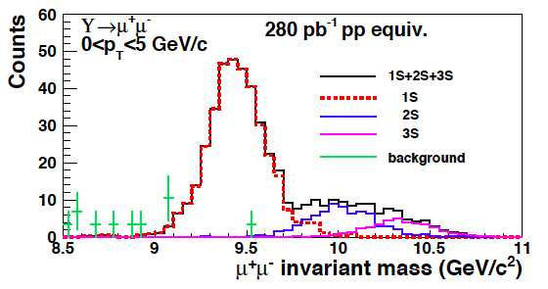
Muon Telescope Detector (MTD)
Relatively high efficiency for J/ψ at low p_{T} → cover wide kinematic range
Separate ϒ(2S+3S) from ϒ(1S)
Potential to separate ϒ(2S) and ϒ(3S) states as muons suffer less from bremsstrahlung
Simulation

Slide 21
ϒ measurement
Excess
N_{ϒ} ~ 50 ± 22
Fit signal distribution after background subtraction:
  Mean of ϒ is fixed to PDG value, while width is determined from simulation.
  Ratio of ϒ(2S)/ϒ(3S) is fixed to pp value, and shape of bb and Drell-Yan background is estimated using PYTHIA

Slide 22
ϒ(2S+3S)/ϒ(1S) ratio
PLB 735 (2014) 127
PRL 1029(2012) 222301
Consistent with di-electron channel within large error bars
The statistical error can be further reduced:
  A factor of 7 more statistics with full Run14+16 data
  Usage of mix-event can reduce statistical error by √2

