Slide 1




Quarkonium measurements via the di-muon decay channel in p+p and Au+Au collisions with the STAR experiment
Takahito Todoroki (BNL)
for the STAR Collaboration
Strangeness in Quark Matter 2016
From June 27th to July 1st 2016
UC Berkeley

Slide 2
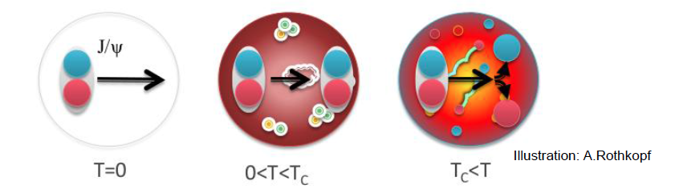
Probe QGP with J/ψ
Color-screening : J/ψ dissociates in the medium
J/ψ suppression was proposed as a direct proof of deconfinement
T. Matsui and H. Satz PLB 178 (1986) 416
HOWEVER
Various production mechanisms
  Prompt: direct production; decay of ψ(2S) and χ_{c} (40%)
  Non-prompt: B-meson decay (up to 20% at high p_{T})
Phys. Rev. C 82, 064905, (Modified)
Different effects in play
  Hot nuclear matter effects
    Dissociation
    Regeneration
    Medium-induced energy loss
  Cold nuclear matter effects

Slide 3
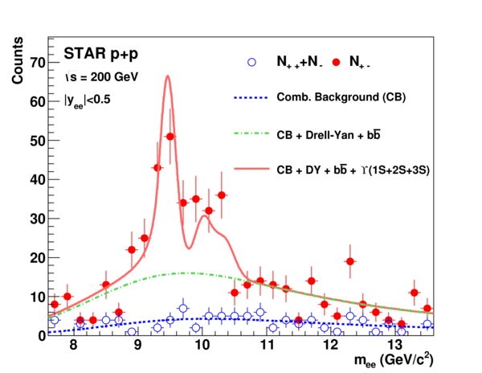
ϒ : A cleaner but rarer probe
Advantage
  Much smaller effects from co-mover absorption and regeneration → ( σ_{cc} ~ 800μb, σ_{bb} ~ 2μb )
Sequential melting of different ϒ states
Low combinatorial background
Disadvantage
Phys. Lett. B 735 (2014) 127
Much lower production rates (m_{b} >> m_{c})
Feed-down contribution to ϒ(1S)
Separation of different ϒ states via the di-electron channel is challenging due to bremsstrahlung.
Notes:
Feed-down contribution to ϒ(1S) : smearing ratio among different states

Slide 4

The Solenoid Tracker At RHIC (STAR)
Mid-rapidity detector: |η| < 1, 0 < φ < 2π
TPC: precisely measure momentum and energy loss
TOF: measure time-of-flight
BEMC: trigger on and identify electrons
MTD (|η|<0.5) : trigger on and identify muons
  Installed 63% in 2013 and 100% in 2014 behind magnet
  Precise timing measurement (σ~100 ps)
  Dimuon trigger for quarkonia
Time-Of-Flight
Muon Telescope Detector
Time Projection Chamber
Barrel ElectroMagnetic Calorimeter
Notes:
Di-muon trigger rejection factor is 26
Muon purity above 1.5 GeV/c is >~85%
# of good MTD hits in MB is 1.6, and is 4 in 0-5% most central events

Slide 5
J/ψ cross section and x_{T} scaling in p+p collisions
J/ψ cross section
x_{T} scaling
PRL 113 (2014) 192301
JHEP 05 (2015) 103
PRC 80, 041902(2009)
Inclusive J/ψ cross section measured in 0 < p_{T} < 20 GeV/c
  CGC+NRQCD and NLO NRQCD agree with data
x_{T} scaling of high-p_{T} J/ψ observed for 500 GeV p+p collisions
  Breaking of x_{T} scaling : affected by soft process

Slide 6
J/ψ yield extraction
Full statistics from 2014 Au+Au 200 GeV run
p_{T} > 0 GeV/c
p_{T} > 5 GeV/c
Signal extraction
Mixed-event → combinatorial background.
Fit background-subtracted unlike-sign with Gaussian+pol3
Signal = (counting in[2.9,3.3] GeV/c²) – (residual background)
No bremsstrahlung tail
N ~ 25000
S/B ratio & Significance
S/B = 1:29, ~ 22σ @ p_{T} > 0 GeV/c
S/B = 1:1.8, ~ 15σ @ p_{T} > 5 GeV/c

Slide 7
Invariant yield of J/ψ
First mid-rapidity measurement of J/ψ yield in Au+Au collisions via the di-muon channel for 0 < p_{T} < 15 GeV/c

Slide 8
Invariant yield of J/ψ
Di-electron:
STAR PLB 722 (2013) 55
STAR PRC 90, 024906 (2014)
First mid-rapidity measurement of J/ψ yield in Au+Au collisions via the di-muon channel for 0 < p_{T} < 15 GeV/c
Consistent with the published di-electron results using Run10 data over the entire kinematic range.

Slide 9
J/ψ suppression:
Suppression at Low-p_{T}
  Dissociation
  Regeneration
  Cold nuclear matter effect
At high p_{T}, strong suppression in 0-20% and a rising trend in 20-60% central collisions
  Dissociation
  Formation time effect; B feed down

Slide 10
J/ψ suppression:
Di-electron:
STAR PLB 722 (2013) 55
STAR PRC 90, 024906 (2014)
Consistent with di-electron channel results for the entire p_{T} range within uncertainties in all centralities

Slide 11
J/ψ R_{AA} vs p_{T} : RHIC vs LHC
Less suppressed at LHC in low-p_{T} → larger regeneration contribution due to higher charm cross-section
More suppressed at LHC in high-p_{T} → larger dissociation rate due to higher temperature

Slide 12
R_{AA} vs. centrality
Central collisions : significant suppression is observed for p_{T} > 0 GeV/c and p_{T} > 5 GeV/c → interplay of different effects
Peripheral collisions : R_{AA} of J/ψ for p_{T} > 0 GeV/c is smaller than that for p_{T} > 5 GeV/c probably due to cold nuclear matter effects

Slide 13
Centrality dependence : RHIC vs LHC
p_{T} > 0 GeV/c
ALICE : PLB 734 (2014) 314
PHENIX : PRL 98 (2007) 232301
STAR data are consistent with PHENIX with better statistical precision for p_{T} > 0 GeV/c

Slide 14
Centrality dependence : RHIC vs LHC
p_{T} > 0 GeV/c
ALICE : PLB 734 (2014) 314
PHENIX : PRL 98 (2007) 232301
STAR data are consistent with PHENIX with better statistical precision for p_{T} > 0 GeV/c
p_{T} > 0 GeV/c : more suppressed at RHIC in central collisions

Slide 15
Centrality dependence : RHIC vs LHC
p_{T} > 0 GeV/c
ALICE : PLB 734 (2014) 314
PHENIX : PRL 98 (2007) 232301
p_{T} > 5 GeV/c
CMS: JHEP 05 (2012) 063
STAR data are consistent with PHENIX with better statistical precision for p_{T} > 0 GeV/c
p_{T} > 0 GeV/c : more suppressed at RHIC in central collisions
High p_{T} : less suppressed at RHIC in all centralities
Notes:
Expect to reduce the systematic uncertainties

Slide 16
Transport Models
Transport model:
Model I at RHIC: PLB 678 (2009) 72
Model I at LHC: PRC 89 (2014) 054911
Model II at RHIC: PRC 82 (2010) 064905
Model II at LHC: NPA 859 (2011) 114
Model I : Tsinghua Group
Model II :
TAMU Group
ALICE : PLB 734 (2014) 314
CMS: JHEP 05 (2012) 063
Transport models including dissociation and regeneration effects qualitatively describe p_{T} dependence shape
Model I : below data at low-p_{T} for LHC and shows different trend at high p_{T} for RHIC
Notes:
Uncertainty @ LHC : charm cross section (I & II), shadowing (II)
Model I @ RHIC : dissociation + regeneration; Cronin effect
Model II @ RHIC : dissociation + regeneration + formation time effect + B feed-down; Cronin + Shadowing + Nuclear absorption
Model I @ LHC : dissociation + regeneration; Cronin effect + Shadowing
Model II @ LHC : dissociation + regeneration + formation time effect + B feed-down; Shadowing

Slide 17
Transport Models
Transport model:
Model I at RHIC: PLB 678 (2009) 72
Model I at LHC: PRC 89 (2014) 054911
Model II at RHIC: PRC 82 (2010) 064905
Model II at LHC: NPA 859 (2011) 114
p_{T} > 0 GeV/c
ALICE : PLB 734 (2014) 314
PHENIX : PRL 98 (2007) 232301
p_{T} > 0 GeV/c : both models can describe centrality dependence at RHIC, but tends to overestimate suppression at LHC
Notes:
Uncertainty @ LHC : charm cross section (I & II), shadowing (II)
Model I @ RHIC : dissociation + regeneration; Cronin effect
Model II @ RHIC : dissociation + regeneration + formation time effect + B feed-down; Cronin + Shadowing + Nuclear absorption
Model I @ LHC : dissociation + regeneration; Cronin effect + Shadowing
Model II @ LHC : dissociation + regeneration + formation time effect + B feed-down; Shadowing

Slide 18
Transport Models
Transport model:
Model I at RHIC: PLB 678 (2009) 72
Model I at LHC: PRC 89 (2014) 054911
Model II at RHIC: PRC 82 (2010) 064905
Model II at LHC: NPA 859 (2011) 114
p_{T} > 0 GeV/c
ALICE : PLB 734 (2014) 314
PHENIX : PRL 98 (2007) 232301
p_{T} > 5 GeV/c
CMS: JHEP 05 (2012) 063
p_{T} > 0 GeV/c : both models can describe centrality dependence at RHIC, but tends to overestimate suppression at LHC
p_{T} > 5 GeV/c : there is tension among models and data
Notes:
Uncertainty @ LHC : charm cross section (I & II), shadowing (II)
Model I @ RHIC : dissociation + regeneration; Cronin effect
Model II @ RHIC : dissociation + regeneration + formation time effect + B feed-down; Cronin + Shadowing + Nuclear absorption
Model I @ LHC : dissociation + regeneration; Cronin effect + Shadowing
Model II @ LHC : dissociation + regeneration + formation time effect + B feed-down; Shadowing

Slide 19
Does J/ψ flow?
Measure the second-order Fourier coefficient (v₂)
  Primordial: little or zero v₂
  Regenerated: inherit v₂ from the constituent charm quarks
For p_{T} above 2 GeV/c, v₂ is consistent with zero → contribution of regenerated J/ψ is small
  Non-flow effects estimated using J/ψ-h correlation in pp collision can account for possible deviation of v₂ from zero at high p_{T}
J/ψ → e⁺ + e⁻
STAR, PRL 111 (2013) 052301
L. Yan, P. Zhuang, and N. Xu, PRL 97 (2006) 232301
V. Greco, C.M. Ko, and R. Rapp, PLB 595 (2004) 202
X. Zhao and R. Rapp, arXiv: 0806.1239
Y. Liu, N. Xu and P. Zhuang, NPA 834 (2010) 317
U.W. Heinz and C. Shen, (private communication)

Slide 20
Does J/ψ flow?
Measure the second-order Fourier coefficient (v₂)
  Primordial: little or zero v₂
  Regenerated: inherit v₂ from the constituent charm quarks
Consistent results from di-muon channel within large error bars

Slide 21
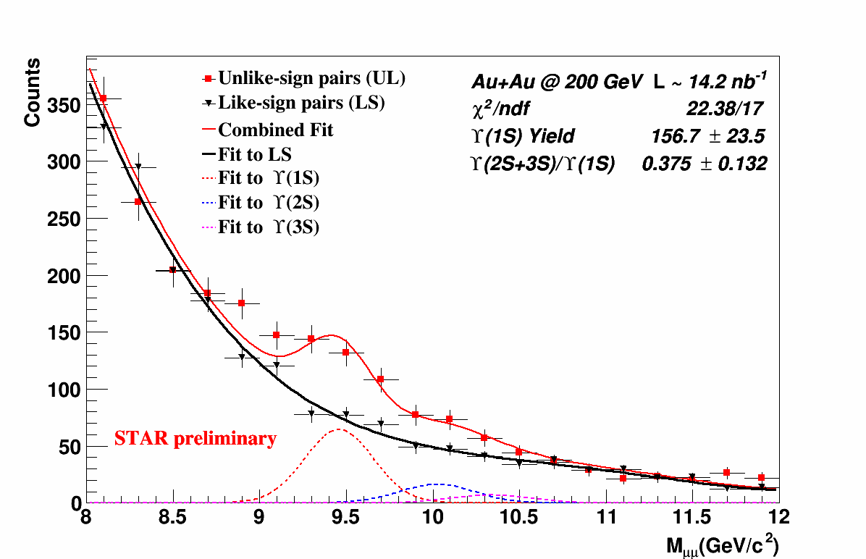
ϒ(2S+3S)/ϒ(1S) ratio
N_{Υ(1S)} ~ 157 ± 24
95% Upper Limit
World-wide PRC 88(2013) 067901
CMS : PRL 109(2012) 222301
CMS : JHEP 04 (2014) 103
Signs of Y(2S+3S) from the di-muon channel
  Challenging for di-electron channel due to Bremsstrahlung
Hint of less melting of ϒ(2S+3S) at RHIC than at LHC

Slide 22
Summary
First J/ψ and ϒ measurements via di-muon channel at mid-rapidity at RHIC
p+p collisions at √s = 500 GeV
  Inclusive J/ψ cross section can be described by CGC+NRQCD & NLO NRQCD for 0<p_{T}<20 GeV/c
Au+Au collisions at √s_{NN} = 200 GeV ( Run 14 full statistics )
  Clear J/ψ suppression above 5 GeV/c in central collisions → Dissociation
  J/ψ R_{AA} can be qualitatively described by transport models including dissociation and regeneration. However there is tension at high p_{T}
  Updated J/ψ v₂ in di-electron channel using Run10+11 data → favors small contribution from regeneration above 2 GeV/c
  Hint of less melting of ϒ(2S+3S) at RHIC compared to that at LHC
Similar amount of data from Run16 on tape. Stay tuned!!

Slide 23
Back Up

Slide 24
ϒ(2S+3S)/ϒ(1S) ratio
N_{Υ(1S)} ~ 157 ± 24
Fit the like-sign and unlike-sign simultaneously:
  Mean of ϒ is fixed to PDG value, while width is determined from simulation.
  Ratio of ϒ(2S)/ϒ(3S) is fixed to pp value, and shape of bb and Drell-Yan background is estimated using PYTHIA

Slide 25
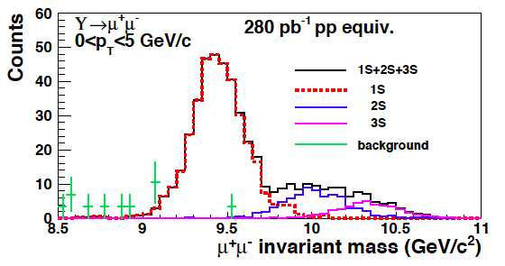
Muon Telescope Detector (MTD)
Relatively high efficiency for J/ψ at low p_{T} → cover wide kinematic range
Separate ϒ(2S+3S) from ϒ(1S)
Potential to separate ϒ(2S) and ϒ(3S) states as muons suffer less from bremsstrahlung
Simulation

Slide 26
Run13 p+p 500 GeV Analysis details
Decay channel: J/ψ → μ⁺ + μ⁻
Data set: p+p collisions at 500 GeV taken in 2013
MTD dimuon trigger: two hits in MTD
    Sampled integrated luminosity ~ 28.3 pb⁻¹
Muon identification
  Match TPC tracks to MTD
  Require z residual below 20 cm
Background: fitting Gaussian (signal) & pol3
Signal extraction: Integral of Gaussian
STAR Preliminary

Slide 27

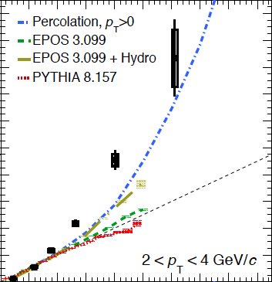

A closer look: event multiplicity dependence
ALICE pp @ 7 TeV
arXiv:1505.00664
Stronger-than-linear rise of open charm production vs event activity.
Similar behavior seen for inclusive J/ψ at both mid- and forward-rapidity.
Several ideas on the market:
  PYTHIA 8: c and b quarks produced in Multi-Parton-Interaction -> underestimate yield at large multiplicity
  Percolation model: string screening -> quadratic rise at high multiplicity
  Hard process is associated with larger gluon radiation
D meson
Collective effects in high-multiplicity pp collisions?
Do we see similar or different behavior at RHIC?

Slide 28
J/ψ yield vs event activity
ALICE : JHEP09(2015)148
Stronger-than-linear growth for relative J/ψ yield → Soft and hard processes are correlated
Different trends for low and high p_{T} J/ψ
PYTHIA8 and Percolation model reproduce trends in data
Measurements at high multiplicities can help distinguish different models

Slide 29
Characterize event activity
Multiplicity of
TOF matched tracks
|η| < 0.9
Insensitive to pile-up effects

Slide 30
Run14 Au+Au 200 GeV Analysis details
Decay channel: J/ψ, ϒ → μ⁺ + μ⁻
Dimuon trigger: two hits in MTD
Data set: Au+Au collisions at 200 GeV recorded in 2014
  Integrated luminosity ~ 14.2 nb⁻¹
  Equivalent or more data will be taken in 2016
Muon identification cuts
  Energy loss measurement by TPC
  Match TPC tracks to MTD
    Distance between MTD hits and projected TPC tracks along both z and φ directions
    Time difference between MTD measured time and expected travel time of muons

Slide 31
Comparison to di-electron

Slide 32
J/ψ R_{AA} vs p_{T} : STAR vs Transport Models
Transport model:
Model I at RHIC: PLB 678 (2009) 72
Model I at LHC: PRC 89 (2014) 054911
Model II at RHIC: PRC 82 (2010) 064905
Model II at LHC: NPA 859 (2011) 114
Di-electron:
STAR PLB 722 (2013) 55
STAR PRC 90, 024906 (2014)

Slide 33
J/ψ R_{AA} vs p_{T} : STAR vs PHENIX
PHENIX PRL 98 (2007) 232301

Slide 34
J/ψ R_{AA} vs p_{T} : Mid vs Forward rapidity
PHENIX : PRC 84 (2011) 054912

Slide 35
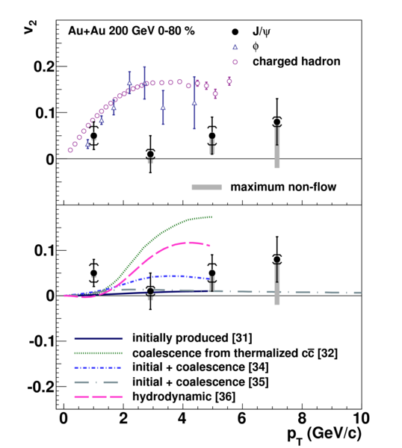
Compare J/ψ v₂
  By combining published results with Run11 analysis, the statistical error bar is reduced by a factor of √2.
  Additional systematic uncertainty is assigned due to J/ψ yield extraction.
STAR, PRL 111 (2013) 052301

