Slide 1
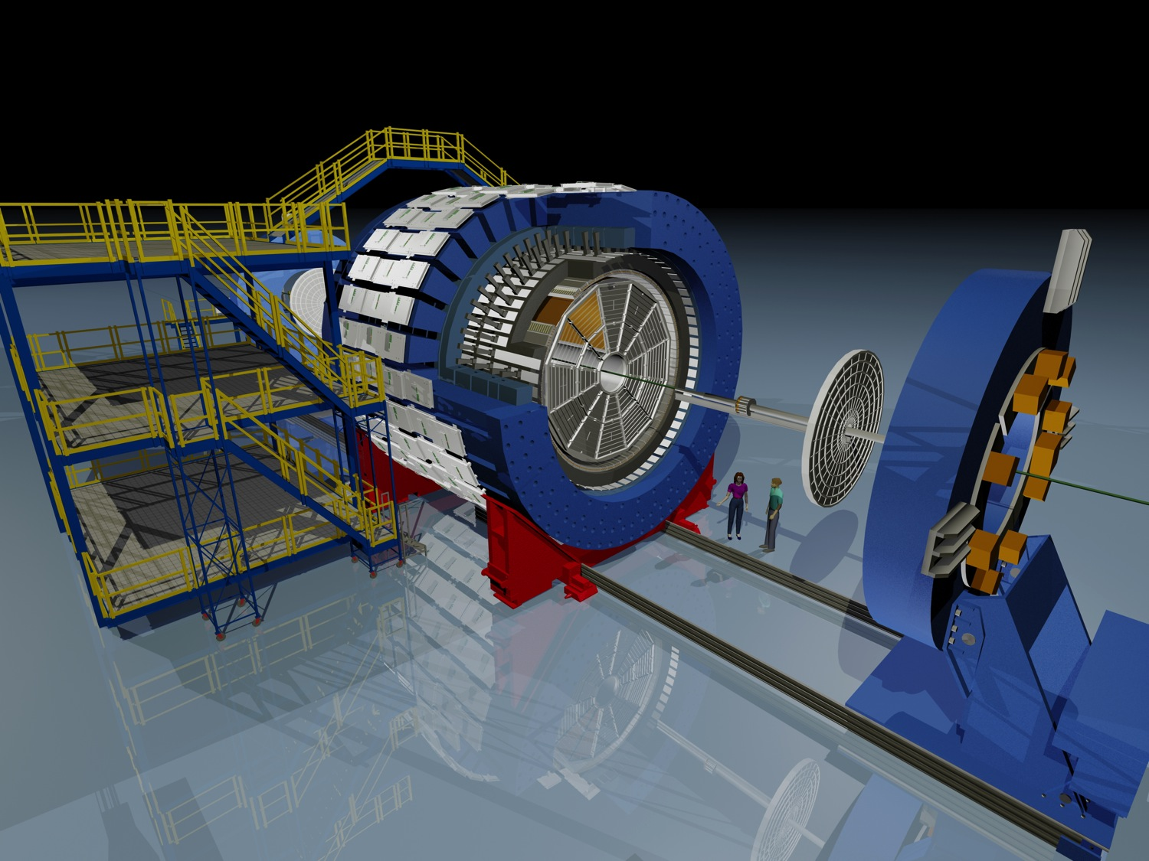
Optical Fibers and Electronics for the STAR Event Plane Detector
Catherine Tomkiel, Lehigh University
For the STAR Collaboration

Slide 2
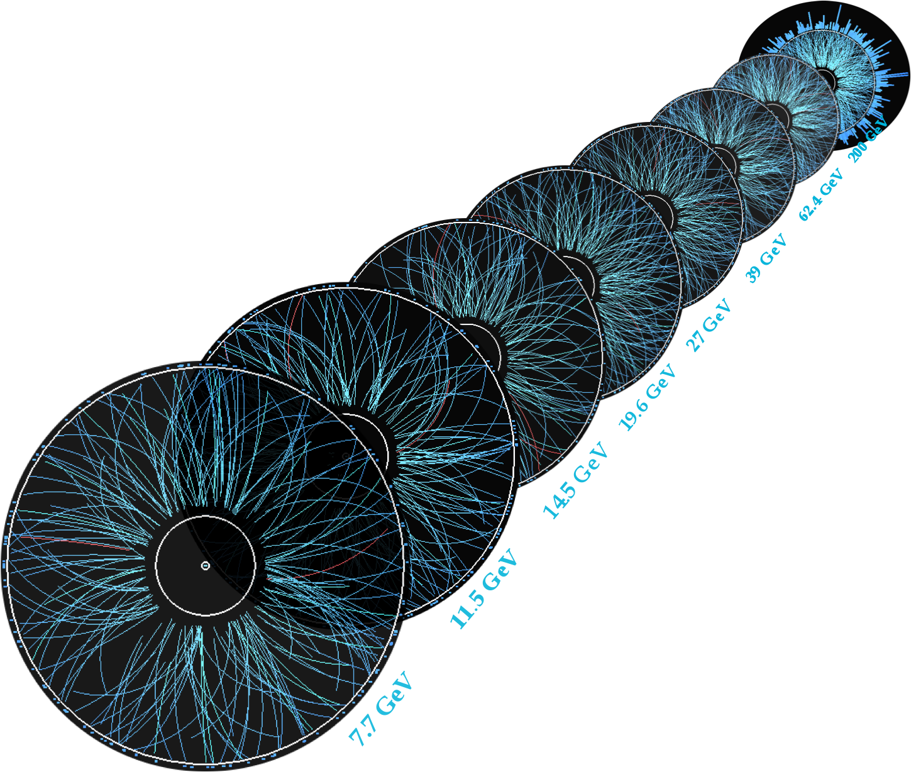
Beam Energy Scan
Key measurements and goals
Location of critical point and first order phase transition
The EPD will improve Centrality and Event Plane measurements, and Triggering
Catherine Tomkiel, APS DNP October 2017 Meeting

Slide 3
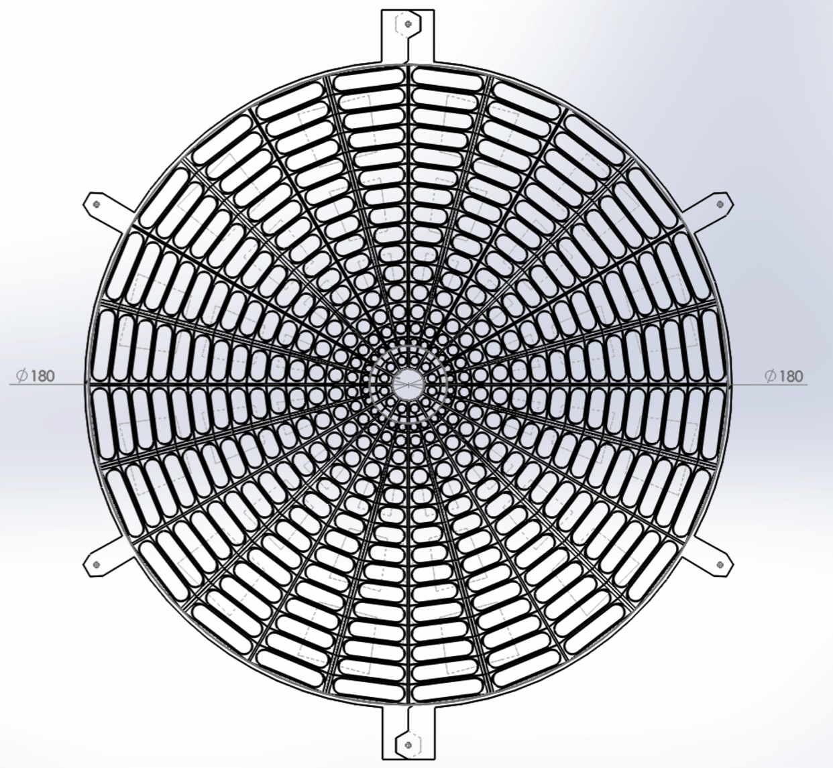
Overview
Overview
Super sector
Replacement for Beam-Beam Counter (BBC)
Made of plastic scintillator
Two, 1.8m diameter wheels of 12 super sectors each
Each super sector contains 31 optically isolated channels (744 total)
Optical fiber coupled to Silicon Photomultipliers (SiPMs)
Read out by STAR electronics

Slide 4
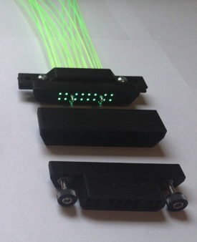
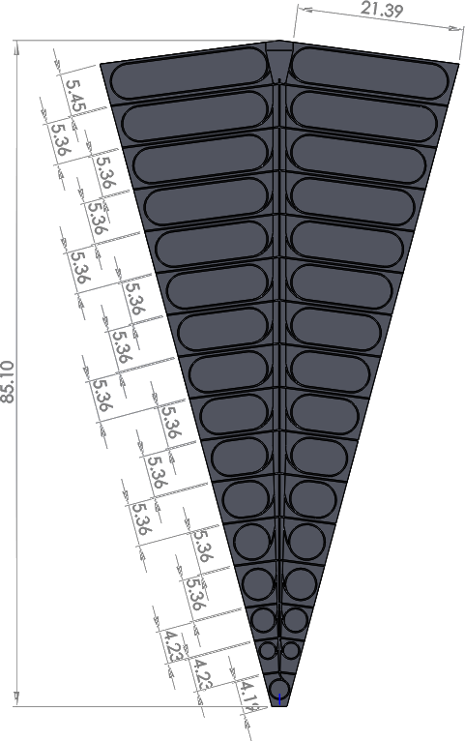
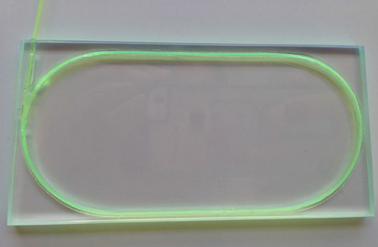
Super Sector Construction
Super Sector Construction
Clear fibers
Embedded 32-channel
fiber-to-fiber connector
Embedded Wavelength Shifting (WLS) fibers
A test tile
Connected to 5.5 meters of clear fiber with 3D-printed custom connectors
Super Sector wrapped in Tyvek and 2 layers of black paper (light tight)
4

Slide 5
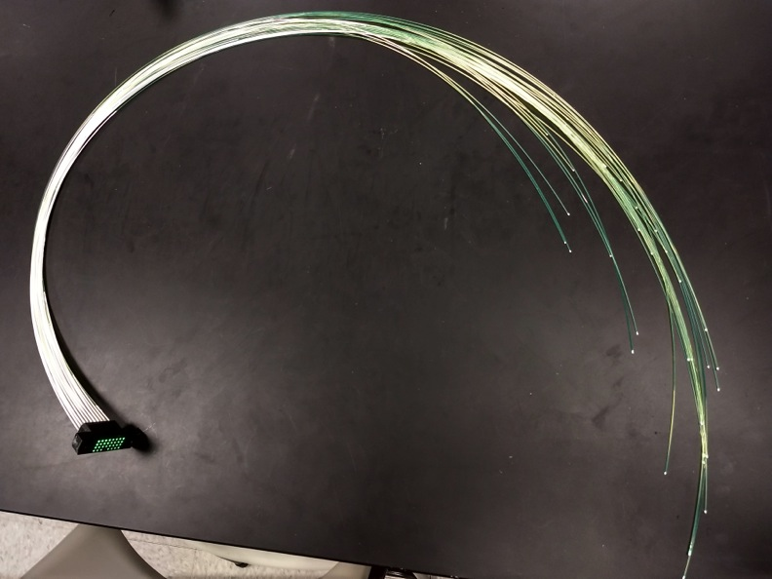
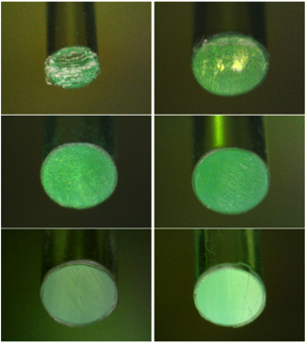
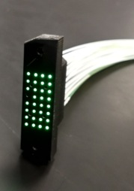
Wave Length Shifting Fiber Preparation
Reflective Paint
3D-printed custom connectors
Reflective Paint on Ends
WLS→ reflective paint for
“Central Channel”
Decreases cross-talk
WLS Fiber ends painted
Increases light yield by ~30-50%
Fibers must be polished for optimal coupling
5
Catherine Tomkiel, APS DNP October 2017 Meeting
5

Slide 6
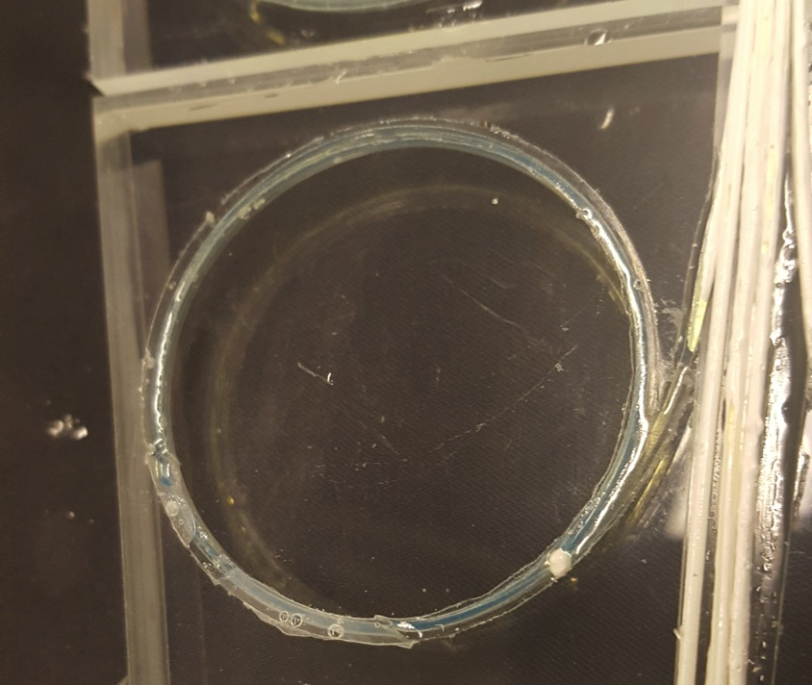
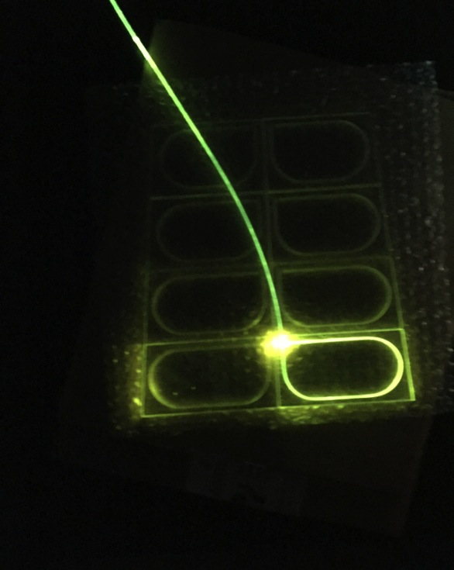
Front WLS grooves
3 Loops of WLS per tile
Increases yield by ~2x compared to 1 loop
Central channel and front grooves filled with reflective epoxy
Catherine Tomkiel, APS DNP October 2017 Meeting
6

Slide 7
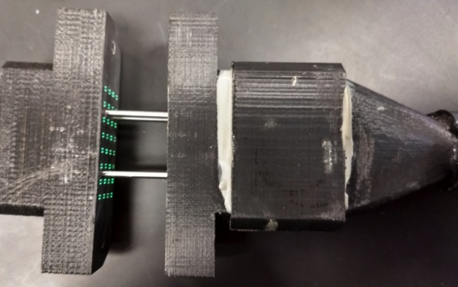
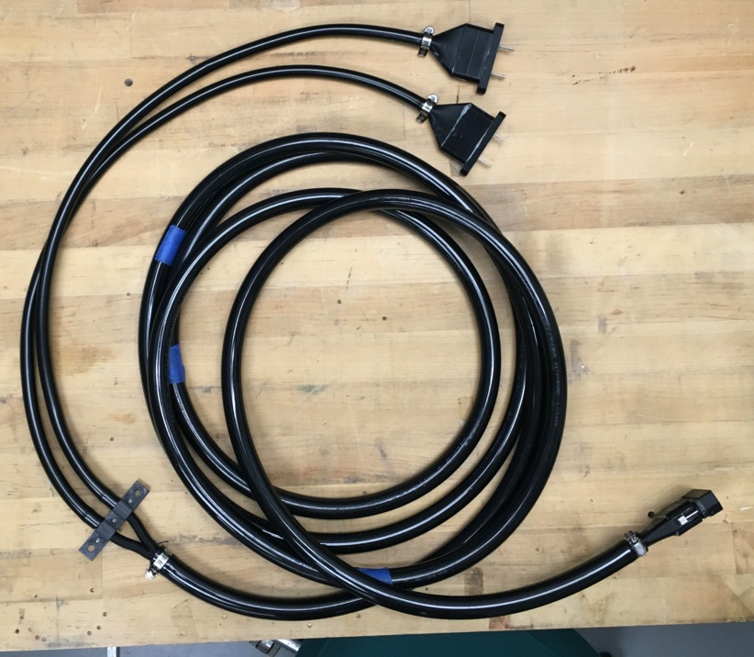
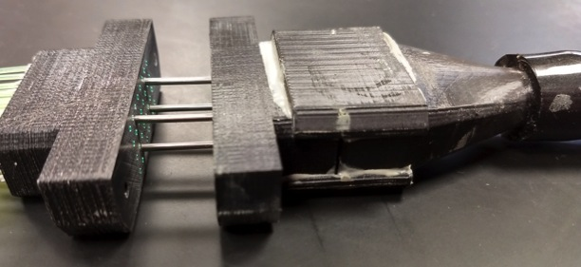
5.5-m-long Clear Fiber Bundles
Connected to 5.5 meters of clear fiber
CF attenuation length: >10 m
WLS attenuation length: >3.5m
Fiber-to-SiPM
CF Connector epoxied together for mechanical stability and light-tightness
Alignment pins
Fiber-to-Fiber
Catherine Tomkiel, APS DNP October 2017 Meeting
7

Slide 8
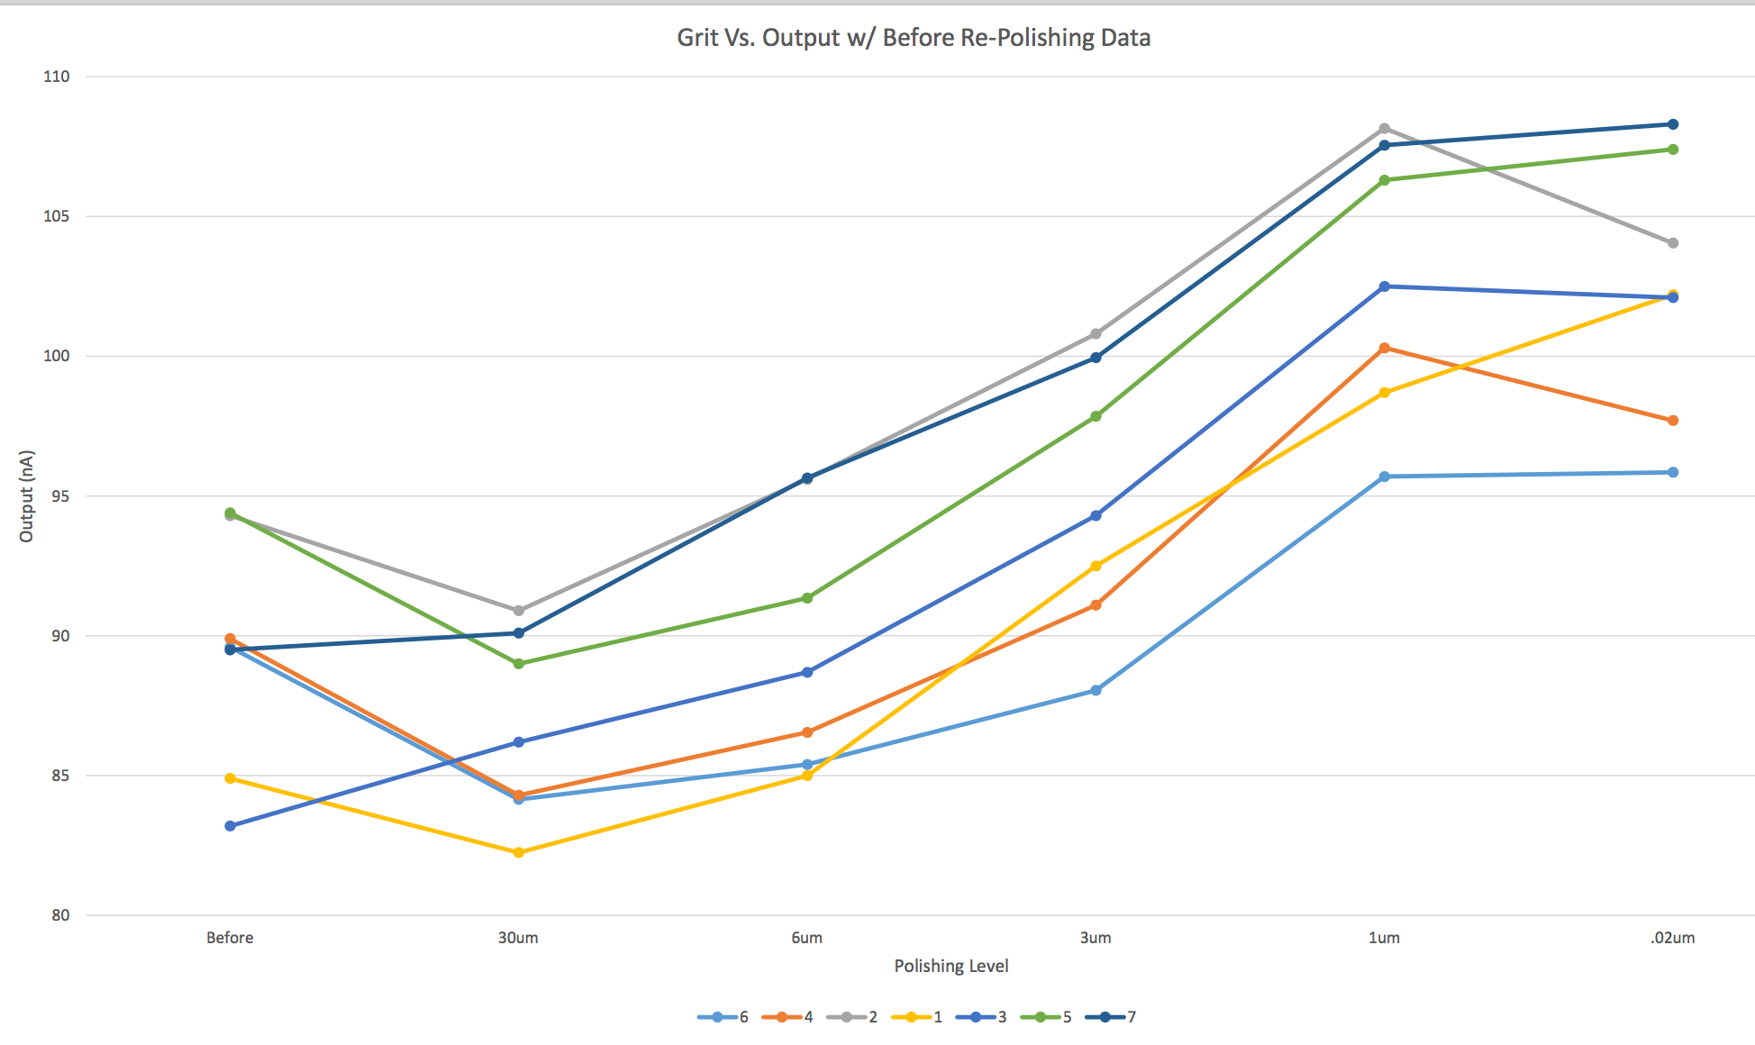
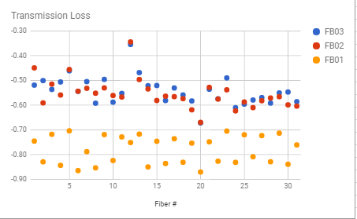
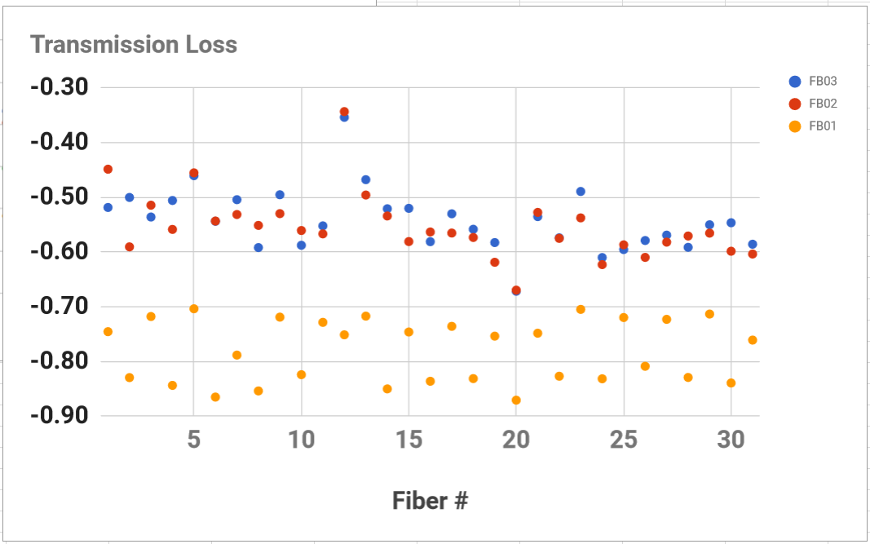
Effect of Polishing on Transmission
Better polish improves transmission
Correlation between visual inspection and transmission test
100
transmission (a.u.)
80
30 μm
1 μm
fineness of polishing cloth
Catherine Tomkiel, APS DNP October 2017 Meeting
8

Slide 9
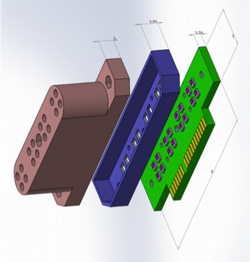
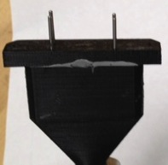
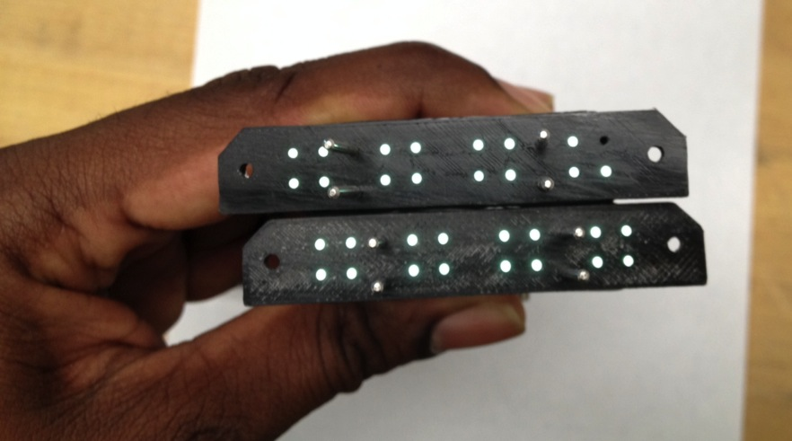
Clear fiber bundle meets readout electronics
Fiber-to-Silicon Photomultiplier
connector (FSC)
Connector
Spacer
SiPM
15 ch
CF Connector epoxied together for mechanical stability and light-tightness
Alignment pins
16 ch
Catherine Tomkiel, APS DNP October 2017 Meeting
9

Slide 10
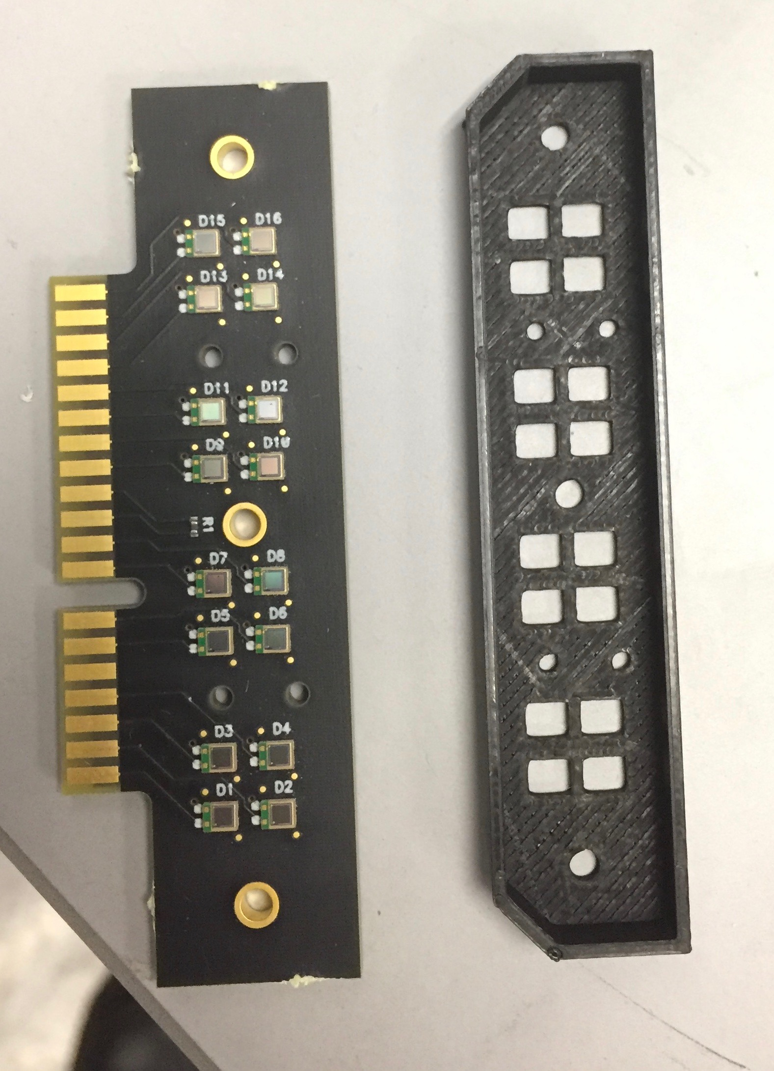
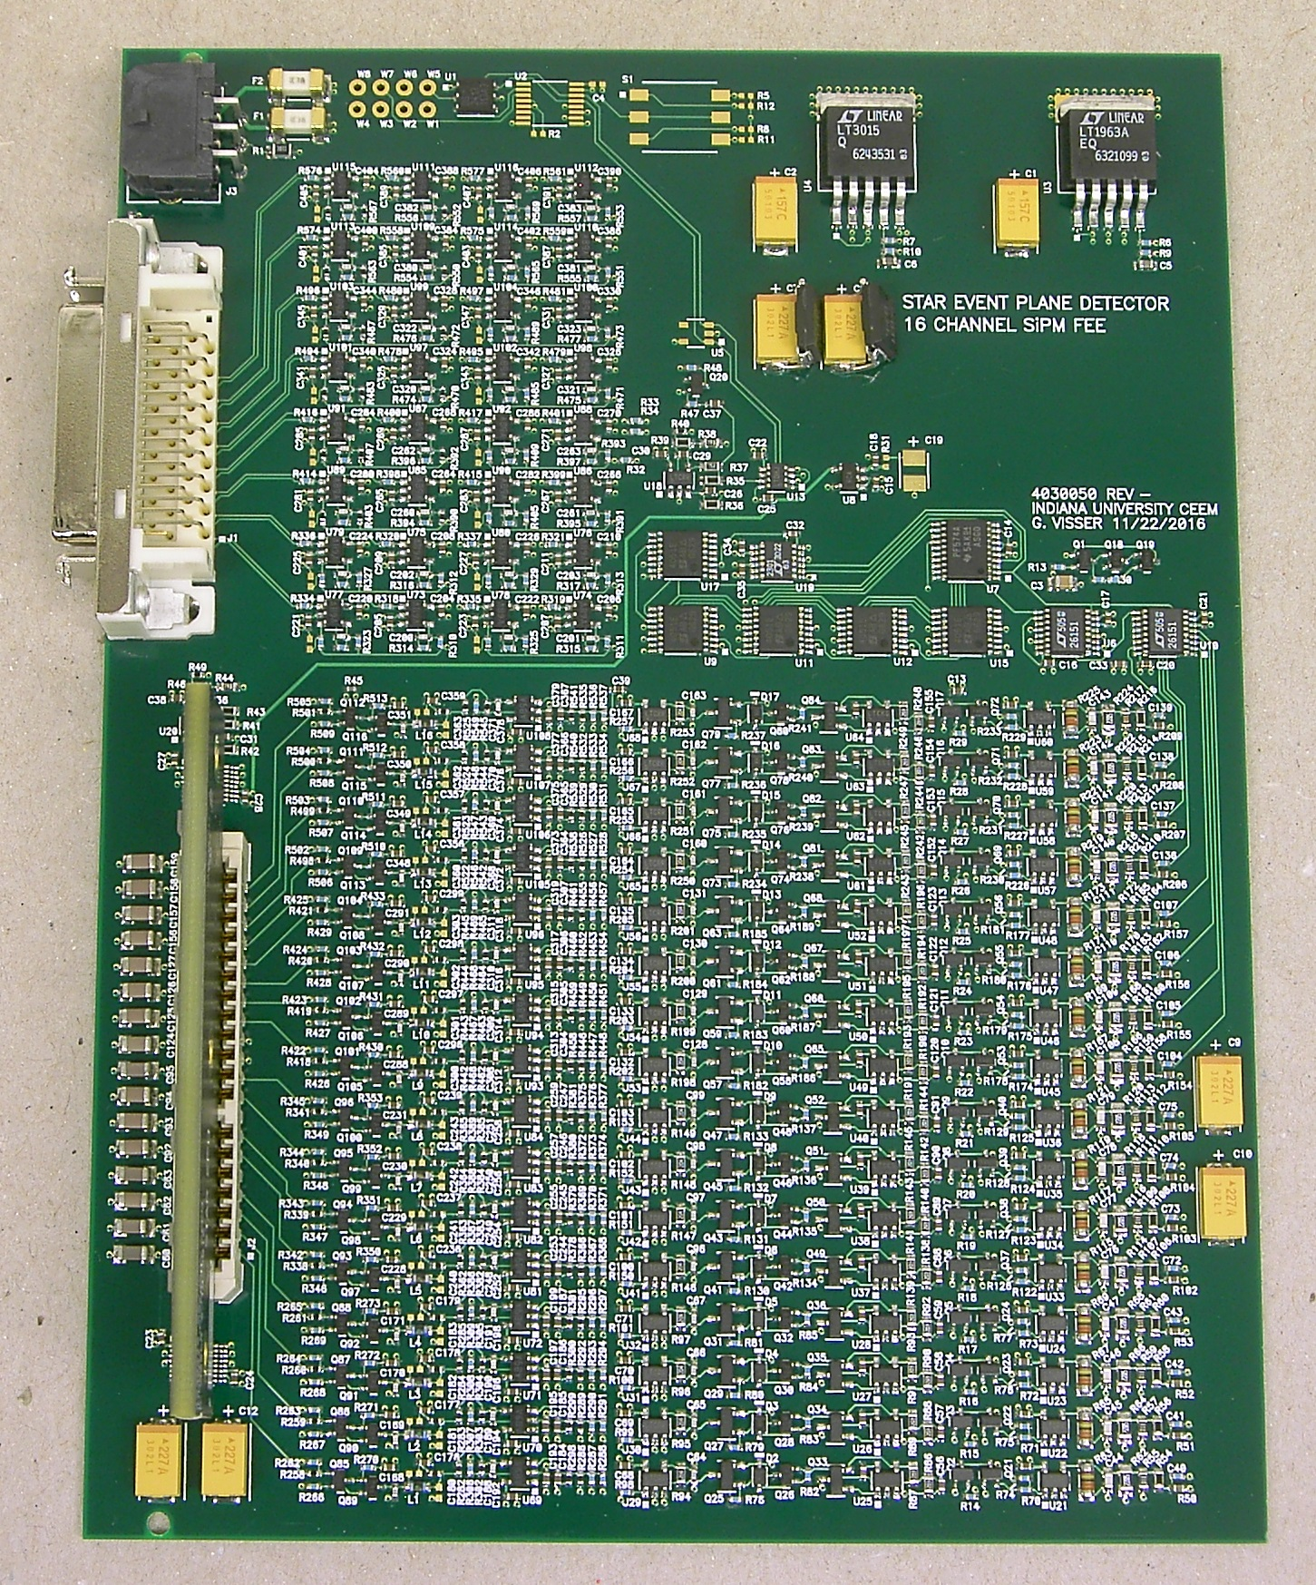
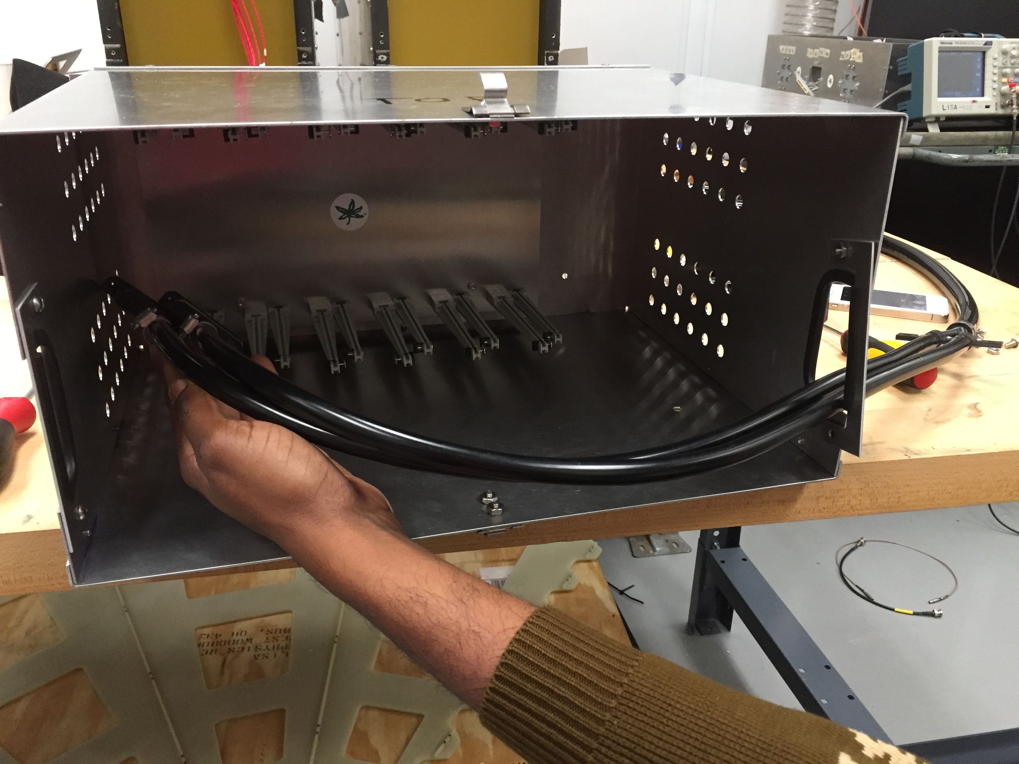
Clear fiber bundle meets readout electronics
Custom Designed Front End Electronics Card
EPD FSC spacer block
EPD SiPM card: 16, 25-μm SiPMs
FEE Box
Catherine Tomkiel, APS DNP October 2017 Meeting

Slide 11
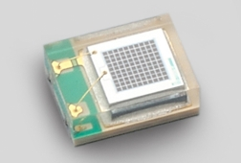
Read-Out Silicon Photomultipliers – (SiPM)
Clear fiber leads into photosensitive area of SiPM, which digitizes the signal
New technology for hadron colliders – Used in medical technology
Advantages:
– No sensitivity to magnetic fields
– very compact
Disadvantages:
– Neutron radiation sensitive
→ Placement is important!
Hamamatsu SiPM:S13360-1325PE
25x25 micron pixels
Catherine Tomkiel, APS DNP October 2017 Meeting
11

Slide 12
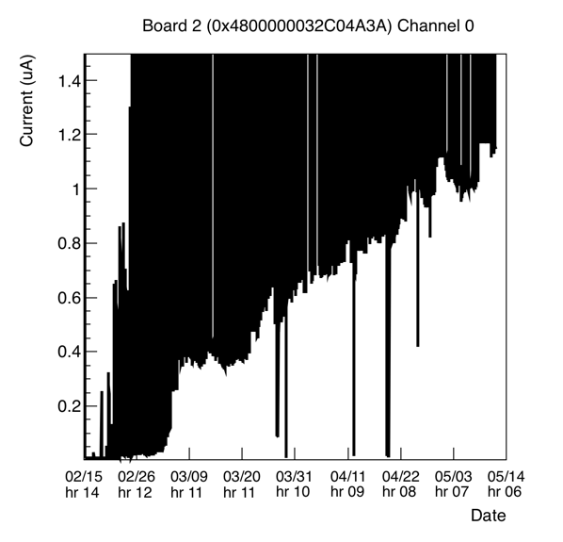
Dark Current Silicon Photomultipliers – (SiPM)
beam on (“light current”)
beam off (“dark current”)
Data from pp 500 GeV run
Radiation here is greater than it will be for BES-II
Tile 1, closest to be beampipe
End of run I_{d}~ 1 μA
Operational until I_{d} < ~15 μA
SiPMs good for equivalent of
12 more pp runs
Catherine Tomkiel, APS DNP October 2017 Meeting
12

Slide 13
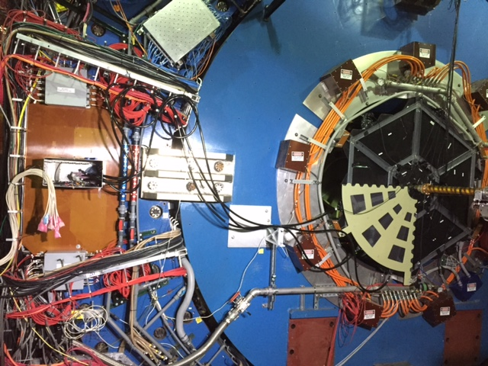
2017 – Quarter Wheel in place at STAR
Clear fiber bundles
FEE box
power/control/signal
cables to TUFF & Rx
EPD/8
BBC
Catherine Tomkiel, APS DNP October 2017 Meeting
13

Slide 14
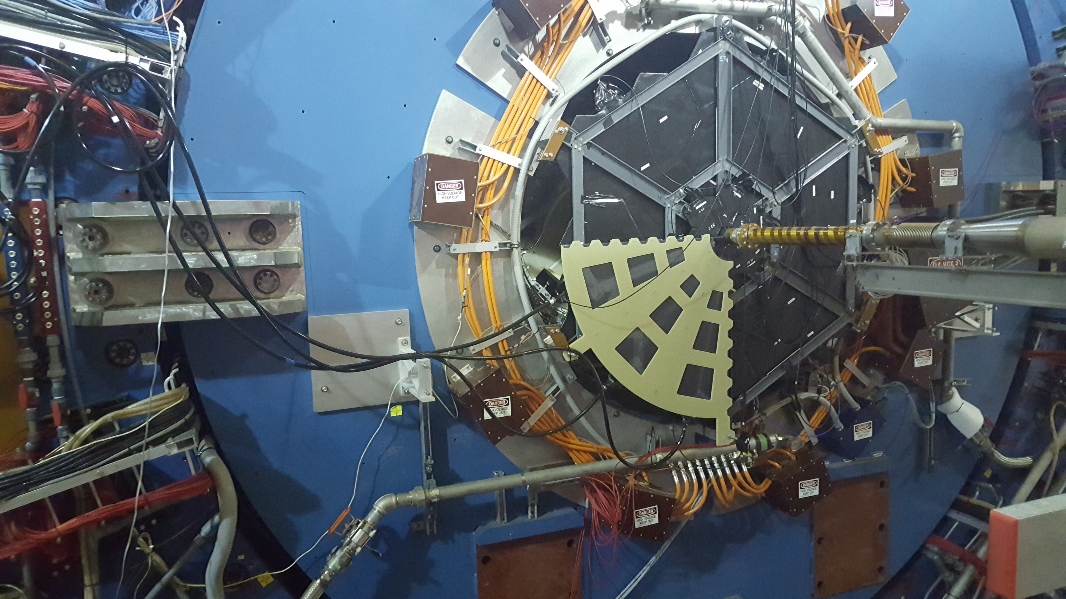
Summary
Updated electronics and increased number of channels is an important upgrade for many measurements, including those for BES-II
Data from Run 17 will be discussed by Justin Ewigleben
All super sectors have been constructed: 24 SS plus extra 6 as spares. They are to be installed before Run 18.
Catherine Tomkiel, APS DNP October 2017 Meeting

Slide 15
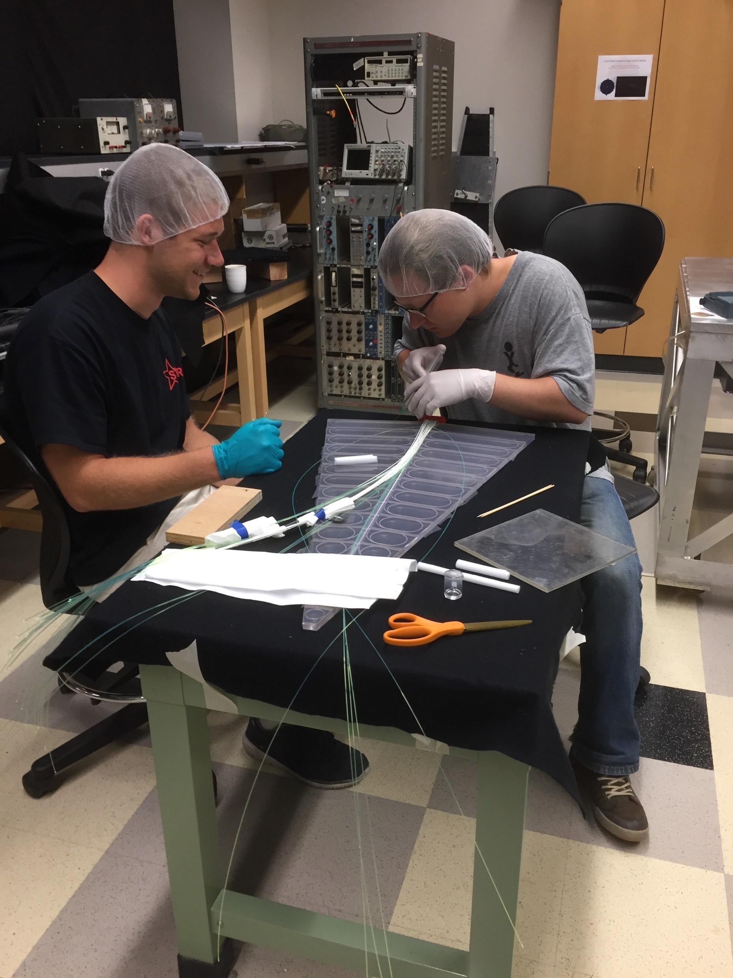
Supersector production
mill isolation grooves (1.65 mm wide) on back ½-way (6 mm deep)
TiO₂ + epoxy mixture for isolation grooves, mill the front
remaining isolation grooves
WLS fiber grooves (3.5mm), with ramps
epoxy FFC with WLS fibers
optical glue WLS in sigma grooves and central channel
TiO₂ + epoxy mixture for front isolation grooves
polish edges, touch-up
wrap
bench tests
Catherine Tomkiel, APS DNP October 2017 Meeting

Slide 16
Design
2 Wheels, each composed of 12 supersectors
Each supersector: 31 optically-isolated tiles
1.2-cm-thick scintillator (Eljen EJ-200)
3 turns of WLS fiber (Kuraray Y-11, 1 mmD)
(3 turns ~doubles light output rel. 1 turn)
R_{in}=4.5 cm, R_{out}=90 cm, z_{mount}=375 cm
Each of 12x31x2=744 channels
optical signal transported 5.5 m on clear fiber (Kuraray 1.15 mmD BJ round)
coupled to SiPM (Hamamatsu S13360-1325PE)
25-μm pixels → 1600+ illuminated pixels
read out by STAR FEEs/QTs, similar FPS
Custom-built connector components
3D-printed
Catherine Tomkiel, APS DNP October 2017 Meeting

Slide 17
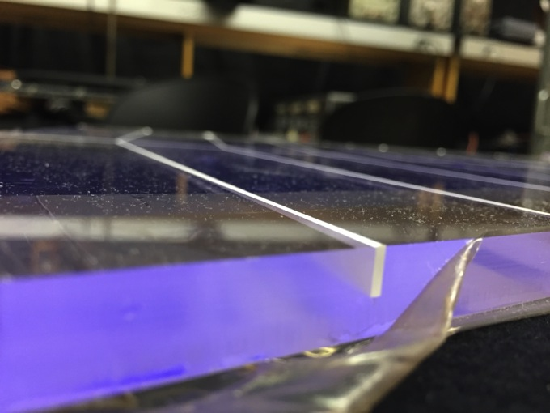
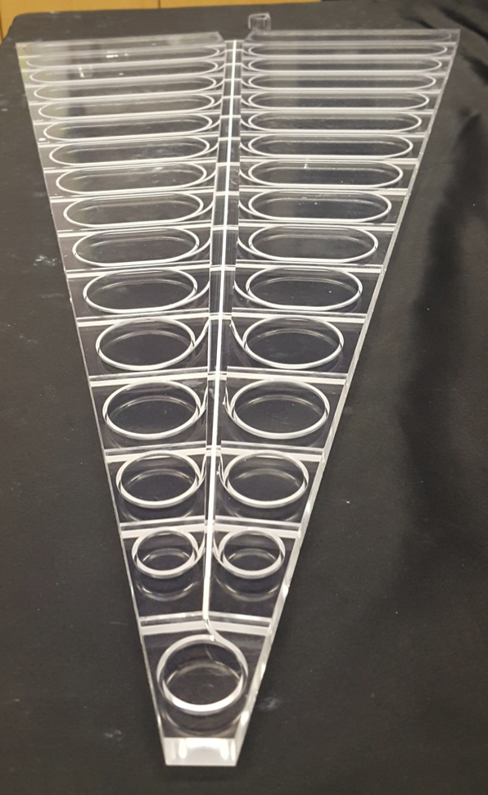
Front isolation grooves
Mill “half-way” and fill groves with TiO₂ + epoxy mixture (reflective epoxy)
Optical isolation!
Flip over and finish milling the groves + Fiber channels
Catherine Tomkiel, APS DNP October 2017 Meeting
17

Slide 18
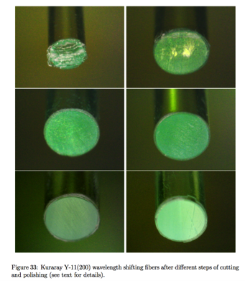
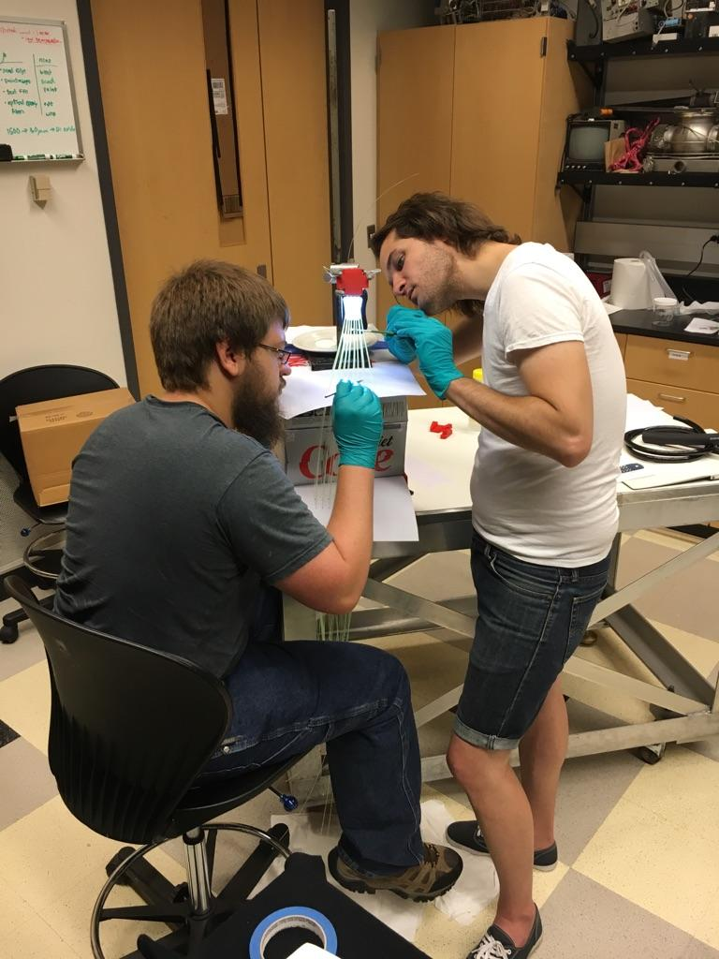
Fiber bundle construction at Lehigh
Justin Ewigleben
Daniel Brown
100
transmission (a.u.)
80
Coming to join them:
Catherine Tomkiel, Prashanth
30 μm
1 μm
fineness of polishing cloth

