Slide 1




Experimental measurements of photon induced reactions from ultra-peripheral to central collisions
Lepton Pair Production via Two-Photon Process at STAR
Wangmei Zha for the STAR Collaboration
University of Science and Technology of China
The first international workshop on the physics of Ultra Peripheral Collisions, Playa del Carmen, Mexico, Dec. 12, 2023

Slide 2
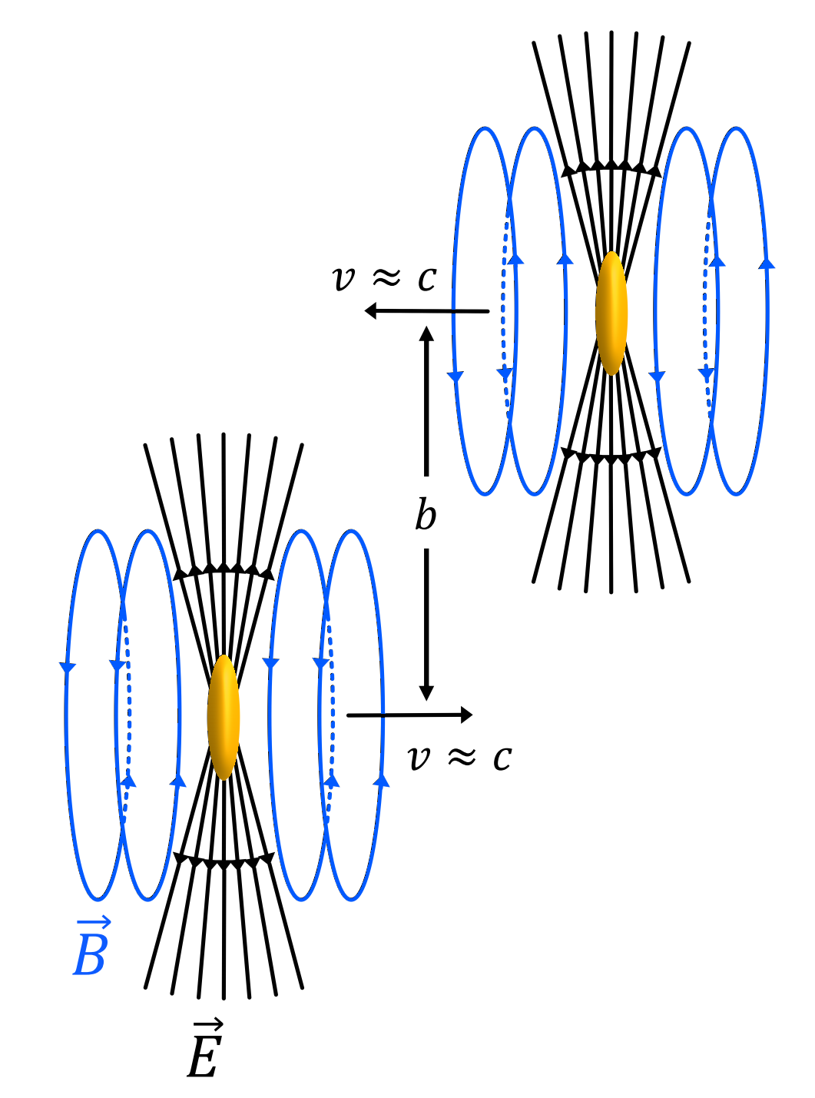
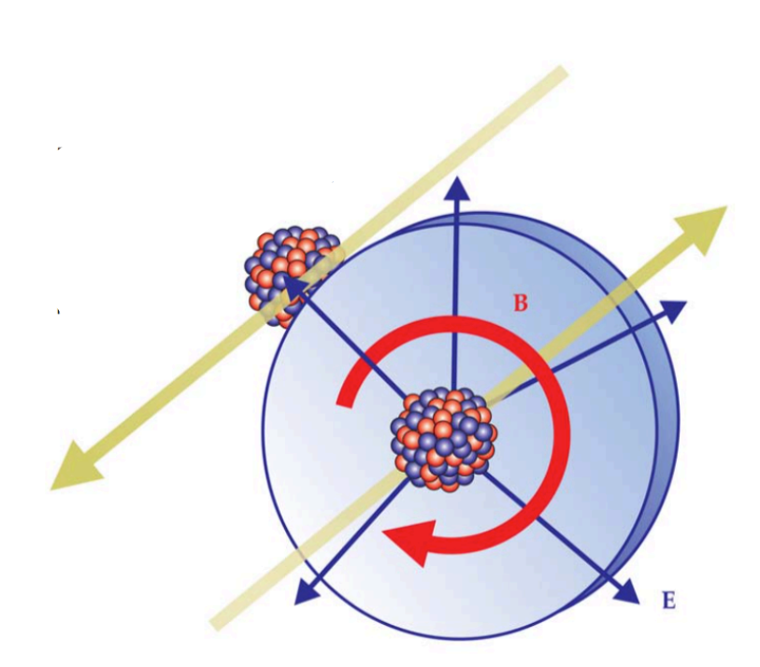
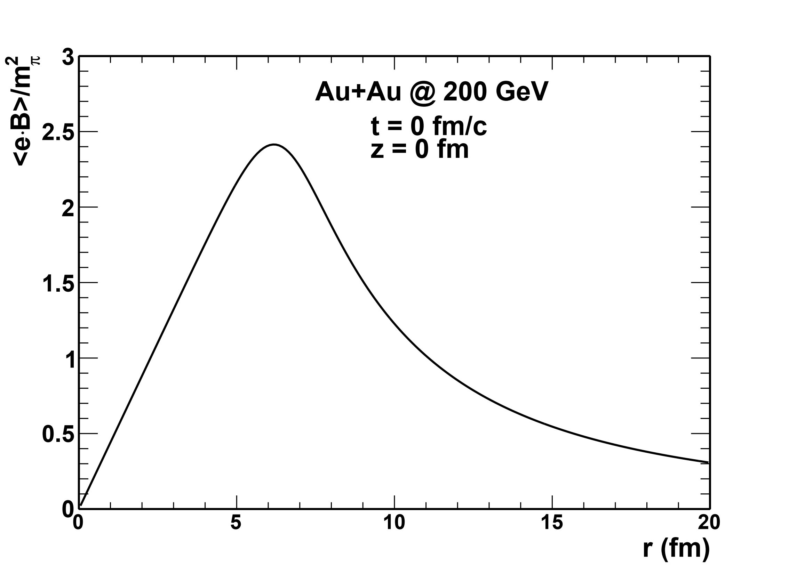
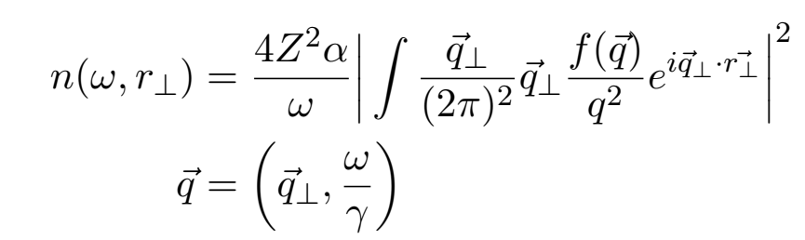

Giant electromagnetic field in heavy-ion collisions
S. Klein and J. Nystrand,
Physics Today 70 (2017) 40
$$m_{π}^{2}:3.3×{10}^{14} T$$
Ultra-Peripheral Collisions
(UPC)
Clouds of quasi-real photons being present with heavy nuclei
Equivalent Photon Approximation

Slide 3
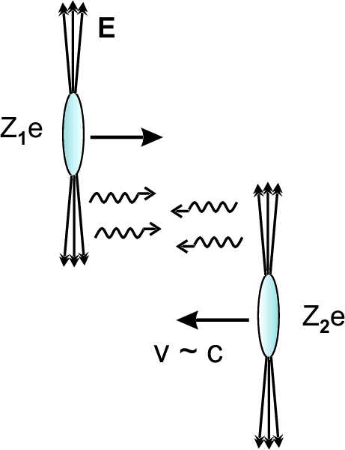
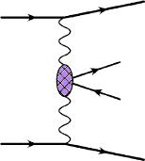
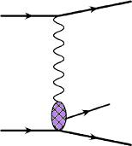
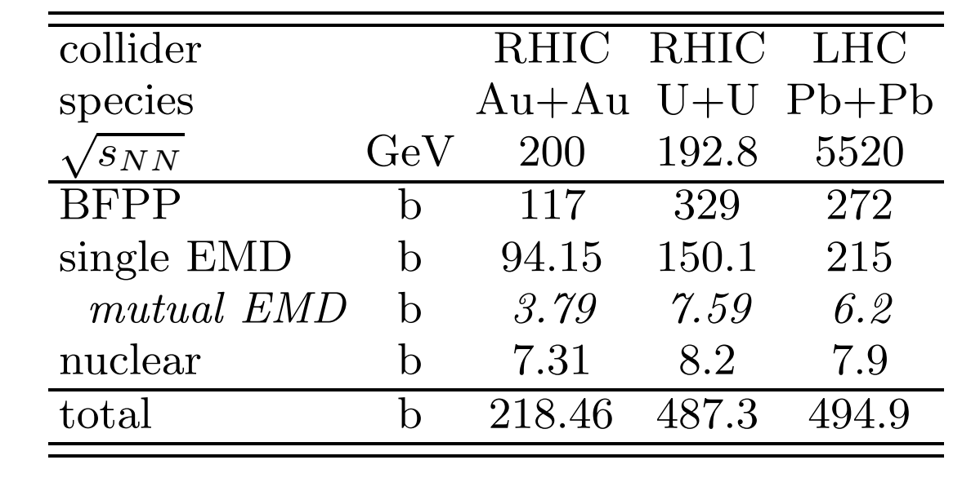
Photoproduction in Ultra-peripherial Heavy-ion Collisions
C.A. Bertulani, S.R. Klein and J. Nystrand, Ann. Rev. Nucl. Part. Sci.55:271
(2005)
=
+
V=ρ , ω , φ , J/ψ
...
Photon-photon
interactions
Photon-nucleus
interactions
Electromagnetic interaction
W. Fischer etal., PRC 89 (2014) 014906
The abundant photon induced reactions
UPC related physics
=
The physics of photoproduction

Slide 4
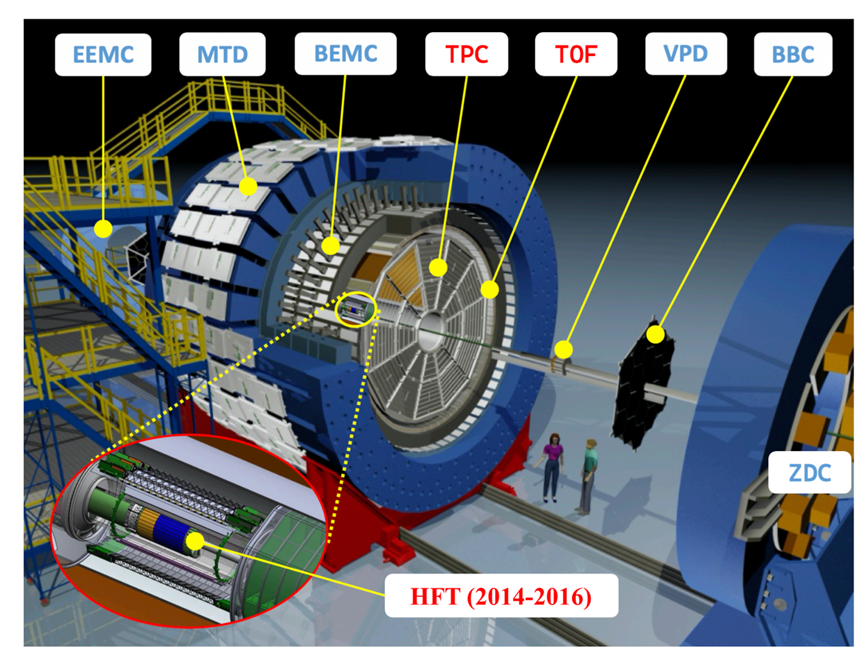
The equipment (STAR) to photograph the collisions

Slide 5
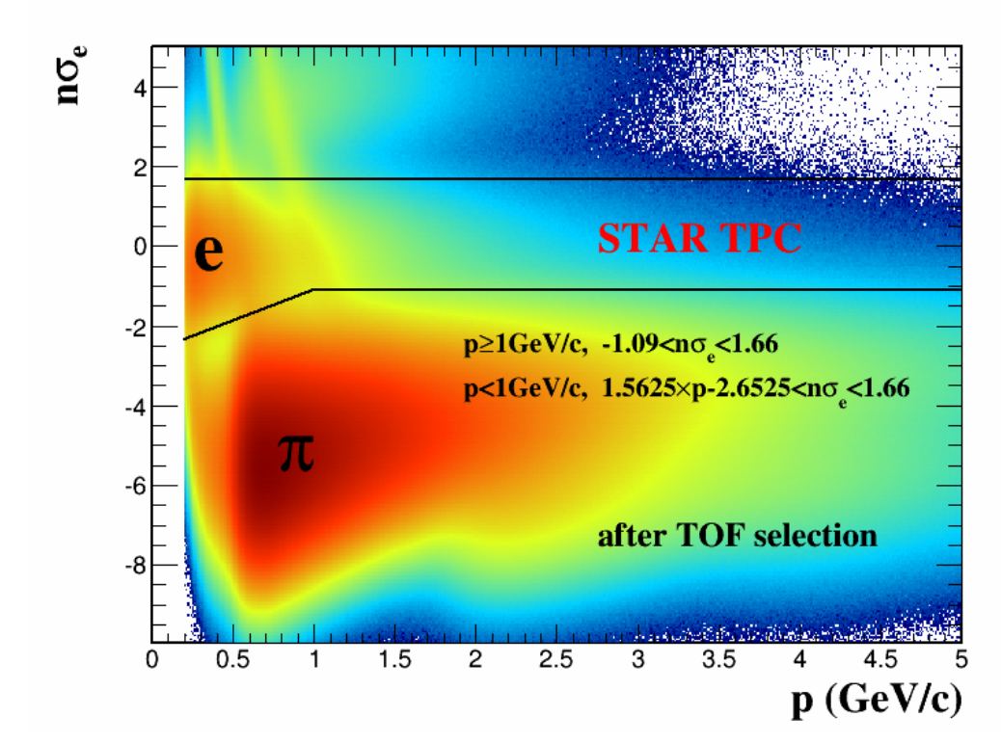
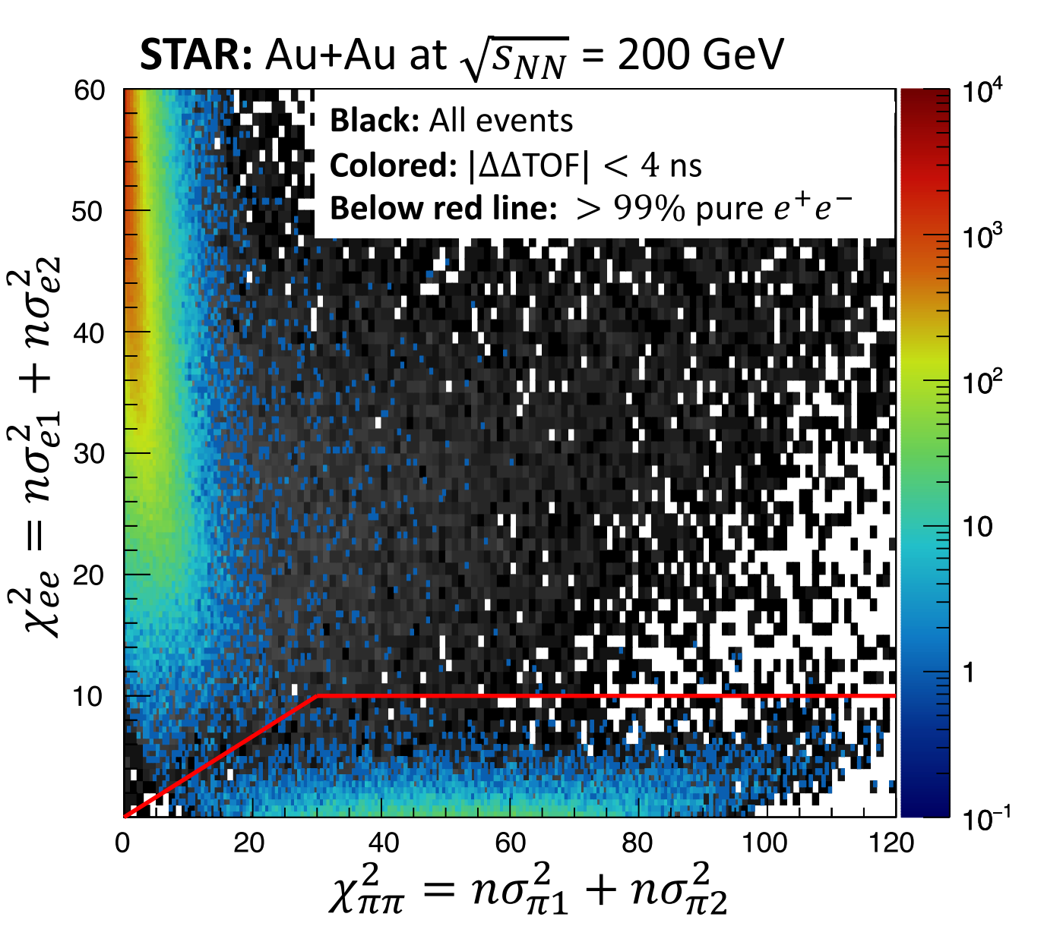
Electron Identification at STAR
Excellent electron identification in MB and UPC
  Purity > 99%

Slide 6
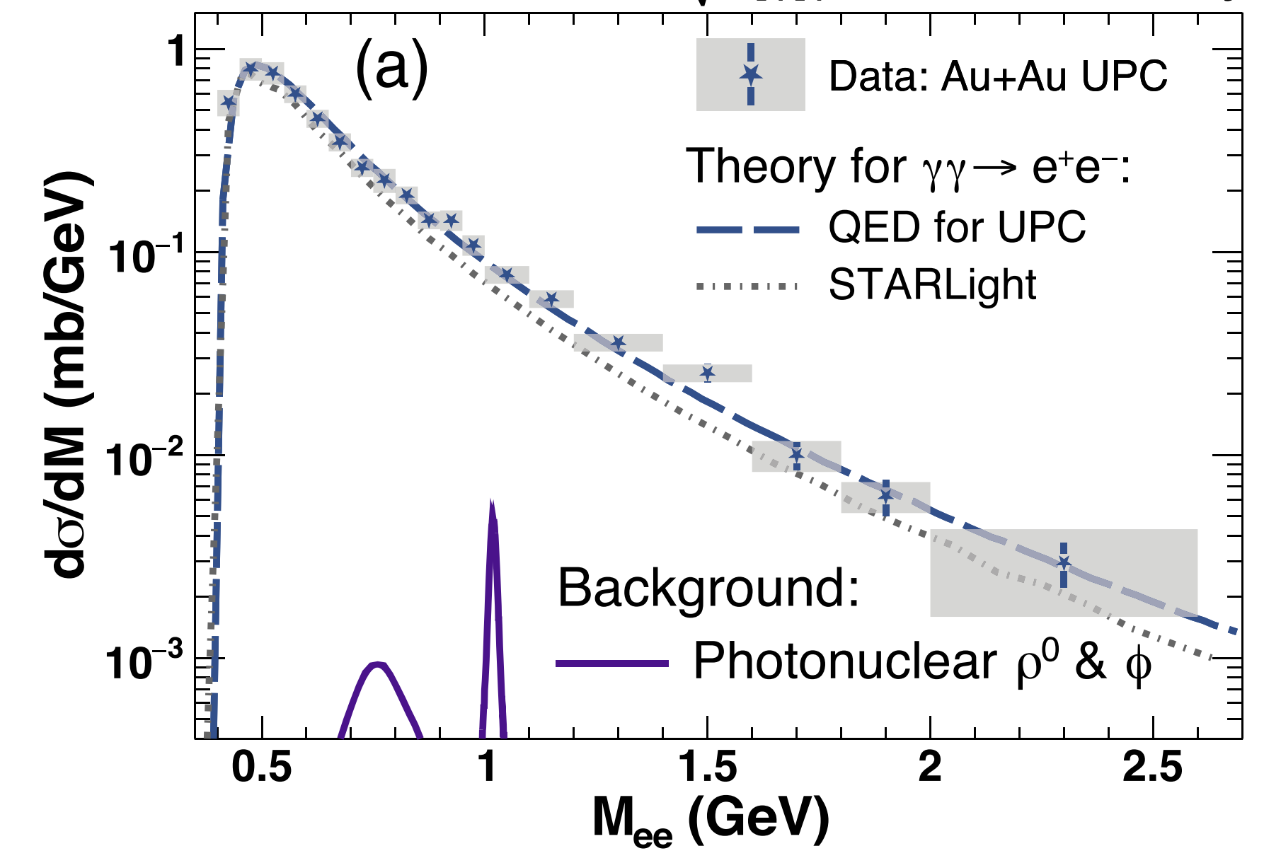
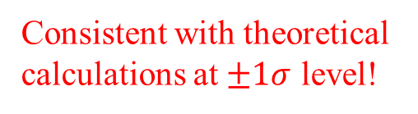
The observation of Breit-Wheeler process
STAR, PRL 127 (2021) 052302
MCD
Data : 0.261±0.004 (stat.) ± 0.013 (sys.) ± 0.034 (scale) mb
STARLight gEPA QED
0.22 mb 0.26 mb 0.26 mb
Consistent with theoretical calculations at $±1σ$ level!
The simplest process to convert energy to matter

Slide 7
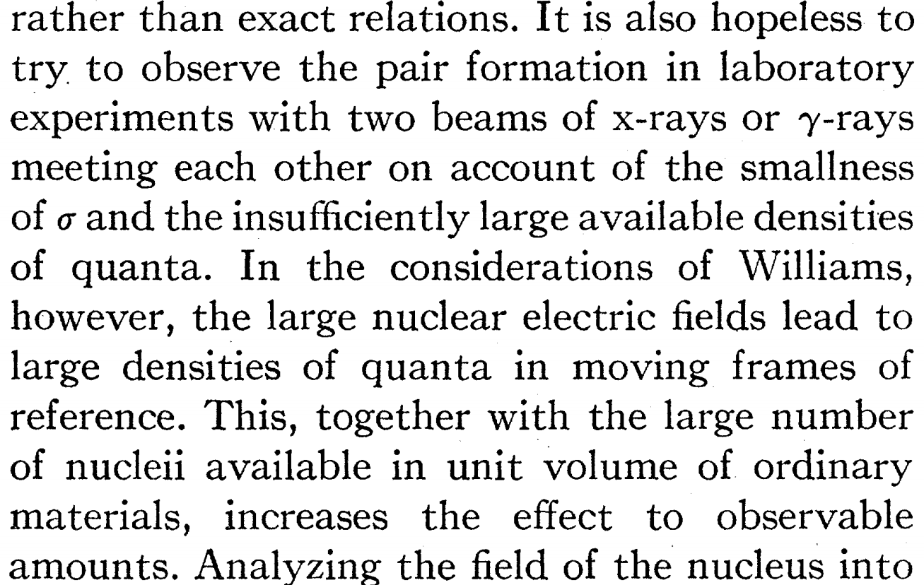
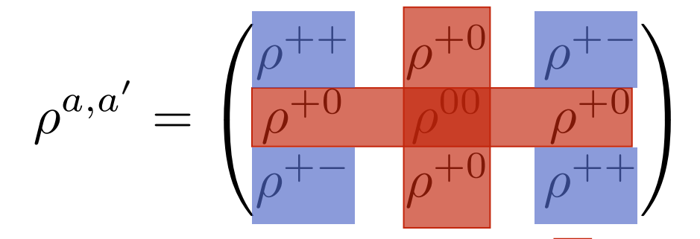
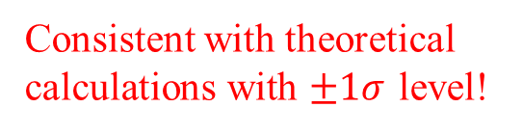
The observation of Breit-Wheeler process
STAR, PRL 127 (2021) 052302
MCD
Data : 0.261±0.004 (stat.) ± 0.013 (sys.) ± 0.034 (scale) mb
STARLight gEPA QED
0.22 mb 0.26 mb 0.26 mb
Consistent with theoretical calculations with $±1σ$ level!
1934 Breit & Wheeler : “Collision of two Light Quanta”
Physical Review 46 (1934): 1087

Slide 8
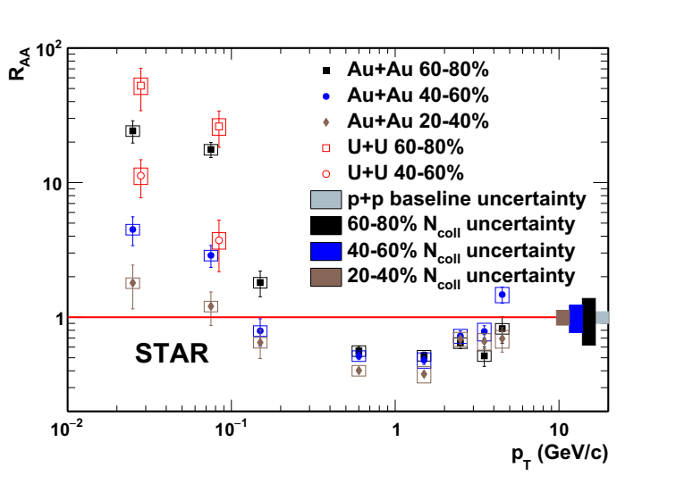
Story began from the peripheral heavy-ion collisions (Non-UPCs)
ALICE: PRL 116, 222301 (2016)
STAR: PRL 123 (2019) 132302
Significant enhancement of J/ψ yield observed at very low p_{T} in peripheral heavy-ion collisions.
Origin from coherent photon-nucleus interactions!
New probe for QGP?

Slide 9
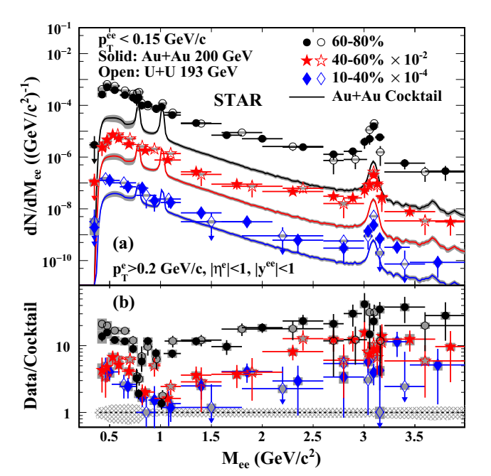
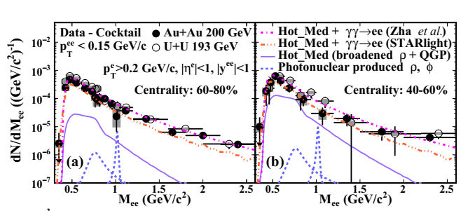
Breit-Wheeler process in non-UPCs
STAR, PRL 121 (2018) 132301
S.R. Klein, PRC 97 (2018) 054903
W. Zha etal., PLB 781 (2018) 182
Negligible ρ photoproduction!
Significant excess in 60-80% central Au + Au and U + U collisions for the whole invariant mass range!
The excess can be described by the coherent photon-photon process!

Slide 10
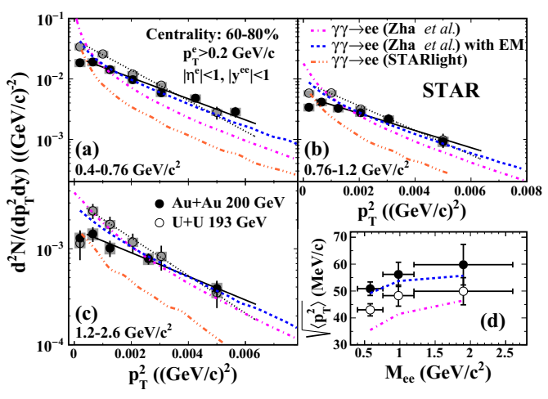
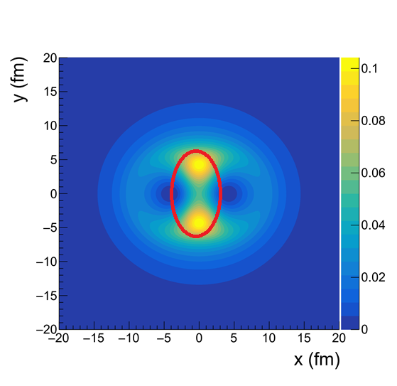
Broadening of transverse momentum
12% in nuclear overlap region
Au+Au 200GeV
40-60% y=0
W. Zha etal., PLB 781 (2018) 182
Novel probe for QGP?
Possible medium effects --- magnetic field trapped in the QGP?

Slide 11
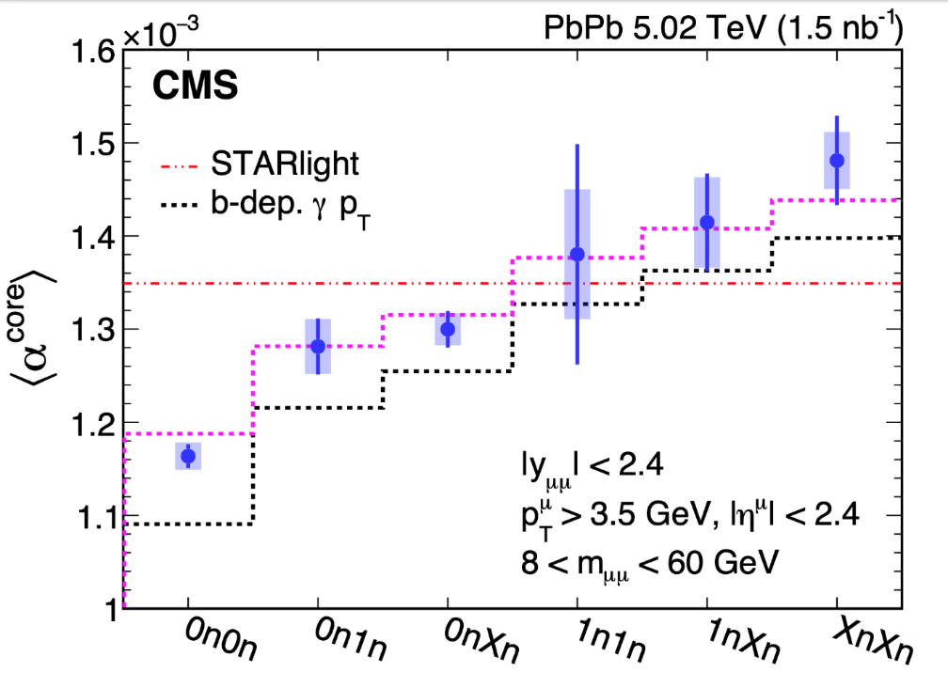
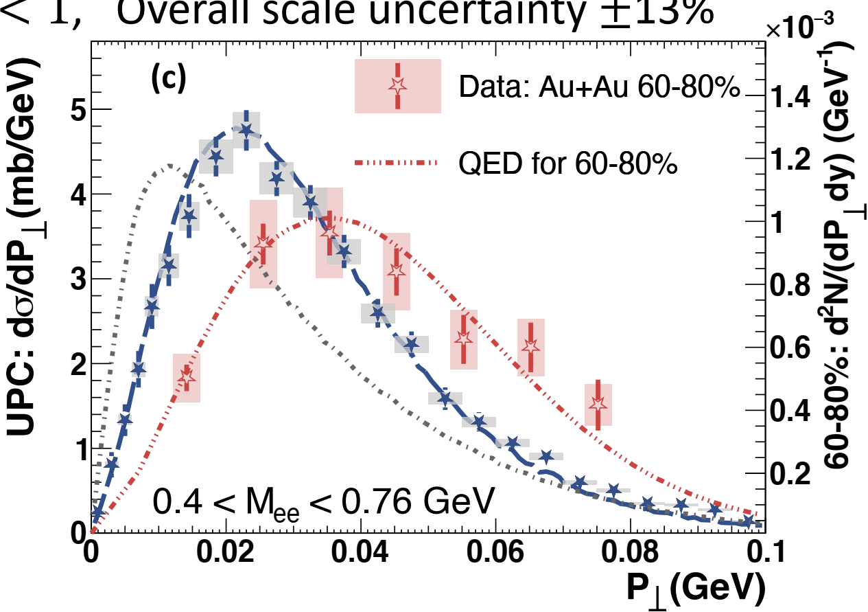
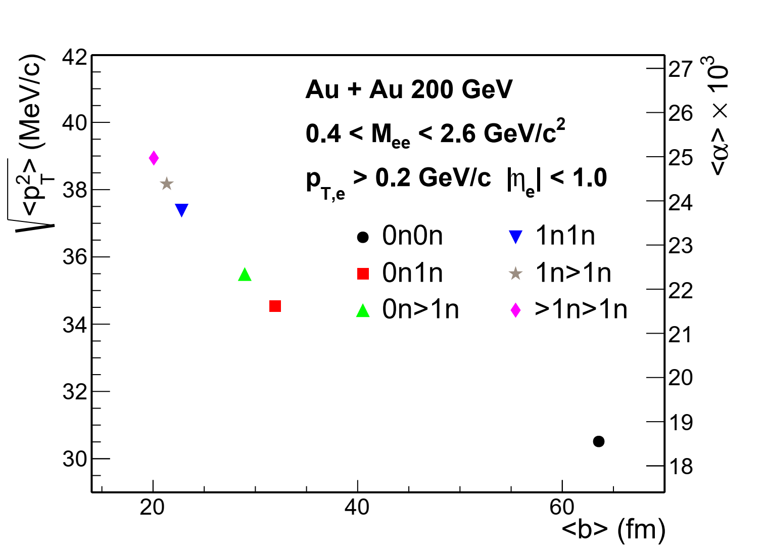
Impact parameter dependent broadening
CMS, PRL 127 (2021) 122001
PLB 800 (2020) 135089
W. Zha etal, PLB 800 (2020) 135089
The “broadening” mainly originates from the lack of impact parameter dependence in traditional EPA approaches.
J.D. Brandenberg etal.,
arXiv:2006.07365
Shi Pu etal., Acta Phys. Sin. 72 (2023) 072503.

Slide 12
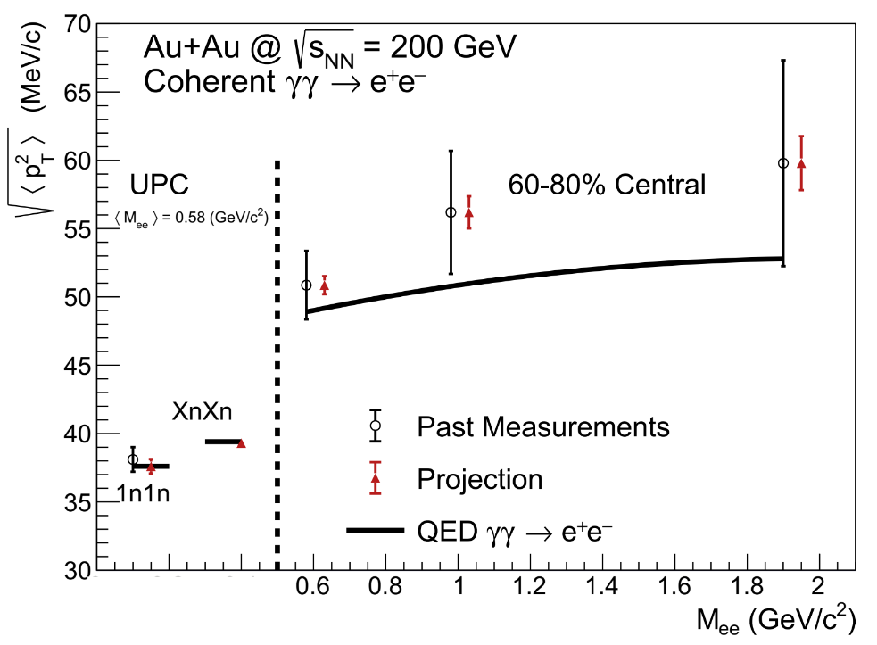
The room for QGP effect
J.D. Brandenburg, J. Seger, Z. Xu and W. Zha, Rep. Prog. Phys. 86 (2023) 083901
~20 times more statistics
Push for more precise multi-differential measurements

Slide 13
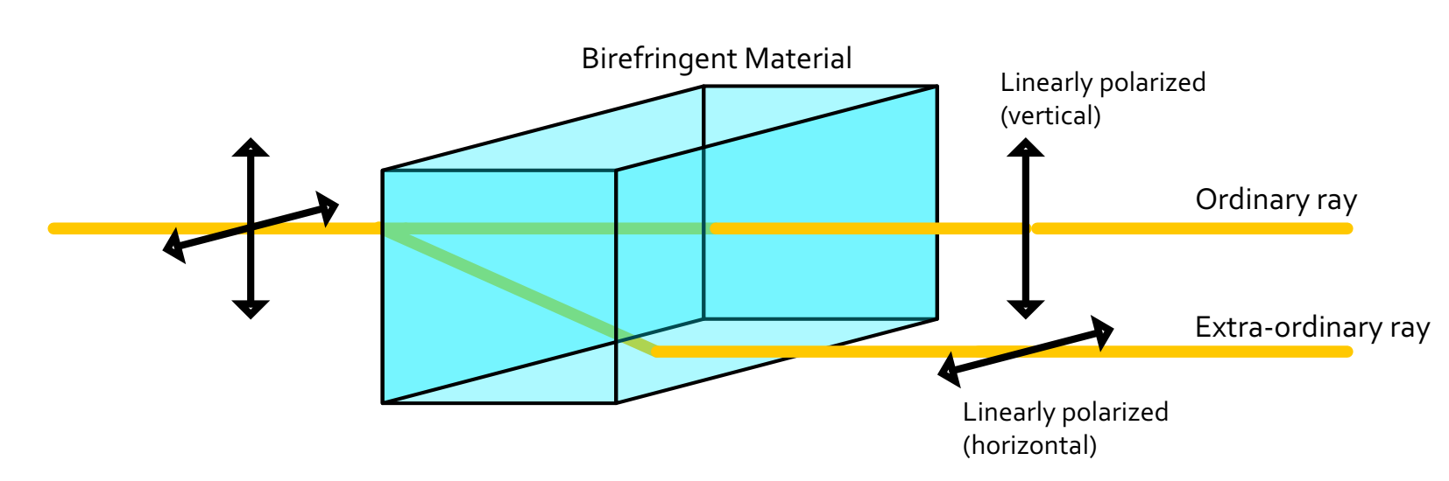
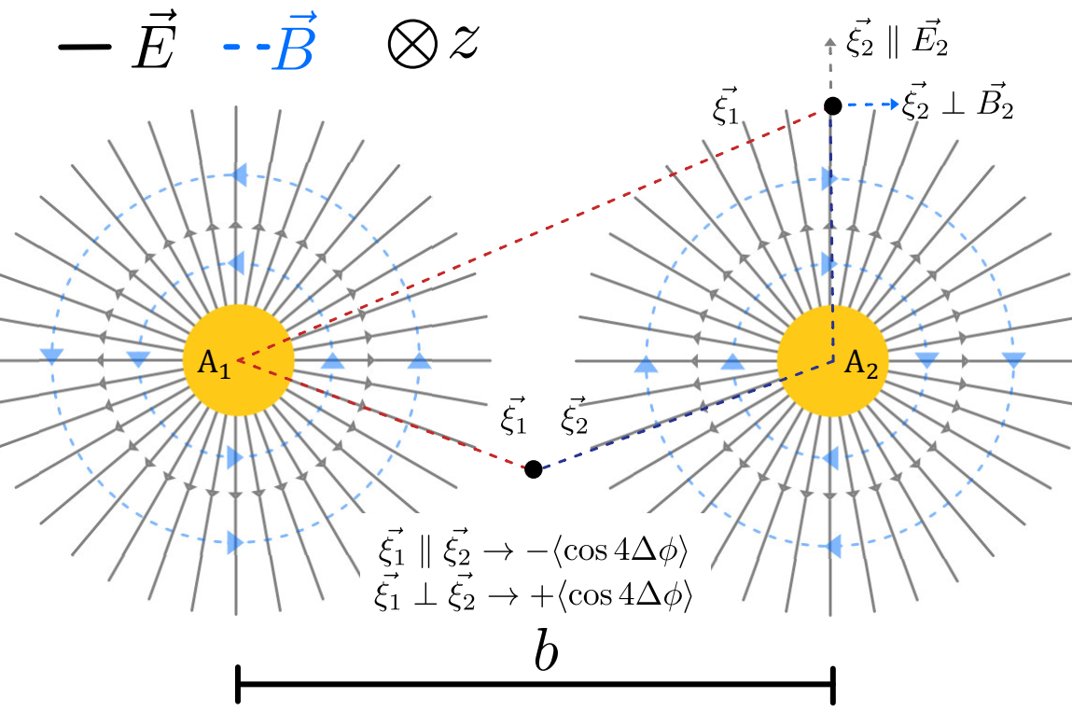
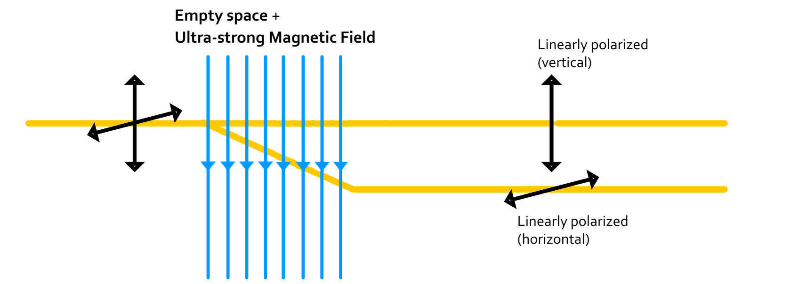
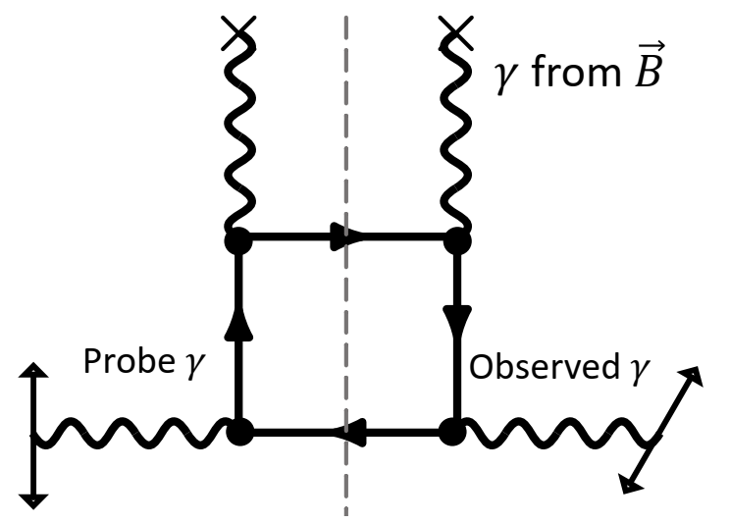
Birefringence and linear polarization
Birefringence
The photons are linearly polarized!
QED Vacuum Birefringence
C. Li, J. Zhou, Y.-j. Zhou, Phys. Lett. B 795, 576 (2019)
Link to Vacuum Birefringence!

Slide 14
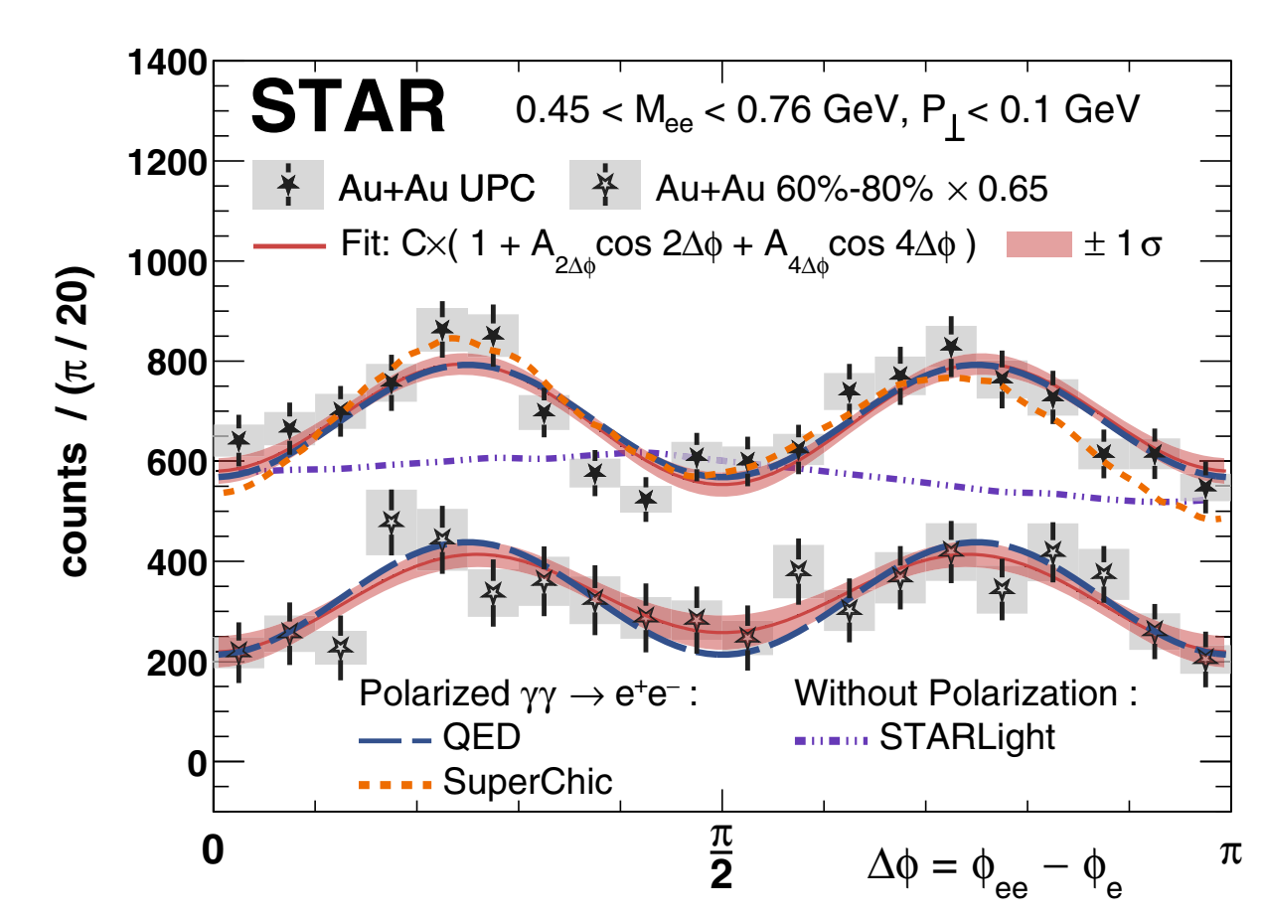
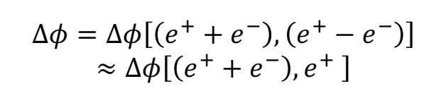
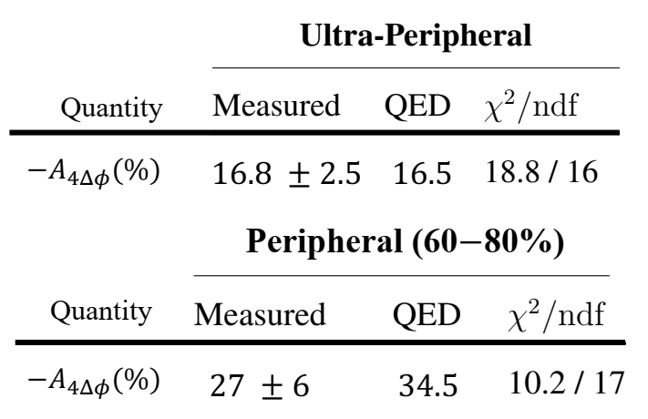
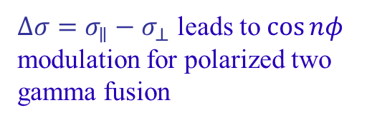
Birefringence of the QED vacuum
$∆σ=σ_{∥}−σ_{⊥}$ leads to $\cos{nφ}$ modulation for polarized two gamma fusion
The first observation of angular modulation for B-W process in heavy-ion collisions (both for UPC and non-UPC).

Slide 15
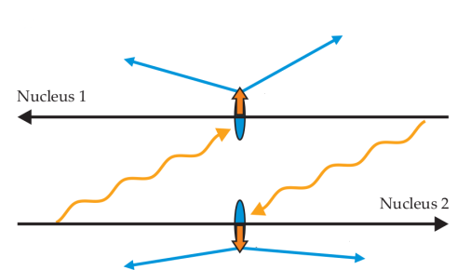
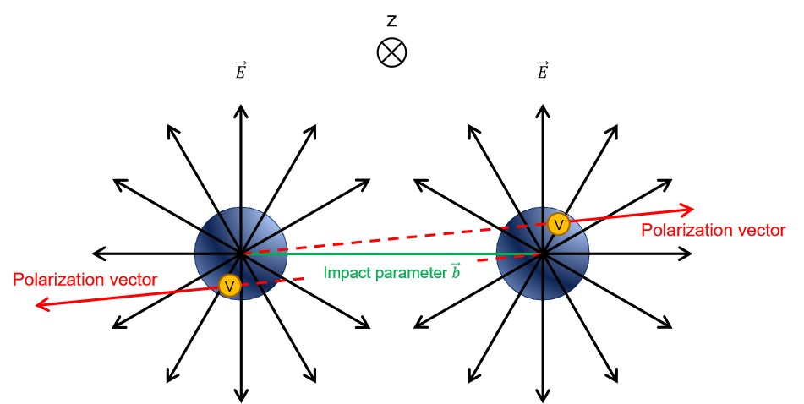
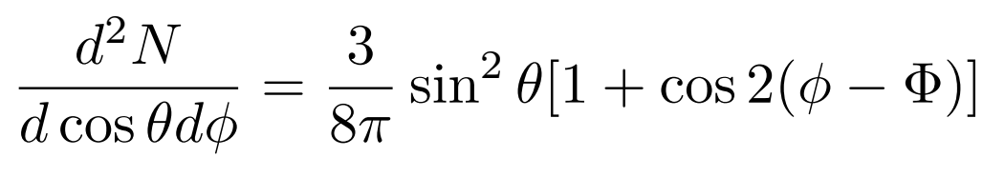
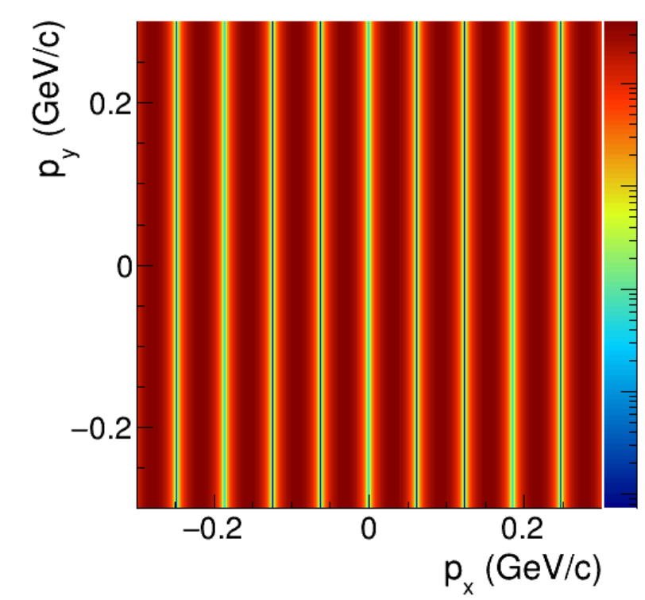
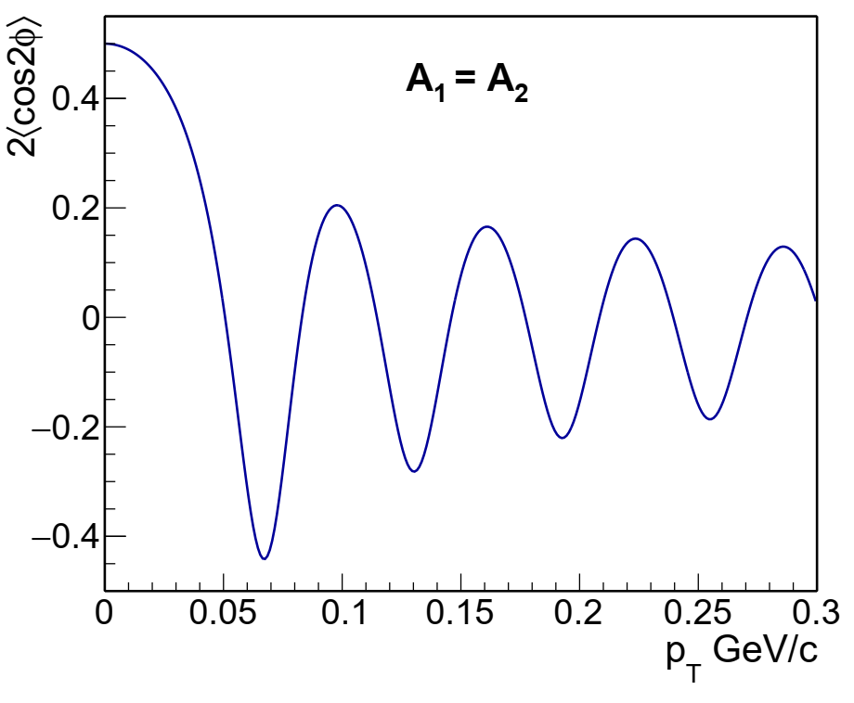
Double slits interference in polarization space
Linearly polarized photons
？
？
Decay along the impact parameter
PRD 103 (2021), 033007
The second order modulation

Slide 16
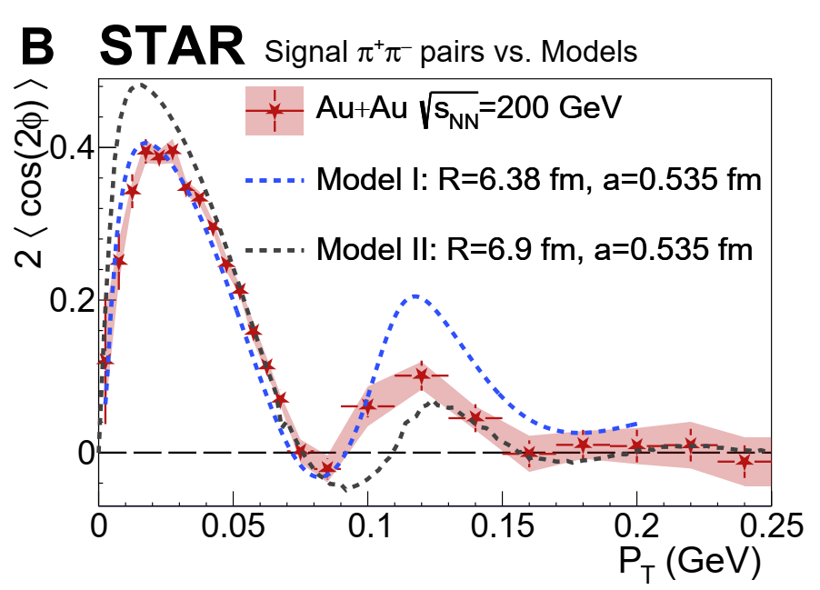
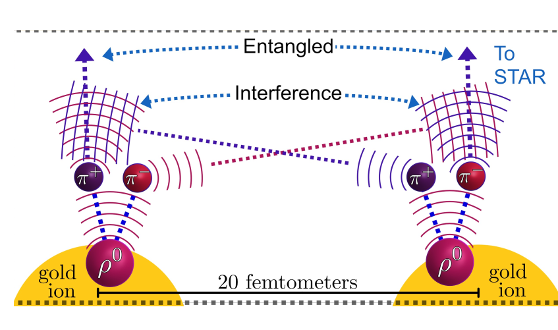
Double slits interference in polarization space
STAR，Sci. Adv. 9 (2023) eabq3903
Example of EPR paradox
Figure from Zhangbu
[1] Xing, H et.al. J. High Ener. Phys. 2020, 64 (2020).
[2] Zha, W., JDB, Ruan, L. & Tang, Z. Phys. Rev. D 103,
033007 (2021)
The life time ρ : ~1fm/c
b ~20fm
Prediction for U? Second peak?
Sensitive to the nuclear geometry / gluon distribution

Slide 17
Summary
Observation of Breit-Wheeler process in HIC
Existence of B-W process in non-UPCs – Novel probe for QGP
  -Impact parameter dependence
  -More precise measurement toward central collision
  -More solid theoretical baseline
The linearly polarized photons in HIC
  -Angular modulation for B-W process --- link to Vacuum Birefringence
  -Double-slit interference in polarization space for photoproduction

