Slide 1

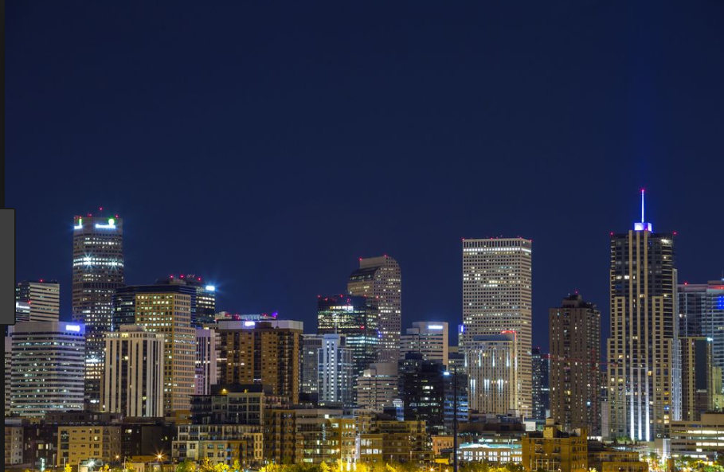



Ultra-peripheral Collisions at
Janet Seger (for the STAR Collaboration)
Creighton University
Apr. 10-12, 2019
Denver, CO

Slide 2

Ultra-peripheral Collisions
Large impact parameter(b > R₁ + R₂) → no nuclear overlap → no “collision” → electromagnetic interactions dominate
Relativistic heavy ions are intense source of quasi-real photons
  Q ~ 1/R ~ 0.06 GeV (Au) or 0.28 GeV (p)
  Photon flux ~ Z² from each nucleus
  Experimentally: very low multiplicity events with small momentum transfer, rapidity gaps
Photoproduction in γp and γA interactions
QED processes in γγ interactions
R₁
b > R₁ + R₂
R₂

Slide 3
Photoproduction of vector mesons
Has been extensively studied at HERA, RHIC, LHC
Factorize into
  photon emission
  interactions with nuclear target
Allows one to probe the nucleus via QCD to learn about shadowing, saturation effects, nPDFs

Slide 4
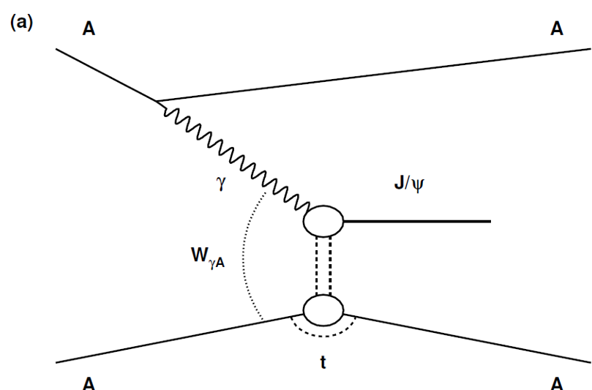
Photoproduction of vector mesons
Has been extensively studied at HERA, RHIC, LHC
Factorize into
  photon emission
  interactions with nuclear target
Allows one to probe the nucleus via QCD to learn about shadowing, saturation effects, nPDFs
Coherent interaction: Photon interacts with entire nucleus
  Nucleus generally remains intact
  Small momentum transfer: p_{T} ~ ħ/R_{A} ~ 15 MeV
  Max photon energy ~ γħ/R_{A} ~ 3 GeV at RHIC

Slide 5
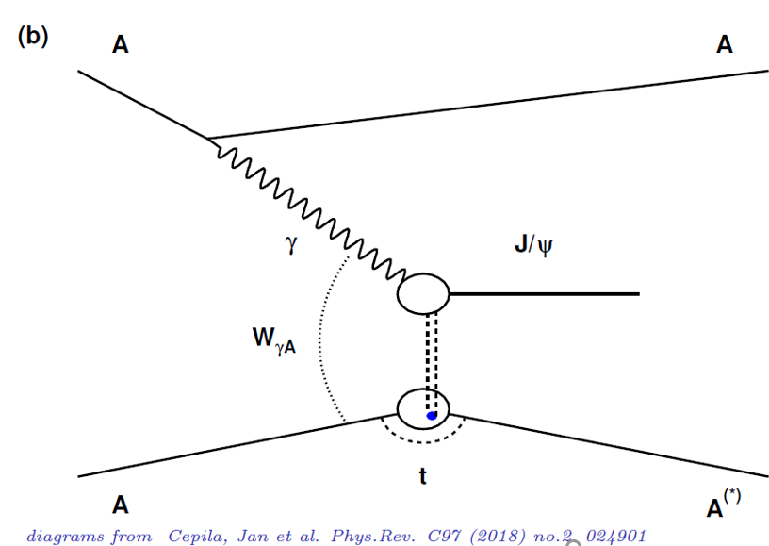
Photoproduction of vector mesons
Has been extensively studied at HERA, RHIC, LHC
Factorize into
  photon emission
  interactions with nuclear target
Allows one to probe the nucleus via QCD to learn about shadowing, saturation effects, nPDFs
Coherent interaction: Photon interacts with entire nucleus
  Nucleus generally remains intact
  Small momentum transfer: p_{T} ~ ħ/R_{A} ~ 15 MeV
  Max photon energy ~ γħ/R_{A} ~ 3 GeV at RHIC
Incoherent interaction: Photon can interact with individual nucleons
  Nucleus generally breaks
  Momentum transfer is bigger: p_{T} ~ ħ/R_{A} ~ 100 MeV
  Max photon energy ~ γħ/R_{A} ~ 20 GeV at RHIC
Diagrams from Cepila, Jan et al. , Phys. Rev. C97 (2018) no 2, 024901

Slide 6
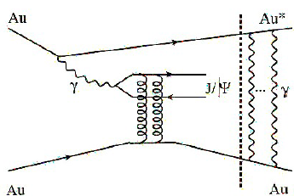
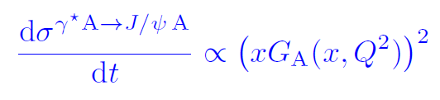
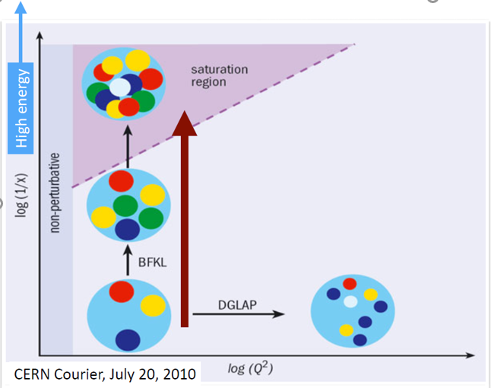
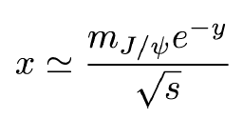

Heavy Vector Mesons: J/ψ
2-gluon exchange at the lowest order
Probe of gluon distribution function
For vector mesons:
Measurements at different rapidities sample different values of x

Slide 7
The STAR detector
Central tracking and particle identification, forward counters and neutron detection
Time Projection Chamber: tracking and identification in |η| <1
Time-Of-Flight: multiplicity trigger, identification and pile-up track removal
Barrel ElectroMagnetic Calorimeter: topology trigger and pile-up track removal
Beam-Beam Counters: scintillator counters in 2.1<|η|<5.2, forward veto
Zero Degree Calorimeters: detection of very forward neutrons, |η| > 6.6

Slide 8
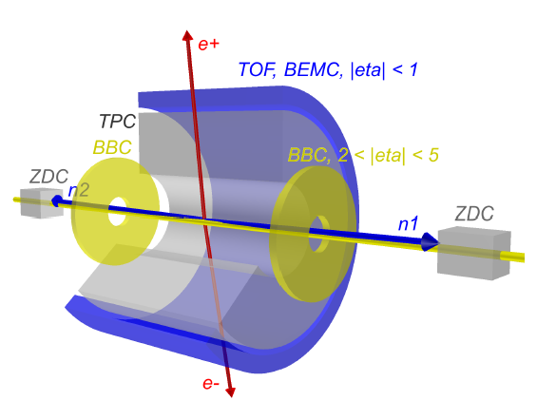
UPC trigger at STAR
Trigger requires:
Back-to-back hits in BEMC
Limited activity in TOF
Veto from both BBCs
Signal in both ZDCs (xnxn)
  Energy deposition within 1/4 to 4 beam-energy neutrons
  Full efficiency for single neutrons

Slide 9
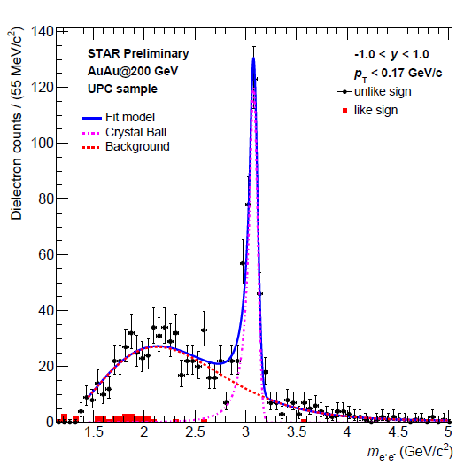

J/ψ candidates observed in e⁺e⁻ decay channel
200 GeV Au+Au data from 2014 run at STAR
Selection criteria:
Vertex with exactly two tracks of opposite sign
|y| < 1
p_{T} < 0.17 GeV/c
Like-sign background is minimal
Non-negligible background from e⁺e⁻ continuum is parametrized with empirical formula
  Effective convolution of γ γ → e⁺e⁻ cross section and detector effects

Slide 10
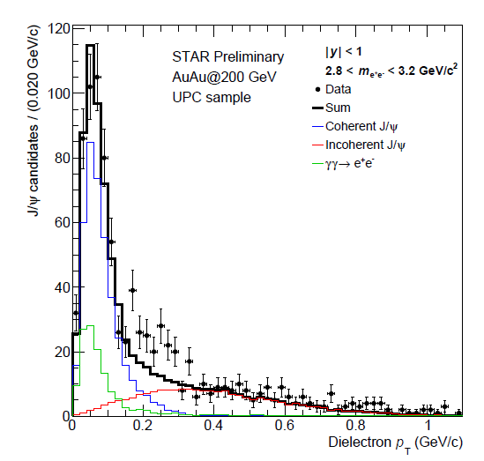
Transverse momentum of J/ψ candidates
Select candidates within J/ψ mass peak
Distribution is mostly well reproduced by the template from STARLIGHT for different contributions
  e⁺e⁻ normalized using mass fit
  Discrepancy in region 0.2 GeV/c < p_{T} < 0.4 GeV/c

Slide 11
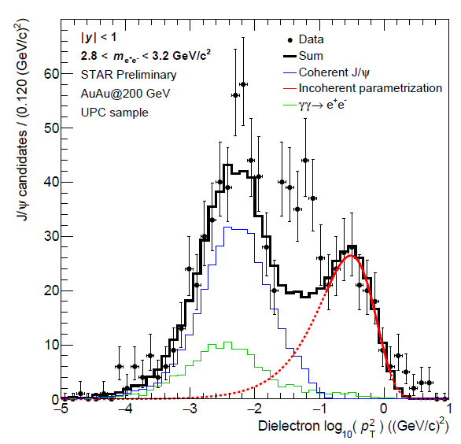

Separate incoherent from coherent
Plot as a function of log₁₀(p_{T}²)
Parametrize the incoherent contribution at high p_{T} (well above coherent peak)
Extrapolate to lower p_{T} and subtract to get coherent sample

Slide 12
Diffractive dip seen in coherent d²σ/dtdy
After subtraction of incoherent contribution
t≈ - p_{T}²
Model comparisons:
STARLIGHT: Klein, Nystrand, CPC 212 (2017) 258-268
  Vector meson dominance and
  Glauber approach
MS: Mäntysaari, Schenke, Phys.Lett. B772 (2017) 832-838
  Dipole approach with IPsat amplitude
  Scaled to XnXn using STARLIGHT
CCK: Cepila, Contreras, Krelina, Phys.Rev. C97 (2018) no.2, 024901
  Hot spot model for nucleons, dipole approach
  Scaled to XnXn using STARLIGHT

Slide 13
Diffractive dip seen in coherent dσ/dtdy
Slope below first diffractive minimum is consistent with the Glauber approach in STARLIGHT
After subtraction of incoherent contribution
t≈ - p_{T}²
Model comparisons:
STARLIGHT: Klein, Nystrand, CPC 212 (2017) 258-268
  Vector meson dominance and
  Glauber approach
MS: Mäntysaari, Schenke, Phys.Lett. B772 (2017) 832-838
  Dipole approach with IPsat amplitude
  Scaled to XnXn using STARLIGHT
CCK: Cepila, Contreras, Krelina, Phys.Rev. C97 (2018) no.2, 024901
  Hot spot model for nucleons, dipole approach
  Scaled to XnXn using STARLIGHT

Slide 14
Diffractive dip seen in coherent dσ/dtdy
Slope below first diffractive minimum is consistent with the Glauber approach in STARLIGHT
After subtraction of incoherent contribution
t≈ - p_{T}²
Model comparisons:
STARLIGHT: Klein, Nystrand, CPC 212 (2017) 258-268
  Vector meson dominance and
  Glauber approach
MS: Mäntysaari, Schenke, Phys.Lett. B772 (2017) 832-838
  Dipole approach with IPsat amplitude
  Scaled to XnXn using STARLIGHT
CCK: Cepila, Contreras, Krelina, Phys.Rev. C97 (2018) no.2, 024901
  Hot spot model for nucleons, dipole approach
  Scaled to XnXn using STARLIGHT
Diffractive dip around |t| ≈ 0.02 GeV² is correctly predicted by the dipole MS and CCK models

Slide 15
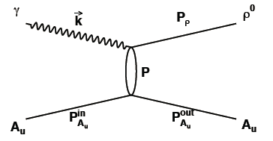
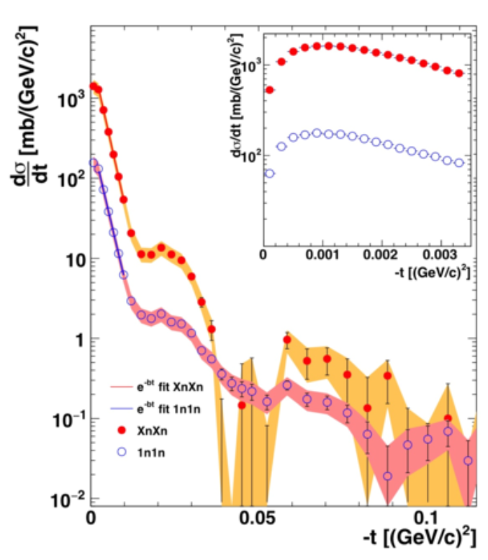
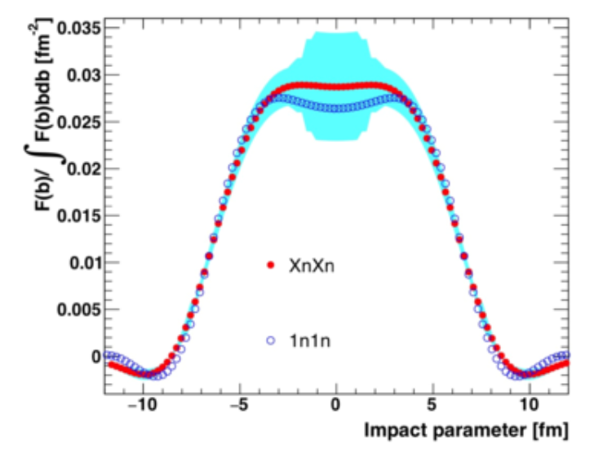

Coherent ρ photoproduction
High statistics 200 GeV Au+Au dataset
Like-sign background has been subtracted
Incoherent fit to dipole form factor at high t, extrapolated to lower t and subtracted to reveal coherent signal
Diffractive dips evident
Fourier-Bessel transform of dσ/dt gives nuclear density profile
$Au+Au→ρ+Au+Au+XnXn, \sqrt{s_{NN}}$=200 GeV
STAR: Phys. Rev. C 96 (2017) 54904

Slide 16

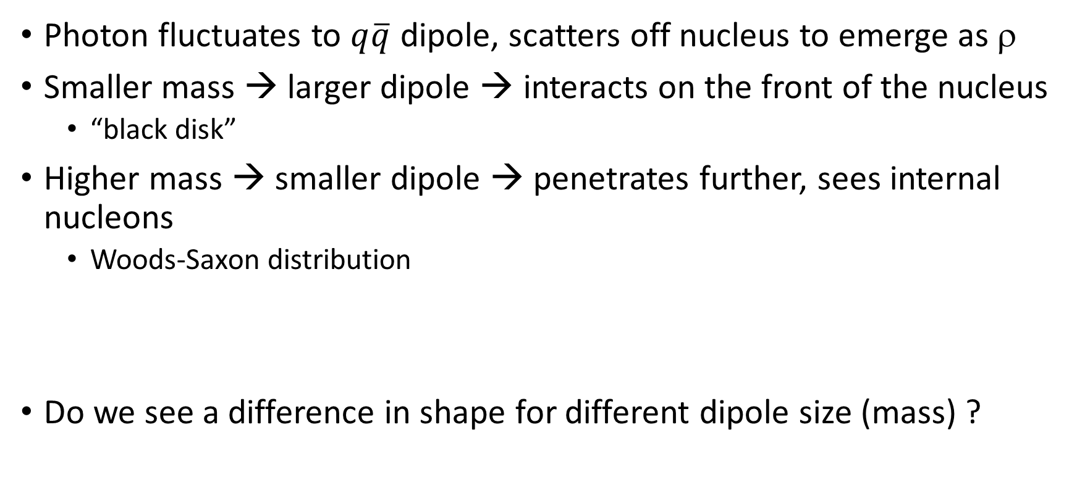
Shadowing changes effective shape of nucleus
Photon fluctuates to $q\overline{q}$ dipole, scatters off nucleus to emerge as ρ
Smaller mass → larger dipole → interacts on the front of the nucleus
  “black disk”
Higher mass → smaller dipole → penetrates further, sees internal nucleons
  Woods-Saxon distribution
Do we see a difference in shape for different dipole size (mass) ?

Slide 17
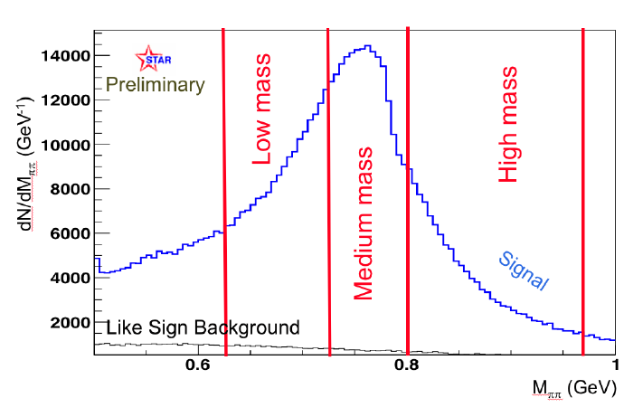
Data selection and mass binning
Exactly 2 tracks from a common vertex
|Z_{vtx}| < 50 cm
|y_{ππ}| > 0.04 (removes cosmic rays)
Each track has > 25 space points
0.62 GeV/c² < M_{ππ} < 0.95 GeV/c²
Divide into three mass bins of ~ equal statistic
$Au+Au→ρ+Au+Au+XnXn, \sqrt{s_{NN}}$=200 GeV
PoS(DIS2018)047

Slide 18
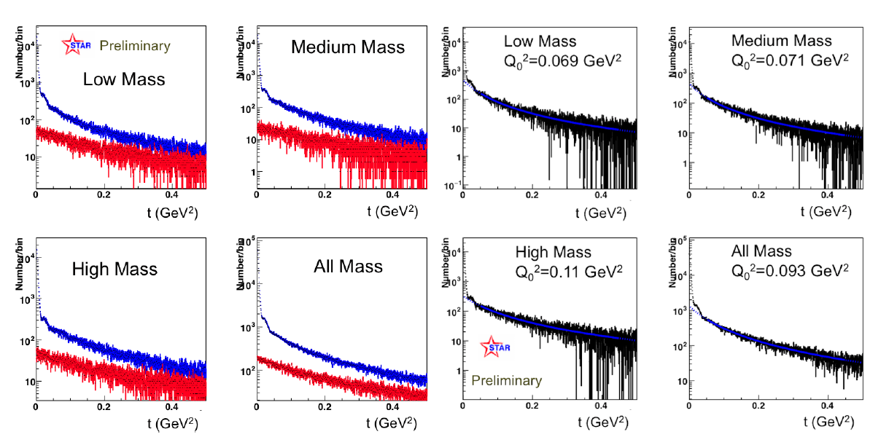
Subtract like-sign and incoherent backgrounds
Red: like-sign background
Blue: opposite sign pairs

Slide 19
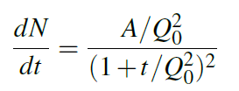
Subtract like-sign and incoherent backgrounds
Red: like-sign background
Blue: opposite sign pairs
After subtraction of like-sign background
Fit with dipole form factor
PoS(DIS2018)047

Slide 20
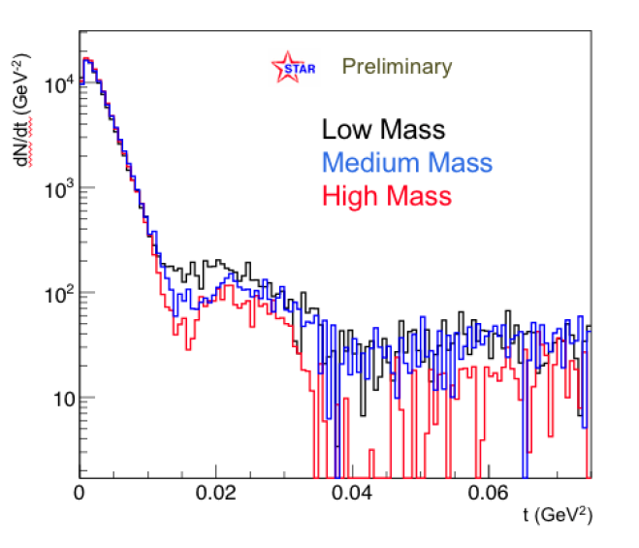
dσ/dt for Coherent ρ mesons
$Au+Au→ρ+Au+Au+XnXn, \sqrt{s_{NN}}$=200 GeV
After subtraction of incoherent contribution
Normalized to same number of events/M_{ππ} bin
Depth of diffractive dip varies with mass
PoS(DIS2018)047

Slide 21

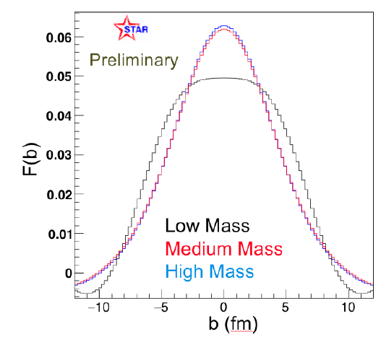
Transform to F(b)
$Au+Au→ρ+Au+Au+XnXn, \sqrt{s_{NN}}$=200 GeV
Use t_{max} = 0.006 GeV² for baseline
  Below first dip
  Vary as systematic
If saturation is present, the profile will broaden, since absorption in the center cannot increase above one
  In the black disk limit, F(b) would be constant
  Expect lower-mass to be broader, flatter
PoS(DIS2018)047

Slide 22
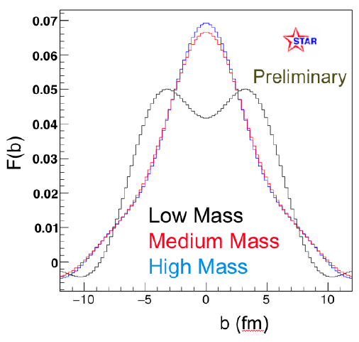
Windowing effect from choosing t_{max}
PoS(DIS2018)047
PoS(DIS2018)047
Choice of t_{max} affects the shape, particularly at b = 0 fm
Does not change the general trend that lower-mass → wider distribution

Slide 23
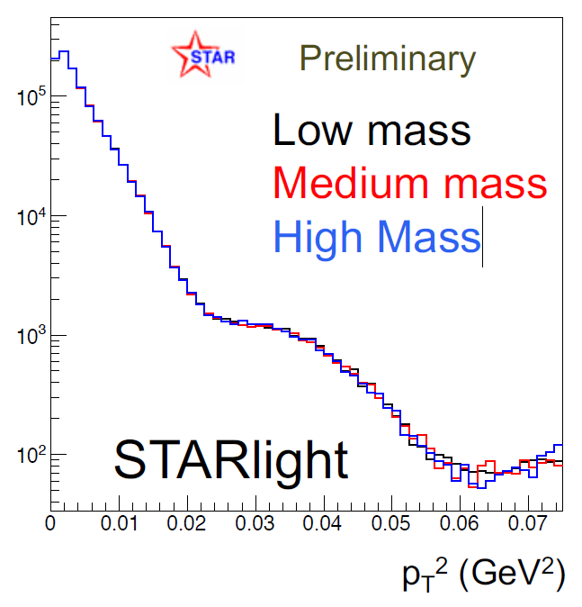
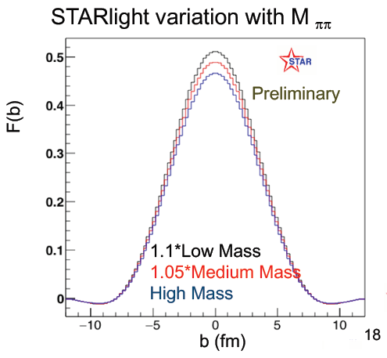
STARLIGHT, for comparison
No shadowing effects included
STARLIGHT variation with M_{ππ}
STARLIGHT

Slide 24
Conclusions
STAR has a high statistics sample of coherently produced ρ mesons
  Allows clear observation of diffractive dips
  Shape of dσ/dt sensitive to distribution of interaction sites
  M_{ππ} serves as a proxy for dipole size
  Pilot study shows shape difference with mass (dipole size)
    Systematic effects due to choice of t_{max}
Diffractive structure also seen in lower-statistics sample of coherently produced J/ψ
  Location of diffractive dip in dσ/dt consistent with dipole models
  Slope of dσ/dt at low t reproduced by Glauber model

