Slide 1
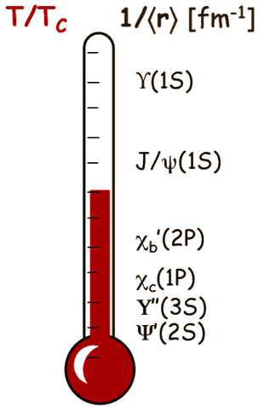
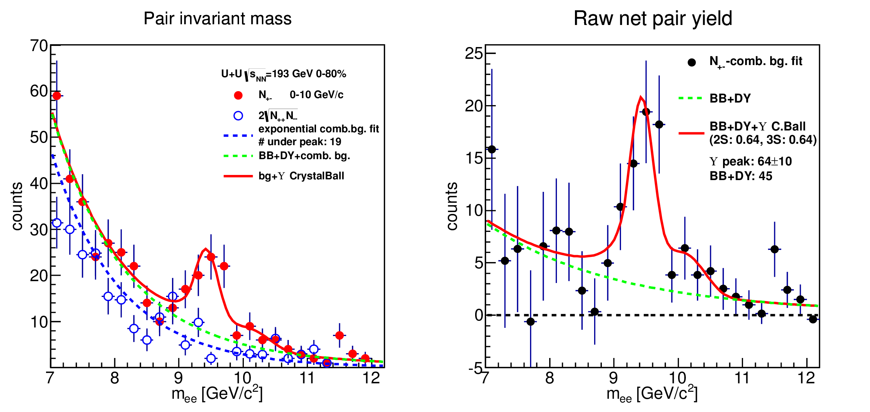
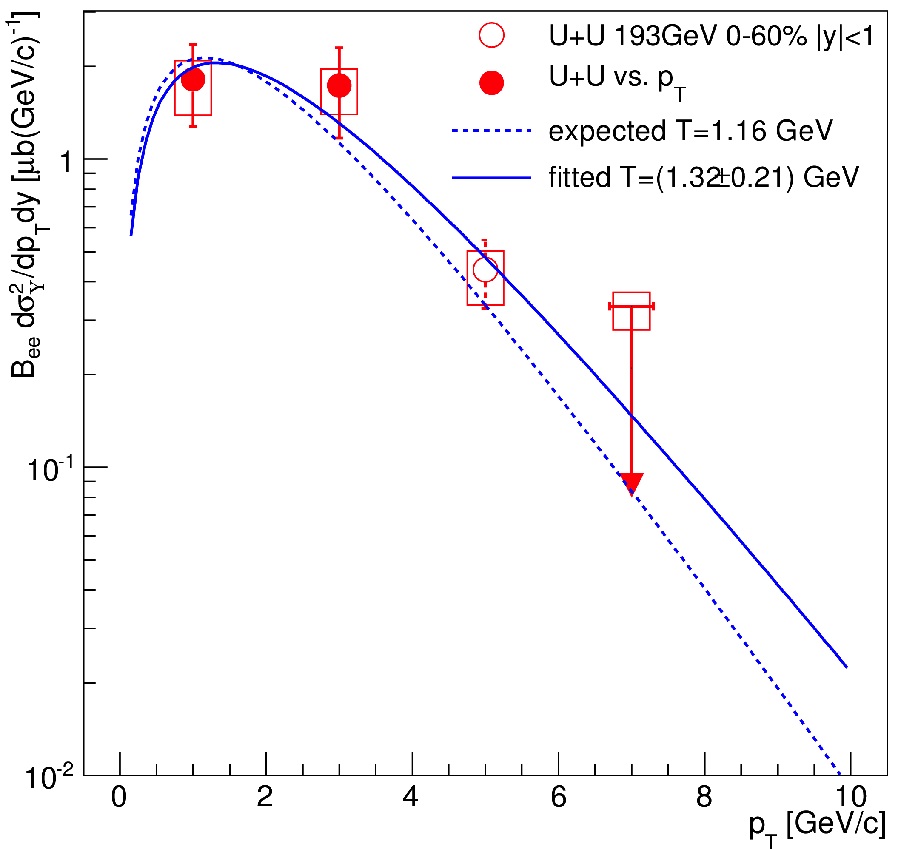
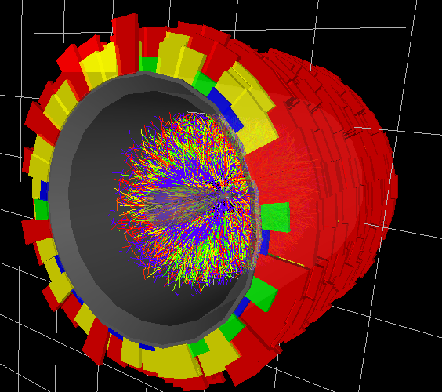
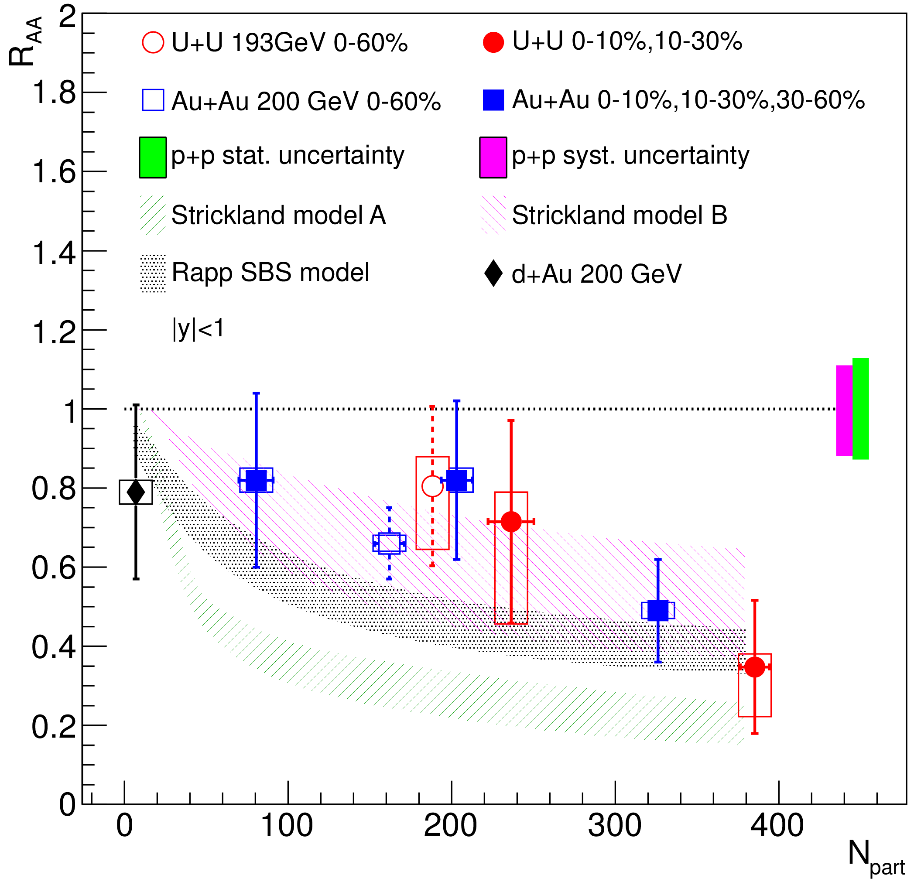
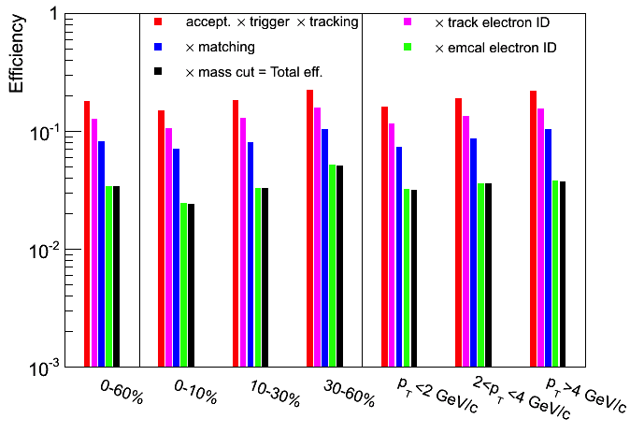
ϒ production in U+U collisions at the STAR experiment
Róbert Vértesi for the STAR collaboration
Motivation
Upsilon yield
Quarkonium as an sQGP thermometer
Due to Debye-screening, Quarkonium states are expected to dissociate at different temperatures in the sQGP, providing a “thermometer” for the medium [1].
J/ψ suppression was suggested to be a smoking gun signature for QGP [2]. However, effects such as quark pair recombination (in the plasma) and feed-down, co-mover absorption (in the hadronic phase) complicate the interpretation of J/ψ measurements
Peak extraction
Because of scarcity of statistics, the peak parameters are fixed from embedded MC. The relative suppression of the excited states is taken from the 0-60% centrality data. This decreases random fluctuation, but shows up in the systematics.
Spectrum and x-section
Combinatorial background: double exponential fit on like-sign e⁺/e⁻ pairs
Peak fit is sum of 3 Crystall Ball functions (for 1S, 2S, 3S)
STAR preliminary
STAR preliminary
Sub-tract
64±15
Upsilons in RHIC: a cleaner probe
Recombination and co-mover absorption are negligible at RHIC energies.
Central 193 GeV U+U collisions provide the highest energy density at RHIC, where the strongest suppression of ϒ states are expected.
Models with different formalisms and assumptions, however, give different predictions. Two popular examples are Refs. [3,4]. Precise data are needed to constrain the models.
BB and DY fitted together with peak
ϒ cross section (STAR preliminary)
U+U 193 GeV, 0-60% centrality stat. syst
Measurement
Major systematic uncertainties (%) (STAR preliminary)
Geometrical acceptance | +1.7 -3.0
Trigger efficiency | +1.1 -3.6
Tracking efficiency | 11.8
TPC electron identification | +4.0 -6.4
TPC-BEMC matching | 5.4
BEMC electron identification | 5.9
Embedding p_{T} and y shapes | 2.1
Signal extraction | +4.8 -18
Experiment: Solenoidal Tracker at RHIC
Reconstruction in the the dielectron channel ϒ→e⁺e⁻ (BR~2%) at mid-rapidity (|y|<1.0), in 3 centrality and p_{T} bins.
The Upsilon is not abundant: identification and background rejection is a challenge.
15M events (263 μb⁻¹ integrated luminosity) processed; 2296 e⁺e⁻ pairs with a reconstructed invariant mass m_{ee}>5 GeV remain after selection. Most of them are background from several sources: combinatorial pairs (random correlation), Drell-Yan (DY) electrons, pairs from open bb production (BB).
STAR preliminary
1. Trigger on energetic clusters in the Barrel Electromagnetic Calorimeter (BEMC)
Fit function is .
The expected value for T is extrapolated from ISR, CDF and CMS measurements
2. Time Projection Chamber (TPC):
Find electron tracks based on energy loss dE/dx: -1.2<nσ_{e}<3
Nuclear modification factor
4. ID cuts in the BEMC:
Energy matches momentum (0.75<E/p<1.4)
Energy deposit is compact, mostly in a single tower (E/Etower>0.7)
Nuclear modification factor (R_{AA}) compares the corrected yield in A+A collisions to that in p+p, scaled by the number of binary collisions.
3. Match clusters and tracks
Yield in current measurement
Acceptance x
Efficiency
_
from the Glauber model
Reference yield
Acceptance and efficiency
Geometrical acceptance, trigger, tracking, matching and cluster compactness cut efficiencies are from embedded simulation.
E/p and dE/dx efficiencies are calculated using single identified electron samples.
Around 2-3% of the ϒ are reconstructed.
STAR preliminary
STAR preliminary
Conclusion
As expected, data trend towards stronger suppression of ϒ(1S+2S+3S) with higher number of participants This indicates an increased dissociation of the ϒ states with energy density Potential model ‘A’ of Ref. [3], based on heavy quark free energy, is disfavored
Nuclear Physics Institute
Academy of Sciences of the Czech Republic
The work has been supported by the grant 13-02841S of the Czech Science Foundation (GACR). The work has been supported by the MSMT grant CZ.1.07/2.3.00/20.0207 of the European Social Fund (ESF) in the Czech Republic: “Education for Competitiveness Operational Programme” (ECOP).
References: [1] Á. Mócsy, P. Petreczky, Phys. Rev. D77, 014501 (2008)
[2] T. Matsui, H. Satz, Phys.Lett. B178, 416 (1986)
[3] M. Strickland, D. Bazow, Nucl.Phys. A879, 25 (2012)
[4] A. Emerick, X. Zhao, R. Rapp, Eur.Phys.J A48, 72 (2012)
Notes:
Submitted abstract:
Upsilon production in U+U collisions at the STAR experiment
Due to color screening, the production of quarkonia in high energy heavy ion collisions is expected to be sensitive to the energy density of the medium. Sequential suppression of different quarkonium states may therefore serve as a thermometer of the medium. Although the suppression of charmonia was anticipated as a key signature of the QGP, the observed energy dependence of $J/\psi$ suppression is rather weak. This phenomenon is explained by the recombination (coalescence) of $c\bar{c}$ pairs. Bottomonia, on the other hand, are less affected by recombination and can provide a cleaner probe of the strongly interacting medium. Recent STAR results show that in $\sqrt{s_{NN}}=200$ GeV central Au+Au collisions the Upsilon 1S state is suppressed more than if only cold nuclear matter effects were present, and the excited state yields are consistent with a complete suppression.
The energy density in U+U $\sqrt{s_{NN}}=193$ GeV central collisions is estimated to be about 20% higher than that of $\sqrt{s_{NN}}=200$ GeV central Au+Au. Therefore U+U collisions provide a further test of the sequential suppression hypothesis. The STAR detector collected a total of 17.2 million high-tower triggered events in $\sqrt{s_{NN}}=193$ GeV U+U collisions in the year 2012, corresponding to an integrated luminosity of 263.4 $\mu b^{-1}$. Upsilon yields at mid-rapidity, measured in central and mid-central collisions through the dielectron channel, as well as the nuclear modification factor with respect to the number of participants, will be reported in this presentation.

