Slide 1


ϒ results from STAR
5th International Workshop on
Heavy Quark Production in
Heavy Ion Collisions
Utrecht University, The Netherlands
14/Nov/2012
Manuel Calderón de la Barca Sánchez

Slide 2
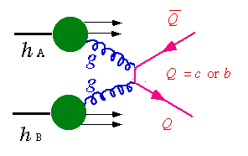

Outline
Studying bottmonium in hot/cold QGP medium.
Triggering on ϒ production in STAR
Baseline measurement: ϒ cross section in pp collisions.
ϒ and CNM effects: towards a d+Au
ϒ in hot nuclear matter: ϒ Nuclear modification factor in AuAu
Conclusions
e⁻/μ⁻
e⁺/μ⁺
ϒ
T=0
0<T<T_{C}
T_{C}<T

Slide 3
Bottomonium suppression in a hot medium
Expectation: suppression due to hot nuclear effects.
  Color screening (Re V), Landau damping (Im V).
Recent news: Heavy quark potential from (quenched) Lattice QCD
  A.Rothkopf, et al. PRL 108 (2012) 162001
  Broadening due to collisions with medium (Im V) possibly more important than screening (Re V).

Slide 4
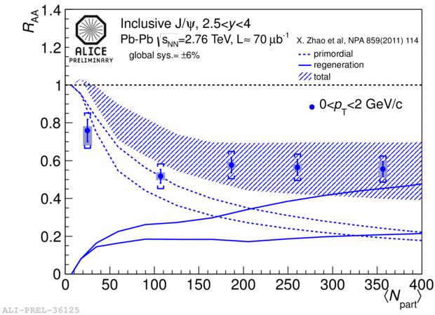
ϒ : A cleaner probe of the QGP
Recombination effects
  J/ψ : Evidence for large effects.
  ϒ: Expect negligible contribution.
      σ_{cc} @ RHIC: 797 ± 210 ⁺²⁰⁸₋₂₉₅ μb. (arXiv:1204.4244)
      σ_{bb} @ RHIC: ~ 1.34 – 1.84 μb (PRD 83 (2011) 052006)
Co-mover absorption effects
  ϒ(1S) : tightly bound, larger kinematic threshold.
    Expect σ ~ 0.2 mb, 5-10 times smaller than for J/y
      Lin & Ko, PLB 503 (2001) 104

Slide 5
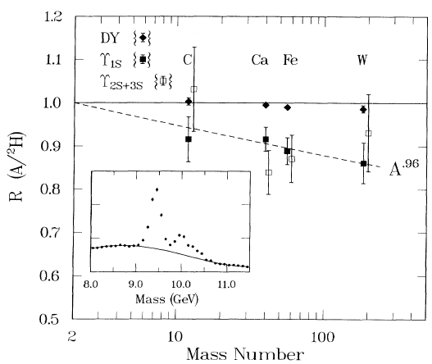
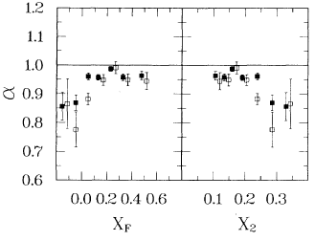
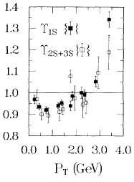
Cold Nuclear Matter Effects
J/ψ CNM effects at RHIC:
  Can be as large as ~0.6 depending on kinematic region.
    Shadowing, nuclear absorption, Cronin can all play role.
ϒ : CNM effects established by E776 (√s=38.8 GeV):
  Magnitude and A dep: ϒ(1S)=ϒ(2S+3S). α can be as low as ~ 0.8.

Slide 6
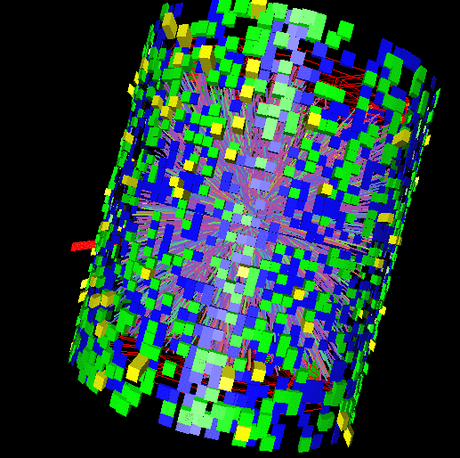
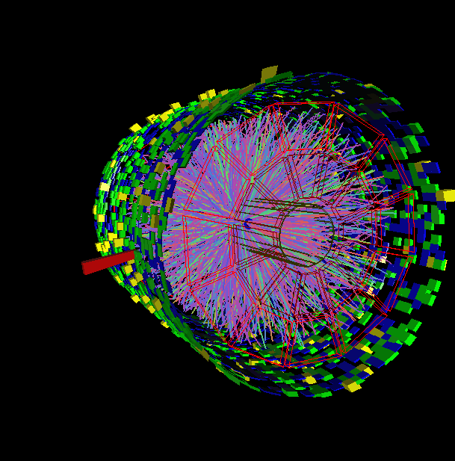
Upsilons in STAR
Upsilons via Triggering, Calorimetry, Tracking, and matching of tracks to calorimeter towers.

Slide 7
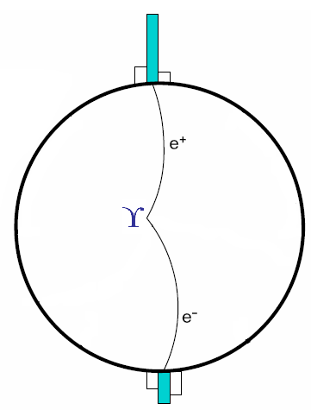
Triggering on ϒ decays
Level 0 Trigger (p+p,d+Au,Au+Au):
Hardware-based
Fires on at least one high tower
Level 2 Trigger (p+p,d+Au):
Software-based
Calculates:
  Cluster energies
  Opening angle
  Mass
High rejection rate allowed us to sample entire luminosity

Slide 8
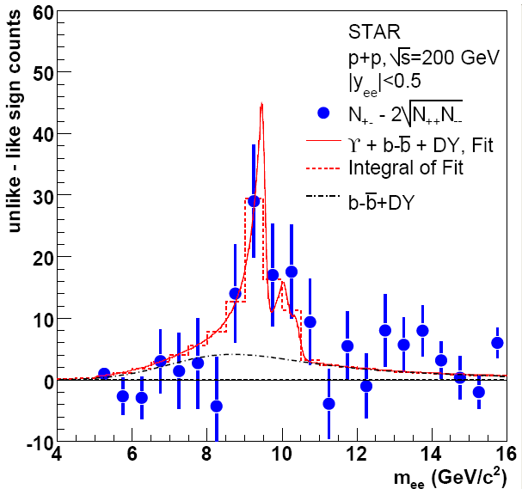
ϒ in p+p 200 GeV in STAR
2006
2009
Phys. Rev. D 82 (2010) 12004
∫L dt = 7.9 ± 0.6 pb⁻¹
N_{ϒ}(total)= 67±22(stat.)
∫L dt = 19.7 pb⁻¹
N_{ϒ}(total)= 145±26(stat.)
STAR Preliminary

Slide 9
ϒ Comparison to NLO pQCD
CEM: R. Vogt, Phys. Rep. 462125, 2008
CSM: J.P. Lansberg and S. Brodsky, PRD 81, 051502, 2010
Comparison to NLO
STAR √s=200 GeV p+p ϒ+ϒ′+ϒ″→e⁺e⁻ cross section consistent with pQCD Color Evaporation Model (CEM)

Slide 10
ϒ vs √s, World Data
STAR Preliminary
STAR √s=200 GeV and CMS √s=7 TeV p+p
ϒ+ϒ′+ϒ″→e⁺e⁻ cross section consistent with pQCD and world data trend

Slide 11
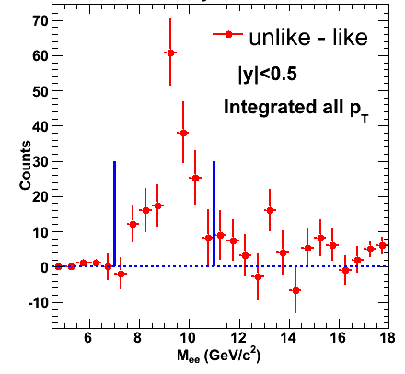
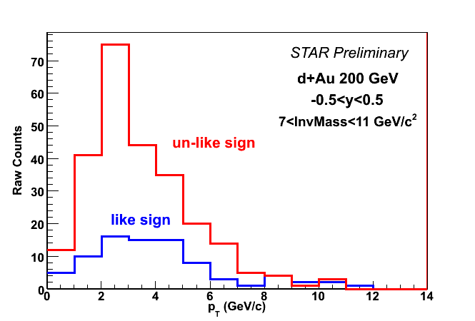
ϒ in d+Au 200 GeV
STAR Preliminary
Signal has ~8σ significance
p_{T} reaches ~ 5 GeV/c
∫L dt = 32.6 nb⁻¹
N_{ϒ+DY+bb}(total)= 172 ± 20(stat.)

Slide 12
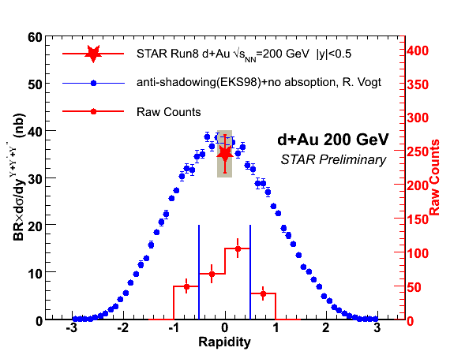
ϒ in d+Au 200 GeV, Comparison
σ_{dAu} = 2.2 b σ_{pp} = 42 mb
N_{bin} = 7.5 ± 0.4 for minbias dAu
R_{dAu} = 0.78 ± 0.28 ± 0.20
Note: Includes DY and bb
STAR √s=200 GeV d+Au ϒ+ϒ′+ϒ″→e⁺e⁻ cross section consistent with pQCD

Slide 13
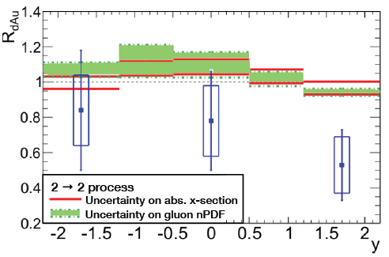
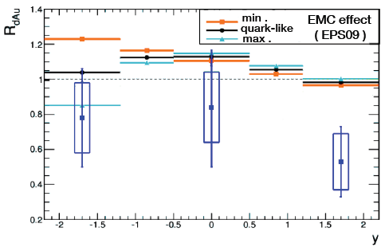
dAu Comparison to models
Shadowing/Antishadowing of gluon nPDF
Absorption cross section
EMC effect
  All expect slight enhancement at mid-rapidity.
  Data indicate suppression in CNM beyond these effects.
  Note that preliminary STAR dAu result includes DY contribution
    Final results from STAR coming soon.
A. Rakotozafindrabe, et al.
arXiv:1207.3193

Slide 14
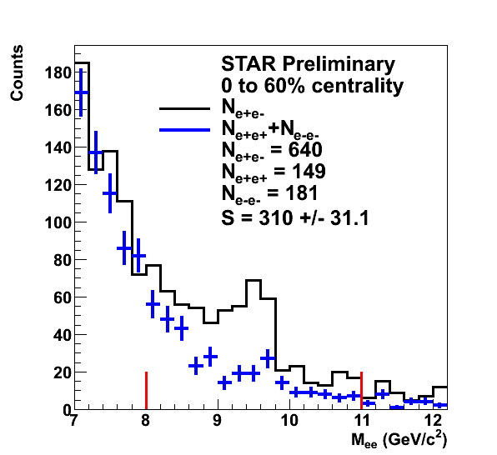
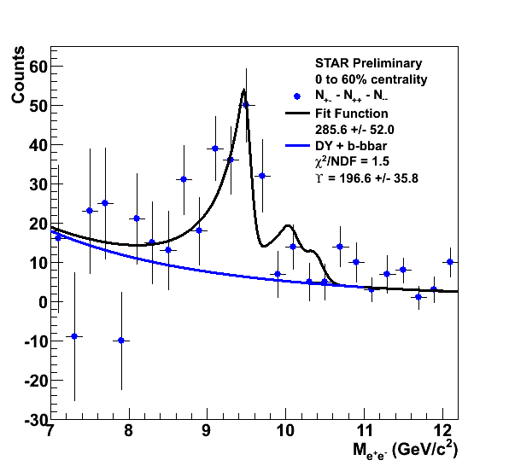
ϒ in Au+Au 200 GeV
Raw yield of ○→e⁺e⁻ with |y|<0.5 = 197 ± 36
∫L dt ≈ 1400 µb⁻¹

Slide 15
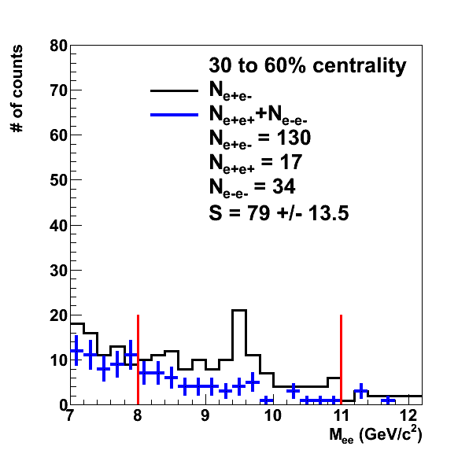
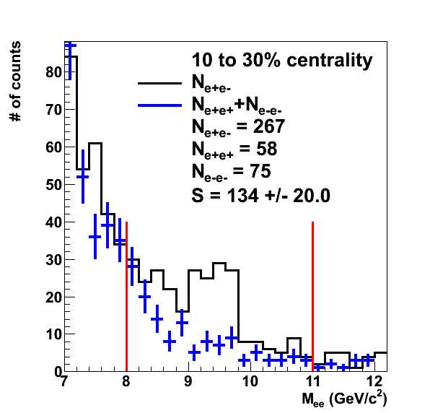
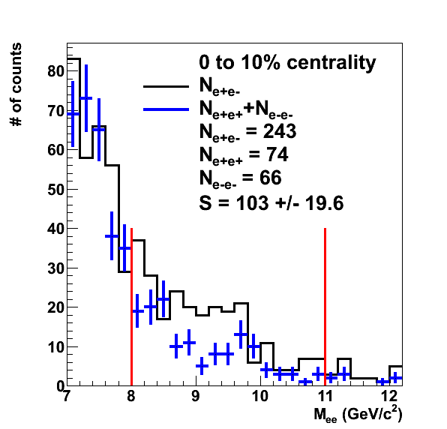
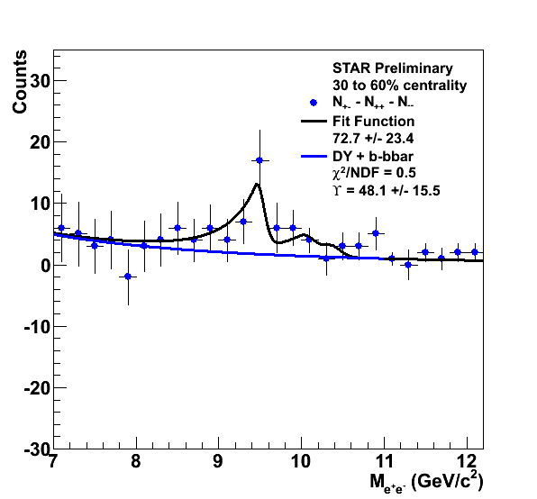
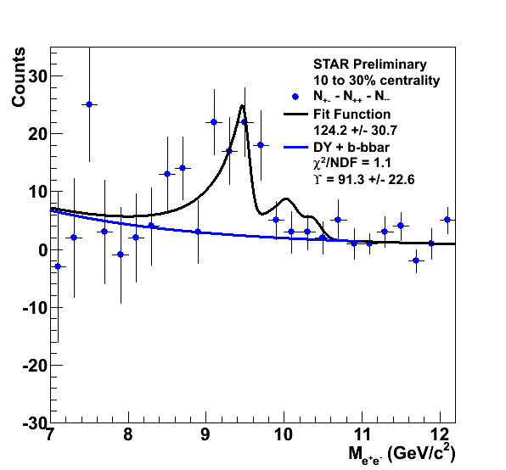
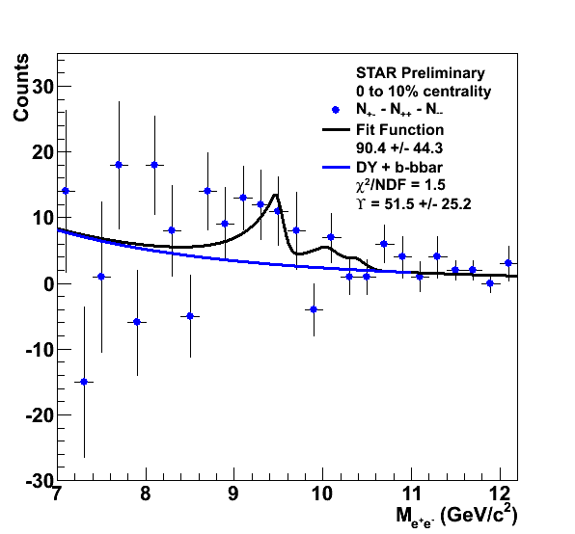
ϒ in Au+Au 200 GeV, Centrality
STAR Preliminary
STAR Preliminary
STAR Preliminary
Peripheral
Central

Slide 16
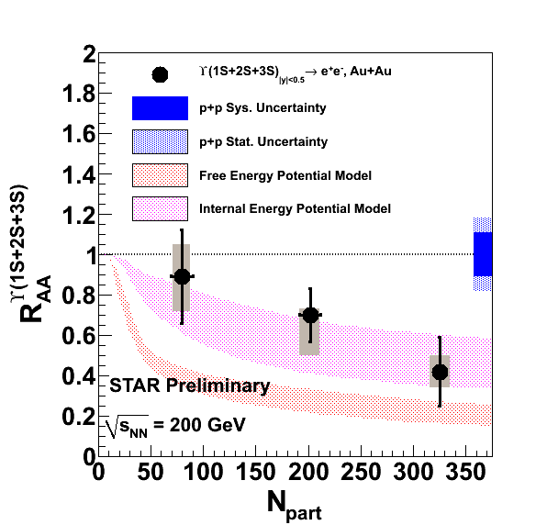
ϒ in Au+Au 200 GeV, R_{AA}
Models from M. Strickland and D. Bazow, arXiv:1112.2761v4
Indications of Suppression of Upsilon(1S+2S+3S) getting stronger with centrality.
Reduced pp statistical uncertainties, increased statistics from 2009 data vs 2006 data.

Slide 17
ϒ R_{AA} Comparison to models I
Incorporating lattice-based potentials, including real and imaginary parts
  A: Free energy
    Disfavored.
  B: Internal energy
    Consistent with data vs. N_{part}
Includes sequential melting and feed-down contributions
  ~50% feed-down from χ_{b}.
Dynamical expansion, variations in initial conditions (T₀, η/S)
  Data indicate:
    428 < T₀ < 442 MeV at RHIC
    for 3 > 4πη/S > 1
M. Strickland,
PRL 107, 132301 (2011).

Slide 18
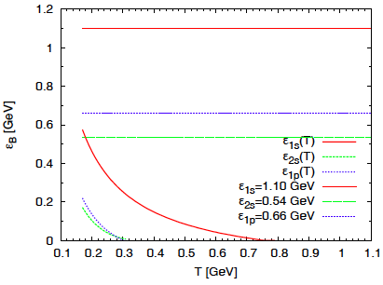
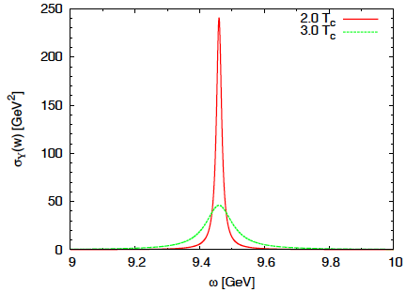
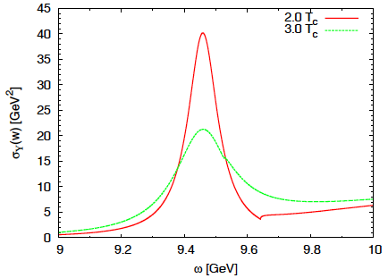
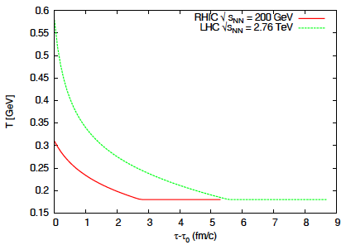
ϒ R_{AA} Comparison to models II
Strong
Binding
Weak
Binding
Weak vs. Strong Binding
  Narrower spectral functions for “Strong” case
  Ratios of correlators compared to Lattice: favor “Strong” binding case
Kinetic Theory Model
  Rate Equation: dissociation + regeneration
  Fireball model: T evolution. T ~ 300 MeV
Emerick, Zhao & Rapp.
EPJ A (2012) 48:72

Slide 19
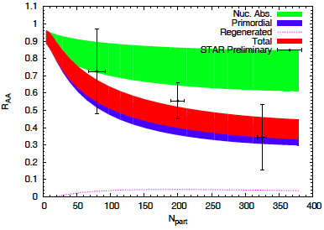
ϒ R_{AA} Comparison to models II
Comparison to data for “Strong” binding:
  Mostly consistent with data
  Little regeneration: Final result ~ Primordial suppression
  Large uncertainty in nuclear absorption. Need dAu, pPb.
  T ≈ 300 MeV
    Would like to see sensitivity to initial temperature.
Emerick, Zhao & Rapp.
EPJ A (2012) 48:72
Both models:
  Connections to Lattice QCD (Deconfinement)
    Potential Models or Spectral functions.
  Dynamical evolution (hydro or kinetic theory).
  Include feed-down contributions.

Slide 20
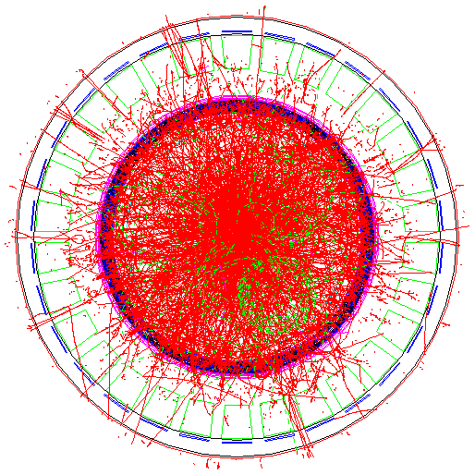
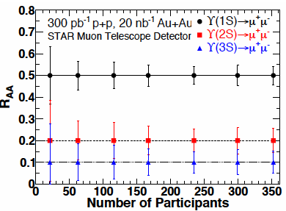
Future: ϒ via STAR MTD
MTD (MRPC)
A detector with long-MRPCs
  Covers the whole iron bars and leave the gaps in between uncovered.
  Acceptance: 45% at ||<0.5
  118 modules, 1416 readout strips, 2832 readout channels
Long-MRPC detector technology, electronics same as used in STAR-TOF
Run 2012 -- 10%; 2013 – 43%+; 2014 – 100%: ϒ via μ+μ-

Slide 21
Conclusions
Measured ϒ production in p+p, d+Au, and
Au+Au collisions at 200 GeV
Increased statistics from run 9 will refine our p+p measurements
Production in d+Au : important to investigate.
  Models: Information on nPDF (anti-shadowing), hadronic σ, EMC.
  Indications of suppression. Final results coming soon.
ϒ suppression vs. N_{part}.
  R_{AA} consistent with suppression of feed down from excited states only (~50%).

Slide 22
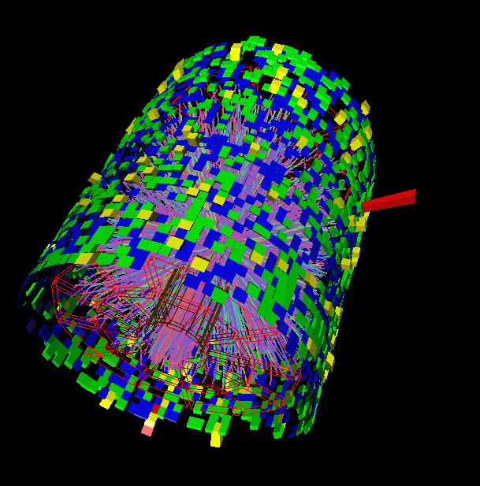
Thank you

