Slide 1
Open heavy flavor in STAR
STAR
David Tlusty
NPI ASCR, CTU Prague
for the STAR collaboration

Slide 2
Outline
Motivation
Analysis methods, Detector Setup and Particle Identification (PID)
D⁰ and D* in p+p 200 GeV collisions
D⁰ in Au+Au 200 GeV collisions
Non Photonic Electrons in p+p 200 GeV collisions
analysis status on D⁰ and D* in p+p 500 GeV collisions
Summary

Slide 3
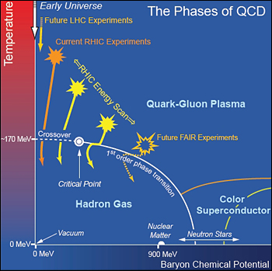
QCD phase diagram and RHIC
What were early stages of the Universe
What are properties of strong interaction
Search for and characterize the new state of matter – Quark Gluon Plasma
RHIC is an intersecting storage ring and particle accelerator
Two independent rings each 3.834 km circumference
Can collide any nuclear species on any other.
Max Energy:

Slide 4
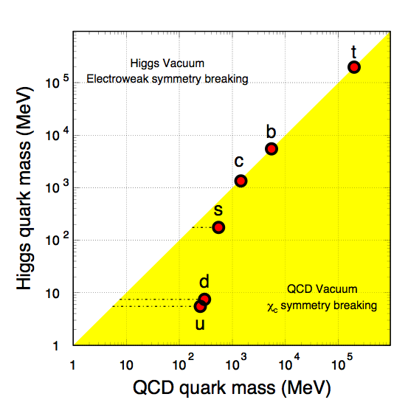
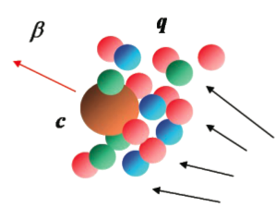
Why to study heavy quarks
X. Zhu, et al, PLB 647, 366(2007)
Mass is believed to be external to QCD (=> stay heavy even in QGP)
Produced in initial hard partonic collisions – following number-of-binary-collisions scaling
Sensitive to initial gluon density and gluon distribution. Due to it’s large mass a good pQCD test at RHIC collision energies.
Couple differently with the medium than light quarks. Reveal critical features of the medium
Spectra could be significantly modified but still would retain memory about their interaction history

Slide 5
How to measure charm quarks
Indirect measurements through decay Leptons
can be triggered easily (high p_{T})
Higher B.R.
Indirect access to the heavy quark kinematics
mixing contribution from all charm and bottom hadron decays
Direct reconstruction
direct access to heavy quark kinematics
hard to trigger (high energy trigger only for correlation measurements)
smaller Branching Ratio (B.R.)
large combinatorial background (need handle on decay vertex)

Slide 6
The STAR detector
VPD: minimum bias trigger
TPC: PID, tracking
TOF: PID (β, time resolution = 110 ps)
BEMC: remove pile-up tracks, Energy triggers, E/p
BSMD: EM shower shape
Year 2009 72% of full TOF
Year 2010/2011 100% of full TOF

Slide 7
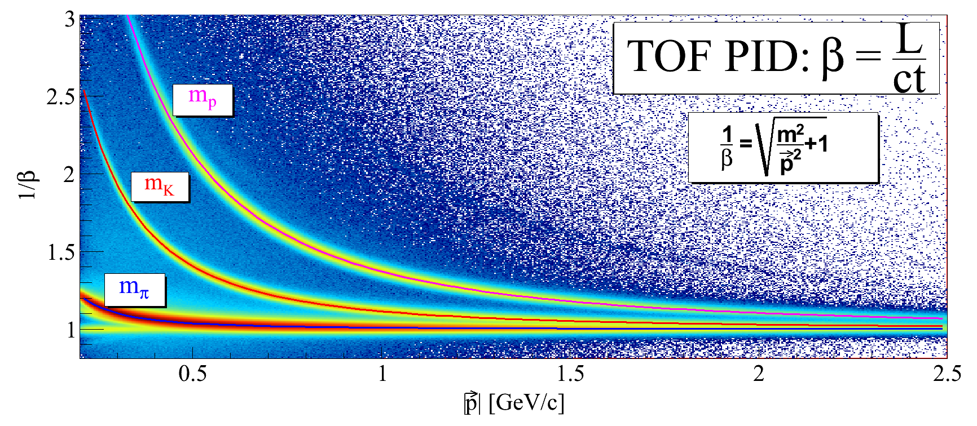
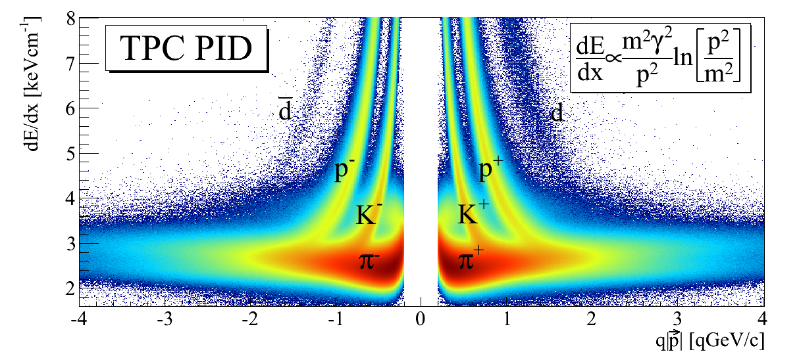
Hadron Identification
STAR preliminary
Kaons: TOF only
Pions: TOF if available, otherwise TPC dE/dx with matching to BEMC required to remove pile-up tracks
STAR preliminary
STAR preliminary
|nσ_{π}|<2
|nσ_{π}|<2

Slide 8
Electron Identification: shower profile
Electron showers are widely developed, firing several BSMD strips.
Hadron showers are much less developed, firing mostly one or zero strip.

Slide 9
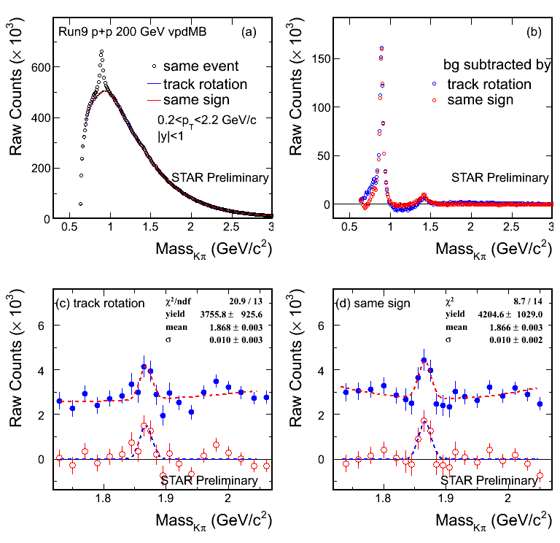
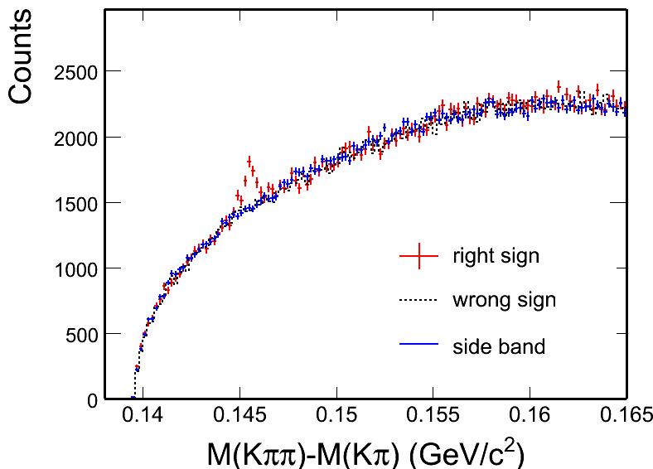
D⁰ and D* signal in p+p 200 GeV
K*⁰
K*⁰
K*⁰
K₂*
K₂*(1430)
STAR Preliminary
D⁰
D⁰
D⁰ mass window zoom
D⁰ mass window zoom
p+p minimum bias 105 M
Different methods reproduce combinatorial background.
Consistent results from two background methods.
D⁰
D⁰

Slide 10
D⁰ and D* p_{T} spectra in p+p 200 GeV
STAR preliminary
D⁰ scaled by N_{D0}/N_{cc}= 0.56^{[1]}
D* scaled by N_{D*}/N_{cc}= 0.22^{[1]}
Consistent with FONLL^{[2]} upper limit.
Xsec = dN/dy|^{cc}_{y=0} * F * σ_{pp}
F = 4.7 ± 0.7 scale to full rapidity.
σ_{pp}(NSD) = 30 mb
The charm cross section at mid-rapidity is:
202 ± 56 (stat.) ± 40 (sys.) ± 20 (norm.) μb
The charm total cross section is extracted as:949 ± 263 (stat.) ± 253 (sys.) μb
[1] C. Amsler et al. (Particle Data Group), PLB 667 (2008) 1.
[2] Fixed-Order Next-to-Leading Logarithm: M. Cacciari, PRL 95 (2005) 122001.

Slide 11
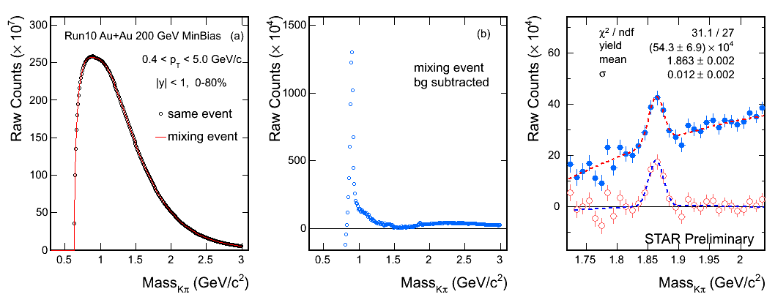
D⁰ signal in Au+Au 200 GeV
STAR Preliminary
K*⁰
STAR Preliminary
D⁰
Minimum bias 0-80% 280M Au+Au 200 GeV events.
S/√(S+B) = 8
Mass = 1863 ± 2 MeV (PDG value is 1864.5 ± 0.4 MeV)
Width = 12 ± 2 MeV

Slide 12
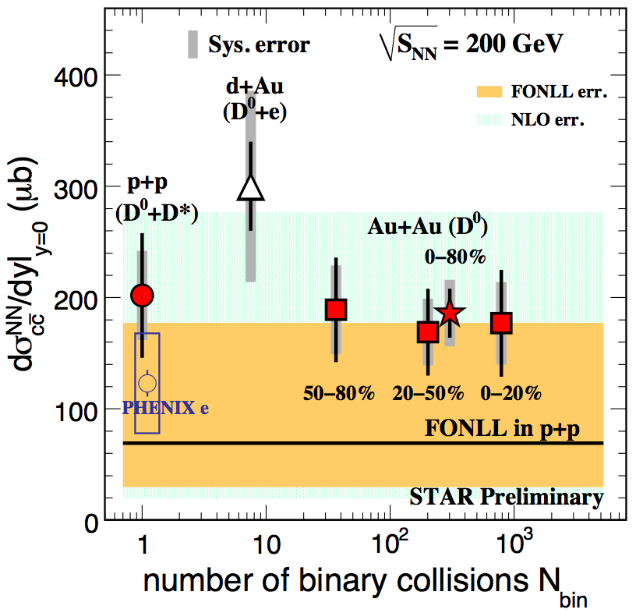
Number-of-binary-collisions scaling
[1] FONLL: M. Cacciari, PRL 95 (2005) 122001.
[2] NLO: R. Vogt, Eur.Phys.J.ST 155 (2008) 213
[3] PHENIX e: A. Adare, et al., PRL 97 (2006) 252002.
Measurements from
Year 2009 p+p : D⁰ + D*
Year 2010 Au+Au: D⁰
are consistent
Charm cross section in Au+Au 200 GeV is estimated from D0 cross section, scaled by 1/0.56, the same fragmentation ratio as pp. Results:
Mid-rapidity:
186 ± 22 (stat.) ± 30 (sys.) ± 18 (norm.) μb
Total cross section:
876 ± 103 (stat.) ± 211 (sys.) μb
Charm cross section follows number of binary collisions scaling =>
Charm quark produced at early stage of collisions.

Slide 13
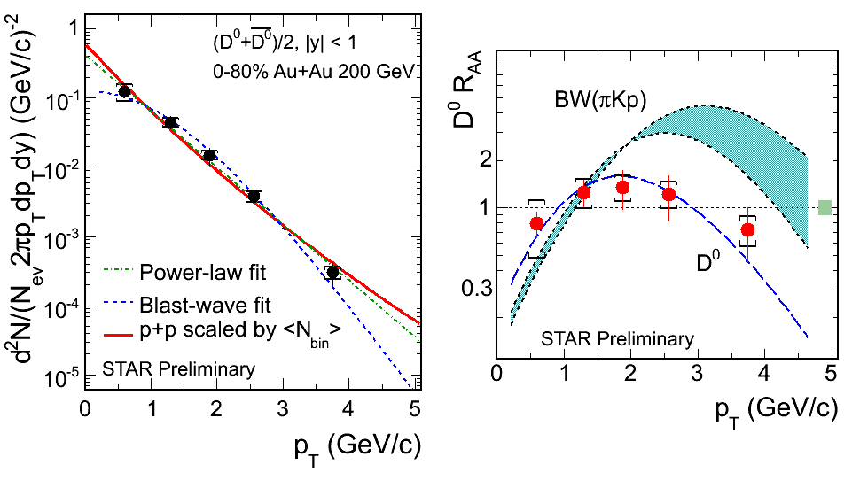
D⁰ R_{AA} vs p_{T}
BW(πKp): B. I. Abelev et al., PRC79 (2009) 34909.
D⁰ Au+Au 0-80% divided by p+p with <Nbin> scaled.
Below 3 GeV/c, R_{AA} consistent with unity. Consistent with D⁰ yield N_{bin} scaling behavior.
Blast-wave predictions with light hadron parameters are different from data
=> D⁰ freeze-out earlier than light hadrons?

Slide 14
Non Photonic Electrons (NPE) measurement
Background Dominated by Photonic Electrons from :
Doesn’t depend on detector material budget
BR: 1.2%.
BR: 0.7%.
Depends on detector material budget
Mostly from
Conversion probability: 7/9* X₀
When material budget is large, gamma conversion dominate all the background.

Slide 15
NPE analysis method in p+p 200 GeV
Reconstruction method:
p_{T}(partner)>0.3GeV/c
STAR Phys. Rev. D 83, 052006 (2011)
STAR Phys. Rev. D 83, 052006 (2011)
Photonic Electron Reconstruction Efficiency ε_{pho}
Estimated from embedding
Precision is critical to N_{npe}

Slide 16
NPE p_{T} spectra
STAR Phys. Rev. D 83, 052006 (2011)
compound of year 2005 and 2008
integrated luminosity
compound efficiency consisting from
STAR Phys. Rev. D 83, 052006 (2011)
(A): point-to-point uncertainties
(B): scaling uncertainties
(C): scaling uncertainties common to both Run2008 and Run2005

Slide 17
Bottom contribution to NPE
Distributions of the azimuthal angle between NPE and hadrons normalized per NPE trigger
STAR Phys. Rev. Lett. 105 (2010) 202301
near side (|Δφ|<1.5) fit, r_{B} as parameter
STAR Phys. Rev. Lett. 105 (2010) 202301
Independent measurement of r_{B}
different mostly due to the decay kinematics

Slide 18
Separate Measurement of B and D meson Spectra at RHIC
From the measured spectra, integrated cross sections at 3<p_{T}<10 GeV/c are determined:
STAR Phys. Rev. D 83, 052006 (2011)
Extrapolation to full kinematic phase space based on two PYTHIA tunings:
1.34 μb and 1.83 μb
consistent with FONLL prediction

Slide 19
D⁰ signal in p+p 500 GeV
STAR preliminary
Like-sign background subtracted.
S/√(S+2B) = 4
from 52 M minimum bias events
STAR preliminary
Rotated background subtracted.
S/√(S+2B) = 4.1

Slide 20
D* in p+p 500 GeV
Minimum bias events
Triggered events
STAR preliminary
STAR preliminary
2< p_{T} < 20 GeV/c
2< p_{T} < 20 GeV/c

Slide 21
Summary
D⁰ and D* are measured in p+p 200 GeV up to 6 GeV/c – the first direct measurement at RHIC
D⁰ are measured in Au+Au 200 GeV up to 5 GeV/c.
1) Charm cross sections at mid-rapidity follow number of binary collisions scaling
2) R_{AA} is consistent with unity.
Indicate charm is produced at early stage of the collisions.
consistent with FONLL upper limit whereas the production of B-decay and D-decay electrons are consistent with FONLL.
Difference from Blast-Wave predictions with light hadron parameters could indicate that D⁰ decouple earlier from the medium than light hadrons.
Sufficient D⁰ and D* signal from p+p 500 GeV collisions promises first open charm cross section calculation in such energy with p_{T} coverage being 0.4 – 7.0 GeV/c

Slide 22
Backup Slides

Slide 23
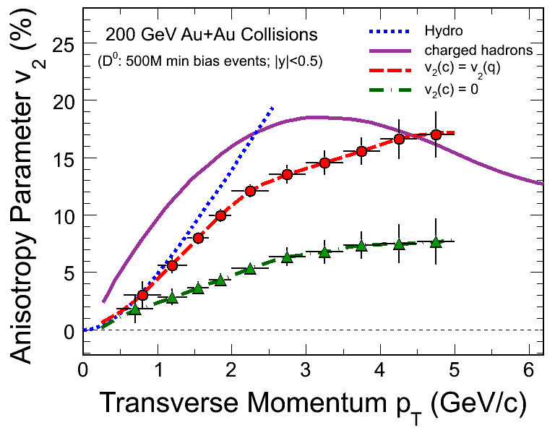
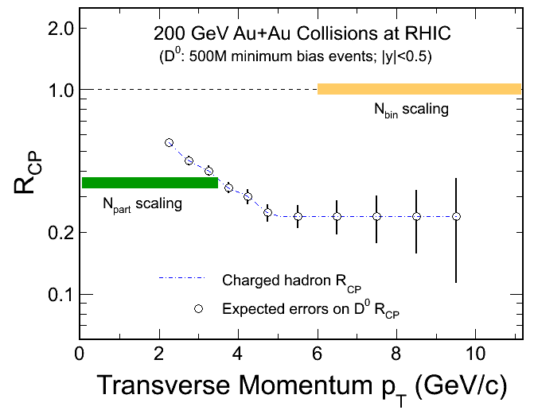
Outlook
TPC
SSD
IST
PXL
FGT
STAR Heavy Flavor Tracker Project.
Reconstruct secondary vertex.
Dramatically improve the precision of measurements.
Address physics related to heavy flavor.
v₂ : thermalization
R_{CP}: charm quark energy loss mechanism.

Slide 24
Systematic error study
Raw Counts – Difference between methods
nFitPoints - difference between
MC(nFitPts>25)/MC(nFitPts>15) and
Data(nFitPts>25)/Data(nFitPts>15)
3) DCA - difference between MC(dca<1)/MC(dca<2) and Data(dca<1)/Data(dca<2)

Slide 25
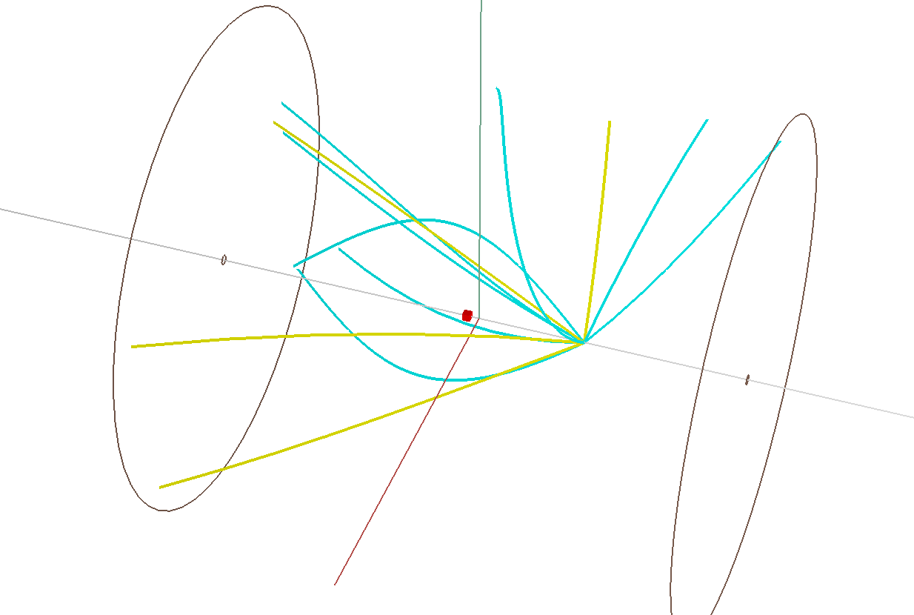
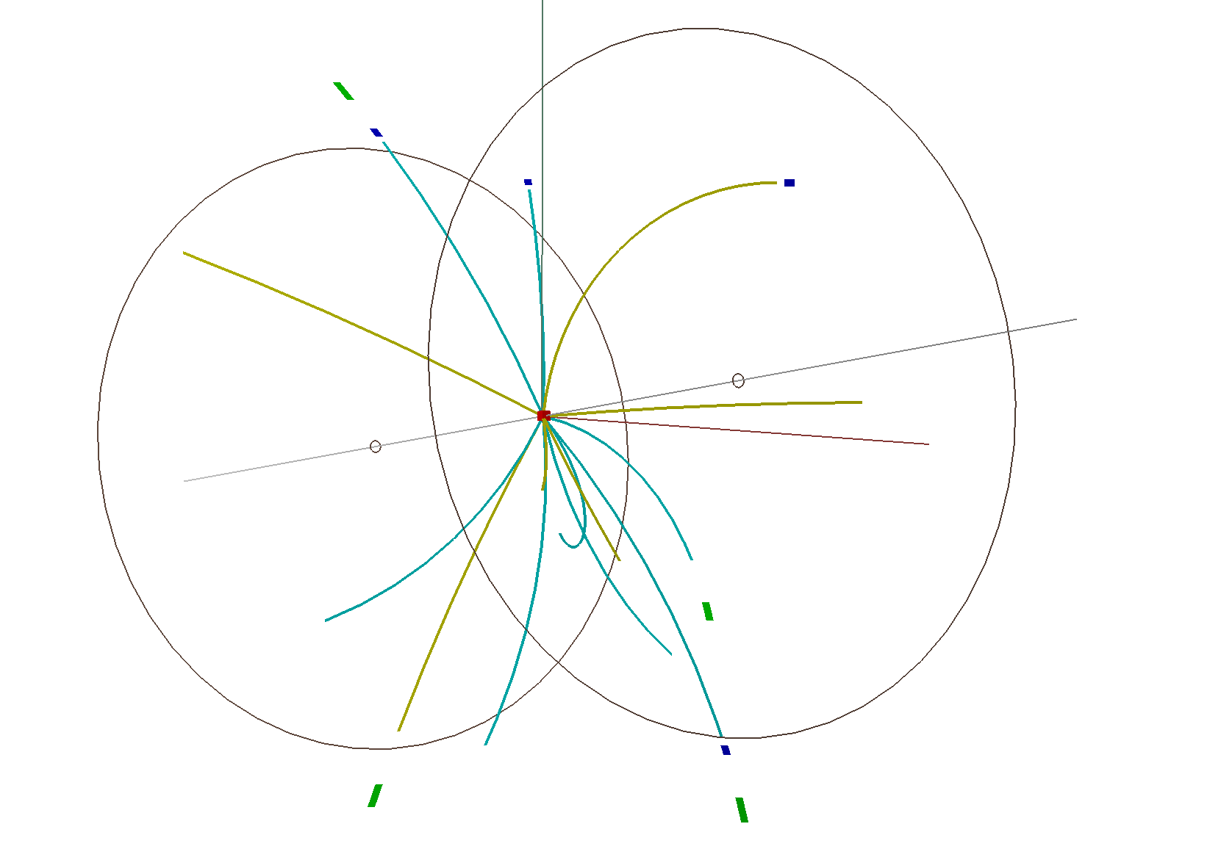
Pile-up removal
pp collisions peak luminosity L_{peak} = 5*10³¹ cm⁻²s⁻¹ in year 2009.
EventRate = L_{peak}*σ^{NSD}(30 mb) = 1.5 MHz
TPC readout ~ 80 μs => TPC sees tracks from 120‎ collisions. Pile-ups are removed by‎
‎ |VpdVz - TpcVz| < 6cm cut
‎ TPC PPV reconstruction algorithm
‎‎

Slide 26
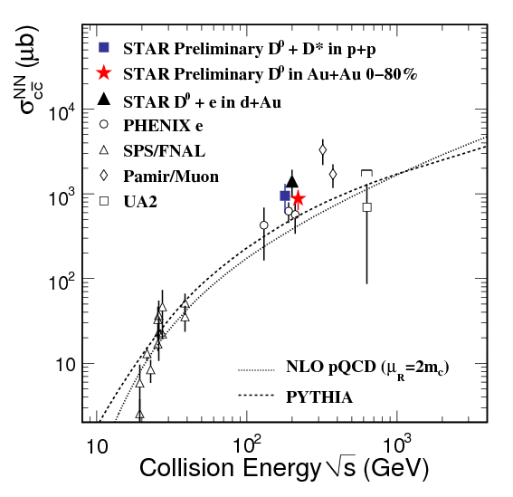
Charm cross section vs
Most precise measurement so far, provide constraint for theories.

