Slide 1

ϒ Production and Suppression in Heavy Ion Collisions at STAR
February 5, 2013
Anthony Kesich
University of California, Davis
STAR Collaboration

Slide 2
Outline
Motivation for measuring Upsilons
The Solenoidal Tracker At RHIC and its triggers
ϒ production cross section in p+p
ϒ production in d+Au
ϒ Nuclear Modification Factor in Au+Au
Suppression Models
Conclusions

Slide 3
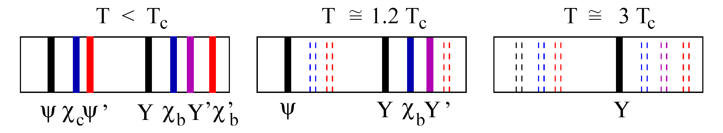
Goal: Quarkonia states in A+A
Charmonia: J/Ψ, Ψ’, χ_{c} Bottomonia: ϒ(1S), ϒ(2S), ϒ(3S),χ_{B}
Key Idea: Quarkonia Melt in the plasma
    Color screening of static potential between heavy quarks
    Suppression of states is determined by T_{C} and their binding energy
    Lattice QCD: Evaluation of spectral functions ⇒ T_{melting}
    Originaly proposed by Matsui & Satz (1986)
When do states melt?
A .Mocsy, Summer Quarkonium Workshop, BNL, 2011
H. Satz, HP06

Slide 4
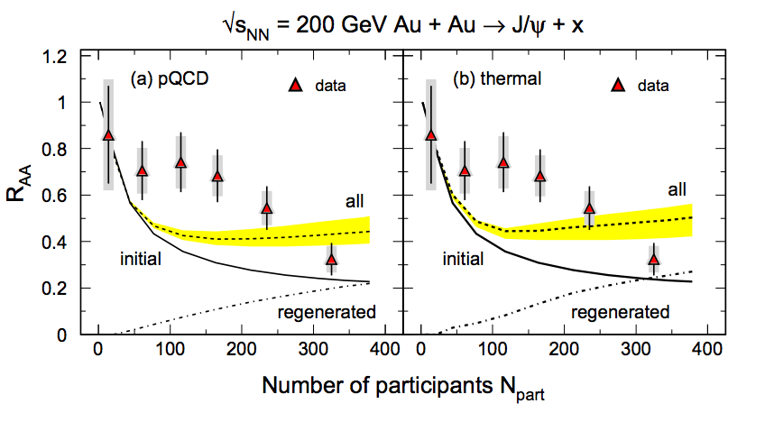
Quarkonia at RHIC
Why do ϒ at RHIC instead of J/Ψ?
A cleaner probe compared to J/Ψ
  co-mover absorption → negligible
  recombination → negligible
    σ_{cc} = ~800 µb
    σ_{bb=} ~ 2µb
Challenge: low rate, rare probe
  Large acceptance detector
  Efficient trigger
R. Rapp et al., arXiv:0807.2470 [hep-ph]
Data from: H. Pereira Da Costa [PHENIX Collaboration], Nucl. Phys. A 774 (2006) 747.
Regeneration of J/ψ!

Slide 5
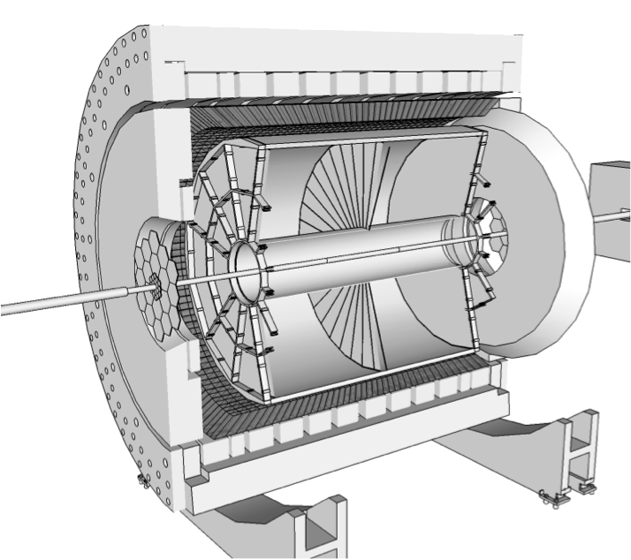
STAR
Time Projection Chamber
|η| < 1
Full φ coverage
Tracking and EID via Ionization
EM Calorimeter
|η| < 1
Full φ coverage
Electron ID via E/p
Event Triggering

Slide 6
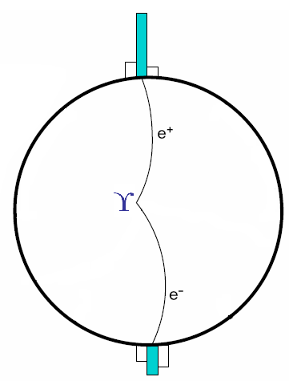
Triggering on ϒ decays
Level 0 Trigger (p+p,d+Au,Au+Au):
Hardware-based
Fires on at least one high tower
Level 2 Trigger (p+p,d+Au):
Software-based
Calculates:
  Cluster energies
  Opening angle
  Mass
High rejection rate allowed us to sample entire luminosity

Slide 7
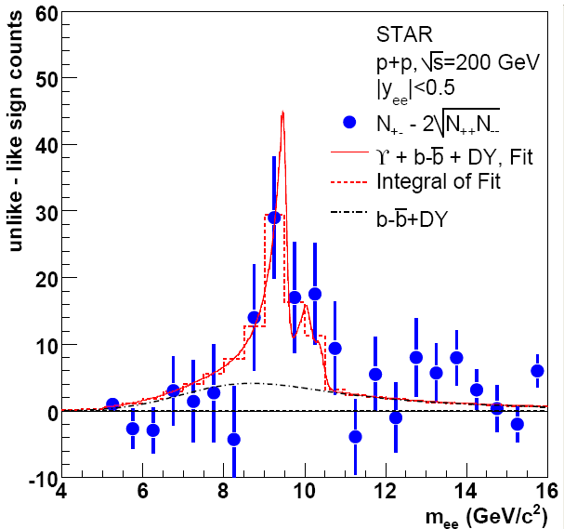
ϒ in p+p 200 GeV
2009, ∫L dt = 19.7 pb⁻¹
2006, ∫L dt = 7.9 pb⁻¹
Phys. Rev. D 82 (2010) 12004
Statistical error reduced by
a factor of 2!
N_{ϒ}(total)= 145±26(stat.)
STAR Preliminary

Slide 8
ϒ in p+p 200 GeV, Comparisons
CEM: R. Vogt, Phys. Rep. 462125, 2008
CSM: J.P. Lansberg and S. Brodsky, PRD 81, 051502, 2010
STAR Preliminary
STAR √s=200 GeV p+p ϒ+ϒ′+ϒ″→e⁺e⁻ cross section consistent with pQCD and world data trend

Slide 9
ϒ in d+Au 200 GeV
STAR Preliminary
Signal has ~8σ significance
p_{T} reaches ~8 GeV/c
∫L dt = 32.6 nb⁻¹
N_{ϒ} = 79 ± 17 (stat.) ± 13 (syst.)
Efficiency/calibrations under study

Slide 10
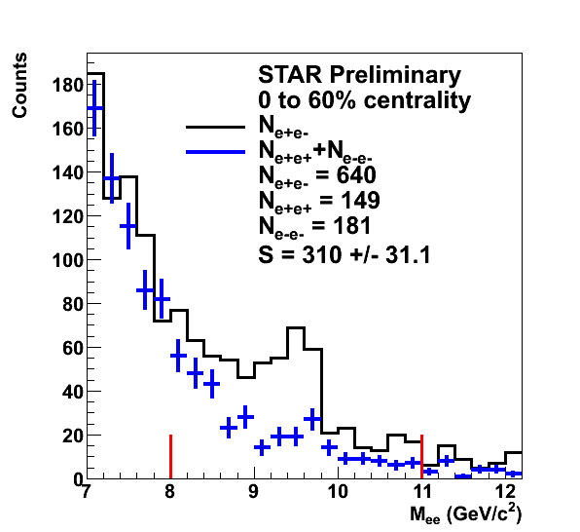
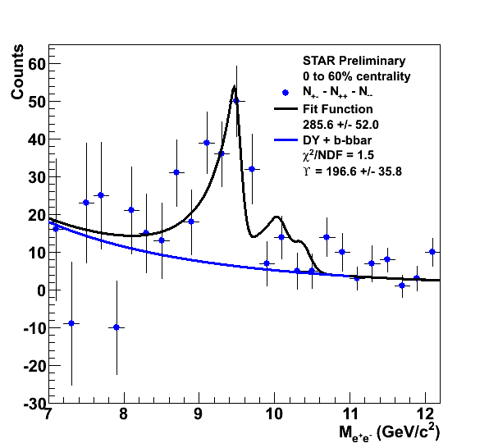
ϒ in Au+Au 200 GeV
Raw yield of ○→e⁺e⁻ with |y|<0.5 = 197 ± 36
∫L dt ≈ 1400 µb⁻¹

Slide 11
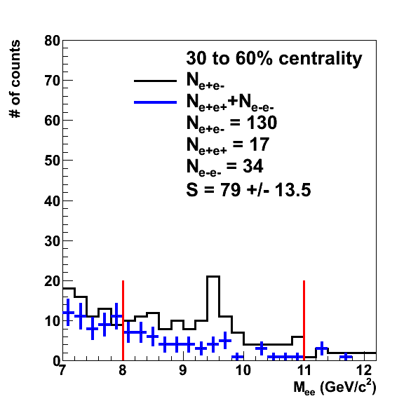
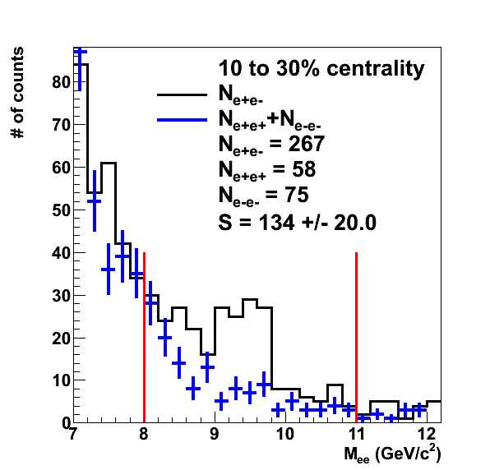
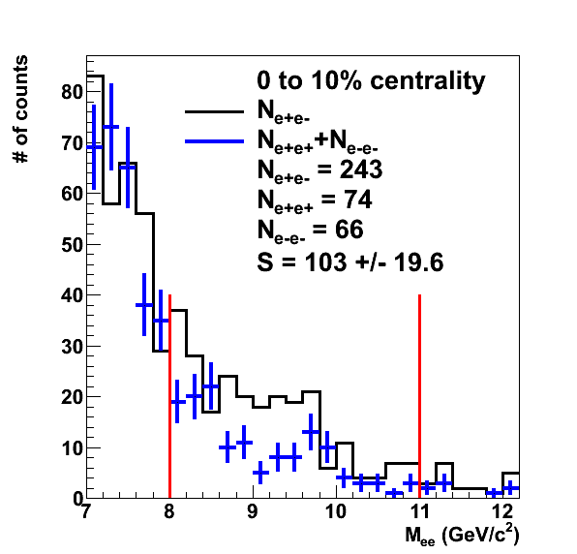
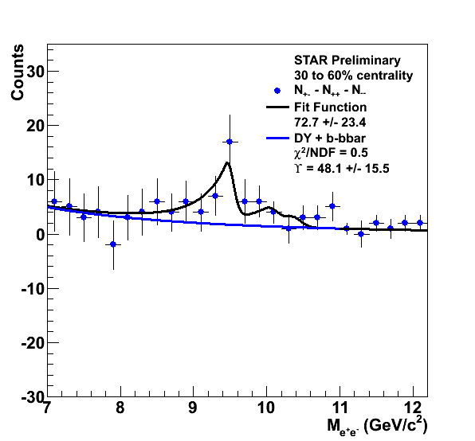
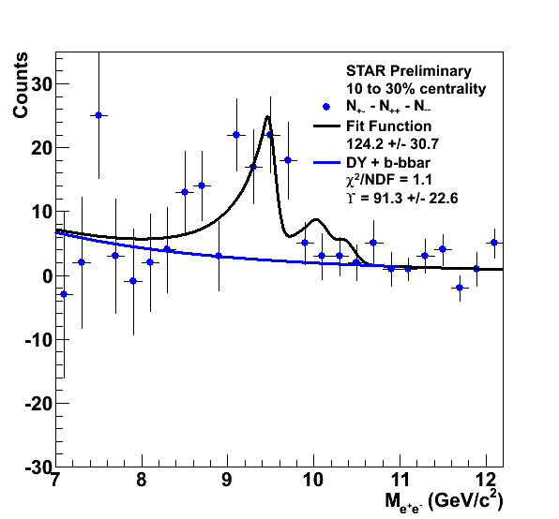
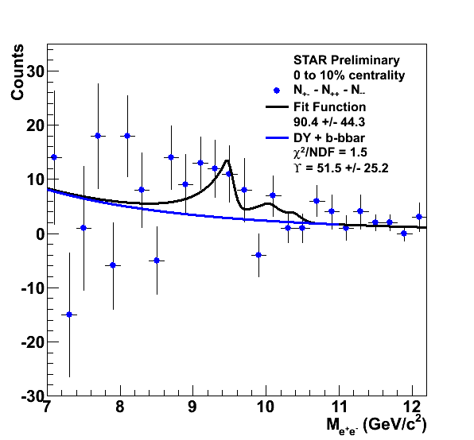
ϒ in Au+Au 200 GeV, Centrality
STAR Preliminary
STAR Preliminary
STAR Preliminary
Peripheral
Central

Slide 12
ϒ in Au+Au 200 GeV, R_{AA}
Models from M. Strickland and D. Bazow, arXiv:1112.2761v4
A. Emerick et al., Eur. Phys. J. A48 (2012) 72
Strickland uses a dynamic model with fireball expansion and feed-down
  Results are consistent with complete 2S and 3S suppression in this model
  Model is assumes a T₀ in the range of 428-442 MeV and 1/4π< η/S < 3/4π
Emerick & Rapp band covers two scenarios:
  Binding energy of the Upsilon decreases with T (Weak Binding)
  Suppression is due to gluo-dissociation of Upsilon (Strong Binding)

Slide 13
Outlook
Au+Au @ 200 GeV, 2011
Same setup as in 2010
Double the total luminosity
  Approximately 2.8 nb⁻¹
p+p @ 500 GeV, 2011
High energy doubles Upsilon cross section
Excited-to-ground state ratio
P_{T} spectrum
Approximately 22 pb⁻¹ of data

Slide 14
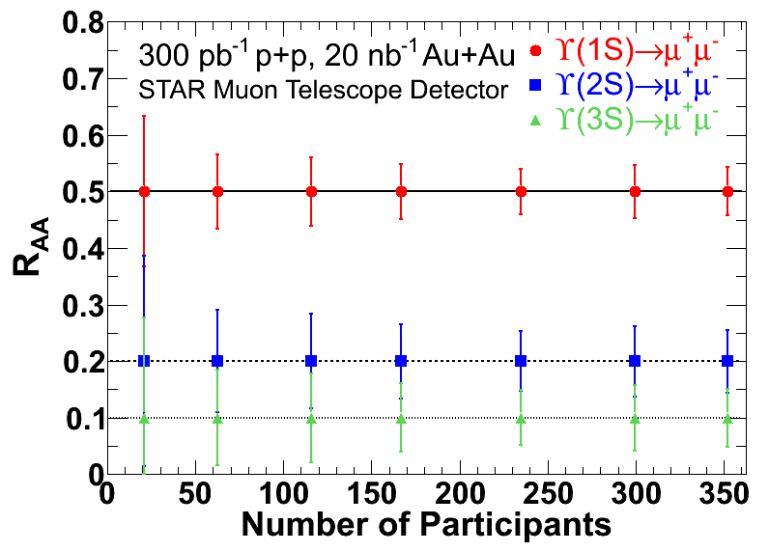
Outlook
Statistical Error Projection for Muon Detectors
New muon detectors will open up a second, cleaner channel
for Upsilon detection. About 60% of it is currently installed.
Important due to increased material in the detector from new vertexer

Slide 15
Conclusions
Measured ϒ production in p+p, d+Au, and
Au+Au collisions at 200 GeV
Au+Au results consistent with 2S and 3S suppression
Increased Au+Au statistics from run 11 will further decrease R_{AA} uncertainties
New muon channel will enhance and compliment our electron measurements

Slide 16
Thank you

