Slide 1
STAR measurement on di-lepton spectrum from p+p collisions at 200 GeV
STAR
Bingchu Huang (for STAR Collaboration)
University of Science and Technology of China (USTC)
Brookhaven National Laboratory (BNL)

Slide 2
Outline
Motivation
Di-electron production in 200GeV p+p collisions
Invariant mass distribution of e⁺e⁻ pairs
Particle cocktail simulation
Light meson and heavy flavor components
Comparison with data
ω (782) yields
Summary & outlook

Slide 3
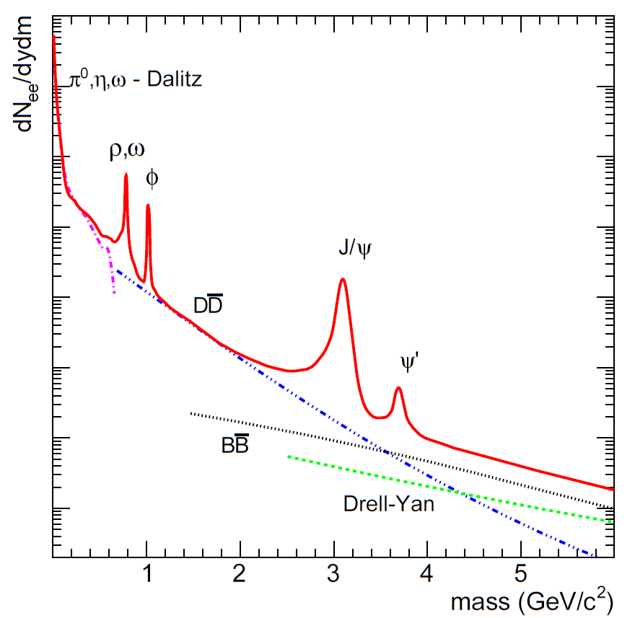
Di-lepton measurement of p+p at 200 GeV
p+p is a baseline for Au+Au.
This analysis will focus on p+p 200 GeV analysis.
It will provide a good reference for Au+Au topics:
Measurements | Physics
low mass | thermal radiation of QGP; in-medium modifications of vector meson (ρ ω φ), chiral symmetry restoration
intermediate mass | thermal radiation of QGP; heavy flavor modification; resonances in QGP
large mass: heavy quarkonia | T of QGP, color screening, quarkonium production mechanism

Slide 4
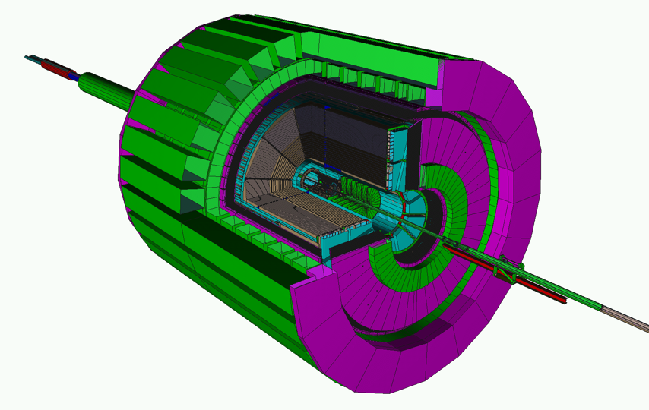
STAR Detector
Tracking: TPC
Particle ID: TOF
Time Projection Chamber
1. Tracking
2. Ionization energy loss (dE/dx PID):
3. Coverage -1<η<1
Time Of Flight ----
1. Timing resolution (<100ps)
2. Coverage: -0.9<η<0.9
3. Install (4% y2008,
72% y2009, 100% y2010)

Slide 5
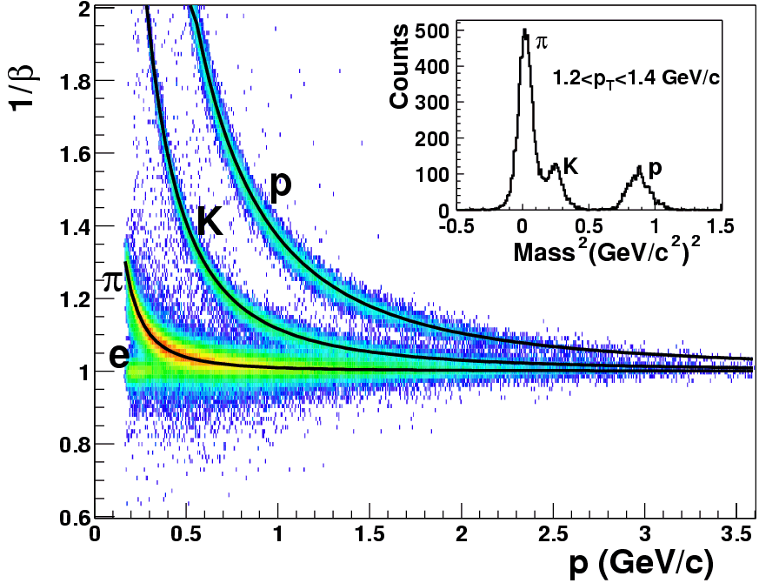
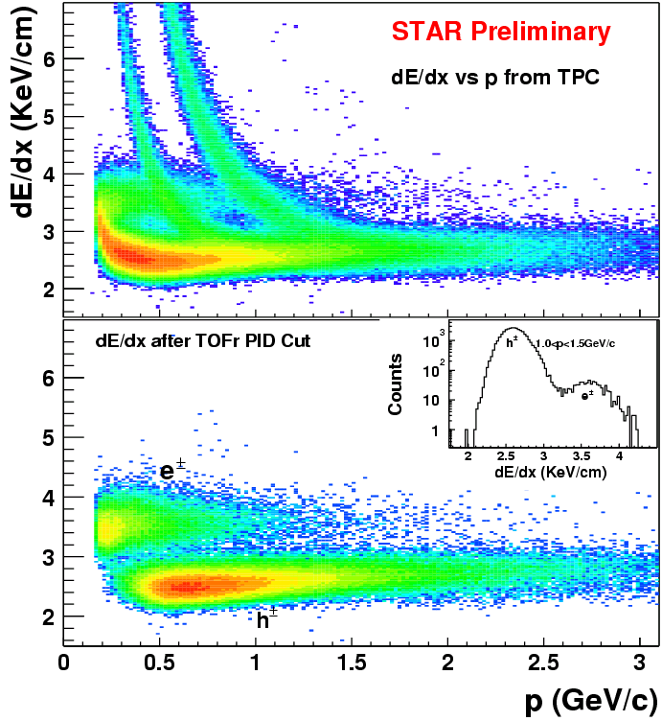
STAR Time of Flight detector performance
|1/β-1|<0.03
TOF PID: (π, K) ~ 1.6, proton ~ 3 GeV/c
STAR Collaboration, PLB616(2005)8
TOF enables clean electron PID up to p_{T} < 3 GeV/c. (STAR Collaboration, PRL94(2005)062301)
M. Shao et al., NIMA 558(2006)419

Slide 6
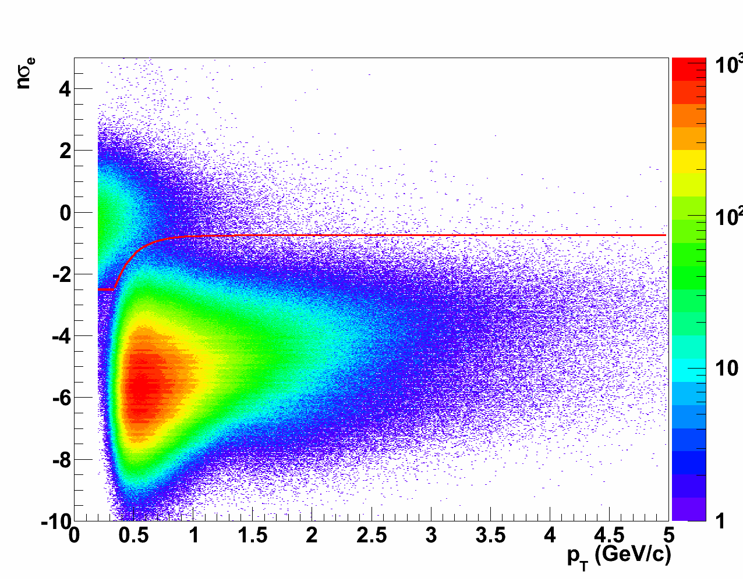
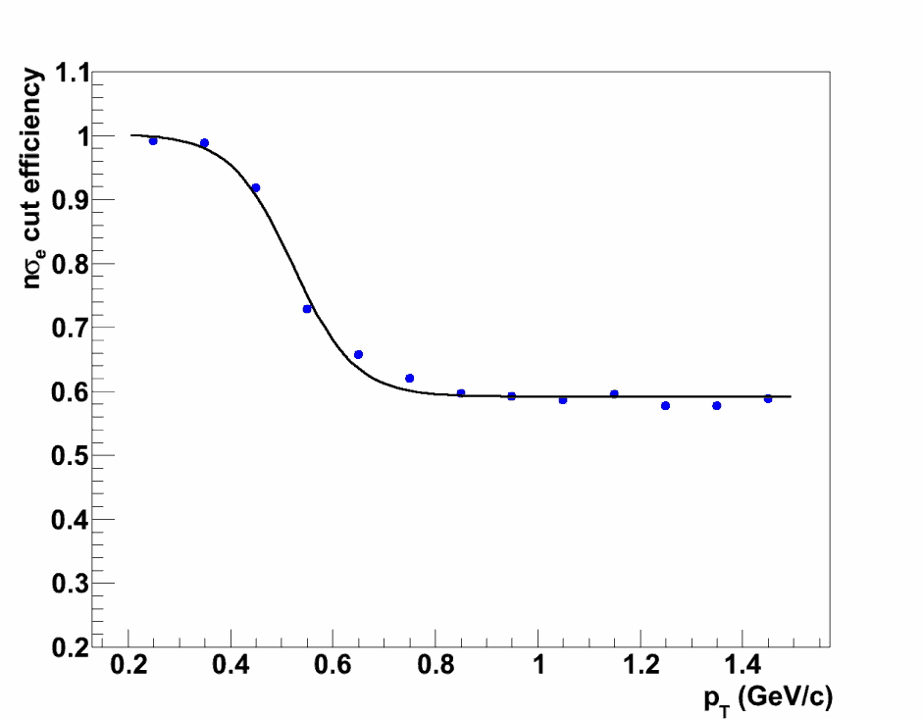
Electron ID
Event Cut : 300 M p+p 200 GeV events from year 2009.
|vertexZ|<50 cm && |vpdVz-vertexZ|<6 cm
~107 M events after cut.
nσ_{e} cut: f(p_{T})<nσ_{e}<2.
STAR Preliminary
STAR Preliminary
f(p_{T})
The dE/dx cut efficiency on e
High electron purity: 99%. Efficiency: greater than the 60% for the dE/dx cut.

Slide 7
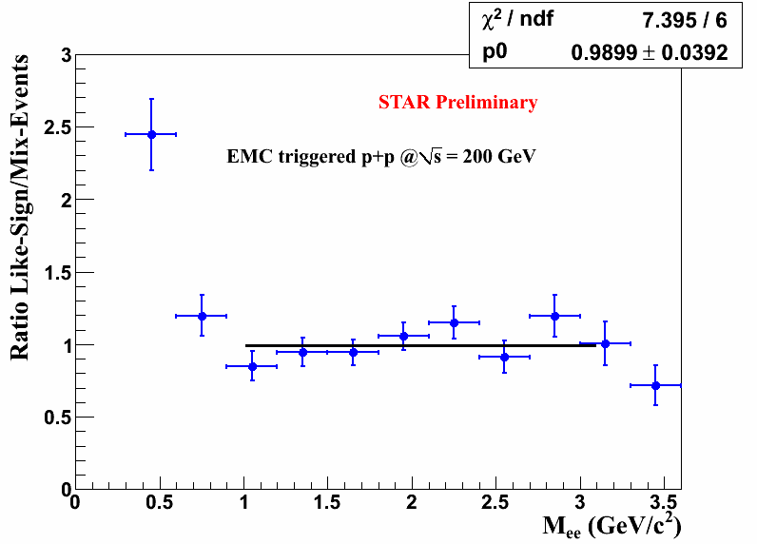
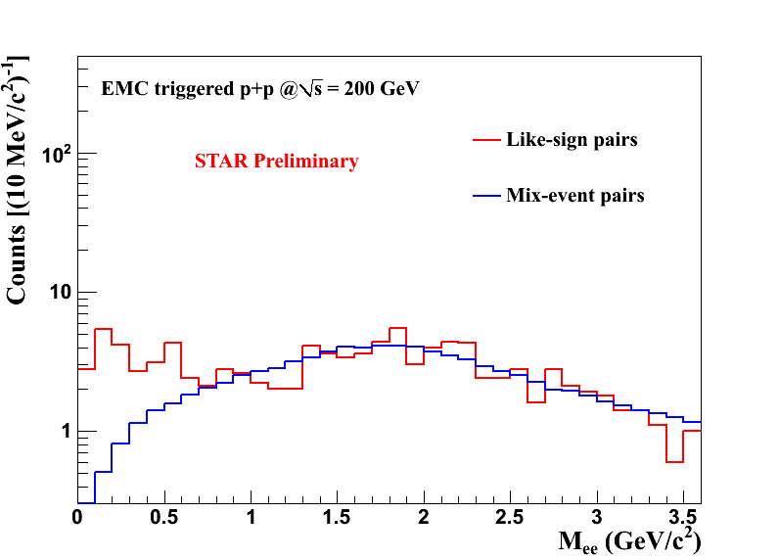
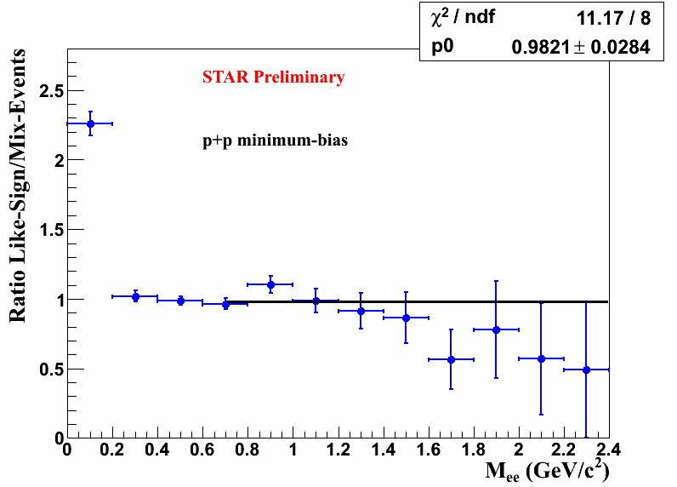
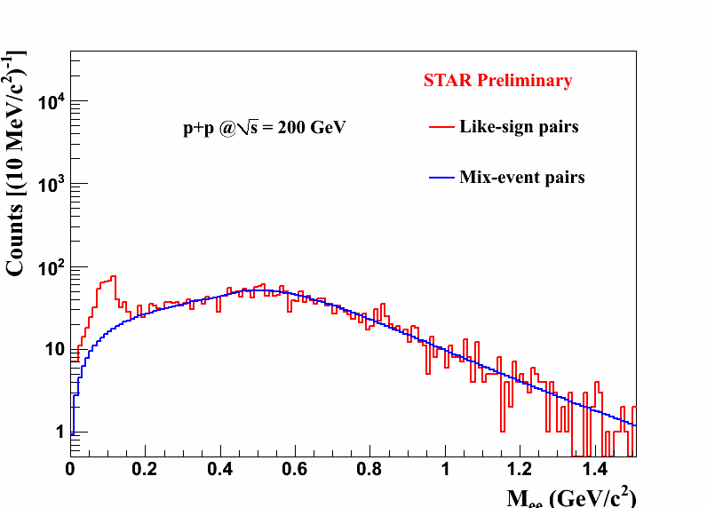
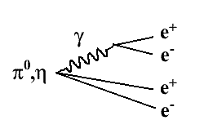
Di-lepton background
Mix-event normalize to like-sign within 0.4 - 1.5 GeV/c²
Mix-event consistent with like-sign within 1-3 GeV/c²
Cross-pair bg. can only be described by like-sign method.
For minimum bias events, we subtracted like-sign bg at M_{ee}<0.7 GeV/c², mix-event bg subtraction was applied at 0.7<M_{ee}<3.5 GeV/c².

Slide 8
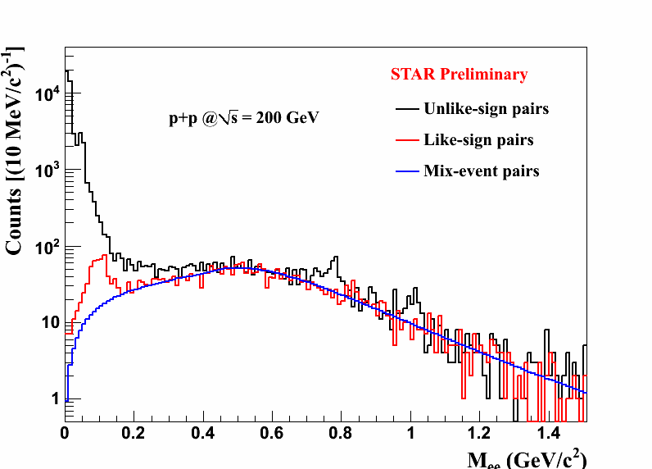
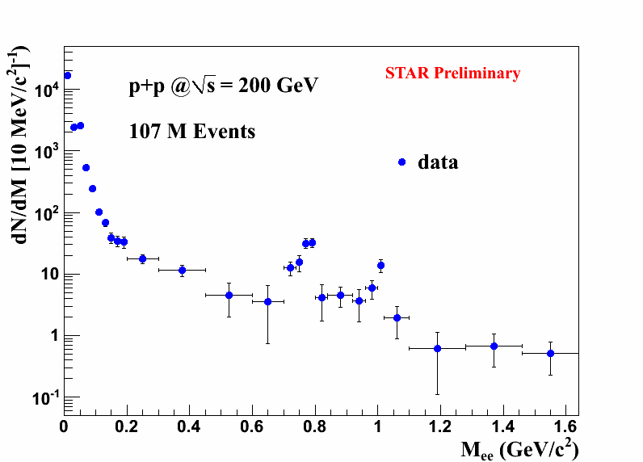
Di-lepton invariant mass spectrum in p+p collisions --- low mass range
Di-lepton at run9 p+p collisions: signal excess above background
ω: S/B~0.7, significance: 5 σ
φ: S/B~1, significance: 4 σ

Slide 9
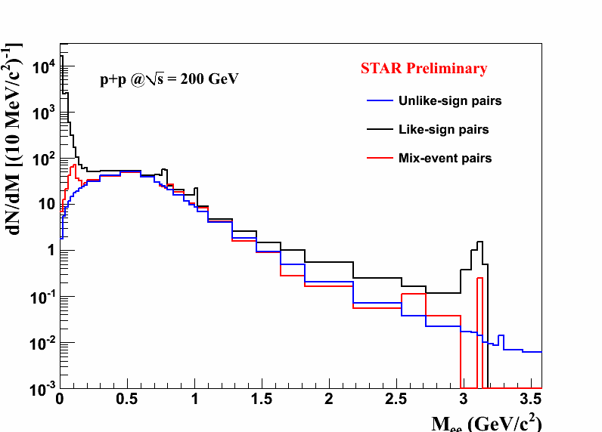
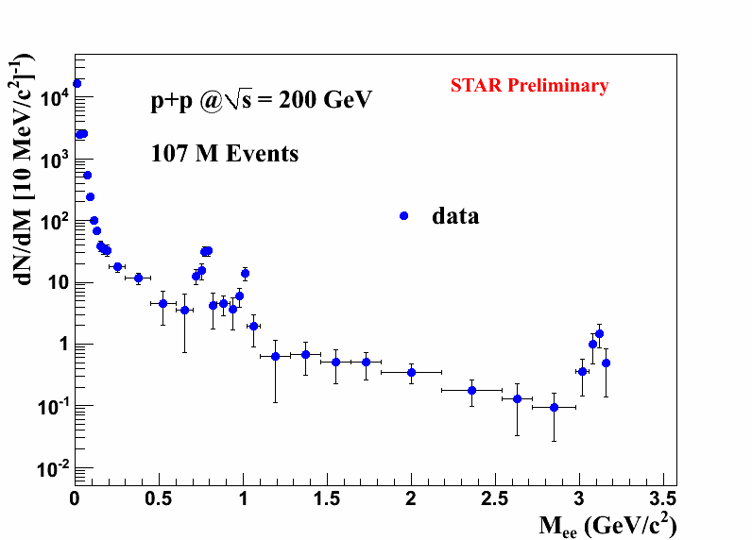
Di-lepton invariant mass spectrum in p+p collisions --- full range

Slide 10
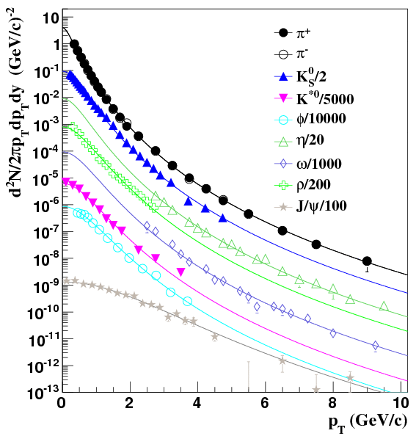
Particle cocktail simulation: spectrum input
STAR: π±, K_{S}, K*, φ, ρ
PHENIX: η, ω, J/ψ
Tsallis blast-wave model (TBW) is an implementing Tsallis statistics in the Blast-Wave model and is used to fit identified particle spectra at RHIC.
Parameters:
q-1: the degree of non-equilibrium.
T: the average temperature of the local source.
β: the average flow velocity (0 in p+p collisions).
Z. Tang et al., PRC 79,051901(R)(2009);
M. Shao et al., J. Phys. G: Nucl. Part. Phys. 37 (2010) 085104
In GEANT simulation: input the particle Tsallis fit function; output the e⁺e⁻ invariant mass cocktail.
Same cuts were applied in simulation as in data.

Slide 11
Source of ee pairs
Mesons:
Dalitz: π⁰ ω η η’ ϕ
Two body: ρ ω ϕ J/ψ
Heavy flavor:

Slide 12
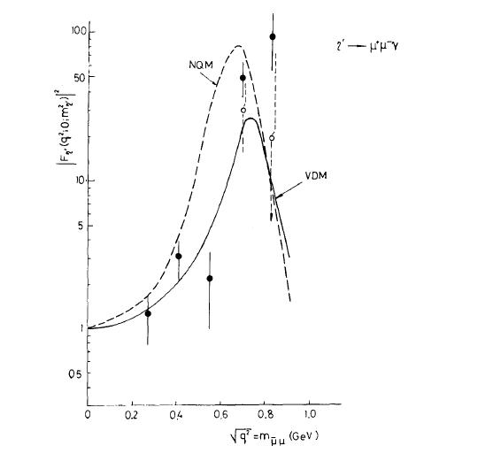
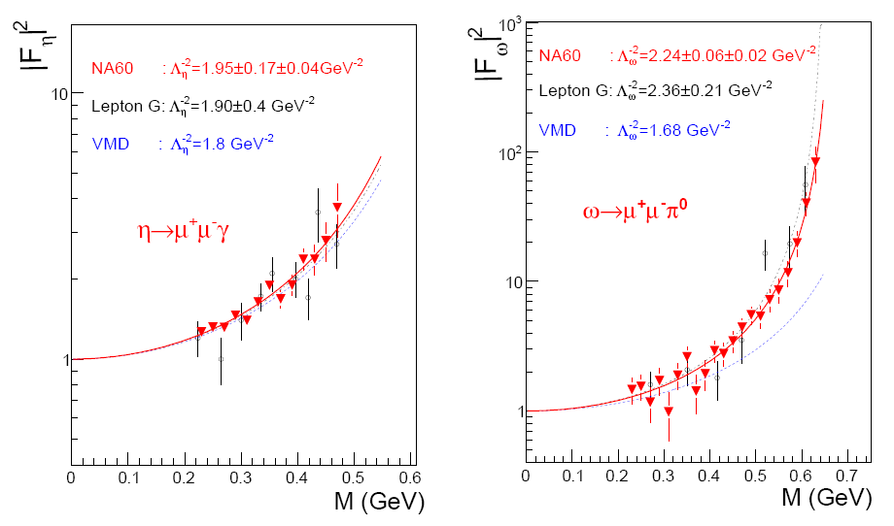
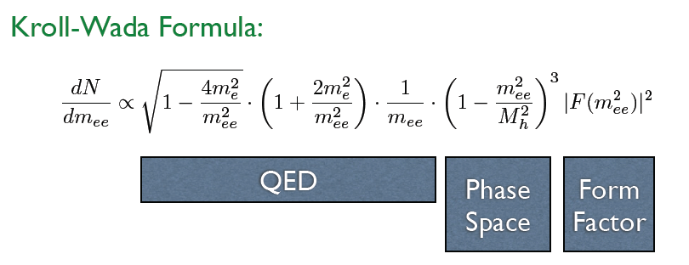
Dalitz decay --- π⁰ ω η η’ ϕ
NA60: Phys. Lett. B 677 (2009) 260-266
PHYSICS REPORTS (Review Section of Physics Letters) 128, No. 6 (1985) 301—376.
phase space of ω :

Slide 13
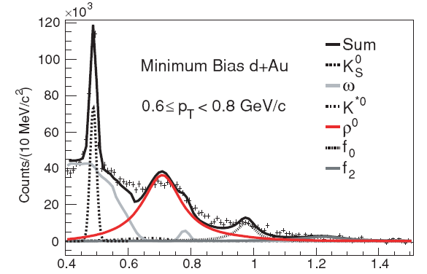
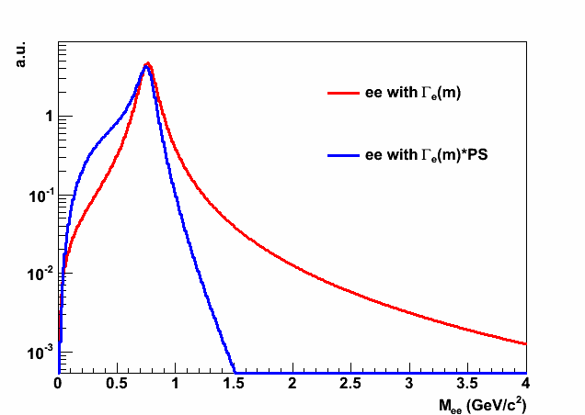
ρ line shape
Described by a BW×PS function in ππ.
PHYSICAL REVIEW C 78, 044906 (2008)
ρ→ee: use Γ_{e} instead of Γ_{π} in BW function.

Slide 14
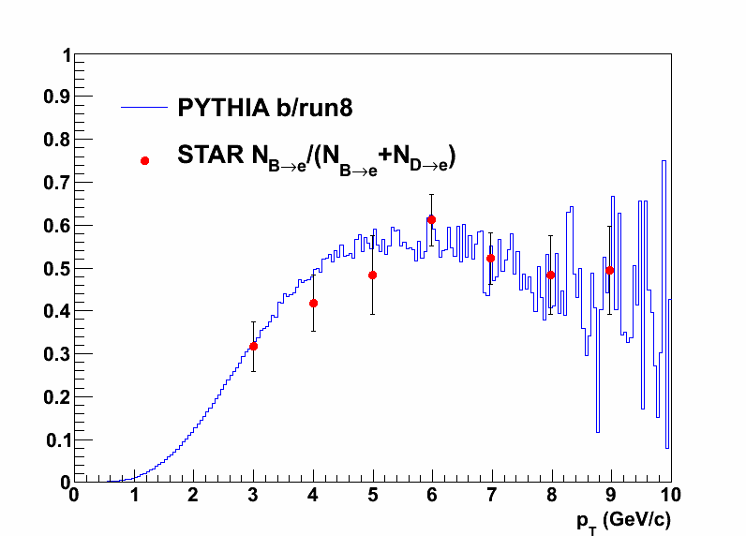
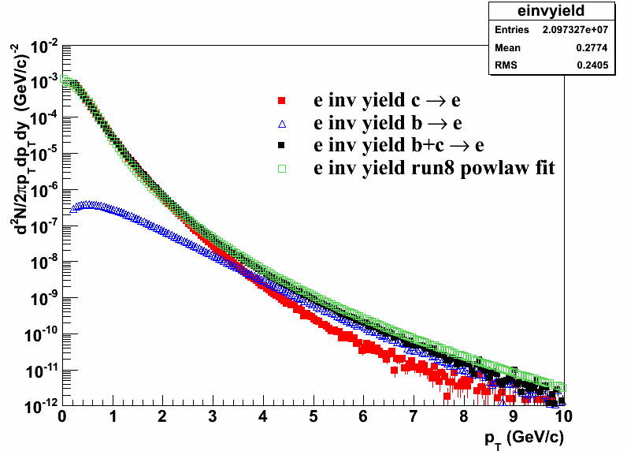
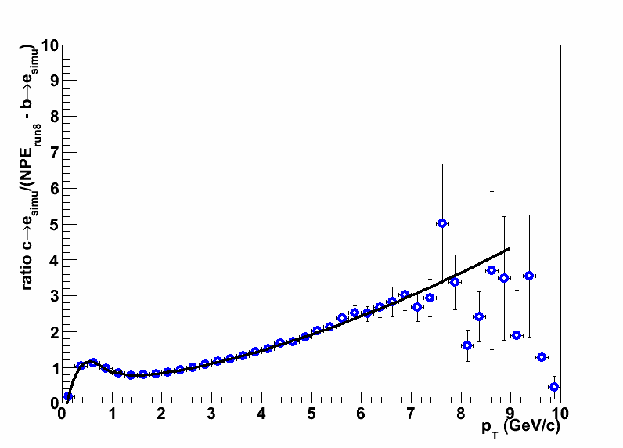
Charm and bottom
PRL 105, 202301 (2010)
Procedures:
Scale simulated b→e/NPE_{run8} to STAR published b→e/(B→e+D→e).
Compare simulation c→e and NPE_{run8} – scaled b→e.
Tune the shape of simulation c→e.
Reproduce and contributions.
ccbar: STAR measured cross section as input;
STAR Collaboration, PRL94(2005)062301
bb/cc ratio from PYTHIA

Slide 15
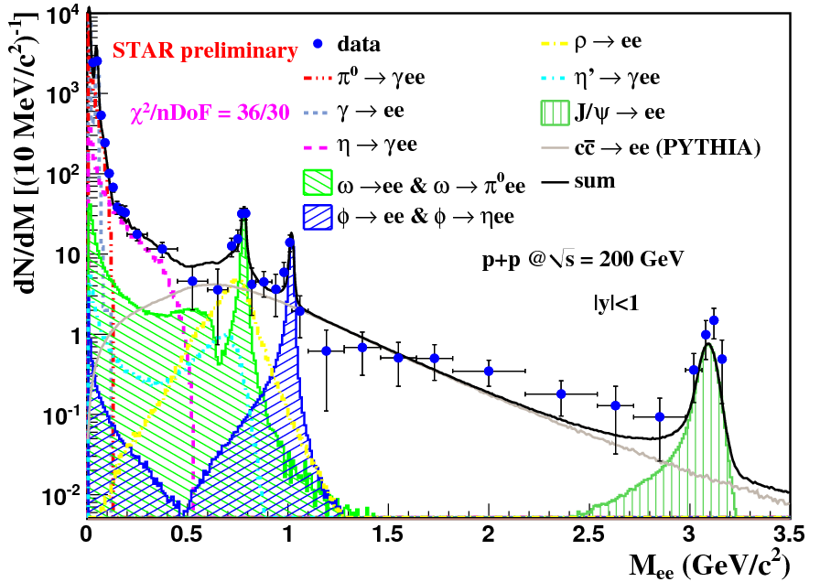
Cocktail comparison with data
The cocktail simulation can describe p+p data.
The enhanced yield in the LMR and IMR observed in the heavy ion collisions by HELIOS, NA38/50, NA60 and PHENIX etc.. STAR has 355M minimum-bias Au+Au events at 200 GeV to study the enhancement at those mass range.
The p+p results is a baseline for Au+Au.
Statistical errors only

Slide 16
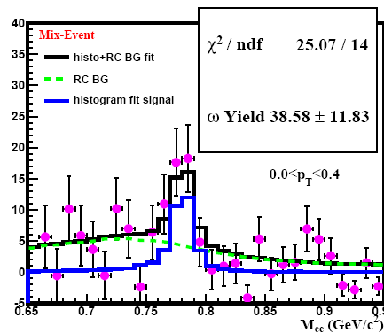
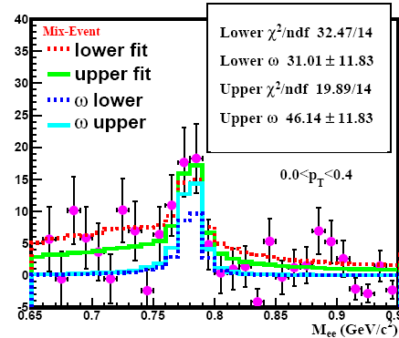
ω raw yields fit
Raw yield fit: two histograms combined fit
1) ω
2) rest components of the cocktail.
Systematic uncertainty estimation:
Take the other bg. particle yields uncertainty as systematic uncertainty.
Fit range 0.7-0.85 GeV/c²

Slide 17
ω raw yields fit
STAR Preliminary

Slide 18
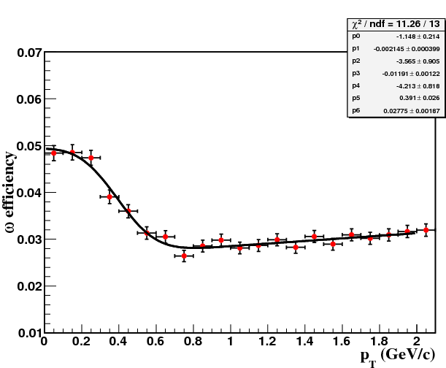
ω efficiency
ω embedding data correct the acceptance and TPC+TOF efficiency.
For omega:
|y|<1
For electron:
|η|<1, p_{T}>0.2
STAR Preliminary
Function only guide eyes.

Slide 19
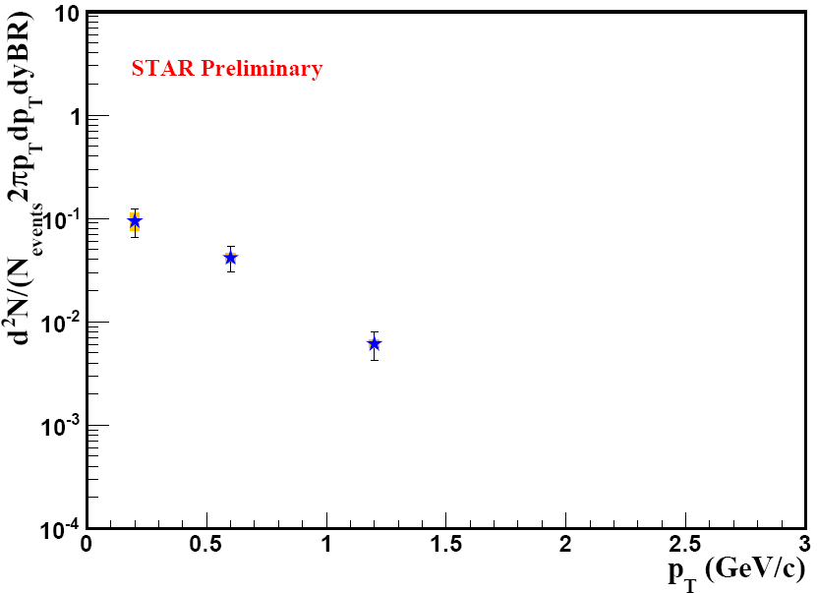
ω invariant yields

Slide 20
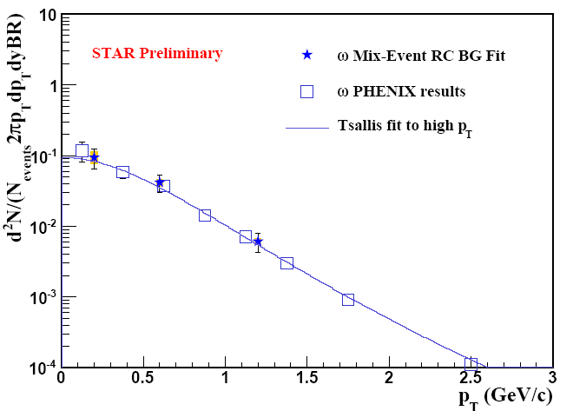
ω invariant yields comparison
PHENIX results:
arXiv:1005.3674
Tsallis fit is only the fit function of the previous published high p_{T} ω yields reconstructed by hadron channel!
Z. Tang et al., PRC 79,051901(R)(2009)

Slide 21
Summary
STAR’s di-lepton measurement enabled by TOF detector.
Di-electron continuum measured in 200 GeV p+p collisions. Cocktail simulation is consistent with data.
The ω invariant yields are obtained, they are consistent with the PHENIX submitted results reconstructed by e+e- channel, and also consistent with the Tsallis fit of ω results from hadron channel.
Outlook:
1. Systematic uncertainty estimation on continuum will be completed.
2. The p+p results provide a good reference for Au+Au. We will look into the Au+Au data at 200 GeV.

Slide 22
Thanks!

Slide 23
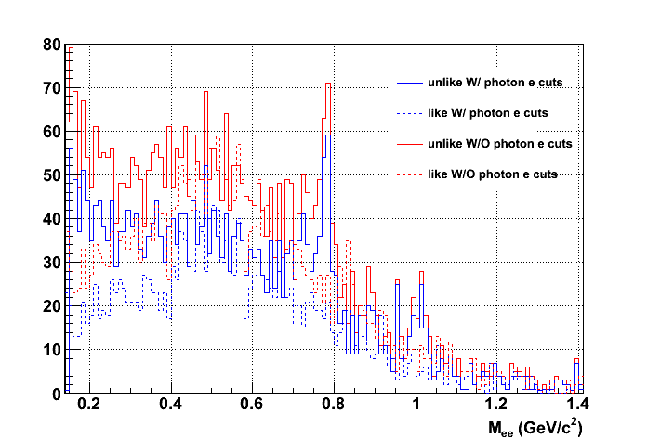
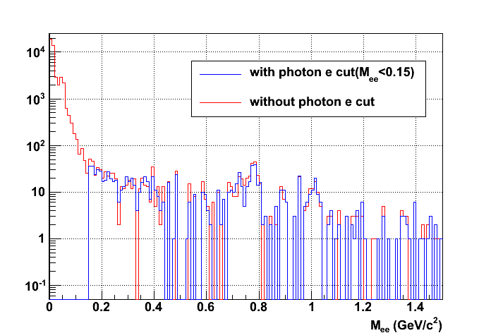
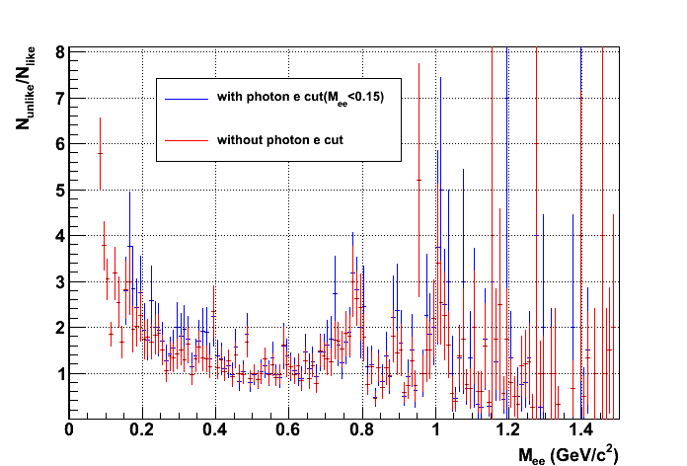
Photonic electron rejection doesn’t help too much for pp analysis.

Slide 24
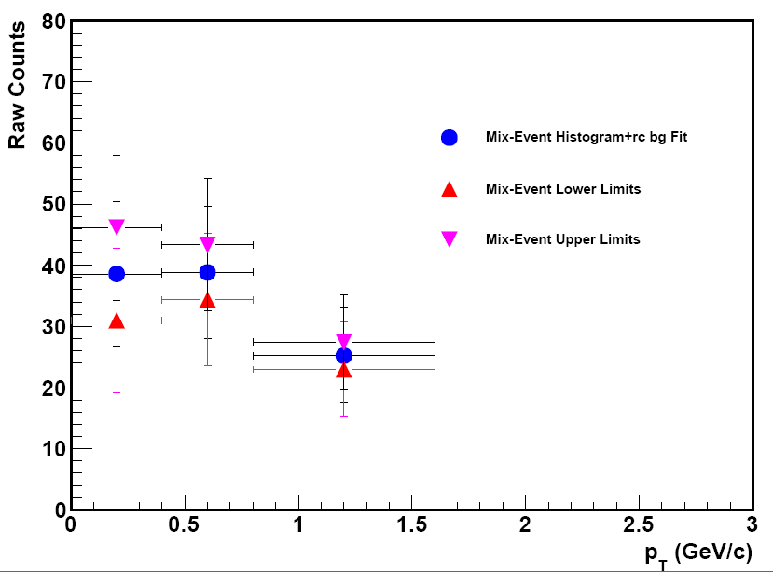
Raw yields
STAR Preliminary

