Slide 1
Measurements of ϒ Production and Nuclear Modification Factor at STAR
Anthony Kesich
University of California, Davis
STAR Collaboration

Slide 2
Outline
Motivation for measuring Upsilons
The Solenoidal Tracker At RHIC and its triggers
ϒ production cross section in p+p
ϒ production and CNM effects in d+Au
ϒ Nuclear Modification Factor in Au+Au
Conclusions

Slide 3
Goal: Quarkonia states in A+A
Charmonia: J/Ψ, Ψ’, χ_{c} Bottomonia: ϒ(1S), ϒ(2S), ϒ(3S)
Key Idea: Quarkonia Melt in the plasma
Color screening of static potential between heavy quarks:
Suppression of states is determined by T_{C} and their binding energy
Lattice QCD: Evaluation of spectral functions ⇒ T_{melting}
Sequential disappearance of states:
⇒ Color screening ⇒ Deconfinement
⇒ QCD thermometer ⇒ Properties of QGP
When do states melt?
T_{diss}(Ψ’) ≈ T_{diss}(χ_{c})< T_{diss}(ϒ(3S)) < T_{diss}(J/Ψ) ≈ T_{diss}(ϒ(2S)) < T_{diss}(ϒ(1S))
H. Satz, HP2006

Slide 4
Measuring the Temperature
Lattice QCD Calculations:
Quarkonia’s suppression pattern
➔ QGP thermometer
Dissociation temperatures of quarkonia states
S. Digal, P. Petreczky, H. Satz, hep-ph/0110406
For ϒ production at RHIC
A cleaner probe compared to J/Ψ
co-mover absorption → negligible
recombination → negligible
d-Au: Cold Nuclear Matter Effects
Shadowing / Anti-shadowing at y≈0
Challenge: low rate, rare probe
Large acceptance detector
Efficient trigger
A .Mocsy, Summer Quarkonium Workshop, BNL, 2011
Expectation:
ϒ(1S) no melting
ϒ(2S) likely to melt
ϒ(3S) melts

Slide 5
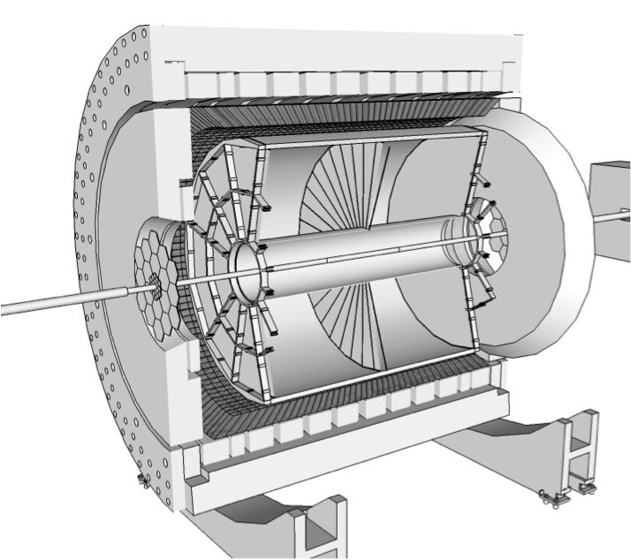
STAR
Time Projection Chamber
|η| < 1
Full φ coverage
Tracking and EID via Ionization
EM Calorimeter
|η| < 1
Full φ coverage
Electron ID via E/p
Event Triggering

Slide 6
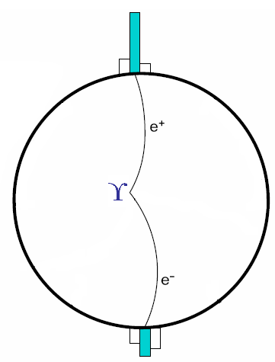
Triggering on ϒ decays
Level 0 Trigger (p+p,d+Au,Au+Au):
Hardware-based
Fires on at least one high tower
Level 2 Trigger (p+p,d+Au):
Software-based
Calculates:
Cluster energies
Opening angle
Mass
E₁ Cluster
L0 Trigger Tower
High rejection rate allowed us to sample entire luminosity
E₂ Cluster

Slide 7
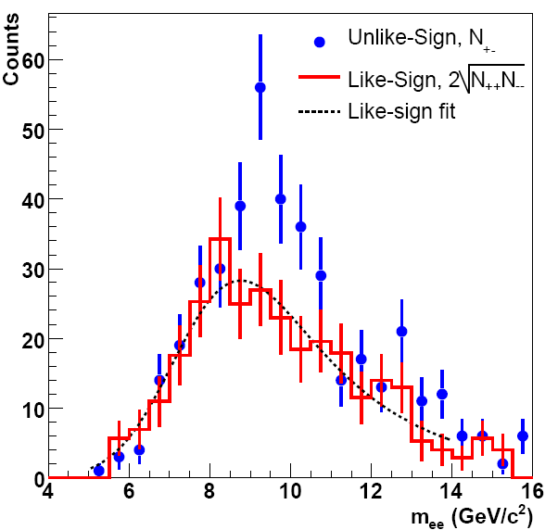
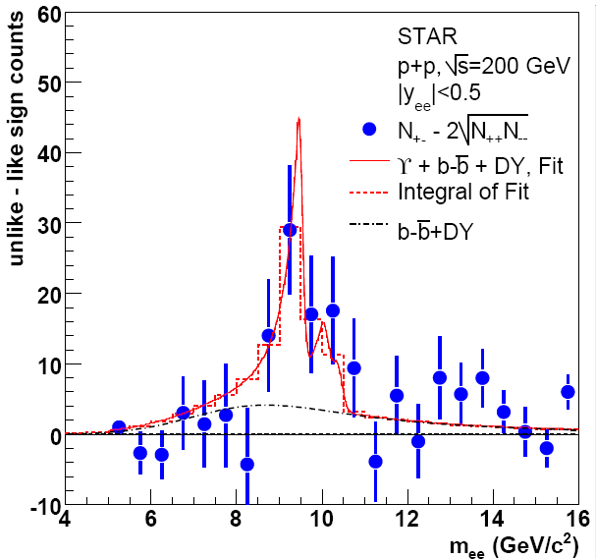
ϒ in p+p 200 GeV
|y| < 0.5 ∫L dt = 7.9 ± 0.6 pb⁻¹ N_{ϒ}(total)= 67±22(stat.)
Phys. Rev. D 82 (2010) 12004

Slide 8
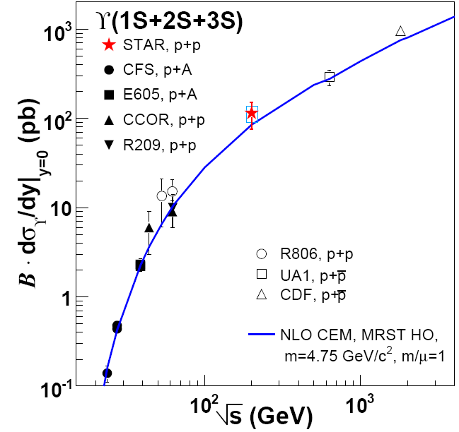
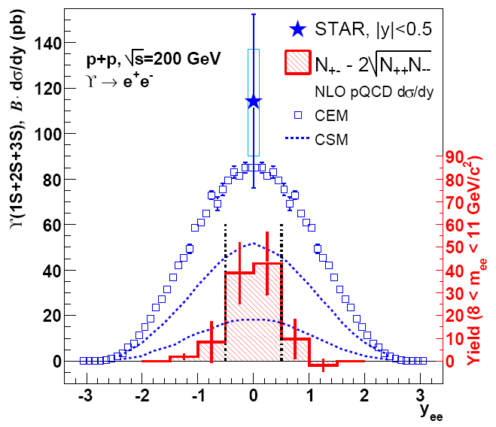
ϒ in p+p 200 GeV, Comparisons
STAR √s=200 GeV p+p ϒ+ϒ′+ϒ″→e⁺e⁻ cross section consistent with pQCD and world data trend
Phys. Rev. D 82 (2010) 12004

Slide 9
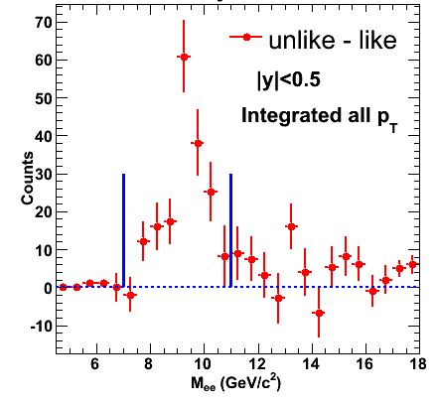
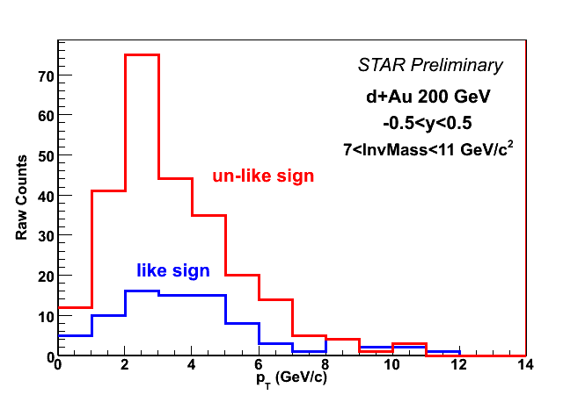
ϒ in d+Au 200 GeV
Signal has ~8σ significance
p_{T} reaches ~ 5 GeV/c
STAR Preliminary
|y| < 0.5 ∫L dt = 32.6 nb⁻¹ N_{ϒ}(total)= 172 ± 20(stat.)

Slide 10
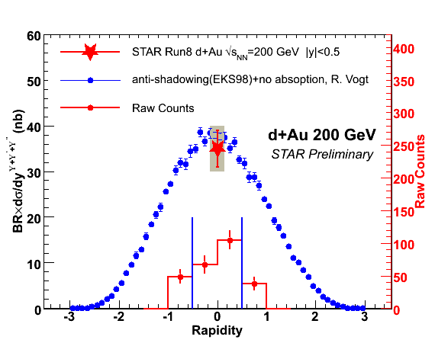
ϒ in d+Au 200 GeV, Comparison
σ_{dAu} = 2.2 b σ_{pp} = 42 mb
N_{bin} = 7.5 ± 4 for minbias dAu
STAR √s=200 GeV d+Au ϒ+ϒ′+ϒ″→e⁺e⁻ cross section consistent with pQCD and minimal shadowing effects

Slide 11
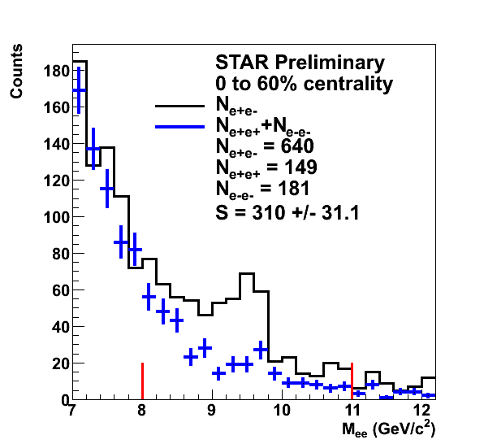
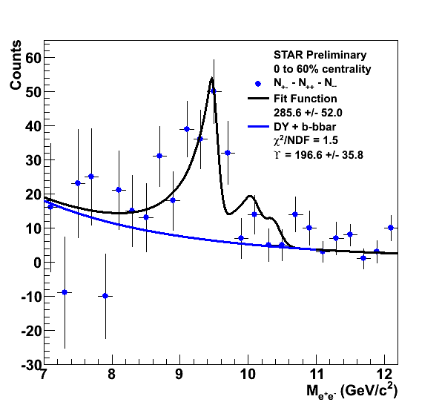
ϒ in Au+Au 200 GeV
Raw yield of ϒ→e⁺e⁻ with |y|<0.5 = 197 ± 36
∫L dt ≈ 1400 µb⁻¹

Slide 12
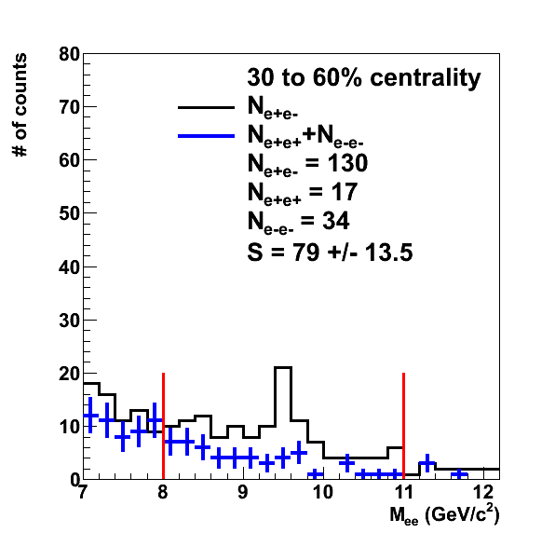
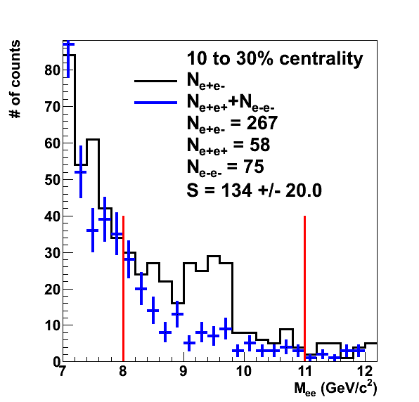
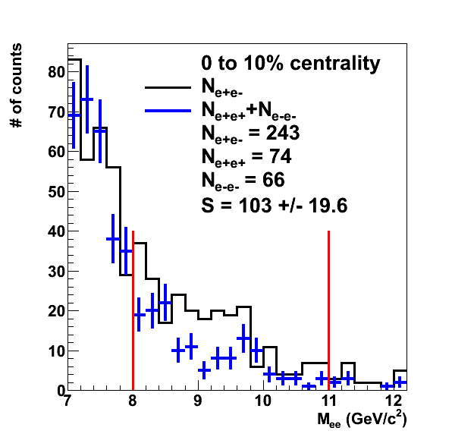
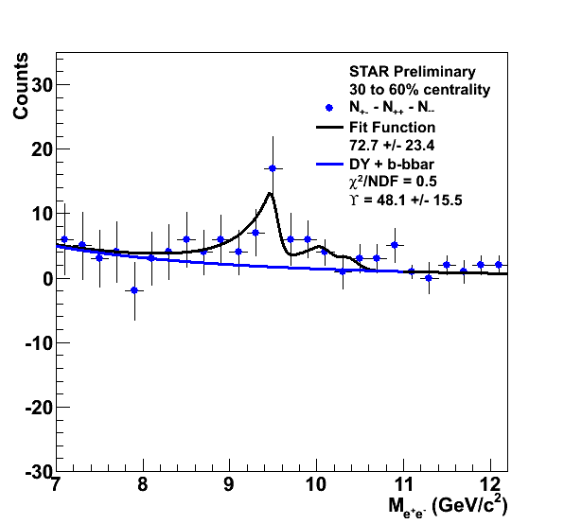
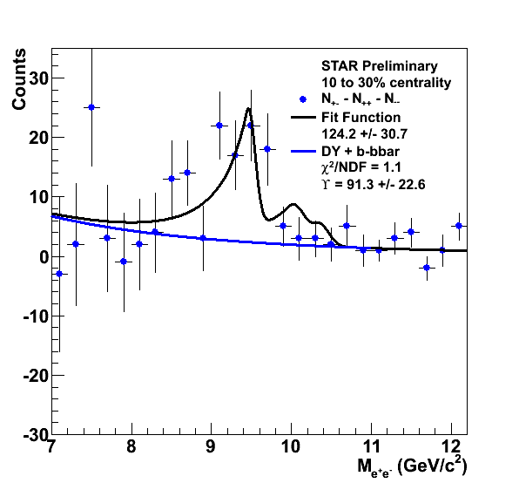
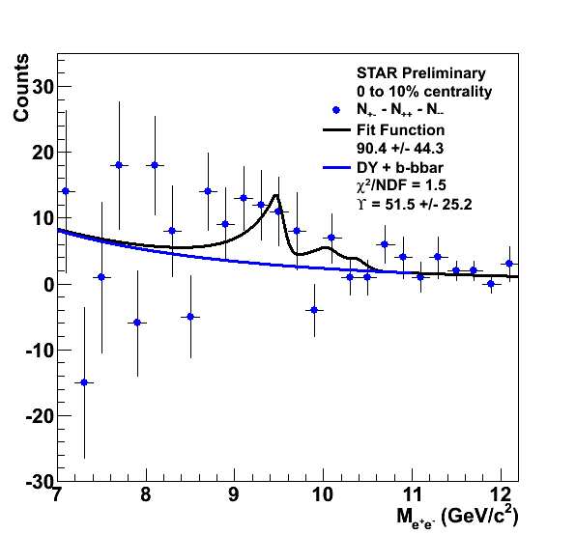
ϒ in Au+Au 200 GeV, Centrality
STAR Preliminary
STAR Preliminary
STAR Preliminary
Peripheral
Central

Slide 13
ϒ in Au+Au 200 GeV, R_{AA}

Slide 14
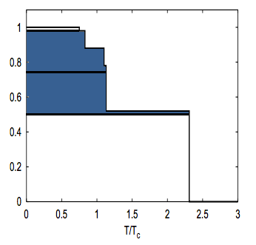
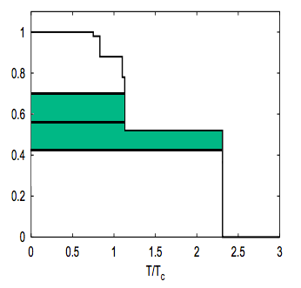
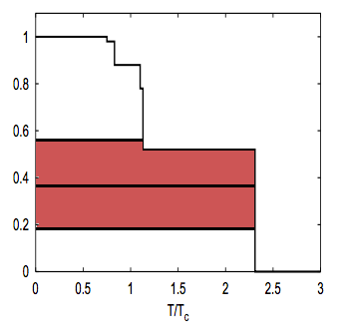
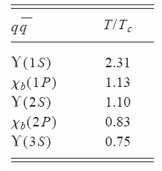
ϒ in Au+Au 200 GeV, Comparison
30-60% Centrality
STAR Preliminary
10-30% Centrality
STAR Preliminary
0-10% Centrality
STAR Preliminary
Lattice-based static model
S. Digal, P. Petreczky, and H. Satz, Phys Rev. D 64,094015 (2001)
Gives 1.1 ≤ T/T_{c} ≤ 2.3 for most central events
Consistent with only 1S survival

Slide 15
ϒ in Au+Au 200 GeV, Comparison
Assumes dynamic system evolution and feed-down
Model A uses Free Energy
Model B uses Internal Energy
The three curves cover a range 428 MeV ≤T₀≤442 MeV
Clearly, more statistics are needed to reach a conclusion
M. Strickland and D. Bazow, arXiv:1112.2761v4

Slide 16
Conclusions and Outlook
Measured ϒ production in p+p, d+Au, and Au+Au collisions at 200 GeV
Production in d+Au consistent with binary scaling and cold nuclear matter effects
Au+Au results consistent with complete 2S+3S suppression in central collisions
Increased statistics from run 11 will further decrease R_{AA} uncertainties

