Slide 1


J/ψ MEASUREMENTS AT STAR
Olga Hájková for STAR Collaboration
Faculty of Nuclear and Physical Sciences
Czech Technical University in Prague
The 28th Winter Workshop on Nuclear Dynamics
Dorado del Mar, Puerto Rico on April 7-14, 2012

Slide 2
Outline
Motivation for J/ψ measurements.
STAR detector and particle identification.
J/ψ production in p+p and Au+Au collisions.
J/ψ elliptic flow in semi-central Au+Au collisions.
J/ψ – hadron correlations.
J/ψ polarization in p+p collisions.
Future of J/ψ measurements.
Conclusions.

Slide 3
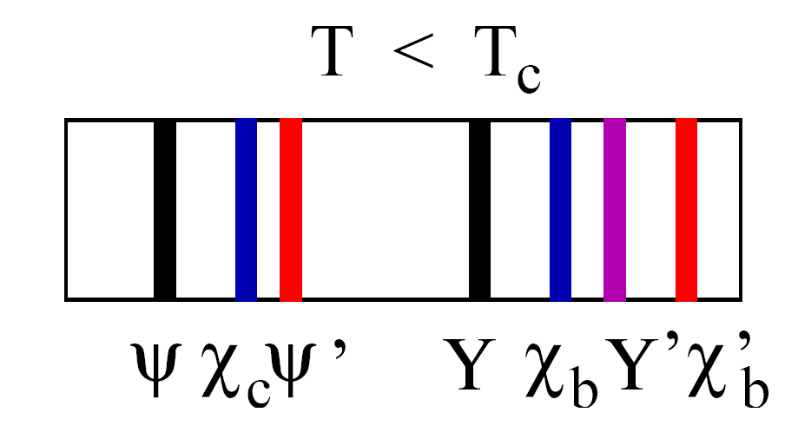
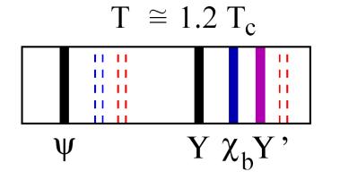
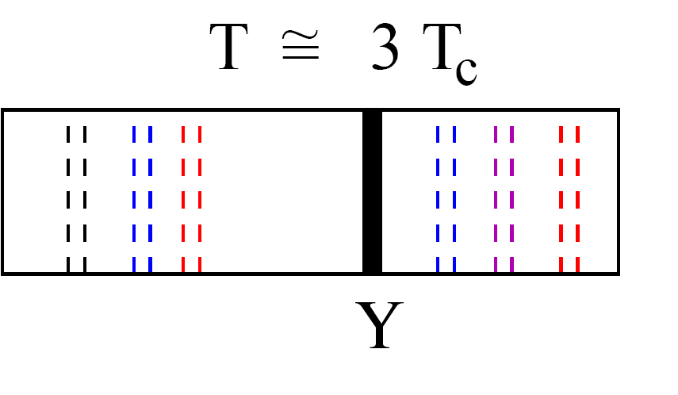
Quarkonia in nuclear matter
J/ψ could originate from different sources: direct production (production mechanism is unclear) and feeddowns from ψ', χ, B mesons.
With increasing temperature of nuclear matter the different quarkonium states “melt” sequentially as a function of their binding strength: the most loosely bound state disappears first, the ground state last. → QGP THERMOMETER. J/ψ at 200 GeV is expected to melt in central Au+Au collisions.
Also other effects as cold nuclear matter effects and regeneration could influence the observed yields.
H. Satz, Nucl. Phys. A (783):249-260(2007)

Slide 4
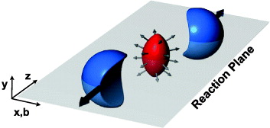
J/ψ elliptic flow v2 - motivation
J/ψ v2 measurement is a tool to decide if J/ψs come from charm quark and antiquark coalescence.
J/ψ produced by pQCD → small or zero v2
Recombinated J/ψ → large v2 (when charm quarks can flow)
Comparison with model allows consider the contribution from both – direct and recombinated J/ψ – to the total yield.
New J. Phys. 13 (2011) 055008

Slide 5
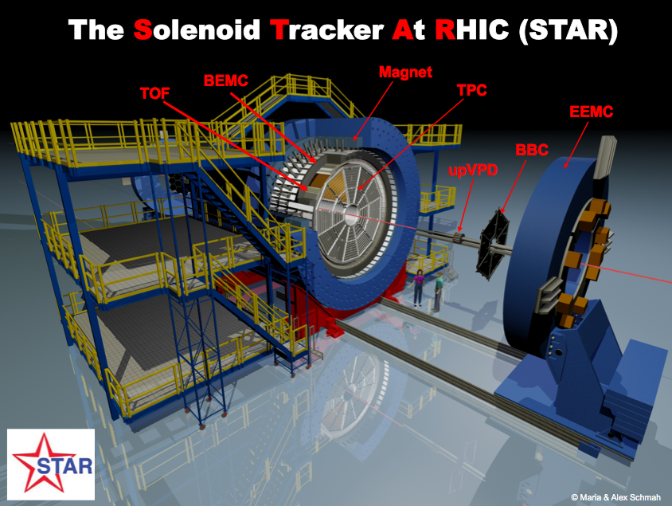
STAR detector at RHIC
Large acceptance:
|η|<1, 0<φ<2π
Time Projection Chamber – tracking, particle identification, momentum
Time of Flight detector – particle identification
BEMC – energy deposited in towers, triggering

Slide 6
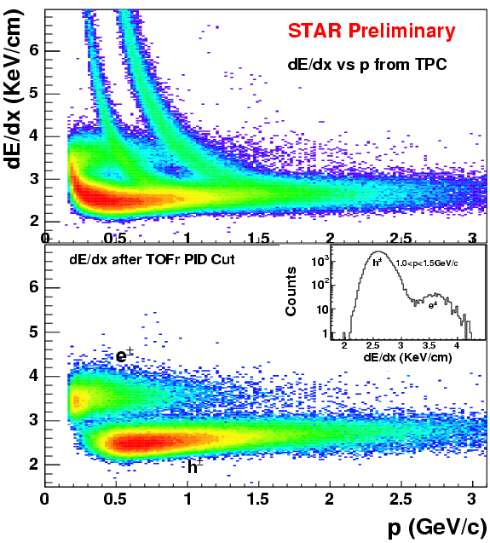
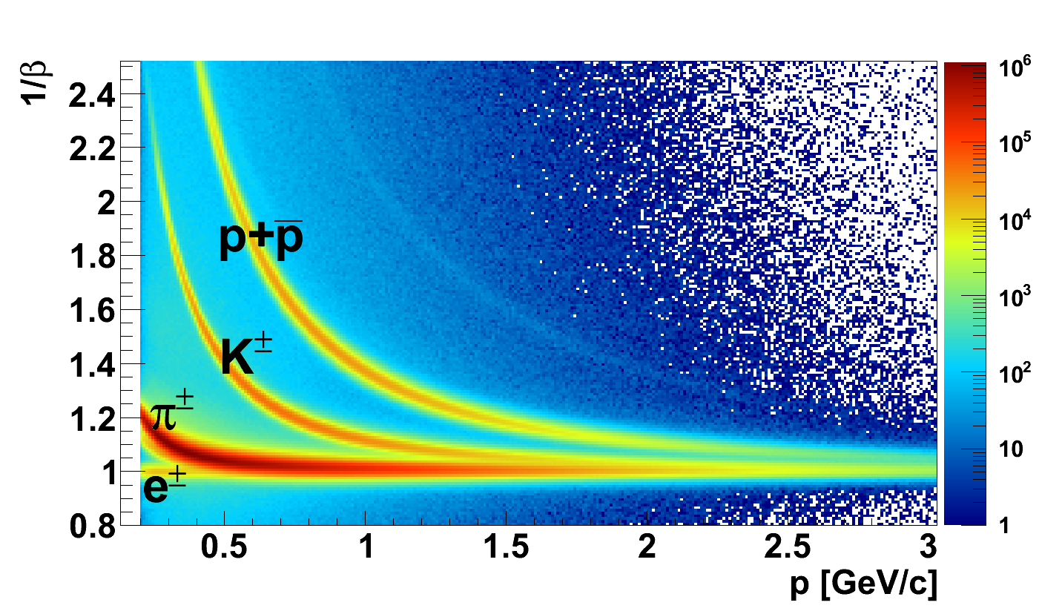
Electron identification
J/ψ are reconstructed via electron-positron decay channel (BR 5.9%).
Electrons are identified from:
TPC – dE/dx information, momentum
ToF - particle velocity 1/β
BEMC – E/p (energy deposited in tower)
TPC – particle energy loss
K
p
e
π
TPC and ToF together are great tool for distinguish electrons and hadrons in low p region.

Slide 7
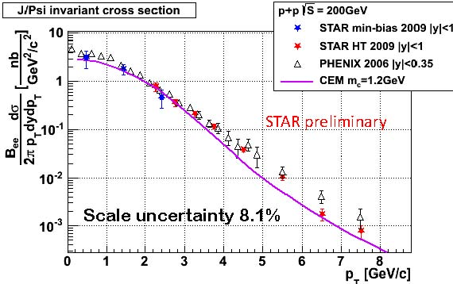
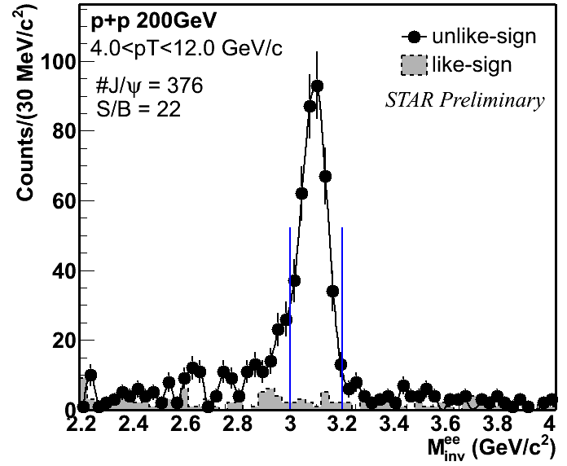
J/ψ spectra in p+p collisions at √s=200GeV
p+p spectrum as a baseline
arXiv:1107.0532v1 [hep-ex]
Signal was obtained via e+e- channel.
Strong signal for high pT.
Results are consistent with other measurements.

Slide 8
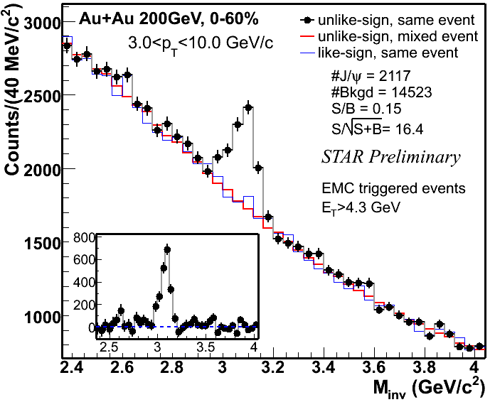
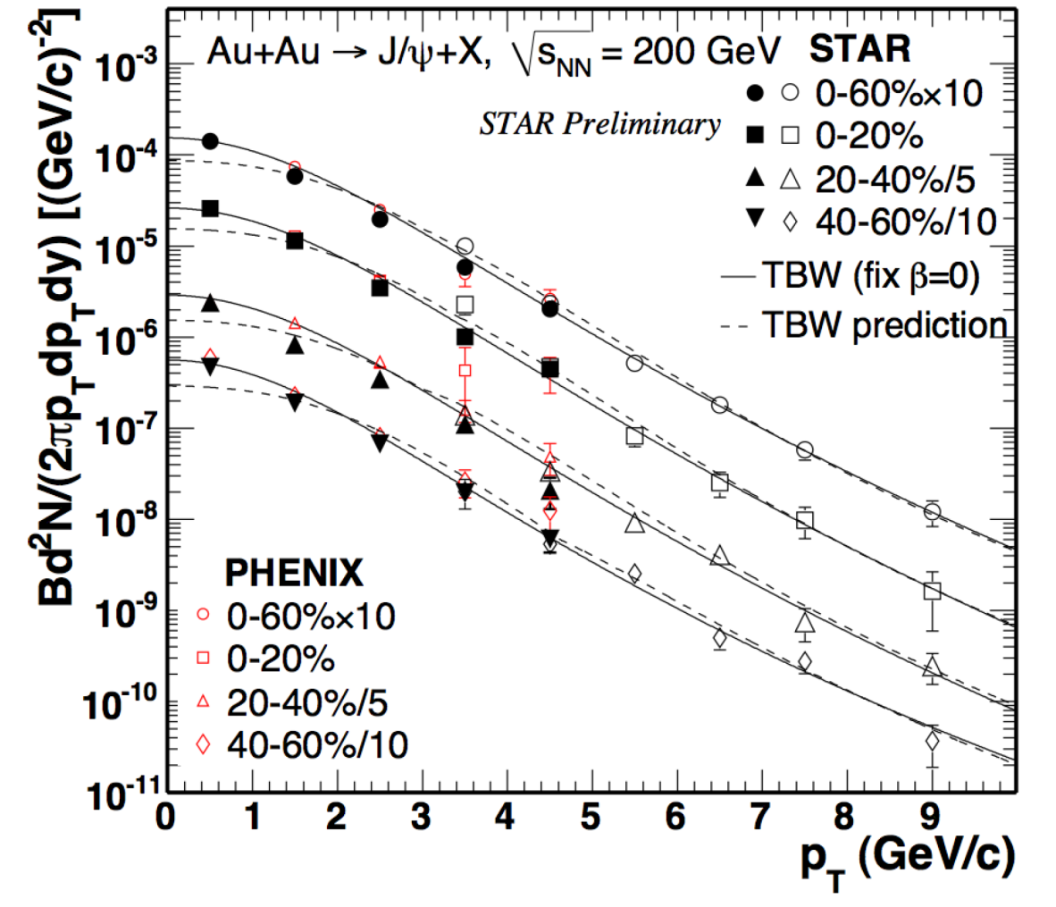
J/ψ spectra in Au+Au collisions at √sNN=200GeV
High significance.
Consistent with other RHIC measurements. Moreover we extend pT region up to 10GeV/c.
Measured spectra mismatch the blast wave model predictions from light hadrons in low pT region.
Phys. Rev. Lett. 98, 232301 (2007)
JPG 37, 085104 (2010)
ArXiv:1101.1912 (2011)

Slide 9
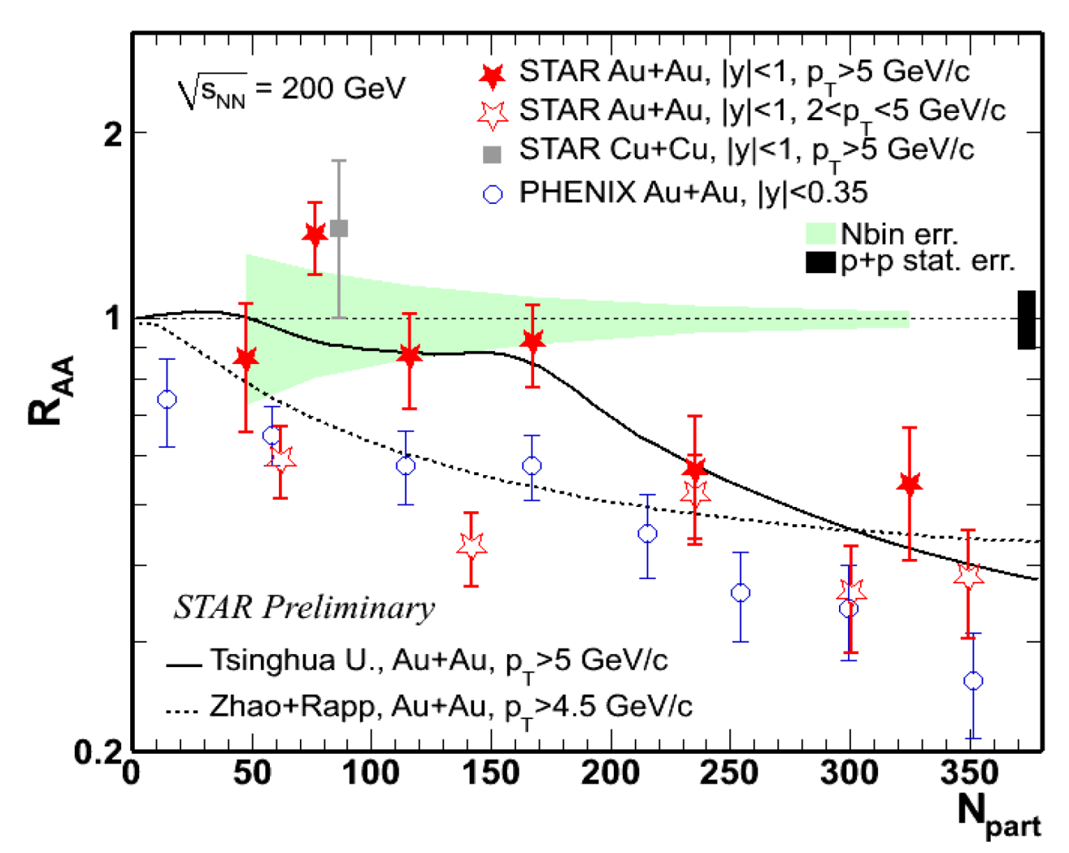
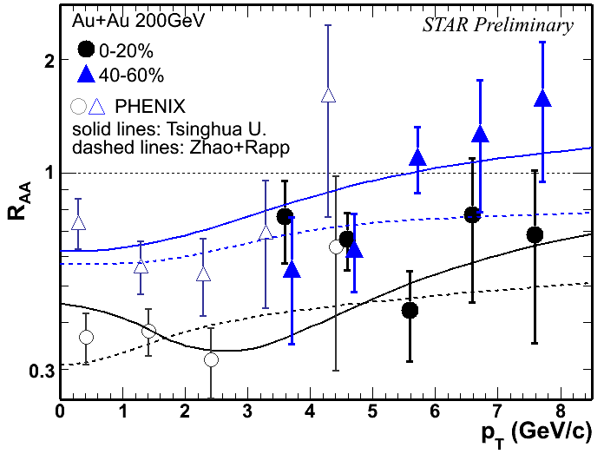
RAA in Au+Au collisions
Y. Liu, et al., PLB 678:72 (2009), Tsingua U.
X. Zhao and R.Rapp, PRC 82, 064905(2010)
STAR CuCu: PRC80, 014922(R), PLB 678:72 (2009), PRC 82,064905(2010)
PHENIX: PRL98, 232301
Suppression of J/ψ in central and semi-central collisions is observed.
RAA increases with pT and decreases with centrality.
At high pT suppression is present only in central collisions.

Slide 10
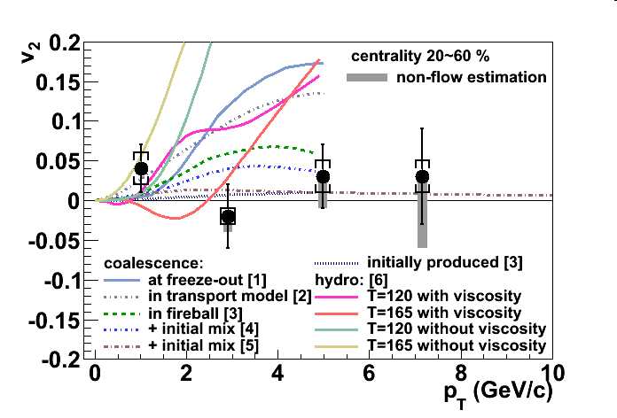
J/ψ elliptic flow v2 - results
STAR Preliminary
J/ψ v2 is consistent with zero at high-pT.
J/ψ v2 measurement disfavors coalescence from thermalized charm quarks.
7.8fm
MB
20-60%
MB
7.8fm
20-40%
7.8fm
[1] V. Greco, C.M. Ko, R. Rapp, PLB 595, 202.
[2] L. Ravagli, R. Rapp, PLB 655, 126.
[3] L. Yan, P. Zhuang, N. Xu, PRL 97, 232301.
[4] X. Zhao, R. Rapp, 24th WWND, 2008.
[5] Y. Liu, N. Xu, P. Zhuang, Nucl. Phy. A, 834, 317.
[6] U. Heinz, C. Shen, priviate communication.

Slide 11
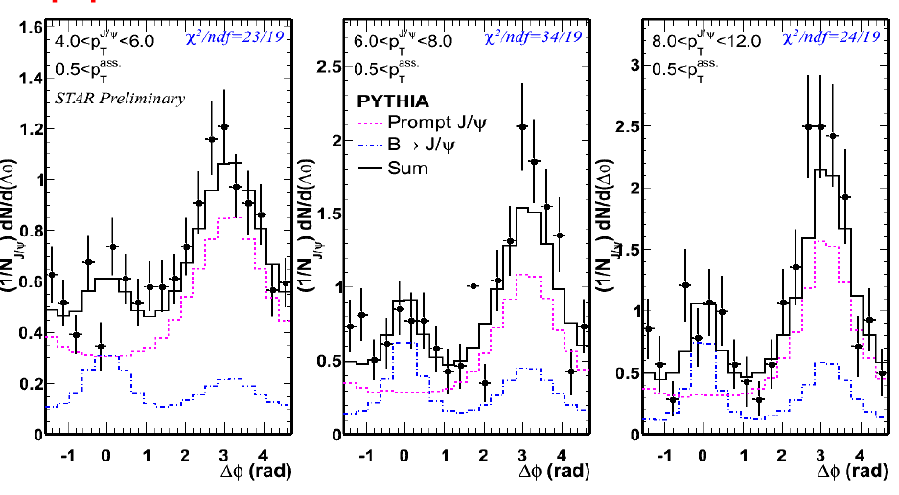
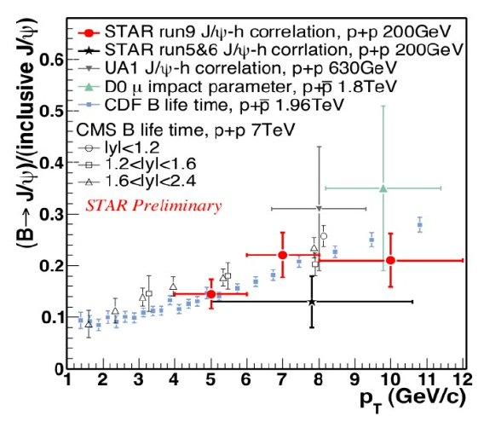
J/ψ – hadron correlation,
B → J/ψ feed down
J/ψ – hadron correlation.
.
Determination of B → J/ψ contibution to J/ψ production.
Comparision with other collaborations results shows no beam energy dependence.
Feed down contribution was established as 10-25 percent.
.

Slide 12
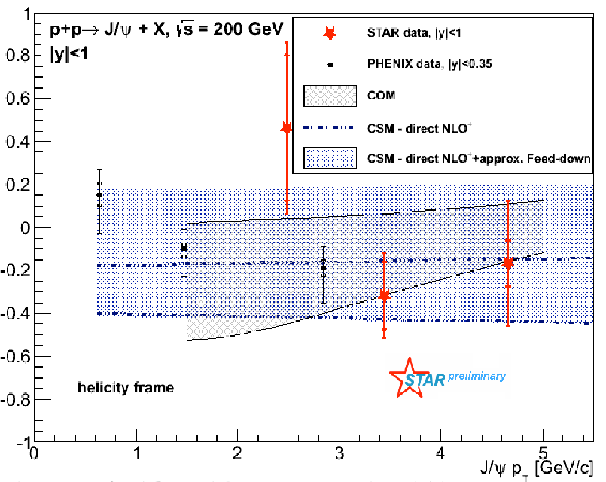
J/ψ polarization in p+p collisions at √s=200GeV
Measurement of J/ψ polarization may help to understand its production mechanism.
Each production model calculated with different J/ψ polarization.
Results are consistent with COM and CSM predictions.
PHENIX: Phys. Rev. D 82, 012001 (2010)
COM: Phys. Rev. D 81, 014020 (2010)
CSM NLO+: Phys. Lett. B, 695, 149 (2011)

Slide 13
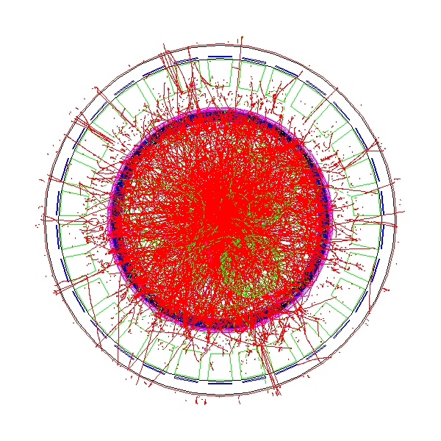
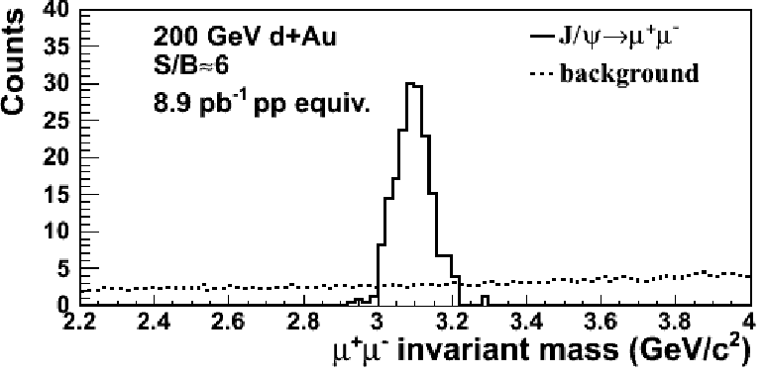
Muon Telescope Detector – future of J/ψ mesurements.
L. Ruan et al., Journal of Physics G: Nucl. Part. Phys. 36 (2009) 095001
Predictions for J/ψ: S/B=6 in d+Au and S/B=2 in central Au+Au.
Reconstruction of J/psi in central Au+Au collisions from low to high pT – excellent mass resolution.
MTD (MRPC): Multi-gap Resistive Plate Chamber. Gas detector.
With HFT together it will be possible to study B → J/ψ + X decays.

Slide 14
Conclusions
Spectra of J/ψ measured in Au+Au collisions mismatch the blast wave model predictions from light hadrons in low pT region.
J/ψ - The suppression was observed in central and semi-central collisions in Au+Au collisions. The suppression decreases with pT.
J/ψ v2 in Au+Au is consistent with zero at high pT. J/ψ v2 measurement disfavors coalescence from thermalized charm quarks.
B → J/ψ feed down contribution was determined as 10-25 percent.
Measurement of J/ψ polarization in mid-rapidity in p+p collisions is consistent with the COM and CSM predictions.

Slide 15
Thank you! :-)

Slide 16
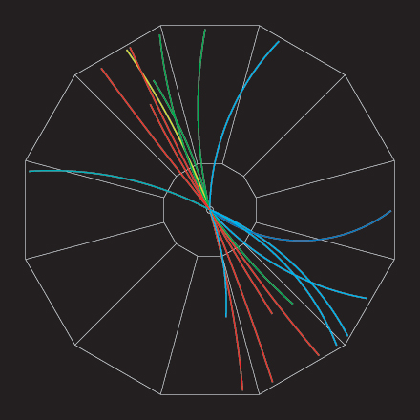
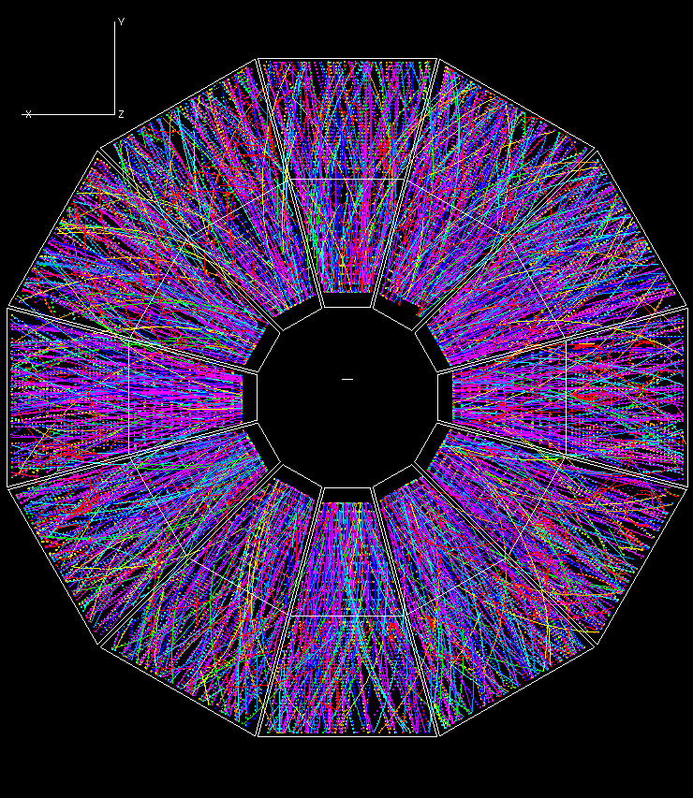
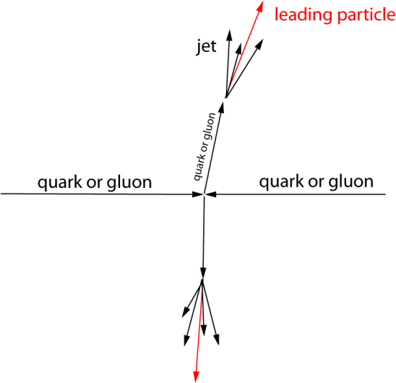
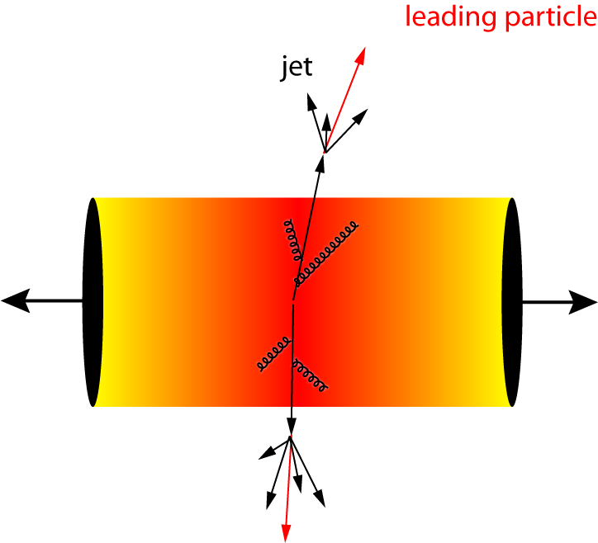
Hot and cold nuclear matter effects
nuclear modification factor RAA :
p+p
Au+Au
p+p collision as a baseline
RAA = 1 – no nuclear effect observed
RAA < 1 - suppression
Cold nuclear matter effects
(d+Au collisions, shadowing, nuclear absorption).
Hot nuclear matter effect
(Au+Au collisions, suppression, recombination).

