Slide 1
The status of high p_{T} Non-photonic electron-hadron correlations in AuAu 200GeV collisions
Wenqin Xu
University of California, Los Angeles
For the STAR collaboration
APS April meeting
01/May/2011
Anaheim, California

Slide 2
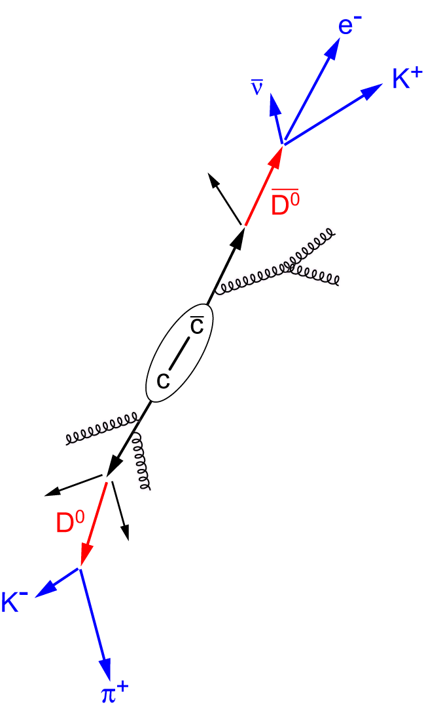
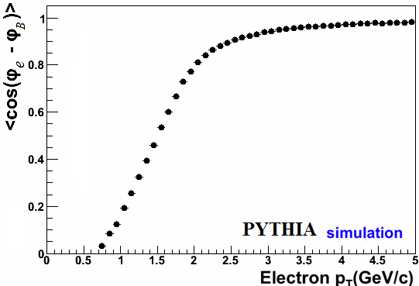
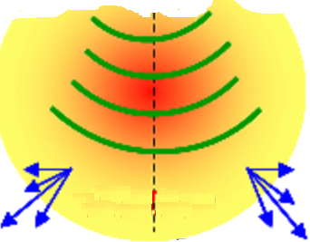
Non-photonic electrons (NPE)
Heavy quarks are good probes to study the QCD matter
NPE: semi-leptonic decays of open heavy quark hadrons
Heavy flavor daughter electrons represent
parent momentum direction well,
when p^{e}_{T} >1.5 GeV/c for D case,
and when p^{e}_{T} > 3 GeV/c for B case.
trigger
In AuAu central collisions:
Broadening is seen on the away side
of the NPE-hadron azimuthal correlations
Need to disentangle bottom and charm
contributions -- has been achieved in
Proton-Proton collisions via studying
the near side of NPE-hadron azimuthal
correlations

Slide 3
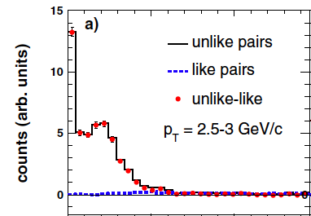
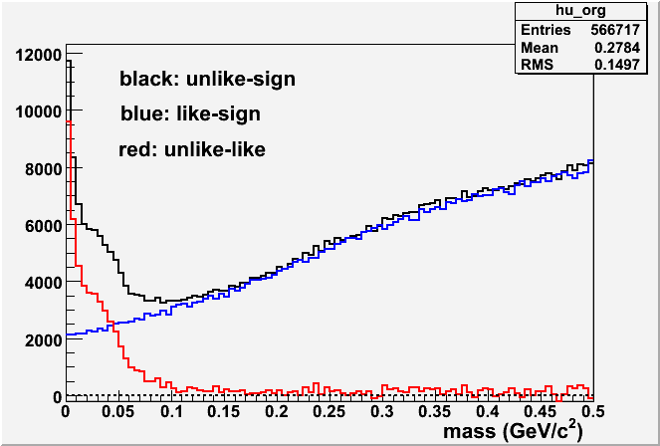
The background in NPE analysis
The main background is photonic electrons (PE):
Photon conversions in material
Dalitz decays of pseudoscalar mesons
Reconstruct the invariant masses of electron
pairs , apply opening angles cuts
PE estimated by unlike sign pairs subtracting
like sign pairs
Statistically subtract the contribution of PE in
the studies of electron yield and correlations
STAR Phys.Rev.D83 (2011) 052006
Hadron Contaminations controlled by
Ionization energy loss difference in STAR TPC gas
Electromagnetic shower energy and profile
Principle of the Analysis
One major approach to study heavy quark (charm and bottom) production in STAR is through measuring the electrons from their semi-leptonic decay (non-photonic electron, for short NPE).
There are primarily two types of photonic electron (PHE) background: photon conversion and Dalitz decays:
To identify the photonic electron via mass reconstruction and small mass cut, get its statistics using unlike-like method, then the electron decay from heavy quark is:
Here ε is photonic electron reconstruction efficiency.

Slide 4
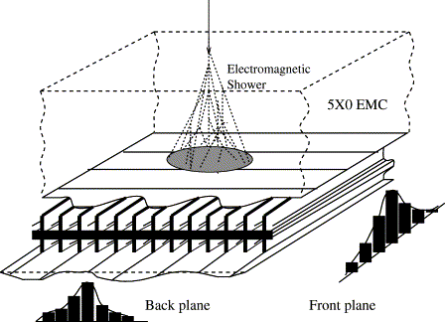
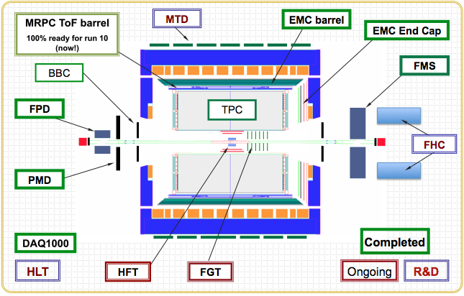
The detectors used in NPE analysis
BSMD: a wire proportional
counter - strip readout detector,
embedded at ~5.6 radiation
lengths depth in BEMC.
Two layers/planes of strips,
along eta and phi directions.
The major detectors used in NPE analysis:
Time Projection Chamber(TPC)
Barrel Electromagnetic Calorimeter(BEMC)
Barrel Shower Maximum Detector(BSMD)
Principle of the Analysis
One major approach to study heavy quark (charm and bottom) production in STAR is through measuring the electrons from their semi-leptonic decay (non-photonic electron, for short NPE).
There are primarily two types of photonic electron (PHE) background: photon conversion and Dalitz decays:
To identify the photonic electron via mass reconstruction and small mass cut, get its statistics using unlike-like method, then the electron decay from heavy quark is:
Here ε is photonic electron reconstruction efficiency.

Slide 5
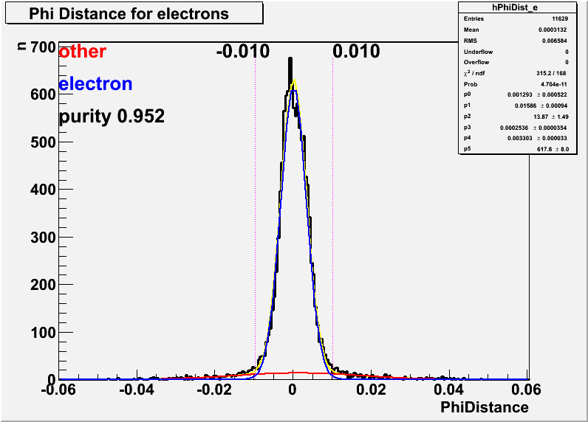
High tower triggers
High tower triggers (equivalently) require the highest transverse energy (E_{T}) measured by
BEMC towers in an event exceeding certain energy thresholds
4 different high tower triggers in Run10 at STAR:
NPE11 with E_{T} > 2.64GeV, NPE15 with E_{T} > 3.6GeV
NPE18 with E_{T} > 4.3GeV, NPE25 with E_{T} > 6.0GeV
For example: ~1.4(nb)⁻¹ NPE18 events were collected (the dataset for following figures)
To identify high p_{T} electrons,
TPC track – high energy BEMC tower
matching is required
Principle of the Analysis
One major approach to study heavy quark (charm and bottom) production in STAR is through measuring the electrons from their semi-leptonic decay (non-photonic electron, for short NPE).
There are primarily two types of photonic electron (PHE) background: photon conversion and Dalitz decays:
To identify the photonic electron via mass reconstruction and small mass cut, get its statistics using unlike-like method, then the electron decay from heavy quark is:
Here ε is photonic electron reconstruction efficiency.

Slide 6
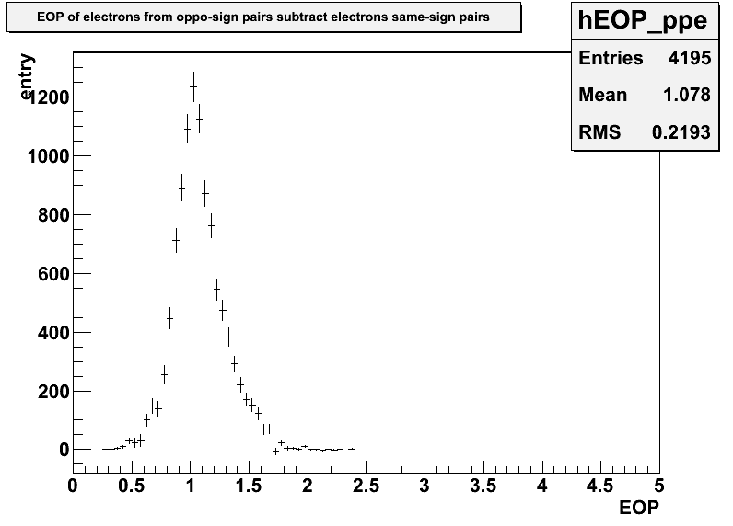
Electron/hadron separation: Tower Energy over TPC momentum ratio
Electrons deposit most of their energy into BEMC
->
Tower Energy over TPC momentum ratio (E/P) ~ 1
Not necessary for hadrons!
Principle of the Analysis
One major approach to study heavy quark (charm and bottom) production in STAR is through measuring the electrons from their semi-leptonic decay (non-photonic electron, for short NPE).
There are primarily two types of photonic electron (PHE) background: photon conversion and Dalitz decays:
To identify the photonic electron via mass reconstruction and small mass cut, get its statistics using unlike-like method, then the electron decay from heavy quark is:
Here ε is photonic electron reconstruction efficiency.

Slide 7
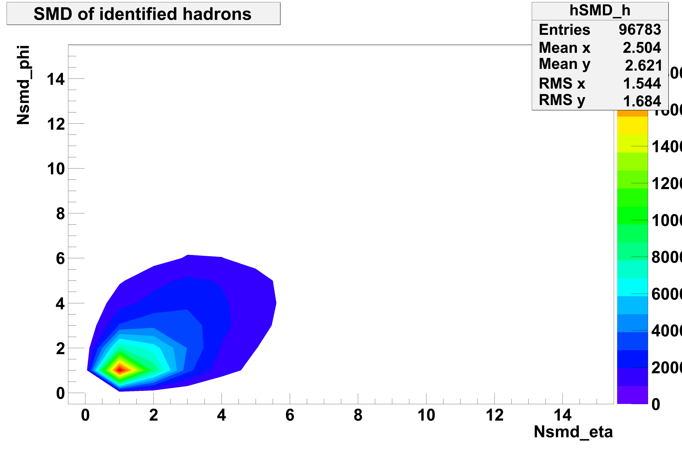
Electron/hadron separation: BSMD shower profile – number of strips
Electrons showers are widely developed,
firing several BSMD strips.
Hadron shower are much less developed,
firing most times one and sometimes two
strips
Number of BSMD strips
in eta and phi plane
of a clean electron
sample (identified
as photonic electrons).
Number of BSMD strips
of a clean hadron
sample (excludes electrons
via ionization energy loss
in TPC).
Principle of the Analysis
One major approach to study heavy quark (charm and bottom) production in STAR is through measuring the electrons from their semi-leptonic decay (non-photonic electron, for short NPE).
There are primarily two types of photonic electron (PHE) background: photon conversion and Dalitz decays:
To identify the photonic electron via mass reconstruction and small mass cut, get its statistics using unlike-like method, then the electron decay from heavy quark is:
Here ε is photonic electron reconstruction efficiency.

Slide 8
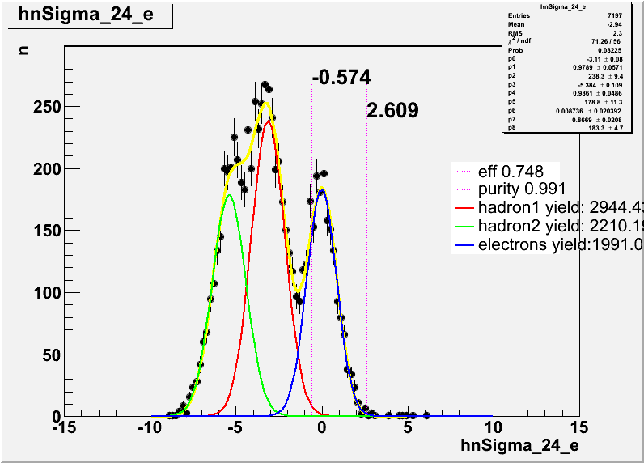
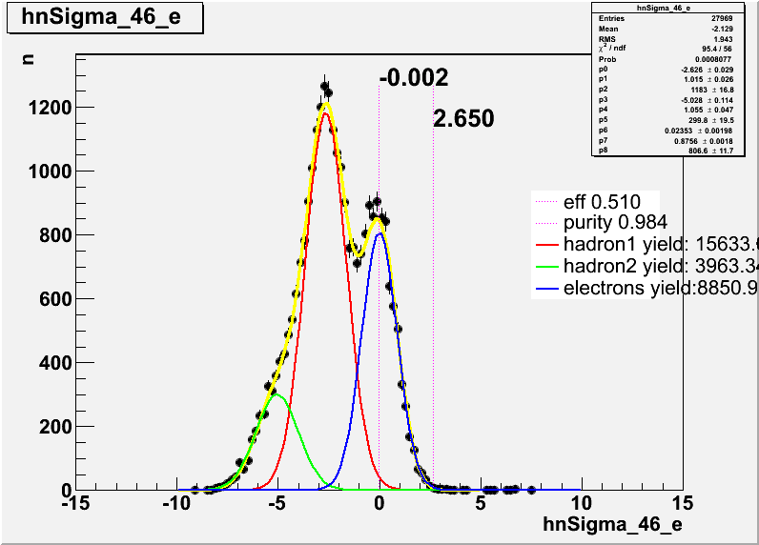
Electron/hadron separation:
Nσ_{electron} distribution
[1]:H. Bichsel, Nucl. Instrum. Methods Phys. Res., Sect. A
562, 154 (2006).
1
Nσ_{e} for 3<p_{T}<4GeV
Nσ_{e} for 4<p_{T}<6GeV
h1
With cuts: 0.5<E/P<1.7
Nbsmde>1 && Nbsmdp>1
h1
e
e
h2
h2
Final hadron contamination can be under 2%, while maintaining reasonable efficiency

Slide 9
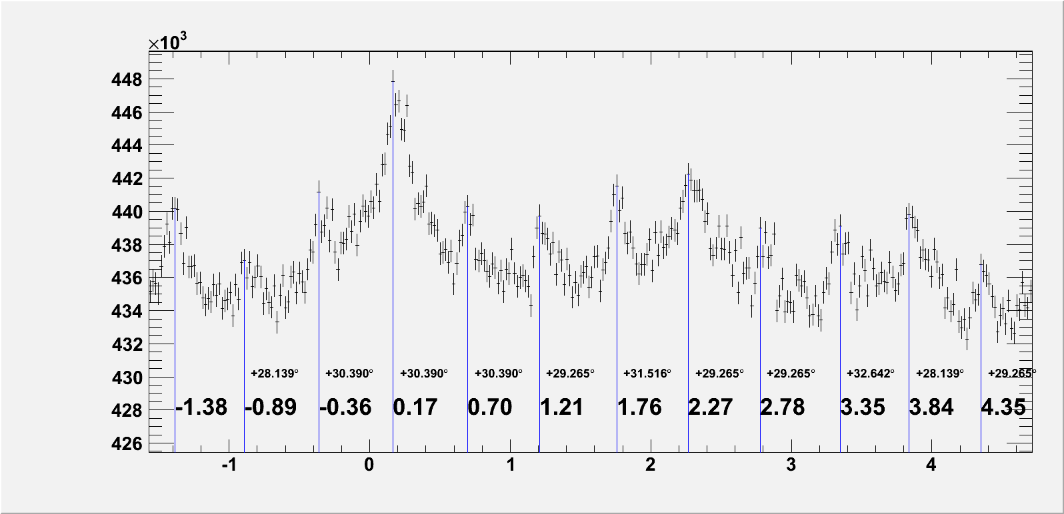
Backgrounds: Detector effects and flow
There was a mal-function TPC sector in the negative eta side.
This bad sector will create an enhancement effect in the near side
in the two particle azimuthal correlations
Two particle hadron azimuthal correlations from mixed events are
used to correct this type of detector effect.
An example of two particle hadron azimuthal correlations from mixed events:
high p_{T} TPC tracks from one event combined with low p_{T} TPC tracks from another event
ϕ(rad)
The elliptic flows of trigger
NPEs and associated hadrons also
contribute into a background
Extensive studies are under way.
Δϕ(rad)

Slide 10
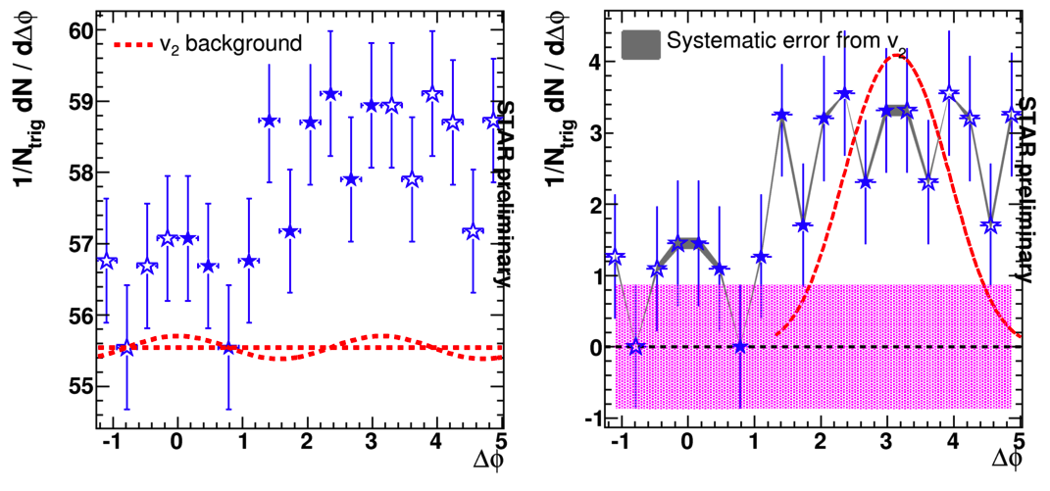
Summary
The study of NPE-hadron correlation from Run10 is progress.
Thanks to DAQ 1000, we have collect large data sample in Run10
~ 60Million NPE18 events
Since we have removed SVT SSD, Run10 is with low photonic electron background.
→
Expect much smaller uncertainties on NPE-hadron correlations
The uncertainties could reduce by a factor
of ~4 at certain centrality bins.
Stay tuned!
NPE-hadron correlations
Bertrand Biritz for STAR, Quark Matter 2009

Slide 11
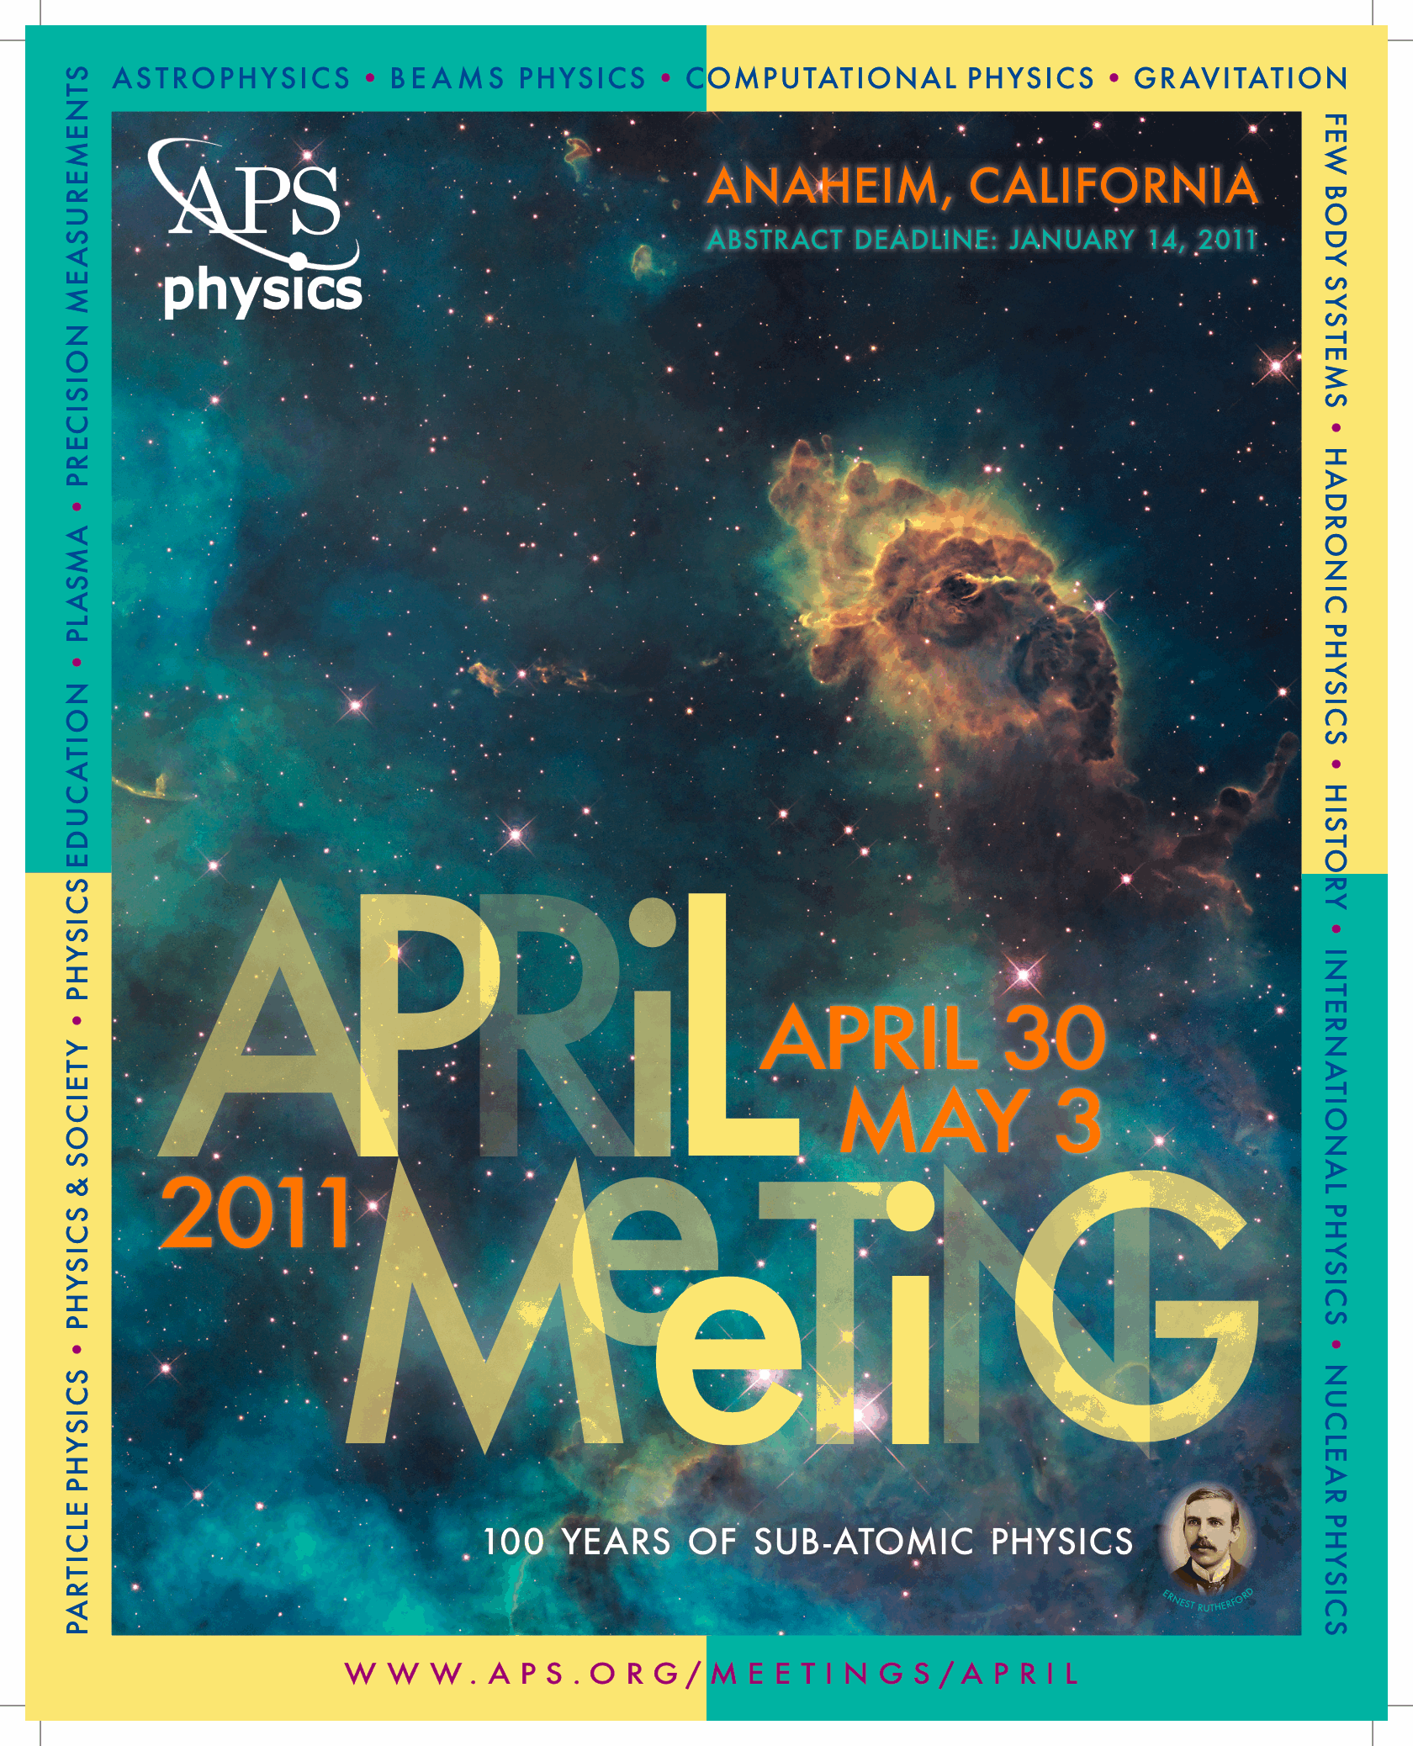
backup

Slide 12
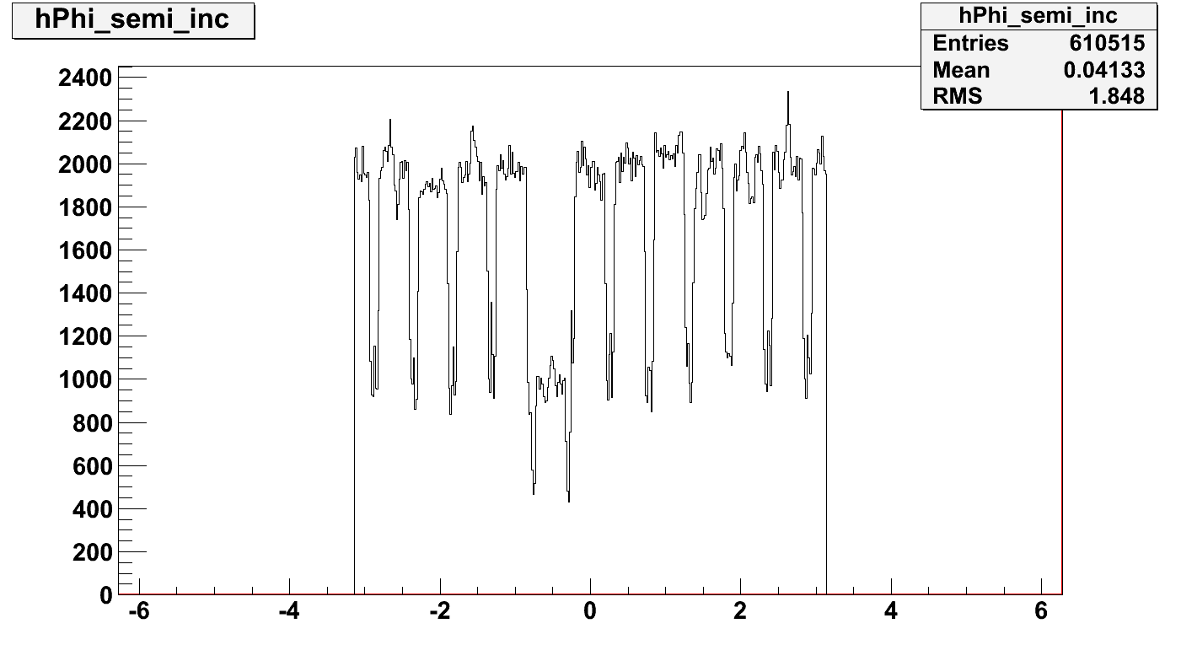
Phi angle in TPC for trigger hadrons
Type 2
Type 1
There are 12X2 sectors,
the boundary inefficiency is also high
Type 1
The enhancement of hole + hole
at 1 position
Phi angle in TPC for
associated hadrons
0.5-1GeV
Type 2:
The enhancement of boundaries + bad sector
Is at 12 positions (eta->X2)
ϕ

