Slide 1


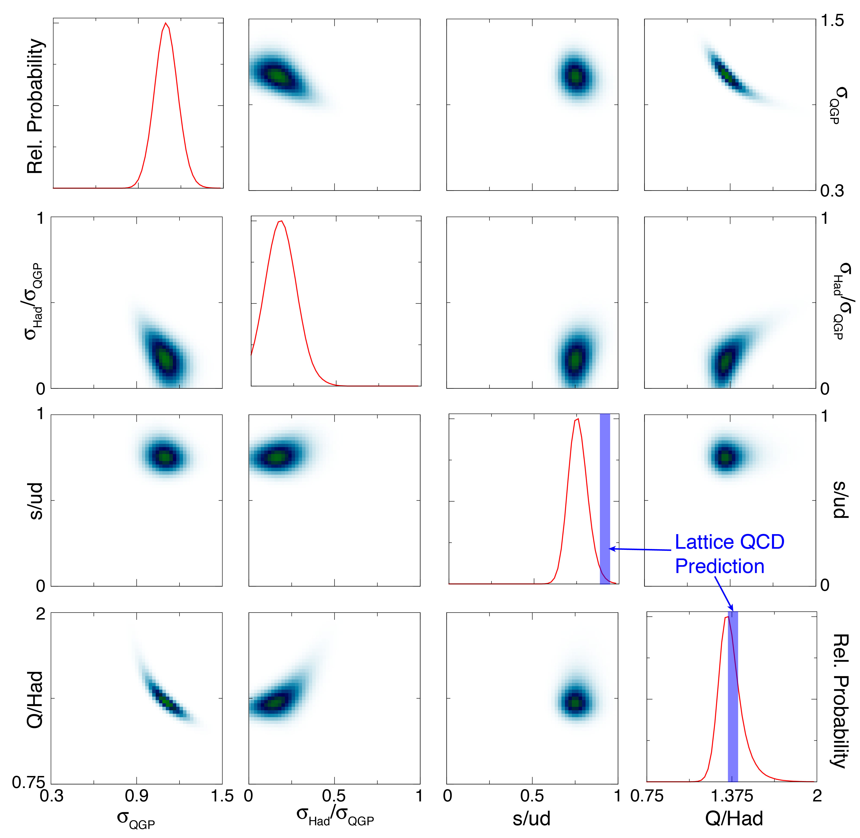


Measurements of the Charge Balance Function at RHIC from √s_{NN} = 7.7 to 200 GeV
Gary D. Westfall, for the STAR Collaboration (Michigan State University)
Abstract The balance function, which measures the correlations between opposite sign charge pairs, is sensitive to the mechanisms of charge formation and the subsequent relative diffusion of the balancing charges. The study of the balance function can provide information about charge creation times as well as the subsequent collective behavior of particles. We present charge balance functions in terms of relative pseudorapidity from Au+Au collisions at incident energies ranging from √s_{NN} = 7.7 to 200 GeV and compare these results with recent results for Pb+Pb collisions at √s_{NN} = 2.76 TeV from the ALICE Collaboration [1]. We find that the charge balance function narrows as the collisions become more central and as the incident energy increases. This behavior is consistent with the concept of delayed hadronization of a deconfined quark-gluon plasma (QGP). We also present balance functions in terms of relative rapidity for identified π⁺π⁻ pairs, K⁺K⁻ pairs, proton-antiproton pairs, and pK⁻ pairs from central Au+Au collisions at √s_{NN} = 200 GeV. We compare to a model [2] that relates these balance functions to the correlations of deconfined up, down, and strange quarks in the QGP that is created in central Au+Au collisions at √s_{NN} = 200 GeV. We find our results are consistent with two waves of quark creation in time, one early in the collision (≈1 fm/c) and a second occurring at hadronization (≈5-10 fm/c). We find that the densities of up, down, and strange quarks in the QGP extracted from the model comparison are consistent with current lattice gauge calculations.
[1] ALICE Collaboration, Phys. Lett. B 723, 267 (2013).
[2] Scott Pratt, Phys. Rev. Lett. 108, 212301 (2012); Scott Pratt, Phys. Rev. C 85, 014904 (2012); Scott Pratt, PoS(CPOD 2013)023.
Balance Functions from RHIC Beam Energy Scan – Delayed Hadronization of the QGP
We have analyzed Au+Au collisions from the BES (7.7, 11.5, 19.6, 27, 39, 62.4, and 200 GeV)
Balance functions measured for all charged particles with 0.2 < p_{t} < 2.0 GeV/c and |η| < 1.0 in terms of Δη
The balance function can be written as
To compare with the ALICE results, we have corrected the STAR results for acceptance in η
We have reanalyzed ALICE’s results using a lower cut in Δη as previously done by STAR to remove HBT and coulomb effects
The balance function narrows in central collisions
The balance function narrows as the incident energy is raised
Phys. Lett. B
723, 267 (2013)
We divide the measured widths by the width of the balance function in the most peripheral bin
The relative widths narrow in central collisions and at higher energies
This argues in favor of delayed hadronization
The fact that we still see a narrowing of the balance function at 7.7 GeV implies that we still have a QGP at 7.7 GeV
Band represents
systematic error
Generalized Balance Functions – Chemistry of the QGP
Scott Pratt predicts that two waves of quark creation can be studied using balance functions
  Scott Pratt, Phys. Rev. Lett. 108, 212301 (2012)
The first wave occurs ≈1 fm/c after the collision when the gluons thermalize into the QGP
The second wave of quark production occurs after an isentropic expansion when hadronization occurs around ≈5-10 fm/c
  The majority of quark production takes place in the second wave
  The generalized balance function can be written as
Au+Au, 0-5%, 200 GeV
TPC+TOF particle identification
  Pions and kaons: p_{t} > 0.2 GeV/c, p < 1.6 GeV/c
  Protons: p_{t} > 0.4 GeV/c, p < 3.0 GeV/c
The decay ϕ ⟶ K⁺ + K⁻ is suppressed for the kaon balance function
4 parameter fit was done to B(Δy) for pion pairs, kaon pairs, proton pairs, and pK⁻ pairs
Used STAR efficiency code to calculate measured balance functions
Comparison of Pratt’s model [Scott Pratt, PoS(CPOD 2013)023] to STAR data:
  The ratio of strange quarks to up and down quarks
    s/u = s/d = 0.75
      Expected from LQCD: 0.9 – 0.95
  The ratio of the number of quarks in QGP to the number of final state hadrons
    Q/Had = 1.35
      Expected from LQCD: 1.4
    This is the first time that the chemistry of the quark gluon plasma has been directly measured

