Slide 1




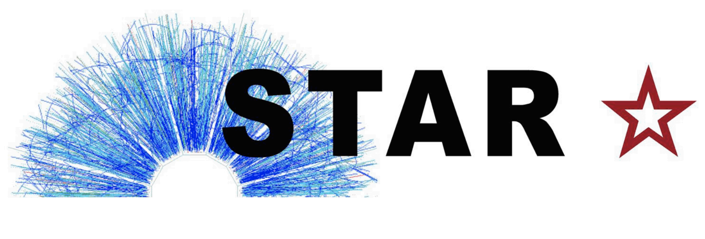
Probing gluon saturation through two-particle correlations at STAR and the EIC
Xiaoxuan Chu (for the STAR Collaboration)
Brookhaven National Laboratory
Sep 6th 2023
Supported by

Slide 2
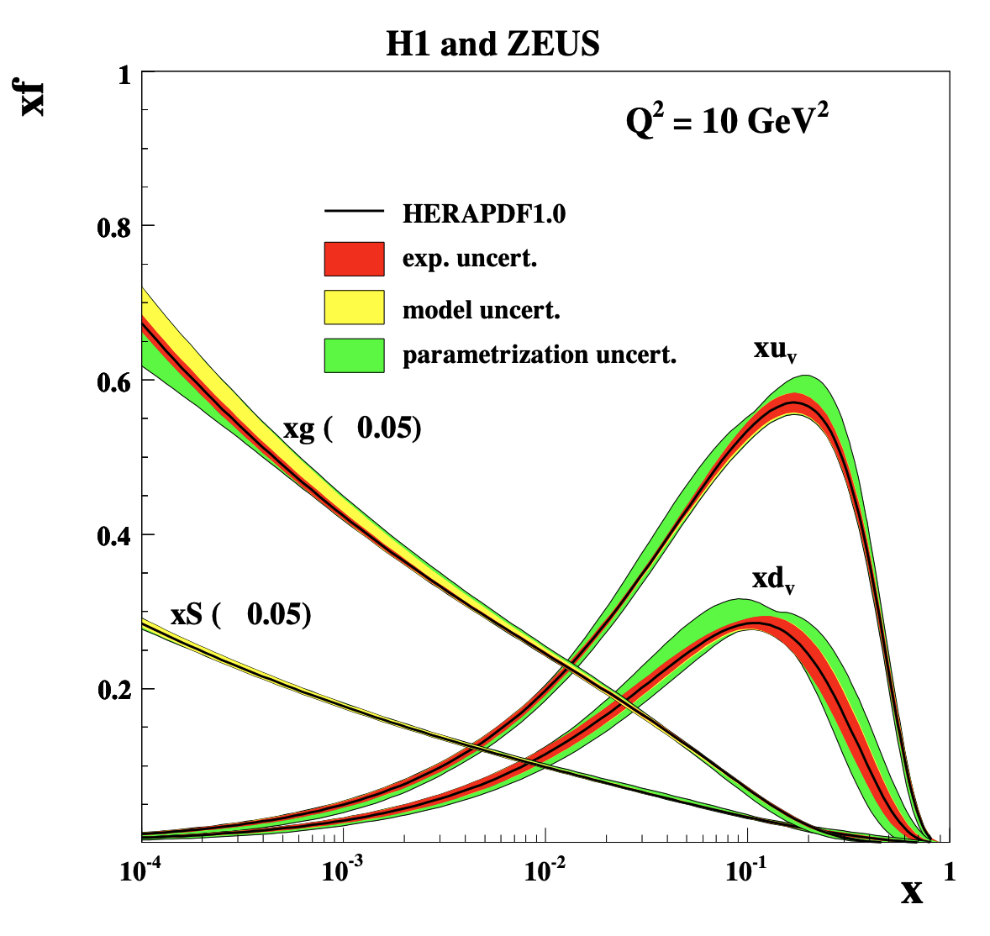
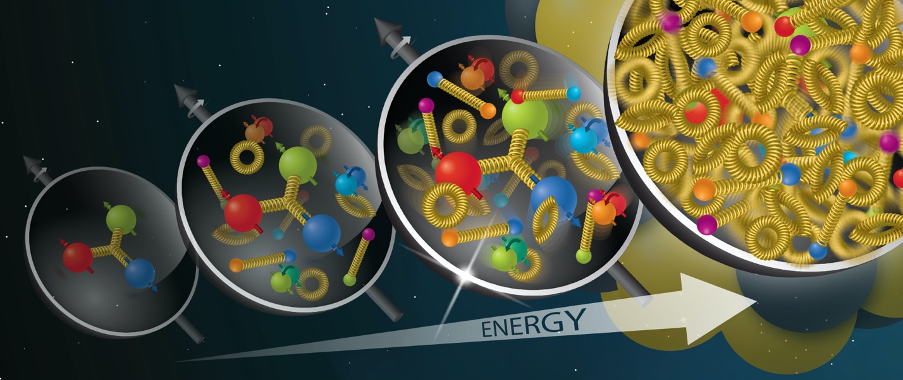
High gluon density in nucleon
H1 and ZEUS, JHEP01 (2010) 109
Particles from high energy collisions can be used to probe and take “snap shots” of the partonic structure of the proton.
Results from DIS: At sufficiently small $x$, the wave function of the proton is dominated by gluons and the gluon density has to be saturated at some point.

Slide 3
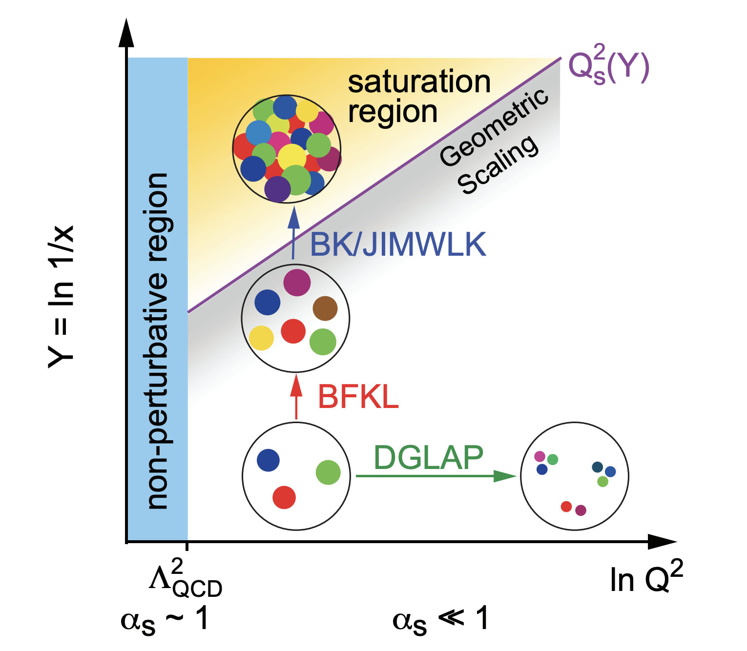
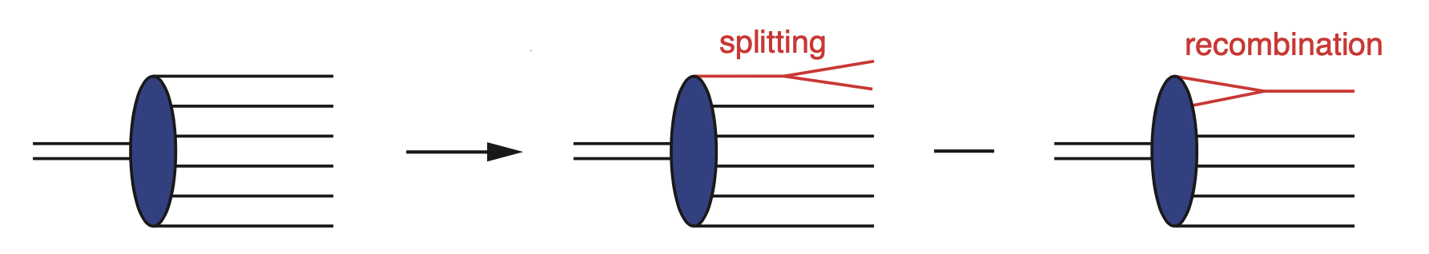

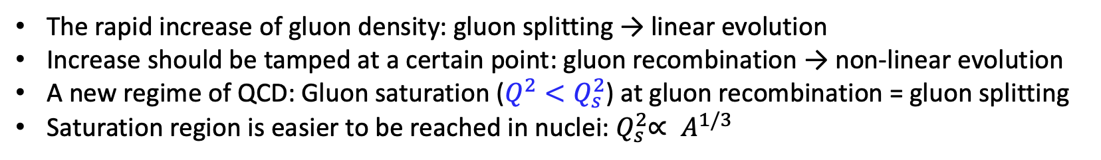
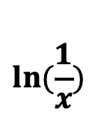

Gluon saturation
Balitsky-Fadin-Kuraev-Lipatov (BFKL) evolution equation
Balitsky-Kovchegov (BK) evolution equation
Color Glass Condensate (CGC) framework
Gluon density
$$ln⁡(\frac{1}{x})$$
$\frac{∂N(x)}{∂ln⁡(1/x)}=α_{s}K_{BFKL}⨂N\left(x\right) −$ ${ α}_{s}N^{2}\left(x\right)$
linear nonlinear
$$ln⁡(Q^{2})$$
The rapid increase of gluon density: gluon splitting → linear evolution
Increase should be tamped at a certain point: gluon recombination → non-linear evolution
A new regime of QCD: Gluon saturation ($Q^{2}<Q_{s}^{2}$) at gluon recombination = gluon splitting
Saturation region is easier to be reached in nuclei:${ Q}_{s}^{2}∝ A^{1/3}$
How to probe nuclear gluon distributions at saturation region?

Slide 4
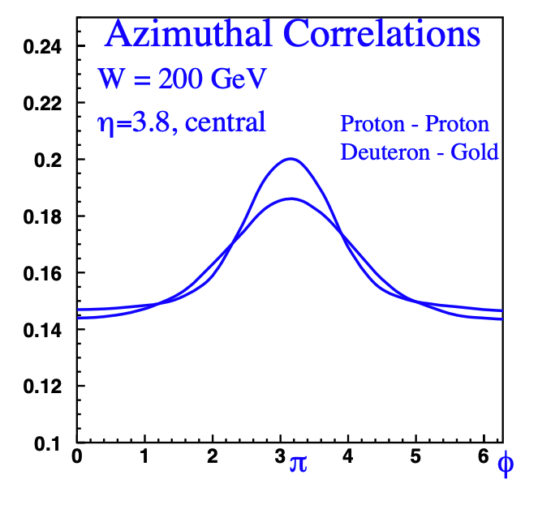





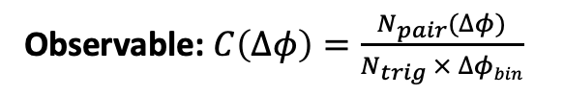



Di-hadron measurement
CGC successfully predicted the strong suppression of the inclusive hadron yields in d+Au relative to p+p by gluon saturation effects → nuclear modified fragmentation serves as another interpretation?
Di-hadron as another observable provides further test, was first proposed by D. Kharzeev, E. Levin and L. McLerran from NPA 748 (2005) 627-640.
$$x_{1}$$
$$x_{2}$$
$$x_{1}$$
$$x_{2}$$
p
p
d/p
Au
$$C\left(∆φ\right)$$
p: non-saturated
Au: saturated
$$p_{T1}=1.5 GeV$$
$$p_{T2}=0.2−1.5 GeV$$
Di-hadron in p+p serves as a baseline: 2-to-2 process.
CGC predicts a back-to-back suppression and a broadening phenomena when gluon saturation appears.
$∆φ$ [rad]
Observable: $C\left(∆φ\right)=\frac{N_{pair}(∆φ)}{N_{trig} × ∆φbin}$

Slide 5
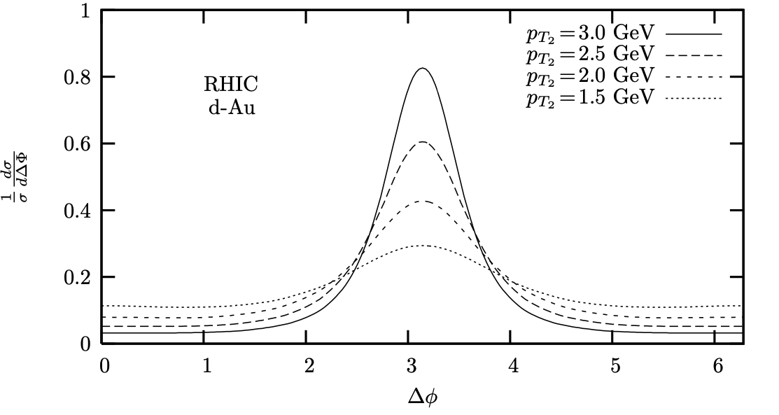
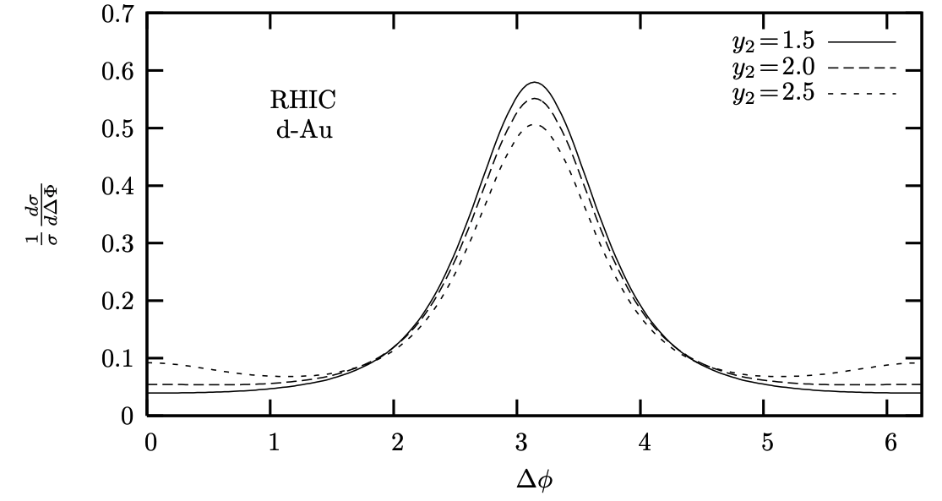
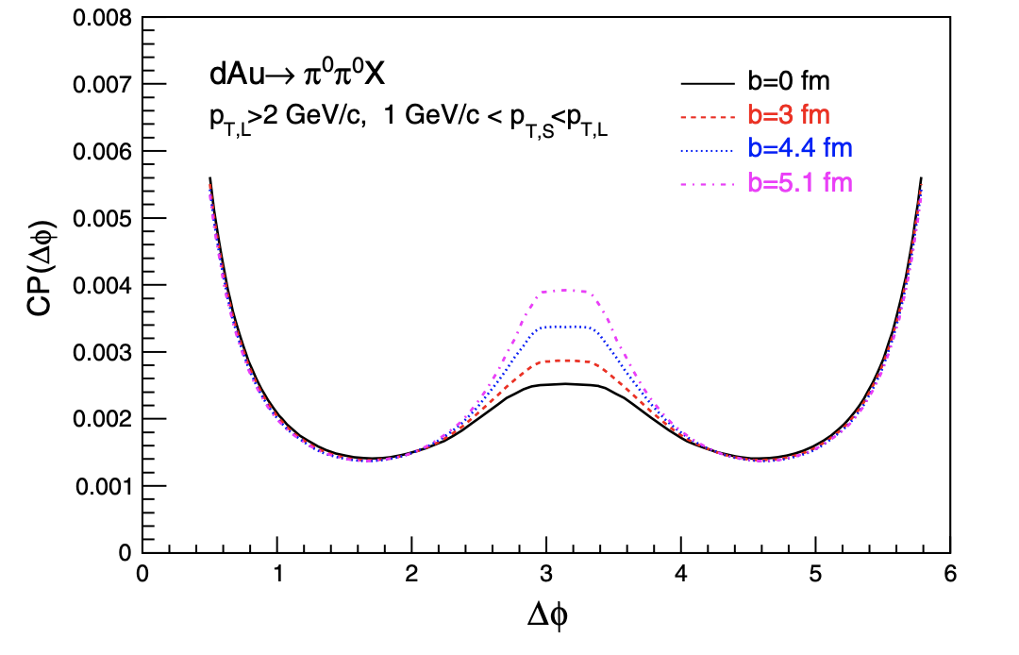
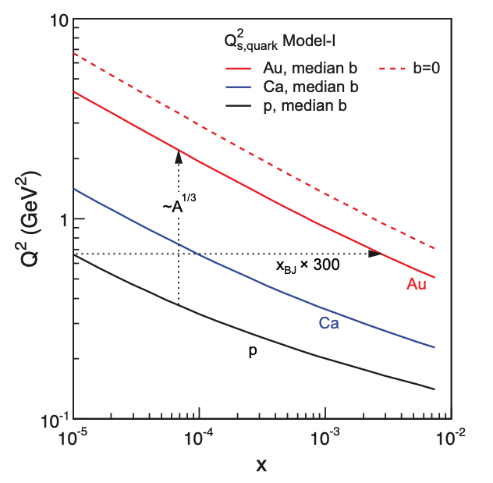

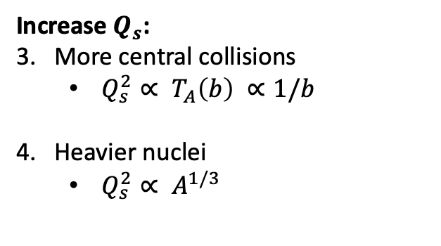









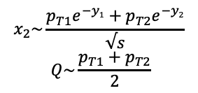

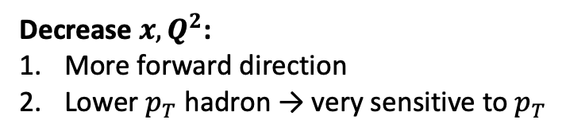
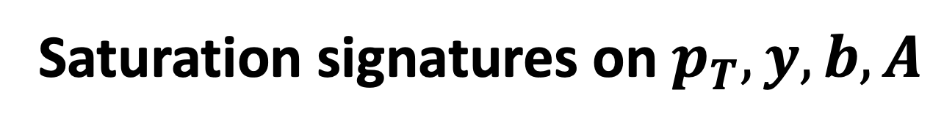


Saturation signatures on $p_{T},y, b, A$
Decrease $x,Q^{2}$:
More forward direction
Lower $p_{T}$ hadron → very sensitive to $p_{T}$
C. Marquet, NPA 796, 41 (2007)
C. Marquet, NPA 796, 41 (2007)
$$p_{T1}=3.5 GeV$$
$$y_{1}=3.5$$
y₁, p_{T1}
$$p_{T1}=3.5 GeV$$
$$p_{T2}=2.0 GeV$$
$$C(∆ϕ)$$
$$y_{1}=3.5,y_{2}=2.0$$
$$C(∆ϕ)$$
varying $p_{T}$
varying $y$
large $x_{1}$
small $x_{2}$
$$x_{2}\sim \frac{p_{T1}e^{−y1}+p_{T2}e^{−y2}}{√s}$$
$$Q\sim \frac{p_{T1}+p_{T2}}{2}$$
p
A
y₂, p_{T2}
J. L. Albacete et al., PRL 105, 162301 (2010)
A. Accardi et al., arXiv 1212.1701
Increase $Q_{s}$:
3. More central collisions
  $Q_{s}^{2}∝ T_{A}\left(b\right) ∝1/b$
4. Heavier nuclei
  $Q_{s}^{2}∝ A^{1/3}$
varying $b$
varying $A$
$$C(∆ϕ)$$

Slide 6
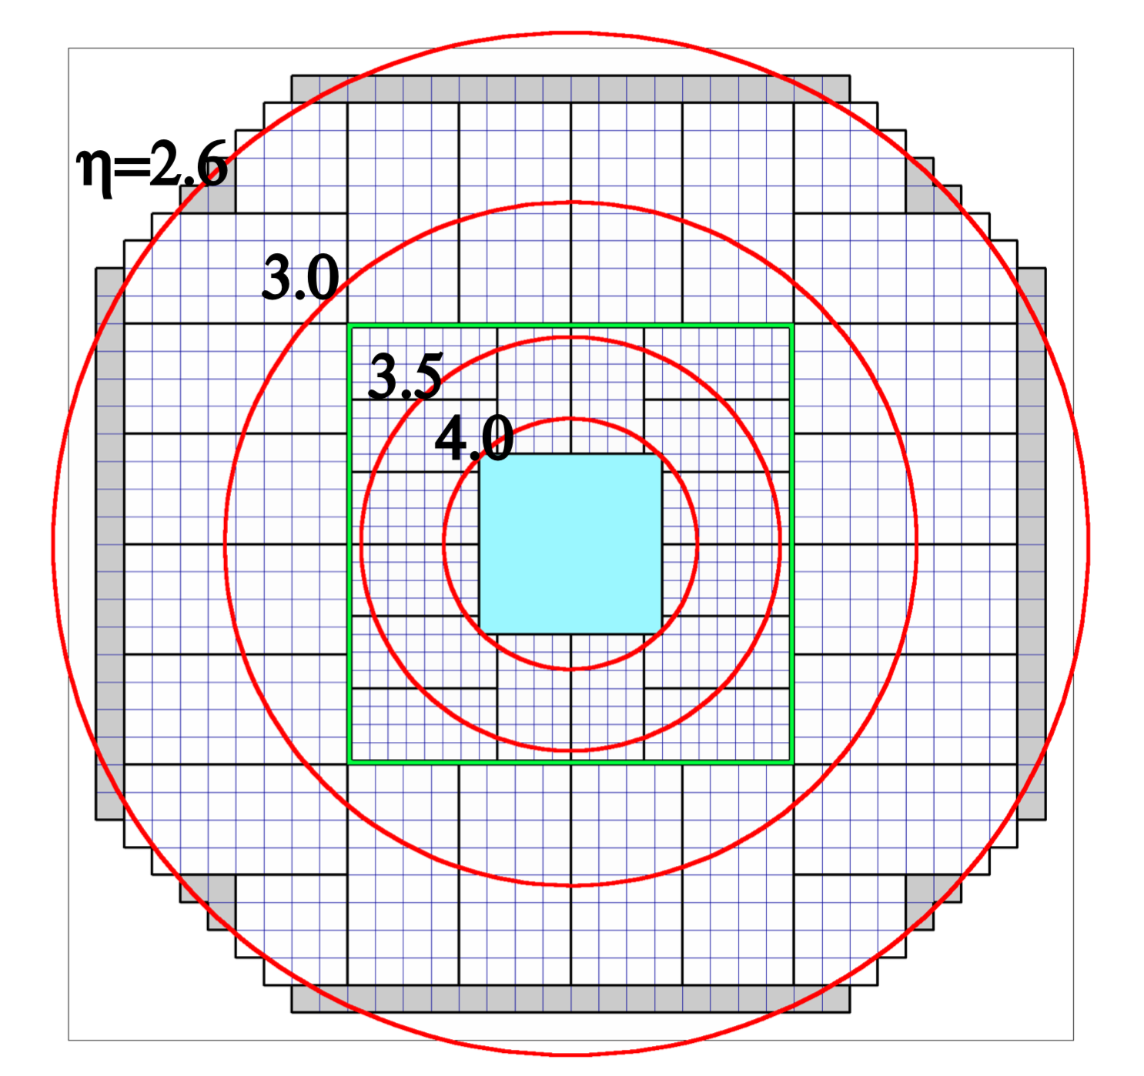
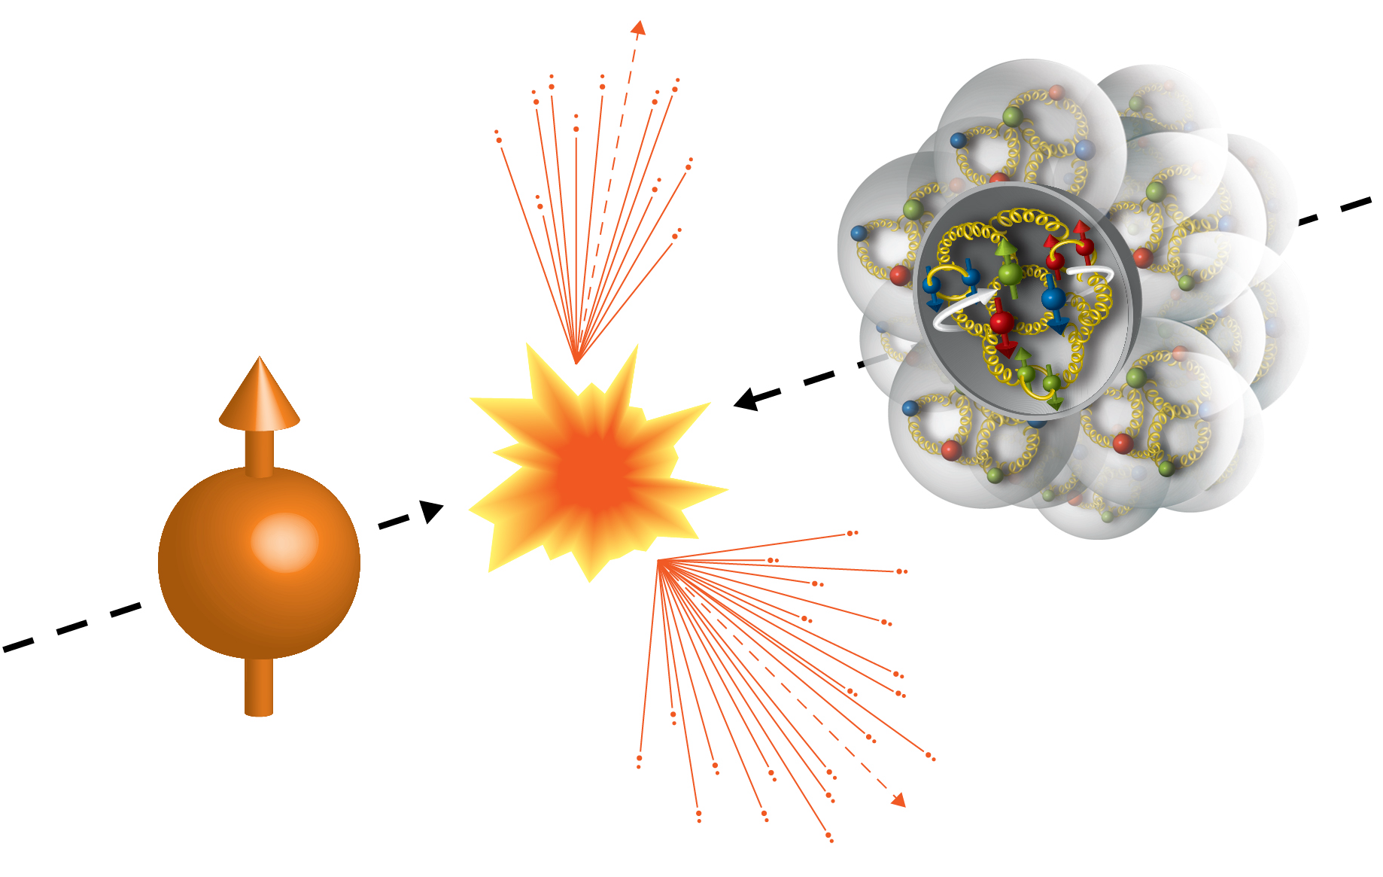
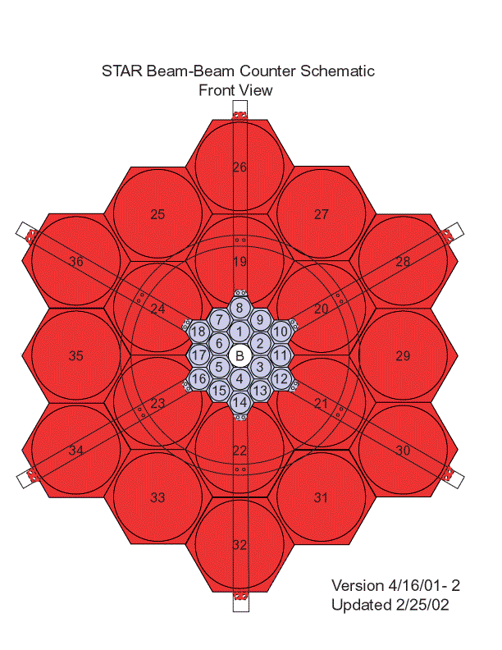
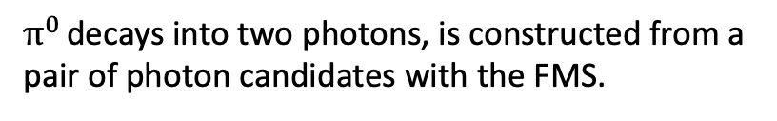


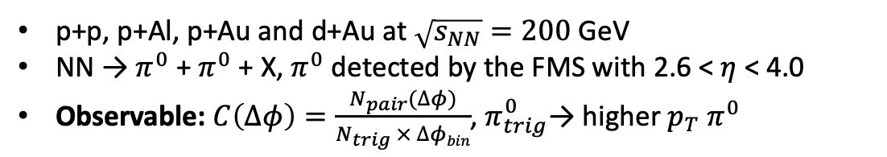


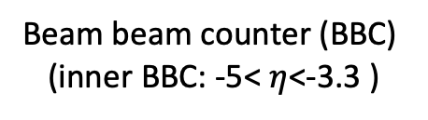
Di-$π^{0}$ measurement at STAR
p+p, p+Al, p+Au and d+Au at $\sqrt{s_{NN}}=200$ GeV
NN → $π^{0}$ + $π^{0}$ + X, $π^{0}$ detected by the FMS with 2.6 < $η$ < 4.0
Observable: $C\left(∆φ\right)=\frac{N_{pair}(∆φ)}{N_{trig} × ∆φbin}$, $π_{trig}^{0}$→ higher $p_{T} π^{0}$
Forward Meson Spectrometer (FMS)
2.6 < $η$ < 4.0
$π^{0}$
$π^{0}$
Beam beam counter (BBC)
(inner BBC: -5< $η$<-3.3 )
$π^{0}$ decays into two photons, is constructed from a pair of photon candidates with the FMS.

Slide 7

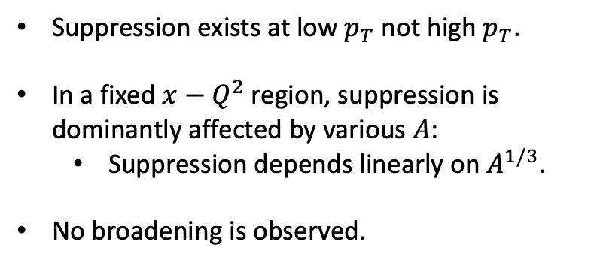

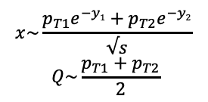

Di-$π^{0}$ results at STAR
STAR, PRL 129, 092501 (2022)
Small $x$ and $Q^{2}$
$$x\sim \frac{p_{T1}e^{−y1}+p_{T2}e^{−y2}}{√s}$$
$$Q\sim \frac{p_{T1}+p_{T2}}{2}$$
Suppression exists at low $p_{T}$ not high $p_{T}$.
In a fixed ${x−Q}^{2}$region, suppression is dominantly affected by various $A$:
  Suppression depends linearly on $A^{1/3}$.
No broadening is observed.
Large $x$ and $Q^{2}$
Gaussian (Area and width) at $∆φ$= $π$+ pedestal

Slide 8

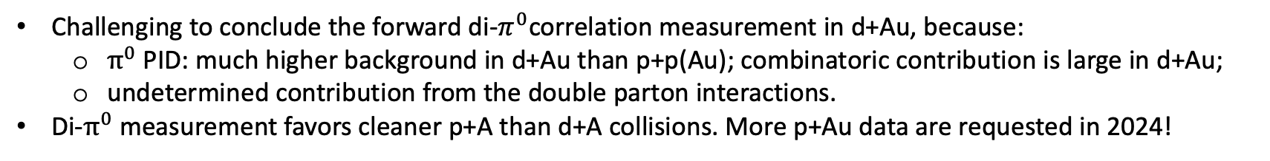
Di-$π^{0}$ results in d+Au at STAR
pp, pA: STAR, PRL 129, 092501 (2022)
Challenging to conclude the forward di-$π^{0}$correlation measurement in d+Au, because:
  $π^{0}$ PID: much higher background in d+Au than p+p(Au); combinatoric contribution is large in d+Au;
  undetermined contribution from the double parton interactions.
Di-$π^{0}$ measurement favors cleaner p+A than d+A collisions. More p+Au data are requested in 2024!

Slide 9
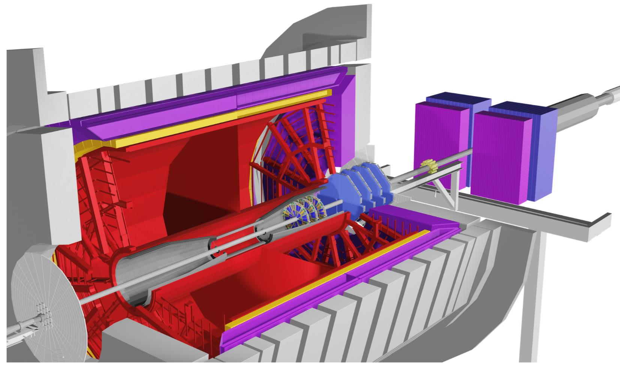
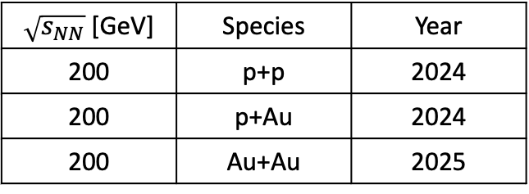

Future measurements with STAR Forward Upgrade
STAR Forward Upgrade: 2.5 < η < 4
Three new systems:
Forward Silicon Tracker (FST)
Forward sTGC Tracker (FTT)
Forward Calorimeter System (FCS)
To explore nonlinear gluon dynamics with expanded observables beyond $π^{0}s$:
Di-$h^{±}$ : access lower $p_{T}$ down to 0.2 GeV/c
Di-jet: $p_{T}^{jet}>5 GeV/c$ → higher $x$ and $Q^{2 }$
Direct photon: q+g$→$q+$γ$; statistic driven
3
1
2
2
3
1
Future STAR data with forward upgrade
$\sqrt{s_{NN}}$ [GeV] | Species | Year
200 | p+p | 2024
200 | p+Au | 2024
200 | Au+Au | 2025
Detector | pp and pA | AA
ECal | ~10%/√E | ~20%/√E
HCal | ~50%/√E+10% | ---
Tracking | charge separation photon suppression | 0.2<p_{T}<2 GeV/c with 20-30% 1/p_{T}

Slide 10


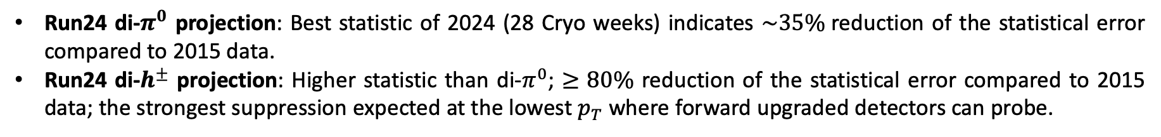
Di-h correlation projections with 2024 data
STAR, Beam User Request 24-25
STAR, Beam User Request 24-25
Run24 di-$π^{0}$
Run24 di-$h^{±}$
Run24 di-$π^{0}$ projection: Best statistic of 2024 (28 Cryo weeks) indicates $\sim 35\%$reduction of the statistical error compared to 2015 data.
Run24 di-$h^{±}$ projection: Higher statistic than di-$π^{0}$; $≥80\%$ reduction of the statistical error compared to 2015 data; the strongest suppression expected at the lowest $p_{T}$ where forward upgraded detectors can probe.

Slide 11
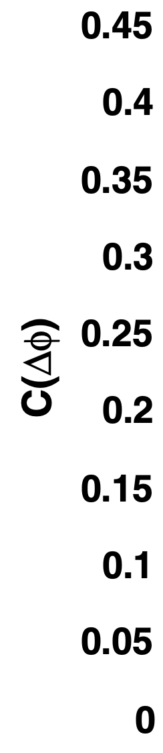
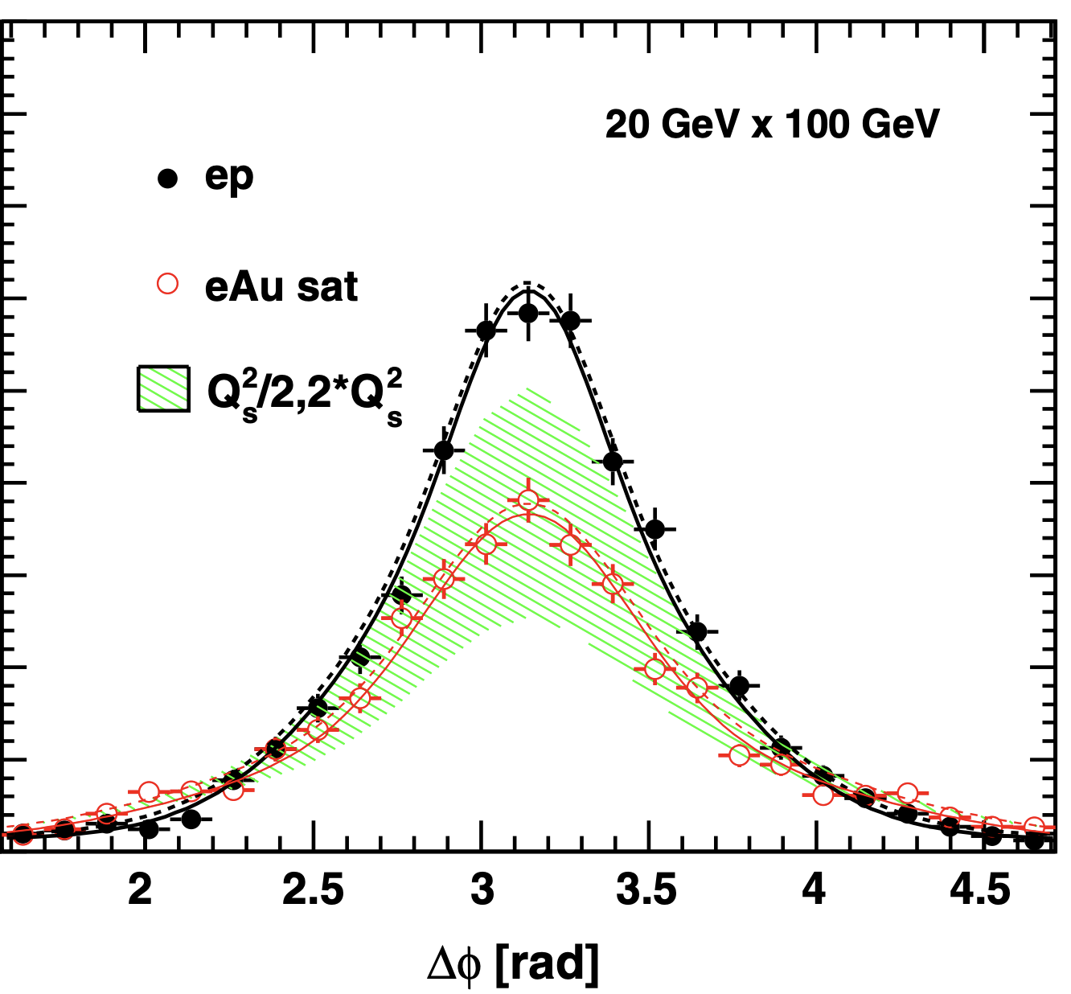
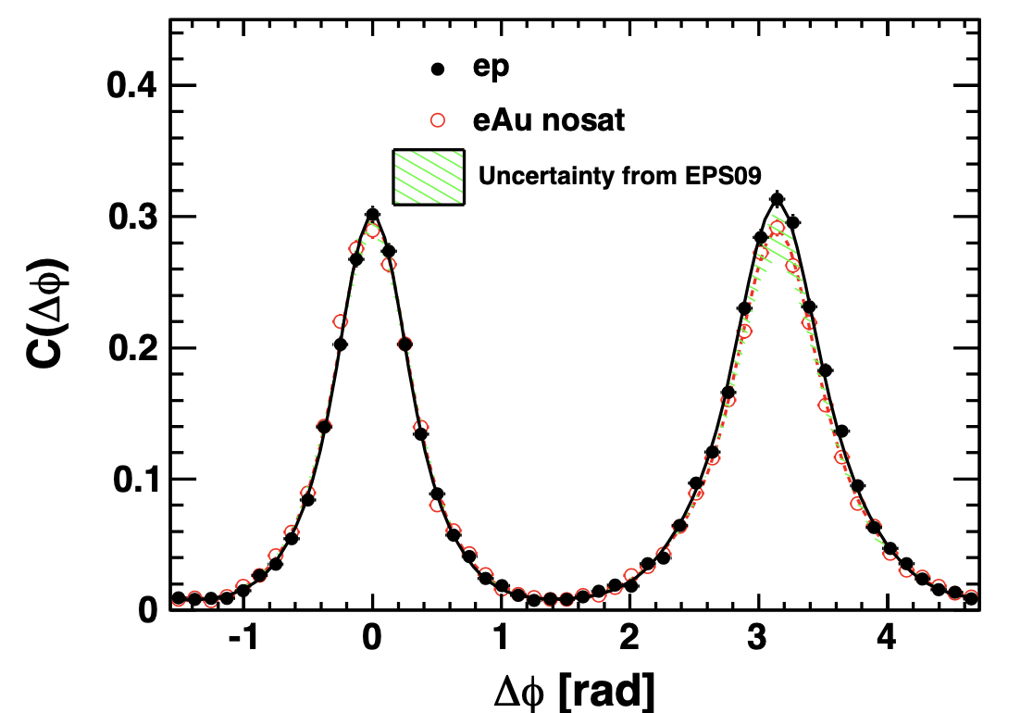
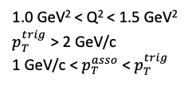
Gluon saturation at the EIC
L. Zheng et al., PRD 89 (2014) 074037
PYTHIA
PYTHIA
e
p
1.0 GeV² < Q² < 1.5 GeV²
$p_{T}^{trig}$> 2 GeV/c
1 GeV/c < $p_{T}^{asso}$< $p_{T}^{trig}$
e
Au
CGC predicts the back-to-back suppression and a broadening phenomena from gluon saturation in e+A collisions.
EIC simulation: constrain sat. and nosat. models with limited statistics of 1 ${fb}^{−1}.$
  Suppression is reproduced by sat. model, not by nosat. model (EPS09 nPDF) including energy loss.

Slide 12
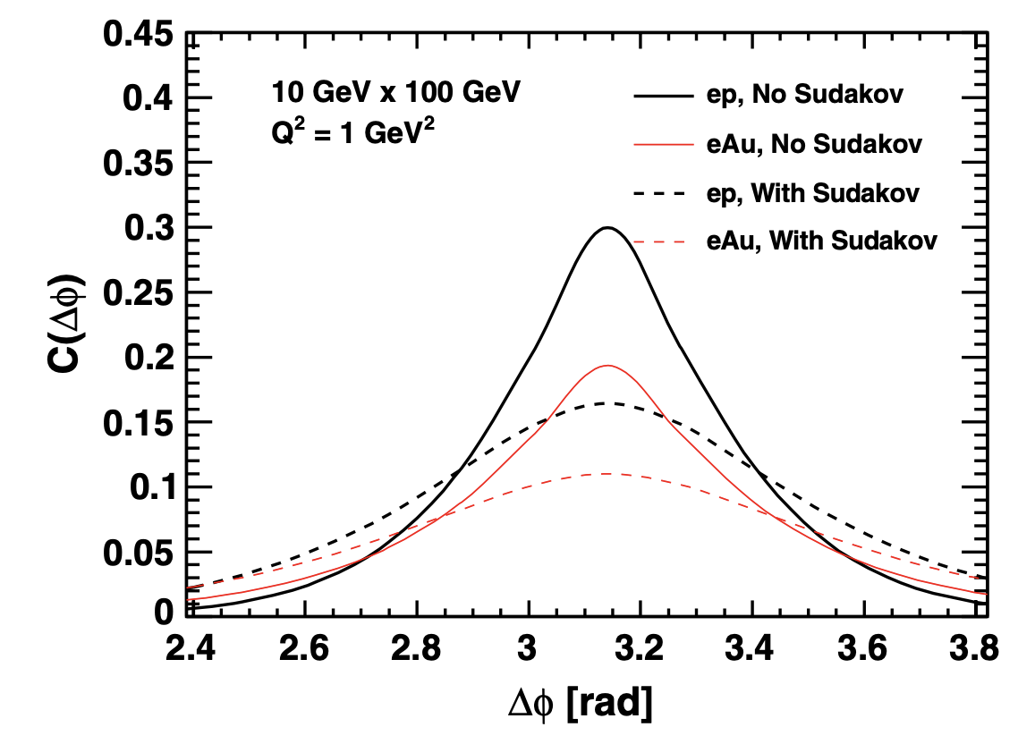
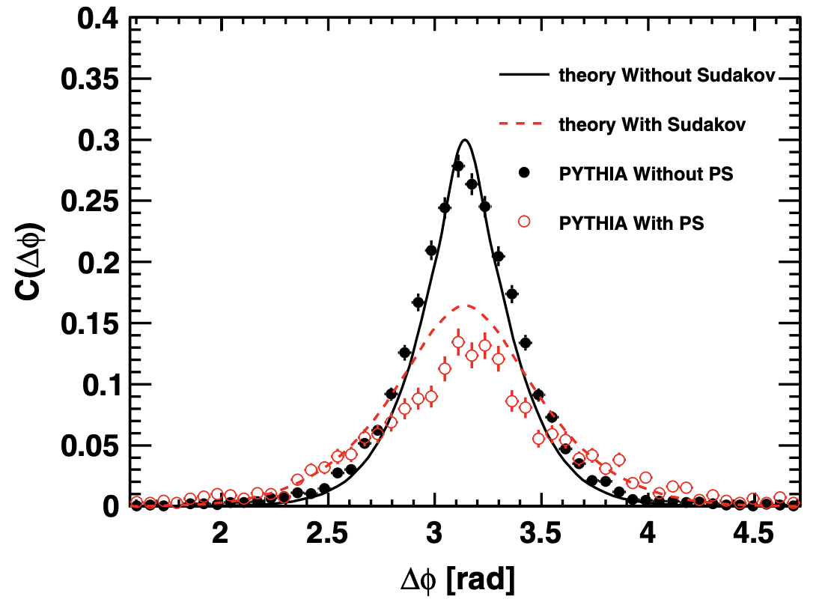
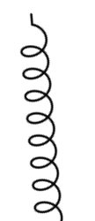




Sudakov effects in e+p and e+A
L. Zheng et al., PRD 89 (2014) 074037
PYTHIA
PYTHIA
$γ/q$ $/g$
$q$ $/g$
$γ/q$ $/g$
$q$ $/g$
Soft gluon radiation
Sudakov effect widens the back-to-back correlation functions, it exits in both e+p and e+A collisions.
Sudakov effect is in agreement with the effect from parton shower in e+p collisions.

Slide 13
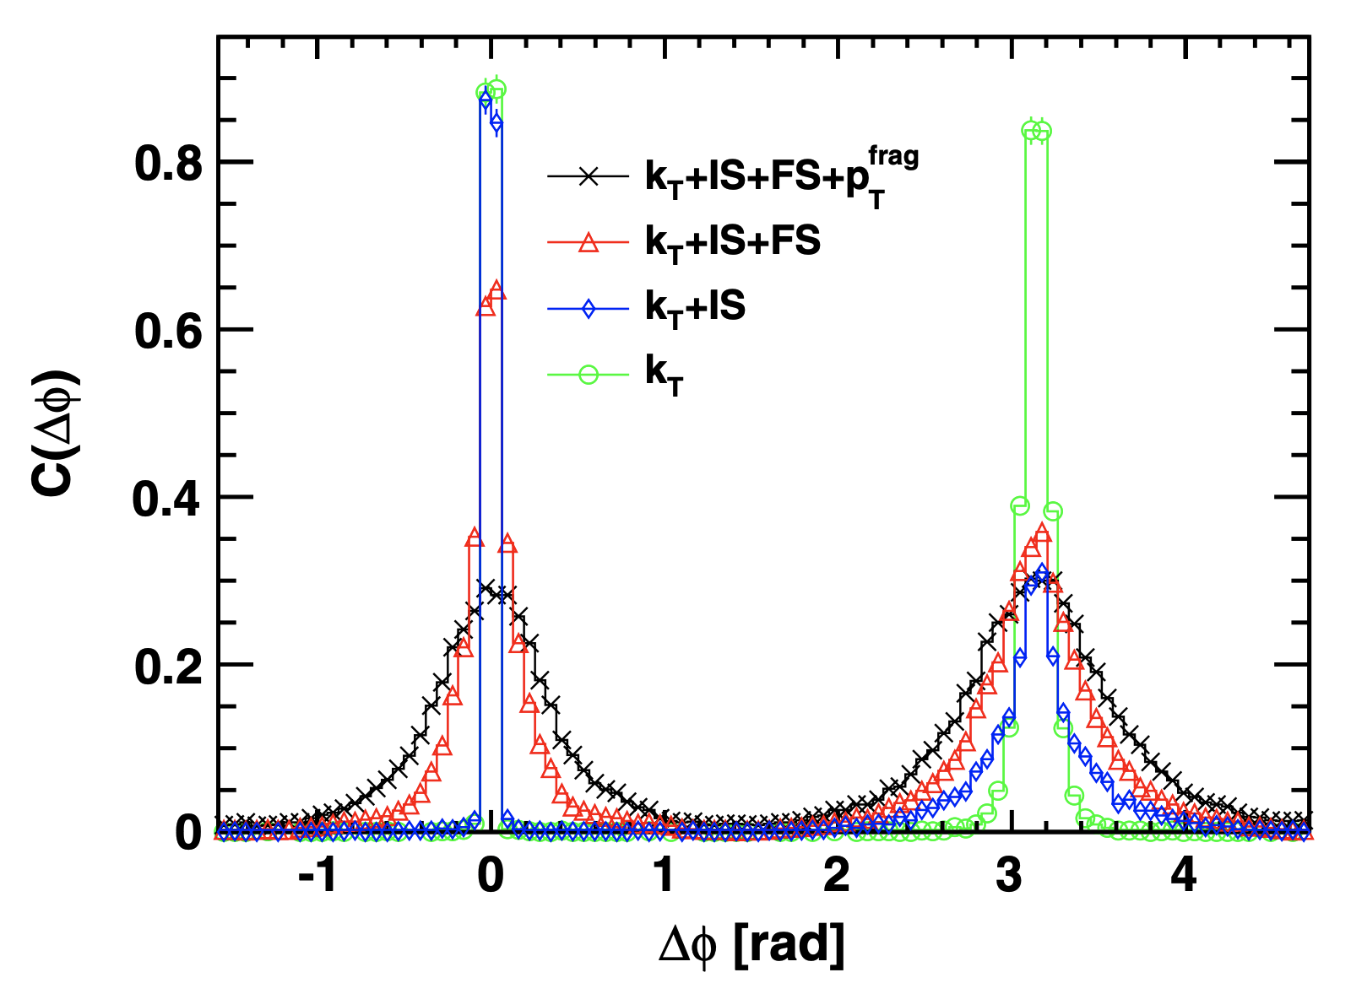
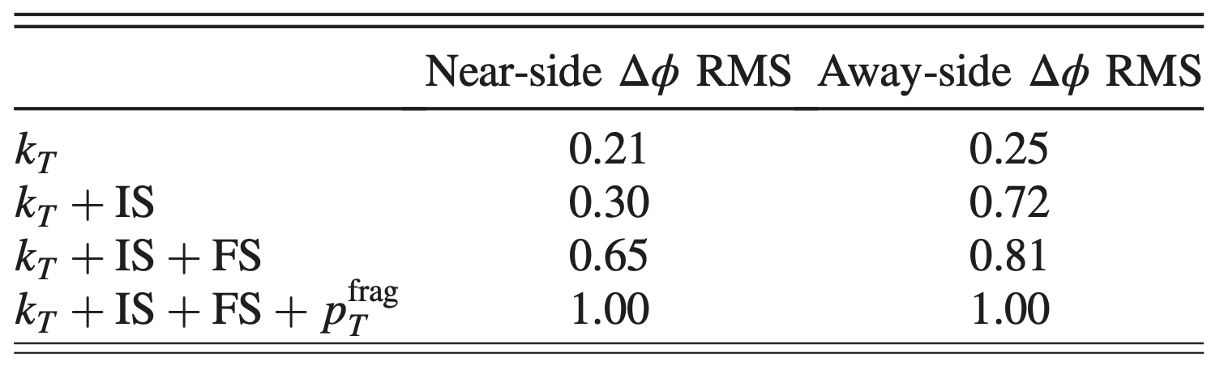

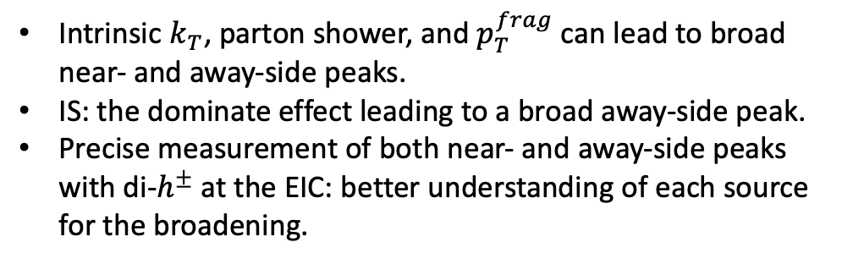

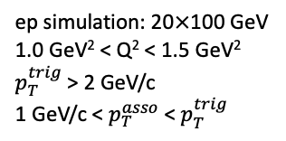
How about broadening?
Factors can cause the broadening:
L. Zheng et al., PRD 89 (2014) 074037
PYTHIA
Initial state parton shower (IS)
$$k_{T}$$
ep simulation: 20$×$100 GeV
1.0 GeV² < Q² < 1.5 GeV²
$p_{T}^{trig}$> 2 GeV/c
1 GeV/c < $p_{T}^{asso}$< $p_{T}^{trig}$
————
$$p_{T}^{frag}$$
Final state parton shower (FS)
Intrinsic $k_{T}$, parton shower, and $p_{T}^{frag}$ can lead to broad near- and away-side peaks.
IS: the dominate effect leading to a broad away-side peak.
Precise measurement of both near- and away-side peaks with di-$h^{±}$ at the EIC: better understanding of each source for the broadening.

Slide 14
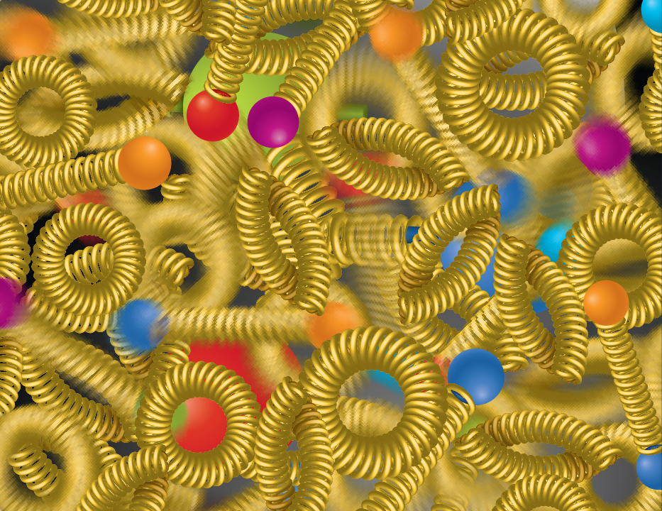
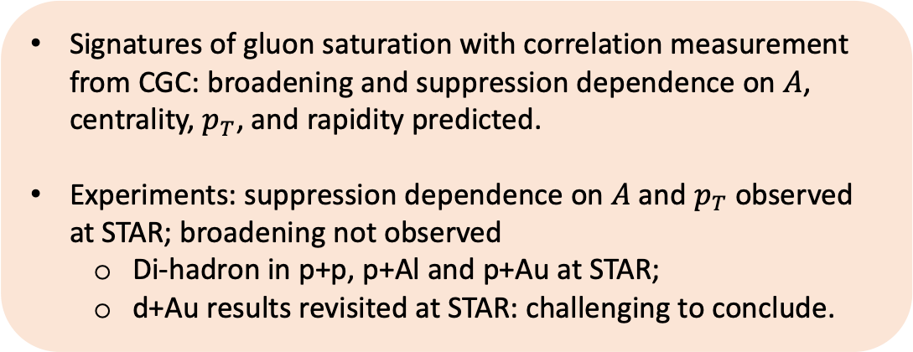
Summary and outlook
Signatures of gluon saturation with correlation measurement from CGC: broadening and suppression dependence on $A$, centrality, $p_{T}$, and rapidity predicted.
Experiments: suppression dependence on $A$ and $p_{T}$ observed at STAR; broadening not observed
  Di-hadron in p+p, p+Al and p+Au at STAR;
  d+Au results revisited at STAR: challenging to conclude.
?
EIC Yellow Report, arXiv:2103.05419
STAR Forward Upgrade provides opportunities to further explore the nonlinear gluon dynamics with various observables.
RHIC result is an important basis for the similar measurements at the future EIC.
Data from the EIC and RHIC: overlapping phase space; complementary probes (e+A and p+A) → test universality.

Slide 15
Back up

Slide 16
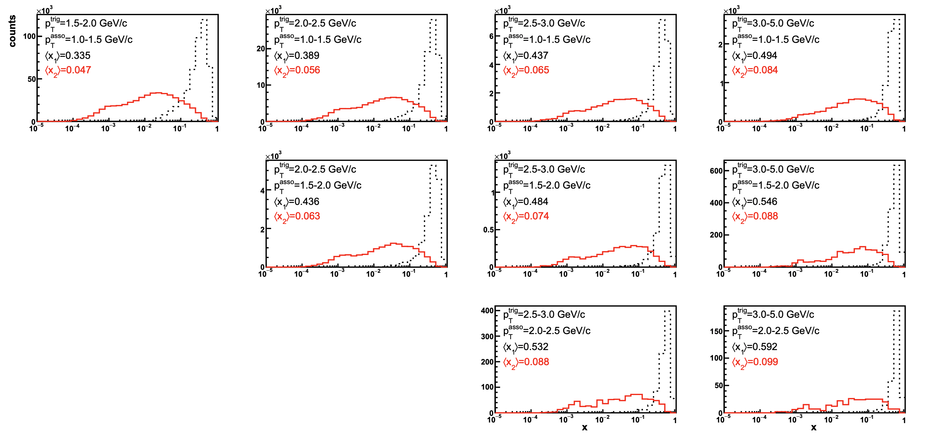
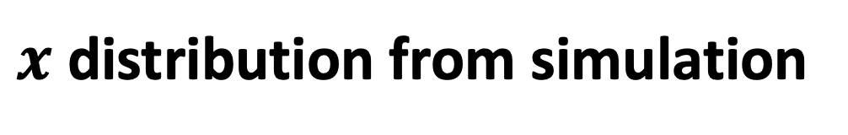

$x$ distribution from simulation
STAR, PRL 129, 092501 (2022) supplemental material
PYTHIA 6
$$\sqrt{s}=200 GeV$$
$$p+p→π^{0}+π^{0}+X$$
$$2.6<η<4.0$$

Slide 17
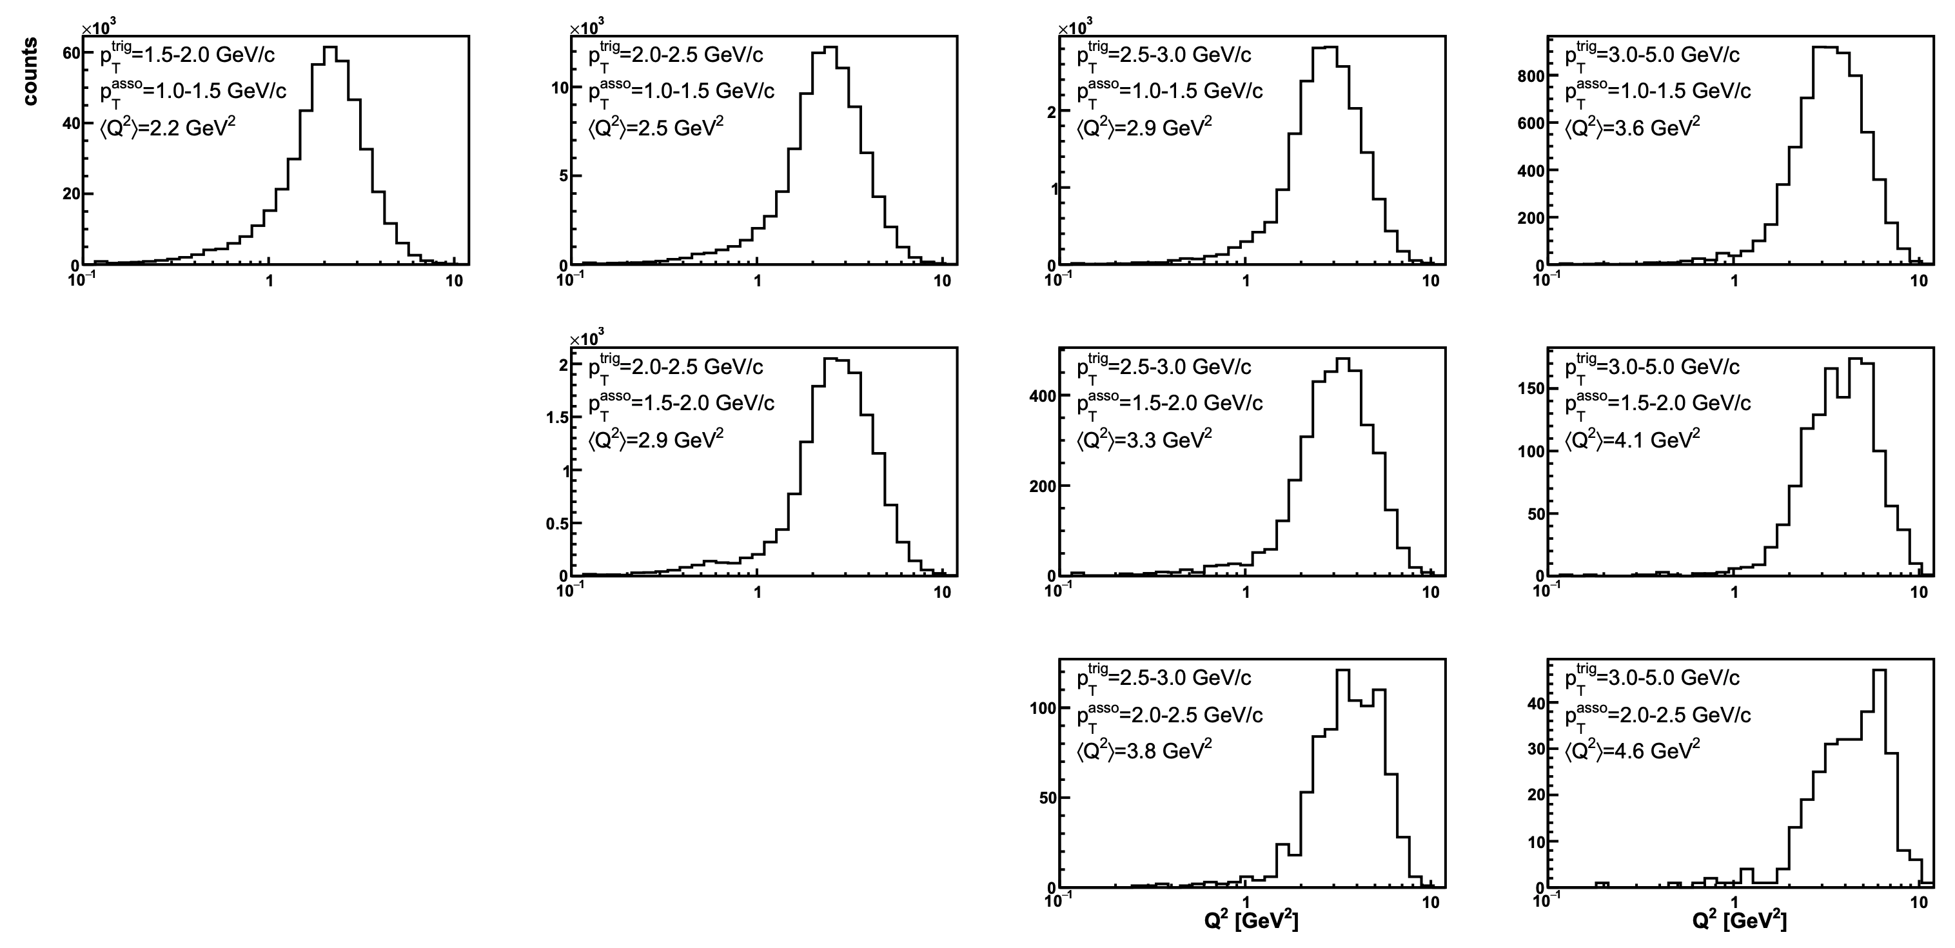
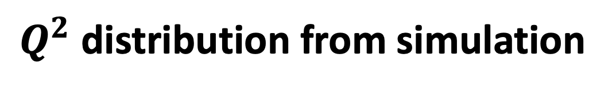
$Q^{2}$ distribution from simulation
STAR, PRL 129, 092501 (2022) supplemental material
PYTHIA 6
$$\sqrt{s}=200 GeV$$
$$p+p→π^{0}+π^{0}+X$$
$$2.6<η<4.0$$

