Slide 1
The Heaviest Known Antimatter
Zhangbu Xu (for the STAR Collaboration)
Heavy and Exotic Antimatter
Evidence of first antihypernucleus
and signal (for discovery)
Mass and Lifetime
What can we do with the discovery?
Production Rates for antimatter
Even Heavier antimatter?
Outlook and Summary

Slide 2
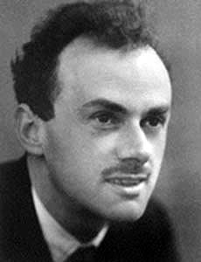
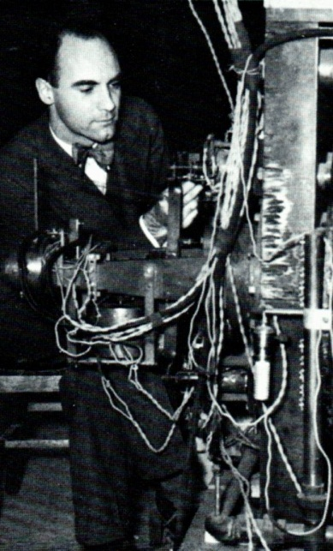
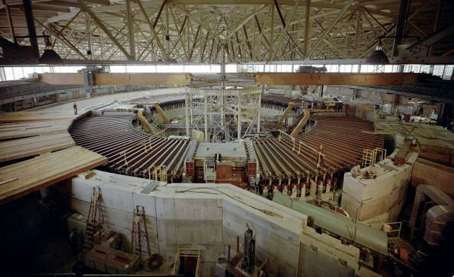
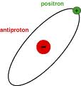
History of Antimatter
In 1928, Paul Dirac theorized possibility of antimatter as one of his equations for quantum mechanics had two “solutions” (regular matter and antimatter)
In 1932, Carl Anderson discovered positrons while studying cosmic rays
Two teams working at the Bevatron in Lawrence Berkeley National Lab discovered antiprotons and antineutrons in 1955 and 1956
In 1965, Antoni Zichichi of CERN and Leon Lederman of Brookhaven National Lab simultaneously discovered antideuteron
In 1995, CERN created antihydrogen atoms at the LEAR by slowing the antiprotons and attaching positrons
Will Pascucci, Choate Rosemary Hall; Wallingford, CT 2010 Summer High-School Student

Slide 3
What is Antimatter?
“Those who say that antihydrogen is
antimatter should realize that we are
not made of hydrogen and we drink
water, not liquid hydrogen”
-- Dirac
Quoted from A. Zichichi (2008)
Antiparticles and antimatter:
the basic difference
Annihilate with normal matter π⁺,π⁻ are each other’s antiparticle
Nuclear force
Long Lifetime

Slide 4
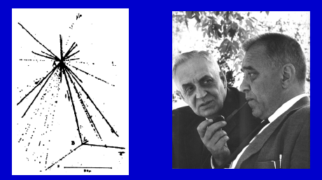
What are Hypernuclei?
Nucleus which contains at least one hyperon in addition to nucleons.
Hypernuclei of lowest A
u d u
u d u
u d u
³He
u d u
t
u d d
³_{Λ}H
u d s
u d d
u d
d
u d
d
Y-N interaction: a good window to
understand the baryon potential
Binding energy and lifetime are very sensitive to Y-N interactions
Hypertriton: ΔB=130±50 KeV; r~10fm
Production rate via coalescence at RHIC depends on overlapping wave functions of n+p+Λ in final state
Important first step for searching for other exotic hypernuclei (double-Λ)
The first hypernucleus was discovered by Danysz and Pniewski in 1952. It was formed in a cosmic ray interaction in a balloon-flown emulsion plate.
M. Danysz and J. Pniewski, Phil. Mag. 44 (1953) 348
No one has ever observed any antihypernucleus before RHIC
Notes:
4

Slide 5
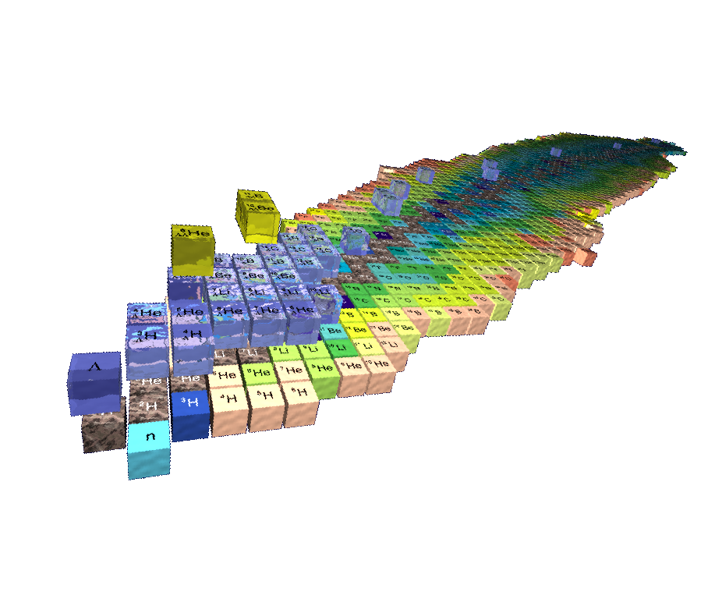
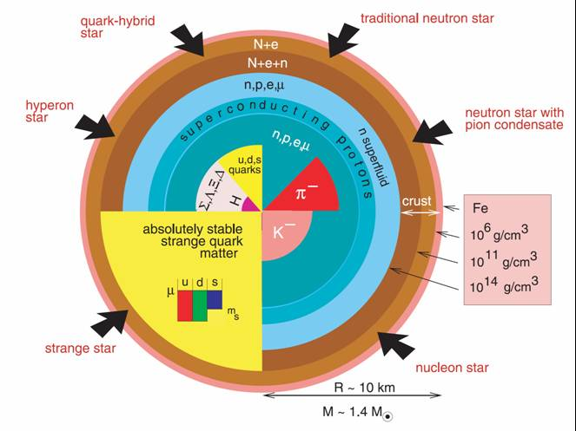
from Hypernuclei to Neutron Stars
hypernuclei Λ-B Interaction Neutron Stars
S=-2
S=-1
S=-0
Saito, HYP06
Several possible configurations of Neutron Stars
Kaon condensate, hyperons, strange quark matter
Single and double hypernuclei in the laboratory:
study the strange sector of the baryon-baryon interaction
provide info on EOS of neutron stars
J.M. Lattimer and M. Prakash,
"The Physics of Neutron Stars", Science 304, 536 (2004)
J. Schaffner and I. Mishustin, Phys. Rev. C 53 (1996): Hyperon-rich matter in neutron stars

Slide 6
Chart of Nuclides
S=-2
S=-1
S=-0
3-D chart of nuclides

Slide 7
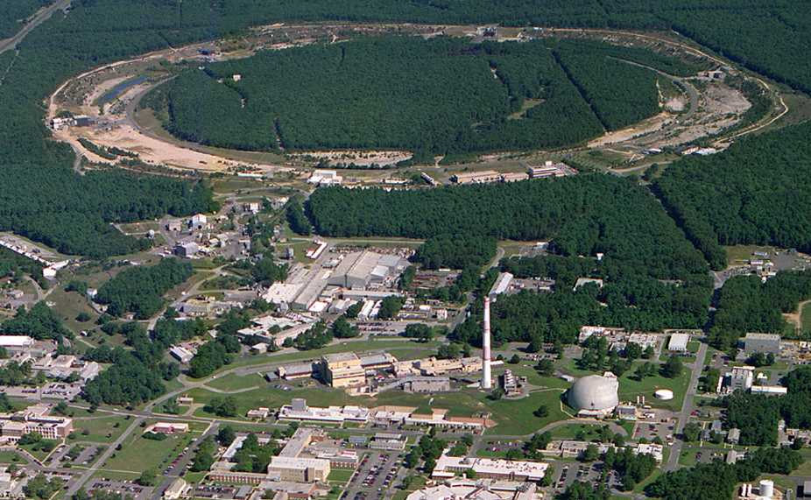
Relativistic Heavy Ion Collider (RHIC)
PHOBOS
BRAHMS
RHIC
PHENIX
STAR
v = 0.99995⋅c = 186,000 miles/sec
Au + Au at 200 GeV
AGS
TANDEMS
Animation M. Lisa

Slide 8
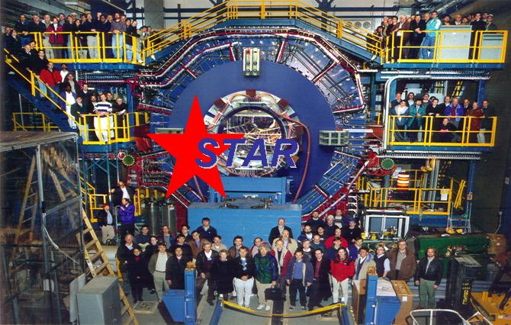

Slide 9
Little Big Bang
BIG; All 4 forces at work; Gravitation dominates; QGP@10⁻⁶s; Slow expansion; Antimatter-matter annihilate;
RHIC
TIME
Little; Strong force at work; QGP@10⁻²³s; Fast expansion; Antimatter-matter decouple; repeat trillion times

Slide 10
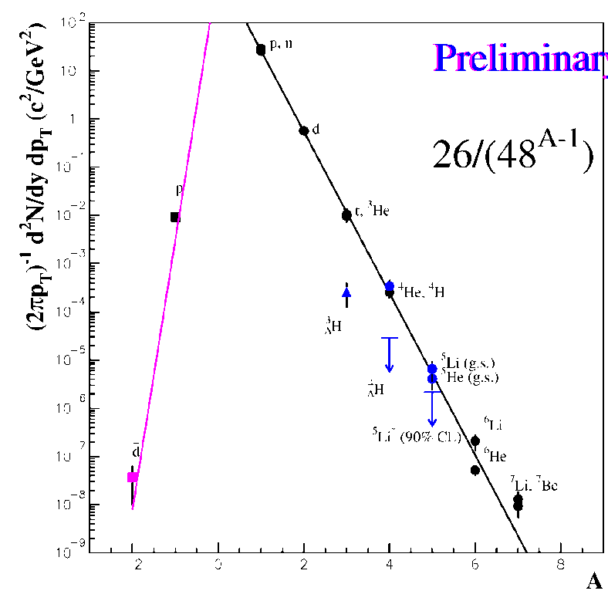
Can we observe hypernuclei at RHIC?
Low energy and cosmic ray experiments (wikipedia):
hypernucleus production via
Λ or K capture by nuclei
the direct strangeness exchange reaction
hypernuclei observed
energetic but delayed decay,
measure momentum of the K and π mesons
|
In high energy heavy-ion collisions:
nucleus production by coalescence, characterized by penalty factor.
AGS data^{[1]} indicated that hypernucleus production will be further suppressed.
What’s the case at RHIC?
[1] AGS-E864, Phys. Rev. C70,024902 (2004)
Notes:
10

Slide 11
A candidate event at STAR
Run4 (2004)
200 GeV Au+Au collision

Slide 13
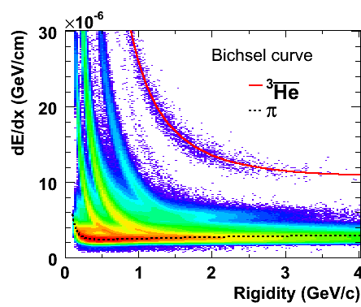
³He & anti-³He selection
Select pure ³He sample: -0.2<Z<0.2 & dca <1.0cm & p >2 GeV
³He: 2931(MB07) + 2008(central04) + 871(MB04) = 5810
Anti-³He: 1105(MB07) + 735(central04) + 328(MB04) = 2168

Slide 14
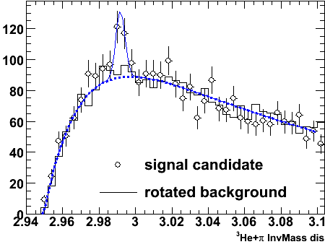
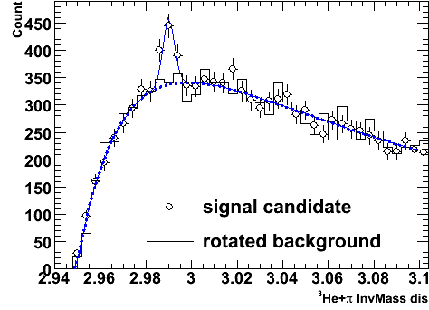
and Combined signals
Combine hypertriton and antihypertriton signal:
225±35
Signal observed from the data (bin-by-bin counting): 70±17;
Mass: 2.991±0.001 GeV; Width (fixed): 0.0025 GeV;
This provides a >6σ signal for discovery

Slide 15
Lifetime of a hypertriton
Lifetime related to binding energy
Theory input: the Λ is lightly bound in the hypertriton
[1] R. H. Dalitz, Nuclear Interactions of the Hyperons (Oxford Uni. Press, London, 1965).
[2] R.H. Dalitz and G. Rajasekharan, Phys. Letts. 1, 58 (1962).
[3] H. Kamada, W. Glockle at al., Phys. Rev. C 57, 1595(1998).

Slide 16
Matter and antimatter are not created equal
But we are getting there !
(AGS,Cosmic)
AGS
RHIC
SPS
NA52

Slide 17
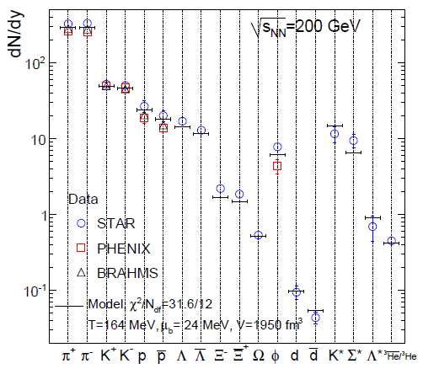
Flavors (u,d, s) are not created equal except in possible QGP
J. Rafelski and B. Muller, Phys.Rev.Lett.48:1066,1982
STAR whitepaper, NPA757(2005)
A. Andronic, P.Braun-Munzinger, J.Stachel, Phys. Lett. B 673 (2009) 142
A. Andronic, P.Braun-Munzinger, K.Redlich, J.Stachel, Phys. Lett. B 652 (2007) 259; B 678 (2009) 350; arXiv:1002.4441

Slide 18
Antinuclei in nature (new physics)
To appreciate just how rare nature produces antimatter (strange antimatter)
RHIC: an antimatter machine
Seeing a mere antiproton or antielectron does not mean much– after all, these particles are byproducts of high-energy particle collisions.
However, complex nuclei like anti-helium or anti-carbon are almost never created in collisions.
AMS antiHelium/Helium sensitivity: 10⁻⁹
Dark Matter, Black Hole➔ antinucleus production via coalescence

Slide 19
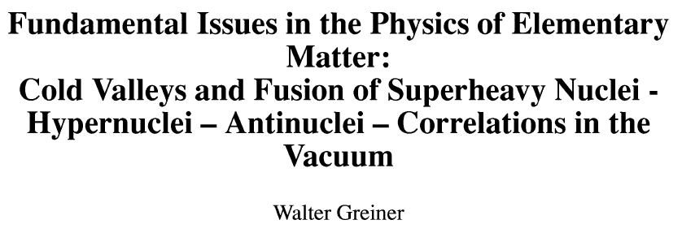
hypernuclei and antimatter from correlations in the Vacuum
Real 3-D periodic table
Pull ‾α from vacuum (Dirac Sea)

Slide 20
Vision from the past
‾α
?
??
2011
The extension of the periodic system into the sectors of hypermatter (strangeness) and antimatter is of general and astrophysical importance.
… The ideas proposed here, the verification of which will need the
commitment for 2-4 decades of research, could be such a vision with considerable attraction for the best young physicists… I can already
see the enthusiasm in the eyes of young scientists, when I unfold these
ideas to them — similarly as it was 30 years ago,… ---- Walter Greiner (2001)

Slide 21
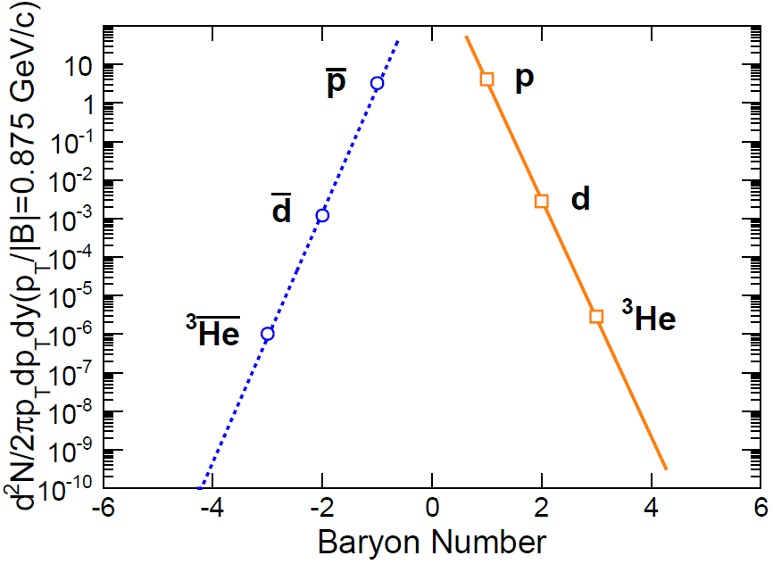
Projected Discovery of antimatter Helium-4 nucleus from STAR
How many possible antimatter nuclei can we discover?
Anti-hypertriton, anti-alpha;
Anti-hyperH4?
Can we get to antimatter ⁶He?
Unless technology and Physics change dramatically, NO!
>10‾α arXiv:0909.0566

Slide 23
Fun news about the discovery
Science Perspectives Vol 328

Slide 24
Conclusion and Outlook
has been observed for 1st time; significance ~4σ.
Lifetime:
data samples with larger statistics
Production rate:
Strangeness and baryon correlation Need specific model calculation for this quantity
Establish trend from AGS—SPS—RHIC—LHC
_{Λ}³H→d+p+π channel measurement: d and ‾d via ToF.
Search for other hypernucleus: ⁴_{Λ}H, double Λ-hypernucleus.
Search for anti-α, antinucleus atomcules
RHIC: best antimatter machine

