Slide 1

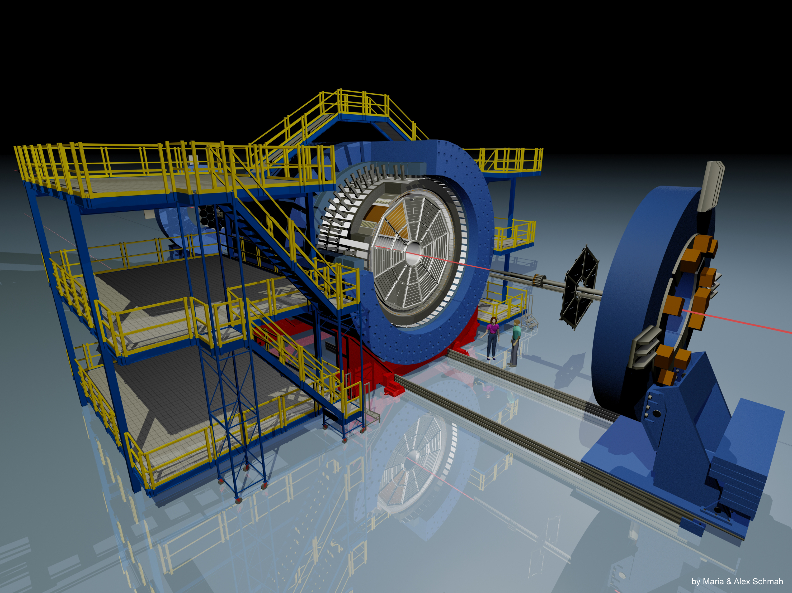
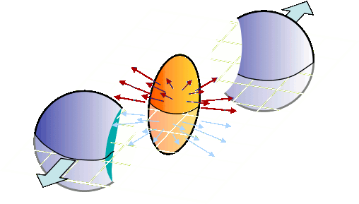

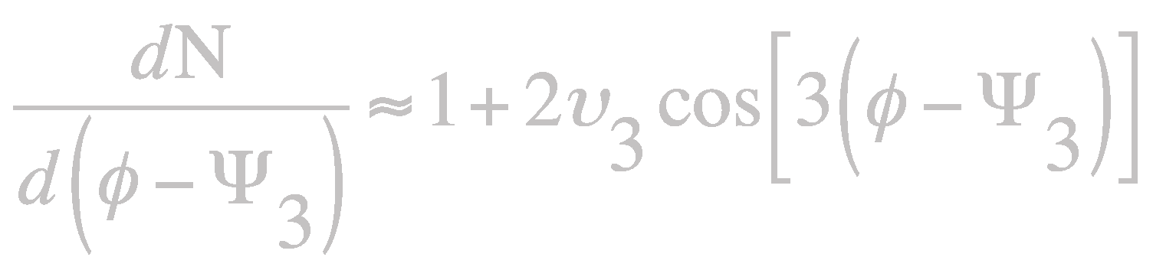



Triangular Flow of Identified
Hadrons in Au+Au Collisions
at √s_{NN} = 39 and 200 GeV
Xu Sun*
for the STAR Collaboration
*Harbin Institute of Technology
*Lawrence Berkeley National Laboratory
Motivation
The Experiment
Methodology
Beam Energy Scan (BES) at STAR:
→ Signatures for QCD phase transition
Triangular flow v₃ sensitive to initial state
fluctuations
Number-of-Constituent-Quark (NCQ)
scaling of v₃ might be sensitive to partonic
degree of freedom
TOF
TPC
PID based on dE/dx and TOF
Φ meson reconstructed with invariant mass
3rd-order event plane reconstructed (|η|<1)
η-gap method used to suppress non-flow
Event plane method used to extract v₃
Phys. Rev. C 81 (2010) 054905
Initial state fluctuation
Solenoidal Tracker At RHIC
Particle anti-Particle
NCQ Scaling
STAR Preliminary
STAR Preliminary
STAR Preliminary
NCQ scaling failed at 39 GeV (up to 0.8 GeV/c²) and 200 GeV
(up to 0.8 GeV/c²) by using scaling factor n_{q}
STAR Preliminary
Observed difference in v₃ between protons and anti-protons
Δv₃ is constant in the measured p_{T} range and the difference is
larger at the lower energy
Δv₃ (proton/antiproton) = (7.4 ± 1.2)*10⁻⁴ at 200 GeV
Δv₃ (proton/antiproton) = (2.1 ± 0.6)*10⁻³ at 39 GeV
Δv₃/Δv₂ = 0.34 ± 0.10 at 39 GeV
STAR Preliminary
STAR Preliminary
J. Phys. G: Nucl. Part. Phys. 38 (2011) 124048
Better NCQ scaling achieved at 39 GeV (up to 0.8 GeV/c²) and 200 GeV
(up to 0.8 GeV/c²) by using scaling factor n_{q}^{3/2}
Mass Ordering
Summary
Δv₃ of protons and anti-protons are bigger at 39 GeV than
200 GeV
Mass ordering for all particle species observed at low p_{T}
➔Radial flow is larger at 200 GeV than 39 GeV ?
Baryon – meson splitting is observed at intermediate p_{T}
Better NCQ scaling achieved by using scaling factor n_{q}^{3/2}
STAR Preliminary
STAR Preliminary
Mass ordering extends for larger p_{T} range at 200 GeV than 39 GeV
➔ Larger radial flow at 200 GeV than 39 GeV ?

