Slide 1
STAR Overview
Li Yi (for the STAR Collaboration)
Yale University

Slide 2
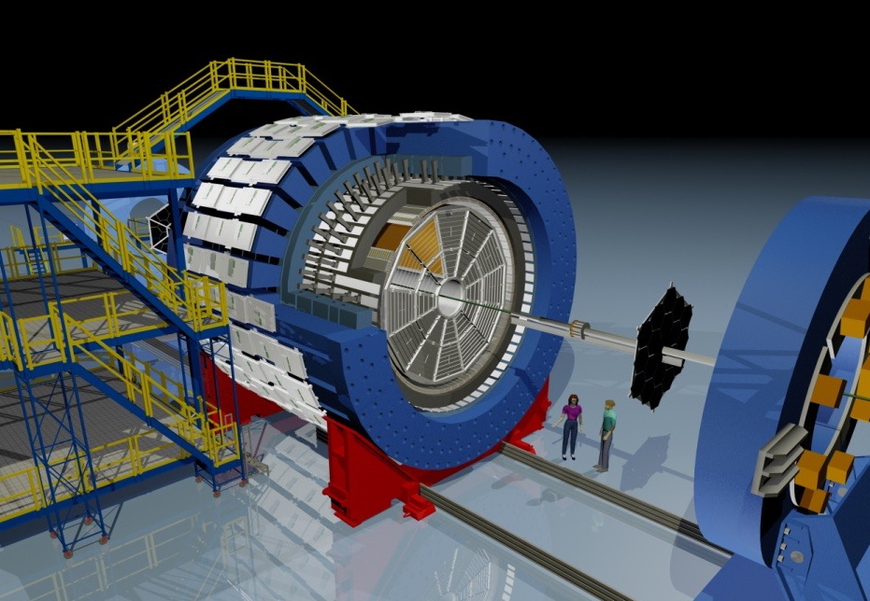
STAR Detector System
Muon Telescope Detector
BEMC
TPC
Magnet
TOF
Heavy Flavor Tracker
 | Period | Detectors
 | 2001-2009 | TPC + BEMC
 | 2010-2011 | TPC + BEMC + TOF
 | 2012 | TPC + BEMC + TOF
 | 2013 | TPC + BEMC + TOF + MTD
 | 2014 | TPC + BEMC + TOF + MTD + HFT
 | 2015 | TPC + BEMC + TOF + MTD + HFT

Slide 3
Heavy Flavor Probes
Heavy flavor quark, primarily produced in initial hard scattering, is exposed to the medium evolution
Charm-medium interaction D⁰ (cu) .. light vs heavy quark: mass hierarchy of parton energy loss
Quarkonia J/ψ (cc), ϒ(bb) expected to be QGP thermometer direct production - thermal dissociation + recombination
Cu+Cu, Au+Au, U+U: system size, energy dependence
p+p: pQCD test, heavy ion reference
p+Au, d+Au: Cold Nuclear Matter effect

Slide 4
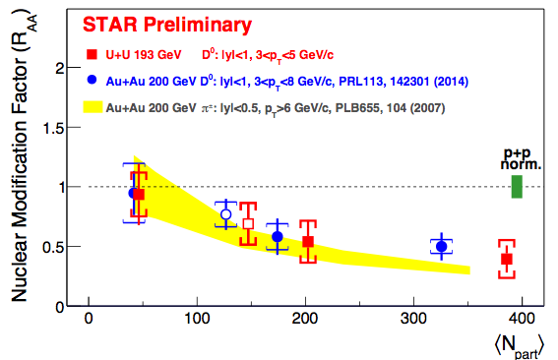
Heavy vs Light Flavor Suppression
Suppression of open charm at high p_{T} in U+U collisions follows the density dependence trend of open charm and pions in Au+Au collisions.

Slide 5
D⁰ Nuclear Modification pT Dependence
STAR, PRL 113, 142301 (2014)
Year 2010 + 2011 Au+Au @ 200 GeV data
Large suppression for pT > 4 GeV/c Strong charm-medium interaction
Indication of enhancement at pT~0.7-2GeV/c Described by recombination models
More precise measurement needed

Slide 6
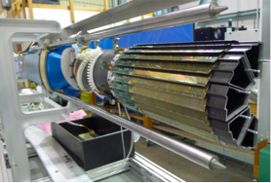
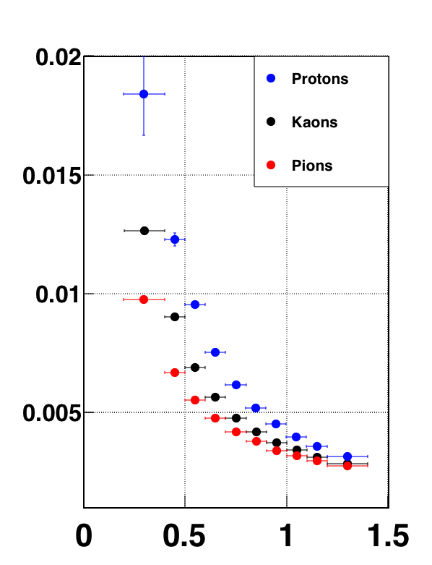
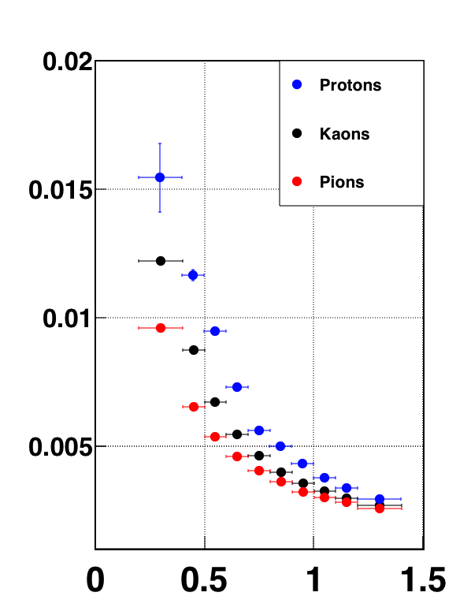
Heavy Flavor Tracker
3 kinds of silicon detectors (PXL, IST, SSD)
PXL: First application of the Monolithic Active Pixel Sensors (MAPS) technology in a collider experiment
Decay vertex reconstruction with high resolution
PXL
Excellent resolution even at low p
DCAxy resolution (µm)
47 μm
46 μm
DCAz resolution (µm)
Exceeded DCA Resolution Design Goal 60μm for Kaon at p= 0.75 GeV/c
H. Qiu, Tue 13:30
HF and Quarkonium
p[GeV/c]
p[GeV/c]

Slide 7
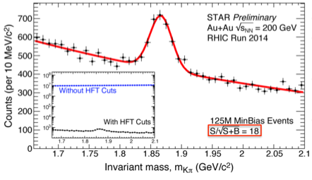
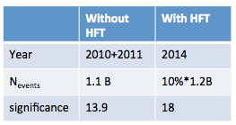
D⁰ signal with HFT
~10% statistics of year 2014 Au+Au
Background greatly suppressed by topology cuts with HFT
Physics results with HFT will come soon.
A. Quintero, Poster
for Optimize D⁰ signal
H. Qiu, Tue 13:30
HF and Quarkonium

Slide 8
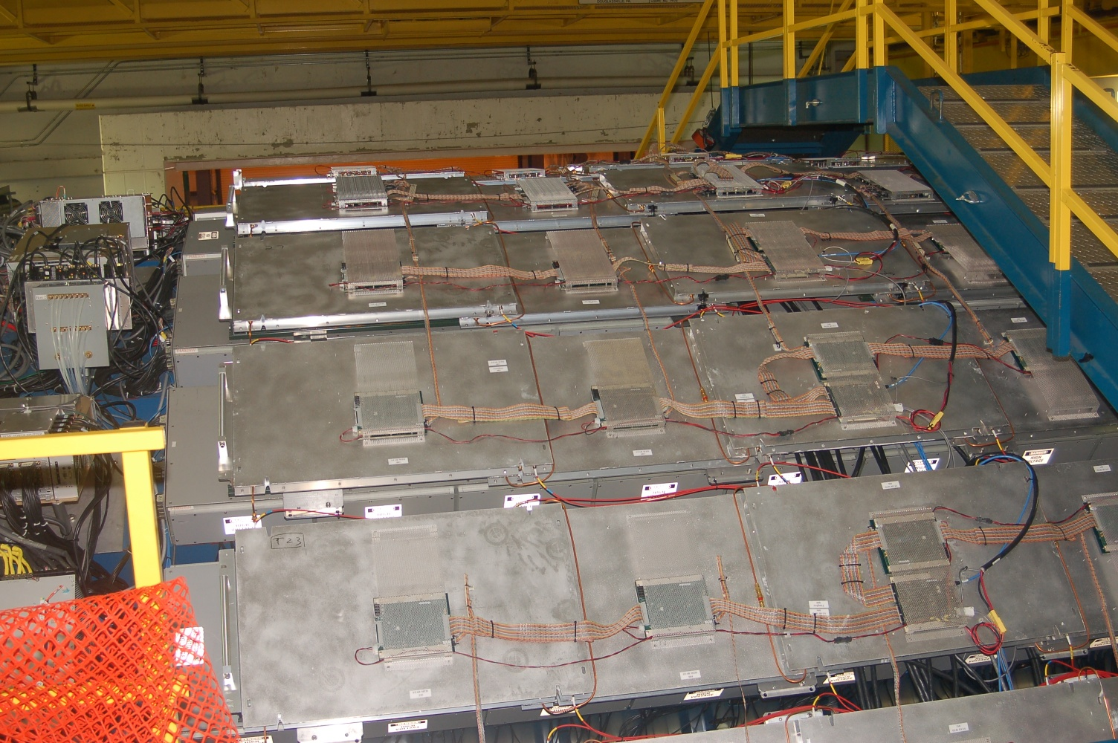
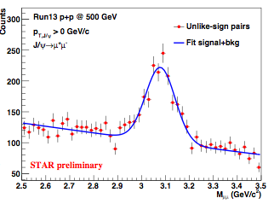
J/ψ with Muon Telescope Detector
Multi-gap Resistive Plate Chamber (MRPC) technology
Precise timing ~ 95 ps
Accurate hit position ~ 1 cm
Muon identification
TPC track and MTD hit match
Dimuon trigger increases low pT accuracy
p+p @ 500 GeV
7.7 pb⁻¹ taken in 2013
J/ψ → μ⁺ μ⁻
R. Ma, Tue 15:20 HF and Quarkonium

Slide 9
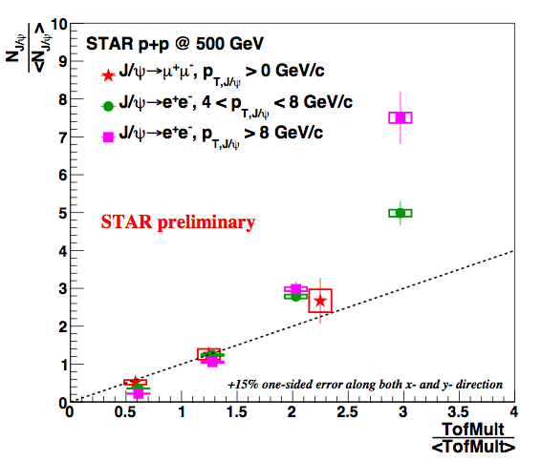
J/ψ Yield vs Multiplicity in p+p 500 GeV
J/ψ → μ⁺ μ⁻ with MTD 7.7 pb⁻¹ taken in 2013
J/ψ → e⁺ e⁻ with BEMC 22 pb⁻¹ taken in 2011
CMS, JHEP 04 (2014)103
Clear correlation between quarkonia yields and multiplicity in pp
Faster rise for higher pT
R. Ma, Tue 15:20 HF and Quarkonium

Slide 10
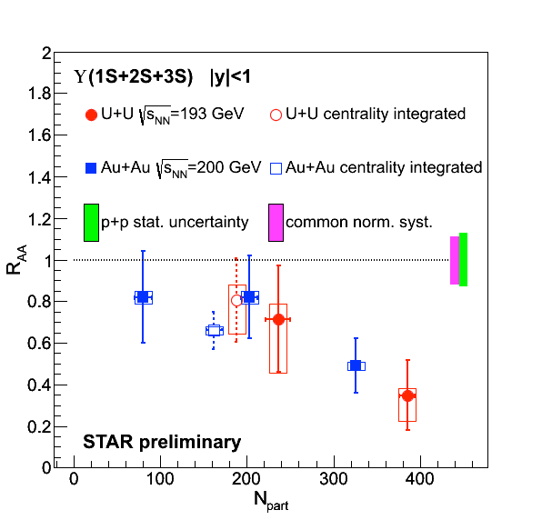
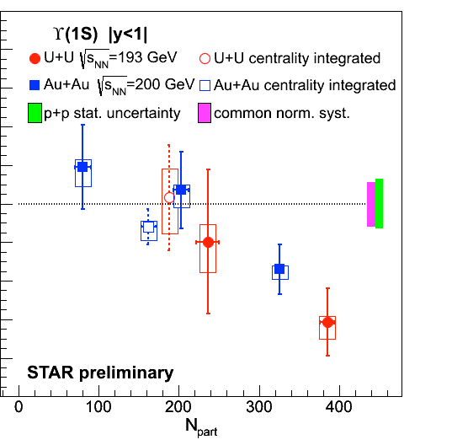
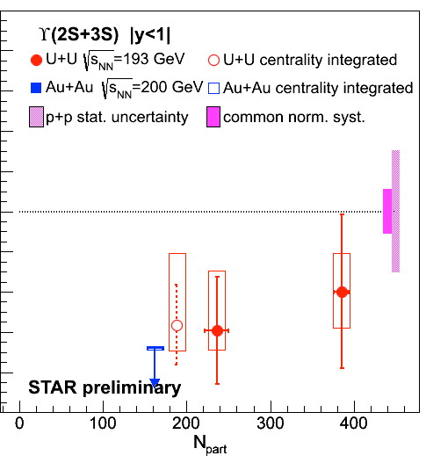
ϒ Suppression
ϒ → e⁺e⁻ with BEMC
ϒ suppression consistent with sequential melting
ϒ(1S) and ϒ(1S+2S+3S):
Peripheral: consistent with no suppression
0-10% central: significant suppression
New U+U data extend Au+Au trends to higher Npart
ϒ(2S+3S):
No evidence in 0-60% Au+Au
Hint of presence in 0-60% U+U data
Stay tuned for dimuon ϒ with MTD
R. Vertesi, Tue 16:20
HF and Quarkonium

Slide 11
Jet Probes in Au+Au 200 GeV
Jet yield suppression
Jet angle diffraction in medium
Where does jet energy go?
Semi-inclusive jet
A. Schmah, Mon 15:30 Jets
Dijet imbalance
K. Kauder, Tue 13:30
Jets

Slide 12
Semi-Inclusive Recoil Jets
Semi-inclusive yield of recoil jets with a high p_{T} hadron trigger
Recoil jet(s)
search area
Trigger
particle
Trigger on high p_{T} hadron → Select hard process with surface bias
Measure the recoil jets → No fragmentation bias on recoil side!
Combinatorial jet-finding background?
A. Schmah, Mon 15:30 Jets

Slide 13
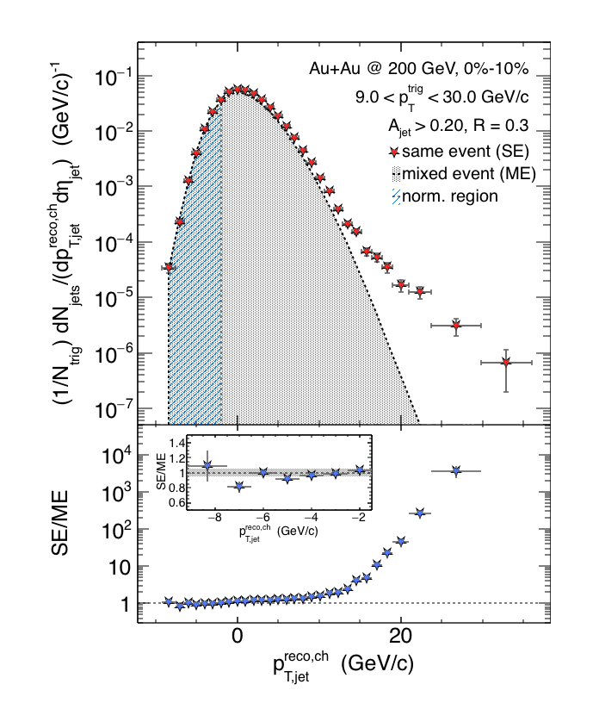
Mixed Event for Jet-finding Background
Central
Pick one random
track per real event
→ add to mixed event
Mixed event
Same event
Preliminary
Combinatorial jet background → statistically described by mixed event
Excellent description of low p_{T} spectrum with mixed event
Significant jet signal at p_{T}-ρA > 10 GeV/c
A. Schmah, Mon 15:30 Jets

Slide 14
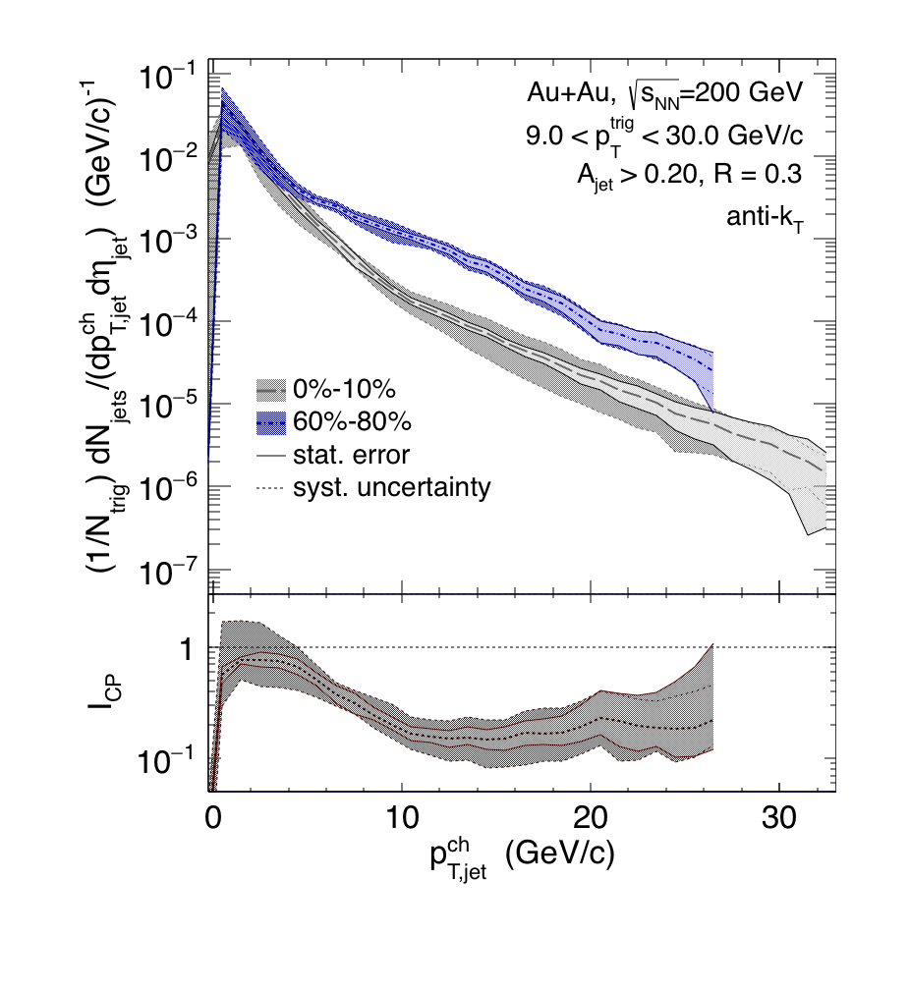
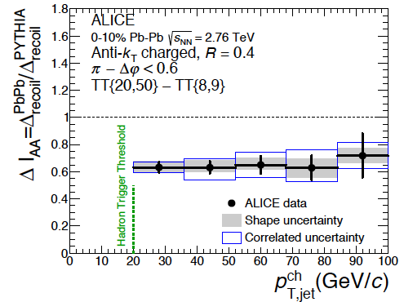
Comparison Central-Peripheral: I_{CP}
After fluctuation unfolding procedure:
I_{CP} close to 1 at low p_{T}
Significant suppression (~0.2)
at p_{T} > 10 GeV/c
Larger suppression compared to LHC
energies
similar Δp_{T} shift with steep spectra
different surface bias?
caveat: different measurement techniques
STAR preliminary
arXiv:1506.03984
ALICE
A. Schmah, Mon 15:30 Jets

Slide 15
Large Angle Jet Scattering?
9 < trigger pT < 30 GeV/c
Peripheral
Central
STAR preliminary
STAR preliminary
Jet angle changes significantly in central for 5 < p_{T} - ρA < 8 GeV/c
- Flow?
- Φ dependent normalization needed?
- Background from multiple interactions?
- More studies needed!
ALICE, arXiv:1506.03984
A. Schmah, Mon 15:30 Jets

Slide 16
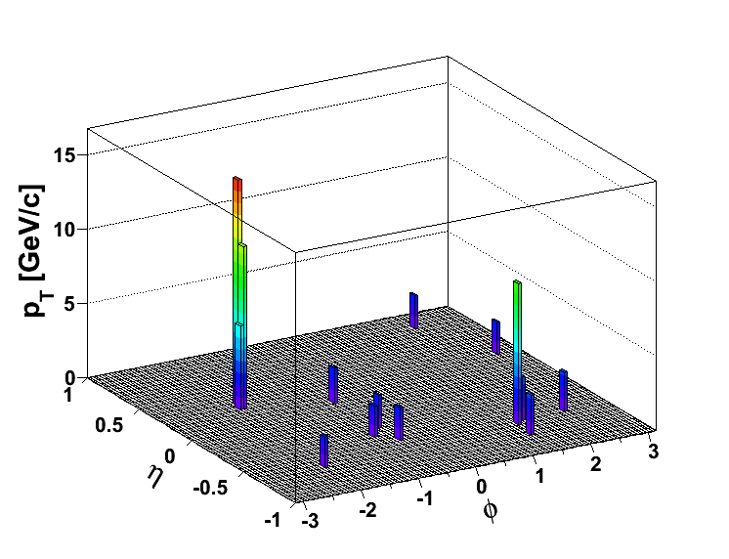
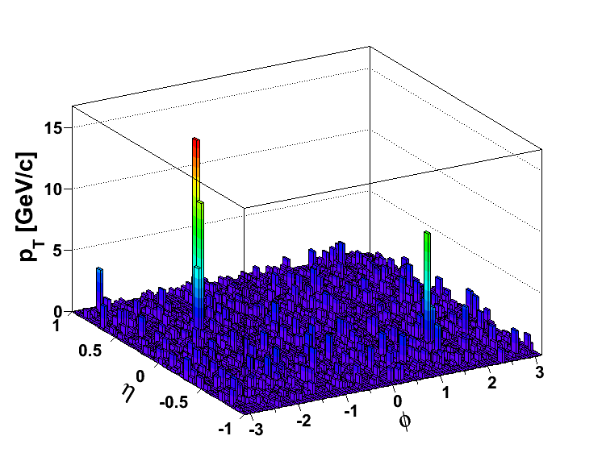
Dijet Imbalance AJ Measurement
K. Kauder, Tue 13:30
Jets
pT,cut=2 GeV/c
pT^{Lead}>20 GeV/c
pT^{SubLead}>10 GeV/c
|Δφ-π|<0.4
Rerun jet-finding algorithm
anti-kT for these dijets
pT,cut=0.2 GeV/c
pT^{Lead}>20 GeV/c (pT,cut=2 GeV/c)
pT^{SubLead}>10 GeV/c (pT,cut=2 GeV/c)
Geom. matching
Geom. matching
Locate dijet with high pT particle cuts
Reconstruct jets with low pT particle cuts

Slide 17
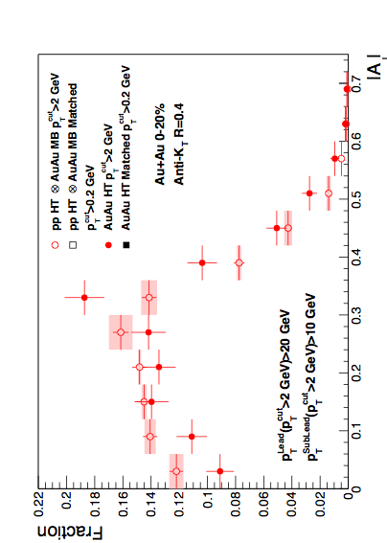
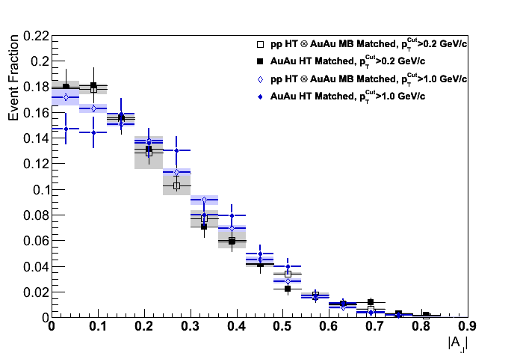
Dijet Imbalance: pT Softening
R=0.4
K. Kauder, Tue 13:30
Jets
Event Fraction
STAR preliminary
STAR preliminary
pT>2 GeV/c
p-value < 10⁻⁴
pT>1 GeV/c
p-value = 0.05 - 0.2
pT>0.2 GeV/c
p-value = 0.8
If AuAu dijet == pp dijet with AuAu background: Aj balanced
If AuAu dijet != pp dijet with AuAu background: Aj imbalanced
From pT＝2 → 1 → 0.2 GeV/c, dijet gradually regains balance.
Lost energy remerges to low pT particles.

Slide 18
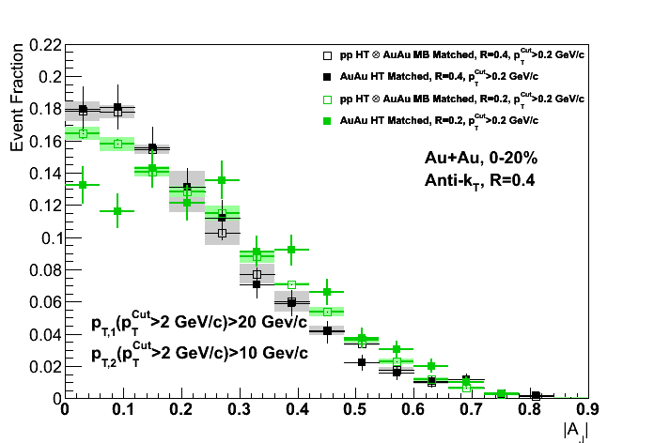
Dijet Imbalance: Jet Traverse Profile
pT>0.2 GeV/c
K. Kauder, Tue 13:30
Jets
R=0.2 Dijet imbalanced
STAR preliminary
↓
p-value = 2 × 10⁻⁴
R=0.4 Dijet balanced
p-value = 0.8
Sub-leading jet gets broadened.

Slide 19
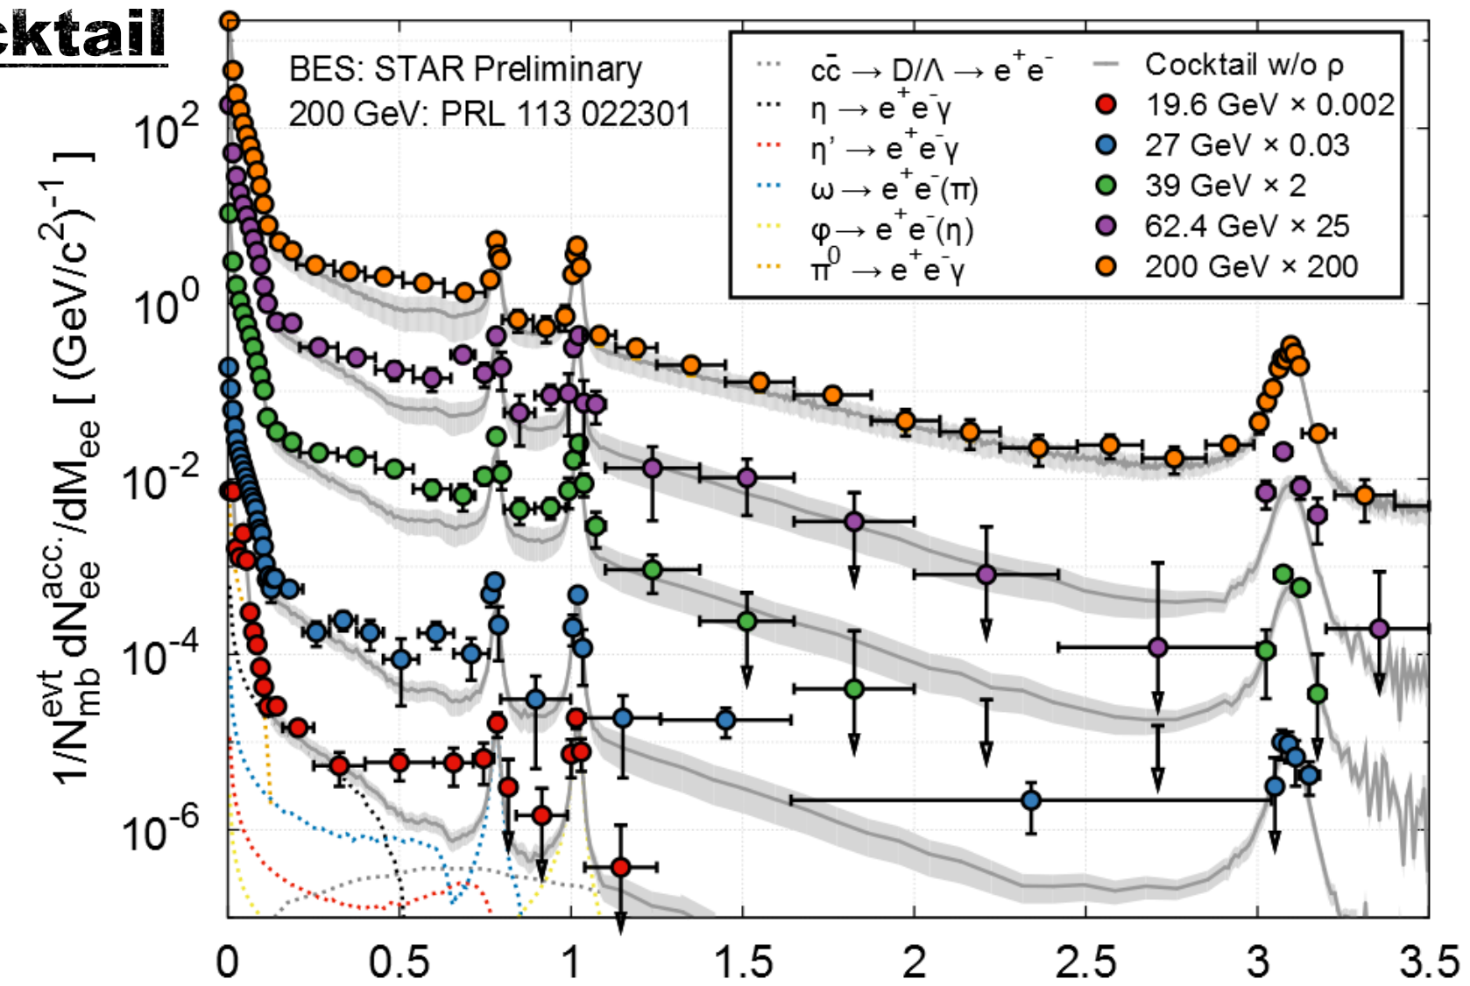
Beam Energy Scan Program
Observables:
1st order phase transition
(1) Azimuthally sensitive HBT
(2) Directed flow v₁
Partonic vs. hadronic dof
(3) R_{AA}: Nucl. Mod. Fact.
(4) Charge separation
(5) v₂ - NCQ scaling
Critical point, correl. length
(6) Fluctuations
Chiral symmetry restoration
(7) Di-lepton production
BES-I: √s_{NN} = 7.7, 11.5, 14.5, 19.6, 27, 39, 62.4GeV
Dielectron invariant mass M_{ee} (GeV/c²)
BES-II and lower energy d+Au and p+p collisions needed
B. Huang Wed 09:00
EW and Associated Topics

Slide 20
Summary and Outlook
MTD and HFT detectors running successfully
J/ψ yield
D⁰ signal
ϒ and D⁰ in higher energy density U+U collisions confirm suppression trend seen in Au+Au
Jet probes at RHIC
Larger jet suppression measured at RHIC energy than LHC
Large jet angle diffraction
Jet substructure broadening and softening
BES-II in 2019-2020

Slide 21
Enjoy the exciting STAR Results!
A. Schmah | Semi-inclusive Jets | Mon 15:30
K. Kauder | Dijet imbalance | Tue 13:30
H. Qiu | D⁰ in Au+Au | Tue 13:30
R. Ma | J/ψ in p+p | Tue 15:20
R. Vertesi | ϒ in U+U | Tue 16:20
B. Huang | Dilepton in BES | Wed 09:00
A. Quintero | D⁰ Finding in Au+Au | Poster session

Slide 24
STAR Physics Programs
 | Period | Detectors | Collisions
 | 2001-2009 | TPC + BEMC | AuAu, dAu, CuCu, pp
 | 2010-2011 | TPC + BEMC + TOF | AuAu, pp
 | 2012 | TPC + BEMC + TOF | UU, CuAu, pp
 | 2013 | TPC + BEMC + TOF + MTD | pp
 | 2014 | TPC + BEMC + TOF + MTD + HFT | AuAu, He³Au
 | 2015 | TPC + BEMC + TOF + MTD + HFT | pp, pAu, pAl
(BES-I)
(BES-I)
Heavy flavor, jet quenching, beam energy scan..

Slide 25
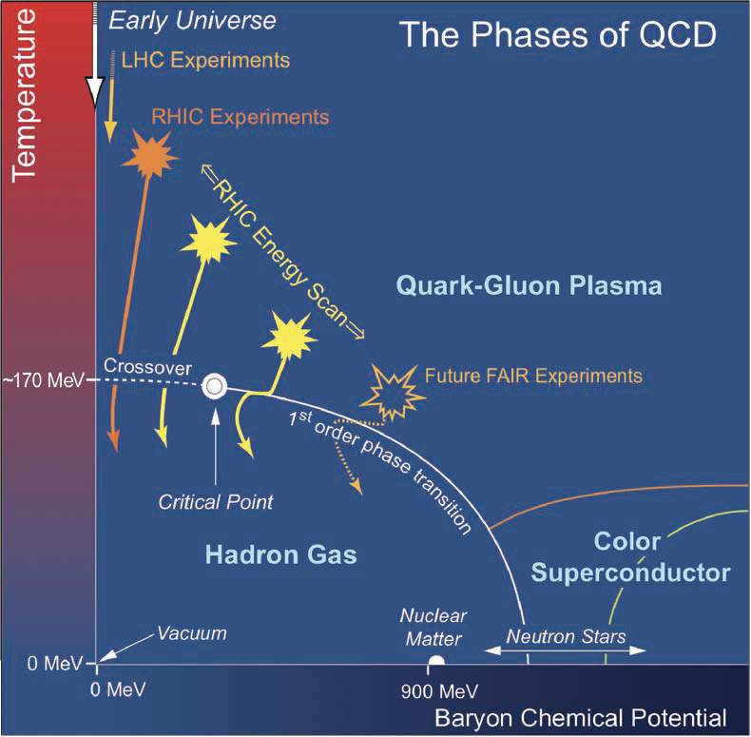
Beam Energy Scan Program
BES-I: √s_{NN} = 7.7, 11.5, 14.5, 19.6, 27, 39, 62.4GeV
Observables:
1st order phase transition
(1) Azimuthally sensitive HBT
(2) Directed flow v₁
Partonic vs. hadronic dof
(3) R_{AA}: Nucl. Mod. Fact.
(4) Charge separation
(5) v₂ - NCQ scaling
Critical point, correl. length
(6) Fluctuations
Chiral symmetry restoration
(7) Di-lepton production
BES-II and lower energy d+Au and p+p collisions needed
B. Huang Wed 09:00
EW and Associated Topics

Slide 26
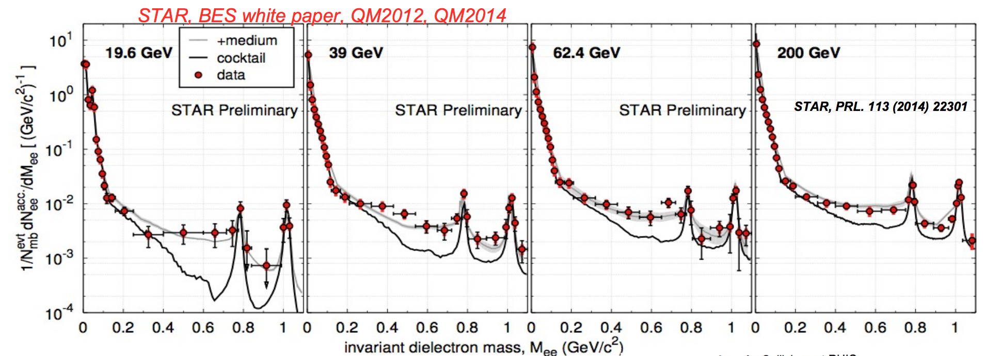
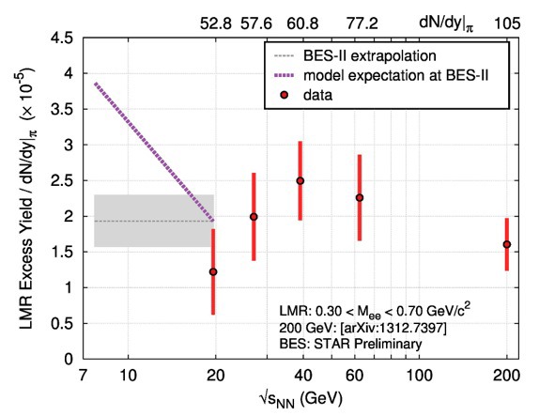
Dielectron in Beam Energy Scan-I
†Model: Rapp & Wambach, priv. communication;
Adv. Nucl.Phys. 25, 1 (2000) Phys. Rept. 363, 85 (2002)
200 GeV to 19.6 GeV excess at Mee<1.1 GeV/c² described by ρ meson in-media broadening
More excess expected from model due to total baryon density increase at lower energy (< 20 GeV)
BES-II needed for more statistics below 20 GeV
B. Huang Wed 09:00
EW and Associated Topics

Slide 27
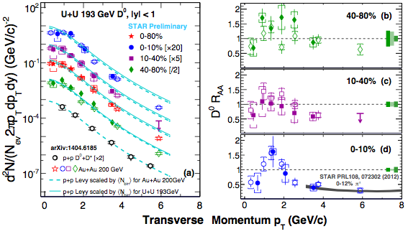
Heavy vs Light Flavor Suppression pT Dependence

Slide 28
Muon Telescope Detector
Multi-gap Resistive Plate Chamber (MRPC) technology
Precise timing ~ 95 ps
Accurate hit position ~ 1 cm
Muon identification
TPC track and MTD hit match

Slide 29
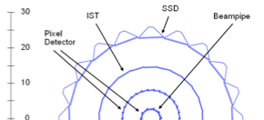
Open Charm with HFT
Heavy Flavor Tracker 3 silicon detectors (PXL, IST, SSD)
Direct reconstruction of heavy flavor hadron decay vertex with high resolution σ = 6.2 μm (PXL)
D⁰ (cu)→ K⁻ π⁺ rest frame life time ~120 μm
Λc⁺ (udc)→ p K⁻ π⁺ rest frame life time ~60 μm
PXL
H. Qiu, Tue 13:30
HF and Quarkonium

Slide 30
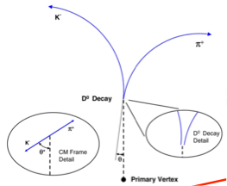
D⁰ signal with HFT
~10% statistics of year 2014 Au+Au
D^{0 →} K⁻ π⁺
Background greatly suppressed by topology cuts with HFT
Physics results with HFT will come soon.
A. Quintero, Poster
for Optimize D⁰ signal
H. Qiu, Tue 13:30
HF and Quarkonium

Slide 31
Do we understand J/ψ in pp?

Slide 32
A closer look: Event Multiplicity Dependence

Slide 33
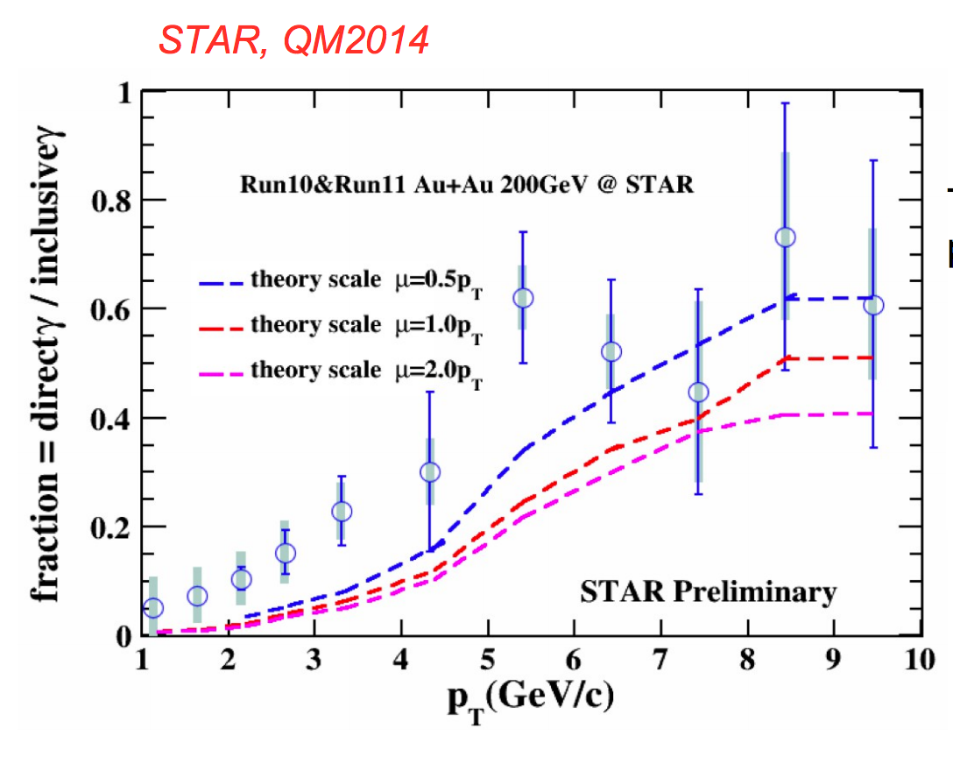
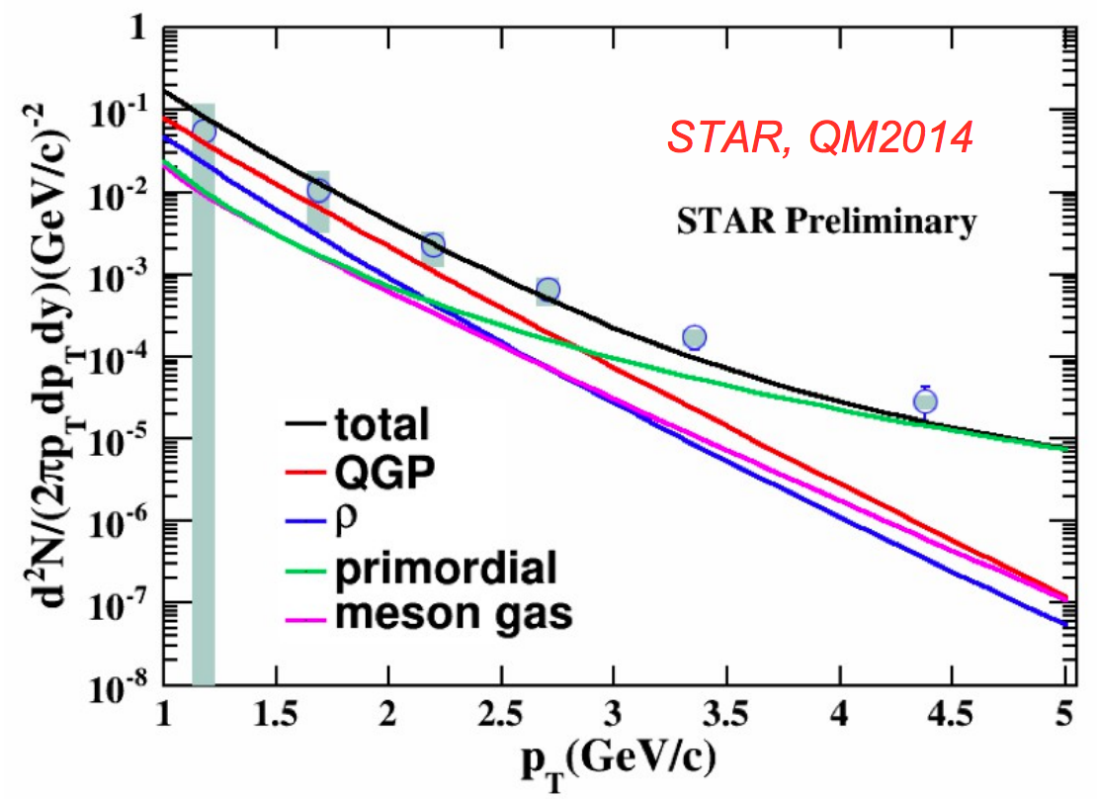
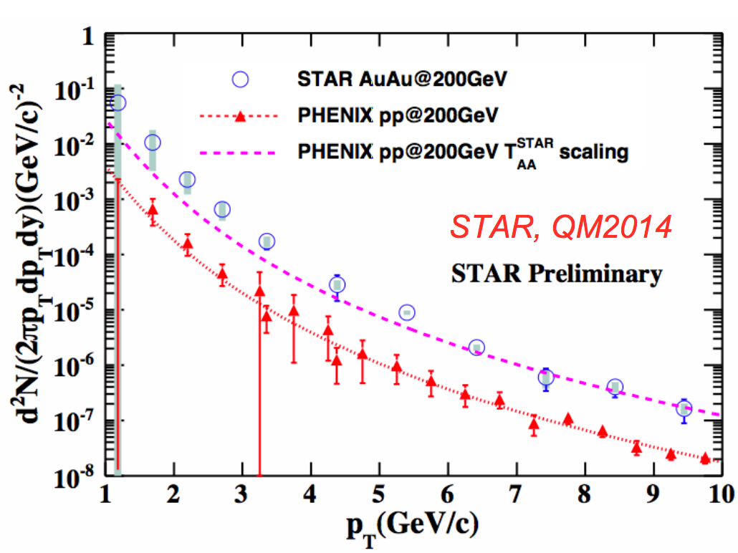
Direct virtual photon yield
In high p_{T} region (5~10 GeV/c):
– consistent with T_{AA} scaled function fit to PHENIX p+p data.
In low p_{T} region:
– an excess is observed in p_{T} range 2~4 GeV/c.
Rapp’s model prediction:
➔ Including QGP, ρ, meson gas, and primordial production contributions.
➔ Well describing the low p_{T} excess in our data within uncertainty.

Slide 34
Nuclear Modification Factor in BES-I
Jet quenching disappear?
Cold nuclear effect?
BES-II and lower energy d+Au and p+p collisions

Slide 35
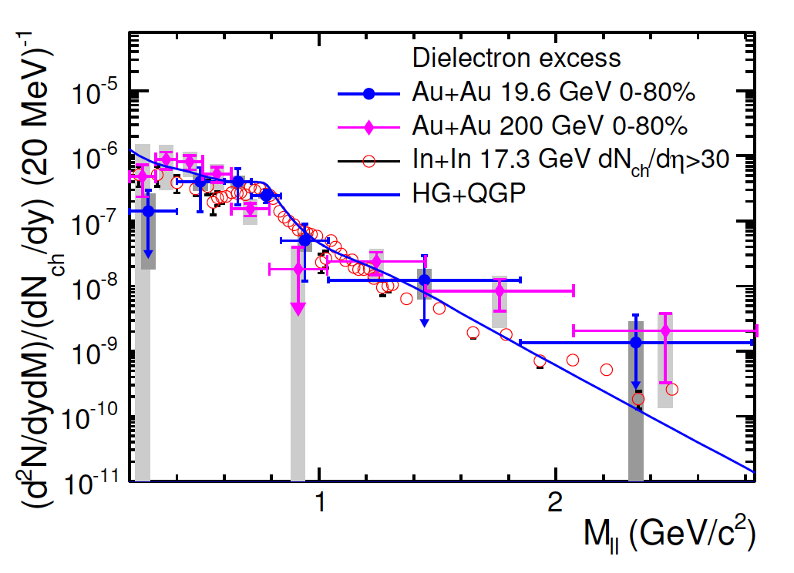
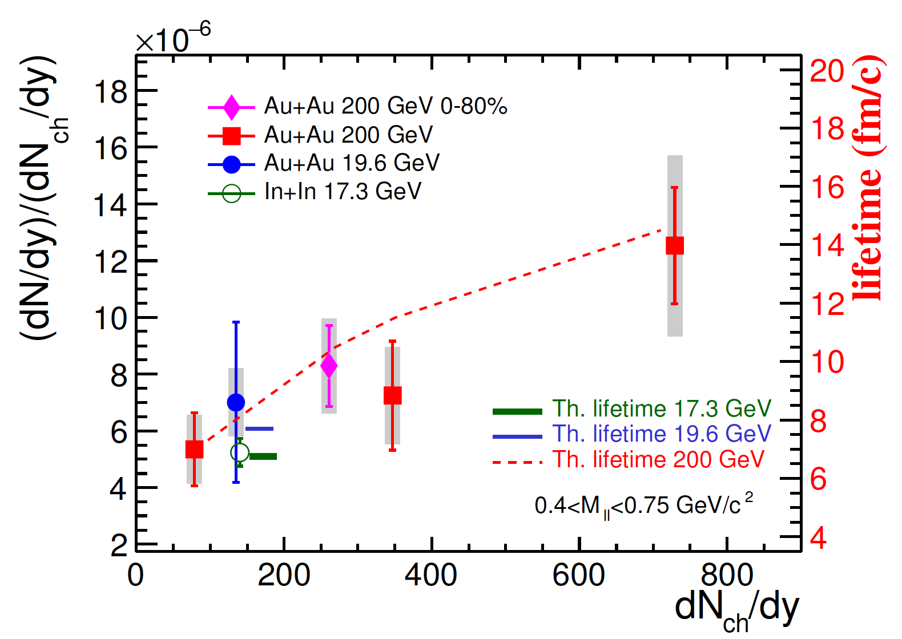
Energy dependence of dilepton excess
arXiv:1501.05341
19.6 GeV consistent with SPS results.
Excess shape at low mass well described by rho in-medium broadening.
Excess yields (after detector acceptance correction) are sensitive to early system lifetime: integrated over duration at the high temperature.

Slide 36
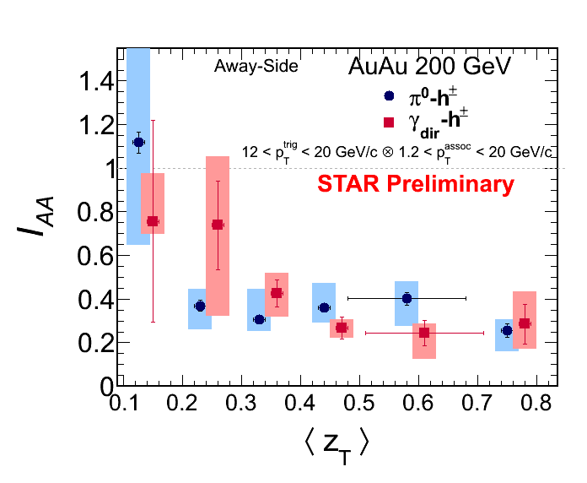
r-jet
I_{AA}^{π0-h} and I_{AA}^{ϒdir-h} show similar and strong suppression
At low z_{T}, data suggests lost energy may start to be recovered (with large uncertainty )

Slide 37
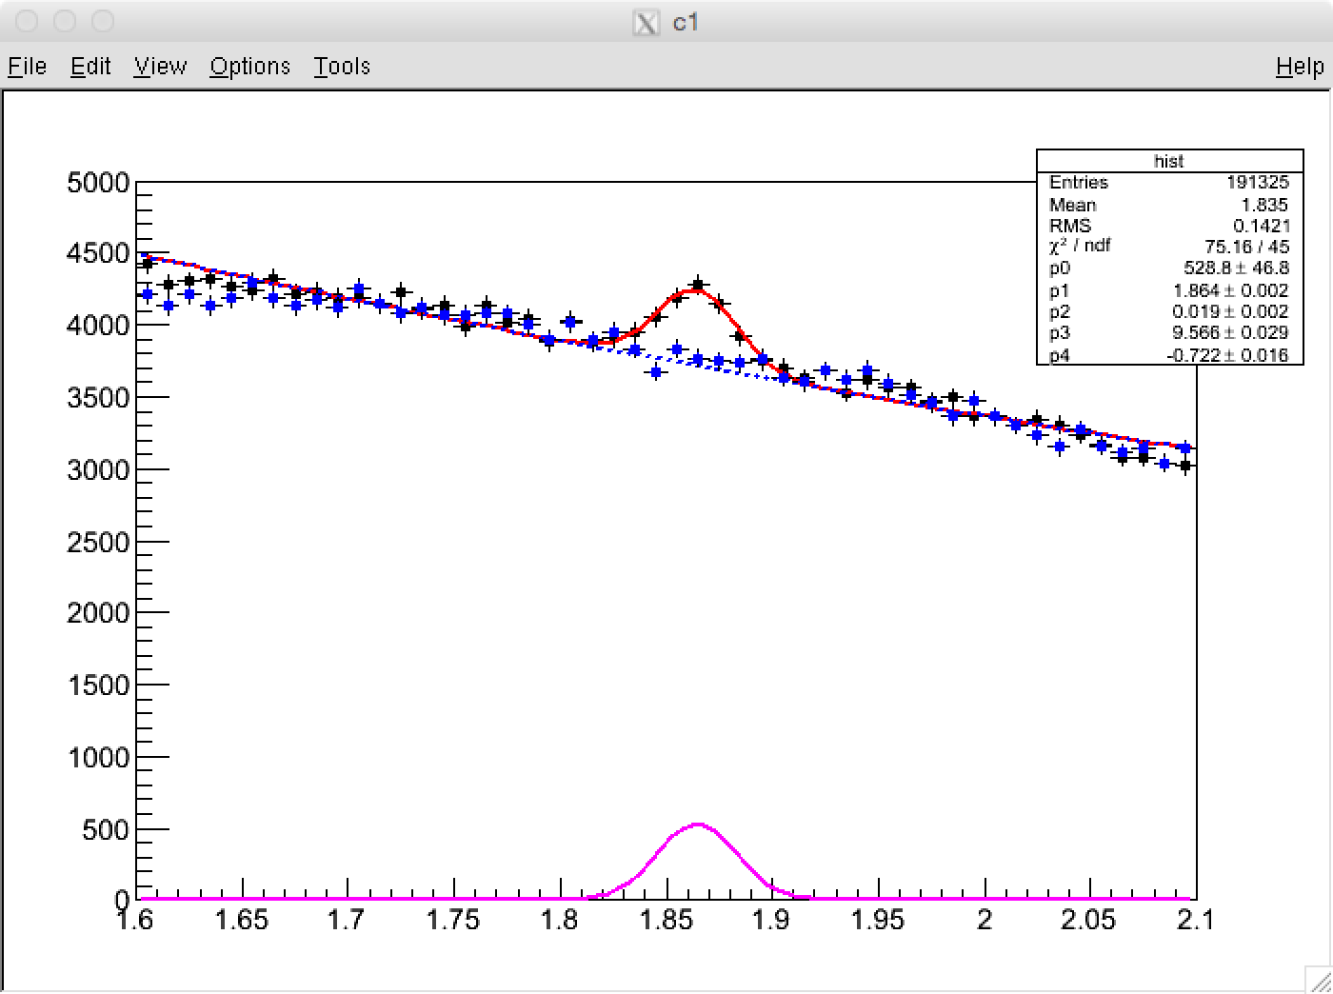
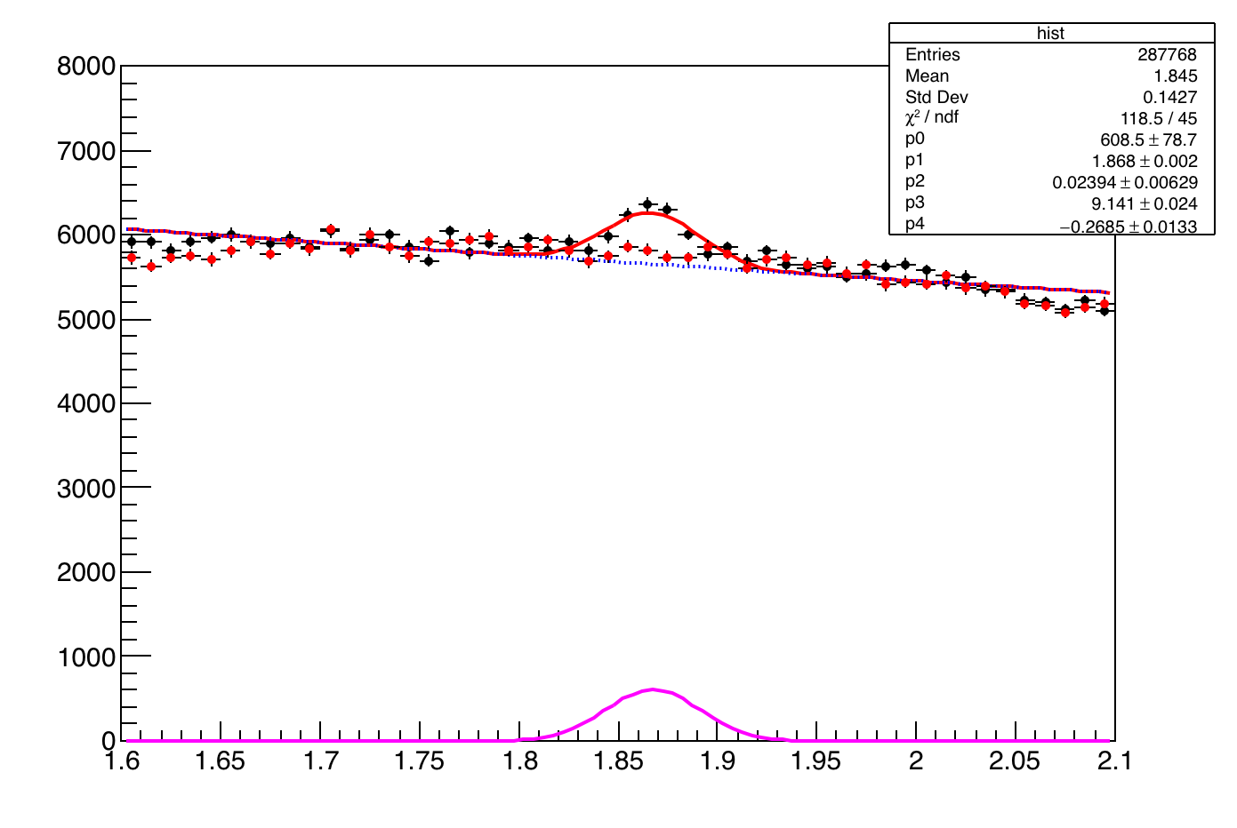
KFParticle: reconstruction of decay particles using Kalman Filter algorithm
D⁰ -> K p
100 million minimum bias events
Yield=2520±224 (11.25σ)
s/√(s+b)=12.79
Optimize D⁰ signal
TMVA for signal optimization
Yield=3653±472 (7.73σ)
s/√(s+b)=13.51

Slide 38
Semi-Inclusive Recoil Jets
Semi-inclusive yield of jets recoiling from a high p_{T} hadron trigger
Recoil jet(s)
search area
Measured
Calculable in fixed-order pQCD
Trigger
particle
Trigger on high p_{T} hadron → Select hard process with surface bias
Measure the recoil jets → No fragmentation bias on recoil side!
How to deal with combinatorial jet-finding background?
A. Schmah, Mon 15:30 Jets

Slide 39
Mixed Event Generation for Jets
Mixed event
Mix only similar centrality, Ψ_{EP} ,
z-vertex position
Pick one random
track per real event
→ add to mixed event
…
Real events
Ev. 1
Ev. 2
Ev. 3
Ev. 765
June 2015
Alexander Schmah - Hard Probes 2015

Slide 40
Jet Substructure
R=0.2
Study Broadening
R=0.4
p_{T}^{Cut} > 0.2 GeV/c
R=0.4
R=0.4
p_{T}^{Cut} > 0.2 GeV/c
Study Softening
p_{T}^{Cut} > 1 GeV/c
p_{T}^{Cut} > 2 GeV/c

