Slide 1





14. Zimányi
WINTER SCHOOL ON HEAVY ION PHYSICS
Dec. 1. - Dec. 5., Budapest, Hungary
Production of Quarkonia in Heavy Ion Collisions at STAR
Róbert Vértesi
robert.vertesi@ujf.cas.cz .
for the
collaboration
Nuclear Physics Institute Academy of Sciences
of the Czech Republic

Slide 2
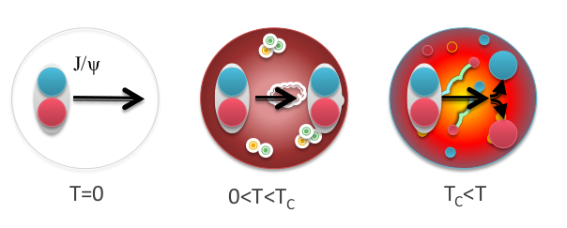
Quarkonia in the sQGP
Debye screening of heavy quark potential
→ Quarkonia are expected to dissociate
T. Matsui, H. Satz, Phys.Lett. B178, 416 (1986)
_
Charmonia (cc):
J/Ψ, Ψ’, χ_{c}
Bottomonia (bb):
ϒ(1S), ϒ(2S), ϒ(3S),χ_{B}
_

Slide 3
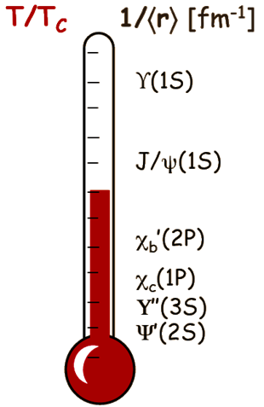
Quarkonia in the sQGP
Debye screening of heavy quark potential
→ Quarkonia are expected to dissociate
T. Matsui, H. Satz, Phys.Lett. B178, 416 (1986)
Sequential melting: Different states
dissociate at different temperatures
Á. Mócsy, P. Petreczky, Phys. Rev. D77, 014501 (2008)
_
Charmonia (cc):
J/Ψ, Ψ’, χ_{c}
Bottomonia (bb):
ϒ(1S), ϒ(2S), ϒ(3S),χ_{B}
_
Quarkonia may serve as sQGP thermometer

Slide 4
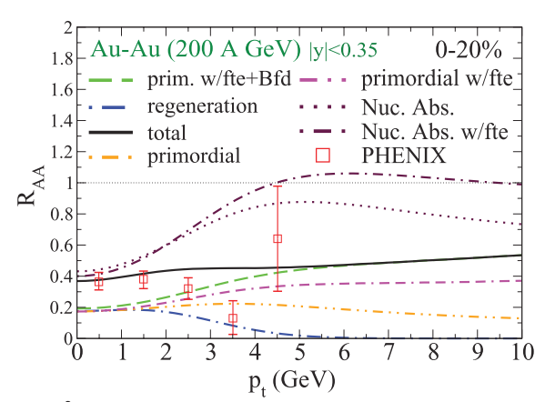
Complications…
Model:
X. Zhao, R.Rapp, PRC82, 064905 (2010)
Data:
PHENIX, Nucl.Phys. A 774 (2006) 747
Feed-down
  χ_{c}, ψ’, B-meson decay to J/ψ
  χ_{b}, ϒ(2S), ϒ(2S) to ϒ(1S) …
Cold nuclear matter effects
  Nuclear shadowing
  (PDF modification in the nucleus)
  Initial state energy loss
  Co-mover absorption
Hot/dense medium effects
  Coalescence of uncorrelated
  charm and bottom pairs.

Slide 5
Complications…
Model:
X. Zhao, R.Rapp, PRC82, 064905 (2010)
Data:
PHENIX, Nucl.Phys. A 774 (2006) 747
Feed-down
  χ_{c}, ψ’, B-meson decay to J/ψ
  χ_{b}, ϒ(2S), ϒ(2S) to ϒ(1S) …
Cold nuclear matter effects
  Nuclear shadowing
  (PDF modification in the nucleus)
  Initial state energy loss
  Co-mover absorption
Hot/dense medium effects
  Coalescence of uncorrelated
  charm and bottom pairs.
Contribution of different effects is not well understood

Slide 6
Measurements at STAR
A wide variety of J/ψ measurements
  Different species
  d+Au → cold nuclear matter (CNM) effects
  Au+Au, U+U → hot plasma effects, different energy densities
  Energy scan
  Change relative contributions
  High-pT J/ψ
  →”turn off” regeneration and CNM effects
Measure ○
  Negligible recombination and co-mover absorption at RHIC energies
  Difficult measurement: Low production rate
  Requires good acceptance and specific triggering
○ states provide a cleaner probe at RHIC

Slide 7
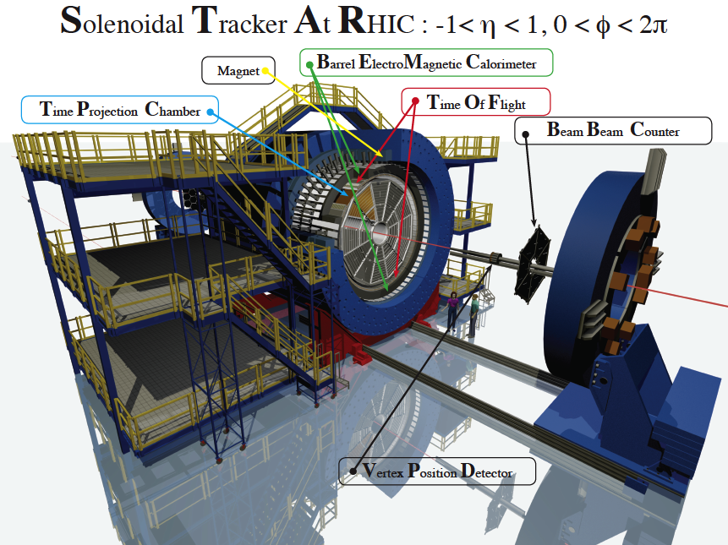
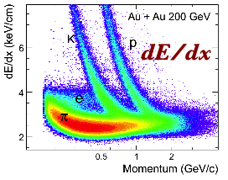
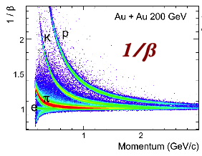
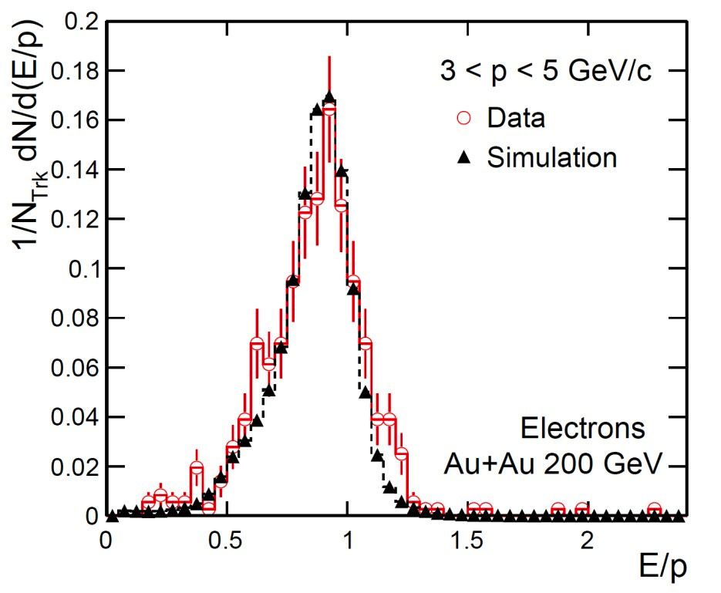
RHIC/STAR
Reconstruction:
  J/ψ → e⁺e– (B_{ee} ~ 6%)
  ϒ → e⁺e– (B_{ee} ~ 2%)
TPC
  dE/dx PID
  Large acceptance,
  uniform in a wide
  energy range
TOF
  PID using flight time
BEMC
  High-p_{T} trigger
  PID using E/p
  and shower shape
VPD
  Minimum
  bias events
TPC
E/p
TOF
BEMC
Notes:
7

Slide 8
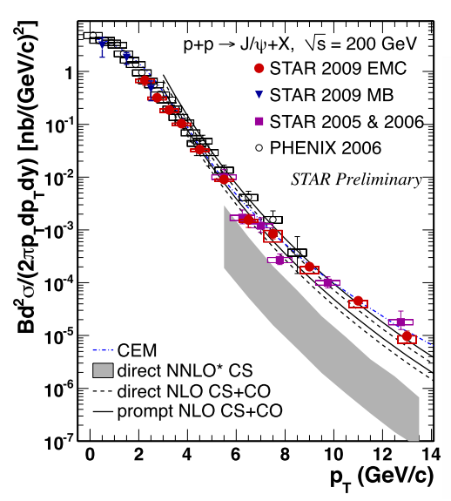
J/ψ spectra, p+p at 200 GeV
Inclusive J/ψ spectra:
STAR Data:
  0<p_{T}<14 GeV/c in year 2009
  Good agreement with PHENIX
STAR 2009 EMC : Phys. Lett. B 722 (2013) 55
STAR 2009 MB: Acta Phys. Polonica B Vol.5, No 2 (2012), 543
STAR 2005 & 2006: Phys. Rev. C80, 041902(R) (2009)
PHENIX 2006: Phys. Rev. D 85, 092004 (2012)
Notes:
8

Slide 9
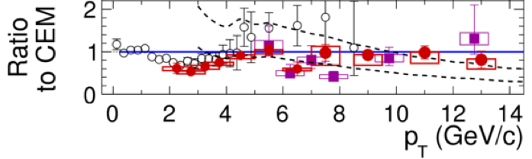
J/ψ spectra, p+p at 200 GeV
Inclusive J/ψ spectra:
STAR Data:
  0<p_{T}<14 GeV/c in year 2009
  Good agreement with PHENIX
Model comparison:
  prompt NLO CS+CO:
  describes the data for p_{T} > 4 GeV/c
  direct NNLO*CS:
  misses high- p_{T} part
  Prompt CEM: reasonable description of spectra, but overpredicts the data at p_{T}∼3 GeV/c
STAR 2009 EMC : Phys. Lett. B 722 (2013) 55
STAR 2009 MB: Acta Phys. Polonica B Vol.5, No 2 (2012), 543
STAR 2005 & 2006: Phys. Rev. C80, 041902(R) (2009)
PHENIX 2006: Phys. Rev. D 85, 092004 (2012)
direct NNLO CS: P.Artoisenet et al., Phys. Rev. Lett. 101, 152001 (2008) and
J.P.Lansberg private communication
NLO CS+CO: Y.-Q.Ma, K.Wang, and K.T.Chao, Phys. Rev. D 84, 51 114001 (2011) and priv. comm.
CEM: A.D. Frawley, T Ullrich, R. Vogt, Pys. Rept. 462 (2008) 125, and R.Vogt priv. comm.
Notes:
9

Slide 10
J/ψ spectra, Au+Au at 200 GeV
J/ψ spectrum softer than
Tsallis Blast-Wave model
  Small radial flow?
  Recombination at low p_{T}?
Tsallis Blast-Wave:
  Hydro-inspired freezeout
  Particles produced according to a Lévy-distribution
STAR low-p_{T} Au+Au, CuCu : arXiv:1310.3563
high-p_{T} Au+Au: Phys.Lett. B722, 55 (2013)
high-p_{T} Cu+Cu : Phys. Rev. C 80 (2009) 041902
PHENIX: Phys. Rev. Lett. 98 (2007) 232301
Tsallis B-W: Z.Tang et al., Chin.Phys.Lett. 30, 031201 (2013)
Notes:
Viscous hydro with decouling temp. Favours higher temp
Teorie includes colasecence and also B-feedown

Slide 11
J/ψ spectra, Au+Au at 200 GeV
J/ψ spectrum softer than
Tsallis Blast-Wave model
  Small radial flow?
  Recombination at low p_{T}?
Viscous hydrodynamics
  J/ψ decouples at 120..165 MeV
  fails at low-p_{T}
Y. Liu et al.
  Includes J/ψ suppression due to color screening
  Includes statistical regeneration
  peripheral: initial production dominates.
  central: regeneration becomes more significant at low p_{T}.
Y. Liu et al., Phys. Lett. B 678, 72 (2009)
U. W. Heinz and C. Shen (2011), private communication.
  Coalescence of charm quarks is needed
Notes:
Viscous hydro with decouling temp. Favours higher temp
Teorie includes colasecence and also B-feedown

Slide 12
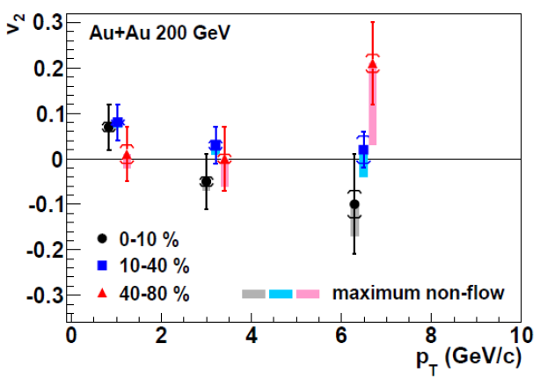
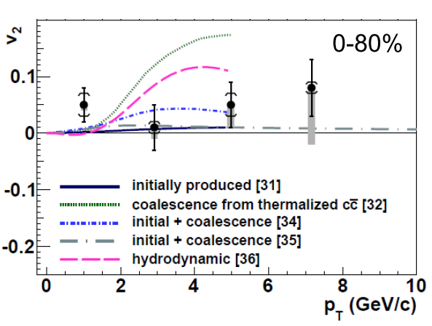
Azimuthal anisotropy (v₂)
STAR Au+Au
√s_{NN}=200 GeV
Phys. Rev. Lett. 111 (2013) 52301
[31] Yan, Zhuang,Xu, PRL97 (2006) 232301
[32] Greco, Ko, Rapp, PLB595 (2004) 202
[34] Zhao, Rapp, PLB 655 (2007) 126
[35] Liu,Xu,Zhuang, NPA834 (2010) 317c
[36] Heinz, Chen (2012)
J/psi v₂ consistent with non-flow at at p_{T}>2 GeV/c
Unique among hadrons!
Regardless of centrality
Thermalized charm quark coalescence does not dominate production
Notes:
Year 2010
Unlike light flavor hadrons ..Does not appeat to flow above pt>2…also trasverse flow beta=0
Plot – modely: j/psi produced by initial pQCD processed expected to stay close to 0.
(includes v2 due to nuclear absorption different path lengt of melting – beond the sensitivity of our data)
If charm qaurks fully thermalize and j/psi get produced by colescence we expect almost the same maximal v2 as for light,
but at larger pt – 4gev
Models that include production from both –initial production and coalescence are ok, plus initla dominates at high pt.
..disfavord models that produce j/psi at pt>2 predominatly by coalescence.
Dodelat – viz barbara

Slide 13
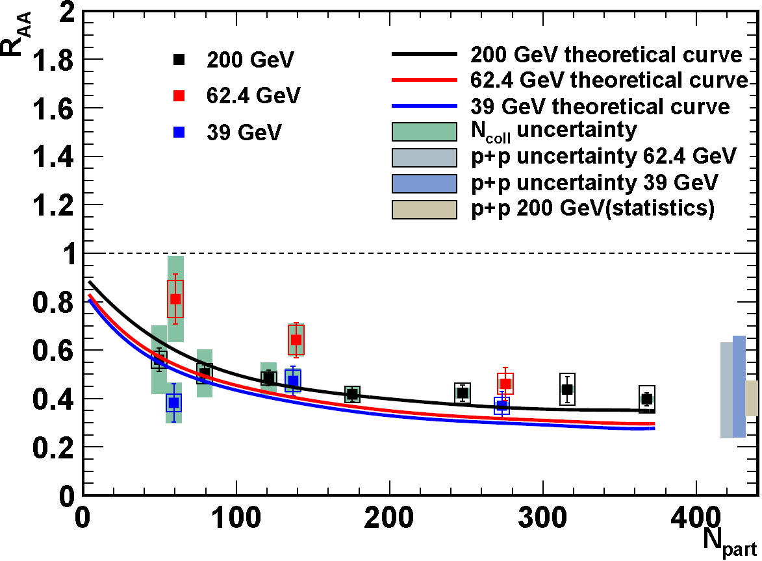
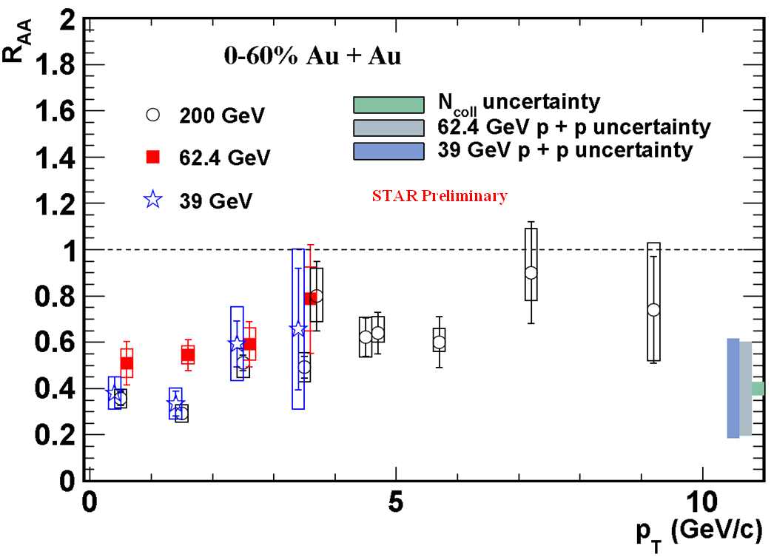
J/ψ R_{AA} vs. beam energy
STAR Preliminary
STAR Preliminary
CEM p+p references for 39 and 62 GeV:
Nelson, Vogt et al., PRC87, 014908 (2013)
Theory: Zhao, Rapp, PRC82, 064905 (2010)
Similar suppression in Au+Au at 200, 62.4 and 39 GeV
  p+p reference is based on CEM calculations
  Large theoretical uncertainty
Consistent with theoretical calculations
  Does coalescence compensate for melting?
Notes:
CEM – model – autors use world-wide open charm data to constrain model..
The left panel of Fig. 3 shows the R AA of J /ψ as a function of N part for Au + Au collisions at 39, 62.4
and 200 GeV. We use the Color Evaporation Model (CEM) prediction as p + p reference baselines for
√s NN = 39 and 62.4 GeV, since there are no available reference data at RHIC for these two energies and results from other
experiments [11, 12, 13, 14, 15] seem to be inconsistent with one another. CEM calculations describe the p T and
rapidity distribution in p + p collisions at
√
s NN = 200 GeV [16]
With the derived pp reference for 39,6 and mesured data at 200 GeV, we obtain the RAA
As the energy increases the QGP temperature increases …
However in the theoretical prediction the regeneration contiribution increases due to large charm cross-section
The model predicts very similar suppression for both 39 and 62 GeV, despite a
signiﬁcant diﬀerence in energy and thus diﬀerent initial energy densities. In this model, larger
suppression of direct J/ψ production at higher energy is oﬀset by an enhanced regeneration rate
due to a larger cross section for charm quarks. These calculations agree reasonably well with
our data within errors.

Slide 14
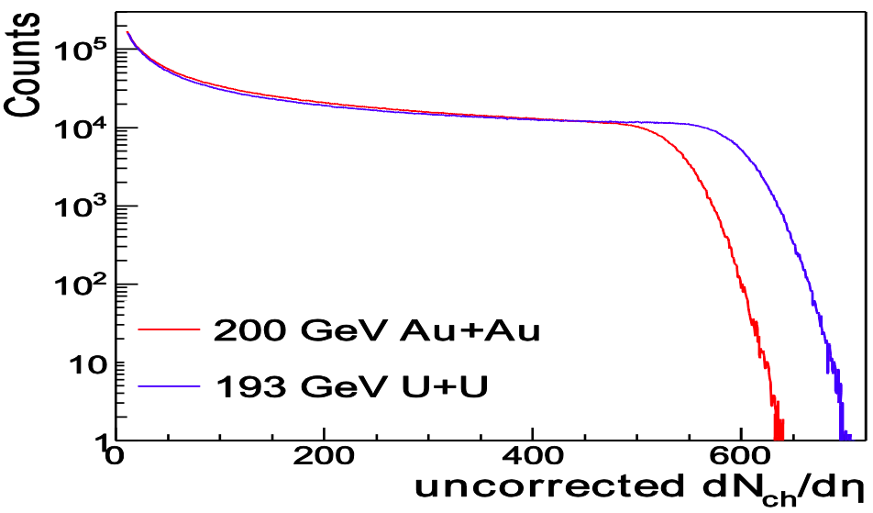
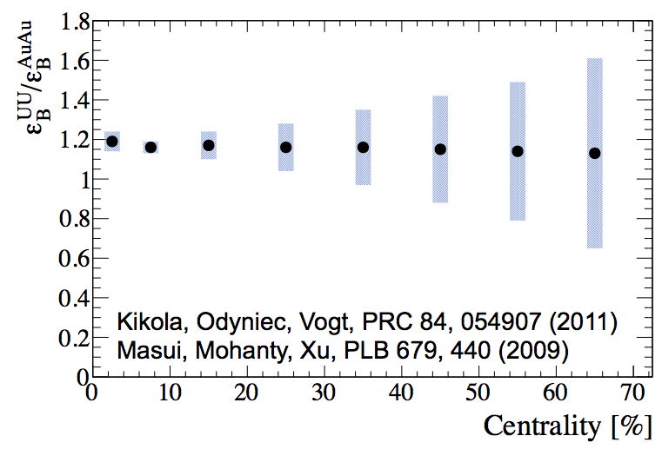
U+U: Higher energy densities
STAR preliminary
RHIC √s_{NN}=193 GeV U+U data (2012)
Reach higher N_{part} than in Au+Au
Provide higher energy density
Further test of dissociation-coalescence interplay

Slide 15
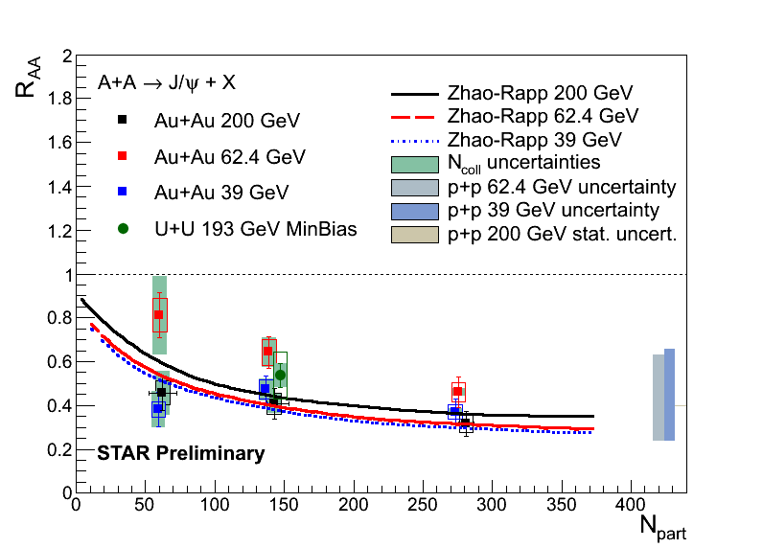
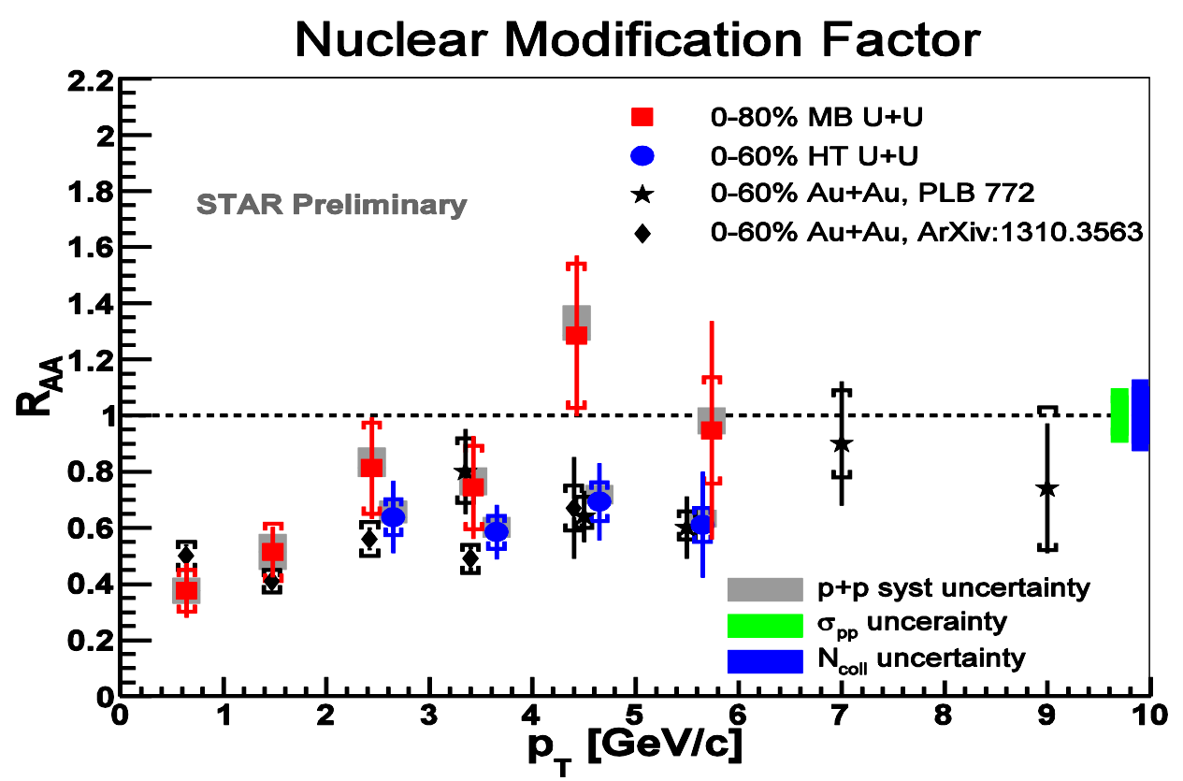
J/ψ R_{AA} in 193 GeV U+U
Nuclear modification factor in U+U similar to Au+Au
  p+p reference is 200 GeV
Notes:
Study of centrality dependence of R_{AA} ongoing
central trigger data available

Slide 16
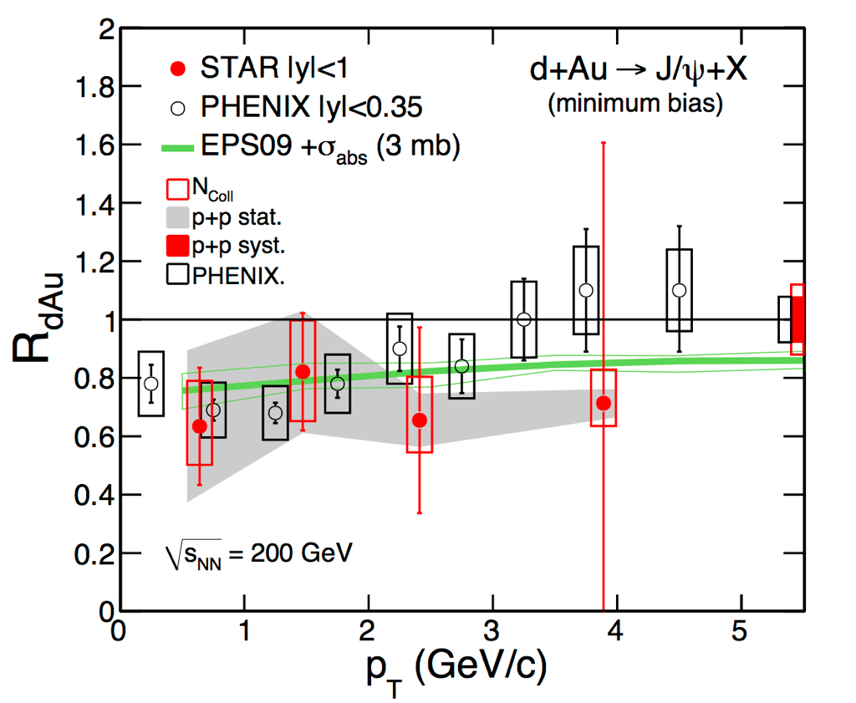
Motivation for high-p_{T} J/ψ
d+Au → study of cold nuclear matter effects
R_{dAu} ≈ 1 for high p_{T}
  → CNM effects are small at high-p_{T}
STAR Preliminary
Notes:
The observed j/psi raa can due to an interplay of color screeing and efects such as
Formation time and modification of parton dist. function.
According to modesls CNM effect at pt>5 should be negligible.
the J/ψ is not suppressed in d+Au collisions
for pT > 5 GeV/c [4] which indicates that cold-nuclear-matter eﬀects are small at high pT .
Therefore, the observed suppression at high pT is a manifestation of the QGP eﬀects. Data from 2008
at high pT is a manifestation of the QGP eﬀects.

Slide 17
Motivation for high-p_{T} J/ψ
d+Au → study of cold nuclear matter effects
R_{dAu} ≈ 1 for high p_{T}
  → CNM effects are small at high-p_{T}
Model:
X. Zhao, R.Rapp, PRC82, 064905 (2010)
Data:
PHENIX, Nucl.Phys. A 774 (2006) 747
STAR Preliminary
Much less regeneration
Notes:
The observed j/psi raa can due to an interplay of color screeing and efects such as
Formation time and modification of parton dist. function.
According to modesls CNM effect at pt>5 should be negligible.
the J/ψ is not suppressed in d+Au collisions
for pT > 5 GeV/c [4] which indicates that cold-nuclear-matter eﬀects are small at high pT .
Therefore, the observed suppression at high pT is a manifestation of the QGP eﬀects. Data from 2008
at high pT is a manifestation of the QGP eﬀects.

Slide 18
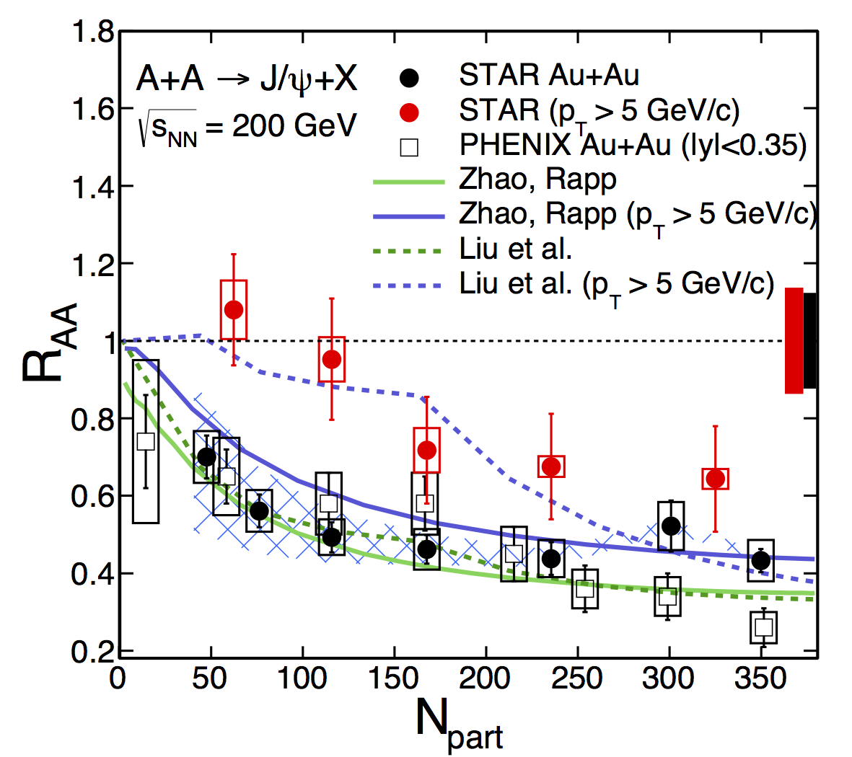
High-p_{T} J/ψ in Au+Au
CNM effects are small
Less regeneration
Suppression of high-p_{T} J/ψ in central collisions
STAR low-p_{T} : arXiv:1310.3563
STAR high-p_{T} : PLB722, 55 (2013)
Liu et al., PLB 678, 72 (2009)
Zhao and Rapp, PRC 82, 064905(2010), PLB 664, 253 (2008)
PHENIX Phys. Rev. Lett. 98, 232301 (2007)

Slide 19
High-p_{T} J/ψ in Au+Au
CNM effects are small
Less regeneration
Suppression of high-p_{T} J/ψ in central collisions
STAR low-p_{T} : arXiv:1310.3563
STAR high-p_{T} : PLB722, 55 (2013)
Liu et al., PLB 678, 72 (2009)
Zhao and Rapp, PRC 82, 064905(2010), PLB 664, 253 (2008)
PHENIX Phys. Rev. Lett. 98, 232301 (2007)
High-p_{T} J/ψ suppression is clearly an sQGP effect

Slide 20
ϒ in p+p – baseline
p+p ϒ cross section vs. y, compared to pQCD predictions
R. Vogt, Phys. Rep. 462125, 2008
Phys.Lett. B735 (2014) 127

Slide 21
ϒ in p+p – baseline
p+p ϒ cross section vs. y, compared to pQCD predictions
R. Vogt, Phys. Rep. 462125, 2008
Phys.Lett. B735 (2014) 127
STAR Preliminary
p+p ϒ cross section, compared to world data trend
→ Leszek Kosarzewski’s
talk on ϒ in p+p 500 GeV

Slide 22
ϒ R_{dAu} – CNM effects
Models include
  Gluon nPDF (Anti)shadowing
  Initial parton energy loss
Indication of suppression at mid-rapidity beyond models
Phys.Lett. B735 (2014) 127
R_{dAu}=0.48 ± 0.14(stat) ± 0.07(syst) ± 0.02 (pp stat) ± 0.06 (pp syst)
|y|<0.5

Slide 23
ϒ R_{dAu} – CNM effects
Models include
  Gluon nPDF (Anti)shadowing
  Initial parton energy loss
Indication of suppression at mid-rapidity beyond models
Phys.Lett. B735 (2014) 127
Phys.Lett. B735 (2014) 127
STAR data consistent with E772

Slide 24
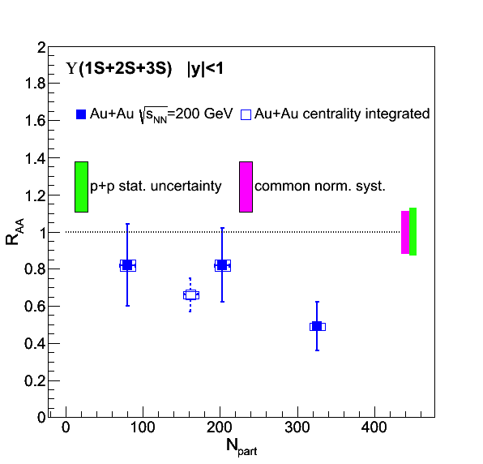
ϒ R_{AA}
Au+Au: Phys.Lett. B735 (2014) 127
Au+Au data
Peripheral data at |y|<1 is consistent with no suppression
Significant suppression
in central data

Slide 25
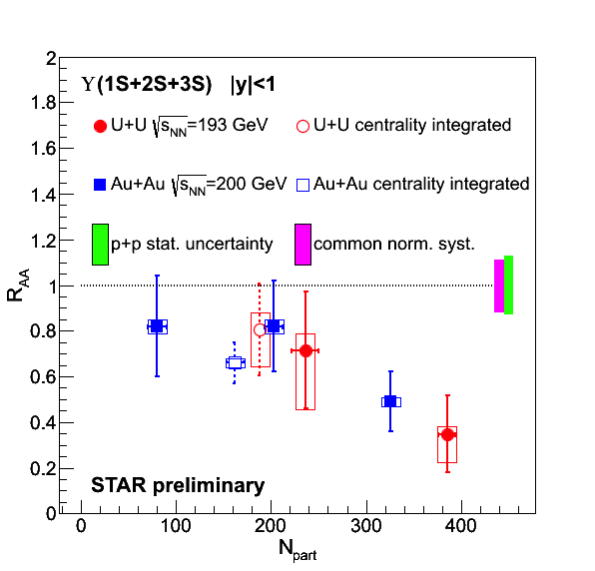
ϒ R_{AA}
Au+Au: Phys.Lett. B735 (2014) 127
Au+Au and U+U data
Peripheral data at |y|<1 is consistent with no suppression
Significant suppression
in central data
Trend in U+U follows and extends trend in Au+Au

Slide 26
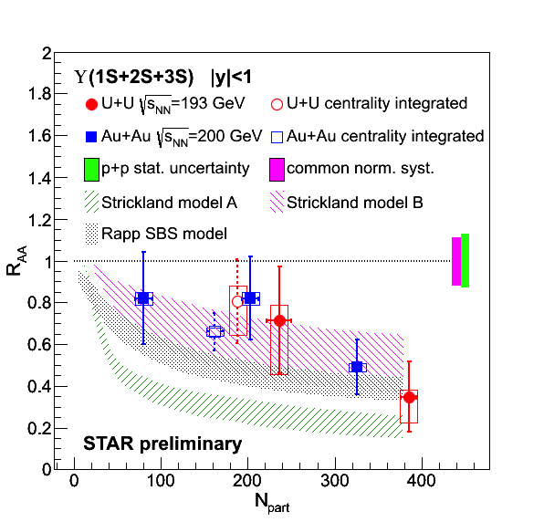
ϒ R_{AA} – data vs. models
Au+Au: Phys.Lett. B735 (2014) 127
Model calculations:
Strong binding scenario,
CNM effects included
Emerick, Zhao, Rapp, Eur. Phys. J A48, 72 (2012)
Potential model based on heavy quark internal energy ‘B’
assumes 428 < T < 443 MeV
Strickland, Bazov, Nucl. Phys. A879, 25 (2012)
Potential model based on heavy quark free energy ‘A’ disfavored
Suppression indicates ϒ melting in colored medium
However: CNM effects need further study
→ Upcoming p+Au run at RHIC in 2015

Slide 27
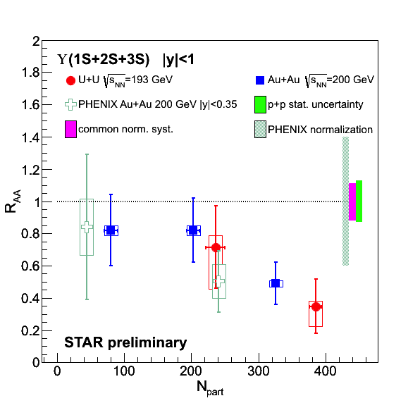
ϒ R_{AA} – RHIC comparison
Au+Au: Phys.Lett. B735 (2014) 127
STAR vs. PHENIX:
data are consistent
PHENIX Collaboration, arXiv:1404.2246

Slide 28
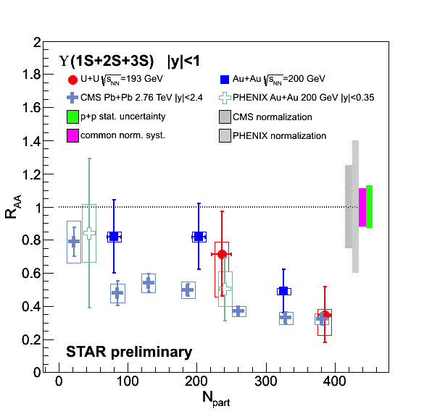
ϒ R_{AA} – RHIC & LHC comparison
Au+Au: Phys.Lett. B735 (2014) 127
STAR vs. PHENIX:
data are consistent
RHIC vs. LHC:
  N_{part} dependence of ϒ suppression is weaker at LHC
  At the highest N_{part} LHC and RHIC suppressions are comparable
  → is suppression driven
  by the energy density?
Note the uncertainties, however
PHENIX Collaboration, arXiv:1404.2246
CMS Collaboration, PRL 109 (2012) 222301

Slide 29
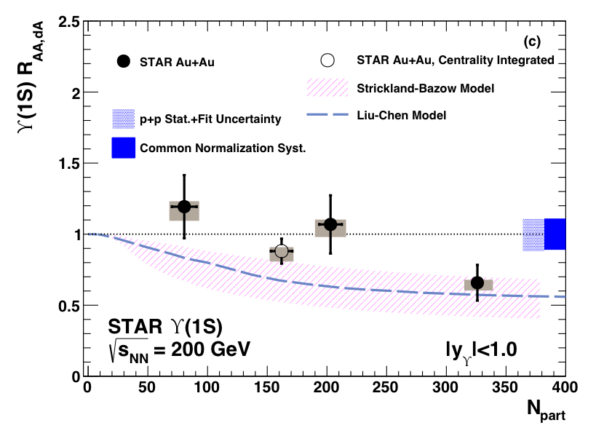
ϒ(1S) R_{AA} in Au+Au
Phys.Lett. B735 (2014) 127
Model calculations
Strickland-Bazov model B:
Hot and cold effects
Nucl. Phys. A879, 25 (2012)
Liu-Chen model:
Dissociation of Quarkonium
No CNM effects
Phys. Lett. B697 (2011) 32
B
ϒ(1S) R_{AA} is consistent with unity in peripheral and mid-central Au+Au
Indication of suppression consistent with model calculation in central Au+Au

Slide 30
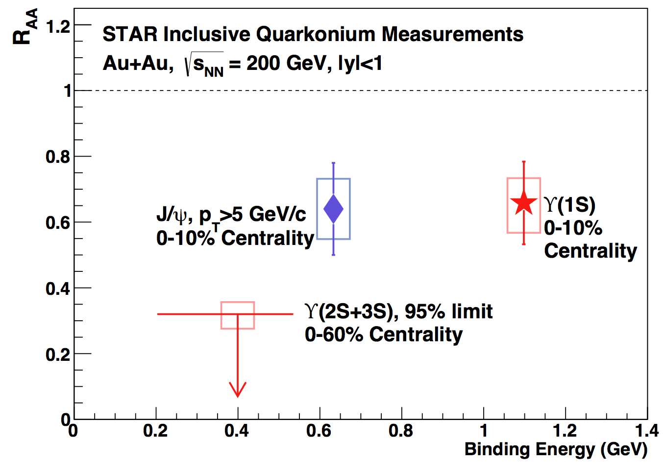
Excited ϒ states in Au+Au
Phys.Lett. B735 (2014) 127
Central Au+Au:
Excited states ϒ(2S) and ϒ(3S) consistent with complete melting
ϒ(1S) suppression is similar to high-p_{T} J/ψ
Au+Au

Slide 31
Excited ϒ states in Au+Au
Phys.Lett. B735 (2014) 127
Central Au+Au:
Excited states ϒ(2S) and ϒ(3S) consistent with complete melting
ϒ(1S) suppression is similar to high-p_{T} J/ψ
Au+Au
ϒ suppression pattern supports sequential melting

Slide 32
Excited ϒ states – LHC comparison
Phys.Lett. B735 (2014) 127
Au+Au
RHIC √s_{NN}=200 GeV Au+Au and
LHC √s_{NN}=2.76 TeV Pb+Pb collisions:
Similar suppression of central ϒ(1S)

Slide 33
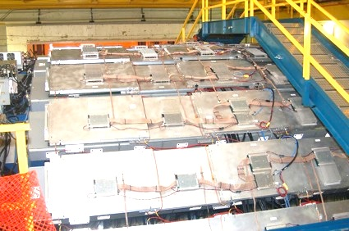
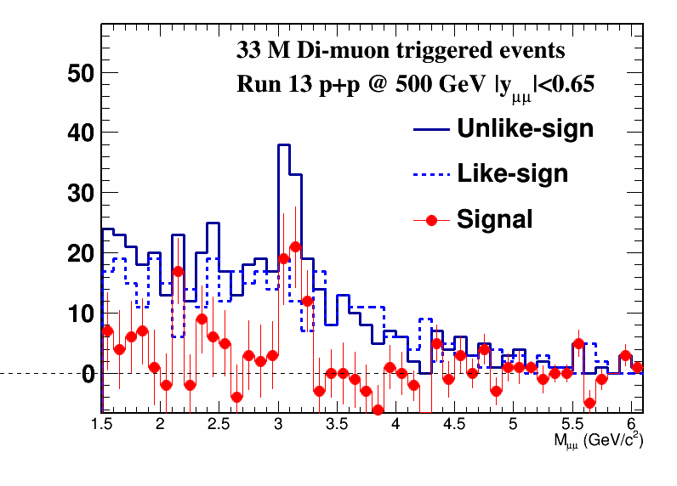
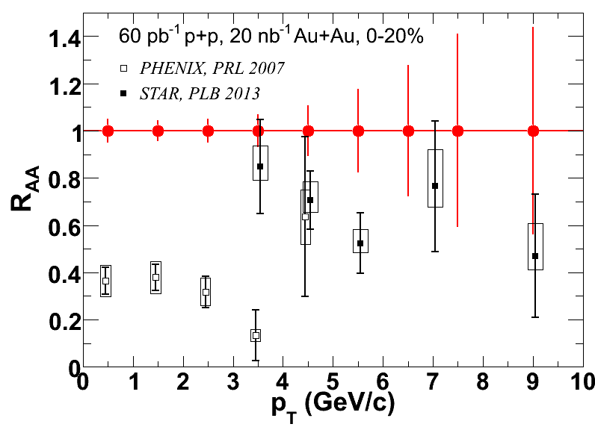
Outlook: Muon Telescope Detector
J/ψ/ϒ → μ⁺μ⁻ (BR ~ 6%)
  No γ conversion
  Less Bremsstrahlung → better resolution
  Less contribution from Dalitz decays
  Trigger capability for J/ψ
  in central A+A collisions
Reconstructed J/ peak
J/ψ projected stat. errors
ϒ projected stat. errors
R_{AA}
<N_{part}>

Slide 34
Outlook: Muon Telescope Detector
J/ψ/ϒ → μ⁺μ⁻ (BR ~ 6%)
  No γ conversion
  Less Bremsstrahlung → better resolution
  Less contribution from Dalitz decays
  Trigger capability for J/ψ
  in central A+A collisions
Run14 data was taken with MTD fully operational
Reconstructed J/ peak
J/ψ projected stat. errors
ϒ projected stat. errors
R_{AA}
<N_{part}>

Slide 35
Summary
  J/ψ suppression similar in central 39, 62.4
  and 200 GeV collisions
  No strong collective behavior of J/ψ observed (v₂, radial flow)
  → thermalized cc-coalescence not dominant in production
  Significant suppression of high-p_{T} J/ψ and similar ϒ(1S) suppression in central A+A collisions
  ϒ(2S) and ϒ(3S) suppression is stronger than Y(1S)
  → clear signal of a deconfined medium
  ϒ(nS) suppression in most central collisions similar to LHC
  U+U measurements show similar suppression patterns to Au+Au
_

Slide 36
Summary
  J/ψ suppression similar in central 39, 62.4
  and 200 GeV collisions
  No strong collective behavior of J/ψ observed (v₂, radial flow)
  → thermalized cc-coalescence not dominant in production
  Significant suppression of high-p_{T} J/ψ and similar ϒ(1S) suppression in central A+A collisions
  ϒ(2S) and ϒ(3S) suppression is stronger than Y(1S)
  → clear signal of a deconfined medium
  ϒ(nS) suppression in most central collisions similar to LHC
  U+U measurements show similar suppression patterns to Au+Au
_
Stay tuned for new great results with MTD

Slide 37

Thank You!
AGH University of Science and Technology
Argonne National Laboratory, Argonne, Illinois 60439
Brookhaven National Laboratory, Upton, New York 11973
University of California, Berkeley, California 94720
University of California, Davis, California 95616
University of California, Los Angeles, California 90095
Universidade Estadual de Campinas, Sao Paulo 13131, Brazil
Central China Normal University (HZNU), Wuhan 430079, China
University of Illinois at Chicago, Chicago, Illinois 60607
Creighton University, Omaha, Nebraska 68178
Czech Technical University in Prague, FNSPE, Prague, 115 19, Czech Republic
Nuclear Physics Institute AS CR, 250 68 Rez/Prague, Czech Republic
Frankfurt Institute for Advanced Studies FIAS, Frankfurt 60438, Germany
Institute of Physics, Bhubaneswar 751005, India
Indian Institute of Technology, Mumbai 400076, India
Indiana University, Bloomington, Indiana 47408
Alikhanov Institute for Theoretical and Experimental Physics, Moscow 117218, Russia
University of Jammu, Jammu 180001, India
Joint Institute for Nuclear Research, Dubna, 141 980, Russia
Kent State University, Kent, Ohio 44242
University of Kentucky, Lexington, Kentucky, 40506-0055
Korea Institute of Science and Technology Information, Daejeon 305-701, Korea
Institute of Modern Physics, Lanzhou 730000, China
Lawrence Berkeley National Laboratory, Berkeley, California 94720
Massachusetts Institute of Technology, Cambridge, Massachusetts 02139-4307
Max-Planck-Institut fur Physik, Munich 80805, Germany
Michigan State University, East Lansing, Michigan 48824
Moscow Engineering Physics Institute, Moscow 115409, Russia
National Institute of Science Education and Research, Bhubaneswar 751005, India
Ohio State University, Columbus, Ohio 43210
Institute of Nuclear Physics PAN, Cracow 31-342, Poland
Panjab University, Chandigarh 160014, India
Pennsylvania State University, University Park, Pennsylvania 16802
Institute of High Energy Physics, Protvino 142281, Russia
Purdue University, West Lafayette, Indiana 47907
Pusan National University, Pusan 609735, Republic of Korea
University of Rajasthan, Jaipur 302004, India
Rice University, Houston, Texas 77251
University of Science and Technology of China, Hefei 230026, China
Shandong University, Jinan, Shandong 250100, China
Shanghai Institute of Applied Physics, Shanghai 201800, China
Temple University, Philadelphia, Pennsylvania 19122
Texas A&M University, College Station, Texas 77843
University of Texas, Austin, Texas 78712
University of Houston, Houston, Texas 77204
Tsinghua University, Beijing 100084, China
United States Naval Academy, Annapolis, Maryland, 21402
Valparaiso University, Valparaiso, Indiana 46383
Variable Energy Cyclotron Centre, Kolkata 700064, India
Warsaw University of Technology, Warsaw 00-661, Poland
University of Washington, Seattle, Washington 98195
Wayne State University, Detroit, Michigan 48201
World Laboratory for Cosmology and Particle Physics (WLCAPP), Cairo 11571, Egypt
Yale University, New Haven, Connecticut 06520
University of Zagreb, Zagreb, HR-10002, Croatia
STAR Collaboration

Slide 38
J/ψ in p+p – polarization
2<pT<6 GeV/c
STAR+PHENIX consistent with NLO+CSM
  Higher statistics needed to discriminate
p+p 500 GeV results will improve precision for future CNM calculations
arXiv:1131.1621

