Slide 1





14. Zimányi
WINTER SCHOOL ON HEAVY ION PHYSICS
Dec. 1. - Dec. 5., Budapest, Hungary
Recent STAR results from the
RHIC Beam Energy Scan program
Róbert Vértesi
robert.vertesi@ujf.cas.cz .
for the
collaboration
Nuclear Physics Institute Academy of Sciences
of the Czech Republic

Slide 2
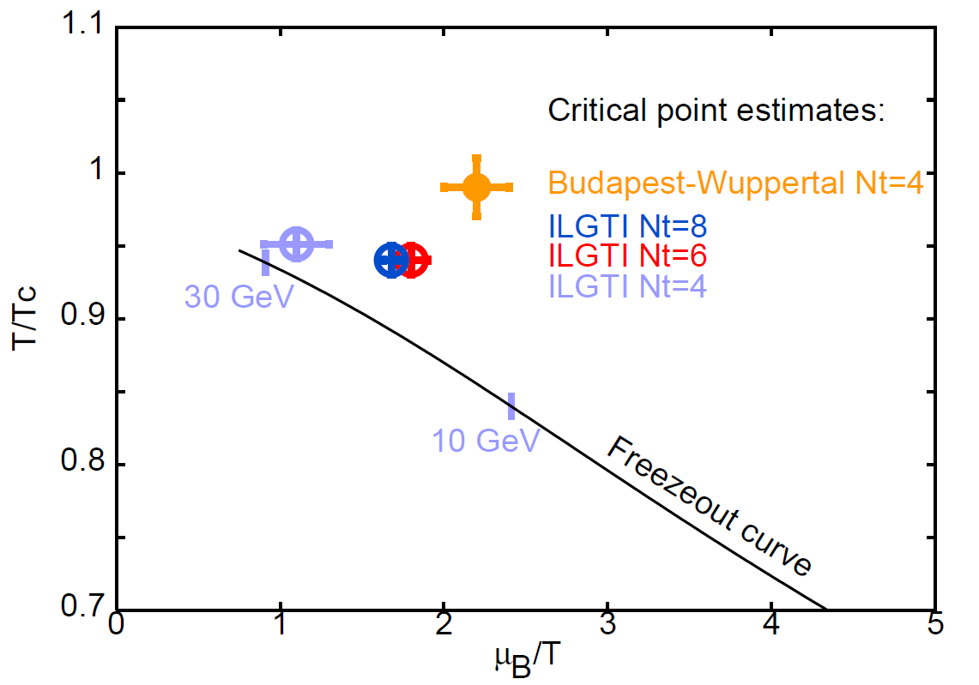
Motivation
Experimental exploration of the QCD phase diagram
Theory: Critical point may be around 10<√s_{NN}<30 GeV
Vary T, μ_{B} by setting different collision energy, species
RHIC: access to a wide range with the same apparatus
Phys. Rev. D 78, 14503 (2008)
Phys.Rev.D 71, 114014 (2005)
JHEP 0404, 50 (2004)
Acta Phys.Polon.Supp. 5 (2012) 825

Slide 3
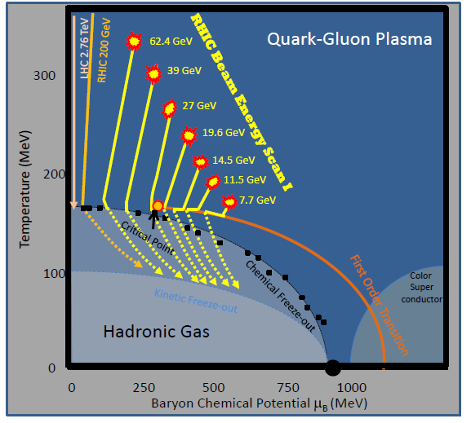
Exploring the QCD phase diagram
Find…
1) Turn-off of sQGP signatures
2) 1st order phase transition signs
3) The QCD critical point
http://arxiv.org/abs/1007.2613

Slide 4

STAR at RHIC
EEMC
Magnet
MTD
BEMC
TPC
TPC
TOF
BBC
Main device: Time Projection Chamber
Coverage: 0 < φ < 2π , |η| < 1.0
Uniform acceptance: All energies and particles
Particle ID: π, K, p through TPC dE/dx aided by TOF
K⁰_{s}, Λ, Ξ, Ω, φ through invariant mass

Slide 5
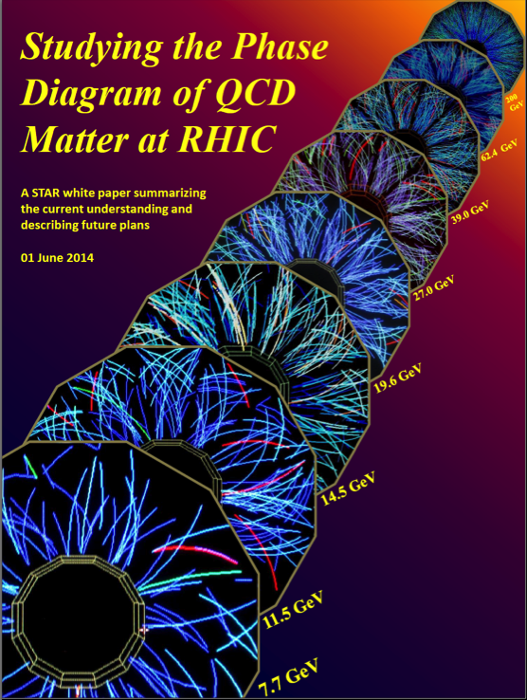
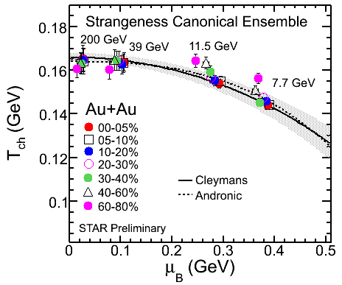
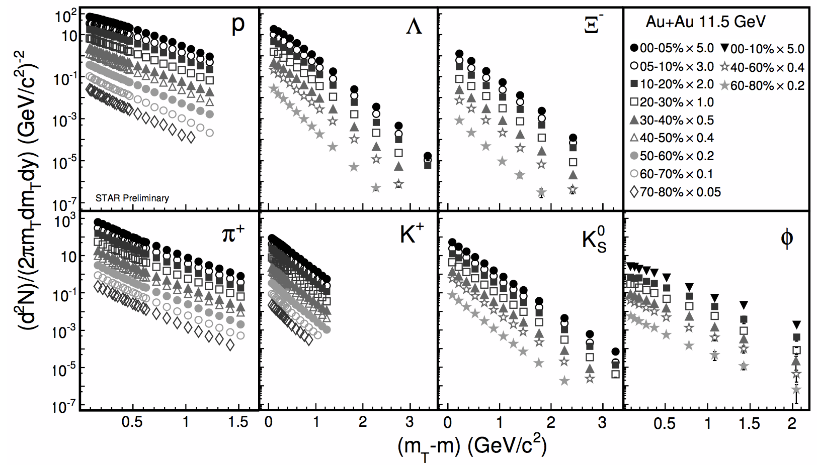
STAR BES-I
√s_{NN} (GeV) | μ_{B} (MeV) | #Events | #Weeks | Year
200 | 20 | 350 M | 11 | 2010
62.4 | 70 | 67 M | 1.5 | 2010
39.0 | 115 | 130 M | 2 | 2010
27.0 | 155 | 70 M | 1 | 2011
19.6 | 205 | 36 M | 1.5 | 2011
14.5 | 260 | 20 M | 3 | 2014
11.5 | 315 | 12 M | 2 | 2010
7.7 | 420 | 4 M | 4 | 2010
STAR preliminary
http://www.bnl.gov/npp/pac.asp
STAR preliminary
Notes:
How is mu_B extracted? Ratios?
Thermal model postdiction – LQCD TC predictions on the same curve!

Slide 6
Exploring the QCD phase diagram
Find…
1) Turn-off of sQGP signatures
2) 1st order phase transition signs
3) The QCD critical point
http://arxiv.org/abs/1007.2613

Slide 7
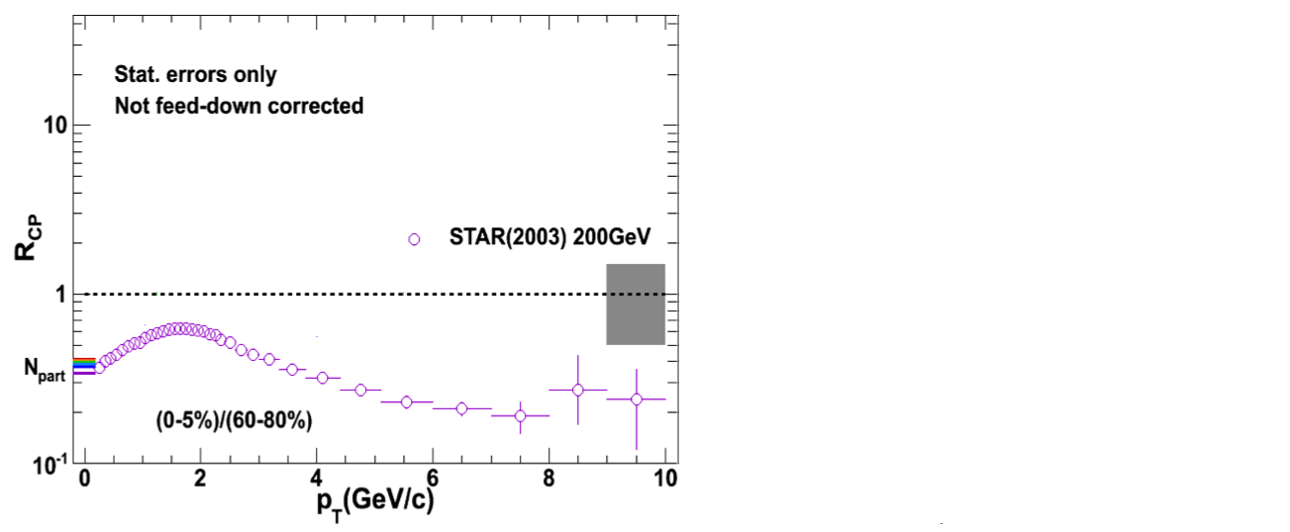
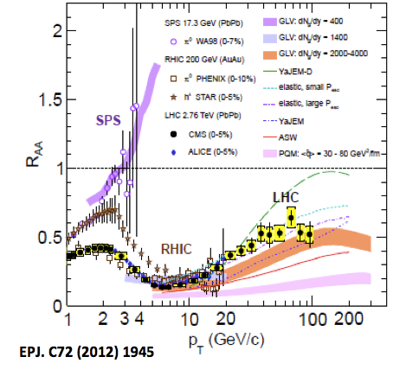
Suppression of high-p_{T} hadrons
PRL 91 (2003) 172302
Eur. Phys. Journal C72 (2012) 1945
Strong suppression in 200 GeV Au+Au collisions
Present also in 2.76 TeV Pb+Pb collisions at LHC

Slide 8
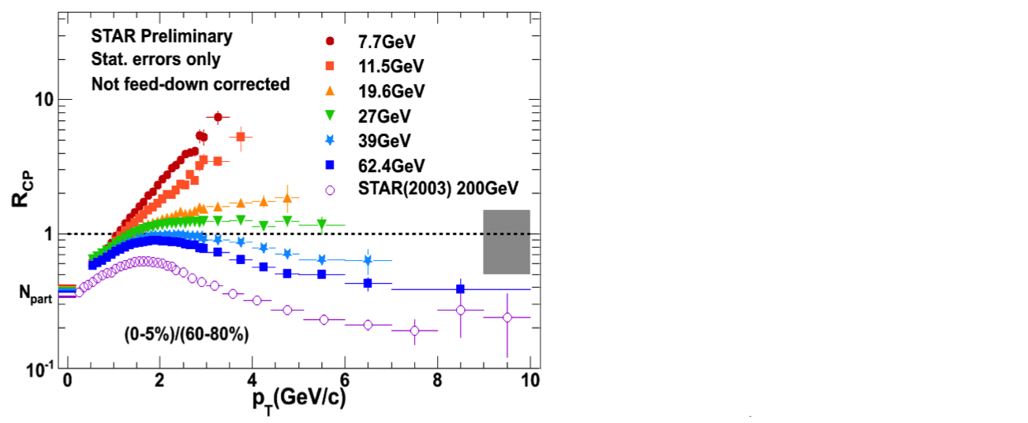
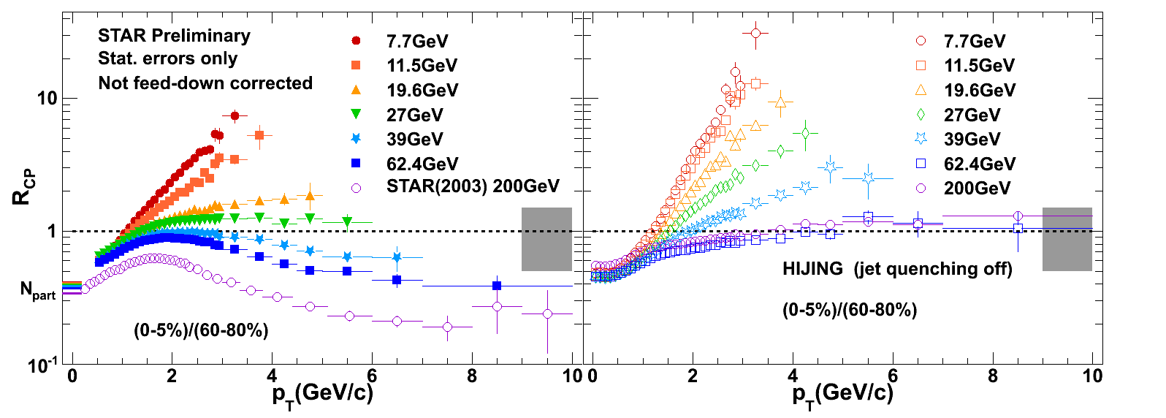
Suppression of high-p_{T} hadrons
Gyulassy, Wang, Com. Phys. Com. 83 307(1994)
Gyulassy, Wang, Com. Phys. Com. 83 307(1994)
Eur. Phys. Journal C72 (2012) 1945
Strong suppression in 200 GeV Au+Au collisions
Present from 39 GeV to 2.76 TeV
Enhancement at low energies
Understanding: Cronin effect
Notes:
Reference- is it correct?

Slide 9
Elliptic flow (v₂) – particles
Phys. Rev. C 88 (2013) 14902
Approximate NCQ scaling holds… DOF=quarks?
Exception: ϕ at 7.7 and 11.5 GeV
  deviation ~2σ – more statistics needed
Notes:
Refererence / prelim.?

Slide 10
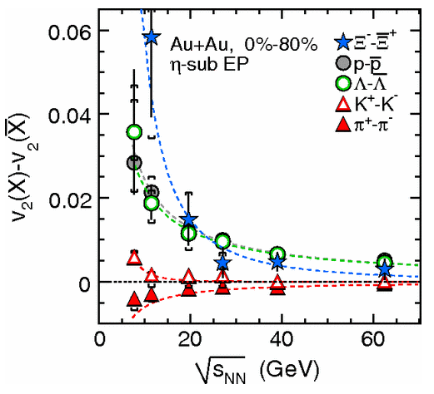
v₂ particle – antiparticle
Phys.Rev.Lett. 110 (2013) 142301
Phys. Rev. C 88 (2013) 14902
Substantial particle-antiparticle split at lower √s_{NN}
Linear dependence on the baryon chemical potential
Notes:
Reference of right plot

Slide 11
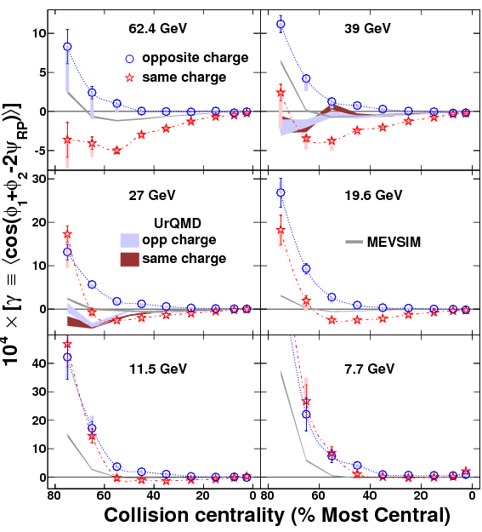
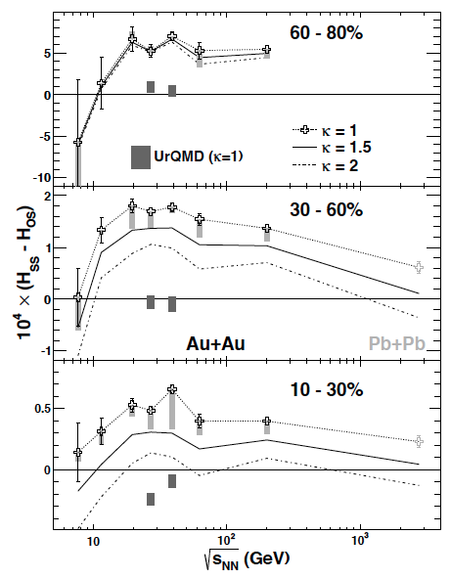
Chiral magnetic effect
QCD allows for local parity violation in sQGP
Possible signatures:
1) Three-point correlator
2) Charge separation
Phys.Rev.Lett. 113,
052302 (2014)
Drop of charge separation below 11.5 GeV consistent with expectations in a dominant hadronic phase
Notes:
Stress that uRQMD is different on both plots – clearly not hadronic?

Slide 12
Exploring the QCD phase diagram
Find…
1) Turn-off of sQGP signatures
2) 1st order phase transition signs
3) The QCD critical point
http://arxiv.org/abs/1007.2613

Slide 13
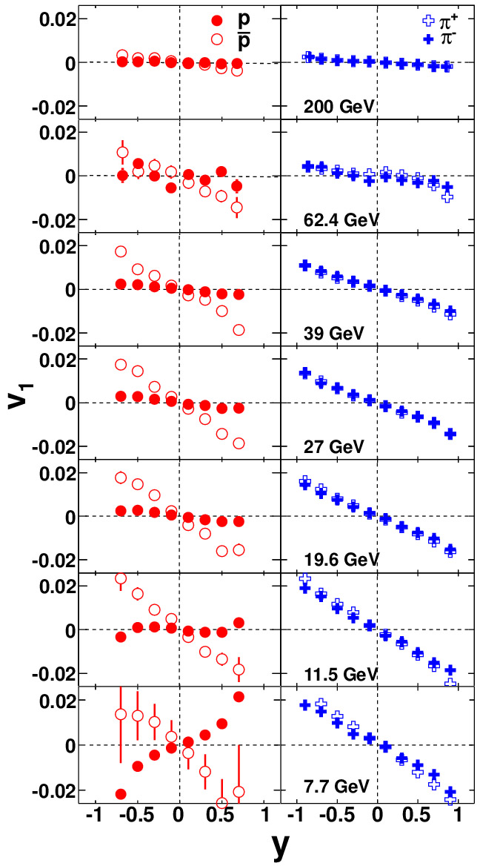
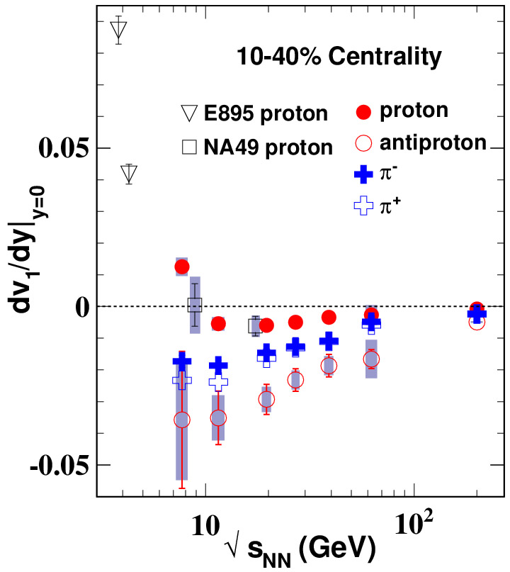
Directed flow (v₁)
Phys. Rev. Lett. 112, 162301 (2014)
Opposite charge pions follow the same trend
Protons-antiprotons are different
→ baryon number transport is important
Proton v₁ slope changes sign
Notes:
SLOPE

Slide 14
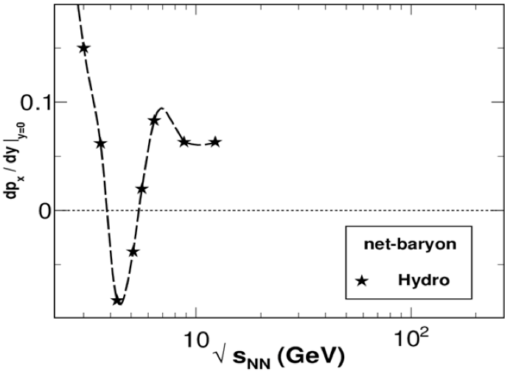
Net proton v₁ slope
Net protons: double sign change
  Simple hydro predicts structure
  More sophisticated UrQMD fails
  Softening of EOS?
    Expected in mixed phase
Phys. Rev. Lett. 112, 162301 (2014)
H. Stoecker, Nucl. Phys. A 750, 121 (2005).

Slide 15
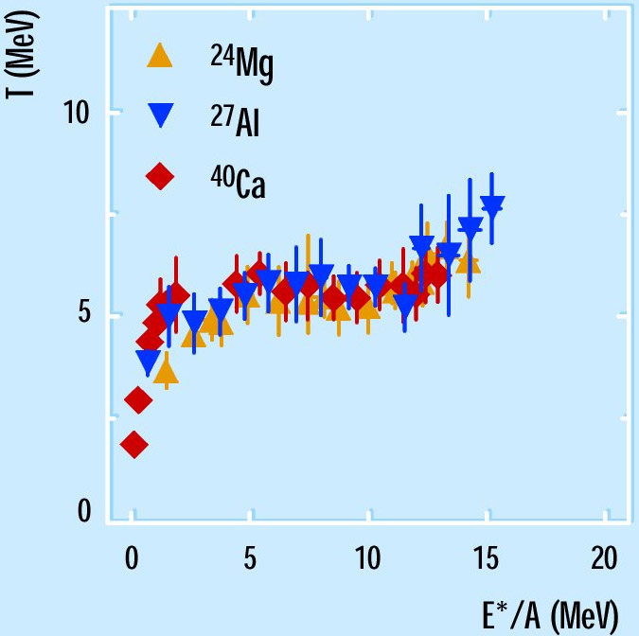
Caloric curve
nuclear liquid-vapor PT
1st order phase transition
→ T(E) plateau
Similar feature in RHIC data!
  <m_{T}> is related to temperature
  E_{T} is related to energy density
H. Feldmeier & J. Schnack,
Rev. Mod. Phys. 72, 655 (2000).
STAR preliminary
J. Mitchell, QM2012

Slide 16
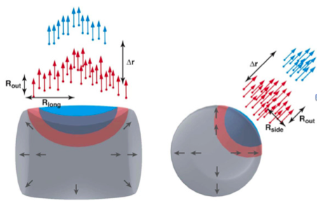
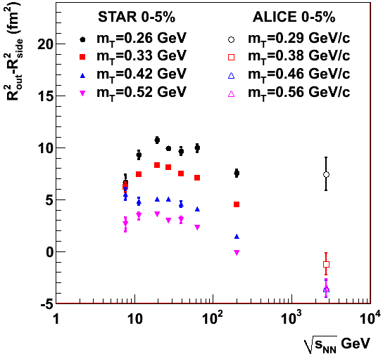
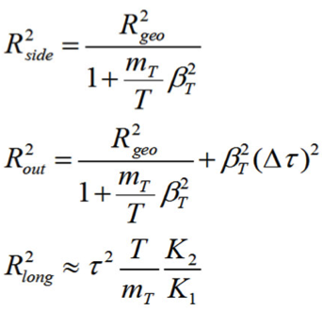
HBT radii (pions)
→ Martin Girard: Kaon BES HBT
Makhlin, Sinyukov,
ZPC.39.69 (1988)
arXiv:1403.4972
(submitted to PRC)
1st order phase transition – longer emission duration expected
Non-monotonicity R_{out}²–R_{side}² may indicate changes in dynamics

Slide 17
Exploring the QCD phase diagram
Find…
1) Turn-off of sQGP signatures
2) 1st order phase transition signs
3) The QCD critical point
http://arxiv.org/abs/1007.2613

Slide 18
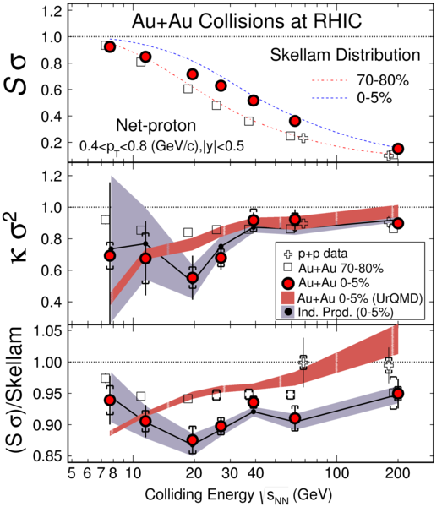


Net proton multiplicity moments
Susceptibilities of conserved quantities (Q, B, S)
Related to multiplicity distribution moments
Volume effect → ratios
Non-monotonic behavior?
Net proton mult.: maybe,
but we need more statistics!
Phys. Rev. Lett. 112 (2014) 32302

Slide 19
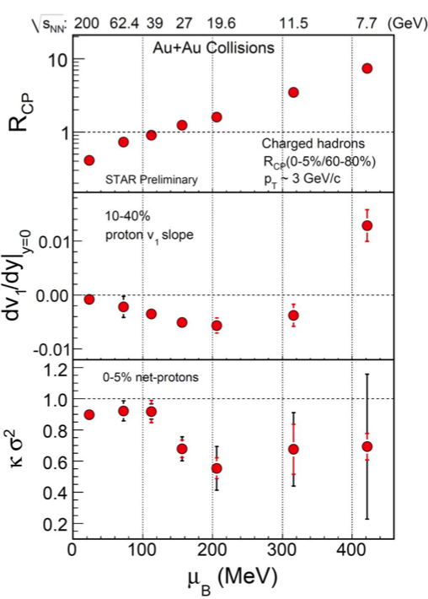
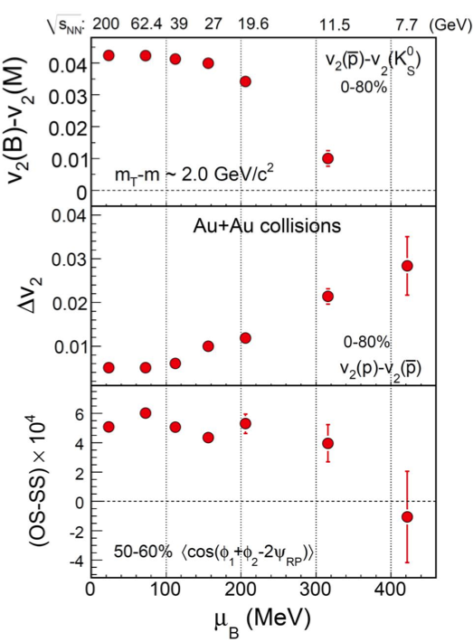
BES I – highlights
PRL 110, 142301 (2013)
PRL 112, 162301 (2014)
PRL 113, 052302 (2014)
PRL 112, 32302 (2014)
http://www.bnl.gov/npp/pac.asp
A wide range of potential sQGP/PT/CP signatures measured
Some key observables identified, interesting region localized
Many of these require better statistics / detector performance
Notes:
label

Slide 20
BES II plan
Collision Energies (GeV): | 7.7 | 9.1 | 11.5 | 14.5 | 19.6
Chemical Potential (MeV): | 420 | 370 | 315 | 260 | 205
Observables | Millions of Events Needed
R_{CP} up to p_{T} 4.5 GeV | NA | NA | 160 | 92 | 22
Elliptic Flow of φ meson (v₂) | 100 | 150 | 200 | 300 | 400
Local Parity Violation (CME) | 50 | 50 | 50 | 50 | 50
Directed Flow studies (v₁) | 50 | 75 | 100 | 100 | 200
asHBT (proton-proton) | 35 | 40 | 50 | 65 | 80
net-proton kurtosis (κσ²) | 80 | 100 | 120 | 200 | 400
Dileptons | 100 | 160 | 230 | 300 | 400
Proposed Number of Events: | 100 | 160 | 230 | 300 | 400
QGP
1st P.T.
C.P.
EM Probes

Slide 21
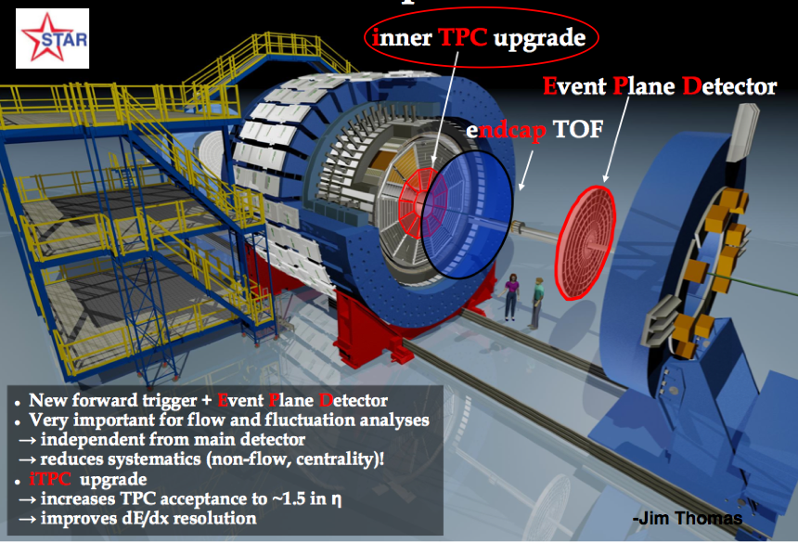
STAR upgrades for BES II

Slide 22
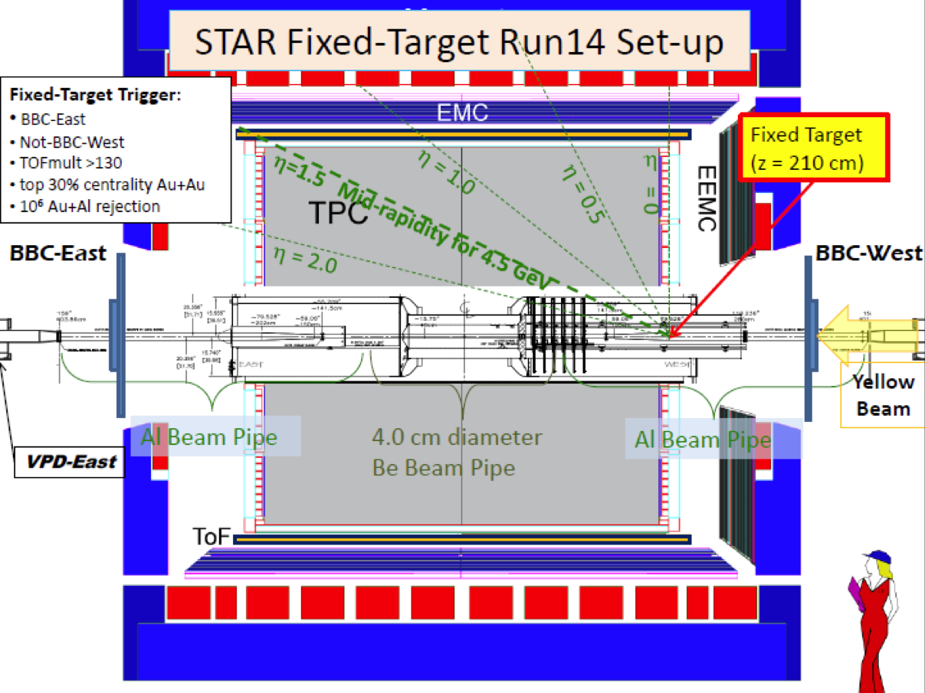
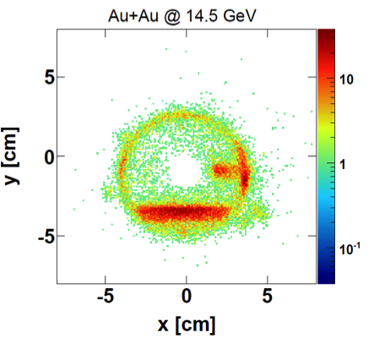
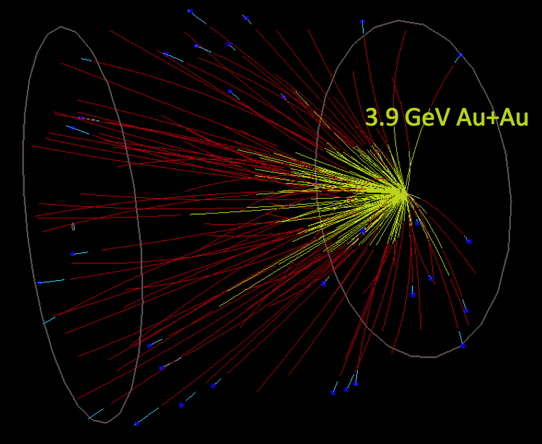
Fixed target program at STAR
Target inserted into beam pipe
Only a small percentage
Does not interfere with collider mode data taking

Slide 23
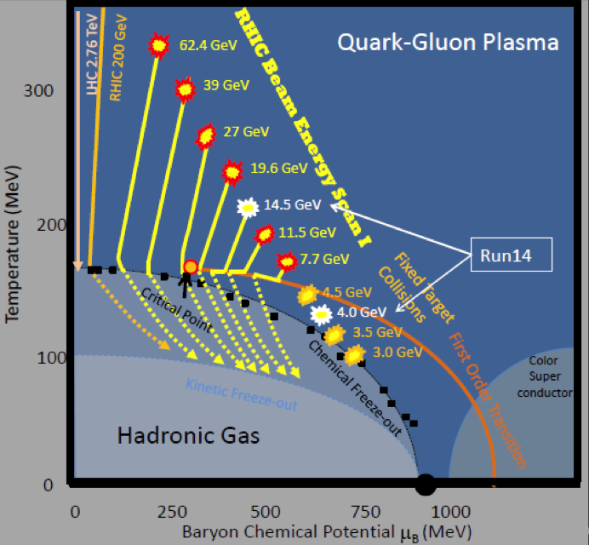
Fixed target program at STAR
Extend range towards higher μ_{B}
Started in 2014
  Collider mode 14.5 GeV
  Fixed target 3.9 GeV
Collider mode √s_{NN} (GeV) | Fixed target
 | √s_{NN} (GeV) | μ_{B} (MeV) | y_{CM}
7.7 | 3.0 | 720 | 1.05
11.5 | 3.5 | 670 | 1.25
14.5 | 3.9 | 633 | 1.37
19.6 | 4.5 | 585 | 1.52

Slide 24
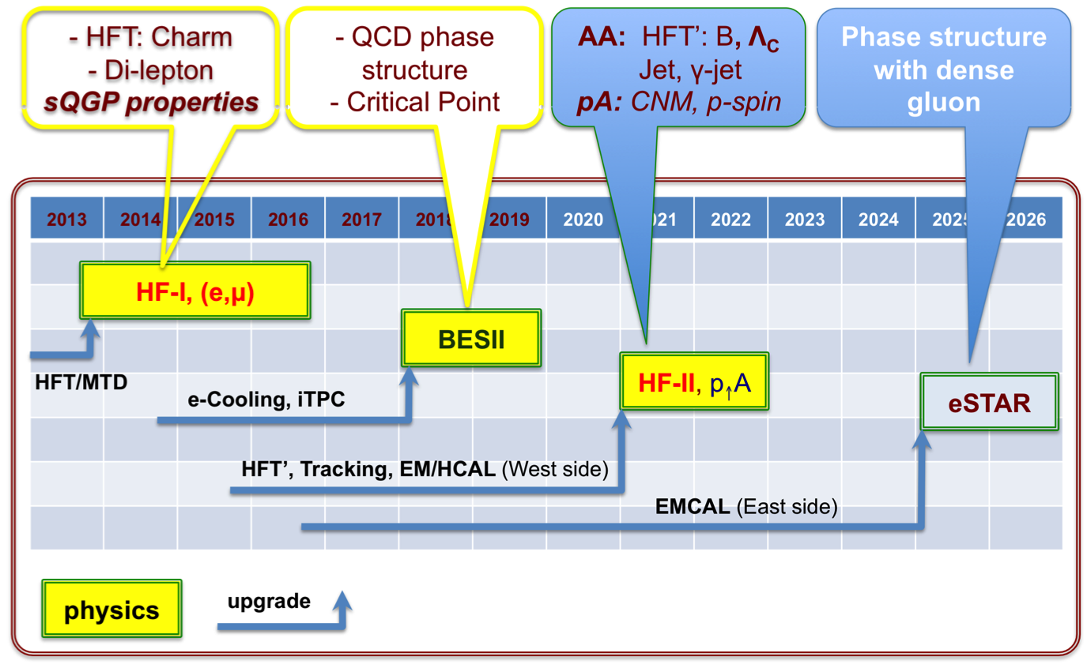
STAR Long-Term Plan
+
https://drupal.star.bnl.gov/STAR/starnotes/public/sn0592

Slide 25
Summary
BES-I covers the right (wide) μ_{B} range
Interesting behavior seen:
  sQGP-turnoff: R_{CP}, Δv₂, chiral magnetic effect
  Phase transition: non-monotonic v₁, HBT radii, caloric curve
  Critical point: Net-proton moments
  …and much more!
BES-II more statistics in a finer scan between 7-20 GeV
  Decisive measurements of likely signatures
  New measurements
Toward understanding the QCD phase diagram

Slide 26

Thank You!
AGH University of Science and Technology
Argonne National Laboratory, Argonne, Illinois 60439
Brookhaven National Laboratory, Upton, New York 11973
University of California, Berkeley, California 94720
University of California, Davis, California 95616
University of California, Los Angeles, California 90095
Universidade Estadual de Campinas, Sao Paulo 13131, Brazil
Central China Normal University (HZNU), Wuhan 430079, China
University of Illinois at Chicago, Chicago, Illinois 60607
Creighton University, Omaha, Nebraska 68178
Czech Technical University in Prague, FNSPE, Prague, 115 19, Czech Republic
Nuclear Physics Institute AS CR, 250 68 Rez/Prague, Czech Republic
Frankfurt Institute for Advanced Studies FIAS, Frankfurt 60438, Germany
Institute of Physics, Bhubaneswar 751005, India
Indian Institute of Technology, Mumbai 400076, India
Indiana University, Bloomington, Indiana 47408
Alikhanov Institute for Theoretical and Experimental Physics, Moscow 117218, Russia
University of Jammu, Jammu 180001, India
Joint Institute for Nuclear Research, Dubna, 141 980, Russia
Kent State University, Kent, Ohio 44242
University of Kentucky, Lexington, Kentucky, 40506-0055
Korea Institute of Science and Technology Information, Daejeon 305-701, Korea
Institute of Modern Physics, Lanzhou 730000, China
Lawrence Berkeley National Laboratory, Berkeley, California 94720
Massachusetts Institute of Technology, Cambridge, Massachusetts 02139-4307
Max-Planck-Institut fur Physik, Munich 80805, Germany
Michigan State University, East Lansing, Michigan 48824
Moscow Engineering Physics Institute, Moscow 115409, Russia
National Institute of Science Education and Research, Bhubaneswar 751005, India
Ohio State University, Columbus, Ohio 43210
Institute of Nuclear Physics PAN, Cracow 31-342, Poland
Panjab University, Chandigarh 160014, India
Pennsylvania State University, University Park, Pennsylvania 16802
Institute of High Energy Physics, Protvino 142281, Russia
Purdue University, West Lafayette, Indiana 47907
Pusan National University, Pusan 609735, Republic of Korea
University of Rajasthan, Jaipur 302004, India
Rice University, Houston, Texas 77251
University of Science and Technology of China, Hefei 230026, China
Shandong University, Jinan, Shandong 250100, China
Shanghai Institute of Applied Physics, Shanghai 201800, China
Temple University, Philadelphia, Pennsylvania 19122
Texas A&M University, College Station, Texas 77843
University of Texas, Austin, Texas 78712
University of Houston, Houston, Texas 77204
Tsinghua University, Beijing 100084, China
United States Naval Academy, Annapolis, Maryland, 21402
Valparaiso University, Valparaiso, Indiana 46383
Variable Energy Cyclotron Centre, Kolkata 700064, India
Warsaw University of Technology, Warsaw 00-661, Poland
University of Washington, Seattle, Washington 98195
Wayne State University, Detroit, Michigan 48201
World Laboratory for Cosmology and Particle Physics (WLCAPP), Cairo 11571, Egypt
Yale University, New Haven, Connecticut 06520
University of Zagreb, Zagreb, HR-10002, Croatia
STAR Collaboration

Slide 27
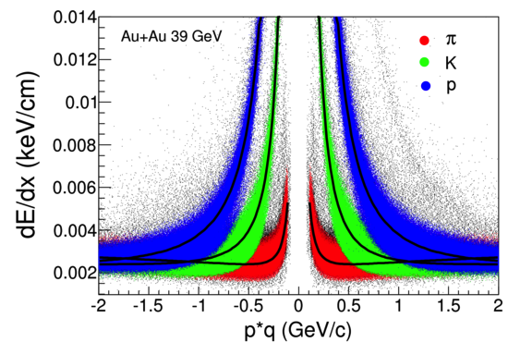
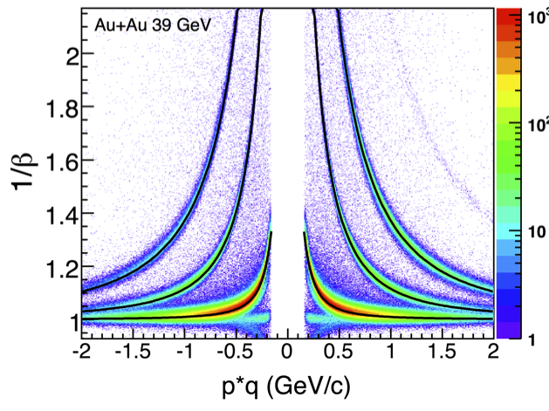
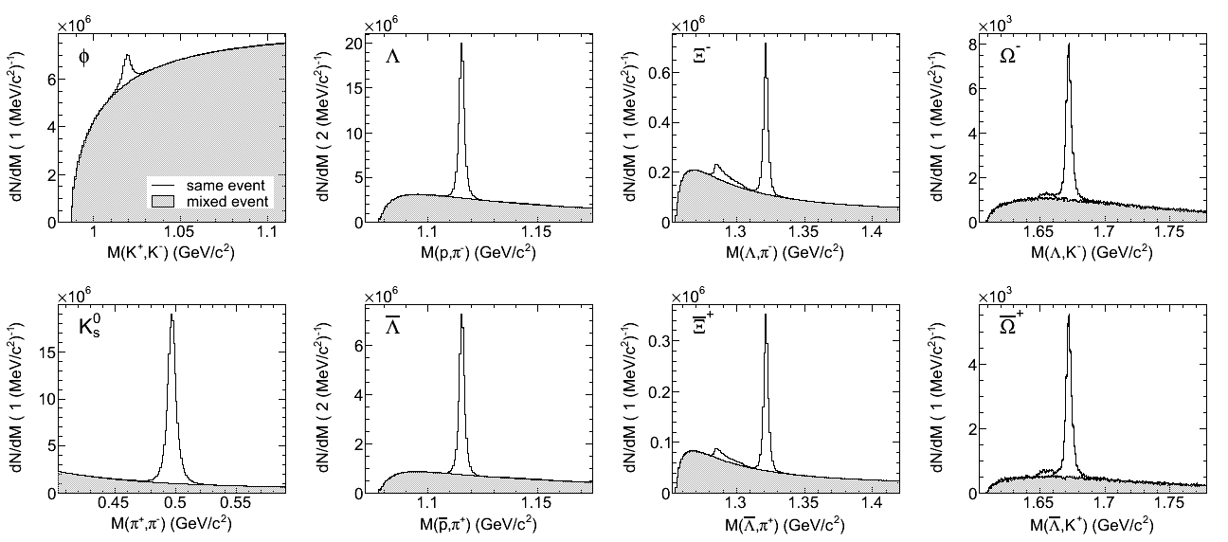
Particle Identification
PID (TPC+TOF):
π/K: p_{T}~1.6 GeV/c
p: p_{T}~3.0 GeV/c
Strange hadrons:
decay topology & invariant mass
TPC
TPC+TOF
Au+Au 39 GeV

Slide 28

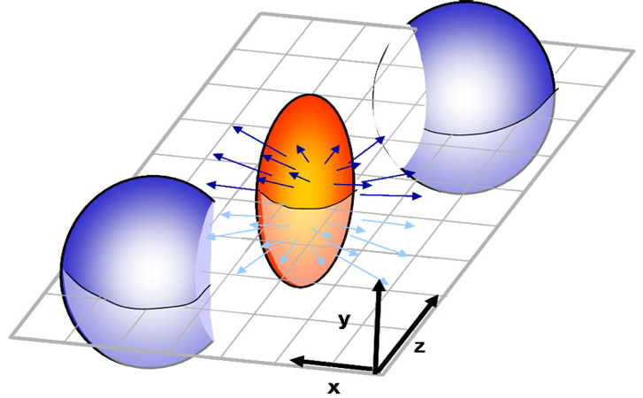
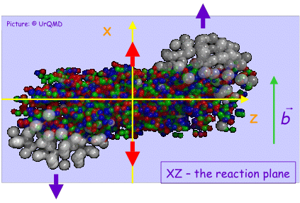
Azimuthal Anisothropy
Directed flow is quantified by the first harmonic:
Directed flow is due to the sideward motion of the particles within the reaction plane.
<p_{x}> or directed flow
Generated already during the nuclear passage time (2R/γ≈.1 fm/c@200GeV)
It probes the onset of bulk collective dynamics during thermalization
rapidity
v₁(y) is sensitive to baryon transport, space - momentum correlations and QGP formation

Slide 29
Elliptic flow (v₂) – antiparticles
Phys. Rev. C 88 (2013) 14902
Approximate NCQ scaling holds… DOF=quarks?
…but particles and antiparticles are different

Slide 30
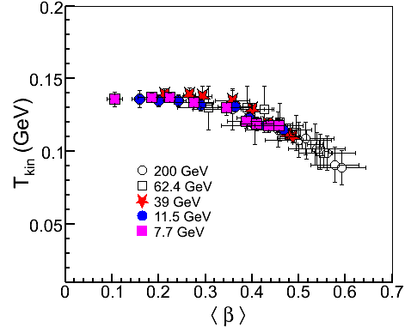
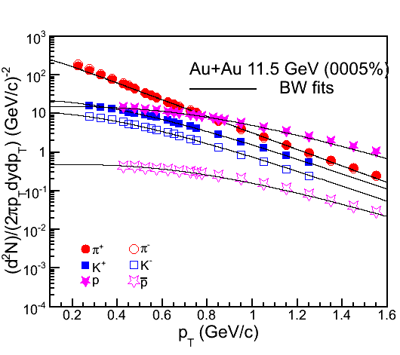
Kinetic freeze-out
Blast Wave: T_{kin} and <β>
Particles used: π,K,p
STAR Preliminary
Au+Au
STAR Preliminary
Higher kinetic temperature corresponds to lower value of average
flow velocity and vice-versa

Slide 31
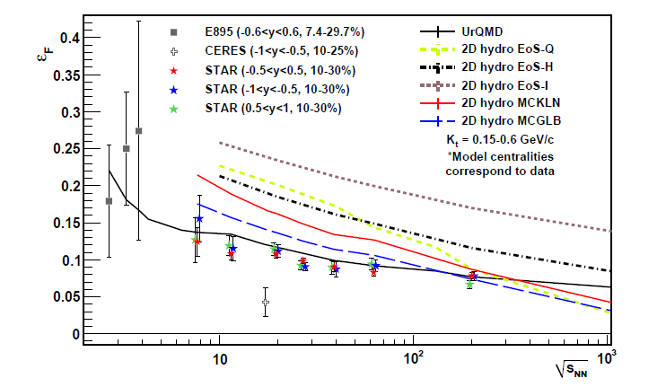
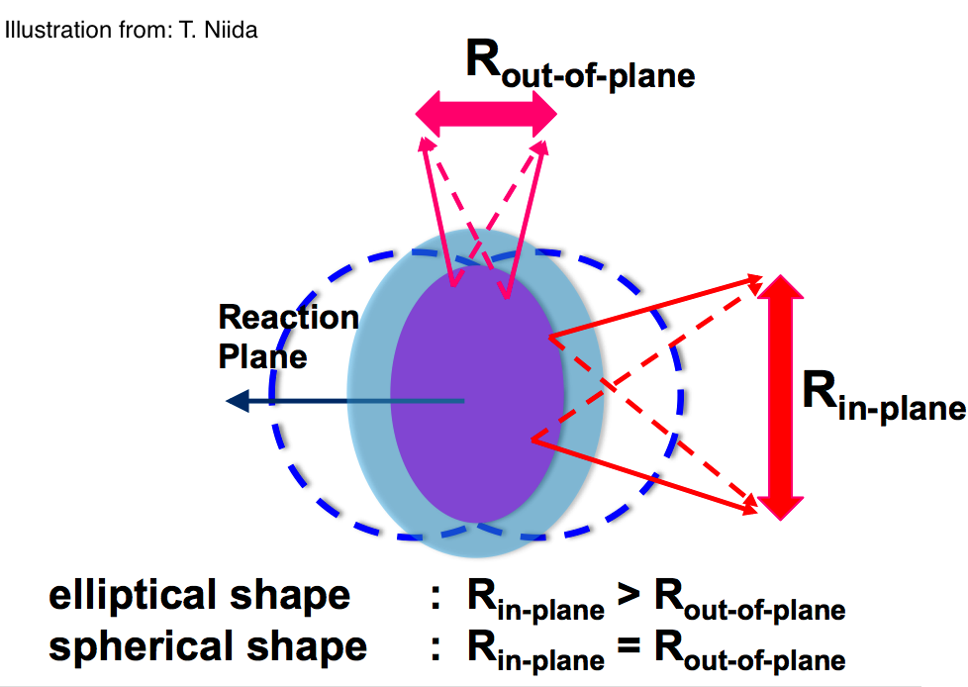
Azimuthally sensitive HBT
arXiv:1403.4972 (submitted to PRC)
Spatial eccentricity at the kinetic freeze-out, ε_{F}
Sensitive to EOS
Smooth, monotonous behavior observed over the BES range
Notes:
Say what’s X and Y

Slide 32
Chiral magnetic effect
Chiral-magnetic effect:
Local parity violation in sQGP
Measure: 3-point correlator, charge separation
Notes:
Predicted
Refer sergei voloshin’s paper…

Slide 33
Net charge multiplicity moments
Susceptibilities of conserved quantities (Q, B, S)
Related to multiplicity distribution moments
Volume effect → ratios
Non-monotonic behavior?
Net charge mult.: no non-monotonic behavior seen
Phys. Rev. Lett. 113 (2014) 92301

Slide 34
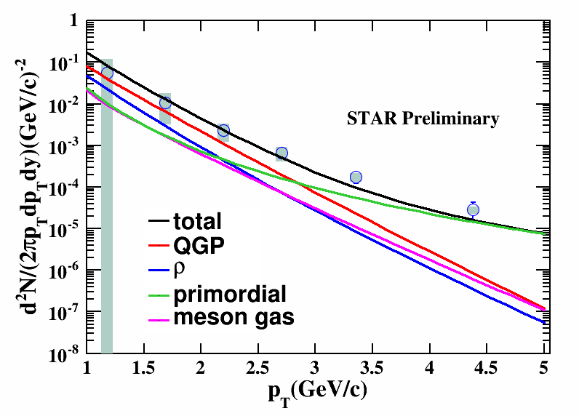
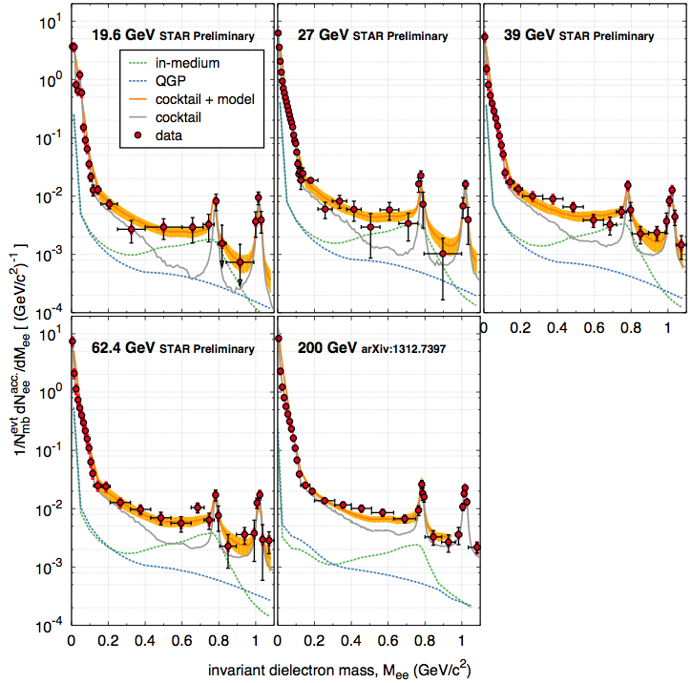
Quantify the Spectral Function
Temperature dependence of rho spectral function
Beam energy range where final state is similar
Initial state and temperature evolution different
Density dependence by Azimuthal dependence (v₂)
Use centrality dependence as another knob
Direct photon results should match with extrapolation
Baryon dependence of rho spectral function
1. LMR excess expected to be consistent with total baryon density increase
Direct virtual photons
STAR Preliminary
QM14: Chi Yang, Patrick Huck

Slide 35
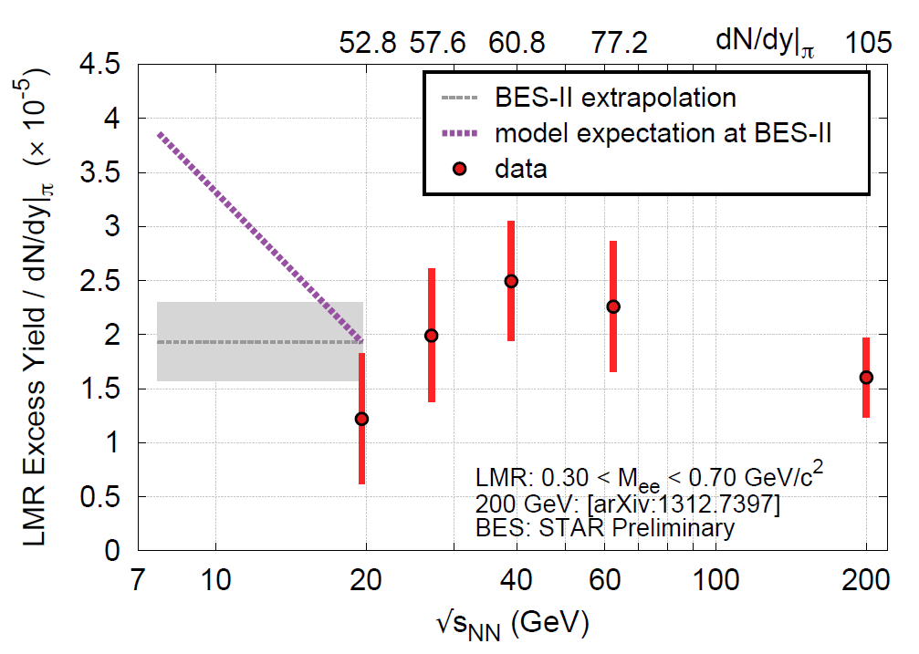
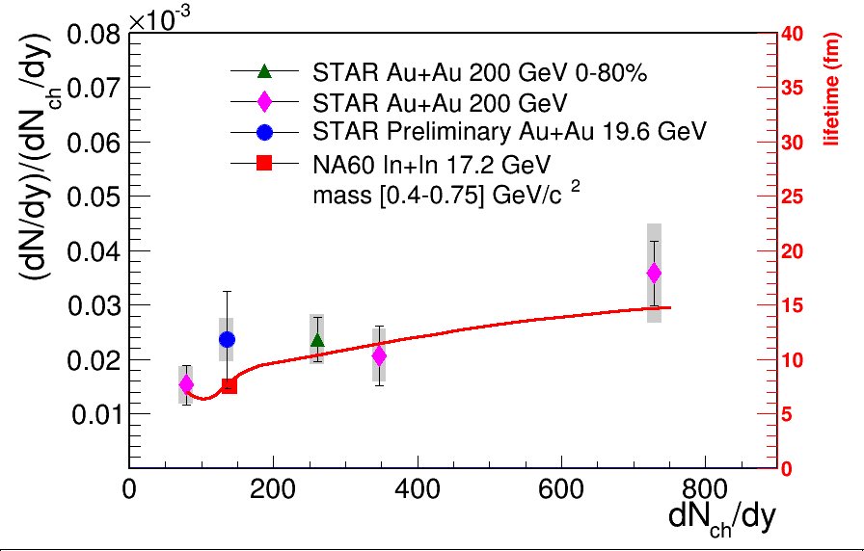
Dilepton Measurements at BES II
Beam Energy
Centrality
BES II enables
measurements at energy <20GeV
STAR Preliminary

Slide 36
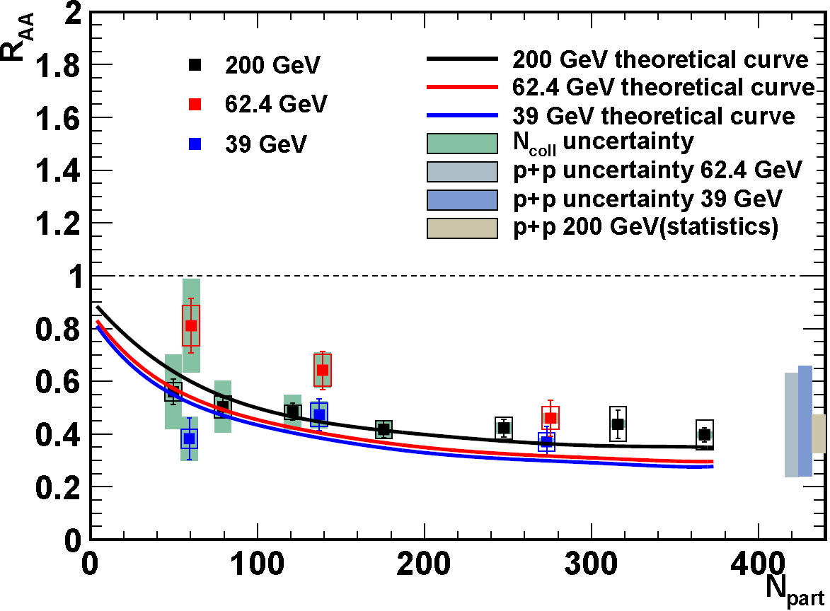
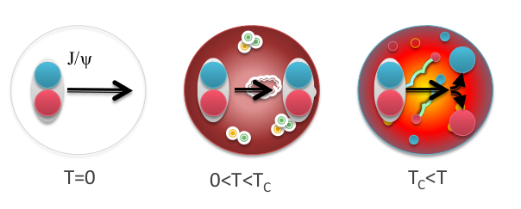
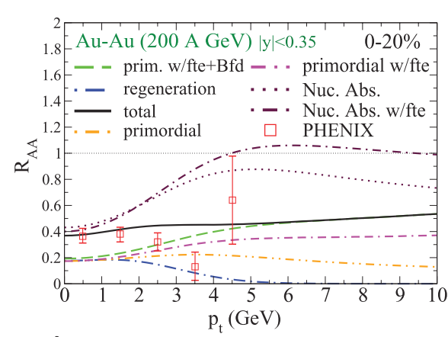
J/ψ R_{AA} vs. beam energy
Expectation
Debye screening
→ dissociation of quarkonia
J/ψ melting to be a smoking gun signature of QGP
T. Matsui, H. Satz, Phys.Lett. B178, 416 (1986)
PHENIX, Nucl.Phys. A 774 (2006) 747
STAR Data (Au+Au)
Similar suppression in Au+Au
at 200, 62.4 and 39 GeV
Note: 62.4 and 39 GeV p+p reference is based on CEM calculations, large uncertainty
Nelson, Vogt et al., PRC87, 014908 (2013)
  Does coalescence
  compensate for melting?
    Zhao, Rapp, PRC82, 064905 (2010)
A complicated story
Nuclear shadowing
Initial state energy loss
Co-mover absorption
Coalescence of uncorrelated charm and bottom pairs.

Slide 37
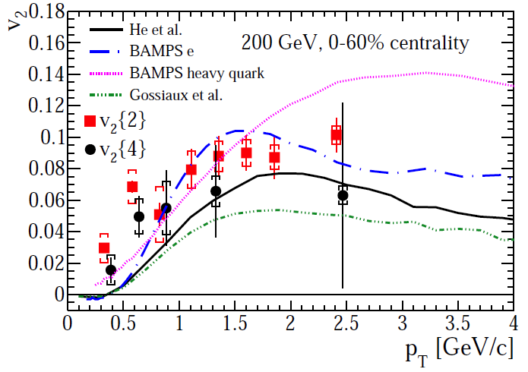
Non-photonic electrons: 200 GeV
STAR
preliminary
Suppression
Significant suppression of NPE in central collisions (p_{T}>4 GeV/c)
Similar to that of light hadrons and D⁰ mesons
Anisotropy (v₂)
Substantial elliptic flow of NPE is seen in 200 GeV Au+Au collisions
Note: it’s challenging for models to describe suppression and flow at the same time
arXiv:1405.6348
(Submitted to PLB)

Slide 38
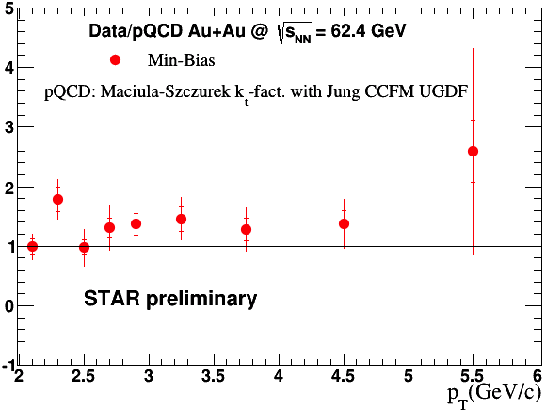
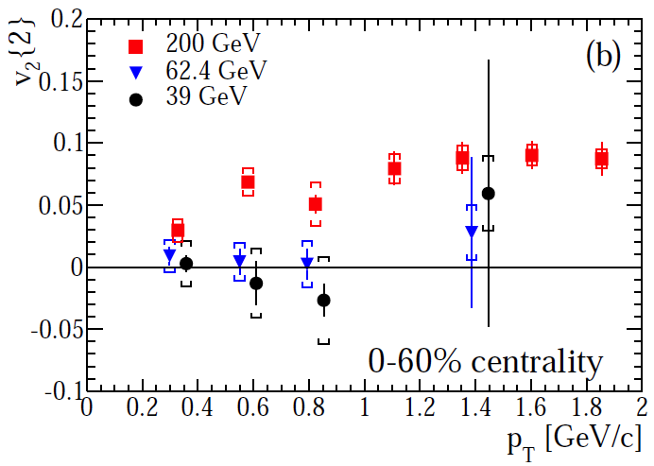
Non-photonic electrons: 39, 62.4 GeV
R_{AA}
Suppression
No sign of suppression of NPE
in 62.4 GeV Au+Au collisions
Note: pQCD-scaled p+p reference
Anisotropy (v₂)
NPE in 39 and 62.4 GeV Au+Au collisions consistent with no flow
(p_{T}<1 GeV/c)
PRD 87 (2013) 9, 094022
STAR preliminary
arXiv:1405.6348
(Submitted to PLB)

Slide 39
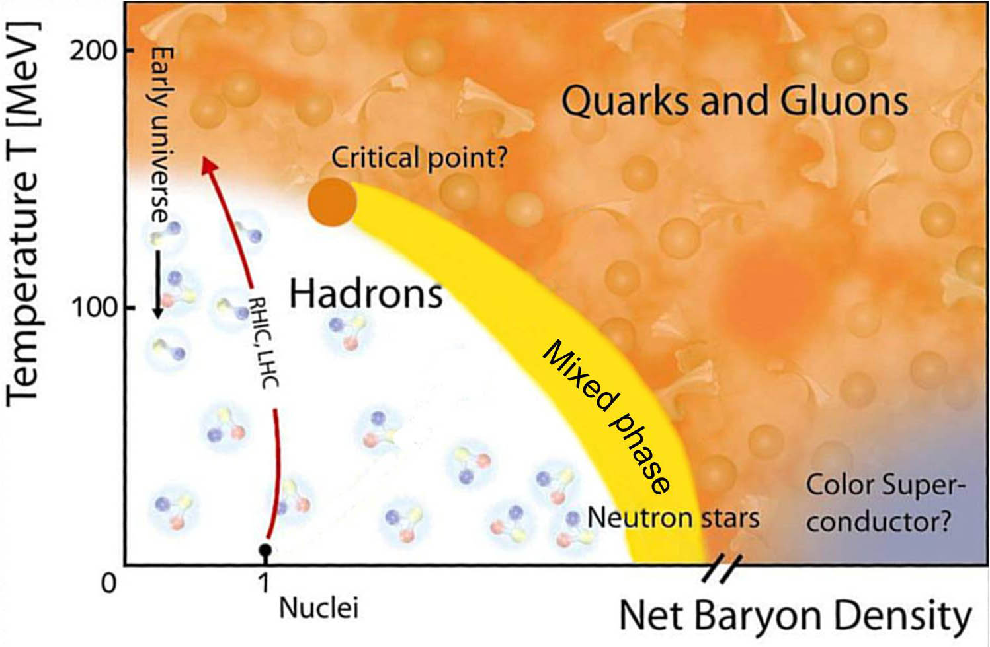
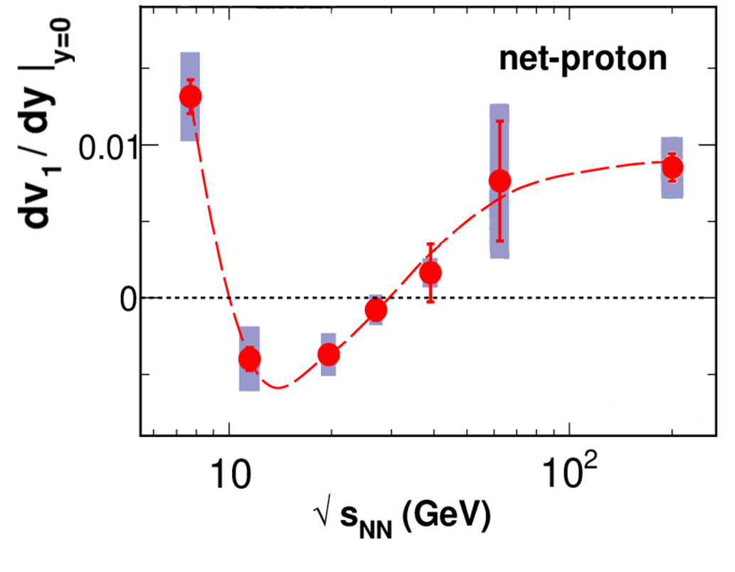
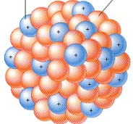

v₁ cartoon by Mike Lisa
PUSH!
Notes:
c_sound plot? compressibilily

Slide 40
v₁ cartoon by Mike Lisa
SOFT...
PUSH!

Slide 41
v₁ cartoon by Mike Lisa
PUSH!
SOFT...
PUSH!
Notes:
Net proton -> only the “mechanical” part

