Slide 1



Charged Hadron Nuclear Modification Factors in the Beam Energy Scan data from STAR
Stephen Horvat
for the STAR collaboration
Yale University

Slide 2
Contents
STAR Detector
Beam Energy Scan
Nuclear Modification Factors (R_{CP})
Physics
  jets as probes
  Cronin enhancement
R_{CP} Results
  charged hadrons
  identified hadrons
x_{T} scaling
Conclusions

Slide 3
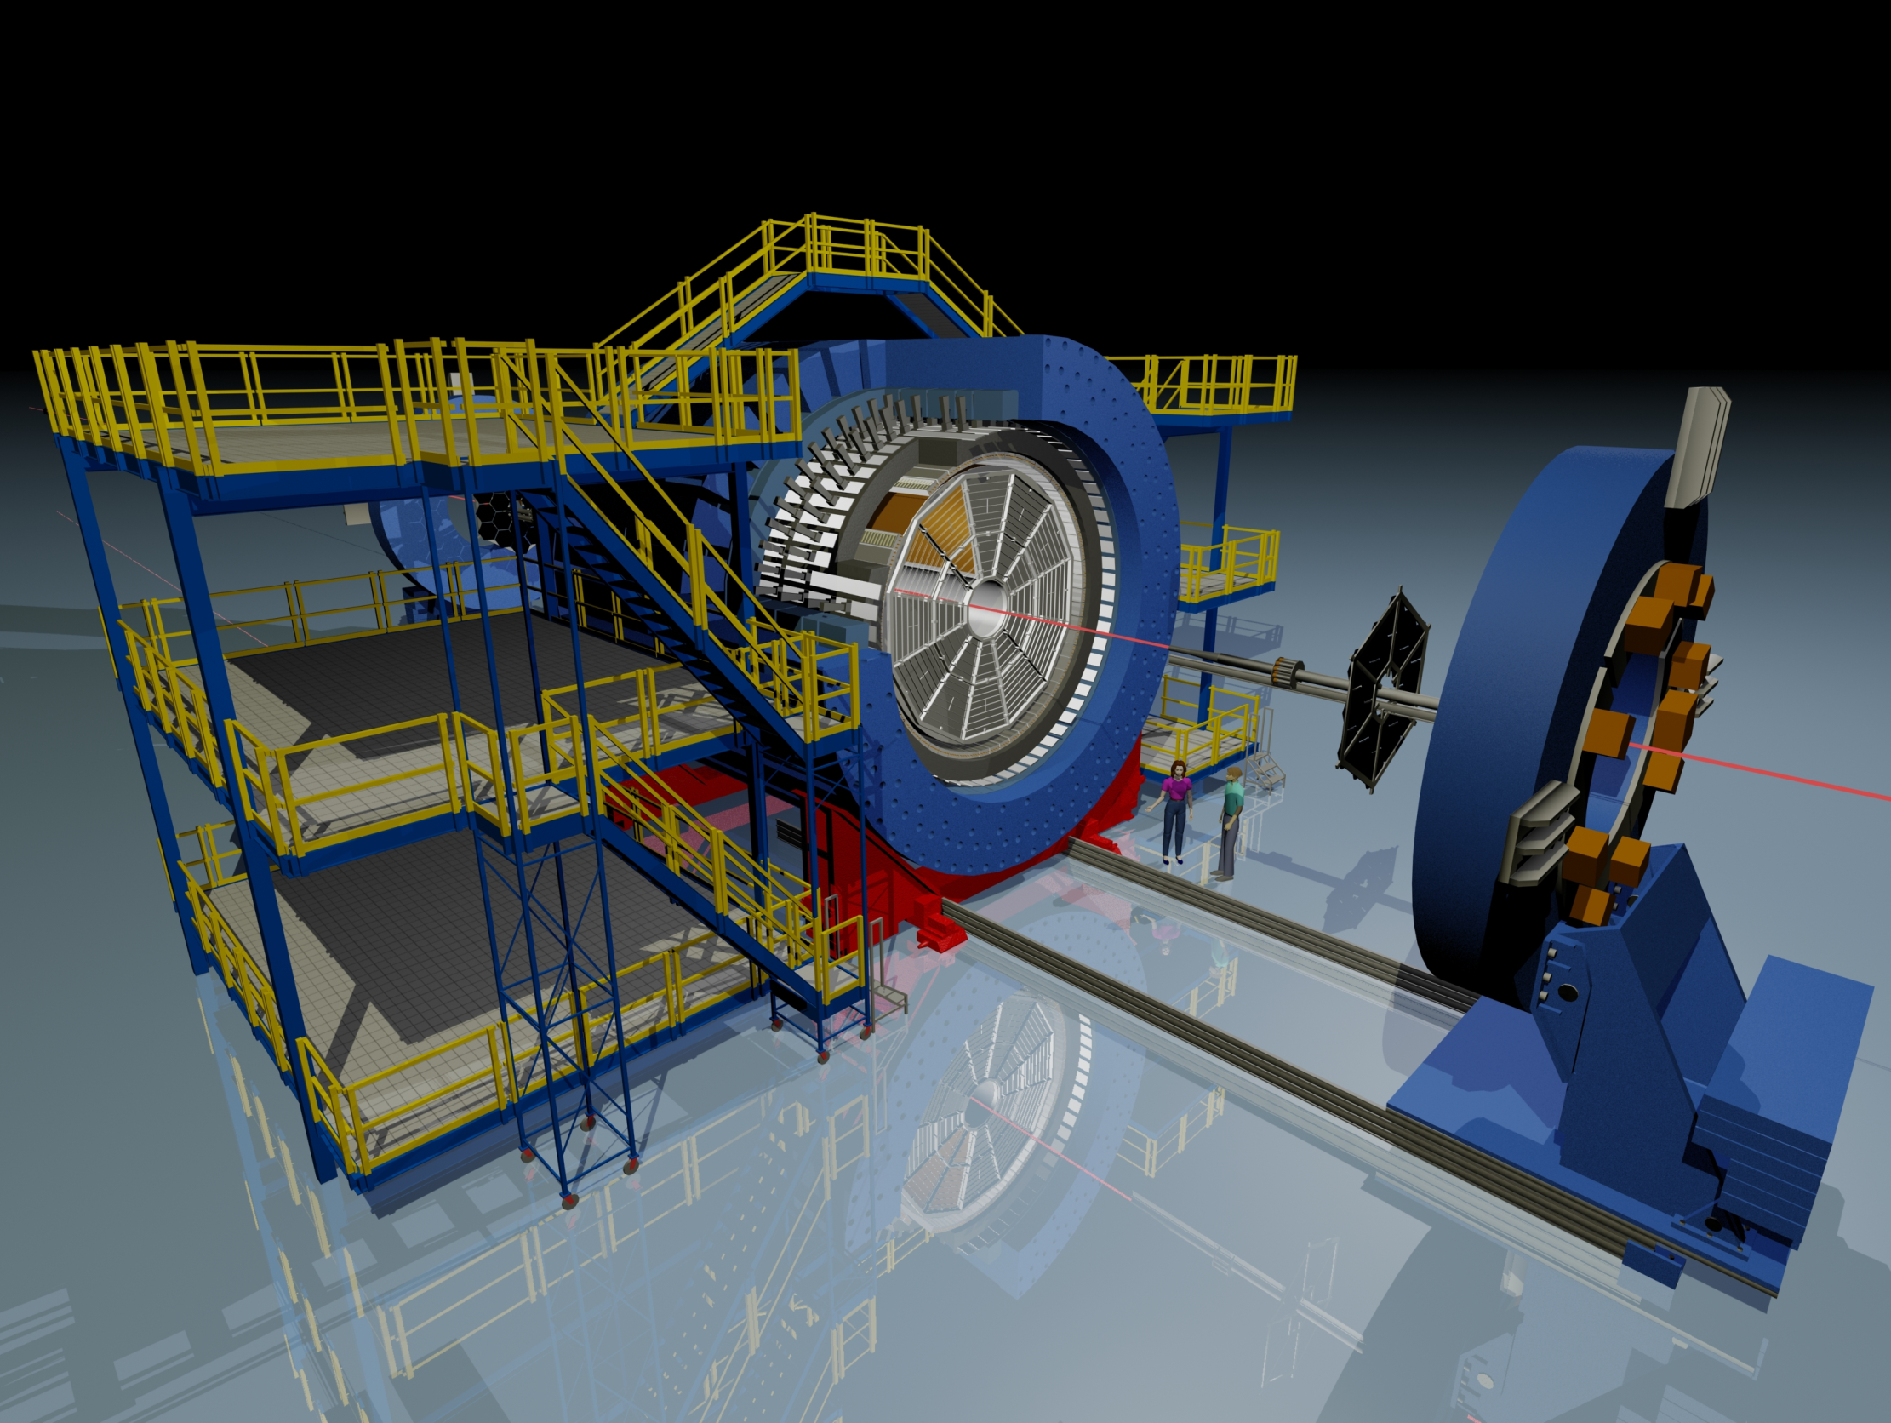

The Solenoid Tracker At RHIC (STAR)
BEMC
Magnet
TOF
TPC
EEMC
BBC
upVPD
TPC: |η| < 1 & 2π in azimuth
TOF: |η| <0.9 & 2π in azimuth
© Maria & Alex Schmah

Slide 4
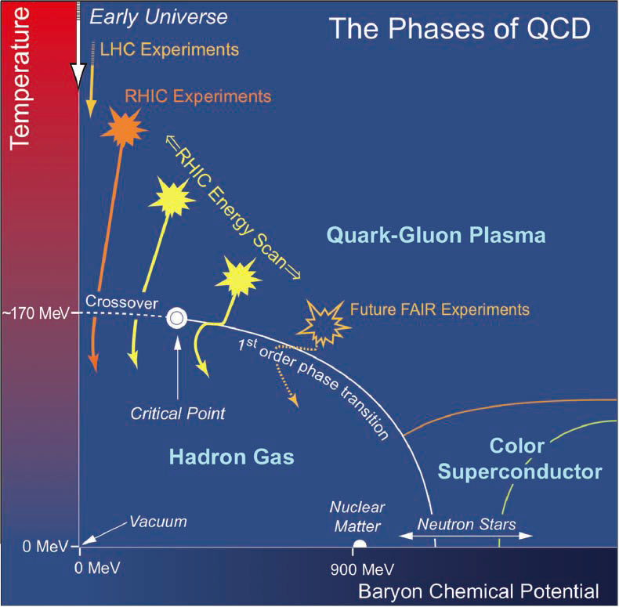
Beam Energy Scan
Is there a critical point and if so where?
Is there evidence for a first order phase transition?
At what energy do key QGP signatures turn off?
    nuclear modification factor
    dihadron correlations
    ncq scaling

Slide 5
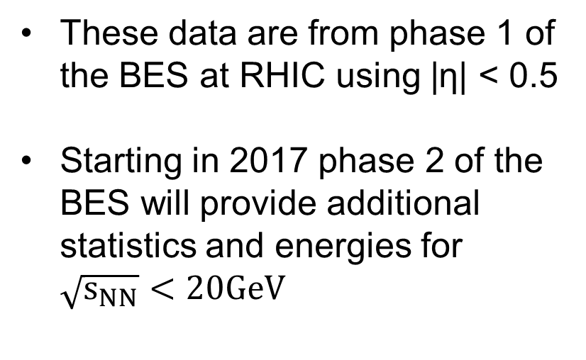
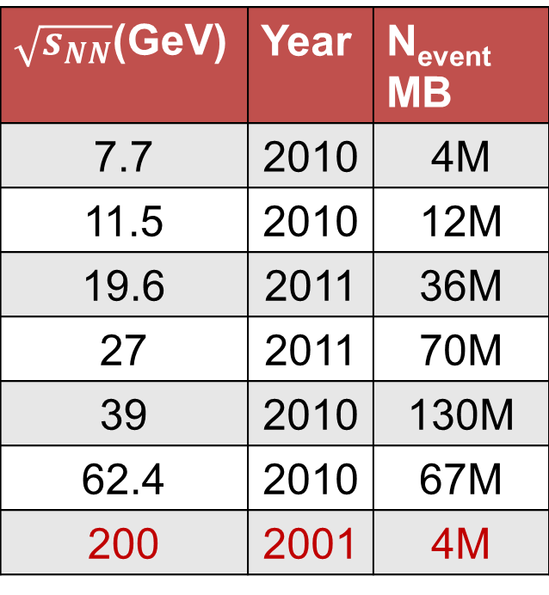
Data
These data are from phase 1 of the BES at RHIC using |η| < 0.5
Starting in 2017 phase 2 of the BES will provide additional statistics and energies for $\sqrt{s_{NN}}<20GeV$
$\sqrt{s_{NN}}$(GeV) | Year | N_{event} MB
7.7 | 2010 | 4M
11.5 | 2010 | 12M
19.6 | 2011 | 36M
27 | 2011 | 70M
39 | 2010 | 130M
62.4 | 2010 | 67M
200 | 2001 | 4M

Slide 6
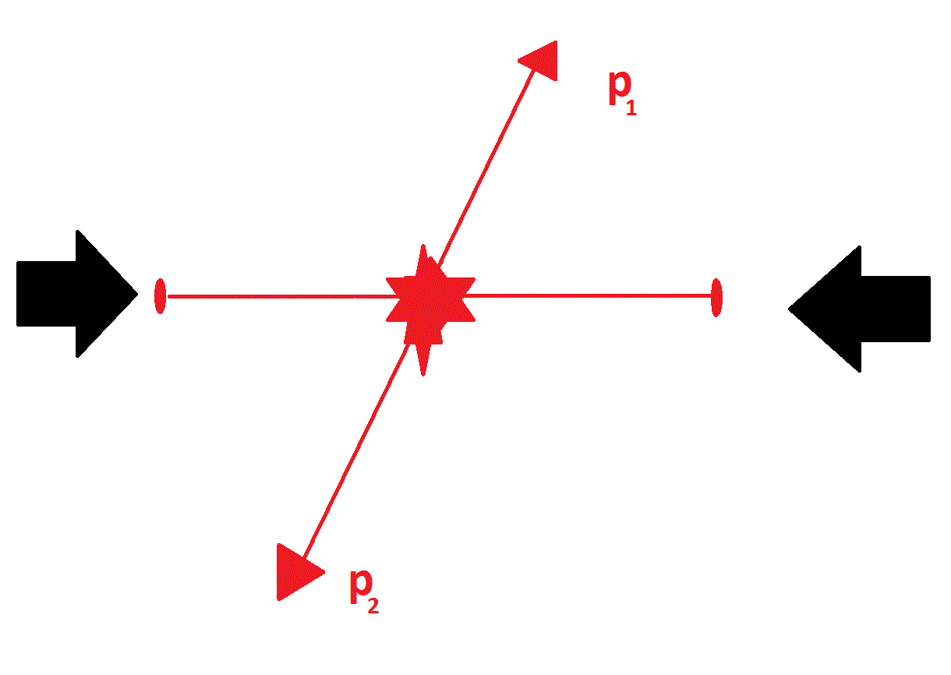
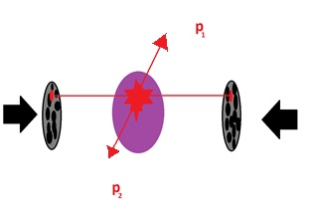
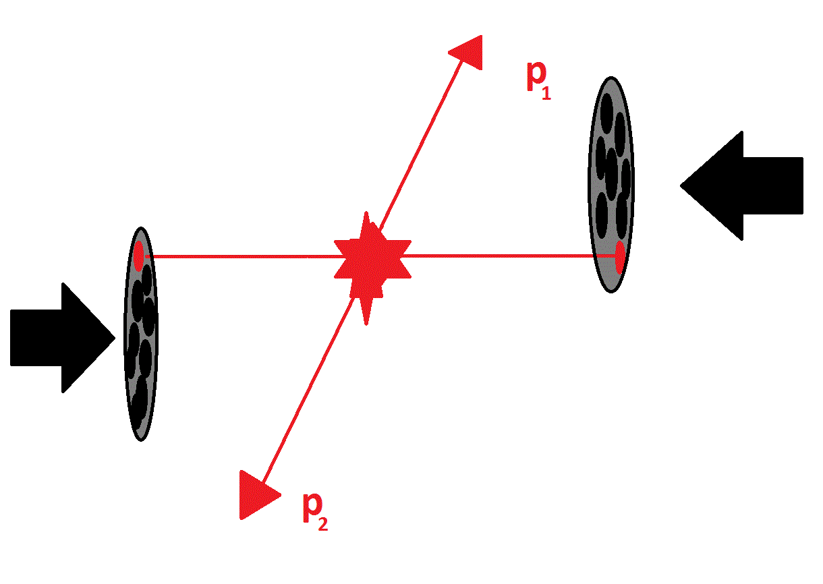
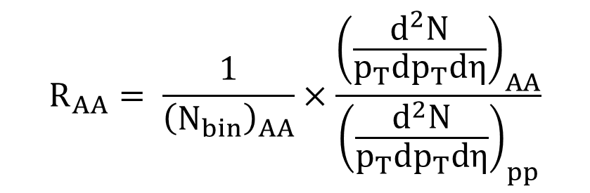
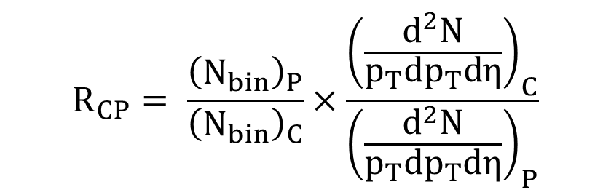
Nuclear Modification Factor
hard scatterings produce early high p_{T} probes
p + p
$$R_{AA}= \frac{1}{{\left(N_{bin}\right)}_{AA}}×\frac{{\left(\frac{d^{2}N}{p_{T}dp_{T}dη}\right)}_{AA}}{{\left(\frac{d^{2}N}{p_{T}dp_{T}dη}\right)}_{pp}}$$
Au + Au
Central
Au + Au
Peripheral
$$R_{CP}= \frac{{\left(N_{bin}\right)}_{P}}{{\left(N_{bin}\right)}_{C}}×\frac{{\left(\frac{d^{2}N}{p_{T}dp_{T}dη}\right)}_{C}}{{\left(\frac{d^{2}N}{p_{T}dp_{T}dη}\right)}_{P}}$$
N_{bin} ≡ number of binary collisions (from Glauber)

Slide 7
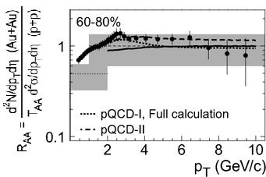
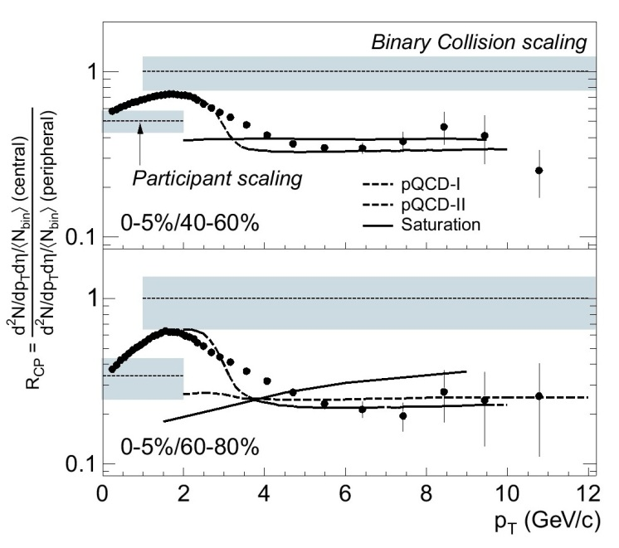
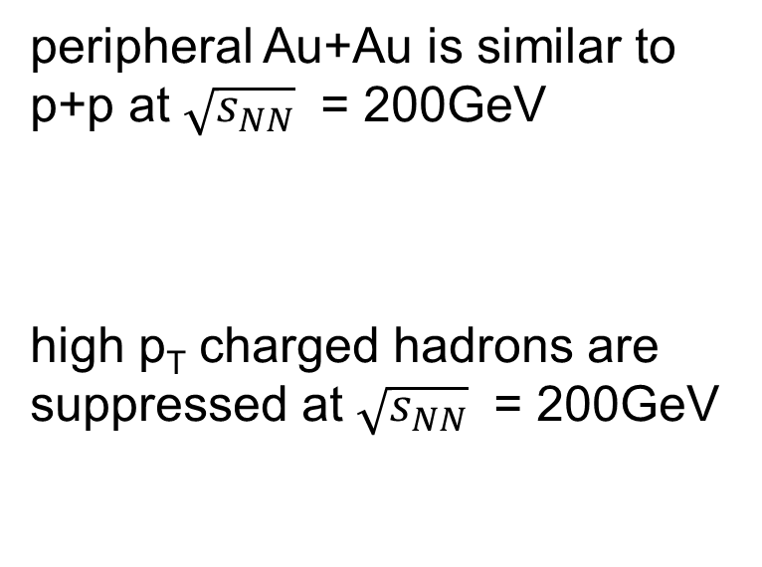
Suppression of high p_{T}
‘Suppression’ ≡ R_{CP} < 1
‘Quenching’ ≡ loss of energy for high momentum particles
peripheral Au+Au is similar to p+p at $\sqrt{s_{NN}}$ = 200GeV
high p_{T} charged hadrons are suppressed at $\sqrt{s_{NN}}$ = 200GeV
STAR AuAu200
Phys. Rev. Lett. 91, 172302 (2003)

Slide 8
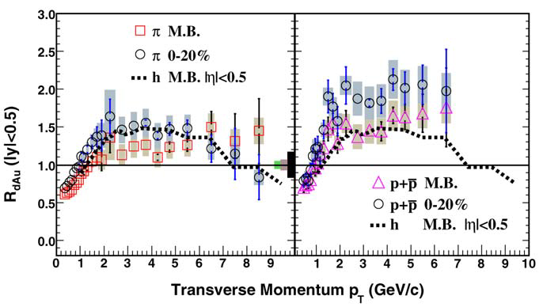
d+Au for Cold Nuclear Matter (CNM)
The suppression observed at 200GeV is not a CNM effect
Protons are more enhanced than pions
  → maybe pions are
  better probes?
Protons
Pions
dAu200
The ‘Cronin Effect’ is the experimentally observed enhancement of spectra in asymmetric collisions relative to a p+p reference
Physics Letters B 637 (2006) 161–169

Slide 9
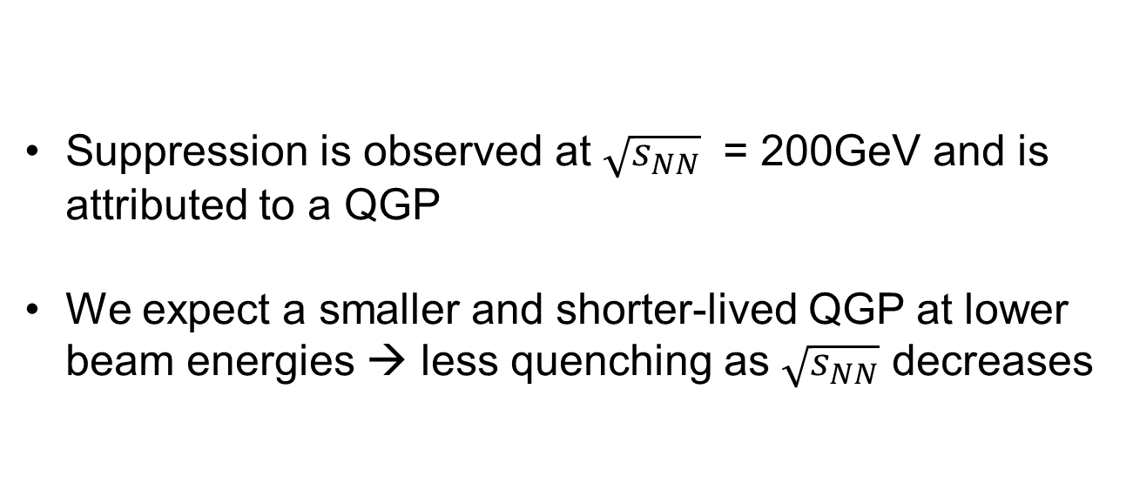
Expectations for the BES
Suppression is observed at $\sqrt{s_{NN}}$ = 200GeV and is attributed to a QGP
We expect a smaller and shorter-lived QGP at lower beam energies → less quenching as $\sqrt{s_{NN}}$ decreases

Slide 10
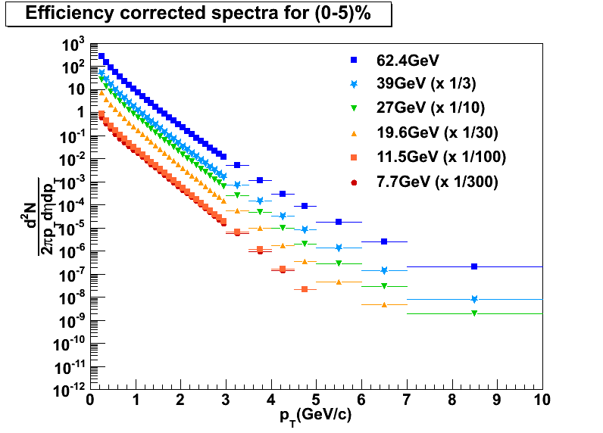
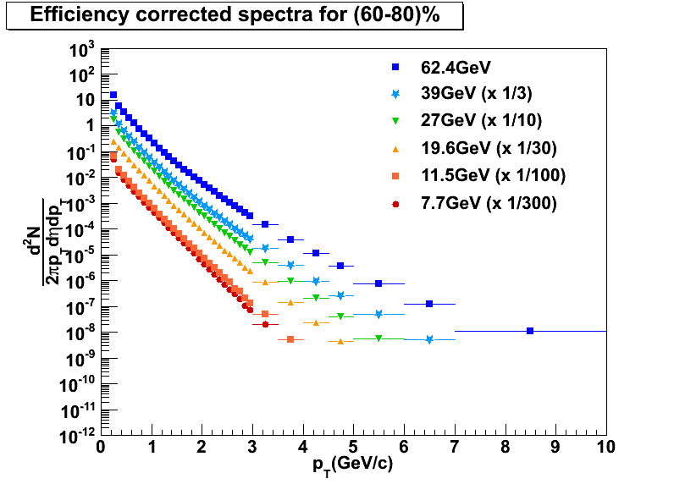


Results - Spectra
Central
Peripheral
Statistical errors only
Statistical errors only
$$\frac{h^{+}+h^{−}}{2}$$
$$\frac{h^{+}+h^{−}}{2}$$
STAR Preliminary
STAR Preliminary
0-5%
60-80%
slopes ~ equal
slopes different
Peripheral spectra shows stronger dependence on beam energy

Slide 11
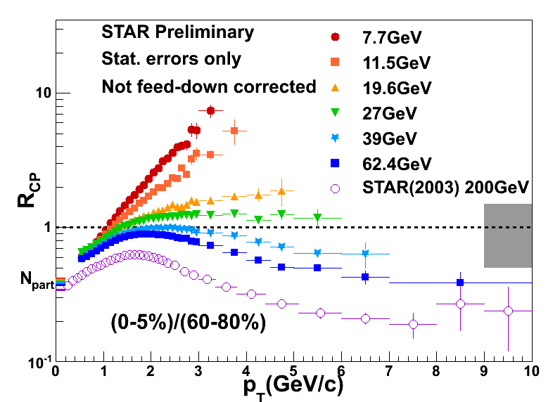
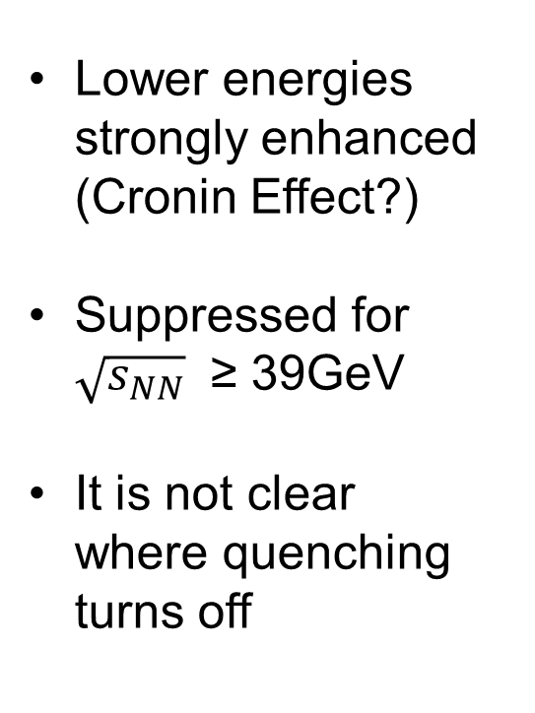
Results - R_{CP}
Lower energies strongly enhanced (Cronin Effect?)
Suppressed for $\sqrt{s_{NN}}$ ≥ 39GeV
It is not clear where quenching turns off
h⁺ + h⁻

Slide 12
To Measure Quenching
This motivates alternative methods to investigate quenching
  species dependence through identified-particle R_{CP}
  comparison to models
  variations from scaling patterns

Slide 13
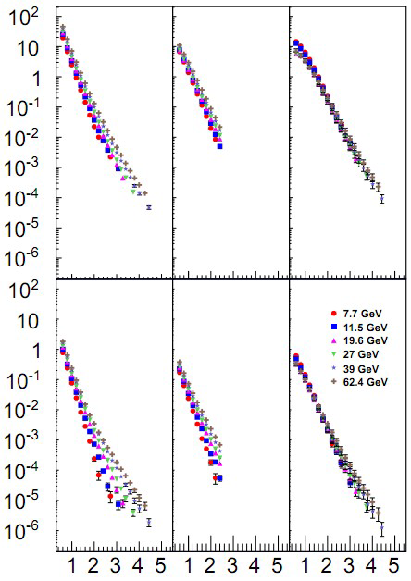

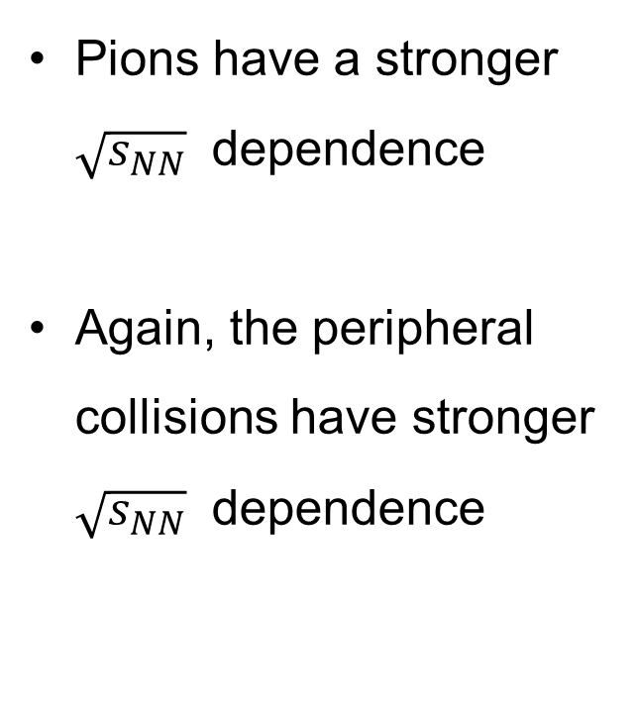
PID Spectra
π⁺
K⁺
p
Pions have a stronger $\sqrt{s_{NN}}$ dependence
Again, the peripheral collisions have stronger $\sqrt{s_{NN}}$ dependence
0-5%
STAR Preliminary
Statistical errors only
π⁺
K⁺
p
60-80%
p_{T} (GeV/c)

Slide 14
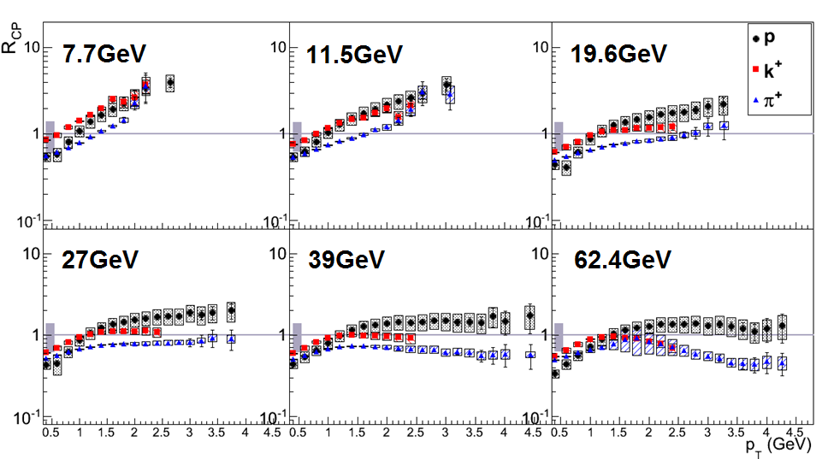
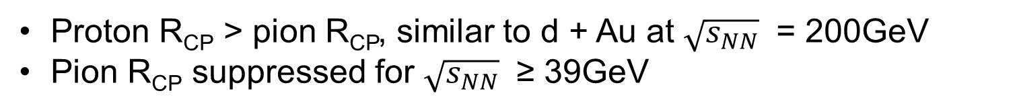
PID R_{CP}
QM2012
STAR Preliminary
Positive particles
Proton R_{CP} > pion R_{CP}, similar to d + Au at $\sqrt{s_{NN}}$ = 200GeV
Pion R_{CP} suppressed for $\sqrt{s_{NN}}$ ≥ 39GeV

Slide 15
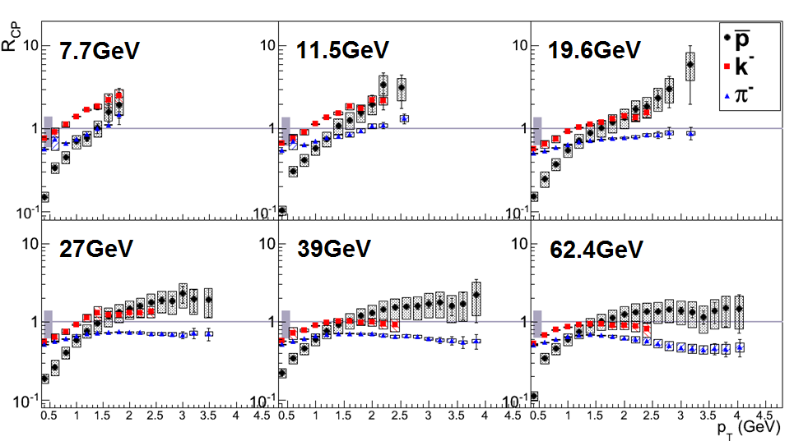
PID R_{CP}
QM2012
STAR Preliminary
Negative particles
Proton R_{CP} > pion R_{CP}, similar to d + Au at $\sqrt{s_{NN}}$ = 200GeV
Pion R_{CP} suppressed for $\sqrt{s_{NN}}$ ≥ 39GeV

Slide 16
PID R_{CP}
Pions are less enhanced than protons
A higher p_{T} reach may reveal suppression for additional beam energies
Anti-proton R_{CP} is lower than protons at low momentum
  annihilation?
Kaon behavior is complex (or strange☺)
  no obvious mass ordering for all energies

Slide 17
Models
HIJING 1.383
  jet quenching on or off
  modeled as -dE/dx within the medium
  default Lund splitting parameters a=0.5,b=0.9
AMPT v1.21/v2.21(uses HIJING 1.383)
  string melting (SM) off uses Lund string fragmentation for hadronization (v1.21)
  SM on uses quark coalescence for hadronization (v2.21)
  default Lund splitting parameters a=2.2, b=0.5
Lund fragmentation formula:

Slide 18
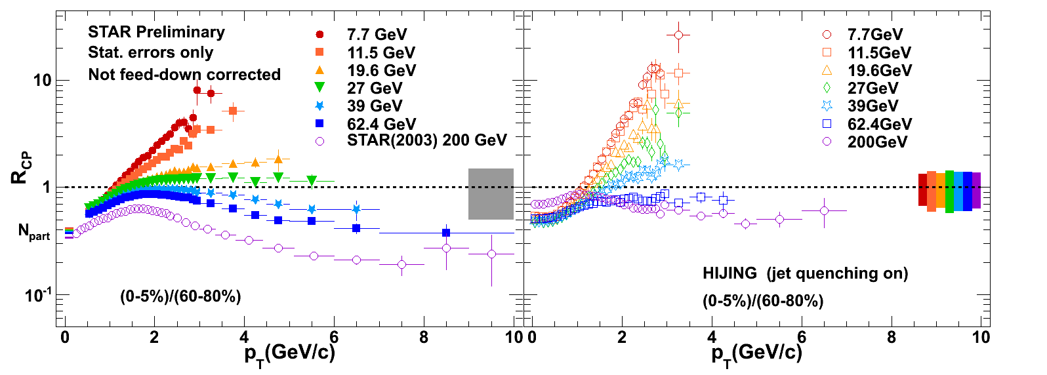
HIJING quenching on
N_{bin}
DATA
HIJING
Similar behavior to data
200GeV has odd low p_{T} behavior
Generally overestimates R_{CP}

Slide 19
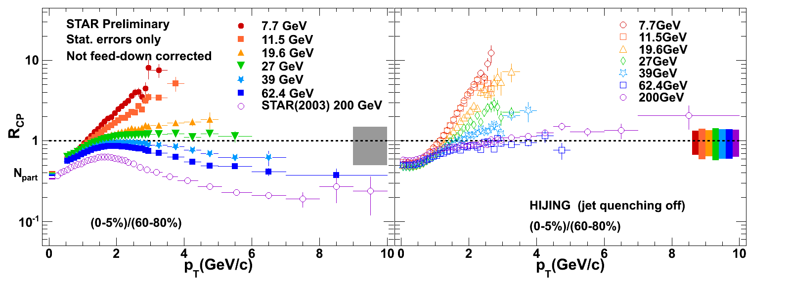
HIJING quenching off
N_{bin}
DATA
HIJING
200GeV better behaved at low p_{T}
7.7GeV barely changed from quenching on

Slide 20
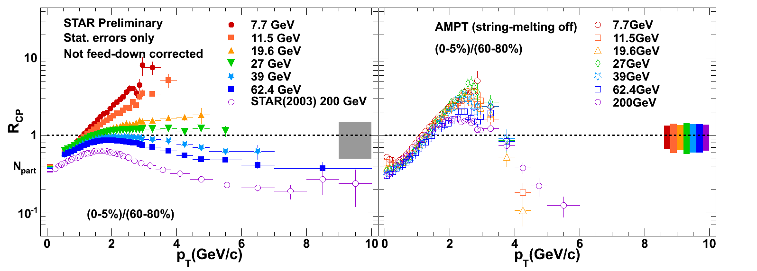
AMPT SM off
N_{bin}
DATA
AMPT
Minimal beam energy dependence
Sharp turn over near 2.5GeV/c

Slide 21
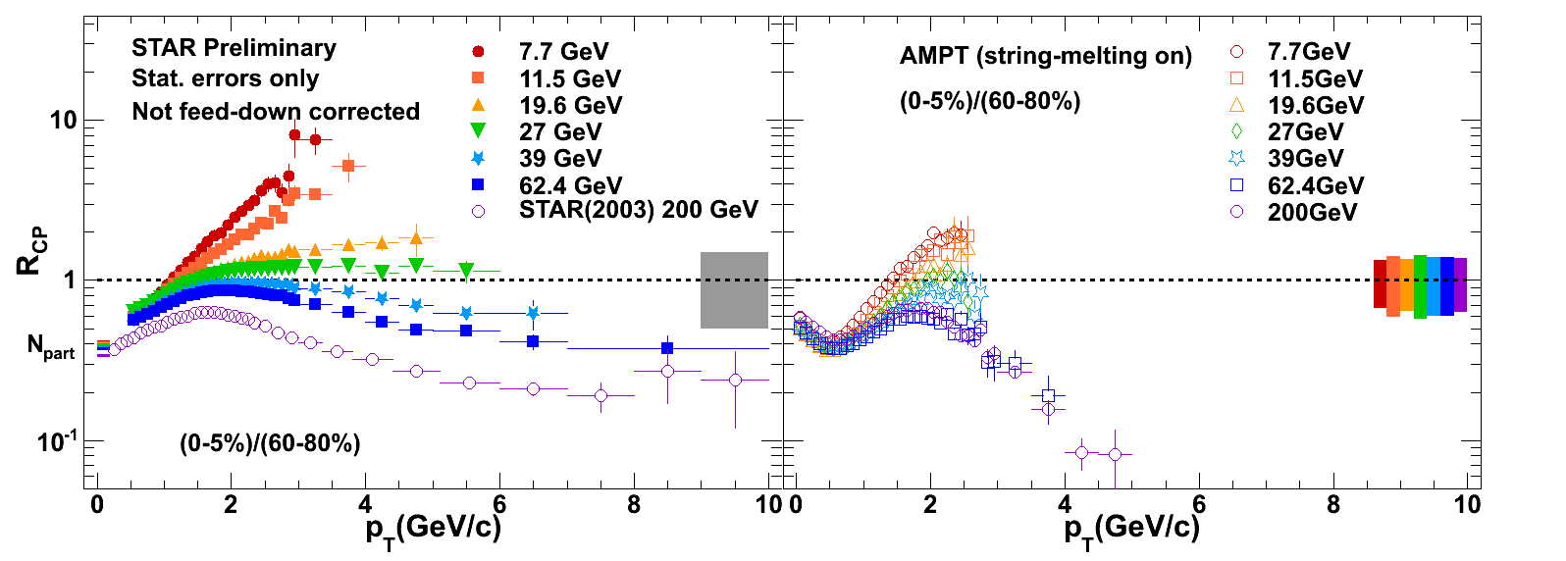
AMPT SM on
N_{bin}
DATA
AMPT
Recovers beam energy dependence
Limited p_{T} reach (same number of simulated events for SM on/off)

Slide 22
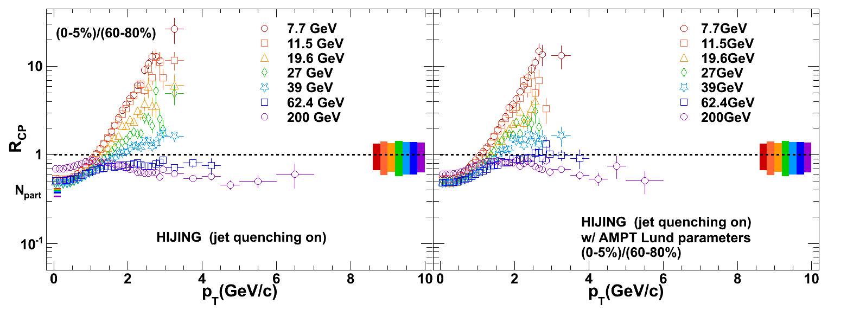
HIJING quenching on, alt
N_{coll}
N_{bin}
HIJING
HIJING
HIJING with AMPT’s Lund splitting parameters
Small effect to R_{CP} from different parameters

Slide 23
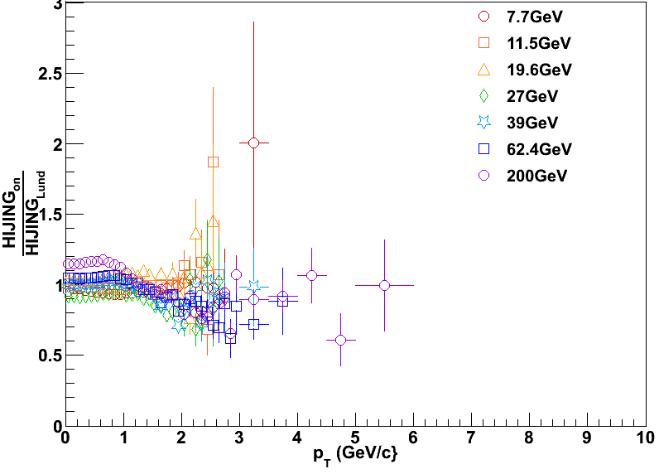
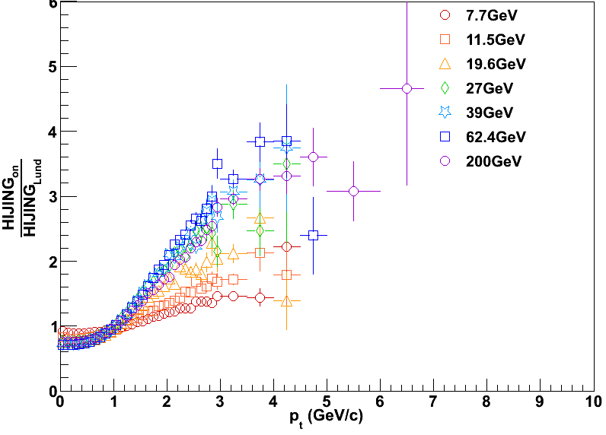
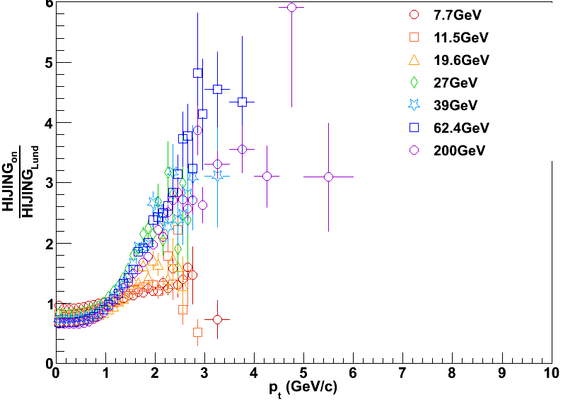
HIJING quenching on, alt
R_{CP} HIJING Lund values
____________________________________________
R_{CP} AMPT Lund values
central spectra ratio
Spectra for central and peripheral are altered by similar amounts when fragmentation parameters are changed
peripheral spectra ratio

Slide 24
Model summary
HIJING captures beam energy dependence of spectra
Jet quenching as modeled in HIJING has a greater effect on higher beam energies
For AMPT, lower beam energies are better matched by SM off, while SM on better captures the beam energy dependence
  physics of hadronization shifts from coalescence to fragmentation?

Slide 25
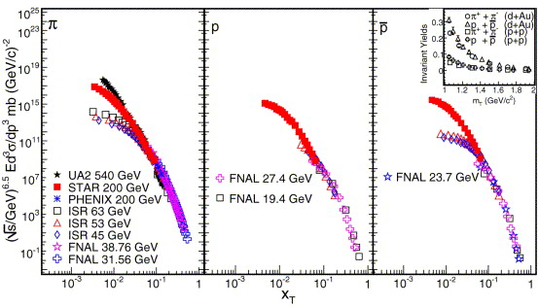
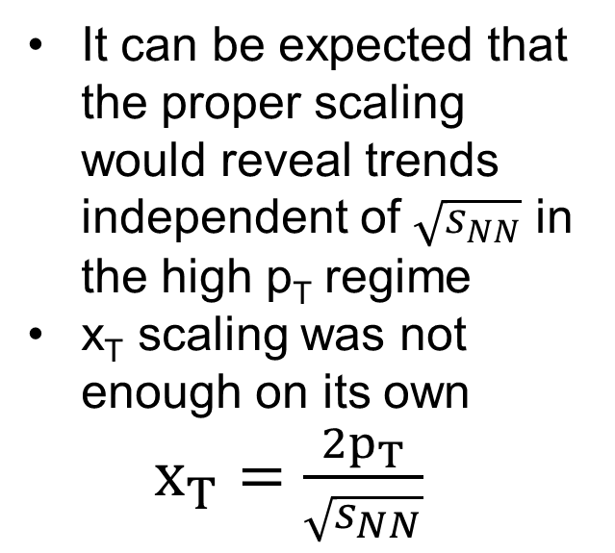
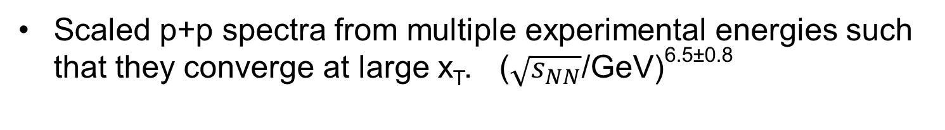
Alternative Scaling
Physics Letters B 637 (2006) 161–169
It can be expected that the proper scaling would reveal trends independent of $\sqrt{s_{NN}}$ in the high p_{T} regime
x_{T} scaling was not enough on its own
$x_{T}=\frac{2p_{T}}{\sqrt{s_{NN}}}$
Scaled p+p spectra from multiple experimental energies such that they converge at large x_{T}. ($\sqrt{s_{NN}}$/GeV)^{6.5±0.8}

Slide 26
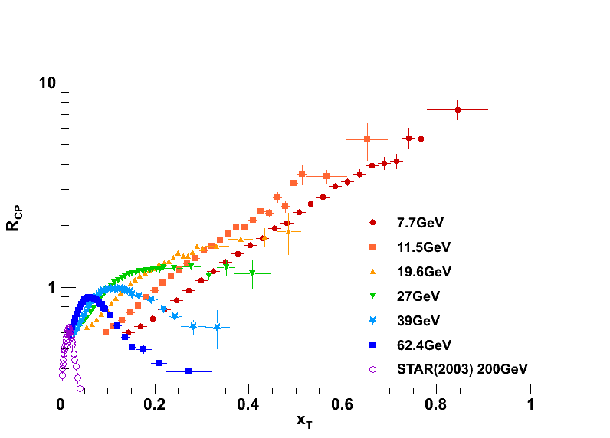
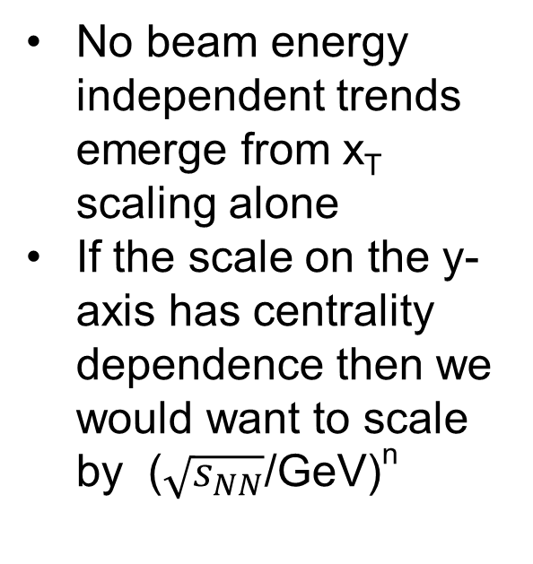
x_{T} scaling
STAR Preliminary
Stat. errors only
No beam energy independent trends emerge from x_{T} scaling alone
If the scale on the y-axis has centrality dependence then we would want to scale by ($\sqrt{s_{NN}}$/GeV)^{n}
There may be centrality dependence to the exponent (6.5±0.8)

Slide 27
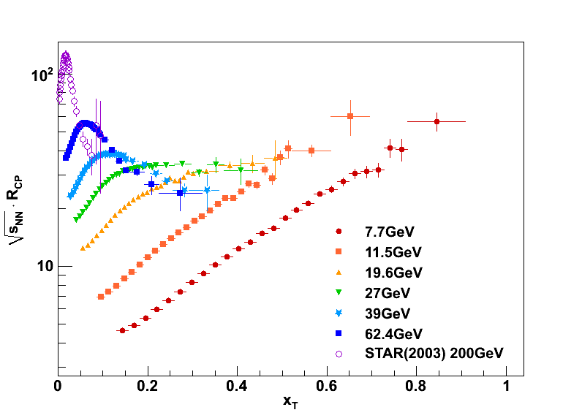
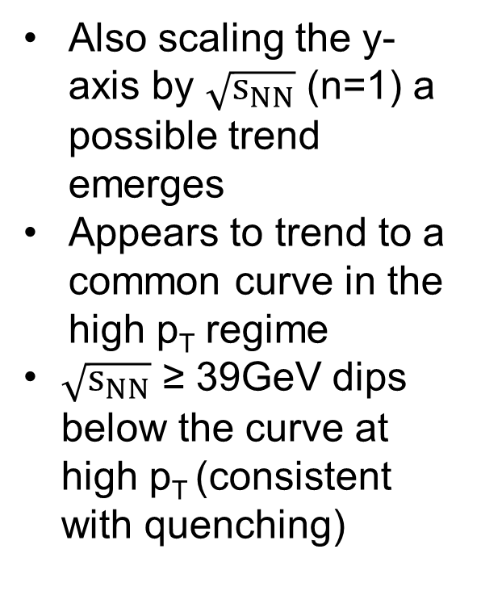
Scaling the y-axis
STAR Preliminary
Stat. errors only
Also scaling the y-axis by $\sqrt{s_{NN}}$ (n=1) a possible trend emerges
Appears to trend to a common curve in the high p_{T} regime
$\sqrt{s_{NN}}$ ≥ 39GeV dips below the curve at high p_{T} (consistent with quenching)

Slide 28
Outlook
Triggered dihadron correlations provide another method to detect jet-quenching and give another signature for the formation of a QGP
p+p data from several BES energies would provide a cleaner reference. Combined with d+Au data, the relative contributions from CNM effects and quenching may be disentangled
Additional models and tunes may improve our understanding of the data by quantifying the relative contributions of quenching and enhancement

Slide 29
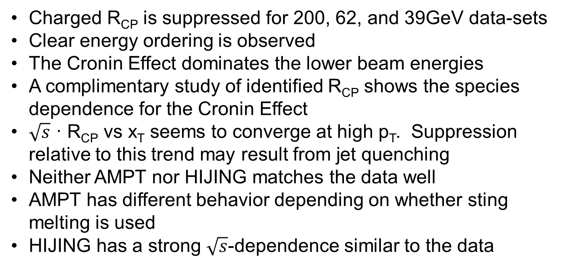
Conclusions
Charged R_{CP} is suppressed for 200, 62, and 39GeV data-sets
Clear energy ordering is observed
The Cronin Effect dominates the lower beam energies
A complimentary study of identified R_{CP} shows the species dependence for the Cronin Effect
$\sqrt{s}$ · R_{CP} vs x_{T} seems to converge at high p_{T}. Suppression relative to this trend may result from jet quenching
Neither AMPT nor HIJING matches the data well
AMPT has different behavior depending on whether sting melting is used
HIJING has a strong $\sqrt{s}$-dependence similar to the data

Slide 30
Thank you!

Slide 31
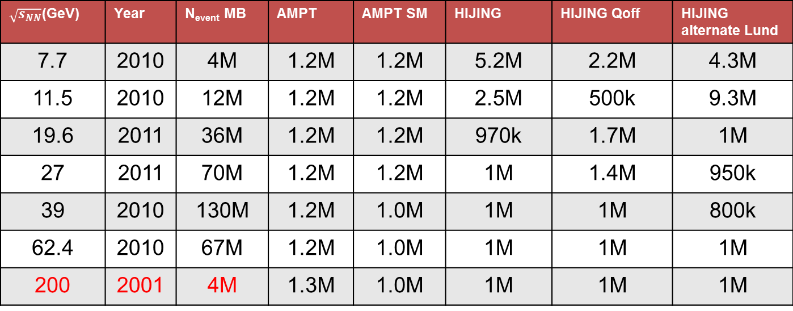
Model statistics
$\sqrt{s_{NN}}$(GeV) | Year | N_{event} MB | AMPT | AMPT SM | HIJING | HIJING Qoff | HIJING alternate Lund
7.7 | 2010 | 4M | 1.2M | 1.2M | 5.2M | 2.2M | 4.3M
11.5 | 2010 | 12M | 1.2M | 1.2M | 2.5M | 500k | 9.3M
19.6 | 2011 | 36M | 1.2M | 1.2M | 970k | 1.7M | 1M
27 | 2011 | 70M | 1.2M | 1.2M | 1M | 1.4M | 950k
39 | 2010 | 130M | 1.2M | 1.0M | 1M | 1M | 800k
62.4 | 2010 | 67M | 1.2M | 1.0M | 1M | 1M | 1M
200 | 2001 | 4M | 1.3M | 1.0M | 1M | 1M | 1M

Slide 32
PHENIX QM2012
PHENIX and STAR results are not completely consistent
STAR sees greater enhancement of central pion spectra for p_{T}<5GeV/c
PHENIX
STAR

Slide 33
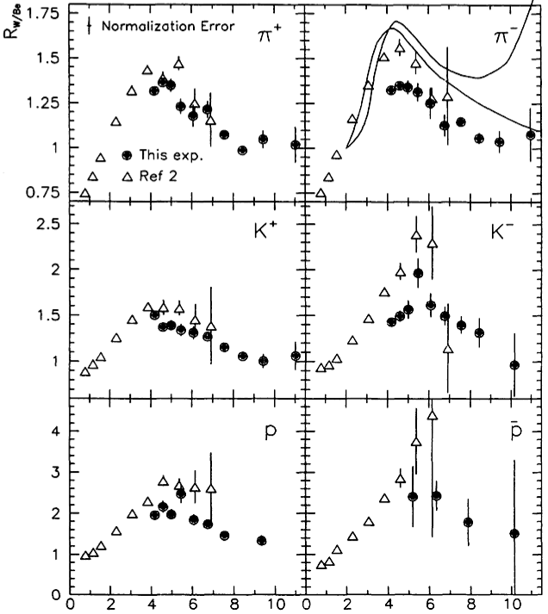

Cronin’s result
PRL 68, 452 (1992) Straub et al.
Some beam energy dependence for the Cronin Effect was previously observed
R(p+W)/(p+Be)
$\sqrt{s_{NN}}$= 27.4 and 38.8 GeV
p_{T} (GeV/c)

Slide 34
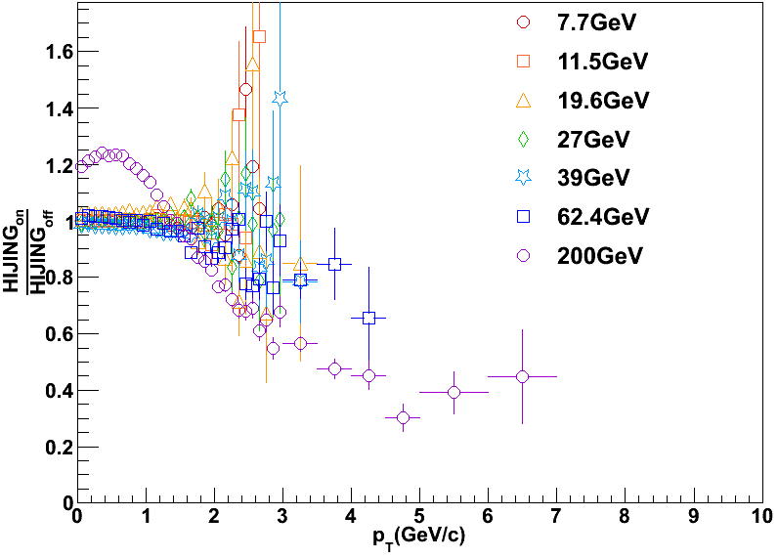

Effect of quenching in HIJING
$$\frac{{R_{CP}}^{Q_on}}{{R_{CP}}^{Q_off}}$$

Slide 35
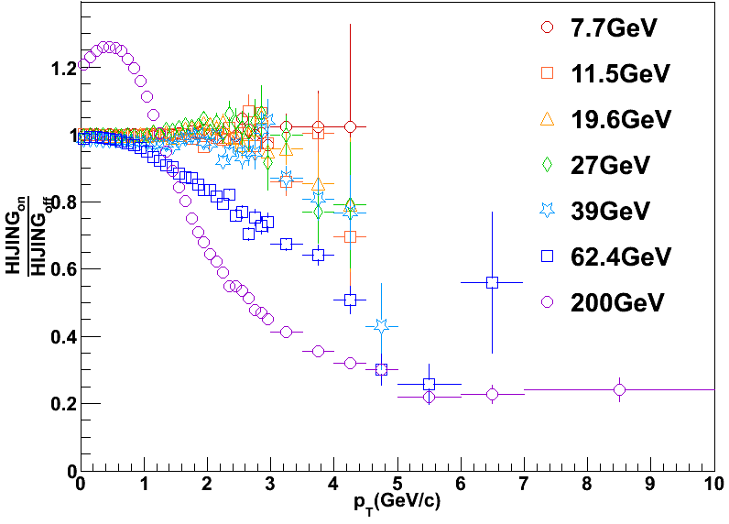
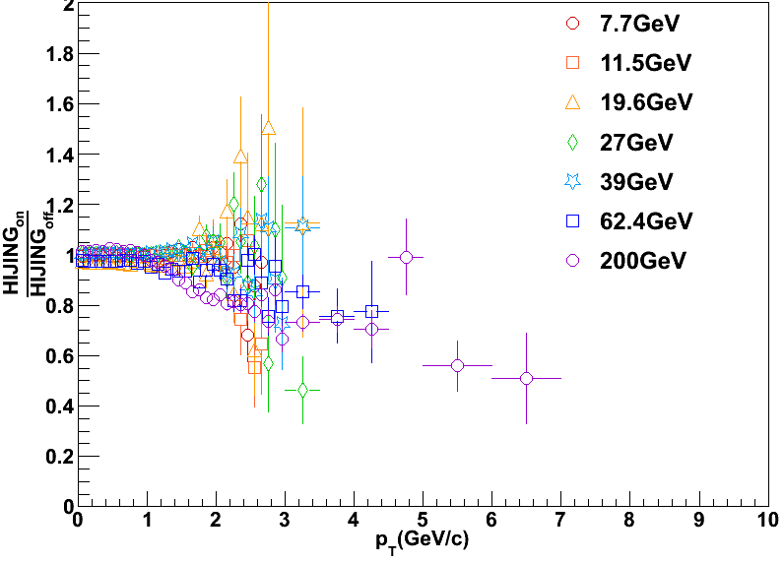
HIJING quenching on/off
Spectra Ratios
Central 0-5% ratio
Peripheral 60-80% ratio
As might be expected, quenching mostly effects central spectra

Slide 36
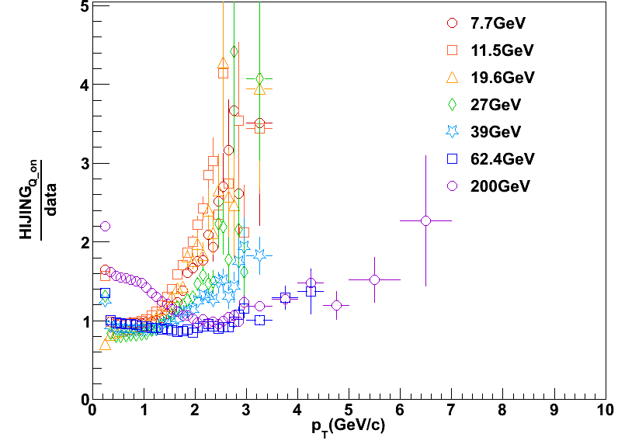
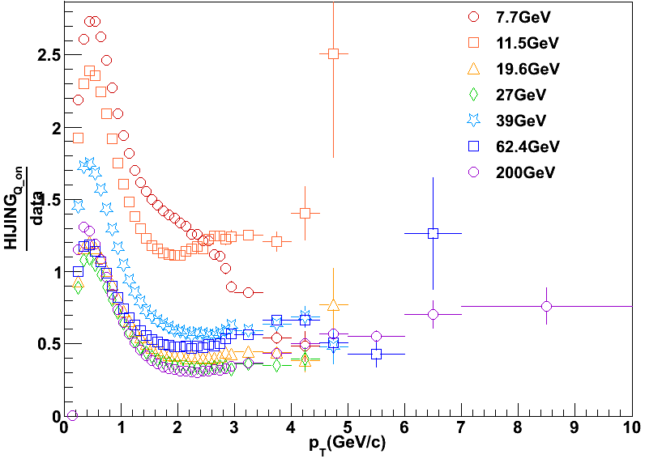
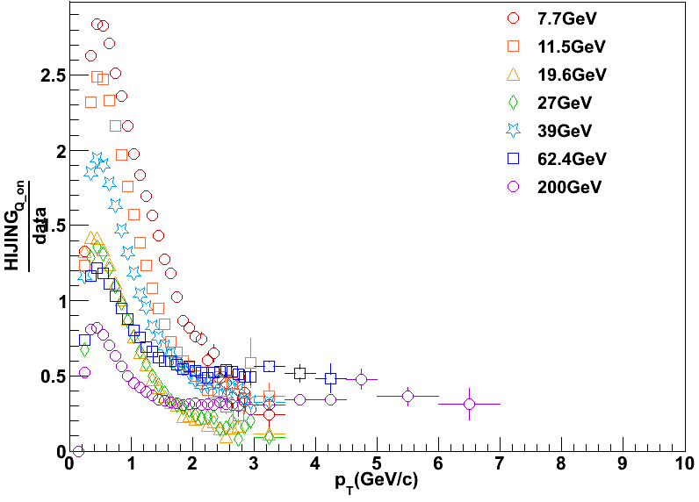
HIJING quenching on/data
central spectra ratio
R_{CP} HIJING Quenching on
_______________________________________________
R_{CP} Data
Spectra for central and peripheral from data disagree with model
peripheral spectra ratio

Slide 37
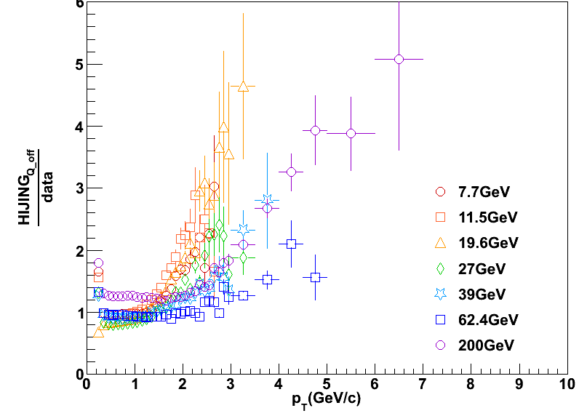
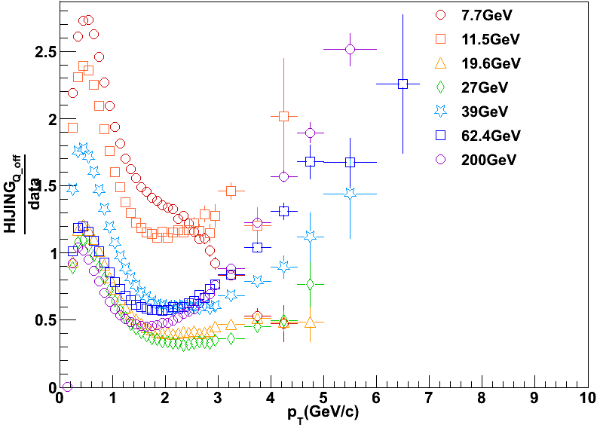

HIJING quenching off/data
R_{CP} HIJING Quenching off
_______________________________________________
R_{CP} Data
central spectra ratio
peripheral spectra ratio
Spectra for central and peripheral from data disagree with model

Slide 38



HIJING quenching Lund/data
R_{CP} HIJING w/ AMPT Lund par.
_______________________________________________
R_{CP} Data
central spectra ratio
peripheral spectra ratio
Spectra for central and peripheral from data disagree with model

Slide 39



AMPT SM off/data
R_{CP} SM off
_________________________________
R_{CP} Data
central spectra ratio
peripheral spectra ratio
Spectra for central and peripheral from data disagree with model

Slide 40



AMPT SM on/data
R_{CP} SM on
____________________________
R_{CP} Data
central spectra ratio
peripheral spectra ratio
Spectra for central and peripheral from data disagree with model

Slide 41


Slide 42


