Slide 1
Cone is medium response,
Ridge is medium itself.
Fuqiang Wang
Purdue University
For the STAR Collaboration

Slide 2
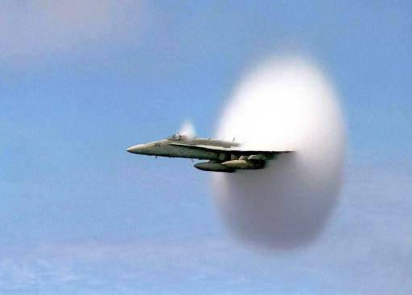
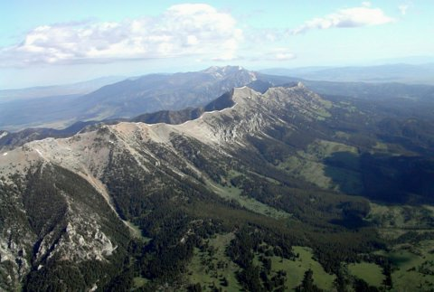
Plan of talk
Away-side cone: medium response to hard probes
Near-side ridge: medium response or itself?
Bridger ridge, Montana

Slide 3
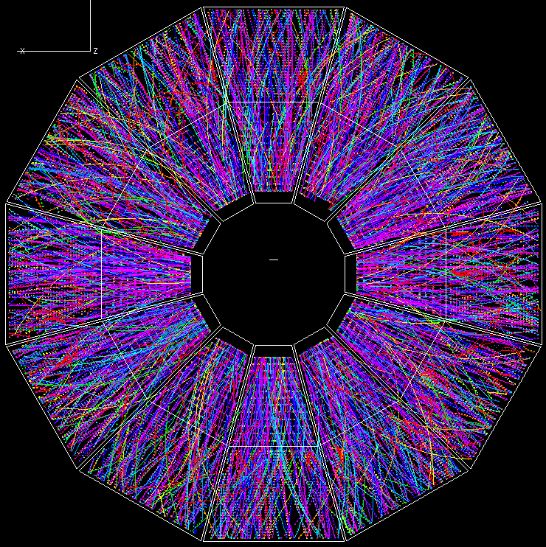
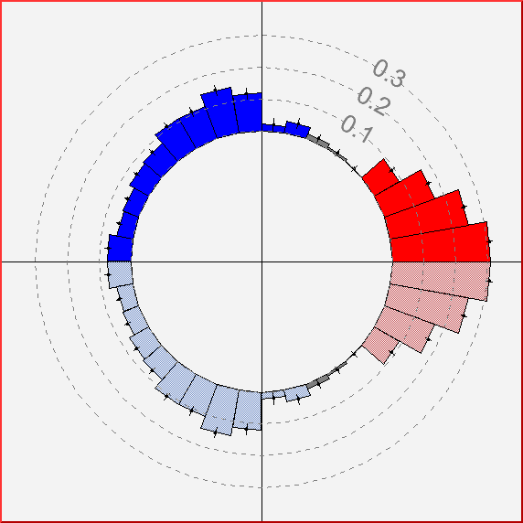
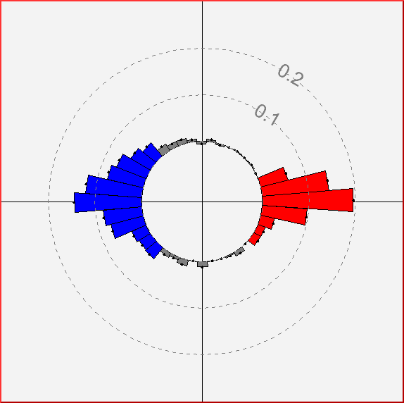
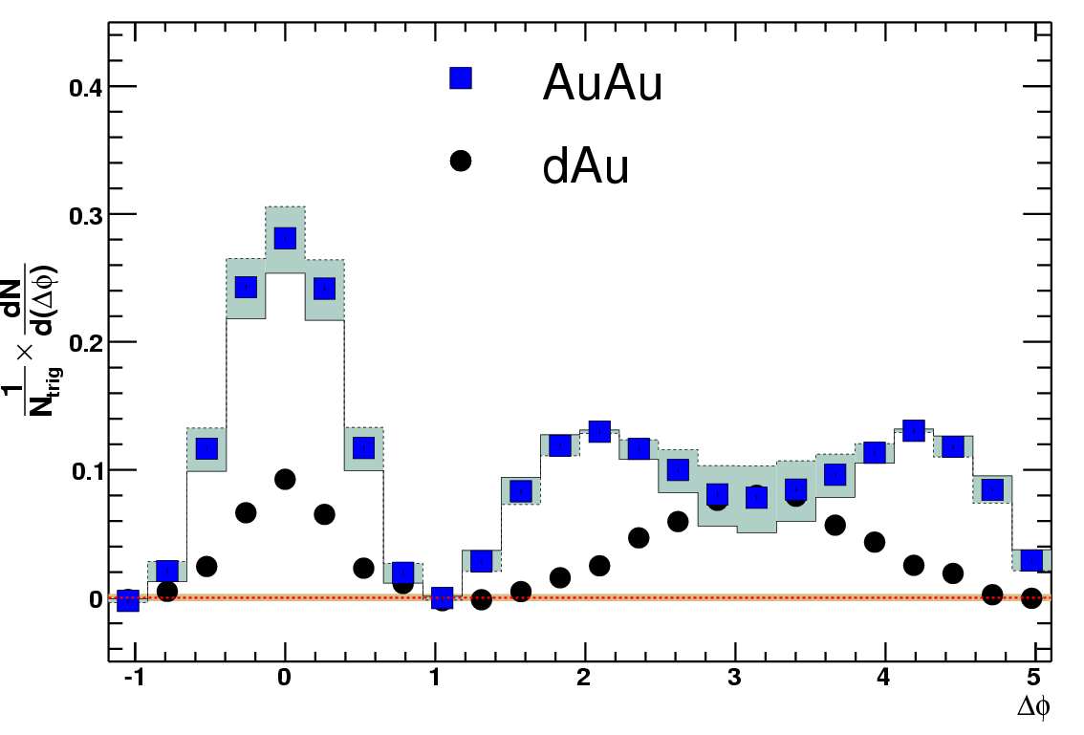
The away-side structure
High p_{T}
trigger particle
Au+Au
Δφ
PHENIX
p+p
trigger
jet
associated
particles
Away-side
-1
0
1
π
Δφ

Slide 4

Possible physics scenarios
p_{T}^{trig}=3-4 GeV/c, p_{T}^{assoc}=1-2.5 GeV/c
trigger jet
trigger
jet
Away-side
-1
0
1
π
Δφ
trigger jet
away
Surface bias
Mach cone
event
1
event
2
away
away
deflected jets

Slide 5
3-particle azimuthal correlation
trigger jet
trigger jet
event
1
event
2
away
away
away
away
Mach cone
deflected jets
Δφ₂
Δφ₂
signature of
conical
emission
= φ₂−φ_{trig}
π
π
0
0
0
π
Δφ₁= φ₁−φ_{trig}
0
π
Δφ₁

Slide 6
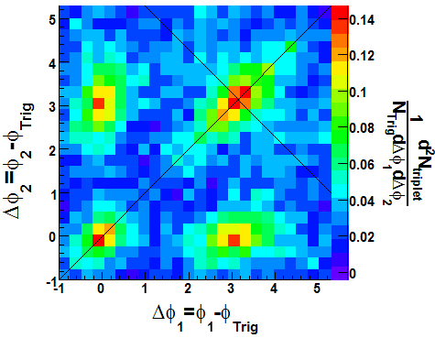
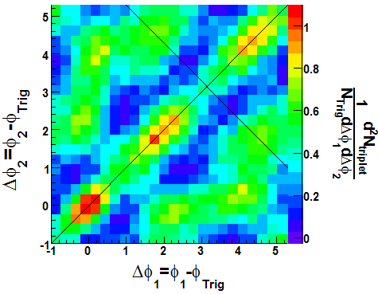
Evidence of conical emission
STAR, PRL 102, 052302 (2009)
d+Au
Au+Au central
trigger
Δφ₂
π
0
0
π
Away-side
Δφ₁

Slide 7
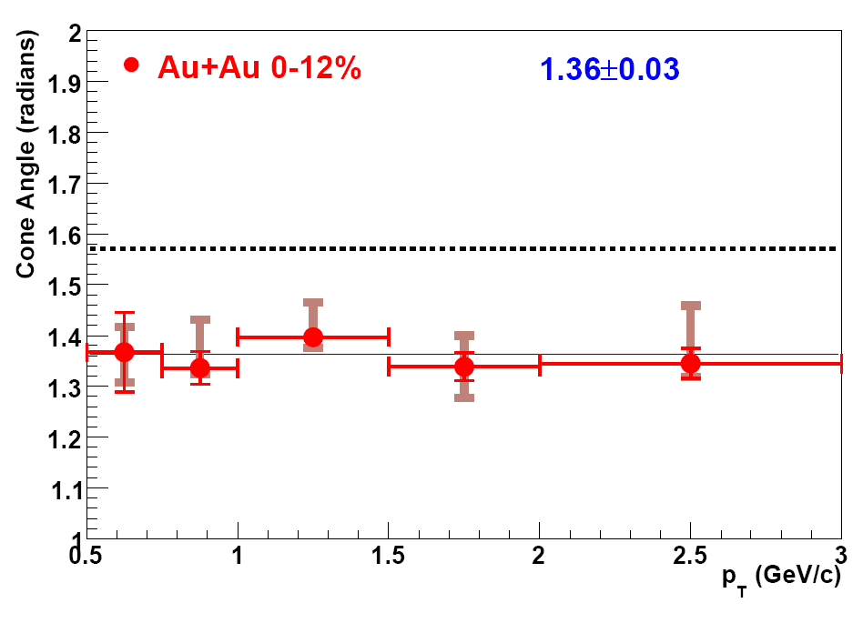
Conical emission angle
STAR, PRL 102, 052302 (2009)
trigger
θ = 1.37
± 0.02 (stat.)
± 0.06 (syst.)
θ
Constant cone angle vs p_{T} suggests Mach Cone shock waves may be the underlying mechanism.
Away-side

Slide 8
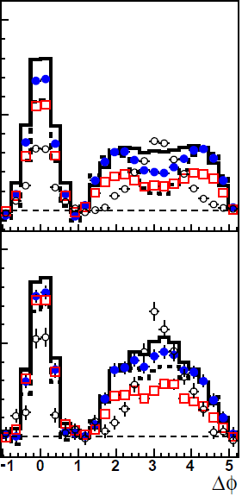
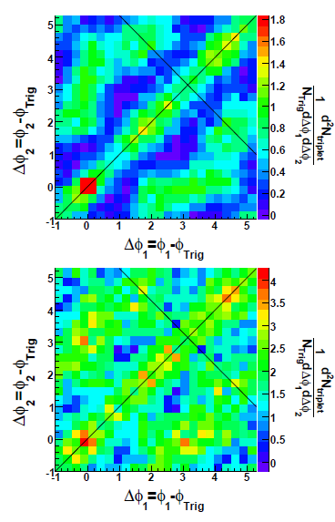
Higher trigger p_{T}
1 < p_{T}^{assoc} < 2 GeV/c
4 < p_{T}^{trig} < 6 GeV/c
1 < p_{T}^{assoc} < 2.5 GeV/c
6 < p_{T}^{trig} < 10 GeV/c
1 < p_{T}^{assoc} < 2.5 GeV/c

Slide 9
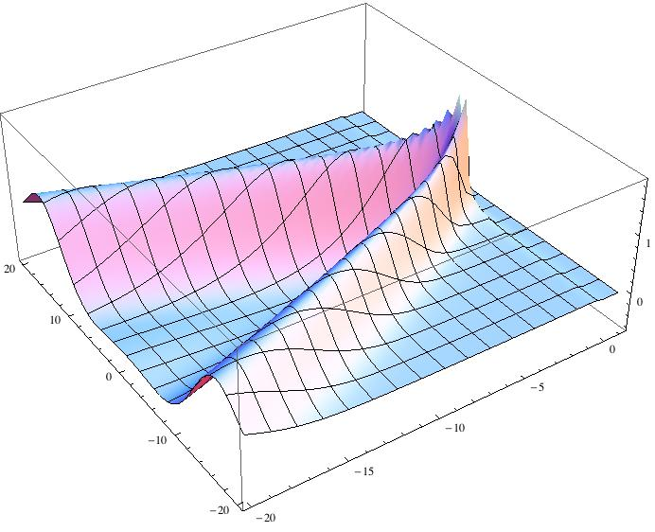
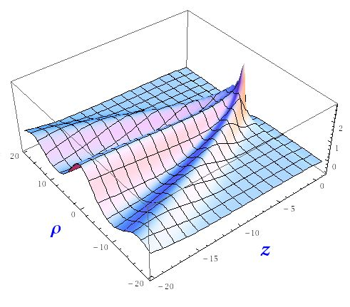
Theory calculations
pQCD + hydro:
Neufeld et al.
arXiv:0807.2996
quark v = 0.99955
← ρ →
← (z - ut)
Parton energy loss:
Renk et al.
PRC 76, 014908 (2007)

Slide 10
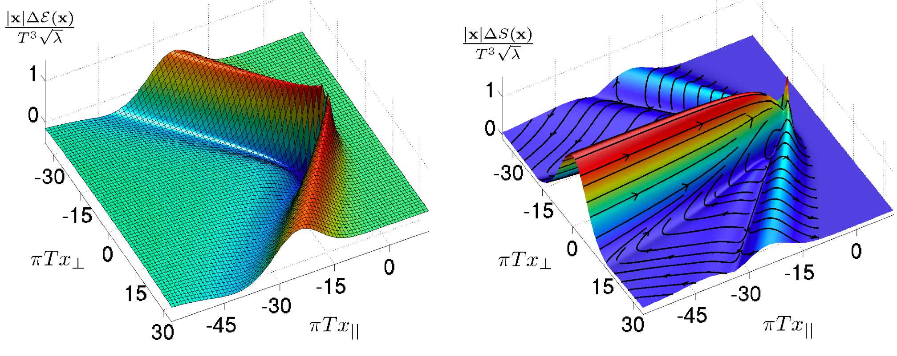
AdS/CFT Correspondence
Maldacena (1997), Gubser, Klebanov,Polyakov; Witten (1998)
N = 4 Super-Yang-Mills
theory in 4d with SU(N_{C})
A string theory in 5d AdS
YM observables at infinite N_{C} and infinite coupling can be
computed using classical gravity.
Chesler & Yaffe
arXiv:0712.0050
Heavy quark u = 0.75c
Measure heavy quark Mach-cone shock waves:
→ Experimental consequence of string theory?
Notes:
- AdS/CFT is an equivalence between a SYM theory and a string theory in AdS spacetime.
- AdS spacetime is a homogenous space with a negative cosmological constant. It is very important that string theory lives one dimensional higher.
- You can also put the gauge theory at finite T, which is then dual to a putting a BH in AdS. BH is a thermal system with a Hawking T. In this relation one identifies the T of gauge theory with the Hawking T.
- The large color and large coupling limit of the SYM is described by the classical limit of string theory.
- A consequence of this AdS/CFT correspondence is that …... Can be translate into a computation in classical gravity.

Slide 11
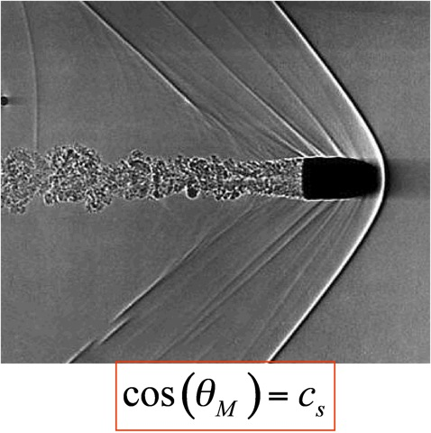
Speed of sound?
p
EOS: p(ε)
QGP
c_{S} = √1/3
= 0.58
HG
c_{S} = 0.45
Mixed phase
c_{S} = 0
θ_{M} = 1.37
ε
speed of sound
c_{S} ~ 0.2
c_{S} far smaller than HG or QGP.
Must have mixed phase (phase transition).
However, model calculations indicate that Mach Cone angle can be altered by medium flow.
Notes:
11

Slide 12
Investigating flow effect on cone angle

Slide 13
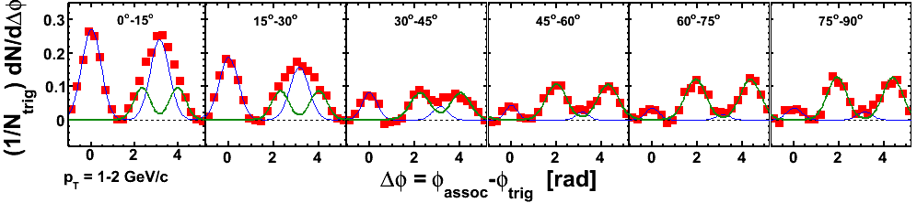
Fit to large Δη azimuthal correlations
Au+Au 20-60%, 3<p_{T}^{trig}<4, 1<p_{T}^{trig}<2 GeV/c
STAR Preliminary
2 Gaus: Ridge at 0 and ridge at π, same shape, diff. magnitudes
2 Gaus: identical conical emission peaks symmetric about π.

Slide 14
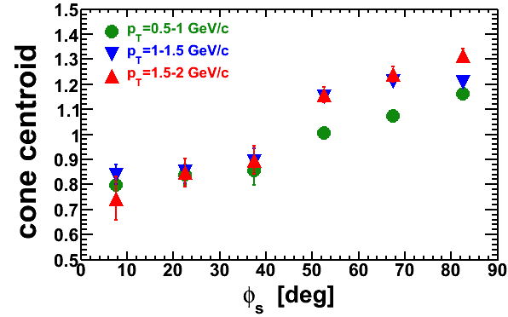
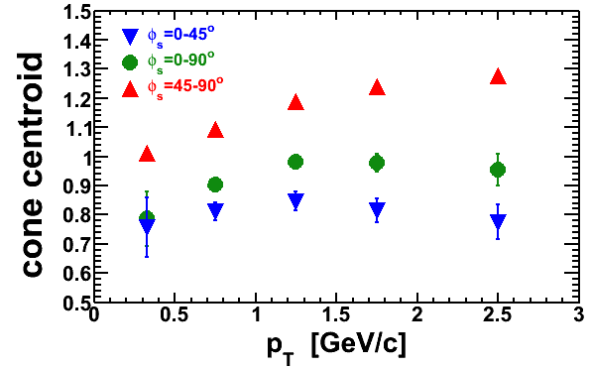
STAR Preliminary
Cone angle takes off after trigger φ_{s}=45º.
Split in p_{T} after φ_{s}=45º.
Cone angle ~constant over p_{T} at φ_{s}<45º.
STAR Preliminary

Slide 15
Is there a back-to-back RIDGE?
Away-Side Ridge
Away 1
RP
Ridge
Near Jet
Trig.
Away 2

Slide 16
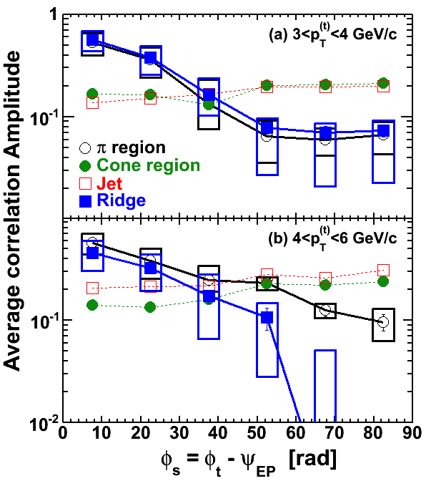
Connection between near- and away-side
STAR Preliminary
Away-side
-1
0
1
π
Δφ

Slide 17
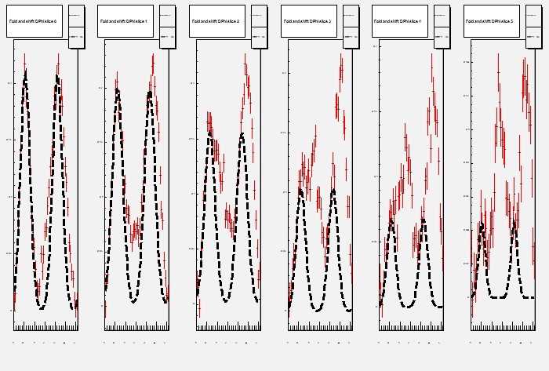
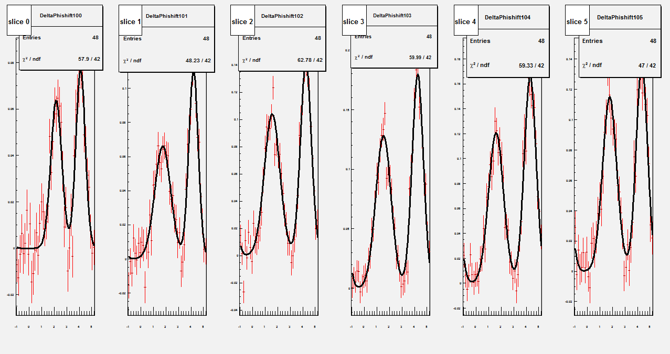
Separate 1st and 2nd quadrants trigger particles
Azimuthal correlation for large |Δη|>0.7
Near-side ridge Gauss repeated at “+π”
Subtract back-to-back symmetric ridge peaks
STAR Preliminary
∆φ
∆φ
∆φ
∆φ
∆φ
∆φ
∆φ
∆φ
∆φ
∆φ
∆φ
∆φ

Slide 18
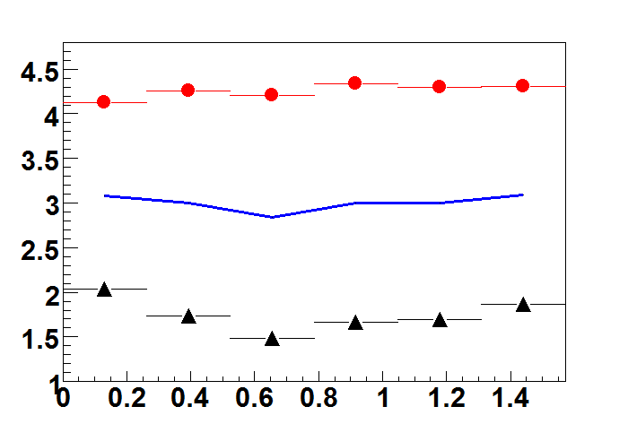
Away-side asymmetric cone positions
STAR Preliminary
1st cone
2nd Cone peak
∆φ
RP
2nd Cone
trigger
1st cone peak
φ_{s}
Evidence of flow effect on conical emission.
Important to disentangle flow effect and conical emission angle.

Slide 19
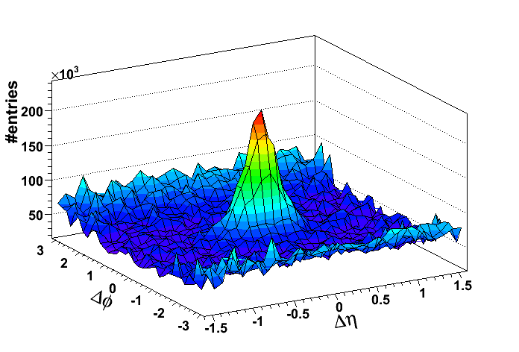
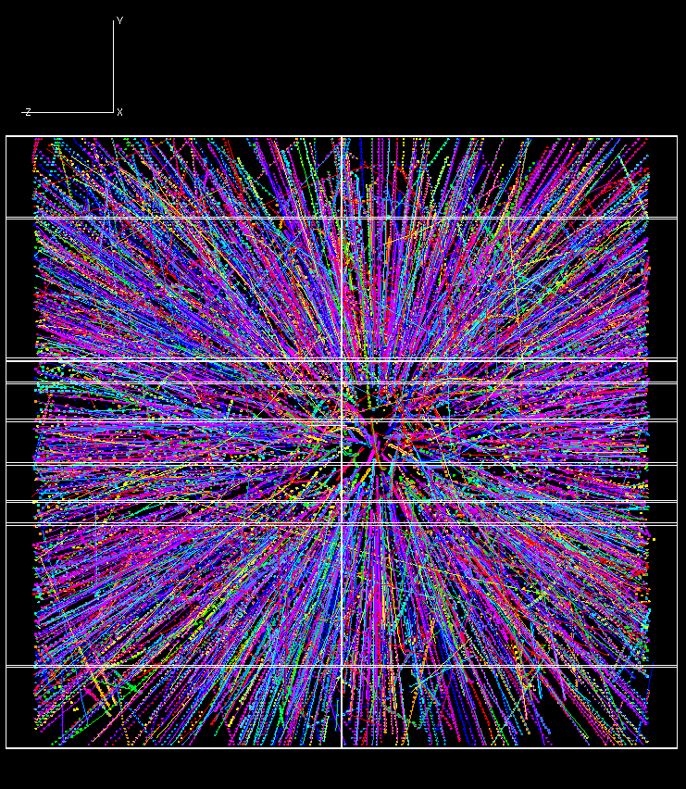
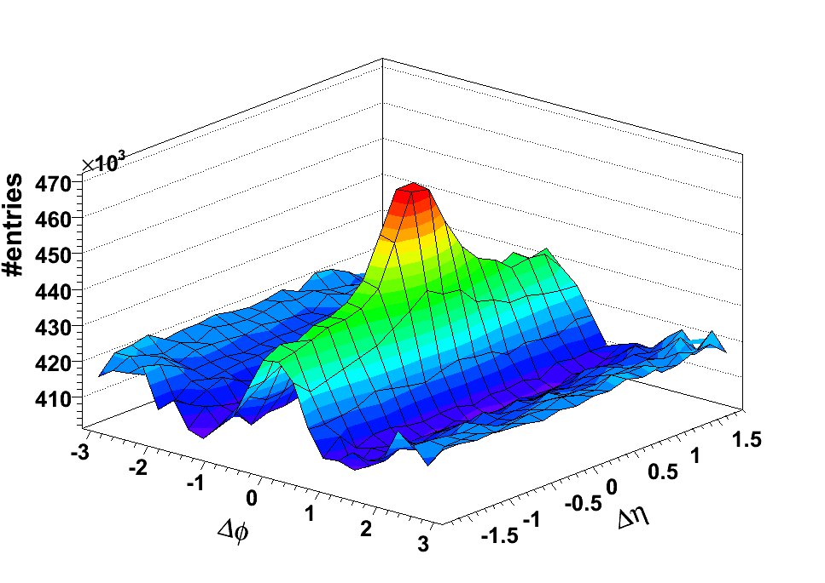
The longitudinal ridge
High-p_{T}
trigger particle
d+Au
associated
particle
η ~ 0
η ~ 1
trigger particle
p_{T} > 3 GeV/c
|Δφ|<0.7
Δη
Δφ
Au+Au
ridge
assoc. particle
p_{T} =1-2 GeV/c
Bridger ridge, Montana
Δφ
Δη

Slide 20
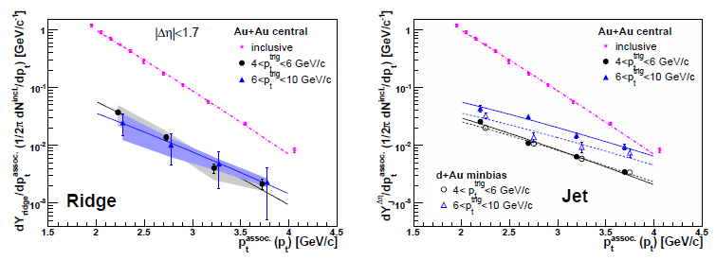
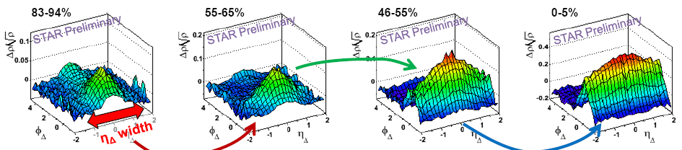
What’s already known about ridge
Ridge increases with centrality.
Ridge pt spectrum is a bit harder than bulk.
Ridge particle composition similar to bulk.
STAR, arXiv:0909.0191
Ridge present in untriggered correlation.
M. Daugherity (STAR), QM’08, J.Phys.G35:104090,2008

Slide 21
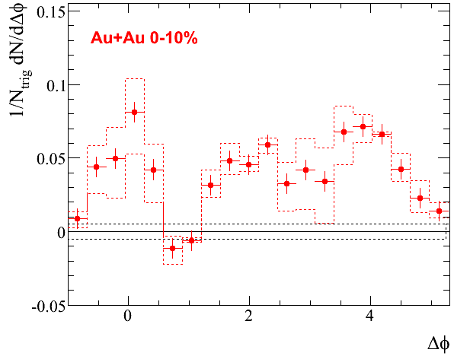
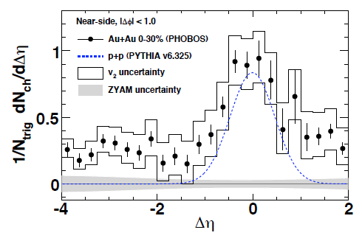
Ridge extended to very large Δη
STAR, arXiv:nucl-ex/0701061
PHOBOS, arXiv:0903.2811
2.7<|Δη|<3.9
p_{T}^{assoc} > 1.0 GeV/c
STAR Preliminary

Slide 22
New insights from
RP-dependent dihadron correlations

Slide 23
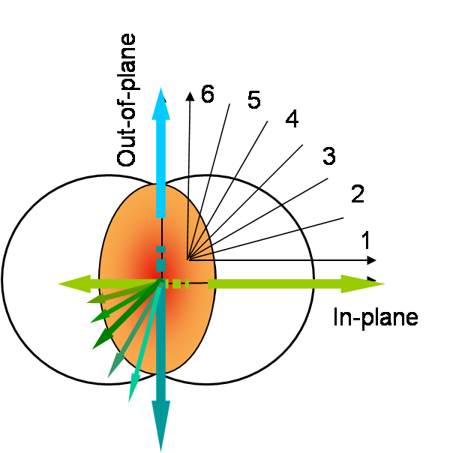
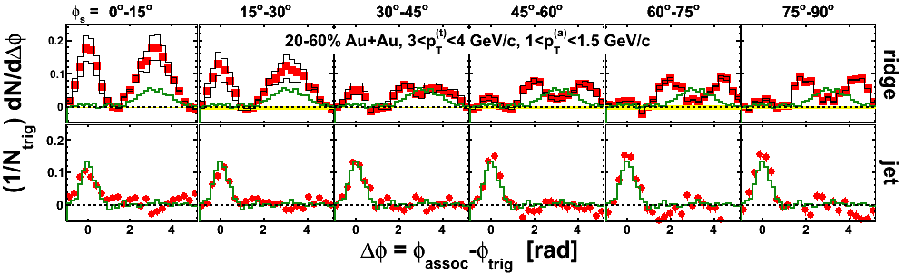
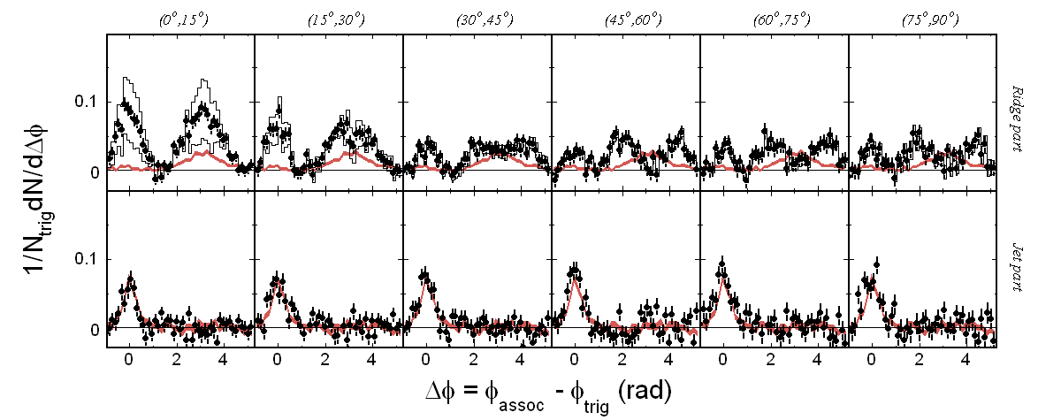
Δη cut to “separate” jet and ridge
jet
ridge
|∆η|>0.7 = ridge + away-side
Jet = (|∆η|<0.7) – Accept.*(|∆η|>0.7)
assuming ridge is uniform in ∆η.
Δη
Δη
Au+Au 20-60%, 3<p_{T}^{trig}<4, 1.5<p_{T}^{trig}<2.0 GeV/c
d+Au
Feng, QM’06. STAR Preliminary

Slide 24
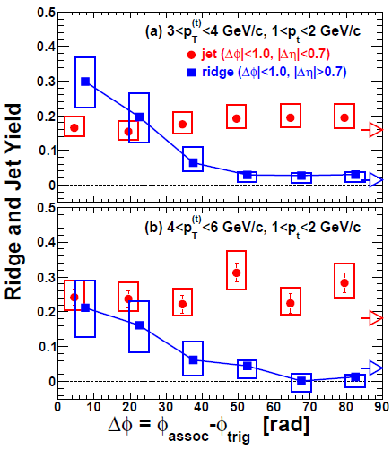
Ridge decreases with RP
STAR Preliminary
Ridge drops when trigger particle moves away from RP.
trigger |φ_{s}|
in-plane
out-of-plane

Slide 25
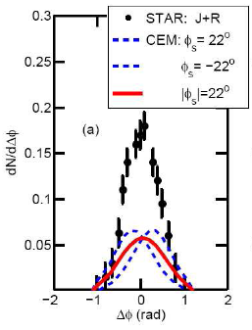
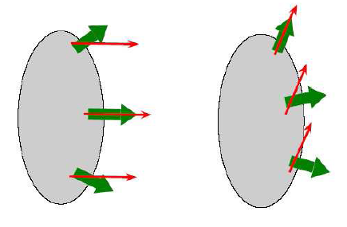
A model prediction motivated by data
Correlated Emission Model (CEM)
Chiu,Hwa, arXiv:0809.3018
Correlated Emission Model (CEM)
in-plane
jet flow aligned
more ridge
out-of-plane
jet flow misaligned
less ridge
Alignment of jet propagation and medium flow produces the ridge.
If correct, would produce measureable asymmetry in near-side ridge correlation peak.

Slide 26
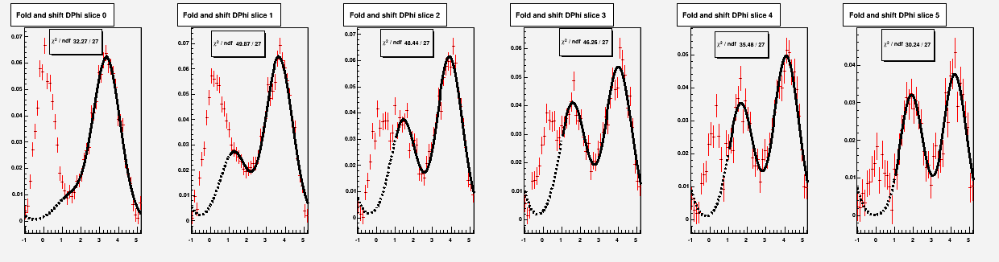
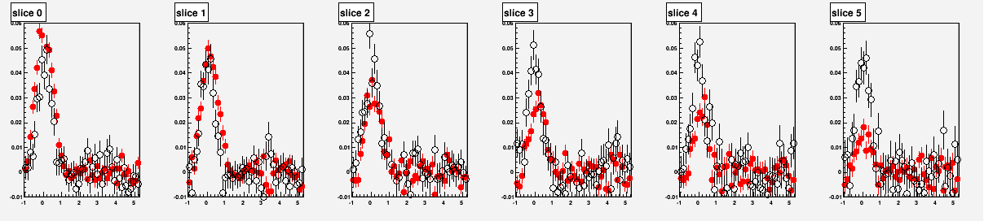
Remove away-side from large Δη correlation
Konzer, QM’09. STAR Preliminary
Au-Au 20-60%
|∆η|>0.7
Trig. pt=3-4 GeV/c, assoc pt=1-1.5 GeV/c
ZYAM
φ_{s} = 0 to -15
-15 to -30
-30 to -45
-45 to -60
-60 to -75
-75 to -90
Ridge
0.05
0
Jet
-1 0 1 π
∆φ = φ_{assoc} – φ_{trig}
Jet remains constant
Ridge Decreases
Jet symmetric
Ridge asymmetric

Slide 27
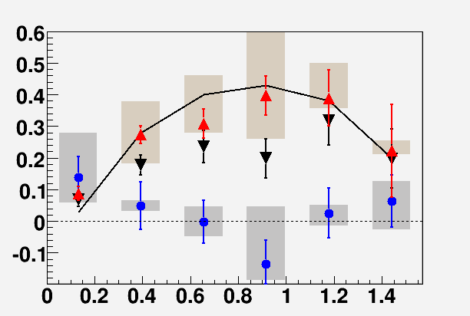
Correlation Asymmetry
STAR Preliminary
trigger pt=3-4 GeV/c
v₂ syst.
CEM model
Ridge
Away-side is Asymmetric (not shown in plot).
Jet is symmetric.
Ridge is Asymmetric!
Ridge may be due to
jet-flow alignment.
Ridge: assoc pt=1-1.5 GeV/c
Ridge: assoc pt=1.5-2 GeV/c
Jet: assoc pt=1.5-2 GeV/c
Jet
in-plane
|φ_{s}|= φ_{trig} – ψ_{RP}
out-of-
plane

Slide 28
New insights from
3-particle Δη-Δη correlation

Slide 29
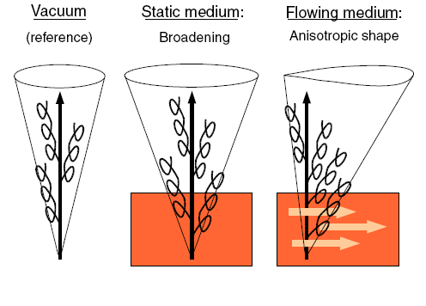
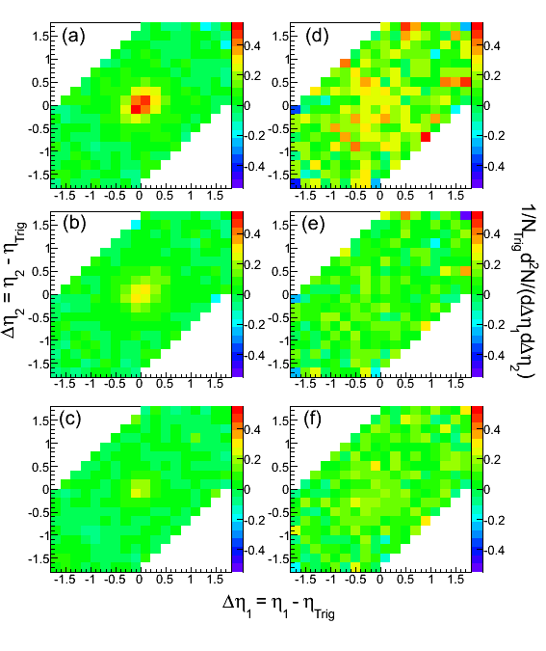
How does long Δη come about?
3-particle Δη-Δη correlations
Many models on the market.
|Δφ|<0.7
3<p_{T}^{trig}<10 GeV/c, 1<p_{T}^{assoc}<3 GeV/c
Netrakanti, QM’09. arXiv:0907.4744
STAR Preliminary
N. Armesto et al.,
Phys. Rev. Lett. 93 (2004) 242301
d+Au
Central Au+Au

Slide 30
3-particle Δη-Δη correlations
Netrakanti, QM’09. STAR Preliminary
3<p_{T}^{trig}<10 GeV/c
1<p_{T}^{assoc}<3 GeV/c
|Δφ|<0.7
dAu
AuAu 12%
Charge independent (All)
STAR Preliminary
AA^{Like} =
(AA^{Like}T^{Like} + AA^{Like}T^{Unlike})
AA^{Unlike} =
All - AA^{Like}

Slide 31
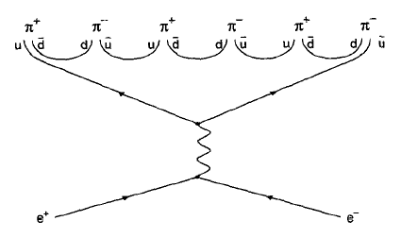
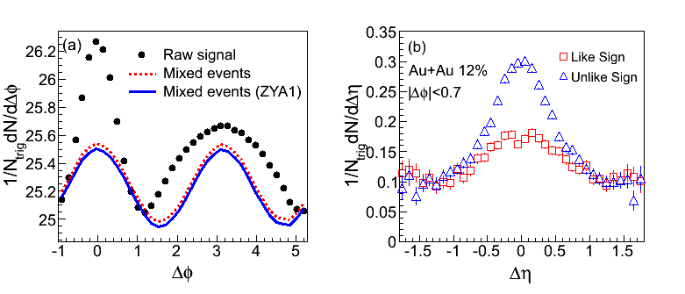
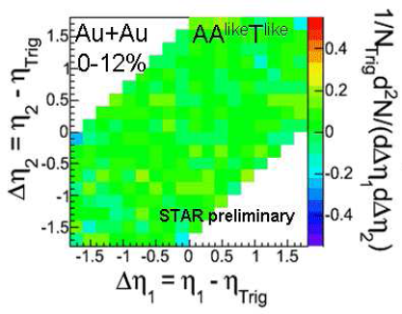
Separate jet and ridge
Jet has charge ordering
ridge does not
jet
ridge
Netrakanti, QM’09. arXiv:0907.4744.
STAR Preliminary
Same-sign triplets:
Only ridge, no jet.

Slide 32
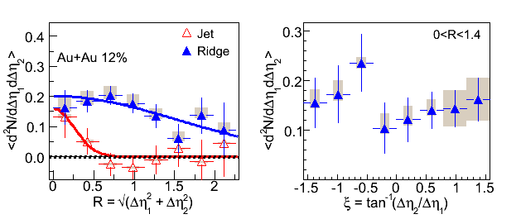
Ridge is structureless
R
ξ
Netrakanti, QM’09. arXiv:0907.4744. STAR Preliminary
Radial Projection
Angular Projection
STAR Preliminary
σ (jet) = 0.25 ± 0.09
σ (ridge) = 1.53 ± 0.41
No prominent subtructures in ridge.

Slide 33
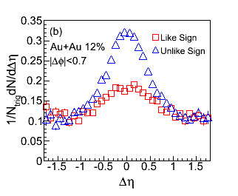
Ridge-jet cross pairs
Netrakanti, QM’09. arXiv:0907.4744. STAR Preliminary
Ridge and jet appear to be anti-correlated.

Slide 34
Experimental facts
Ridge increases with centrality.
Ridge spectrum a bit harder than bulk.
Ridge particle composition similar to bulk.
Ridge present in untriggered correlation.
Ridge is mainly in-plane.
Ridge is asymmetric in Δφ.
Ridge is very wide.
Ridge is random.
No jet-ridge cross-talk.
Ridge may be back-to-back.
Ridge seems unrelated to jet.
Now let’s go to models…

Slide 35
In-medium rad. + long. Flow push
N. Armesto et al., Phys. Rev. Lett. 93 (2004) 242301
Ridge increases with centrality.
Ridge spectrum a bit harder than bulk.
Ridge particle composition similar to bulk.
Ridge present in untriggered correlation.
Ridge is mainly in-plane.
Ridge is asymmetric in Δφ.
Ridge is very wide.
Ridge is random.
No jet-ridge cross-talk.
Ridge may be back-to-back.
Ridge seems unrelated to jet.
x
x
x
x

Slide 36
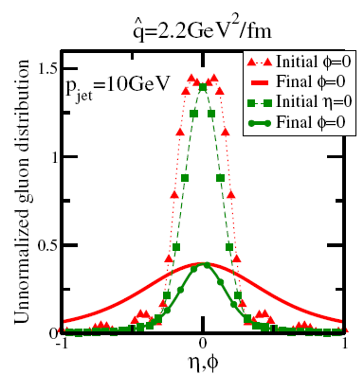
Turbulent color field
A. Majumder et al., Phys. Rev. Lett. 99 (2004) 042301
Ridge increases with centrality.
Ridge spectrum a bit harder than bulk.
Ridge particle composition similar to bulk.
Ridge present in untriggered correlation.
Ridge is mainly in-plane.
Ridge is asymmetric in Δφ.
Ridge is very wide.
Ridge is random.
No jet-ridge cross-talk.
Ridge may be back-to-back.
Ridge seems unrelated to jet.
x
x

Slide 37
Recombination of thermal+shower partons
R.C. Hwa, C.B. Chiu, Phys. Rev. C 72 (2005) 034903
Ridge increases with centrality.
Ridge spectrum a bit harder than bulk.
Ridge particle composition similar to bulk.
Ridge present in untriggered correlation.
Ridge is mainly in-plane.
Ridge is asymmetric in Δφ.
Ridge is very wide.
Ridge is random.
No jet-ridge cross-talk.
Ridge may be back-to-back.
Ridge seems unrelated to jet.
x
x
x

Slide 38
Momentum kick model
C.Y. Wong hep-ph:0712.3282
Ridge increases with centrality.
Ridge spectrum a bit harder than bulk.
Ridge particle composition similar to bulk.
Ridge present in untriggered correlation.
Ridge is mainly in-plane.
Ridge is asymmetric in Δφ.
Ridge is very wide.
Ridge is random.
No jet-ridge cross-talk.
Ridge may be back-to-back.
Ridge seems unrelated to jet.
x
x
x
x

Slide 39
Transverse flow boost
S.A. Voloshin, Phys. Lett. B 632 (2006) 490; E. Shuryak, Phys. Rev. C 76 (2007) 047901
Ridge increases with centrality.
Ridge spectrum a bit harder than bulk.
Ridge particle composition similar to bulk.
Ridge present in untriggered correlation.
Ridge is mainly in-plane.
Ridge is asymmetric in Δφ.
Ridge is very wide.
Ridge is random.
No jet-ridge cross-talk.
Ridge may be back-to-back.
Ridge seems unrelated to jet.
x

Slide 40
Glasma flux tube fluctuation + radial flow
R. Venugopalan et al., arXiv:0902.4435
Ridge increases with centrality.
Ridge spectrum a bit harder than bulk.
Ridge particle composition similar to bulk.
Ridge present in untriggered correlation.
Ridge is mainly in-plane.
Ridge is asymmetric in Δφ.
Ridge is very wide.
Ridge is random.
No jet-ridge cross-talk.
Ridge may be back-to-back.
Ridge seems unrelated to jet.
ridge
ridge
x
Fluctuation of color flux tubes →
excess ridge particles
(larger in-plane due to flow?)

Slide 41
Summary and open questions
Conical emission of correlated particles.
Medium response to hard probes.
Suggests Mach cone shock waves.
  What distortion to Mach angle by medium?
  How to extract speed of sound? EOS?
Ridge is uniform in pseudo-rapidity.
Likely medium itself at early time.
  Is it due to color flux tubes?
  What additional work to falsify this and other models, or learn something from them?

Slide 42
Backups

Slide 43
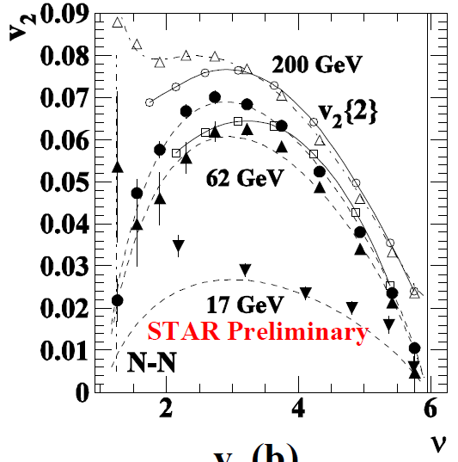
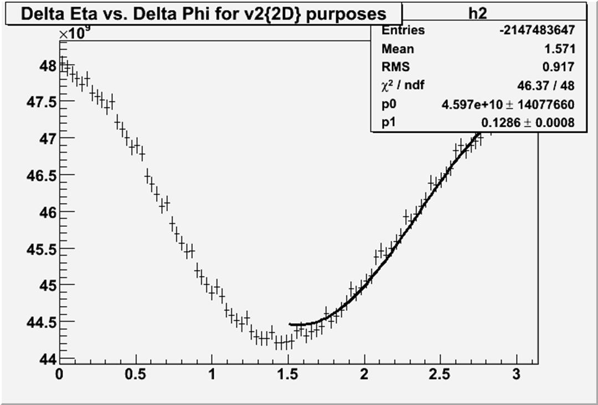
v2 systematic uncertainties

Slide 44
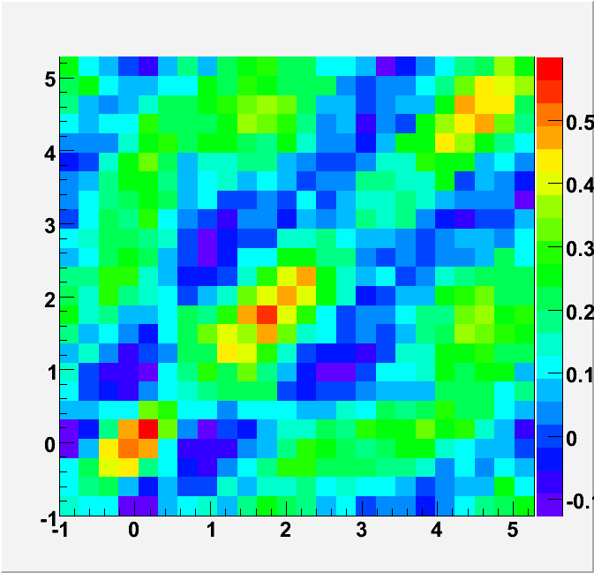
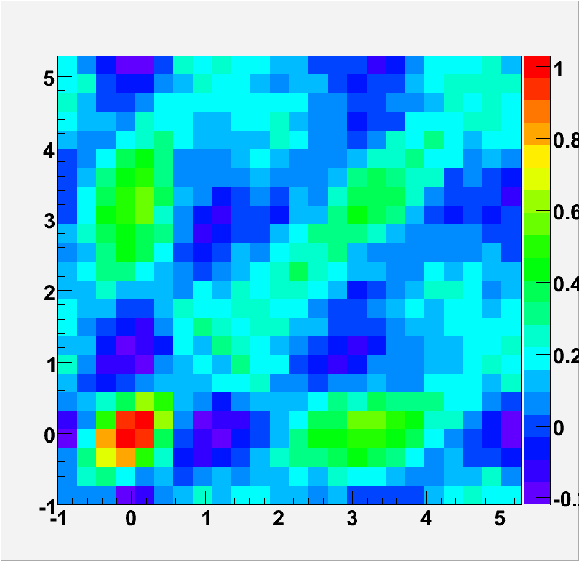







Jet-like 3-p correlation
RP-frame cumulant
Lab-frame cumulant
On-diag projection
On-diag projection
Off-diag projection
Off-diag projection

Slide 45


Slide 46
Large combinatorics
p_{T}^{trig}=3-4 GeV/c, p_{T}^{assoc}=1-2 GeV/c
trigger particle
p_{T} > 3 GeV/c
Δφ
N jet particles ~ 1, N bkgd particles ~ 20
Combinatorial pair bkgd is huge!
assoc. particle
p_{T} =1-2 GeV/c
Extremely difficult analysis.
Careful subtraction of bkgd.
Extensive assessment of systematics.

Slide 47


What’s left on the away-side?
0.2
4
second peak
0.6
3
Peak position
0.5
first peak
0.1
Peak area
0.4
2
Peak σ
φ_{s}
0
φ_{s}
π/2
φ_{s}
Differential pathlength sensitivity
Peak distance

Slide 48


STAR Preliminary
Jet σ constant with φ_{s}.
Ridge σ decreases with φ_{s}.
Cone σ increases with φ_{s}.
STAR Preliminary
Jet σ decreases with p_{T}.
Ridge σ constant with p_{T}.
Cone σ decreases with p_{T}.

Slide 49



2-particle correlation
AuAu ZDC central (0-12%) triggered data,
3<p_{T}^{Trig}<10 GeV/c, 1<p_{T}^{Asso}<3 GeV/c
Black : Raw signal
Pink : Mixed-event background
Blue : Scaled bkgd by ZYA1
Red : Raw signal – bkgd
STAR Preliminary
|Δφ|<0.7
|Δφ|<0.7
Δη acceptance corrected
Ridge

Slide 50




3-particle correlation background
-
-
correlated
Raw ⊗ Raw ➔Raw signal
Raw ⊗ Bkg ➔Hard-Soft
Bkg1 ⊗ Bkg1
Bkg1 ⊗ Bkg2
Soft-Soft

Slide 51

Jet and Ridge contributions
Netrakanti, QM’09. STAR Preliminary
AA^{like}T^{like} :
No Jet
Only Ridge
Ridge (T- A+) A+) = Ridge (T+ A+) A+)
Ridge (T+ A- ) A-) = Ridge (T- A- ) A-)
Ridge (T+ A-) A+) = Ridge (T+ A+) A+)
Ridge (T- A+ ) A-) = Ridge (T- A- ) A-)

