Slide 1
High-p_{T} triggered dihadron correlations with v_{n} background subtraction by STAR
Fuqiang Wang
Purdue University
(For the STAR Collaboration)
STAR

Slide 2
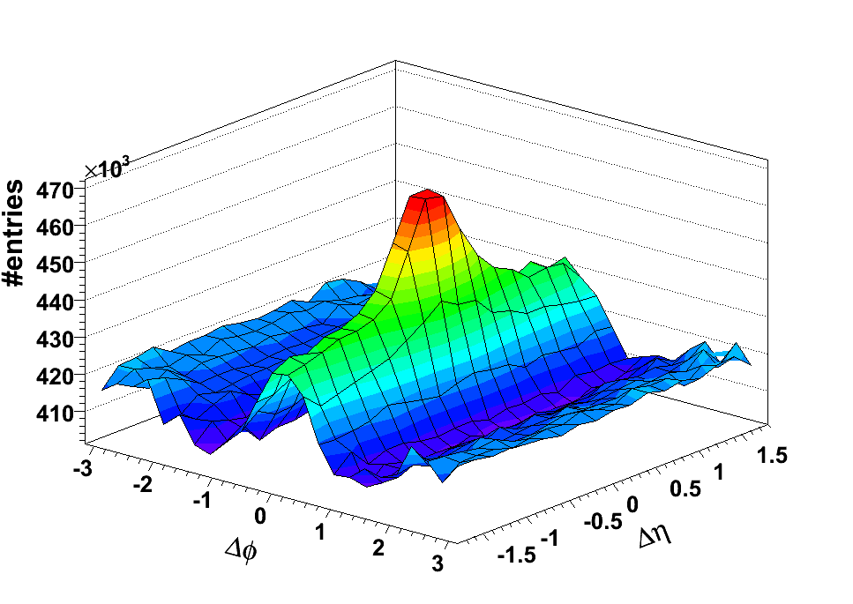
Dihadron cone and ridge correlations -- A motivation
STAR, PRC 82, 024912 (2010)
AuAu
0-12%
1/N_{trig} dN/dΔφ
3 < p_{T}^{trig} < 4 GeV/c
1 < p_{T}^{assoc} < 1.5 GeV/c
0 π Δφ
1 + 2v₂²cos(2Δφ) + 2v₃²cos(3Δφ) + 2v₄²cos(4Δφ)
neglected
Untriggered dihadron correlations: Chanaka De Silva, next talk.

Slide 3
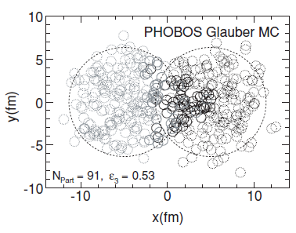
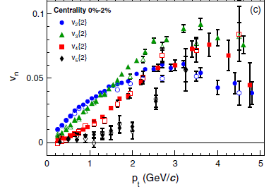
Triangular flow
Alver, Roland, PRC 81, 054905 (2010)
ALICE, PRL 107, 032301 (2011)
Initial state fluctuation; odd harmonics may not vanish.

Slide 4
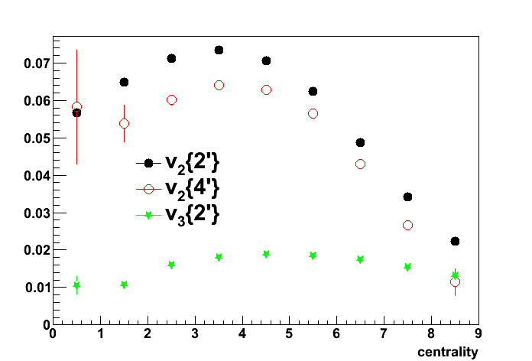
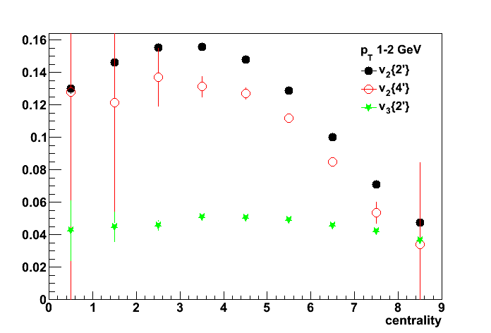
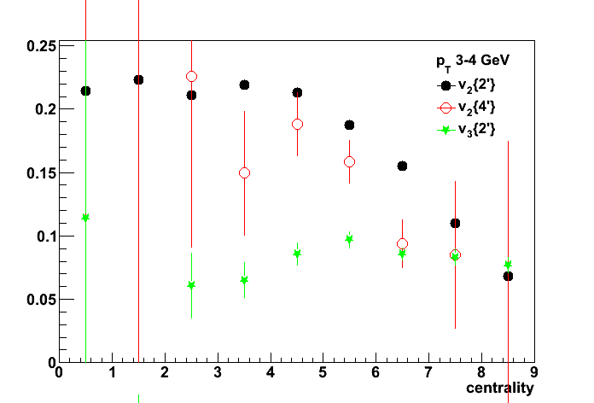
STAR v_{n}{2} measurements
Pairs between η=(-1,-0.5) and η=(+0.5,+1) to reduce nonflow. η-gap = 1.
TPC
<cos(2Δφ)> ≈
v_{n}(p_{T})*v_{n}(p_{T}^{ref}<2)
<cos(2Δφ)>≈
v_{n}²(p_{T}^{ref}<2)
TPC
p_{T}
p_{T}^{ref}
p_{T}^{ref}
p_{T}^{ref}
v_{n}(p_{T})
0.15 < p_{T}^{ref} < 2 GeV/c
Au+Au 200 GeV. Li Yi (STAR), QM’2011 poster.
p_{T}=0-2 GeV/c
p_{T}=1-2 GeV/c
p_{T}=3-4 GeV/c
v₂{2}
v₂{4}
v₃{2}
STAR Preliminary
STAR Preliminary
STAR Preliminary
Peripheral Central

Slide 5
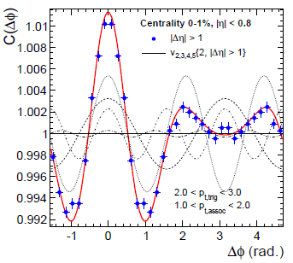
Dihadron correlation & v_{n} -- ALICE
ALICE, PRL 107 (2011)
p_{T}^{ref}=0.2-5 GeV/c
If p_{T}^{assoc}=p_{T}^{ref} , then
“flow” v_{n}(p_{T}^{trig})v_{n}(p_{T}^{assoc}) = trig-assoc dihadron correlation → signal = data – data = 0.
So, result is not surprising, or rather trivial.
v_{n}{raw} = v_{n}{flow} + v_{n}{nonflow} …BUT… v_{n}{raw} – v_{n}{raw} = 0

Slide 6
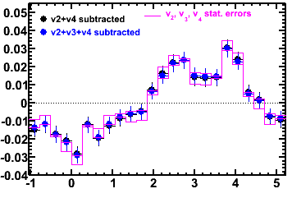
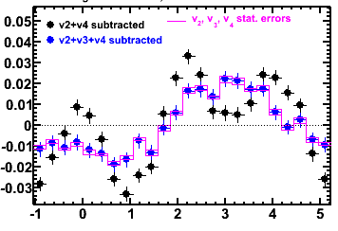
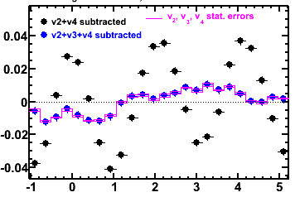
Dihadron correlation & v_{n} -- STAR
p_{T}^{trig}=3-4 GeV/c, p_{T}^{assoc}=1-2 GeV/c, large |Δη|>1
Simple background normalization: average signal = 0.
Au+Au 80-50%
Au+Au 50-20%
ZDC 12%
STAR Preliminary
STAR Preliminary
STAR Preliminary
Δφ
Δφ
Δφ
Associated p_{T} range ~ p_{T}^{ref}. Case of data-data=0: jet-correl nonflow is subtracted;
what’s left are similar between centralities, and resemble a v₁ component.
p_{T}^{ref} should stay away from trigger and assoc p_{T} as much as feasible!

Slide 7
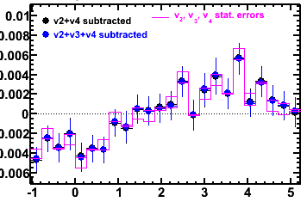
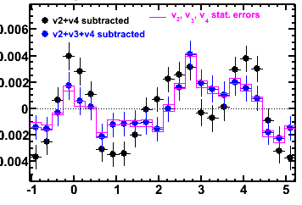
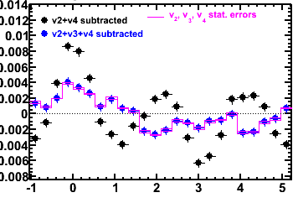
v_{n} subtracted dihadron Correlations (p_{T}^{trig}=3-6 GeV/c, p_{T}^{assoc}=2-3 GeV/c, large |Δη|>1)
Simple background normalization: average signal = 0.
50-20%
ZDC 12%
Au+Au
80-50%
STAR Preliminary
STAR Preliminary
STAR Preliminary
Δφ
Δφ
Δφ
Bkgd subtracted using two-particle v_{n}{2,p_{T}^{ref}<2GeV/c} (flow+fluctuation).
Near-side ridge in central collisions seems still visible. Ridge may be not entirely due to v_{n} .
Away-side is suppressed at high-p_{T} in central collisions. Shape modification at intermediate-low p_{T} .
Signal = v_{n}{raw} – v_{n}{raw, p_{T}^{ref}<2GeV/c}; nonflow still present in subtracted term.

Slide 8
Remarks
Jet-like correlations with p_{T}>3 GeV/c trigger particles are invariant from pp to central AA → these high p_{T} particles are mainly from jets.
High-p_{T} harmonics are due to jet-quenching (surface bias), not to hydrodynamic flow.
Any claim of hydrodynamics describing high p_{T} v_{n} is questionable.
Jet-quenching high-p_{T} v_{n} and hydro-soft v_{n} coincidence does present a background to dihadron correlations.
Most truthful background v_{n} may come from two-particle method: flow + flow fluctuation
v_{n}{4} may not be very relevant: fluctuation effect is negative; and v₃{4}~0.
v_{n} trivial from Fourier coefficient. The issue is nonflow.

Slide 9
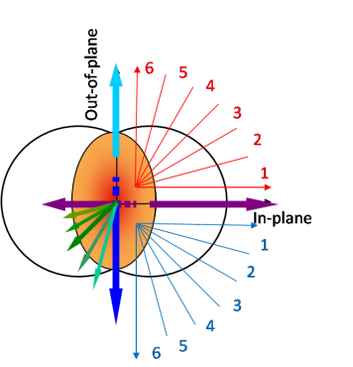
Dihadron Correlations w.r.t. EP
ZYAM background normalization
Paper results
Using FTPC v2
STAR, 1010.0690
STAR Preliminary
Using Fourier v₂{2,|Δη|>0.7}
Δφ
The above results represent the v₂{2} and v₄{ψ₂}=1.15v₂² subtracted signal.
Blue/green curves represent estimated/measured v₃{2}.

Slide 10
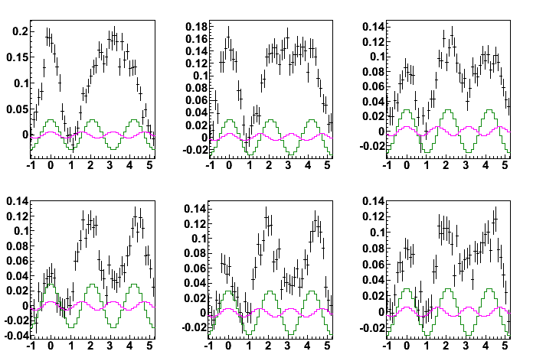
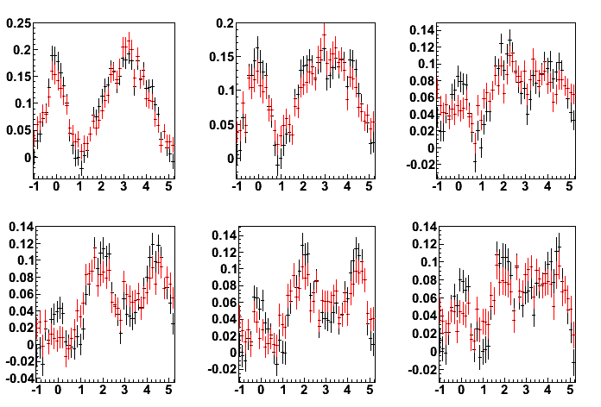
v_{n} subtr dihadron correl. w.r.t. EP
Au+Au 20-60%, p_{T}^{trig}=3-4 GeV/c, p_{T}^{assoc}=1-2 GeV/c, large |Δη|>0.7, ZYAM background.
STAR Preliminary
STAR Preliminary
1/N_{trig}dNdΔφ
Δφ
Δφ
Δφ
Black histograms: only v₂{2} and v₄{ψ₂}=1.15v₂² subtracted signal.
Green is v3{2}; Pink is remainder v₄:
Red histograms: additional v₃{2} and v₄{ψ₂-uncorr} subtracted signal.
Results qualitatively consistent; near-side ridge slightly reduced due to v_{n}.

Slide 11
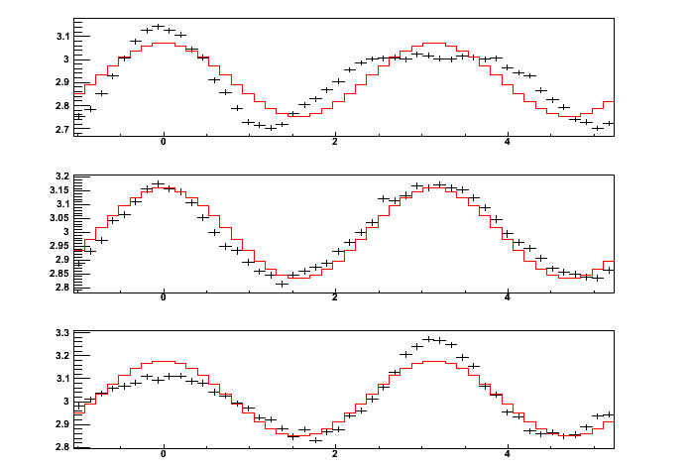
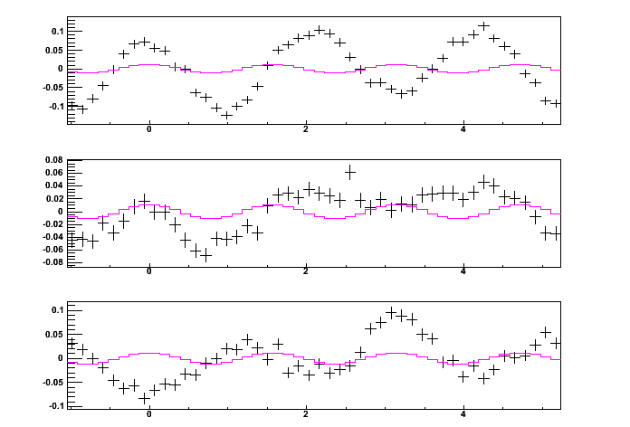
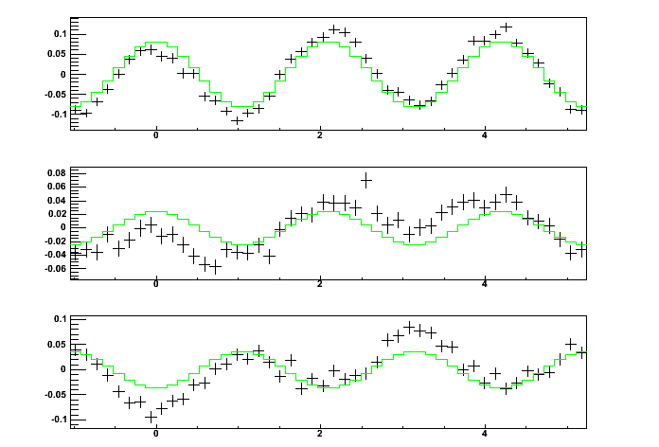
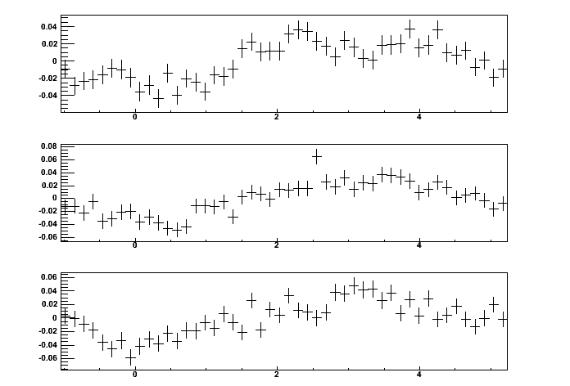
v_{n} subtracted dihadron correl. w.r.t. ψ₃
Au+Au 20-60%, p_{T}^{trig}=3-4 GeV/c, p_{T}^{assoc}=1-1.5 GeV/c, large |Δη|>0.7, Bkgd norm. by <signal>=0
In-phase
raw; v₂ bkgd
v₂ subtr; v₄ bkgd
v₂&v₄ subtr; v₃ bkgd
v₂ & v₄ & v₃ subtr.
1/N_{trig}dNdΔφ
STAR Preliminary
STAR Preliminary
Δφ
Δφ
Out-of-phase
Δφ
Δφ
v₂, v₄ are uncorrelated w.r.t. ψ₃ and do not vary with trigger angle rel. to ψ₃ .
v_{n} subtracted signal has broadened away-side in-plane than out-of-plane.

Slide 12
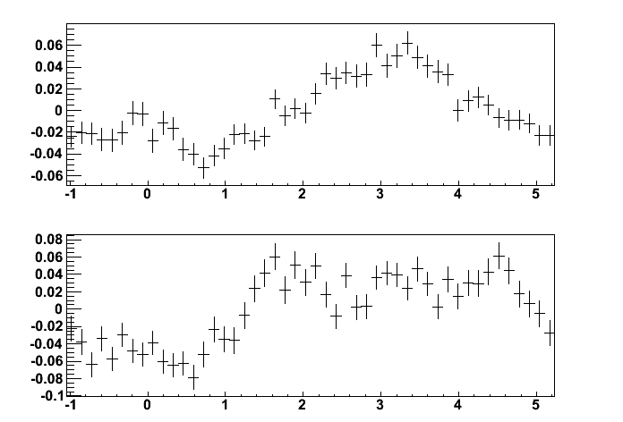
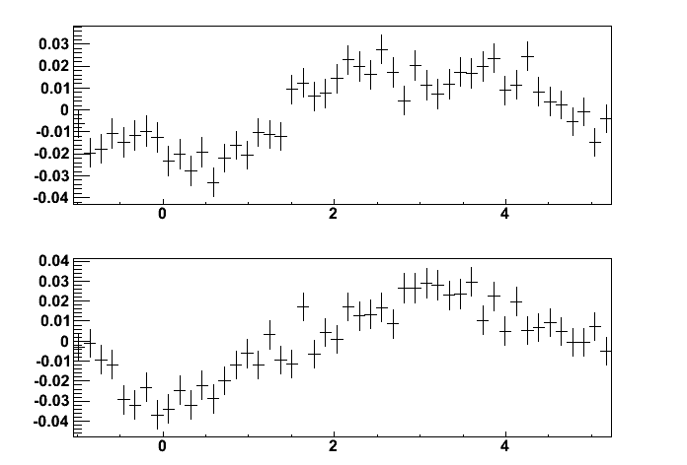
v_{n} subtr. dihadron correl. w.r.t. ψ₂ and ψ₃
Au+Au 20-60%, p_{T}^{trig}=3-4 GeV/c, p_{T}^{assoc}=1-1.5 GeV/c, large |Δη|>0.7, Bkgd norm. by <signal>=0
ψ₂ in-plane
ψ₃ in-phase
trig
trig
STAR Preliminary
STAR Preliminary
1/N_{trig}dNdΔφ
ψ₂ out-plane
ψ₃ out-phase
trig
Δφ
trig
Δφ
Broadens from in- to out-of-plane in ψ₂ while narrows in ψ₃ .
Signs of path-length dependence?

Slide 13
Summary
Fourier coefficient v_{n} is raw signal; it contains flow and nonflow.
Subtracting v_{n} from low p_{T}<2 GeV/c partner, dihadron correlation at p_{T}^{assoc}>2 GeV/c still seems to indicate a near-side ridge and a broad away-side.
Dihadron correlations w.r.t. ψ₂ and ψ₃ may indicate path-length/geometry effects.
We need to address the question of flow and nonflow in v_{n}.

Slide 14
backups

Slide 15
ψ₃ and ψ₂ are uncorrelated

Slide 16
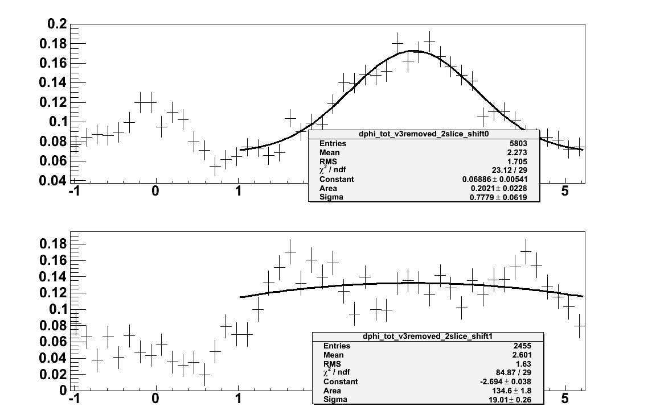
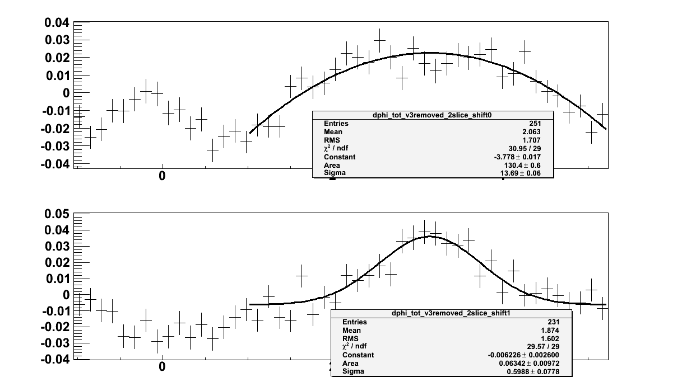
Quantify in- and out-of-plane difference

Slide 17
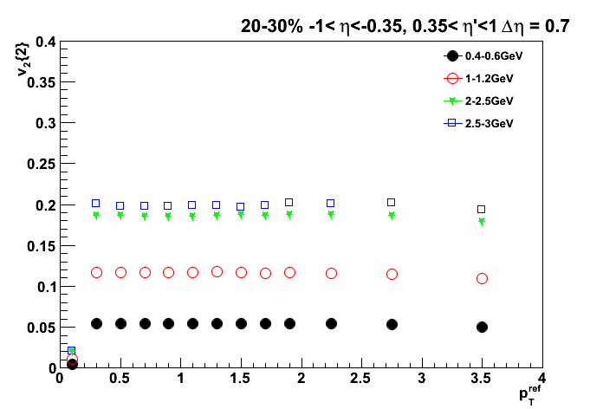
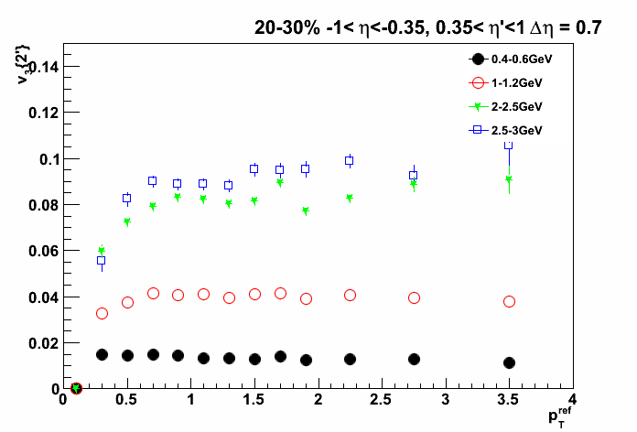
Flow show factorize

Slide 18
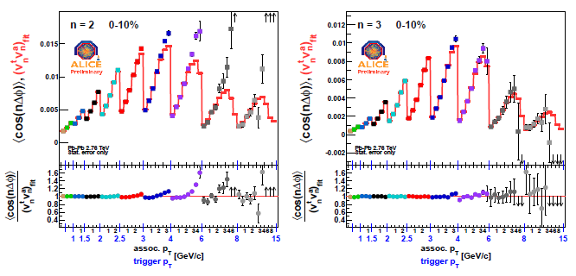
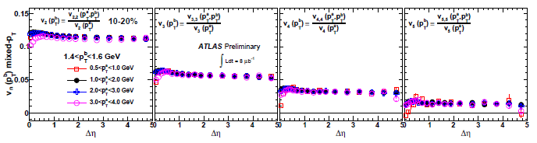
vn factorization
Adare (ALICE), 1107.0285
Jia (ATLAS), 1107.1468

Slide 19
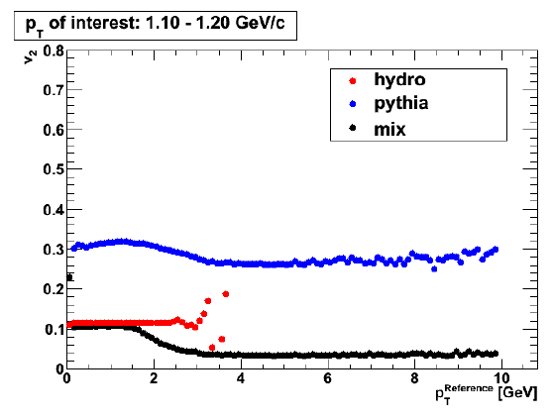
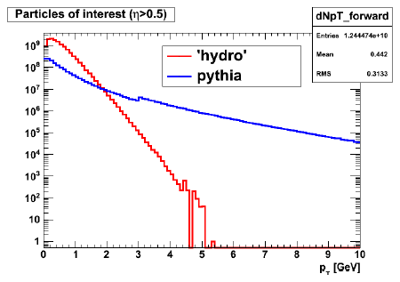
But… Nonflow seems factorize too
Daniel Kikola
Factorization does NOT necessarily mean flow.

Slide 20
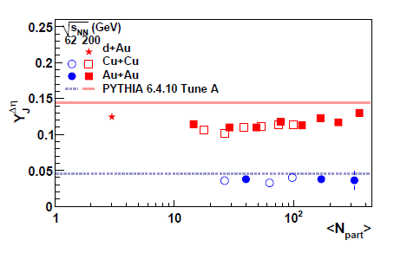
Is there nonflow?
A near-side jet is measured, invariant from pp to central AA.
Away-side jet partner initially present (pQCD).
Jet-medium interaction. Even completely dissipated, they are still nonflow (not RP), and can possibly be distinguished from flow (RP).
Trigger: 3-4 GeV/c, Associated: 1-2 GeV/c
Trigger: 3-6 GeV/c
Associated: 1.5-pt trig
Notes:
Even with trigger pt>3 GeV/c
CGC insignificant at RHIC midrapidity

Slide 21
Geometric Thoughts
Trig.
Jet
Away 1
Away 1 ?
Ridge ?
ψ₂
ψ₃
Ridge
Jet
Trig.
Away 2
Away 2 ?
Dihadron correlations w.r.t. ψ₂ and ψ₃ may show signs of pathlength dependence.

