Slide 1




Recent hard probe measurements from STAR
Fuqiang Wang
Purdue University
For the collaboration

Slide 2
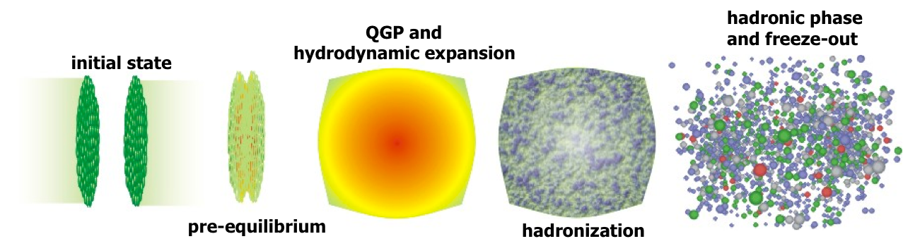
Why hard probes?
Can be reliably calculated by pQCD in pp
Interact with QGP, and interaction processes can be modeled in theory
Comparing AA to pp/pQCD leads to knowledge about the QGP

Slide 3


STAR Experiment at RHIC
EEMC
Magnet
MTD
BEMC
TPC
TOF
VPD
BBC
TPC/TOF/BEMC: |η|<1
HFT: |η|<1
MTD: |η|<0.5
HFT

Slide 4
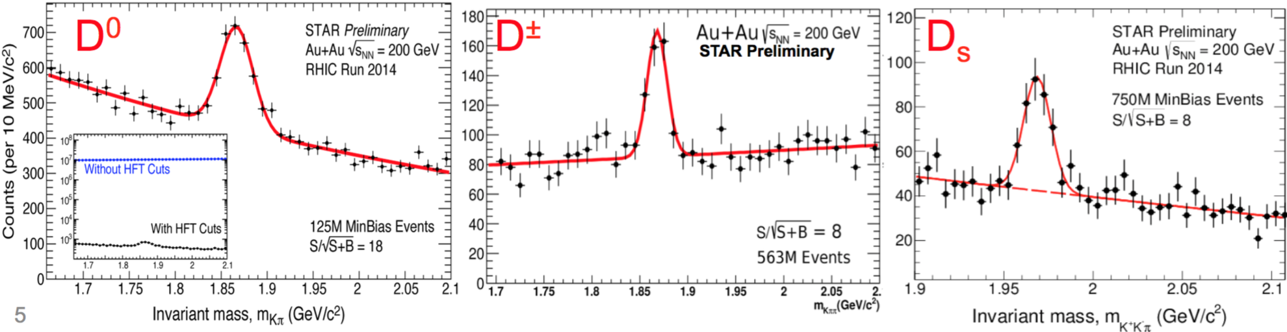
STAR Experiment at RHIC
EEMC
Magnet
MTD
BEMC
TPC
TOF
VPD
BBC
TPC/TOF/BEMC: |η|<1
HFT: |η|<1
MTD: |η|<0.5
HFT

Slide 5
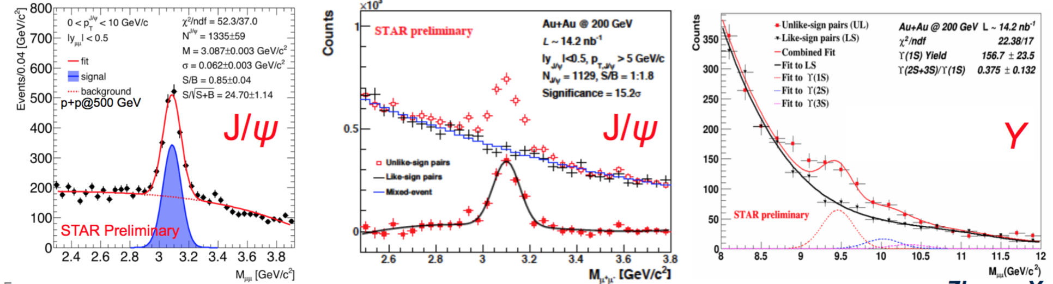
STAR Experiment at RHIC
EEMC
Magnet
MTD
BEMC
TPC
TOF
VPD
BBC
TPC/TOF/BEMC: |η|<1
HFT: |η|<1
MTD: |η|<0.5
HFT

Slide 6
Recent STAR hard probe measurements
Heavy flavor
Jet-jet imbalance
hadron-jet
γ-hadron
hadron-hadron

Slide 7
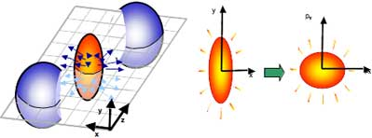
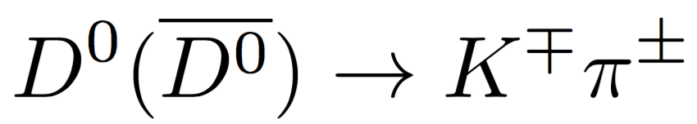
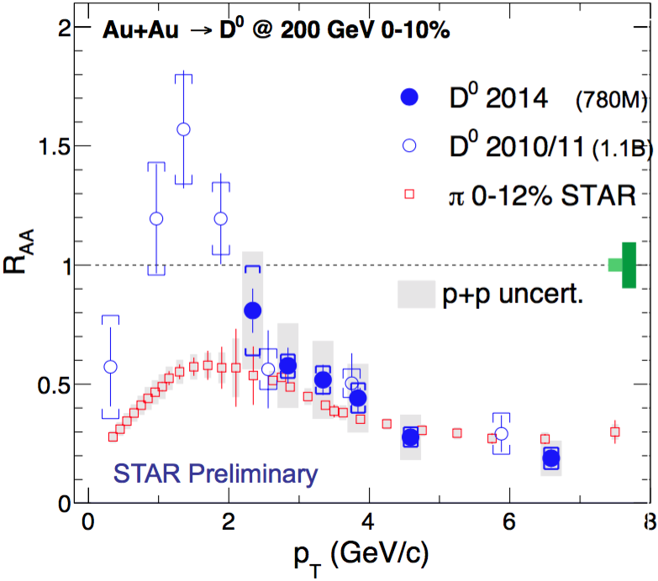
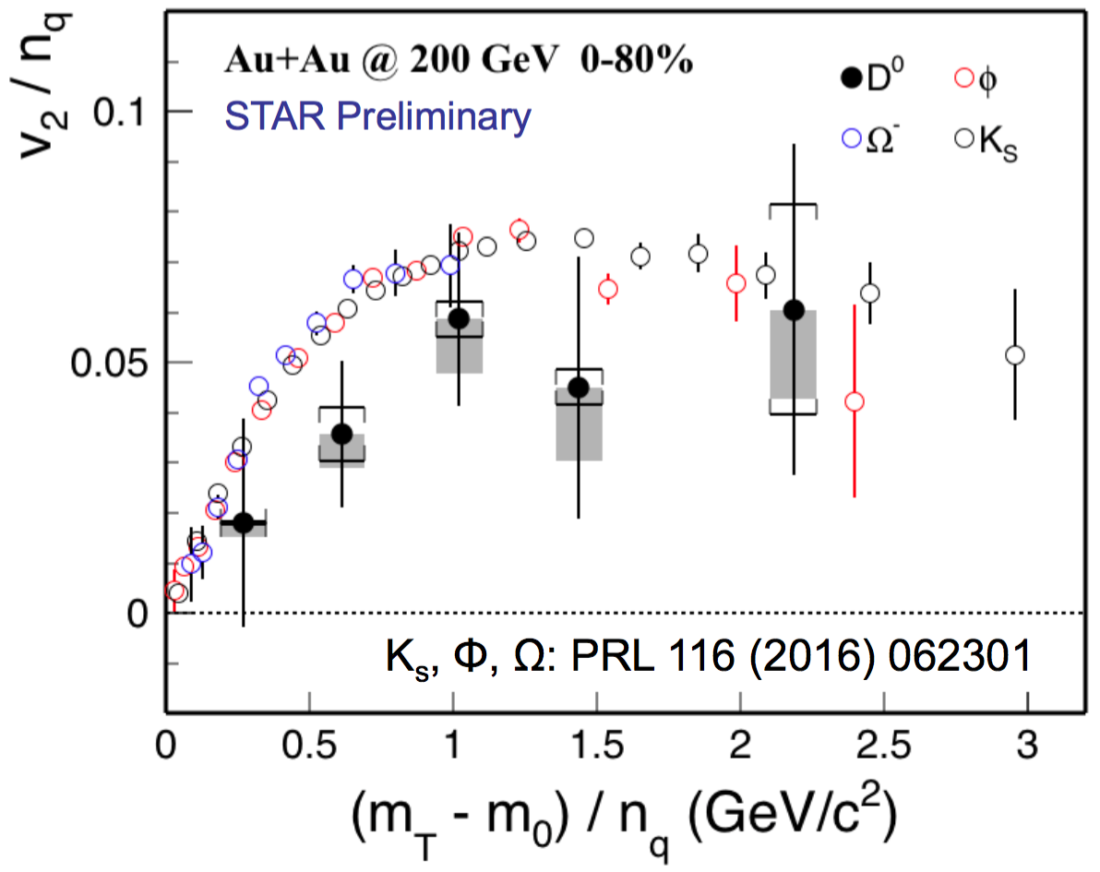

Heavy flavor
Produced early by hard scattering
Heavy, not easily thermalized
Sensitive probe to medium properties: energy loss, flow
charm-medium
interaction
charm flows.
not fully thermalized?

Slide 8
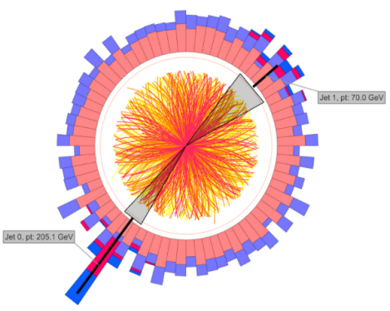
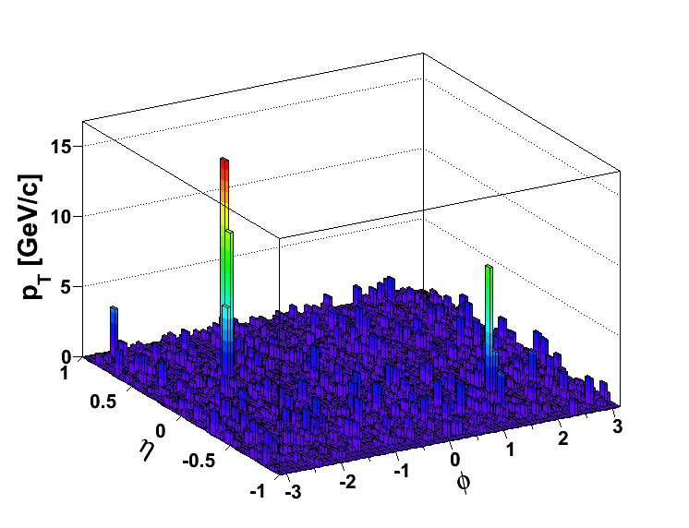
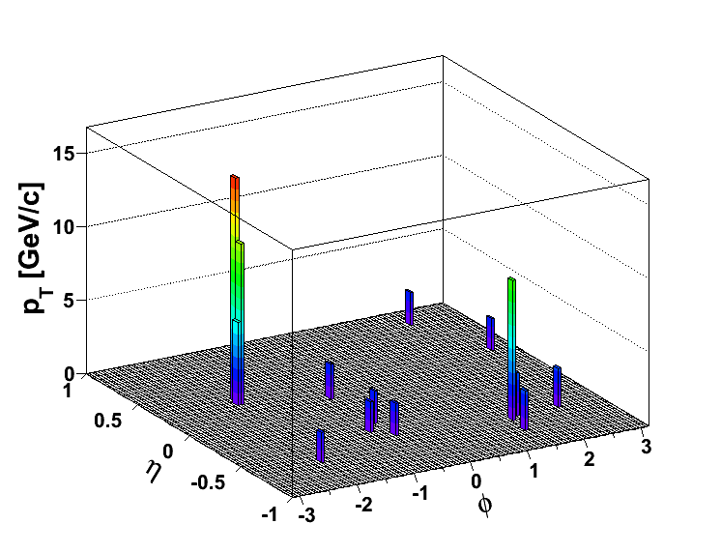
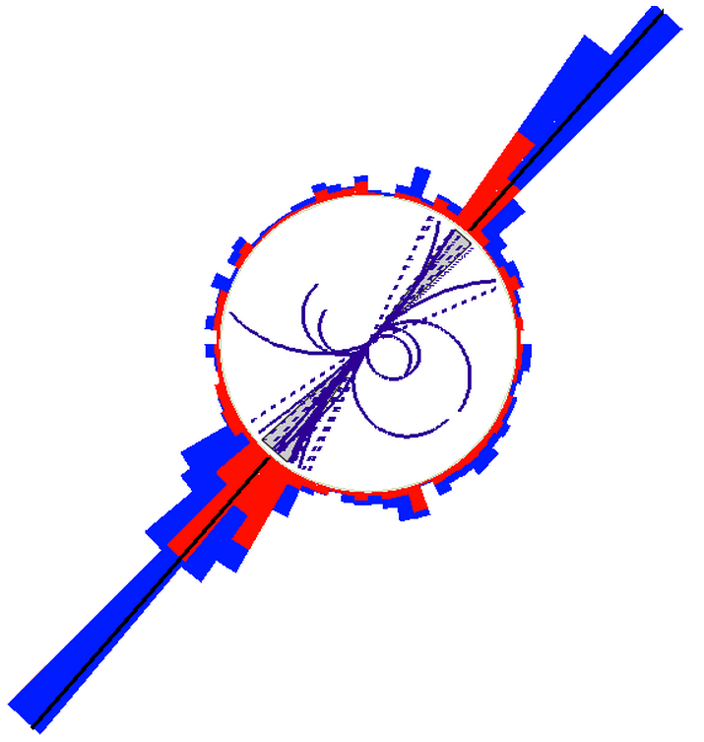
Dijet imbalance
pp
AA
Constituent pT^{Cut} = 2 GeV/c
→ Reduce BG
→ Reduce combinatorial jets
Di-jet Selection:
Jet pT^{Lead}>20 GeV/c
Jet pT^{SubLead}>10 GeV/c
|Δφ-π|<0.4
Constituent pT^{Cut} = 0.2 GeV/c
ATLAS, PRL 105, 252303
CMS, PRC 84, 024906 (2011)

Slide 9
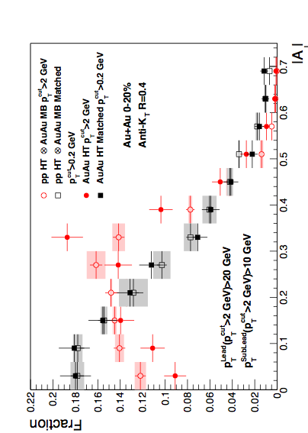
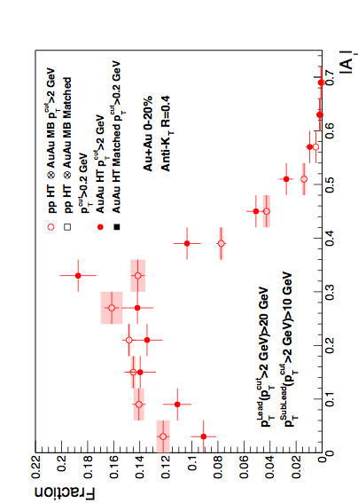
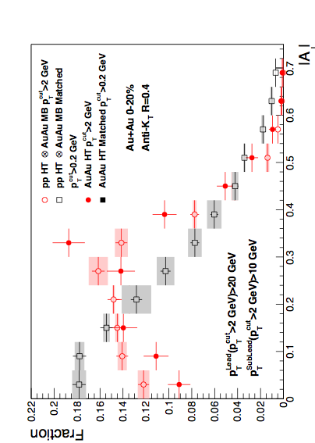
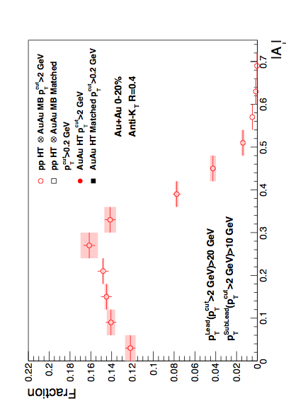

Dijet imbalance
Anti-kT R=0.4, pT^{Lead}>20 GeV & pT^{SubLead}>10 GeV with pT^{cut}>2 GeV/c
Sys. Uncertainties:
- tracking eff. 6%
- tower energy scale 2%
Event Fraction
p-value < 10⁻⁴ (stat. error only)
Central Au+Au
anti-k_{T}, R=0.4
p-value = 0.8 (stat. error only)
Preliminary
Au+Au di-jets more imbalanced than p+p for pT^{cut}>2 GeV/c
Au+Au AJ ~ p+p AJ for matched di-jets (R=0.4)
|AJ|
  “Lost” energy seems contained within R=0.4 and low p_{T}
  Imbalance remains for smaller cone or higher constituent cutoff
  → Observed Broadening and Softening jet-by-jet

Slide 10
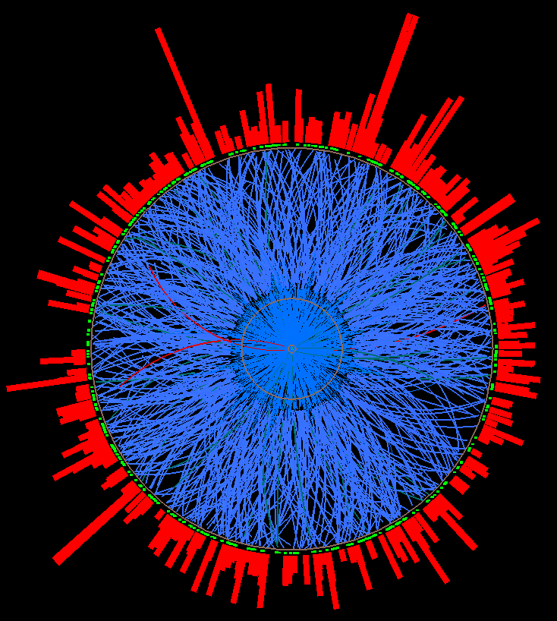
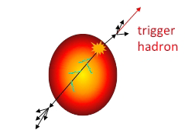
Hadron-jet correlation
Trigger-normalized yield of jets recoiling from a high p_{T} hadron trigger
Measured
Calculable in pQCD
Recoil jet
acceptance
Hadron trigger: 9<p_{T}<30 GeV/c
Charged jet reconstruction
Charged tracks: 0.2<p_{T}^{track}<30 GeV/c
Algorithm: anti-k_{T}, R=0.2, 0.3, 0.4, 0.5
Trigger
hadron
Uncorrelated background measured via mixed events (new method)
Correction for background fluctuations and instrumental effects
Expected geometric bias: surface, not tangential
Large path length for recoil
Model studies: T. Renk, PRC74, 024903; H. Zhang et al., PRL98 212301;…

Slide 11
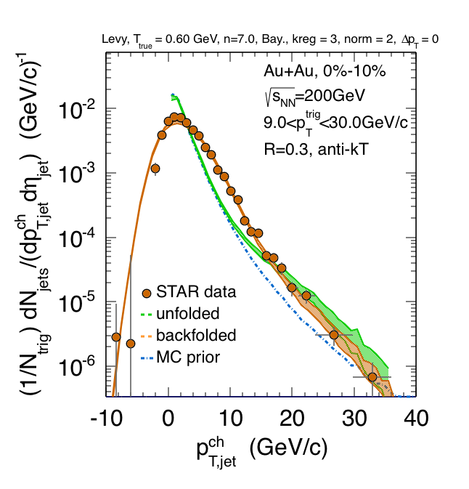
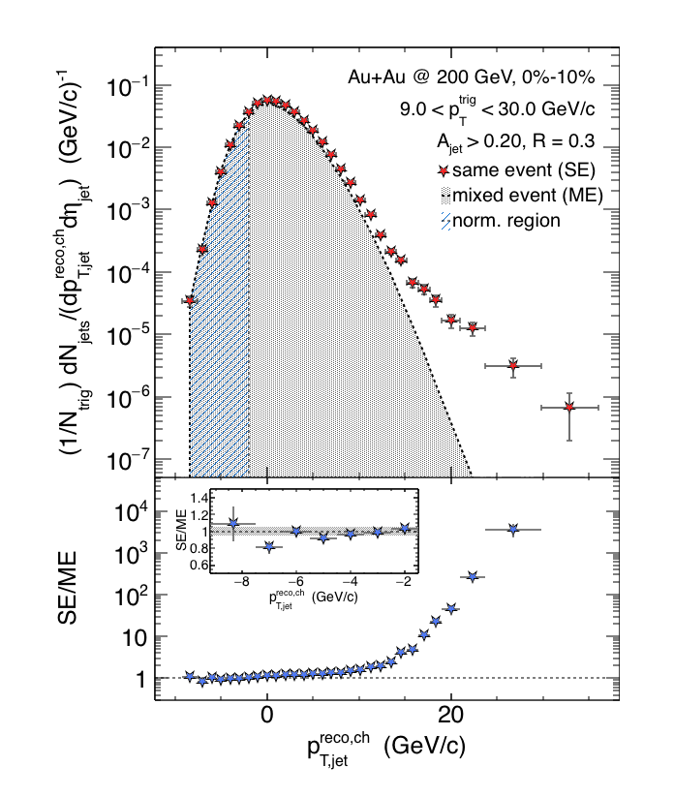
Correction of p_{T}-scale via unfolding
SE-ME
Preliminary
SE-ME
Preliminary
Mixed event distribution is good description of combinatorial jet background
Unfolding generates large off-diagonal covariance➔ corrected distribution is unbinned

Slide 12
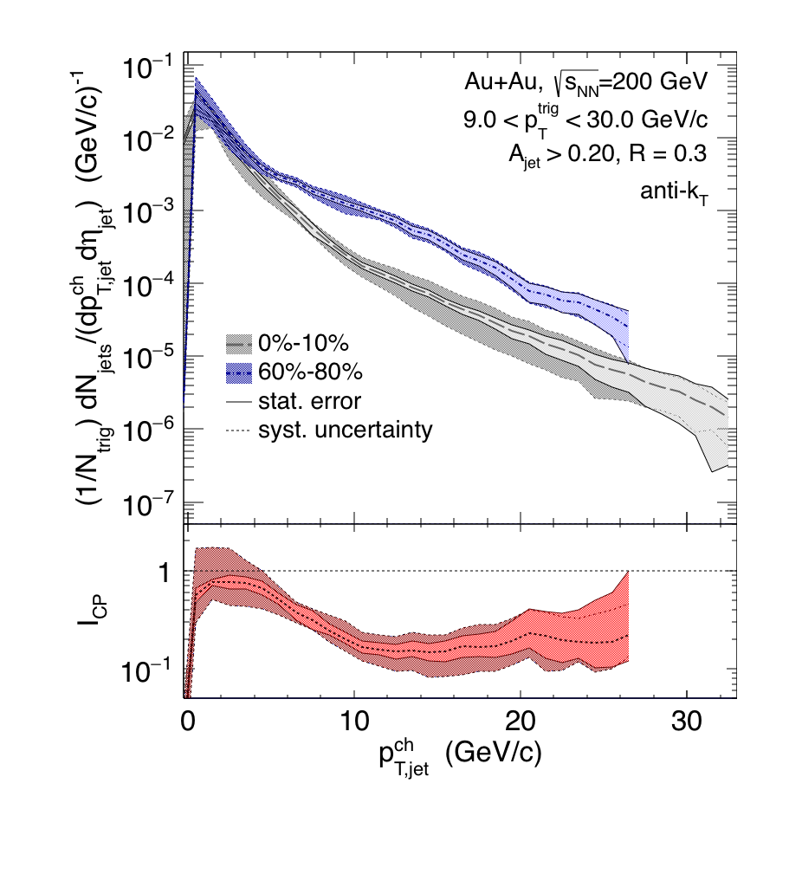
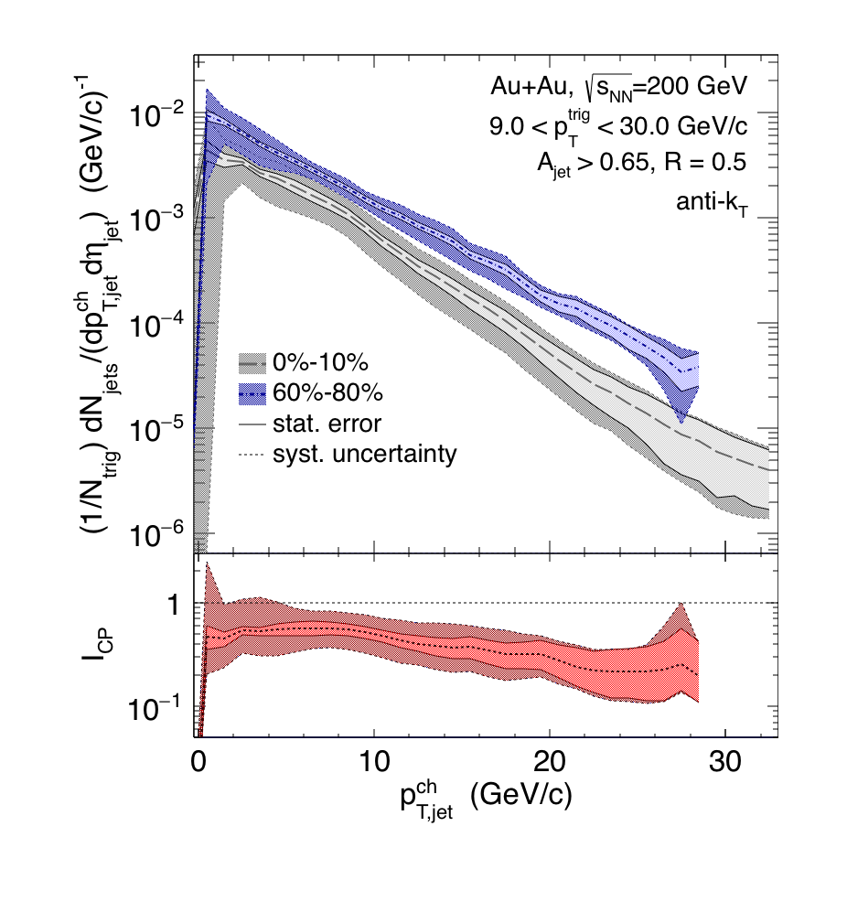
Recoil yield suppression
R=0.3
R=0.5
Preliminary
Preliminary
Spectrum Shift Periph/pp ➔Central
 | p^{ch}_{T,jet} range [GeV] | Shift R=0.3 [GeV] | Shift R=0.5 [GeV]
Au+Au @ 200 GeV | [10,20] | -6.3 ± 0.6 ± 0.8 | -3.8 ± 0.5 ± 1.8
Pb+Pb @ 2.76 TeV ALICE arXiv:1506.03984 | [60,100] |  | -8 ± 2
RHIC: smaller shift for larger R
R=0.5: smaller shift at RHIC than LHC
Out-of-cone energy transport?
comparison requires similar trigger bias ➔ theory calculation

Slide 13
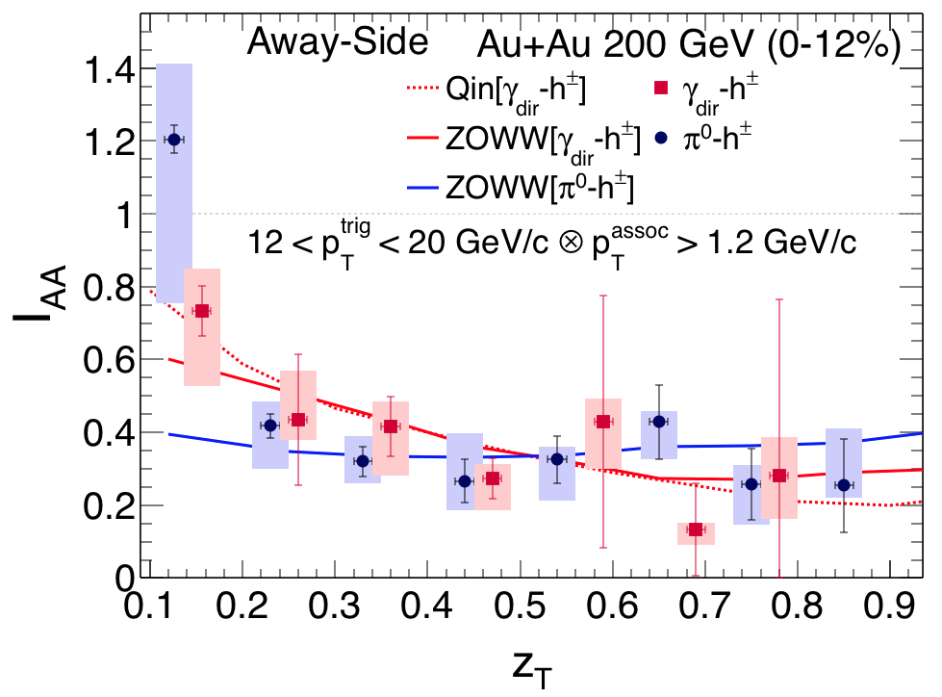
γ-hadron/jet
≈ recoil parton energy
STAR, arXiv:1604.01117
γ (Ε_{initial})
H. Zhang et al.
mostly quark jets
π⁰
surface biased
more medium
= p_{T} / E_{γ}
Suppression: hadron triggers ≈ photon triggers
Suppression less significant at low z_{T}, low p_{T}^{assoc}
Expected differences smaller than current uncertainties
mostly gluon jets

Slide 14
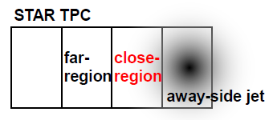
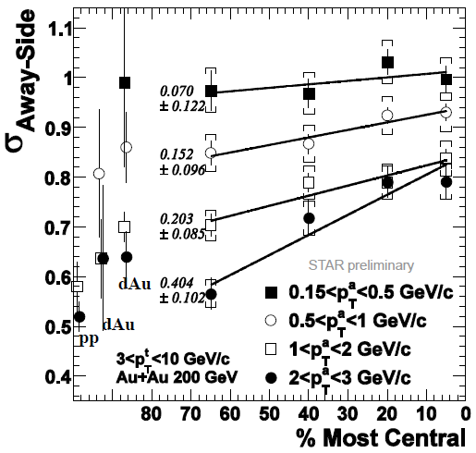
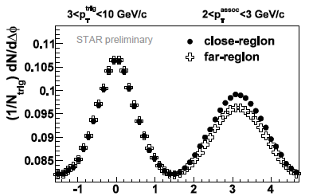
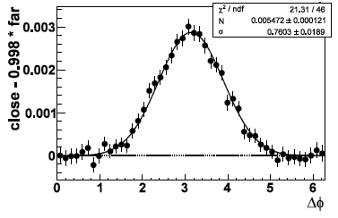
Hadron-hadron correlation
η
STAR Preliminary
Broadens with centrality
Medium effect and/or nuclear k_{T}
Novel subtraction of flow background

Slide 15
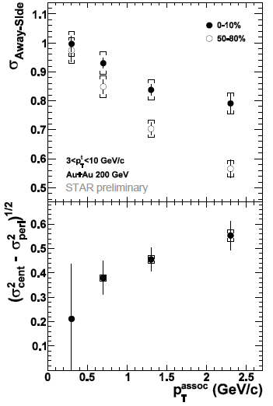
Medium broadening
(σ²_{cent}-σ²_{peri})^{1/2} is not a constant suggests that nuclear k_{T} is not the only source for the observed broadening
The relative effect of medium induced jet broadening is stronger for higher pT associated particles
Need theory/model comparisons

Slide 16
Summary
Wealth of hard probes data from STAR
Heavy quarks flow. Better precision measurement to follow.
The medium is opaque to hard probes
Quantitative knowledge about condensed matter QCD needs more exp.+theory work

