Slide 1



Probing the Spin Structure of the Proton at STAR
Justin Stevens
for the Collaboration

Slide 2
Parton Distributions in Nucleons
Parton Distribution Function: Probability density for finding a parton with flavor f and momentum fraction x in a nucleon
Helicity Distribution: Probability density for finding a longitudinally polarized parton in a longitudinally polarized nucleon
Transversity Distribution: Probability density for finding a transversely polarized parton in a transversely polarized nucleon
At LEADING TWIST in a COLLINEAR FRAMEWORK these functions form a complete description of partonic kinematics
2

Slide 3
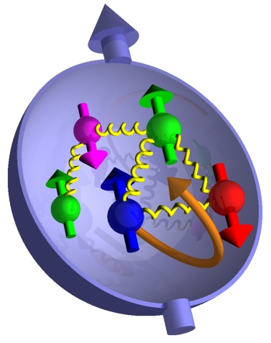
Proton Spin Puzzle
The observed spin of the proton can be decomposed into contributions from the intrinsic quark and gluon spin and orbital angular momentum
Integral of quark polarization is well measured in DIS to be only ~30%, but decomposition (especially sea) is not well understood
Helicity Distribution: Δq, Δg
Not well constrained by DIS and a primary focus of the RHIC spin program
Parton orbital angular momentum: Some sensitivity through Sivers mechanism from correlation of proton spin and parton orbital motion
Transversity Distribution: δq
Chiral-odd property of the proton, which completes the description of quark distributions at leading twist
3

Slide 4
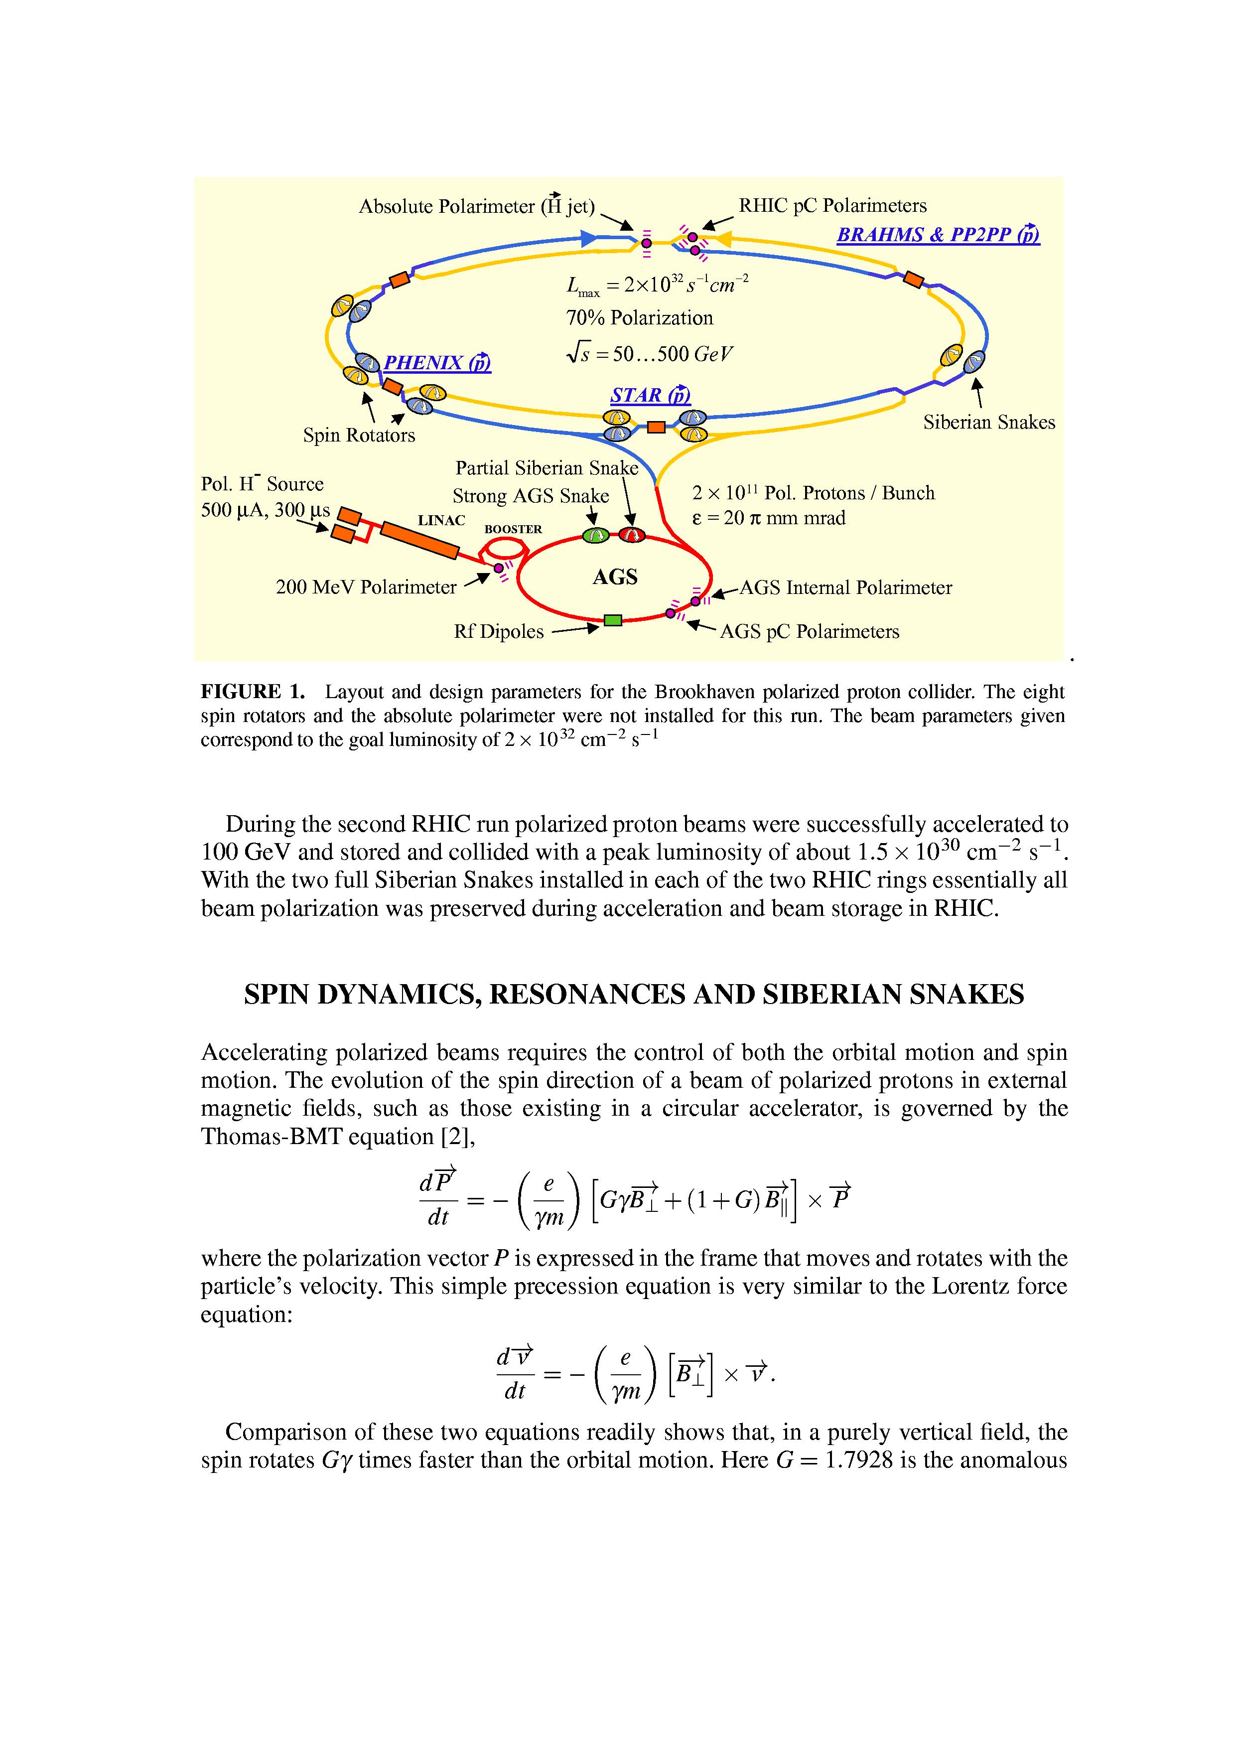
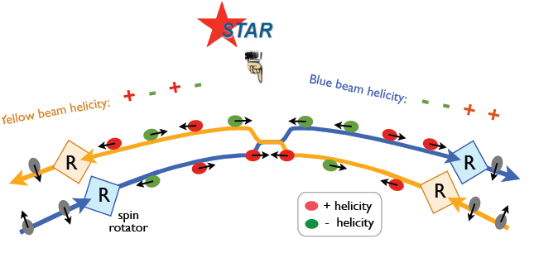
RHIC - First Polarized pp Collider
Spin Rotators at IR’s: transverse and longitudinal spin orientation possible
CNI polarimeters + H-Jet target: measure polarization
√s=200 GeV
  2006: P=58%, 2009: P=56%
√s=500 GeV
  2009: P=40%, 2011: P=50%
AGS Helical Partial Snake
4
Notes:
Pp2pp now in star (diffractive physics with roman pots…)

Slide 5
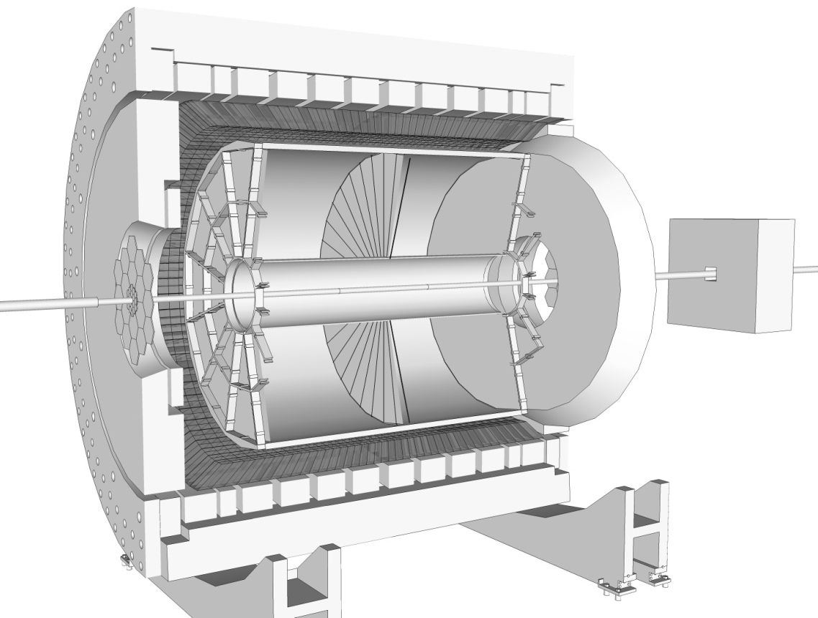
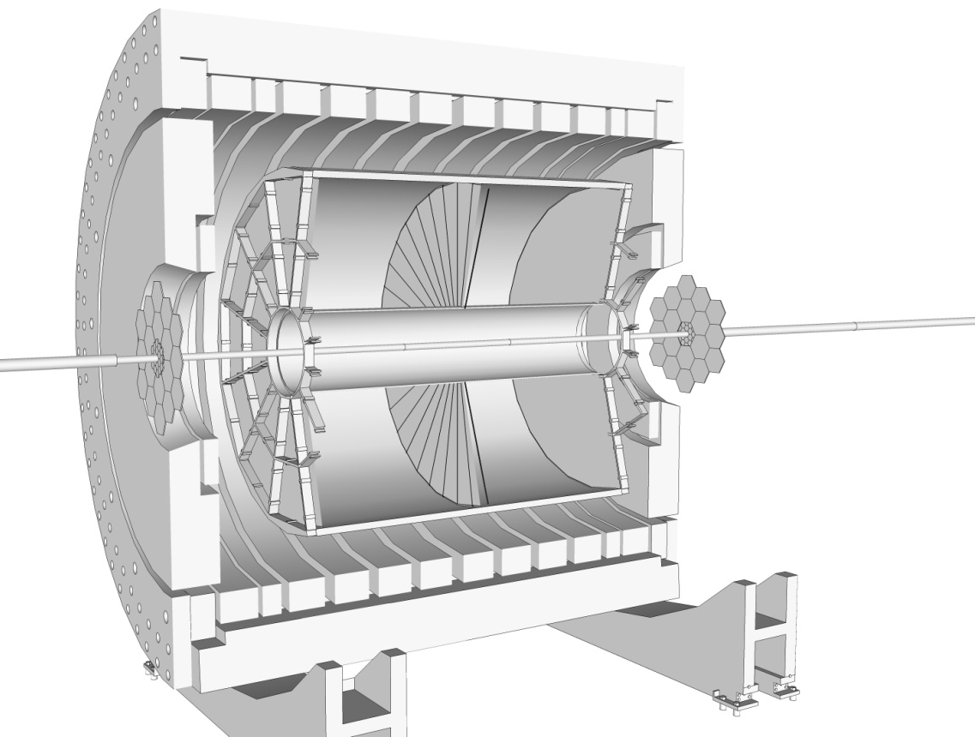
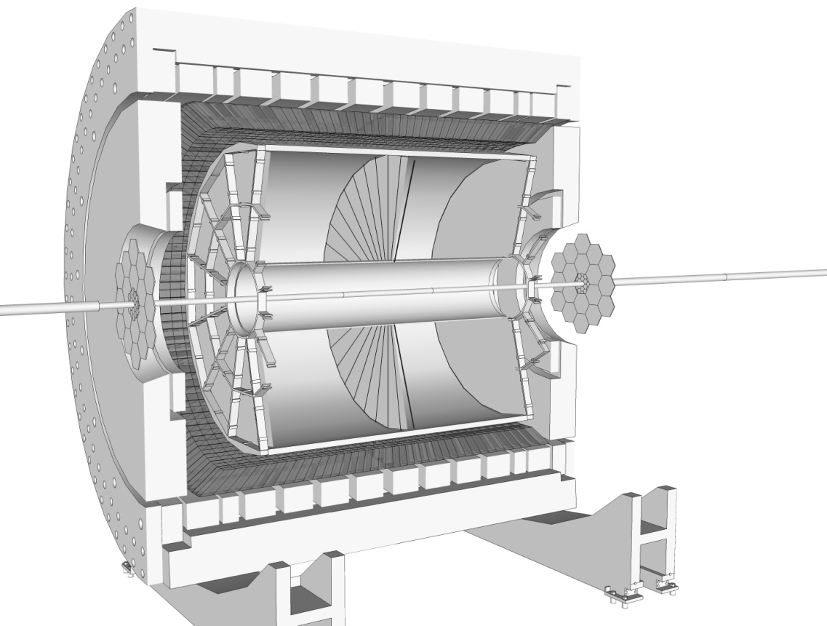
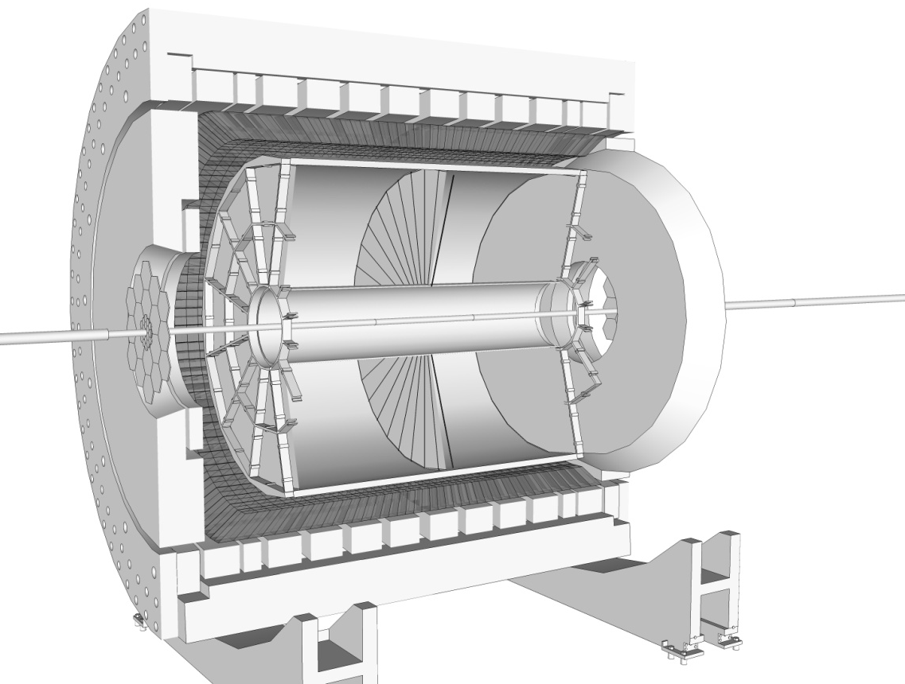
Detector Overview
0.5T Solenoidal Magnet
Triggering Endcap EM Calorimeter (EEMC):
1.1 < η < 2
Time Projection Chamber (TPC):
Charged particle tracking |η| < 1.3
Beam-Beam Counter (BBC):
Luminosity Monitor
Froward Rapidity EM Calorimeter(s):
FPD/FMS
2.5 < η < 4
Triggering Barrel EM Calorimeter (BEMC): |η| < 1
5

Slide 6
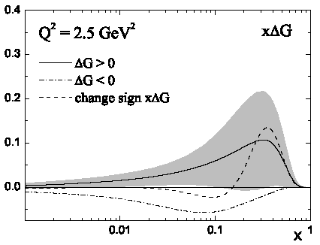
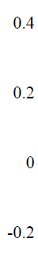
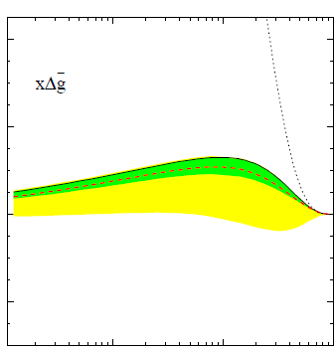
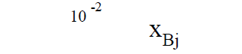
State of ΔG: “Pre-RHIC”
Three 2006 fits of equal quality:
  ΔG = 0.13 ± 0.16
  ΔG ~ 0.006
  ΔG = -0.20 ± 0.41
  all at Q² = 1 GeV²
  Leader et al, PRD 75, 074027
Not well constrained by polarized DIS+SIDIS data
A primary focus of the RHIC longitudinal spin program is mapping Δg(x)
de Florian et. al. PRD 71, 094018
6
Notes:
DIS constraints from evolution of g1

Slide 7



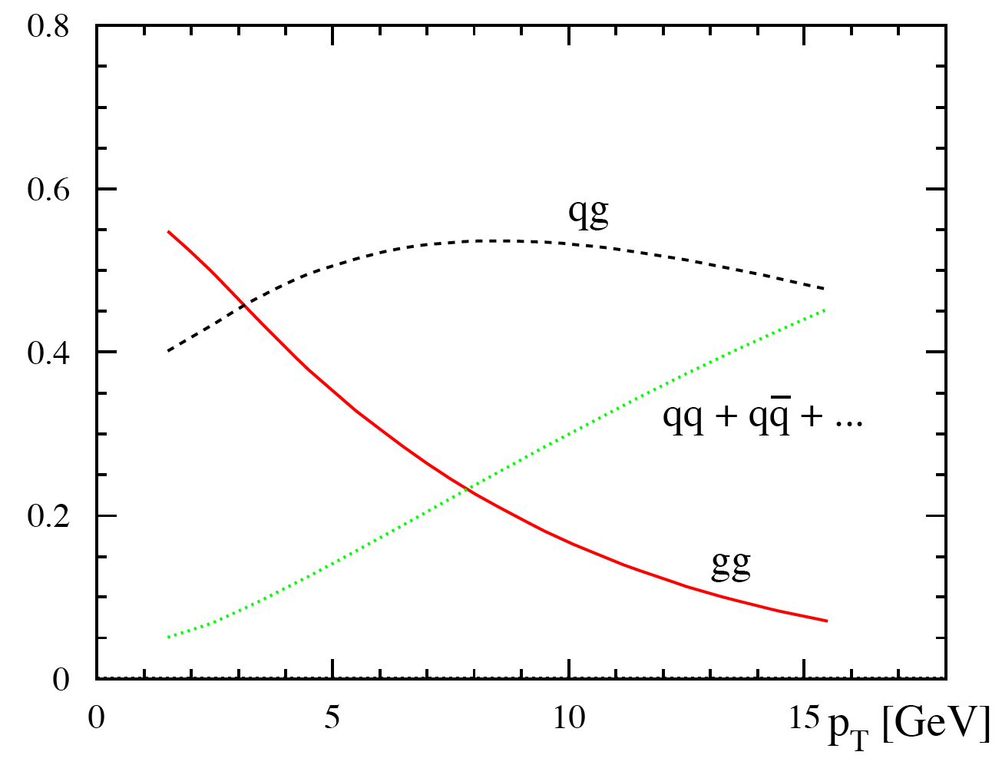
Studying Gluon Polarization at RHIC
Partonic fractions in jet production at 200 GeV
0
10
20
30 pT(GeV)
7
Notes:
For most RHIC kinematics, gg and qg dominate, making A_{LL} for inclusive jets sensitive to gluon polarization.
a_{LL} is partonic asymmetry calculable in pQCD

Slide 8

Reconstructing Jets at STAR
Data Jets
MC Jets
The large acceptance of the STAR detector makes it well suited for jet measurements:
TPC provides excellent charged-particle tracking and p_{T} information over broad range in η
Extensive EM calorimetry over full 2π in azimuth and for -1 < η < 2
Sophisticated multi-level trigger on EMC information at tower and patch scale
Use midpoint cone algorithm
Detector
GEANT
Particle
PYTHIA
8
Notes:
Add note on mid-point cone algo…

Slide 9
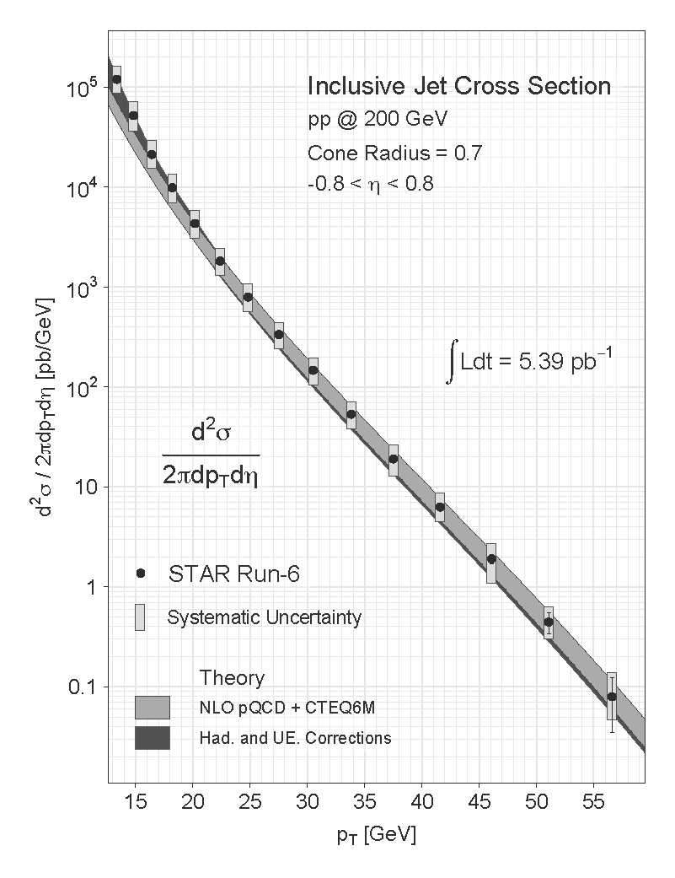
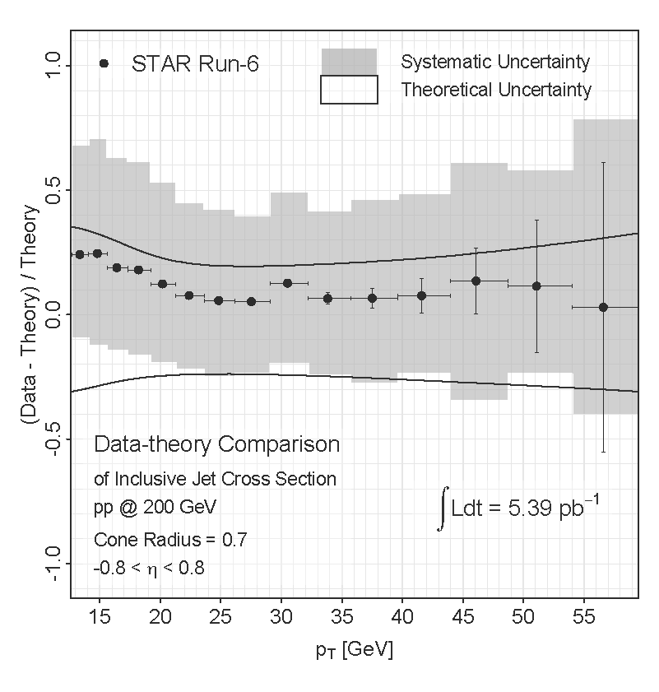

Inclusive Jet Cross Section
p_{T} [GeV/c]
p_{T} [GeV/c]
Data well described by NLO pQCD when including hadronization and underlying event corrections from PYTHIA
Hadronization and UE corrections more significant at low jet p_{T}
9

Slide 10
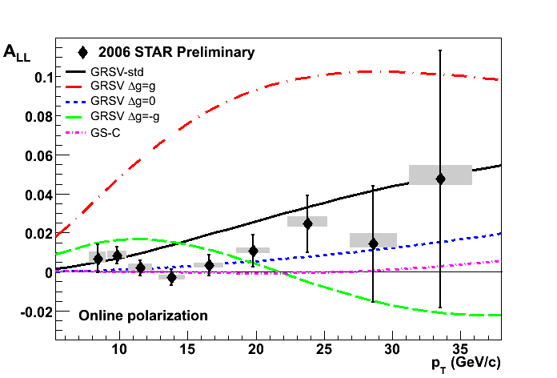
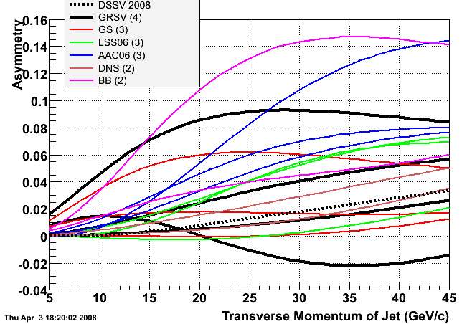
2006 Inclusive Jet A_{LL}
STAR inclusive jet A_{LL} excludes those scenarios that have a large gluon polarization within the accessible x region
10

Slide 11
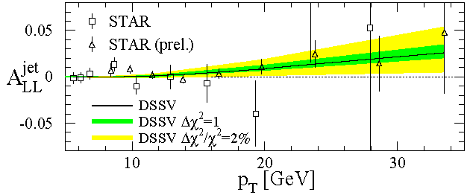
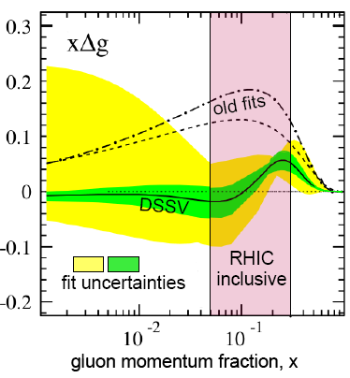
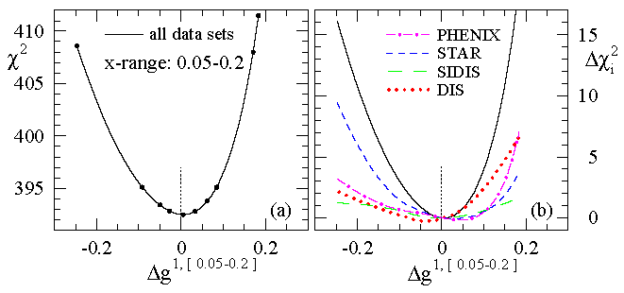
DSSV Global Fit
STAR
de Florian et al., PRL 101, 072001 (2008)
First global NLO analysis which includes DIS, SIDIS, and RHIC pp data
Strong constraint on Δg in the range 0.05 < x < 0.2
Low x range still poorly constrained
11
Notes:
Do you need animations???

Slide 12
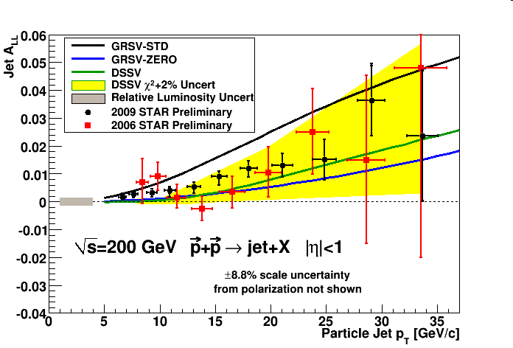
2009 Inclusive Jet A_{LL}
2009 results are a factor of 3 or greater more precise than 2006
Data falls between predictions from DSSV and GRSV-STD
12

Slide 13
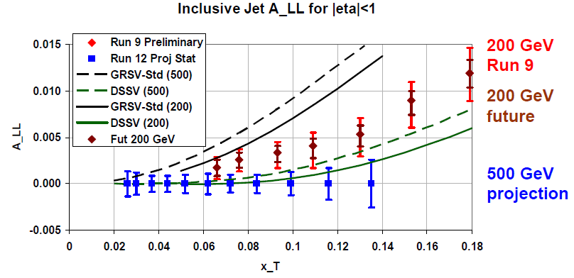
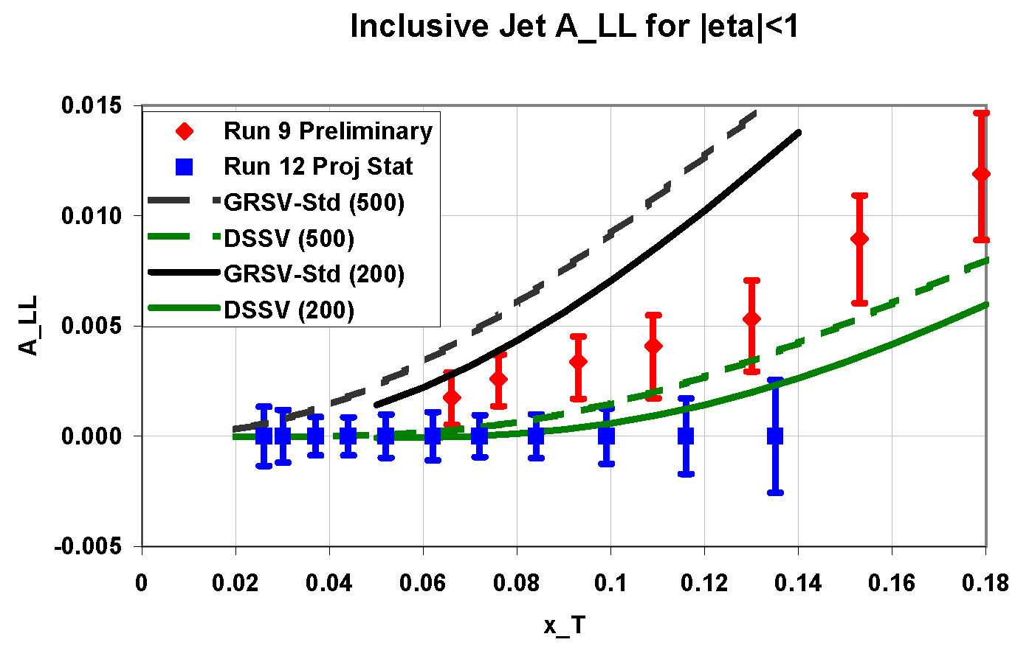
Expected Future Inclusive Jet Sensitivity
Projected Stat Uncertainty: 50% Pol 190 pb⁻¹
Plan to measure inclusive jet A_{LL} in 500 GeV collisions during 2012 and 2013 RHIC runs
  Sensitive to smaller x_{g} at higher beam energy
  Smaller asymmetries expected, so control of systematics important
Future running at 200 GeV expected to significantly reduce uncertainties relative to 2009 data as well
13
Notes:
500 GeV 190 pb-1 (Run 12 and 13)
200 GeV 40? pb-1 (Run 13)

Slide 14
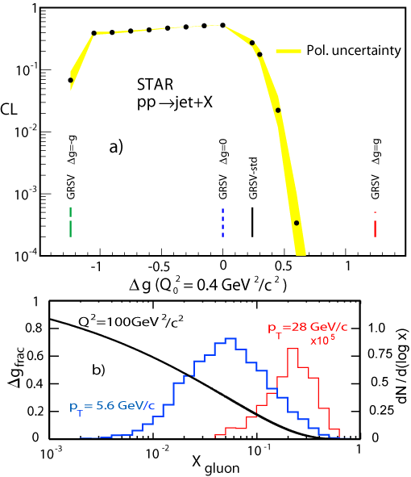
Correlation Measurements: ΔG
Inclusive A_{LL} measurements at fixed p_{T} average over a broad range of x_{gluon}
Reconstructing correlated probes (eg. di-jet, γ-jet) provides information on initial state partonic kinematics at LO
This allows for constraints on the shape of Δg(x)
14

Slide 15
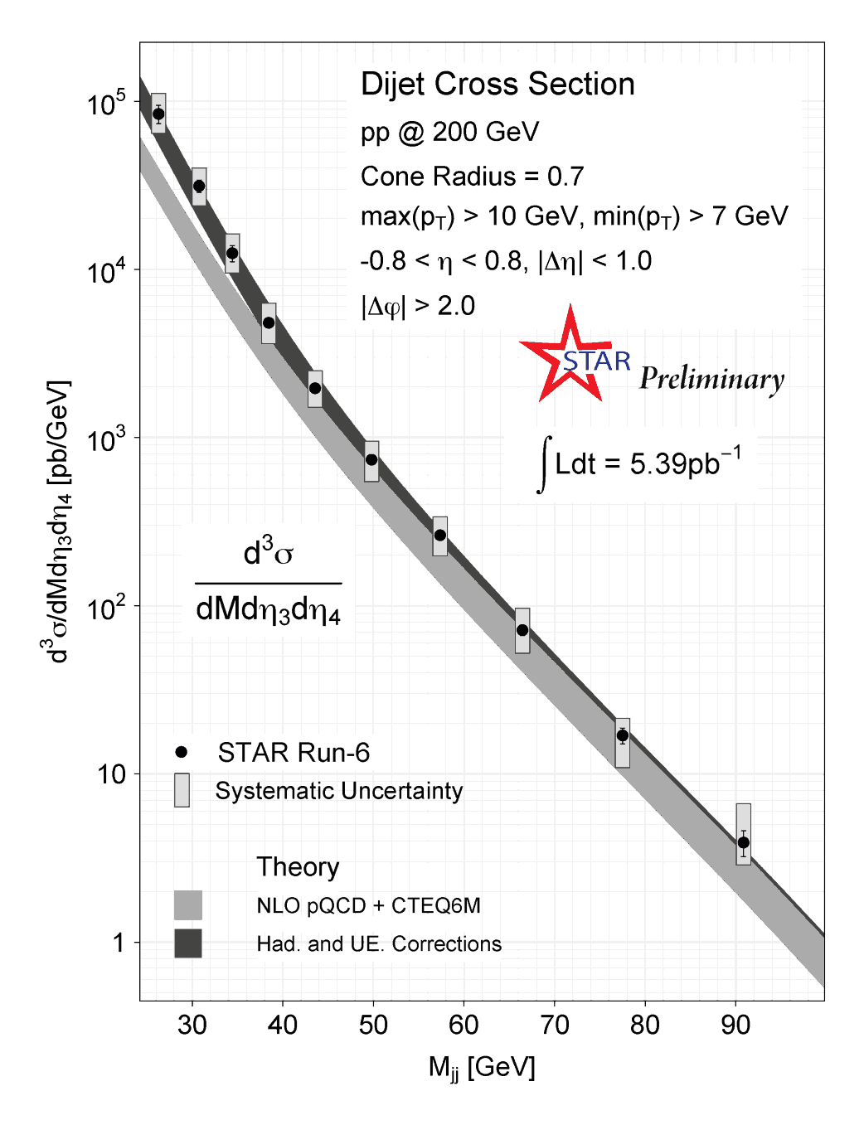
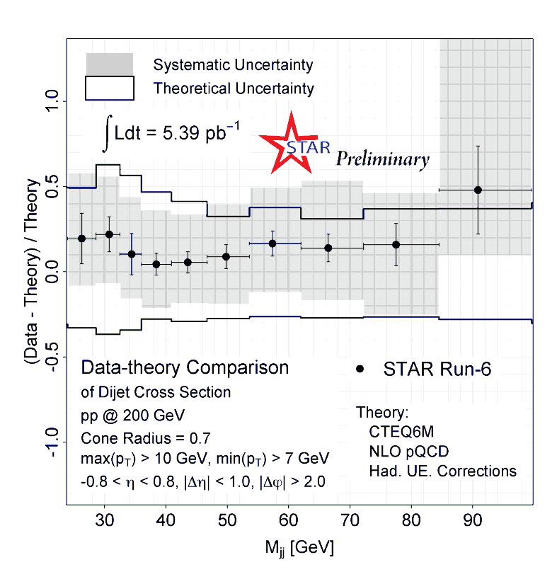
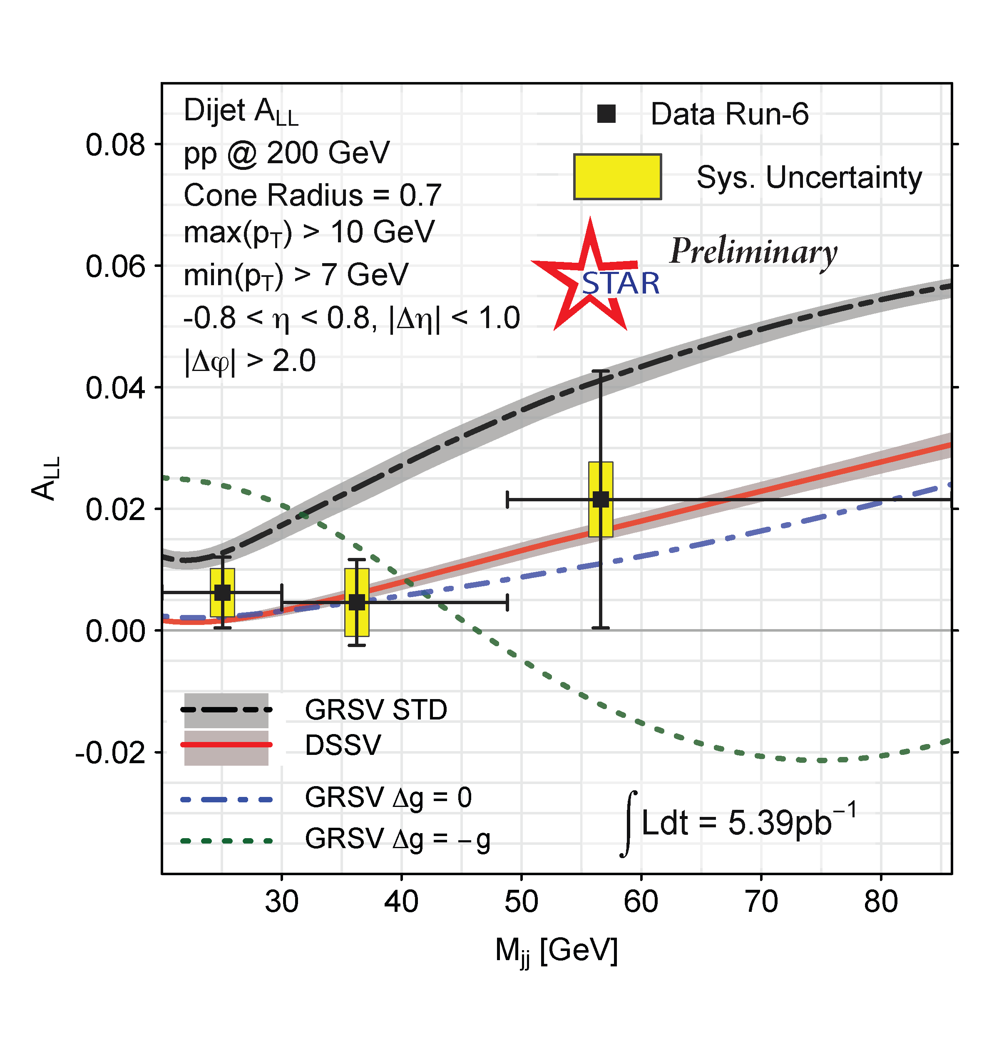
First Dijet Results
Data well described by NLO pQCD when including hadronization and underlying event corrections from PYTHIA
As with inclusive cross section, UE and hadronization corrections become more important at low invariant mass
15

Slide 16
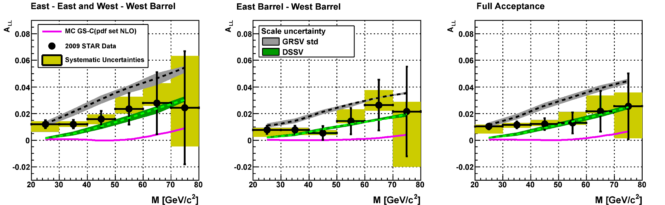
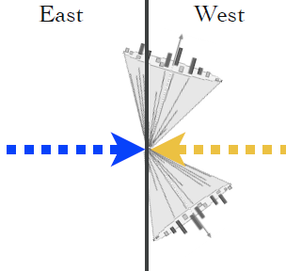

2009 Dijet A_{LL}
2009 data roughly a factor of 3 more precise than 2006 data
Different dijet topologies sensitive to different x ranges
Data fall between DSSV and GRSV-STD
16

Slide 17
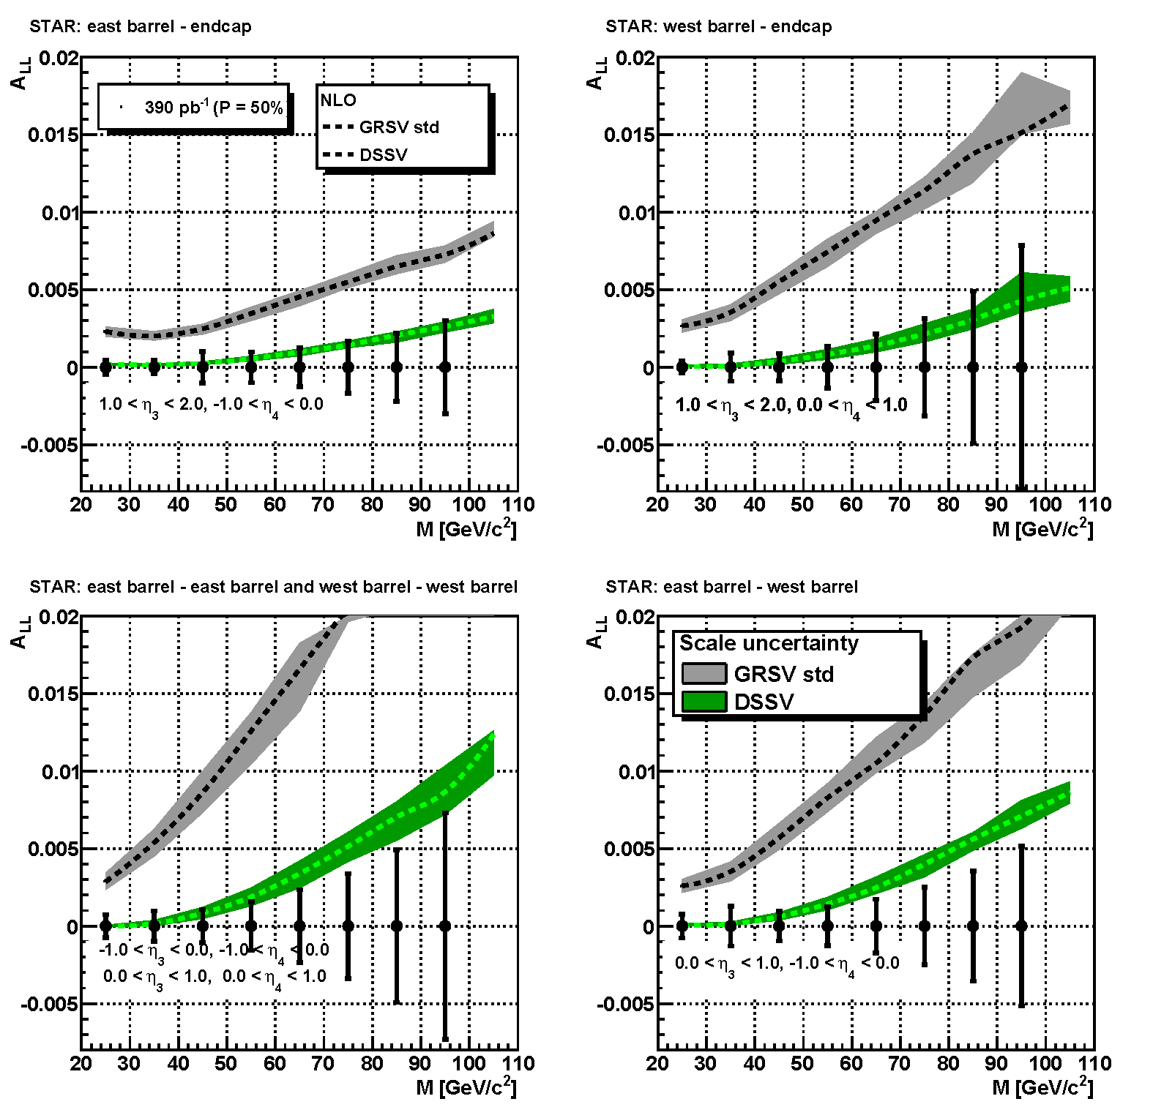
Projected Di-jet Sensitivity @ 500 GeV
Projected Stat. Uncertainty: 50% Pol 390 pb⁻¹
Higher energies give access to lower x_{g}
Expect A_{LL} to be smaller than 200 GeV
Projections shown are purely statistical
Forward jets in EEMC region sensitive to even lower x_{g}
M_{jj} [GeV]
M_{jj} [GeV]
M_{jj} [GeV]
M_{jj} [GeV]
17
Notes:
Assumes 600 pb⁻¹ delivered (390 pb⁻¹ sampled) @ P = 50%

Slide 18
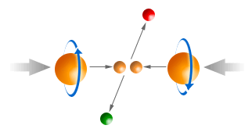
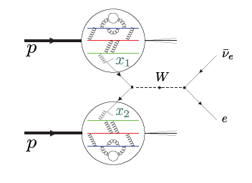
Sea Quark Polarization
18

Slide 19
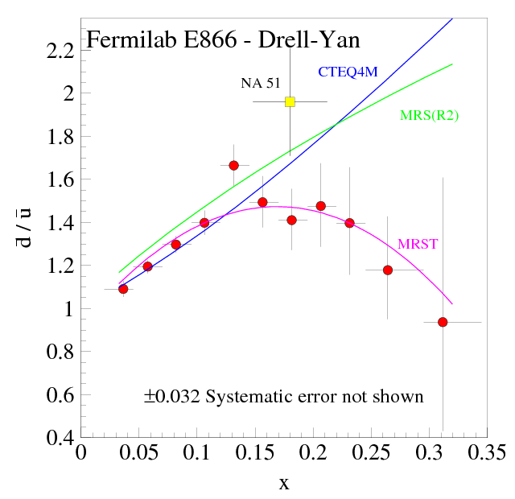
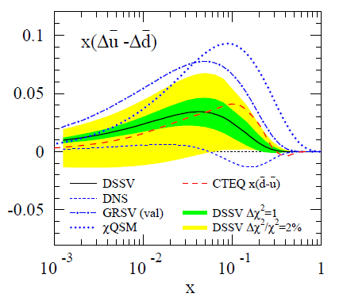
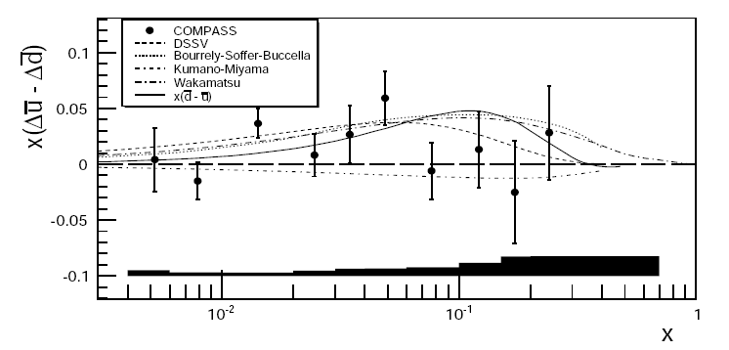
Flavor Asymmetry of the Sea
Upolarized Flavor asymmetry:
Quantitative calculation of Pauli blocking does not explain ratio
Non-perturbative processes may be needed in generating the sea
E866 results are qualitatively consistent with pion cloud models, chiral quark soliton models, instanton models, etc.
PRL 80, 3715 (1998)
Q²=54GeV
arxiv1007.4061
Polarized flavor asymmetry:
Valence u and d distributions are well determined
Polarized flavor asymmetry could help differentiate models
19

Slide 20
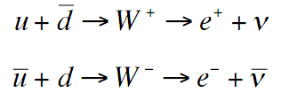
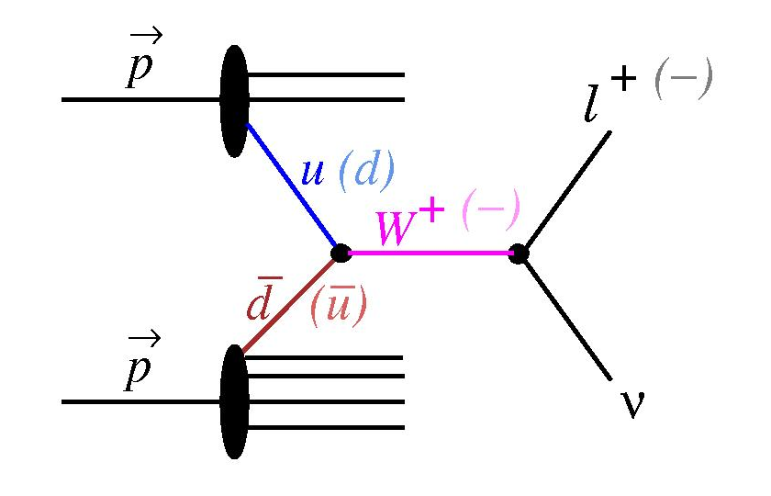
Probing the Sea Through W Production
Detect Ws through e⁺/e⁻ decay channels
V-A coupling leads to perfect spin separation
  LH quarks and RH anti-quarks
Neutrino helicity gives preferred direction in decay
Measure parity-violating single-spin asymmetry:
(Helicity flip in one beam while averaging over the other)
20

Slide 21
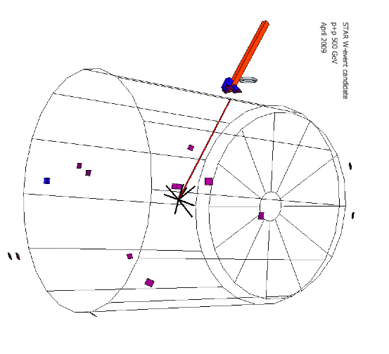
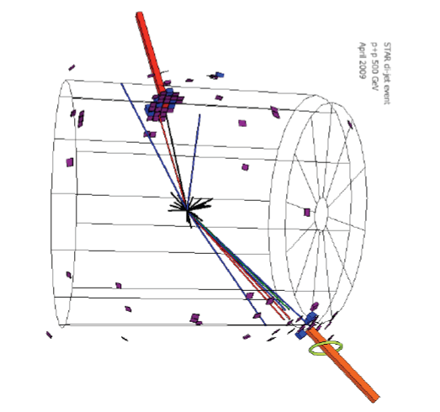
W → e + ν Candidate Event
Isolated track pointing to isolated EM deposit in calorimeter
Large “missing energy” opposite electron candidate
Di-jet Background Event
Several tracks pointing to EM deposit in calorimeter spread over a few towers
Vector pt sum is balanced by opposite jet, “missing energy” is small
21

Slide 22
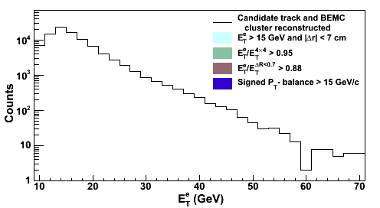
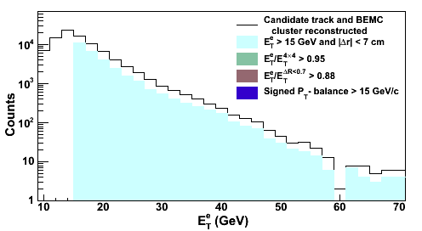
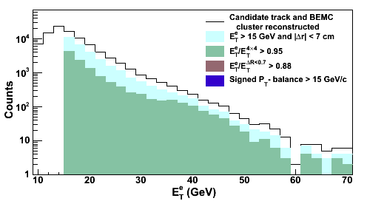
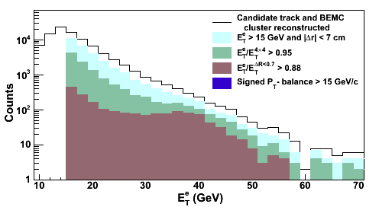
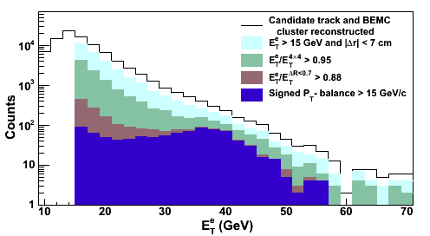
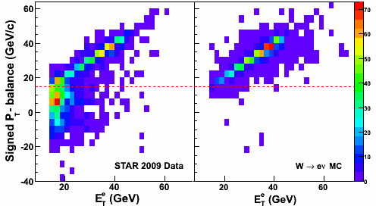
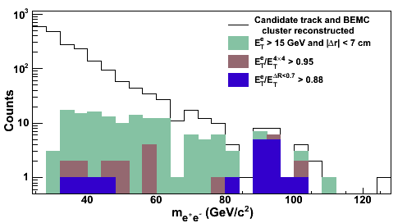
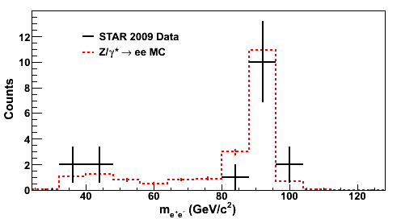
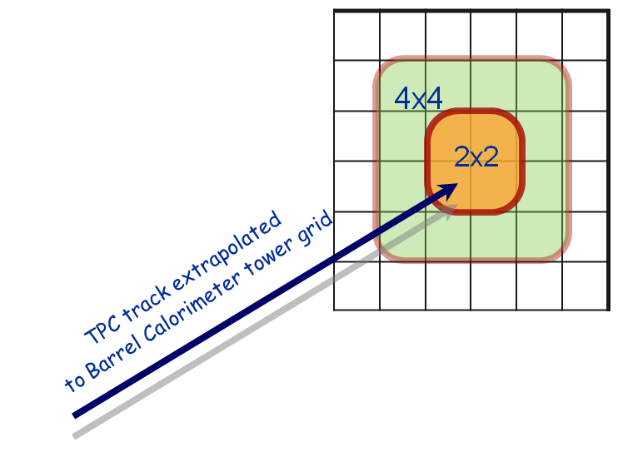
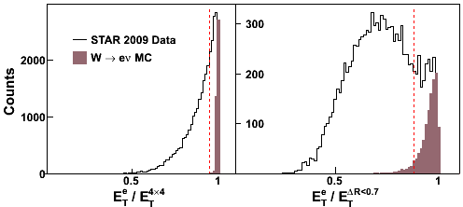
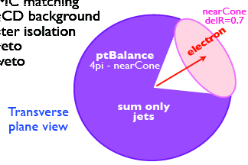
W/Z Algorithm Description
Match high pT track to BEMC cluster
Isolation Ratios
Signed-Pt Balance
22
Notes:
Suppress jets with leading hadron
Near side jet-cone veto
Suppress di-jets and multi-jet events
Require an imbalance in p_{T} of the lepton cluster and any jets reconstructed outside the near side jet cone

Slide 23
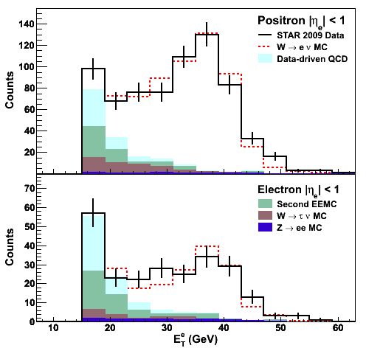

Background Estimation
Sources:
EWK: W -> τ , Z -> e+e-
QCD: Data-driven
Good Data/MC agreement
23

Slide 24

Measured Cross Sections
Reconstruction efficiency determined from MC
Acceptance from NLO calculation with PDF uncertainty folded in
Good agreement between experiment and theory over wide kinematic range
Validates the use of an NLO theory framework to extract helicity distributions from the spin asymmetry A_{L}
arXiv:1112.2980
24

Slide 25

W Cross Section Ratio: R_{W}
Ratio of W+ to W- cross sections sensitive to unpolarized sea quark flavor asymmetry
Complementary to fixed-target DY and LHC collider measurements
arXiv:1112.2980
PRL 80, 3715 (1998)
25

Slide 26




STAR W A_{L}
STAR Run 9 Result
PRL 106, 062002 (2011)
At forward/backward rapidity there is increased sensitivity to single quark flavor
26

Slide 27



Future STAR W Measurements
Forward GEM Tracker upgrade
  6 light-weight triple-GEM disks using industrially produced GEM foils
  Partial Installation for 2012
Multi-year program
  L ≈ 300 pb⁻¹
  P ≈ 70%
  Significant constraints on the polarized anti-quark sea distributions
S/B = 5
η=1
η=2
FGT
27

Slide 28
Transverse Spin Asymmetries
Left
Right
28

Slide 29




Transverse Single Spin Asymmetries
E704
PRL 97, 152302
Large transverse spin asymmetries consistent over an order of magnitude in √s up to 200 GeV
Cross sections measured at forward rapidity at RHIC are reasonably described by pQCD
Proposed pQCD mechanisms for large A_{N}:
  Sivers Effect: parton orbital motion
  Collins Effect: transversity + fragmentation
Left
Initial pQCD prediction
Right
29

Slide 30
Mechanism for Large Transverse Spin Effects
Sivers mechanism: asymmetry in production of forward jet or γ
Collins mechanism: asymmetry in the forward jet fragmentation
S_{P}
S_{P}
k_{T,q}
p
p
p
p
S_{q}
k_{T,π}
Sensitive to proton spin – parton transverse motion correlations
Sensitive to transversity
Need to go beyond inclusive hadron measurements
Possibilities include jets, direct photons, di-hadron correlations, etc.
30
Notes:
Sivers=Initial State and Collins=Final State

Slide 31




Forward Rapidity Collins Asymmetry
Jet axis and leading pion define plane. Angle between normal to plane and spin is Collins Angle, γ
Collins asymmetry in forward direction slightly positive (consistent with observed pion A_{N}), but
shows no sign of cos(γ) dependence.
-3 -2 -1 0 +1 +2 +3
Collins Angle, γ
=γ
A_{N}f(γ)
31
Notes:
Slight positive asymmetry consistent with observed pion asymmetry.

Slide 32



Mid-Rapidity Collins Asymmetry
Measure spin dependent azimuthal distributions of charged pions in fully reconstructed jets
Sensitive to convolution of transversity and Collins fragmentation function
Expect improved uncertainties with continued running and larger simulation statistics to reduce syst.
32

Slide 33




Future Transverse Measurements
Forward rapidity direct γ A_{N}
Drell-Yan & W A_{N}
Forward rapidity jets and correlations
Extracted from
p+p↑ → π+X A_{N}
Extracted from SIDIS Sivers functions (“new” and “old”)
Sivers function measured in SIDIS vs DY expected to differ by a sign
Need DY results to verify the sign change: critical test of TMD approach
33
Notes:
Need IFF as well?

Slide 34

STAR Detector Forward Upgrade
~ 6 GEM disks
Tracking: 2.5 < η < 4
~ 2016
FMS
FHC
W powder E/HCal
Preshower
1/2” Pb radiator
Shower “max”
RICH
Baryon/meson separation
New capabilities for forward rapidity Drell-Yan, forward-forward correlations, forward rapidity jet reconstruction
Significant interest in p+A measurements as well: nature of the initial state in nuclear collisions (understanding the gluon distribution at low-x)
Fits with plan towards an eSTAR detector for a future e-p/A collider (eRHIC)
34

Slide 35





An Electron Ion Collider (EIC) at RHIC
eRHIC: polarized electrons with
E_{e} ≤ 30 GeV will collide with
either polarized protons with E_{e} ≤ 325 GeV or heavy ions E_{A} ≤ 130 GeV/u
27.55 GeV
3rd detector
Science case, summarized in report on recent INT program
(arXiv:1108.1713), includes:
Nucleon spin/flavor structure
3D structure of nucleons and nuclei (TMDs and GPDs)
QCD matter in nuclei: gluon densities, saturation, parton energy loss… (eA physics)
Electroweak interactions
And more…
Beam
dump
Coherent
e-cooler
eSTAR Concept: upgrades to STAR capable of taking advantage of staged eA/ep collisions at eRHIC
27.55 GeV
22.65 GeV
0.6 GeV
30 GeV
Gap 5 mm total
0.3 T for 30 GeV
17.75 GeV
25.1 GeV
Polarized
e-gun
20.2GeV
12.85 GeV
15.3 GeV
7.95 GeV
10.4 GeV
3.05 GeV
ePHENIX
5.5 GeV
100m |--------|
30 GeV
eSTAR
30 GeV
V.N. Litvinenko, January 24, 2011
35

Slide 36
Summary and Outlook
STAR is making significant contributions to our understanding of the spin structure of the proton
  Gluon helicity distributions
  Sea quark helicity distributions
  Parton orbital motion
  Transversity
STAR has a bright future for continuing to explore nucleon spin structure in the coming decade
  Near term: Improved precision with current measurements
  Mid term: Forward upgrades optimized for transverse spin
  Long term: eSTAR as a path towards a staged EIC
36

Slide 37
Backup
37

Slide 38



Full set of DSSV polarized distributions
de Florian et al, PRL 101, 072001
and arXiv:0904.3821
38

Slide 39


2009 Inclusive Jet A_{LL}
Separate into two η bins which sample different partonic kinematics
Models predict a ~20% reduction in A_{LL} from |η|<0.5 to 0.5<|η|<1
Data falls between DSSV and GRSV-STD in both ranges
39

Slide 40



Inclusive Results: π⁰ A_{LL}
p_{T} [GeV/c]
p_{T} [GeV/c]
|η| < 0.95
1.0 < η < 2.0
η = 3.2, 3.7
In Run 6, STAR measured Pi0 A_{LL} in three different pseudorapidity ranges
Mid-rapidity results excludes maximal Δg model, consistent with EEMC result
qg scattering dominates at high η with large x quarks and small x gluons
40

Slide 41



Inclusive Results: π⁺ π⁻ A_{LL}
In Run 5, STAR measured A_{LL} for inclusive charged pions
A_{LL}(π+) - A_{LL}(π-) is sensitive to the sign of ΔG
Trigger using neutral jet patch -> Introduces significant trigger bias (charged pions often subleading particles in jets)
41

Slide 42


Charged pions opposite jets
A_{LL}
A_{LL}
Trigger and reconstruct a jet, then look for a charged pion on the opposite side
Correlation measurement significantly increases the sensitivity of A_{LL}(π⁺)
Full NLO calculations for this observable:
de Florian, arXiv:0904.4402
42

Slide 43

Photon-jet coincidences: Still the ‘golden channel’?
Despite low yield, γ-jet studies offer several key advantages:
Dominance of a single LO pQCD subprocess: qg → qγ
Large spin correlation (→ 1) when partons are back-scattered
Most asymmetric collisions involve high-x (highly polarized) quarks that Compton scatter from low-x (abundant, interesting) gluons
Direct photon should provide most precise estimate of partonic p_{T}, → combined with η_{γ} and η_{jet}, yields robust information on x_{q}, x_{g}
x_{q}
43

Slide 44


e⁺/e⁻ Charge Separation at High P_{T}
BEMC
TPC
TPC
TPC
vertex
positron P_{T} = 5 GeV
electron P_{T} = 5 GeV
+/- distance D ~ 1/P_{T}
P_{T}=5 GeV : D~15 cm
P_{T}=40 GeV : D ~2 cm
200 cm of tracking
44

Slide 45

What About Forward Rapidity?
Run 9 and Run 11 results are limited to mid-rapidity (|η| < 1), where A_{L} is a mixture of quark and anti-quark polarization
At forward/backward rapidity a simplified interpretation emerges as the lepton rapidity can be used to help determine whether the polarized proton provided the quark or anti-quark
Fraction of events where polarized proton provides the anti-quark
q
q
polarized
unpolarized

Slide 46

Inclusive η A_{N} at large x_{F}
STAR 2006 PRELIMINARY
46

Slide 47

Sivers Di-jet Measurement
PRL 99, 142003
Observed asymmetries are an order of magnitude smaller than seen in semi-inclusive DIS by HERMES
Detailed cancellations of initial vs. final state effects and u vs. d quark effects?
47
Notes:
Could put plot from theory showing kink in back to back…

