Slide 1




Heavy Flavor Measurements at STAR
Róbert Vértesi
robert.vertesi@ujf.cas.cz .
for the
collaboration
Nuclear Physics Institute Academy of Sciences
of the Czech Republic

Slide 2
Heavy flavor physics at STAR
sQGP signatures and properties using heavy quarks (c, b)
  p+p 200 and 500 GeV
  d+Au 200 GeV
  Au+Au 39, 62.4 and 200 GeV
  U+U 193 GeV …many more not covered
Outlook: data analysis with the newly installed HFT and MTD
    Open Heavy Flavor
    Quarkonia
Notes:
2

Slide 3
1. Open heavy flavor
Heavy quarks c, b
  Produced in initial hard processes
  Probe the strongly interacting Quark–Gluon Plasma
  Modified spectrum: access parton energy loss
  Flow: sensitive to dynamics, thermalization

Slide 4
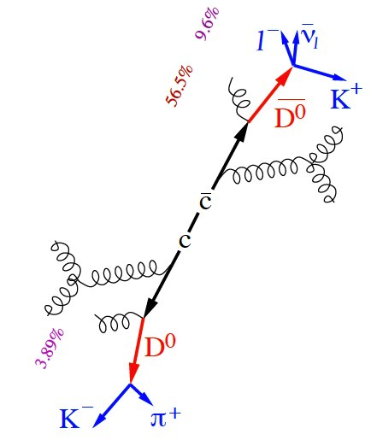
1. Open heavy flavor
Heavy quarks c, b
  Produced in initial hard processes
  Probe the strongly interacting Quark–Gluon Plasma
  Modified spectrum: access parton energy loss
  Flow: sensitive to dynamics, thermalization
Semi-leptonic decays
  Higher branching ratio, easy to trigger on
  Indirect access to kinematics,
  mixture of c and b contributions
Hadronic reconstruction
  Direct access to kinematics
  Large combinatorial bg., difficult to trigger

Slide 5
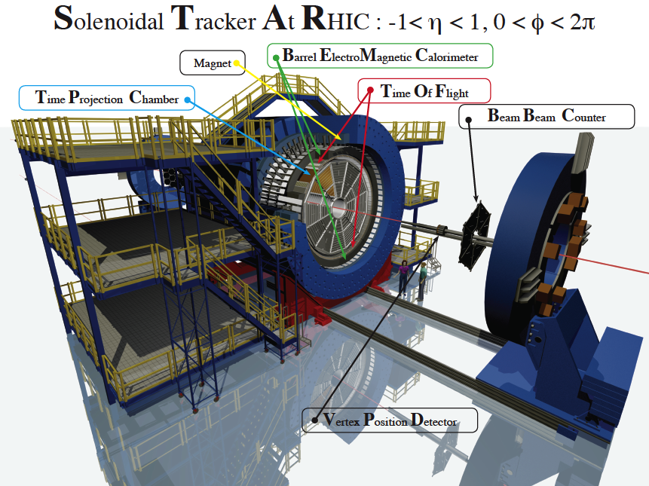
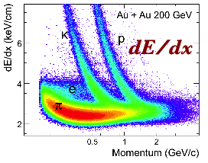
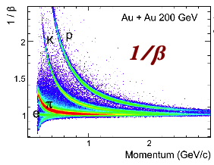
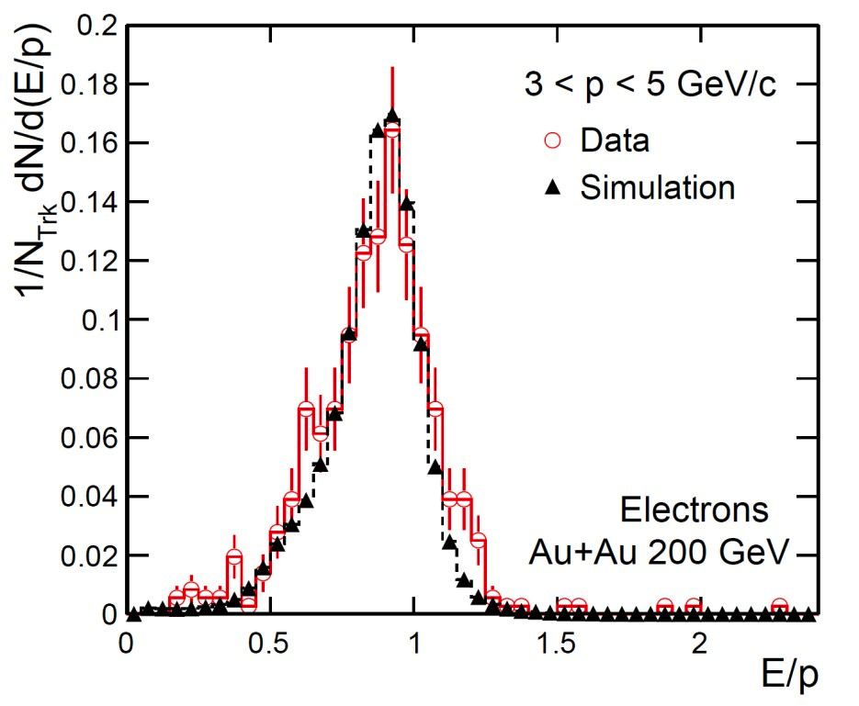
RHIC/STAR
TPC
  dE/dx PID
  Large acceptance,
  uniform in a wide
  energy range
TOF
  PID using flight time
BEMC
  High-p_{T} trigger
  PID using E/p
  ratio
VPD
  Trigger minimum
  bias events
TPC
E/p
TOF
BEMC
Notes:
5

Slide 6
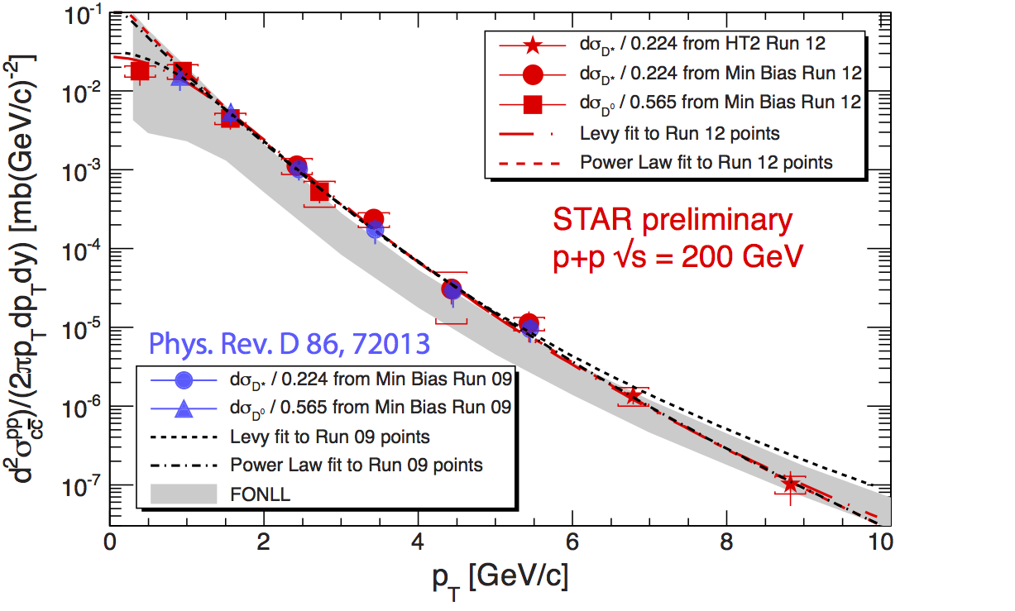
D⁰ and D* production in p+p
p+p 200 GeV
Essential as a baseline for A+A
Consistent with FONLL upper limit
New point at 0<p_{T}<0.7 GeV/c
  Lévy fit describes data well

Slide 7
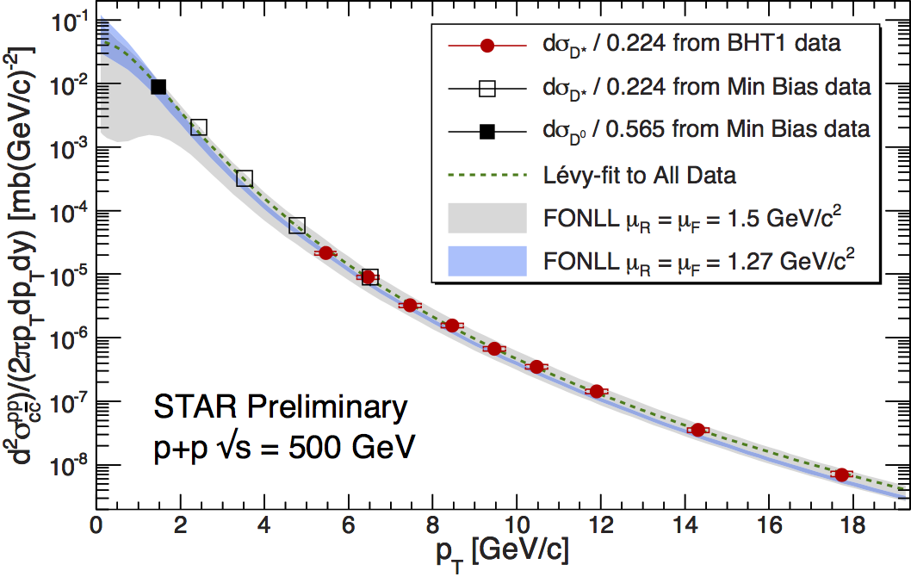
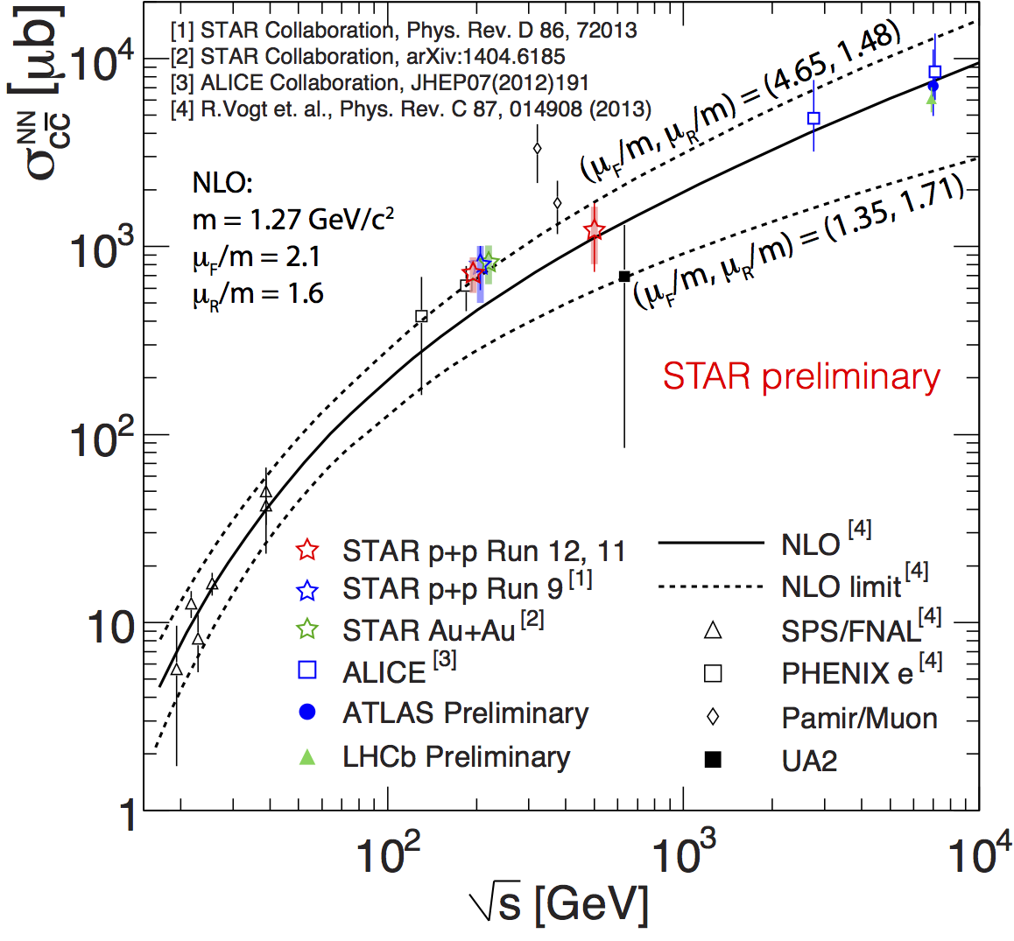
D⁰ and D* production in p+p
p+p 200 GeV
Essential as a baseline for A+A
Consistent with FONLL upper limit
New point at 0<p_{T}<0.7 GeV/c
  Lévy fit describes data well
New 500 GeV measurement
Consistent with NLO calculations

Slide 8
D⁰ production in Au+Au
arXiv:1404.6185
submitted to PRL
Transverse momentum p_{T} (GeV/c)
Total cross section scales with the number of binary collisions

Slide 9
D⁰ production in Au+Au
arXiv:1404.6185
submitted to PRL
Transverse momentum p_{T} (GeV/c)
Total cross section scales with the number of binary collisions
Charm is mostly produced in initial hard processes

Slide 10
D⁰ suppression in Au+Au
Strong suppression in central collisions at p_{T}>2 GeV/c
  Identical to that observed for pions
Enhancement at 1<p_{T}<2 GeV/c
STAR √s_{NN}=200 GeV Au+Au
Transverse momentum

Slide 11
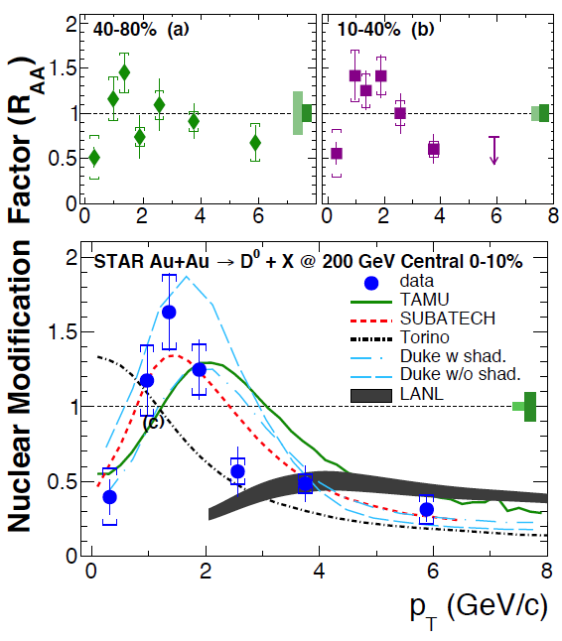
D⁰ suppression and models
Strong suppression in central collisions at p_{T}>2 GeV/c
  Identical to that observed for pions
Enhancement at 1<p_{T}<2 GeV/c
Understanding from models:
  Characteristic low-p_{T} “hump” is described by models that include charm–light quark coalescence
  High-p_{T} suppression is consistent with strong charm–medium interaction
  CNM effects may be important
  → Call for a high-statistics
  p+A (d+A) run
Transverse momentum
arXiv:1404.6185 (submitted to PRL)

Slide 12
D⁰ in U+U collisions
Number of participants
U+U collisions reach ~20% higher Bjorken energy density than Au+Au
Trend in Au+Au continued in U+U
Increasing suppression with N_{part}

Slide 13
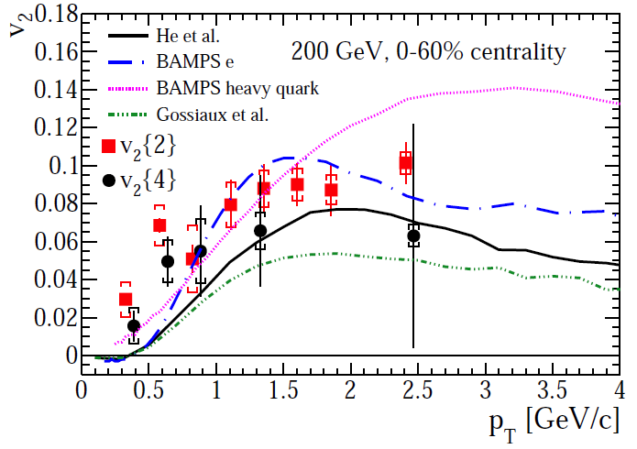
Non-photonic electrons in 200 GeV Au+Au
STAR
preliminary
Suppression
Significant suppression of NPE in central collisions (p_{T}>4 GeV/c)
Similar to that of D⁰ and light hadrons
Radiation energy loss alone not enough to explain suppression
Anisotropy (v₂)
Substantial elliptic flow of NPE is seen in 200 GeV Au+Au collisions
Note: it’s challenging for models to describe suppression and flow at the same time
arXiv:1405.6348
(Submitted to PLB)

Slide 14
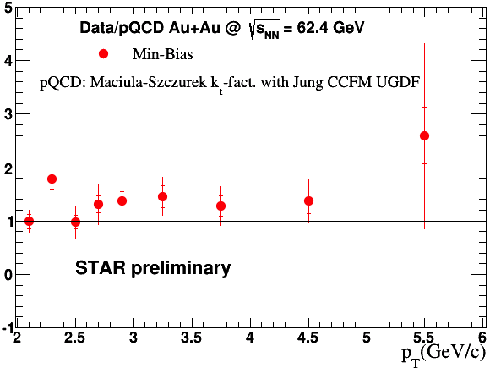
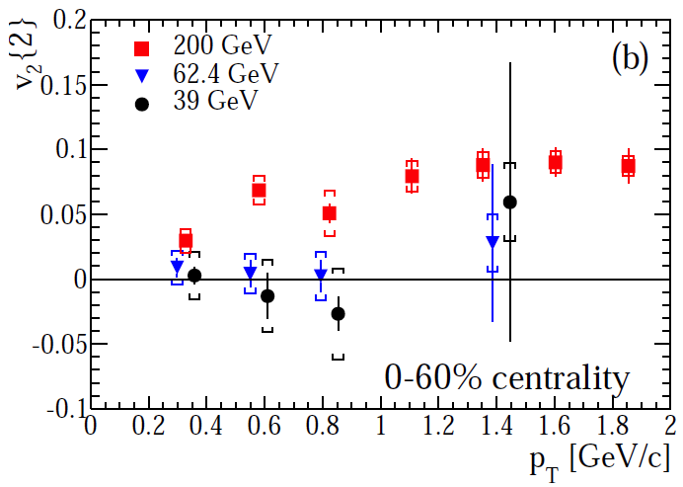
Non-photonic electrons: 39, 62.4 GeV
R_{AA}
Suppression
No sign of suppression of NPE
in 62.4 GeV Au+Au collisions
Note: pQCD-scaled p+p reference
Anisotropy (v₂)
NPE in 39 and 62.4 GeV Au+Au collisions consistent with no flow
(p_{T}<1 GeV/c)
PRD 87 (2013) 9, 094022
STAR preliminary
arXiv:1405.6348
(Submitted to PLB)

Slide 15
2. Quarkonia
Quarkonia probe thermal properties of the sQGP
J/ψ suppression due to color screening
Sequential melting of states → sQGP thermometer
However: picture is complicated by…
Cold nuclear matter effects
Co-mover absorption
Regeneration in the sQGP…
Mócsy, Petreczky,
PRD 77, 014501

Slide 16
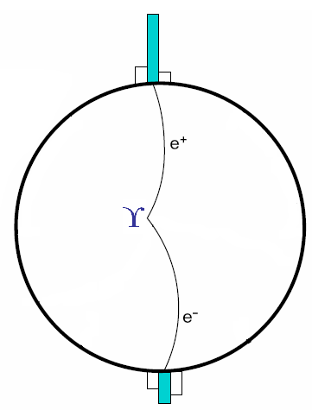
2. Quarkonia
Quarkonia probe thermal properties of the sQGP
J/ψ suppression due to color screening
Sequential melting of states → sQGP thermometer
However: picture is complicated by…
Cold nuclear matter effects
Co-mover absorption
Regeneration in the sQGP…
Precise measurements to disentangle various effects
p+p → reference
d+Au → CNM effects
Vary collision energy: 39 GeV, 62.4 GeV, 200 GeV
Vary colliding systems: U+U vs. Au+Au
High-p_{T} J/ψ → suppress CNM and regeneration
ϒ → negligible recombination and co-mover absorption
Mócsy, Petreczky,
PRD 77, 014501

Slide 17
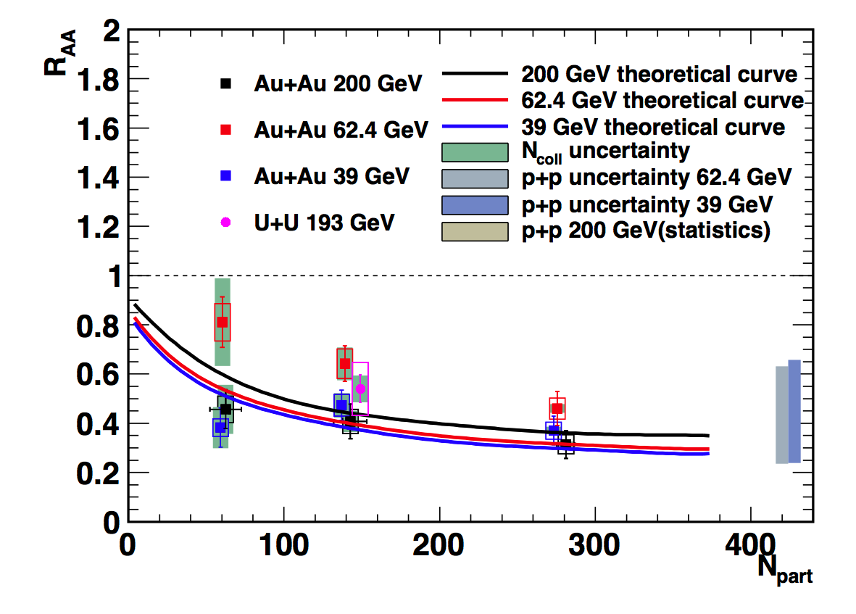
J/ψ suppression: 39, 62.4, 200 GeV
Suppression
Similar to light hadrons
Similar in central collisions from
39 thru 62.4 up to 200 GeV
Note: 39 and 62.4 GeV CEM references
have large uncertainties
Similar in U+U and Au+Au
Model with prompt production and regeneration consistent with data
Theory: Zhao, Rapp,
PhysRevC.82.064905
J/ψ
STAR preliminary

Slide 18
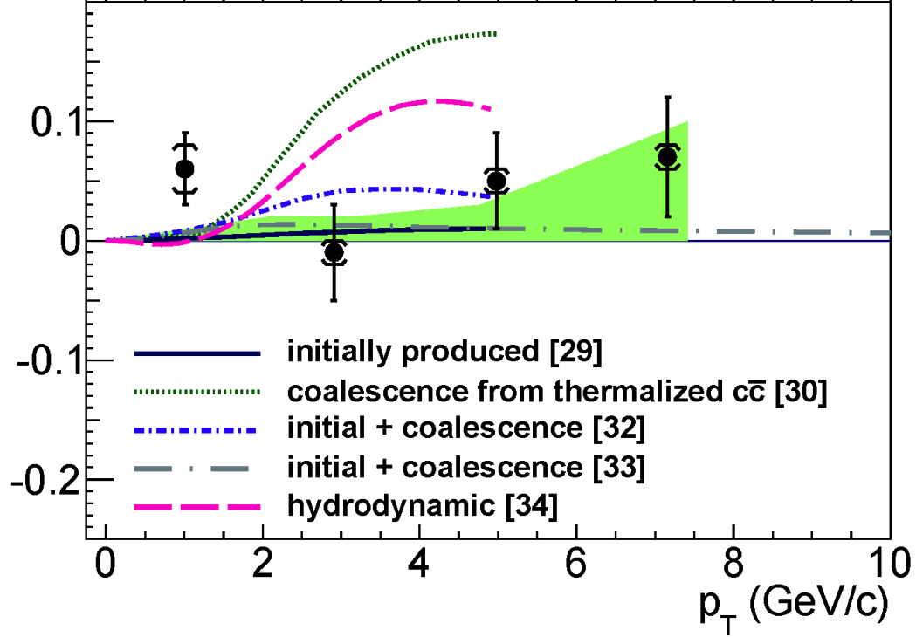
J/ψ suppression and flow in Au+Au
Suppression
Similar to light hadrons
Similar in central collisions from
39 thru 62.4 up to 200 GeV
Note: 39 and 62.4 GeV CEM references
have large uncertainties
Similar in U+U and Au+Au
Model with prompt production and regeneration consistent with data
Anisotropy (v₂)
J/ψ v₂ consistent with non-flow (p_{T}>2 GeV/c; unique among hadrons)
Model with thermalized charm quark coalescence disfavored
Theory: Zhao, Rapp,
PhysRevC.82.064905
J/ψ
STAR preliminary
v₂
STAR Au+Au
√s_{NN}=200 GeV
J/ψ
[29] Yan, Zhuang,Xu, PRL97 (2006) 232301
[30] Greco, Ko, Rapp, PLB595 (2004) 202
[32] Zhao, Rapp, PLB 655 (2007) 126
[33] Liu,Xu,Zhuang, NPA834 (2010) 317c
[34] Heinz, Chen (2012)
Phys. Rev. Lett. 111 (2013) 52301

Slide 19
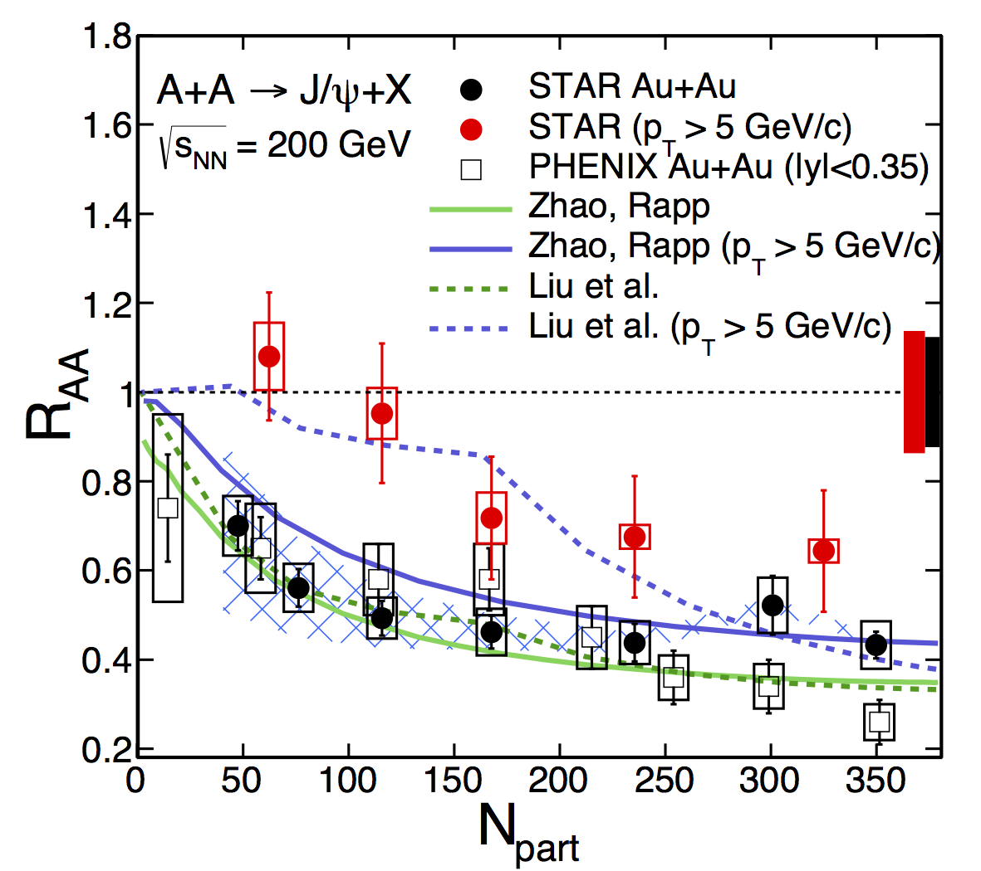
High-p_{T} J/ψ in Au+Au
CNM effects are small
Less regeneration
Suppression of high-p_{T} J/ψ in central collisions
STAR low-p_{T} : arXiv:1310.3563
STAR high-p_{T} : PLB722, 55 (2013)
Liu et al., PLB 678, 72 (2009)
Zhao and Rapp, PRC 82, 064905(2010), PLB 664, 253 (2008)
PHENIX Phys. Rev. Lett. 98, 232301 (2007)

Slide 20
High-p_{T} J/ψ in Au+Au
CNM effects are small
Less regeneration
Suppression of high-p_{T} J/ψ in central collisions
STAR low-p_{T} : arXiv:1310.3563
STAR high-p_{T} : PLB722, 55 (2013)
Liu et al., PLB 678, 72 (2009)
Zhao and Rapp, PRC 82, 064905(2010), PLB 664, 253 (2008)
PHENIX Phys. Rev. Lett. 98, 232301 (2007)
High-p_{T} J/ψ suppression is clearly an sQGP effect

Slide 21
Upsilons in A+A
Co-mover absorption and recombination negligible at RHIC
Suppression in 200 GeV central Au+Au
Trend continues in 193 GeV U+U (20% more energy density)
STAR preliminary
arXiv:1312.3675
accepted in PLB
Model calculations:
Potential based on internal energy
assumes 428<T<443 MeV
  Strickland-Bazov, Nucl. Phys. A879, 25 (2012)
Strong binding scenario, CNM effects included
  Emerick, X. Zhao, R. Rapp, Eur. Phys. J A48, 72 (2012)

Slide 22
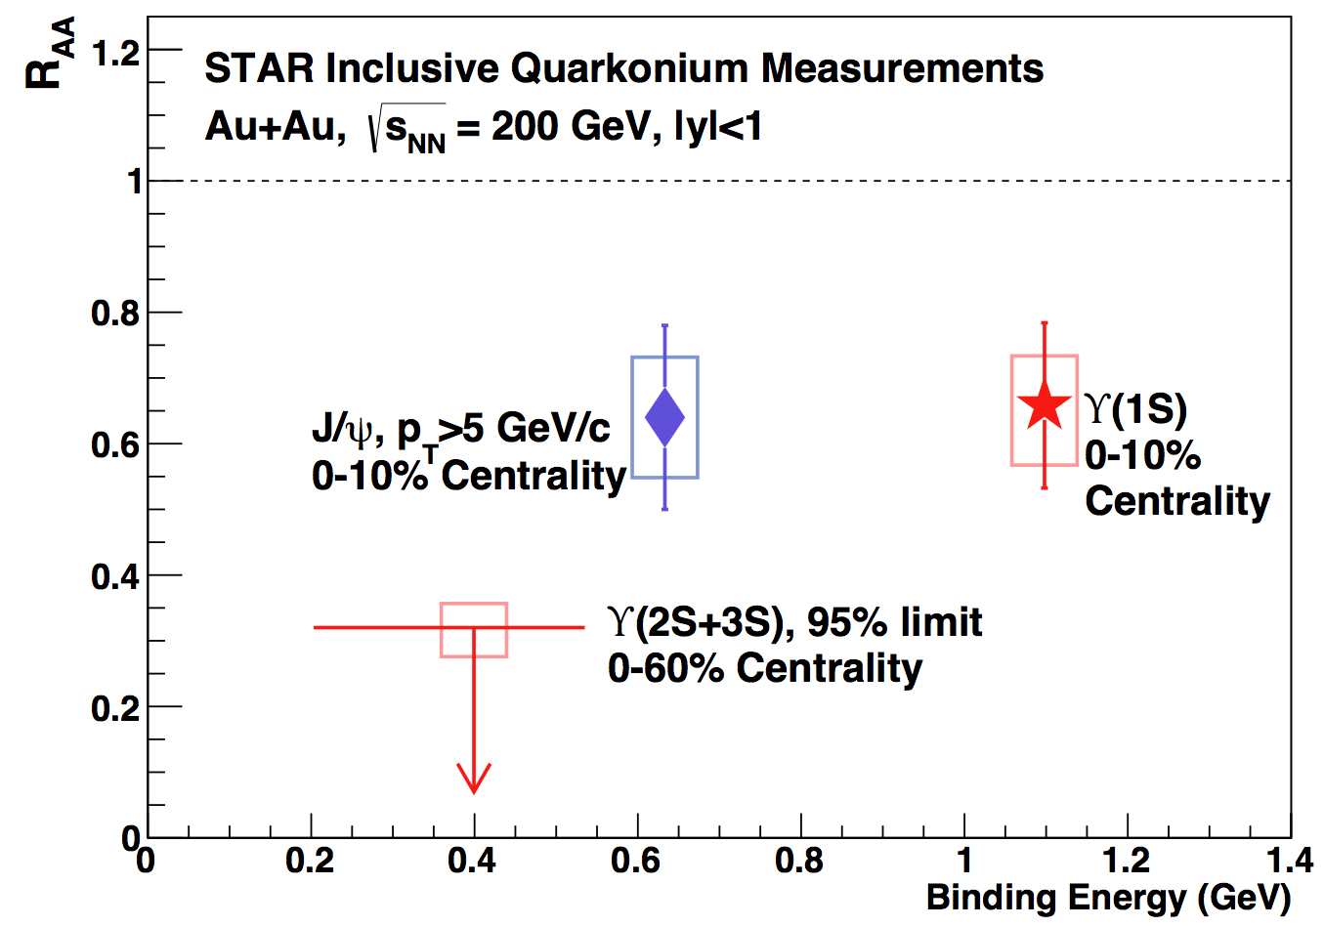
Excited ϒ states in Au+Au
Central Au+Au:
No evidence of excited states ϒ(2S) and ϒ(3S)
ϒ(1S) suppression is similar to high-p_{T} J/ψ
arXiv:1312.3675
accepted in PLB
Suppression of ϒ is an indication of color deconfinement
Au+Au

Slide 23
Excited ϒ states in Au+Au
Central Au+Au:
No evidence of excited states ϒ(2S) and ϒ(3S)
ϒ(1S) suppression is similar to high-p_{T} J/ψ
arXiv:1312.3675
accepted in PLB
Suppression of ϒ is an indication of color deconfinement
Au+Au
However…
d+Au data indicates that CNM effects can be important
Models do not explain mid-rapidity d+Au data
→ Better understanding requires
high-statistics p+A (d+A)
d+Au

Slide 24
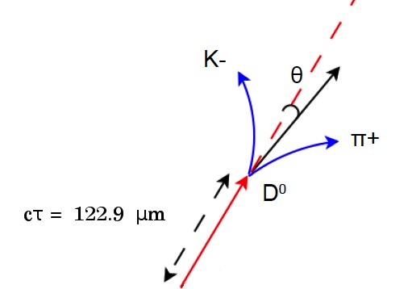
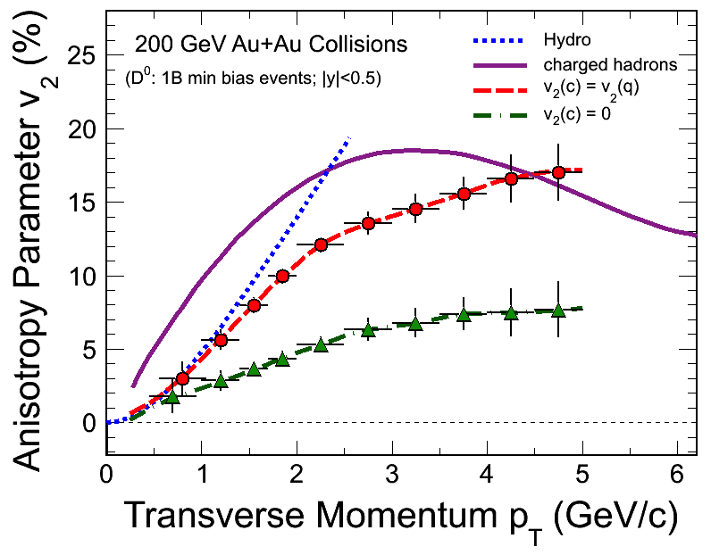
Outlook: Heavy Flavor Tracker
Innermost, silicon detectors (3 subsystems)
Resolves secondary vertex
Physics goal: Precision measurement of heavy quark production
Complete and taking data in Run14
IST at 14 cm
PXL at 2.9 and 8.2 cm
D⁰ v₂ projection
SSD at 22 cm

Slide 25
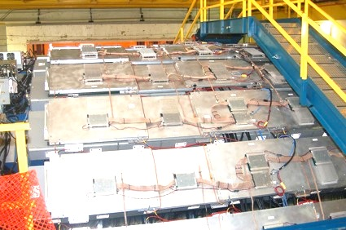
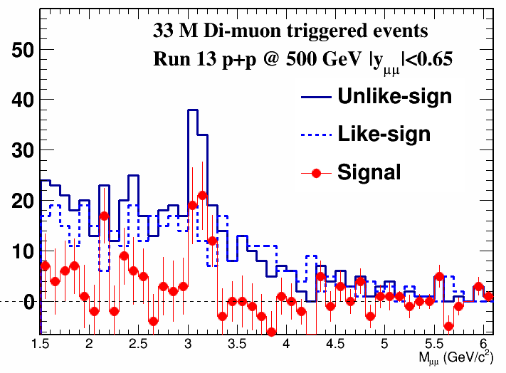
Outlook: Muon Telescope Detector
Outermost, gas detector
Physics goal: Precision measurement of heavy quarkonia through the muon channel
Acceptance:
45% in azimuth, |y|<0.5
Complete and taking data in Run14
counts
R_{AA}
ϒ projection
J/ψ sample data
M_{ee} (GeV/c²)
<N_{part}>

Slide 26
Summary
Open heavy flavor
  Total D⁰ x-section follows N_{bin} scaling → early charm production
  Low-p_{T} D⁰ “hump” → suggests charm–light quark coalescence
  High-p_{T} suppression → indicates strong charm–medium interaction
  No 62.4 GeV NPE suppression or flow observed, contrary to 200 GeV
Quarkonia
  J/ψ suppression similar in central 39, 62.4 and 200 GeV collisions
  No J/ψ elliptic flow is observed → thermalized cc-coalescence unlikely
  Significant high-p_{T} J/ψ and similar ϒ(1S) suppression in central A+A,
  hint for a complete ϒ(2S) and ϒ(3S) suppression
  → clear signal of a deconfined medium
U+U measurements show similar suppression patterns to Au+Au

Slide 27
Summary
Open heavy flavor
  Total D⁰ x-section follows N_{bin} scaling → early charm production
  Low-p_{T} D⁰ “hump” → suggests charm–light quark coalescence
  High-p_{T} suppression → indicates strong charm–medium interaction
  No 62.4 GeV NPE suppression or flow observed, contrary to 200 GeV
Quarkonia
  J/ψ suppression similar in central 39, 62.4 and 200 GeV collisions
  No J/ψ elliptic flow is observed → thermalized cc-coalescence unlikely
  Significant high-p_{T} J/ψ and similar ϒ(1S) suppression in central A+A,
  hint for a complete ϒ(2S) and ϒ(3S) suppression
  → clear signal of a deconfined medium
U+U measurements show similar suppression patterns to Au+Au
Stay tuned for new great results with HFT and MTD

Slide 28

Thank You!
Argonne National Laboratory, Argonne, Illinois 60439
Brookhaven National Laboratory, Upton, New York 11973
University of California, Berkeley, California 94720
University of California, Davis, California 95616
University of California, Los Angeles, California 90095
Universidade Estadual de Campinas, Sao Paulo, Brazil
University of Illinois at Chicago, Chicago, Illinois 60607
Creighton University, Omaha, Nebraska 68178
Czech Technical University in Prague, FNSPE, Prague, 115 19, Czech Republic
Nuclear Physics Institute AS CR, 250 68 Řež/Prague, Czech Republic
University of Frankfurt, Frankfurt, Germany
Institute of Physics, Bhubaneswar 751005, India
Indian Institute of Technology, Mumbai, India
Indiana University, Bloomington, Indiana 47408
Alikhanov Institute for Theoretical and Experimental Physics, Moscow, Russia
University of Jammu, Jammu 180001, India
Joint Institute for Nuclear Research, Dubna, 141 980, Russia
Kent State University, Kent, Ohio 44242
University of Kentucky, Lexington, Kentucky, 40506-0055
Institute of Modern Physics, Lanzhou, China
Lawrence Berkeley National Laboratory, Berkeley, California 94720
Massachusetts Institute of Technology, Cambridge, MA
Max-Planck-Institut f\"ur Physik, Munich, Germany
Michigan State University, East Lansing, Michigan 48824
Moscow Engineering Physics Institute, Moscow Russia
NIKHEF and Utrecht University, Amsterdam, The Netherlands
Ohio State University, Columbus, Ohio 43210
Old Dominion University, Norfolk, VA, 23529
Panjab University, Chandigarh 160014, India
Pennsylvania State University, University Park, Pennsylvania 16802
Institute of High Energy Physics, Protvino, Russia
Purdue University, West Lafayette, Indiana 47907
Pusan National University, Pusan, Republic of Korea
University of Rajasthan, Jaipur 302004, India
Rice University, Houston, Texas 77251
Universidade de Sao Paulo, Sao Paulo, Brazil
University of Science \& Technology of China, Hefei 230026, China
Shandong University, Jinan, Shandong 250100, China
Shanghai Institute of Applied Physics, Shanghai 201800, China
SUBATECH, Nantes, France
Texas A\&M University, College Station, Texas 77843
University of Texas, Austin, Texas 78712
University of Houston, Houston, TX, 77204
Tsinghua University, Beijing 100084, China
United States Naval Academy, Annapolis, MD 21402
Valparaiso University, Valparaiso, Indiana 46383
Variable Energy Cyclotron Centre, Kolkata 700064, India
Warsaw University of Technology, Warsaw, Poland
University of Washington, Seattle, Washington 98195
Wayne State University, Detroit, Michigan 48201
Institute of Particle Physics, CCNU (HZNU), Wuhan 430079, China
Yale University, New Haven, Connecticut 06520
University of Zagreb, Zagreb, HR-10002, Croatia
STAR Collaboration

Slide 29
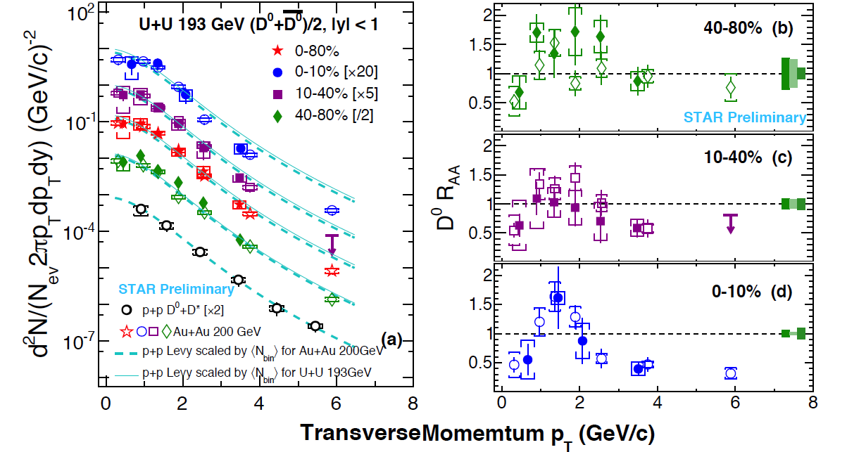
D⁰ in U+U, spectra and R_{AA}

Slide 30
D⁰, model ingredients
R_{AA}
Zhenyu Ye, QM2014

Slide 31
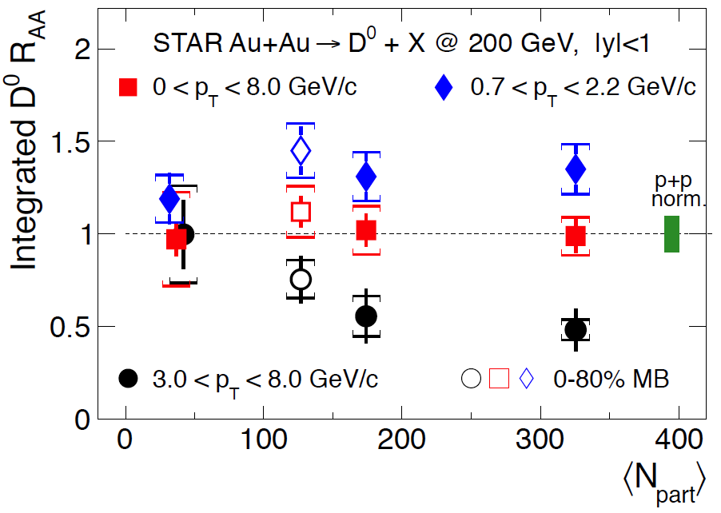
D⁰ R_{AA}

Slide 32
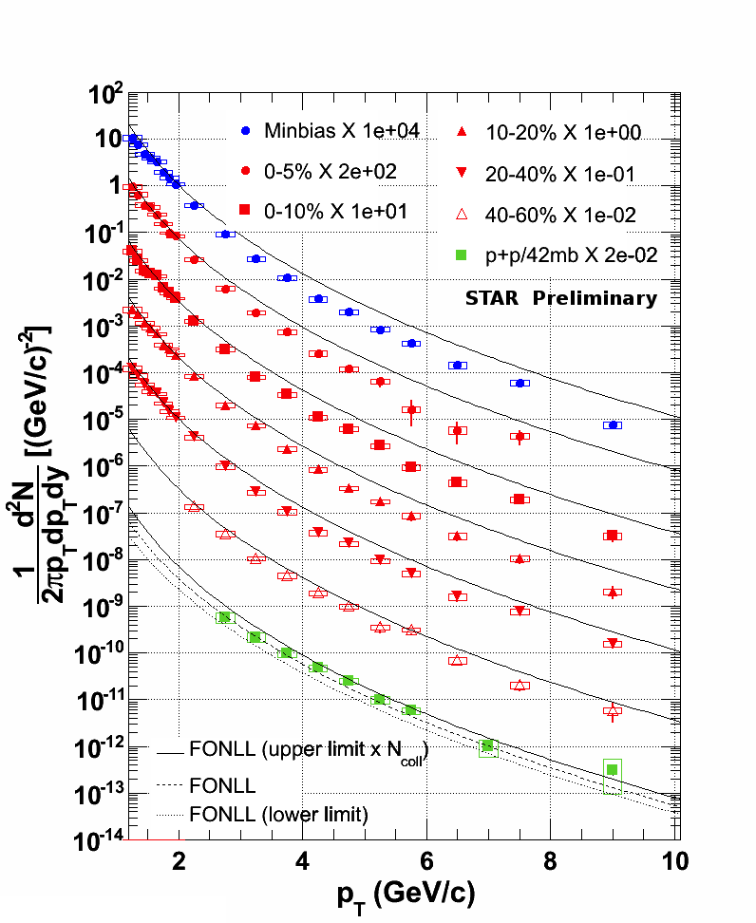
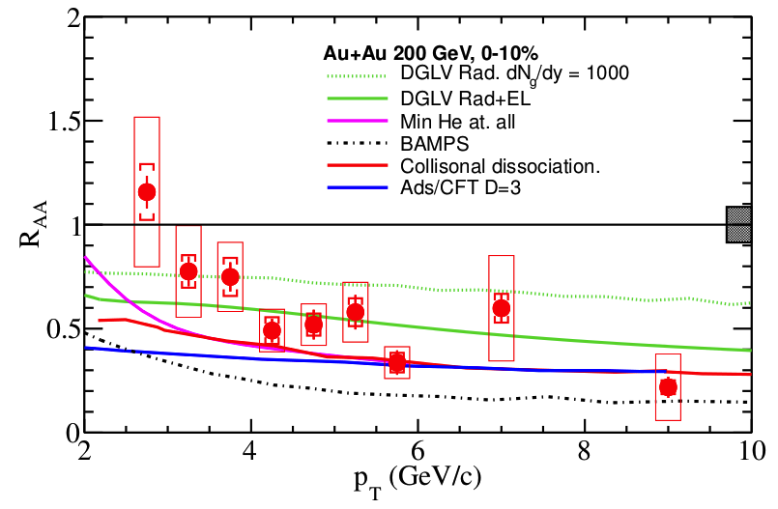
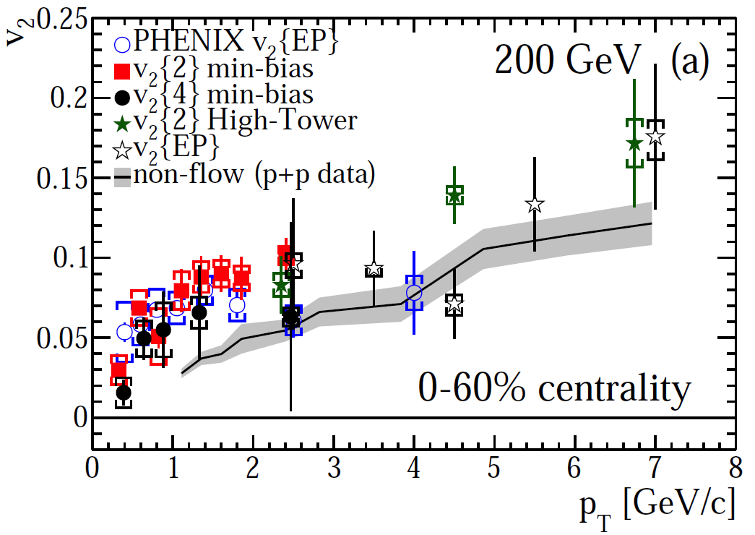
NPE Au+Au 200 GeV
Au+Au 200 GeV

Slide 33
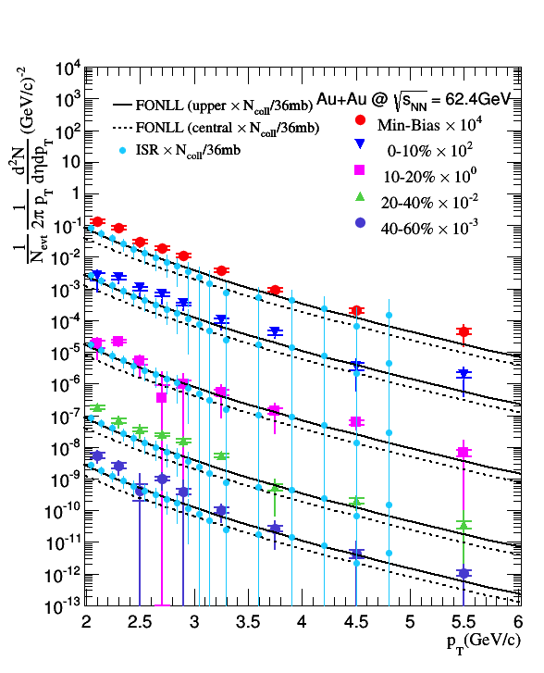
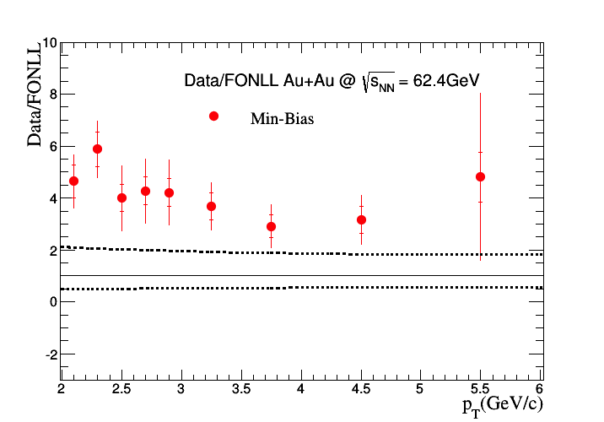
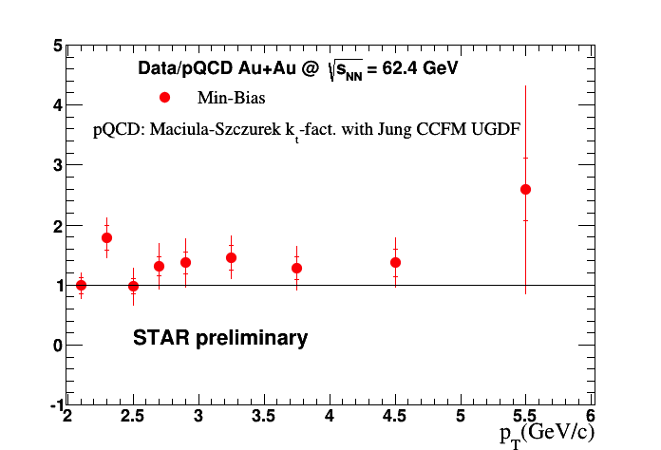
NPE 62.6 GeV FONLL vs. pQCD

Slide 34
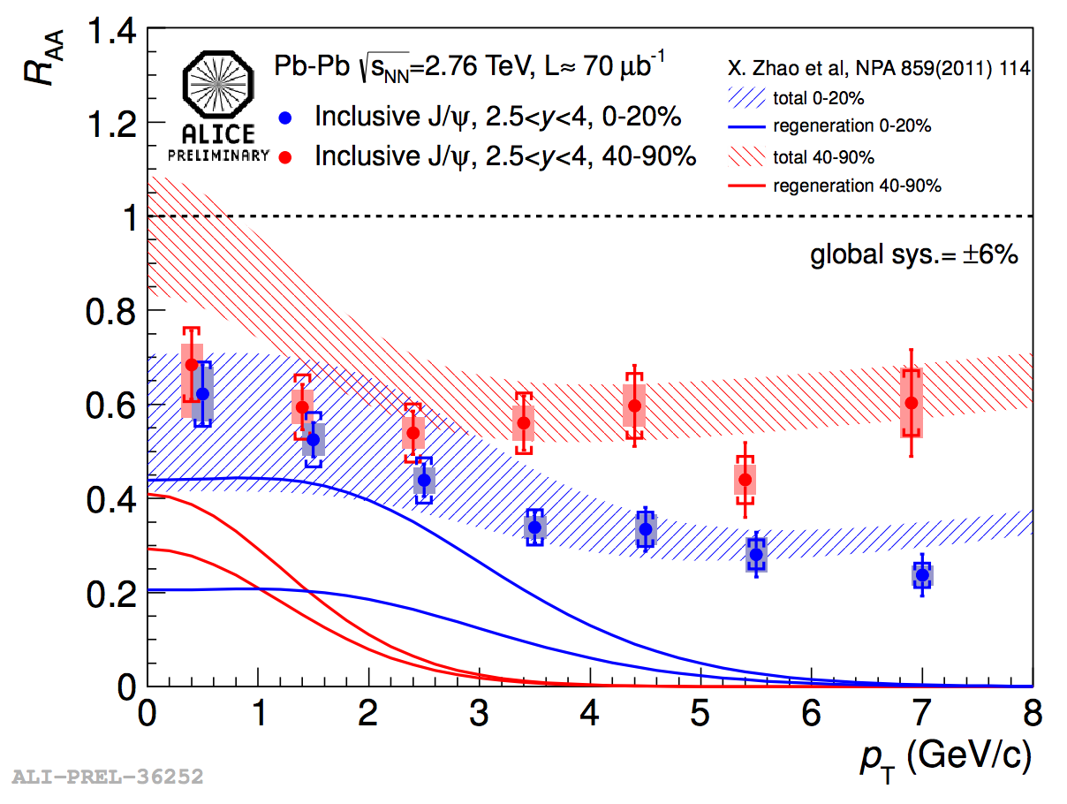
High-pT J/ψ – motivation
R_{dAu} ~ 1 at high P_{T}
→ CNM effects do not play a strong role
Less regeneration at high P_{T}
PHENIX data: Phys. Rev. C 87, 034904 (2013)
Model: E.Eskola, H.Paukkunenea and C.Salgo, Nucl. Phys. A 830, 599 (2009)

Slide 35
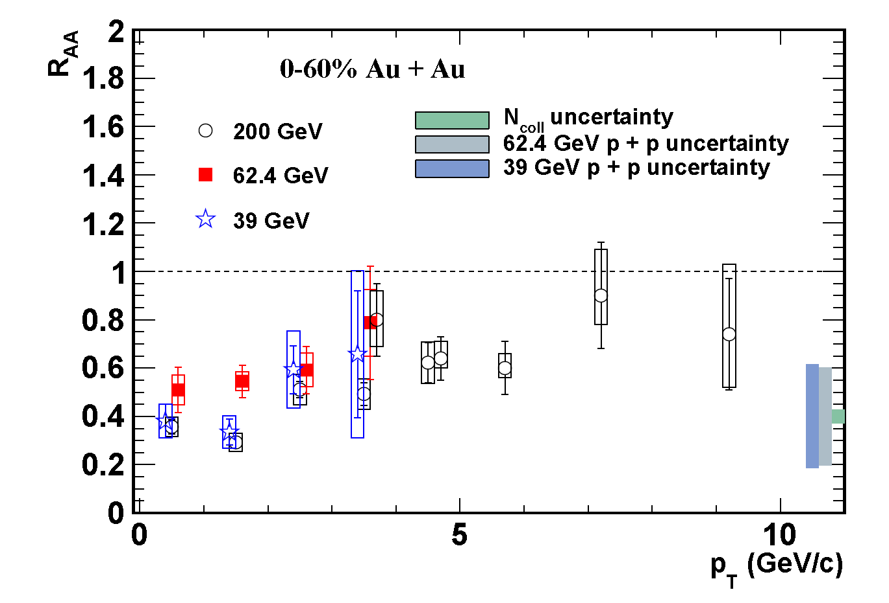
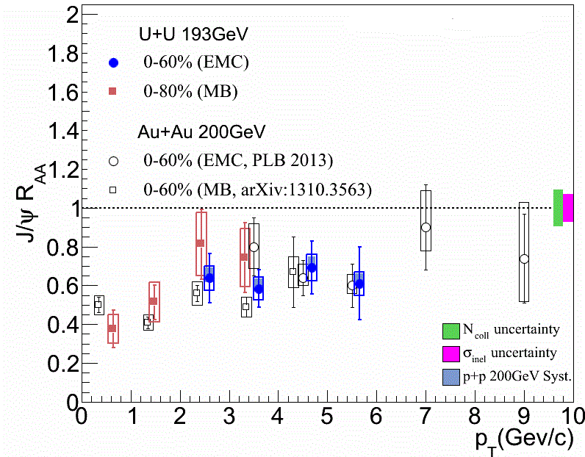
J/ψ vs pT, energy / system
STAR preliminary
STAR preliminary
39, 62, 200 GeV Au+Au
U+U vs. Au+Au

Slide 36
J/ψ in p+p 200 GeV
STAR coverage out to 14 GeV/c
Prompt NLO CS+CO describes the data
Prompt CEM better at high-pT

Slide 37
J/ψ in p+p – polarization
2<pT<6 GeV/c
STAR+PHENIX consistent with NLO+CSM
  Higher statistics needed to discriminate
p+p 500 GeV results will improve precision for future CNM calculations
arXiv:1131.1621

Slide 38
ϒ in p+p 200 GeV

