Slide 1
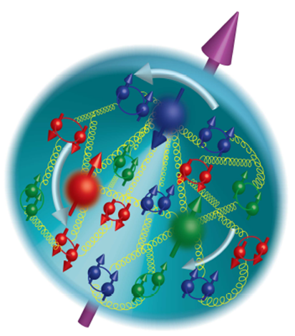

Longitudinal Spin Physics at STAR
Brian Page – Brookhaven National Laboratory
for the STAR Collaboration
Moriond, March 2016

Slide 2
Outline
RHIC and STAR
Theoretical Overview
Gluon Polarization
  Jet / Di-jet A_{LL}
Sea Quark Polarization
  W Boson A_{L}
Summary

Slide 3
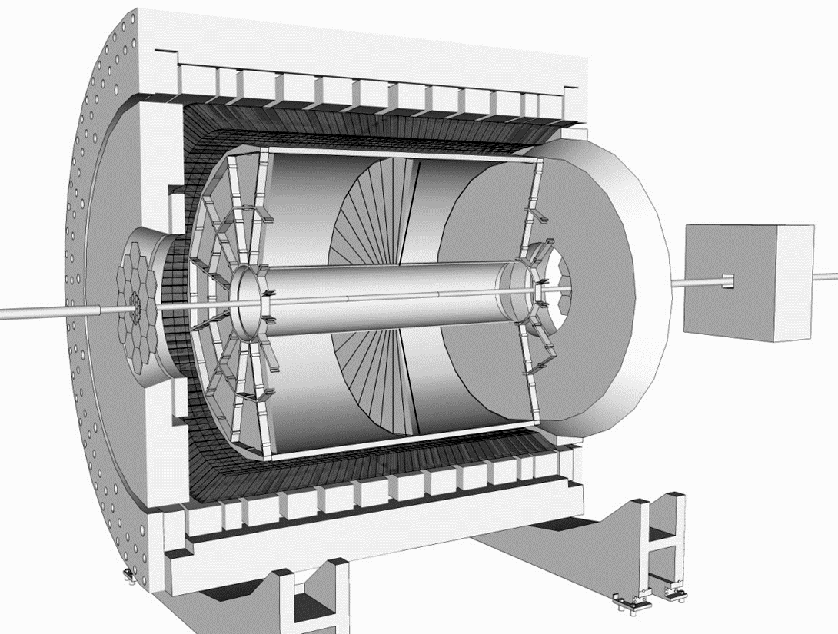
RHIC: First Polarized pp Collider
Time Projection Chamber (TPC)
Charged Particle Tracking |η|<1.3
η = 0
Endcap Electromagnetic Calorimeter:
1<η<2
η = 1
Forward Meson Spectrometer (FMS):
2.5<η<4
Barrel Electromagnetic Calorimeter (BEMC):
|η|<1

Slide 4
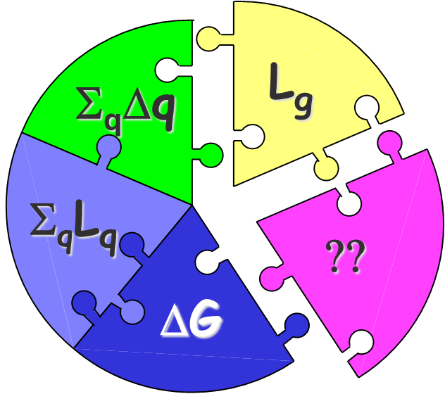
Piecing Together the Proton Spin
Simple picture of proton composed of three valence quarks superseded by complex interaction of quarks, antiquarks, and gluons
The proton’s spin must arise from combination of intrinsic and orbital angular momenta of these components
This talk will deal only with the intrinsic components: ∆G and ∆Σ
Helicity Distributions: Δq, Δg

Slide 5
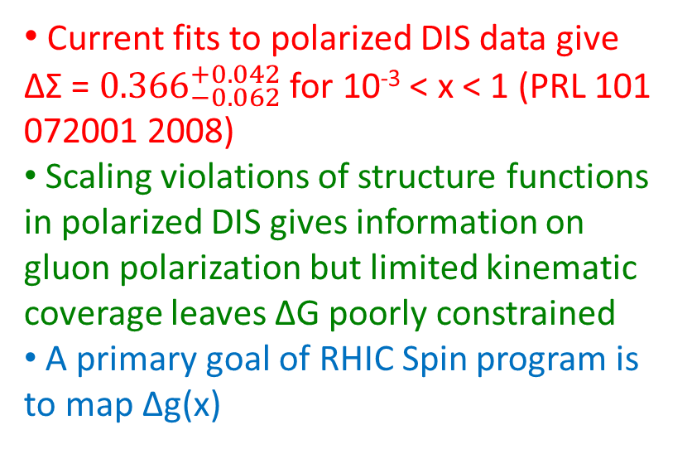
Intrinsic Gluon Contribution: ∆G
Current fits to polarized DIS data give ∆Σ = ${0.366}_{−0.062}^{+0.042}$ for 10⁻³ < x < 1 (PRL 101 072001 2008)
Scaling violations of structure functions in polarized DIS gives information on gluon polarization but limited kinematic coverage leaves ΔG poorly constrained
A primary goal of RHIC Spin program is to map Δg(x)
Kinematic reach of polarized DIS measurements

Slide 6





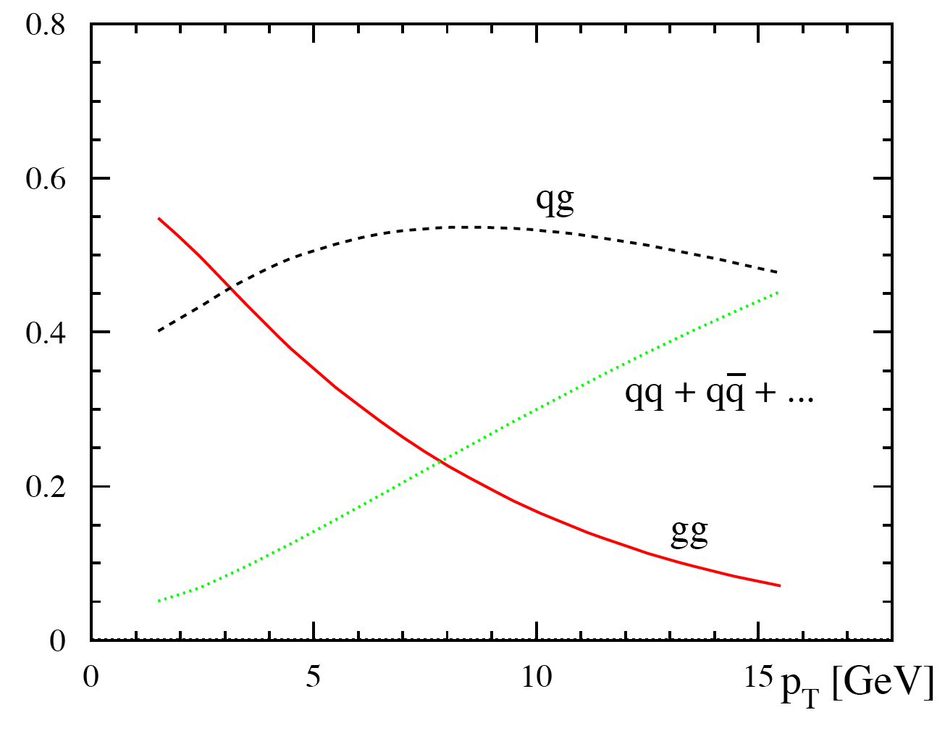
Accessing ∆G at RHIC: A_{LL}
Parton Level Asymmetry
Partonic fractions in jet production at 200 GeV
For most RHIC kinematics, gg and qg dominate, making A_{LL} for jets and hadrons sensitive to gluon polarization.
10
20
30
Cos θ*
p_{T} (GeV)

Slide 7
STAR 2009 Inclusive Jet A_{LL}
Phys. Rev. Lett. 115 92002 (2015)
2009 results have factor of 3 to 4 better statistical precision than 2006 results
Result divided into two pseudorapidity ranges which emphasize different partonic kinematics
Result lies consistently above the 2008 DSSV fit and is consistent with the LSS10p fit

Slide 8
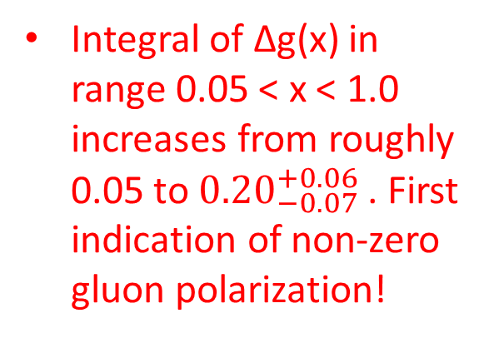
New DSSV Results
Phys. Rev. Lett. 113, 012001
Integral of ∆g(x) in range 0.05 < x < 1.0 increases from roughly 0.05 to ${0.20}_{−0.07}^{+0.06}$ . First indication of non-zero gluon polarization!
Uncertainty shrinks substantially from DSSV* to new DSSV fit
Uncertainty on integral over low x region is still sizable

Slide 9
Data Sets in the Pipeline
arXiv:1501.01220
High statistics 510 GeV data sets from 2012 and 2013 are being analyzed and 200 GeV data from 2015 are on tape
Expected effect of data sets taken after 2009 on uncertainty of ∆g running integral shown
Integral of ∆g(x,Q²) from x_{min} to 1 as a function of x_{min}
200 GeV: x_{min} > 10⁻²
500 GeV + Forward Rapidity: x_{min} > 10⁻³

Slide 10
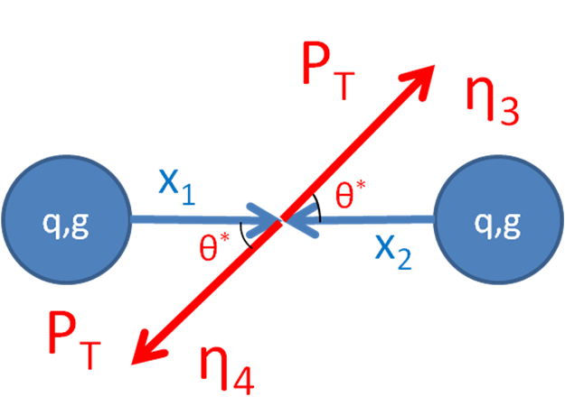
Beyond Inclusive: Di-jet Measurements
Coincidence measurements capture more information about the partonic hard-scattering and provide a more direct link to the initial kinematics than inclusive probes
Leading order expressions show how different jet configurations are sensitive to different kinematic values

Slide 11
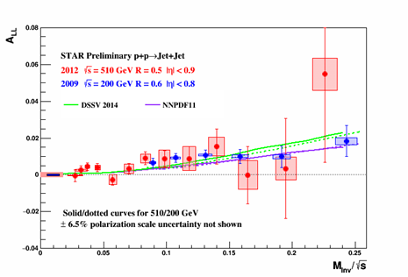
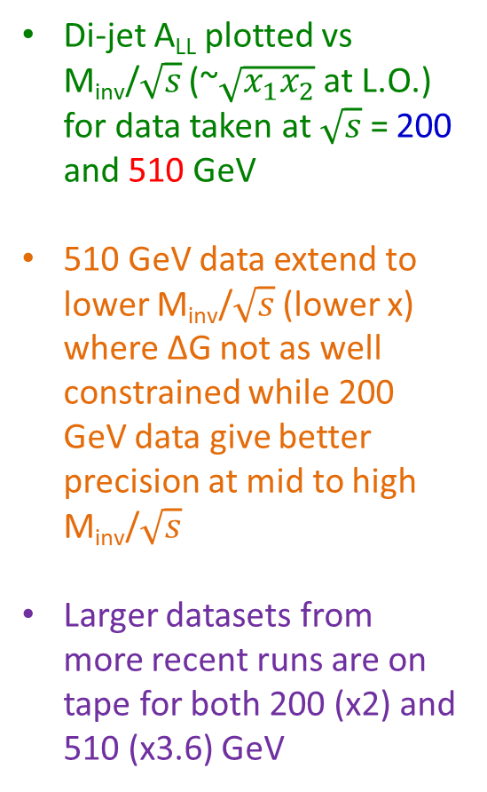
Di-jet A_{LL}
Di-jet A_{LL} plotted vs M_{inv}/$\sqrt{s}$ (~$\sqrt{x_{1}x_{2}}$ at L.O.) for data taken at $\sqrt{s}$ = 200 and 510 GeV
510 GeV data extend to lower M_{inv}/$\sqrt{s}$ (lower x) where ∆G not as well constrained while 200 GeV data give better precision at mid to high M_{inv}/$\sqrt{s}$
Larger datasets from more recent runs are on tape for both 200 (x2) and 510 (x3.6) GeV
arXiv:1602.03922

Slide 12
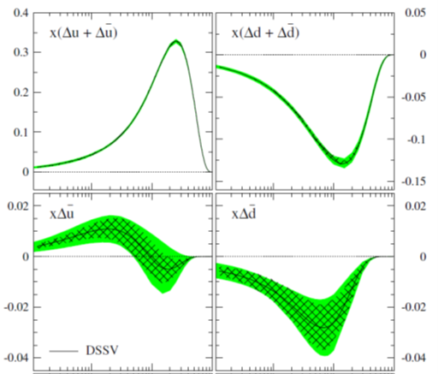
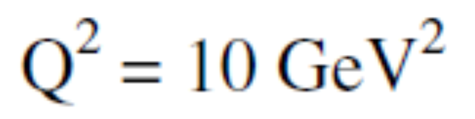
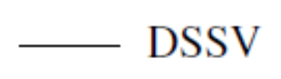
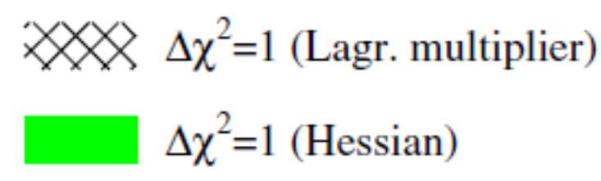


Flavor-Separated Quark Contribution
Phys. Rev. D 80, 034030 (2008)
DIS probes all quark and anti-quark flavors so ∆Σ well constrained
Constraints on individual quark and anti-quark distributions are weaker due to uncertainty in fragmentation functions needed in SIDIS extractions
Expect flavor symmetric light sea, but observe u̅ ≠ d
Comparing anti-quark helicity distributions important for discriminating between models of light sea generation
_
x
10⁻²
x
10⁻²
10⁻¹
10⁻¹
Notes:
E866

Slide 13
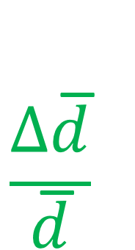




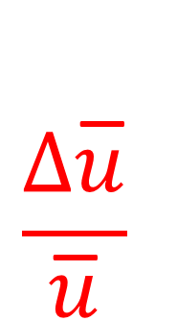
Probing the Sea Quarks
W boson production at RHIC provides complimentary measurements to SIDIS: Data at high Q² and no dependence on fragmentation functions
V-A structure of weak interaction leads to perfect spin separation
Structure of asymmetry allows for enhancement of a given flavor based on decay kinematics
Forward Scatter
Forward Scatter
Backward Scatter
Backward Scatter

Slide 14
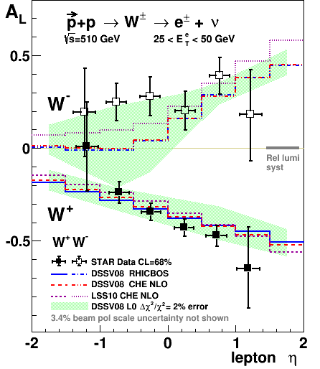


STAR W Results
Phys. Rev. Lett. 113, 72301 (2014)
Asymmetries extracted from combination of 2011 and 2012 data using Profile Likelihood method
A_{L} from W⁺ is consistent with predictions from the 2008 DSSV polarized PDF set
A_{L} from W⁻ is systematically higher than DSSV predictions at negative lepton η
This region has enhanced sensitivity to ∆u̅ contribution
$$−\frac{∆d}{d}$$
$$−\frac{∆u}{u}$$
Notes:
Figure from Phys Rev Lett. 113

Slide 15
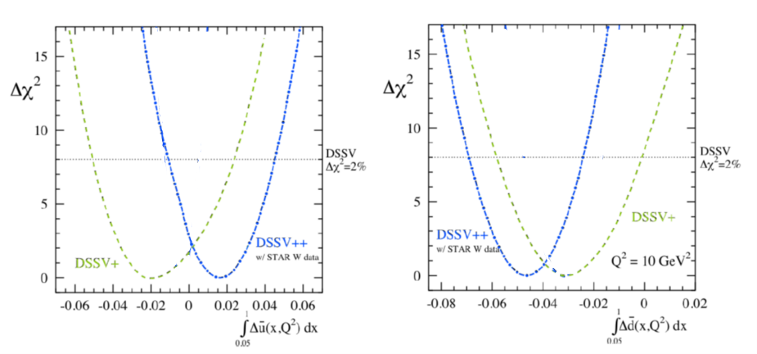
Impact on Global Analyses
arXiv:1304.0079
STAR W A_{L} data from 2011 + 2012 included in preliminary DSSV analysis (DSSV++) and recent NNPDF analysis (NNPDFpol1.1)
STAR W data shifts best fit values for first moments of ∆u̅(x,Q²) and ∆d̅(x,Q²) for x > 0.05
∆u̅ best fit value changes sign when 2011 and 2012 W data added to DSSV fit
Status of polarized anti-quark difference with current RHIC W data and projected future RHIC data compared to various models
arXiv:1602.03922
Notes:
NNPDF pol1.1 from Nucl. Phys. B 887 276-308 (2014) DSSV from arXiv:1304.0079

Slide 16
Summary
Polarized p+p data from RHIC gives access to gluon interactions at leading order and has placed strong constraints on ∆G for x > 0.05
Real W production at RHIC provides a unique probe of the flavor separated light quark and anti-quark distributions
Recent RHIC results have been incorporated into global analyses by the DSSV and NNPDF groups
More recent high statistics datasets at both 200 and 510 GeV are on tape and being analyzed

Slide 17
Backup Slides

Slide 18

Jet Reconstruction
Jet Levels
MC Jets
Anti-K_{T} Algorithm:
Radius = 0.6
Less sensitive to underlying event and pile-up effects
Implemented using FastJet
Used in both data and simulation
Detector
GEANT
Particle
STAR Detector has:
Full azimuthal coverage
Charged particle tracking from TPC for |η| < 1.3
E/BEMC provide electromagnetic energy reconstruction for -1 < η < 2.0
STAR well suited for jet measurements
PYTHIA
Parton

Slide 19
Forward π⁰ A_{LL}
Dilks SPIN2014
Lower values of x probed at more forward pseudorapidities.
Measure isolated neutral pion A_{LL} in Forward Meson Spectrometer

Slide 20
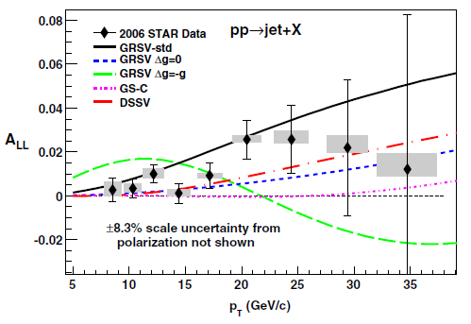
2006 Inclusive Jet A_{LL}
Phys. Rev. D86 032006 (2012)
Run 6 data rules out GRSV-Min and GRSV-Max
Large gluon polarization in the accessible region disfavored

Slide 21
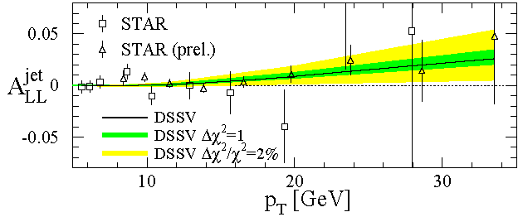
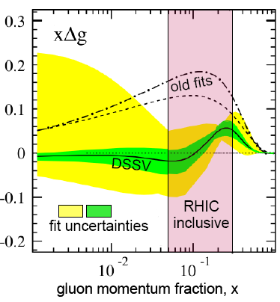
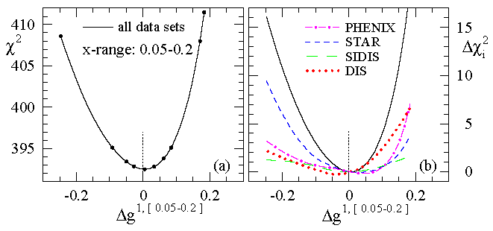
DSSV Global Fit
de Florian et al., PRL 101, 072001 (2008)
STAR
Strong constraint on Δg in the range 0.05 < x < 0.2
Low x range still poorly constrained
First global NLO analysis which includes DIS, SIDIS, and RHIC pp data

Slide 22
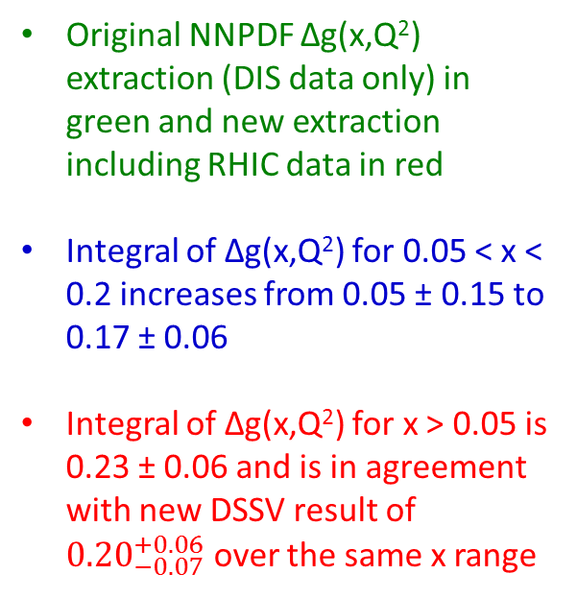
New NNPDF Results
Nucl. Phys. B 887, 276 (2014)
Original NNPDF ∆g(x,Q²) extraction (DIS data only) in green and new extraction including RHIC data in red
Integral of ∆g(x,Q²) for 0.05 < x < 0.2 increases from 0.05 ± 0.15 to 0.17 ± 0.06
Integral of ∆g(x,Q²) for x > 0.05 is 0.23 ± 0.06 and is in agreement with new DSSV result of ${0.20}_{−0.07}^{+0.06}$ over the same x range

Slide 23
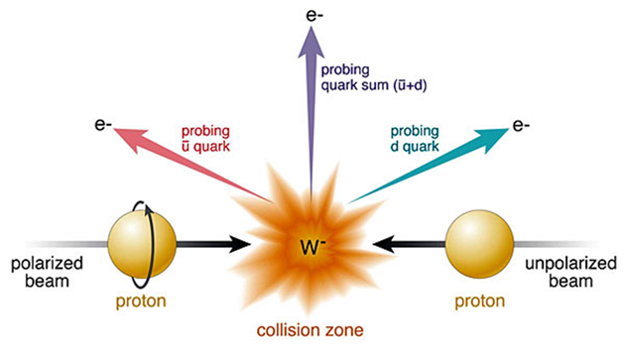
Probing the Sea Quarks

Slide 24
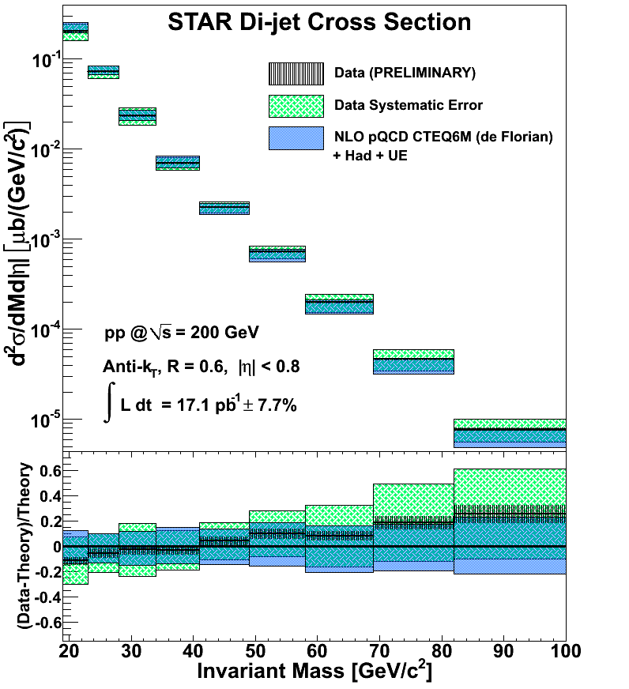
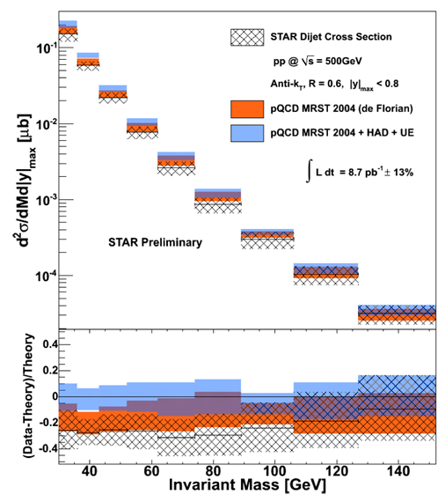
2009 Di-jet Cross Section Results
Thickness of vertical black hashing represents size of statistical error on the measurement
Green hatched box is symmetric about data point and is the quadrature sum of all systematic errors
Thickness of blue box represents error on theory determined by changing factorization and renormalization scales by factor of 0.5 and 2

