Slide 1




STAR Overview
Nu Xu^{(1,2)} (for the STAR Collaboration)
Outline:
1) Introduction
2) STAR Detector System
3) Recent Results From STAR
- On initial conditions and penetrating observables
- On QCD phase structure
4) Summary and Outlook
⁽¹⁾ College of Physical Science & Technology, Central China Normal University, China
⁽²⁾ Nuclear Science Division, Lawrence Berkeley National Laboratory, USA

Slide 2
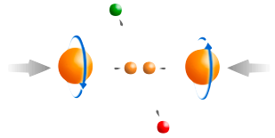
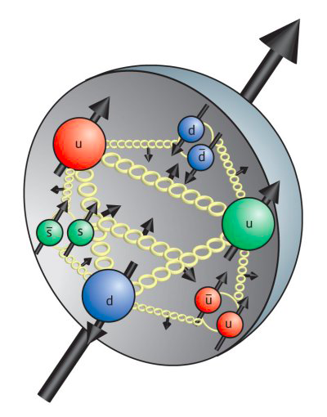

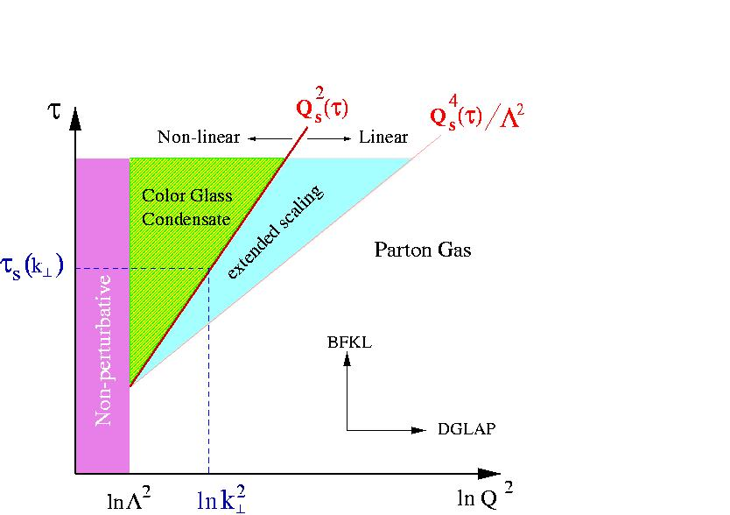
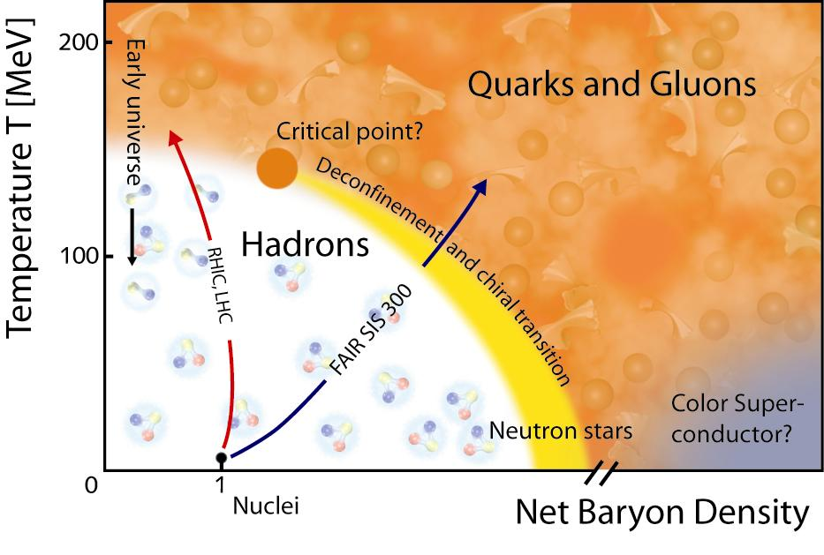
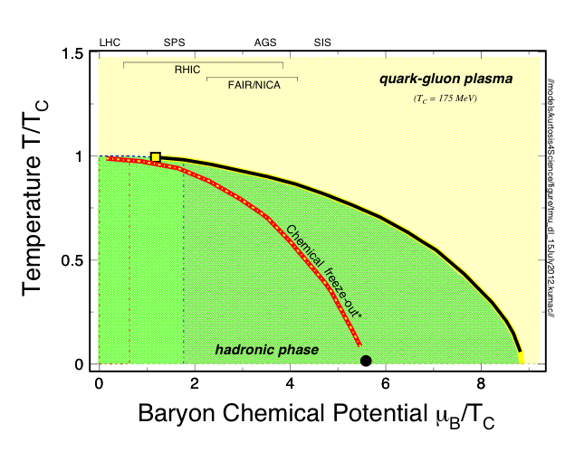
STAR Physics Focus
Polarized p+p Program
- Study proton intrinsic
properties
eSTAR
Since 2010
Study the Structure of Matter
with
QCD Degrees of Freedom!
Small-x Physics Program
- Study low-x properties, initial
condition, search for CGC
- Study elastic and inelastic
processes in pp2pp
1) At 200 GeV at RHIC
- Study medium properties, EoS
- pQCD in hot and dense medium
2) RHIC Beam Energy Scan (BES)
- Search for the QCD critical point
- Chiral symmetry restoration

Slide 3


STAR Detector System
EEMC
Magnet
MTD
BEMC
TPC
TOF
BBC
HFT

Slide 4
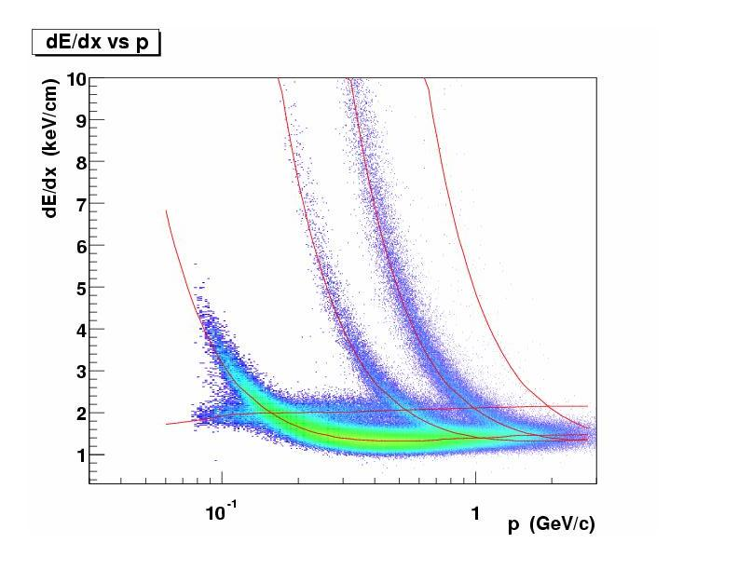
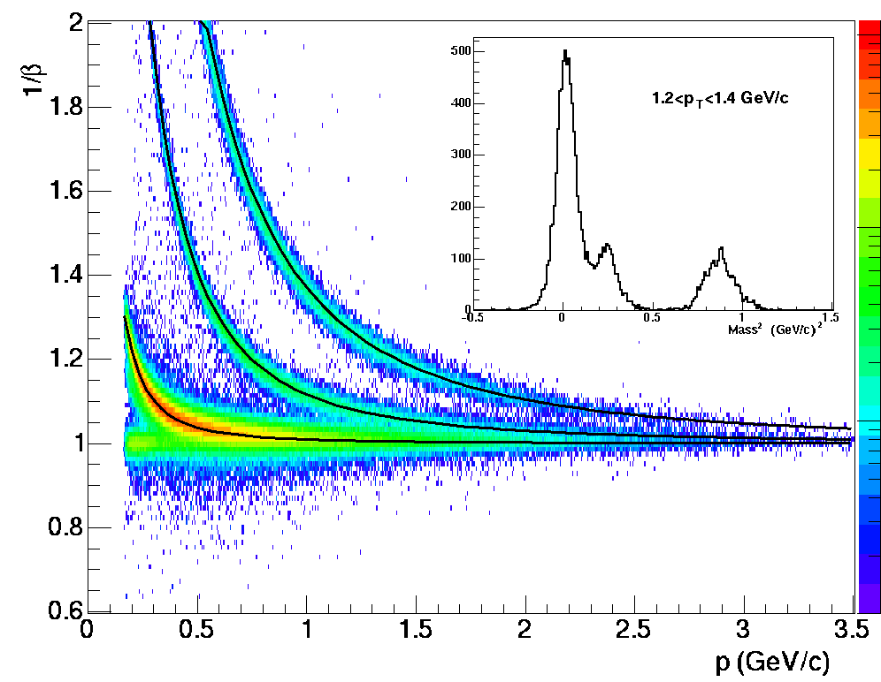
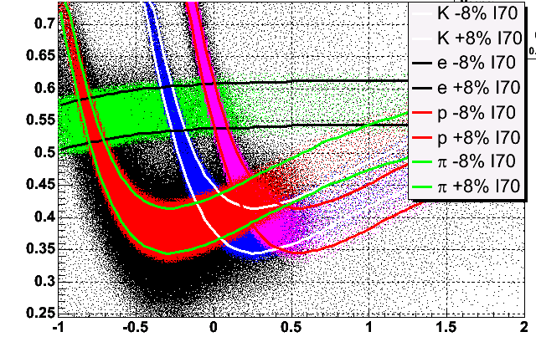
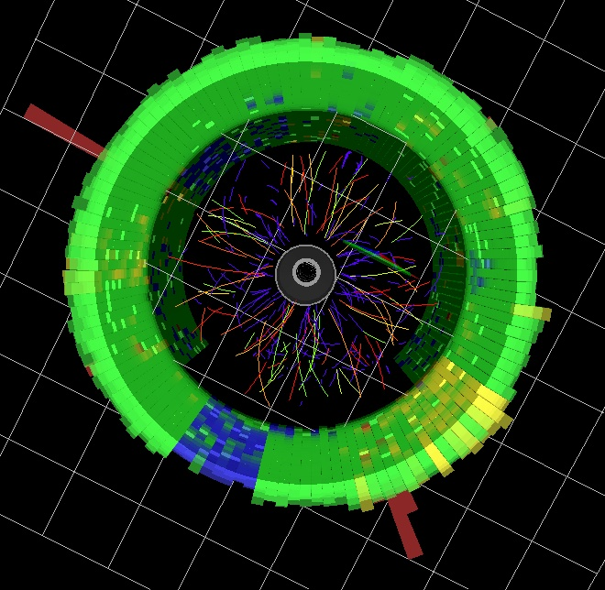
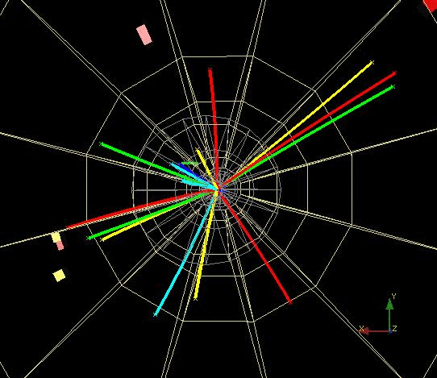
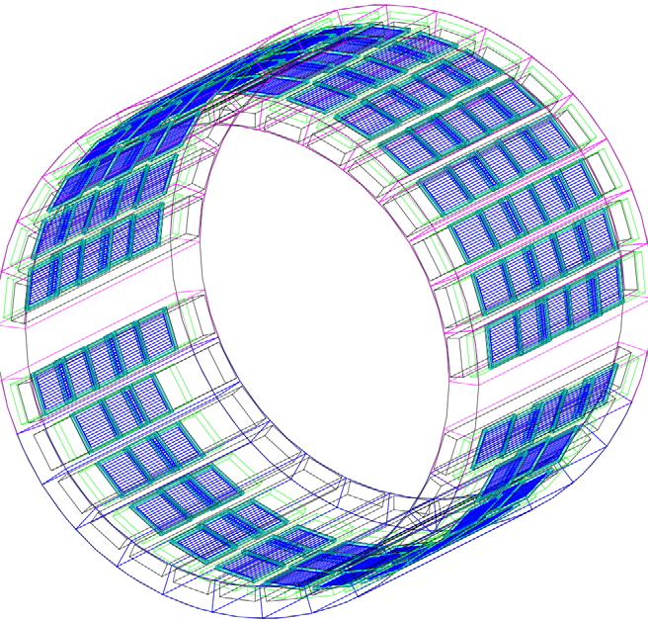
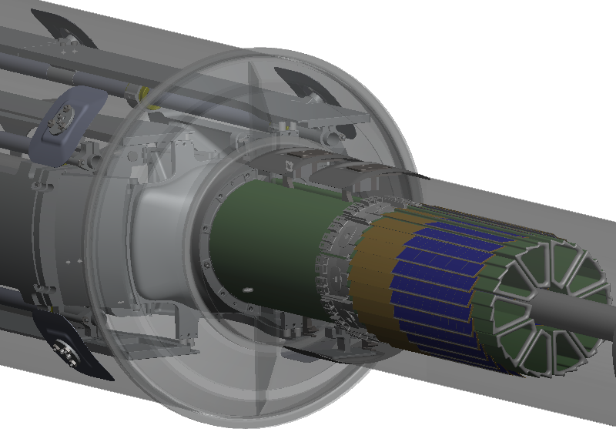
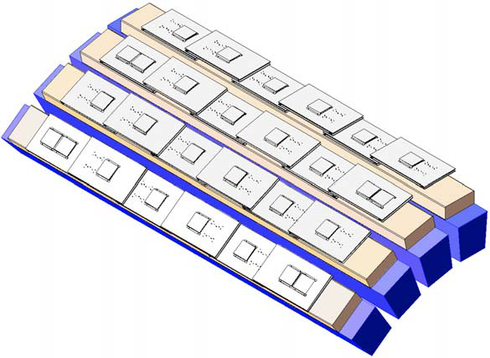
Particle Identification at STAR
TPC TOF TPC
TPC
K p d
π
e, μ
TOF
Log₁₀(p)
Charged hadrons
Hyperons & Hyper-nuclei
MTD
HFT
EMC
Jets
Neutral particles
Jets & Correlations
High p_{T} muons
Heavy-flavor hadrons
Wide acceptance plus excellent particle identification
Multi-fold correlations for identified particles!

Slide 5
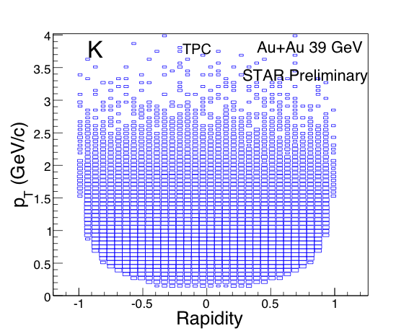
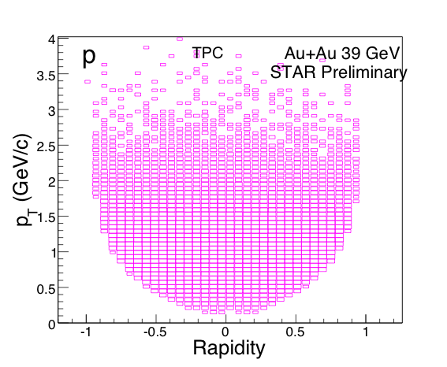
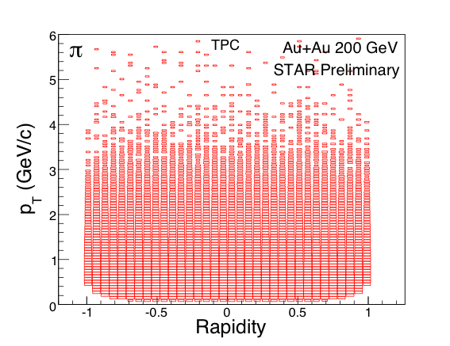
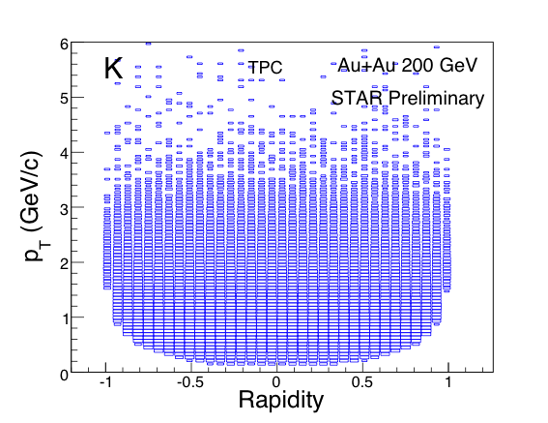
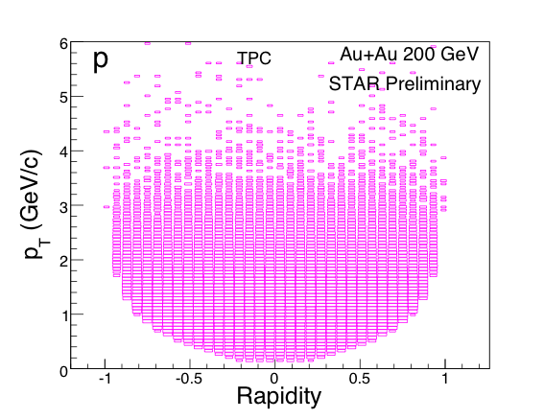
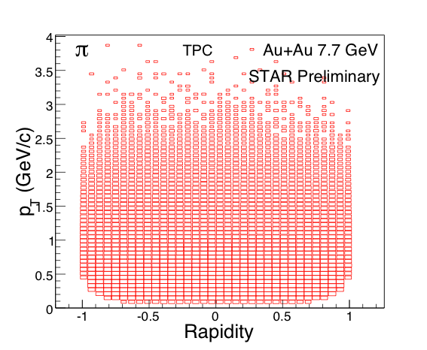
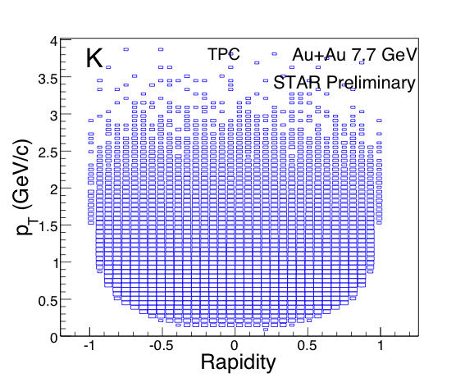
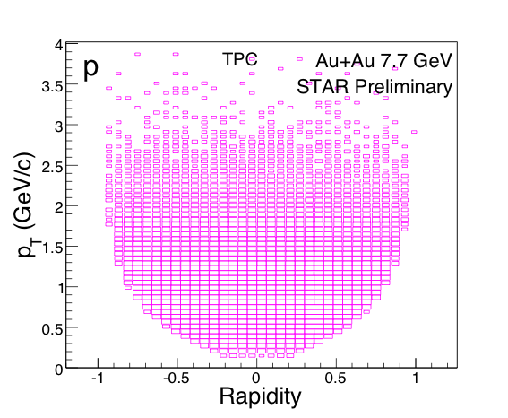
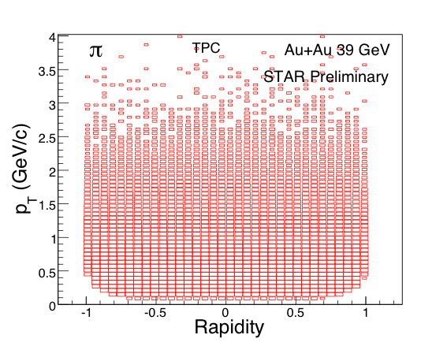
STAR PID for (π, K, p)
Au+Au at 7.7 GeV Au+Au at 39 GeV Au+Au at 200 GeV

Slide 6
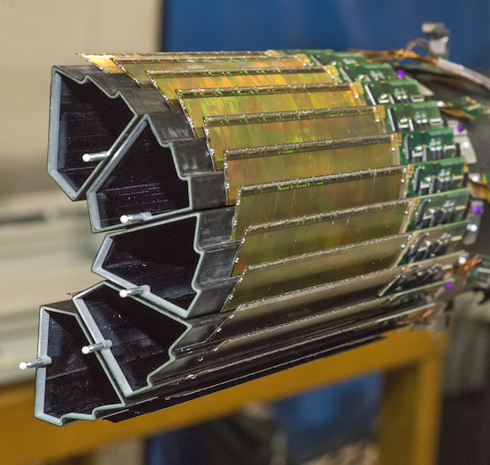
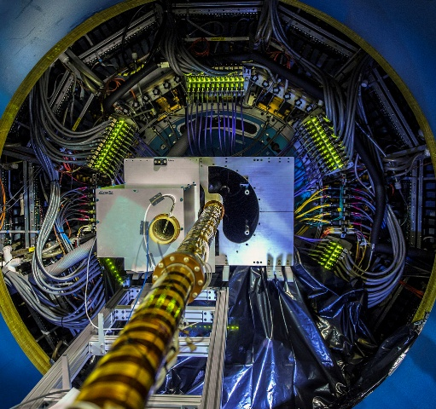
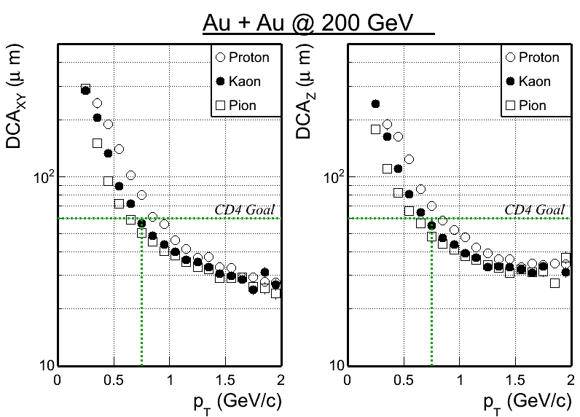
Status: Heavy Flavor Tracker
Heavy Flavor Tracker (HFT)
Physics goal: Precision measurement of heavy quark hadron production in heavy ion collisions
All 3 sub-detectors (PXL, IST, SSD) were completed, installed prior to Run14
PXL – heart of the HFT: state-of-art detector, MAPS technology, first time used at a collider experiment. Integration time ~ 160μs
Taking data with STAR detector system, on track towards the physics goal
With survey and preliminary alignment, Kaons at 750 MeV/c: DCA < 60μm
√s_{NN} = 200GeV Au+Au Collisions
Hao QIU
May 21, [Future experimental facilities, upgrades, and instrumentation]

Slide 7
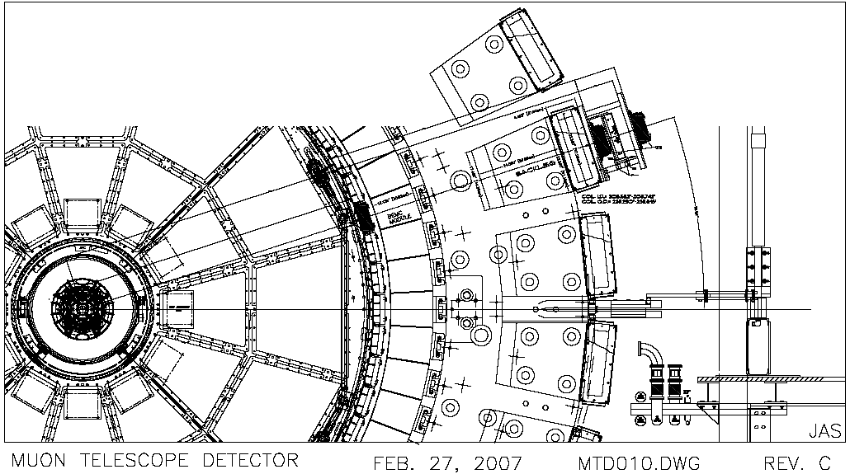
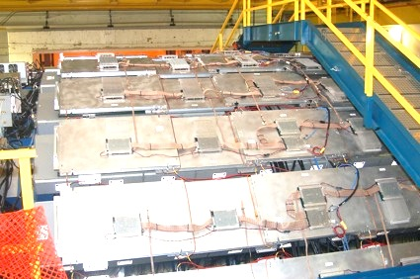
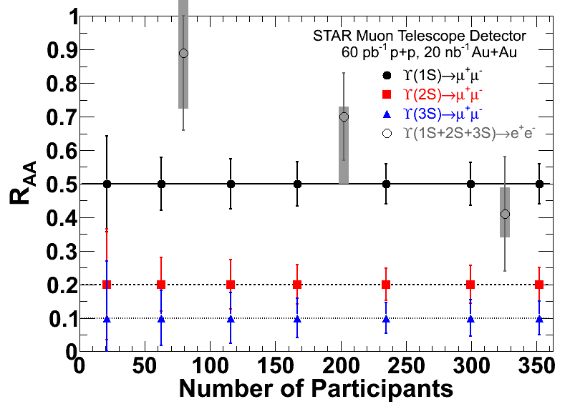
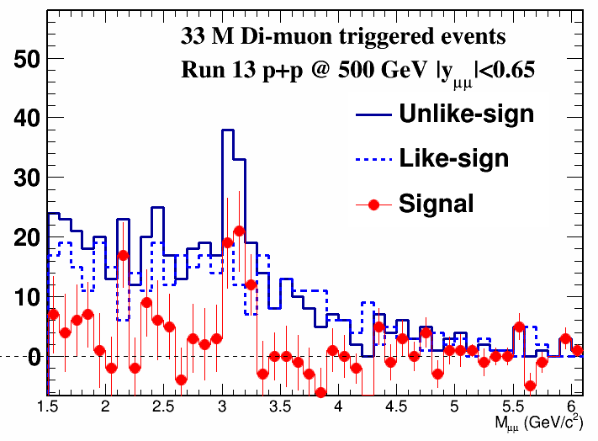
Status: Muon Telescope Detector
Beam pipe
HFT
TPC
TOF
EMC
Magnet
MTD
Muon Telescope Detector (MTD):
Physics goal: Heavy Quarkonia
MRPC technology; covers ~45%
azimuthally and |y| < 0.5
3) Fully installed in Run14: on track for
sampling 10nb⁻¹ in 200GeV Au+Au
for quarkonium physics

Slide 8
STAR Detector Configurations
 | Period | Detectors | Physics
 | 2001-2010 | TPC | u, d, s
 | 2007 | TPC + BEMC | photon
 | 2010 | TPC + TOF | u, d, s + dilepton
 | 2013 | TPC + TOF + MTD | u, d, s, c, b + dilepton
 | 2014 | TPC + TOF + MTD + HFT
STAR: Large coverage, excellent PID, fast DAQ
- detects nearly all particles produced at RHIC
- multi-fold correlation measurements
- Probes: bulk, penetrating, and bulk-penetrating
STAR: Excellent mid-y collider experiment
STAR: Expanding into forward rapidity regions

Slide 9
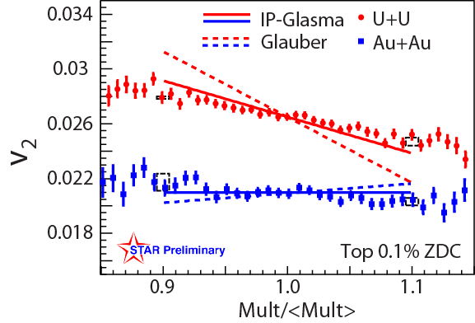
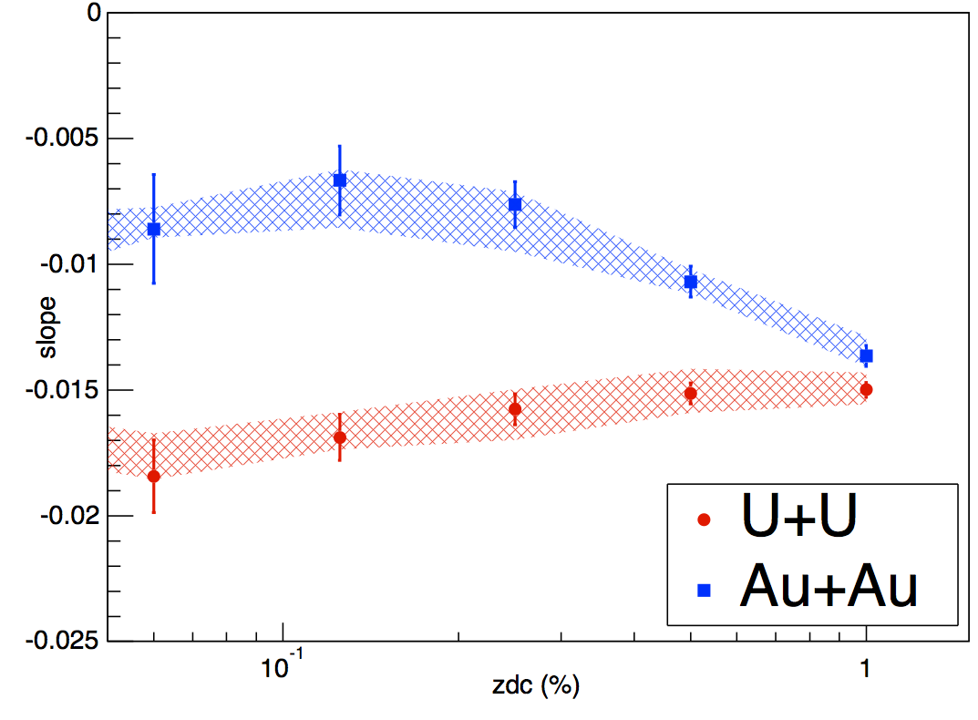


193 GeV U+U Collisions
STAR Preliminary
v₂ Slope
Collision centrality (ZDC)
RHIC delivered the U+U collisions in order to study geometry effects. Model expectation: 20% increase in energy density in very central collisions
Tip-tip and body-body enhanced samples selected via ZDC-mult cut
IP-Glasma model consistent with the observation: implying CGC type of initial condition at RHIC
- Bjoern Schenke, et al. arXiv:1403.2232
- Maciej Rybczyński, et. al. PRC87,044908(13)
Hui WANG
May 19, [Initial state physics]

Slide 10
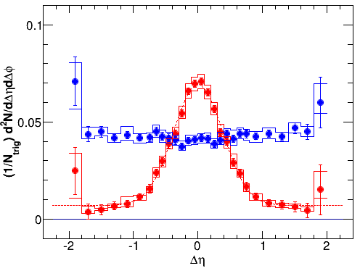
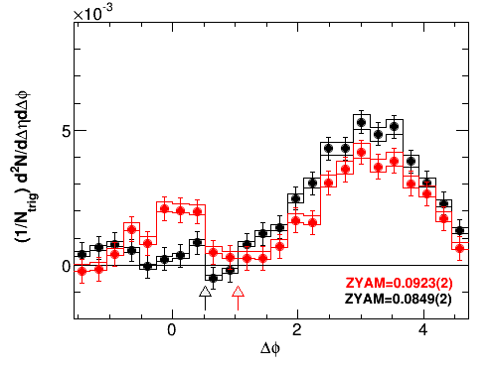
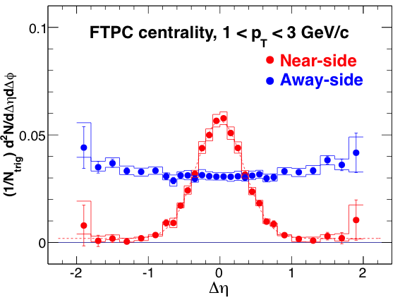
Correlations from d+Au Collisions
200 GeV dAu Collisions, STAR Preliminary
Fit Para. | 40-100% | 0-20%
Width | 0.336(6) | 0.382(9)
Area | 0.0459(10) | 0.0594(18)
Pedestal | 0.0019(4) | 0.0070(9)
χ²/ndf | 19/25 | 19/25
0-20%
40-100%
-4.5 < Δη < -2
Positive
Negative
STAR Preliminary
(1< p_{T} < 3GeV/c)
Near-side peak: centrality dependent
TPC-FTPC correlation, Ridge with Δη~3. Only for positive particles. Flow effect is not seen in this analysis.
Yi LI
May 19, [Initial state physics]

Slide 11
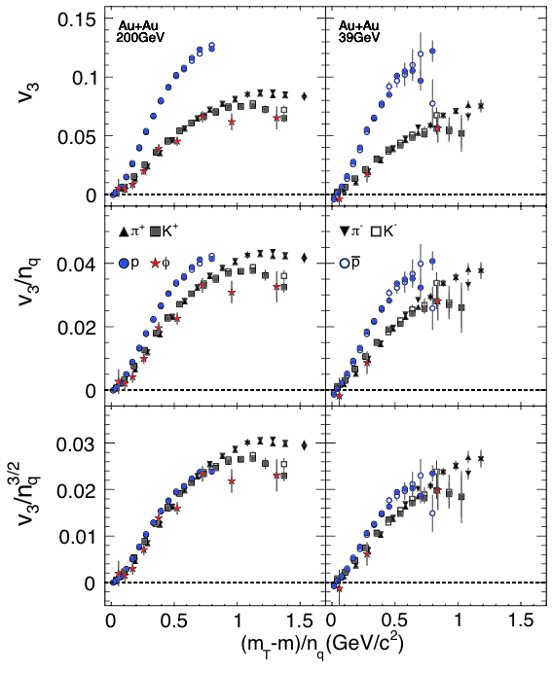
Initial Fluctuation and v_{n}
The first v₃ results from 200 and 39 GeV Au+Au collisions for π, K, p, ϕ
The number of constituent quark scaling does not work for v₃
Hydro inspired (n_{q})^{i/2}, i=3, seems to work for 200 GeV collisions up to m_{T}-m ~ 1 GeV/c²
P. Huovinen, Phys. Lett. B503, 58 (2001)
R. Lacey, J. Phys. G38, 124048(2011)
STAR Preliminary

Slide 12
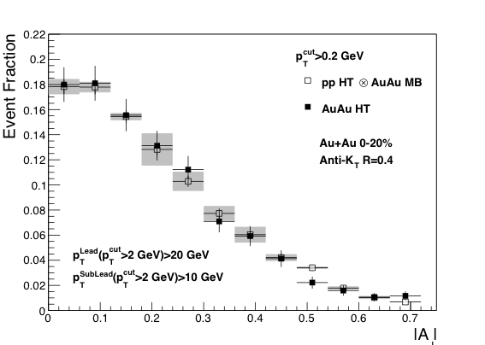
Di-jets Imbalance AJ Result
STAR Preliminary
R=0.4
R=0.4
First di-jets imbalance AJ result in Au+Au collisions at RHIC:
p_{T}>0.2GeV/c, R=0.4: AJ(AuAu) =AJ(pp) changes in Au+Au collisions are all contained in the cone, unlike the LHC. For R=0.2: AJ(AuAu) ≠ AJ(pp), the cone is too small.
Recoil jets are suppressed, path length is maximized.
Tools for jet analysis are ready at RHIC.
Joern PUTSCHKE
May 21, [Jets]

Slide 13
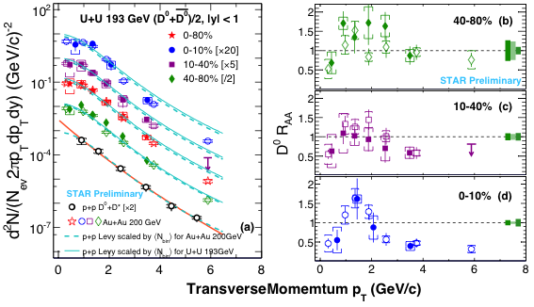
D-mesons in Au+Au/U+U Collisions
- 193 GeV U+U collisions (STAR preliminary):
filled-symbols and solid-lines
200 GeV Au+Au collisions (sub. to PRL, 1404.6185): open-symbols and dashed lines
D⁰ R_{AA}
p_{T} (GeV/c)
D-meson yields, from Au+Au/U+U collisions at RHIC, are similar
As seen in light-flavor hadrons, large suppression in R_{AA} observed at high p_{T}
Model results show that Coalescence is necessary for hadronization in high-energy nuclear collisions
Effect of the cold nuclear matter? p+A collisions data needed.
Zhenyu YE
May 19, [Heavy flavor]

Slide 14
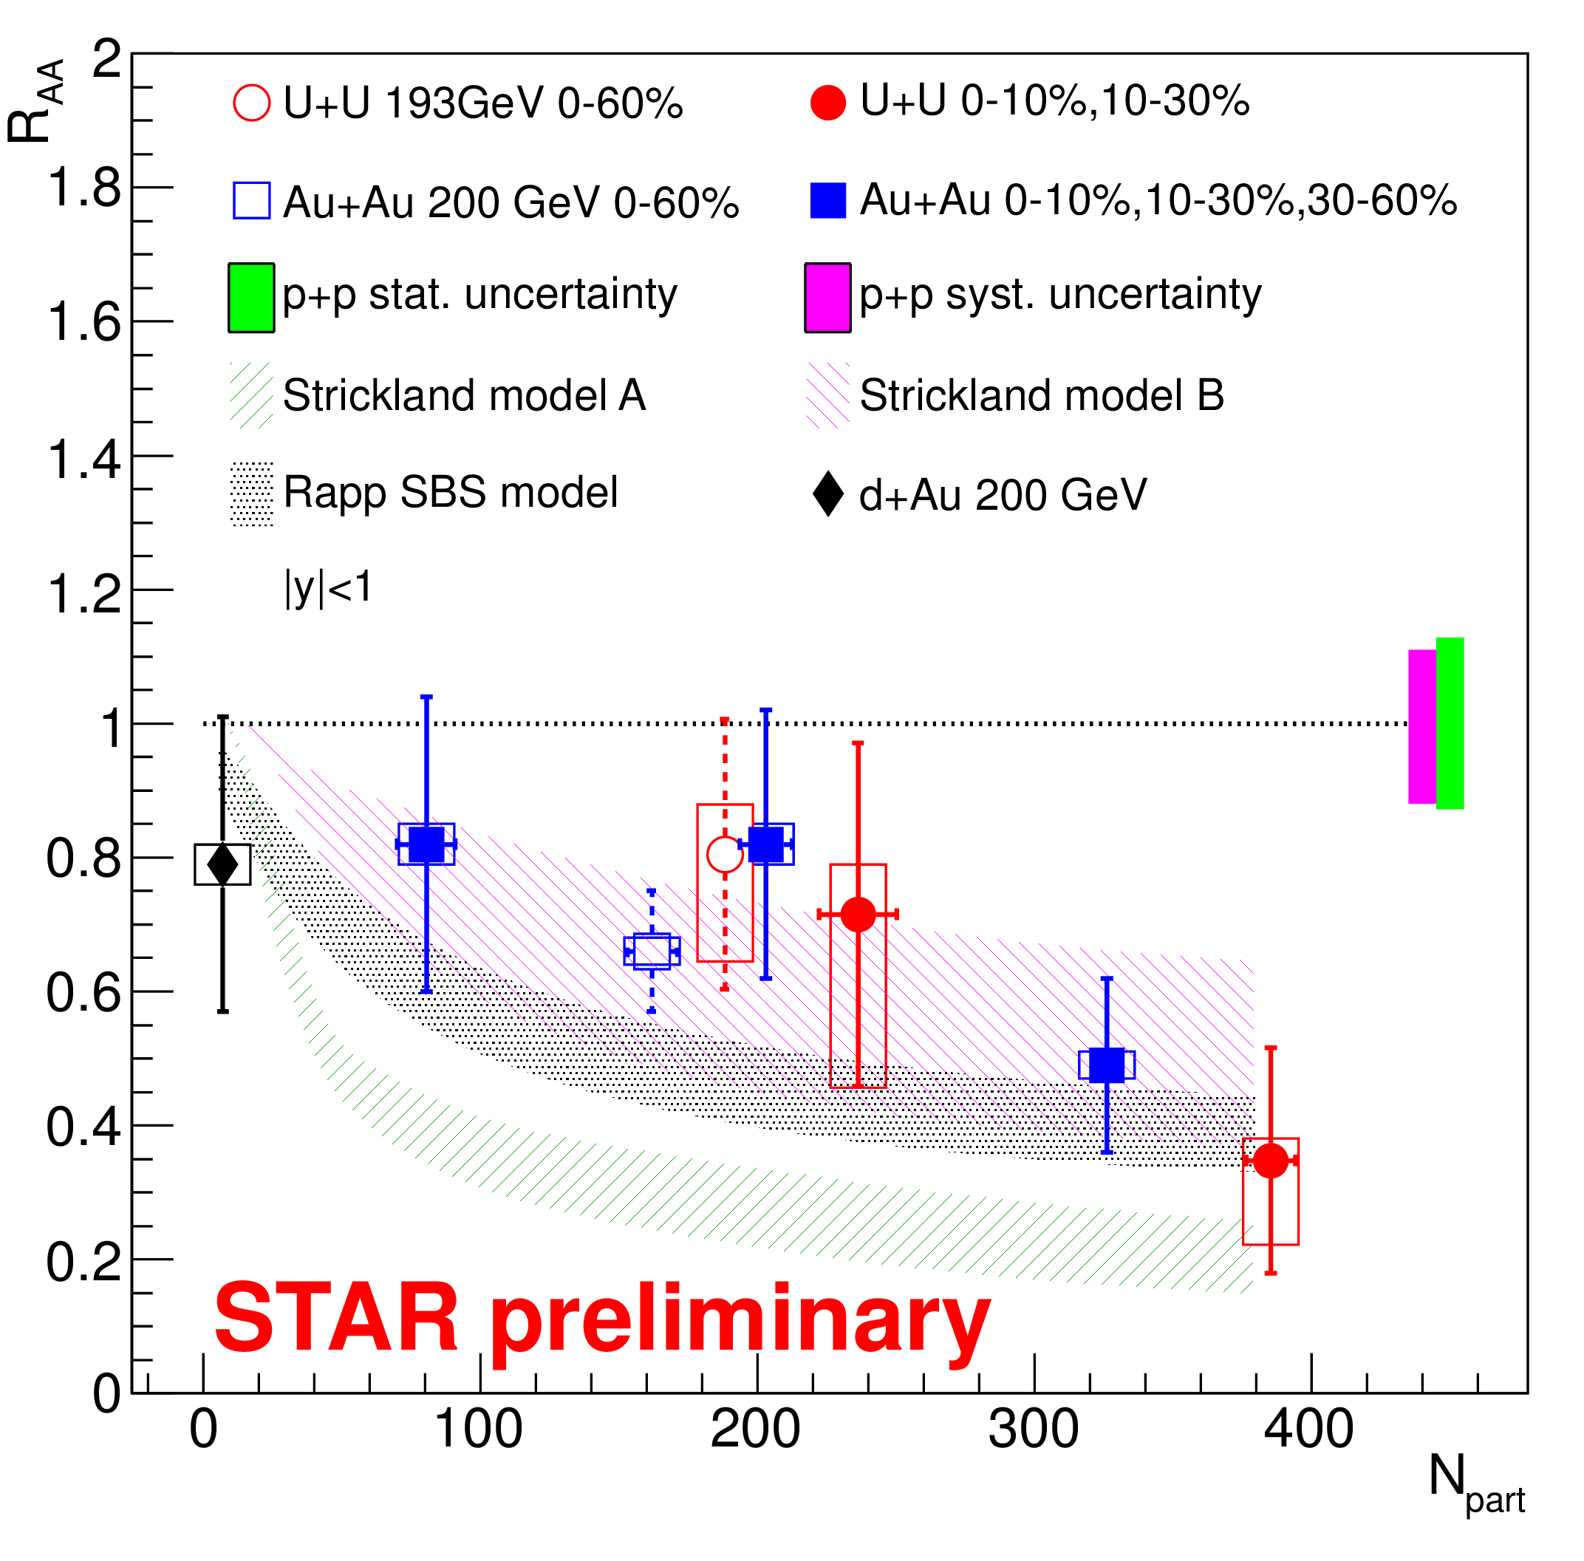
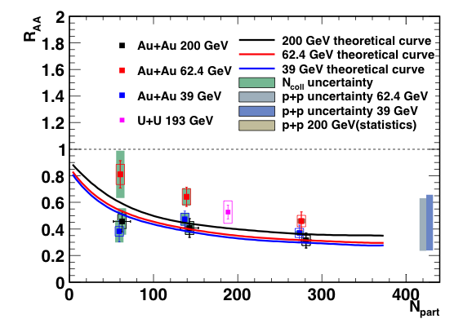
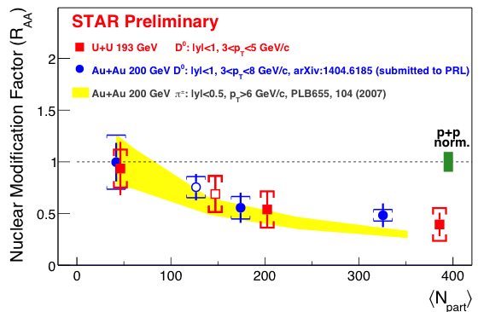
Heavy Flavor from Au+Au/U+U Collisions
J/ψ
STAR Preliminary
Open Charm
ϒ
Central U+U collisions expected to have higher energy density: ~20% increase over Au+Au collisions
Suppression follows the density dependence trend
In 200 GeV Au+Au collisions at RHIC, ~50% J/ψ are formed via coalescence
- X.B. Zhao et al., PRC82, 064905(10)
- L. Yan et al., PRL97, 232301(06)
Wangmei ZHA
May 20, [Heavy flavor]
Xianglei ZHU
May 21, [Thermodynamics and hadron chemistry]

Slide 15
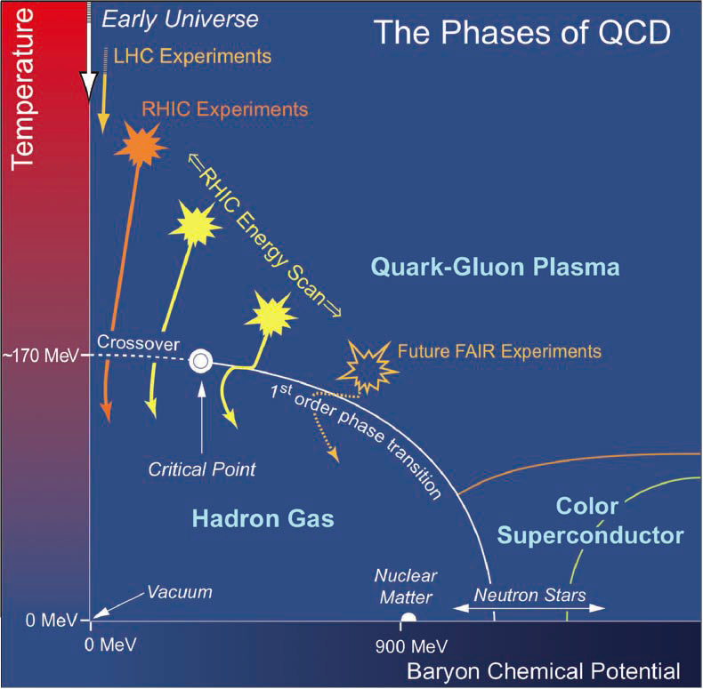
Beam Energy Scan-I at RHIC
Observables:
1st order phase transition
(1) Azimuthally sensitive HBT
(2) Directed flow v₁
Partonic vs. hadronic dof
(3) R_{AA}: Nucl. Mod. Fact.
(4) Charge separation
(5) v₂ - NCQ scaling
Critical point, correl. length
(6) Fluctuations
Chiral symmetry restoration
(7) Di-lepton production
Study QCD Phase Structure
- Onset of sQGP
- Phase boundary and critical point
- Chrial symmetry restoration
BES-I: √s_{NN} = 7.7, 11.5, 14.5, 19.6, 27, 39GeV

Slide 16
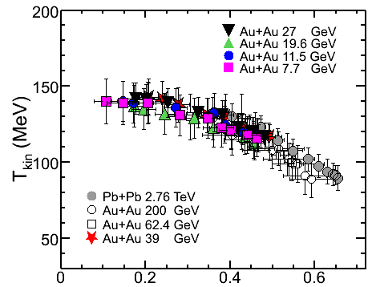
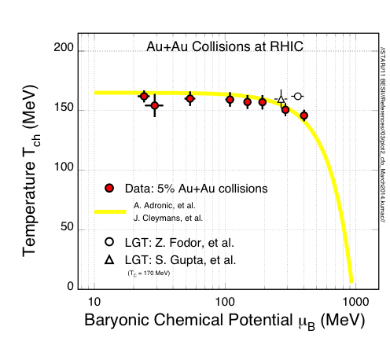
Bulk Properties at Freeze-out
STAR Preliminary
STAR Preliminary
Collective velocity <β> (c)
Chemical Freeze-out: (GCE)
- Central collisions.
- Centrality dependence, not shown,
of T_{ch} and μ_{B}!
Kinetic Freeze-out:
Central collisions => lower value of
T_{kin} and larger collectivity β
Stronger collectivity at higher energy
Xianglei Zhu
May 21, [Thermodynamics and hadron chemistry]
Lokesh KUMAR
May 21, [Thermodynamics and hadron chemistry]

Slide 17
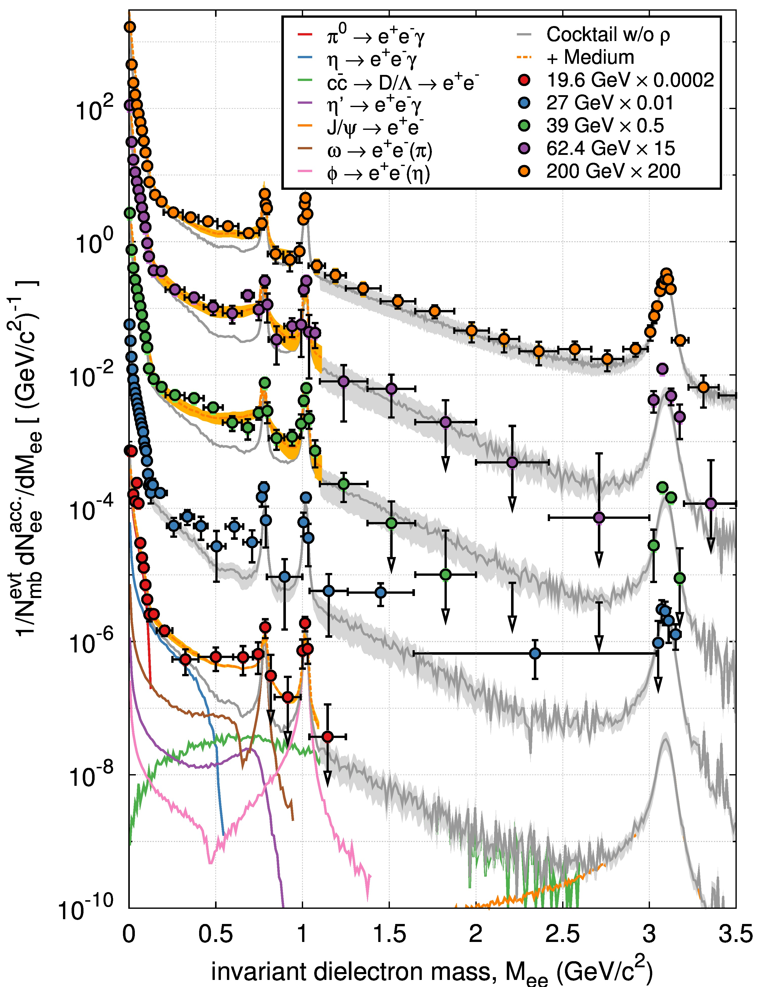
Energy Dependence of Di-electrons
Bulk-penetrating probe:
M_{ee} ≤ 1GeV/c²: In-medium broadened ρ, model results* are consistent with exp. data. At 200GeV, the enhancement is in the order of 1.77±0.11 ±0.24±0.33 within 0.3<M_{ee}<0.7GeV/c²) (* driven by the baryon density in the medium)
1≤M_{ee} ≤ 3GeV/c²: Thermal radiation: exp(-M_{ee}/T)? HFT: Charm contributions.
High statistics data are needed, BES-II!
- STAR: (200GeV data) sub. to PRL. 1312.7397
- R. Rapp: PoS CPOD13, 008(2013)
- O. Linnyk et al, PRC85, 024910(12)
STAR Preliminary
200GeV
62.4GeV
39GeV
27GeV
19.6GeV
Patrick HUCK
May 19, [Electromagnetic probes]

Slide 18
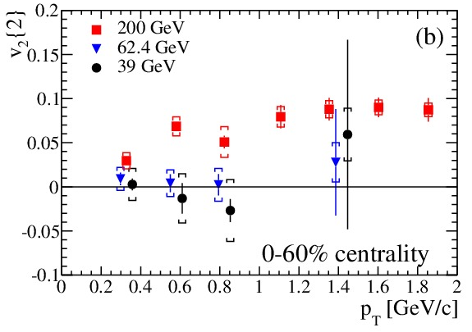
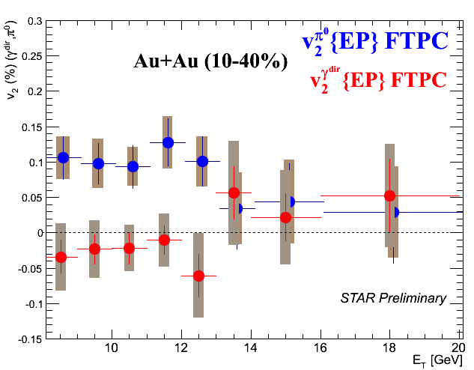
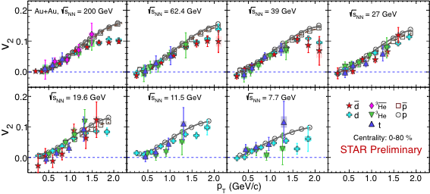
New v₂ Results
NPE: Non-zero v₂ in 200GeV at p_{T} < 2 Gev/c, but at 62.4 and 39GeV collisions, results are consistent with zero.
Direct-γ: At higher energy, 8<E_{T}< 20 GeV, v₂ are consistent with zero.
The v₂ of light nuclei follows the atomic mass number A-scaling, up to proton p_{T}~1.5 GeV/c.
Chi Yang
May 19, [Collective dynamics]
Ahmed M. Hamed May 19, [Electromagnetic probes]
Event anisotropy v₂/A
Md. Rihan HAQUE
May 19, [Collective dynamics]
Transverse momentum p_{T}/A (GeV/c)

Slide 19
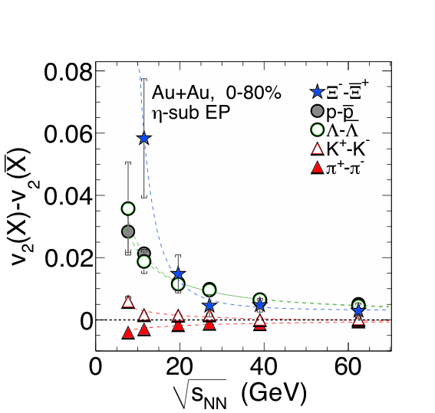
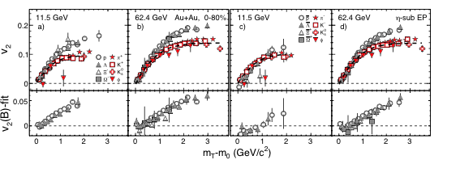
Collectivity v₂ Measurements
STAR: Phys. Rev. Lett. 110 (2013) 142301
Number of constituent quark (NCQ) scaling in v₂ => partonic collectivity => deconfinement in high-energy nuclear collisions
At √s_{NN} < 11.5 GeV, the universal v₂ NCQ scaling is broken, consistent with hadronic interactions becoming dominant.

Slide 20
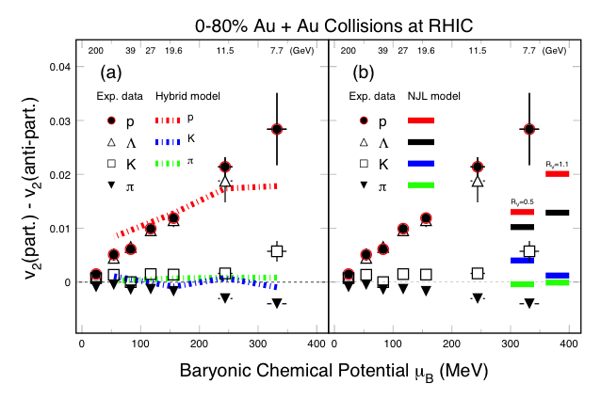
BES v₂ and Model Comparison
Hydro + Transport: consistent with baryon data.
[J. Steinheimer, V. Koch, and M. Bleicher PRC86, 44902(13).]
(b) NJL model: Hadron splitting consistent. Sensitive to vector-coupling, CME, net-baryon density dependent. [J. Xu, et al., arXiv:1308.1753/PRL112.012301]

Slide 21

Study Chiral Effects at STAR
Hot/dense QCD Medium
Parity odd domains form
Chiral Vortical Effect
Λ-proton correlation measurement:
External Magnetic Field
Initial Angular Momentum ➔ Fluid Vorticity
Chiral magnetic effect (CME)
(electric charge)
Chiral vortical effect (CVE)
(baryon charge)
The opposite baryon number (Λ-pbar or Λbar-p) correlations (OB) are similar
The same baryon number (Λ-p or Λbar-pbar) correlations (SB) are lower than that of the OB, as expected from the CVE.
D. Kharzeev, D.T. Son, PRL106, 062301(11)
D. Kharzeev. PLB633, 260 (06)
D. Kharzeev, et al. NPA803, 227(08)
Feng ZHAO
May 20, [QCD phase diagram]

Slide 22



Charge Separation wrt Event Plane
SS - OS
LPV(CME) disappears: with neutral hadrons:
LPV(CME) disappears at low energy:
hadronic interactions become dominant at √s_{NN} ≤ 11.5 GeV
STAR: PRL. 103, 251601(09)
D. Kharzeev. PLB633, 260 (06)
D. Kharzeev, et al. NPA803, 227(08)
STAR: submitted to PRL, arXiv: 1404.1433
Qi-Ye SHOU
May 20, [QCD phase diagram]
Feng ZHAO
May 20, [QCD phase diagram]

Slide 23

Directed Flow v₁: Softest Point
Net-proton slope changes sign twice between √s_{NN} = 7 – 39 GeV
EOS softest point?
Model calculations yet to reproduce the observation
BESII improvement:
- improved reaction plane determination
- systematic centrality dependence analysis
STAR: PRL112, 162301(2014)/aiXiv:1401.3043
[1] D.H. Rischke et al. HIP1, 309(1995)
[2] H. Stoecker, NPA750, 121(2005)
[3] J. Steinheimer et al., arXiv:1402.7236
[4] P. Konchakovski et al., arXiv:1404.2765

Slide 24


Higher Moments
1) Higher moments of conserved quantum numbers: Q, S, B, in high-energy nuclear collisions
2) Sensitive to critical point (ξ correlation length):
3) Direct comparison with calculations at any order:
Extract susceptibilities and freeze-out temperature. An independent/important test of thermal equilibrium in heavy ion collisions.
References:
- STAR: PRL105, 22303(10); ibid, 032302(14)
- M. Stephanov: PRL102, 032301(09) // R.V. Gavai and S. Gupta, PLB696, 459(11) // F. Karsch et al, PLB695, 136(11) // S.Ejiri et al, PLB633, 275(06)
- A. Bazavov et al., PRL109, 192302(12) // S. Borsanyi et al., PRL111, 062005(13) // V. Skokov et al., PRC88, 034901(13)
μ_{B} = 0

Slide 25

Higher Moments Results
BES-II
BES-I
Net-proton results:
All data show deviations below Poisson for κσ² at all energies. Larger deviation at √s_{NN}~20GeV
UrQMD model shows monotonic behavior in the moment products
STAR: PRL112, 32302(14)/arXiv: 1309.5681
Net-charge results:
No non-monotonic behavior
More affected by the resonance decays
STAR: arXiv: 1402.1558
P. Garg et al, PLB726, 691(13)
BES-II is needed:
Higher statistics needed for collisions at √s_{NN} < 20 GeV
Comparing to LGT calculations
T_{f} = 146 ± 6 MeV ,√s_{NN} > 39 GeV
Amal SARKAR
May 21, [QCD phase diagram]

Slide 26
Exploring QCD Phase Structure
1
LHC, RHIC
2
RHIC
3
RHIC, NICA, FAIR
RHIC BES-II
QCD phase structure and critical point
√s_{NN} ≤ 20 GeV
RHIC
Quarkyonic matter?
For region μ_{B} > 500 MeV, √s_{NN} ≤ 5 GeV, fixed-target experiments are much more efficient
RHIC
sQGP properties
√s_{NN} = 200GeV
39 11.5 8

Slide 27
Summary
一、The 200 GeV program:
- Initial Condition: (a) U+U collisions: IP-Glasma results fit to data
(b) d+Au: Collective flow is not observed
- Hot and dense sQGP manifests itself in the measurements of
(a) Di-jet jet A_{J}, jets; (b) Heavy flavor hadron R_{AA}
- HFT/MTD results come soon
二、RHIC Beam Energy Scan Program I (7.7, 11.5, 14.5, 19.6, 27, 39):
- [partonic] < μ_{B} ~ 110 (MeV) ( √s_{NN} ≥ 39 GeV )
- [hadronic] > μ_{B} ~ 320 (MeV) ( √s_{NN} ≤ 11.5 GeV )
(Maximum baryon density at √s_{NN} ~ 8 GeV)
三、RHIC BES-II: focus at √s_{NN} ≤ 20 GeV region
run18 and 19: RHIC e-cooling upgrade, luminosity increase ~10
STAR detector upgrade iTPC+RPD
It is time to discover the QCD critical point!
“The landmark in the QCD phase diagram.”

Slide 28
STAR: Near Future Plans
HFT: Charm
Di-lepton
sQGP properties
- QCD phase structure
- Critical Point
AA: HFT’: B, Λ_{C}
Jet, γ-jet
pA: CNM, p-spin
Phase structure with dense gluon
2013 | 2014 | 2015 | 2016 | 2017 | 2018 | 2019 | 2020 | 2021 | 2022 | 2023 | 2024 | 2025 | 2026
HF-I, (e,μ)
BESII
HFT/MTD
HF-II, p↑A
e-Cooling, iTPC
eSTAR
HFT’, Tracking, EM/HCAL (West side)
EMCAL (East side)
physics
upgrade
eSTAR LOI: drupal.star.bnl.gov/STAR/starnotes/public/sn0592
BES-II whitepaper: drupal.star.bnl.gov/STAR/starnotes/public/sn0598

Slide 29
ACKNOWLEDGEMENTS
1) Argonne National Lab., Argonne, Illinois 60439
2) Brookhaven National Lab., Upton, New York 11973
3) Univ. of California, Berkeley, California 94720
4) Univ. of California, Davis, California 95616
5) Univ. of California, Los Angeles, California 90095
6) Univ. Estadual de Campinas, Sao Paulo, Brazil
7) Univ. of Illinois at Chicago, Chicago, Illinois 60607
8) Creighton Univ., Omaha, Nebraska 68178
9) Czech Technical Univ., Prague, 115 19, Czech Republic
10) Nuclear Physics Inst. ASCR, 250 68,Prague, Czech Republic
11) Univ. of Frankfurt, Frankfurt, Germany
12) Inst. of Physics, Bhubaneswar 751005, India
13) Indian Inst. of Technology, Mumbai, India
14) Indiana Univ., Bloomington, Indiana 47408
15) Alikhanov Inst. for Theoretical and Experimental Physics,
Moscow, Russia
16) Univ. of Jammu, Jammu 180001, India
17) Joint Inst. for Nuclear Research, Dubna, 141 980, Russia
18) Kent State Univ., Kent, Ohio 44242
19) Univ. of Kentucky, Lexington, Kentucky, 40506-0055
20) Inst. of Modern Physics, Lanzhou, China
21) Lawrence Berkeley National Lab., Berkeley, CA 94720
22) Massachusetts Inst. of Technology, Cambridge, MA
23) Max-Planck-Inst. for Physics, Munich, Germany
24) Michigan State Univ., East Lansing, Michigan 48824
25) Moscow Engineering Physics Inst., Moscow Russia
26) National Inst. of Science Education and Research,
Bhubaneswar, 751005 India
27) Ohio State Univ., Columbus, Ohio 43210
28) Panjab Univ., Chandigarh 160014, India
29) Pennsylvania State Univ., Univ. Park, PA 16802
30) Institute of High Energy Physics, Protvino, Russia
31) Purdue Univ., West Lafayette, Indiana 47907
32) Pusan National Univ., Pusan, Republic of Korea
33) Univ. of Rajasthan, Jaipur 302004, India
34) Rice Univ., Houston, Texas 77005
35) Univ. de Sao Paulo, Sao Paulo, Brazil
36) Univ. of Science & Technology of China, Hefei 230026, China
37) Shandong Univ., Jinan, Shandong 250100, China
38) Shanghai Inst. of Applied Physics, Shanghai 201800, China
39) Texas A&M Univ., College Station, Texas 77843
40) Univ. of Texas, Austin, Texas 78712
41) Univ. of Houston, Houston, TX, 77204
42) Tsinghua Univ., Beijing 100084, China
43) United States Naval Academy, Annapolis, MD 21402
44) Valparaiso Univ., Valparaiso, Indiana 46383
45) Variable Energy Cyclotron Centre, Kolkata 700064, India
46) Warsaw Univ. of Technology, Warsaw, Poland
47) Univ. of Washington, Seattle, Washington 98195
48) Wayne State Univ., Detroit, Michigan 48201
49) Inst. of Particle Physics, CCNU, Wuhan 430079, China
50) Yale Univ., New Haven, Connecticut 06520
51) Univ. of Zagreb, Zagreb, HR-10002, Croatia

Slide 30

Stay tuned
for more exciting news from
the STAR Experiment

Slide 31
STAR HIGHTLIGHTS at QM2014
Initial State Physics, Penetrating Probes, sQGP Properties
May 19, 12:00-12:20, Titanium [Initial state physics] Hui Wang “Flow measurements and selection of body-body and tip-tip enhanced samples in U+U collisions at STAR”
May 19, 12:00-12:20, Platinum [Heavy flavor] Zhenyu Ye “Open charmed hadron production in p+p, Au+Au and U+U collisions at STAR”
May 20, 9:40-10:00, Platinum [Heavy flavor] Wangmei Zha “Recent STAR measurements of J/ψ production from Beam Energy Scan and U+U collisions”
May 19, 14:40-15:00, Helium [Electromagnetic probes] Chi Yang “Direct virtual photon and dielectron production in Au+Au collisions at 200 GeV at STAR”
May 19, 16:30-16:50, Helium [Electromagnetic probes] Ahmed M. Hamed “Measurements of direct-photon-hadron correlations and direct-photon azimuthal anisotropy by STAR”
May 19, 17:30-17:50, Titanium [Initial state physics] Li Yi “Searching for the "Ridge" in d+Au collisions at RHIC by STAR”
May 21, 9:40-10:00, Titanium [Jets] Joern Putschke “Semi-inclusive recoil jet distribution and di-jets imbalance measurements in central Au+Au collisions in STAR”
May 21, 11:50-12:10, Platinum [Future experimental facilities, upgrades, and instrumentation] Hao Qiu “STAR Heavy Flavor Tracker”
QCD Phase Structure and Beam Energy Scan at RHIC
May 19, 15:00-15:20, Europium [Collective dynamics] Md. Rihan Haque “Elliptic flow of light nuclei and identified hadrons, their centrality and energy dependence in STAR”
May 21, 10:20-10:40, Helium [Thermodynamics and hadron chemistry] Lokesh Kumar “Systematics of the kinetic freeze-out properties in high-energy nuclear collisions from STAR”
May 21, 11:10-11:30, Helium [QCD phase diagram] Amal Sarkar “Energy dependence of higher moments of net-kaon, net-proton and net-charge multiplicity distribution at STAR”
May 19, 11:00-11:20, Helium [Electromagnetic probes] Patrick Huck “Beam energy dependence of dielectron production in Au+Au collisions from STAR at RHIC”
May 20, 9:20-9:40, Helium [QCD phase diagram] Feng Zhao “Λ(K_{s}⁰)-h± azimuthal correlations with respect to event plane and searches for chiral magnetic and vortical effects at STAR”
May 20, 10:00-10:20, Helium [QCD phase diagram] Qi-Ye Shou “Charge asymmetry dependency of π/K anisotropic flow in U+U and Au+Au collisions at STAR”
May 21, 9:20-9:40, Helium [Thermodynamics and hadron chemistry] Xianglei Zhu “Ω and ϕ production in p+p, Au+Au and U+U collisions at STAR”

