Slide 1
Local Polarimetry with Zero Degree Calorimeter at STAR
Oleksandr Grebenyuk, LBNL STAR Collaboration

Slide 2
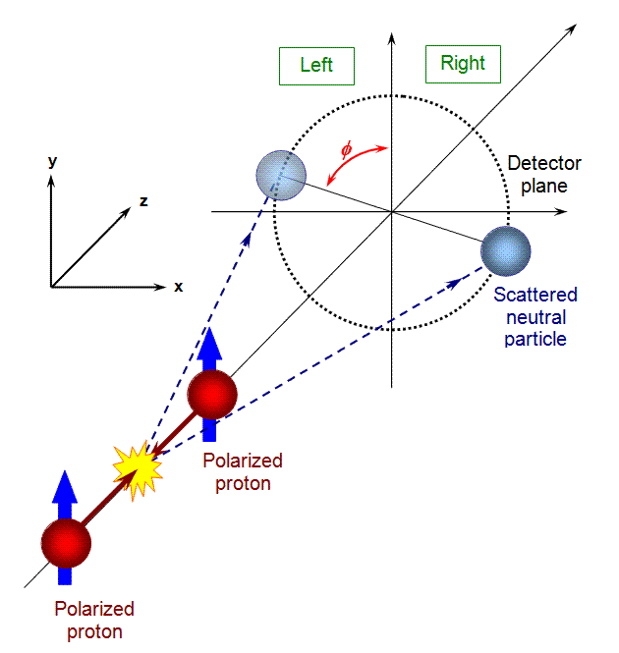
Single-spin asymmetry at zero angle
Hadronic calorimeter equipped with Shower Maximum Detector detects very forward neutral particles
p↑+ p → n + X
Large asymmetry A_{N} of neutron production enables its use as a local polarimeter

Slide 3
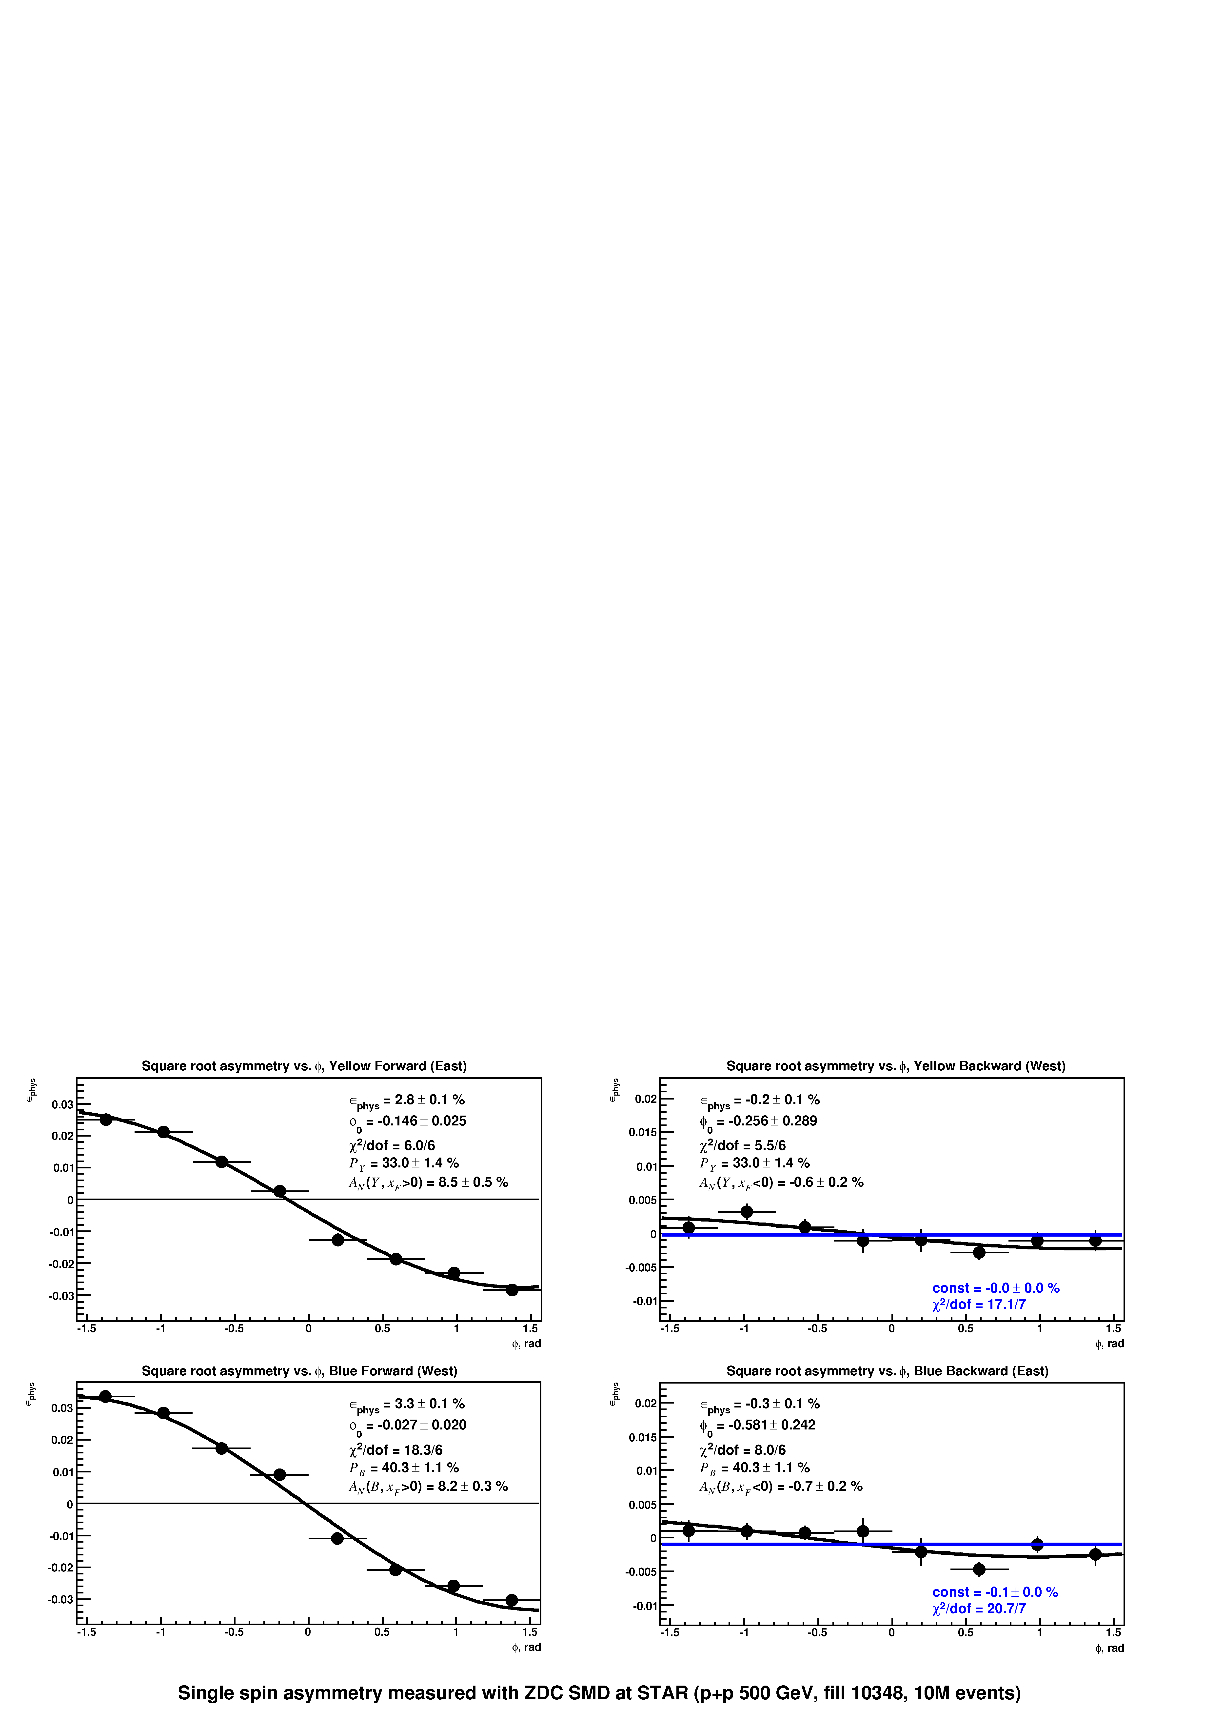
Single-spin asymmetry at zero angle
STAR Preliminary

Slide 4
Results
In 2009 STAR has commissioned Zero Degree Calorimeter as a local polarimeter for polarized proton collisions at √s = 500 GeV
Two independent analyses see consistent analyzing powers A_{N} > 8% for both beams
Analyzed multiple trigger conditions and fill patterns
At 200 GeV analyzing power is about 4%
Launched the online monitoring so results are available very quickly
We acknowledge an excellent pioneering work by PHENIX Collaboration since 2001

