Slide 1


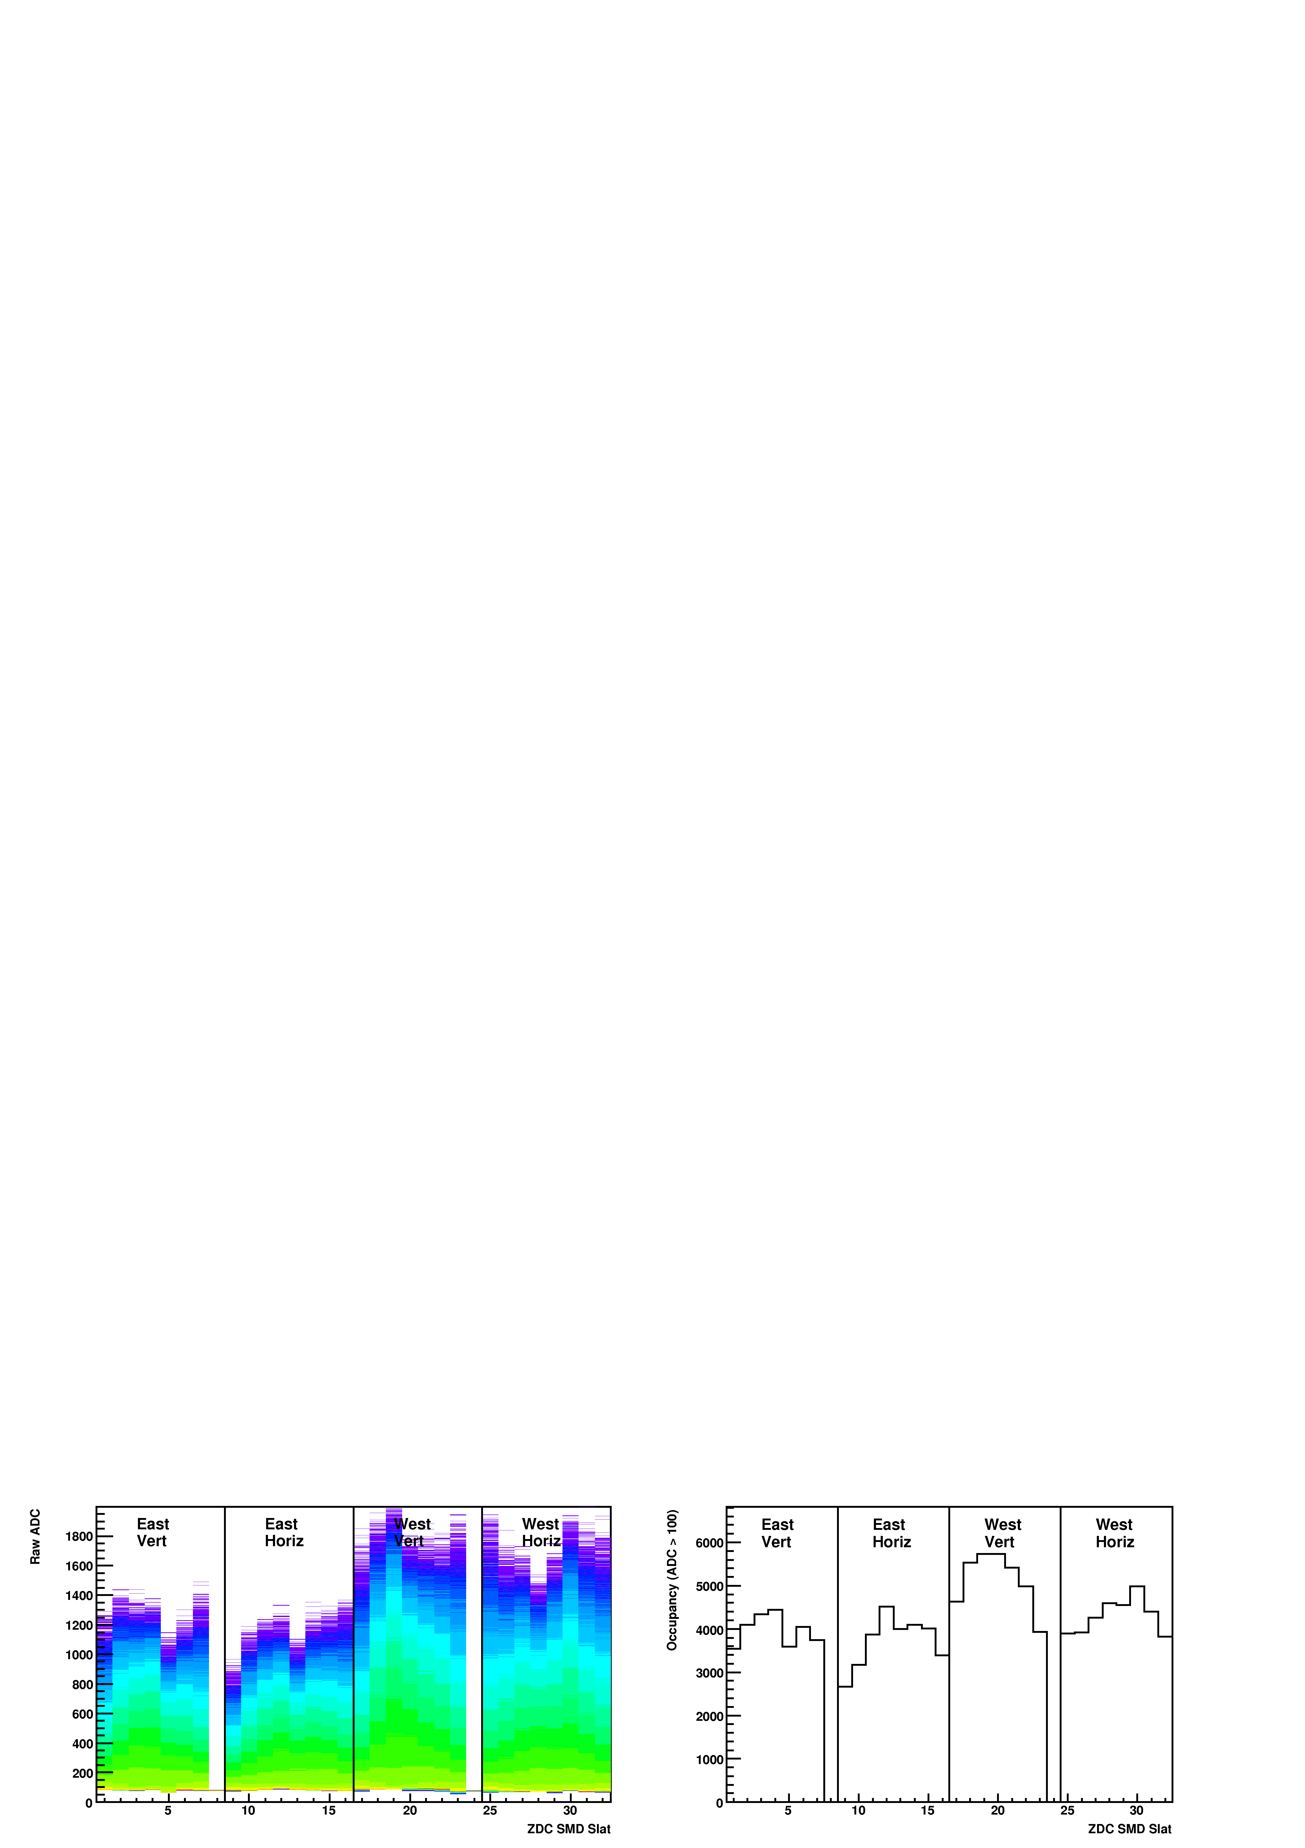
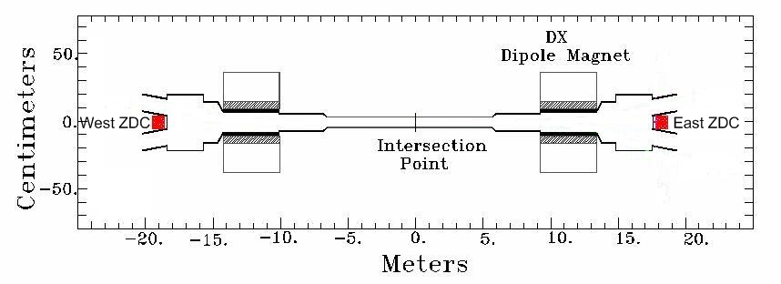
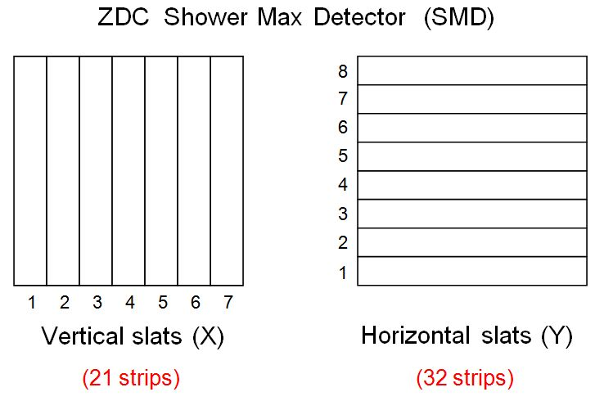
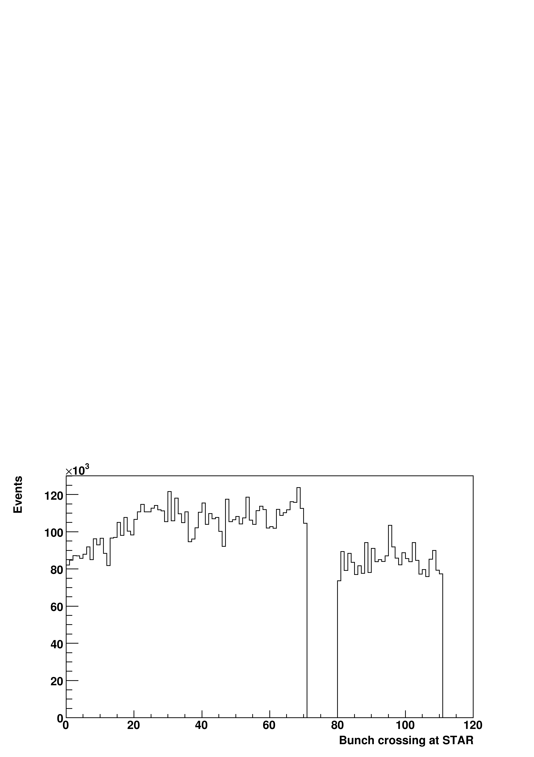
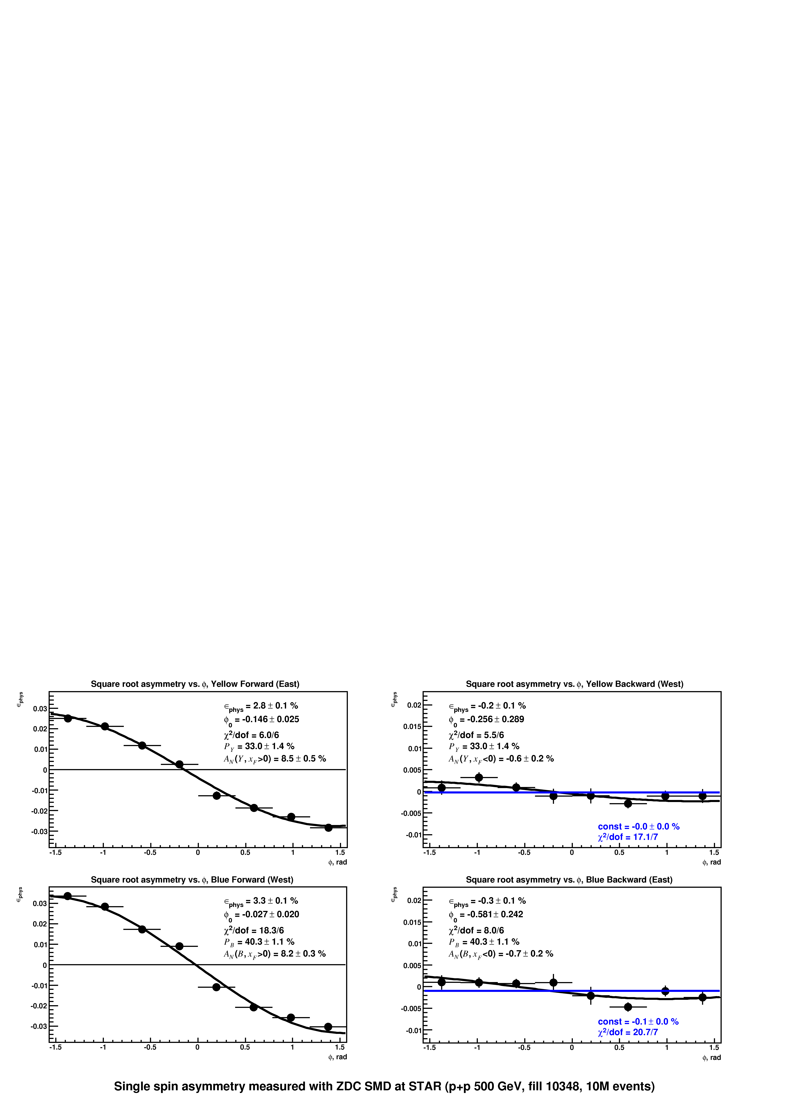
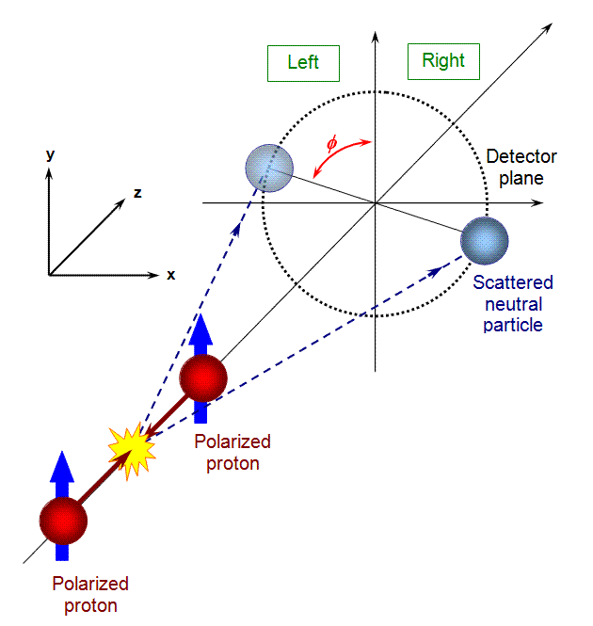
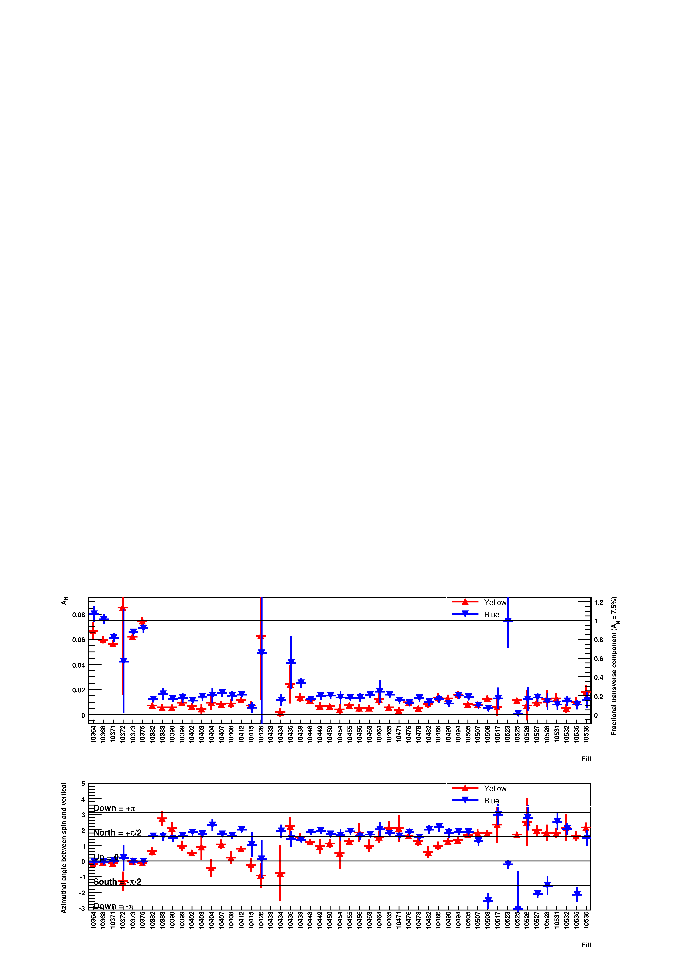
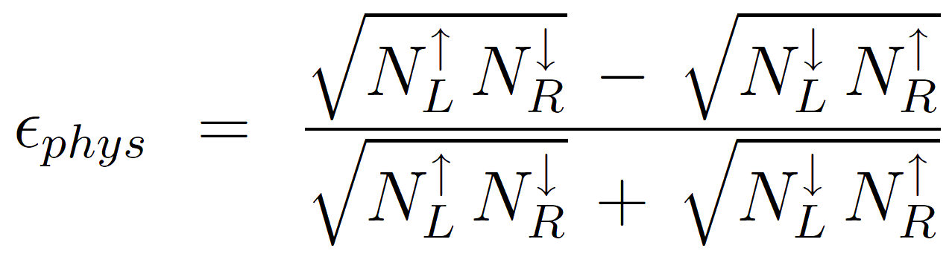
Local Polarimetry with Zero Degree Calorimeter at STAR
Oleksandr Grebenyuk, LBNL
STAR Collaboration
Introduction
In 2009 STAR has commissioned Zero Degree Calorimeter (ZDC)
as a local polarimeter for polarized proton collisions at √s = 500 GeV
ZDC is a Cherenkov-light sampling calorimeter that detects forward neutral particles (<2 mrad)
Upgraded with Shower Maximum Detector (SMD) to provide transverse position of hadronic showers
STAR also uses Beam-Beam Counters (BBC) for polarimetry at √s = 200 GeV
but BBC has insufficient analyzing power at higher energies
Method
Subtract pedestals and match gains of
vertical and horizontal SMD slats
Good hit = combination of highest vertical
and highest horizontal slat in the event
in each of the two ZDCs
Yellow: ++--++--…
Blue: +-+--+-+…
Calculate single spin asymmetry εphys of good hits
Square-root formula is insensitive to small variations
in luminosity and acceptance between spin states
Transverse component of the beam polarization leads to azimuthal modulation of asymmetry
Results
Transverse
Longitudinal running
STAR Preliminary
Two independent analyses see consistent analyzing powers of >8% for both beams
Analyzed multiple trigger conditions and fill patterns
At 200 GeV analyzing power is about 4%
Launched the online monitoring so results are available very quickly
Observe a 10—20% transverse component in longitudinally polarized beams
2009 RHIC & AGS Annual Users’ Meeting, BNL

