Slide 1
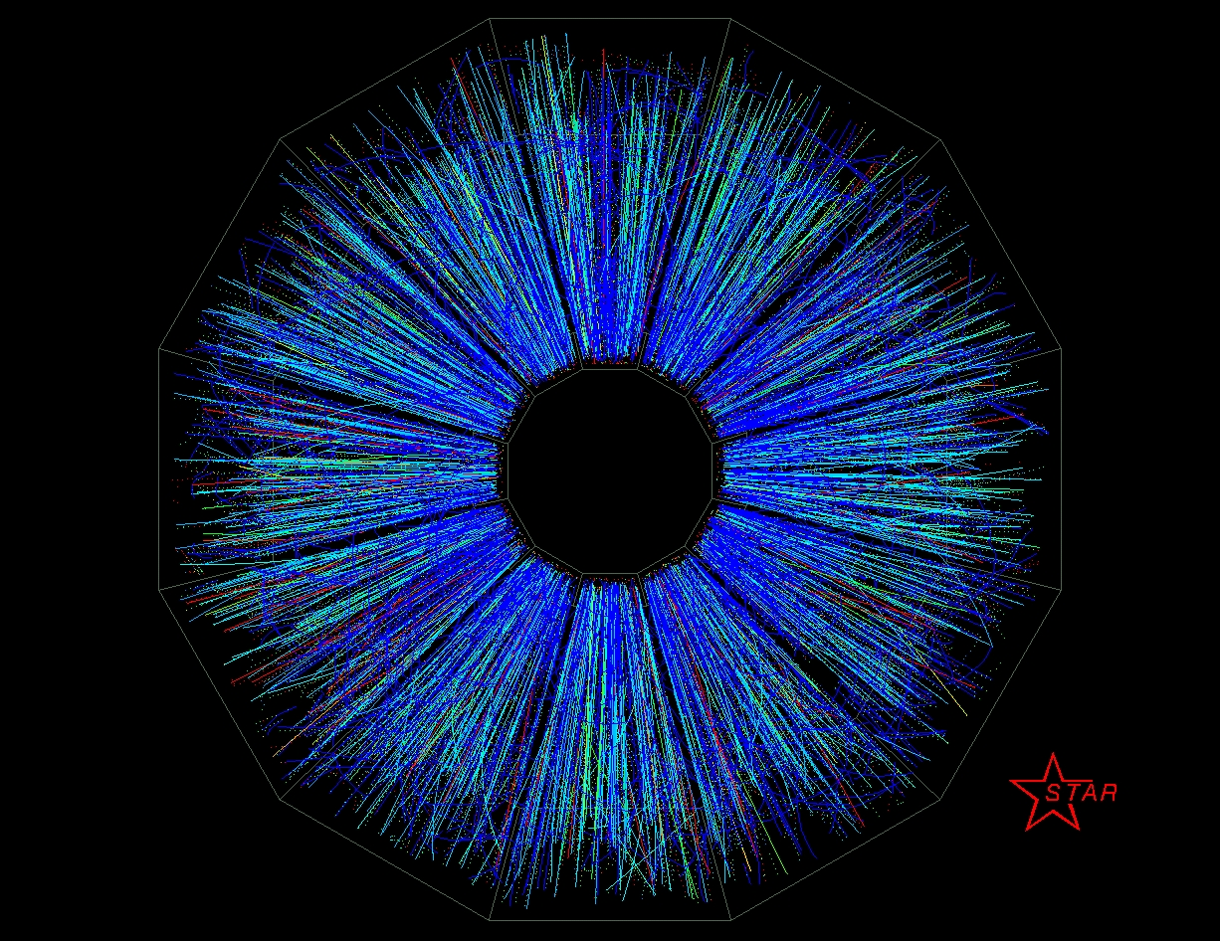


The next decade of physics with STAR
1st Collision
June 12, 2000
James Dunlop for the STAR Collaboration

Slide 2
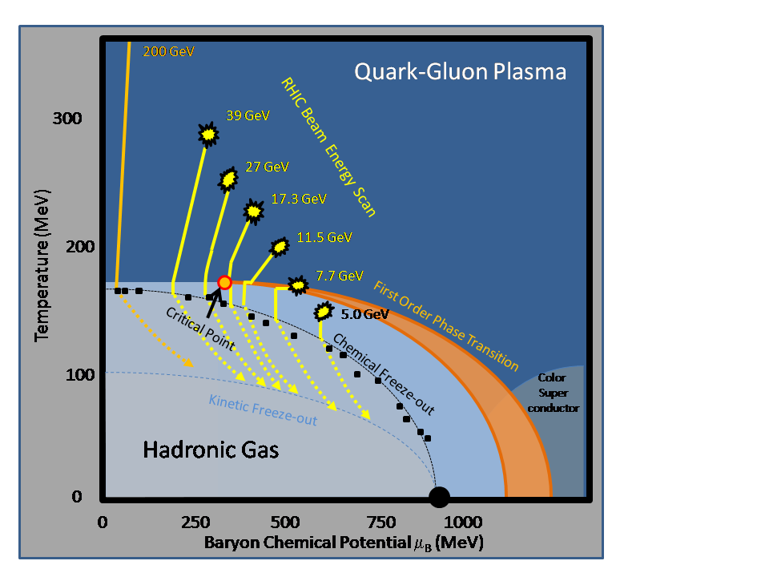
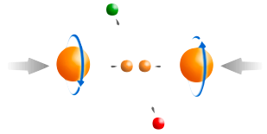
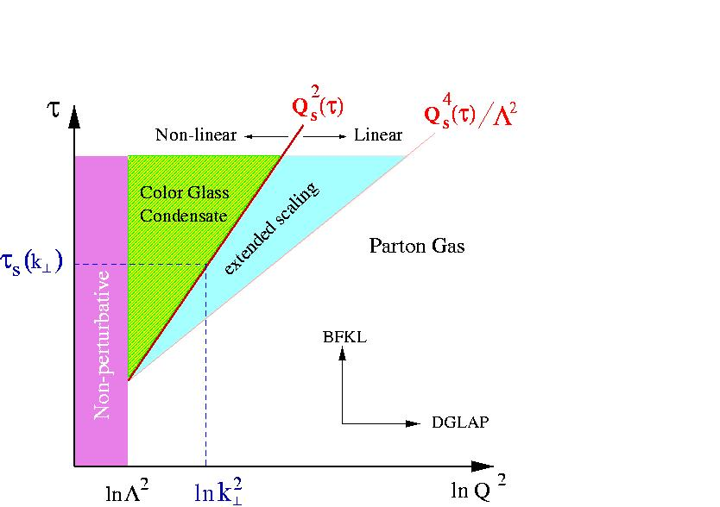
RHIC: Key Unanswered Questions
Hot QCD Matter
Partonic structure
Spin structure of the nucleon
How to go beyond leading twist and
colinear factorization?
Properties of the sQGP in detail
Mechanism of Energy Loss:
weak or strong coupling?
Is there a critical point, and if so, where?
Novel symmetry properties
Exotic particles
What are the properties of
cold nuclear matter?

Slide 3
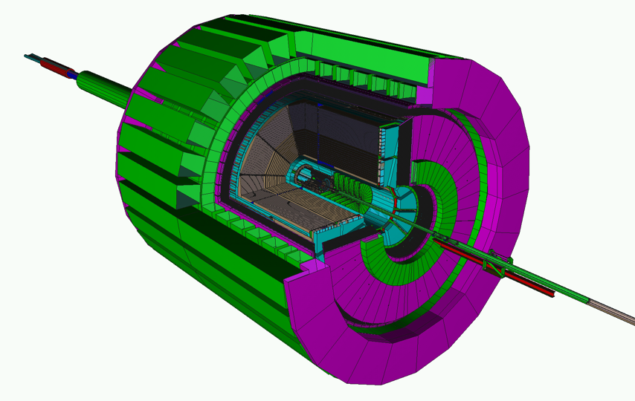
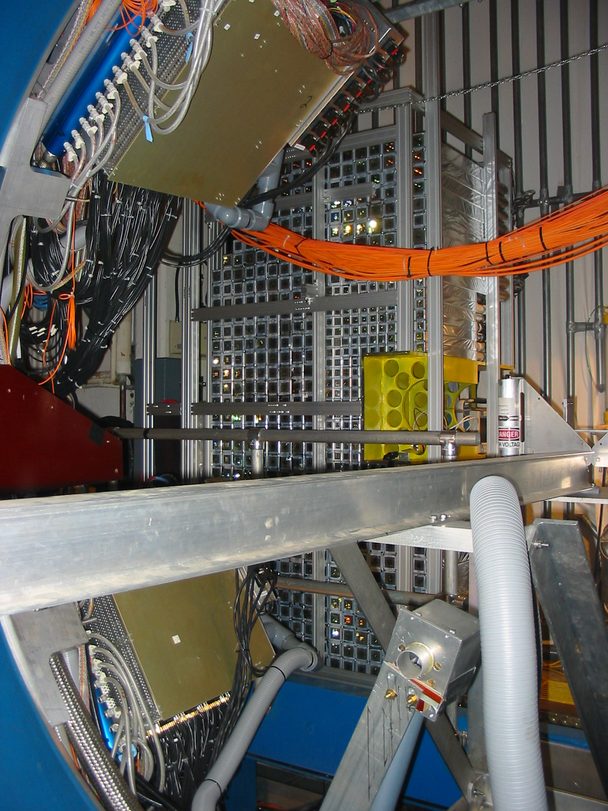

STAR: A Correlation Machine
Tracking: TPC
Particle ID: TOF
Electromagnetic Calorimetry:
BEMC+EEMC+FMS
(-1 ≤ η ≤ 4)
Muon Telescope Detector (2014)
Further Upgrades:
Roman Pots Phase 2
Forward Upgrade
Heavy Flavor Tracker (2014)
Full azimuthal particle identification
over a broad range in pseudorapidity
Forward Gem Tracker
(2012)

Slide 4
How to answer these questions
Hot QCD matter: high luminosity RHIC II (fb⁻¹ equivalent)
  Heavy Flavor Tracker: precision charm and beauty
  Muon Telescope Detector: e+μ and μ+μ at mid-rapidity
  Trigger and DAQ upgrades to make full use of luminosity
  Tools: jets combined with precision particle identification
Phase structure of QCD matter: energy scan
Cold QCD matter: high precision p+A, followed by e+A
  Major upgrade of capabilities in forward direction
  Existing mid-rapidity detectors well suited for portions of e+A program
Is there a universal form of cold QCD matter, and what are its properties?

Slide 5
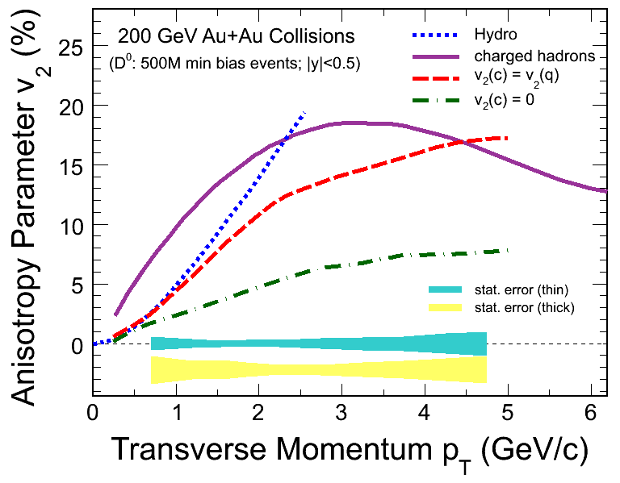
Properties of sQGP: Charm
Does charm flow hydrodynamically?
  Heavy Flavor Tracker: Unique access to fully reconstructed charm at low p_{T}
Are charmed hadrons produced via coalescence?
  Heavy Flavor Tracker: unique access to charm baryons (may affect NPE)
  Muon Telescope Detector: does J/Ψ flow?

Slide 6
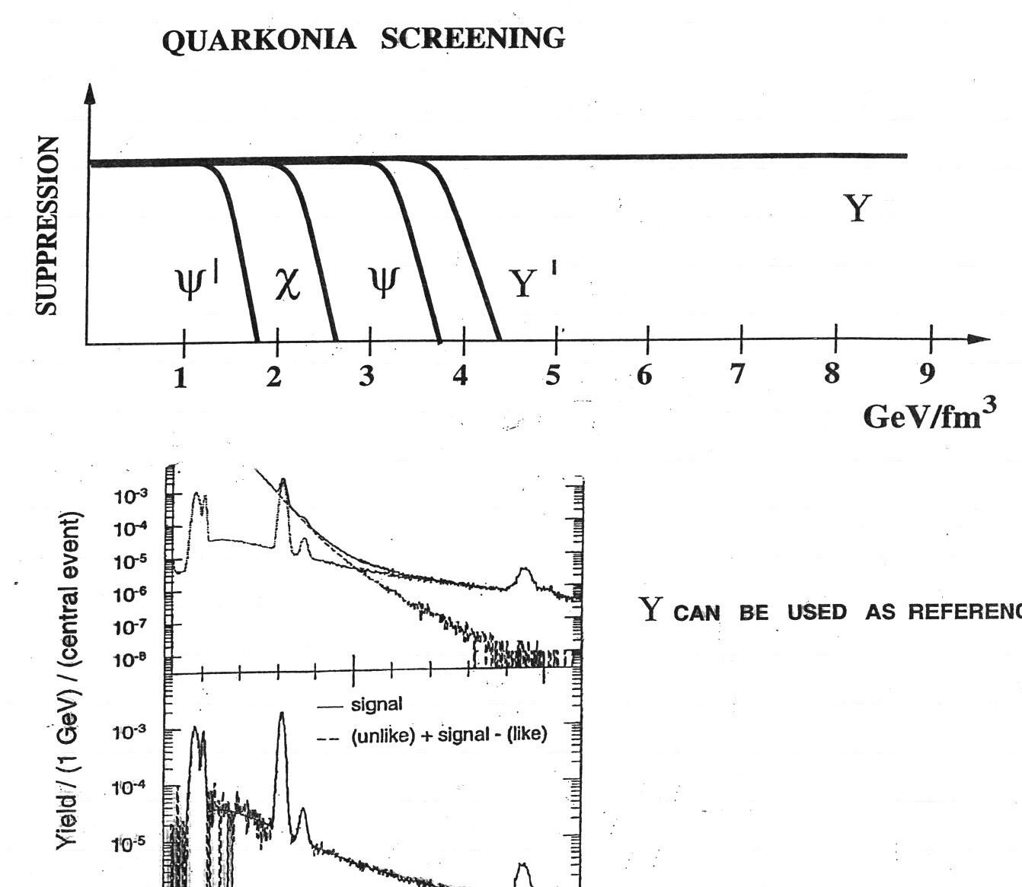
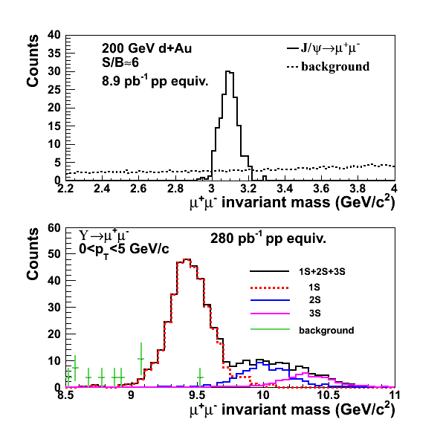
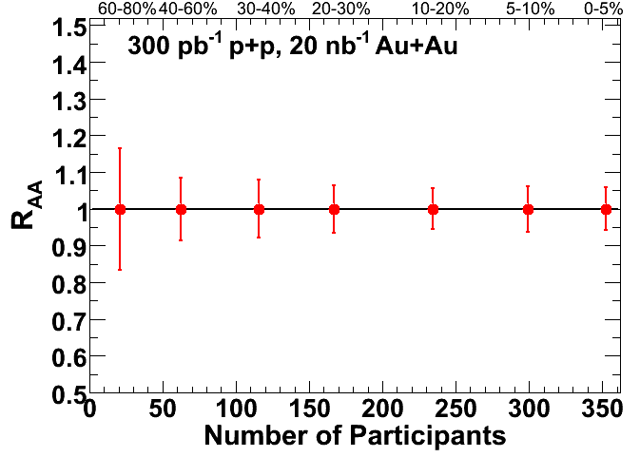
Properties of sQGP: Upsilon
What states of quarkonia is the
energy density of matter at RHIC
sufficient to dissociate?
What is the energy density?
RHIC
Υ
Muon Telescope Detector: Dissociation of Υ, separated by state
  At RHIC: small contribution from coalescence, so interpretation clean
  No contribution of Bremsstrahlung tails, unlike electron channel

Slide 7
Mechanism of partonic energy loss
Is the mechanism predominantly collisional or radiational?
  Detailed, fully kinematically constrained measurements via gamma-hadron and full jet reconstruction
  Pathlength dependence, especially with U+U
Does the mechanism depend on the parton type?
  Gluons: particle identification, especially baryons
  Light quarks: gamma-hadron
  Heavy quarks: Heavy Flavor Tracker and Muon Telescope Detector
Does the energy loss depend on the parton energy and/or velocity?
  High precision jet measurements up to 50 GeV
  Vary velocity by comparing light quarks, charm, and beauty

Slide 8
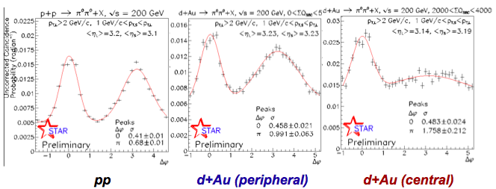
Cold QCD Matter
Hint that RHIC provides unique access to onset of saturation
Compelling and necessary further measurements in future
  Kinematic constraints: photons, Drell-Yan in p+A
  Beyond p+A: the Electron Ion Collider
See C. Perkins

Slide 9
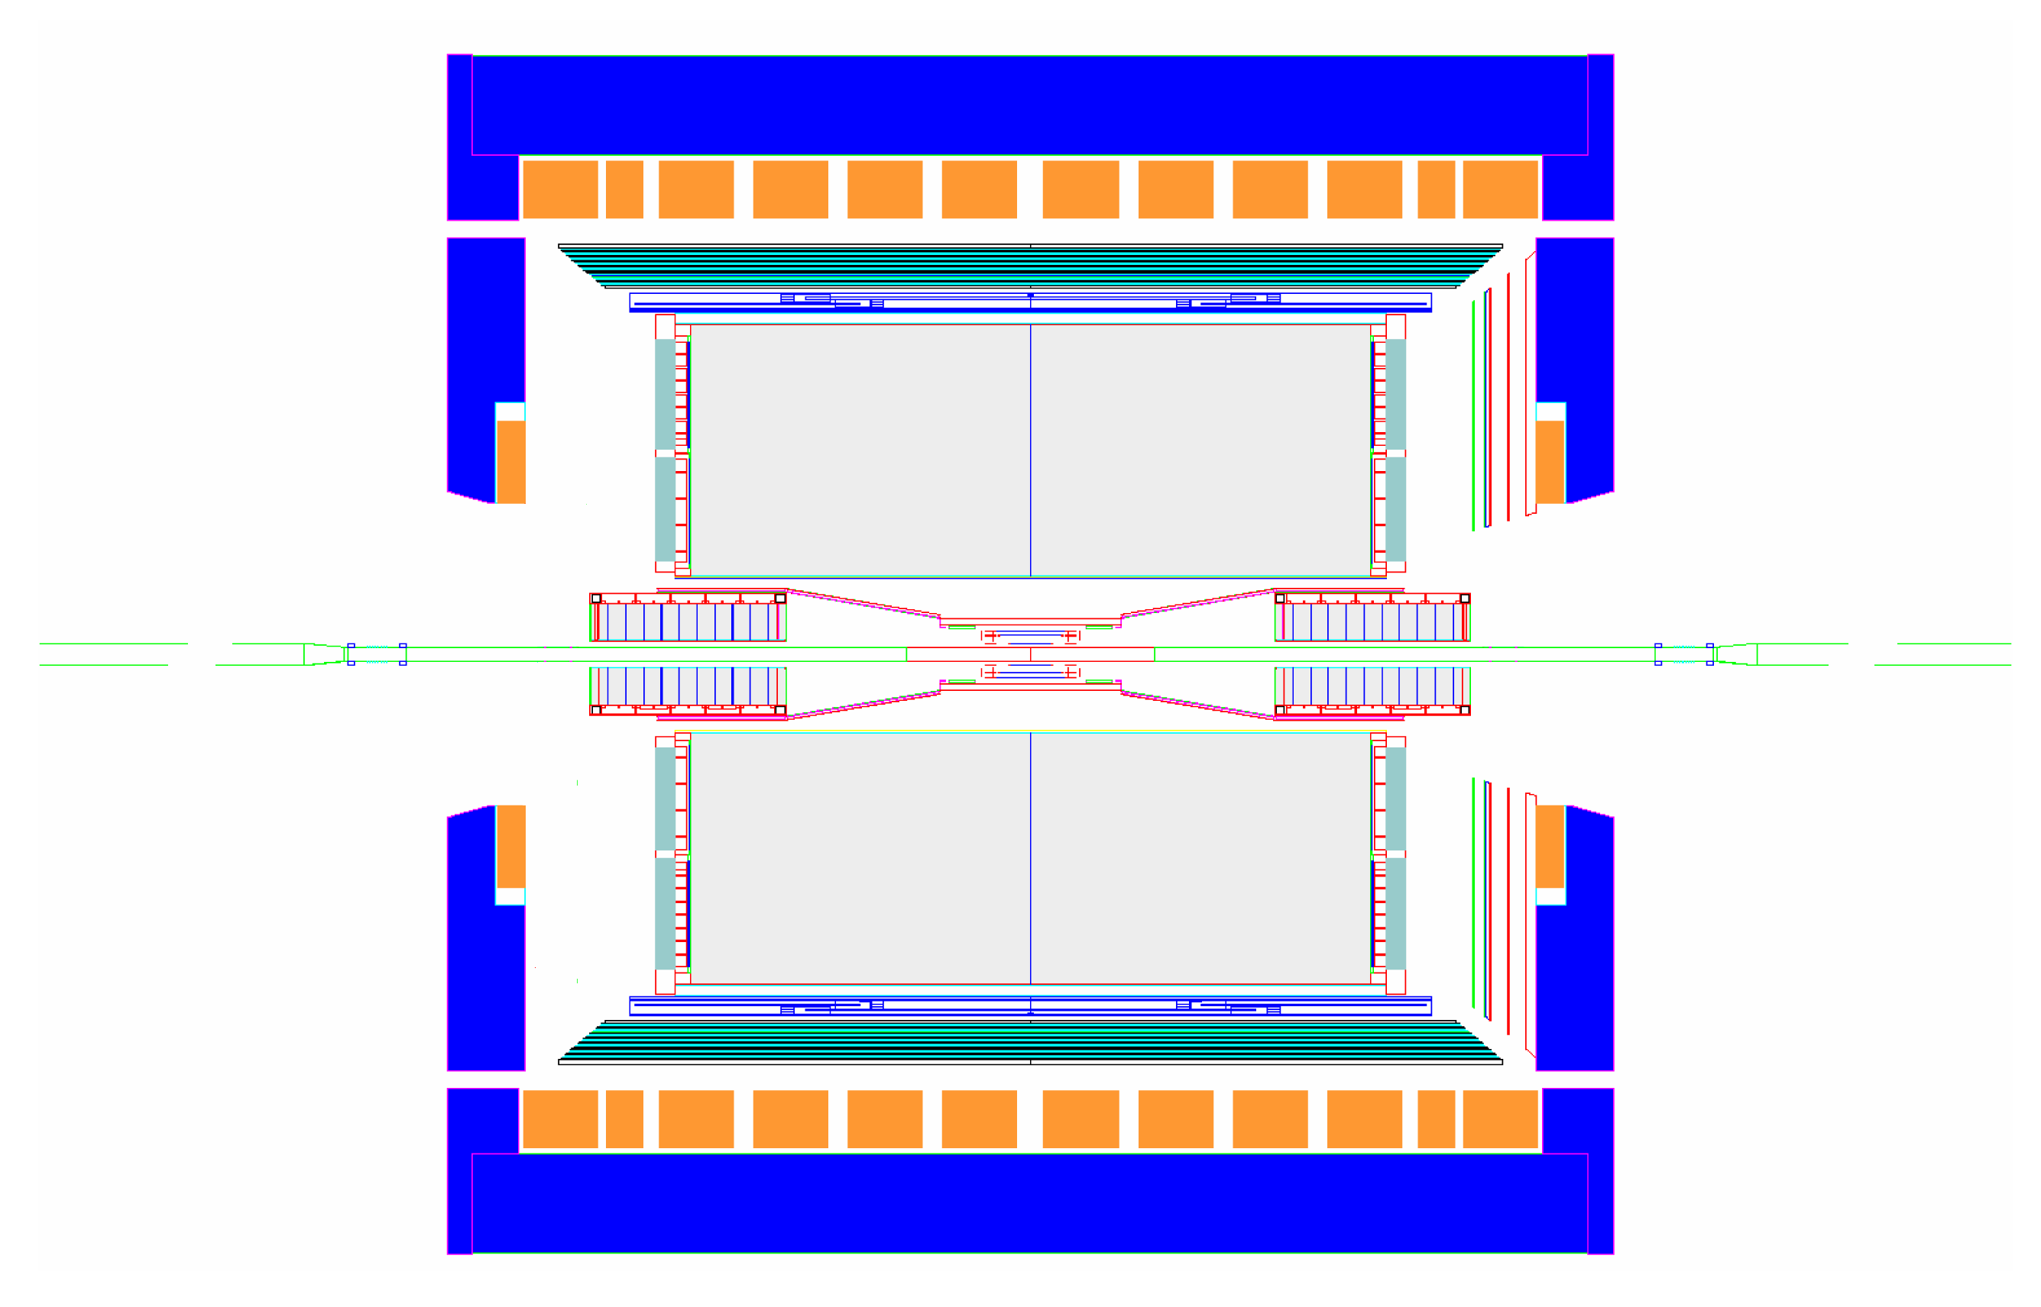
STAR Experiment as of 2014
MRPC ToF Barrel
MTD
EMC Barrel
EMC End Cap
FMS
BBC
FPD
TPC
Roman Pots
Phase 2
DAQ1000
COMPLETE
Trigger and DAQ
Upgrades
FGT
HFT
Ongoing

Slide 10
STAR Forward Upgrade
proton
nucleus
Positive η: Drell Yan
  High precision tracking and background rejection using calorimetry
  Optimized for p+A and p+p
  High momentum scale
Negative η: eRHIC
  Optimized for low energy electrons (~1 GeV)
  Triggering, tracking, identification
  R&D necessary for optimal technology choice
nucleus
electron
To fully investigate cold QCD matter, STAR will move forward
Notes:
Switch colors of the beams

Slide 11
Some planned p+A measurements
Nuclear modifications of the gluon PDF
  Correlated charm production
Gluon saturation
  Forward-forward correlations (extension of existing π⁰-π⁰)
    h-h
    π⁰-π⁰
    γ-h
    γ-π⁰
  Drell-Yan
    Able to reconstruct x₁, x₂, Q² event-by-event
    Can be compared directly to nuclear DIS
    True 2 → 1 provides model-independent access to x₂ < 0.001
  Λ polarization
  Baryon production at large x_{F}
What more might we learn by scattering polarized protons off nuclei?
Forward-forward correlations, Drell-Yan, and Λs are also very powerful tools to unravel the dynamics of forward transverse spin asymmetries – Collins vs Sivers effects, TMDs or Twist-3, …
Easier to measure
Easier to interpret

Slide 12
Targeting p+A: Forward Upgrade West
proton
nucleus
~ 6 GEM disks
Tracking: 2.5 < η < 4
FMS
FHC
Preshower
1/2” Pb radiator
Shower “max”
RICH
Baryon/meson separation
Forward instrumentation optimized for p+A and transverse spin physics
  Charged-particle tracking
  e/h and γ/π⁰ discrimination
  Baryon/meson separation

Slide 13
Energy loss in cold QCD matter
R_{A}^{π}
Hermes, Nucl. Phys.B 780, 1 (2007)
Existing
STAR
Detector
eSTAR
Electron
extension
L_{c} ∝ ν: L_{c} up to 100’s of fm
Complementary probe of mechanism of energy loss
HERMES: mixture of hadronic absorption and partonic loss
  Hadrons can form partially inside the medium
eRHIC: light quarks form far outside medium
Heavy quarks: unexplored to date. Low β: short formation time

Slide 14
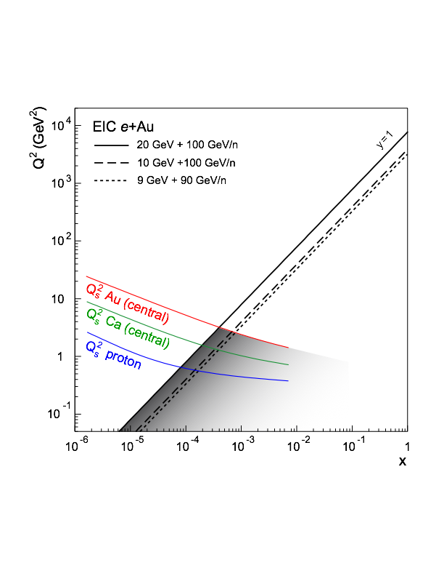
STAR and eRHIC Phase 1
Current detector matches quite well to kinematics of eRHIC
  Particle ID, sufficent p_{T} resolution, etc. at mid-rapidity (Q²>10 GeV²)
Space to extend: focus on 1<Q²<10 GeV² (-2 < η < -1)
Some important phase 1 measurements:
  F_{L} in e+p and e+A
  g₁ in polarized e+p
  SIDIS in e+p and e+A over broad (x,Q²) range, including K and Λ to investigate strange quark distributions and their polarization

Slide 15
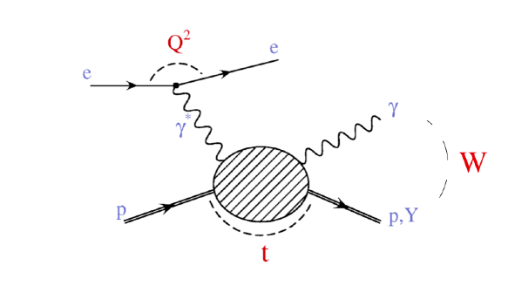
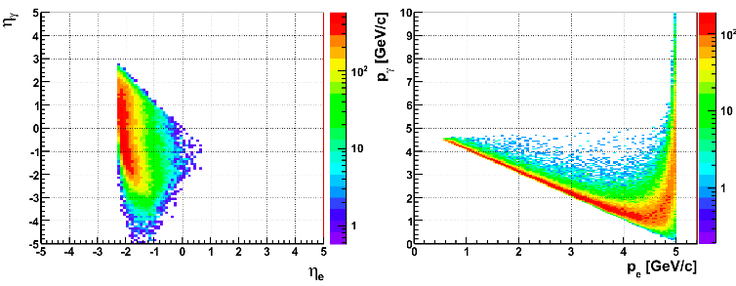
Beyond DIS: DVCS
Investigate Deeply Virtual Compton Scattering
Requires measurement of electron, proton, and photon,
Proton requires Roman Pot, intimately tied to I.R. design
Aperture needs mostly driven by proton energy
Electron requirements appear similar to DIS, 5x50GeV:
Especially important to measure over -2<η<-1
Acceptance needs mostly driven by electron energy
Further possibilities under investigation: diffraction in J/ψ, …

Slide 16
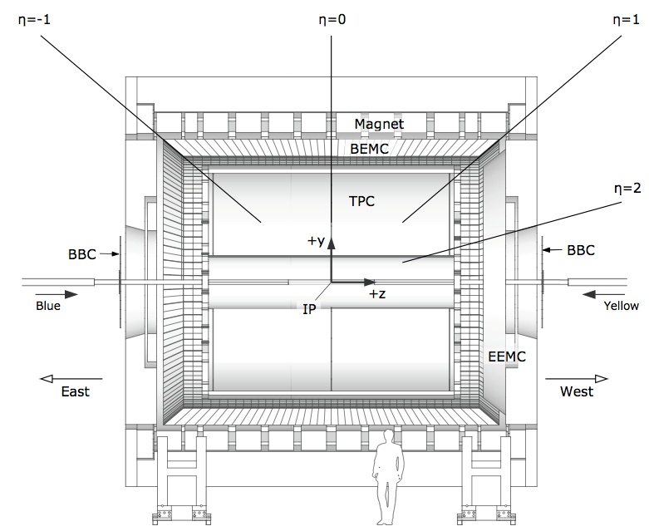
Targeting eSTAR: Forward Upgrade East
ToF: π , K identification,
t0, electron
ECal: 5 GeV, 10 GeV, ...
electron beams
GCT: a compact
tracker with enhanced
electron capability;
seeks to combine high-threshold
(gas) Cherenkov with TPC(-like)
tracking
Indeed, similarities with
Y. Giomataris and G. Charpak
NIM A310 (1991) 589-595 (1991)
PHENIX HBD
P. Nemethy et al. NIM A328 578 (1989)
will certainly involve R&D.
Conventional alternatives are thinkable.
Simulations ahead:
eSTAR task force formed
ToF/ECal
TPC i.s.
GCT
TPC i.s.
ECal

Slide 17
Summary
In the next decade, STAR will address:
Thermalization, properties, and phase structure of hot QCD matter
Mechanism of energy loss
Exotic particles and novel symmetries
Spin structure of the nucleon
with high luminosity beams and detector upgrades
By the end of the decade, STAR will move forward
to fully investigate cold QCD matter
in p+A collisions and at eRHIC
http://www.bnl.gov/npp/docs/STAR_Decadal_Plan_Final%5B1%5D.pdf

Slide 18
Backup

Slide 19
Key unanswered questions
What is the nature of QCD matter at the extremes?
  What are the properties of the strongly-coupled system produced at RHIC, and how does it thermalize?
  Are the interactions of energetic partons with QCD matter characterized by weak or strong coupling? What is the detailed mechanism for partonic energy loss?
  Where is the QCD critical point and the associated first-order phase transition line?
  Can we strengthen current evidence for novel symmetries in QCD matter and open new avenues?
  What other exotic particles are produced at RHIC?
What is the partonic structure of nucleons and nuclei?
  What is the partonic spin structure of the proton?
  How do we go beyond leading twist and collinear factorization in perturbative QCD?
  What is the nature of the initial state in nuclear collisions?

Slide 20
Summary of Measurement Plan

Slide 21
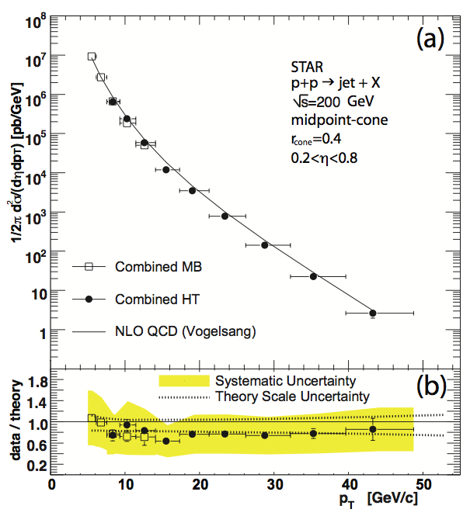
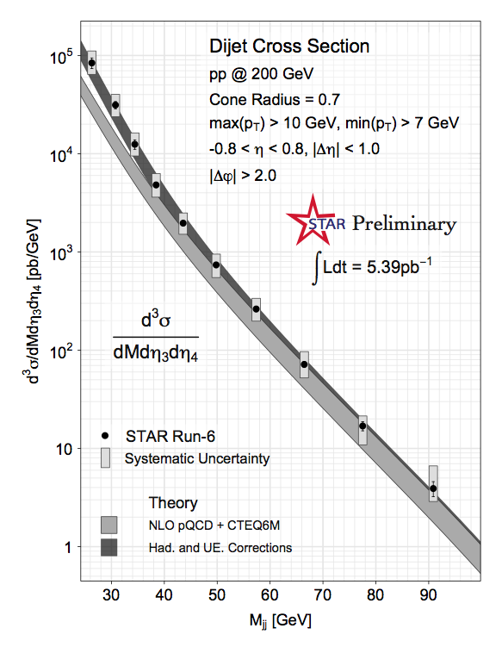
Jets: Proven Capabilities in p+p
B.I. Abelev et al. (STAR Coll.), Phys.Rev.Lett. 97, 252001, 2006
SPIN-2010: Matt Walker/Tai Sakuma, for the collaboration
Jets well understood in STAR, experimentally and theoretically

Slide 22
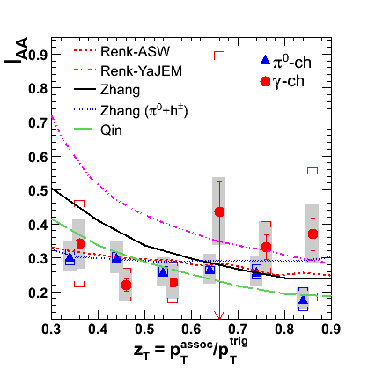
To date: Jets and γ-hadron in A+A
Phys. Rev. C 82, 034909
Triggered: ~0.3 nb⁻¹
Untriggered: ~0.01 nb⁻¹
Beginning results from Run 7 indicative, but not final word
Huge increase in significance with trigger upgrades+luminosity
Complementary to LHC:
RHIC: quarks LHC: gluons
best place to do jets < ~50 GeV

Slide 23
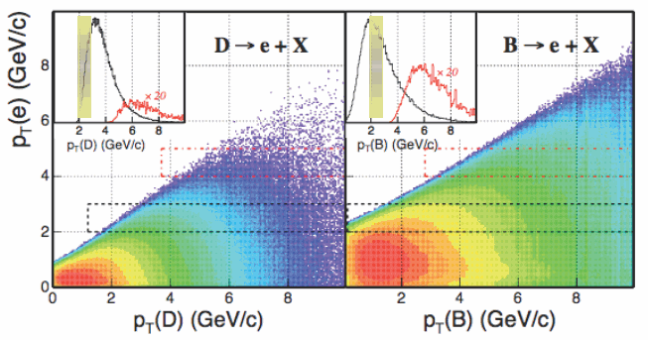
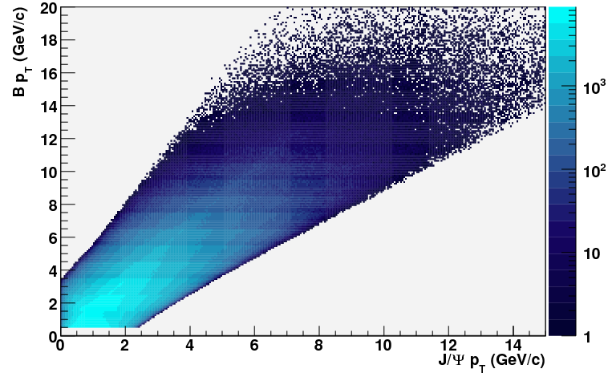
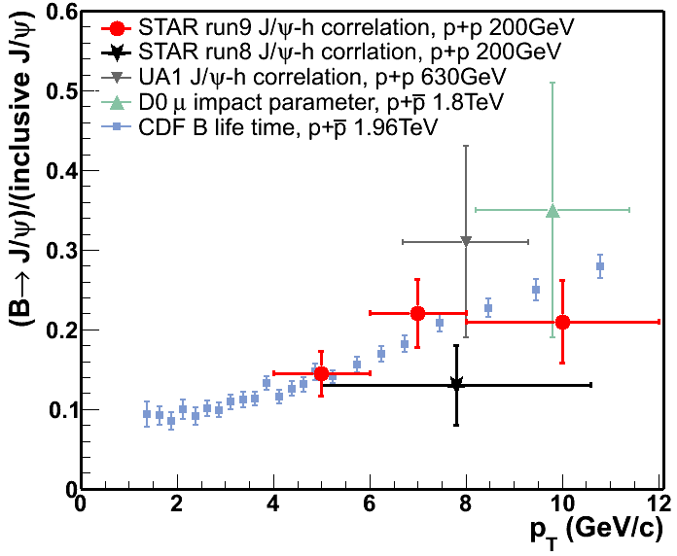
Mass dependence via Heavy Quarks
What is the dependence of energy loss on parton mass?
  Key tools: heavy quarks with precise kinematic reconstruction
  Key technology: Heavy Flavor Tracker and Muon Telescope Detector
STAR
Preliminary

Slide 24
Longer term: STAR and eRHIC
Forward region critical for higher energy options
Major upgrades in forward direction would be needed

Slide 25
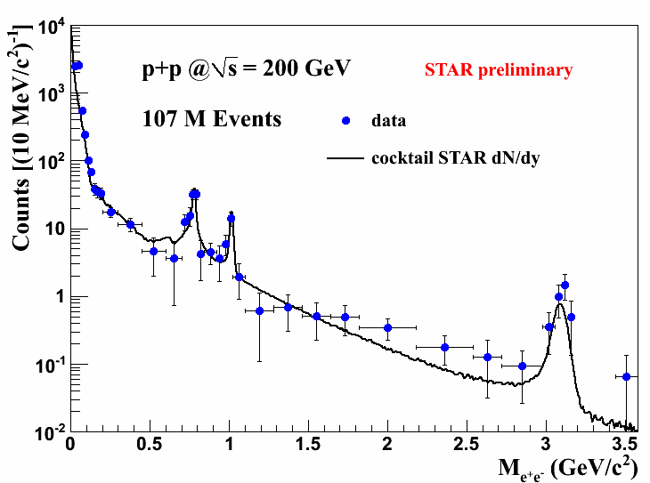
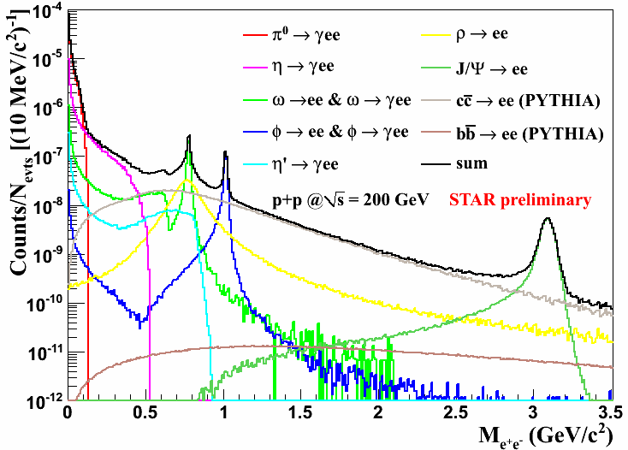
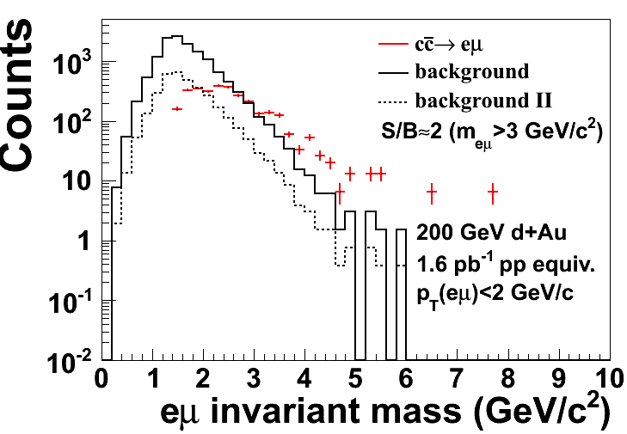
Properties of sQGP: Dileptons
Precise measurements with TOF, DAQ upgrade
Correlated charm in A+A
  Decorrelation? Order of magnitude uncertainty
Address with:
  HFT: D⁰, displacement
  MTD: e-μ correlations
See L. Ruan, Parallel 1C

Slide 26
Jet Capabilities in A+A
Sufficient statistical reach out to ~50 GeV for precision measurements
  Large unbiased datasets
  Trigger upgrades to lessen bias with walking jet patches
Smearing of high momentum charged hadrons under control
  Corrections: need to calibrate level of smearing
  Hard cutoff in hadrons: small loss of jets that fragment hard
Dominant uncertainty fluctuations in the underlying event
Notes:
Backup

Slide 27
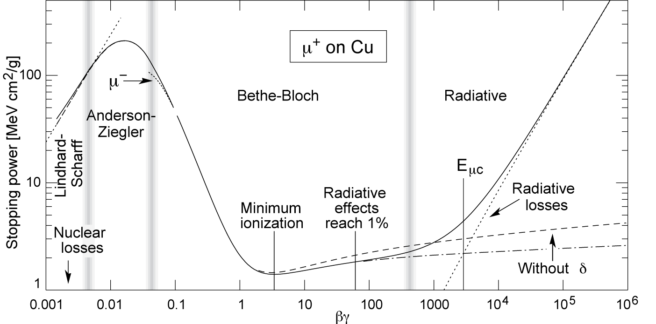
Velocity dependence
“Passage of Particles through Matter”, Particle Data Book
Bremsstrahlung
Radiative dE/dx
b
c
light partons
QED: different momenta, different mechanisms
Just beginning the exploration of this space in QCD

